Slide 1
Dynamics of Submerged Diffuser Pressurization
31st Space Cryogenics Workshop
May 15, 2025
Jacob M. Brodnick – NASA, Fluid Dynamics Branch (MSFC-ER42)

Slide 2
Executive Summary
  The dynamics of submerged diffuser pressurization, especially in low gravity, were assessed for a cryogenic propellant tank using computational fluid dynamics (CFD) analysis.
  The intent is to help inform future trade studies of tank pressurization for spacecraft engine restarts.
  Propellant is typically settled near feedline ports, away from diffusers, by applying small amounts of thrust prior to tank pressurization and subsequent engine operation.
  Consumable mass, which can become significant for multiple engine burns, is expended to operate any of the numerous small thruster options.
  Understanding how to efficiently perform submerged pressurization may reduce settling times and save net consumable mass.
  The present analysis is the first step of a concerted effort to better understand if submerged pressurization is viable or optimal for any applications or parameter spaces in future NASA missions.
  Objectives of the analysis include:
    Validate a modeling methodology for bubble detachment, a primary mechanism of submerged pressurization
      Promotes confidence in one aspect of submerged pressurization simulations
    Simulate submerged pressurization for a generic tank and set of conditions
      Informs operating spaces for future testing
    Identify forward work needed to increase confidence in submerged pressurization predictions

Slide 3
Description of Submerged Diffuser Dynamics
  Submerged pressurization in high-g results in significant mixing between the pressurant and cryogen.
    This can be useful to chill incoming noncondensable gas, especially during ground operations, making the ullage resistant to later slosh induced collapse, i.e., pressure decline.
  However, efficient propellant tank pressurization relies on distributing high temperature pressurant into a tank while minimizing mixing with the cryogen.
    This is critical for autogenous pressurization to avoid excessive loss of the pressurant through condensation.
  Submerged pressurization may be more effective in low-g than in high-g due to the lack of buoyancy.
  Designing a pressurization system that precludes ullage bubble detachment or facilitates bubble agglomeration is likely to minimize mixing with the cryogen.
  Low flow rate and uniform gas distribution are expected to be favorable pressurization system traits for low-g submerged pressurization.
Illustration of Submerged Pressurization in High-g
(Bubble columns form combining with the bulk ullage volume)
Before Pressurization
During Pressurization
After Pressurization
Illustration of Submerged Pressurization in Micro-g
(Bubble agglomeration near the diffuser is believed to be possible)
Before Pressurization
During Pressurization
After Pressurization

Slide 4
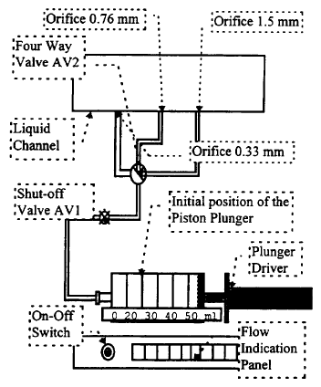
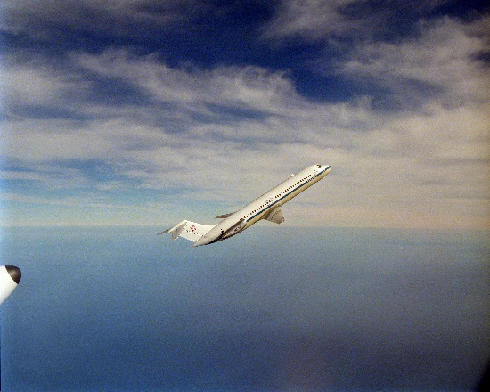
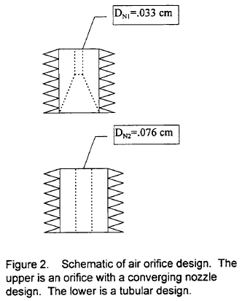
Bubble Detachment Validation
Analysis Objective:
  Validate a CFD modeling methodology for bubble detachment
    Promotes confidence in one aspect of submerged pressurization simulations
Test Description [1]:
  Testing was conducted to measure periodic bubble departure size for standard temperature and pressure air in water.
  Both ground and parabolic flight testing were conducted.
  Air was injected into a water flow loop enabling steady water cross flow velocity.
  The test matrix included variation of gravity level, air orifice diameter, air volumetric flow rate, and water cross flow rate.
Bubble Formation and Detachment Flight Test Article
DC-9 Parabolic Flight Aircraft
Air Orifice Designs

Slide 5
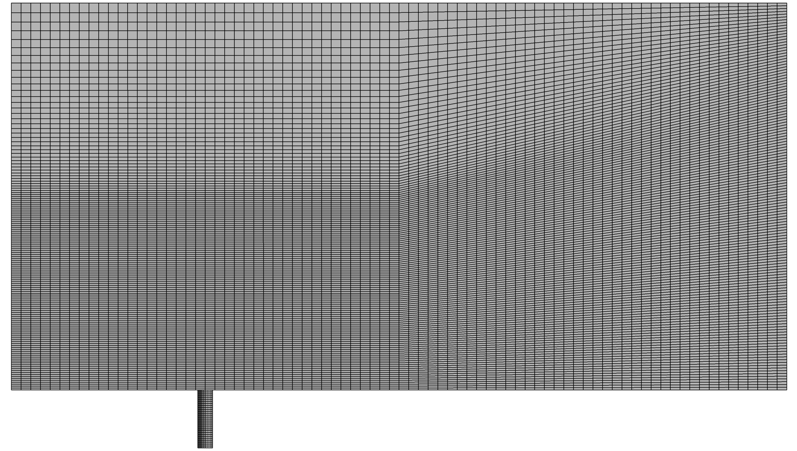
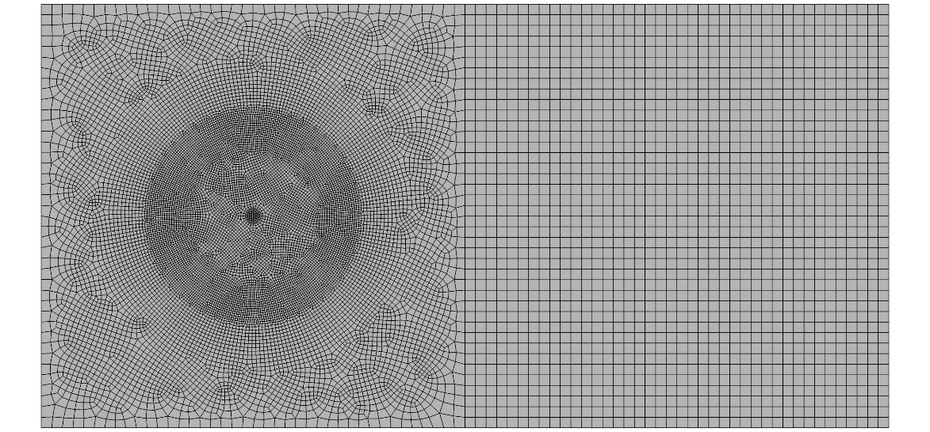
Bubble Detachment Validation
Simulation Methodology:
  The pressure based CFD solver Loci-STREAM-VoF was used.
  Modeled laminar flow of compressible gas and incompressible liquid while tracking the gas-liquid interface via a geometric volume of fluid (VoF) method.
  1st order spatial and temporal resolution were used with a Courant–Friedrichs–Lewy (CFL) number timestep limiter on VoF interface advection of 0.2.
  Fluid properties for water and air at 300 K and 1 atm were used.
  Surface tension and contact angle, nominally 70°, were modeled.
    Surface tension and contact angle were not measured in the experiment.
  Gravity of 9.81 m/s² was applied for ground test simulations.
All Hexahedral Cell Computational Mesh
Refinement surrounding orifice and stretching beyond
Side View
0.076 cm air orifice
Bottom View
Illustration of Computational Domain
Boundary Conditions Shown
Fixed Pressure Inflow (Water)
Volumetric Outflow (Mixed)
1” square cross-section water channel
Volumetric Inflow (Air)
Adiabatic No-slip Walls

Slide 6
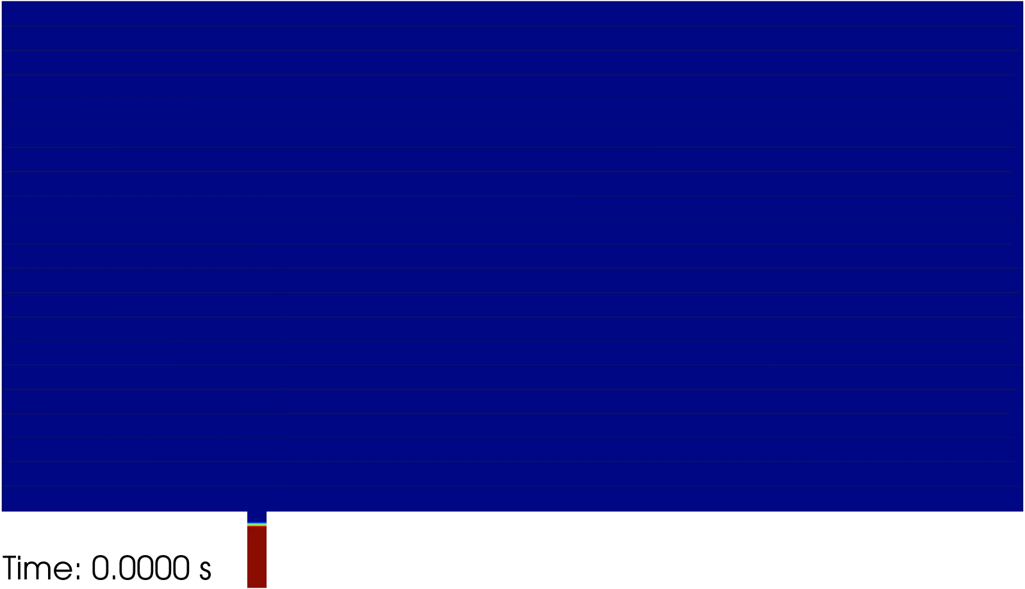
Bubble Detachment Validation
Simulation Results:
  Analysis of the 0.076 cm air orifice was conducted for multiple conditions.
  Bubble detachment diameter was well validated.
    Bubble volume immediately following detachment was used to calculate equivalent spherical diameter.
    Test data was generated via counting pixels in imagery; details of this process were not documented. [1]
  Significant sensitivity to contact angle was noted, so future validation activities should include high pedigree contact angle measurements.
  Simulations are continuing to demonstrate bubble detachment diameter periodicity.
Contact Angle (°) | Bubble Detachment Diameter (mm) | Error (% Diff.)
60 | 3.50 | -21.98
70 | 3.98 | -11.24
80 | 4.54 | 1.44
90 | Detachment Not Observed
Animation of Bubble Formation and Detachment
Conditions: 0.076 cm air orifice at 1g with 10.5 cm/s cross flow
*CFD results using a 70° contact angle

Slide 7
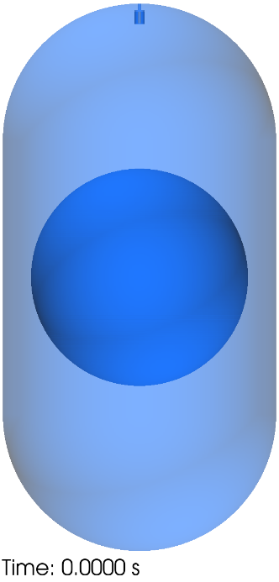
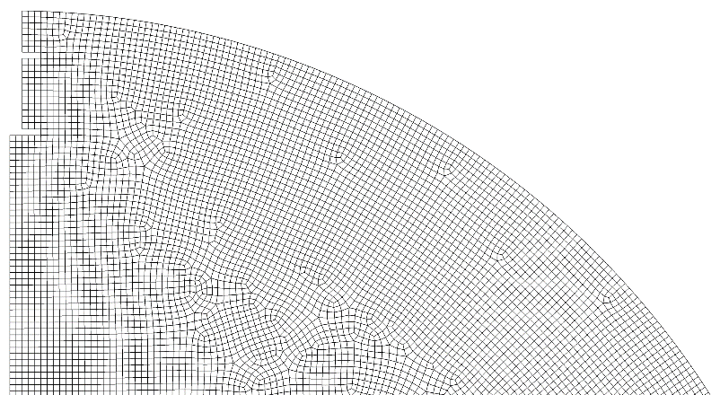
Submerged Pressurization Prediction
Analysis Objective:
  Simulate submerged pressurization for a generic tank and set of conditions
    Informs operating spaces for future testing
Simulation Methodology:
  A methodology comparable to the bubble detachment validation simulations was used with notable changes.
  Used laminar equations but turbulence will be needed, at least at higher pressurization rates.
    Simulation of turbulence and corresponding gas-liquid interface treatment is on-going.
  Fluid properties for gas and liquid parahydrogen were used.
    Initial Conditions: Saturated at 20 K
    Inflow Conditions: 300 K gas
  A contact angle of 10° was modeled.
  Phase change was modeled via the Hertz-Knudsen-Schrage equation with a 0.001 phase change coefficient.
  Modeled a generic large-scale three-dimensional tank.
    4 m long and 2 m radius cylindrical barrel section
    2 m radius hemispherical domes
    0.075 m radius and 0.17 m long cylindrical gas diffuser open area
  Began each simulation with an 80% fill level and quiescent condition.
Computational Domain
Initial Fluid Distribution Shown (VoF Isosurface)
Nominal Computational Mesh
Near Gas Diffuser Region Shown

Slide 8
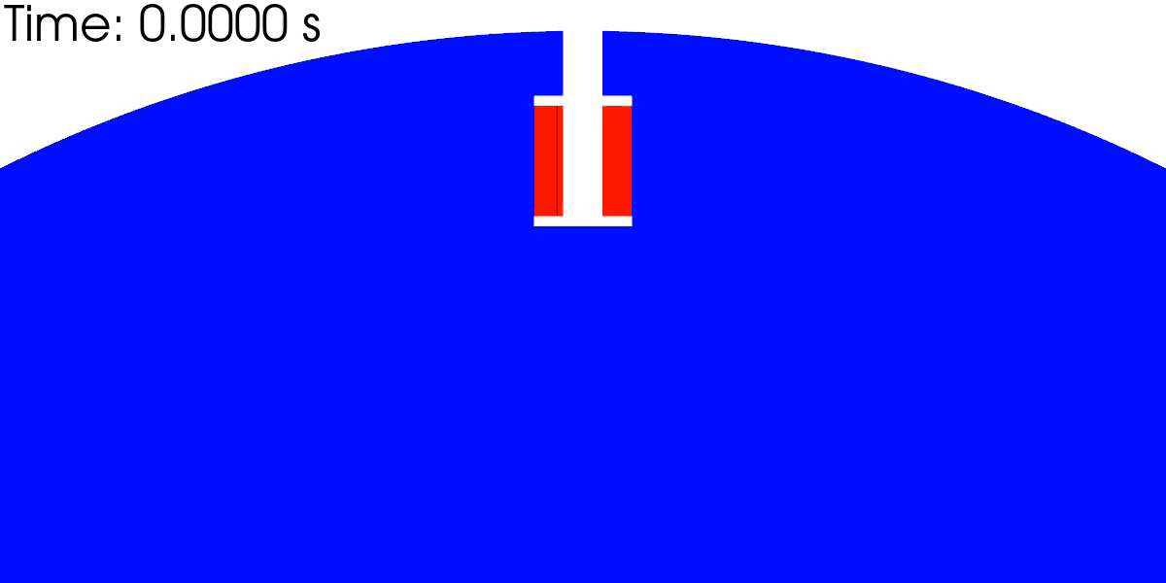
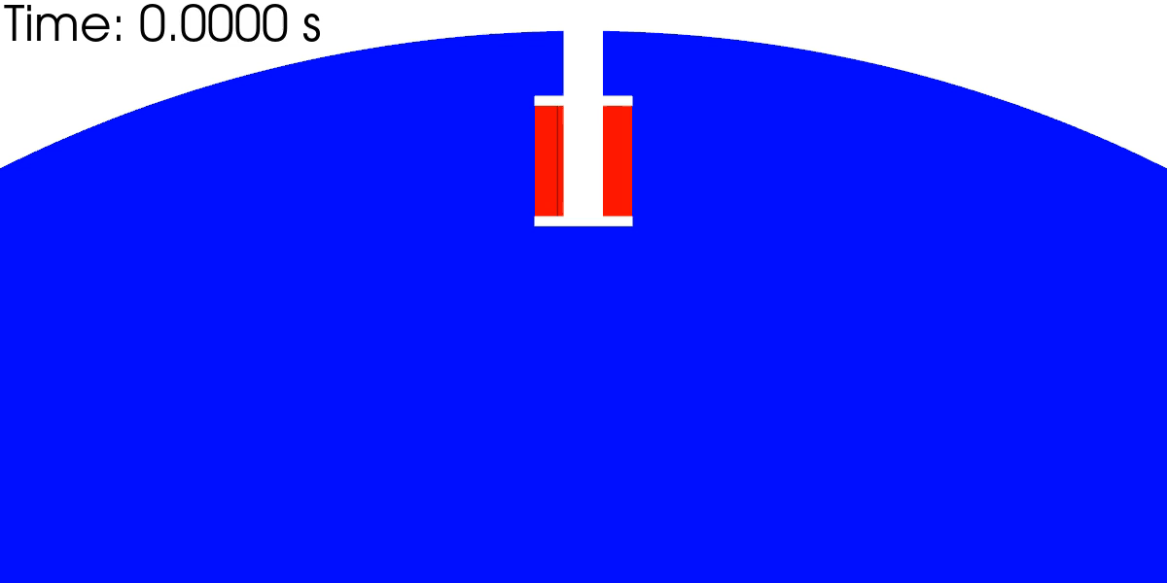
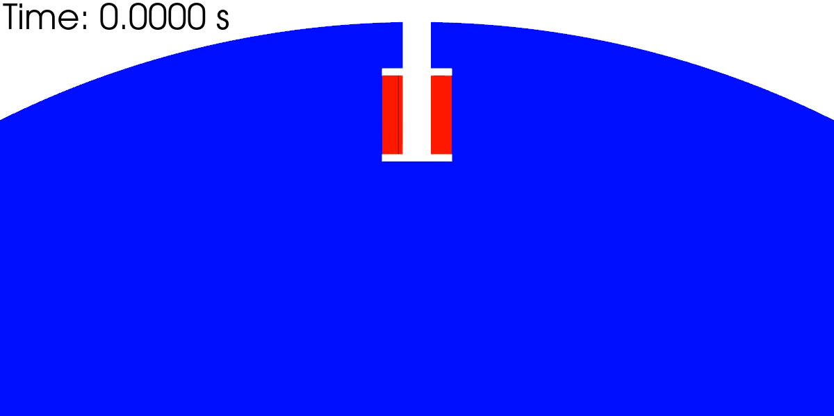



Submerged Pressurization Prediction
Simulation Results:
  3D simulations without phase change were conducted to establish bubble detachment potential as a function of flow rate.
  As expected, high pressurization rates show signs of significant mixing at the gas-liquid interface in the form of interface distortion and liquid entrainment.
    Interface breakup may be present at the higher flow rates but could be under resolved in the present simulation.
  The low flow rate results show gradual growth of a smooth gas-liquid interface, a feature expected to facilitate gas stratification and thus pressurization.
  The cylindrical diffuser design results in liquid being trapped inside the gas bubble during pressurization.
Liquid Fraction Animations
Velocity Streamlines Shown
$$\dot{m}=0.001 kg/s$$
$$\left(V_{DiffExit,AVG}=0.165 m/s\right)$$
$$\dot{m}=0.01 kg/s$$
$$\left(V_{DiffExit,AVG}=1.65 m/s\right)$$
$$\dot{m}=0.1 kg/s$$
$$\left(V_{DiffExit,AVG}=16.5 m/s\right)$$

Slide 9
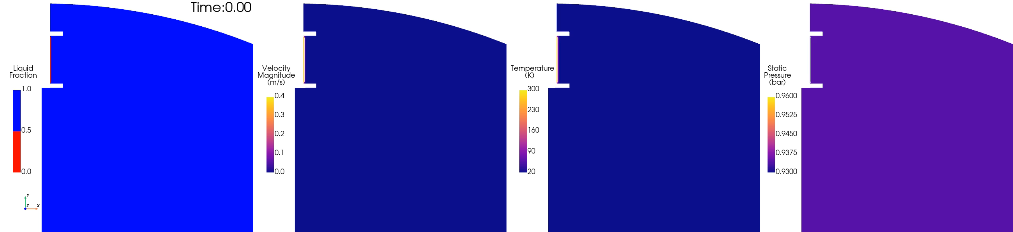
Submerged Pressurization Prediction
Simulation Results:
  2D axis-symmetric simulations with phase change were conducted to identify key dynamics affecting submerged pressurization and numerical considerations needed to capture them.
  The flow field of a single simulation at a low flow rate is first presented to highlight several typical features of the modeling submerged pressurization.
  The bubble spreads outward from the injection site, but traps liquid as was noted in the 3D simulation results.
  Velocity is greatest in the direction of injection and along the bubble interface as the flow is redirected along the liquid and recirculation develops.
  A layer of cooler gas exists near the gas-liquid interface due to heat transfer with the liquid.

Slide 10
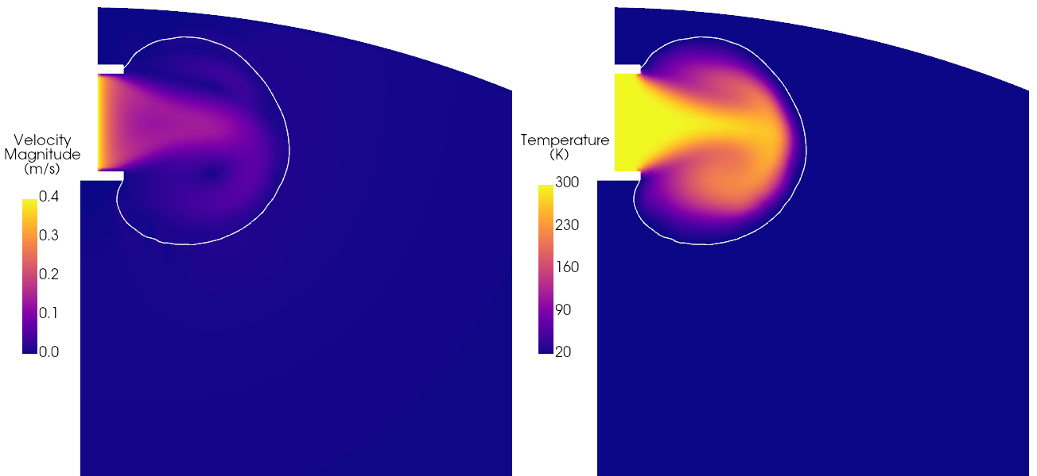
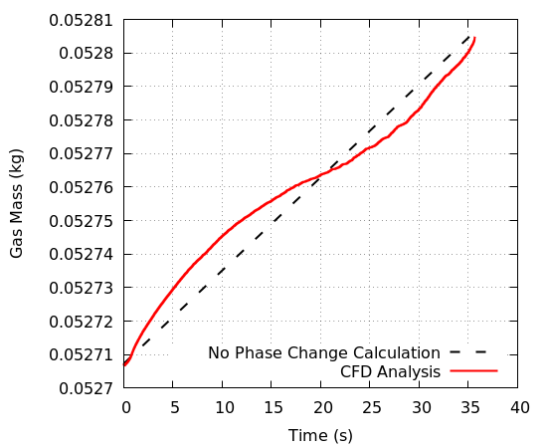
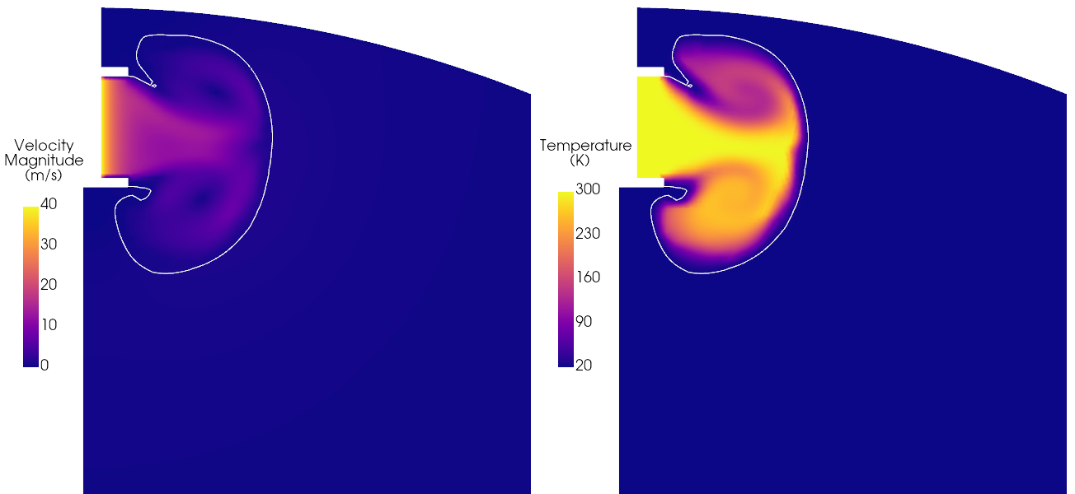
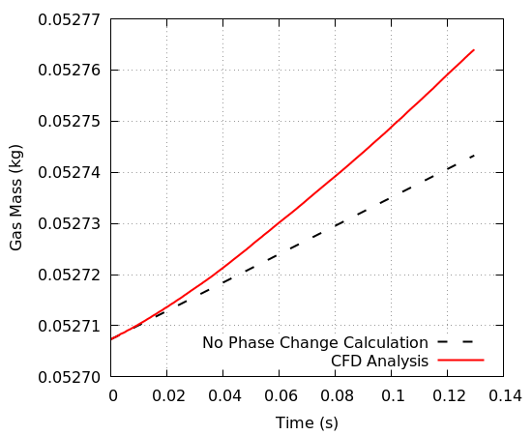


Submerged Pressurization Prediction
Simulation Results:
  Comparisons at high and low flow rates for the same pressure are shown.
  Increasing pressurant velocity pushes hot gas nearer the gas-liquid interface, shown by the white line, maintaining higher heat transfer rates.
    Notice the difference in velocity magnitudes shown.
  Evaporation is evident early on at both flow rates.
    More evaporation per mass of pressurant added was observed at the high flow rate.
  A transition to condensation at the low flow rate is indicative of more rapid pressurization than heat transfer to the liquid which is favorable.
Constant Pressure Comparisons
$$\dot{m}=0.001 kg/s$$
Instantaneous results shown
$$\dot{m}=0.1 kg/s$$
Instantaneous results shown

Slide 11
Conclusion
  A CFD analysis methodology was validated to a reasonable degree for bubble detachment size.
    Higher pedigree and more complete test data would allow for a more precise validation effort.
  Validation for heat and mass transfer for different cryogenic fluid management applications has been done in the past for similar modeling methodologies, but direct validation of submerged pressurization is sought.
  Initial results of submerged pressurization on a generic large scale cryogenic tank were obtained.
  Generally, low speed pressurization was found to be most beneficial.
  However, high speed pressurization and high temperature gradients near the gas-liquid interface should be captured with turbulence modeling, interface turbulence modeling, and sufficient spatial resolution.
  Solution verification will be conducted in the future along with study of an expanded parameter space.
  It should be noted that more realistic diffuser designs, and capture of their internal flow, could introduce additional modeling difficulties like multiple discrete gas jet injection sites (perforated plates), liquid interaction with mesh screens, and initial clearing of liquid from a diffuser interior.

Slide 12
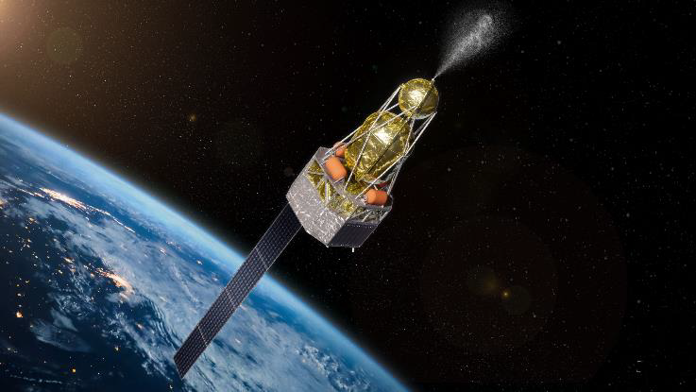
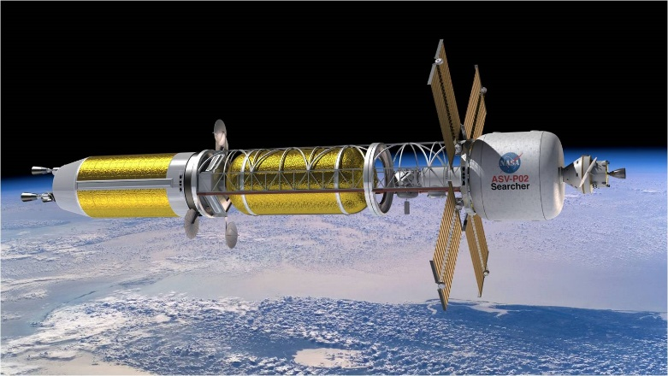
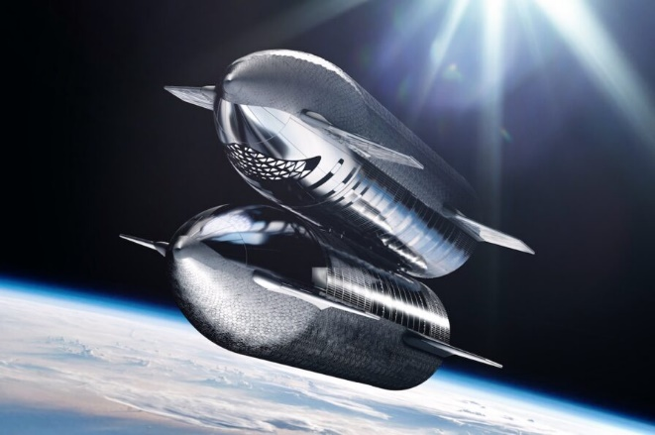
Forward Work
Flight Opportunities 244-P
  University of Florida (UF) parabolic flight experiment
  Bubble departure validation – GHe / LN2 and GN2 / LN2
  Bubble heat and mass transfer validation
Aerospace Corp. Parabolic Flight
  Submerged pressurization validation – GHe / LN2 and GN2 / LN2
Large CFM Demonstration Mission Support
  Inform pressurization design
  Post-flight submerged pressurization validation – GHe / LH2 and GH2 / LH2
Mars Mission Support
  Inform pressurization design
Large CFM Demo Concept – NASA
Nuclear Thermal Propulsion Concept – NASA
Starship Propellant Transfer Concept – SpaceX

Slide 13
References
  H.K. Nahra and Y. Kamotani, “Bubble Formation and Detachment in Liquid Flow Under Normal and Reduced Gravity”, NASA TM 1998-206614, 36th Aerospace Sciences Meeting, Jan. 1998.

