Slide 1
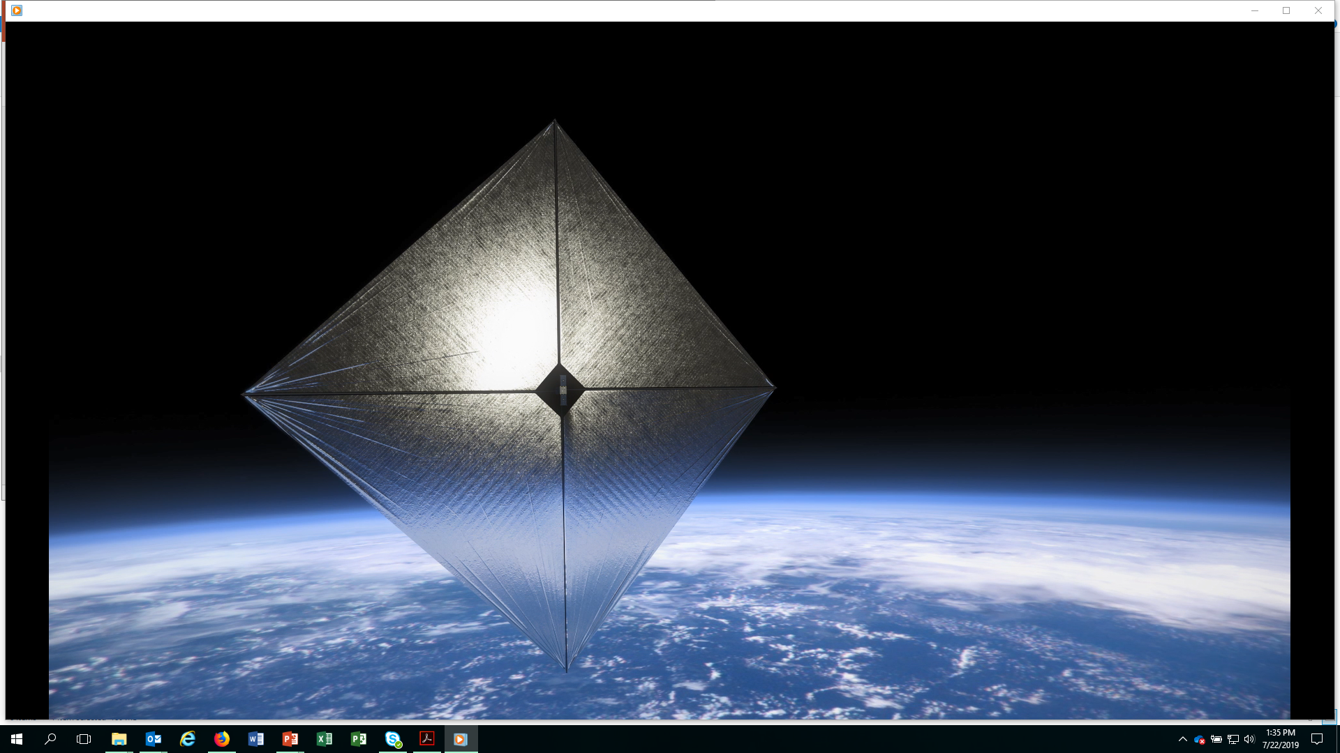

Advanced Composite Solar Sail System (ACS3)
Overview
Philip Shih, Project Manager (NASA Ames Research Center)
Keats Wilkie, Principal Investigator (NASA Langley Research Center)
28 May 2025 – Society Broadcast Engineer Chapter 40 Meeting

Slide 2
Advanced Composite Solar Sail System (ACS3)
Solar Sail Technology Demonstrator
ACS3 is a Low-Earth Orbit (LEO) Solar Sail technology flight demonstrator for future composite-based small-satellite solar sail propulsion systems.
Launched on April 23, 2024
Partner roles and responsibilities:
  NASA Ames Research Center (ARC) – Project Management, provides payload control avionics subsystem (AS) for SBS and camera system, and AS Flight Software (FSW), 12U bus procurement and payload integration
  NASA Langley Research Center (LaRC) – ACS3 Sail/Boom Subsystem (SBS)
  Santa Clara University Robotic Systems Lab – ACS3 Ground Station and Operations Support
  NASA STMD GCDP – Deployable Composite Boom Project (DCB) technology for booms.
  Rocket Lab – Launch Provider

Slide 3
Mission ObjectivesSolar Sail Technology Demonstrator
Objectives:
  Demonstrate successful deployment of an 80m² solar sail with high performance composite booms by a small satellite as well as packing and deployment system in Low Earth orbit
    ACS3 is the first solar sail mission using deployable composite booms technology and a 12U Cubesat while previous solar sail missions used metallic booms.
  Evaluate the efficacy of the design and the shape of the solar sail.
  Characterize the thrust functionality of the solar sail during the orbit maneuver.

Slide 4
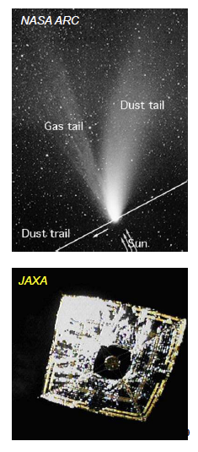
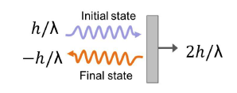

What is Solar Sailing?Solar Sail Technology Demonstrator
Solar Sailing are large area, lightweight membrane structures that produce propellantless thrust using momentum transfer of reflecting solar photons.
The momentum of sunlight is called solar radiation pressure (SRP)
  Comet tails are partly directed by SRP
Solar radiation pressure is not solar wind.
  Solar wind forces, i.e., forces due to the charged particle flux of the sun, are ~10⁻³ smaller than SRP.
Before ACS3 mission, the state of art in solar sailing is 14-m IKAROS solar sail, launched and successfully flown by JAXA in 2010.
Momentum of a photon
Momentum transfer to a perfect reflector
$$p_{photon}=\frac{h}{λ}$$

Slide 5
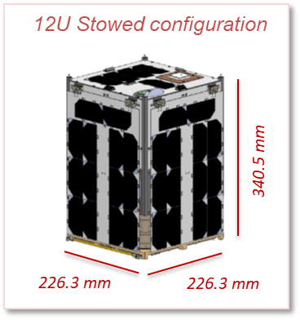
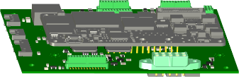

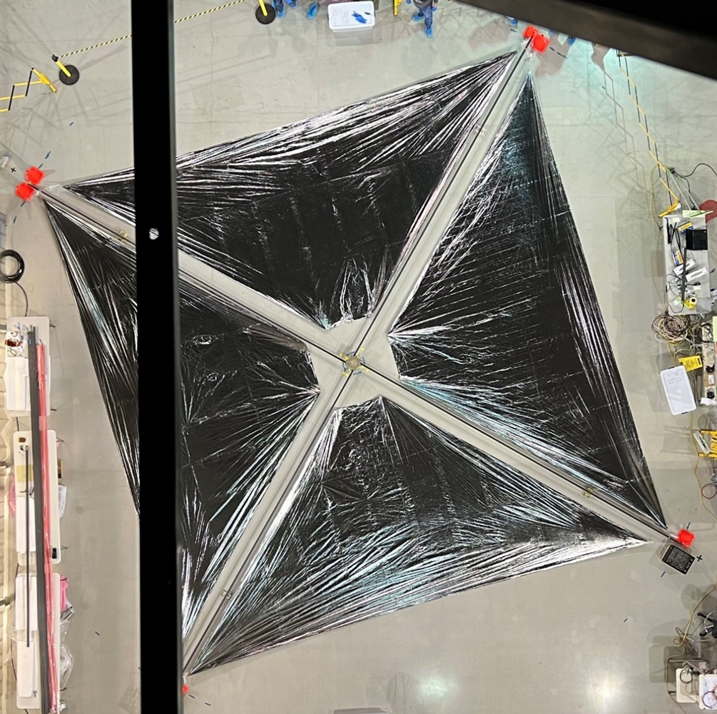
ACS3: 12U Spacecraft Subsystem
Sail diagnostic cameras (2/4)
Spacecraft Bus:
S-band transceiver
UHF radio
Flight computer
ADCS
Reaction wheels (4)
Magnetorquers (3 x 3-axis)
Sun sensors (5)
GPS receiver
Star tracker
IMU
EPS
Avionics Subsystem (AS)
Payload AS Control Electronics
Board included with spacecraft bus avionics stack.
Controls sail diagnostic cameras and SBS.
Sail-Boom Subsystem (SBS)
14 m
NASA ARC
NASA LaRC
Spacecraft bus “-Z” plate:
Pop-up UHF antennas (4)
S-band antenna patches (2)
Sun sensor (1)
AST-NanoAvionics

Slide 6
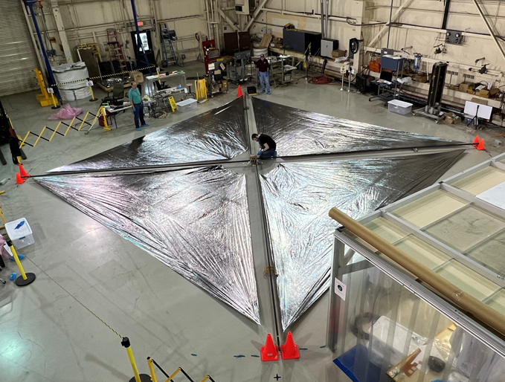
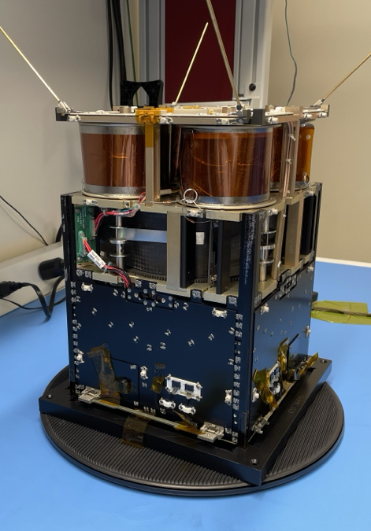
ACS3: What it looks like
Sail Boom System
Total Sail Area: ~80m²

Slide 7
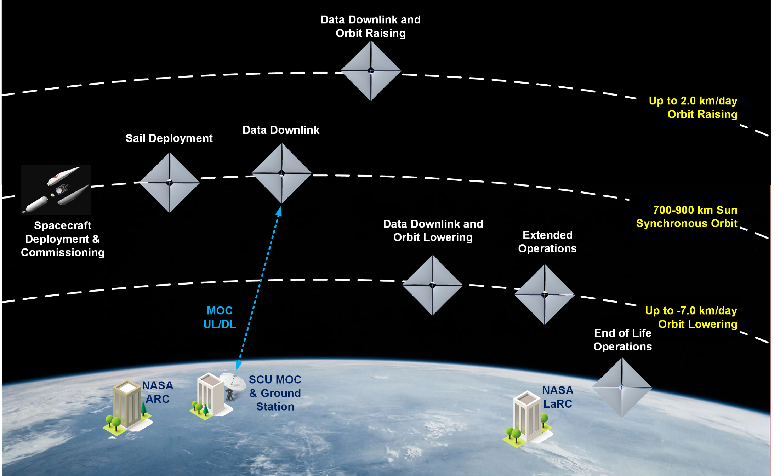
ACS3 Concept of Operations
~1 month
~1-3 days
~1-3 months
~3 weeks
~1 month
duration TBD
~1 day (decommissioning)

Slide 8


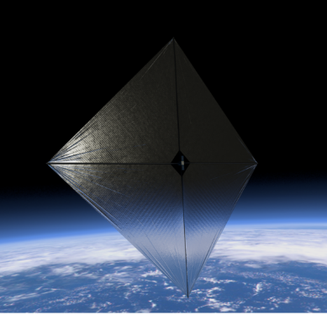
ACS3 Mission Operation Overview
NASA Ames + Langley
Flight Directors
Ops decision making
Spacecraft Director
Coordinate and manage teams for successful ops
Mission Control Center (MCC) @ Santa Clara University (SCU)
Operate ground station to communicate with s/c
S/C Commands transmission
S/C raw Telemetry receipt and sharing
ACS3 spacecraft
Spacecraft Operations
Generate/select commands for s/c ops
Flight Dynamics
Generate/send s/c TLEs, GPS data
Subject Matter Experts (SMEs)
Provide technical expertise on s/c

Slide 9
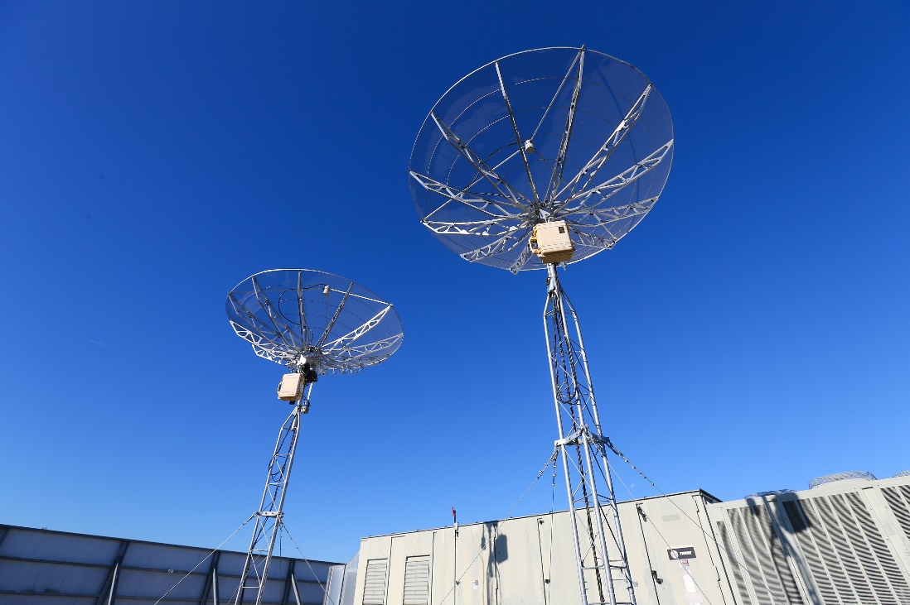
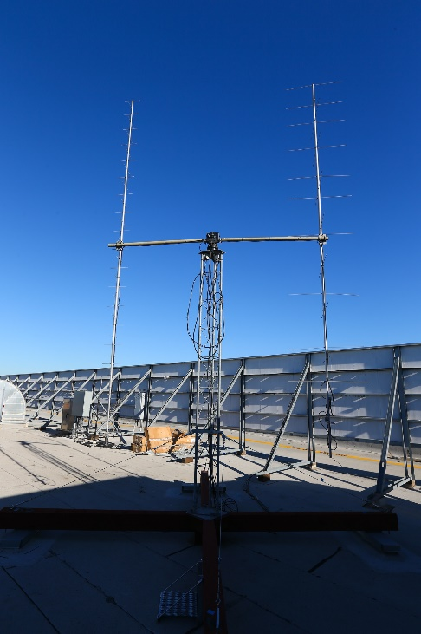
SCU Communication Stations
Ground Segment has been operating for 10+ years with a similar architecture for NASA, academic and industry missions.
Facility includes 2 S-Band capable stations and 1 UHF station.

Slide 10
ACS3 Communication Links
Two Comm Links used in the mission operations
UHF Uplink/Downlink - 401.5 MHz
  Data Rate: 2400 bps
  Beacons (System health information)
  Commanding
  Backup Communication Link for telemetry and imagery downloads
S-Band Uplink/Downlink
  Uplink: 2072.65 MHz, Downlink: 2268 MHz
  Data Rate: 100 kbps to 1 Mbps
  Main comm link
  Commanding, Telemetry and Imagery downloads
  Orbital Maneuvers

Slide 11
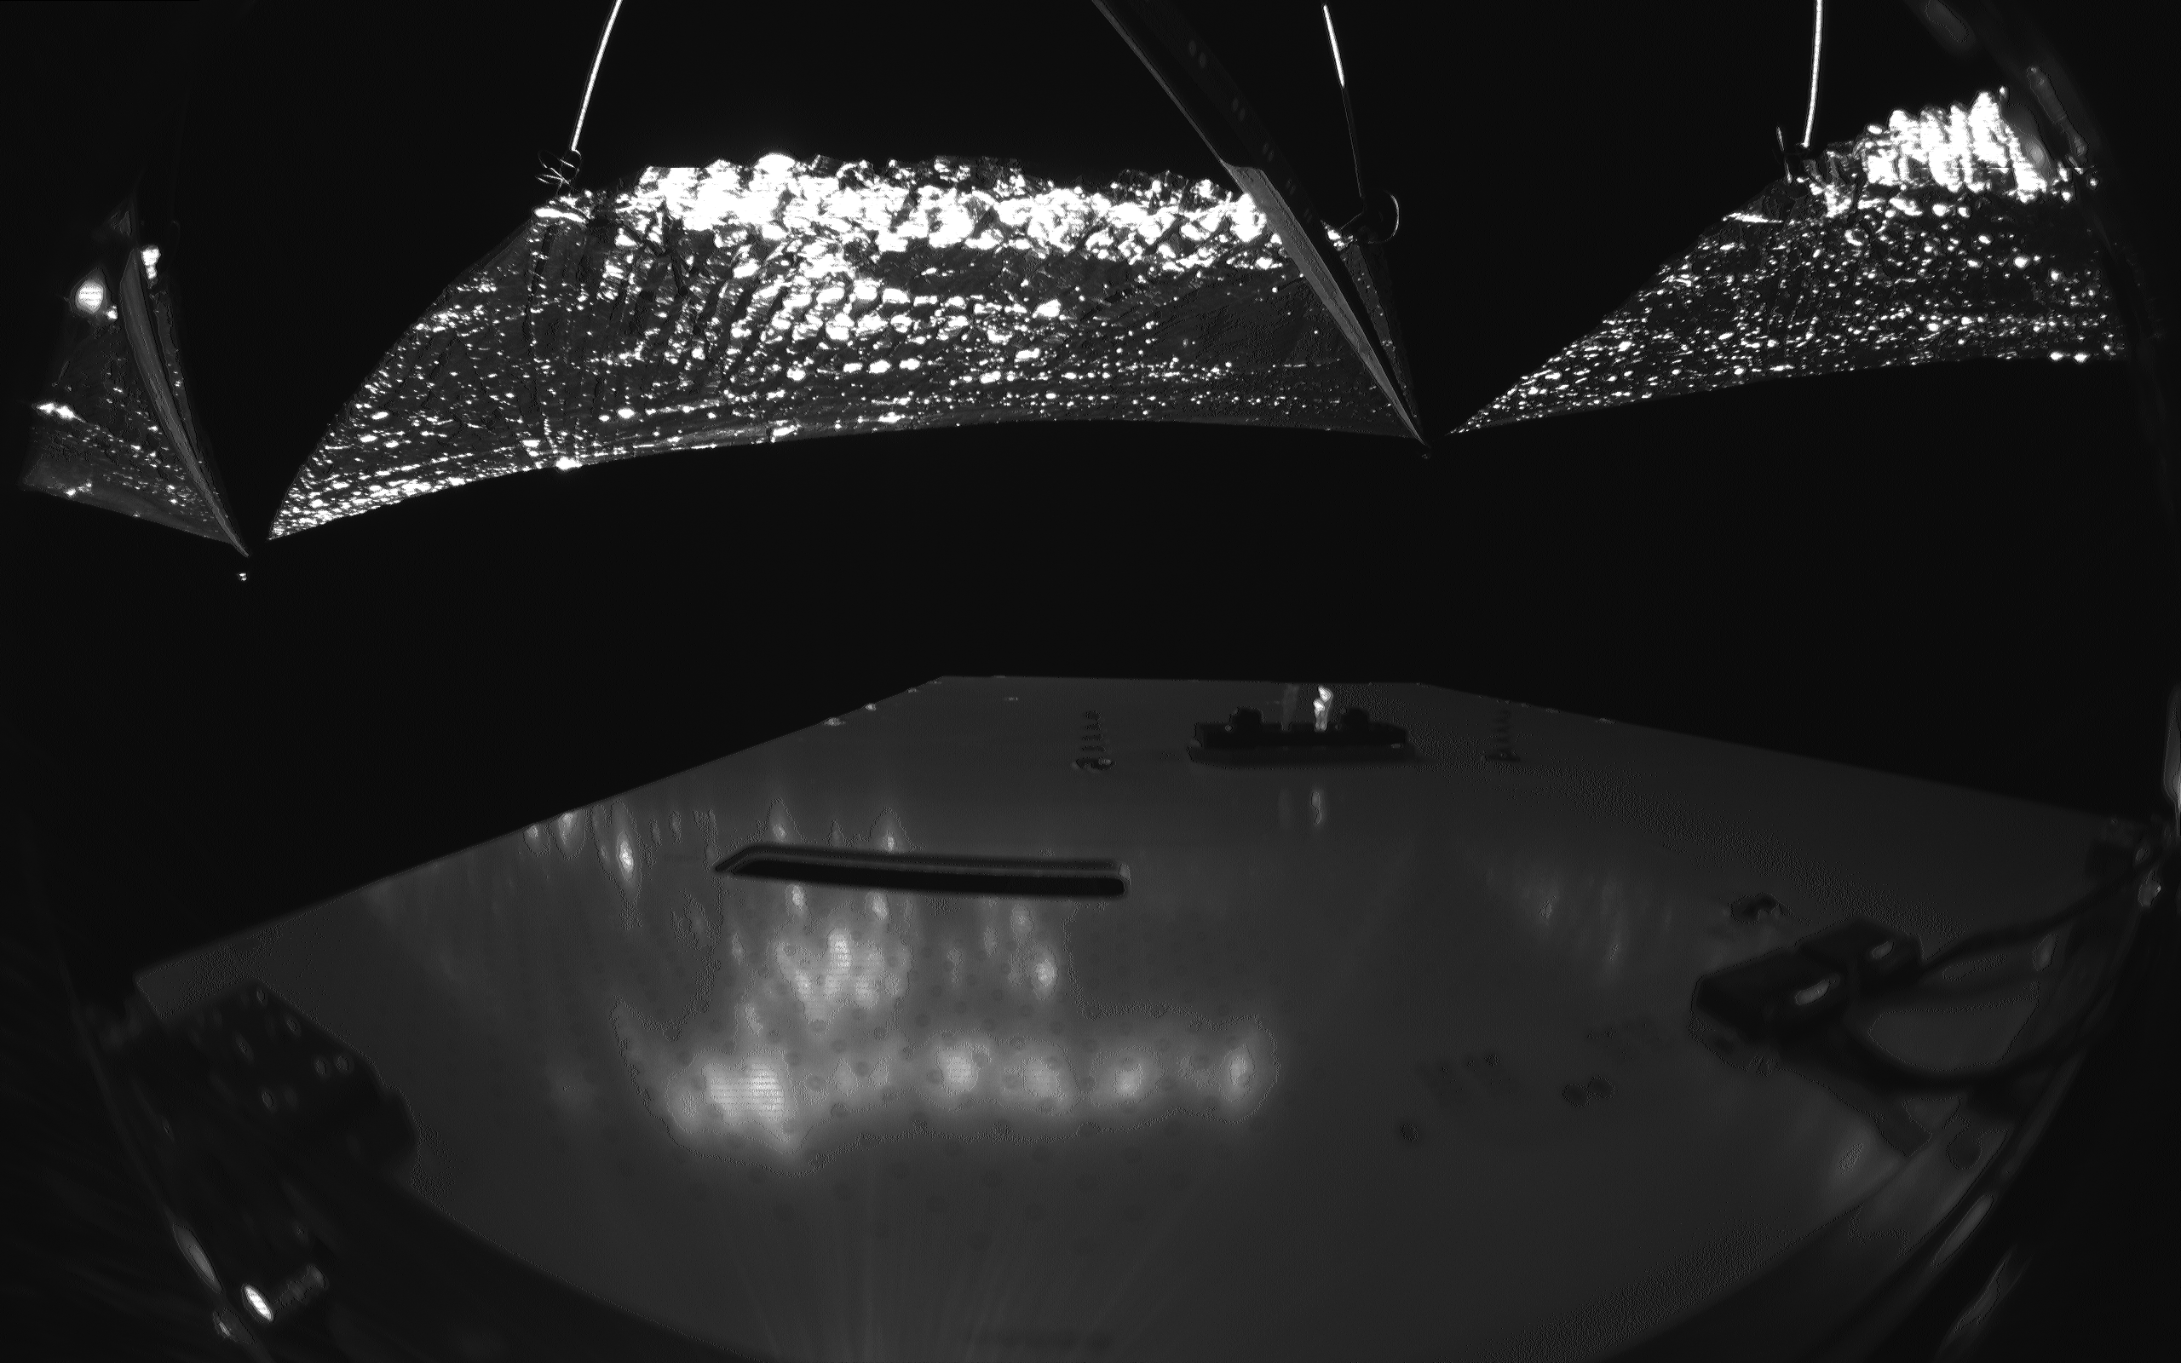
Mission Current Status
The spacecraft was launched in April 2024 and the solar sail was deployed in late August 2024.
NASA has been sending contact schedules periodically to SBE since the launch of the spacecraft.
From October 2024 to early April 2025, the spacecraft battery has been in negative charging as it was mainly charged by earth’s albedo and the sun was behind the solar panel of the spacecraft. The ground station was unable to make consistent contact with the spacecraft until late April.
Imagery operations and orbit maneuvering demonstration has been delayed due to the power charging condition.
The spacecraft battery charging becomes more feasible in recent weeks for imagery operations, spacecraft pointing and orbit maneuvering
Solar Sail
Solar Panel

Slide 12
Comm Link Needs for the Extended Mission
It is estimated that the deorbit of the spacecraft will not be completed until May 2026 for end-of-mission disposal as we may not have complete attitude control of the spacecraft for a controlled accelerated deorbiting.
Remaining operations that require S-band link of the spacecraft before being passivated for deorbit have been delayed after the spacecraft is back to positive charging in early May 2025:
  Solar Sail Characterization
  Collecting telemetry and high-resolution images backlog
  Downloading high-resolution images for sail shape analysis
  Orbit raising and lowering
  Spacecraft deorbiting
  Imagery Operation

