Slide 1
An Experimental Parametric Study on the Whirl-Flutter Stability of Tiltrotors
MAY 21, 2025
Presented by Martin Sekula
Research Aerospace Engineer
Co-Authors
Robert Thornburgh, DEVCOM ARL
Andrew Kreshock, DEVCOM ARL
Hao Kang, DEVCOM ARL
Thomas Ivanco, NASA
Garrett McHugh, NASA
Aeroelasticity Branch
NASA Langley Research Center
1

Slide 2
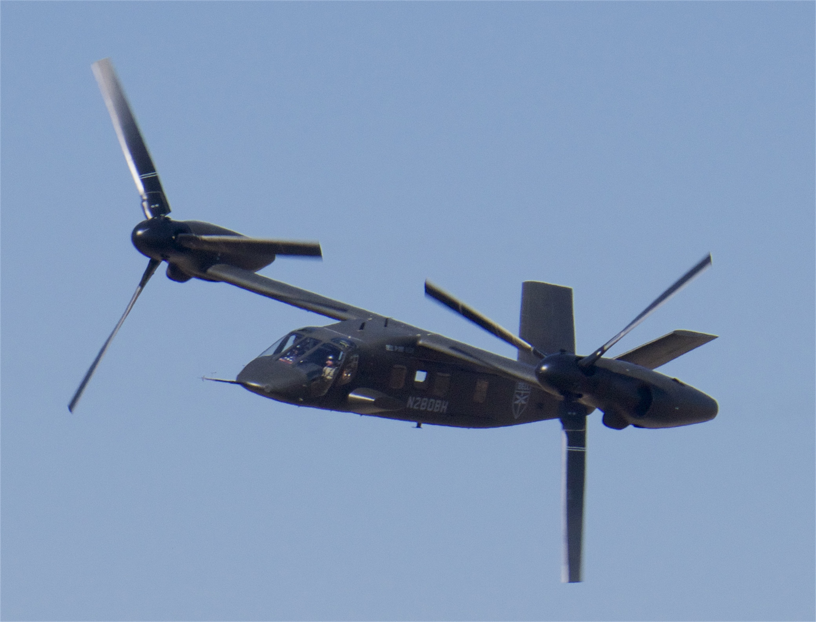
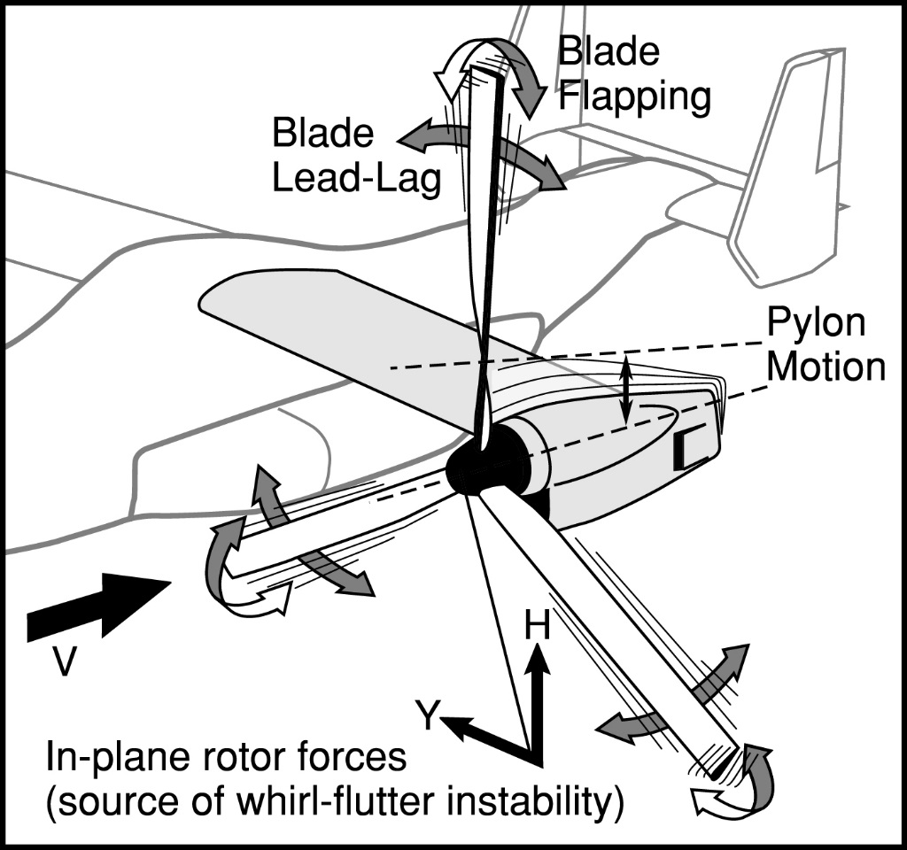
Introduction
Bell V-280 Valor
Tiltrotor whirl flutter results from the interaction between wing structure and rotor aeromechanics
21 May 2025
2
Notes:
With the introduction of tiltrotor design as part of the Army’s Future Vertical Lift program, there has been renewed interest in the performance of tiltrotor aircraft. One of the factors limiting the speed of tiltrotors is the instability known as whirl flutter.
What is whirl flutter
Hard to predict

Slide 3
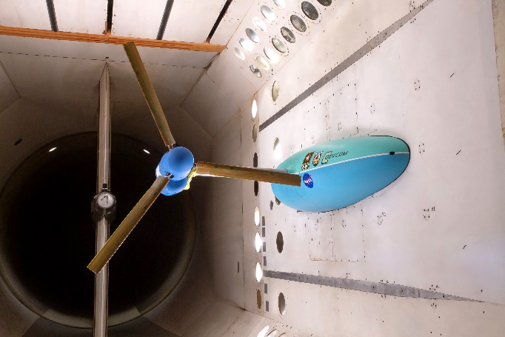
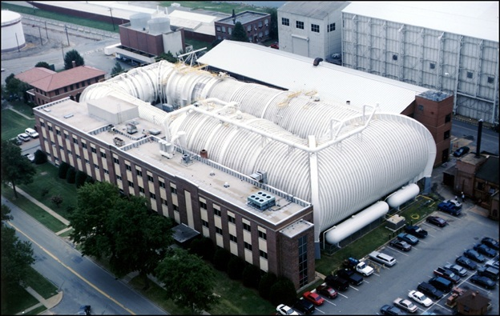
TRAST Wind-Tunnel Model
TiltRotor Aeroelastic Stability Testbed (TRAST)
Army and NASA effort
Semi-span model
8-ft-diameter rotor
Derived from XV-15 tiltrotor
Transonic Dynamics Tunnel (TDT)
TRAST in the Langley Transonic Dynamics Tunnel
21 May 2025
3
Notes:
Limited experimental data to validate analysis methods. Most of it is V-22 specific
Army and NASA developed TRAST
General testbed rather than vehicle specific
Properties are roughly scaled to XV-15, so its response characteristics are similar to actual flight vehicle
Wind-tunnel testing will generate experimental whirl-flutter data to support analysis validation

Slide 4
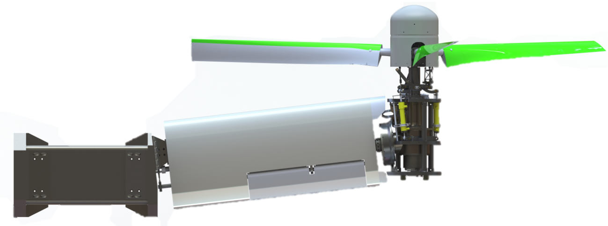
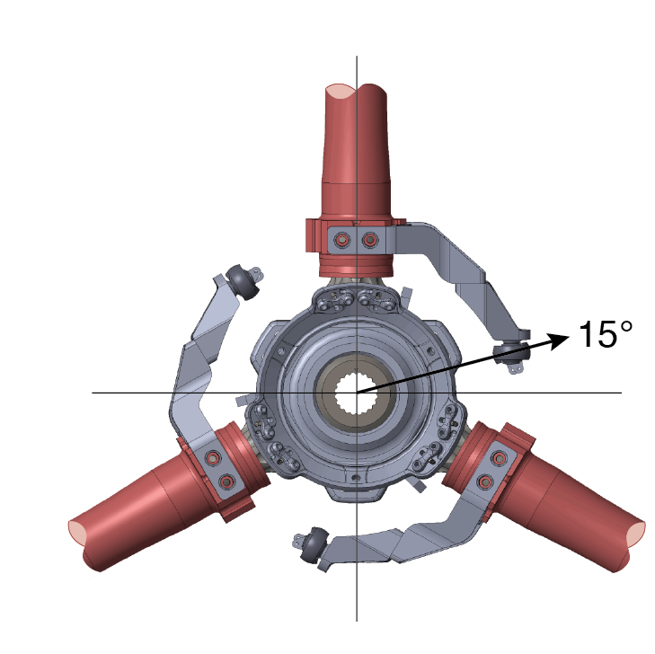
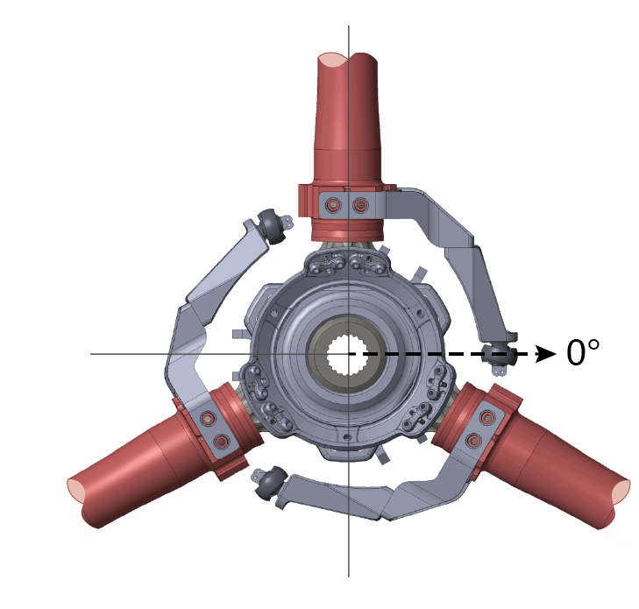
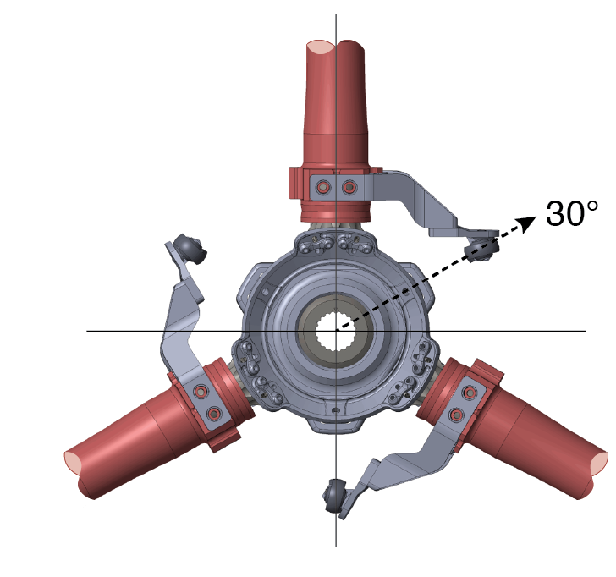
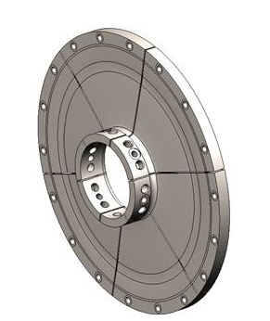
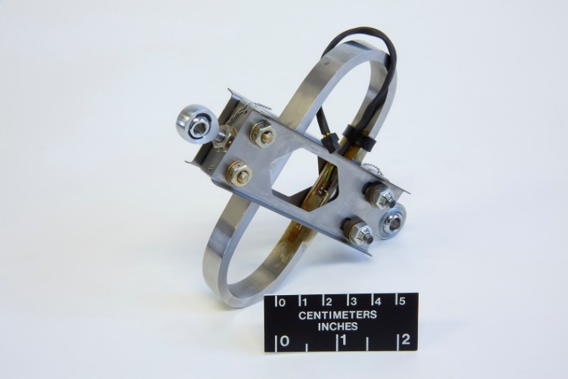
TRAST Features
Gimballed hub with adjustable pitch-flap coupling
-
-
Pitch Spring
Diaphragm Spring
21 May 2025
4
Notes:
Relatively reconfigurable compared to most models
Control-system geometry , Delta-3
One of the key aspects influencing whirl-flutter behavior is the stiffness of the connection between the wing and the pylon. In a flight vehicle there is a conversion mechanism and some sort of locking actuator that determines the stiffness. In TRAST, a replaceable pair of springs is used instead. This prevents the pylon from converting during testing, but allows a range of stiffnesses to be tested, which is extremely valuable for analysis validation.
Diaphragm spring. Baseline and half-yaw
Pitch spring.
Two blade sets

Slide 5
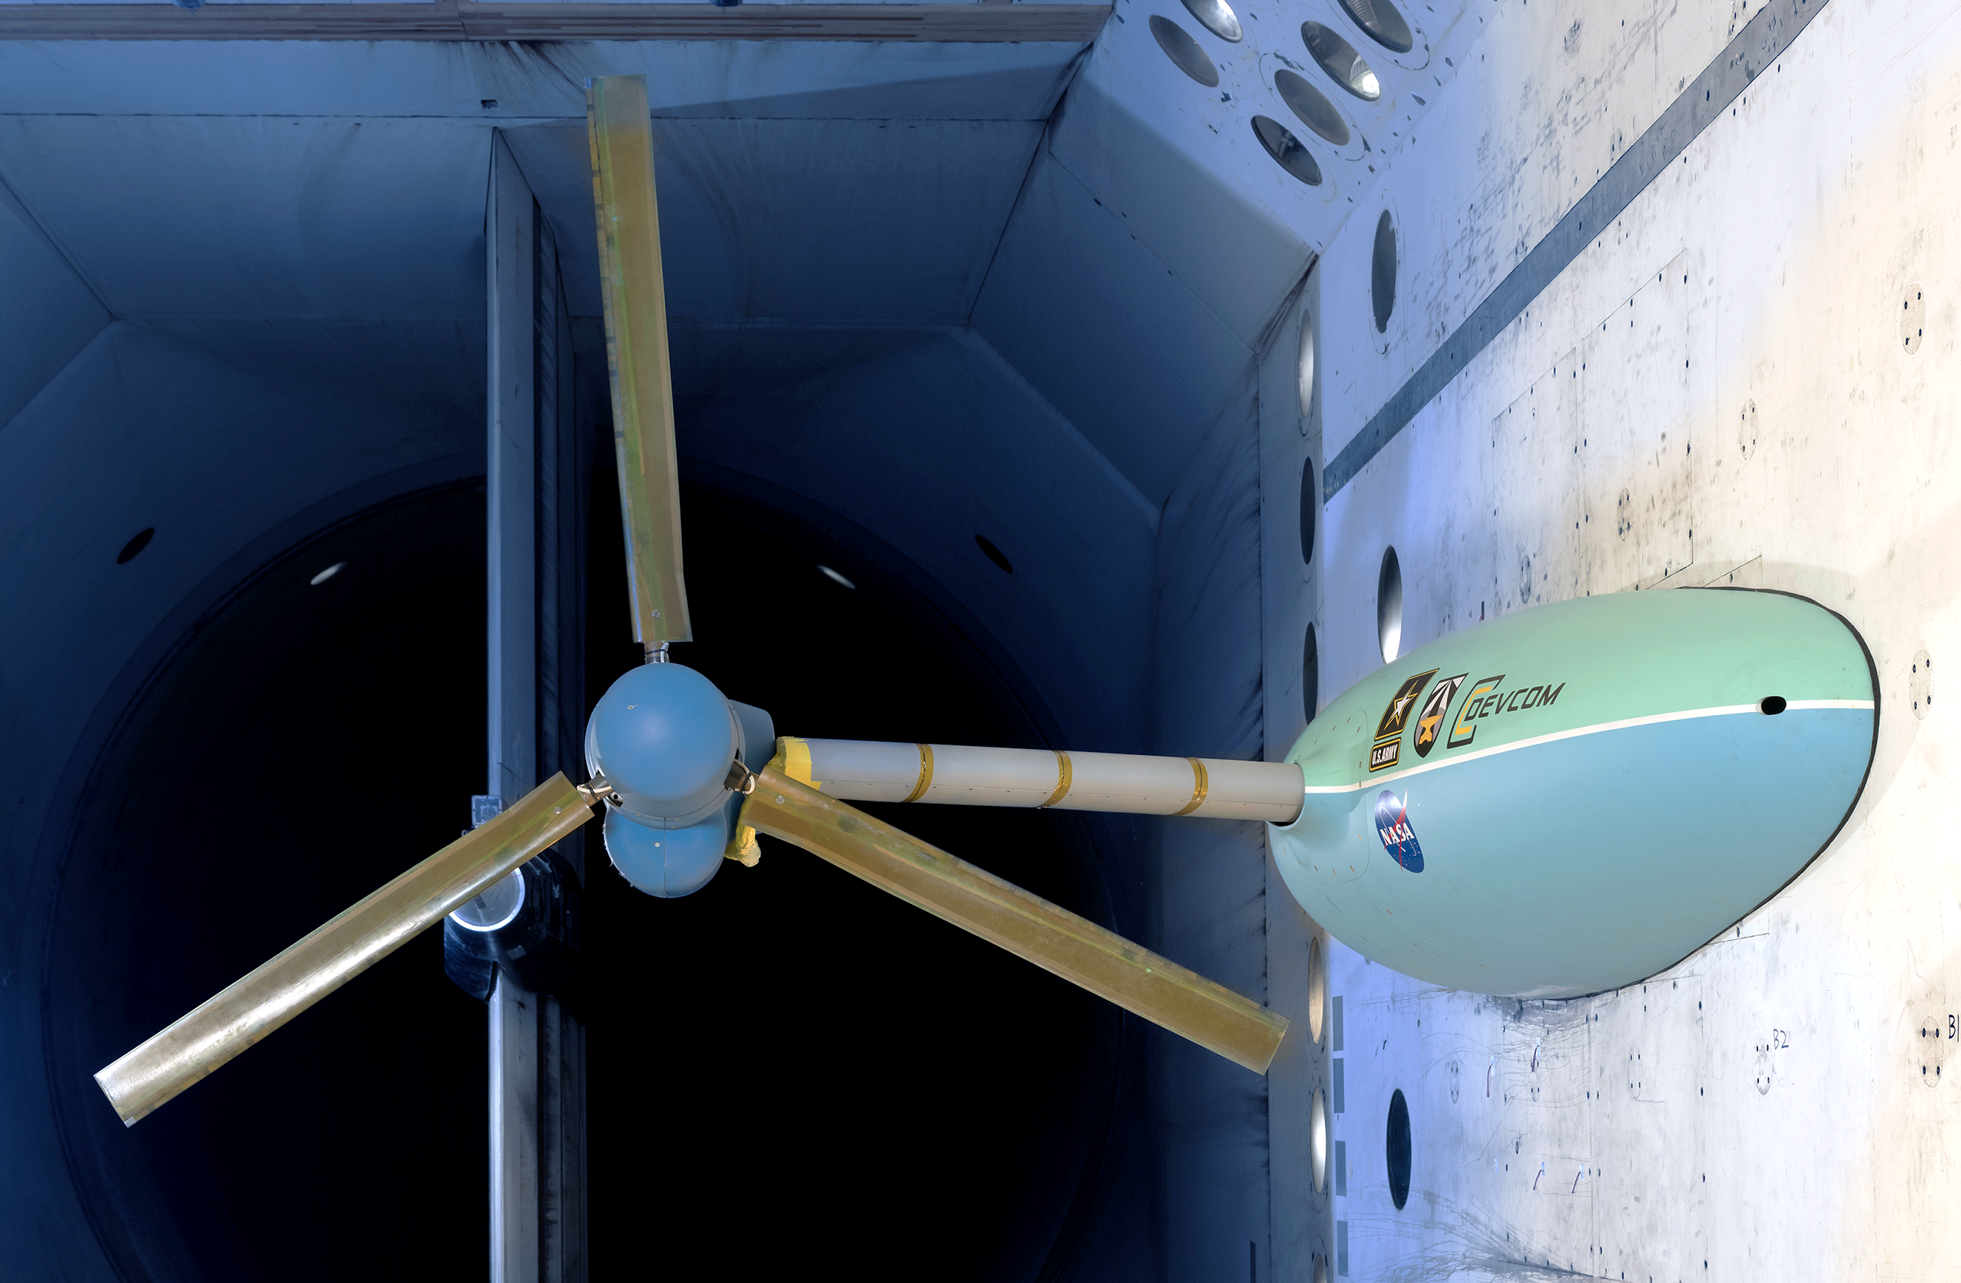
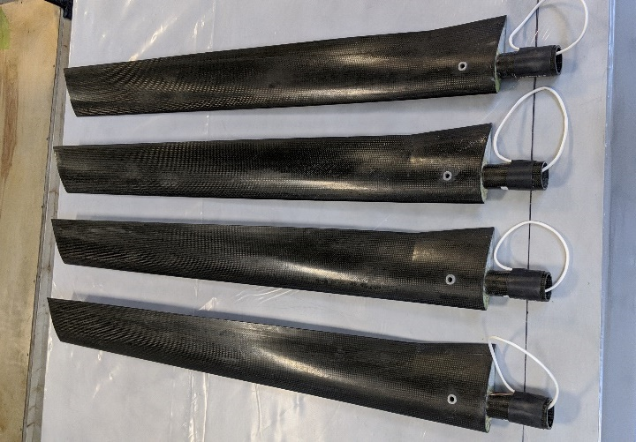
Wind-Tunnel Operation
Collective required for windmilling operation at constant rotor speed
Fiberglass Rotor Blades
Two blade sets with identical planform but different stiffness
Carbon-Fiber Rotor Blades
21 May 2025
5
Notes:
Two blade sets
Airplane mode
Although the TRAST has a motor, all of the data I am showing today was measured with the motor disconnected and the rotor allowed to windmill during tunnel operations. The rotor is free to spin, and rotor speed is controlled by changing the collective as tunnel speed increases. The reason for testing windmilling is that rotor thrust has been shown to have a stabilizing effect on tiltrotors, and thus a windmilling rotor typically represents the worst-case condition for whirl-flutter.

Slide 6
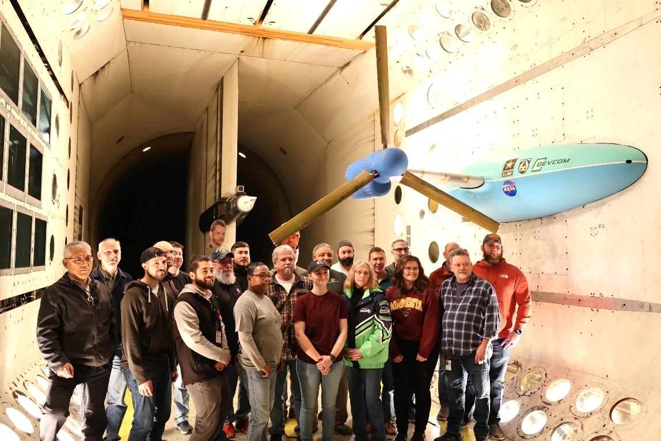
Wind-Tunnel TesT
Primary Objectives
Whirl-flutter measurements across a range of control-system geometries (delta-3 angles)
Test General Predictive Control (GPC) stability augmentation
Secondary Goals
Fiberglass vs. carbon-fiber blade comparison
Aileron performance
Model deformation using Digital Image Correlation (DIC)
Tertiary Goals
Investigate reduction in pitch-spring stiffness
Investigate reduction in pylon-yaw stiffness
Oct. 17 to Dec. 1, 2023
Accomplished all test objectives
Tested 12 different configurations at multiple rotor speeds
21 May 2025
6
Notes:
Langley TDT
2nd entry. 1st entry produced some results, but was primarily for validation of TRAST operation and the testing procedures
Because of the changes made following the first test, we were able to improve our testing efficiency. Tested 12 different configurations and obtained about 12,000 free-decay stability measurements.

Slide 7
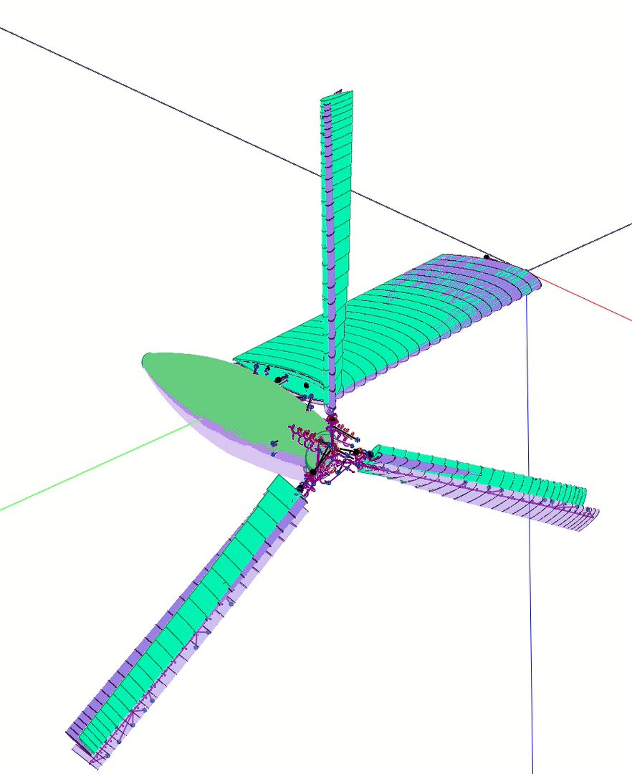
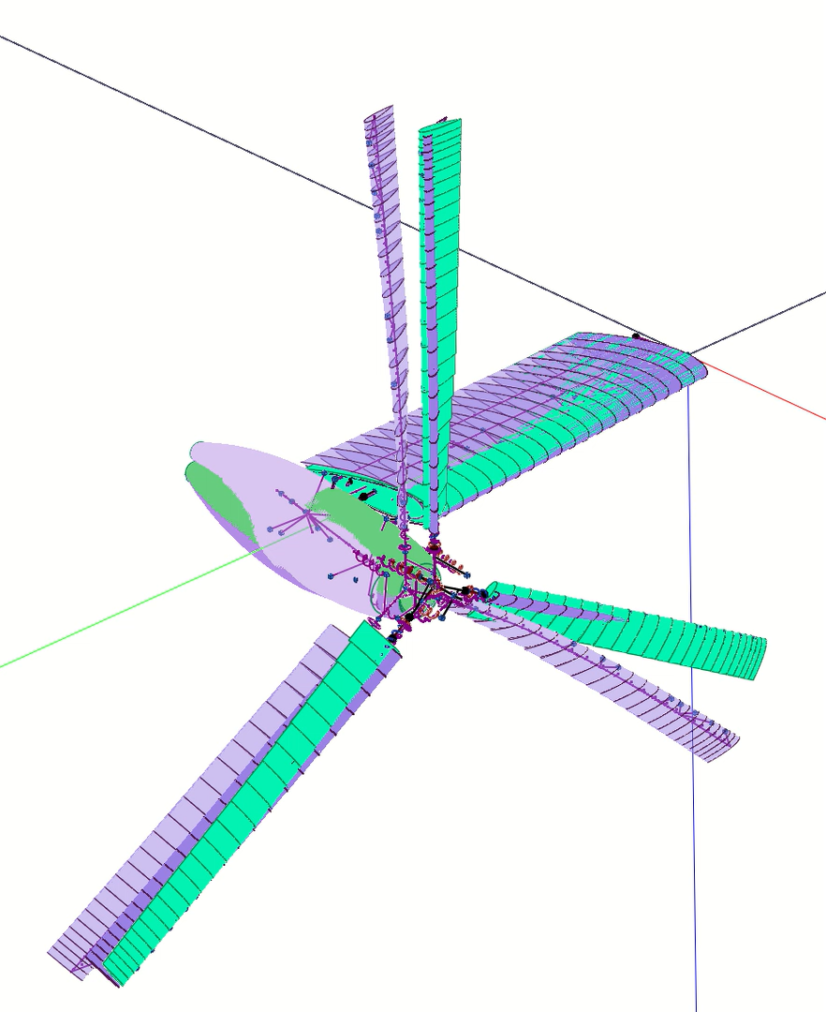
Modal Response and Measurement
Other Instrumentation
Pitch-Spring Tension
Diaphragm-Spring Strain
Blade Bending Gages
3 Accelerometers for wing-tip motion
8 Accelerometers for full pylon motion
Strain Gages for Wing Bending Moment
Wing-Vertical Mode
Wing-Inplane Mode
21 May 2025
7
Notes:
Before we get into the results, talk about the TRAST behaves and how we obtain stability measurements
Airplane mode
There are four basic dynamic modes of the wing-pylon system, but it is only the two lowest frequency modes that typically go unstable and really limit flight speed.
The first is what we call the wing-vertical mode, which is predominately flapwise bending of the wing, but with some amount pylon pitching motion as well. It is typically around 5 Hz, and its frequency and shape are very sensitive to the pitch spring stiffness.
The second is the wing-inplane mode. It is a combination of chordwise bending of the wing and yawing motion of the pylon. It is around 7-1/2 Hz.
Sensors: bending gages, accelerometers, pitch-spring load. We also have blade bending gages, but they are not as useful for system-level response.

Slide 8
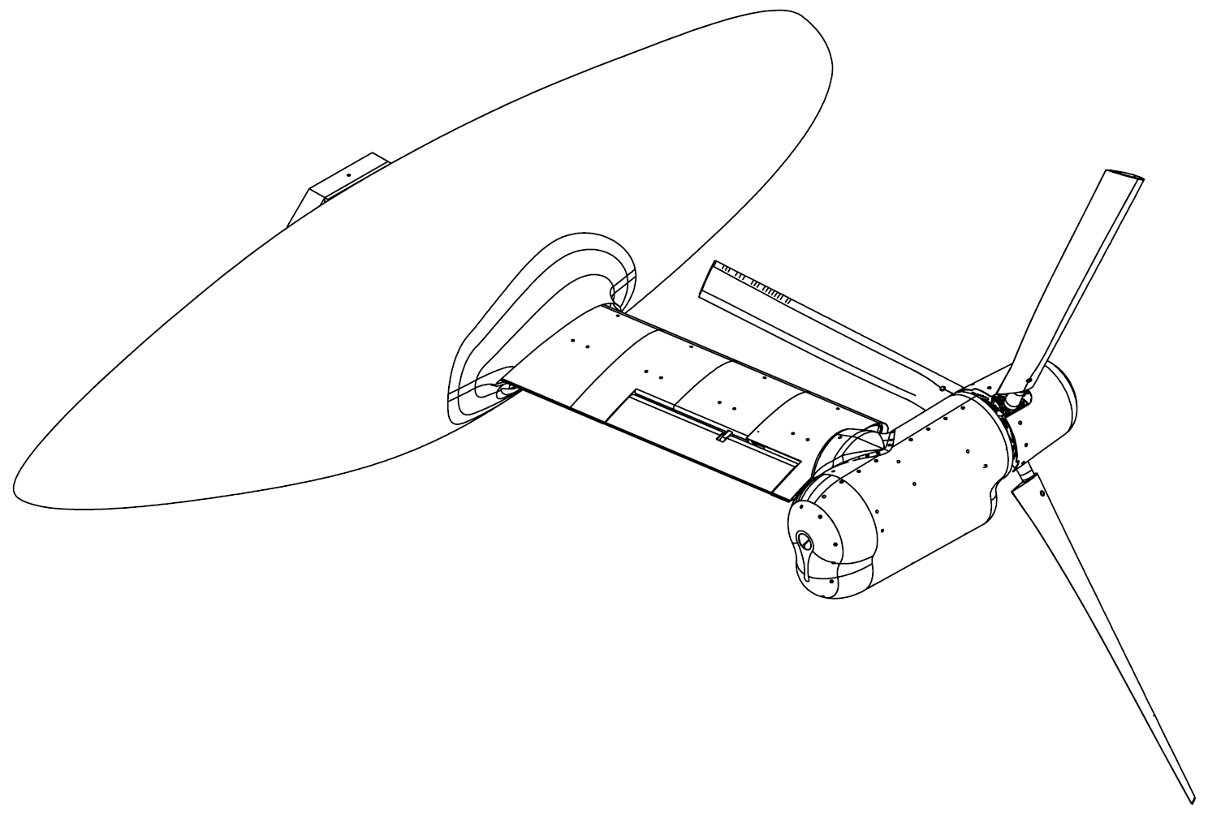
Stability Measurements
Excitation Amplitude
Swashplate Actuator 1
Excitation Methods
Aileron
Collective
Positive Cyclic Stir
Negative Cyclic Stir
Fwd/Aft Cyclic
Lateral Cyclic
Free Decay
Wing Bending Moment
21 May 2025
8
Notes:
During testing, our objective is to measure the frequency and damping of those two modes and track how they change with tunnel speed. To do this, we excite the model and measure the response during free decays.
We used two methods to excite the model. One was to oscillate the aileron on the trailing edge of the wing. This did a fair job of exciting the wing-vertical mode, but our primary excitation method was through swashplate oscillation. Since we use hydraulic actuators we can oscillate up to 20 Hz. Also, by changing the phase between the actuators we can induce either collective oscillations, which are effective at exciting the wing-inplane mode, or cyclic stirs, which excite the wing-vertical mode.
Example

Slide 9
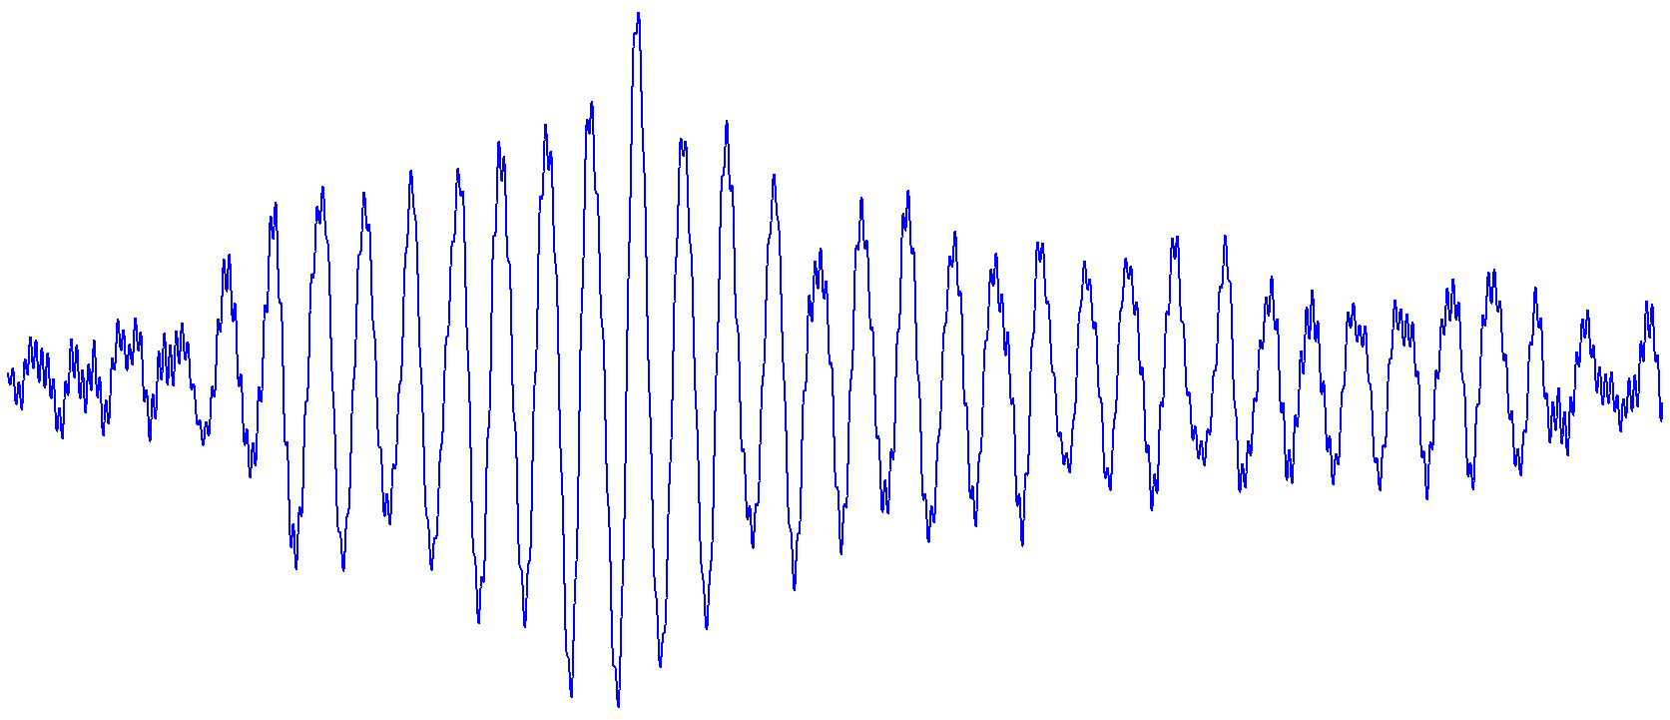
Effect of Turbulence
Prony method over 1-cycle increments
21 May 2025
9
Notes:
In the ideal world, obtaining damping values from a free decay is a very straight forward process. We typically use the moving-block method, which is good at getting damping values from signals that may be contaminated by frequencies other than the mode of interest.
One of the challenges we have is that tunnel turbulence results in a random forced response of the model, even while you are trying to measure the free decay. At low speeds, this isn’t too much of a problem, as you can excite the model well above the noise floor. But turbulence increases with tunnel speed and it becomes difficult to produce a response that is sufficiently above the noise floor without exceeding limit loads on the model.
This results in scatter in the measured damping values that increases with tunnel speed.
We have been working on methods to overcome this. Advertise Gray’s paper. The results presented here are computed by taking advantage of the Prony method’s ability to get damping and frequency from very short time segments. So if we have say 5 free decay measurements for a given tunnel speed, rather than simply average 5 moving-block estimates with large scatter, we instead we take each free decay and use one-cycle segments with 95% overlap and produce several hundred Prony estimates from each measurement. We can then combine those estimates from the 5 free decays into a single set with over 1000 points to average. This has been shown to more effectively statistically remove the random turbulence effect that just averaging 5 moving-blocks.
Also, we have observed that the damping sometimes changes with the amplitude of the oscillation. Because each Prony is very short, each estimate has a corresponding amplitude. You can then sort the Prony estimates based on this amplitude and obtain damping as a function of amplitude. Results in this presentation are all at the moderate amplitude of 3000 in-lb of wing bending moment.

Slide 10
Effect of Pitch-Flap Coupling
Wing Vertical Mode 727 RPM
Wing Vertical Mode 909 RPM
Configuration
Fiberglass Blades
4000 lb/in Pitch Spring
Baseline Diaphragm Spring
21 May 2025
10
Notes:
Now moving on to results
Primary test objective was data on the effect of pitch-flap coupling.
6 values ranging from 0 to -30 deg.
Done in our baseline configuration with 4k pitch spring and fiberglass blades
Frequency drops with increasing speed, not significantly affected by delta_3
2 effects on damping. Expect more negative delta_3 to be less stable and damping to decrease monotonically with increasing speed. But we also see increase in damping at high speeds with less negative delta_3
This is a result of the regressive lag rotor mode coupling with the wing mode

Slide 11
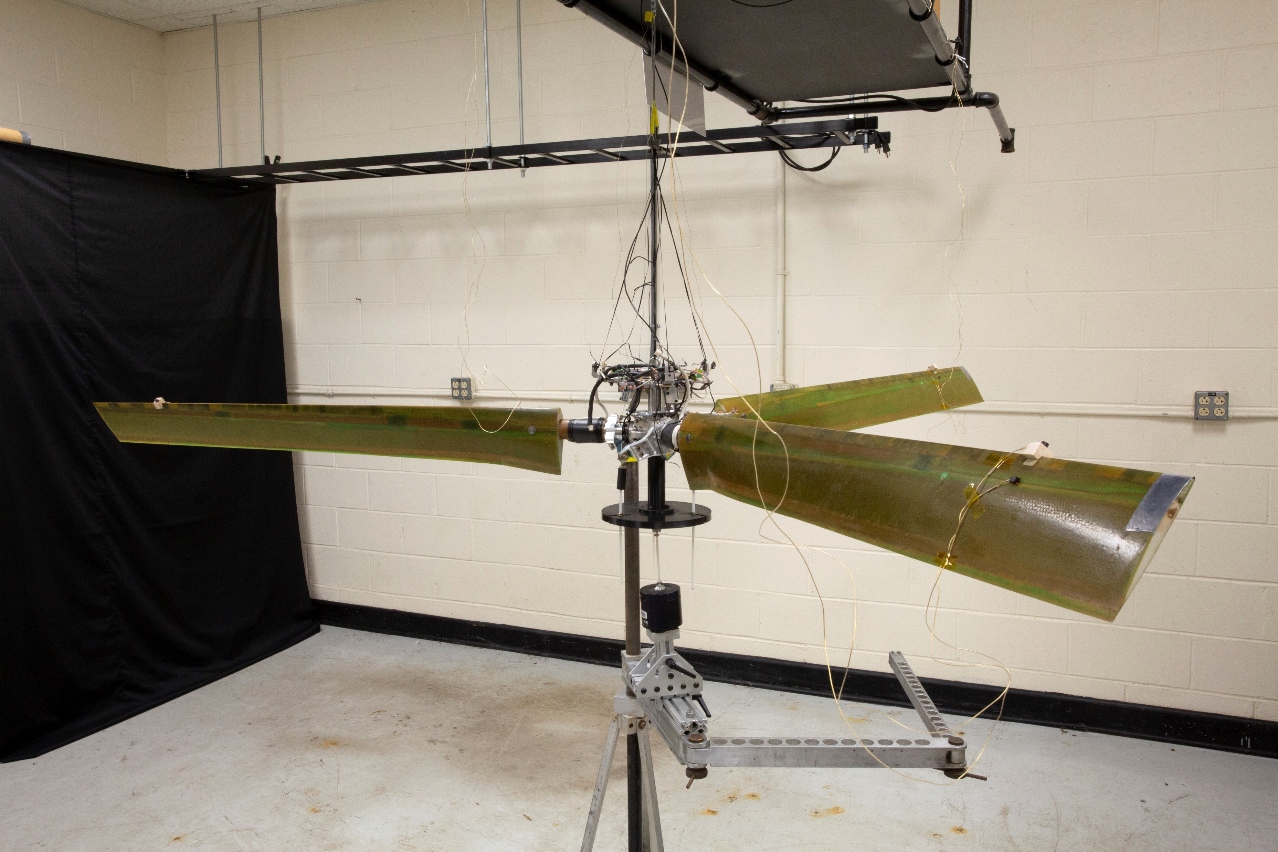
Blade and Rotor Modes
Fiberglass blade frequencies for the free-free hub
21 May 2025
11
Notes:
The reason this is so dependent on tunnel speed is because the very large change in collective that occurs with increasing speed causes large changes in the blade frequencies.
The demonstrate this and obtain validation data, a free-free vibration test was done on the hub and blades.
With increasing collective the flap frequencies increase and the lag frequencies decrease
So as speed increases the regressive-lag frequency steadily drops until it crosses the wing frequencies.
Lag motion verify effective at removing energy, thus more damping

Slide 12
Operational Regressive Lag Mode
Free decays not possible
Seen in chordwise bending moment
Constant-frequency excitation
Stepped across frequency range at each tunnel speed
Extracted regressive lag frequency from FRFs
Fiberglass blades, δ₃ = ‑10°, 909 RPM
21 May 2025
12
Notes:
We also wanted to get validation data on the regressive lag frequency while operating, but not discernable from free-decay data
Noticed that it was visible in blade chordwise bending gages if swept the stick stir frequency across it
At each tunnel speed, created an FRF by stepped sine oscillation (0.1-Hz df, 0.25-deg amp positive stir)
From each FRF, used a modal curve fitter (POLYMAX) to compute regressive lag frequency at that tunnel speed.
This gives the plot of RL freq vs tunnel speed
Had to stop as frequency approached wing-vertical frequency due to loads
Very time consuming, so we had to sneak them in where practical. That is why the odd combination of rpm and config

Slide 13
Wing Inplane Mode
727 RPM
909 RPM
Configuration
Fiberglass Blades
4000 lb/in Pitch Spring
Baseline Diaphragm Spring
21 May 2025
13
Notes:
In addition to wing-vertical mode, we also measured the wing inplane mode
Less affected by delta_3
As the regressive lag frequency drops, it also crosses the wing inplane mode at a lower tunnel speed than wing-vertical mode
This crossing also affects frequency
For delta_3 near zero, this mode will go unstable before wing-vertical
Very dangerous mode, so we did not go as close to boundary as wing-vertical mode

Slide 14
Effect of Blade Stiffness
Wing-Vertical Mode
Configuration
909 RPM
4000 lb/in Pitch Spring
Baseline Diaphragm Spring
Carbon-Fiber Blades
Fiberglass Blades
21 May 2025
14
Notes:
The purpose of testing another a carbon-fiber blade set in addition to the fiberglass blades is to produce further data on the interaction between the wing modes and the blade modes
Carbon-fiber blades are significantly stiffer than the fiberglass blades, so the rotor blade frequencies are also higher.
Thus the coupling does not occur until higher tunnel speeds.
This can be seen in comparison between the comparable configurations
For CF blades the damping decreases below zero before coupling can occur to create the increase in damping (best seen in -15deg delta_3)
More results in ERF paper from last year

Slide 15
Effect of Yaw Stiffness
Wing Vertical Mode
Wing Inplane Mode
Configuration
Fiberglass Blades
727 RPM
5000 lb/in Pitch Spring
δ₃ = -20°
21 May 2025
15
Notes:
We also obtained stability data for cases with different pitch springs and diaphragm springs.
All of this was done for fiberglass blades with -20deg delta_3
This sample compares effect of yaw stiffness
Counterintuitive in that the decrease in yaw stiffness actually results in an increase in stability for this configuration

Slide 16
Effect of Tunnel Pressure
Configuration
Carbon-Fiber Blades
909 RPM
4000 lb/in Pitch Spring
δ₃ = -30°
Baseline Diaphragm Spring
Pressure (psf) | Density (slug/ft³)
2100 | 0.00232
1900 | 0.00209
1700 | 0.00188
21 May 2025
16
Notes:
Took advantage of the fact that we can change tunnel pressure, and thus density, at the TDT
Bulk of our testing was at 1900 psf, about 200 psf below atmospheric
For one configuration, acquired data at about 200 psf above and below this (+/- 10% change in density)
Obviously more density, larger aero effect, lower stability boundary
Chose -30deg delta_3, CF blades, to minimize effect of regressive lag coupling

Slide 17
Mode Shape Measurements
Free-decay measurements are also obtained from other sensors
Fourier transform at the modal frequency
Normalizing based on wing-bending moment produces an effective mode shape
Wing Bending Moment
Wing-bending moments used as reference for all shape measurements
Pylon Pitch Acceleration
8 pylon accelerometers combined to produce 6-dof pylon motion
Rotor gimbal rotation converted to fixed frame to produce lateral and longitudinal disk motion
Forward/Aft Rotor Disk Motion
21 May 2025
17
Notes:
Although damping and frequency measurements are the primary data acquired in whirl flutter testing, we also wanted to collect data to describe the changes in modal shape caused by airspeed
Reason for all of the sensors was to also get mode shape information
Wing bending moments used for damping and frequency because they have been shown to produce the most consistent results
Using the frequency from the wing-moment free decay, we can compute matching Fourier transform on other channels
The amplitude and phase of these channels relative to wing moment constitute an effect mode shape for the free decay mode
The signals from the 8 accelerometers on the pylon were synthesized to provide rigid-body acceleration of the pylon in all 6 degrees of freedom
Had to convert from accelerations to displacements. Easy
The ratio of pitching rotation to vertical motion was most interesting for wing-vertical mode
Also looked at gimballed motion of the rotor disk. Used azimuth to convert from rotating frame to fixed frame

Slide 18
Mode Shape Change with Velocity
Pylon pitch from accelerometers
Pylon Pitch
(deg per 1000-in-lb)
Fwd/Aft Disk Motion
(deg per 1000-in-lb)
Fwd/aft rotor motion
Configuration
Fiberglass Blades
909 RPM
4000 lb/in Pitch Spring
Baseline Diaphragm Spring
Amplitudes are normalized to wing-bending moment
21 May 2025
18
Notes:
We averaged mode shapes for each tunnel speed and were then able to look at how the mode shapes changed with increasing velocity
Observed increases in the magnitude of the pitching component in the wing-vertical mode with increasing tunnel speed.
Also small increase in how pitch lags vertical motion. Affect of delta_3 not clear
Rotor motion goes up then starts to decrease ?
Rotor motion phase angle affected by coupling with regressive lag mode

Slide 19
Conclusions
Successfully completed wind-tunnel testing of the TiltRotor Aeroelastic Stability Testbed (TRAST)
Obtained extensive experimental data for analysis validation
  Pitch-flap coupling from -0° to -30°
  Blade sets with different stiffness
  Tunnel density variation
  Changes in wing-pylon connection stiffness
Results include study of effects not typically quantified during whirl-flutter testing
  Data to assess regressive-lag mode coupling with wing modes
  Measured changes in gimbal and pylon motion with tunnel speed
21 May 2025
19

Slide 20

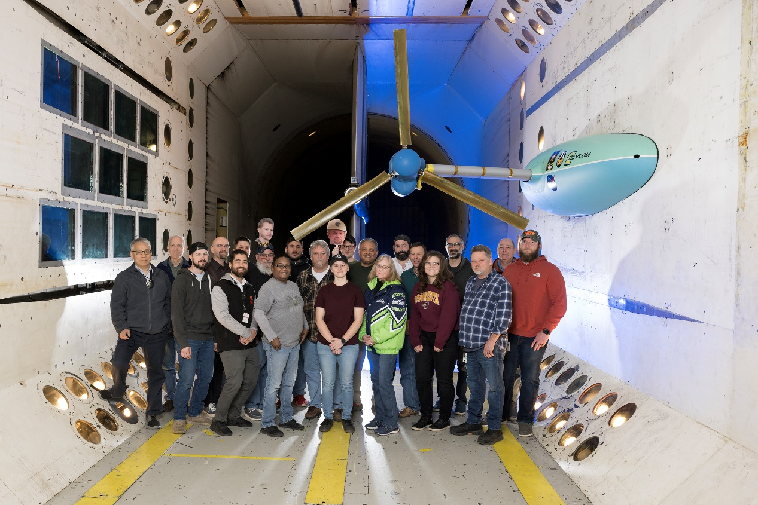


Thank you

