Slide 1
2025 SIVB:
Living on the Edge: Challenges for supporting Humans in Deep Space
¹Bruce M. Link, ²Gioia D. Massa, ²Trent M. Smith, ²Elison B. Blancaflor, ³Raymond Wheeler, ³Ralph Fritsche, ⁴Angela M. Herblet
¹Amentum Services Inc., NASA Ames Research Center; ²NASA, Kennedy Space Center; ³NASA, Retired, Kennedy Space Center; ⁴NASA, Marshall Space Flight Center
STI: 20250002879

Slide 2
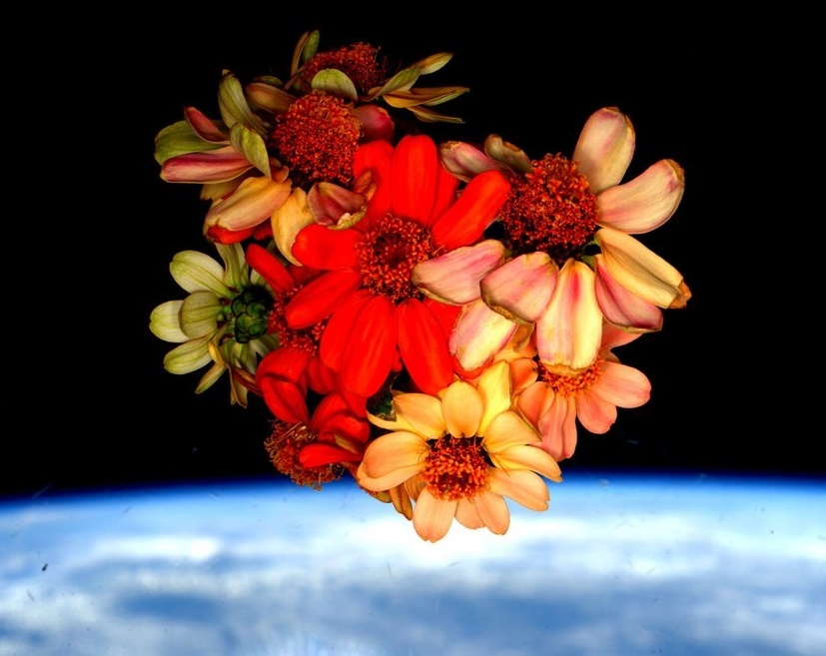
Thank you!
Veggie, APH, and Space Crop Production teams
NASA’s astronauts
NASA’s Biological and Physical Sciences Division, ISS Program, Human Research Program, Mars Campaign Office

Slide 3

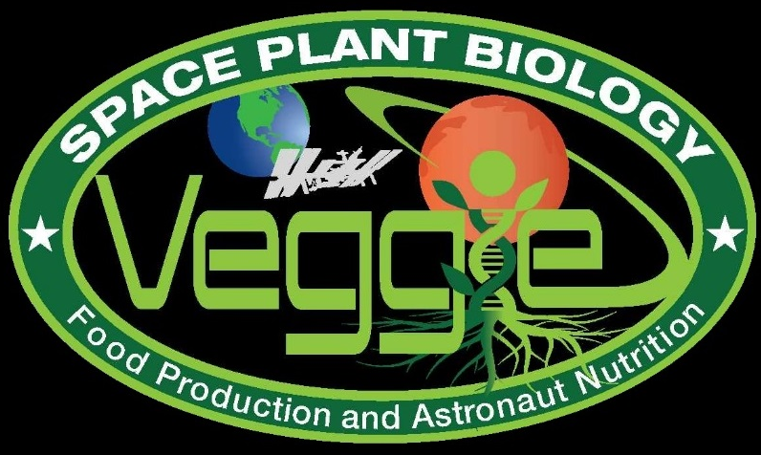
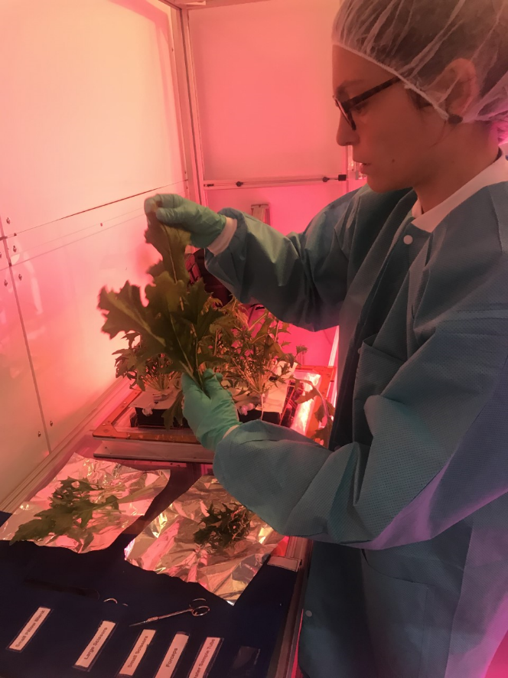
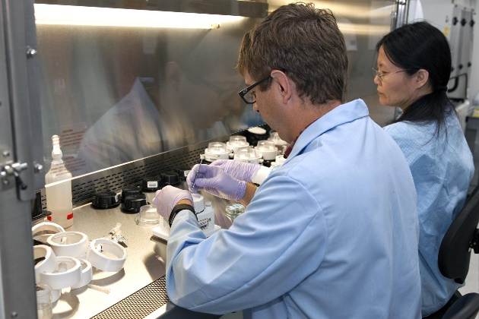
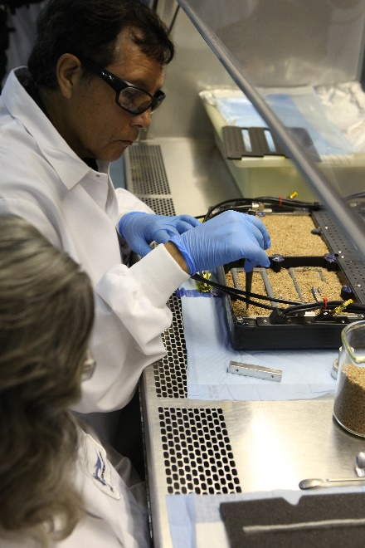
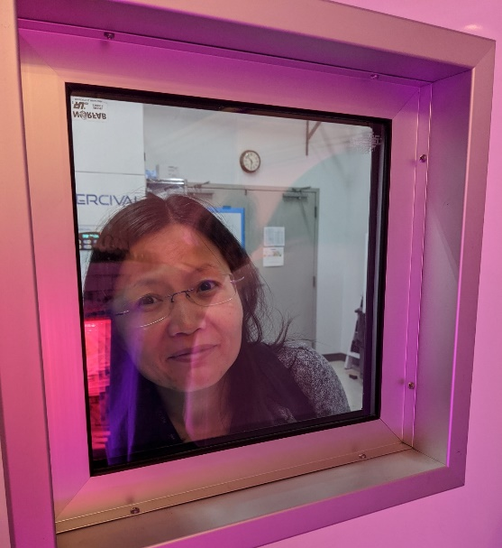
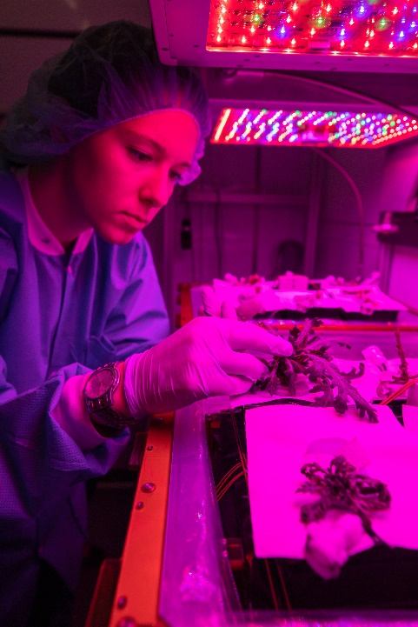
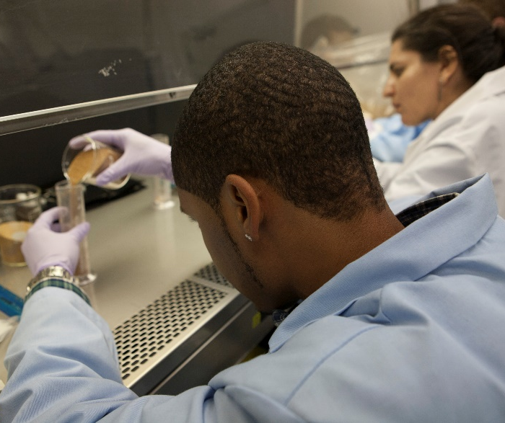
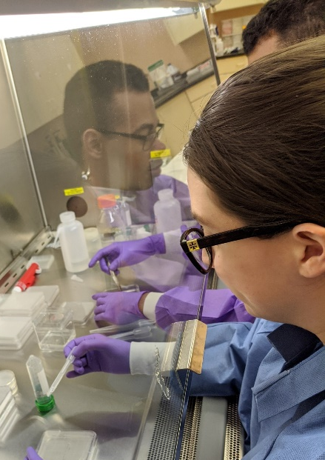
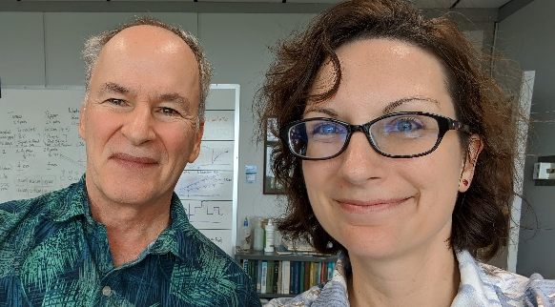
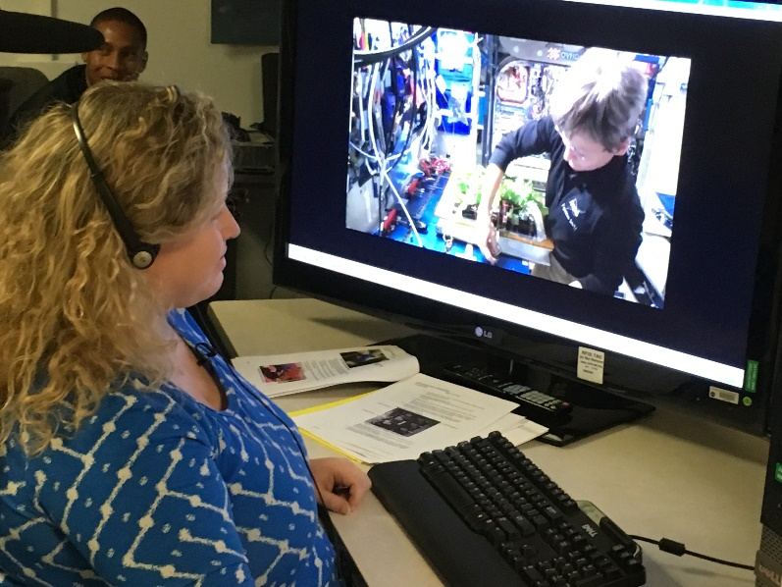
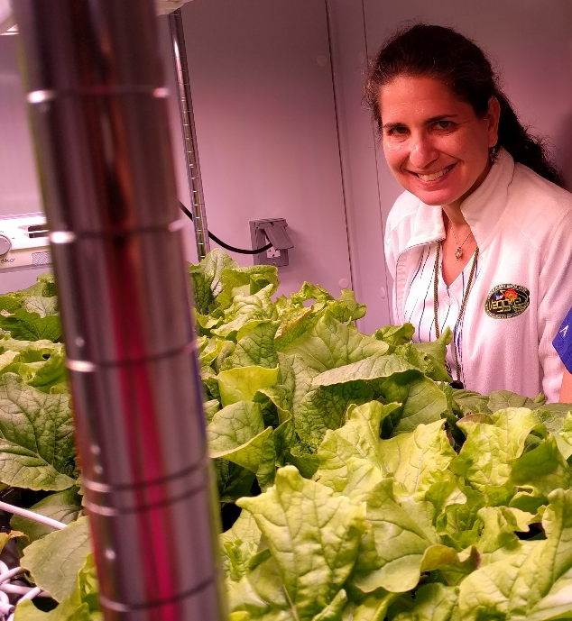
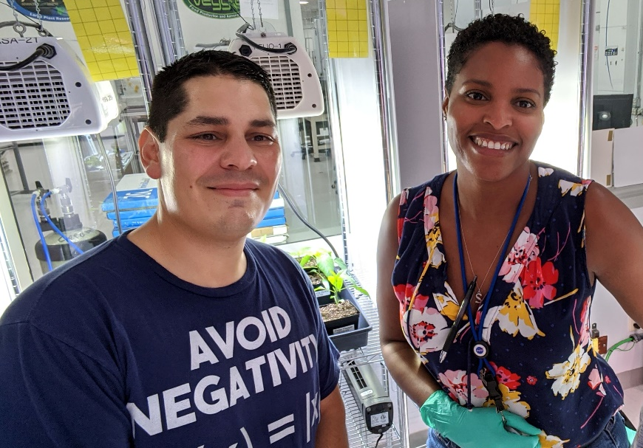
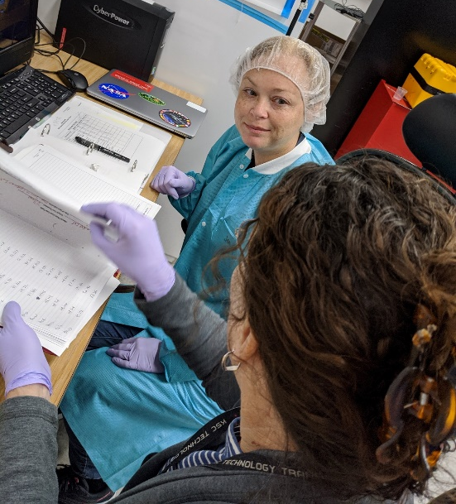

Slide 4
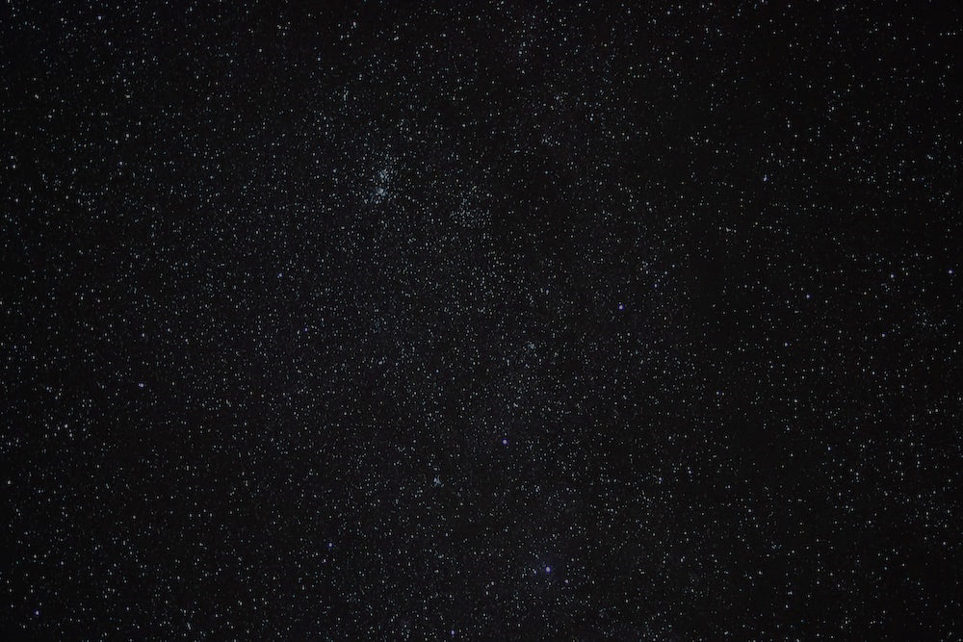
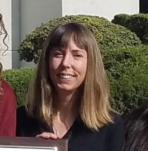
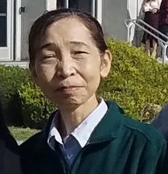

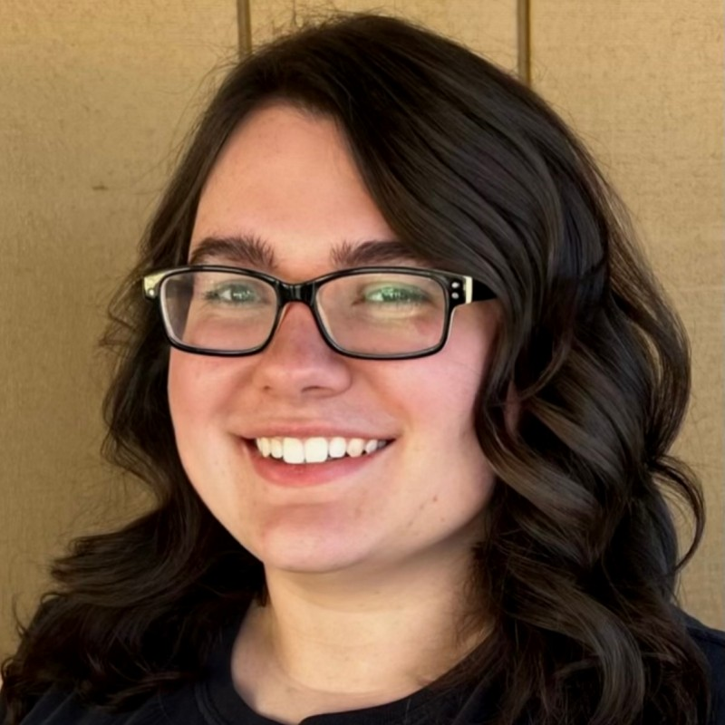

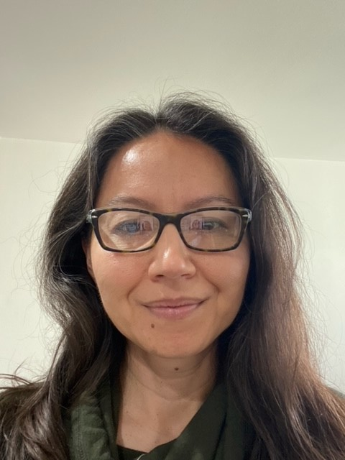
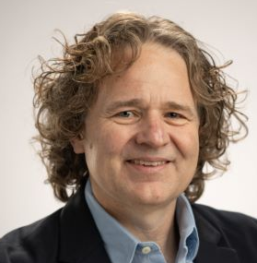
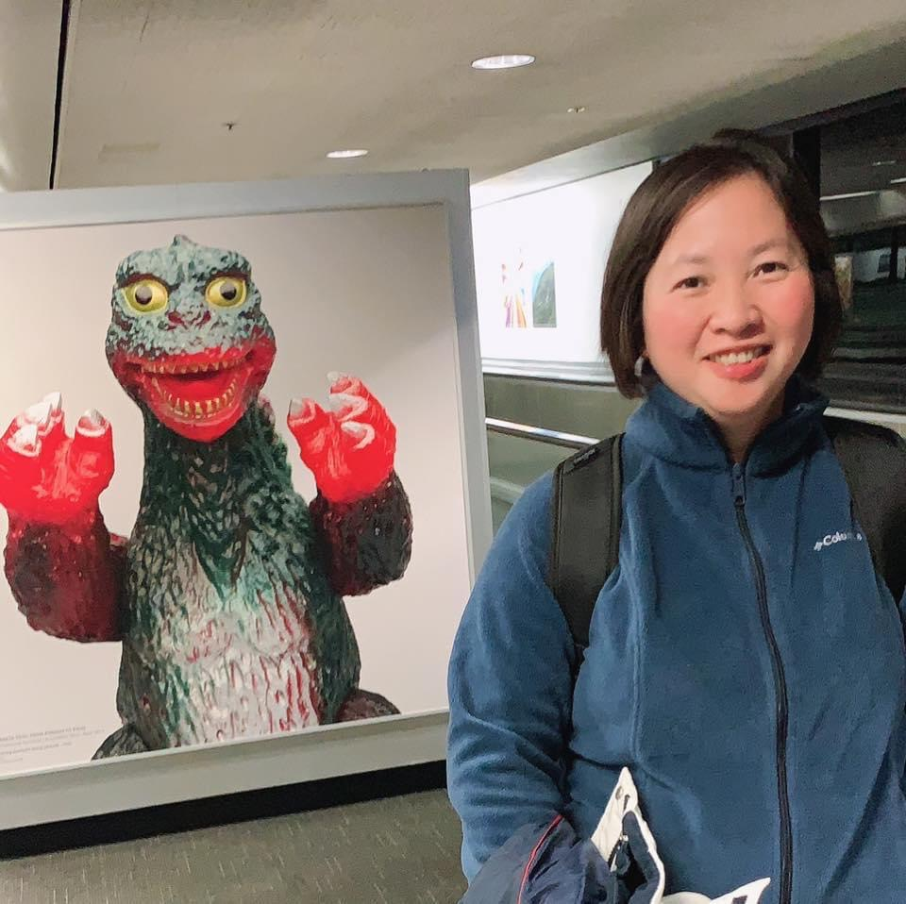

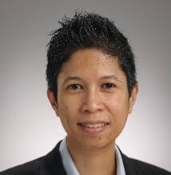
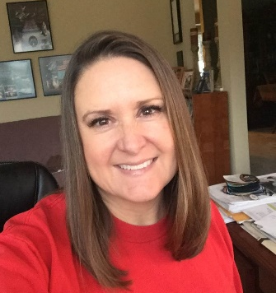

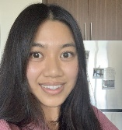
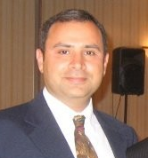
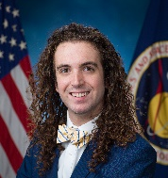
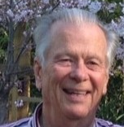
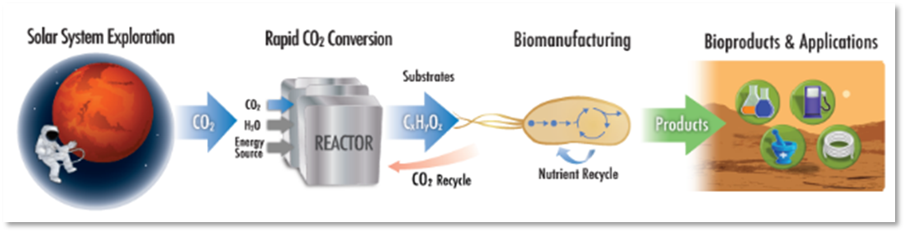

Synthetic Biology Team
Frances Donovan, PhD Project Manager, PI
Natalie Ball
Hiromi Kagawa,
Ph.D.
Sandra Vu
Sadie Downing
Matthew Paddock
Ami Hannon Ph.D.
Hami Ray,
Ph.D., dPM
A. Mark Settles,
Ph.D.
Jessica Kong
Philip Sweet, PhD
Candice Tahimic,
Ph.D.
Synthetic Biology GCD project Elements
Lisa Anderson
Oscar Roque
Alyssa
Villanueva
Sean Sharif
Kevin Sims, Payload Manager
Harry Jones, Ph.D.
Systems Engineer
Safety: Daniel Varnum-Lowry
Q/A: Leonard Hee
Logistics at KSC: Satro Narayan
CO₂ based manufacturing
BioNutrients
Former team members and students: Aditya Hindupur, Amy Gresser, Aphrodite Kostakis, Asif Rahman, Ava Karanjia, Benjamin Alva, Eliza Zaroff, Eric Litwiller, Jason Samson, Jing Li, John Hogan, Jon Galazka, Julie Levri, Katherine Fisher, Leonard Lee, Matthew Kanan, Marilyn Murakami, Mathangi Soundararajan, Michael Dougherty, Paul Milazzo, William Tyukayev
Image Credit: NASA
Notes:
I want to finish off by giving a shout out to the whole synthetic biology team here at NASA currently as well as former team members who all have contributed to the synthetic biology project.

Slide 5


EXECUTORS
Thank You!
PARTNERS
COLLABORATORS
NASA: Marshall Space Flight Center, Kennedy Space Center, Johnson Space Center
NASA Leaders: Robyn Gatens,
Jim Broyan, Molly Anderson, Monsi Roman, Denise Morris
Challenge Core Team: Angela Herblet, Dane Gobel, Ralph Fritsche, Bruce Link, Trent Smith, Savannah Bullard, Chris Frangione, Josh Neubert
All of the supporting Judges and Subject Matter Experts from industry, government and academia
Teams, finalists, and winners
Canadian Space Agency
Impact Canada
Privy Council Office
Methuselah Foundation
Institute of Competition Sciences
Smart Design and NYCxDesign
The Ohio State University
Intl. Life Sciences Institute
DSFC Simunauts
Retired Astronaut Scott Kelly
Retired Astronaut Don Thomas
CSA Astronaut Jeremy Hansen
Martha Stewart
Alton Brown
Tyler Florence

Slide 6
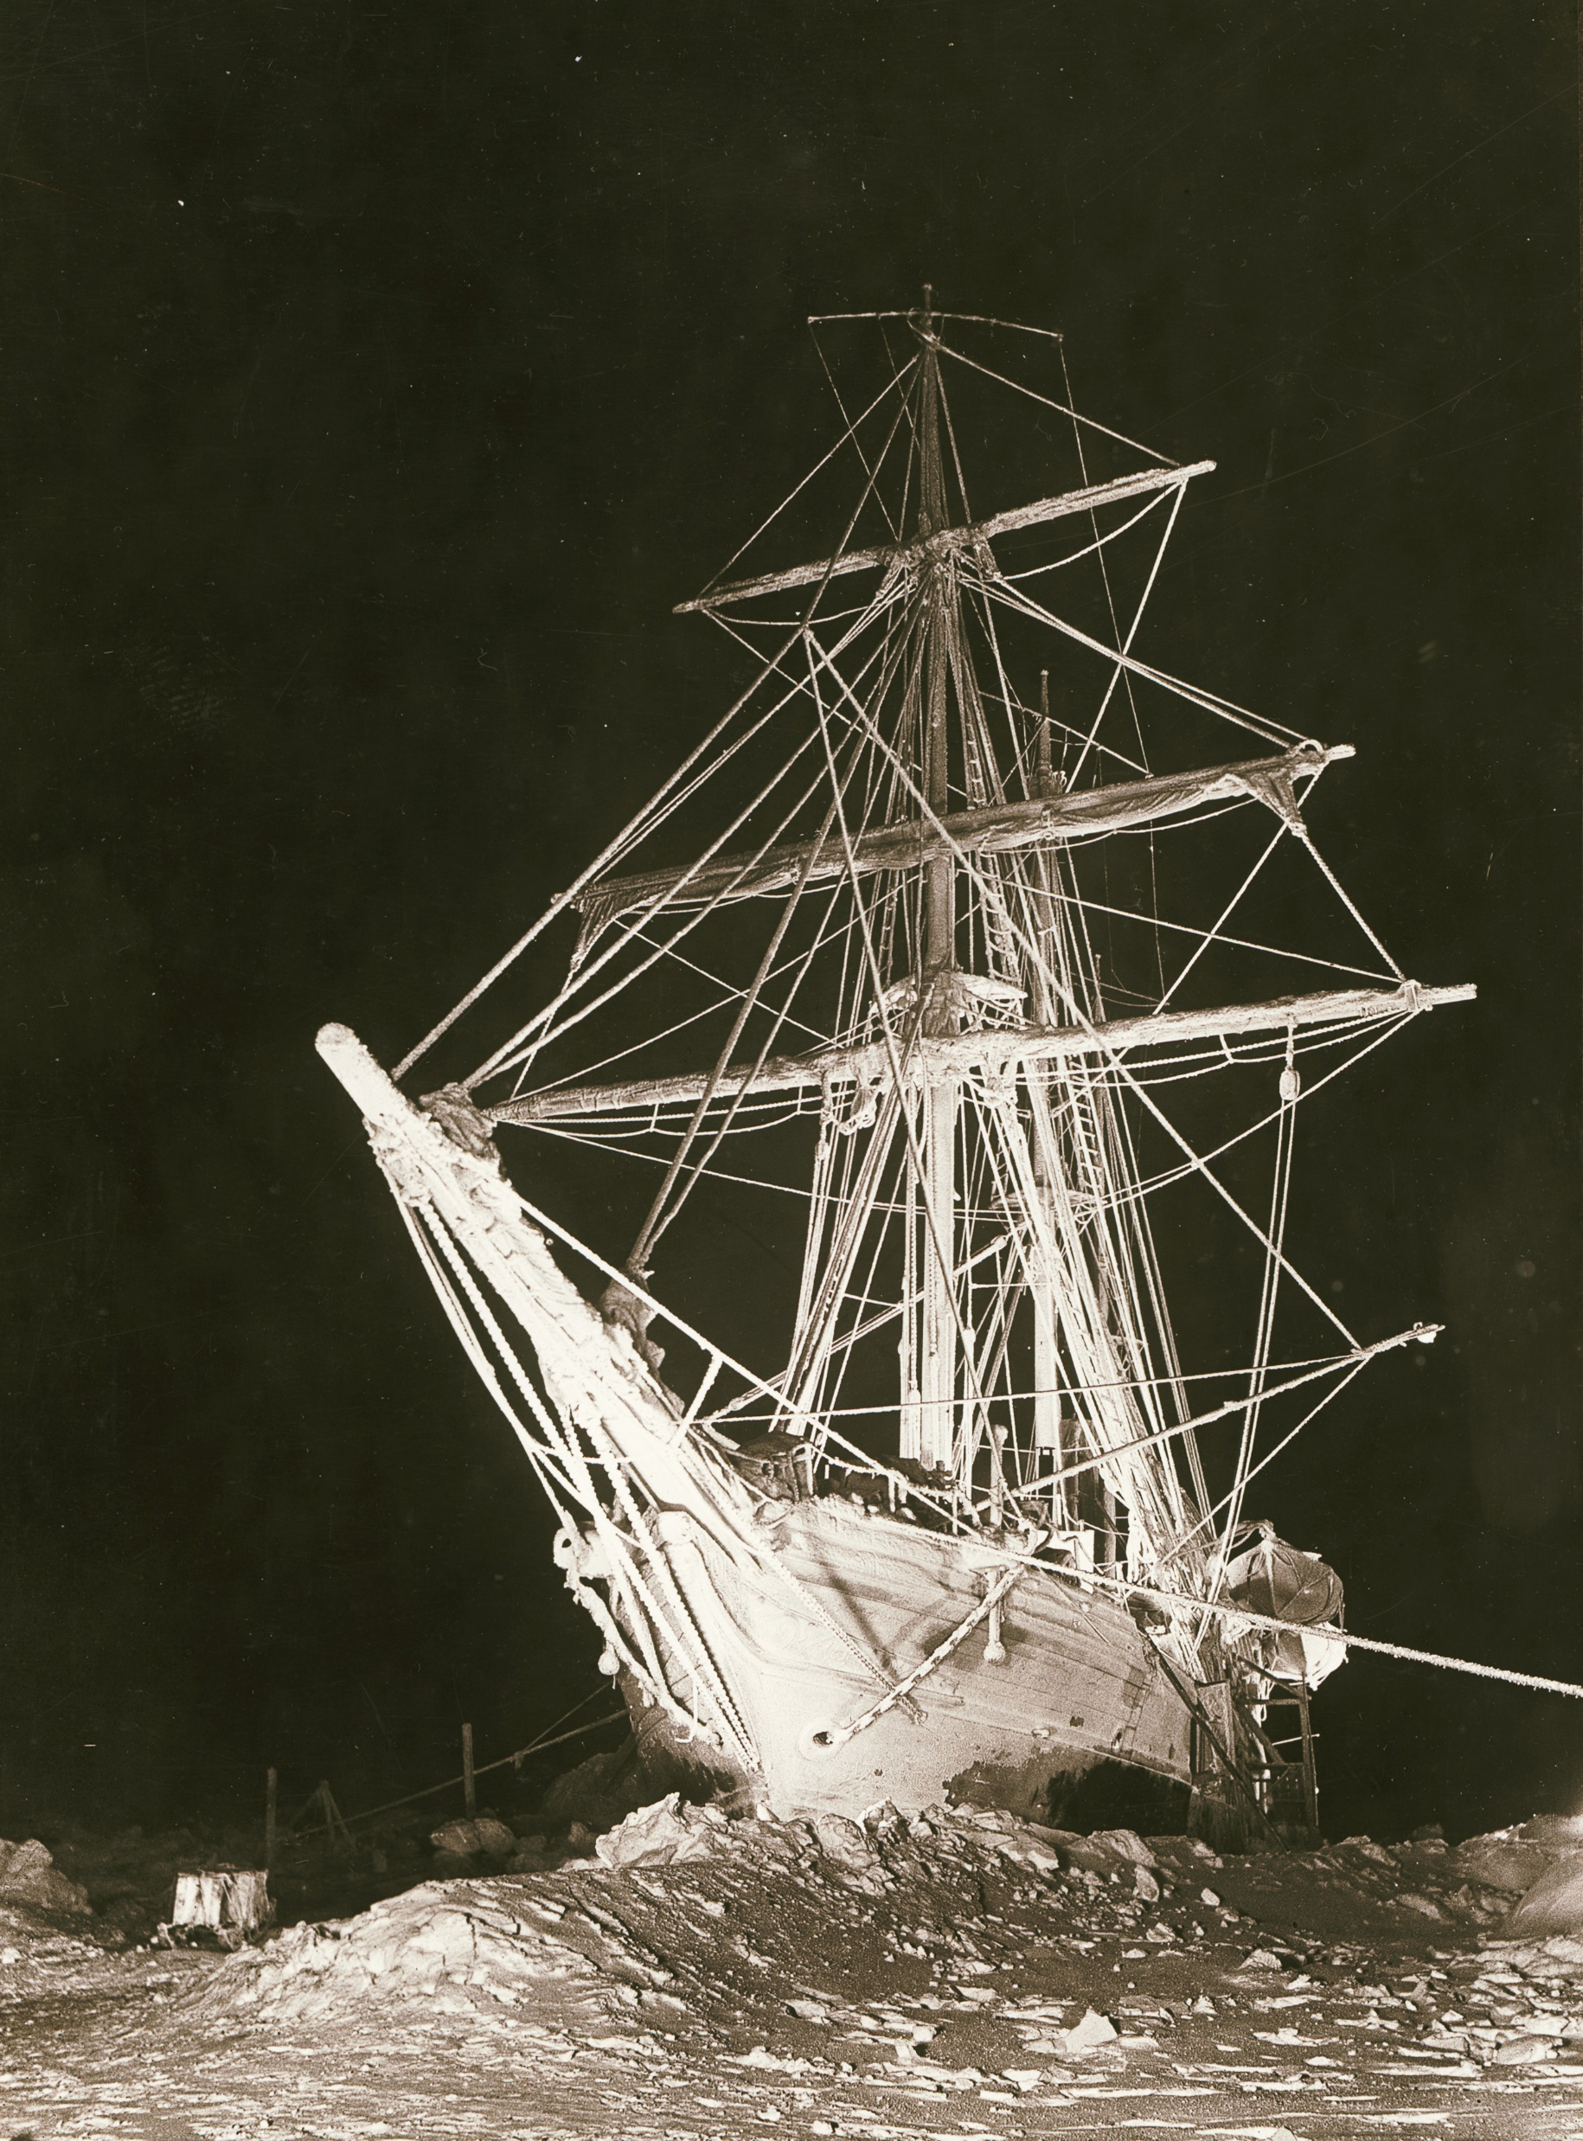
The great age of Exploration
[Explorers] “wanted for hazardous journey. Low wages, bitter cold, long months of complete darkness, constant danger, safe return doubtful. Honor and recognition in case of success.“
– Sir Ernest Shackleton.
Do we really want to add “starvation likely” to this?
State Library of New South Wales, Public domain, via Wikimedia Commons

Slide 7
A Few Examples of Nutritional Challenges during Exploration:
Columbus ran out of supplies during his exploration of the Americas
Vitamin C deficiency (Scurvy):
Columbus’ first settlement at La Isabela may have failed due to scurvy https://doi.org/10.1002/oa.2406
Magellan (1519 – 1522) circumnavigation (15% loss of crew to scurvy)
Anson (1741 – 1744) circumnavigation (66% loss to scurvy and typhus)
Robert Falcon Scott
  Discovery Expedition (1901- 1904, Shackleton incapacitated)
  South Pole Expedition (1910 – 1913, played a role in their deaths)
Notes:
On Scott’s first Expedition, Shackelton became incapacitated and had to be dragged back in the sledge due to scurvy. On Scott’s second expedition it slowed his return from the pole, as well as stopping the relief party from setting out to meet him at the appointed place. Scott actually reached the spot 3 days early, but there was no relief. He would have made it if there had been.

Slide 8
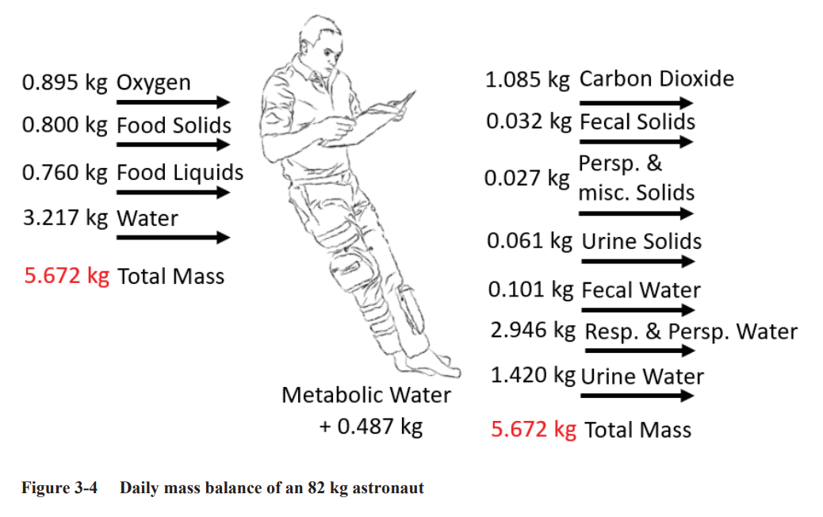
Human Life Support Requirements
NASA/TP-2015–218570/REV2
From: Life Support Baseline Values and Assumptions Document, https://ntrs.nasa.gov/api/citations/20210024855/downloads/BVAD_2.15.22-final.pdf

Slide 9
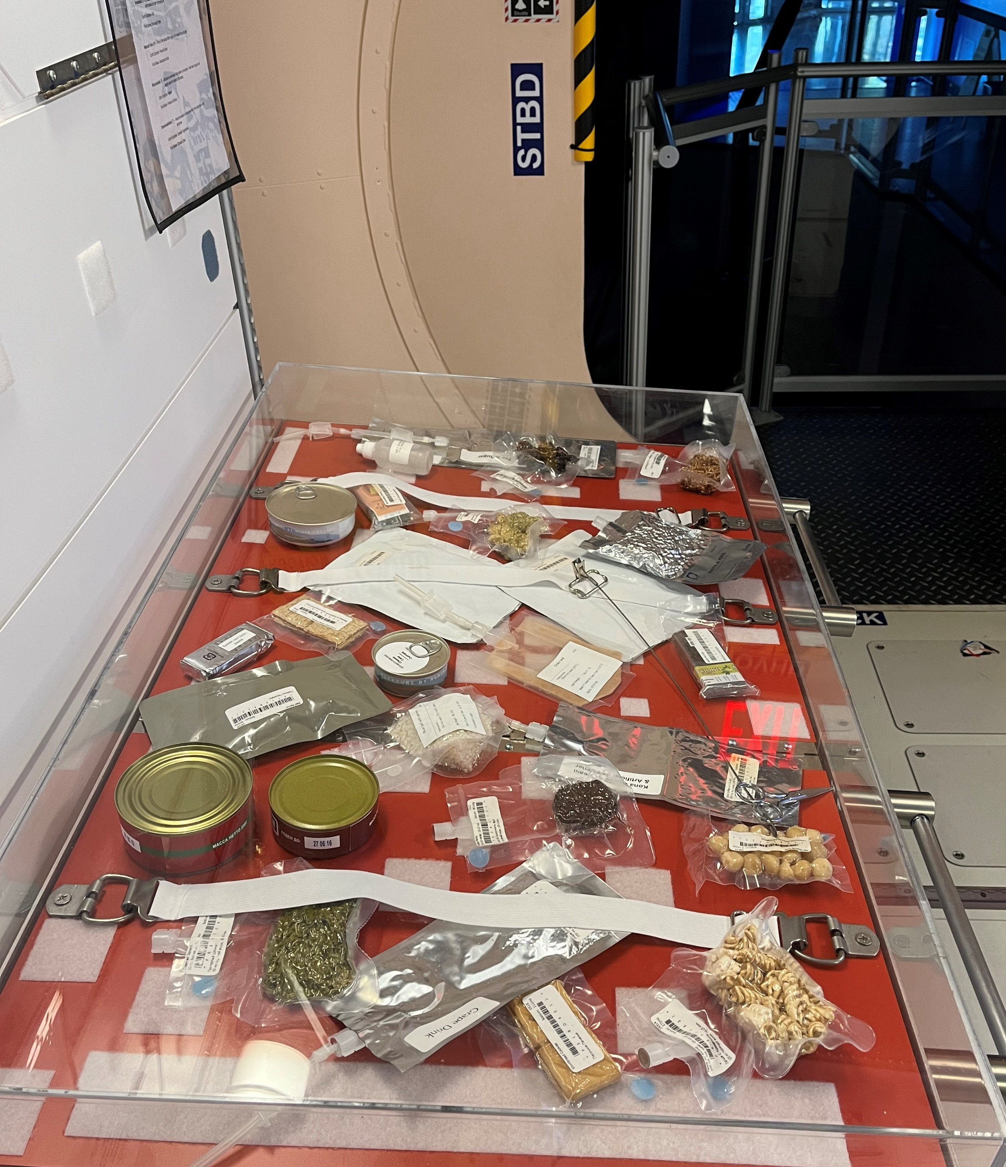
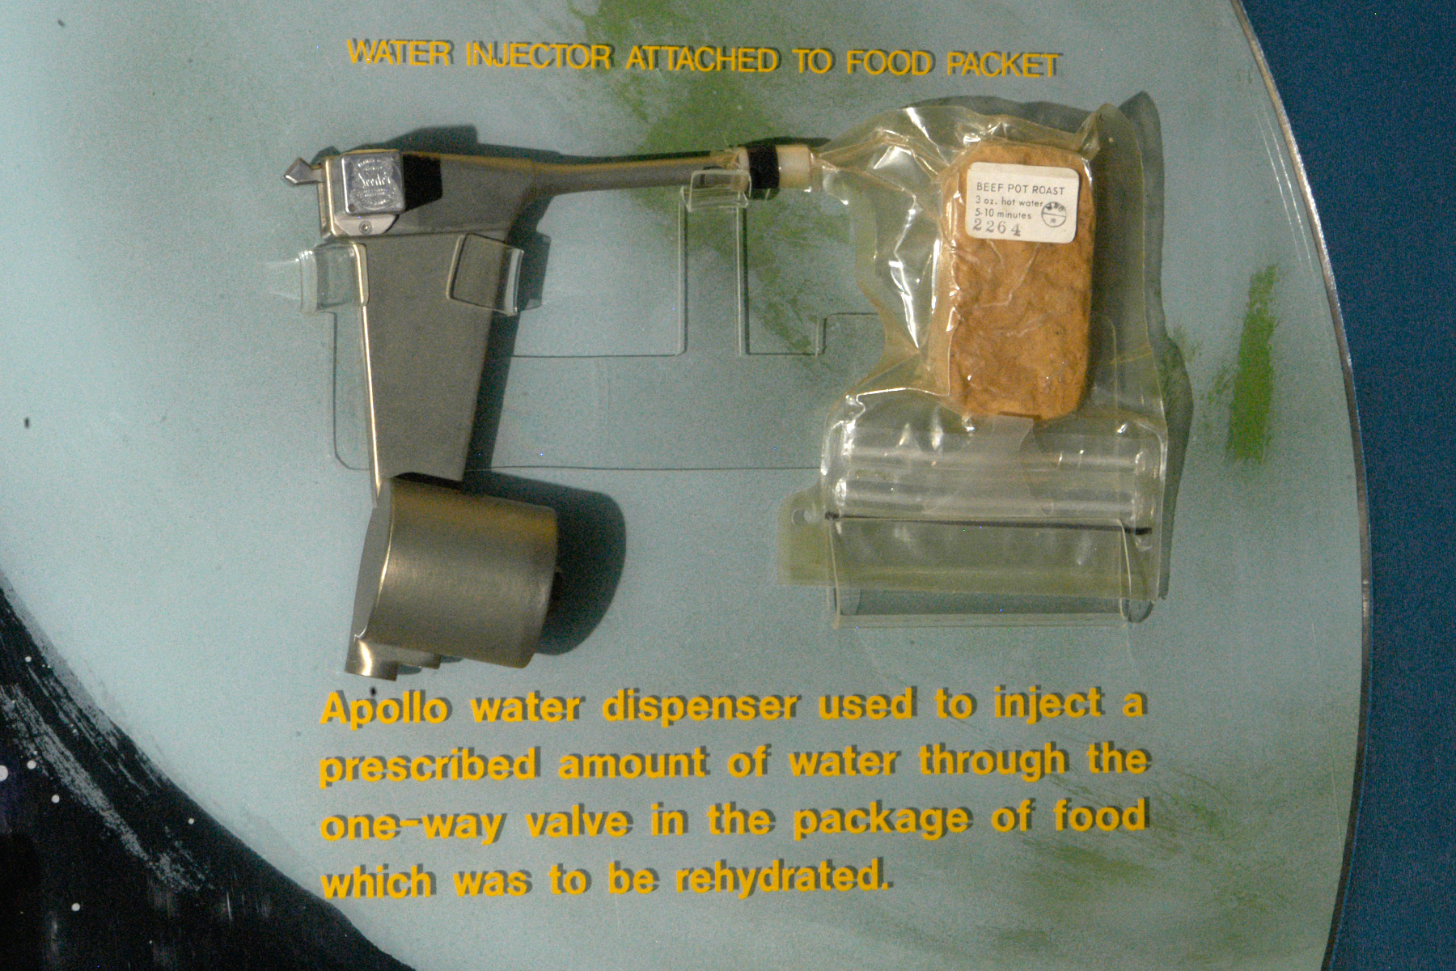
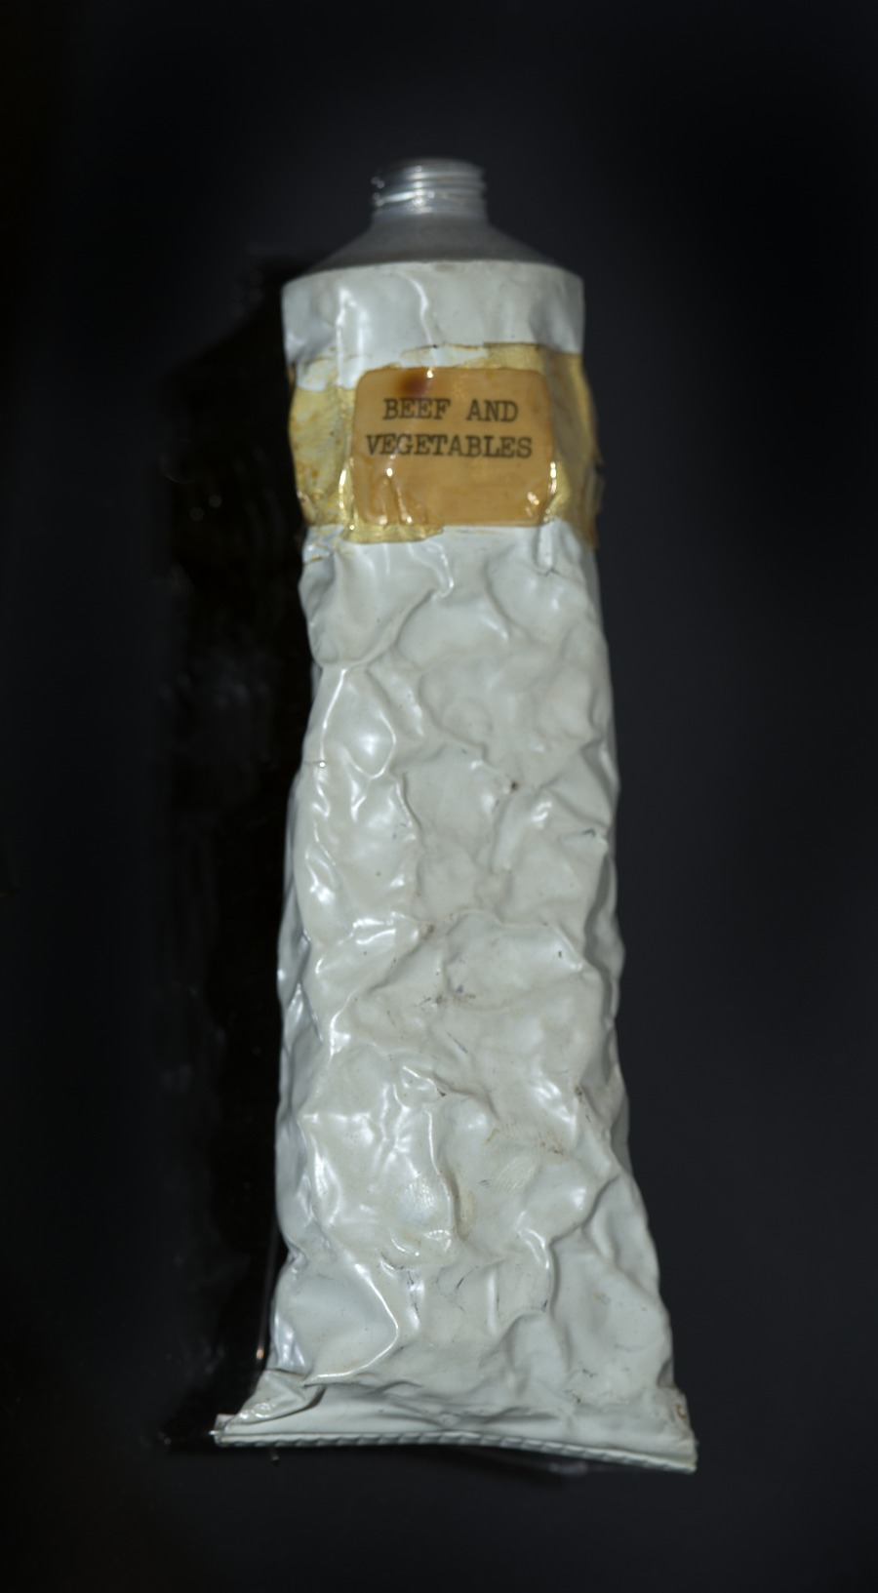
Traditional Food Solutions
Apollo Era Foods with hot water rehydration
ISS Food system Display MSFC
Mercury MA-6: John Glenn.
National Museum of the US Airforce
Notes:
Photos all public domain details in Alt Txt with each photo

Slide 10
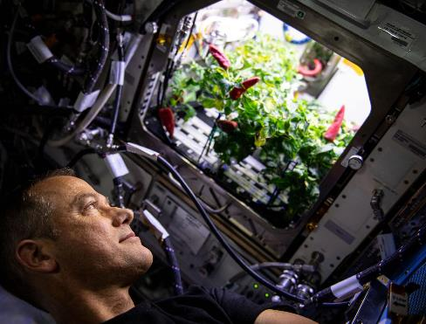
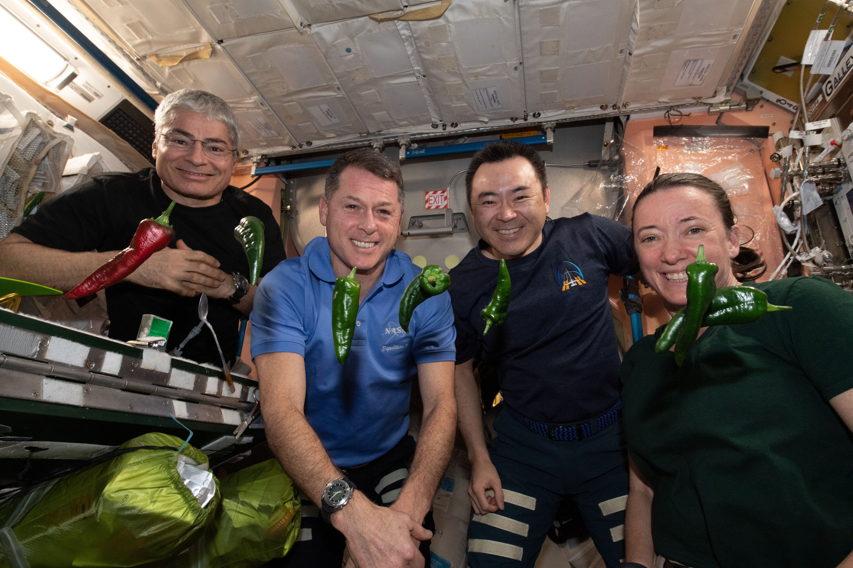
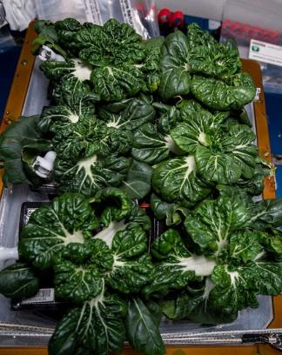
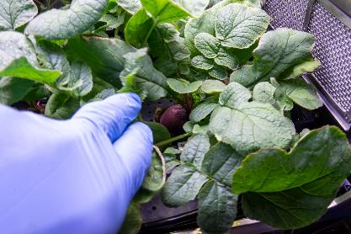
Vegetables Grown on the International Space Station
Photos courtesy of NASA
Astronauts Sampling Chili Peppers
Chili Peppers in Advanced
Plant Habitat (APH)
Radishes
in APH
Pak Choi
in Veggie

Slide 11
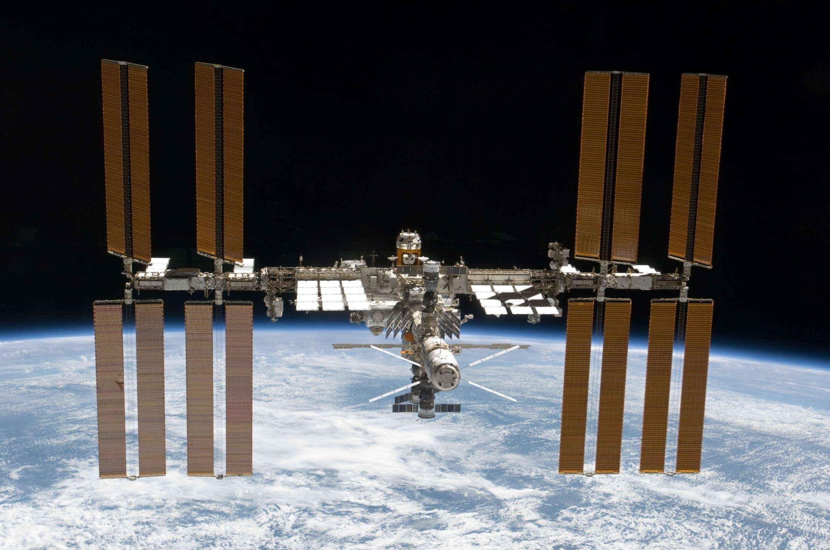
The International Space Station

Slide 12
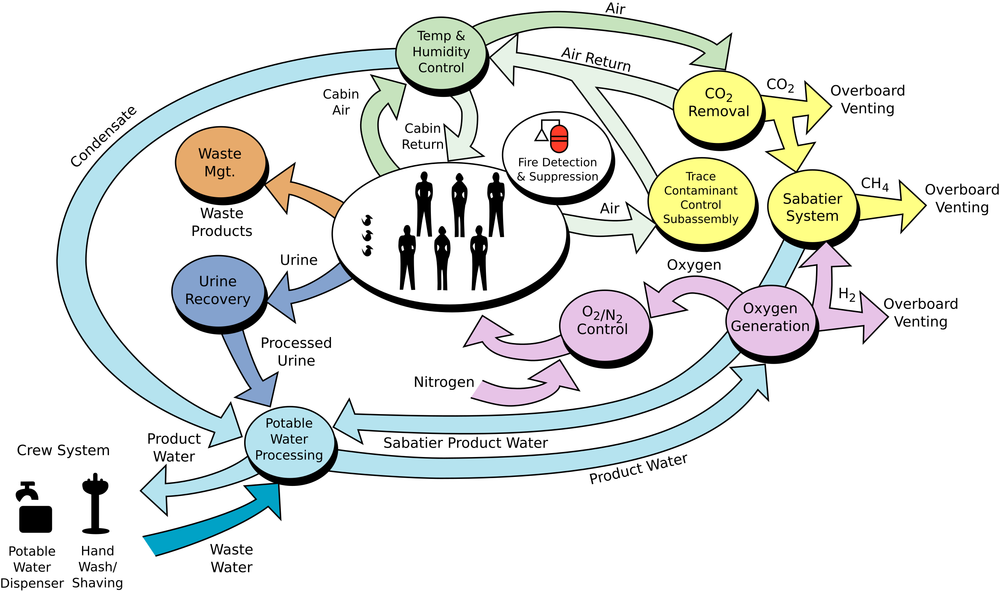
ISS Physiochemical Life Support
Brine
Food

Slide 13
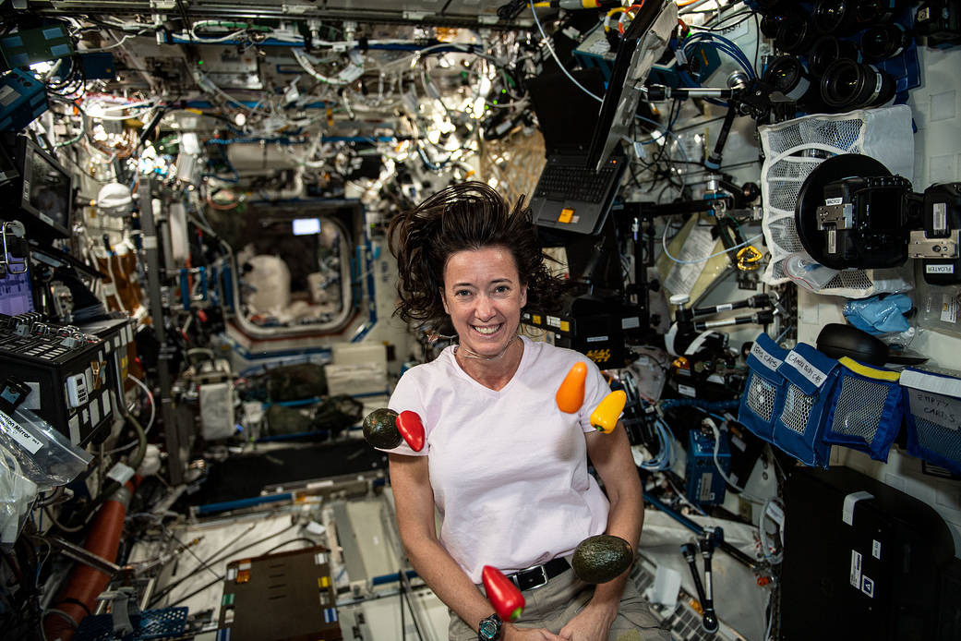
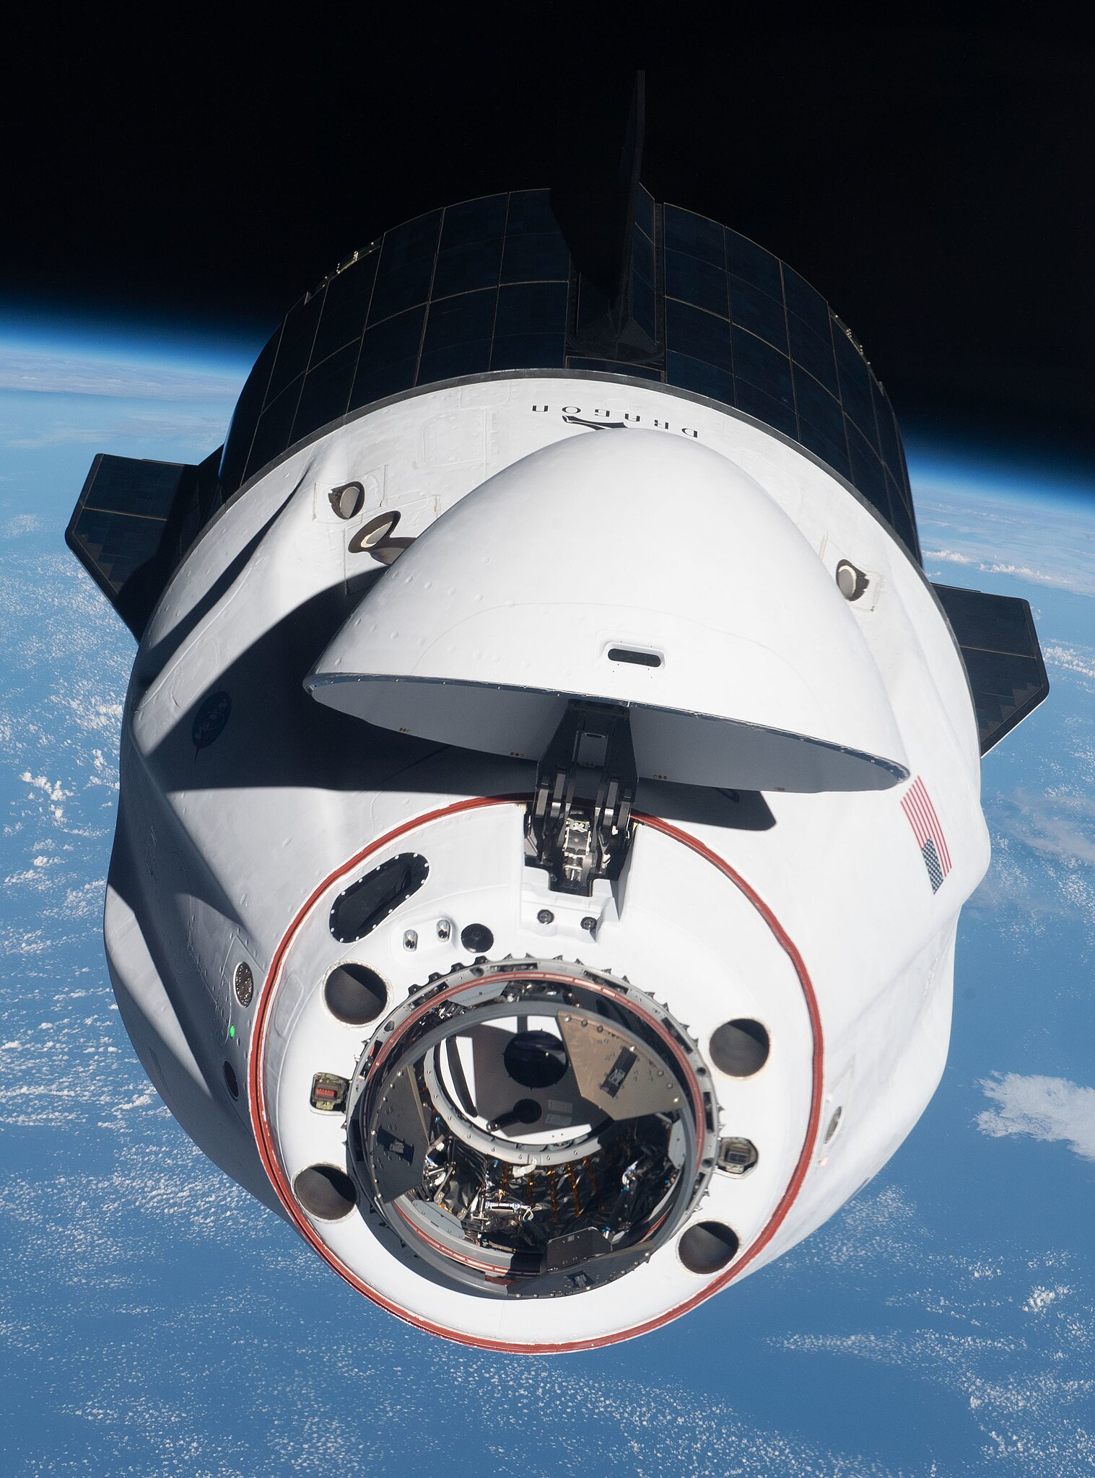
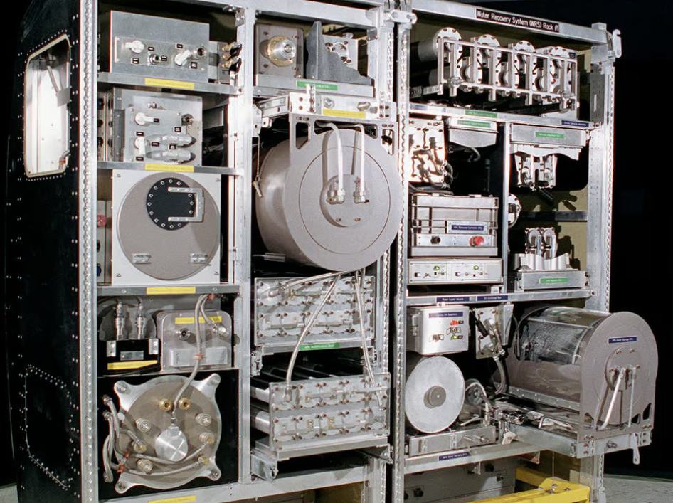
ISS Life Support System
Happy Crew
Resupply
Physiochemical ECLSS

Slide 14
The Challenge
ISS missions must be constantly resupplied
  Consists largely of stabilized foods
  No refrigeration or freezing
  Current Food System is intended for 2 yrs
Mars Missions: food likely to be 5 to 10 yrs old on the return mission

Slide 15
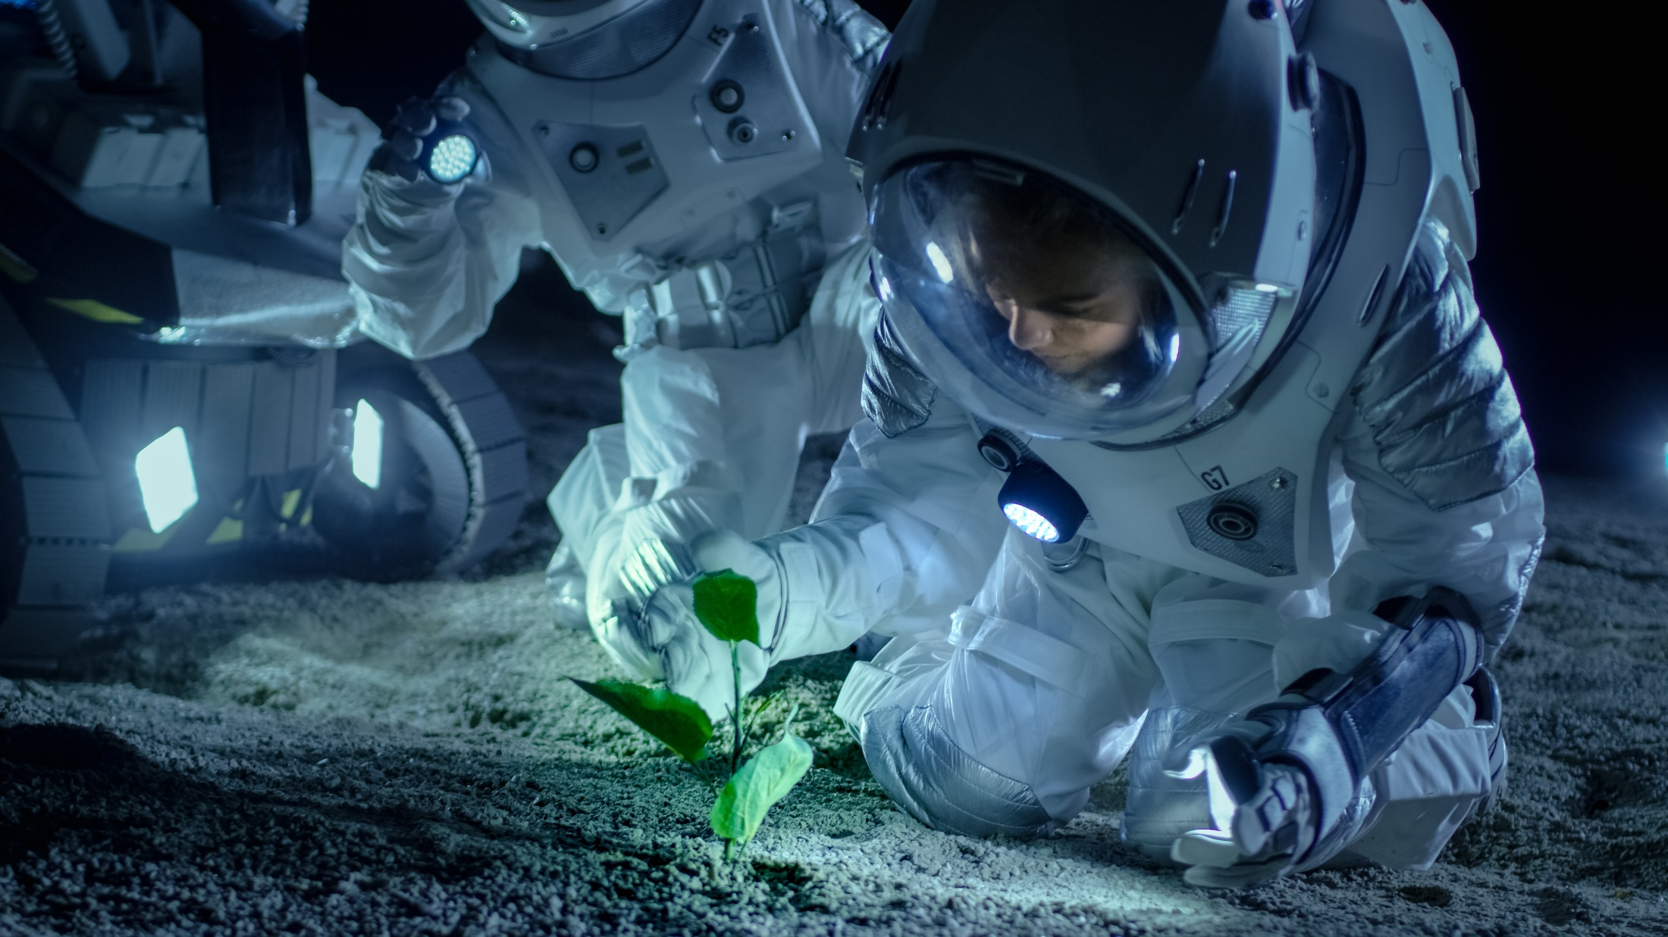

How will we feed people in Deep Space?
What if farm to table started here?
Notes:
Future planetary habitats Long-duration human space exploration with living and working spaces on the Moon and Mars will require a high degree of self-sufficiency including a sustainable food source.
To help solve this problem, NASA is exploring the possibility of opening a NASA Centennial Challenge for the public to help NASA create a system capable of providing astronauts with healthy, nutrient-filled food.
NASA uses competition and prizes to help maintain and advance America's leadership in technology and innovation.
NASA is exploring the possibility of opening a Lunar Nutrition Centennial Challenge for the public to help NASA create a system capable of providing astronauts with healthy, nutrient-filled food. The challenge will incentivize the public, academia and industry to participate in the development of food systems that can provide adequate nutrition to future long duration mission explorers.

Slide 16
Plants for “Bioregenerative” Life Support
Metabolic
Energy
HUMANS
food
(CH₂O) + O₂ CO₂ + H₂O
Clean Water Waste Water
Liquid and
Solid Waste
Light
(CH₂O) + O₂*+ H₂O CO₂ + 2H₂O*
Clean Water Waste Water
PLANTS
Inedible
Biomass
Wheeler et al., 2001. In: Tako et al. (Eds.) Proc. IES CEEF.

Slide 17
NASA’s Space Crop Production Vision
Ensure Food System Security on Long Duration Missions Beyond LEO
Near-Term Goal
Nutrient Supplementation of Prepackaged Food
Near term missions will rely on Physico-Chemical Regenerative ECLSS and Stowed Food with Supplemental Fresh Food
Long-Term Goal
Staple Crops to Move towards Earth Independence
For future, longer duration habitation on the Moon or Mars, Bioregenerative Life Support including Plants can be expanded to increase Mission Autonomy and Earth Independence

Slide 18
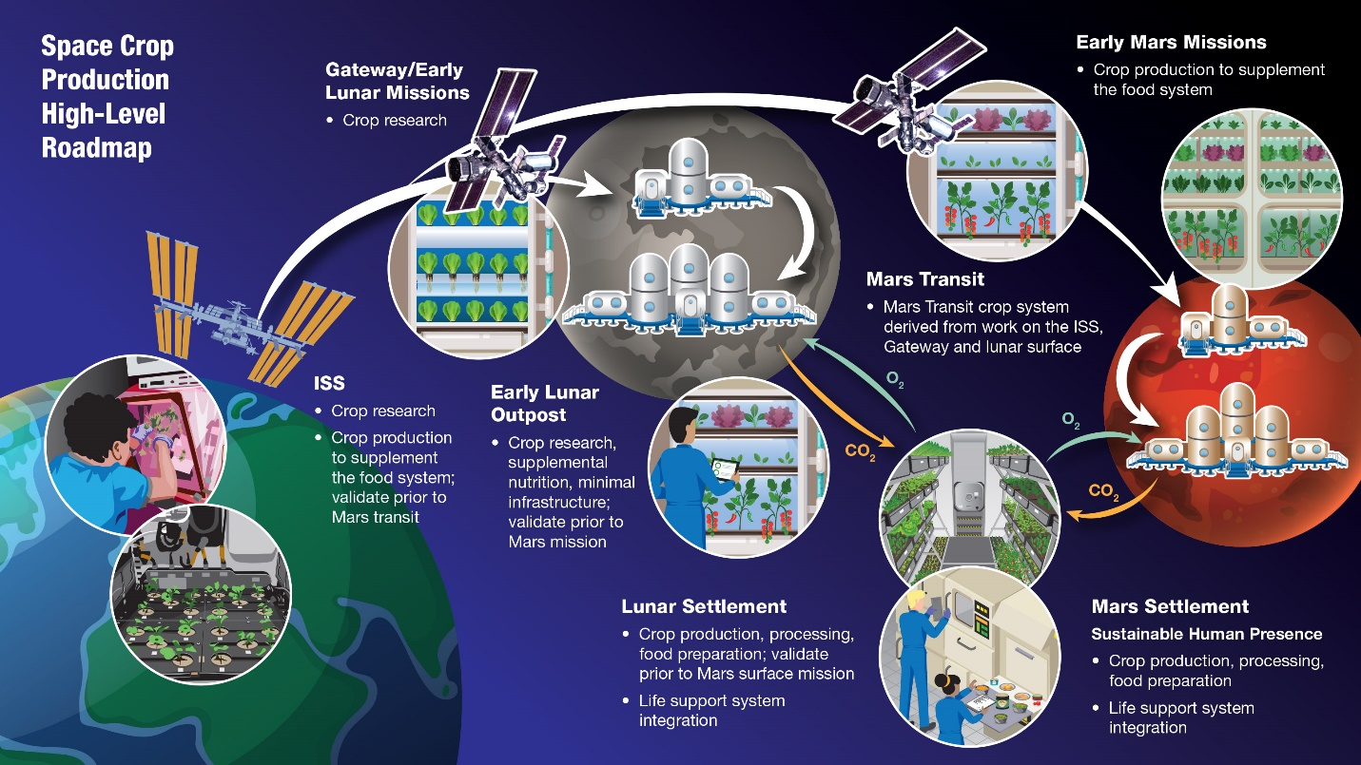
Douglas et al., 2021, Sustaining Astronauts: Resource Limitations, Technology Needs, and Parallels between Spaceflight Food Systems and those on Earth, Sustainability

Slide 19
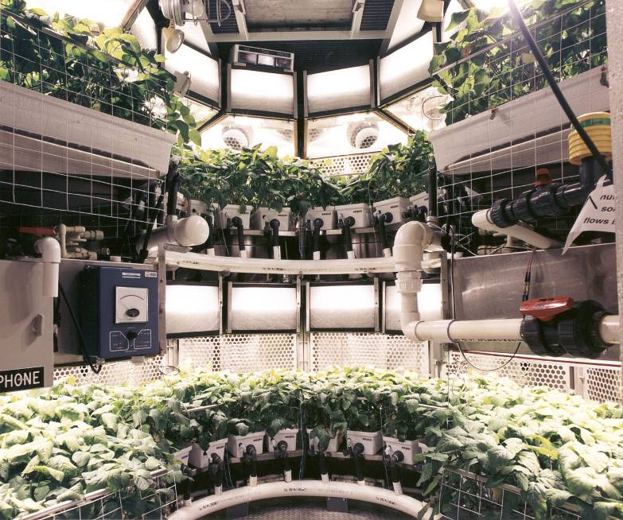
NASA’s Biomass Production Chamber
Kennedy Space Center, FL, US
Perhaps the
world’s first
example
of a
“vertical farm”
(1987-2000)
Soybeans ⇒

Slide 20
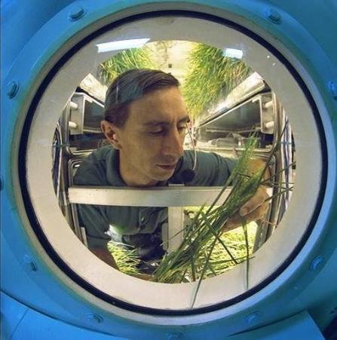
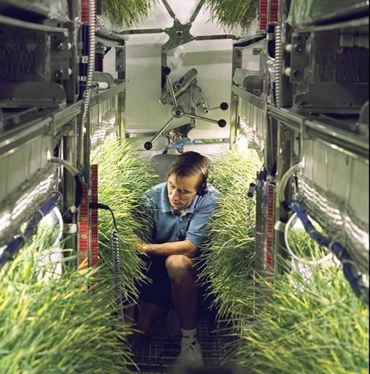
One Human and 11 m² of Wheat !
(all the O₂ needed for a 15-day test)
Nigel Packham at NASA’s
Johnson Space Center
Photos courtesy of NASA Johnson Space Center

Slide 21


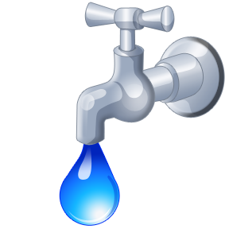

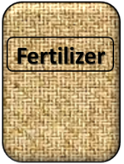

Cardinal Factors to Consider for Plants to Thrive in Space
O₂

Slide 22

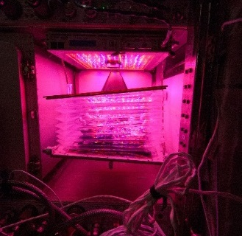



How these work in the Space Environment
Key plant characteristics may be modified with novel light recipes
No natural convection without gravity so need to mix the air
O₂
Water forms a ball, and water and air don’t mix well, and roots need both
Fertilizer is heavy to launch so we need to learn how to recycle plant (and other) wastes

Slide 23

The Space Environment
….and how these work with and without Gravity!
Please Play Video 2

Slide 24



Why grow plants in space?
Food
Psychological well being
Atmosphere
Water

Slide 25







Bioregenerative Life Support Testing Around the World
1960
1980
2000
2020
Russia - Inst. for Biomedical Problems--IMPB (Moscow)
Russia - Inst. of Biophysics--IBP (Krasnoyarsk, Siberia)
US NASA
US NASA (CELSS) NASA (ALS) NASA (LSHS) AES/HDU MCO
Japan Japan Aerospace Lab.; Tokyo Univ., Inst. Env. Sci. (IES); JAXA
European Space Agency; Germany DLR
Europe Cadarache; Berlin
Canada University of Guelph / CSA
University Studies (US, Europe, Japan, Canada, Australia)
China National Space Agency
Chile ??

Slide 26


Volume Constraints in Space
Module of the International Space Station
Trash can build in closed systems like the ISS !

Slide 27

Space Crop Attributes
Compact size (low height and volume)
High yield
High edible/total biomass ratio (harvest index)
Rapid growth
Ease of propagation
Good nutritional attributes
Minimal processing requirements
Low debris and dust formation (leaves, flowers, pollen, etc.)

Slide 28



Volume Constraints: Use Short, High Yielding Crops
Dwarf Rice Dwarf Wheat
Dwarf Tomato
‘Apogee’ Wheat ‘Perigee’ Wheat
Conventional Plant Breeding
and Selection

Slide 29



Genetically Engineered Plants Dwarf Plums Developed by USDA ARS
Plums and Tree Fruit
Dwarf Plum at 1 year age
No Dormancy Requirements
Overexpression of FT flowering gene in plums (ARS researchers) resulted in dwarf growth habit and early flowering
Srinivasan et al., 2012, PLOS ONE; Graham et al., 2015 Grav. Space Research

Slide 30

Artemis Base Camp

Slide 31


Slide 32


A7L Suit
3.7 PSI/ 25.5 kPa

Slide 33

The Problem with Pressure…
Lunar Habitat Likely:
“atmospheric pressures of 8.2 psi with 34% oxygen concentration and 10.2 psi with 26.5% oxygen.”
Burke et. al 2022
https://ntrs.nasa.gov/citations/20220013669
Pre-Breath time | Pressure kPa | Pressure PSI | Torr (mm Hg) | Equivalent Altitude ft/ m
7 hrs | 101 | 14.7 | 760 | Sea Level (0)
 | 84.3 | 12.2 | 632 | 5,000/ 1,524
3.5 hrs | 69.7 | 10.1 | 523 | 10,000/ 3,048
0.33 hrs | 57.2 | 8.29 | 429 | 15,000/ 4,572
0.33 hrs > | 37.5 | 5.45 | 282 | 25,000/ 7,620

Slide 34
Likely Cabin Environment:
Low Pressure: 8.2 PSI (57 kPa)
High Oxygen: 34% (66% Nitrogen)
Elevated CO₂ (1000 – 2000 ppm)?
Shirt sleeve Temperature
Partial Gravity

Slide 35

Are there other ways to produce food in Space?
Notes:
Image public Domain, National Cancer Institute

Slide 36




Fermented Foods and Genetic Engineering in Support of Spaceflight
Fermented food production is spaceflight compatible – Small resource requirements, long shelf life, high radiation tolerance.
Fermented foods provide beneficial microbes, nutrients, bioactive compounds, flavors and food preservation.
Genetic engineering can make fermented food products into a nutrient and therapeutic compound delivery system.
Extensive history of production in non-sterile environments, amazing variety.
Fermented foods ~5000 variations worldwide, (Ray, R.C. et al., 2024 https://doi.org/10.1007/978-3-031-72000-0_1)
Earliest evidence for the deliberate application of fermentation circa 7000 BC, (McGovern 2004 https://doi.org/10.1073/pnas.040792110).(Tamang 2020 https://doi.org/10.1111/1541-4337.12520)
36
Photo credits creative commons
Notes:
NASA-ARC Bionutrients/ Donovan:
can be made with cereals (i.e. breads), legumes (i.e., miso, nato, soy sauce), vegetables (i.e., kimchi, sauerkraut, kocho), roots and tubers (gari, fufu, lafun), fermented fish sauce and pastes, sausage, milk (i.e., yogurt, cheese, kefir, levan), Images https://creativecommons.org/licenses/by/2.0/ My favorite quote from Christine Baumgarthuber from the introduction to “Fermented Foods. The history and science of a microbiological wonder“I sought connection to a sweep of time vaster than my own moment. For ages ordinary people have brewed beer, ripened cheese, cured meats in time of war and peace, of plenty and of want. Only quite recently has the art come to be seen as arcane, even dicey.

Slide 37



What Could Fermentation in Space Look Like?
Yogurt
Kefir
Cottage cheese
Essential Fatty Acids
Vinegar
Miso
Yeast based production
Kombucha
Fermentation of waste products to generate fuels, feedstocks, fertilizers, generate enzymes or compound for further purification
Feasibility
Feedstocks required and shelf-life of that feedstock – any ISRU?
Biproducts or waste generation
Gas/ethanol production
Is it ready to consume? Post processing requirements
Can it be pasteurized or otherwise made safe?
Can the product be removed from the live culture?
https://www.sciencenews.org/article/ferment-miso-orbit-space-food-taste-iss. Coblentz et a l10.1016/j.isci.2025.112189
BioNutirents 2 production of carotenoids and follistatin above. Bionutrients 1, Koichi Wakata (Run 5, January 2023) right.
37
Notes:
NASA-ARC Bionutrients/ Donovan:
Publicly released images of BioNutrients experiments

Slide 38






BioNutrients – native and engineered nutrient supply
Aim: Develop and demonstrate an on-demand nutrient production system for long duration missions to support nutrient degradation in stored foods.
Flight-tested, evolvable microbial production platform capable of producing many compounds (e.g., nutrients, medicines).
Space-adapted microbial hosts for future generic use and genetic engineering.
On-orbit safety and operational systems for future implementation.
Mission Implementation Concept
Incubation
Safety
Test
BioNutrients-1 Flight Production Pack Development for 5 year on-orbit shelf-life testing
Engineering microbes to produce nutrients and medicines on-demand
Developing microbes adapted for use
in space
Notes:
NASA-ARC Bionutrients/ Donovan:

Slide 39








BioNutrients-2/Gen-1 System: FEP bioreactor, new products, including yogurt, kefir and a protein therapeutic.
ISS
Ground Control
BN-2 yeast ISS production packs (S. boulardii producing beta-carotene, S. cerevisiae producing zeaxanthin, and K. lactis producing follistatin).
BN-2 yeast ground controls (S. boulardii producing beta-carotene, S. cerevisiae producing zeaxanthin, and K. lactis producing follistatin).
BN-2 ground controls yogurt top, kefir bottom.
Run 1 of yogurt and kefir on ISS. Left: kefir (blue color at initial hydration turns yellow as culture grows and pH lowers), Upper right: yogurt.
Nicole Mann and Josh Casada hydrating and shaking the yeast and yogurt packs respectively. Featured in Space Station Science Highlights: Week of January 2, 2023 | NASA ISS Research on Twitter: "BioNutrients-2 tests an on-demand system to produce key nutrients from yogurt, kefir, and a yeast-based beverage. The study could help maintain the crew's health while reducing launch mass and volume requirements. https://t.co/fuxW39uTWd https://t.co/bzFZVYMIxS" / Twitter
Notes:
NASA-ARC Bionutrients/ Donovan:

Slide 40

How will we feed people in Deep Space?
What if farm to table started here?
Notes:
Future planetary habitats Long-duration human space exploration with living and working spaces on the Moon and Mars will require a high degree of self-sufficiency including a sustainable food source.
To help solve this problem, NASA is exploring the possibility of opening a NASA Centennial Challenge for the public to help NASA create a system capable of providing astronauts with healthy, nutrient-filled food.
NASA uses competition and prizes to help maintain and advance America's leadership in technology and innovation.
NASA is exploring the possibility of opening a Lunar Nutrition Centennial Challenge for the public to help NASA create a system capable of providing astronauts with healthy, nutrient-filled food. The challenge will incentivize the public, academia and industry to participate in the development of food systems that can provide adequate nutrition to future long duration mission explorers.

Slide 41
Deep Space Food Challenge
Single Cell Fermentation systems
  Fusarium (e.g. Natures Fynd, Quorn)
  Nuerospora
  Yeast
  Hydrogen Oxidizing bacteria (Solar Foods)
Culture Systems (plants and meats)
Growth systems
  Plants
  Fungi
  Insects
Engineered metabolisms

Slide 42





All photos and logos courtesy of DeLeon Technologies, used by Permission

Slide 43


Team Hevin: Grow only the Fruit!
Space Grapes
Apple Sauce
Melon Smoothie
Images provided with permission by: Jorman Heflin, team Hevin
Notes:
Grapes being induced into calli on plates
Concept is to then grow only the fruit cells and generate something like apple sauce or a “grape” by putting them in edible shells.

Slide 44

Images provided with permission by: Jorman Heflin, team Hevin

Slide 45

Used with Permission from Interstellar and the Deep Space Food Challenge 2025

Slide 46


Used with Permission from Interstellar and the Deep Space Food Challenge 2025

Slide 47

Single Cell Fermentation Systems
NASA Image DSFC 2024

Slide 48



All photos from NASA: Deep Space Food Challenge

Slide 49


Larval Bed
Used with Permission from Interstellar and the Deep Space Food Challenge 2025

Slide 50







µBites
PCT/US24/10136
Notes:
micro-Bites slides supplied by Lahiru Jayakody, Southern Illinois University, Used by permission

Slide 51



Tech overview
Notes:
micro-Bites slides supplied by Lahiru Jayakody, Southern Illinois University, Used by permission

Slide 52





Tech overview
µBites cookies: waste polymers to high-value nutrients/alternate proteins
The system
needs ~800 g of total organic carbon
needs 1.8 L of water to produce 1 kg of protein
occupies only 0.24 m³
requires 31.1 kWh of energy
The preliminary estimated cost is ~$1.2/100 g of cookies containing 15 g of protein.
Notes:
micro-Bites slides supplied by Lahiru Jayakody, Southern Illinois University, Used by permission

Slide 53

Thought on Future Systems:
Future Systems must be more Sustainable
Must work with the ECLSS System
  Think about all of your inputs and outputs
Key Considerations:
  Resource Use
  Reliability
  Acceptability
  Safety
  Food production and preparation equipment and time
  Cost and Schedule Feasibility

Slide 54
Food for Thought
There are many challenges to solve and many solutions
Solutions ultimately need to be integrated into the life support system
Don’t forget to consider the environment that the solution is being designed for, and when it is needed

Slide 55

Questions?
Steve Schwartzkopf at NASA Ames ca. 1984-1985

