Slide 1

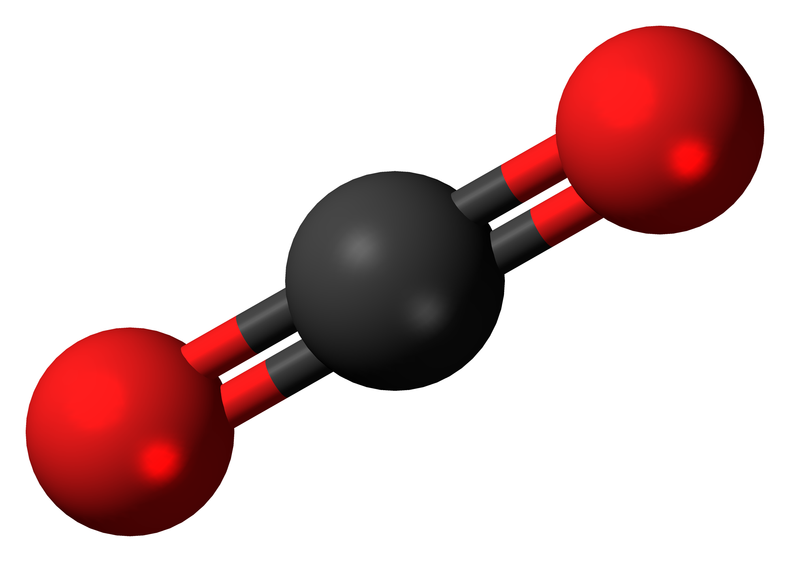
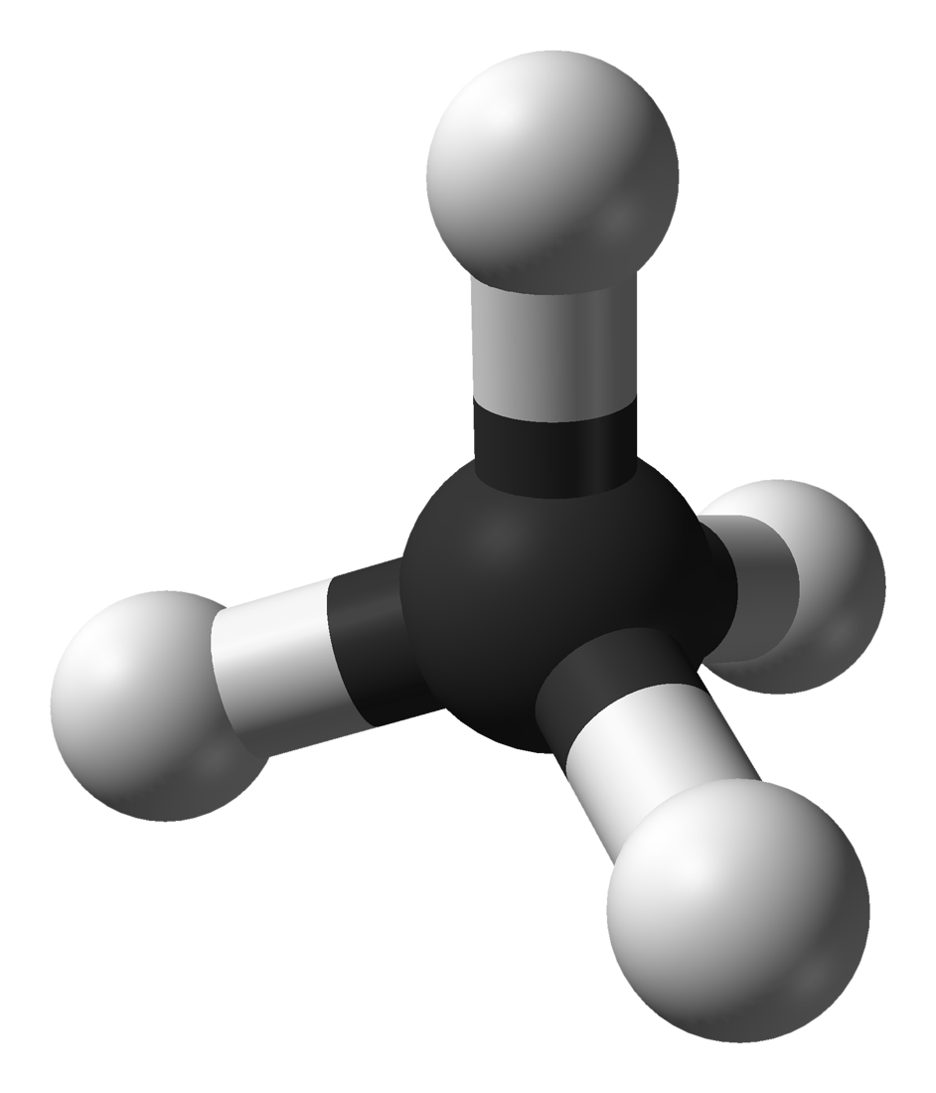
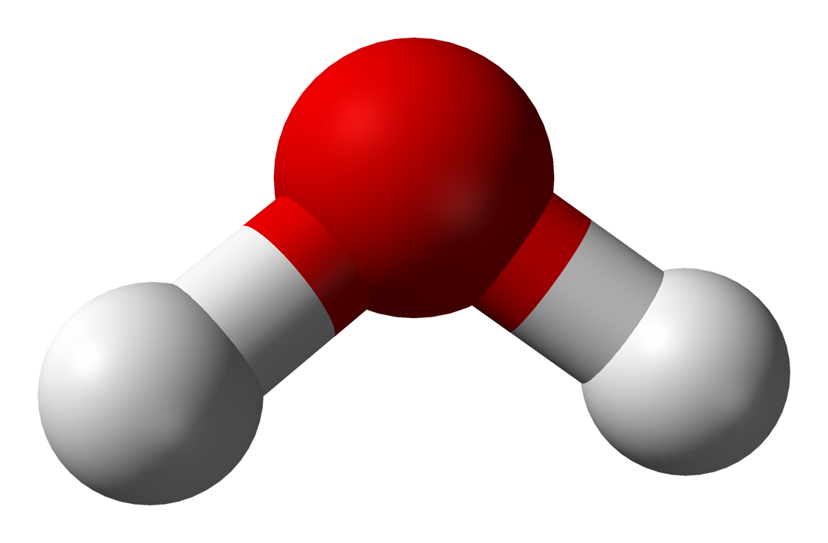

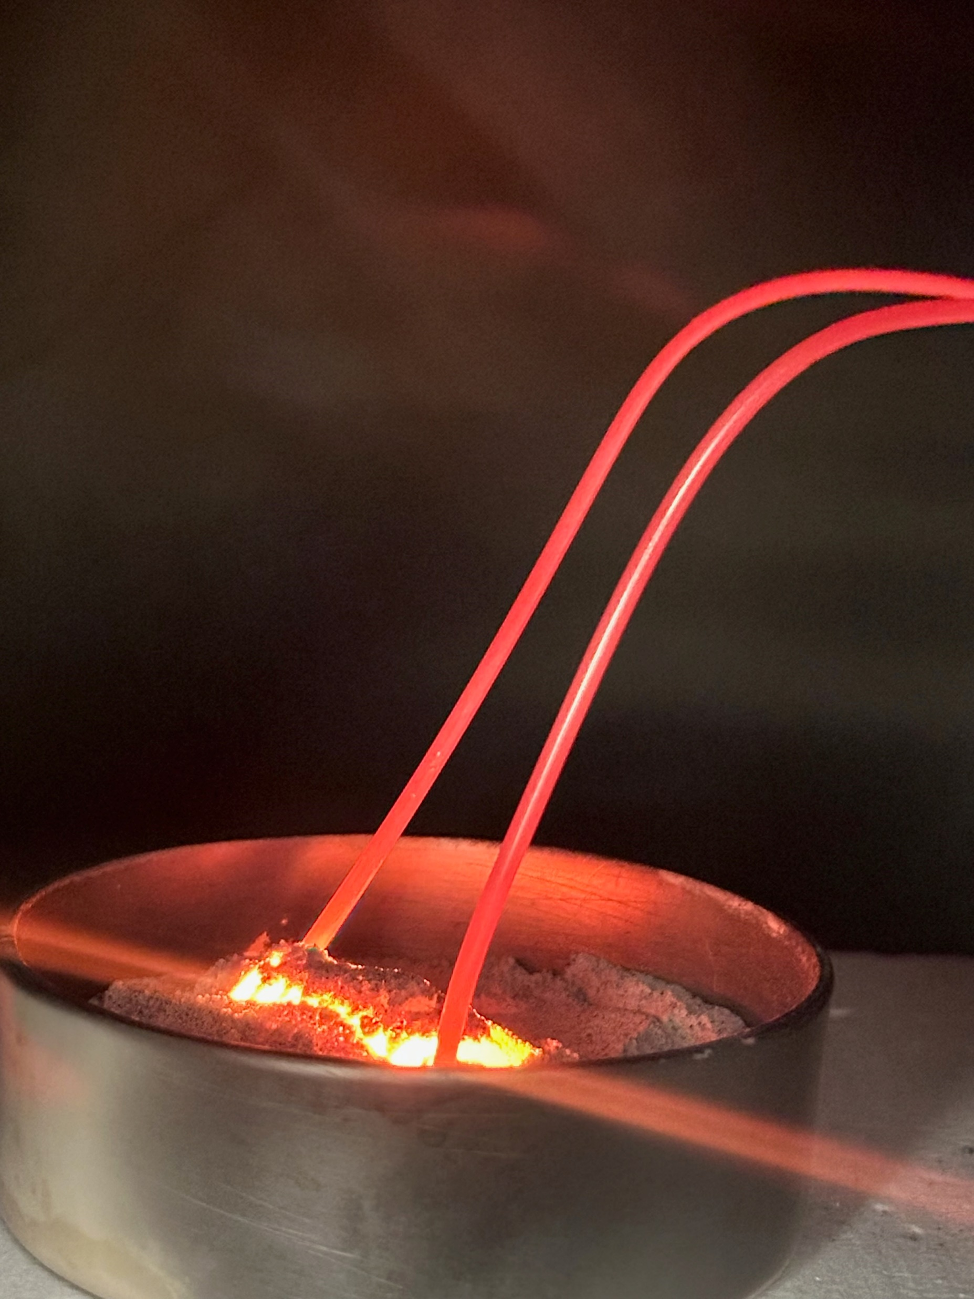
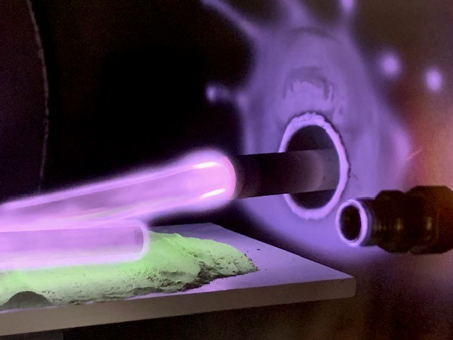
IN-SITU PROPELLANT PRODUCTION TECHNOLOGY AT KENNEDY SPACE CENTER
J. Schwend ^{1 *} , K.W. Engeling Ph.D. ² , T. L. Gibson Ph.D. ¹
¹ Astrion Inc, Kennedy Space Center, FL 32899 ² National Aeronautics and Space Administration, Kennedy Space Center, FL 32899
Introduction
Sabatier Reactor
The capability to produce propellant In-Situ is critical to NASA’s exploration goals. With approximately 90% of a rocket’s take-off weight being attributed to propellant [1], it would be unsustainable and inefficient to rely on resupply missions for all off-planet propellant needs.
Kennedy Space Center (KSC) is known as the world’s leading spaceport, meaning KSC has the infrastructure, safety measures, and experience to handle rocket propellants on small and large scales.
The most notable advancement towards ISPP was the MOXIE demonstration on Mars, where NASA and MIT successfully extracted oxygen from the Mar’s atmosphere on board the Perseverance Rover through solid oxide electrolysis [3]. Electrolysis is just one example of the many
possible methods to create propellant in-situ, and researchers at Kennedy Space Center have been working to advance
and expand ISPP technology.
One of the legacy ISPP technologies at KSC has been the Sabatier system, the system that was previously on board the ISS to recycle CO2 as part of life support systems.
The current Sabatier assembly at KSC was first reported in 2014. The assembly at KSC has been shown to produce pure methane and water products from CO₂ and H2 with near 100% conversion [2]. The system has been continuously used for experimentation from the lens of Martian ISPP since then, including the investigation of catalyst material, heat exchange configurations, and the recycling of hydrogen.
The main challenges in implementing this technology for ISPP applications lies in the thermal management systems. The Sabatier process is exothermic, meaning it releases excess heat as part of its chemical reactions. Researchers at KSC have investigated the thermal management systems on the Sabatier assembly through experimental and modeling methods, with the guiding goal of producing 6978 kg of methane over 428 days as necessary for a human Mars return method utilizing “methalox” propulsion [3].
`
KSC Research & Technology supporting role: “In-Situ Propellants and Consumable Production”
Heat
Mars
CO₂
Sabatier Reactor
CH₄
Propellant Storage
cooling & compression
CH₄
Researchers at KSC have been working to develop several ISPP technologies:
- the Sabatier reactor for methane & oxygen production on Mars
- molten regolith electrolysis and carbo-thermal reduction for
oxygen production from lunar regolith
- plasma production of hydrazine, MMH, and dinitrogen tetroxide for
off-planet hypergolic propellant production.
Although some of the ISPP technologies described here are in further development stages than others, there is still much work to be done. None of these technologies produce propellants in liquid form, the form necessary for propellant applications.
There are constantly new off-planet resources being discovered and validated, requiring new technology development and bringing more possibilities
to ISRU technology.
H₂O
H₂
H₂O
O₂
O₂
Plasma Chemistry
O₂
H₂
Mars return vehicle
Researchers at KSC aim to use the highly energetic environment of plasma to perform chemical synthesis.
Plasma systems are advantageous due to their versatility, low power requirements, and low temperatures compared to chemical or electrolysis processes.
Previous efforts have demonstrated the production of dinitrogen tetroxide (N₂ O₄) from air (O₂ and N₂) as well as simulated Martian atmosphere (95% CO₂, 3% N₂, 2% Ar at Earth’s atmospheric pressure).
The team has also shown the production of hydrazine (N₂ H₄) from nitrogen and hydrogen, with efforts still underway for optimization and scaling. The same experimental setup is also being utilized to explore the production of monomethylhydrazine (MMH). Both are useful propellants for small spacecraft and satellites, with hydrazine,
MMH and N₂ O₄ fueling the Orion spacecraft.
Figure 1: Overview of the Sabatier reaction for Martian ISPP applications
Oxygen from Regolith
Lunar regolith contains about 45% oxygen by mass, which can be extracted and utilized for propellant applications. There are two main oxygen-from-regolith (O2FR) technologies under development at KSC: Molten Regolith Electrolysis (MRE) and Carbothermal Reduction (CaRD).
 | CaRD: Carbo-thermal Reduction Demonstration | MRE: Molten Regolith Electrolysis
Description | The CaRD (Carbo-thermal reduction demonstration) project is being led out of JSC partnered with Sierra Space, with the goal of raising the TRL through relevant environment testing and eventually a lunar surface demonstration. In 2023, NASA performed the successful demonstration of carbon monoxide extraction from regolith in a vacuum environment for the first time [6]. | Early work focused on characterizing volatiles emitted from regolith melts, increasing understanding of regolith melting under high vacuum [8]. KSC partnered with Lunar Resources Inc. with the goal of raising the technology readiness level and reducing the risks associated with scaling MRE [9]. In 2024, NASA performed the successful extraction of molecular oxygen from regolith in a vacuum environment.
Challenges | Requires multiple steps to result in oxygen. Consumes a carbon source. Requires high temperatures, at least 1500C. | Requires high temperatures, at least 1600C, to keep regolith and metal products in a molten state.
Advantages | Has been demonstrated at a relevant scale for terrestrial processes. Can be compatibility with a ride range of regolith, including lunar and Martian. | Production of oxygen in a 2-step process. Produces metals as a bi-product which can be utilized for other ISRU applications.
KSC Role | KSC was chosen to design a flight forward analytical instrument for the quantification of CO and CO2 gases produced in the demonstration [7]. KSC is providing support in avionics development for a full, flight ready system. | KSC is the primary NASA center for regolith operations and performed the MRE scaled demonstration using the ASSIST (Atmosphere-to-Vacuum Simulated Space Test) chamber. KSC developed VMOMS (Volatile Monitoring and Oxygen Measurement System) for quantification of O2 during the MRE demonstration.
Plasma systems would likely need be paired with complimentary ISRU technology or require the transport of some reactants from earth.
There are several other plasma based ISRU technologies that have already been demonstrated by researches at KSC or are within the scope of future work for KSC, shown in Table 1.
Air
Plasma
Resource Discovery
Technology
Development
Martian Atmosphere
Oxidizer
N₂ + H₂
ISRU Demonstration
Hydrazine
N₂ + H₂ +
MMH
carbon source
Figure 2: Reactants and products of the plasma propellant production processes being developed at KSC.
Application | Description | Goal/Outcome | Notes
Plasma Dissociation of CO2 | Using specific plasma conditions to perform carbon dioxide dissociation into carbon monoxide and oxygen. | Creating oxygen from the Mars atmosphere at lower temp- eratures and power requirements compared to electrolysis. | This is a widely researched topic [4], with the main challenge of preventing recombination of CO and O2.
Plasma Production of CH4 | Using a hydrogen plasma with a graphite electrode to produce methane. | An alternative methane production method at lower power requirements than the Sabatier reaction. | This technology was briefly demonstrated at KSC.
Plasma Regolith Reduction | Positive hydrogen ions from hydrogen plasma can reduce silicates and create water from regolith [5]. | An alternative O2FR technology that operates at lower temperatures and power requirements. | To produce O2, this would be a multi-step process. This technology has been demonstrated at KSC.
Figure 3: Lab testing of regolith melts for off-gassing characteristics under high vacuum.
Table 1: Overview of additional plasma based ISRU technologies.
Table 2: Summary of oxygen from regolith technology development at KSC.
References: [1] NASA Glenn Research Center. “Ideal Rocket Equation.” 2023. [2] Muscatello, A. C., Hintze, P.E., Gibson, T.L., et al. “Mars Atmospheric In Situ Resource Utilization Pro-jects at Kennedy Space Center.” ASCE Earth & Space Conference, Orlando, FL. 2016. [3] Hintze, P. E., Meier, A. J., Shah, M.G., DeVor, R., “Sabatier System Design Study for a Mars ISRU Propellant Production Plant.” International Conference on Environmental Systems, Albuquerque, NM. 2018. [4] McKinney, L., Pitts, R., Engeling, K., Guerra-Garcia, C. “Plasma Chemical Conversion and Re-source Generation Beyond Low-Earth Orbit.” International Astronautical Conference, Milan, Italy. 2025. [5] Gott, R., Peterson, E., Engeling, K., Azim, N., Franco, C., Olson, J. “Plasma Reduction of Regolith for Oxygen Liberation.” Gaseous Electronics Conference, 2021. [6] NASA. “NASA Successfully Extracts Oxygen from Lunar Soil Simulant.” 2023. [7] Gott, R.P., Olson, J. A., Azim, N., et.al. “Carbo-thermal Reduction Demonstration Gas Analysis Subsystem Development.” International Conference on Environmental Systems, Louisville, KY. 2024. [8] Engeling, K.W., Meier, A. J., Peterson, E., et al. “Characterization of Volatiles from Simulated Lunar Highland Melts Under Vacuum.” Lunar Polar Vola-tiles Conference, Boulder, CO. 2022. [9] NASA Space Technology Mission Directorate. “Molten Regolith Electrolysis Annual Program Re-view.” 2024.
jessica.schwend@nasa.gov
kenneth.engeling@nasa.gov
tracy.l.gibson@nasa.gov
Space Resources
Round Table
June 2025

