Slide 1

NLDAS-3: Next-Generation
Land Data Assimilation System to Support
North American Water-Informed Decisions
Jonathan L. Case* (University of Alabama – Huntsville)
David M. Mocko (SAIC)
Christopher R. Hain (NASA Marshall Space Flight Center)
Fadji Z. Maina (University of Maryland Baltimore County)
Kristen M. Whitney (University of Maryland)
Sujay V. Kumar (NASA Goddard Space Flight Center)
Ryan A. Wade (University of Alabama - Huntsville)
Kim A. Locke (SAIC)
Kristopher D. White (NOAA/NWS Huntsville, AL)
.…and more than 30 scientists from NASA Goddard and Marshall Space Flight Centers

Slide 2
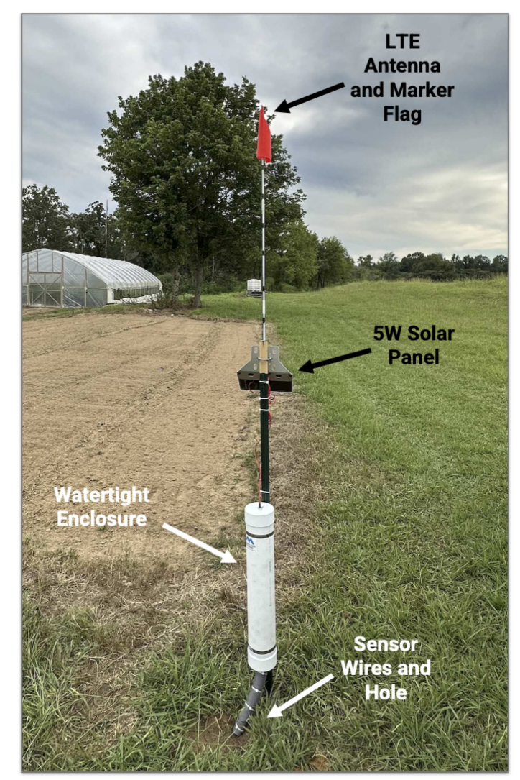
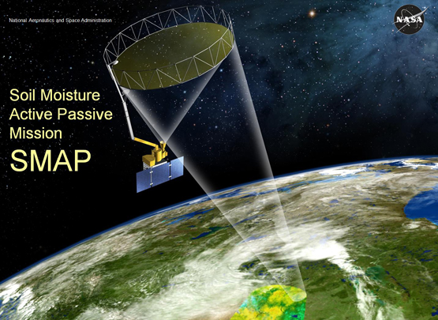
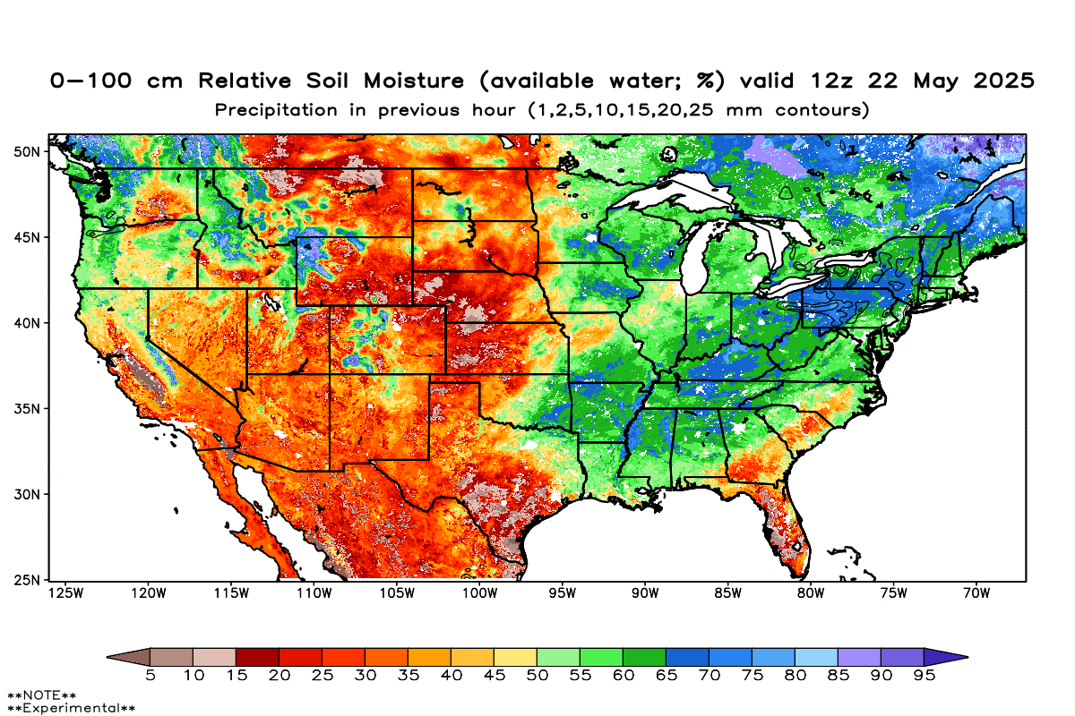
Complementary Soil Moisture Sources
Ford and Quiring (2019; Water Resources Research) discuss utility of complementary soil moisture sources: in situ, remote sensing, models
In-Situ:
-Calibrated measurements
-Sparse spatial coverage
Remote Sensing:
-Broader spatial coverage
-Limited temporal revisits
-Require retrievals
Land Surface Models:
-High-resolution in space & time
-Parameter & physics assumptions
-Computational requirements
    No “one-size fits all” solution for soil moisture applications
    Complementary use of all sources benefit drought and pluvial monitoring

Slide 3
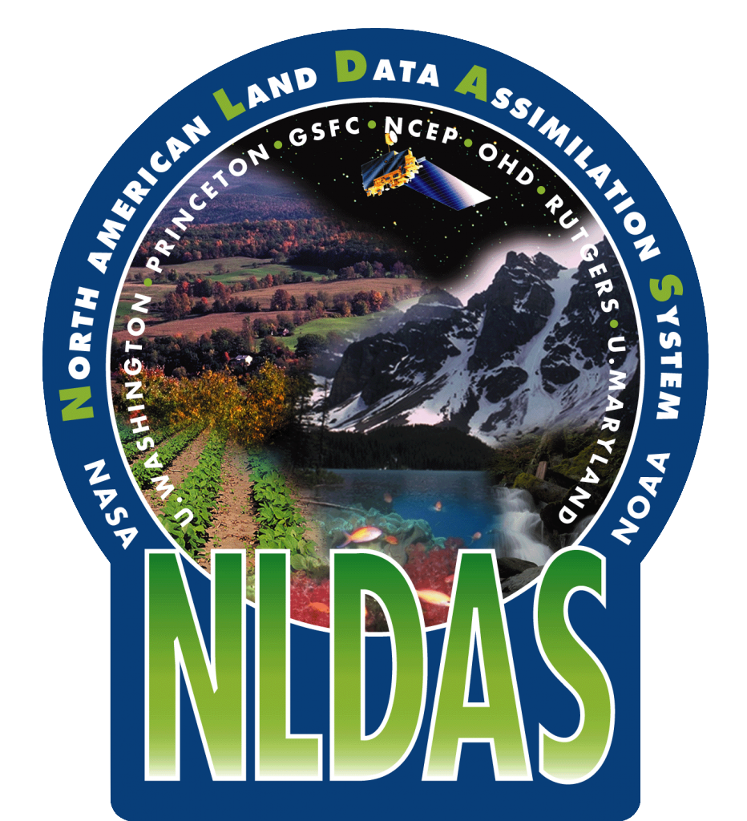
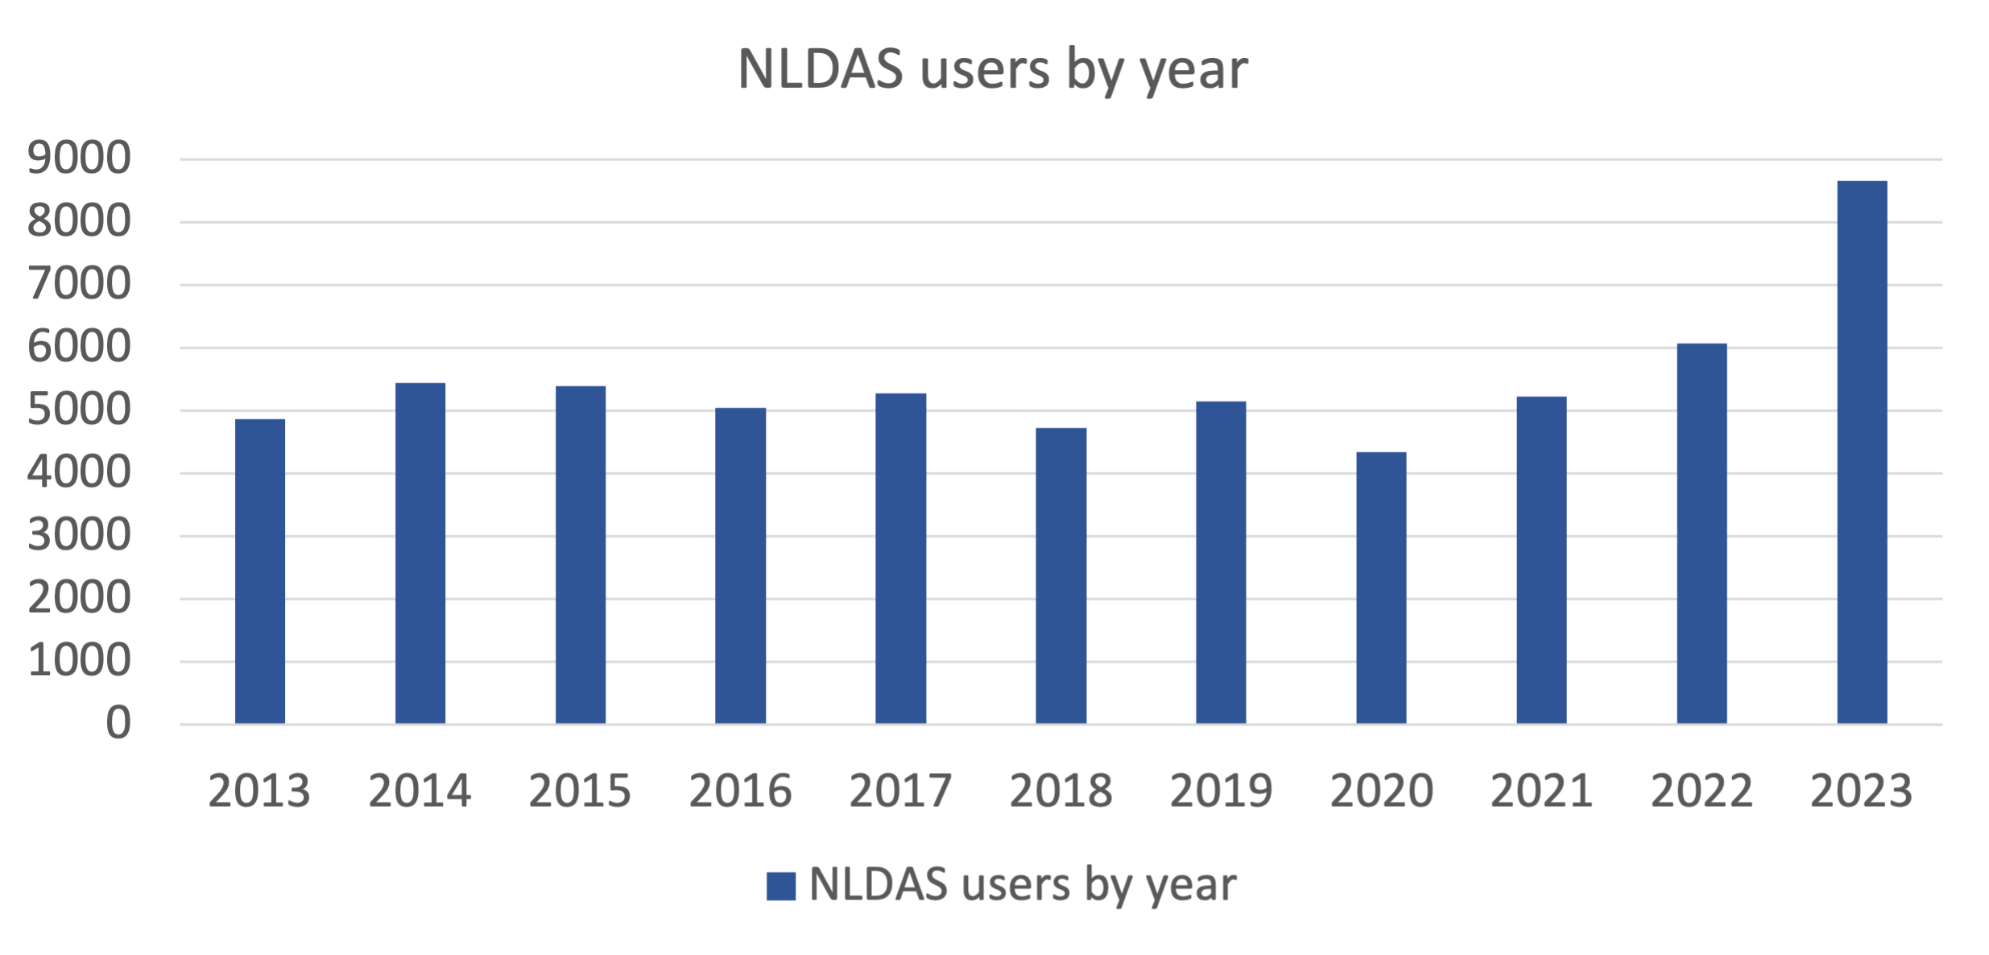
North American Land Data Assimilation System (NLDAS) Background
NLDAS: widely-used land modeling system, operational at NOAA
NLDAS-2 unique users has grown to over ~8,500 per year,
plus those who obtain data from NOAA
Used by numerous different stakeholders and science groups
  UNL/NDMC/drought.gov/state-level agencies
  NOAA/NWS, NOAA/CPC, NOAA/PSL (EDDI)
  GRACE-DA, OpenET, WWAO,
  WLDAS, QuickDRI
  USGS, EPA, FEMA, CUAHSI, USDA
  NASA SPoRT and their stakeholders
  State-level climate offices; private enterprises
NASA GES DISC users by year

Slide 4
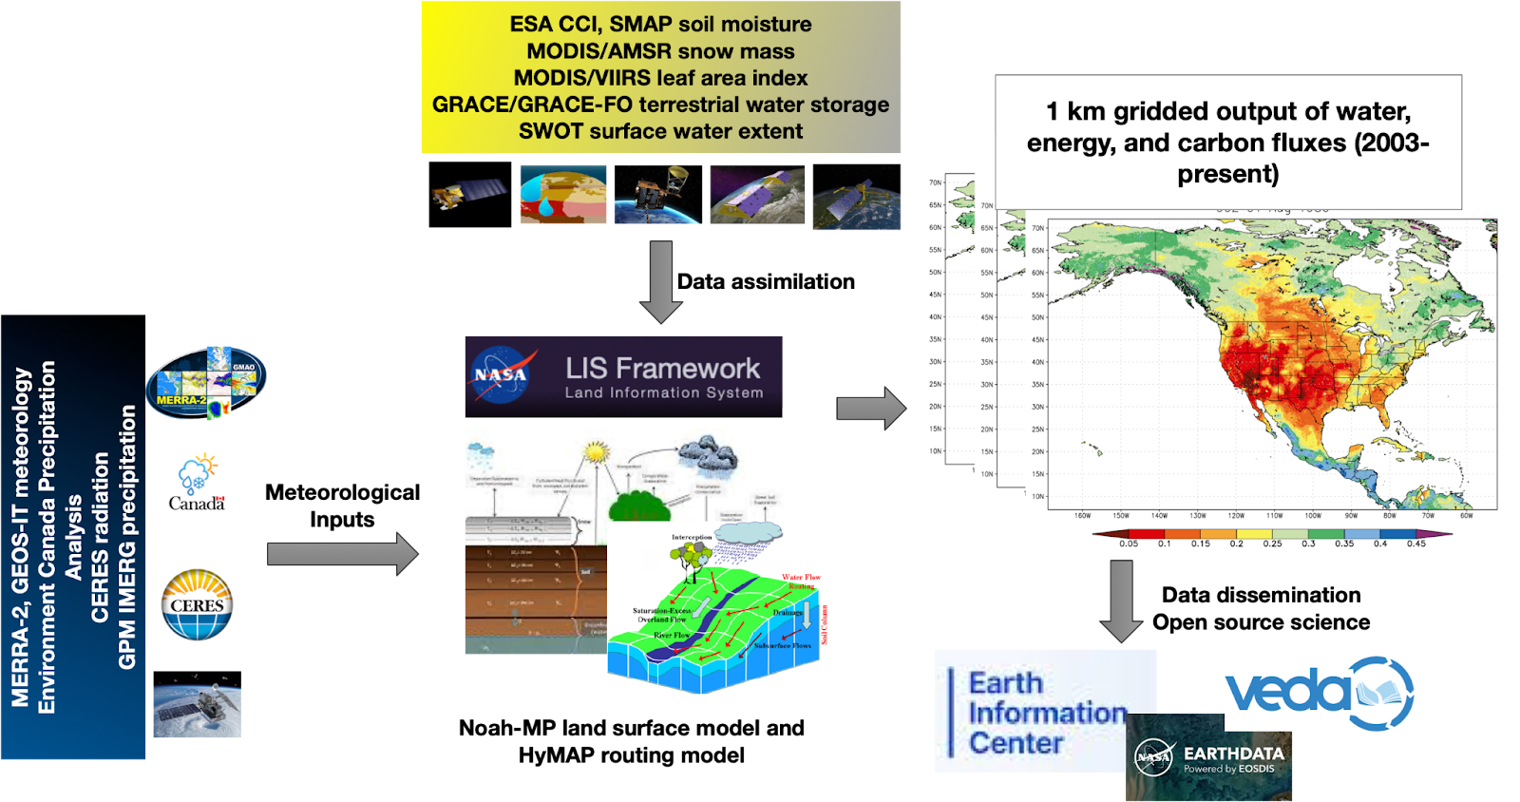
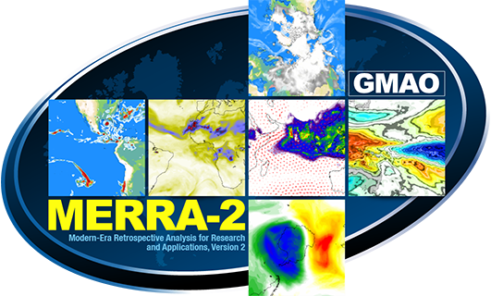

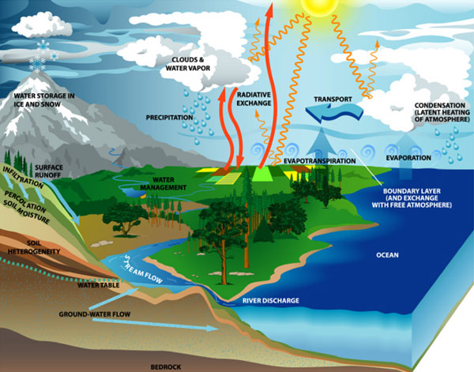

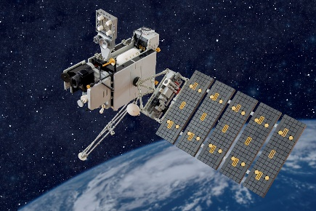


Introducing NLDAS-Phase 3 (NLDAS-3)
Improvements in red
High resolution outputs
(water, energy, carbon fluxes)
over a larger domain
Satellite Data Assimilation (soil moisture, snow, terrestrial water, vegetation)
Land Information System
Running Noah-MP model
Blended meteorological inputs
Providing real-time cloud-based outputs (with more variables) & analysis platforms
Notes:
Basic depiction of the general framework improvements shown in red

Slide 5

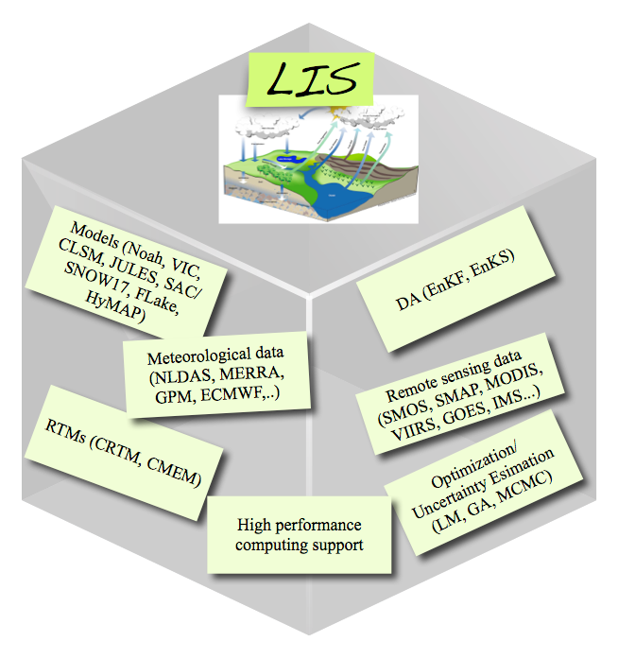
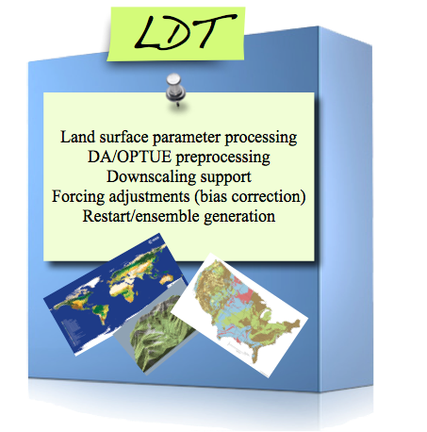
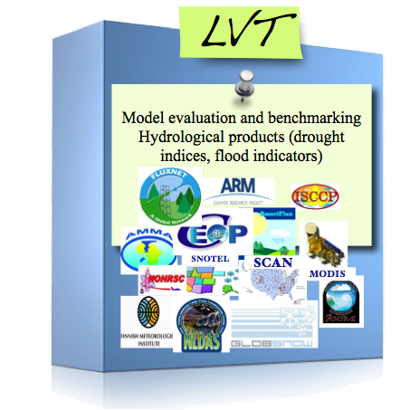

NASA Land Information System at the core of NLDAS-3
Use NASA’s Land Information System (LIS) software framework
Assimilate remotely-sensed products (soil moisture, snow, TWS, vegetation)
Use a modern state-of-the-art land-surface model (LSM): Noah-MP
Use a modern state-of-the-art river routing model – HyMAP
Websites: https://lis.gsfc.nasa.gov/ https://github.com/NASA-LIS/LISF

Slide 6
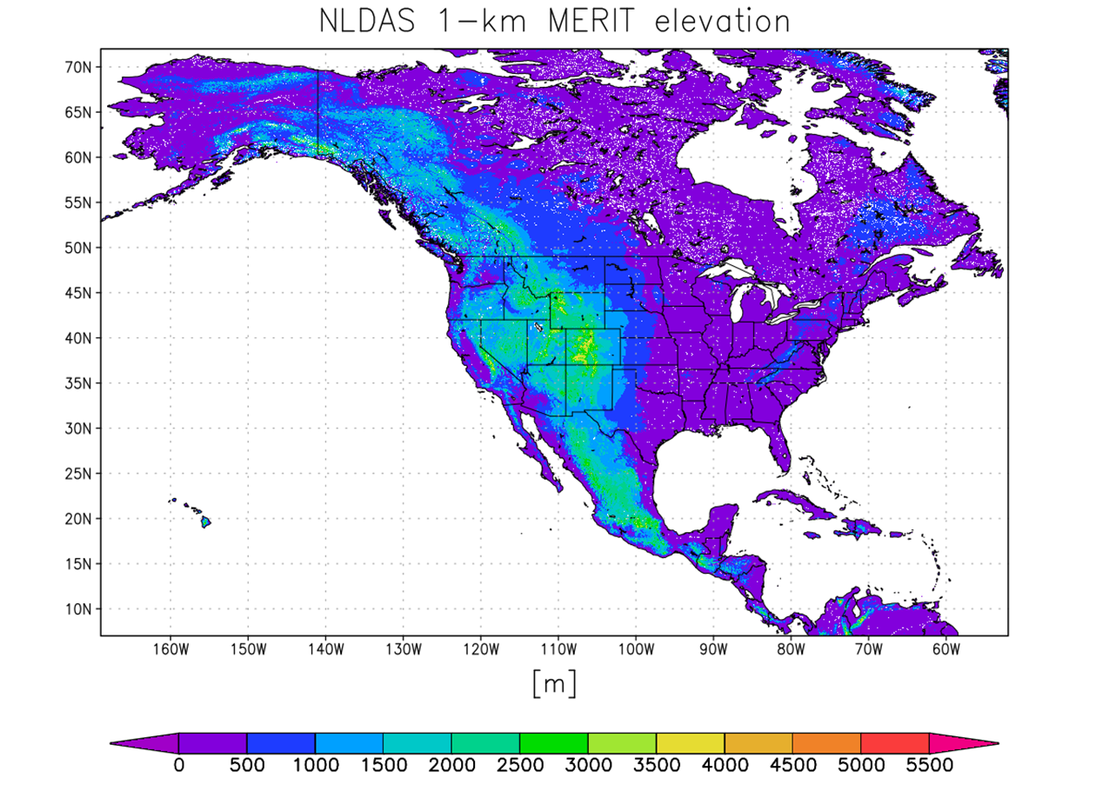
NLDAS-2 vs. NLDAS-3 Comparison
NLDAS-2
Grid spacing: ~14 km
Domain: CONUS (25º to 53º N)
Land points: 76,088
NLDAS-3
Grid spacing: 1.0 km
Domain: 7º to 72º N
169º to 52º W
Land points: 27,245,580
NLDAS-2
& SPoRT-LIS extent
The huge increase in the number of land points for NLDAS-3 — combined with the ensembles needed for data assimilation — requires significant computational resources!

Slide 7
NLDAS-2 vs. NLDAS-3 Comparison
Attribute | NLDAS-2 | NLDAS-3
Spatial coverage | CONUS (25º to 53º N / 125º to 67º W) | North America including Alaska, Hawaii, Puerto Rico, and Central America (7º to 72º N / 169º to 52º W)
Spatial resolution | ~14 km | ~1 km
Latency | 4 days | 7 hours
Precipitation | CPC daily analysis over CONUS | Assimilation using gauges, IMERG, CaPA, with MERRA-2/GEOS-IT as background
Surface meteorology | NARR with constant lapse-rate adjustment | MERRA-2/GEOS-IT/CERES with dynamical downscaling
Land surface models | 4 (Noah, VIC, Mosaic, SAC) | 1 (Noah-MP)
Data assimilation | None | Assimilation of remotely-sensed soil moisture, leaf area index, snow, terrestrial water storage
Forecasting | None | 2 to 4 week ensemble forecasts

Slide 8
NLDAS-3: Enhancing NLDAS for the Future
Put the “DA” into NLDAS
  Add data assimilation of unique [NASA] observations
  Resolve combined natural + human impacts on the water and energy cycle.
Build on previous joint efforts with NOAA, with these priorities:
  Modern land-surface model (Noah-MP) with groundwater,
  prognostic vegetation, and river routing model
  Reduce 4-day latency of current NLDAS-2 and enable forecasting capabilities
  Make NLDAS truly “North American”, including AK, HI, PR, and Central America
  Improve the quality of forcing data
  Finer spatial scales
Transition to stakeholders via NASA SPoRT’s proven R2O paradigm (e.g., “SPoRT-LIS”)

Slide 9
NLDAS-3 Stakeholder Engagement Applications
Stakeholder | Application Area / Need
NDMC | Drought
NOAA NIDIS | Drought
NOAA and CIRES | Water Resources
USGS MD-DE-DC Water Science | Water Resources
USDA NASS | Agriculture
NASA Acres | Agriculture
Nutrien Ag Solutions | Agriculture
USBR | Water Supply
Regional Drought Early Warning Systems | Drought
State Meteorologists and Drought Authors | Agriculture
State Ag Extension Orgs | Agriculture, Drought, Flooding, Weather
Microsoft | Technology Development
National Interagency Fire Center | Fire Management
The Weather Channel | Drought, Flooding, Weather
Google | Technology Development

Slide 10
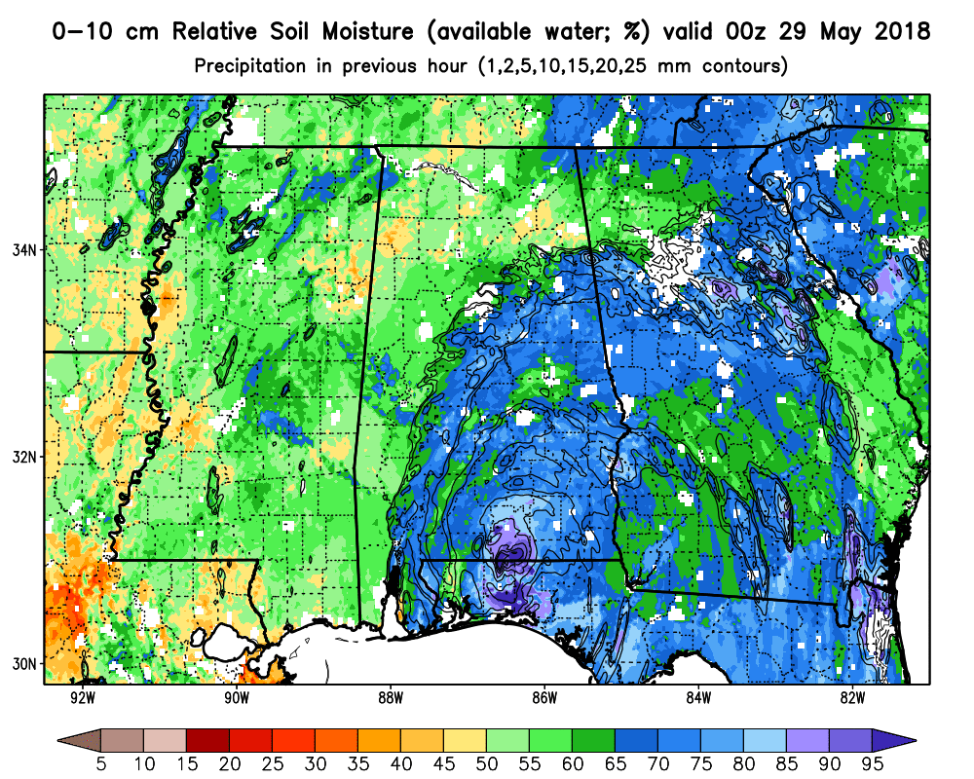
Near Real-time NLDAS-3
What do stakeholders need?
  User-centric design of the product system
  Low latency
  Easy to use formats
  Integration into decision-support systems
  Derived products
  Essential Agricultural Variables
  **NLDAS-3 is designed to address user requirements and is being co-developed with our stakeholder community.

Slide 11
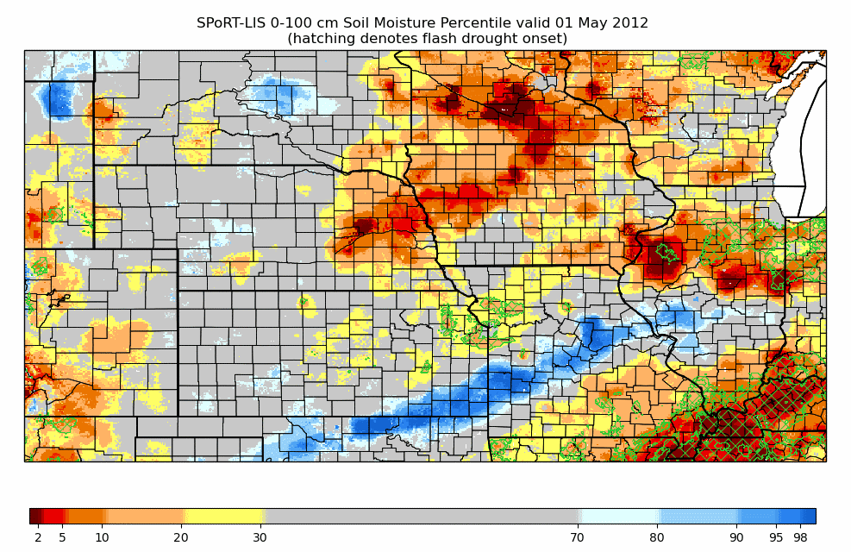
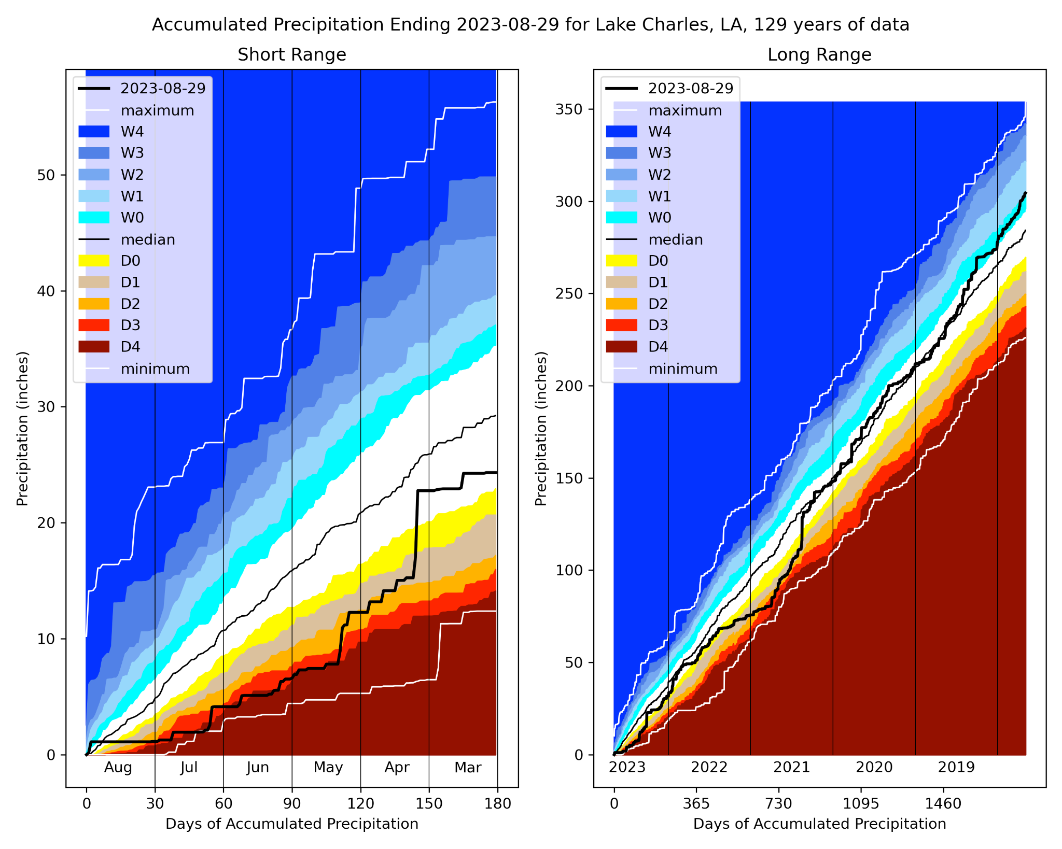
Enhanced Product Ideas for NLDAS-3
Soil Moisture Volatility Index flash drought metric
(upper-right)
Composite/Blended Drought Indicators such as those
at https://ndmcblends.unl.edu/Home.aspx
Dr. Nielsen-Gammon’s “Precipitation Fingerprint
Plots”, derived from NLDAS-3 forcing (bottom-right)
Layered data formats (cloud-optimized geoTIFFs)
Interactive capabilities to query areas of interest
County- and HUC-basin masking for bulk stats
Time-depth cross sections
Soil moisture associated with lightning-initiated wildfires
Notes:
Based on previous stakeholder feedback and recent research, we envision a variety of value-added products that can enhance situational awareness and enable stakeholders to interact more efficiently with the NLDAS-3 output. SMVI for identifying flash drought onset regions, blended drought indices such as those shown on the NDMC web page, the precipitation fingerprint plot at specific NLDAS-3 grid points or masked regions for contextualizing short vs. long-term drought, layered data for stakeholder DSSs, geographical and hydrologic masking for obtaining bulk stats, applying soil moisture to other high-impact phenomena such as wildfires.

Slide 12
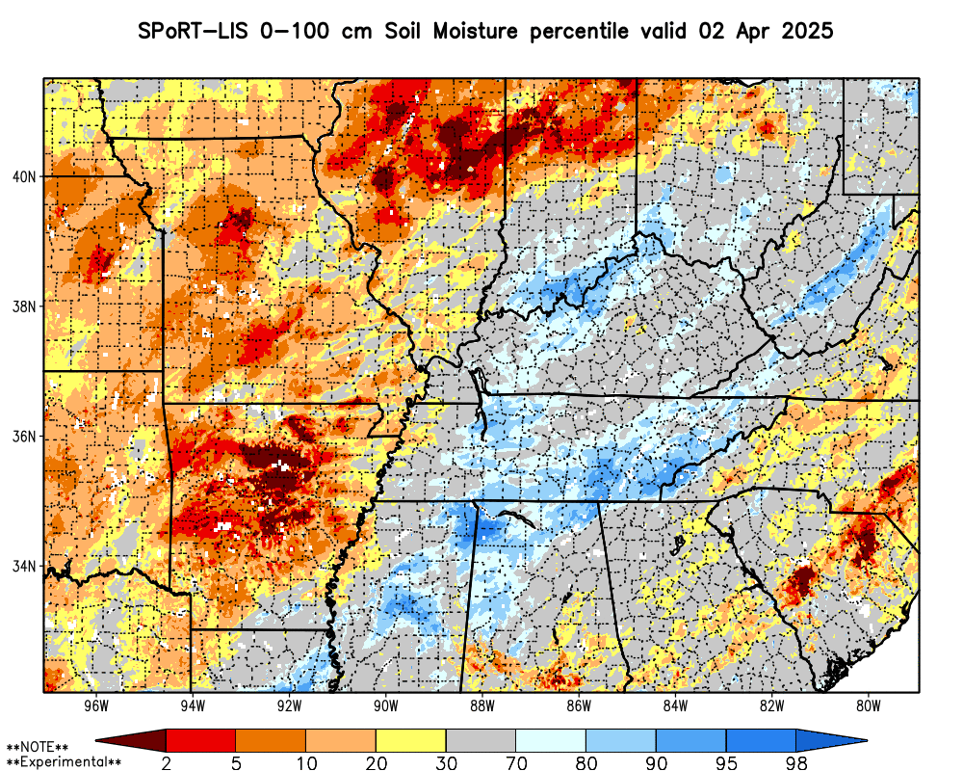
Forecast Soil Moisture Percentiles
SPoRT currently generates 14-day forecast soil moisture percentiles, driven by GFS forecast precip
For NLDAS-3 forecasts, we envision:
  14-30 day forecasts, bridging gap from short-term forecasting to S2S
  Deterministic and ensemble outputs
Forecast ensemble proposal:
  Daily spread of forecast LSM solutions, forced by all GEFS members
  Probabilities of soil moisture falling below or exceeding threshold percentiles
  Soil Moisture Volatility Index for flash drought prediction
Notes:
In recent years, we implemented experimental daily percentile forecasts of soil moisture from the SPoRT-LIS, going out 2 weeks, updated daily. For now, the forecast percentiles use GFS model predictions for input forcing. However, as we implement NLDAS-3 in real-time, we plan to explore the ensemble space for generation a prediction component to NLDAS-3, with daily predictions going out to 30 days. This will help bridge the gap between short-term forecasting and Subseasonal 2 Seasonal forecasts. We initially plan to implement an ensemble prediction approach using all members of the GEFS model in order to generate probabilities of soil moisture falling below or exceeding key percentile thresholds. We can also examine flash drought indicators such as the SMVI to look at the probability of a flash drought occurring in the next 2-4 weeks.

Slide 13
Estimated NLDAS-3 Data Timeline
Product | Variables | Production Estimate
NLDAS-3 Surface meteorology (hourly; Jan 2001 to present) | Precipitation, SW/LW down at the surface, 2-m T/q, 10-m winds | Beta version available now
NLDAS-3 Open Loop (no surface data assimilation) | Soil moisture/temps, snow, surface fluxes, groundwater, LAI, streamflow | Late summer 2025
NLDAS-3 Full DA (multivariate surface data assimilation) | Same as Open Loop | Late fall 2025
NLDAS-3 Forecasting | Soil moisture, hydrometeorology | 2026
For updates on NLDAS-3 data availability: https://ldas.gsfc.nasa.gov/nldas/v3

Slide 14


Thank you!
Any Questions?
SPoRT-LIS archives now available at GHRC DAAC:
https://dx.doi.org/10.5067/SPORT/LIS/DATA101
NLDAS-3 project page:
https://ldas.gsfc.nasa.gov/nldas/v3

Slide 15
Backup Slides

Slide 16
Updates to SPoRT-LIS
BIG NEWS!! SPoRT-LIS archives are being populated to https://dx.doi.org/10.5067/SPORT/LIS/DATA101
Global Hydrometeorology Resource Center Distributed Active Archive Center (GHRC DAAC)
Enables public access of ALL SPoRT-LIS historical data
  Raw outputs: 1-2x daily 1981 - 2015; hourly 2015 - present
  Climatology database and daily soil moisture percentiles: 1981 – present
  Monthly restart files and templates for re-running LIS over periods of interest
  Daily VIIRS GVF in LIS input format (2012 - present)
  Sample code and python jupyter notebooks for reading / visualizing

Slide 17
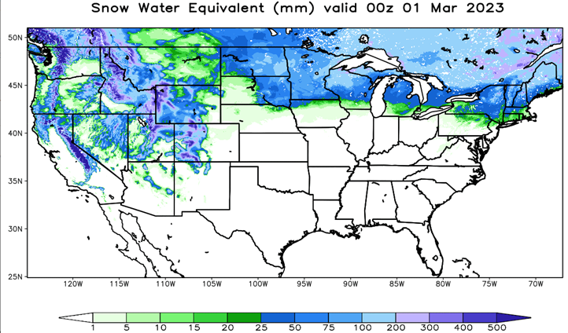
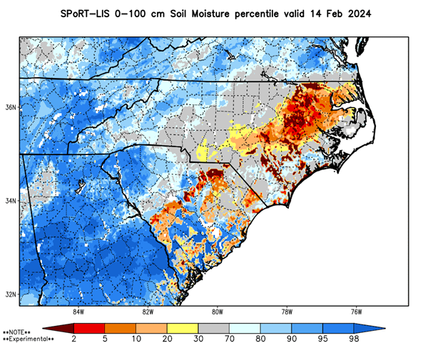
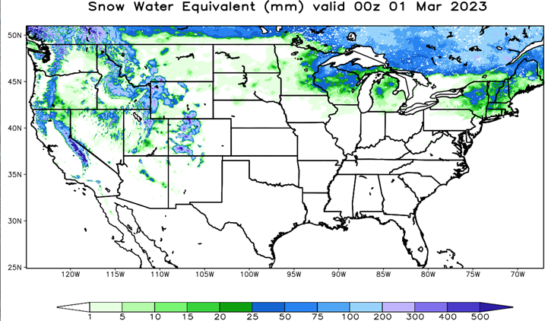
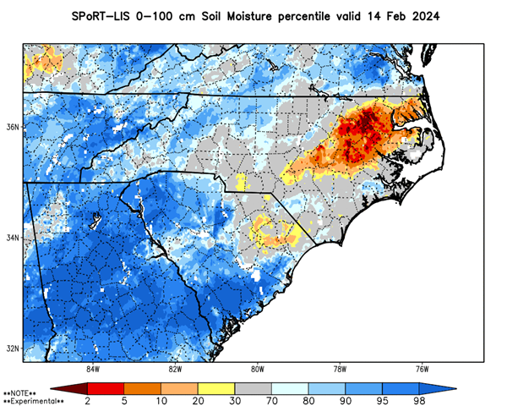
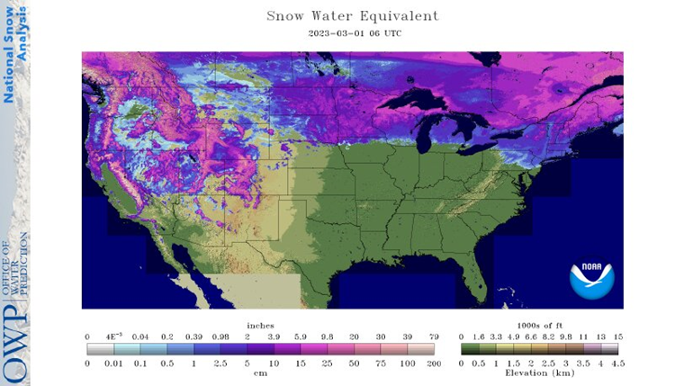
Updates to SPoRT-LIS: Fixes
Improved with GDAS
forcing
NLDAS-2 Bug: Too little snow
Bug
Soil table fix
NOHRSC Snow
0-100 cm percentiles
14 Feb 2024
(Left) Soil texture inconsistency w/ historical database: Led to anomalously low percentiles in sandy soils [thanks to Elliott Wickham, SC State Climo office]
(Right) NLDAS-2 warm 2-m Temp bias, 2022-23
  Switched to GDAS forcing for real-time outputs; Oct 2023 - present
  Back-processing archives with corrected NLDAS-2 forcing for GHRC DAAC

Slide 18
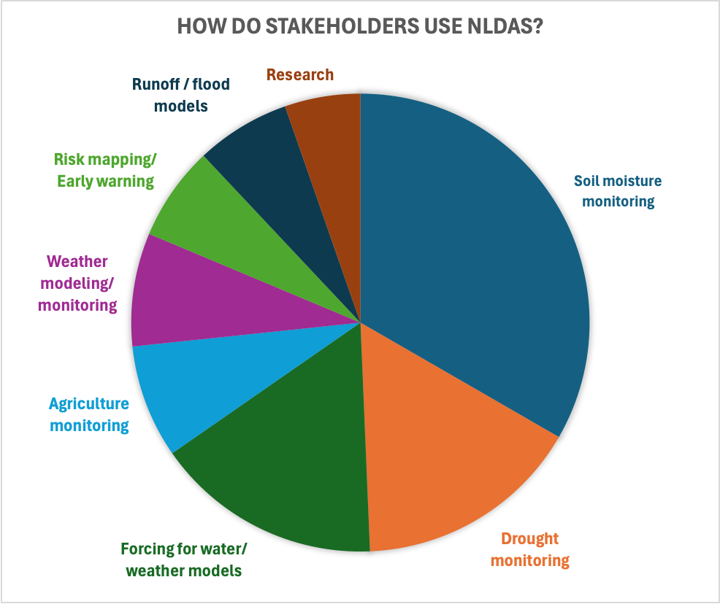
Summary of Stakeholder Feedback
Specific NLDAS Uses from
Previous Workshops
Drought and flood operations
Wildfire risk and prescribed burn planning
NWP model data input
Climatologies/Anomalies
Generating refET for EDDI
Runoff/soil saturation for flood and landslide risk
Forcing for snow models
Building ML/DL models
Watershed modeling
Notes:
Summary of responses from our first two workshops polling the broader NLDAS user community.

Slide 19
Previous Feedback on Priority Needs
High-priority Model Improvements:
Decreased output latency
Better forcing data quality
Finer spatial resolution
Assimilation of observational data
Expanding the model spatial domain
Atmospheric forcing datasets back to 1980, for historical context
Easier data access
Choice of output formats
Consistent datasets
Requests for Derived Products and Applications:
Soil moisture percentiles and outlooks
Drought percentiles, indices, and forecasts
ET and PET products
Soil hydrologic conductivity
Modeled ET and runoff
GIS-enabled data
Weekly change maps
Model uncertainty information

Slide 20
Requests for Derived Products and Applications
From Today’s Workshop Registration Responses:
Reference evapotranspiration (Penman-Monteith PET), actual evapotranspiration, EDDI, SPEI
FAO56 PET (we currently rely on GridMET)
Soil moisture percentiles - crop yields
Climatology and percentiles
Experimental forecast products; derived fields
Enhance accuracy of U.S. Drought Monitor and as inputs into our other operational combined drought indicators
Flash drought detection
River and flood modeling
Notes:
Registration responses regarding high priority model improvements were largely the same as previous workshops. Here are specific derived product requests from you, the drought monitoring experts at NOAA and NDMC. We will discuss these information needs more shortly.

Slide 21
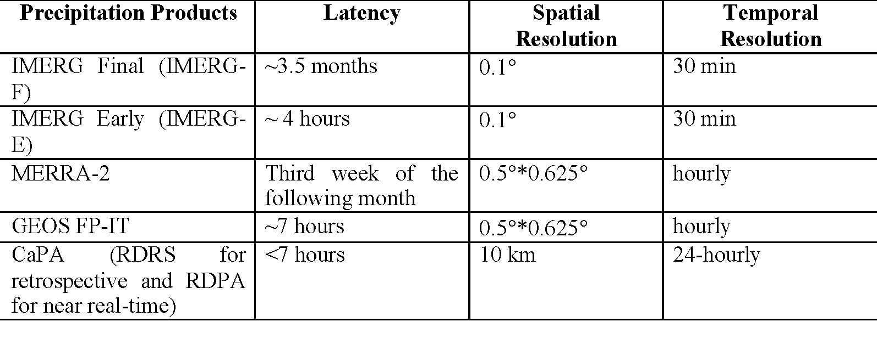
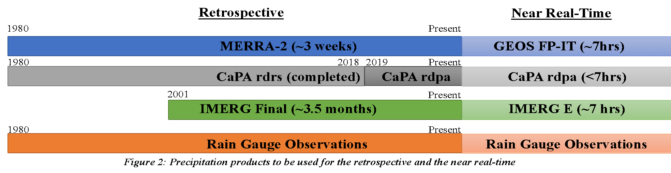
A NASA Data-driven Meteorological Forcing in Retrospective and Real Time
GEOS-IT
We are considering two products:
“Full DA” product: Starting ~2000, which is when many remotely-sensed DA products and IMERG begin
“Open Loop” product: Starting ~1980, with no data assimilation
GEOS-IT

Slide 22

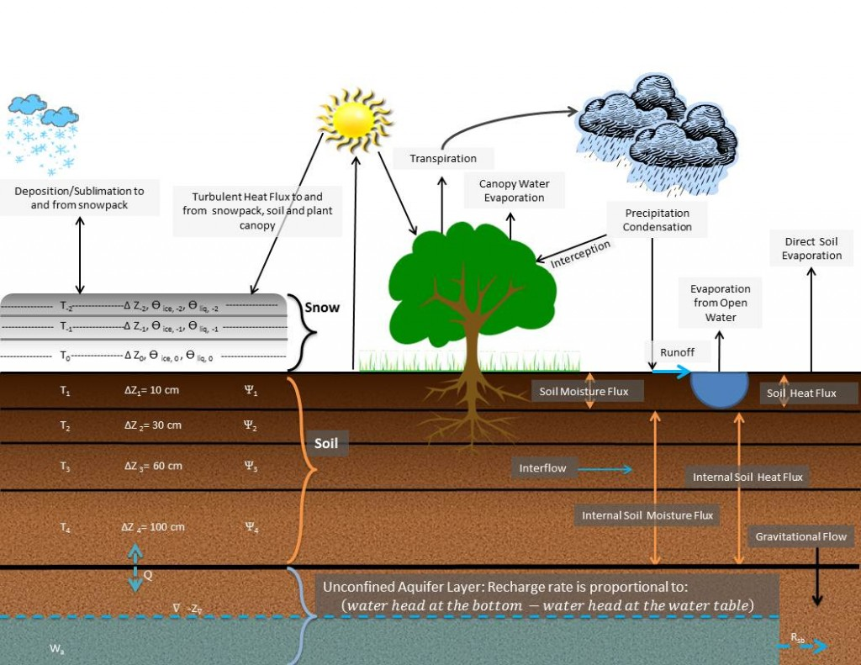
Data Assimilation and Modeling
Noah-MP LSM (managed by NCAR) is used in several other systems (NWM, WRF, UFS, etc.).
Contains advanced physics, including 3-layer snow physics, etc. For NLDAS-3, we will use options for groundwater and for prognostic phenology.
Assimilated data products:
  Soil moisture (SMAP, AMSR-E, etc.)
  Snow (Optical, passive microwave, ML)
  MODIS/VIIRS 4-day LAI
  GRACE/GRACE-FO TWS
  SWOT (river height into HyMAP river routing model – in development)
  Future: NISAR, other upcoming missions

Slide 23
Late and Early “full DA” NLDAS-3 Products
Final NLDAS-3 product (“Late Look”)
MERRA-2 surface meteorology and background for precipitation analysis (product has ~3 weeks latency)
IMERG-Final (product has ~3.5 months latency)
GRACE/GRACE-FO TWS assimilation (product has ~3-4 months latency)
Soil moisture, snow, vegetation DA
Serves as “best possible” analysis for most accurate quantification of all key water cycle components
Will be produced for the full period of record
Near real-time NLDAS-3 product (“Early Look”)
Latency of about ~7 hours (1x per day)
NASA’s GEOS-IT surface meteorology and background for precipitation analysis
IMERG-Late / Early
Near real-time DA for soil moisture, snow, veg
Early run will restart from last-available Final states, continuing to real-time
Will be provided for the gap between the late-look and near-time period.

Slide 24
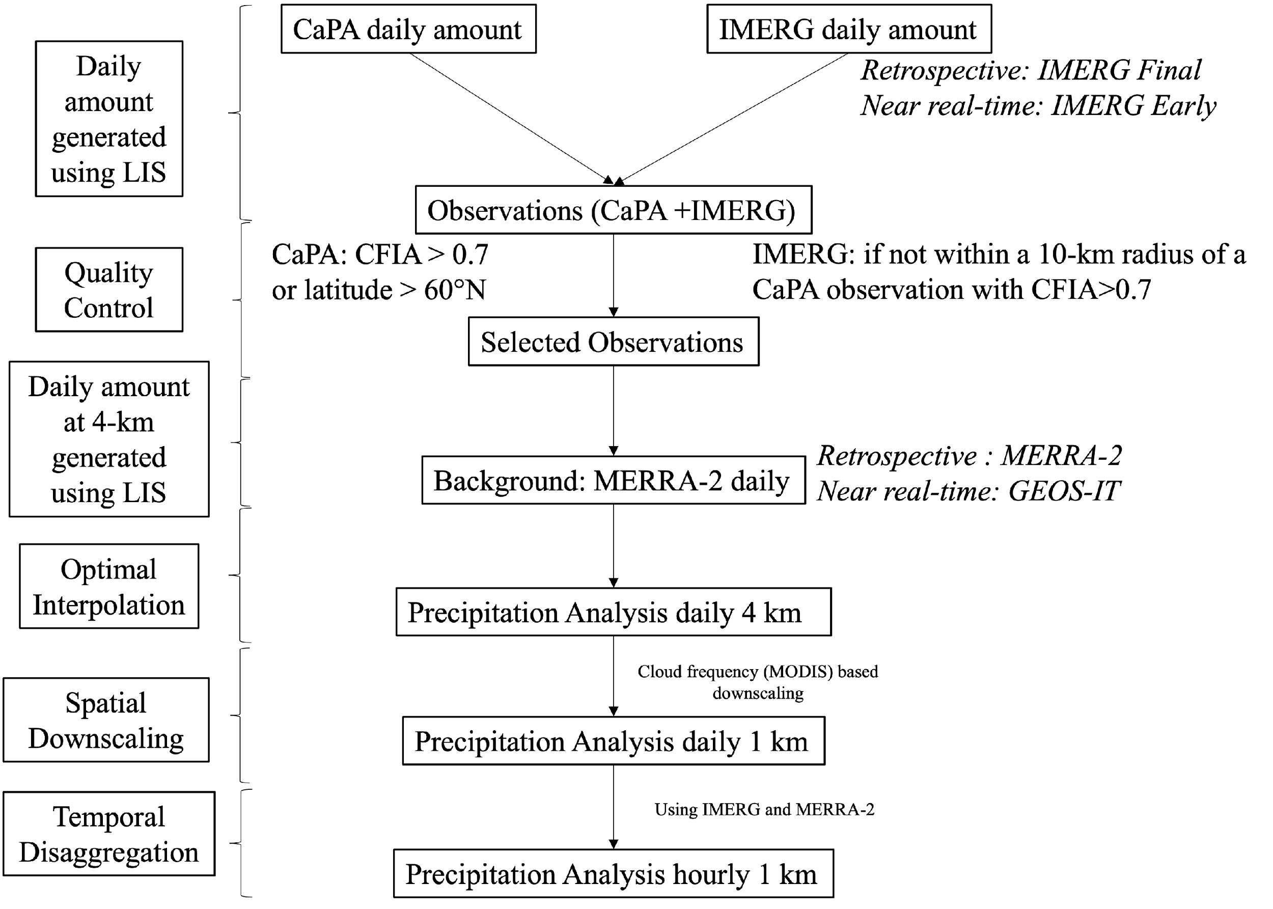
What goes into NLDAS-3 meteorology (precipitation)?
NLDAS-3 uses advanced optimal interpolation techniques to blend well-known and widely used meteorological forcing: NASA’s MERRA-2 and IMERG and ECCC Canada’s CaPA
The algorithm downscales precipitation data from 4 km to 1 km resolution by integrating MODIS-derived monthly cloud cover frequency, calculated from daily Terra and Aqua satellite cloud flags, based on the assumption that cloud frequency correlates with precipitation patterns.

Slide 25
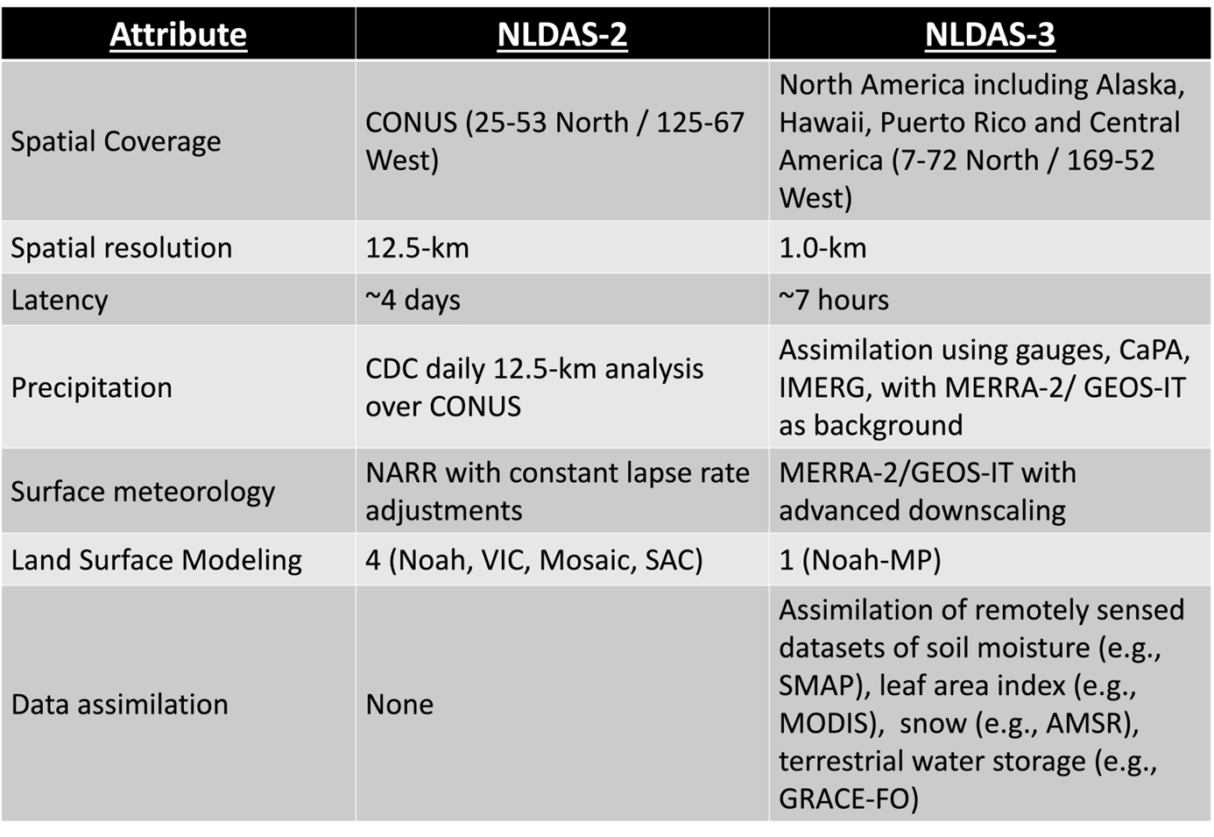
Towards NLDAS-3: 1-km North American analyses
NLDAS-2
& SPoRT-LIS extent
Bug
Soil table fix

Slide 26
1-km Surface Meteorology
The other surface meteorological variables are also downscaled to 1-km:
Surface temperature, moisture, & pressure adjusted via a dynamic (local, hourly) lapse rate method (Whitney et al. submitted).
Winds adjusted via MicroMet (uses topographic slope, curvature, azimuth).
Shortwave down using CERES/POWER data → downscaled via slope-aspect correction from 1-km topography.
Longwave down using CERES/POWER data → downscaled via a dynamic (local, hourly) lapse rate method (similar to surface temperature, moisture, pressure).

Slide 27
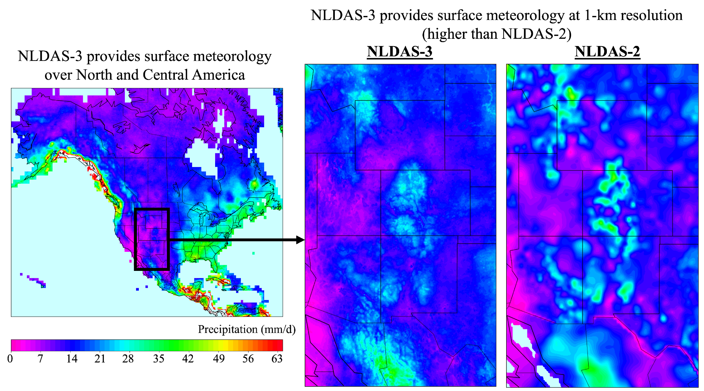
NLDAS-3 Provides Sfc Meteorology at 1-km Resolution
NLDAS-3 provides surface meteorology over North & Central America
NLDAS-3 provides surface meteorology at 1-km resolution (higher than NLDAS-2)

Slide 28
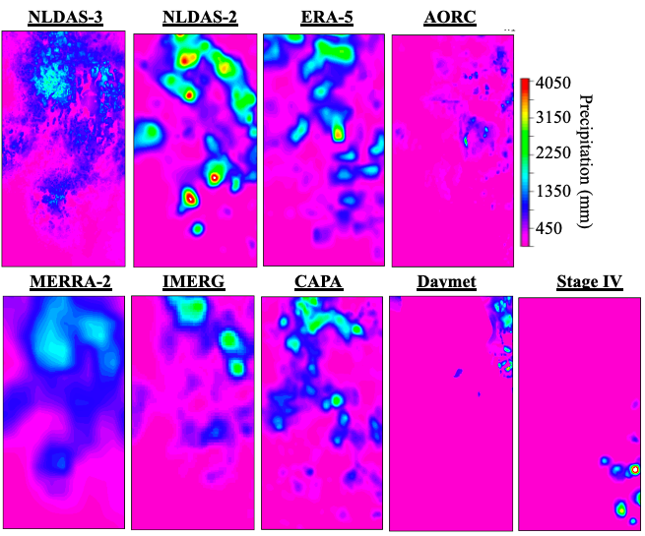
NLDAS-3 Provides Sfc Meteorology at 1-km Resolution

Slide 29
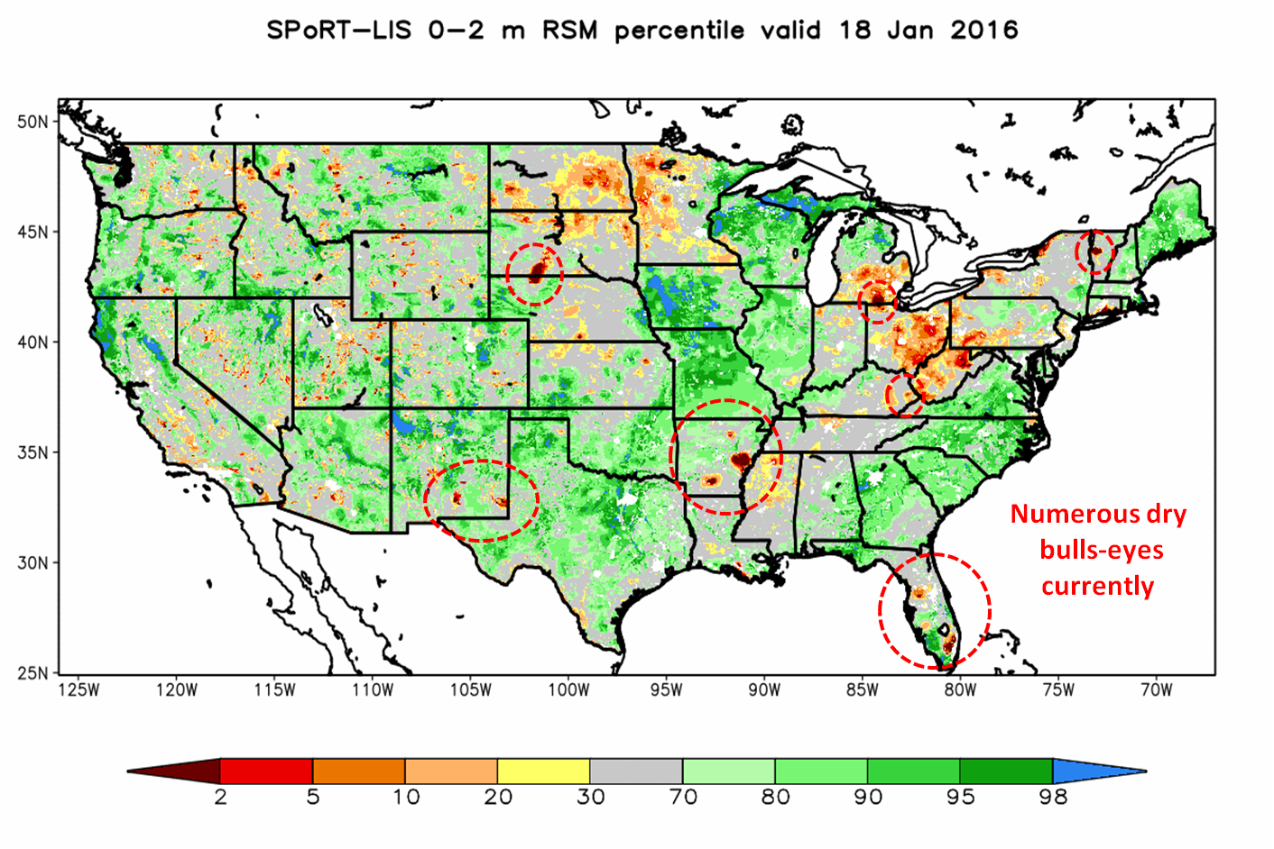
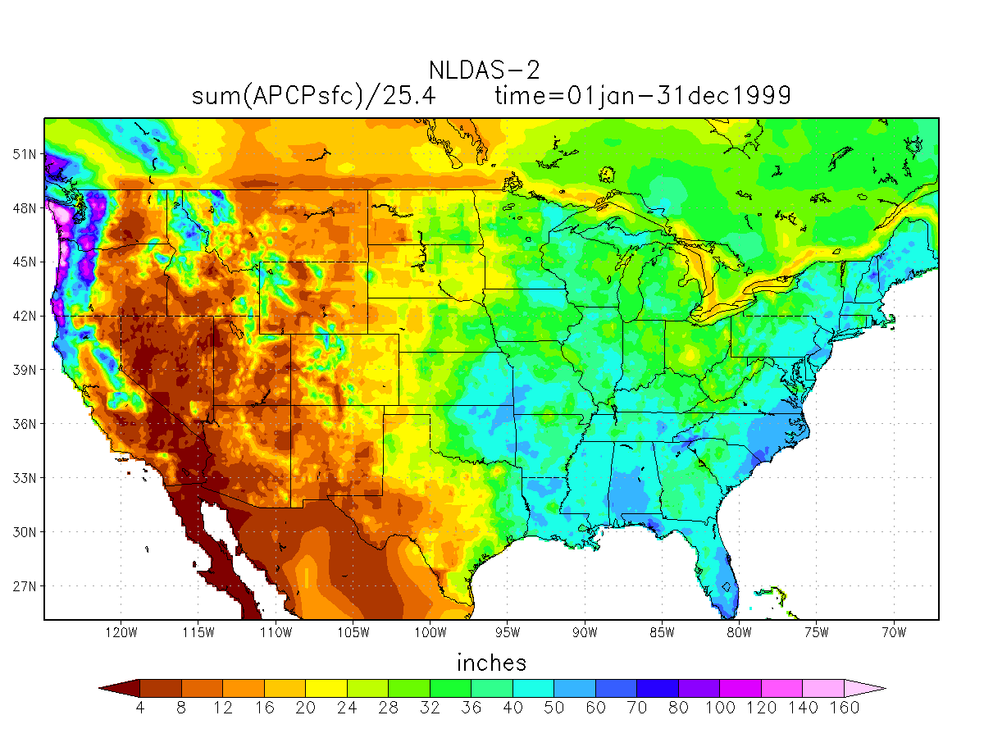
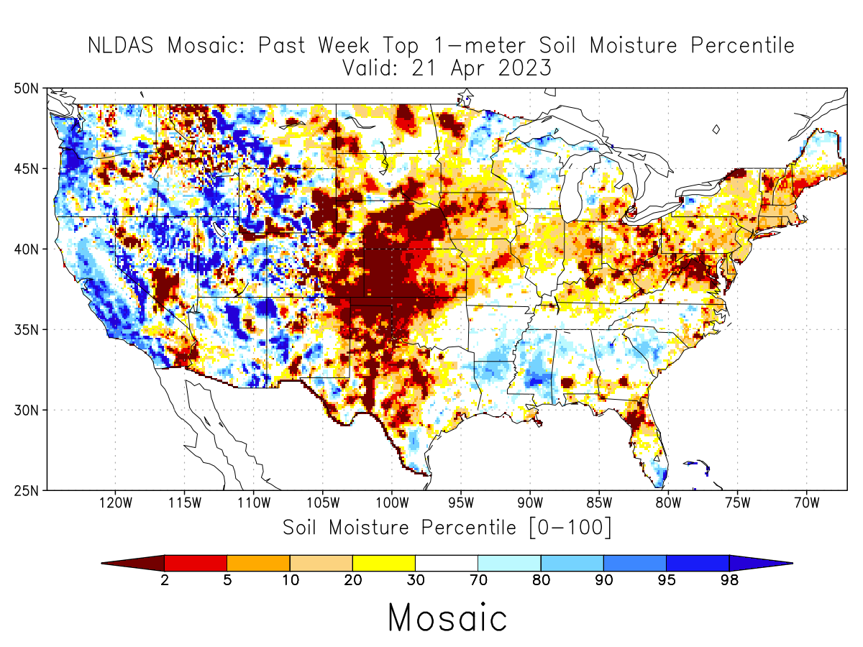
Resolving Stakeholders’ Issues
Recurring/persistent dry bulls-eyes in precipitation and soil moisture from QC issues in the daily gauge analysis.
Cross-border (U.S.-Canada) precipitation issues related to the blending scheme between different input products.
Change in interpolation scheme in January 2012 affected soil moisture climatologies (esp. in intermountain West and along U.S.-Mexico border).
There are many downstream and value-added data products that rely on the quality of NLDAS forcing and model outputs.

Slide 30
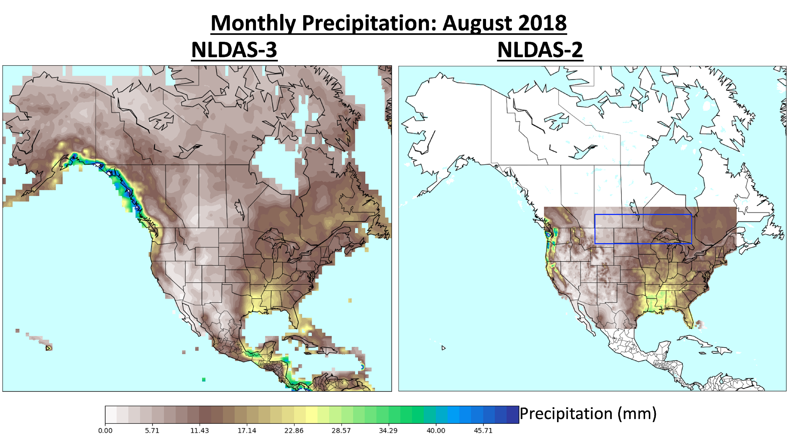
NLDAS-3 Overcomes NLDAS-2 Border Issues

Slide 31
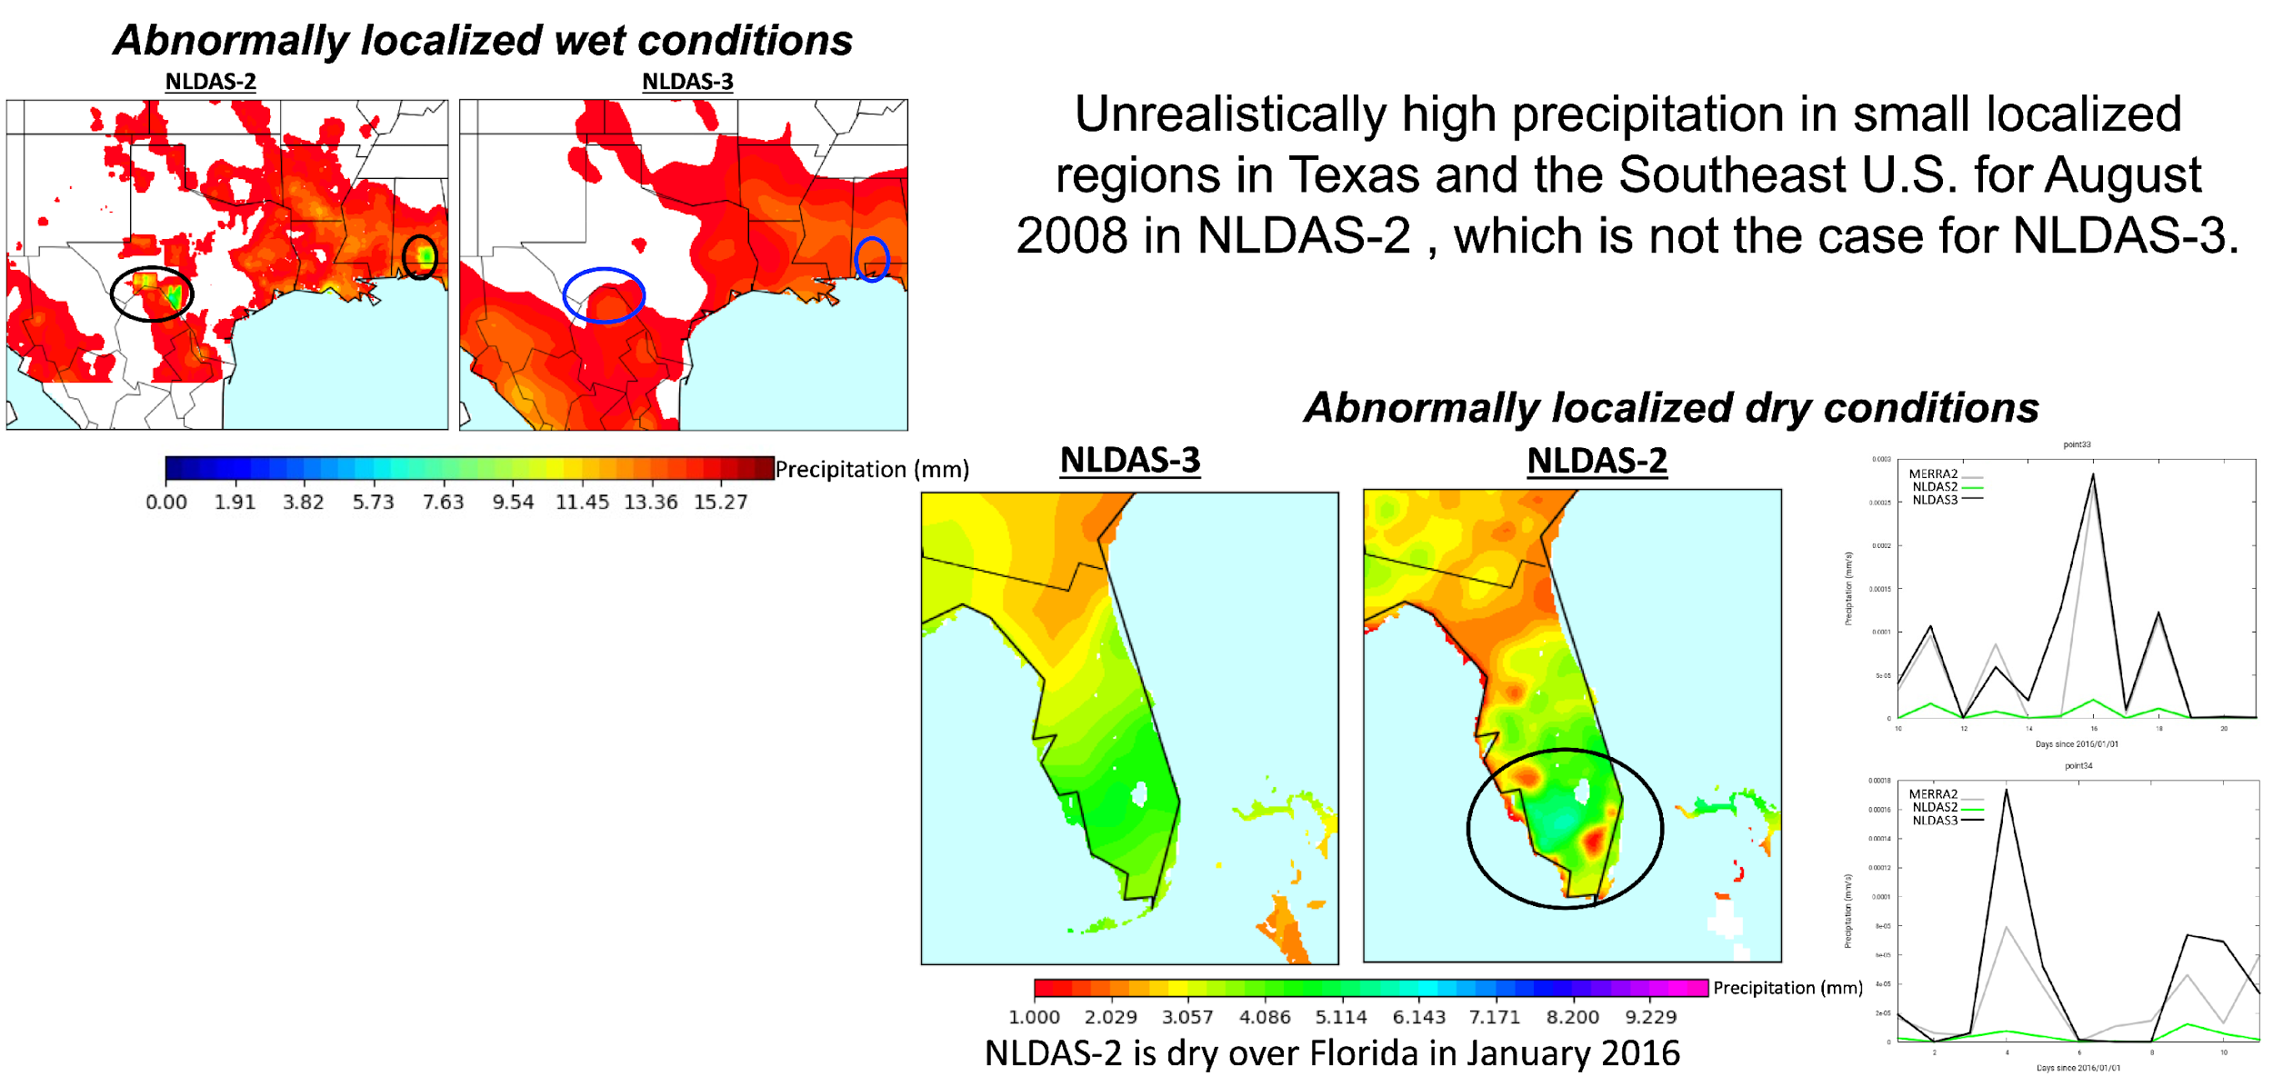
NLDAS-3 does not induce local high and low precipitation values
Unrealistically high precipitation in small localized regions in Texas and the Southeast U.S. for August 2008 in NLDAS-2, which is not the case for NLDAS-3
Precipitation (mm)
Precipitation (mm)
NLDAS-2 is dry over Florida in January 2016
MERRA-2
NLDAS-2
NLDAS-3
Precipitation (mm)

Slide 32
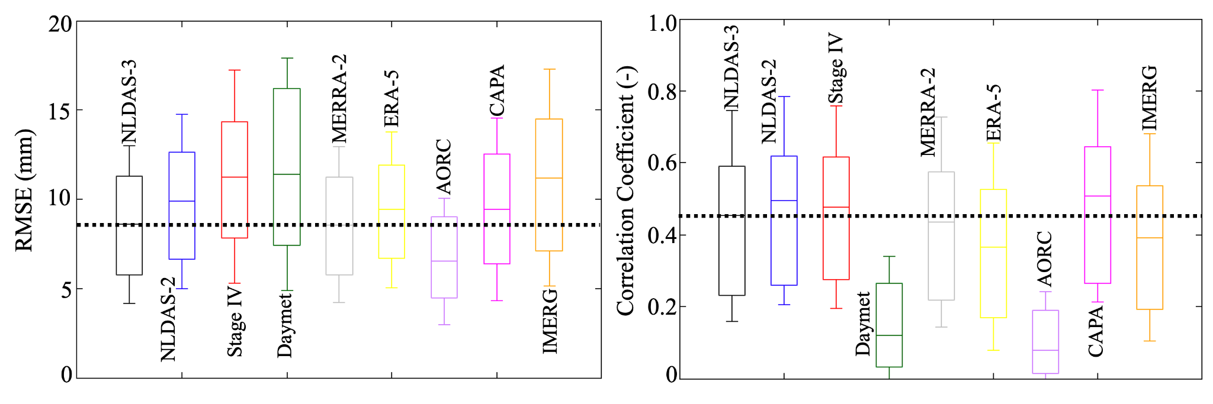
NLDAS-3 precipitation evaluation (vs ground obs)
AORC outperforms other products by ingesting ground observations.
NLDAS-3 performs better than NLDAS-2 but slightly below MERRA-2.

Slide 33
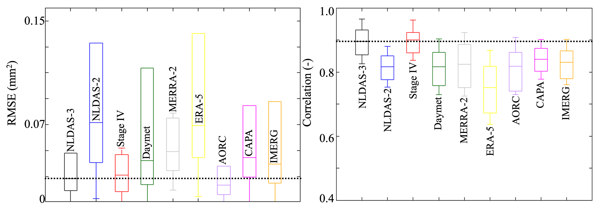
NLDAS-3 precipitation evaluation (extended triple collocation)
The extended triple collocation shows that NLDAS-3 has lower RMSE and higher correlation coefficient than the other products

Slide 34
NLDAS-3 Data Temporal Resolution
We are considering providing NLDAS-3 model output data (from both the Noah-MP LSM and the HyMAP river routing model) at daily-average temporal resolution only.
NLDAS-3 surface meteorology and precipitation will still be provided hourly (to drive the models): precipitation, SW/LW downward radiation, winds, surface pressure, 2-m air temperature/humidity.
Reasoning:
  Reduces data storage by a factor of 1/24th due to smaller file sizes;
  Significant improvement in model simulation speed by writing data only once, minimizing I/O wall-clock time.
A discussion on this topic is already ongoing on the NLDAS-3 GitHub: https://github.com/NASAWaterInsight/NLDAS-3/discussions

Slide 35
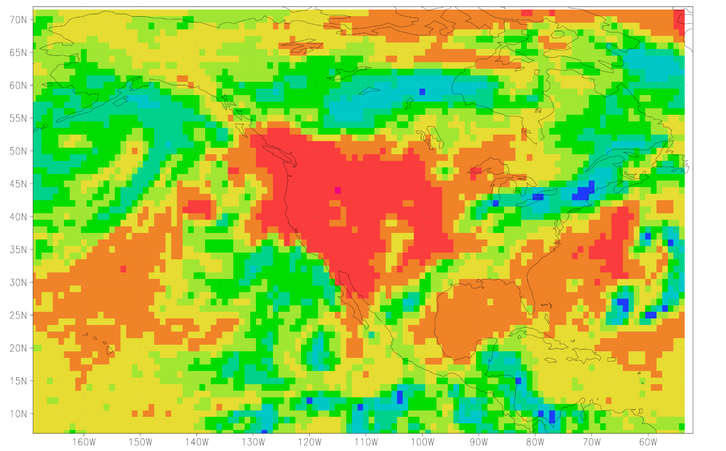
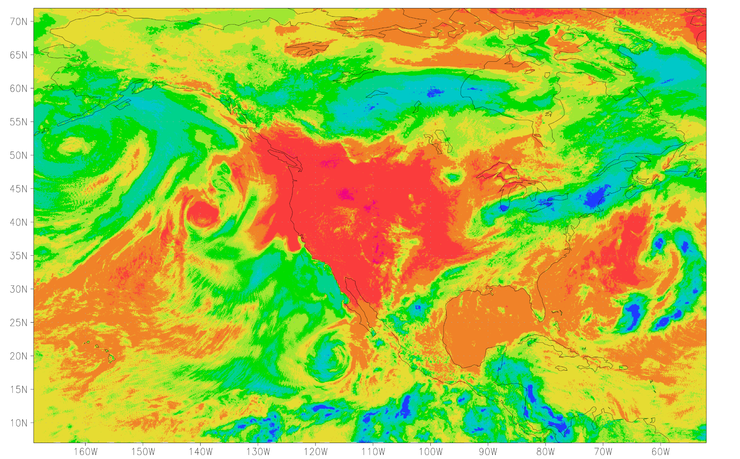
Downscaling of CERES Downwelling Shortwave Radiation
Current NASA POWER products from CERES/GEO imagers provide hourly radiative flux estimates at coarser resolutions than the proposed NLDAS-3 framework.
To address this, we developed an ML-based method to downscale 1° CERES fluxes to 4-km using the original 4-km resolution of GOES for NLDAS-3.
Original CERES 1°
Downscaled CERES at 4-km
Notes:
Current NASA POWER products based on observations from CERES/GEO imagers can provide estimates of hourly radiative fluxes; however, these products are at much coarser resolutions than the proposed NLDAS-3 framework.
Therefore, we have developed an ML-based method to use the original 4-km resolution of GOES to downscale the 1° CERES fluxes to 4-km for NLDAS-3.

Slide 36
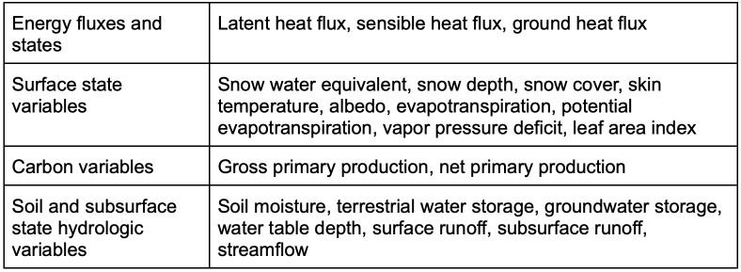
NLDAS-3 Variables and Data Access
Data in netCDF-4 format, accessible from the cloud for analysis without downloading large datasets.
Spatial, regional, and variable subsetting tools for targeted data downloads.
Cloud-optimized GeoTIFF and GIS collections of selected variables based on stakeholder needs.
Notes:
Data will be in netCDF-4 format, accessible from the cloud, enabling users to perform analysis without downloading large datasets.
We will provide spatial / regional / variable subsetting tools to allow users to download data specific to their region and variable of interest.
We plan to provide cloud-optimized GeoTIFF, GIS-based, etc. collections of selected variables based on stakeholder requirements.

Slide 37
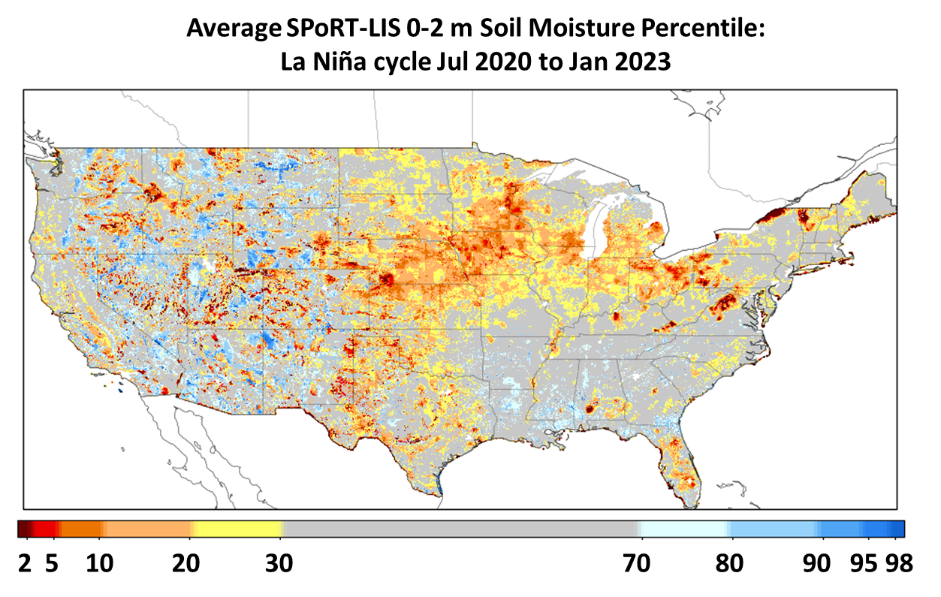
Applications: Historic Soil Moisture Percentiles
Examine mean soil moisture percentiles during El Niño and La Niña episodes
Most recent La Niña and El Niño periods shown at right using SPoRT-LIS daily percentiles, averaged between mid-points of months experiencing at least 0.5° C anomaly in Ocean Niño Index (ONI)
Notes:
Here we show some examples of analyzing historical soil moisture anomalies using the SPoRT-LIS daily percentiles, associated with La Nina and El Nino phases. This image shows that in the most recent La Nina, we had anomalously dry soils across much of the Plains and Midwest region. Knowing historical correspondences like this is very important for anticipating crop yields and irrigation needs.

Slide 38
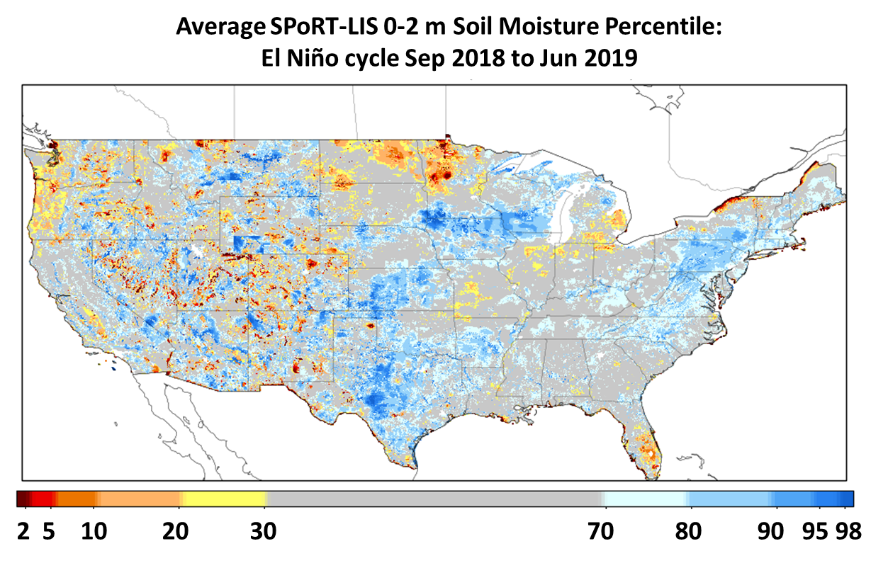
Applications: Historic Soil Moisture Percentiles
Examine mean soil moisture percentiles during El Niño and La Niña episodes
Most recent La Niña and El Niño periods shown at right using SPoRT-LIS daily percentiles, averaged between mid-points of months experiencing at least 0.5° C anomaly in Ocean Niño Index (ONI)
Notes:
Conversely during the most recent El Nino of 2018-2019, much of the central and eastern U.S. experienced soils that were wetter than normal.

Slide 39
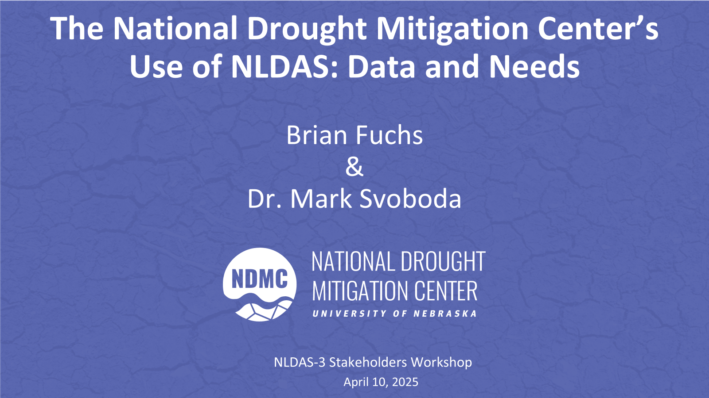

Slide 40
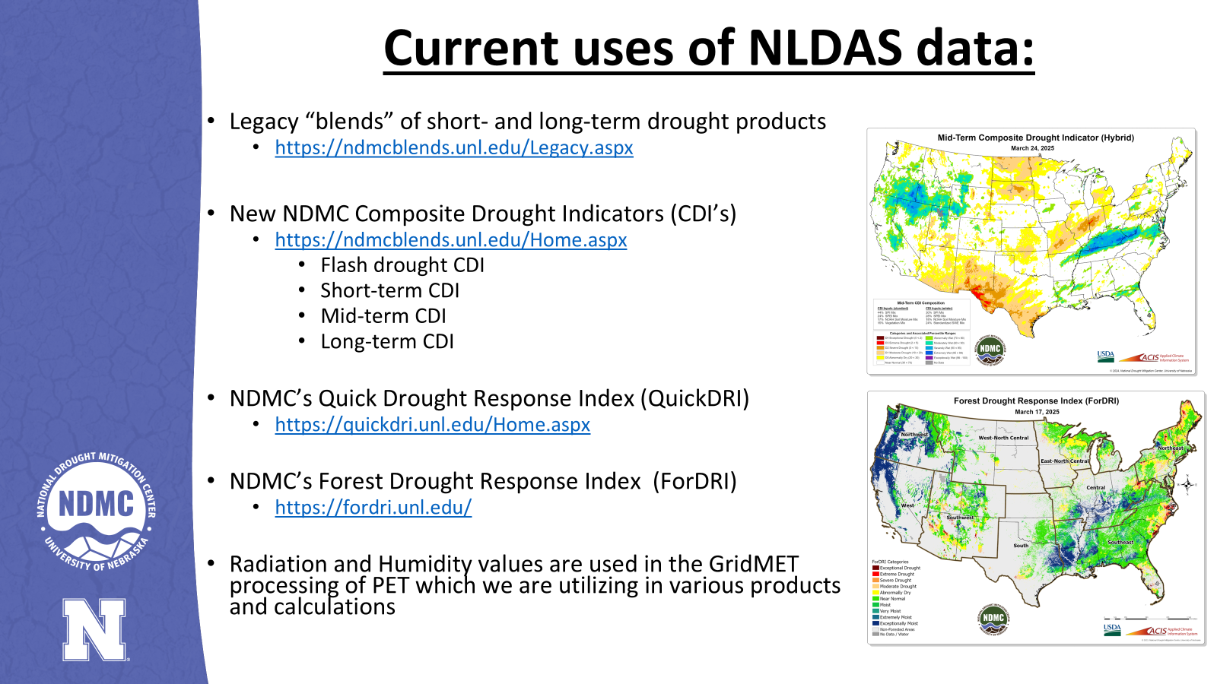

Slide 41
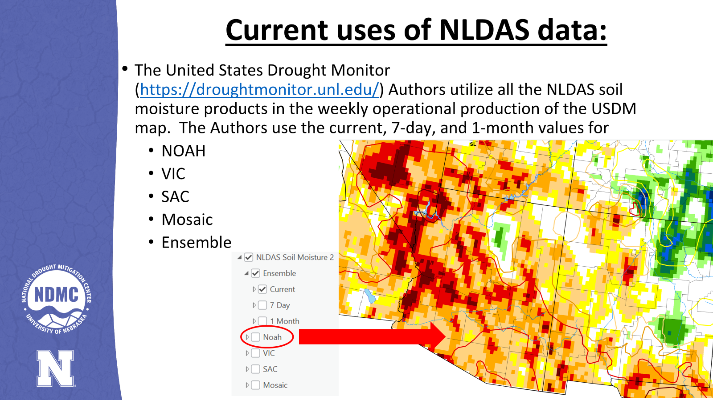

Slide 42
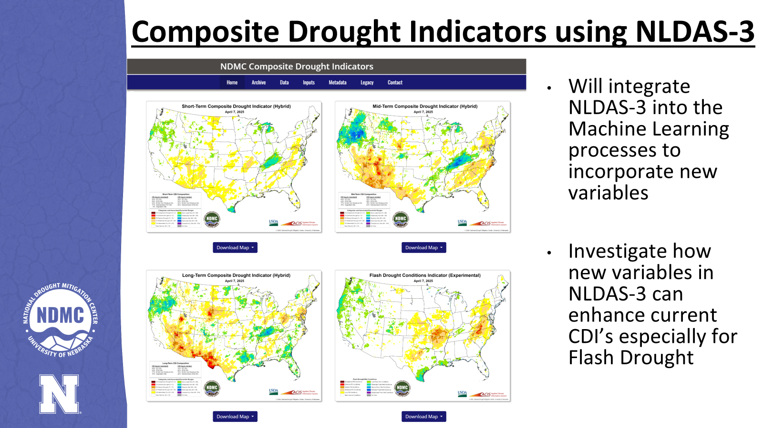

Slide 43
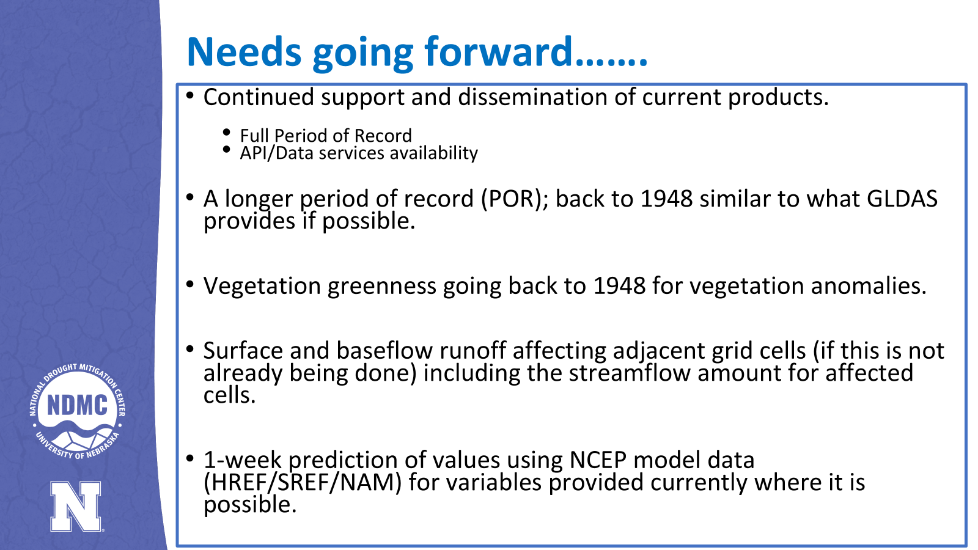

Slide 44
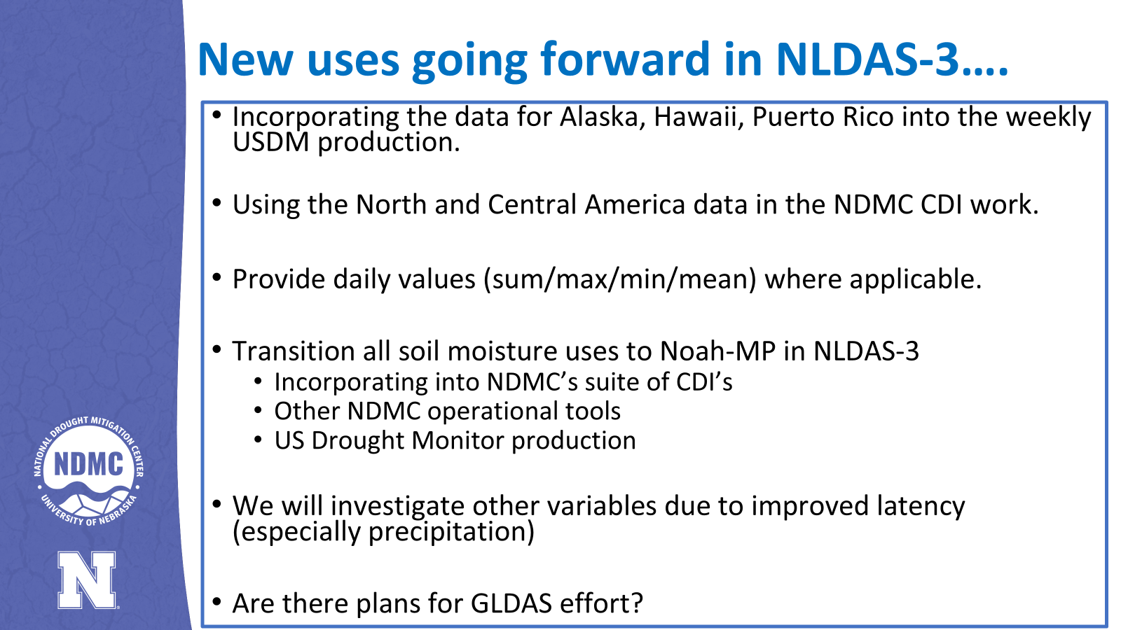

Slide 45

Using NLDAS drivers in drought monitoring:
the Evaporative Demand Drought Index (EDDI)
Mike Hobbins
University of Colorado-Cooperative Institute for Research in Environmental Sciences
(at NOAA-Physical Sciences Laboratory)
NLDAS-3 Drought Monitoring Workshop, April 10, 2025

Slide 46
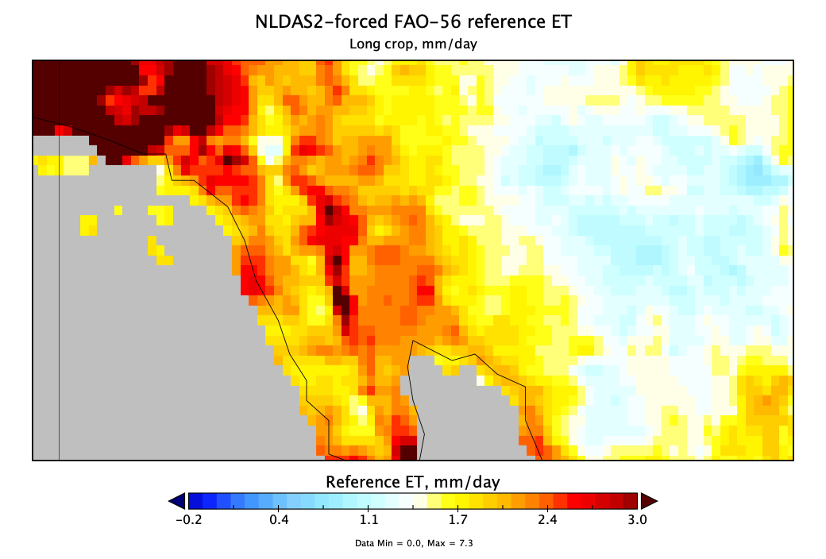
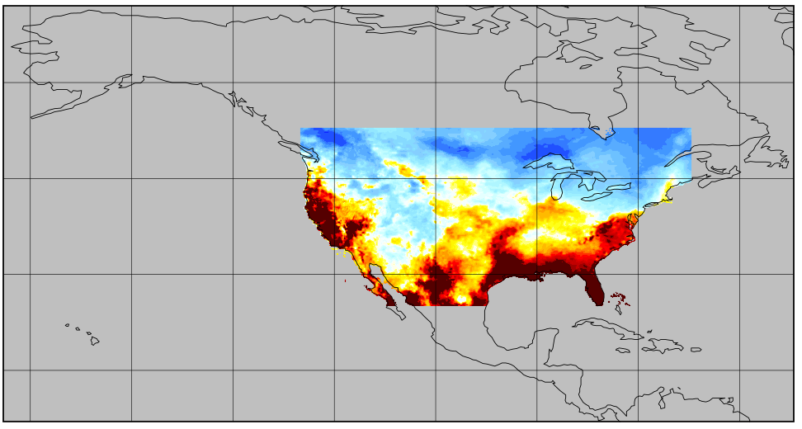


ET₀: NLDAS-3 vs. NLDAS-2
NLDAS-2
NLDAS-3
12-km resolution
224 lat * 464 long
~100k cells
Hourly drivers: 40.7 MB / day
ET₀: 1.8 MB / day
1979 - present
1-km resolution
6500 lat * 11700 lon
732 x NLDAS-2
Hourly drivers: 12.58 GB / day
ET₀: 0.304 GB / day
2000 - present
~1.5 GB / day for drivers & ET₀
after trimming variables
& converting hourly to daily
13.7 TB for 25 years of data

