Slide 1
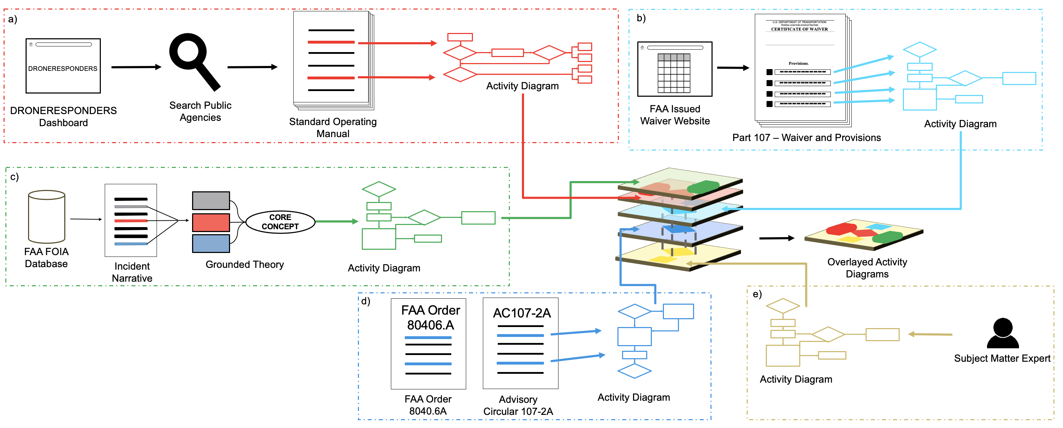
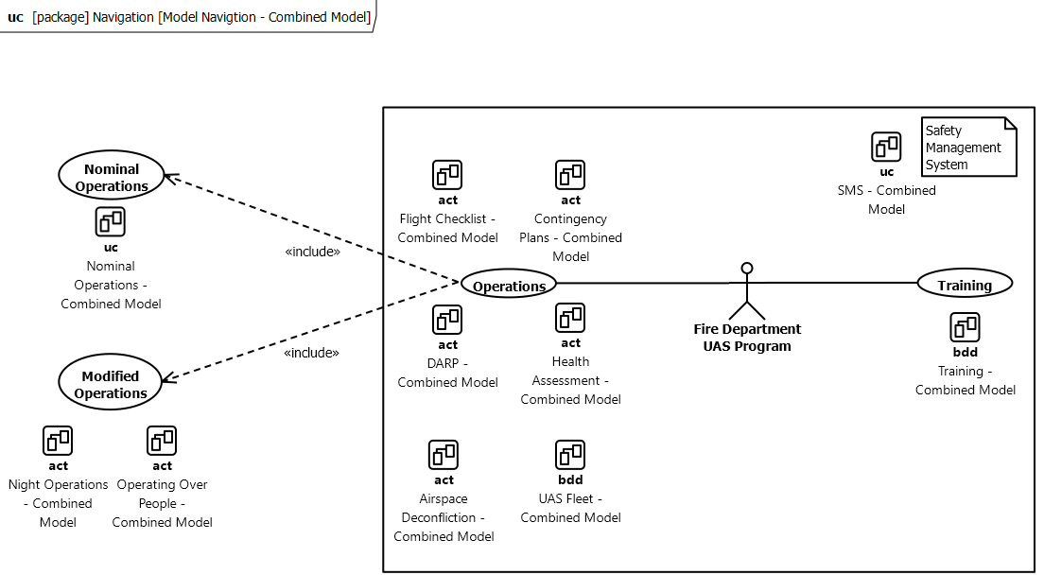
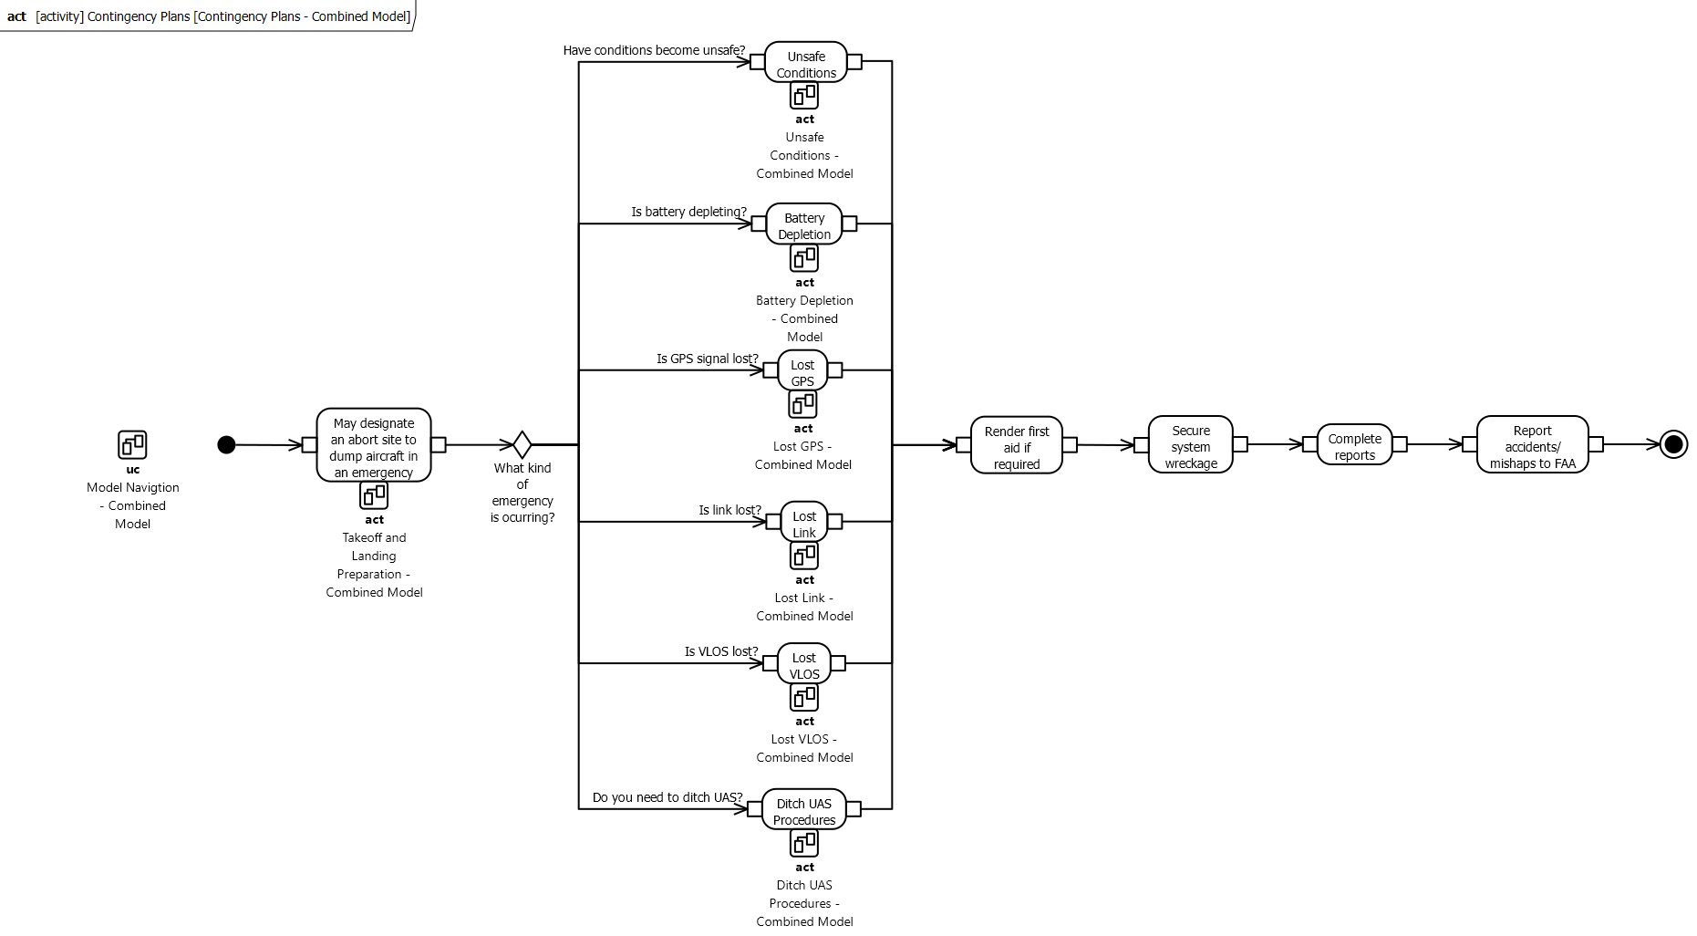
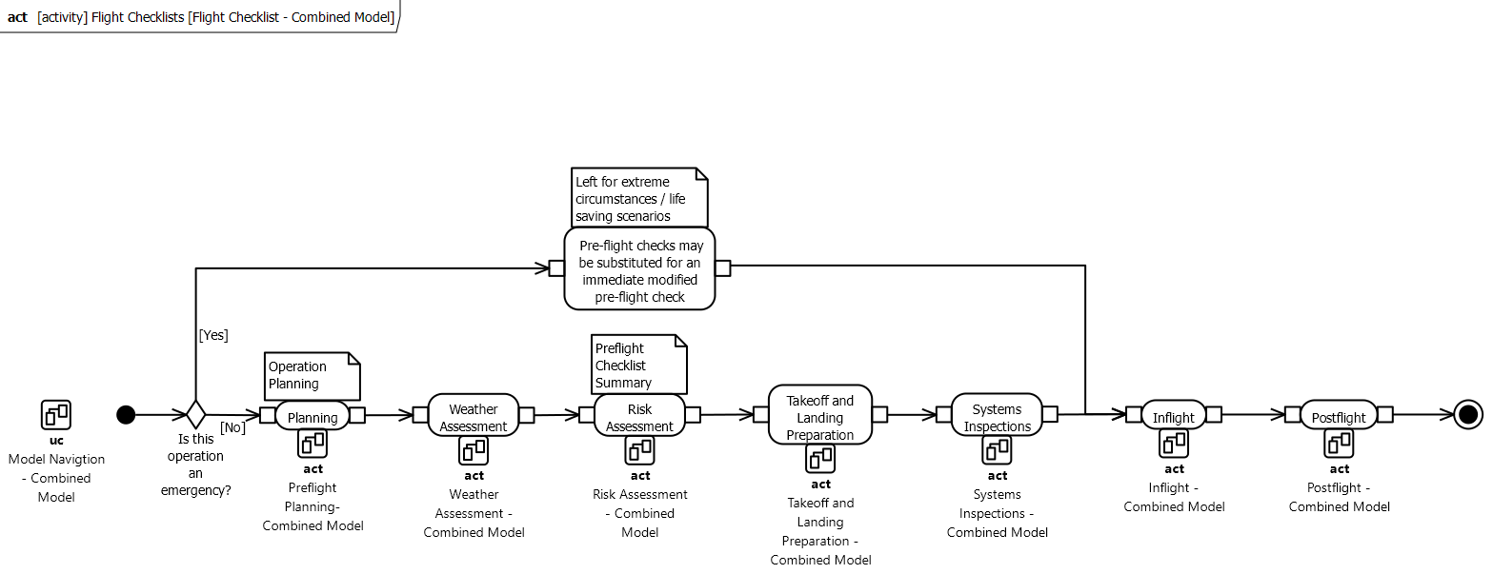
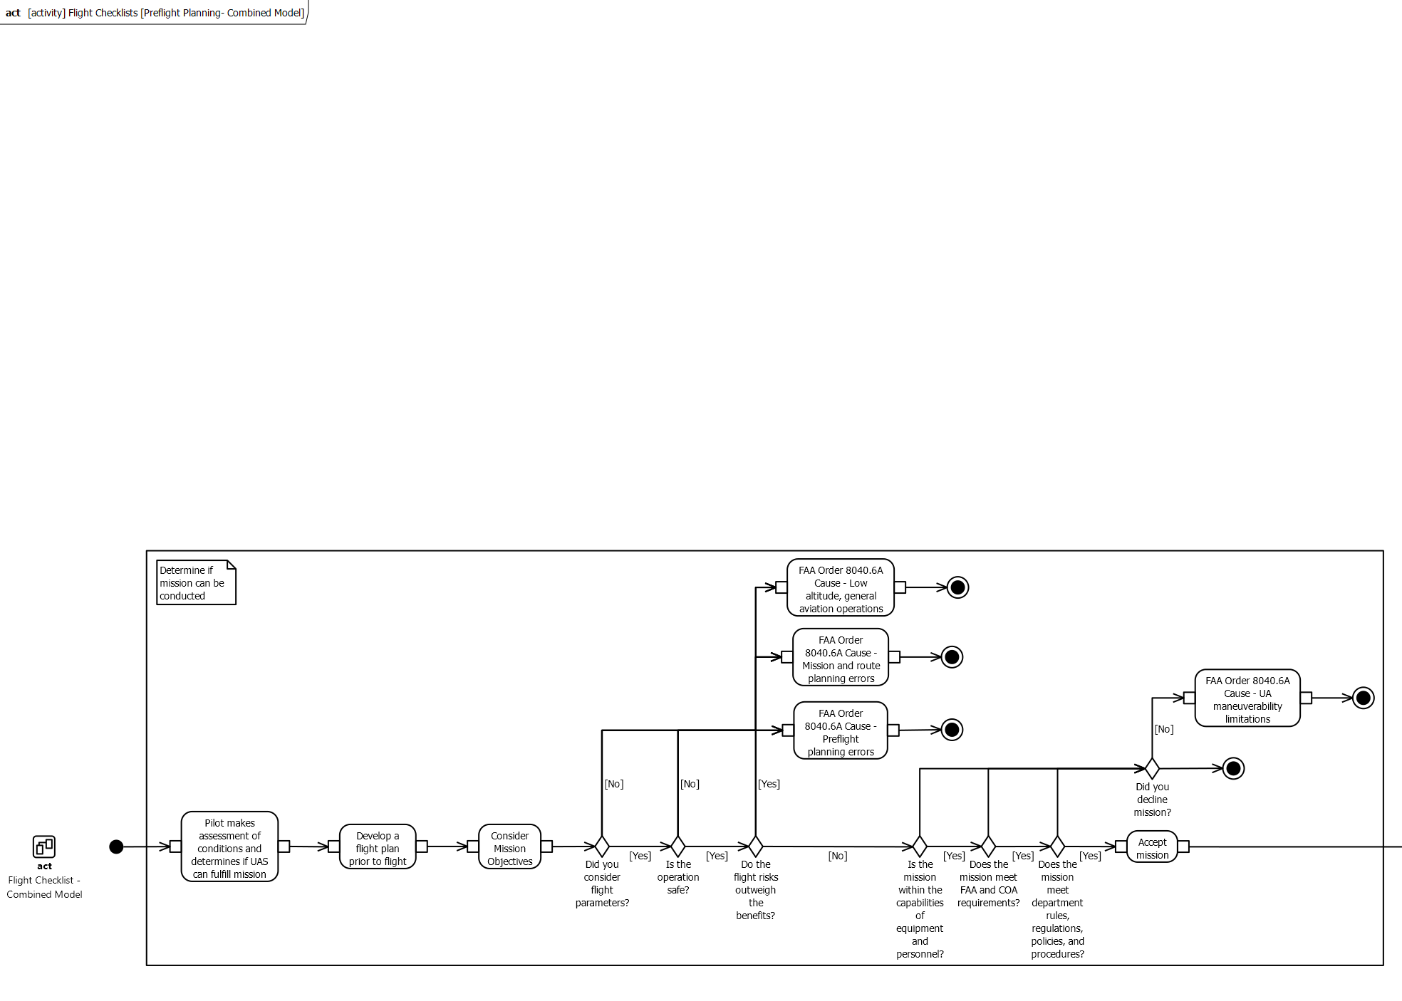
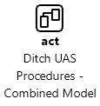
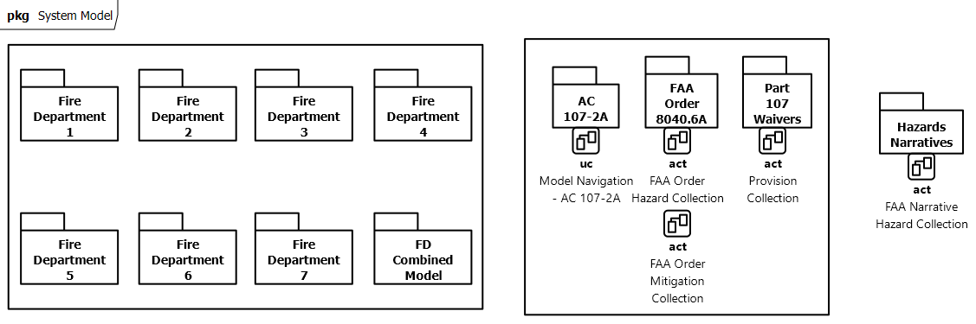
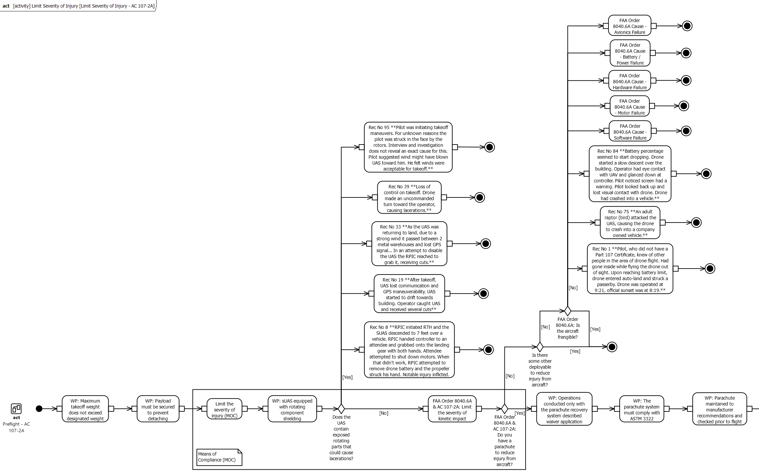





Modeling Mitigations and Hazards in UAS Emergency Response Operations
Ethan Jordan
University of
North Dakota
Carlos Paradis
KBR @ NASA Ames Research Center
Misty Davies
NASA Ames Research Center
Charles Werner
DRONERESPONDERS
Becky L. Hooey
NASA Ames Research Center
Introduction
Results: Contingency Plans
Emerging aviation includes the use of small Unmanned Aerial Systems (sUAS) in novel operations. Yet, operations are not as standardized across agencies, which could benefit from lessons learned in novel scenarios. Standardization would also facilitate novel hazard assessment spread across incident databases.
Contingency plans are used to mitigate immediate hazards during operations (e.g., battery failure). Specific contingencies are in place for specific scenarios, such as Ditch Procedures. An SOP mitigation-hazard gap is exemplified on the absence of UAS safety procedures limiting the severity of accidents, which is present in AC 107-2A.
Method
UAS Standard Operating Manuals (SOP), Title 14 CFR Part 107, FAA Orders, Waiver Provisions, Hazards, and Interviews are modeled using Model Based Systems Engineering (MBSE) to display the safety architecture of UAS emergency response missions.
MODEL NAVIGATION
CONTINGENCY PLANS
FLIGHT CHECKLIST
PREFLIGHT PLANNING
DITCH PROCEDURES
LIMIT SEVERITY
Results: Flight Checklists
Fire departments use a variety of checklists for planning. We modeled these checklists in different levels of specificity. Flight checklists convey broader steps in the operation while more specific models such as preflight planning are conveyed separately for mitigation-hazard gap analysis.
Contact: carlos.v.paradis@nasa.gov

