Slide 1


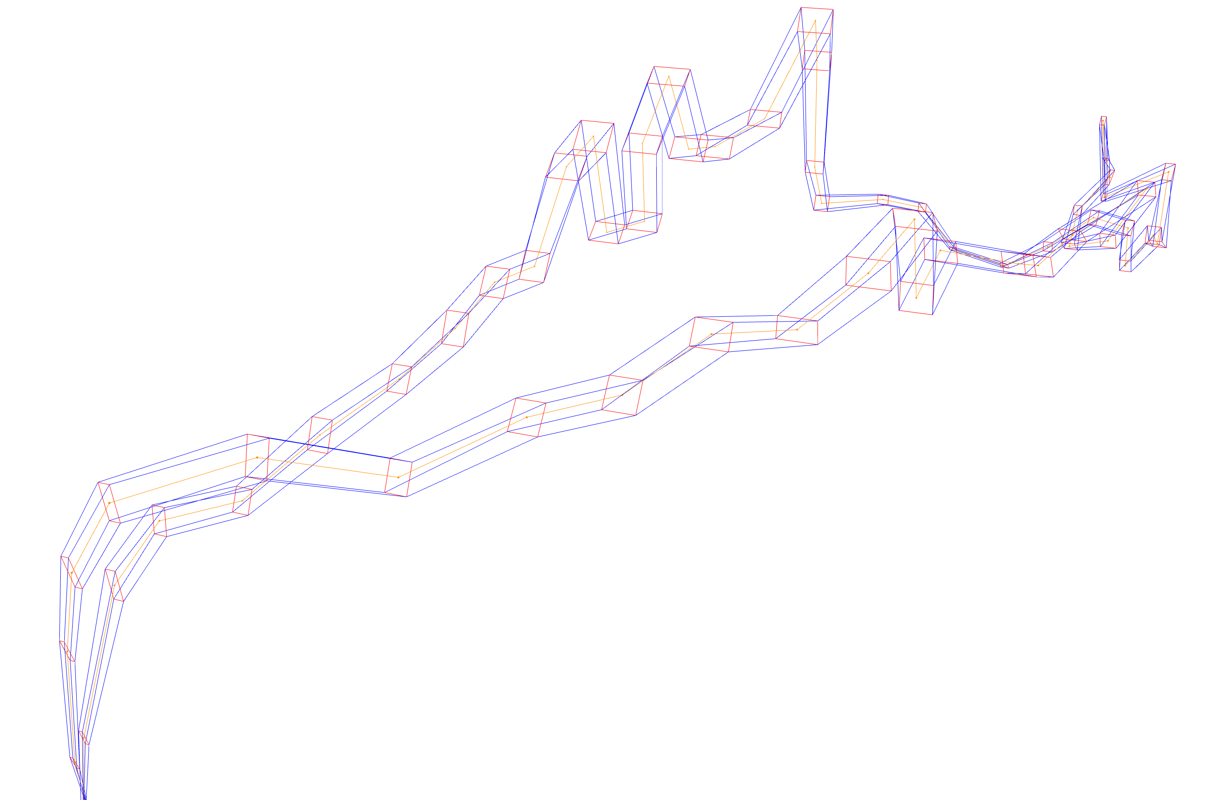



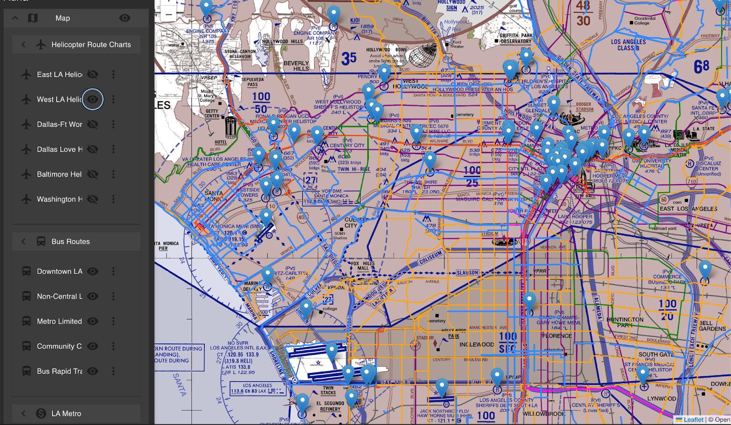
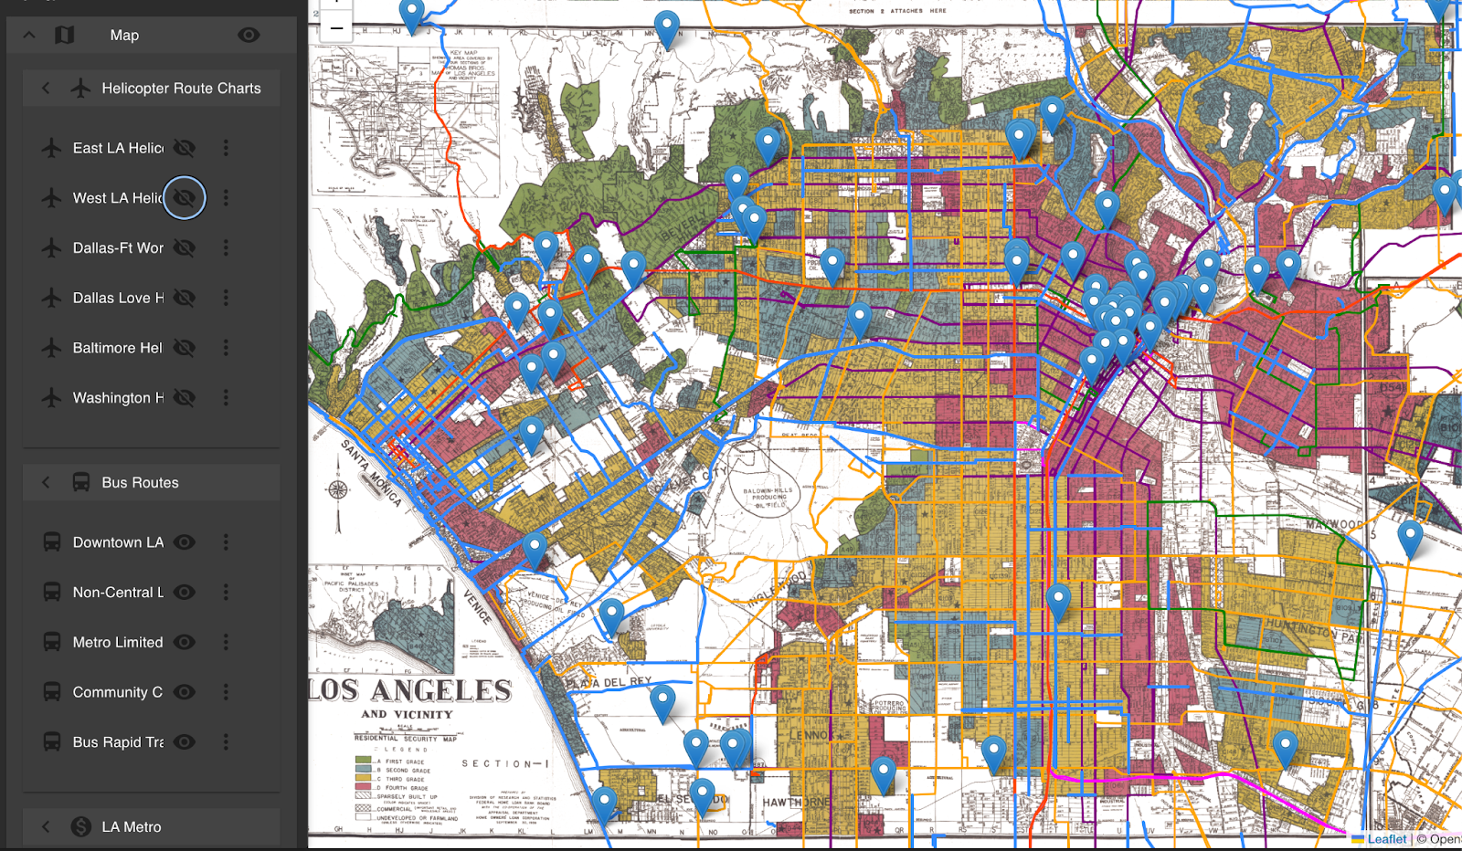

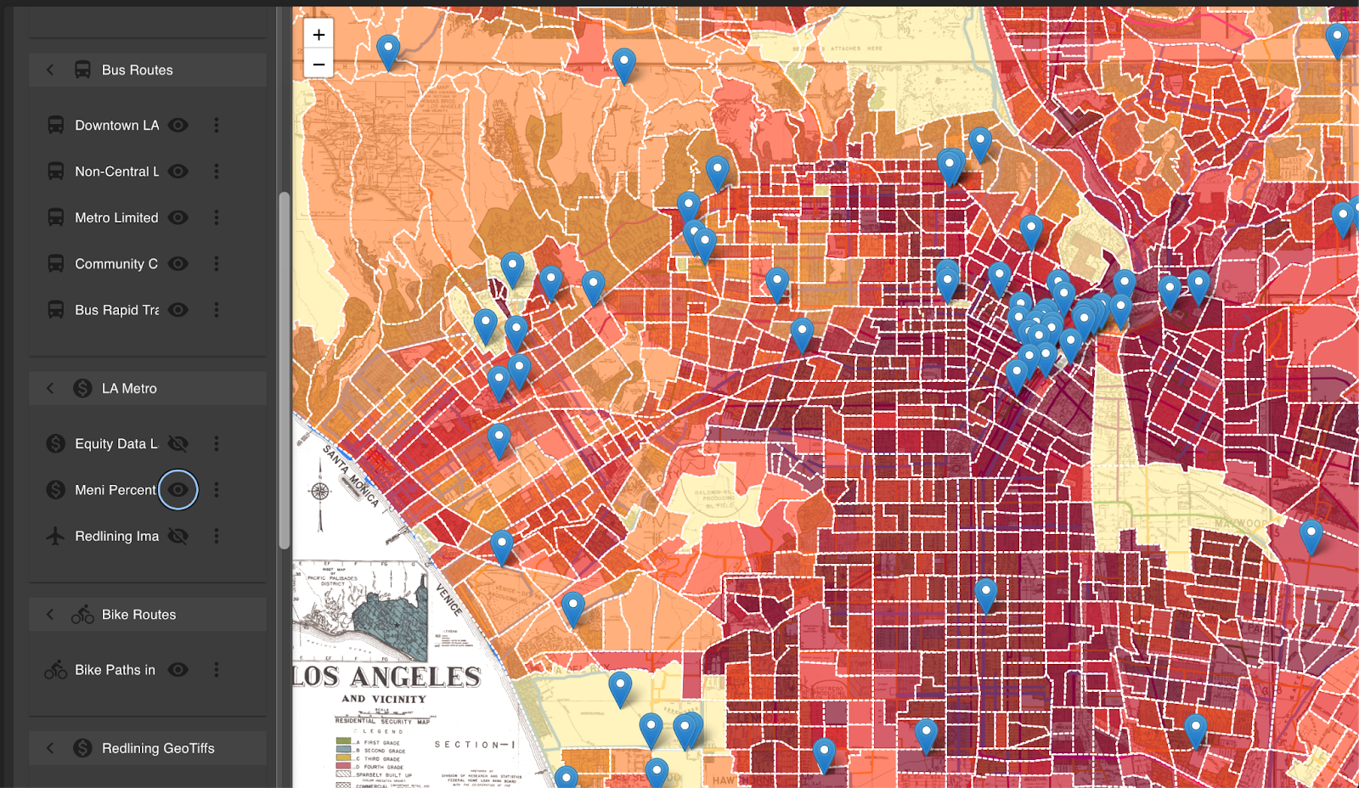

Identifying, Simulating and Visualizing Highways in the Sky
Vedant Malhotra
University of Nevada Reno
Leah Yanagisawa
University of Hawaii Manoa
Kiana Partovi
University of Nevada Reno
Carlos Paradis
KBR @ NASA Ames Research Center
Misty Davies
NASA Ames Research Center
Introduction
Method
Increasing traffic congestion and advances in Urban Air Mobility led to new aerial modes of transportation opportunities.
Flight Zone
Flight Zone
c
d
e
f
flight levels
UAM Station
(Departure)
UAM Station
(Destination)
uam
b
uam
t=1
t=2
1. Sherlock Warehouse
2. Trackpoints
3. Trajectories
4. Convert coordinates (lat,lon) to cartesian (y,x)
a
4
uam
flight access node
uam
flight access node
UAM station
3
UAM station
3
t=3
t=4
car, uam
car, uam
The emergence of Urban Air Mobility, however, introduces new aviation safety hazards due to increased airspace congestion.
2
ground access node
2
ground access node
7.1 Euclidian Distance
Road
Road
car
car
5. Cartesian Trajectories
6. Trajectory Normalization
1
conventional road node
1
conventional road node
car
car
7.2. Dynamic Time Warp
8.Trajectory Clusters
t=1
t=2
9. Selected Cluster
t=3
t=4
To increase safety in urban air mobility operations, concept of operations propose the use of corridors.
(a) UAM Corridor Detection
(b) Simulation Physical Representation
(c) MatSIM Network Model
(d) Trajectory Visualization and Replay
(a) To aid in defining geometry and candidate location of urban air mobility corridors and vertiports, we cluster existing air traffic in congested areas to identify corridors.
(b) Both the identified corridor air traffic (rotorcrafts) and surrounding ground traffic (car, public transportation) are considered as part of two simulation scenarios: (b.1) with and (b.2) without the presence of urban air mobility (corridor) and its associated vertiports.
(c) The trajectories and ground traffic are discretized as a geo-referenced network, where additional link attributes of the roads and the corridor such as capacity and speed are mapped to the network links so simulated traffic congestion can be measured with and without the presence of urban air mobility in a given region of interest.
(d) Both the identified and simulated trajectories can be “replayed”, one at a time, to identify how closely the trajectories reconstruct the full corridor. This can be used for manual inspection of trajectory overlap.
References
Auna
Acknowledgements
1. Rothfeld, Raoul Leander. "Agent-based Modelling and Simulation of Urban Air Mobility Operation." PhD diss., Ph. D. thesis, Technische Universität München, 2021.
2. Rothfeld, Raoul, Milos Balac, Kay O. Ploetner, and Constantinos Antoniou. "Agent-based simulation of urban air mobility." In 2018 Modeling and Simulation Technologies Conference, p. 3891. 2018.
3. Rothfeld, Raoul, Mengying Fu, Miloš Balać, and Constantinos Antoniou. "Potential urban air mobility travel time savings: An exploratory analysis of munich, paris, and san francisco." Sustainability 13, no. 4 (2021): 2217.
4. Balac, Milos, and Sebastian Hörl. "Synthetic population for the state of California based on open-data: examples of San Francisco Bay area and San Diego County." In 100th Annual Meeting of the Transportation Research Board (TRB). 2021.
5. Paradis, Carlos, and Misty D. Davies. "Visualizing Corridors in Terminal Airspace using Trajectory Clustering." In 2022 IEEE/AIAA 41st Digital Avionics Systems Conference (DASC), pp. 1-9. IEEE, 2022.
6. Eshow, Michelle M., Max Lui, and Shubha Ranjan. "Architecture and capabilities of a data warehouse for ATM research." In 2014 IEEE/AIAA 33rd Digital Avionics Systems Conference (DASC), pp. 1E3-1. IEEE, 2014.
The capability to identify, simulate and replay existing corridors is part of a larger ecosystem of tools to better understand emerging modes of transportation, defined in the tool, Auna. Further references can be found in NTRS:
Interpretability and Geometry of Trajectory Corridors: https://ntrs.nasa.gov/citations/20240009440
Auna: A Geospatial System for Assessing Multimodal Mobility: https://ntrs.nasa.gov/citations/20240016154
Contact: carlos.v.paradis@nasa.gov

