Slide 1


www.xplosafe.com
Flow-Through and Closed-Loop Recirculating Swing Beds for Carbon Dioxide Adsorbent Evaluation Within a Rapid Cycle Amine System
John R. Tidwell, Ph.D., Nicholas F. Materer, Ph.D., Hanna R. Anderson, Michael L. Teicheira, Shoaib Shaikh
54th International Conference on Environmental Systems
Prague, Czech Republic
July 13th-17th, 2025
XploSafe LLC – 712 Eastgate Street, Stillwater, OK 74074
Phone: (405) 334-5720; info@xplosafe.com
This manuscript has been authored by the employees of XploSafe LLC under Contract/Grant No. 80NSSC23CA167 and 80NSSC22PB246 with the National Aeronautics and Space Administration. The United States Government has a nonexclusive, irrevocable, worldwide license to prepare derivative works, publish or reproduce this manuscript for publication acknowledges that the United States Government retains such a license in any published form of this manuscript. All other rights are retained by the copyright owner. Trade names are used in this presentation for identification only. Their usage does not constitute an official endorsement, either expressed or implied, by the National Aeronautics and Space Administration.

Slide 2
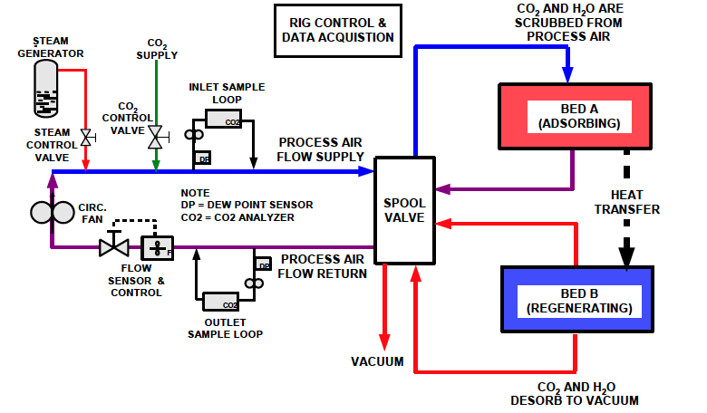
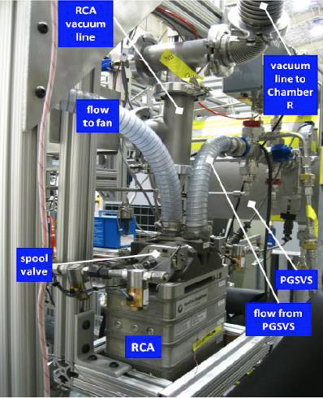
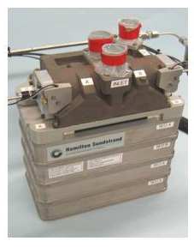
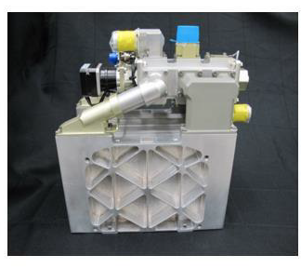
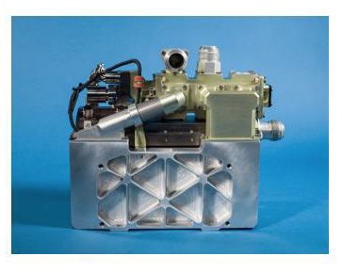
Rapid Cycle Amine Swing Bed Testing
Fundamental technologies within the Portable Life Support System (PLSS)
O₂ supply
CO₂ removal
humidity control
pressure regulation
Requirements for Testing
Functional material
Capability of screening sub-scale
xEMU simulating test rig
Parameters and/or test articles to simulate
RCA 1.0 Prototype Testing Schematic
RCA 1.0 Installed into PLSS 1.0
RCA 1.0
RCA 2.0
RCA 3.0
Conger, B., Mcmillin, S., “In Design and Development Comparison of Rapid Cycle Amine 1.0, 2.0, and 3.0,” 46th International Conference on Environmental Systems. 2016.; Sturtz, R., Conger, B. and Chullen, C., “Rapid Cycle Amine Testing History, ” 49th International Conference on Environmental Systems, 2019.; Chullen, C., Campbell, C., Papale, W., Hawes, K. and Wichowski, R., “Rapid Cycle Amine 3.0 System Development,” 45th International Conference on Environmental Systems, 2015.

Slide 3
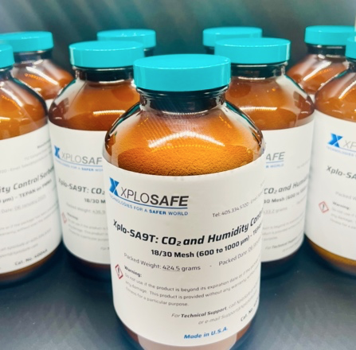
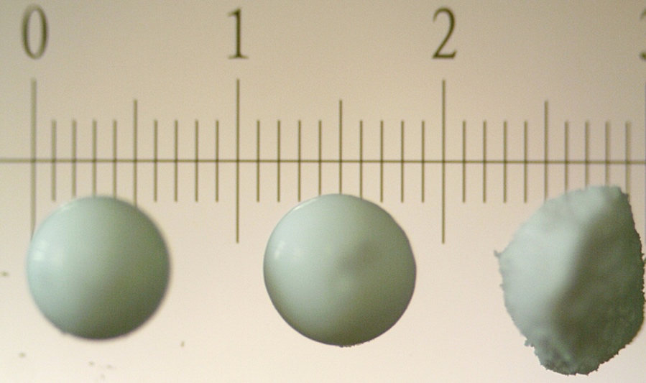
Foundational Research and Material Development
Multi-kilogram bottled Xplo-SA9T
TEPAN
MMPA
Soda Lime
Xplo-SA9T, MMPA-Sorbent, Soda Lime
1 ± 0.01 mm scale
Active CO₂ Adsorbing Component(s)
Tidwell, J. R., Materer, N. F., Kadossov, E. B., Anderson, H. R., Brown, Z. A., Teicheira, M. L., Shaikh, S. and Apblett, A. W., “Xplo-SA9T: Optimization of Sorbent Technology With Existing and New Amine Variants for Carbon Dioxide Removal and Humidity Control, ”
53rd International Conference on Environmental Systems, 2024.

Slide 4
Foundational Research and Material Development
Previous Results Using Thermal Desorption Tube CO₂ Adsorption/Desorption Screening
Tidwell, J. R., Materer, N. F., Kadossov, E. B., Anderson, H. R., Brown, Z. A., Teicheira, M. L., Shaikh, S. and Apblett, A. W., “Xplo-SA9T: Optimization of Sorbent Technology With Existing and New Amine Variants for Carbon Dioxide Removal and Humidity Control, ”
53rd International Conference on Environmental Systems, 2024.

Slide 5
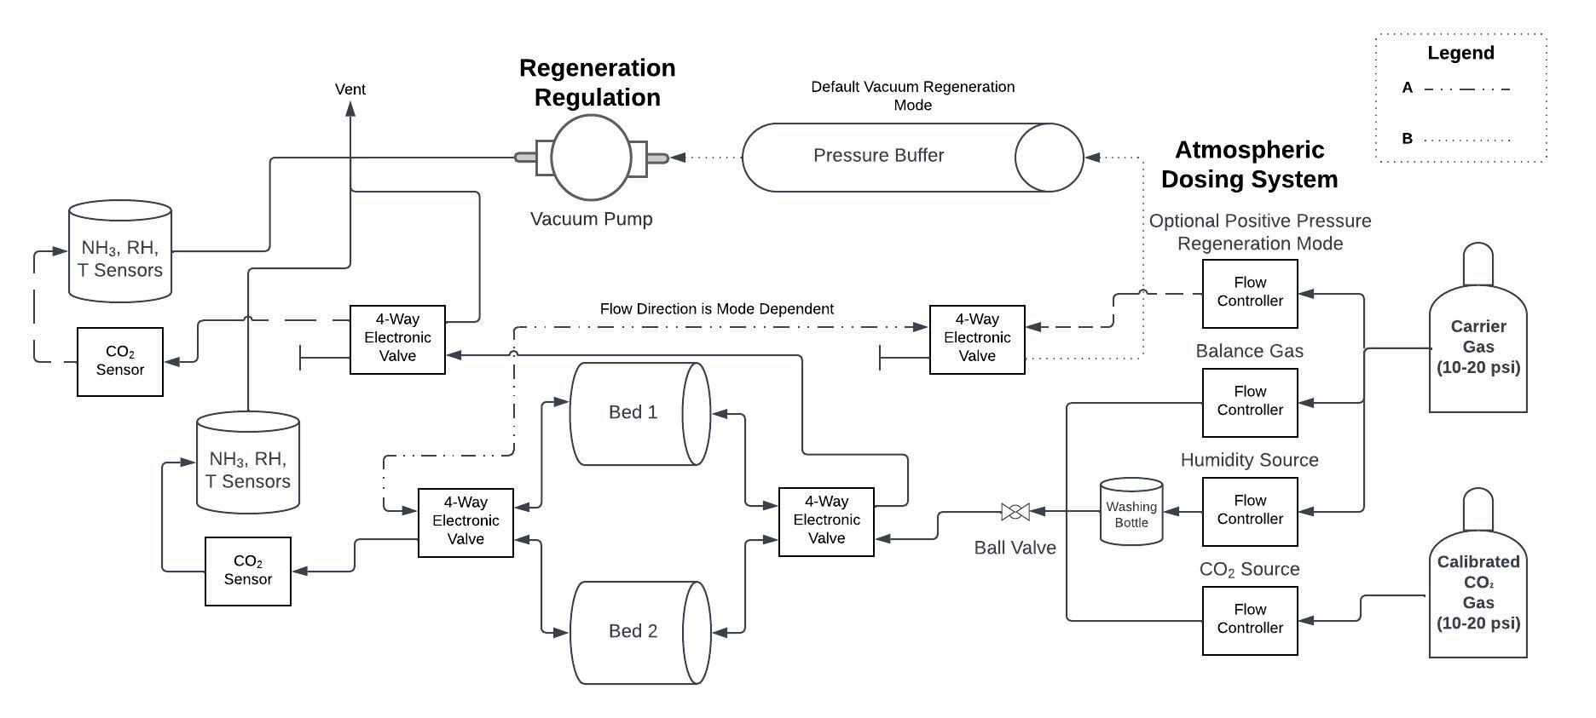
Flow-Through Swing Bed and Sub-Scale Test Rig Schematic

Slide 6
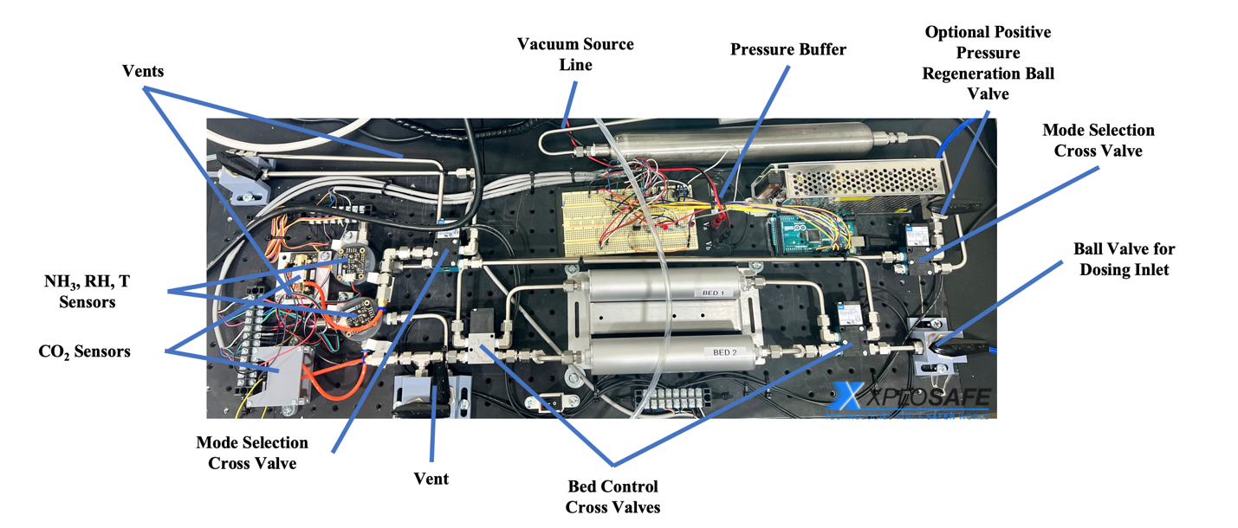
Sub-Scale Flow-Through Test Rig
Notable Capabilities: Adjustable Parameters:
high-throughput testing
~128 mL beds
vacuum or positive pressure regeneration modes
regeneration outlet sensing in positive pressure regeneration mode
calibrated dosing system
sensors: temperature, humidity, NH₃ concentration, CO₂ concentration
flow rate
mass of sorbent
CO₂ dosing rate
humidity
half-cycle timing
regeneration pressure
regeneration mode
logging time intervals

Slide 7
8-hour EVA Simulation Results Utilizing the Sub-Scale Test Rig
Key Takeaway Points:
comparison between two materials: Xplo-SA9T and MMPA-Sorbent
bed volume held constant between materials
dosing parameters remain constant
both materials remove humidity, Xplo-SA9T is more efficient
both materials result in CO₂ steady states, MMPA-Sorbent is more efficient
Xplo-SA9T lasts ~ 140 minutes before any rise toward CO₂ steady state
MMPA-Sorbent lasts ~200 minutes before any rise toward CO₂ steady state

Slide 8
8-hour EVA Simulation Results Utilizing the Sub-Scale Test Rig
Key Takeaway Points:
soda lime is non-regenerable
dosing parameters remain constant to previous two materials
soda lime requires humidity for adequate CO₂ removal
soda lime lasts ~180 minutes before any breakthrough then plateaus at dosing concentration
bed volume held constant between materials
Overall Utility:
this test rig is capable of screening material regardless of particle size, regenerability, or humidity requirement and can be used with any Swagelok capable bed

Slide 9
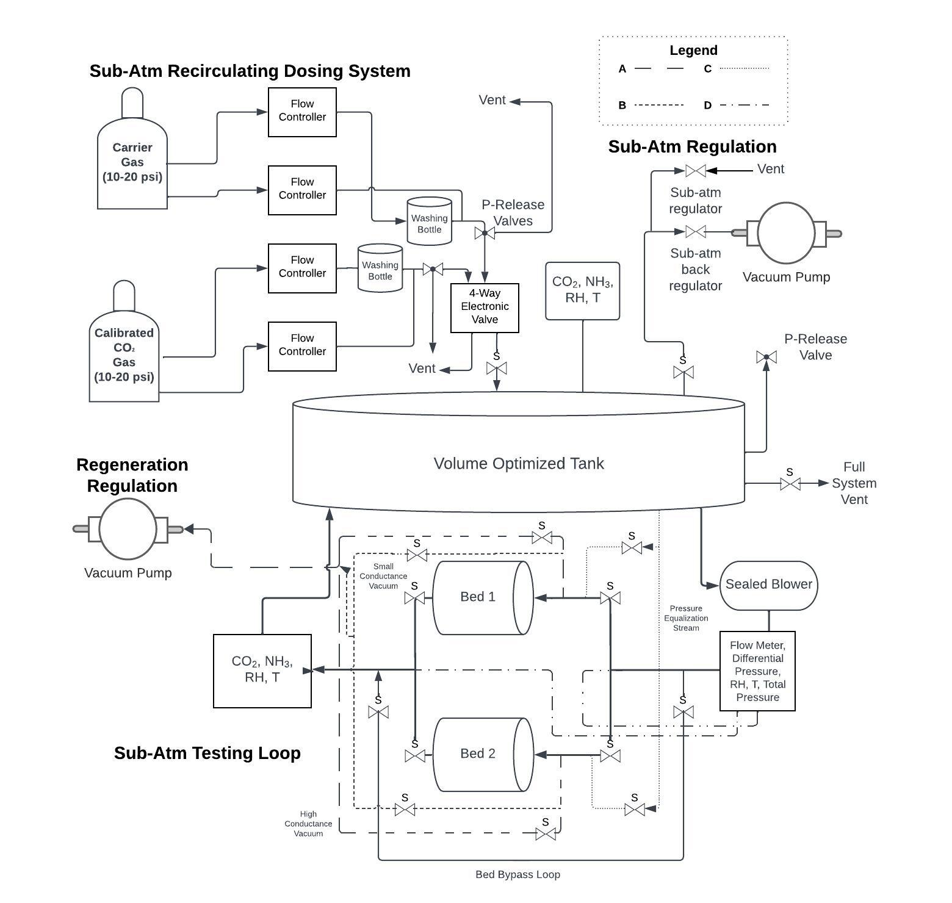
Closed-Loop Swing Bed and RCA-Scale Test Rig Schematic

Slide 10
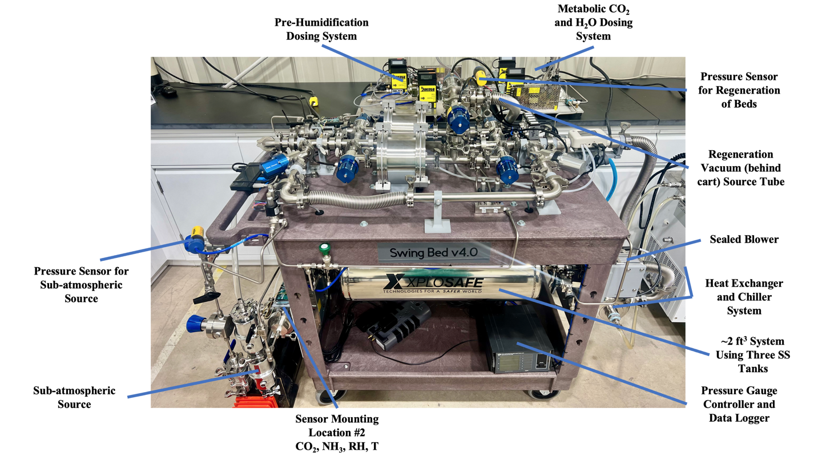
Front View of the RCA-Scale Test Rig

Slide 11
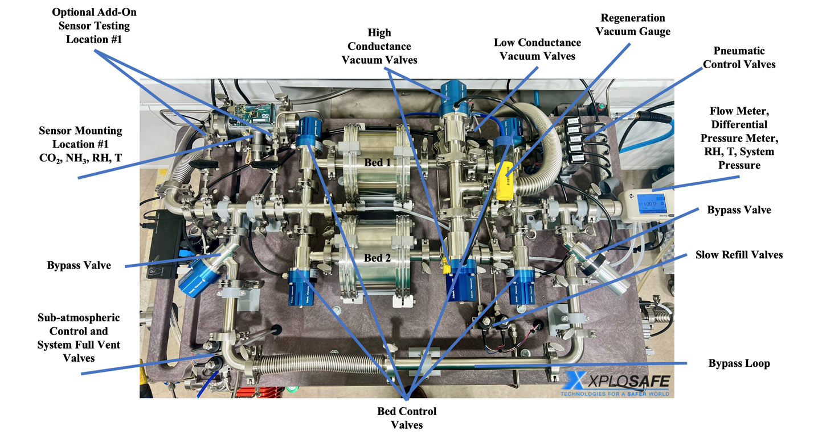
Top View of the RCA-Scale Test Rig

Slide 12
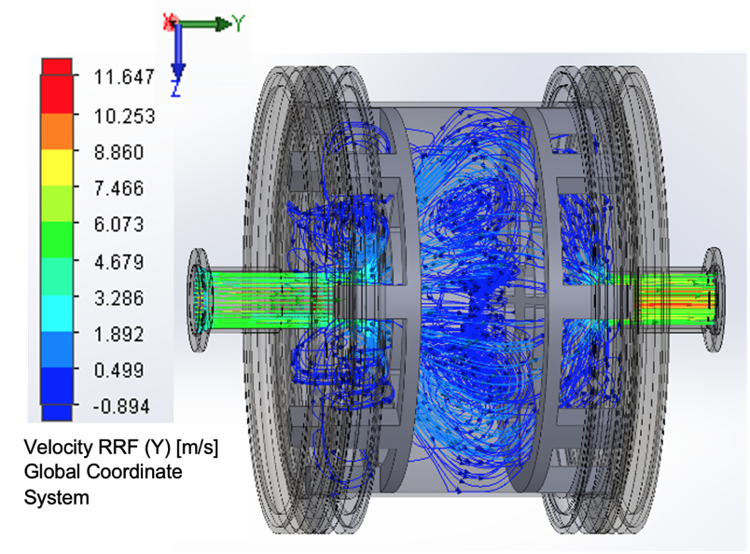
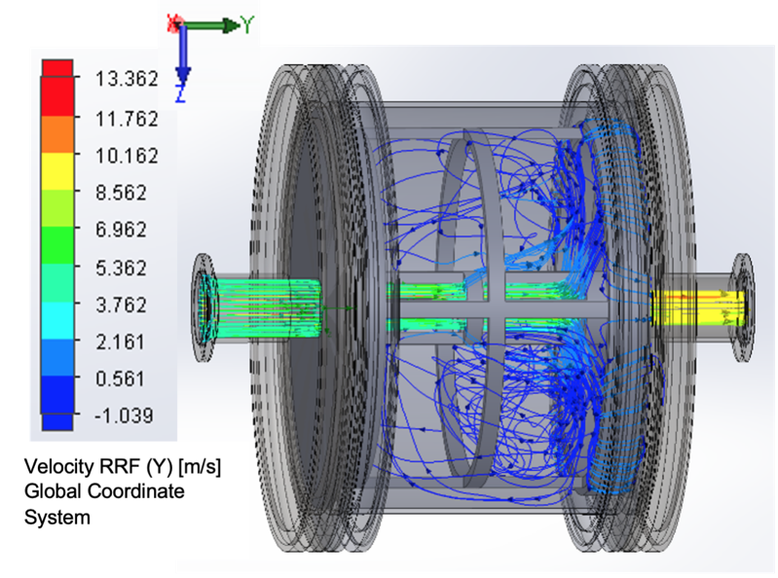
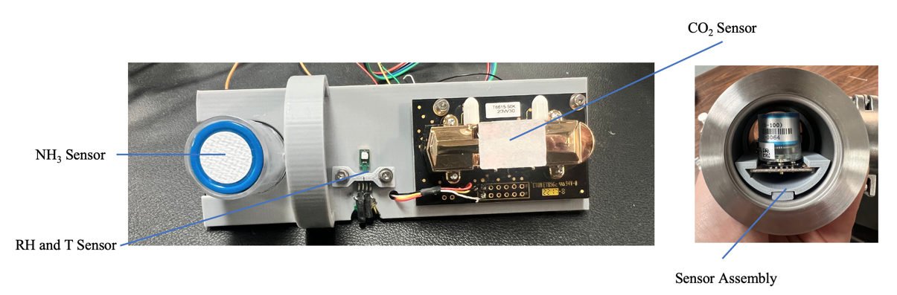
Closed-Loop Swing Bed Capabilities and Design Considerations
Notable Capabilities:
adjustable pressures including sub-atmospheric
up to ~1992 mL internal volume
RCA-prototype testing capable with KF-25 adapters
adjustable metabolic profile dosing
adjustable flow rates including 6 acfm
~2 ft³ internal volume simulating spacesuit
adjustable vacuum regeneration pressure and conductivity
adjustable half-cycle timing
adjustable logging time intervals
short and long duration EVA capable e.g. > 25 hours
Sensing:
bed inlet: relative humidity, temperature, flow rate, pressure
bed outlet: relative humidity, temperature, NH₃ and CO₂ concentration
across bed inlet to bed outlet is a differential pressure measurement
simulated helmet inlet: relative humidity, temperature, NH₃ and CO₂ concentration
vacuum in high conductance line and sub-atmospheric control line
blower speed and temperature
ability to test alternate sensors at bed outlet and simulated helmet inlet
chosen flow-cell setup below does not leak even down to 30 torr
Flow simulation using traditional bed spacers.
Flow simulation using removable internal cartridge with outward flow to potentially increase residence time.

Slide 13
8-hour EVA Simulation Results Utilizing the RCA-Scale Test Rig

Slide 14
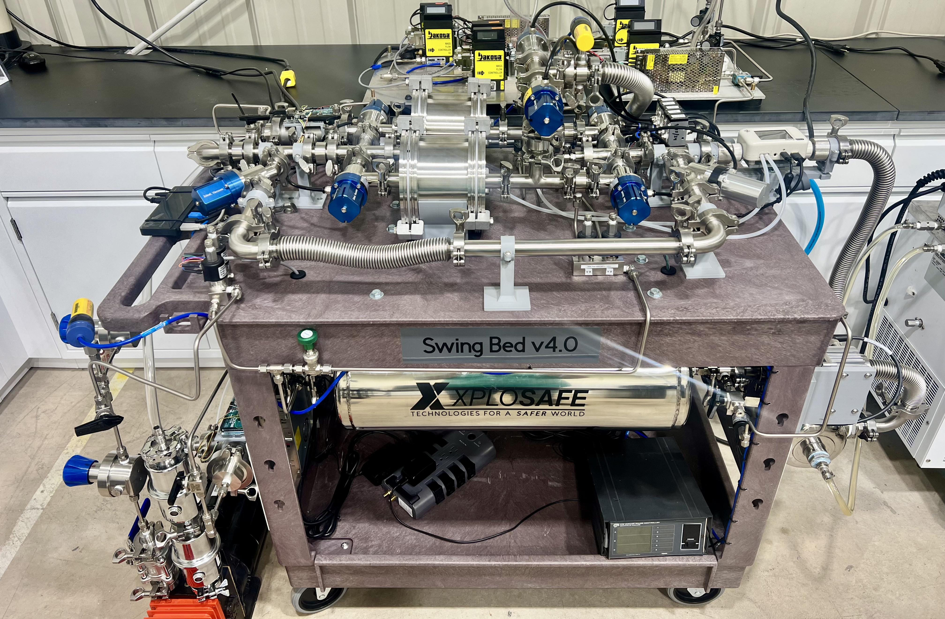
Conclusions and Future Work
RCA-Scale Swing Bed Test Rig
Sub-Scale swing bed affords high-throughput testing, vacuum and positive pressure regeneration
RCA-Scale swing bed simulates realistic xEMU conditions and can test prototypes of various designs
Xplo-SA9T and MMPA-Sorbent are regenerable adsorbents that were compared directly to soda lime
Xplo-SA9T was tested at the RCA-Scale and proved viable at 4.3 psia, 6 acfm, and a metabolic dosing rate of 1650 BTU/h.
Future work will include multiple metabolic profile tests, residence time testing, temperature screening, and potentially thermally linking the beds
Summary of RCA-Scale Experiments
Experimentally Tracked Conditions | Timed Half-Cycle | Timed Half-Cycle | Goal | Units
Half-Cycle Timing | 1 | 0.5 | - | minutes
Adsorbent Bed Volume | 948 | 948 | 715－1050 | mL
Pressure Drop Across Material | 2.57 ± 0.06 | 2.04 ± 0.06 | ≤ 2.5 | in H₂O
Average System Pressure | 4.6 ± 0.2 | 4.2 ± 0.2 | 4.3 | psia
Average Flow Rate | 5.9 ± 0.1 | 6.0 ± 0.1 | 6 | acfm
Ammonia Maximum at Bed Output | 0 ± 1 | 0 ± 1 | 0 | ppm
Ammonia Maximum at Helmet Inlet | 0 ± 1 | 0 ± 1 | 0 | ppm
Average Carbon Dioxide Concentration | 3.9 ± 0.4 | 2.4 ± 0.2 | 3 | mmHg
Maximum Carbon Dioxide Spike Concentration | 4.5 ± 0.5 | 2.9 ± 0.3 | 3 | mmHg
Conger, B., Mcmillin, S., “In Design and Development Comparison of Rapid Cycle Amine 1.0, 2.0, and 3.0,” 46th International Conference on Environmental Systems. 2016.; Sturtz, R., Conger, B. and Chullen, C., “Rapid Cycle Amine Testing History, ” 49th International Conference on Environmental Systems, 2019..

Slide 15

Acknowledgements
54th International Conference on Environmental Systems and attendees
The authors would like to acknowledge the contributions of Cinda Chullen, Lawrence Barrett, and all other NASA JSC employees who have provided wisdom, guidance, and funding for this work.
Financial support for the project was provided by the NASA SBIR program under Contracts No. 80NSSC23CA167 and 80NSSC22PB246.

Slide 16
Questions?
Thank You
XploSafe LLC
712 Eastgate Street
Stillwater, OK 74074
(405) 334-5720
www.xplosafe.com
John R. Tidwell, Ph.D.
johnt@xplosafe.com

