Slide 1
Impact of Real Gas Properties on Multiphysics Modeling of an NTP Fuel Element
ANS Annual Conference 2025
ANSTD Technical Session
Corey D. Smith (Nuclear Engineering Lead)
Supported by: Jacob Stonehill
June 16th, 2025

Slide 2
Acknowledgements
This work was supported by NASA’s Space Technology Mission Directorate (STMD) through the Space Nuclear Propulsion (SNP) Project
Contract No. 80LARC23DA003

Slide 3
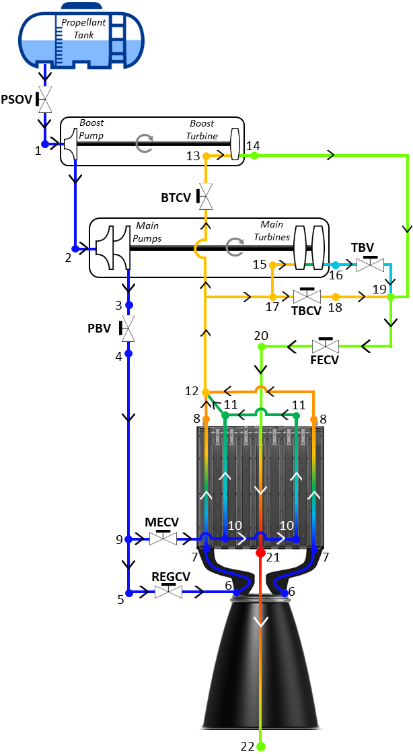
Importance of NTP Modeling and Simulation
Modeling and simulation (M&S) drives NTP technology maturation and risk reduction activities.
Nuclear thermal and electric propulsion (NTP / NEP) systems allow for shorter mission and trip time to minimize exposure to cosmic radiation and zero gravity
  NTP: High Power Density (5 – 10 MW/L) / Short Burn Time (~minutes)
  NEP: Low Power Density (0.05 – 0.2 MW/L) / Long Burn Time (~years)
NTP is a monopropellant rocket design:
  Combination of cryogenic propellant tanks, turbopumps, a nuclear reactor, and a converging / diverging nozzle to optimize thrust
  Specific impulse enhancement over chemical rockets due to low molecular weight of propellant (i.e., Hydrogen)
Engine performance is measured by three primary parameters:
  Thrust – Function of propellant flow rate
  I_{sp} – Function of temperature and propellant type
  Mass – Dependent on reactor geometry and mission class

Slide 4
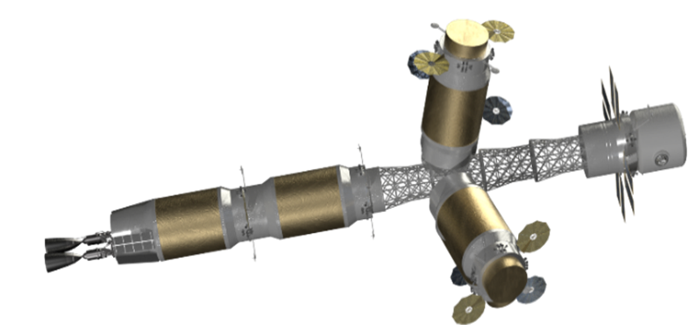
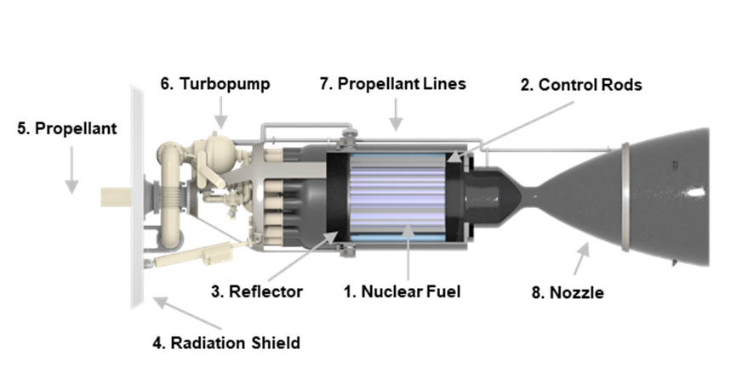
Importance of NTP Modeling and Simulation
Modeling and simulation (M&S) drives NTP technology maturation and risk reduction activities.
Technical complexities and associated cost with physical testing of NTP systems increases the need for accurate and computationally efficient M&S
  M&S utilized at all stages of technology development
  Engine designers rely on a wide range of modeling approaches
Extreme multiphysics operating environments present for NTP pose significant challenges for proper modeling
  Identify the proper balance between computational efficiency and model fidelity for the specific application
  Maintaining a consistent fluid property database across all NTP modeling efforts creates a baseline when comparing model results
Goal of this Work: Assess the M&S impacts between ideal and real gas fluid properties for the parahydrogen propellant option

Slide 5
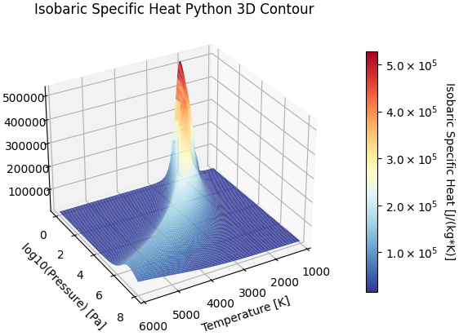
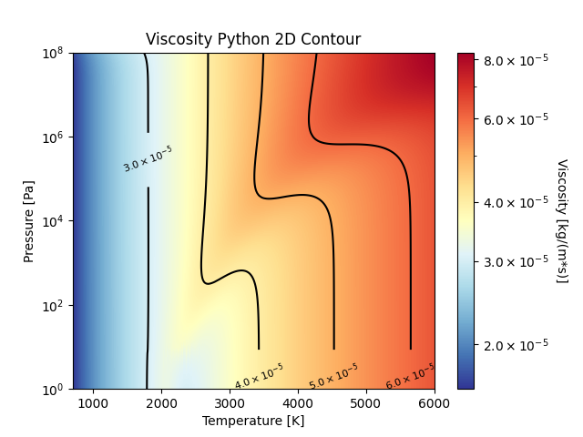
Version 05 Parahydrogen Properties Database
Hydrogen supply stored in a liquid state, so the parahydrogen nuclear spin isomer is of interest.
Assessment of the performance impact requires a comprehensive thermophysical and transport property database
  This work leverages recent parahydrogen property work that was performed by AMA and NASA’s SNP project [10, 11]
NIST’s REFPROP database only reaches 1000 K and does not account for dissociation, requiring different approaches for expected NTP conditions
  Modern efforts required the generation of a new dataset to account for dissociation effects between 700 – 6000 K
  Relies on REFPROP data for temperatures below 700K
Validated Temperature and Pressure Ranges:
  13.8 K to 6000 K
  1 Pa to 100 MPa
The validated temperature and pressure range cover any possibly observed conditions in an NTP engine cycle.

Slide 6


Inclusion of Finite Element Analysis
Multidimensional, time-dependent heat transfer provides the best prediction of solid temperatures.
Finite element software captures spatial effects that are otherwise ignored at the cost of computation time
  Requires case-specific mesh generation
  User-defined multiphysics to fit each application
This work utilizes MOOSE as the framework for higher fidelity analyses given its modular build and flexibility
  Inherently transient and allows quasi-static analysis
  Modularity improves extensibility to future work problems
Packages used in this work include:
  Thermal Hydraulics Module (THM)
  Heat Transfer Module
  Fluid Properties Module
[5-6]

Slide 7
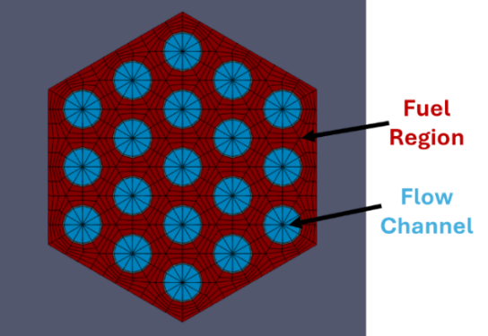
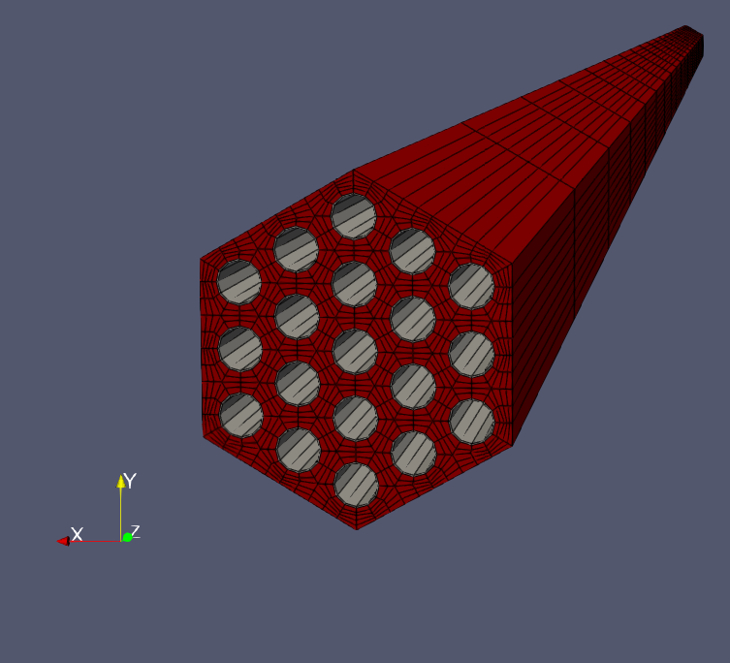
Reference Fuel Element Test Case
This work required the usage of a publicly-available NTP reactor benchmark.
The Small Nuclear Rocket Engine (SNRE) is a common NTP reactor benchmark from the end of the NERVA program
  Reactor comprised of a hexagonal fuel and tie-tube element lattice
  19 intra-elemental flow channels for gas superheating
This work leverages an example configuration from past INL research performed by Dr. Vishal Patel et. al.
  Greater similarity in element-level modeling approaches, less deviation when compared to full-core model results from SNRE
Geometry Parameter | Value | Operating Conditions | Value
Active Core Length | 89 cm | Inlet Temperature | 372.1 K
Flow Channel Radius | 0.13 cm | Pressure Drop | 360 kPa
Channel Pitch | 0.41 cm | Thermal Power | 357.49 MW
Element Flat-to-Flat | 1.91 cm | Max Fuel Temperature | 2861.85 K
[1]

Slide 8
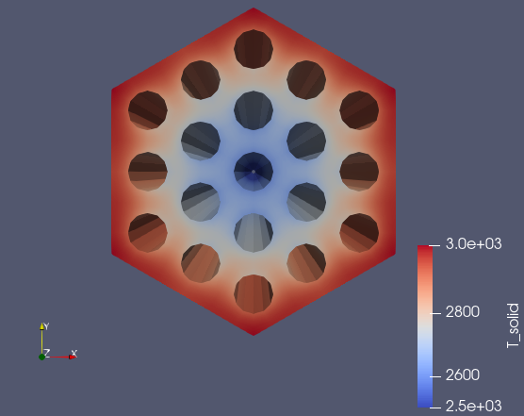
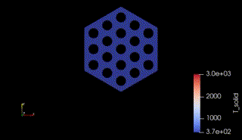
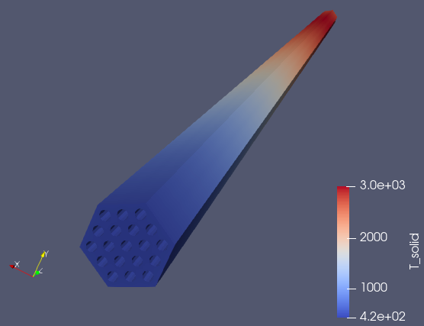
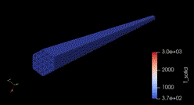


MOOSE Finite Element Modeling Results
Analysis involved investigation into both quasi-static and true transient thermal performance.
$$Steady State Full Power$$
$$True Transient Temperature Ramp$$

Slide 9
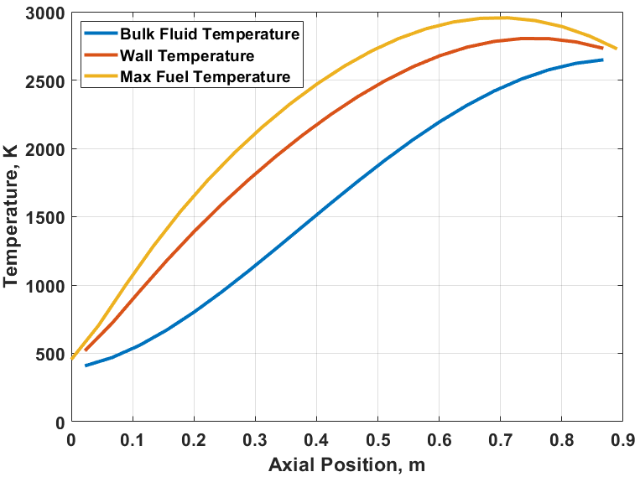
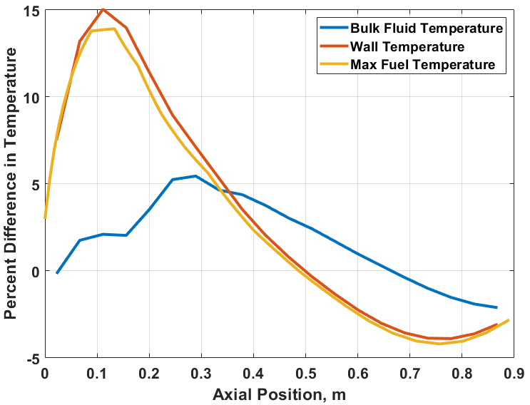
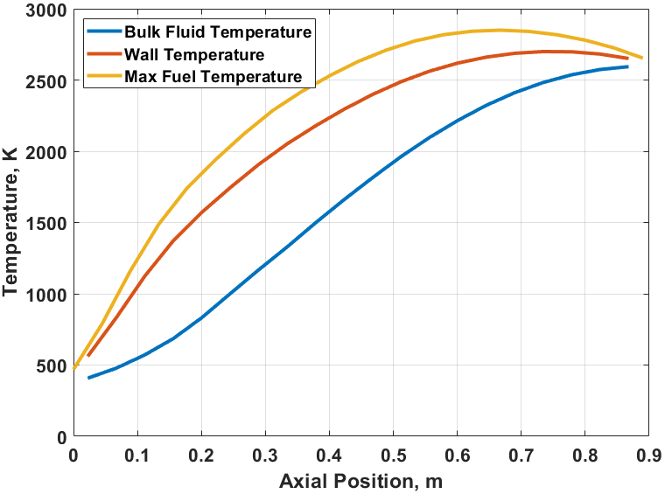



Real vs. Ideal Properties Impact on Axial Temperatures
Axial temperature distributions as well as percent differences are plotted and assessed.
$$ε=100\%∗\left(\frac{Real Gas−Ideal Gas}{Real Gas}\right)$$
$$Ideal Gas$$
$$Properties$$
$$Real Gas$$
$$Properties$$
The real gas results observe a temperature flattening in comparison to the ideal gas properties, yielding increased temperatures near the inlet and a decreased maximum fuel temperature.

Slide 10
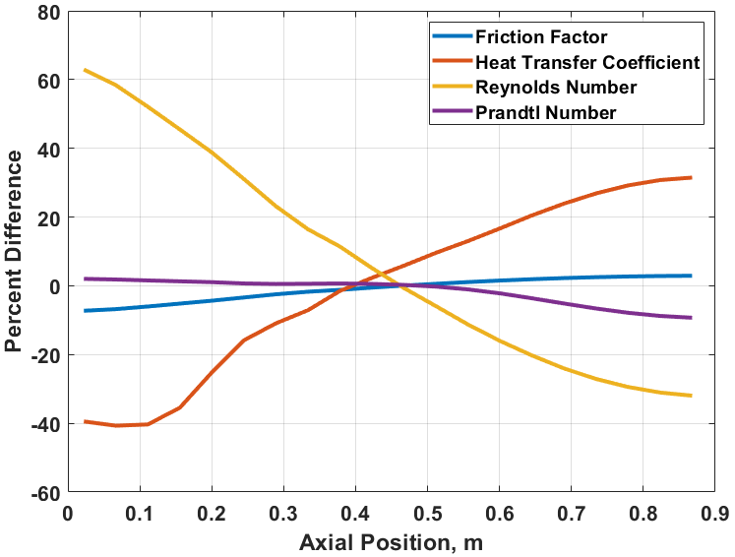

Results Summary and Takeaways
Comparison of reduced order and MOOSE quasi-static results to the MOOSE transient results.
$$ε=100\%∗\left(\frac{Real Gas−Ideal Gas}{Real Gas}\right)$$
Output Parameter | Ideal Gas Results | Real Gas Results | Difference (Percent)
Pressure Drop | 310 kPa | 330 kPa | 20 kPa (6.06%)
Max Fuel Temperature | 2955.4 K | 2849.7 K | -105.7 K (-3.71%)
Exit Velocity | 434.2 m/s | 439.6 m/s | 5.4 m/s (1.23%)
Strong variation in the axial Reynolds number impacts the calculation of the heat transfer coefficient across the axial length, leading to significant fuel temperature deviation.

Slide 11
Conclusions and Future Work
Analysis of the results of this preliminary study will impact forward work strategy and planning.
Conclusions
Modeling of NTP systems requires addressing the complex multiphysics through various approaches, each with appropriate underlying assumptions
  NTP technology maturation will require uncertainty mitigation with these assumptions to reduce operational risk
Introduction of real gas properties along with dissociation effects yield strong impacts on the calculated wall and maximum fuel temperature in the fuel element
  Fluid temperatures and channel-wise pressure losses are less impacted, but the deviation may propagate when performing transient analysis
Future Work
Assessment of the impact of real gas properties and other thermal modeling assumptions on the simulation results at the unit cell and finite reactor level
  Will include transient engine modeling to inform reactor boundary conditions through all operating modes
Study the impacts to the neutronic performance due to the variations in thermal performance using the Cardinal coupled multiphysics framework

Slide 12
References
[1] V. PATEL, M. EADES and C. R. JOYNER, "SPOC Benchmark Case: SNRE Model," Idaho National Laboratory, Idaho Falls, 2016.
[2] B. G. SCHNITZLER and S. K. BOROWSKI, "Neutronics Models and Analysis of the Small Nuclear Rocket Engine (SNRE)," in 43rd AIAA/ASME/SAE/ASEE Joint Propulsion Conference & Exhibit, Cincinnati, 2007.
[3] M. E. STEWART and B. G. SCHNITZLER, "Thermal Hydraulics and Structural Analysis of the Small Nuclear Rocket Engine (SNRE) Core," in 43rd AIAA/ASME/SAE/ASEE Joint Propulsion Conference & Exhibit, Cincinnati, 2007.
[4] J. STONEHILL, C. D. SMITH and K. B. PALOMARES, "Thermal Analysis of the Small Nuclear Rocket Engine Benchmark Case using the MOOSE Framework," in Nuclear and Emerging Technologies for Space, Idaho Falls, 2023.
[5] J. HANSEL, D. ANDRS, L. CHARLOT and G. GIUDICELLI, "The MOOSE Thermal Hydraulics Module," Journal of Open Source Software, vol. 9, no. 94, p. 6146, 2024.
[6] E. SHEMON, Y. MIAO, S. KUMAR, K. MO, Y. S. JUNG, A. OAKS, S. RICHARDS, G. GIUDICELLI, L. HARBOUR and R. STOGNER, "MOOSE Reactor Module: An Open-Source Capability for Meshing Nuclear Reactor Geometries," Nuclear Science and Engineering, vol. 197, no. 8, pp. 1656-1680, 2023.
[7] C. SMITH, J. STONEHILL, D. NIKITAEVA and M. DUCHEK, "Assessment of Reduced Order Thermal Modeling Assumptions for Nuclear Thermal Propulsion," in Nuclear and Emerging Technologies for Space, Huntsville, 2025.
[8] S. W. CHURCHILL, "Friction-Factor Equation Spans All Fluid Regimes," Journal of Chemical Engineering, vol. 84, no. 24, pp. 91-92, 1977.
[9] J. MCCARTHY and H. WOLF, "The Heat Transfer Characteristics of Gaseous Hydrogen and Helium," Rocketdyne , Canoga Park, 1960.
[10] J. P. MCDONALD, C. D. SMITH and A. D. BOYLSTON, "SNP-DOC-0046: Parahydrogen Thermophysical Properties V05 Final Report," National Aeronautics and Space Administration, 2024.
[11] C. SMITH, A. BOYLSTON and J. MCDONALD, "Parahydrogen Properties Version 05 Database Release for Nuclear Thermal Propulsion Applications," in Nuclear and Emerging Technologies for Space, Santa Fe, 2024.

Slide 13
Questions?
Corey Smith
corey.d.smith@ama-inc.com
corey.d.smith@nasa.gov

