Slide 1

www.xplosafe.com
Evaluation of Traditional and Vacuum-Regenerable Sorbents Exposed to a Multi-Gas Contaminant Mixture in the Trace Contaminant Control Unit
Evgueni B. Kadossov (presenter), Nicholas F. Materer, John R. Tidwell, Michael L. Teicheira, Shoaib Shaikh – XploSafe, Stillwater, OK
Cinda Chullen – NASA Johnson Space Center, Houston, TX
54th International Conference on Environmental Systems
Prague, Czech Republic
13−17 July 2025
XploSafe LLC – 712 Eastgate Street, Stillwater, OK, USA 74074
Phone: (405) 334-5720; info@xplosafe.com
This presentation is a joint work of employees of the National Aeronautics and Space Administration and employees of XploSafe LLC under Contract/Grant Nos. 80NSSC21C0579 and 80NSSC20C0554 with the National Aeronautics and Space Administration. The United States Government may prepare derivative works, publish or reproduce this presentation, and allow others to do so. Any publisher accepting this presentation for publication acknowledges that the United States Government retains a nonexclusive, irrevocable, worldwide license to prepare derivative works, publish or reproduce the published form of this presentation or allow others to do so for United States Government Purposes. Trade names are used in this presentation for identification only. Their usage does not constitute an official endorsement, either expressed or implied, by the National Aeronautics and Space Administration.

Slide 2
Trace Contaminant Control
Hatch Components
Trace Contaminant Control (TCC) Unit
Removes airborne contaminants
Sorbent is in a serviceable cartridge
150-hour extravehicular activity (EVA)-approved life
Hatch location allows sorbent replacement
Removes
Ammonia generated by the carbon dioxide removal sorbent and human metabolism
Toxins released during suit outgassing
Harmful gases generated by the astronauts themselves
NASA has identified 18 compounds that require mitigation.
A TCC test bed mimicking the sub-atmospheric environment within the Exploration Portable Life Support System (xPLSS) has been constructed for testing vacuum-regenerable and non-regenerable TCC sorbents.
Figures From: Todd, K., Hostetler, J., Espinosa, N., and Chullen, C., “Exploration Portable Life Support System Hatch Component Design Challenges and Progress,” ICES-2020-519, 2020.

Slide 3
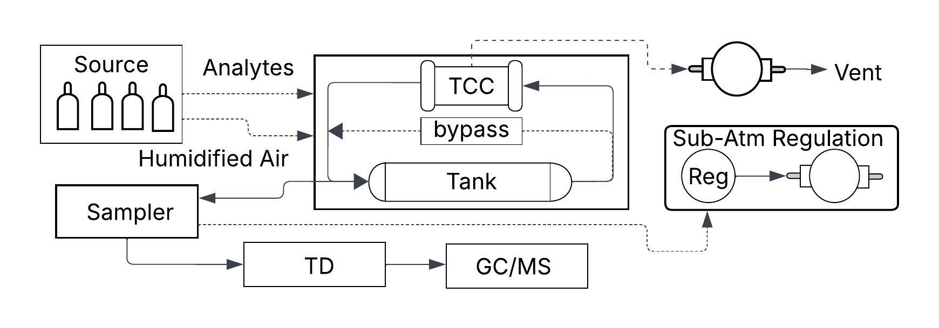
Block Diagram of the TCC Test Bed
The TCC test bed system includes four main subsystems:
Sub-atmospheric recirculation loop similar to the xEMU (Extravehicular Mobility Unit)
Dosing system to supply humidified air and required trace contaminant concentrations
Autosampler that periodically collects 50 mL samples of the gas stream
Regeneration subsystem that facilitates pressure swings from 4 psia to <1 Torr

Slide 4
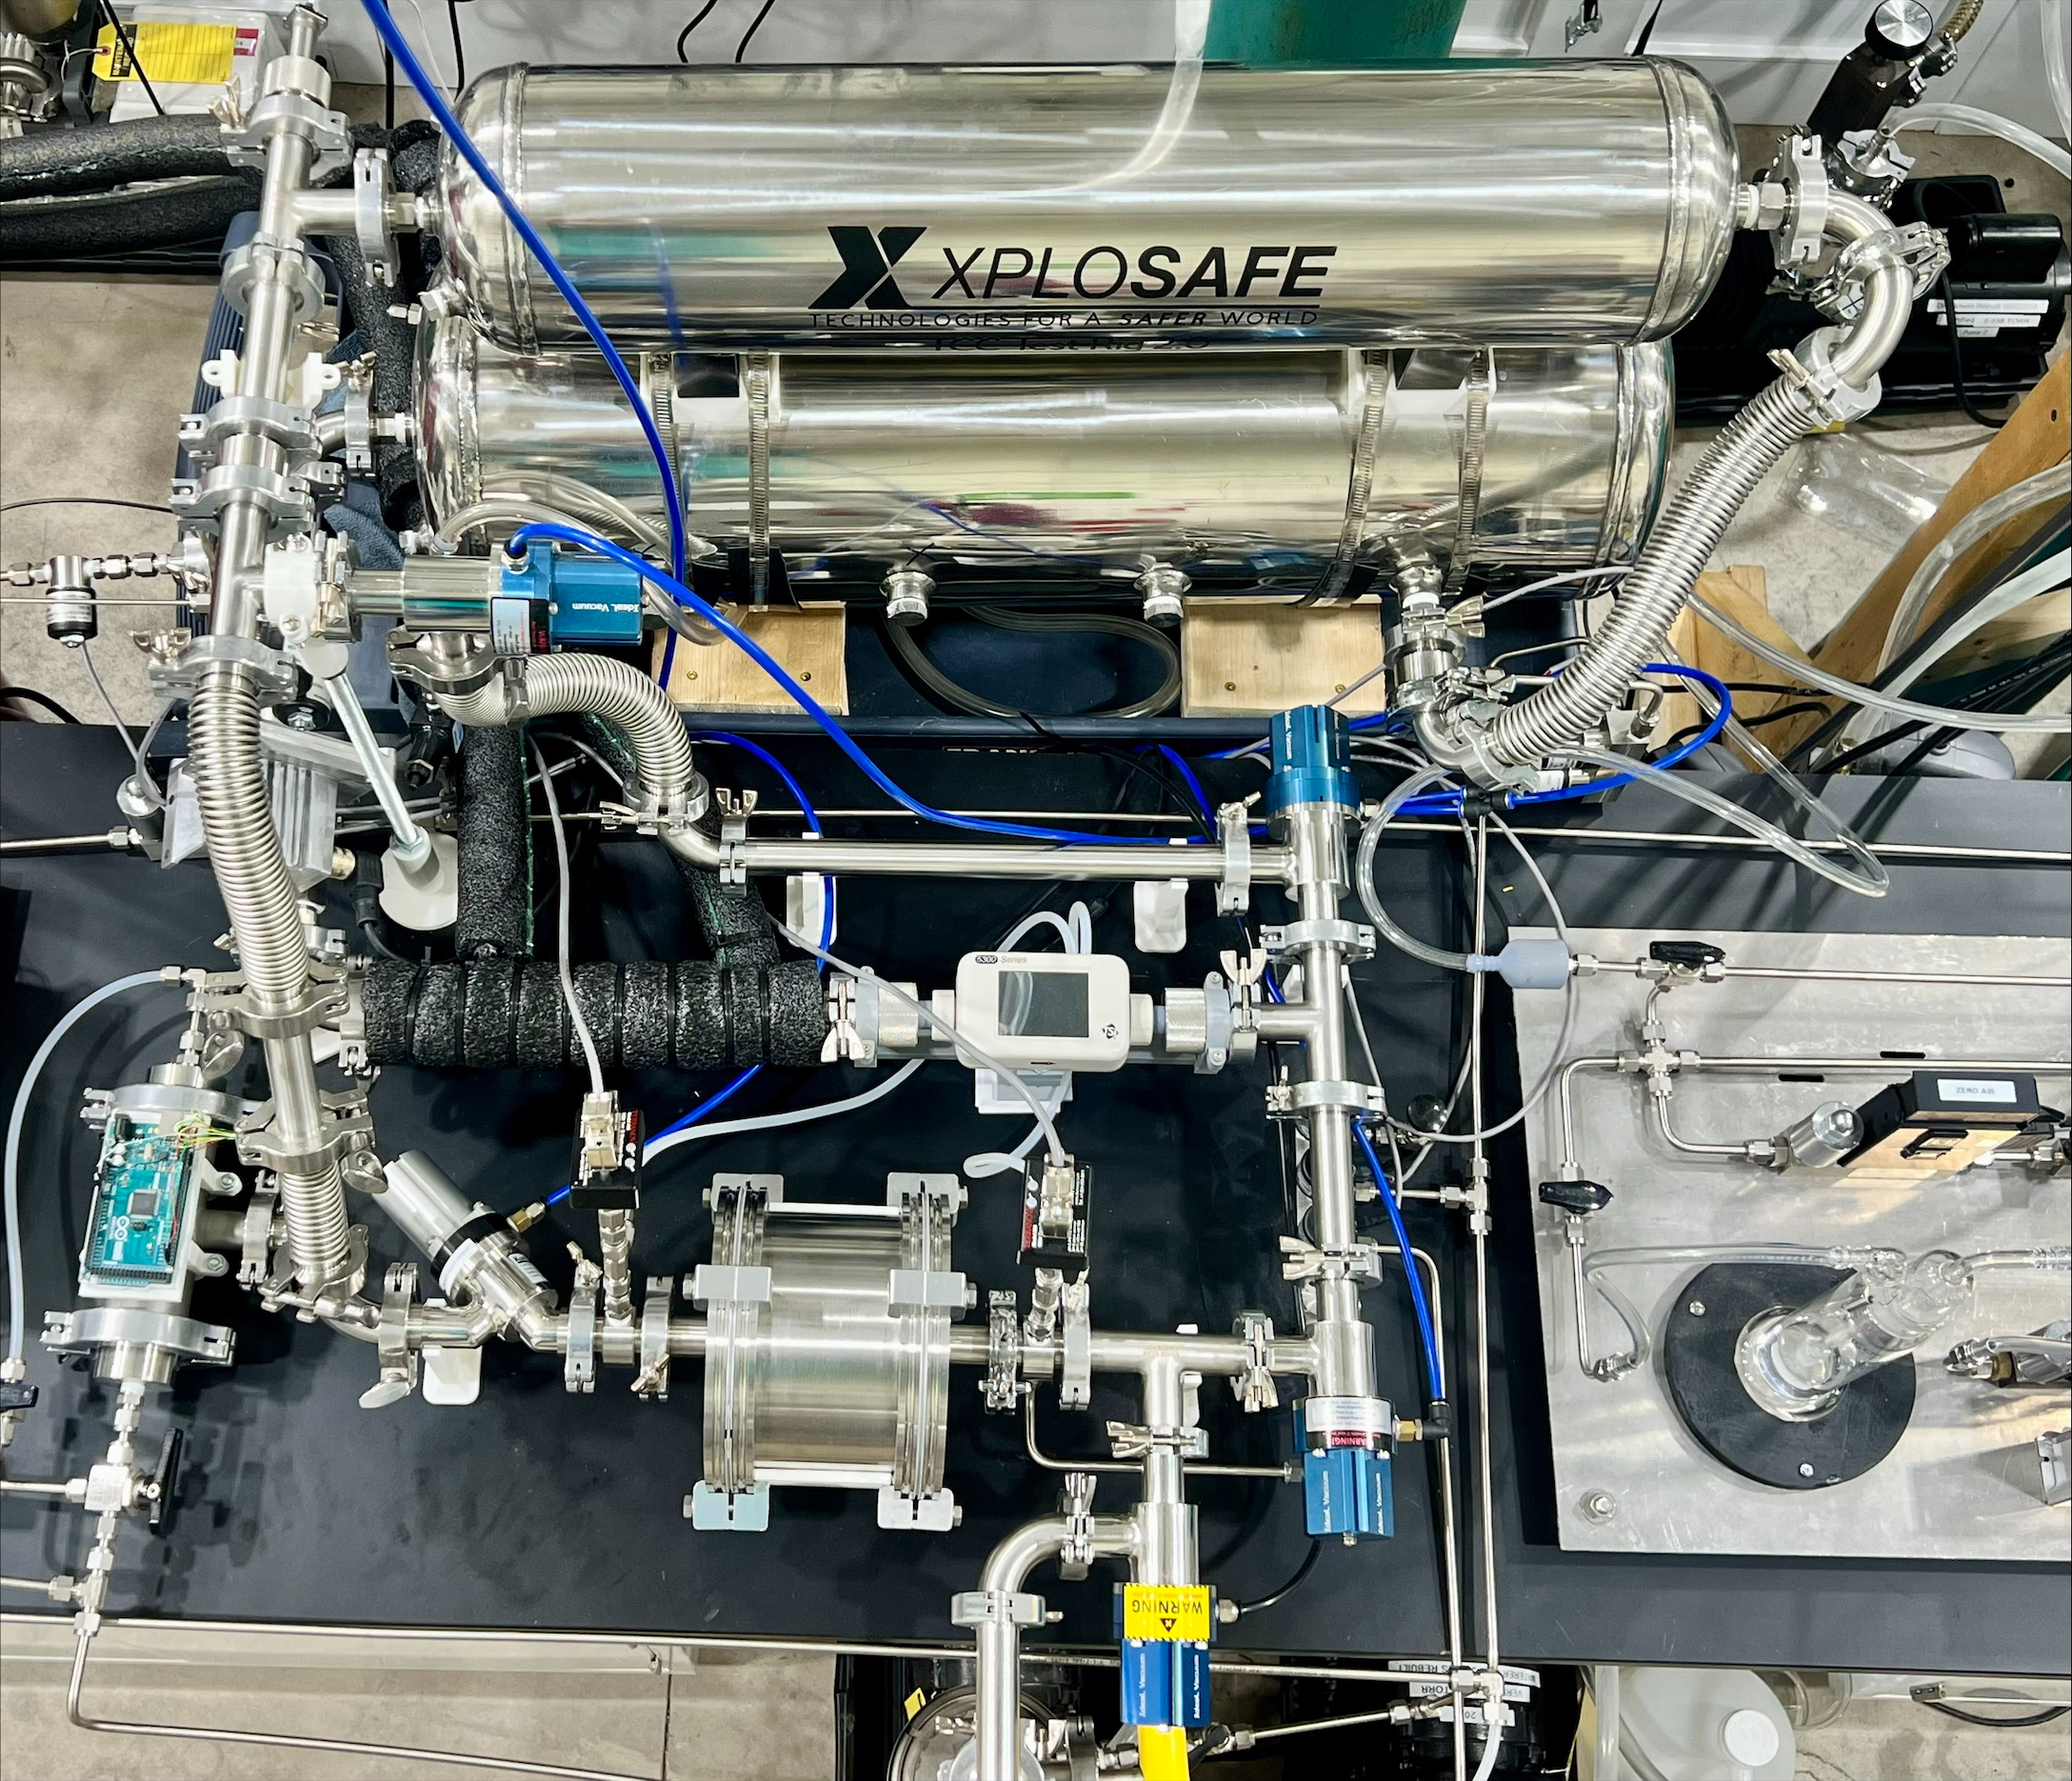
TCC Test Bed: Gas Recirculation Loop
Stainless-steel
tanks
Bypass loop
Micronel blower
Laminar flow element with a cooling coil
TSI flow meter
(5300 series)
Pressure sensors
Sorbent cartridge holder
Vacuum regeneration line
TCC recirculation loop, which contains two stainless-steel tanks to simulate the xPLSS volume of 2 ft³ and a stainless-steel holder for a replaceable sorbent cartridge

Slide 5
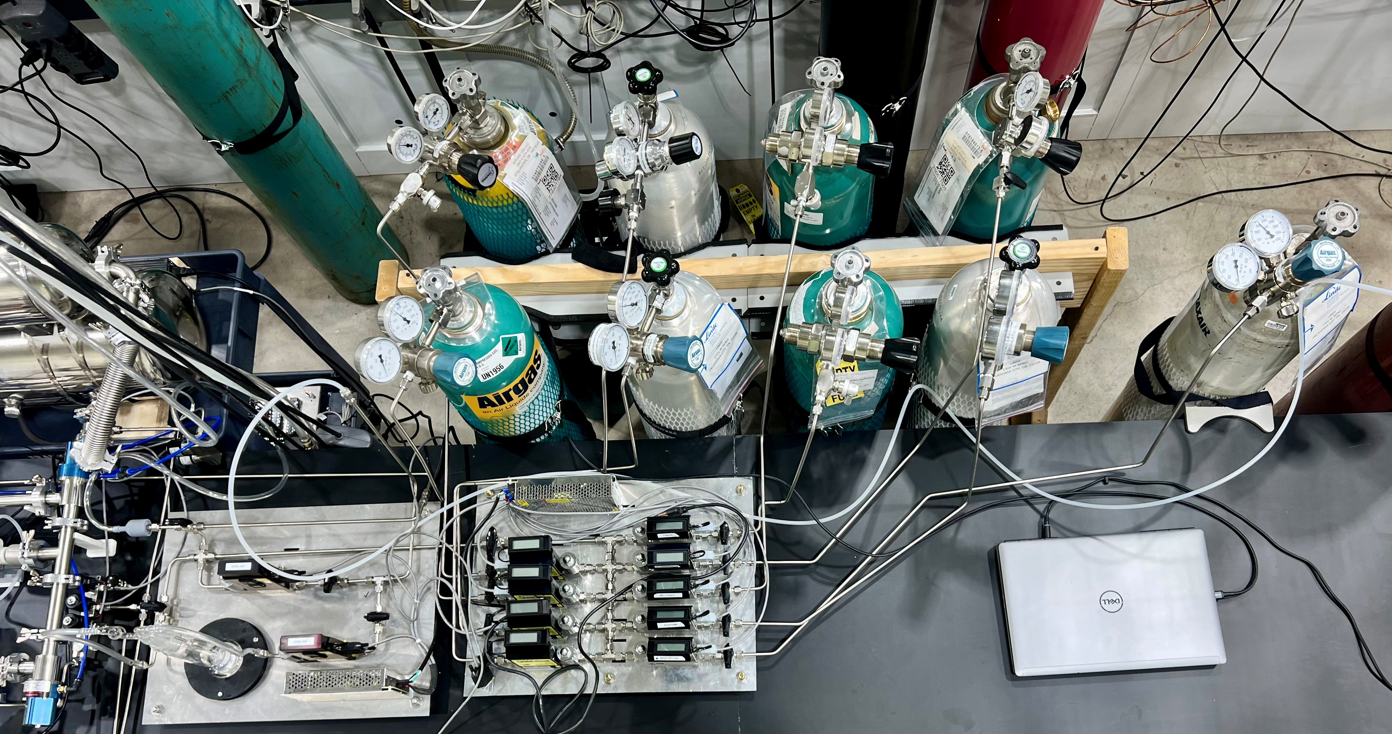
TCC Test Bed: Analyte Dosing System
Humidity control module
Flow controllers connected to nine different gas sources
The flow controllers create a mixture of NASA contaminants (injected at the NASA daily source rates) and humidified air, which is supplied to the TCC recirculation loop.

Slide 6
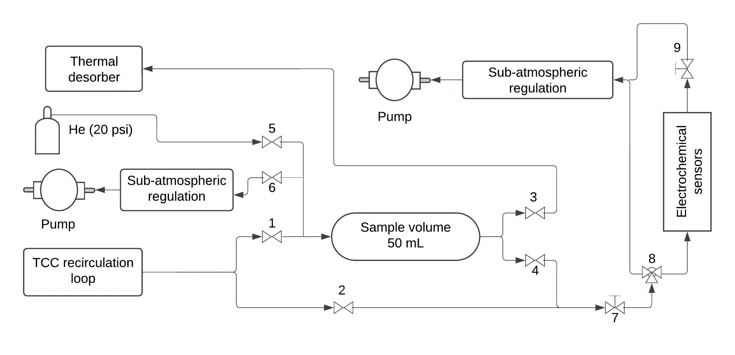
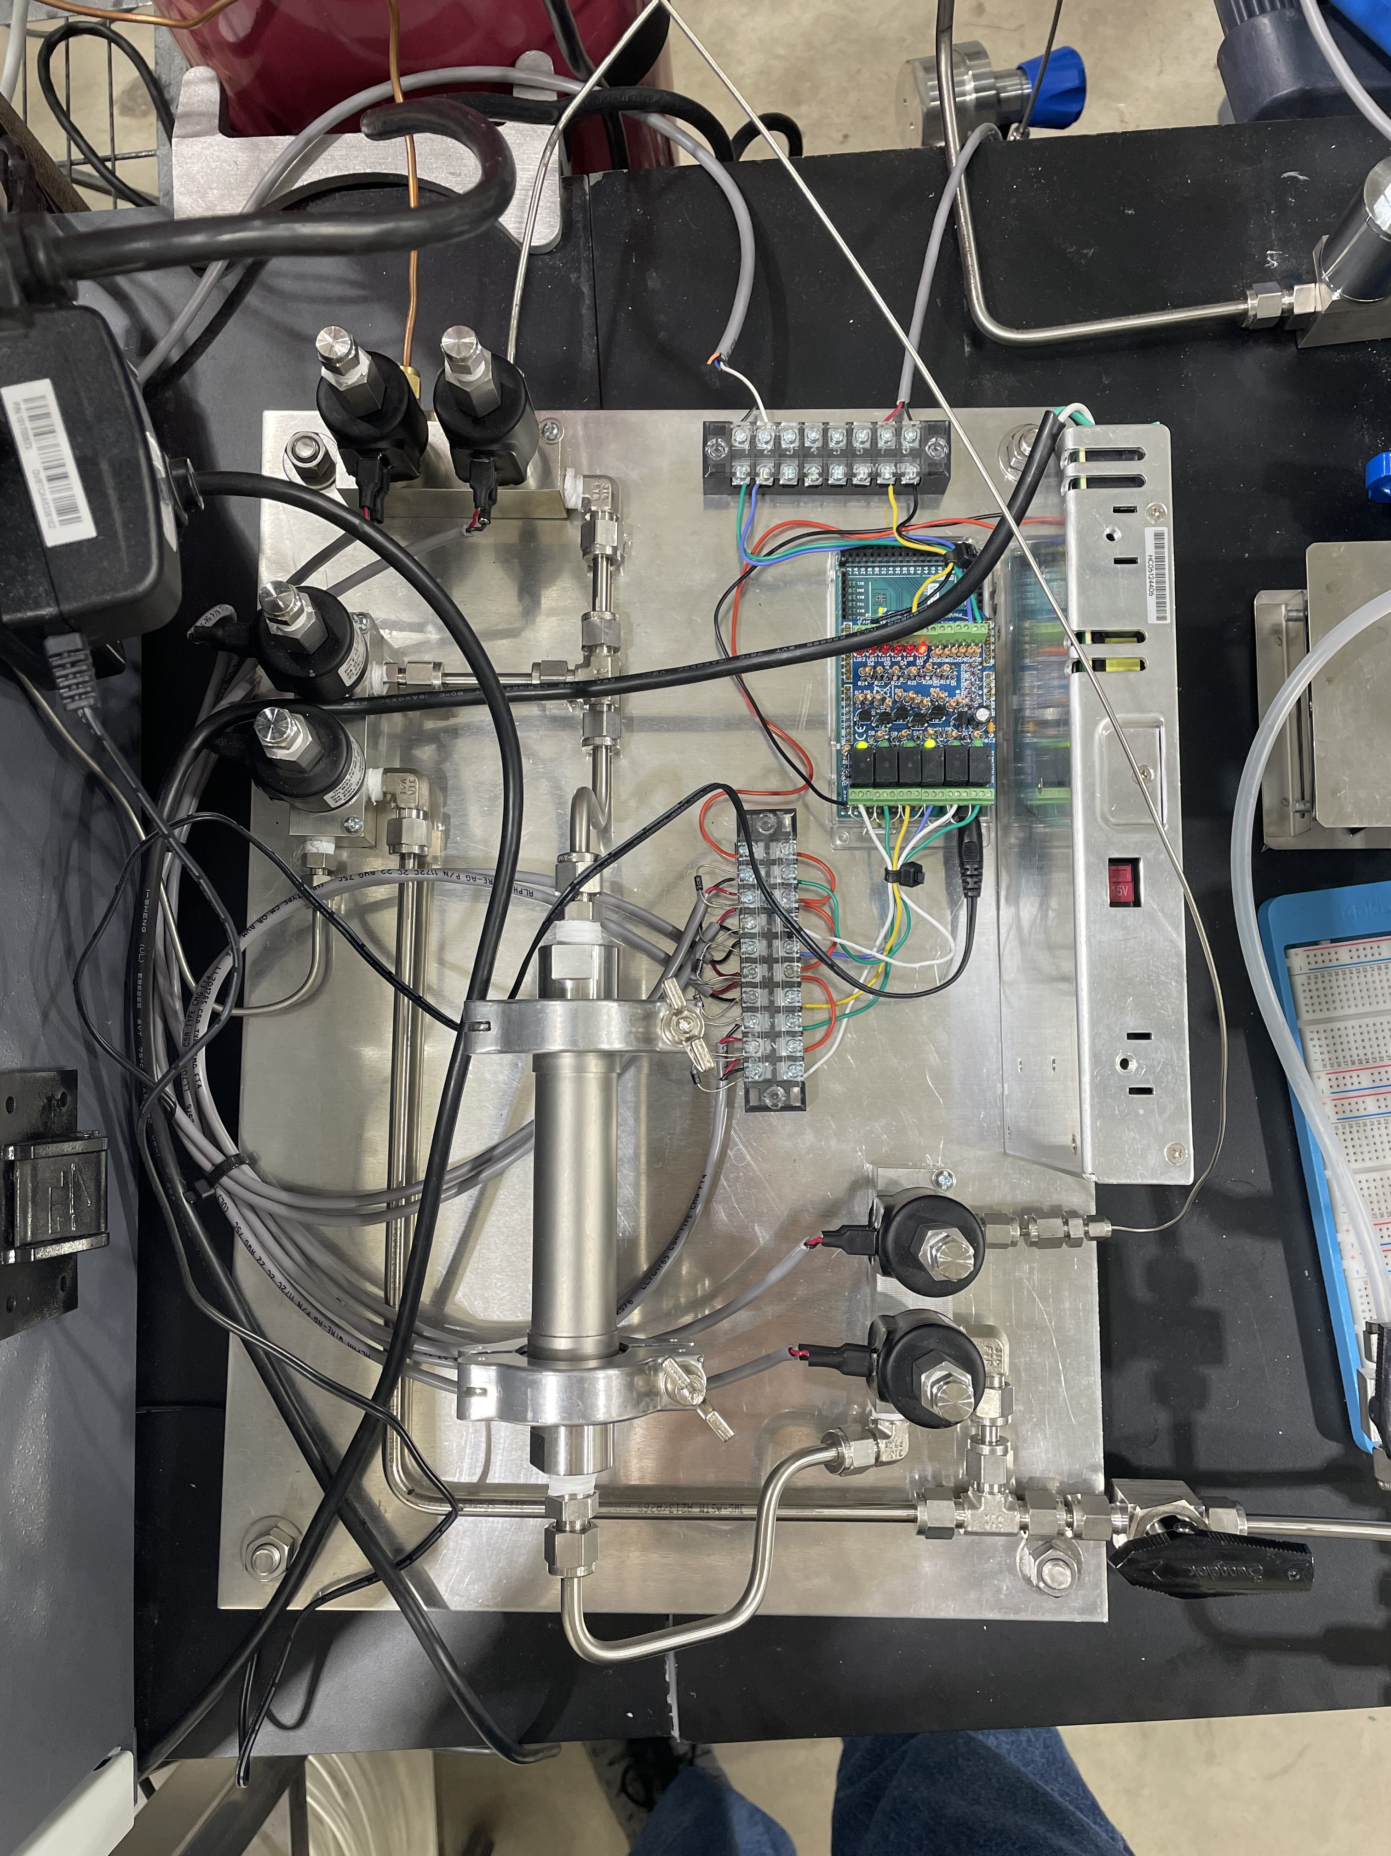
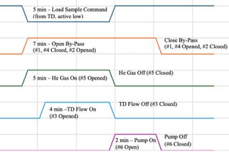
TCC Test Bed: Automatic Gas Sampler
The automatic gas sampler allows sampling a fixed volume of gas (50 mL) from the TCC recirculation loop with its subsequent analysis by thermal desorption combined with gas chromatography/mass spectrometry.
Timing sequence showing the open and closed positions of the automatic valves #1-6 during a sampling event initiated by the TD-GC/MS instrument.

Slide 7
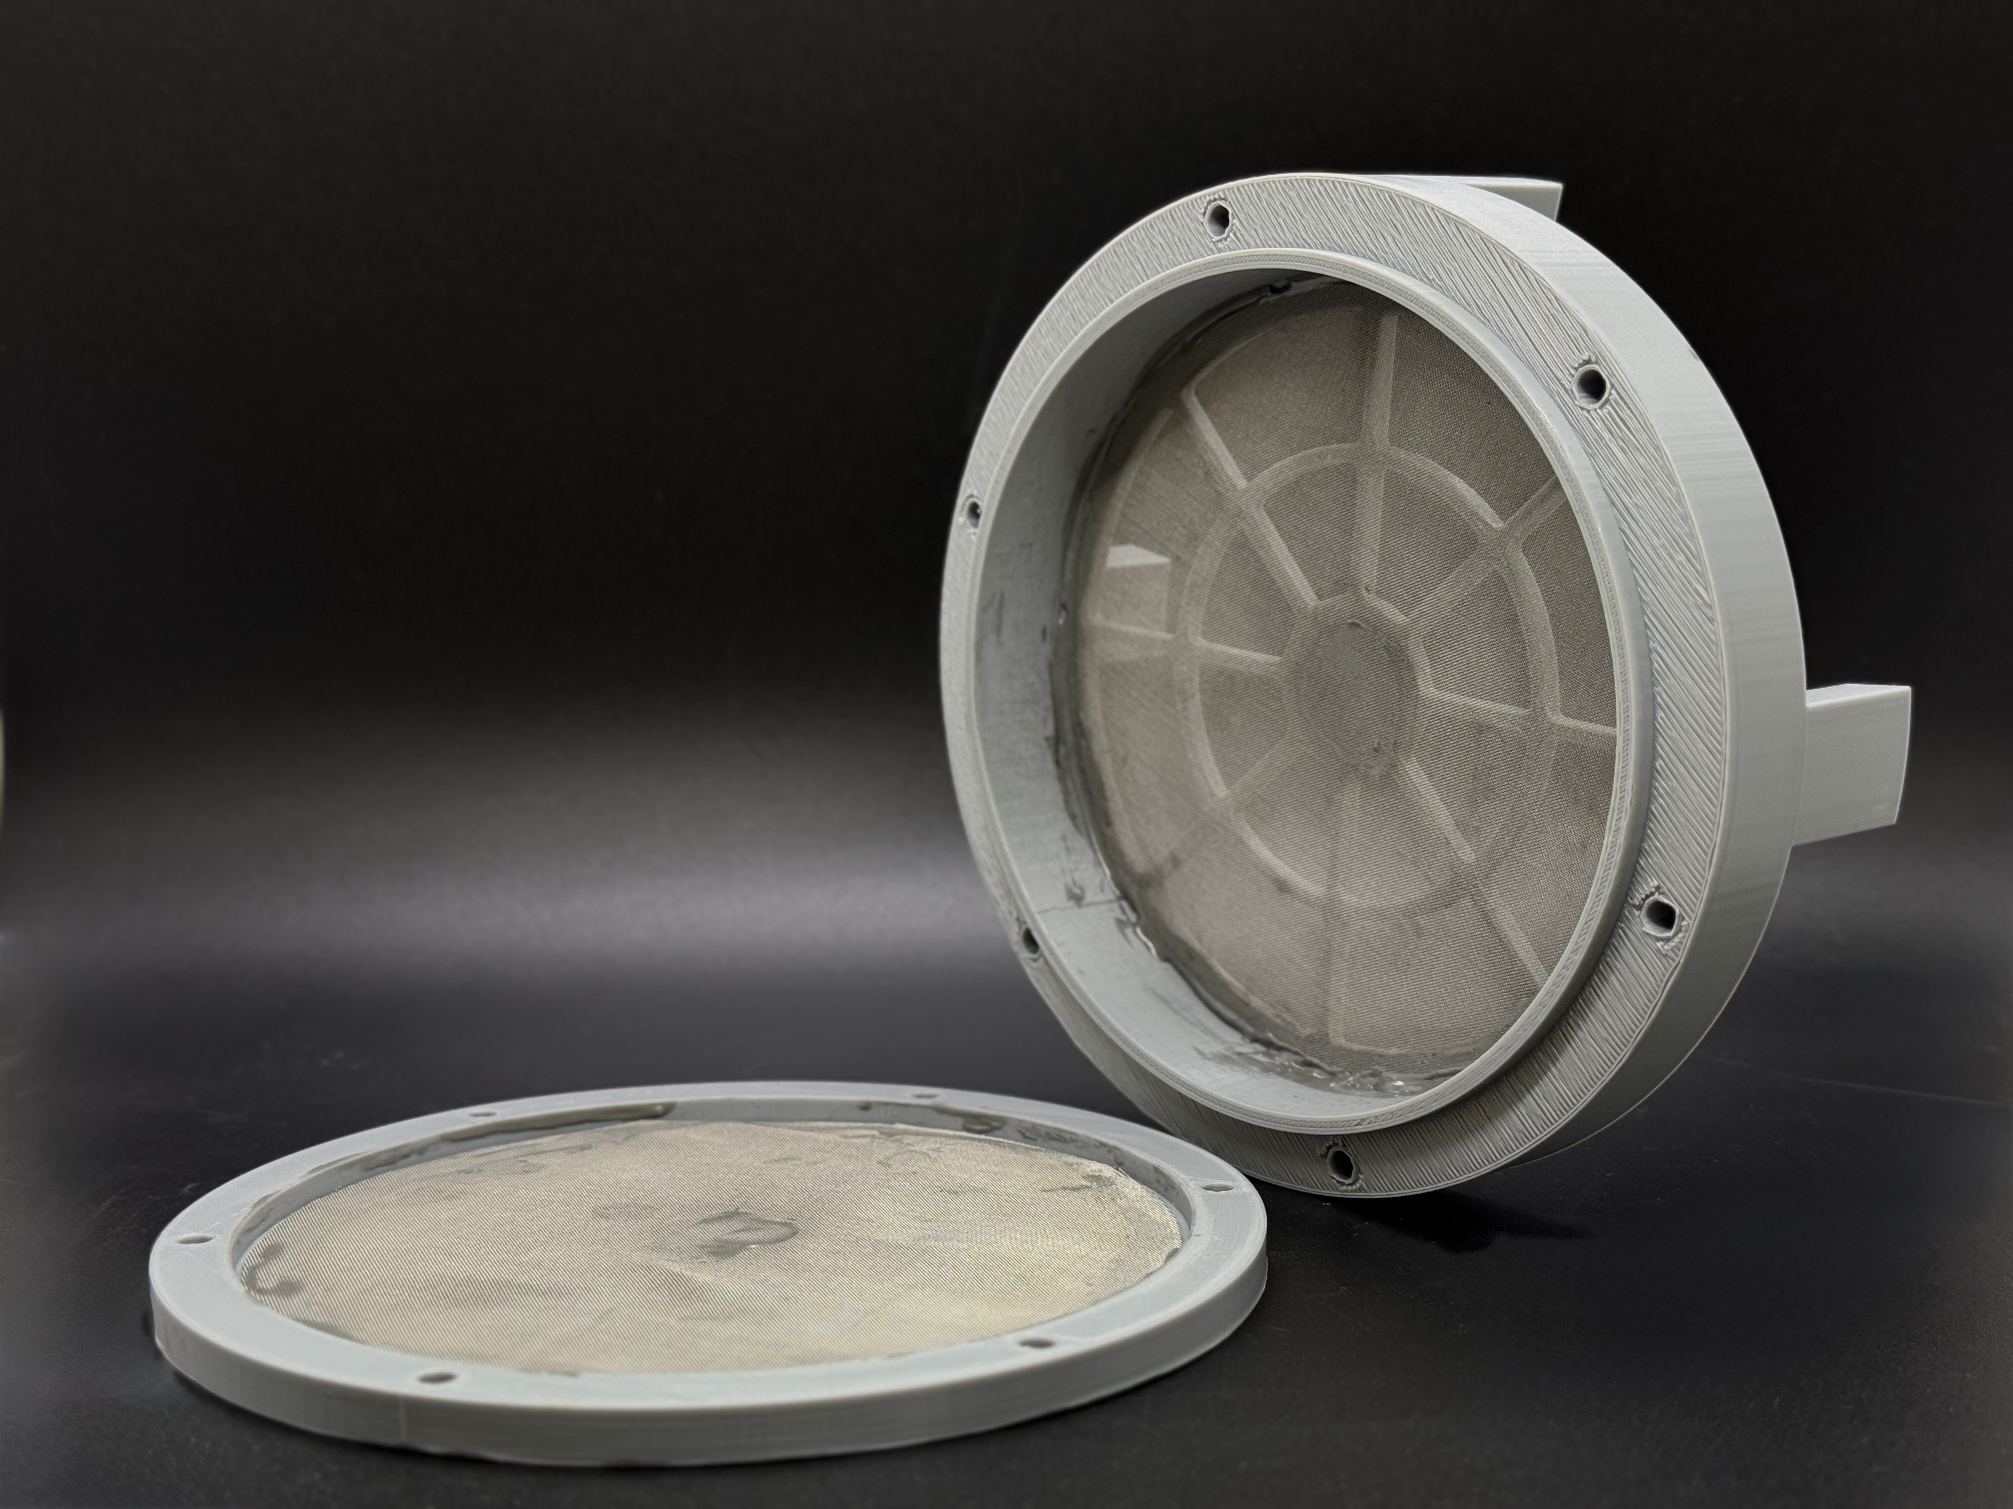
Sorbent Cartridge Design
A sorbent cartridge with a volume of 230 mL was designed and 3D printed.
Stainless-steel mesh pieces are permanently attached to both cartridge sides.
The cartridge is tightly fit inside the stainless-steel cylindrical holder in the TCC recirculation loop.
The holder allows pressure swings from 4.3 psia to <1 Torr without mechanical failure.

Slide 8
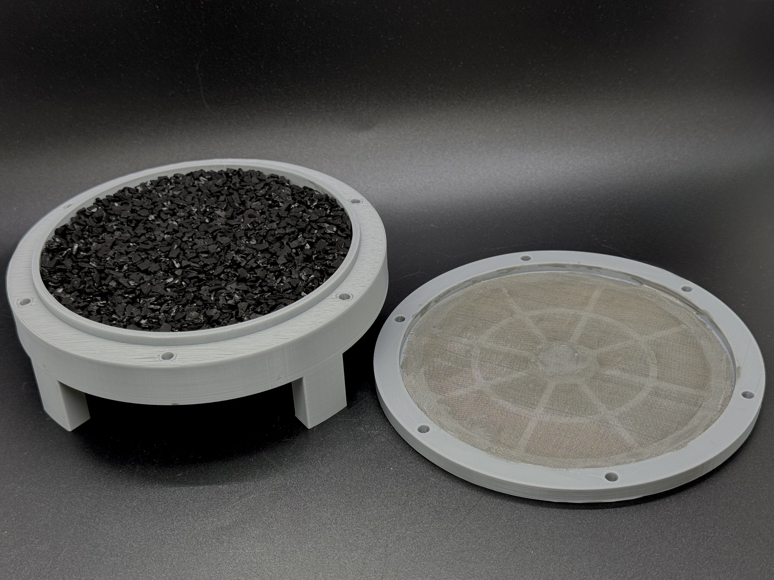
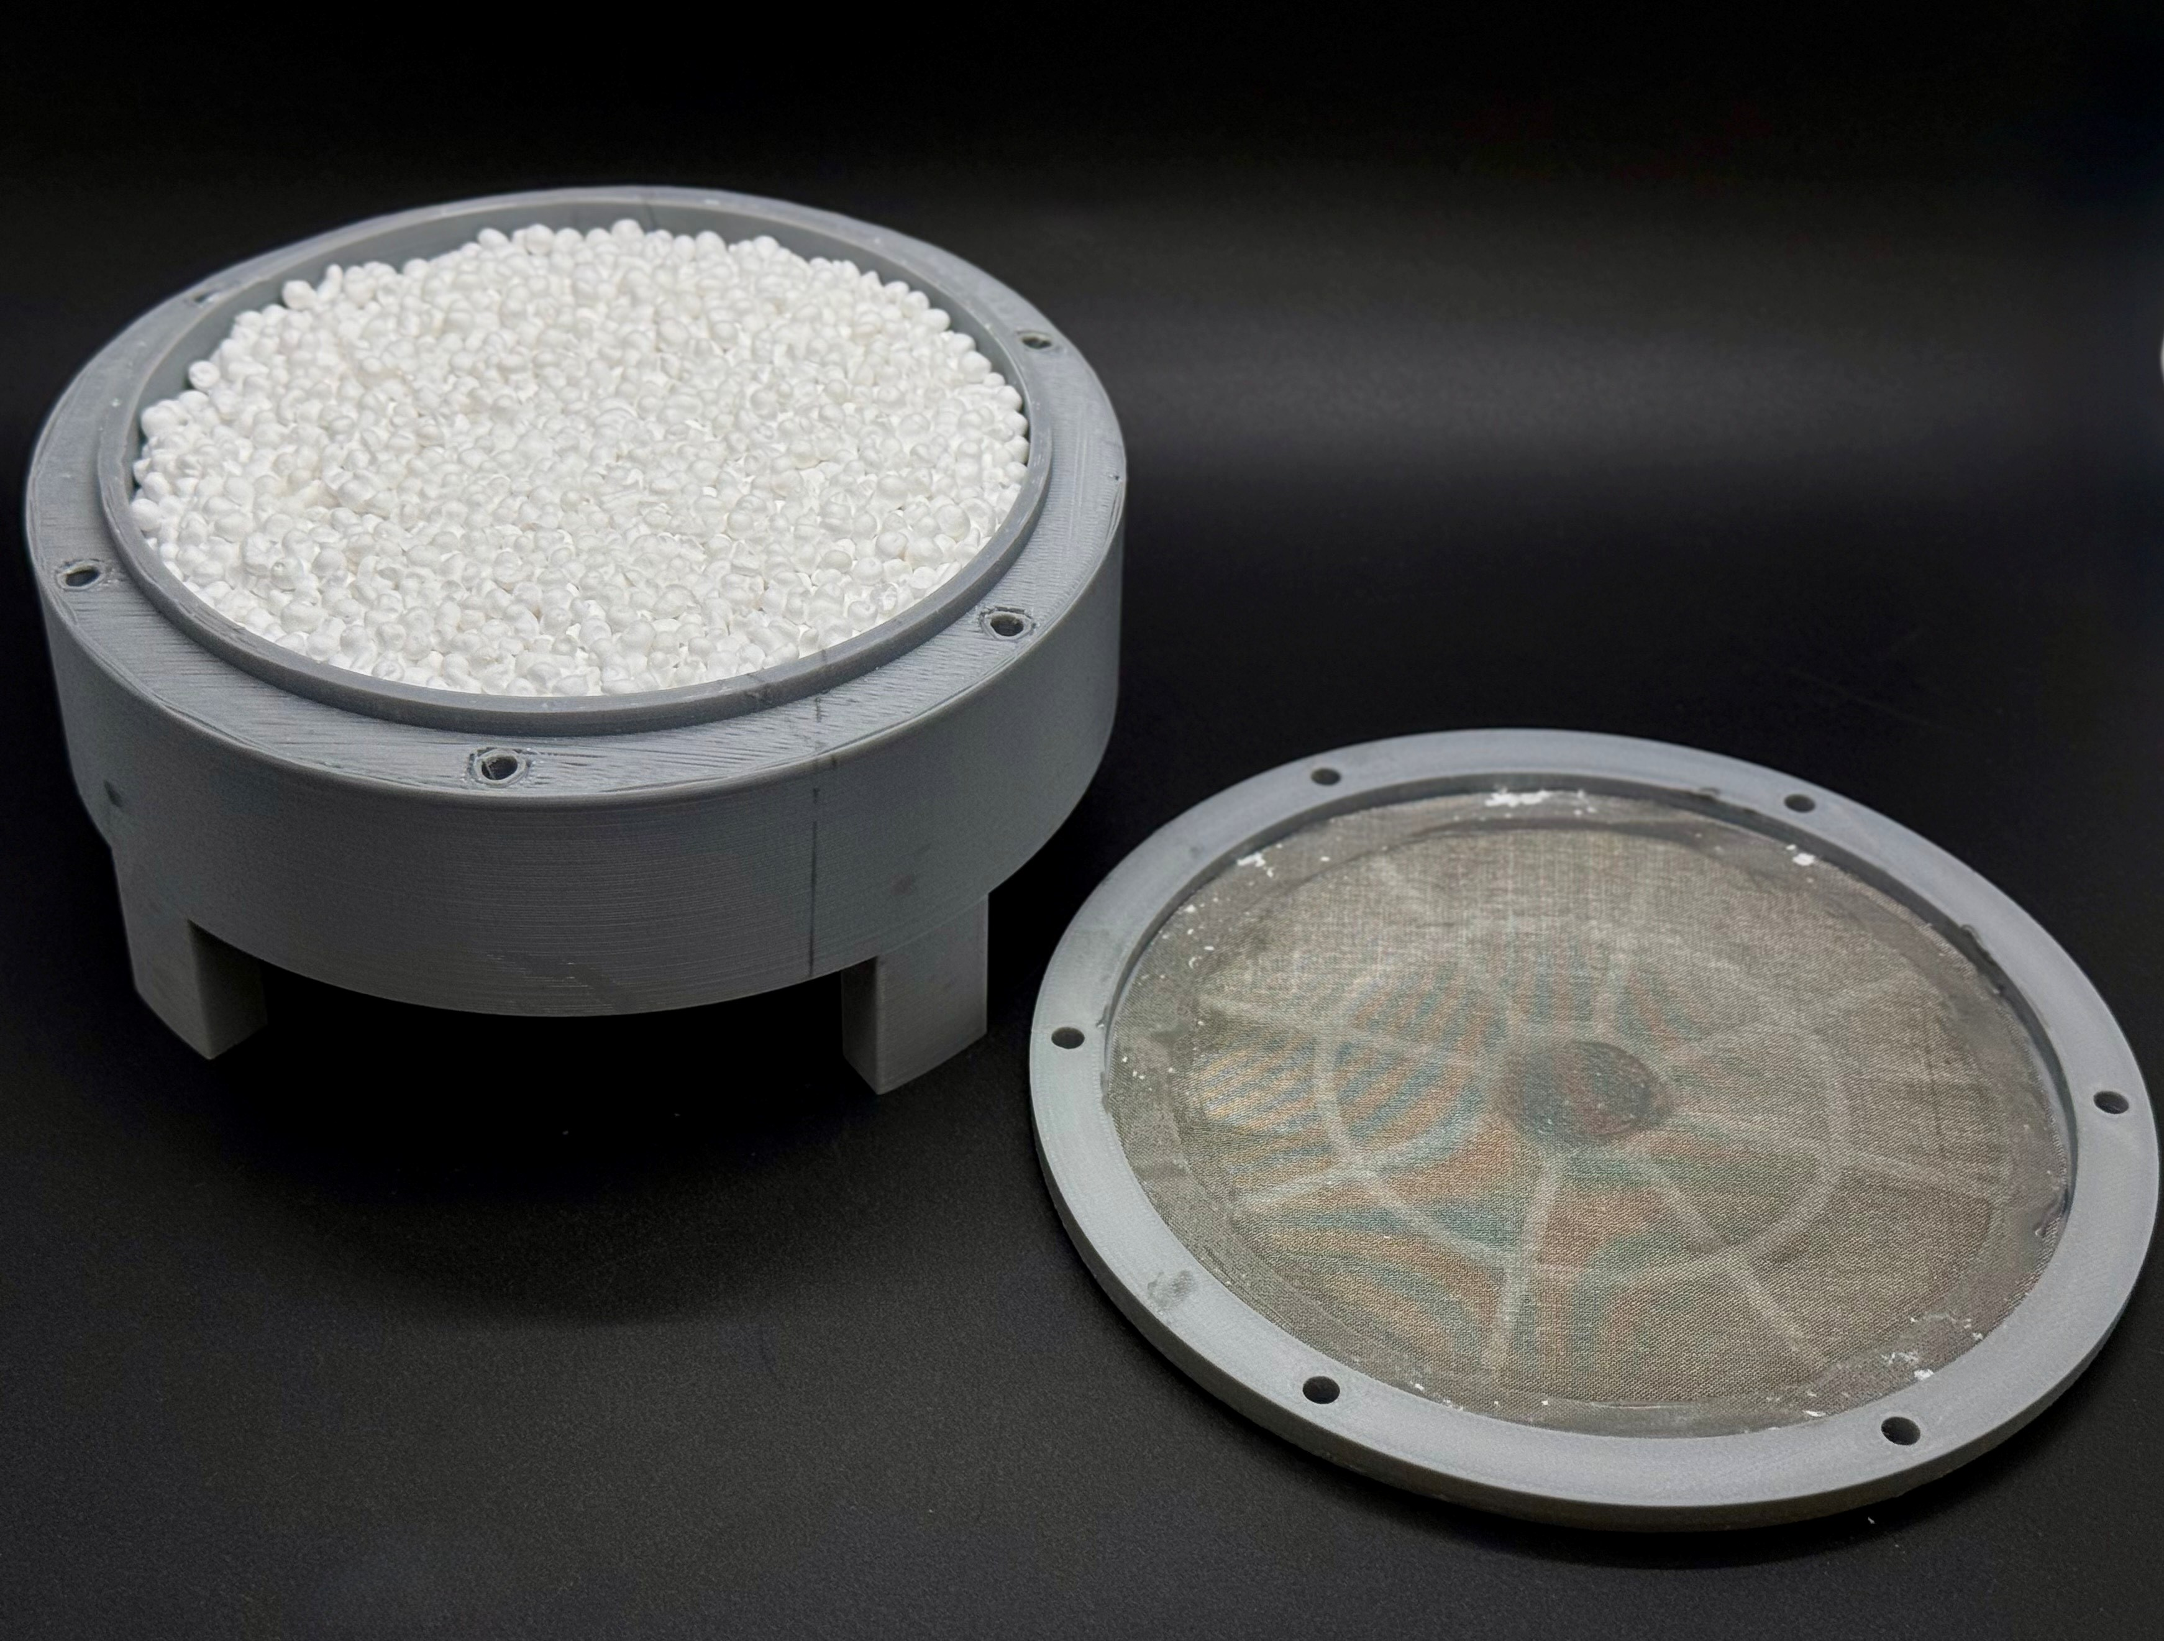
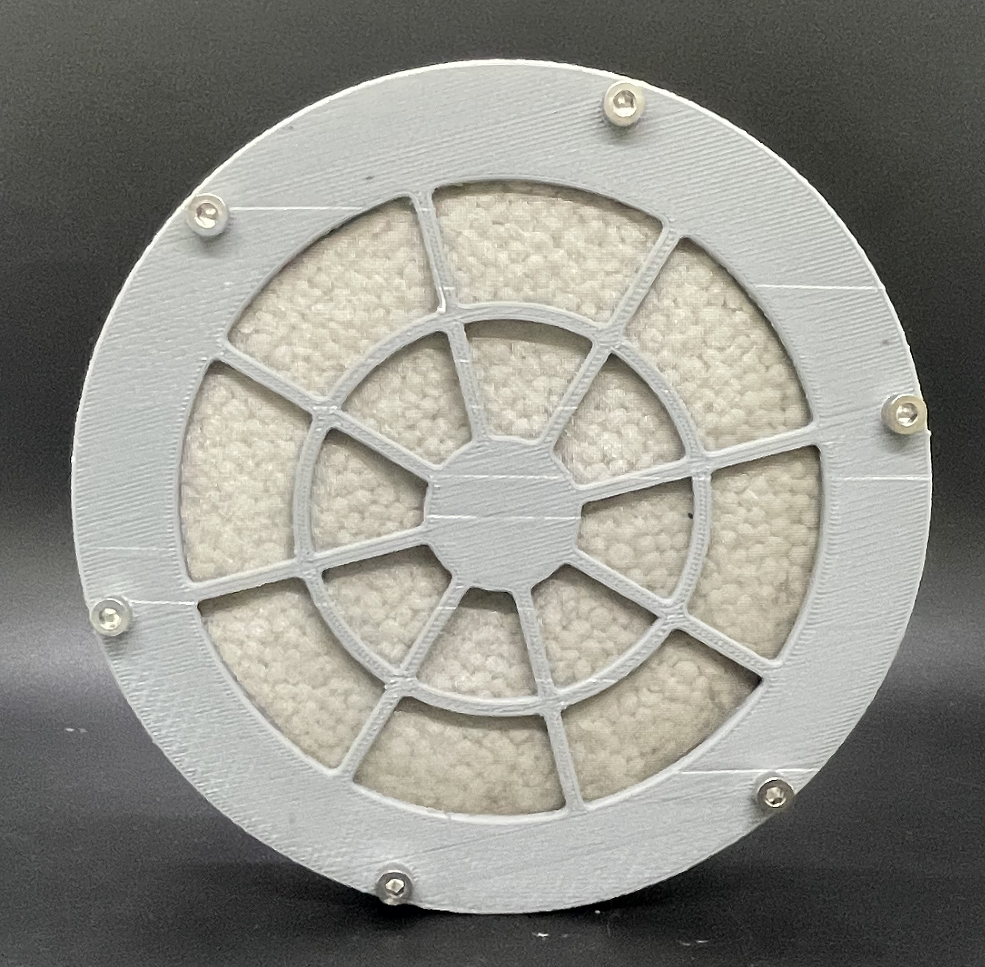
Sorbent Cartridges with TCC Sorbents
Sorbent cartridge (230 mL) filled with sieved Ammonasorb II particles (size: 2.3−3.3 mm), which were dried under vacuum at 75 °C for 24 hours.
Sorbent cartridge (460 mL) filled with nanoporous silica beads (size: 3.1−4.2 mm), which were calcined at 550 °C for 48 hours.
Front view of the sorbent cartridge (460 mL) filled with nanoporous silica beads

Slide 9


Gas Mixture Generation
The flow rate of each analyte injected to the recirculation loop of the TCC test bed was computed based on its NASA source rate using the following formula:
$Source rate \left(\frac{mg}{day}\right)= Injection rate \left(\frac{mL}{min}\right)×Gas concentration \left(\frac{ng}{mL}\right)×\frac{mg}{{10}^{6}ng}×\frac{8 h}{day}×\frac{60 min}{h}$
In which,
$$Gas concentration in \frac{ng}{mL} =Gas concentration \left(ppm\right)×\frac{Molecular weight \left(\frac{g}{mol}\right)}{Molar volume \left(\frac{L}{mol}\right)}$$
The concentration of each gas in the system can be computed by using the total flow into the mixing tube, which includes the balance air and flow of all other gases:
$$Gas concentration \left(ppm\right)=Gas cylinder \left(ppm\right)×\frac{Gas flow}{Total flow}$$

Slide 10
Gas Mixture of TCC Contaminants: Calculated Flow Rates
A mixture of nine TCC contaminants was supplied to the TCC recirculation loop at a flow rate of 200 mL/min. The contaminant injection rates matched the NASA daily source rates, and total gas flow rate before the recirculation loop was 250 mL/min.
Contaminant | Gas cylinder concentration (ppm) | Flow rate (mL/min) | Injection rate (ng/min)
Acetone | 50 | 4.0 | 402
Acetaldehyde | 100 | 9.3 | 1380
Ammonia | 10000 | 29.8 | 167000
1-Butanol | 50 | 8.6 | 1040
Ethanol | 500 | 12.5 | 9400
Formaldehyde | 50 | 17.8 | 875
Furan | 50 | 5.4 | 625
Methanol | 500 | 3.9 | 2130
Methyl mercaptan | 50 | 20.4 | 1730
Humidified gas carrier |  | 138

Slide 11
Predicted Breakthrough Times for Nine TCC Analytes
NASA source rates, sorption capacities, and calculated times required to reach 80% of the contaminant capacities for Ammonasorb II and nanoporous silica beads (OSU-6 sorbent content: ~21%).
Contaminant | NASA source rate¹ (mg/day) | Sorption capacity (mg/g) |  | Projected breakthrough time (h)
 |  | OSU-6 | Ammonasorb II | Nanoporous silica beads | Ammonasorb II
Acetone | 0.193 | 2.0 | 0.46 | 1061 | 1907
Acetaldehyde | 0.663 | 0.040 | 0.028 | 6 | 13
Ammonia | 80 | 1.4 | 16 | 2 | 160
1-Butanol | 0.50 | 9.0 | > 12 | 1843 | 14400
Ethanol | 4.51 | 7.2 | 11.6 | 163 | 2058
Formaldehyde | 0.42 | 0.0042 | 0.0027 | 1 | 5
Furan | 0.3 | 0.002 | 0.098 | < 1 | 720
Methanol | 1.02 | 1.0 | 2.6 | 100 | 2039
Methyl mercaptan | 0.83 | 0.004 | > 1 | < 1 | 916
$$Time \left(h\right)=\frac{\left(0.80\right)×sorbent mass \left(g\right)×sorbent capacity \left(\frac{mg}{g}\right)}{Injection rate \left(\frac{ng}{min}\right)}×\left(\frac{h}{60 min}\right){×10}^{6}$$
¹J. Hostetler and T. Shurtz: Requirements for the Exploration PLSS (xPLSS) Trace Contaminant Control System (TCC). NASA Technical Report 2020, 20190033446.

Slide 12
Non-regeneration Breakthrough Studies
230-mL sorbent cartridges filled with Ammonasorb II particles (126 g) and nanoporous silica beads (76 grams) were evaluated on the TCC test rig under sub-atmospheric pressure (4.3 psia).
Nine NASA contaminants were continuously injected into the TCC recirculation loop at their NASA source rates.
Analyte concentrations measured at different stages of the TCC test run. The empty fields indicate that the measured concentrations are below the detection limits.
Contaminant | Source rate (mg/day) | 7-Day SMAC limit (ppm) | Measured concentrations (ppm)
 |  |  | Nanoporous silica beads |  |  | Ammonasorb II
 |  |  | 0−30 min | 1−3 h | 20−24 h | 0−24 h | 150−180 h
Acetone | 0.193 | 22 | 0.10 | 0.10 | 0.13 | 0.24 | 0.13
Acetaldehyde | 0.663 | 2 |  | 0.9 | 1.8
Ammonia | 80 | 3 | 0 | 30 | 64 | 0 | 2
1-Butanol | 0.50 | 25
Ethanol | 4.51 | 1000 |  | 0.7 | 5.8 |  | 0.69
Formaldehyde | 0.42 | 0.1
Furan | 0.3 | 0.025 | 0.03 | 0.9 | 1.1
Methanol | 1.02 | 70 | 1.1 | 2.6 | 7.4 | 0.69 | 2.8
Methyl mercaptan | 0.83 | 0.2 |  | 0.7 | 3.6
Ammonasorb II: No analyte exceeded its SMAC limit during a continuous 180-hour run.
Nanoporous silica beads: Ammonia, furan, and methyl mercaptan broke through and exceeded their NASA SMAC limits within the first three hours.
The measured pressure drop across both sorbents was ~0.18 in-H₂O, which was below the limit of 0.3 in-H₂O specified by NASA.

Slide 13
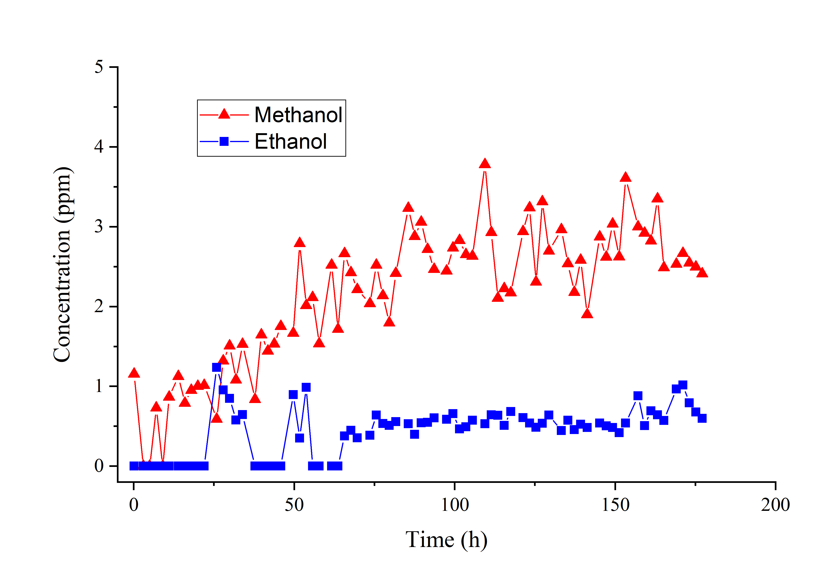
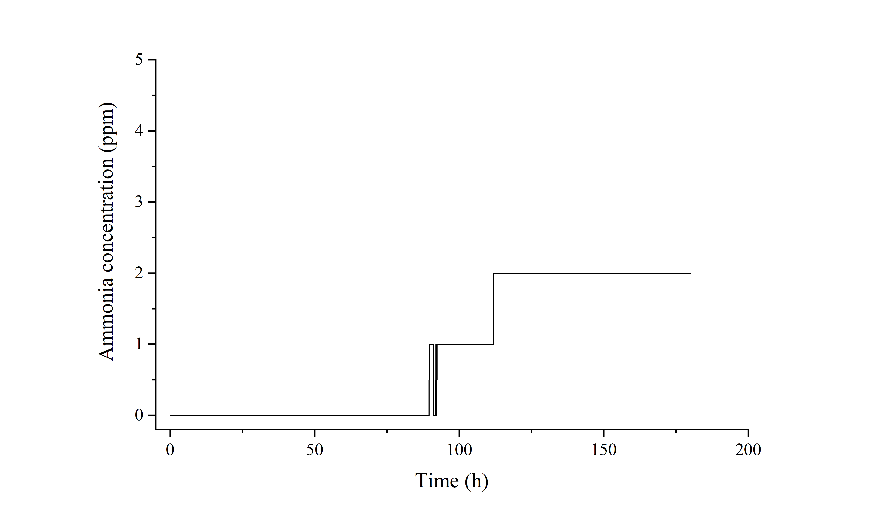
Non-regeneration Breakthrough Studies: Ammonasorb II Sorbent
Ammonia
The methanol concentration steadily increased from 0 to 2.5 ppm and remained stable till the completion of the experiment.
The ammonia concentration slowly increased from 0 to 2 ppm remaining within the NASA SMAC limit of 3 ppm.

Slide 14
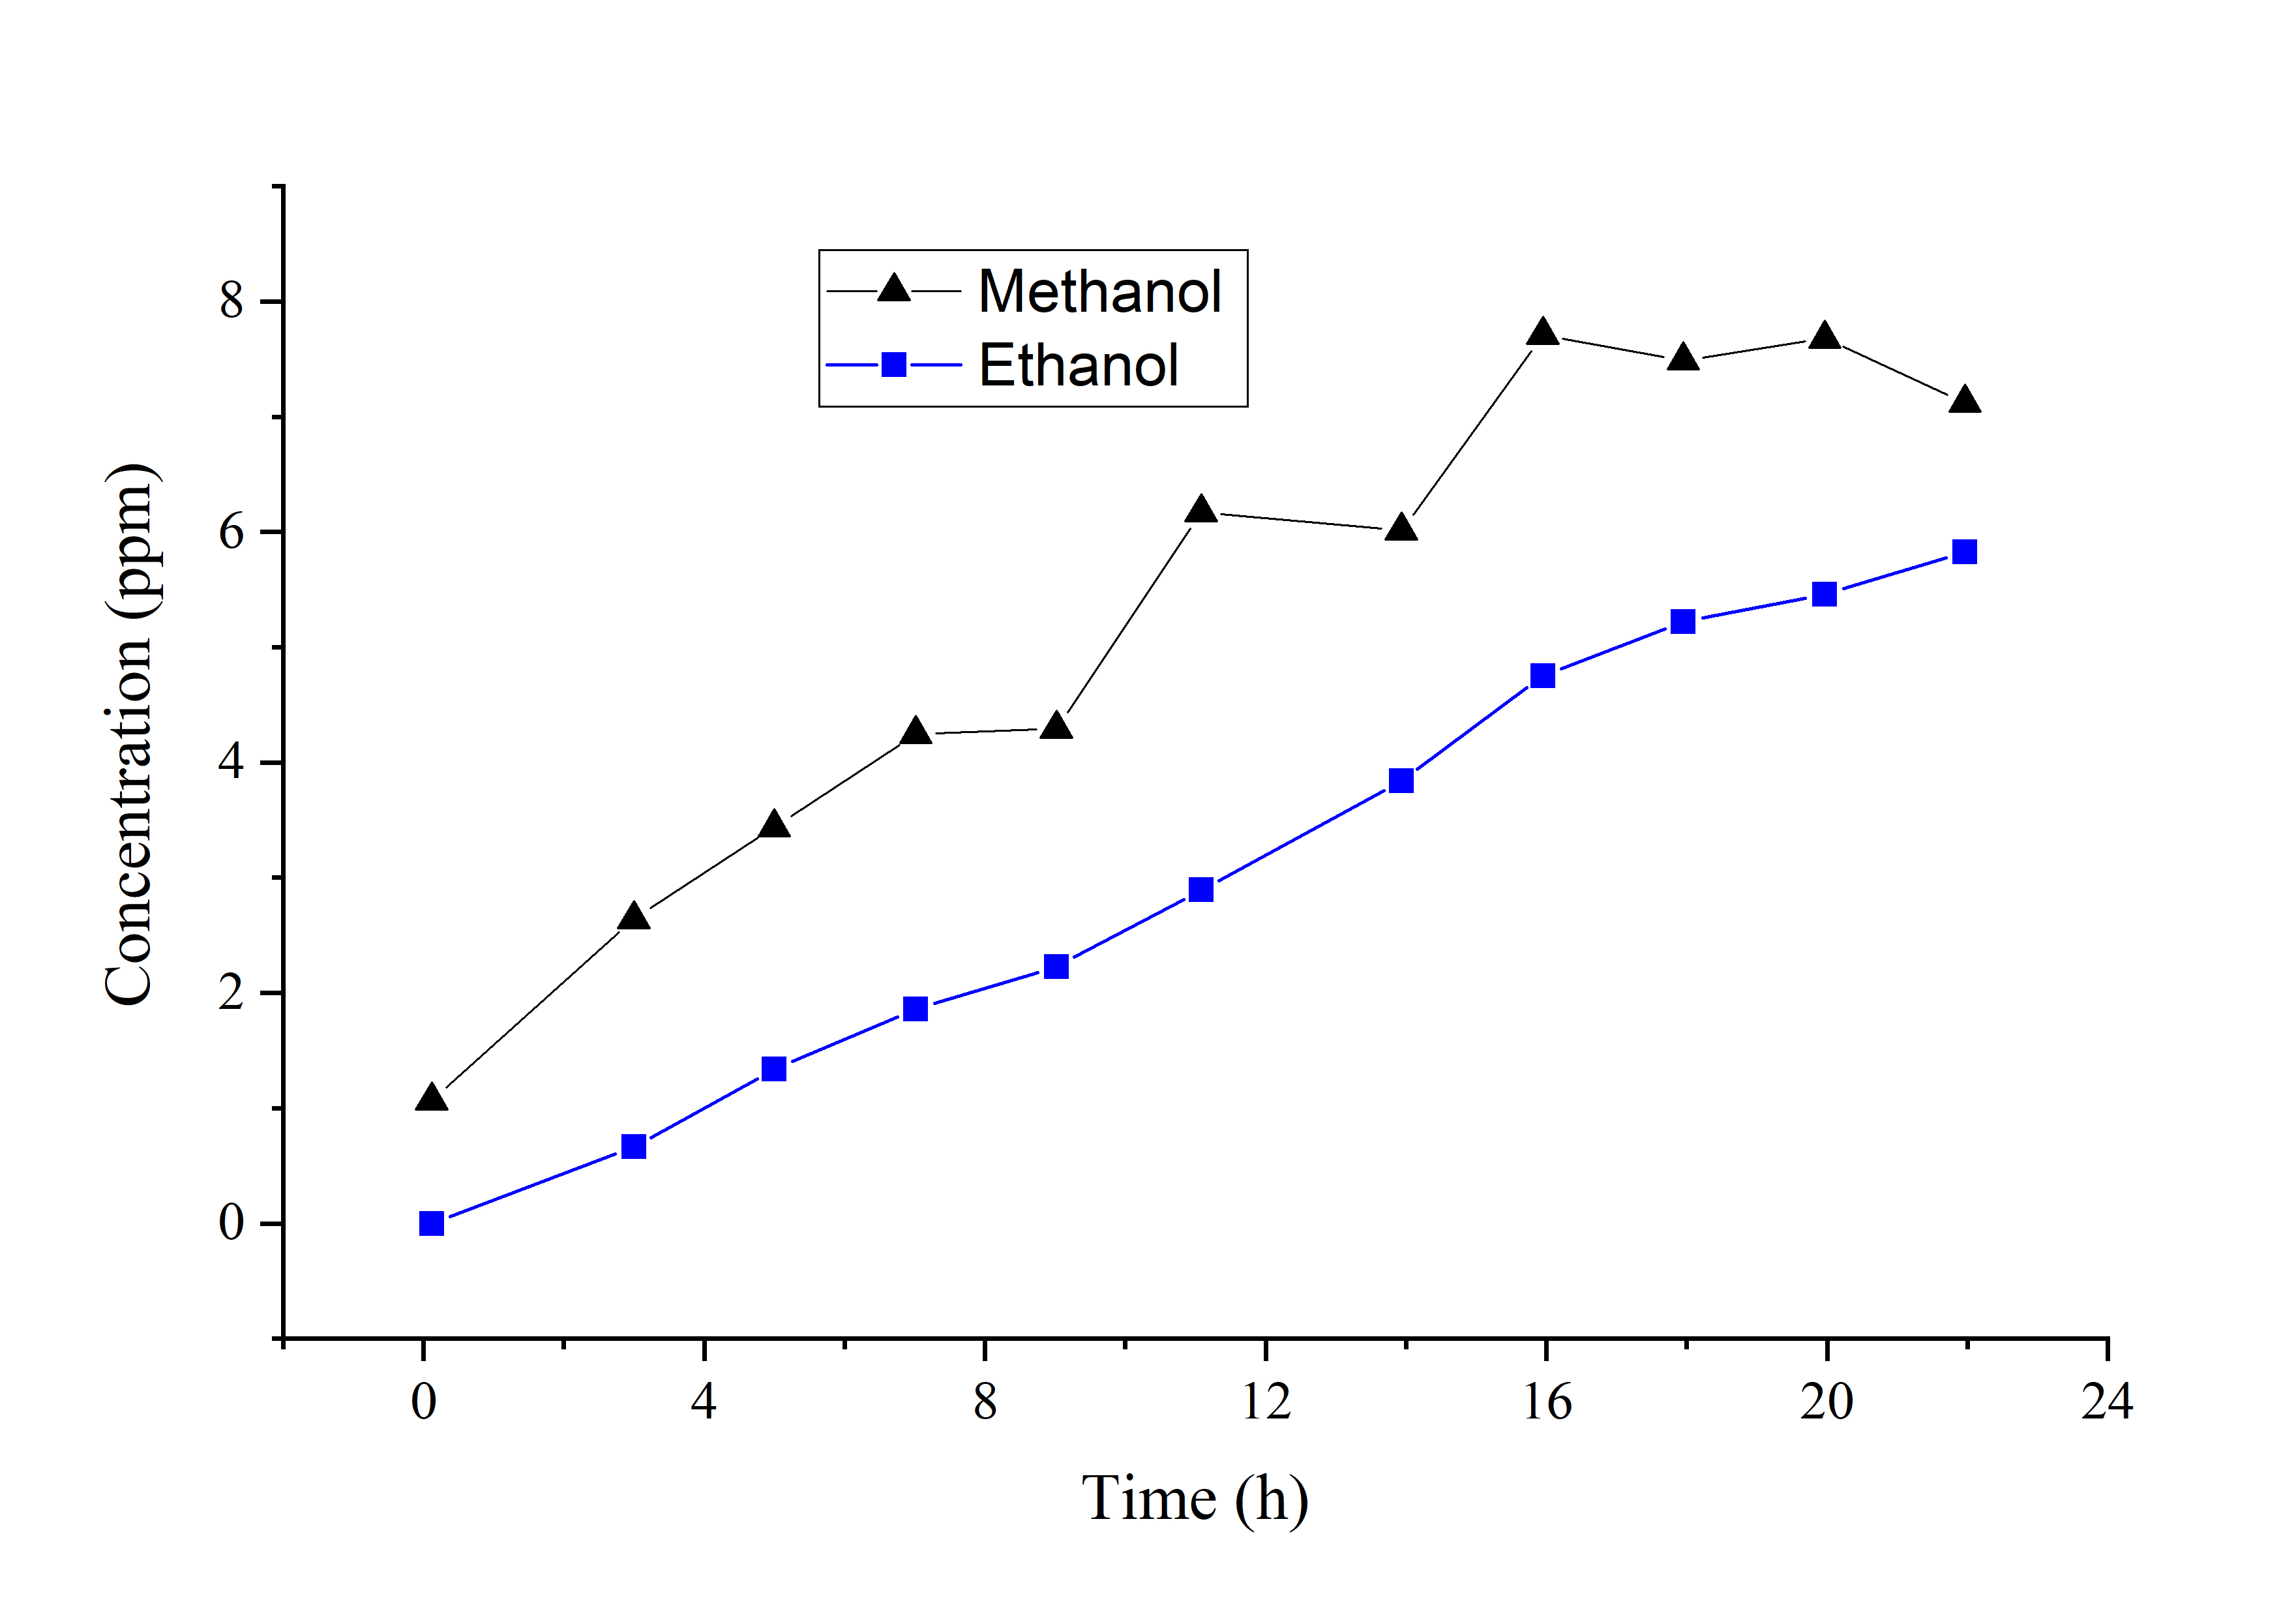
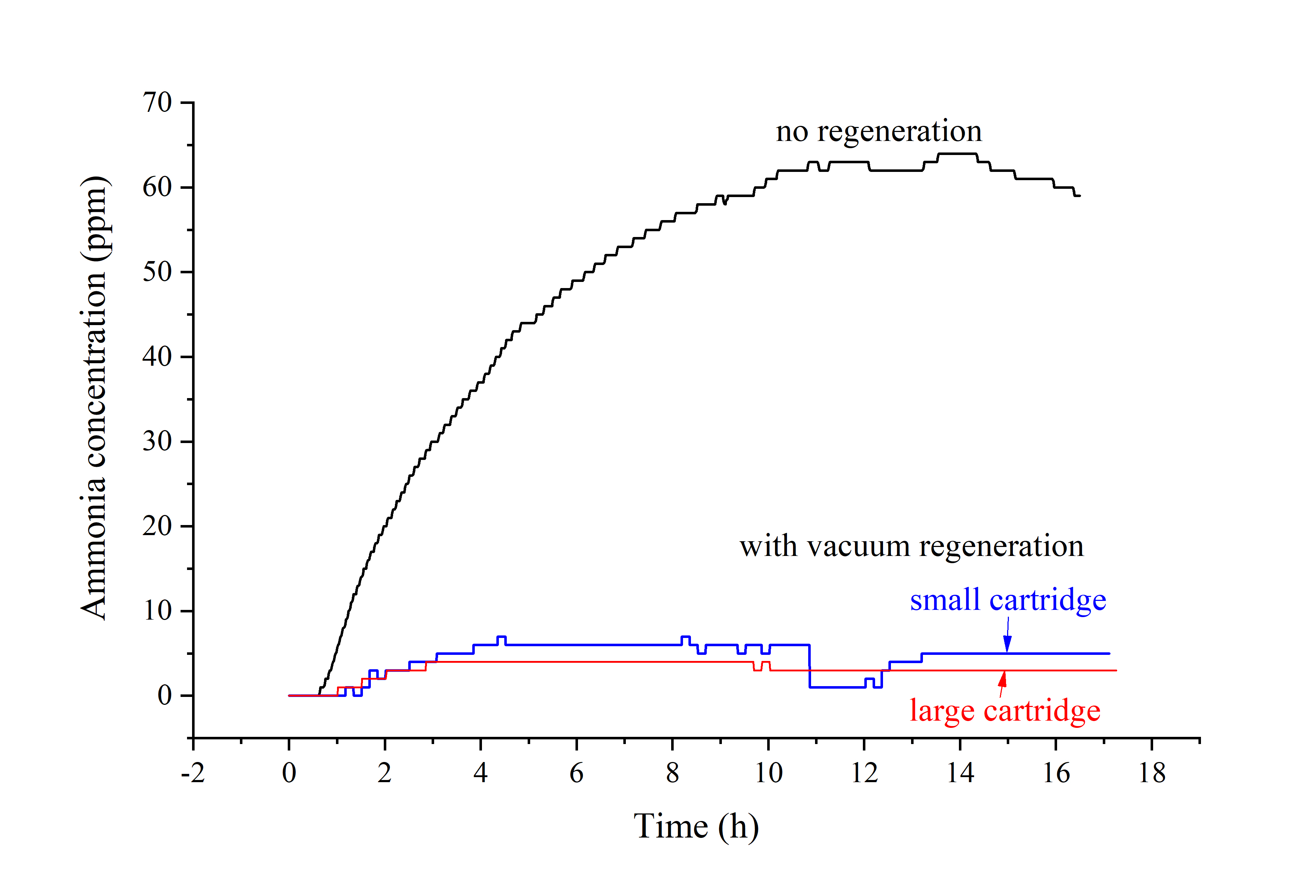
Non-regeneration Breakthrough Studies: Nanoporous Silica Beads
Ammonia
The methanol and ethanol concentrations continuously increased while remaining below the SMAC limits.
Ammonia showed up after 40 min and exceeded the 7-day SMAC limit of 3 ppm at 50 min.

Slide 15
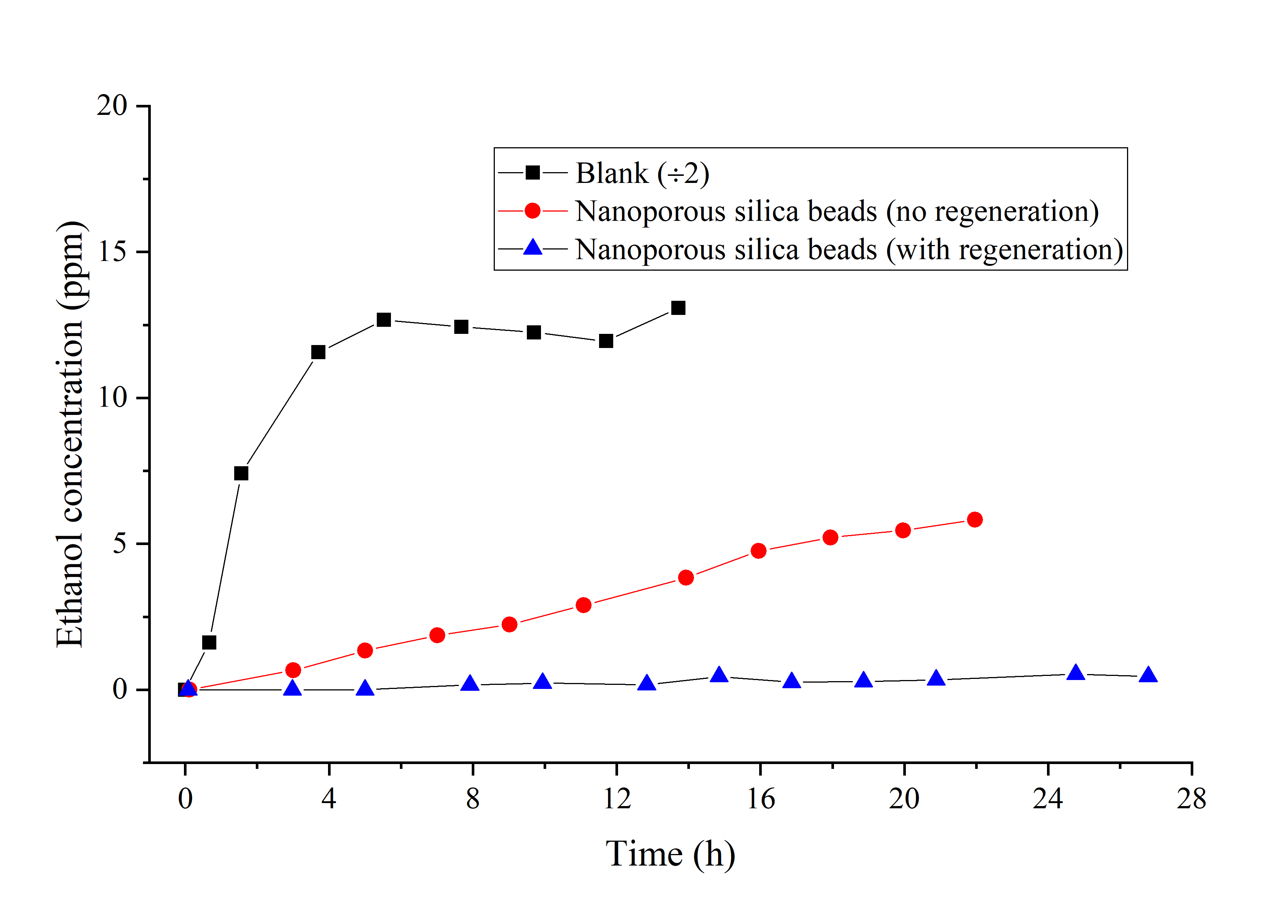
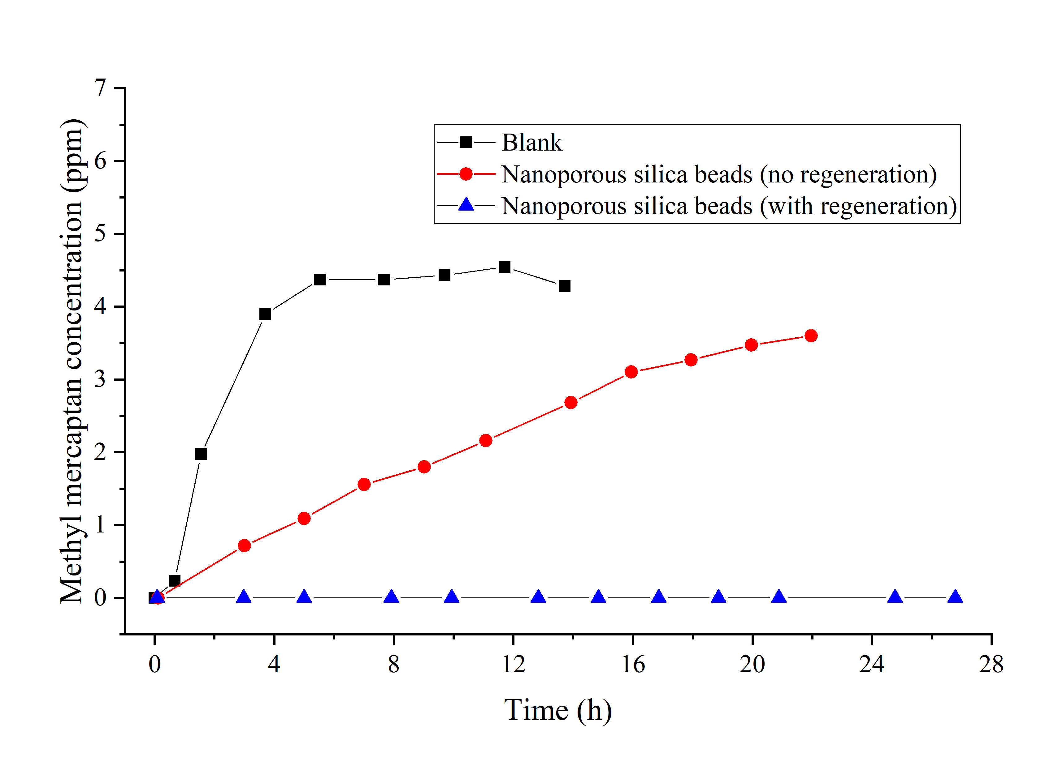
Effect of Vacuum Regeneration on Analyte Breakthroughs
Periodic vacuum regeneration reduced the analyte concentrations in the TCC recirculation loop to sub-ppm levels.
Each vacuum regeneration cycle consisted of 2 min gas flow followed by 2 min evacuating to a pressure below 1 Torr.
During the regeneration half-cycle, the analyte flow to the TCC recirculation loop was stopped simulating a swing bed.
Ethanol
Methyl Mercaptan

Slide 16
Vacuum Regeneration Breakthrough Studies: Nanoporous Silica Beads (230 mL)
Analyte concentrations measured using nanoporous silica beads in the small (230 mL, 76 g) sorbent cartridge at different stages of the TCC test run under vacuum regeneration. The empty fields indicate that the measured concentrations are below the detection limits.
Contaminant | 7-Day SMAC limit (ppm) | Measured average concentrations (ppm)
 |  | 0−30 min | 1−8 h | 9−16 h | 17−24 h | 25−32 h | 33−48 h | 49−96 h
Acetone | 22 | 0.2 | 0.1 | 0.1 | 0.1 | 0.1 | 0.1 | 0.1
Acetaldehyde | 2
Ammonia | 3 | 0 | 4 | 4 | 3 | 2 | 1 | 0
1-Butanol | 25
Ethanol | 1000 |  | 0.1 | 0.3 | 0.4 | 0.4 | 0.4 | 0.4
Formaldehyde | 0.1
Furan | 0.025 |  | 0.034 | 0.041 | 0.046 | 0.042 | 0.039 | 0.040
Methanol | 70 | 0.3 | 0.6 | 0.8 | 0.6 | 0.7 | 0.4
Methyl mercaptan | 0.2
Ammonia and furan slightly exceeded their SMAC limits during the run. The other analytes remained below the SMAC limits for 96 hours (12 EVA durations).

Slide 17
Vacuum Regeneration Breakthrough Studies: Nanoporous Silica Beads (460 mL)
After doubling the sorbent volume, the concentrations of all NASA analytes remained below their SMAC limits over the entire run (96 hours).
The pressure drop increased insignificantly to 0.2 in-H₂O remaining below the NASA-specified limit of 0.3 in-H₂O.
Analyte concentrations measured using nanoporous silica beads in the large (460 mL, 145 g) sorbent cartridge at different stages of the TCC test run under vacuum regeneration. The empty fields indicate that the measured concentrations are below the detection limits.
Contaminant | 7-Day SMAC limit (ppm) | Measured average concentrations (ppm)
 |  | 0−30 min | 1−8 h | 9−16 h | 17−24 h | 25−32 h | 33−48 h | 49−96 h
Acetone | 22 | 0.6 | 0.4 | 0.3 | 0.3 | 0.4 | 0.3 | 0.3
Acetaldehyde | 2
Ammonia | 3 | 0 | 3 | 3 | 3 | 2 | 1 | 1
1-Butanol | 25
Ethanol | 1000 |  | 0.1 | 0.3 | 0.4 | 0.4 | 0.4 | 0.4
Formaldehyde | 0.1
Furan | 0.025
Methanol | 70 | 1.7 | 6.1 | 3.9 | 5.8 | 5.1 | 2.5 | 0.8
Methyl mercaptan | 0.2

Slide 18
Conclusions
Quantitative sub-atmospheric recirculation tests with nine priority contaminants at NASA sources rates can be performed for over 150 continuous hours.
Ammonasorb II has passed a 150-hour test with nine priority contaminants.
With regeneration, nanoporous silica beads can maintain the concentrations of NASA-priority contaminants below 7-day NASA SMAC limits at sub-atmospheric pressure.
With regeneration, these beads can replace the lifetime-limited, non-regenerable Ammonasorb II sorbent, eliminating sorbent replacement.
We anticipate that the vacuum-regenerable TCC sorbent will allow the TCC functionality to be included in the Rapid Cycle Amine (RCA) CO₂ removal system, reducing power consumption and simplifying the logistics of future space missions.
Future works will focus on:
Optimizing the regeneration cycle timing
Optimizing the sorbent bed for regeneration (residence time, regeneration flow)
Minimizing the sorbent mass
Performing extended testing

Slide 19



Acknowledgements
The authors would like to acknowledge the contributions of Cinda Chullen, Lawrence Barrett, and all other NASA JSC employees who have provided guidance and funding for this work.
Funding: NASA SBIR program (Contracts No. 80NSSC20C0554 and 80NSSC21C0579)

Slide 20
Questions?
General Inquiries
info@xplosafe.com
Ph:+1.405.334.5720
Michael Teicheira, COO
miket@xplosafe.com
Shoaib Shaikh, CEO
shoaib@xplosafe.com
www.xplosafe.com

