Slide 1



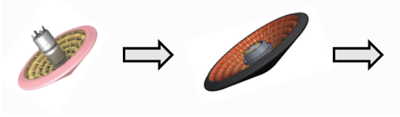
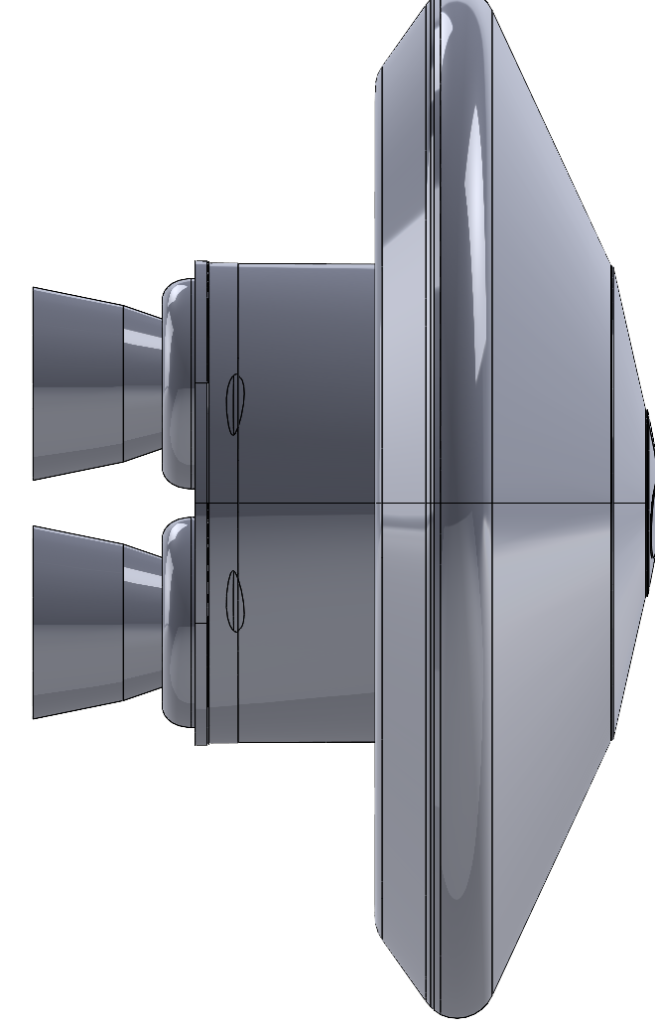
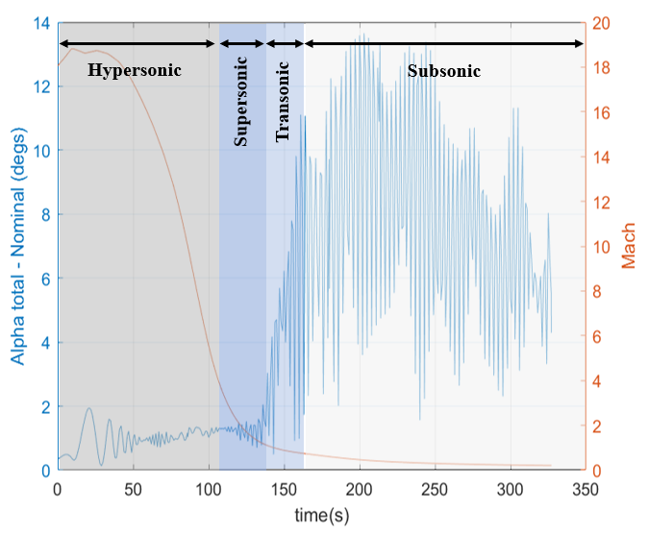
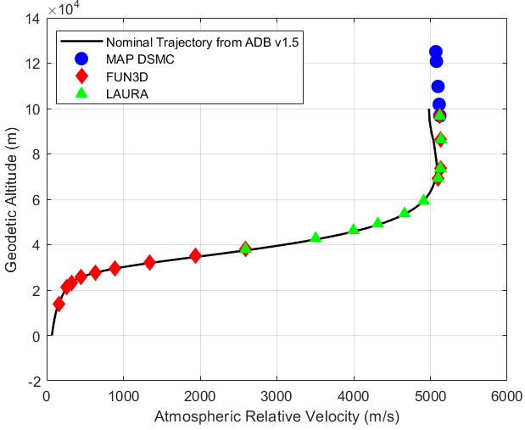
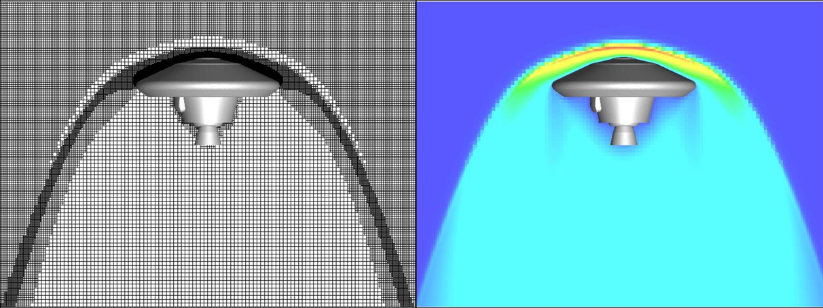

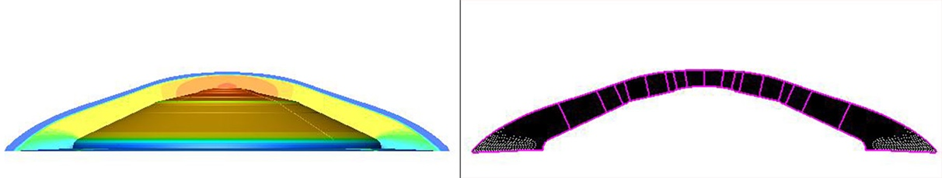

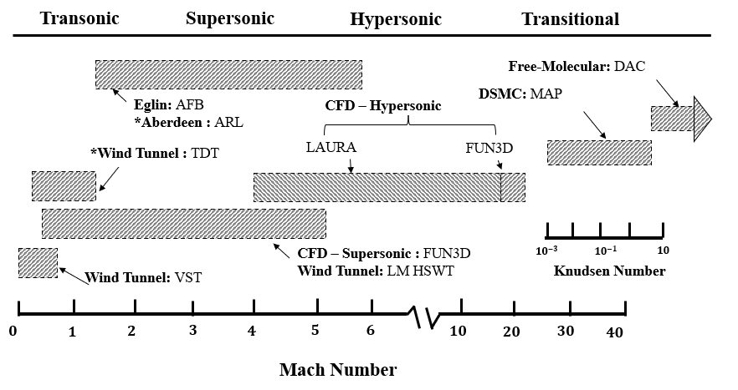
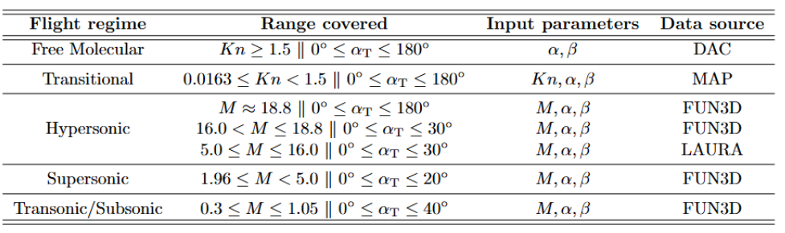
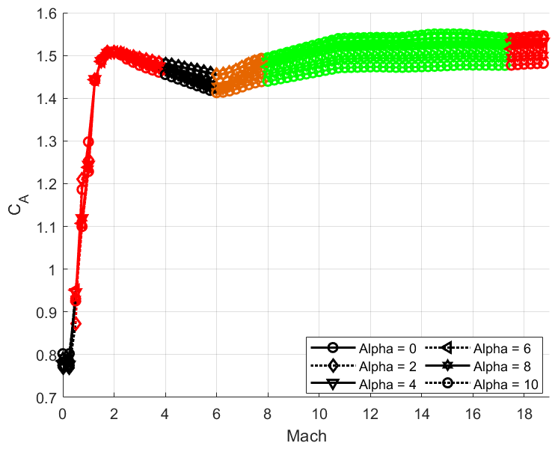
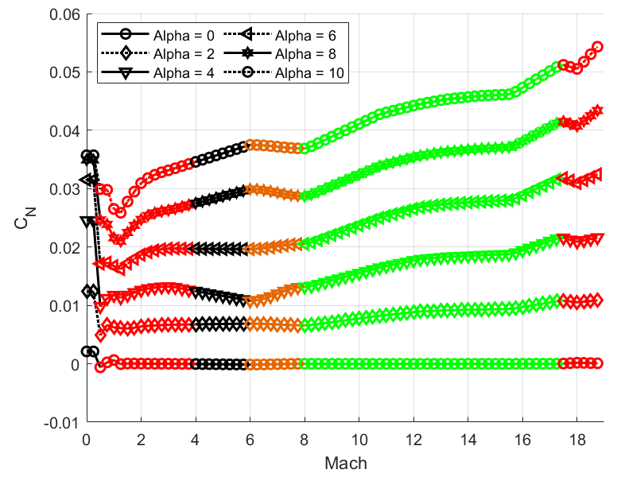
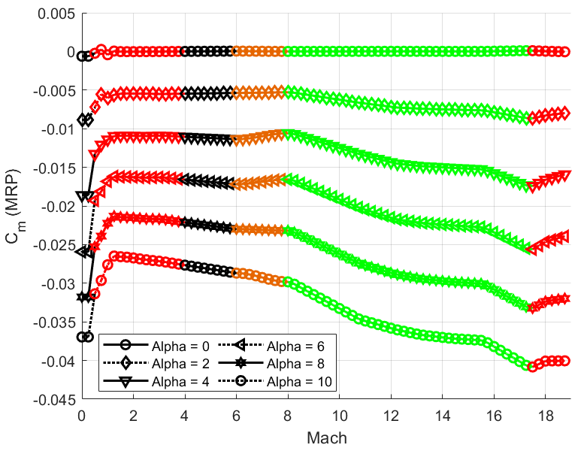
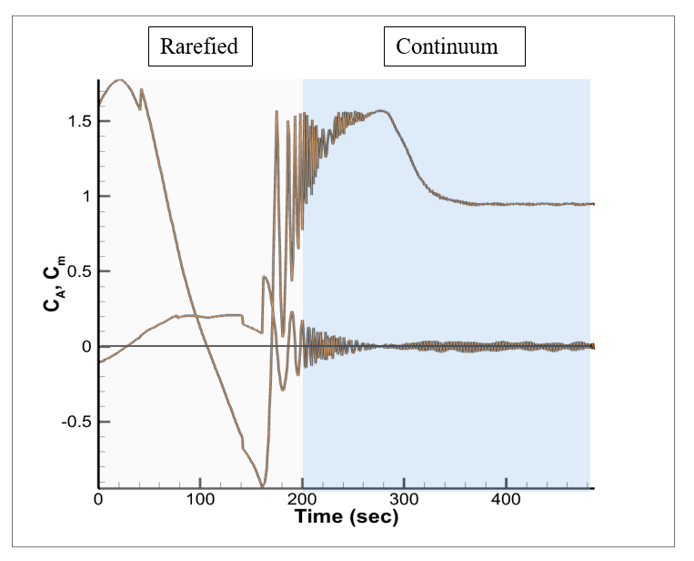
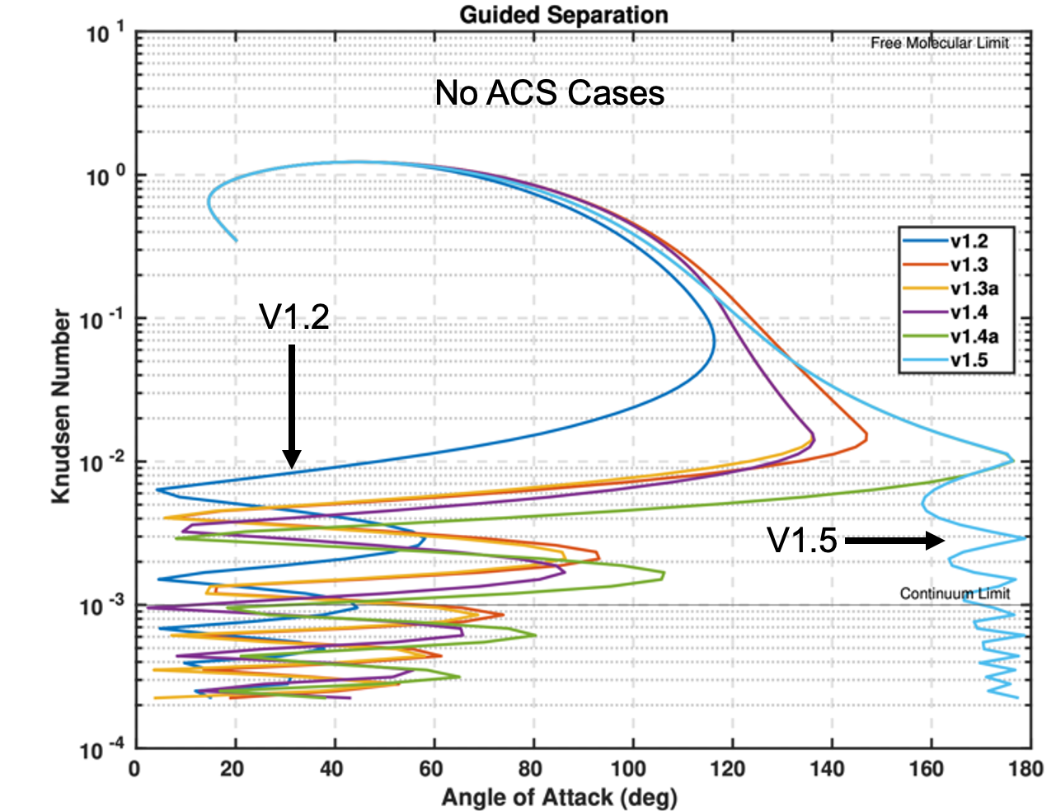
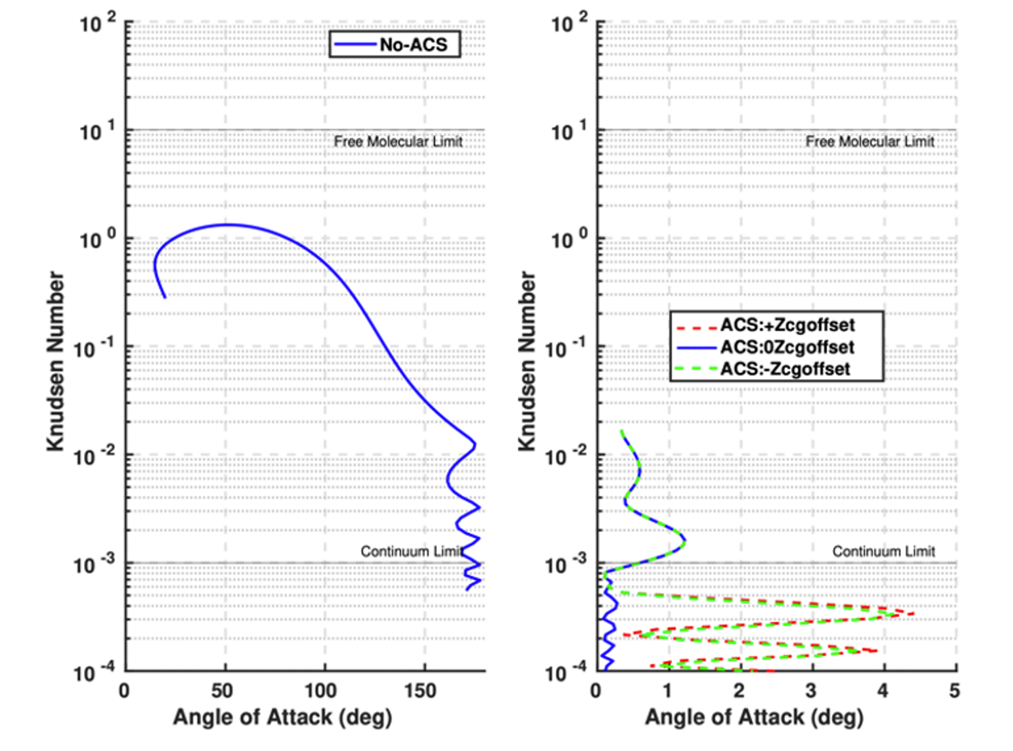
Aerodynamic Database Development for
Vulcan Engine Recovery Aeroshell (VERA)
Hisham Shehata¹, Soumyo Dutta²,
Michael Manwell¹, Ashley Korzun² and F. McNeil Cheatwood²
¹ Analytical Mechanics Associates, ² NASA Langley Research Center
IPPW, Stuttgart, Germany, 23-27 June 2025
Motivation
Workflow Architecture
Submission ID : 108
The size of traditional rigid aeroshells are constrained by launch vehicle diameter.
A Hypersonic Inflatable Aerodynamic Decelerator (HIAD) can be stowed for launch, then deployed prior to atmospheric entry, enabling the delivery of large payloads.
VERA questions: 1) Can Vulcan forego an attitude control system (ACS)? 2) Does large payload volume degrade dynamic stability enough that a supersonic drogue chute is required?
Max Diameter:
3 m 6 m >10 m
Aerosciences
ADB
Flight Mechanics
Aerodynamics database (ADB) provides 6-DOF static and dynamic aero coefficients when queried by POST2 during atmospheric flight trajectory simulation.
ADB draws from expertise, existing datasets, computational tools/methods, and historical implementation from IRVE-II, IRVE-3, and LOFTID flight demonstrations.
Inputs: Kn, V, M, α, β
Outputs : Force/moment static aero coefficients, dynamic damping aero coefficients.
Data Analysis
End Users
IRVE-3
LOFTID
VERA
CFD Support
Wind Tunnel Support
Ballistic Range Testing
Flight Test (For Validation)
IRVE: Inflatable Reentry Vehicle Experiment
LOFTID: Low-Earth Orbit Flight Test of an Inflatable Decelerator
Aerodatabase-ing and Modeling
Flight Trajectory Simulation (POST2)
  To answer these questions, VERA’s aerodynamics database (ADB) will include a larger angle-of-attack (AOA) domain and additional testing beyond the typical ADBs.
POST2: Program to Optimize Simulated Trajectories II
Aerodynamic Database Summary
Data Sources
MAP: Direct-Simulation Monte Carlo flow field solver
High-altitude, rarefied wake flow field simulations
Reacting gas chemistry with surface catalysis
Cartesian/cut-cell grid topologies.
LAURA: Navier-Stokes flow field solver
Hypersonic continuum flow field simulations
Reacting gas chemistry with surface catalysis
Structured grid flow field topologies
MAP: rarefied
LAURA: hypersonic
Baseline Trajectory (ADB v1.5 with ACS)
Trajectory Anchor Points
FUN3D: Navier-Stokes flow field solver
Full flowfield (forebody and wake) simulations
For hypersonic solutions at continuum limit, 5-species air is used. For supersonics and below, perfect-gas assumed.
Unstructured grid topologies
FUN3D: sub/trans/super/hypersonic
MAP: Monte Carlo Aerodynamics Package
LAURA: Langley Aerothermodynamics Upwind Relaxation Algorithm
FUN3D: Fully Unstructured Navier-Stokes 3D
Aerodynamic Database Output
Overview of Data Sources
Data Coverage (Static Aero)
Flight Trajectory Implementation – POST2
Without ACS
Without ACS
With ACS
Axial and pitch moment coefficients
Use of the V1.5 ADB, with its aerodynamic data from 0-180 deg (from MAP for transitional and FUN3D for high-altitude continuum), convinced the customer that an ACS was required to ensure proper orientation the reentry vehicle prior to hypersonic entry.
Conclusions
Future
Acknowledgements
The VERA ADB offers comprehensive and high-fidelity coverage characterizing the aerodynamics across rarefied and continuum regimes.
Expanded AOA domain of this ADB revealed need for ACS, and it has been added.
Low subsonic tests show good dynamic stability, but compressible subsonic, transonic and supersonic testing is needed to determine requirements for drogue parachute.
Ultimately, the ADB will include additional dynamic aero characterization from NASA Langley’s Transonic Dynamics Tunnel, as well as ballistic range tests at Aberdeen Proving Ground, to define drogue deployment conditions.
Collaborators include Brian Hollis, Adam Wise, Derek Liechty, Bruce Owens, and Matthew Rhode.
Corresponding author: Sam Shehata (Hisham.m.mhehata@NASA.gov)
Submission ID: 108

