Slide 1
Wireless Power Transfer for Space Applications
Multiple Ways to Bring Power to All Areas Night or Day
Dr. Darren Boyd
NASA Marshall Space Flight Center
Principal Investigator/Project Manager focused on
Solar Sail and Power Beaming Technologies
June 19, 2025
Notes:
Thank Les and Chris

Slide 2

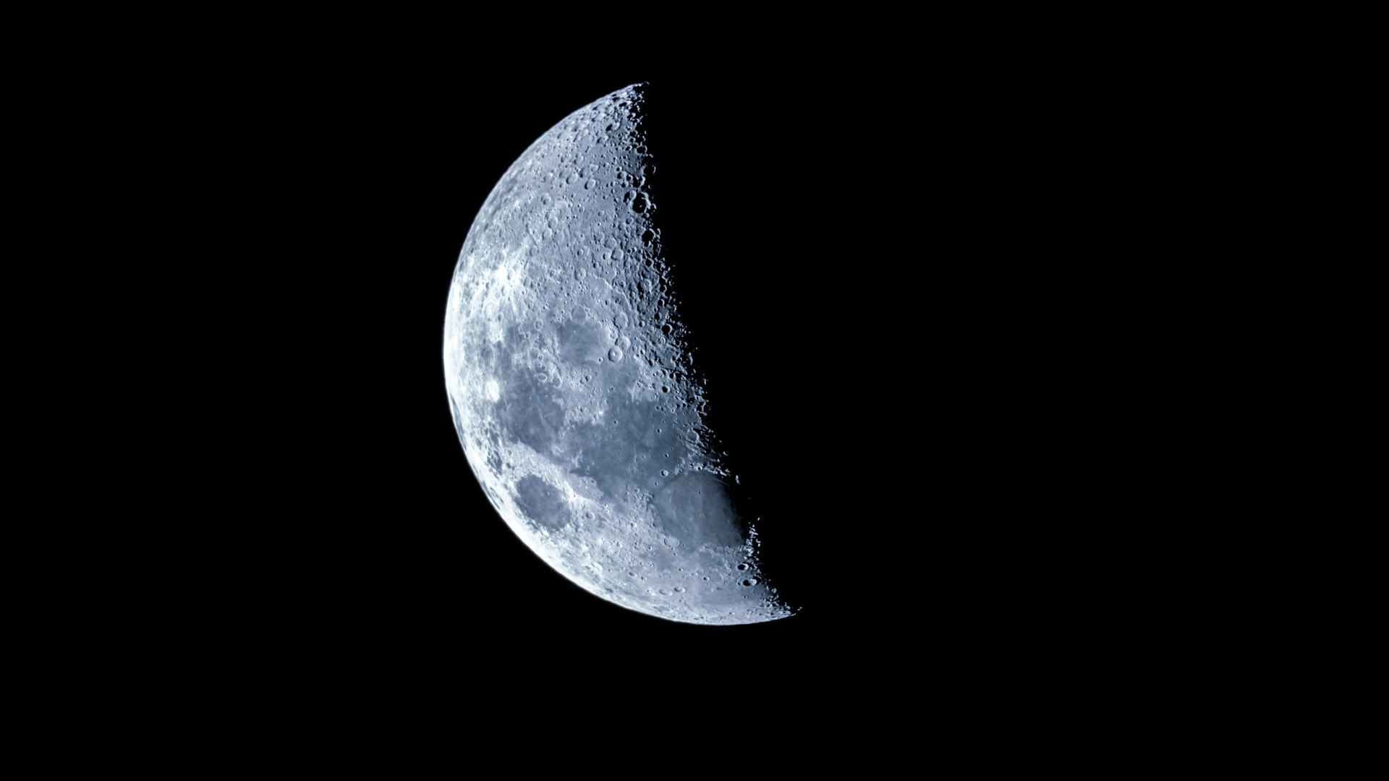
Power – The Key Commodity Needed to Explore the Lunar Surface
Equatorial Illumination Limits
  Cyclical periods of 14 days illuminated; 14 days dark
Illumination
The primary and scarce resource to produce power
The 14-day lunar night temperatures drop to ~-208ºF (140K)
  Most electronic systems will not survive
  Life limiting factor for both robotic and human missions
Polar Illumination Limits
  Intermittent with up to 100s hours darkness
  Highly dependent on location and elevation

Slide 3
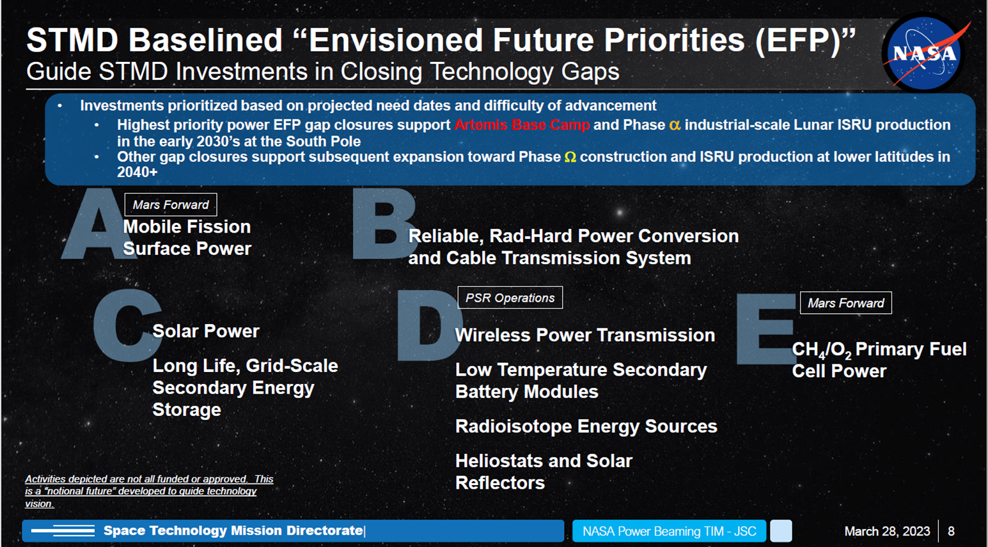
The Lunar Power Problem
Current Options:
  Include nuclear power or heat source (Limited Supply)
  Limit the mission to last only as long as the first lunar day it is on the Moon (Mission Limiting)
  Explore only the South Pole where power is nearly continuously available
Current thinking on providing remote power
  Cable from South Pole power source
    Limited distance a cable may be run
  Beam power from South Pole power source
    Line of sight limitations (tens of kilometers)
  Mobile surface nuclear reactor

Slide 4
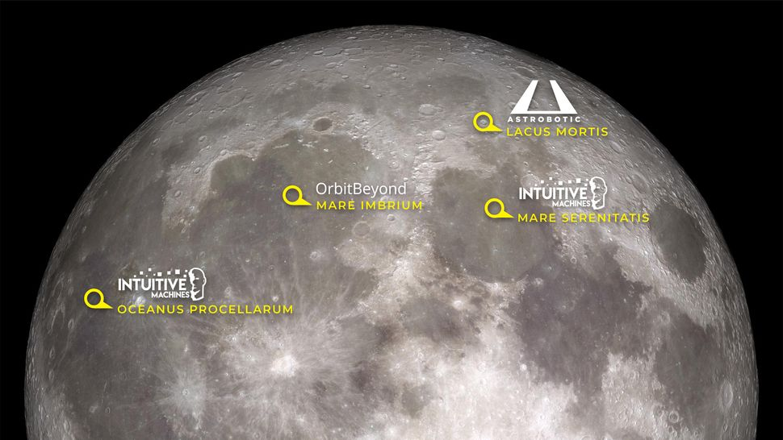
Scientists Want Global Lunar Access
(not just near the south pole)

Slide 5
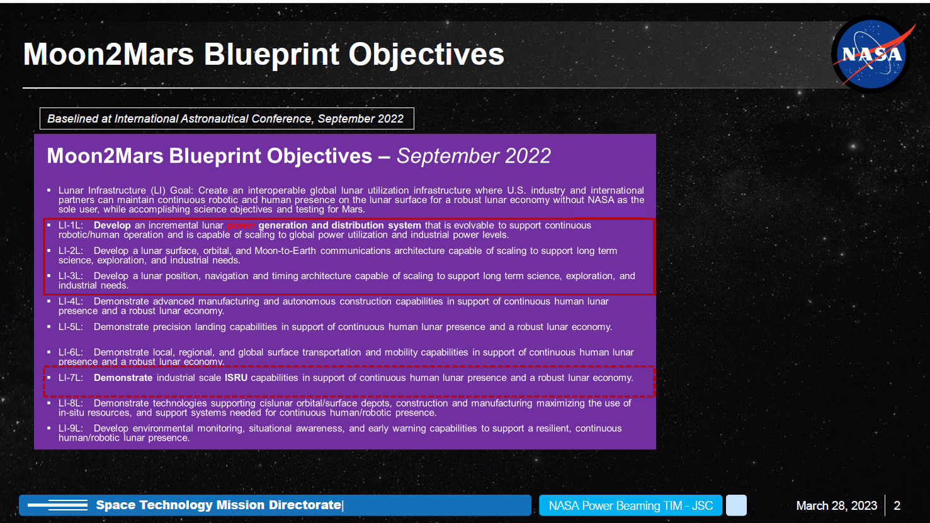
NASA’s current plans do not lead to as-needed “global power” for utilization

Slide 6
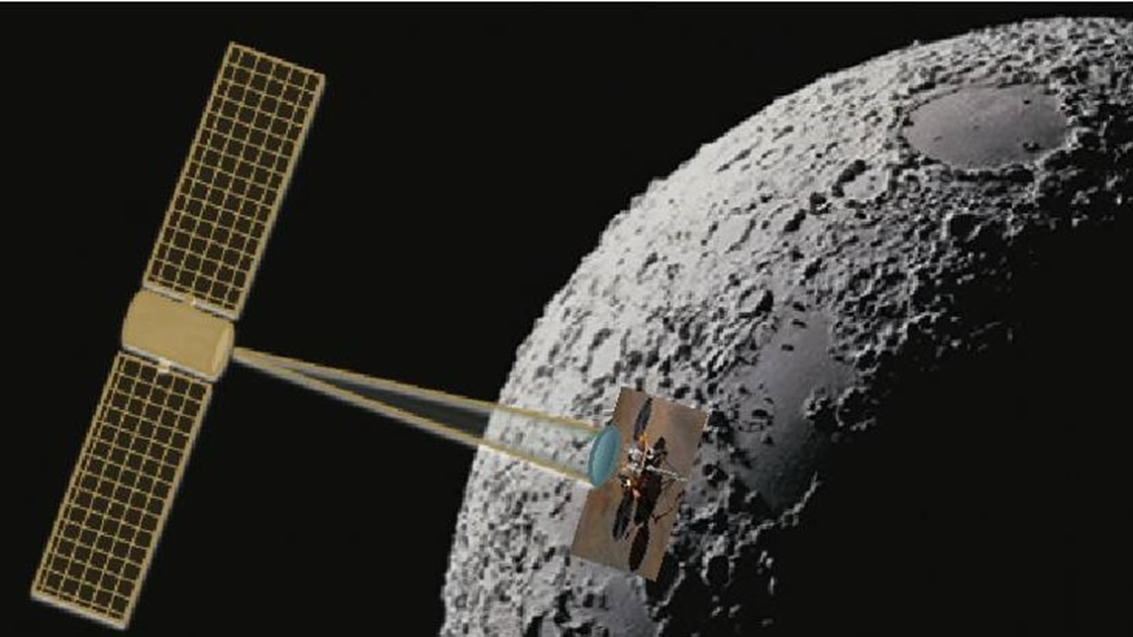
What if we can provide power anywhere on the Moon from space?
Enables (some examples):
Multiple landers and rovers operating continuously anywhere on the moon
Crewed campsites or bases anytime anywhere on the moon
Free from the tyranny of the lunar night

Slide 7
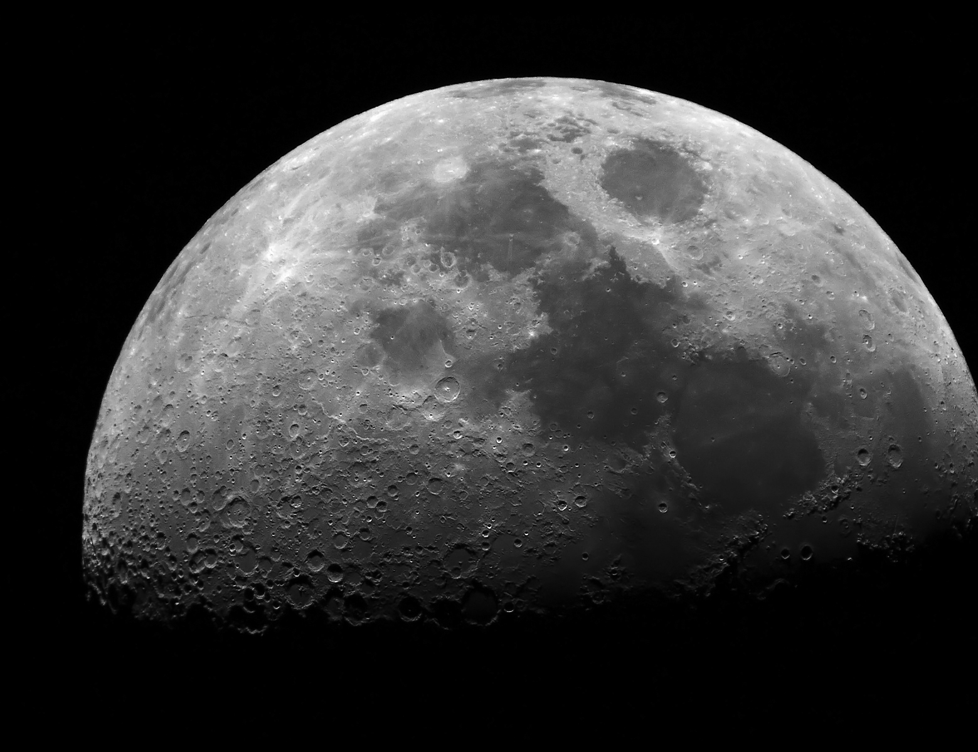

Putting the Pieces Together
Formulating a multi-technology roadmap approach
  Laser
  Radio Frequency (RF)
  Investigating others
For multiple applications and power needs
  Robotic Rovers
  Habitats
  Crewed Rovers
  Lunar Surface Manufacturing
With multiple partnerships!

Slide 8
Recent Efforts in Wireless Power Transfer
History of small-scale energy harvesting for sensors
Use of recently developed NASA Marshall Space Flight Center ultra-lightweight deployable antennas as rectennas in microwave power beaming applications with custom electronics
Pursuing opportunity to partner on space based solar power orbit to surface microwave demonstration
Partnerships in current proposals for optical power beaming
Investigation of surface to orbit optical power beaming demonstration
Participation/leadership in NASA agency study on space based solar power
Various other collaborations in space based solar power for lunar and Mars applications
Partnership with Tennessee Tech University on Quasi-Wireless Energy Transfer technologies
Power beaming roadmap development

Slide 9
Lunar Surface Asset Power
Requirements Estimates
 | Small Robotic Rover |  | VIPER Sized Robotic Rover |  | Lunar Base | Crewed Rover
 | Survival | Operating | Survival | Operating | Operating | Survival | Operating
Power Required | 5 W | 30 W | 100 W | 450 W | 50,000 W | 2000 W | 6000 W
Total Daily Energy Required | 120 Whr | 720 Whr | 2400 Whr | 10,800 Whr | 1,200,000 Whr | 48,000 Whr | 144,000 Whr

Slide 10
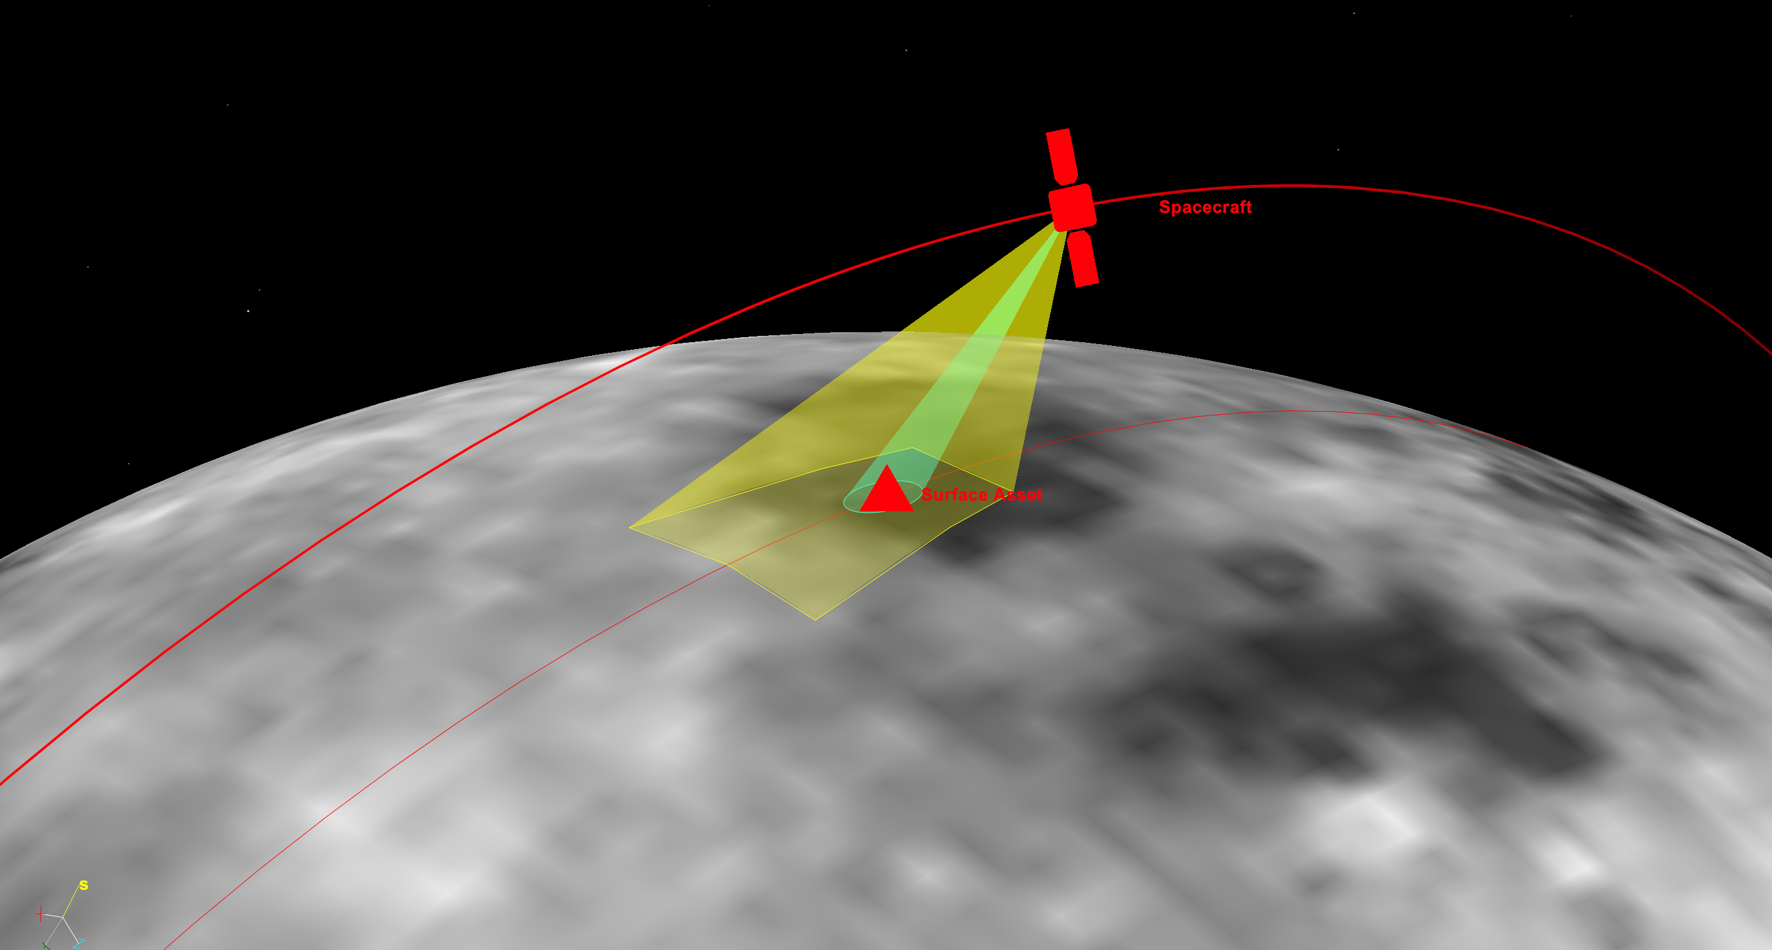
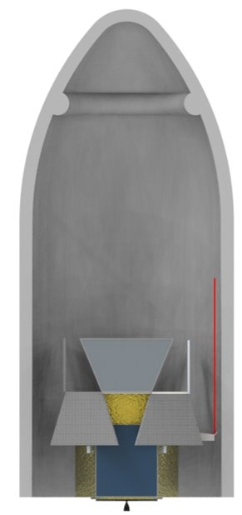
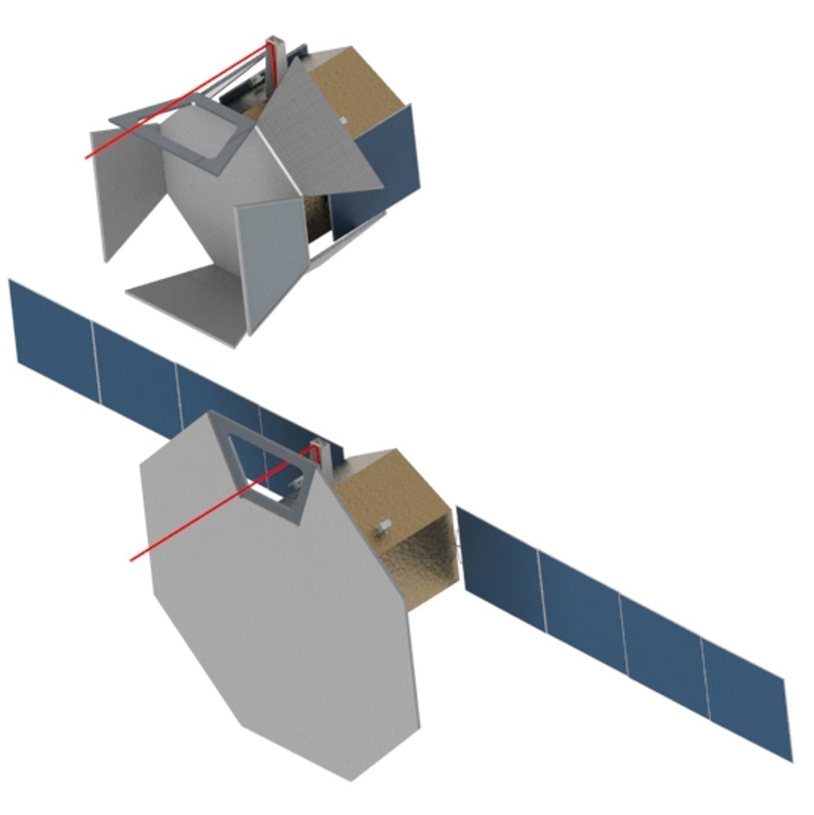

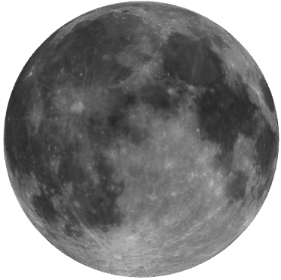
ACO Concept for a Lunar Orbiting Space Beamed Power Demonstration
Goal: Demonstrate power beaming from an orbiting spacecraft to a surface asset using laser and RF
  No new technology needed for spacecraft bus
  All beaming technology exists for Earth use
250 km orbit
Laser and RF demonstrated on same spacecraft, but NOT AT THE SAME TIME
laser
RF
1 year mission
Risk Class D
Dedicated launch vehicle, post-TLI release of spacecraft
Study team assumed the Surface Assets are carried on CLPS lander:
15 m² conventional PV array;
100 m² rectenna
Receiving Asset on Lunar Surface
2.5 m
Position known to within 10 m; laser fine pointing resolves uncertainty
Stowed
LEO
Spacecraft and Mission Parameters
Spacecraft Mass | 2300 kg
Propulsion Type | Monoprop hydrazine
Mission Delta-V | 1100 m/s (includes 9.4% margin; 15% desired)
Laser power | 1 kW output / 250 W at target
RF power | 2 kW output / < 1 W at target
Falcon 9
LOI
6 m
25 m²
16 m
LLO
Deployed
TLI

Slide 11
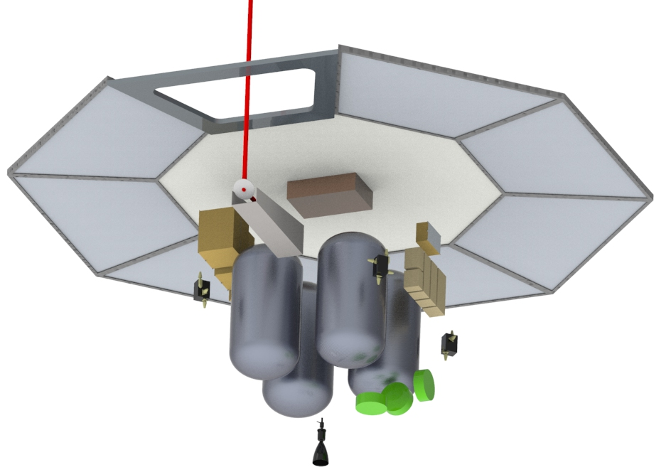
Concept Demonstrates Both Laser and RF
2300 kg total mass
Power
Deployable solar arrays (not shown) and secondary batteries; 1.2 kW spacecraft; 3.3 kW power beaming system; 4.5 kW total peak during discharge
Laser cutout
Deployed RF Array
(25 m²)
Thermal
Employs spacecraft structure as radiator, fluid loop, phase change material (PCM); PCM needed to absorb heat during power beaming; recharged within 1 orbit for use during next power beaming event
Laser box
Laser steering mirror
Power
boxes
Avionics
GNC
3-Axis stabilized; reaction wheels for attitude control; RCS for momentum unloading
RCS
Mechanisms
Solar array deployment; Deployable radiator; RF phased array antenna deployment; Laser pointing mirror
Propulsion
Blowdown hydrazine system; 2 @ 100lbf main thruster; 4 pods of 4 @ 5 lbf thrusters RCS
Momentum wheels
Main thruster
(1 shown, but
s/c has 2)
Structures and Avionics
Standard, low risk designs

Slide 12

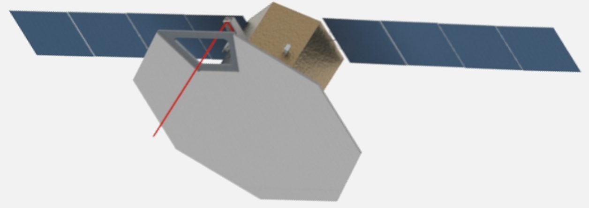
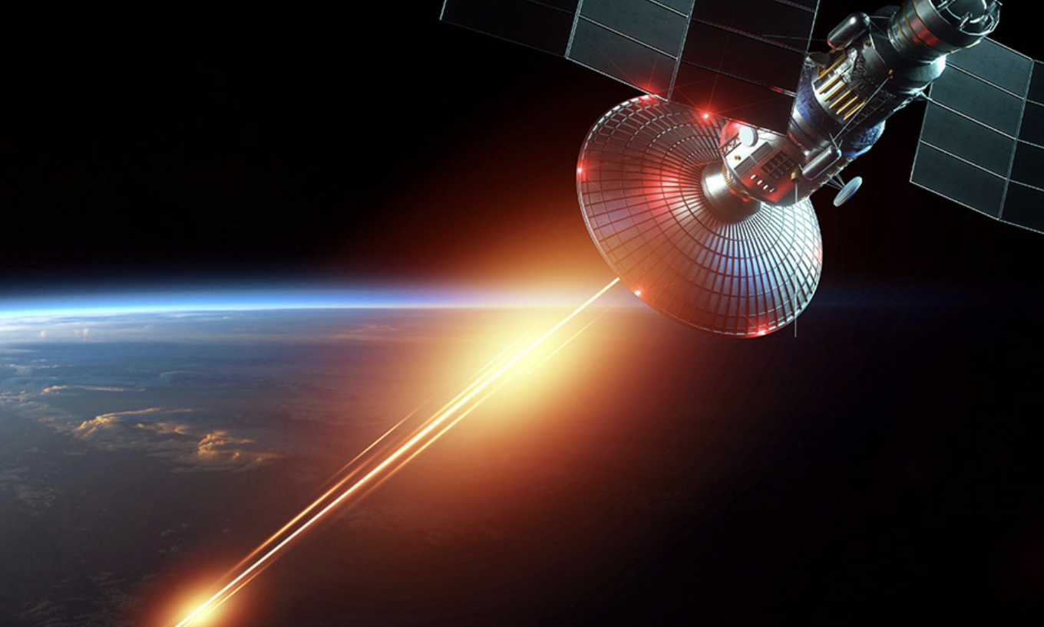

Demo Mission Power Beaming Technologies: Laser
To LASER
Power Supply
Battery
BATTERY is the source of energy during laser operation

Slide 13
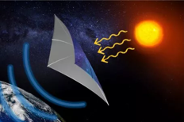
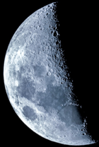
Demo Mission Power Beaming Technologies: Microwave RF
Power Supply
RF Beamer
Battery

Slide 14
Can the Demo Mission Provide Residual Capability Immediately?
 | Small Robotic Rover |  | VIPER Sized Robotic Rover |  | Lunar Base | Crewed Rover
 | Survival | Operating | Survival | Operating | Operating | Survival | Operating
Power Required | 5 W | 30 W | 100 W | 450 W | 50,000 W | 2000 W | 6000 W
Total Daily Energy Required | 120 Whr | 720 Whr | 2400 Whr | 10,800 Whr | 1,200,000 Whr | 48,000 Whr | 144,000 Whr
Laser Demo Meets Rqmt? | Yes | Yes | Possible; Case by case | Possible; Case by case | No | No | No
If we did the demo at a higher altitude (500 km for example), we would get about 1.8x more energy since the pass time is higher

Slide 15
ACO Study Summary Results
Radio Frequency (RF) versus optical power beaming assessment:
  Determined that RF scaled most efficiently to higher powers required (40 kW – 50 kW) for crew applications
    Requires large (100s of square meters) rectenna to be deployed on the surface near the asset
  Determined that optical scaled most efficiently for robotic missions, landers and rovers (Up to ~10kW)
    Uses existing solar panels; no new receiver required for the users
The demo mission would demonstrate both technologies on the same spacecraft
  250 km altitude circular orbit
  Spacecraft power system sized to operate a laser system that could deliver 250 W dc to the user (assume solar panel 25% efficiency; a 1 kW laser power illuminating the surface solar panel)
  The RF system on the spacecraft would be sized to use the same spacecraft power system, accepting the resulting very low power at the surface asset (~1 W)

Slide 16
Lunar Space Solar Power
A Possible Technical Phased Approach
Nearest term users will be robotic
  Optical beamed power delivered to the surface by the demonstration will be of sufficient magnitude to be immediately usable by robotic surface systems (250 W at the solar panel)
  10 - 100 W/m² at the surface
Farther term users will include human habitats (40 – 50 kW required)
  RF [5.8 GHz] beamed power delivered to the surface by the demonstration will NOT be of sufficient magnitude to be immediately usable by habitats or crewed systems (1 W at the rectenna)
    Higher frequency systems require smaller antenna/rectenna combinations, but the technology is not as mature
  Additional, higher-power system will have to be deployed
Full scale system will likely include multiple spacecraft power stations
  Reduces the power generation and beaming requirement for each spacecraft element
  Economies of scale should benefit system implementation cost

Slide 17
Questions?
Dr. Darren Boyd
NASA Marshall Space Flight Center
darren.r.boyd@nasa.gov

Slide 18
BACK-UP

