Slide 1
Unveiling the System-of-Systems Complexity in Regenerative ECLSS: Insights from ISS
ICES-2025-125
Presenter/ Co-author: Cynthia Reuland, Aerodyne Industries
NASA JSC EC3 ECLS Subsystem Manager
Authors: Leon Chen, The Aerospace Corporation
Joseph Rivas, Amentum
William Misek KBR Wyle Services
Alicia Rangel NASA JSC EC3
54th International Conference on Environmental Systems (ICES)
13-17 July 2025, Prague, Czech Republic
Trade names and trademarks and company names are used in this report for identification only. Their usage does not constitute an official endorsement, either expressed or implied, by the National Aeronautics and Space Administration

Slide 2
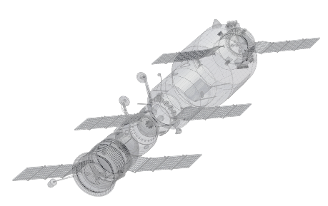
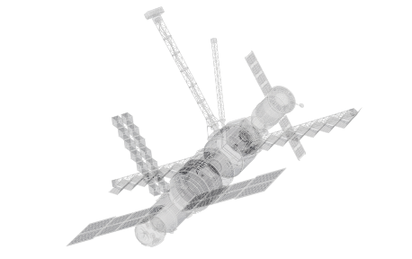
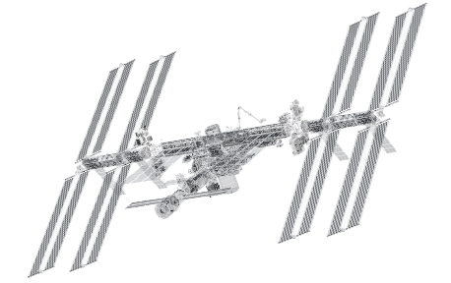
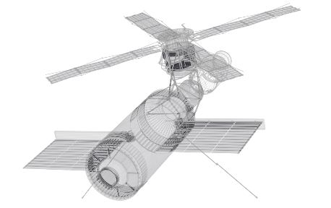
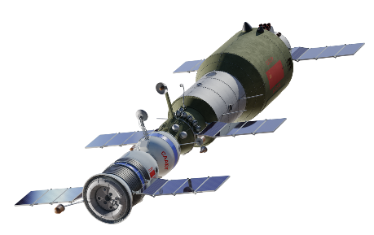
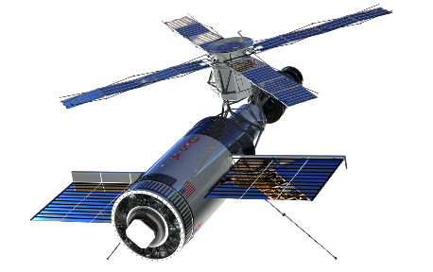
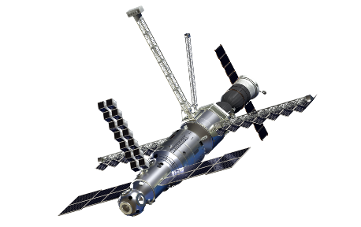
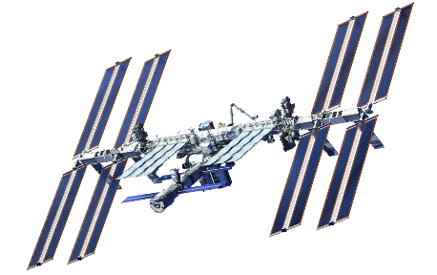
Importance of ECLSS to Human Spaceflight
Humans have a long history of spaceflight aboard various spacecraft and one of the key systems that keep astronauts alive is the ECLS system
ECLSS plays an essential role in accomplishing the goal of sustaining human presence as its absence would render human space exploration impossible and severely restricted
Life support systems are also essential for enabling long-duration space missions, such as those that involve crewed missions to the Moon, Mars, or beyond
These missions require systems that can generate and recycle resources, such as air, water, and food, as resupply missions may not be possible or feasible
Salyut-1 [24]
April 1971 – October 1971
Skylab [25]
May 1973 – February 1974
Mir [26]
February 1986 – March 2001
ISS [27]
Nov 1998 - Current
Notes:
[24] Uri. J, “50 Years Ago: Launch of Salyut, the World’s First Space Station,” NASA, April. 2021.
[25] Uri.J, “50 Years Ago: The Launch of Skylab, America’s First Space Station,” NASA, May. 2023.
[26] “Space Shuttle – Mir,” NASA
[27] “International Space Station,” NASA

Slide 3
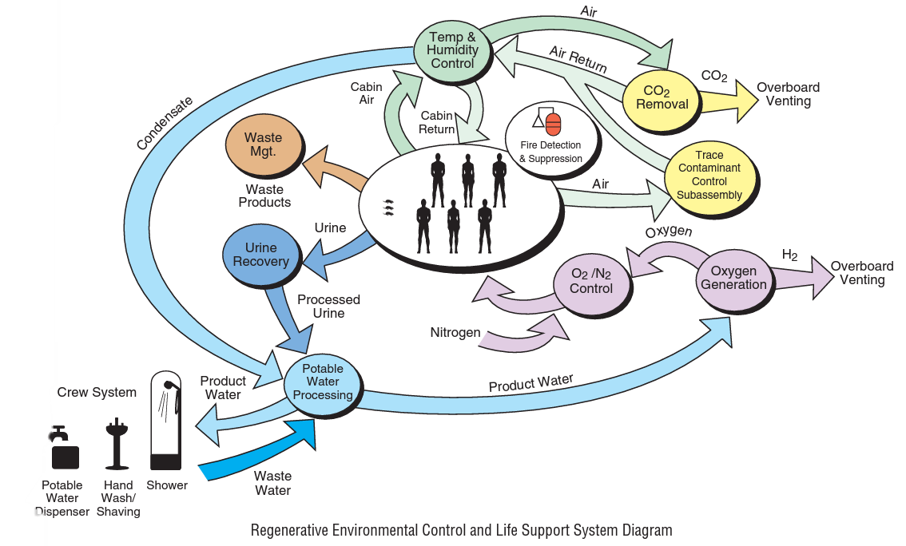
The Prevailing Challenge of ECLSS
The constituent subsystems of an ECLSS exhibit a high degree of interconnectivity and mutual dependency, forming a complex, integrated network
Conventional analytical approaches have predominantly focused upon discrete components or individual subsystems, often neglecting that the emergent complexities manifest at the holistic system-of-systems stratum
Consequently, a comprehensive apprehension of these systemic interdependencies, requisite for robust technological assessment and overarching system-level optimization, frequently remain elusive

Slide 4
The Imperative of a System-of-Systems Paradigm
Isolated Subsystem Development:
Historically, the development and testing of individual ECLSS subsystems, for instance, oxygen recovery apparatus, have often proceeded in relative isolation
Such a siloed approach may inadvertently overlook or inadequately account for the cascading downstream repercussions upon interconnected subsystems, including, but not limited to, water reclamation and waste management architectures
Holistic System-of-Systems Perspective
This paradigm facilitates a comprehensive, cross-functional evaluation of the entire life support architecture.
Modifications within a singular subsystem can be assessed for their potential to perturb or enhance the functionality of the integrated whole, thereby revealing complex interrelationships.
The adoption of this perspective is conducive to the enhancement of overall system functionality, resilience, and optimization.
It is considered fundamental for the rigorous evaluation of novel technologies, the execution of comprehensive trade studies, and the establishment of frameworks for long-term operational sustainability.

Slide 5
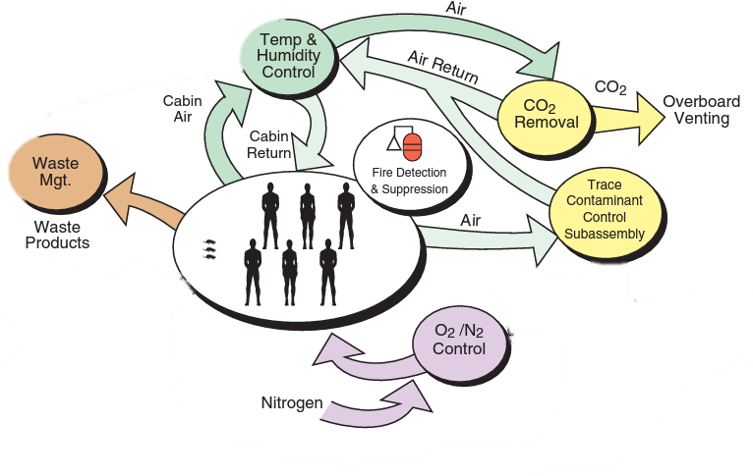
The ISS as a Preeminent Experimental Testbed
ISS serves as a prime example with its long-standing and evolving ECLS systems
The ISS is equipped with an advanced regenerative ECLSS architecture, representing a zenith of current operational capabilities in closed-loop life support.
An extensive corpus of operational data, accumulated over several decades of continuous human presence and system management, provides an unparalleled empirical foundation.
The ISS serves as an invaluable analogue and source of practical insights for the design and development of future orbital/surface habitats, including emergent commercial Low Earth Orbit (LEO) platforms.
Trace Contaminant Control System
Major Constituent Analyzer
Urine Processing Assembly
Carbon Dioxide Removal Assembly
Water Processing Assembly
Atmosphere Revitalization rack
Water Recovery System Racks
2001
2008
2007
Open Loop
LiOH Can
Oxygen Generation System Rack
Air Bags
Oxygen Generation Assembly
O₂ and N₂ Air Tanks
Matured ISS ECLSS Systems
Early ISS ECLSS Systems
Notes:
The objective is to leverage the substantial repository of ISS operational knowledge to inform and refine the design parameters for future ECLS systems, with a view towards achieving enhanced robustness and operational efficiency.

Slide 6
Methodology of System Decomposition
Analytical Approach: A systematic deconstruction of the major ECLS subsystems is undertaken to meticulously examine:
The constituent components and their designated functionalities
The nature and extent of interdependencies, including resource flows and control signal exchanges
Potential failure modalities and the consequential impacts propagated throughout the interconnected system
Principal ISS ECLSS Subsystems Subject to Analysis:
Water Recovery and Management (WRM)
Waste Management (WM)
Atmosphere Control and Supply (ACS)
Oxygen Generation System (OGS)
Temperature and Humidity Control (THC)
Atmosphere Revitalization (AR)

Slide 7
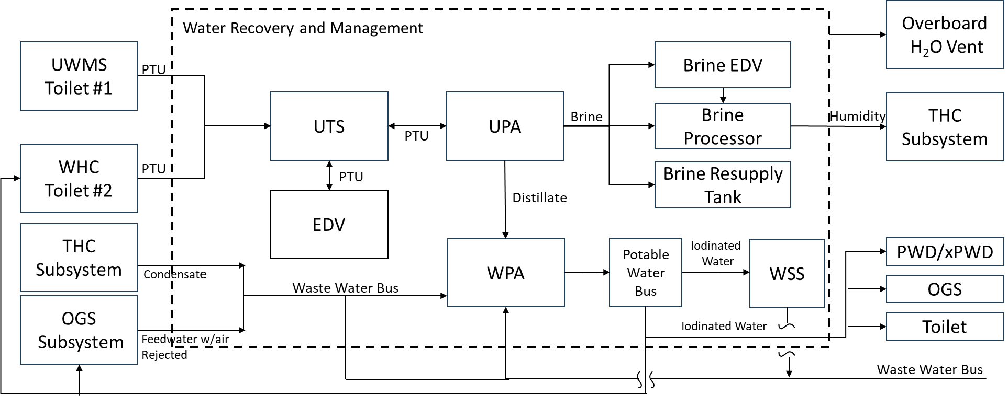
Water Recovery and Management (WRM) Subsystem
The WRM subsystem is tasked with the storage, distribution, collection, processing, and ultimate disposal of water, ensuring the provision of potable water for crew consumption, oxygen generation, and other essential applications
Notes:
Principal Components:
Condensate and Wastewater Distribution Network.
Condensate Storage Tank.
Water Recovery System (WRS), comprising:
Water Processor Assembly (WPA): Processes UPA-derived distillate, humidity condensate, and Sabatier product water to potable standards via a multi-stage process involving filtration, catalytic oxidation, and ion exchange.
Urine Processor Assembly (UPA): Employs Vapor Compression Distillation (VCD) for the reclamation of water from pretreated urine, yielding distillate and a concentrated brine byproduct.
Brine Processor Assembly (BPA): A technology demonstration unit designed to effect further water recovery from UPA brine through membrane distillation techniques.
Urine Transfer System (UTS) and Water Storage System (WSS).
Key System Interfaces: Receives influent from the Universal Waste Management System (UWMS)/Waste and Hygiene Compartment (WHC); provides processed water to the Oxygen Generation System (OGS); receives condensate from the Temperature and Humidity Control (THC) subsystem.

Slide 8
Waste Management (WM) Subsystem
The WM subsystem is responsible for the systematic collection, processing, and disposal of human metabolic waste products, a function critical for maintaining crew health and habitable conditions
UPA
Pretreated
Urine
WPA
Waste Management
Visiting Vehicle
Potable
Water
Solid
Waste
AR
Subsystem
Odor
Notes:
ISS Waste Collection Apparatus:
ACY toilet (located in the Service Module).
Waste and Hygiene Compartment (WHC) (US Orbital Segment).
Universal Waste Management System (UWMS) (US Orbital Segment; currently in a non-operational status).
WHC Integration within ECLSS:
Collected urine is transferred to the UPA for water reclamation.
Solid waste is containerized and designated for disposal via departing cargo vehicles, which undergo destructive atmospheric reentry.
Key System Interfaces:
Provides pretreated urine influent to the UPA.
Interfaces with the Air Revitalization Subsystem (ARS) for the management of airflow, odor, and humidity control.
Interacts with the thermal control system, which dissipates heat generated during UPA distillation processes.
Interfaces with visiting cargo vehicles for the offloading of solid waste.

Slide 9
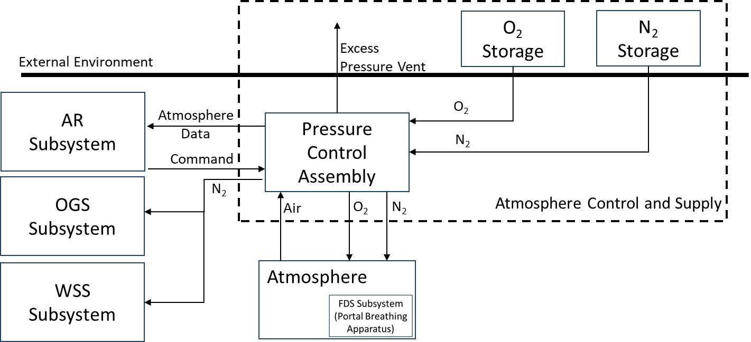
Atmosphere Control and Supply (ACS) Subsystem
Core Functions of ACS:
To maintain a safe, breathable, and verisimilar terrestrial atmosphere within the ISS, regulating total pressure within specified parameters (typically 724-770 mmHg)
To monitor atmospheric composition and provide replenishment of Oxygen (O₂) and Nitrogen (N₂) as dictated by consumption and leakage rates
To support nominal mission operations, Extravehicular Activities (EVAs), and inter-module pressure equalization
Notes:
Sources of Atmospheric Constituents: Resupply via Progress and ATV cargo vehicles, in-situ generation via Elektron and OGA systems, utilization of High-Pressure Gas Tanks (HPGTs), and planned integration of the Nitrogen Oxygen Recharge System (NORS).
Principal Components:
Pressure Control Assembly (PCA): Monitors total atmospheric pressure, detects rapid depressurization events, modulates the introduction of O₂ and N₂, provides vacuum access, and incorporates overpressure relief mechanisms.
Key System Interfaces:
Supplies oxygen to the Fire Detection and Suppression (FDS) system for Portable Breathing Apparatus (PBA) utilization during emergencies.
Exchanges data with the ARS (specifically, the Major Constituent Analyzer - MCA) regarding partial pressures of atmospheric gases.
Provides nitrogen to the OGS for purging operations.
Interfaces with the Water Storage System (WSS) as part of integrated resource management.

Slide 10
Oxygen Generation Subsystem(OGS)
The OGS is designed to produce molecular oxygen for crew respiration via the electrolytic dissociation of water
Oxygen Generation Assembly (OGA):
Comprises multiple Orbital Replacement Units (ORUs) that facilitate the electrolysis process, including water feed management, deionization, the electrolysis cell stack, oxygen outlet conditioning, hydrogen sensing and separation (Rotary Separator Accumulator - RSA), process control, and nitrogen purge capabilities.
Feedwater with air Rejected
WRM
Atmosphere
Oxygen Generation System
O₂
Potable
Water
ACS
H₂
N₂
Sabatier
Vent
Notes:
Key Components (housed within the OGA Rack):
Key System Interfaces:
Receives potable feedwater from the Water Recovery System (WRS); water containing excessive entrained gas is rejected back to the WRS.
Delivers generated oxygen directly to the ISS cabin atmosphere.
Transfers the hydrogen byproduct to the Sabatier system for further processing (water and methane production) or, alternatively, vents excess hydrogen to the vacuum of space.
Receives nitrogen from the ACS for internal purging procedures.

Slide 11
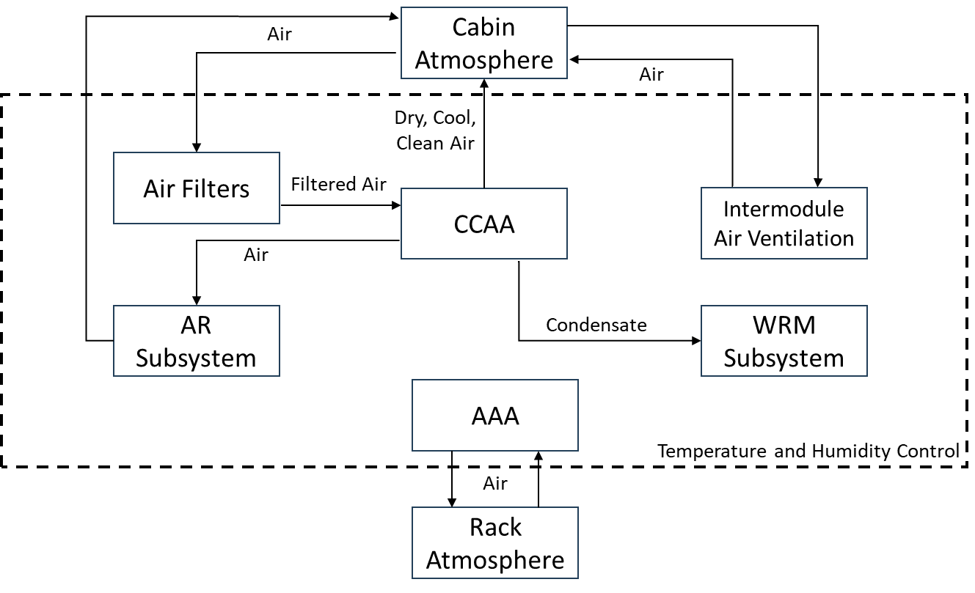
Temperature and Humidity Control (THC) Subsystem
Core Functions of THC:
To thermally condition and actively circulate the cabin atmosphere
To remove humidity to provide to the WRM for processing
To provide intramodule and intermodule ventilation (IMV)
To perform particulate and activated carbon filtration for contaminant removal for improved WRM input
To ensure adequate airflow for the effective operation of smoke detection systems
Principal Hardware:
Common Cabin Air Assemblies (CCAA): Integrated units containing fans, condensing heat exchangers, and water separators
Intermodule Ventilation (IMV) fans and valves: Facilitate controlled air exchange between ISS modules
Avionics Air Assembly (AAA): Provides dedicated cooling for avionics racks and payload equipment.
Notes:
Redundancy Considerations: Redundancy is a critical design feature, particularly given the centralized nature of certain ECLS functions (e.g., WRM and ARS). Strategies include R&R of ORUs, redundant CCAA units in specific modules (e.g., USL), and the availability of portable ventilation units.
Key System Interfaces:
Provides conditioned (cooled and dehumidified) air to the ARS, enhancing the efficiency of CO₂ removal and trace contaminant control processes.
Transfers condensate collected by CCAA water separators to the WRS wastewater bus for subsequent reclamation.

Slide 12
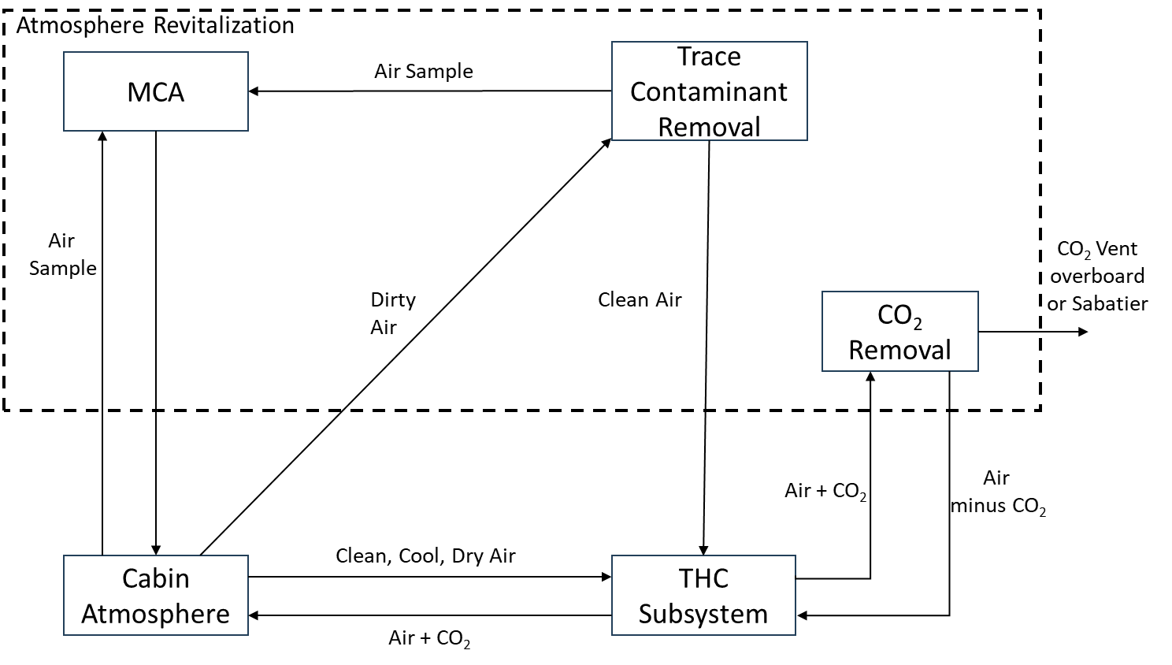
Atmosphere Revitalization (AR) Subsystem
Core Functions of AR:
To remove carbon dioxide (CO₂) produced as a byproduct of crew respiration
To control and remove trace chemical contaminants originating from material off-gassing, metabolic processes, and other sources
To monitor the concentrations of major atmospheric constituents
Principal Components:
Carbon Dioxide Removal Assembly (CDRA): Sequesters CO₂ from the cabin air; the collected CO₂ is either vented overboard or directed to the Sabatier reactor to close the loop
Trace Contaminant Control System (TCCS): Employs sorbent beds and catalytic oxidation to remove a broad spectrum of volatile organic compounds and other trace contaminants
Major Constituent Analyzer (MCA): Monitors and reports the partial pressures of key atmospheric components, including O₂, N₂, CO₂, H₂, CH₄, and H₂O.
Notes:
Key System Interfaces:
Receives conditioned air from the THC subsystem to optimize CDRA performance; THC AAA units provide cooling for AR equipment racks.
The MCA provides atmospheric composition data to the ACS, which may inform O₂ N₂ resupply decisions.
The CDRA interfaces with the regenerative ECLSS by supplying CO₂ to the Sabatier Reactor System.

Slide 13
Synthesis: The Comprehensive Interconnectivity Matrix
The intricate network of interconnections underscores the profound importance of:
Integration-aware design philosophies
Coordinated and holistic subsystem management strategies
Notes:
Visualizing the System-of-Systems Architecture:
Presentation of ISS ECLSS Interconnectivity Table
It should be explained that highlighted cells within this matrix denote direct operational dependencies or shared resource pathways between the corresponding subsystems.
Emphasis should be placed on how this matrix serves as a cogent visual representation of the deeply integrated, systemic nature of the ECLSS.

Slide 14
Conclusion and Future Implications
A thorough and nuanced understanding of ECLSS interconnectivity is posited as indispensable for the advancement of life support technology
Advantages of the System-of-Systems Approach:
It mitigates the risks associated with developing subsystems in isolation, fostering a more integrated and synergistic design process
It is conducive to enhancements in overall system compatibility, operational efficiency, and performance robustness
Ultimately, it contributes to augmented mission sustainability and crew safety
The ISS as a Foundational Precedent:
The decades of operational experience accrued from the ISS program yield an invaluable repository of empirical data and practical insights
This knowledge base is of critical relevance to the development of future commercial space stations and habitats intended for deep-space exploration
Prospective Outlook:
The adoption of this systemic framework is anticipated to facilitate the seamless integration of emergent technologies, thereby ensuring that future life support architectures are not only reliable but also scalable and resilient to meet the evolving demands of human space exploration

Slide 15
Questions?
JSC
Crew & Thermal
Systems
Division

