Slide 1
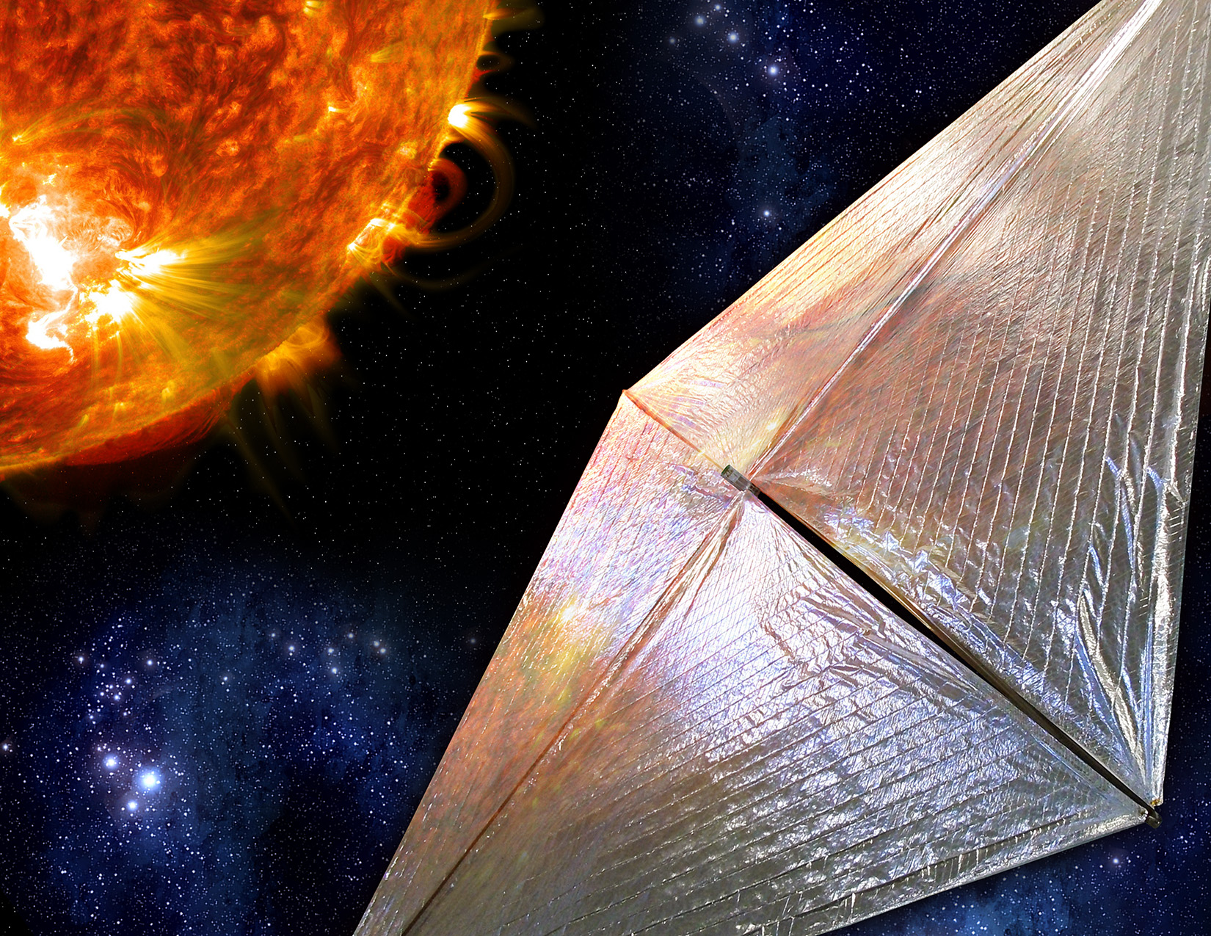

Applications of Solar Sail Technology Towards Conventional Missions
John Inness, Darren Boyd, Andressa Johnson, and Michael Fritzinger
NASA MSFC
Benjamin Diedrich
Astrion
ISSS 2025

Slide 2
Solar Sail Flight Hardware Unique Requirements
Ultra-low mass components (avionics, structures) to enable highest A_{c}
Need for large sail area drives need for deployable lightweight structures
Challenging thermal environments, including thermomechanical interactions of sail, sail deployment system, and sail shape
The large, flexible, time varying nature of solar sails requires sophisticated G&C designs
Sail material must be ultra-light while also being resistant to wrinkling, tears and darkening from radiation exposure
Power generation must be compatible with highly constrained trajectory designs
Very difficult to test on earth!

Slide 3
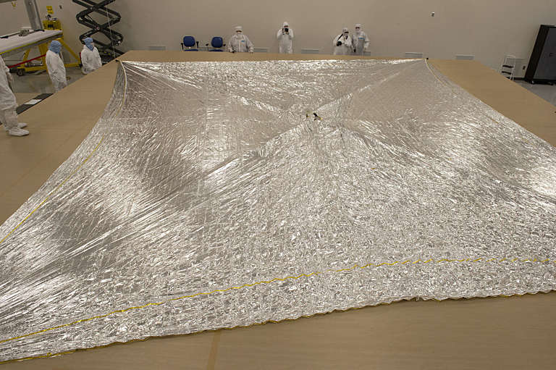
Solar Sail Thin Film Membrane
The “sail” of a solar sail is crucial for mission success. Needs to be highly reflective for a larger force component and lightweight to maximize acceleration. Current state of the art sails are only 2.5 microns thick which are thinner than a human hair.

Slide 4
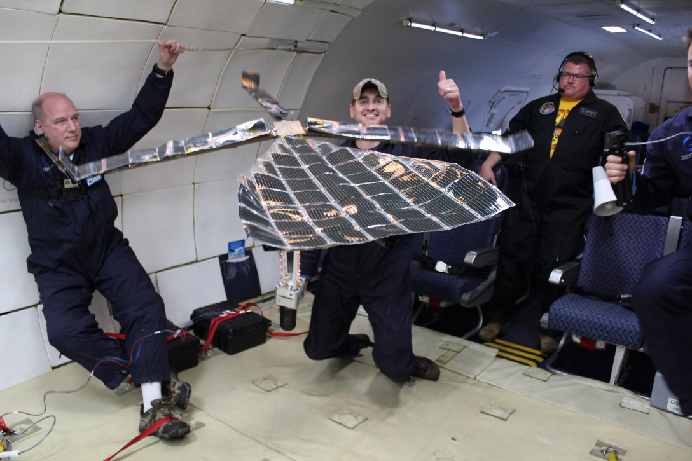
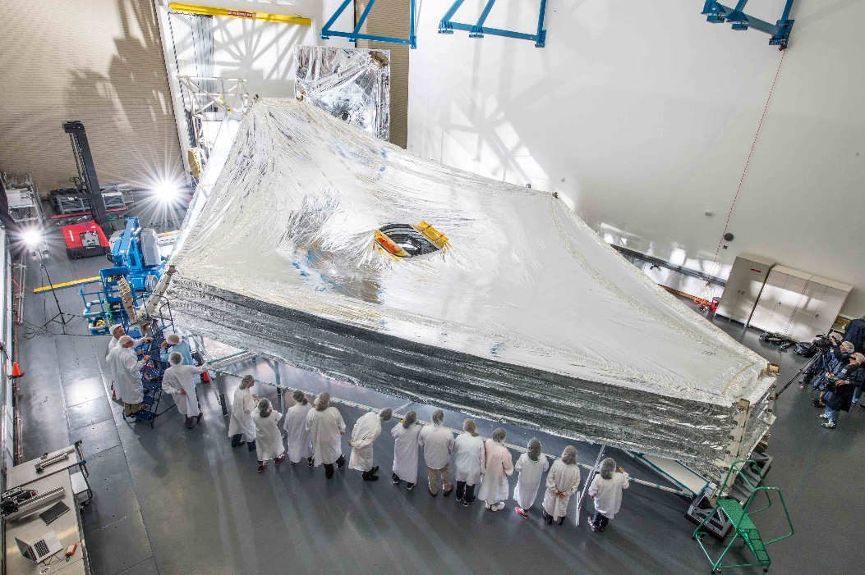
Solar Sail Thin Film Membrane
LISA-T during early development
The same thin film material used by solar sails can be adapted for other missions to serve as a solar shield or part of a thin film solar panel which can generate a larger power supply compared to similarly massed rigid solar panels
James Webb Sunshield

Slide 5
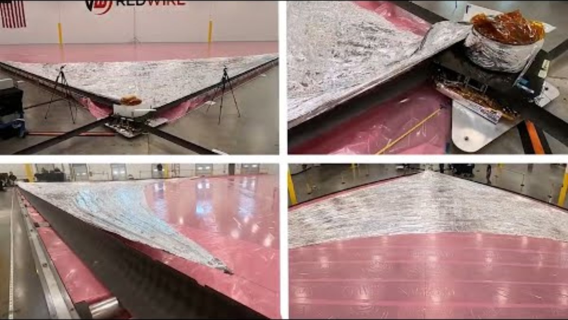
Large Deployable Structures
Large deployable structures are required to enable solar sail missions, mainly for sail deployment
These are developed in conjunction with the thin film material with the nominal profile being elongated booms that are rolled up like a tape measure

Slide 6
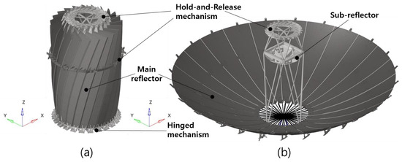
Large Deployable Structures
Radio-communication or intelligence satellite missions requiring a large, deployable antenna arrays
Science missions requiring boom-isolation of sensitive instruments to obtain precise electromagnetic, thermal, or radiation observations
Short term lunar infrastructure systems requiring maximum payload capability to the lunar surface
Deployable reflector antennae SAR-Satellite

Slide 7
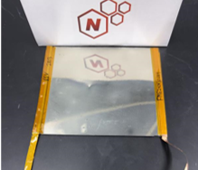
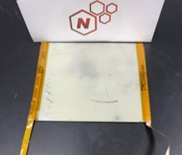
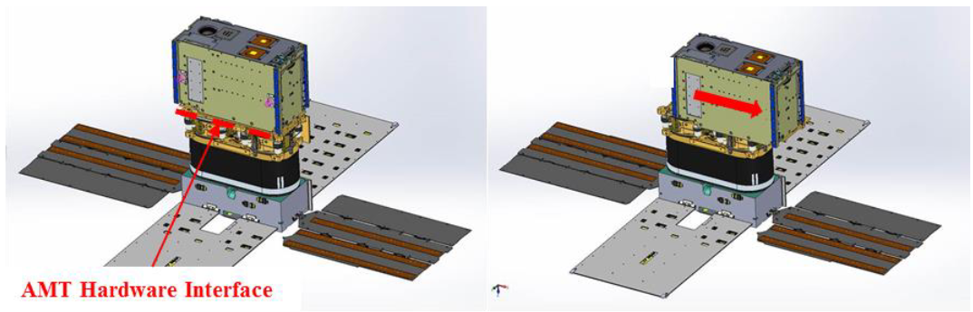
Propellantless Control Actuators
To reduce reliance on consumables with long duration space sailing missions, solar sail missions have developed propellantless control actuators designed to desaturated reaction wheels such as reflectivity control devices and active mass translators

Slide 8
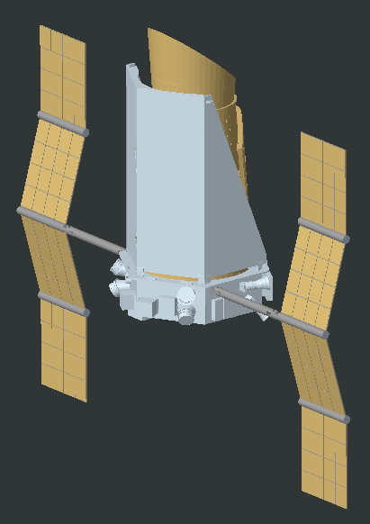
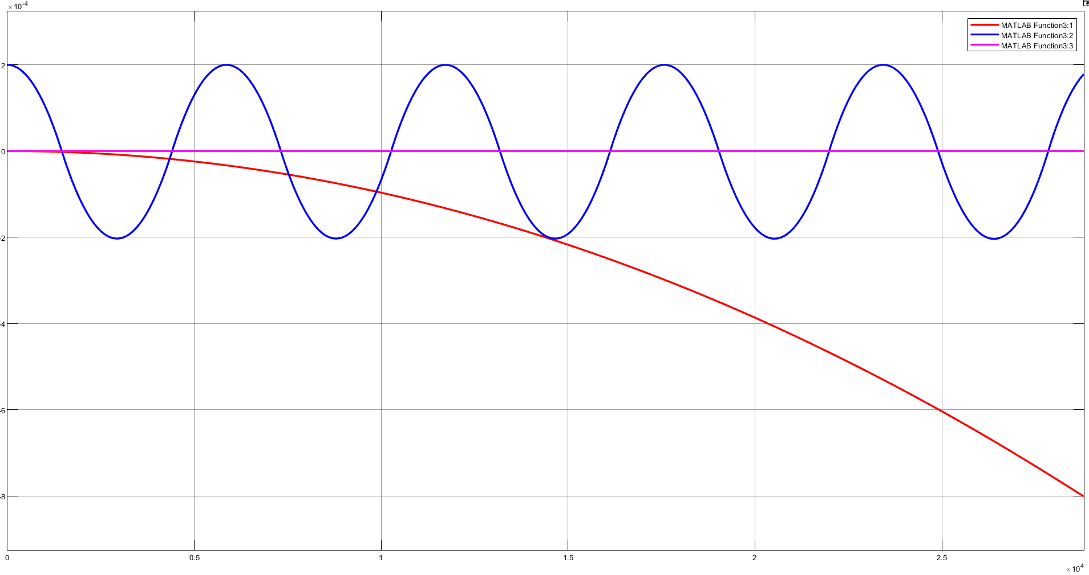
Propellantless Control Actuators
Kepler Telescope with RCD Array
Current studies by NASA MSFC have shown that RCDs can aid in fine pointing with a space telescope
This pointing control can be done without the use of reaction wheels, removing one of the primary contributions to spacecraft jitter, reaction wheel imbalance
Preliminary RCD Control

Slide 9
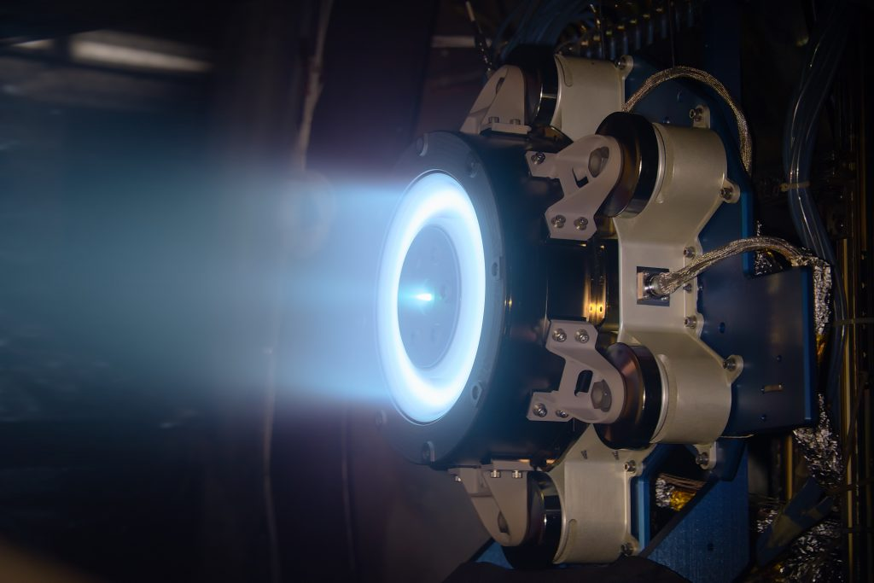
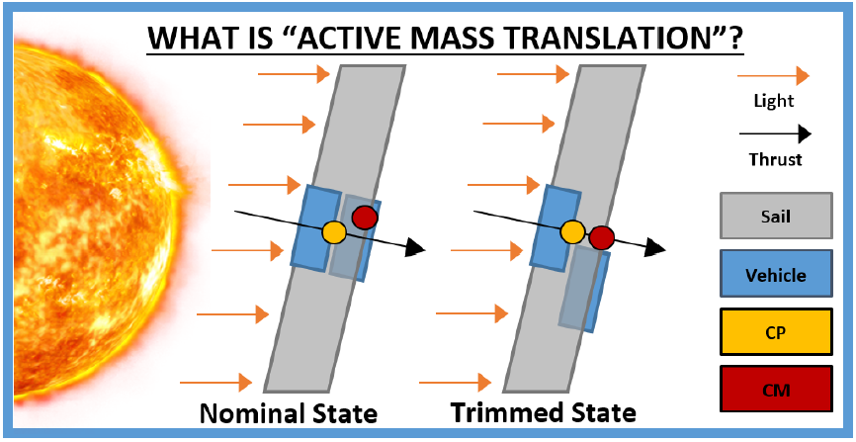
Propellantless Control Actuators
Active mass translators can be also used for conventional low thrust missions like electric thrusters to “trim” a spacecraft and enable extended burns.
They can also be used for trimming a deorbiting satellite and maintain control during the orbit decay period.

Slide 10
The Challenge
Solar Sail missions provide a catch 22. Several missions are enabled with solar sail propulsion but not many are willing to pay for the technology development portion of them.
How can we as the solar sailing community look to bring some of these more novel space sailing technologies and bring them to non-sailing missions to enable future solar sailing missions?

Slide 11

Questions?

