Slide 1
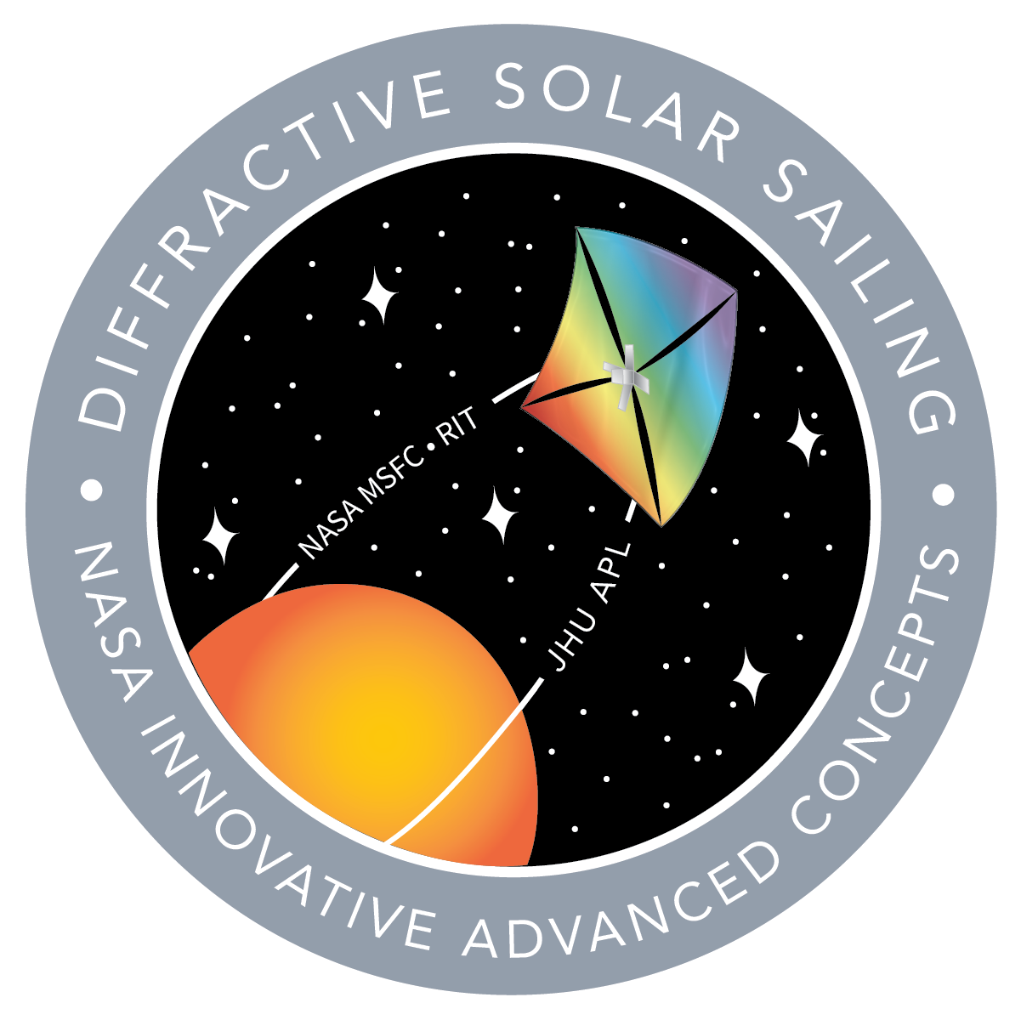
Mission Design and Guidance, Navigation, and Control Challenges of a Diffractive Sail
John Inness, Megan Estrada (NASA MSFC)
Amber Dubill, Noble Hatten, Michael Marshall (JH APL)
Benjamin Diedrich (Astrion)

Slide 2
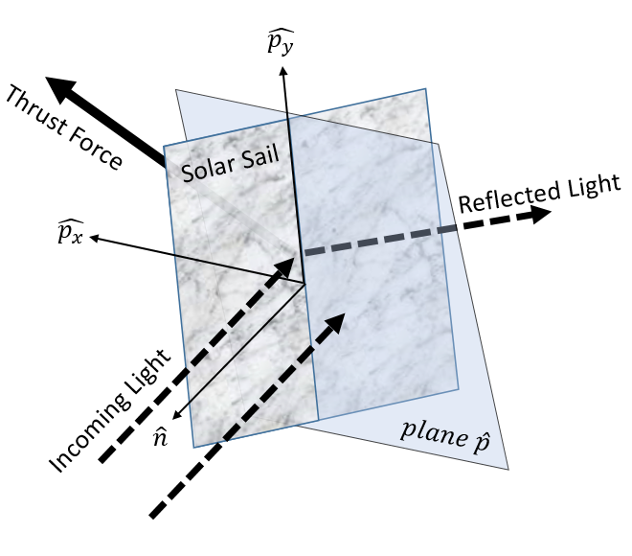
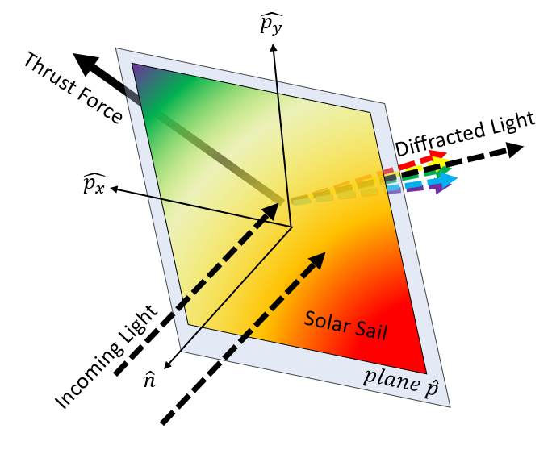
Diffractive Solar Sailing Concept
Diffractive solar sailing relies on the mechanism of diffraction, rather than reflection to produce a radiation pressure force for low thrust maneuvers
Sails used in this method are theoretically more efficient than traditional solar sails for spiraling trajectories because of the ability to produce an “in plane” thrust force
Diffractive sails can also be integrated to produce unique torques for momentum management, especially in the spin axis of the sail to circumvent current GNC issues with traditional sails
Diffractive Solar Sail
Reflective Solar Sail

Slide 3
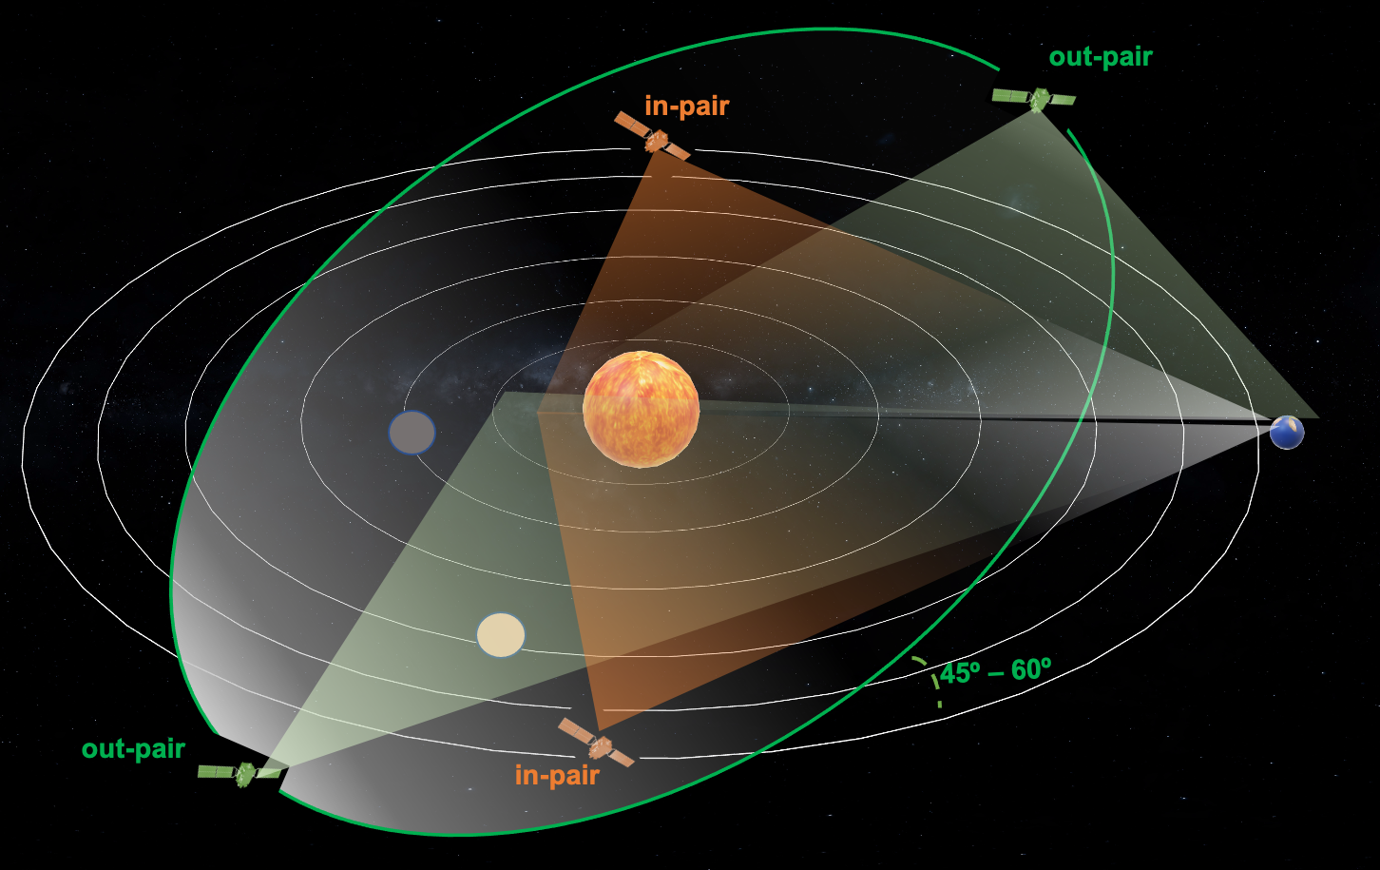
Solar Polar Imager Concept
Science Objectives:
Understand how surface and subsurface flows, and toroidal magnetic field instabilities produce the cyclic solar dynamo, the root cause of solar activity.
Understand the conditions leading to solar explosive activity and the role of the largescale magnetic field connections
Determine how conditions in the solar wind vary with latitude and longitude to changing global solar conditions and throughout the solar cycle.
Gaps identified in current solar observation capabilities call for simultaneous observations outside the ecliptic plane – at minimum 2 satellites supplemented with in-plane observations for heliophysics
With a diffractive solar sailing approach, observations can be taken during TOF, not just at destined orbit, within one solar cycle, to compare observations at changing orbital radii as well as inclination
Payload Instruments | Mass (kg) | Average Power (W) | Science Objective
Compact Doppler Vector Magnetograph | 13.4 | 19.6 | 1, 2
EUV Imager | 4.0 | 27.6 | 2, 3
Visible Light Coronagraph | 4.0 | 4.0 | 2, 3
White Light Heliospheric Imager | 7.2 | 7.0 | 3
DC Magnetometer(s) | 1.7 | 4.0 | 3

Slide 4
Mission Design
Baseline mission consists of two spacecraft in heliocentric orbit:
  Semimajor axis = 0.48 au
  Inclination with respect to ecliptic plane = 60°
  180° phase separation between spacecraft
0.3 au solar distance constraint during cruise to target orbit.
Assumptions
  Spacecraft mass = 400 kg
  Effective sail area = 4500 m²
  Spacecraft maintain a 0° sun incidence angle (SIA) for the entire mission

Slide 5
Mission Design – Cruise CONOPS
Earth departure
Venus gravity assist
Spacecraft separation
Sail deployment
Solar distance reduction
Inclination increase
Solar distance increase and phase separation finalization
*Sailing phases are not completely distinct.

Slide 6
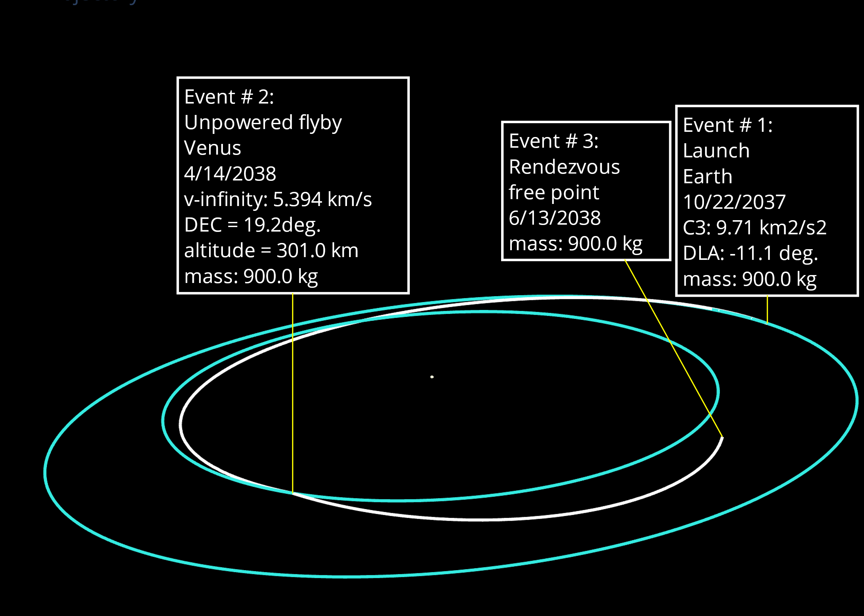
Pre-Sail Deployment
Two spacecraft launch as single unit and travel ballistically to Venus.
VGA provides ~10° of inclination change.
Spacecraft separate and deploy solar sails after VGA.
Solar sailing starts 60 days after VGA.

Slide 7
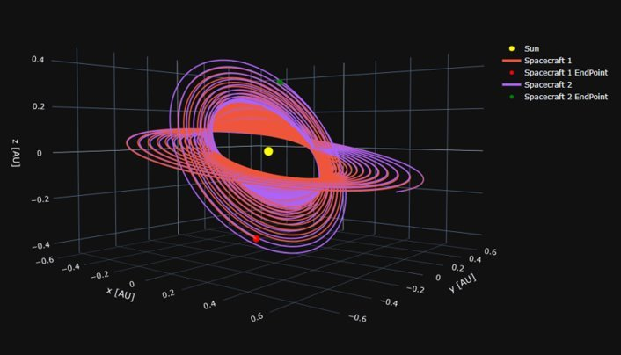
Post-Sail Deployment
Mission Phase | Duration [yrs]
Pre – Sail Deployment* | 0.64
Spiral In | 4.08
Inclination Raise | 3.67
Spiral Out | 2.30
Total Time of Flight | 10.69
*Pre – Sail Deployment consists of the time it takes to complete the VGA and 60 day wait time.

Slide 8
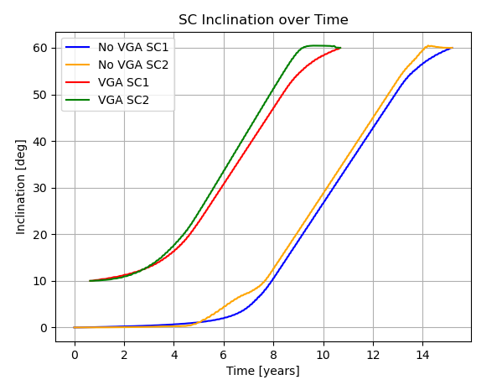
Venus Gravity Assist Impact
Comparison between the baseline VGA CONOPS and a CONOPS without a VGA (solar sailing starts at Earth).
VGA reduces overall time of flight by 4.49 years.
Mission Phase | No VGA [yrs] | VGA [yrs] | Time Difference [yrs]
Pre – Sail Deployment* | --- | 0.64 | +0.64
Spiral In | 7.98 | 4.08 | -3.90
Inclination Raise | 5.05 | 3.67 | -1.37
Spiral Out | 2.15 | 2.30 | +0.15
Total Time of Flight | 15.18 | 10.69 | -4.49
*Pre – Sail Deployment consists of the time it takes to complete the VGA and 60 day wait time.

Slide 9
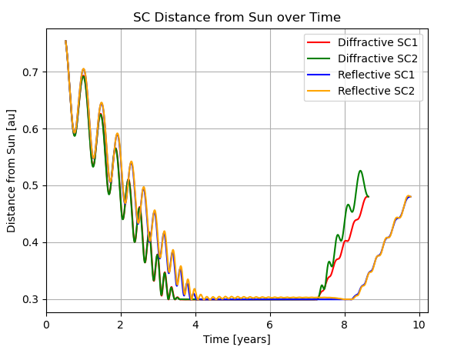
Reflective vs Diffractive
Ideal versions of the diffractive sail and a reflective sail were used to achieve as close of a direct comparison of sail performance as possible.
Ideal diffractive solar sail was constrained to maintain a 0° SIA while the ideal reflective sail was constrained to maintain an SIA ≤ 90°.
The ideal diffractive sail outperformed the ideal reflective sail by 1.14 years.
Mission Phase | Reflective Sail [yrs] | Diffractive Sail** [yrs] | Time Difference [yrs]
Pre-Sail Deployment* | 0.64 | 0.64 | 0.00
Spiral In | 3.34 | 2.75 | -0.59
Inclination Raise | 4.34 | 3.99 | -0.35
Spiral Out | 1.57 | 1.37 | -0.20
Total Time of Flight | 9.89 | 8.75 | -1.14
*Pre – Sail Deployment consists of the time it takes to complete the VGA and 60 day wait time.
** Times of flight do not match VGA times of flight because VGA times of flights were not modeled with an ideal diffractive sail.

Slide 10
ADCS Differences Overview
Force Vector
Force Vector
Diffracted Light
Reflected Light
Reflective sails steer utilizing pitch/yaw to change the force vector while diffractive sails utilize roll to steer the sail with the diffractive grating providing the force offset.
Sunlight
Sunlight

Slide 11
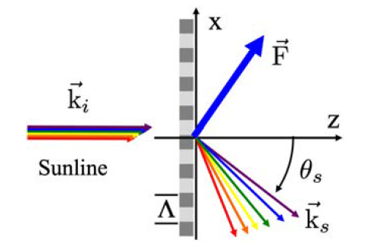
ADCS – Diffractive Mesh Modeling
3D sail shape modeled as mesh of flat plate triangle elements
Each element uses sun-pointing force model with small angle approximation
  Constant µ_{s} and µ_{n}
  Projected area cos(SIA)
  Force oriented by sail element

Slide 12
ADCS – Diffractive Mesh Modeling
Total force & moment sum of element forces & moments
Worst-case pitch/yaw & roll torque shapes found by varying boom tip and sail membrane out-of-plane displacements
  Size control system actuators for flight sail shape variations
Worst-case solar torques normalized by pressure, area, and boom length
Sail shape | Worst-case pitch/yaw shape | Worst-case roll shape
M_{PY} | 5.4e-3 | 2.6e-3
M_{R} | 1.03e-10 | 5.0e-6

Slide 13
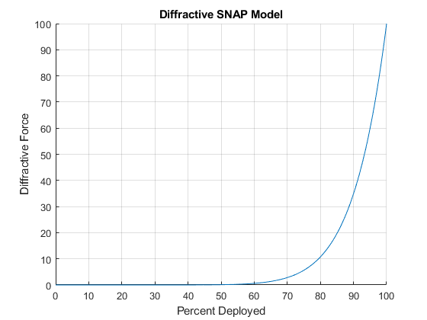
ADCS Challenges – Deployment SNAP
One of the ADCS challenges with a diffractive sail is the diffractive Sudden Non-Aligned Pressure (SNAP) where the full force of the diffractive sail only comes into play near the end of sail deployment.
This SNAP effect can be modeled approximately as an exponential function with the force parallel to the sail plane

Slide 14
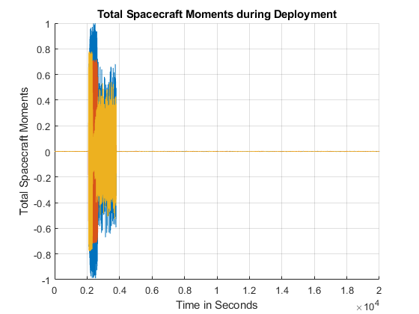
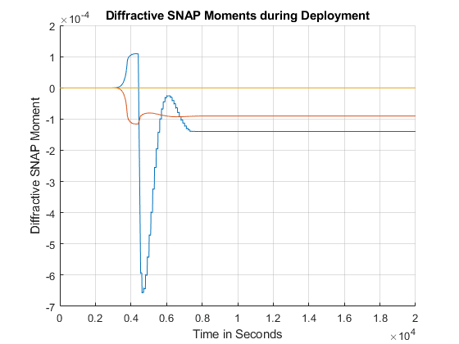
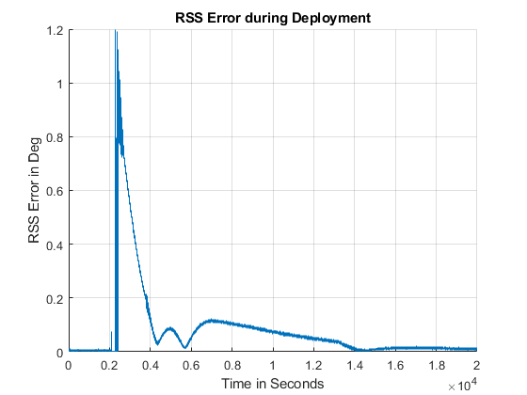
ADCS Challenges – Deployment SNAP
The diffractive SNAP becomes a non-factor during deployment with the moments caused by the deployment being lost in the noise compared to the other forces on the sailcraft.
Note: Moments normalized about maximum spacecraft moment

Slide 15
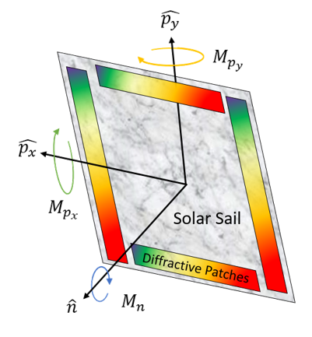
ADCS Challenges – RCDs
Utilizing reflectivity control devices (RCD) in a conventional sailcraft requires a tenting angle to reflect solar light to create a roll moment while utilizing diffractive patches and the RCD opacity control enables RCD’s to be embedded flat within the sail

Slide 16
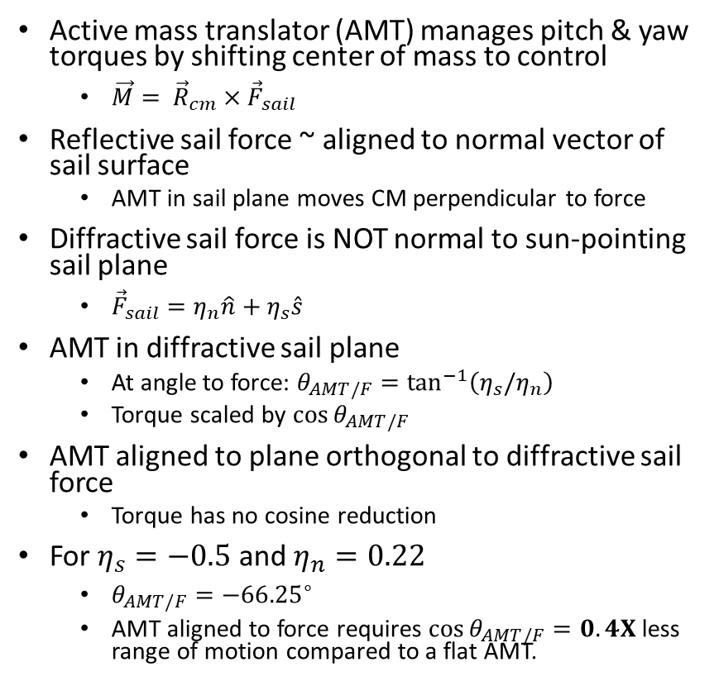
ADCS – AMT - Cant Angle
Reflective Sail
Diffractive Sail
AMT Aligned to Sail
Active mass translator (AMT) manages pitch & yaw torques by shifting center of mass to control
  $\vec{M}= {\vec{R}}_{cm}×{\vec{F}}_{sail}$
Reflective sail force ~ aligned to normal vector of sail surface
  AMT in sail plane moves CM perpendicular to force
Diffractive sail force is NOT normal to sun-pointing sail plane
  ${\vec{F}}_{sail}=η_{n}\hat{n}+η_{s}\hat{s}$
AMT in diffractive sail plane
  At angle to force: $θ_{AMT/F}=\tan^{−1}\left(η_{s}/η_{n}\right)$
  Torque scaled by $\cos{θ_{AMT/F}}$
AMT aligned to plane orthogonal to diffractive sail force
  Torque has no cosine reduction
For $η_{s}=−0.5$ and $η_{n}=0.22$
  $θ_{AMT/F}={−66.25}^{∘}$
  AMT aligned to force requires $\cos{θ_{AMT/F}}=0.4X$less range of motion compared to a flat AMT.
Normal
Force
Normal
Force
AMT
angle
CM
CM
CM
CM
AMT movement
AMT movement
Diffractive Sail
AMT Aligned to Force
Normal
Force
CM
CM
AMT movement

Slide 17
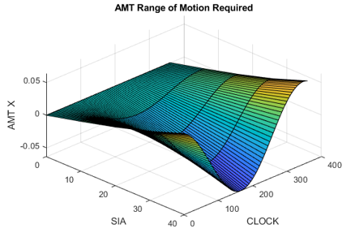
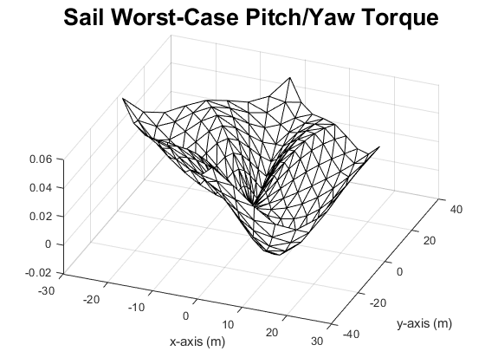
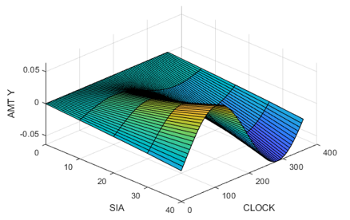
ADCS – AMT Design
Original modeling tool (2015) found optimal AMT position to minimize solar torque given
  Specified SIA and Clock angles
  Sail model
  Model of CG as function of AMT position
Updated tool (in progress)
  Uses worst-case pitch/yaw torque sail shape variation from sensitivity study
  Generates sail force/torque model
  Calculate X and Y cg for zero X and Y torque at each SIA and Clock
    RxF torques (CG x F) in X and Y equal X and Y torques from shape model
  Calculate corresponding X and Y AMT position using bus to sail mass relation
    CG X and Y equal X and Y AMT position scaled by bus / (bus + sail)
F
CG x F
CG
CG x F
AMT
Position
CP

Slide 18
Next Steps
Technology demonstration of diffractive radiation pressure in space
  Pursuing multiple options for low cost demonstration opportunities ranging in complexity/scope
Integrate diffractive sailing technology into existing reflective sailing attitude control method baselines (RCD’s, Passive Diffractive Patches – “fins”, etc)
Continued development of fully diffractive sails in two areas:
  Scaling manufacturing techniques of diffractive “patches” (< 6 in^2) to large format sails ( > 26,000 ft^2)
  Increase momentum transfer efficiencies across solar spectrum while minimizing mass with various diffractive optical mechanisms
Continued involvement in the solar sailing community (domestic and international) for collaborations and adaptations of diffractive solar sailing technologies

Slide 19
Questions?

