Slide 1
Considerations for Airspace Integration Enabling Early Multi-Aircraft (m:N) Operations
July 9, 2025
Andrew Lacher
Chief Technologist for Future Airspace Operations
NASA Langley Research Center
Hampton, Virginia, USA
Approved for Release – STRIVES #20250006383

Slide 2
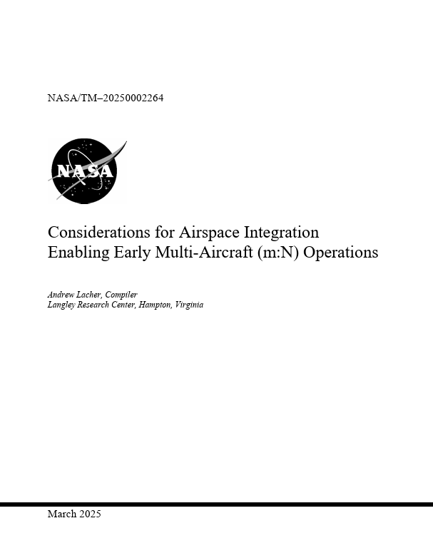
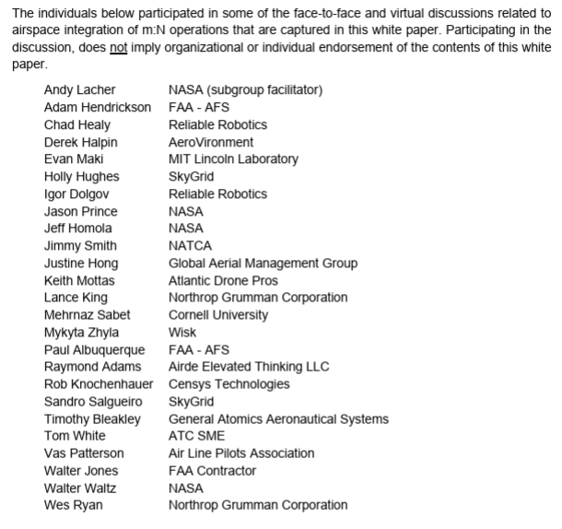

Paper Published – March 2025
Accessed ~1000 Times
Peer Reviewed: David Wing (NASA), Ken Goodrich (NASA), Erick Corona (Wisk), and Maxime Gabriel (Joby)
https://ntrs.nasa.gov/api/citations/20250002264/downloads/NASA-TM-20250002264.pdf

Slide 3
Scope
Airspace Integration → A significant operational barrier to m:N operations
Human centric air traffic control
Voice interaction with air traffic control
Explore mechanism for m:N operations beyond what is likely to be enabled by the FAA’s BVLOS rule

Slide 4
Challenges with Today’s ATM
Human-Centric
Requires Voice Communications
Could ATC interaction be a limiting factor in the number of aircraft a single remote pilot could simultaneously manage?
Will the remote pilot be able to maintain the necessary situation awareness to safely monitor multiple aircraft and interact with multiple controllers on different radio frequencies at the same time, including switching their attention between aircraft as needed?
Will the remote pilot be able to manage the cognitive effort and maintain the necessary focus?
Is there a potential for the remote pilot to confuse aircraft or controllers as they respond to revised clearances and/or ATC instructions?
Will latency in communications, the need to potentially repeat communications, and delays in remote pilot response/action have a cascading effect on traffic efficiencies (i.e., place constraints on ATC ability to be responsive, potentially requiring increased spacing buffers) resulting in reduced capacity?

Slide 5
Approach
Operational mechanisms that don’t involve receiving ATC separation services
As if the aircraft is operating under visual flight rules (VFR)
Three Strategic Components
VFR-like Technology-Enabled Operations
ATC Preapproved Terminal Airspace Areas for Technology-Enabled Operations
Transition between m:N Operations and Operations with a Dedicated Remote Pilot

Slide 6
Clarity of Terms
Multi-aircraft Operations or m:N Operations
One or more remote pilots or equivalent individual(s) are supervising, responsible, and accountable for two or more aircraft in the air at the same time enabled by high-levels of automation controlling the safe intended trajectory of the aircraft and which has authority to perform much of the flight operations including decision-making for the safety of flight
Pilot, Pilot-in-Command
The human who has the command-and-control authority over flight operations of the uncrewed aircraft even though it may be remote. Depending upon the specific design of the aircraft and its ground control system, this human pilot may not be able to exert inner-loop control over the aircraft remotely. They would be able to influence the aircraft’s flight path through high-level guidance and supervision. It is not assumed that this individual would necessarily have the same qualifications, experience, training, and licensing requirements of today’s pilots. It is assumed that they would have qualifications, experience, training, and licensing requirements commensurate with their duties to ensure safe flight operation.

Slide 7
Contents
Does not make a recommendation
Provides details regarding subgroup discussion on strategic components
Identifies “Areas Requiring Further Study”
Identifies key enablers
Present a strategic alternative
One RPIC → One ATC Sector

Slide 8
Thank You

Slide 9
Assumptions
The necessary technological capabilities and enablers would exist and be able to be assured as being safe to the acceptance of aviation regulations.
m:N operations using the VFR-like technology-enabled operational approach would be demonstrated to be interoperable with existing piloted and remotely piloted operations.
Technology-Enabled Operations would be applicable and available to Part 91 and Part 135 operators.
Initially, VFR-like Technology-Enabled Operations would be first authorized in airspace where VFR operations routinely occur today (e.g., Class E airspace, below FL180 or above FL600) and may be explicitly permitted by ATC in other airspaces (see Section 4).

Slide 10
BVLOS NPRM is a Key Step
The subgroup believes that the forthcoming BVLOS NPRM will:
Create a path toward routine m:N operations for limited UAS operations
Be constrained to airspace and operations not receiving ATC services
Be dependent upon technology capabilities (both in the air and on the ground) that would ensure aircraft remain separated from hazards including other BVLOS UAS and traditionally crewed aircraft operating in the vicinity
Establish a residual risk level acceptable to the regulator
Enable BVLOS operations of UAS where encounters with traditionally crewed aircraft are likely to be minimal due the nature of the airspace in which the operations are occurring
Potentially involve changes to right-of-way rules
Be dependent upon strategic mitigations/procedures to help reduce the risk of encounters with other aircraft

