Slide 1
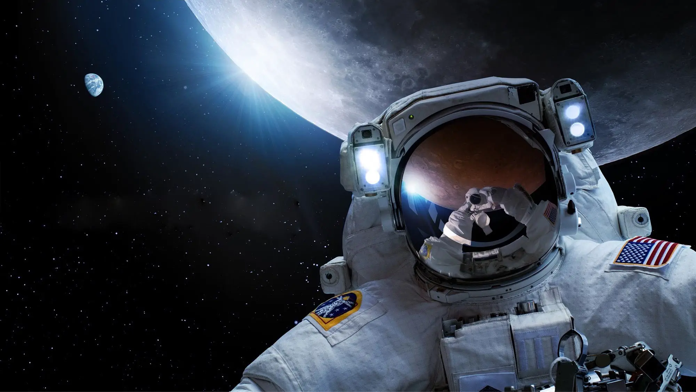


Development of the Crew State and Risk Model for Autonomous Biomedical Physiology State Monitoring and Prediction During Exploration Extravehicular Activities
ICES-2025-157
Bradley Hoffmann, PhD, KBR, Houston, TX, USA
Kyoung Jae Kim, PhD, KBR, Houston, TX, USA
Dillon Frisco, MS, JEStech, Houston, TX, USA
Lori Cooper, MS, JEStech, Houston, TX,USA
Crystal Kirkley, PhD, NASA ARC, Mountain View, CA, USA
Alejandro Garbino, MD, PhD, GeoControl Systems, Houston, TX, USA
Karina Marshall-Goebel, PhD, NASA JSC, Houston, TX, USA
Dan Buckland, MD, PhD, NASA JSC, Houston, TX, USA
EVA and Environmental Physiology Lab (EEPL)
Biomedical Research and Environmental
Sciences Division (SK)
Human Health and Performance Directorate
NASA Johnson Space Center, Houston, TX, USA

Slide 2
Outline
Martian EVA Paradigm
EVA Biomedical Telemetry
The Crew State and Risk Model
EVA Human Thermal Regulation and Hydration
Model Baseline Summary
Preliminary Results
Conclusion & Future Directions
Notes:
CSRM aims to provide individualized physiology and performance models to predict pre-EVA physiology state and readiness while providing real-time capability during EVA operations.

Slide 3
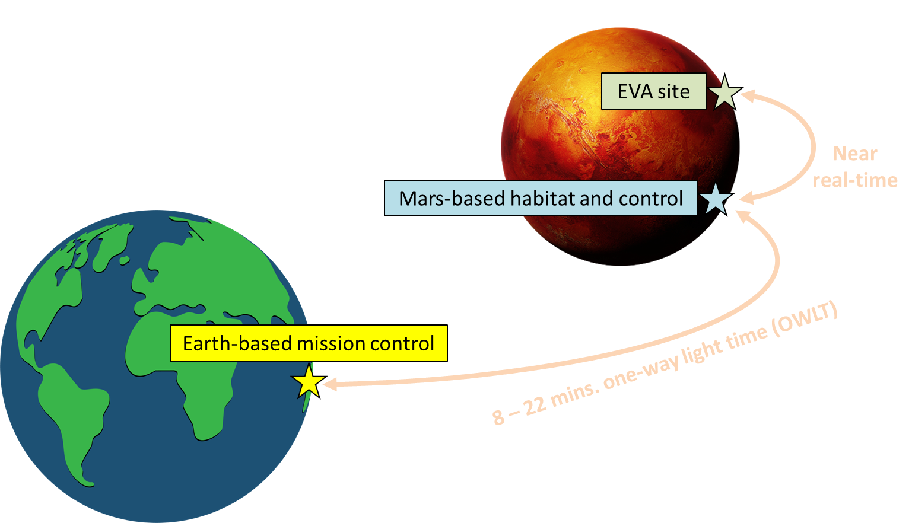
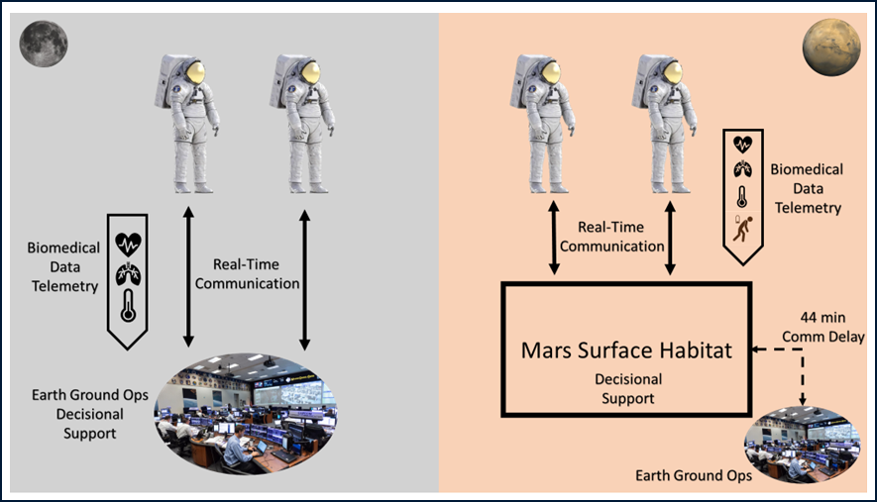
Martian EVA Paradigm
Conceptual operational communication difference between lunar and Martian EVAs
Martian EVA will require new paradigms of operations:
  Less reliance on mission control for real-time EVA decision support.
  Crew will require more autonomy and information to make decisions.
  Biomedical data will need to be available to crew directly both EVA and IVA.
Mars ConOps (Coan 2020)
PersEIDS (McGrath, ICES 2023)
Notes:
CSRM aims to provide individualized physiology and performance models to predict pre-EVA physiology state and readiness while providing real-time capability during EVA operations.

Slide 4
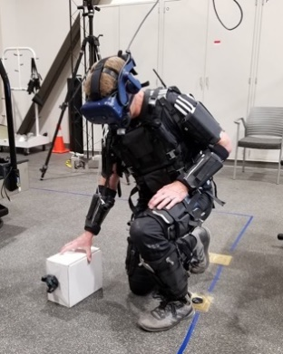
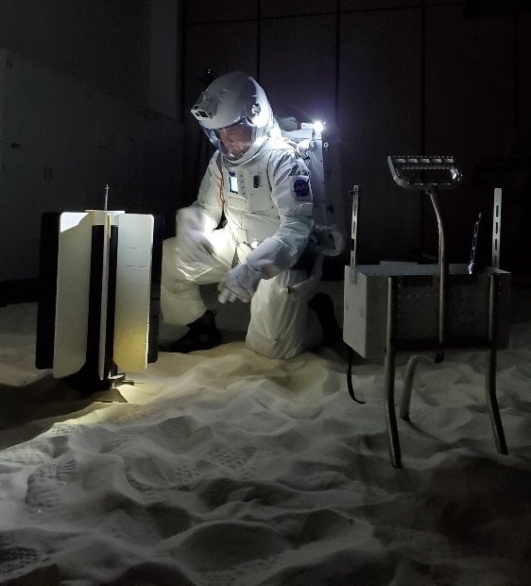
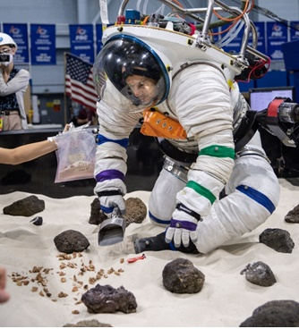
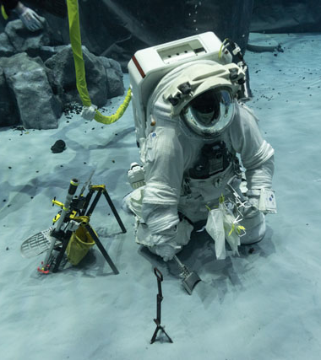
Crew State and Risk Model (CSRM)
To be successfully prepared for missions to the Moon and Mars, it is expected that crew will undergo significant training in relevant, realistic simulation environments on Earth. For extravehicular activities (EVA):
  Operational suit training - Neutral Buoyancy Laboratory (NBL)
  Operational training and research - Active Response Gravity Offload System (ARGOS)
  Research immersive, cognitive-focused events in virtual reality
    Assessments of Physiology and Cognition in Hybrid-reality Environments or APACHE (APACHE, Baughman ICES 2022).
CSRM Motivation: During long duration exploration missions, crew will be unable to rely on mission control for real-time biomedical support. Performing EVAs during these exploration class missions will necessitate a level of autonomy beyond our current capability.
  Coupling baseline Earth data with in-flight measures pre-EVA will allow development of modeled predictions for individualized crew health, performance, and state –
  During EVA, real-time data will also be collected and can be used to update predictions of crew state as the EVA progresses.
Notes:
CSRM aims to provide individualized physiology and performance models to predict pre-EVA physiology state and readiness while providing real-time capability during EVA operations.

Slide 5
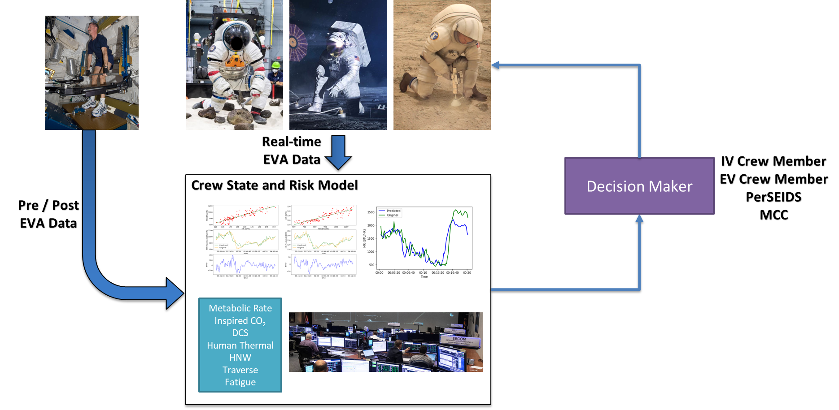
Crew State and Risk Model (CSRM)
The CSRM consists of seven core models that encompass primary EVA physiology domains.
  Metabolic Rate
  Inspired CO2
  Human Thermal Regulation
  Hydration, Nutrition, and Waste Management (HNW)
  Decompression Sickness (DCS)
  Fatigue (Cognitive and Physical)
  Traverse (Metabolic cost of ambulation)
Each model is baselined during 1-G simulated EVA shirt-sleeve testing. Once baselined each model is then validated during EVA pressure suited testing and operations.
All models have now been baselined and currently undergoing pressurized suited testing and validations.
Notes:
The CSRM is a collection of seven core EVA physiology domains. The metabolic energy model estimates metabolic rate profiles from expected planetary EVA tasks. Levels of carbon dioxide (CO₂) inspired within a suit are estimated through the inspired CO₂ model. The human thermal regulation model predicts core body temperature and heat storage at < 3% error. Hydration and nutrition status are predicted using the hydration, nutrition, and waste management model for readiness and recovery. The decompression sickness (DCS) model estimates risk and sensitivity to DCS based on mission profiles. The fatigue model estimates time and probability to physical exhaustion. Metabolic cost due to suited ambulation along an EVA path is generated using the traverse model. Holistically, CSRM predicts key crew states through physiology determinants of performance between model interactions.

Slide 6
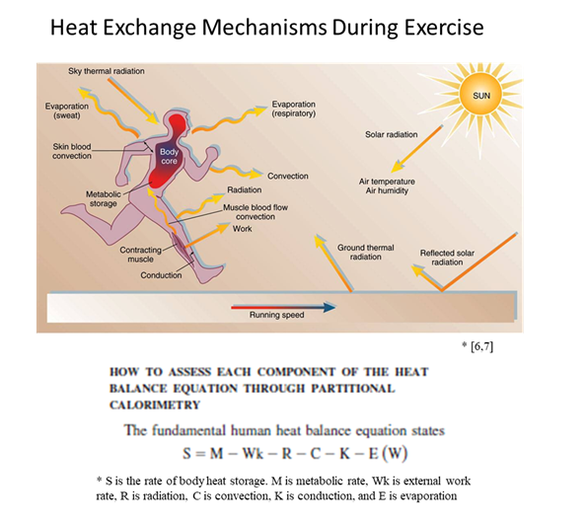
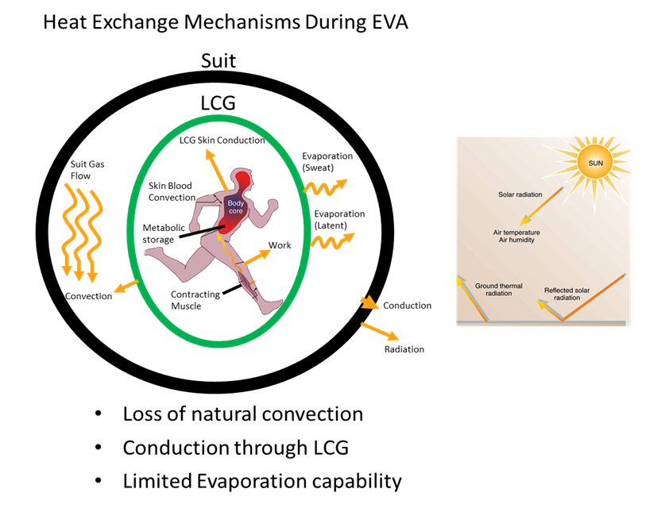
EVA Human Thermal Regulation
During EVA the suit provides the only means to offload heat. If EVA tasks drive up workload this in turn will drive up heat loading which will increase the rate of consumable usage. If heat is not offloaded it is stored in the body causing downstream physiologic effects.
Notes:
the surface height, the steepness of the slope in the same direction as the heading, and the perpendicular direction to the slope before calculating distance.

Slide 7
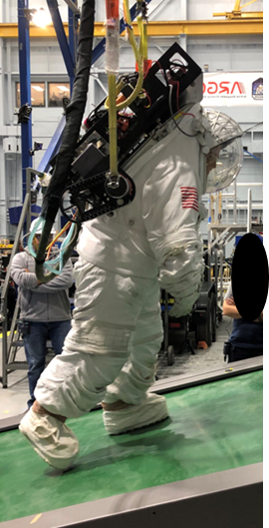
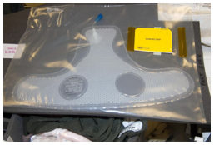
EVA Hydration
During operations for ISS, crew may perform 6 to 7 hours of EVA in a single event.
  The existing amount of water available in the EMU is a 32 oz (0.95L) disposable in-suit drink bag (DIDB – Figure).
Lunar EVAs were expected to be longer, have increased physiological demands and to be done at a much higher frequency leading to increased hydration requirements.
EVA frequency will impact hydration states and ultimately effect crew readiness for subsequent EVAs.
Disposable In-suit Drink Bag
located in-suit by crew chest.

Slide 8
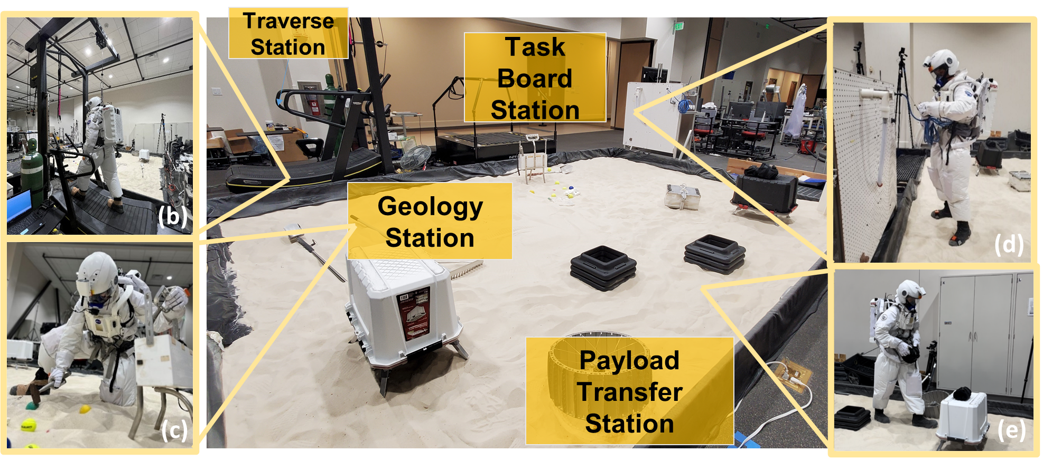
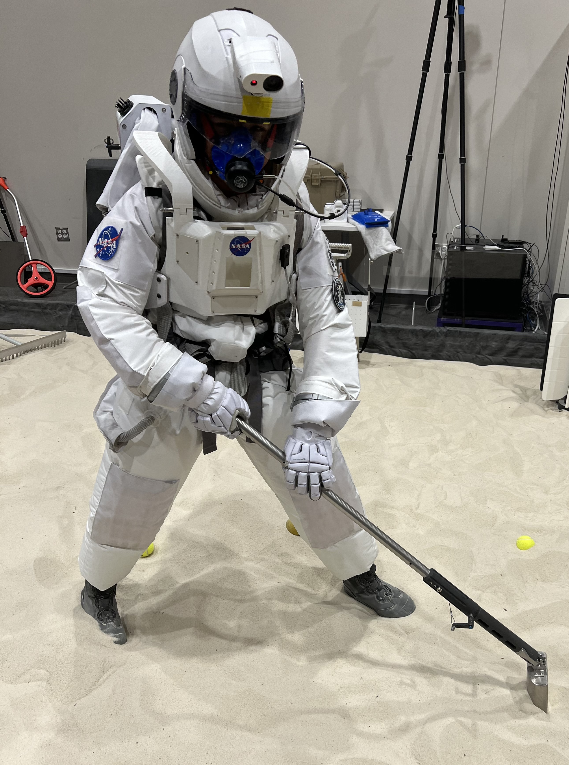
Thermal and Hydration Baseline
Model baseline development for thermal and hydration was completed in a Hybrid Space Suit Simulator (HS3) (n=6).
  Tasks included Traverse, geology (hammer, rake, trench, drive tube), payload transfer, and simple taskboard circuit.
  The baseline data for thermal was checked against an ARGOS lunar suited test series for preliminary accuracy.
  The baseline data for hydration was checked against an NBL microgravity suited test series to test model accuracy.

Slide 9
Summary of the Thermal Model
The CSRM thermal model outputs an individualized predicted core temperature and heat storage during EVA using available suit telemetry for decision support of thermal flight limits.
The thermal model uses relationships between metabolic rate and heart rate to derive core temperature. Both metabolic rate and heart rate are data telemetry from the suit during EVA.
One facet of the thermal model is a predicted mean skin temperature using metabolic rate and delta temperature of the liquid cooling and ventilation garment.
  This measure is to provide inputs into the heat storage estimation.
(1) Core Body Temperature: CT = b(1) + b(2).*HR + b(3).*MR
(2) Mean Skin Temperature: SKT = b(1) + b(2).*MR + b(3).*ΔLCG;
(3) Heat Storage: Qstor = m_{body} * C_{p,body} * (0.2 * ΔSKT + 0.8 * ΔCT)/1.055
CT – Core Temperature
HR – Heart Rate
MR – Metabolic Rate
SKT – Mean Skin Temperature
LCG – Liquid Cooling Garment Temperature
Qstor – Heat Storage
m_{body} – Body Mass
C_{p,body} – Specific Heat of the body

Slide 10
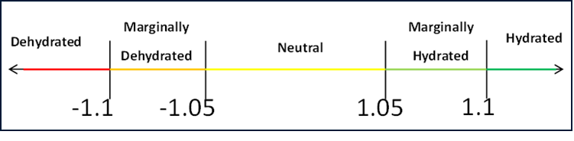
Summary of the Hydration Model
The Hydration model focuses on hydration status pre/post EVA. Three main driving factors of hydration are body weight changes, water intake through the disposable insuit drink bag (DIDB), and void output.
Urine specific gravity (USG) is used as a hydration truth and gives the model hydration trending inputs (Hydrated, Neutral, Marginally Hydrated, Dehydrated).
Using the H_{n} and H_{n+1},we get the final hydration state values as a corresponding difference represented by the H_{state}.
(1) $H_{n}=\left[\left(1.3∗{BW}_{PRE}{ + 1.411∗DIDB}_{PRE}+{1.42∗MAG}_{PRE}− 1.0∗{FOOD}_{PRE}\right)∗0.64\right]+/−1.35∗{USG}_{PRE}$
(2) $H_{n+1}=\left[\left(1.3∗{BW}_{POST}{ + 1.411∗DIDB}_{POST}+{1.42∗MAG}_{POST}− 1.0∗{FOOD}_{POST}\right)∗0.64\right]+/−1.35∗{USG}_{POST}$
$${Final Hydration State=H_{n} − H}_{n+1}$$
H_{n} – Pre-EVA Hydration
H_{n+1} – Post-EVA Hydration
BW – Body Weight
DIDB – Disposable Drink Bag Weight
MAG – Maximum Absorption Garment Weight
FOOD – Food Intake Weight
USG – Urine Specific Gravity
Notes:
Explaining hydration final hydration state and tested against HS3 + NBL data.
Hydration Status in chart is derived from literature scales of Body Weight, Drinking water Intake, and USG scales to test against Hn Calculations.

Slide 11
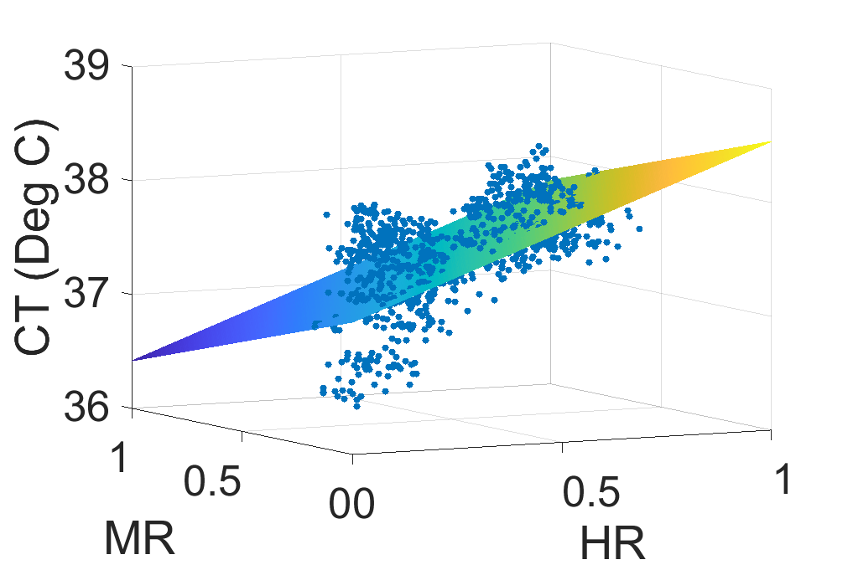
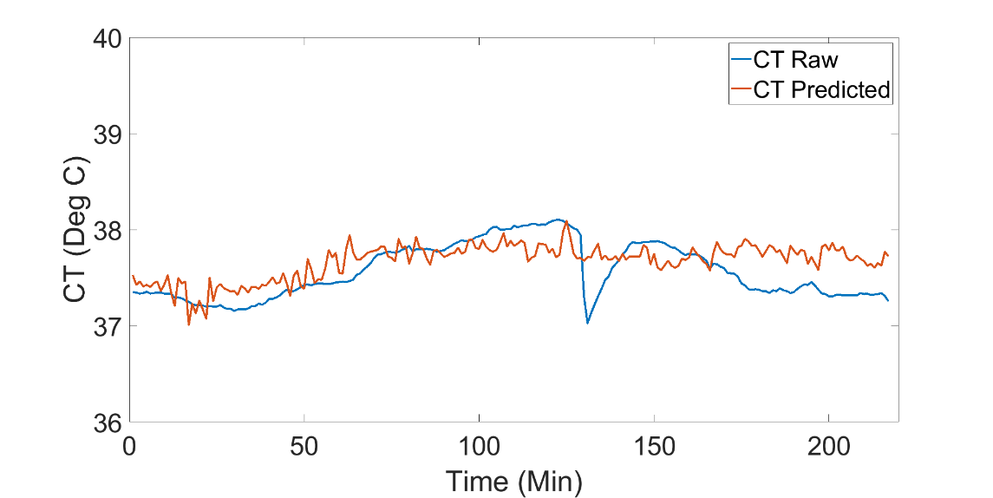
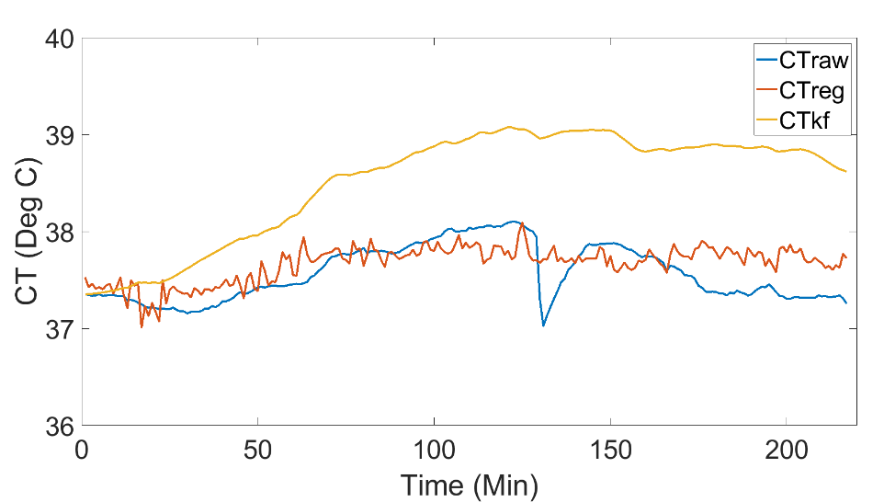
Preliminary Results
The initial spread of data showed agreement of a linear trend from data collected during EVA tasks in the HS3 analog (Figure A).
  Average error for CT were 0.25 ± 0.19 °C for the baseline HS3 dataset.
Core body temperature output during ARGOS lunar suited testing with estimation error 0.2 ± 0.15 °C (Figure B).
Comparison of the CSRM to a field-based model during ARGOS lunar suited testing.
  Field based model error higher at 0.95 ± 0.44°C.
Core Temp relations to heart rate and metabolic rates during 1G analog
Core temp equation tested against 1/6th G pressure suit testing
Core temp equation tested against and Kalman filter (Buller et al., 2013) 1/6th G pressure suit testing
CT – Core Temperature
HR – Heart Rate
MR – Metabolic Rate

Slide 12
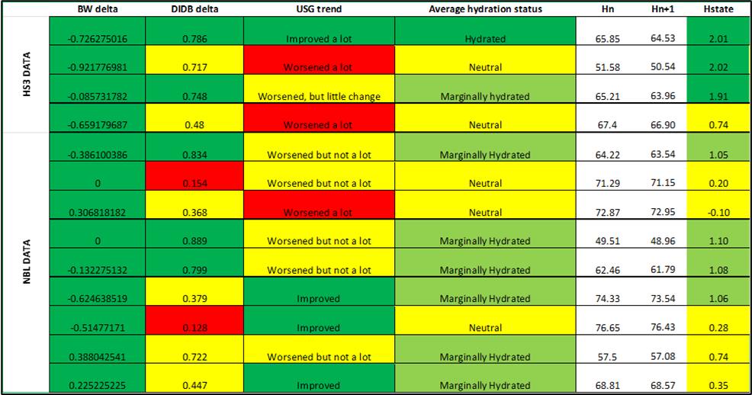
Preliminary Results
The data displayed below shows the three main drivers of hydration for EVA: body weight change pre- to post-EVA (BW delta), water intake during EVA (DIDB delta), and void output.
Urine specific gravity (USG) provides an EVA hydration trend.
The output of predicted hydration state at a 70% accuracy between a pre- and post-EVA seen during NBL testing.
  Likely due to varying hydration strategies during crew EVA training events.
H_{n} – Pre-EVA Hydration
H_{n+1} – Post-EVA Hydration
BW – Body Weight
DIDB – Disposable Drink Bag Weight
MAG – Maximum Absorption Garment Weight
FOOD – Food Intake Weight
USG – Urine Specific Gravity

Slide 13
Conclusions and Future Directions
The Crew State and Risk Model aims to provide crew autonomy through data availability and predictive modeling support for EVA readiness and state predictions during EVA.
  Ultimately to enable successful EVA mission objectives while keeping crew safety for Martian and exploration EVA.
The thermal model provides core body temperature and heat storage predictions using available suit telemetry.
The hydration model provides a pre- to post-EVA hydration status that aims to assist decisional processes for EVA recovery and readiness.
The CSRM models in the next phase of development will move into a validation stage using available pressure suit analogs.
  Lunar and Martian offloading capabilities.

Slide 14
References
Baughman, Alex, et al. "Assessments of Physiology And Cognition in Hybrid-reality Environments (APACHE)--Physical Workload Approximation." 51st International Conference on Environmental Systems, 2022.
Buller, Mark J., et al. "Estimation of human core temperature from sequential heart rate observations." Physiological measurement 34.7 (2013): 781.
Coan, David. "Exploration EVA System Concept of Operations Summary for Artemis Phase 1 Lunar Surface Mission." EVA Exploration Workshop 2020. No. JSC-E-DAA-TN77584. 2020.
Hoffmann, B. et al. Human Thermal Analysis of Traverse and Geology Tasks During Simulated Lunar Extravehicular Activity. in 2023 IEEE Aerospace Conference 1–8 (2023). doi:10.1109/AERO55745.2023.10116010.
Hew, Monica, et al. "Developing a hybrid spacesuit simulator as a research tool for assessing extravehicular activity relevant workload." 52nd International Conference on Environmental Systems (ICES). No. ICES-2023-352. 2023.
McGrath, Timothy, et al. "A Decision Support System for Extravehicular Operations Under Significant Communication Latency." 52nd International Conference on Environmental Systems (ICES). No. ICES-2023-327. 2023.
Miller, M. J., Claybrook, A., Greenlund, S., Marquez, J. J. & Feigh, K. M. Operational Assessment of Apollo Lunar Surface Extravehicular Activity. NASA NTRS (2017). https://ntrs.nasa.gov/citations/20170007261

Slide 15
Acknowledgments
Shayne York
Aly Ung
Amanda Hager
Taylor Schlotman
Lauren Cox
Rachel Thompson
Katie Heinemann
Austin Alexander
David Smith
Stephen Lin
Hybrid Space Suit Simulator Team
  Monica Hew
  Zachary Wusk
  Benjamine Estep
  Jazmyne Lones-Humphrey
ARGOS facility team
NBL Facility team
xEMU pressure garment team

Slide 16
Thank you!
The presented efforts were funded by the NASA Mars Campaign Office (MCO).
Contact: bradley.hoffmann@nasa.gov

