Slide 1
AIAA AVIATION, July 21 – 25, Las Vegas, NV
Title: Extrapolating the Sustainability Benefits of Collaborative Digital Departure Reroute
Authors: Shannon Zelinski , Heather Arneson , Swati Saxena, Dan Howell
Session: ATS-12: ML/AI in Air Transportation IV
Chair:
Date: Jul 24, 2025, Time: 2:20 pm – 2:40 pm, Location: Summit 226
Other Papers:
Thunderstorm Pattern Analysis Using Vision Transformers and Optimal Transport for Aviation Operations, The George Washington University,
Human-Centric Flight Planning Recommender System: A Chain-of-Thought Approach, The George Washington University
Aviation-Specific Large Language Model Fine-Tuning and LLM-as-a-Judge Evaluation, NASA Ames
Synthetic Data Generation for Computer Vision based Autonomous Landing for Small UAS Package Delivery, The George Washington University
Enhancing Clear-Air Turbulence Forecasts: A WTCNN-LSTM Framework Utilising Energy Dissipation Rate, The Hong Kong Polytechnic University, Hong Kong

Slide 2

Extrapolating the Sustainability Benefits of Collaborative Digital Departure Reroute
Shannon Zelinski – NASA Ames Research Center
Dr. Heather Arneson– NASA Ames Research Center
Dr. Swati Saxena – NASA Ames Research Center
Dr. Dan Howell – Regulus Group LLC
NASA Ames Research Center
Moffett Field, CA, USA

Slide 3
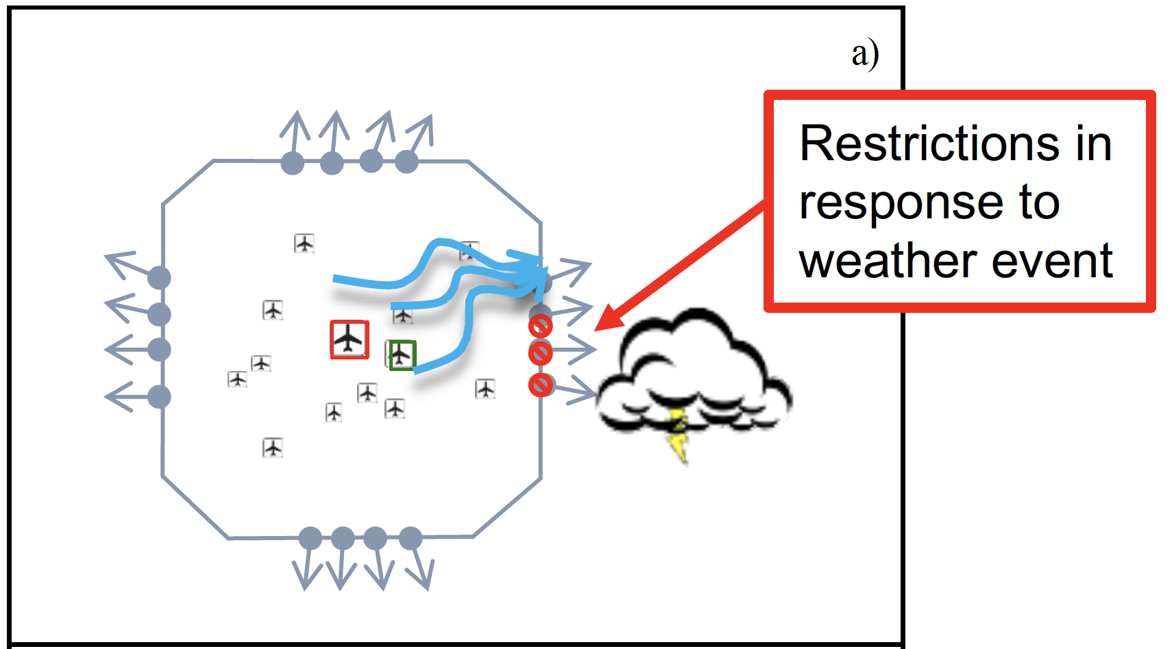
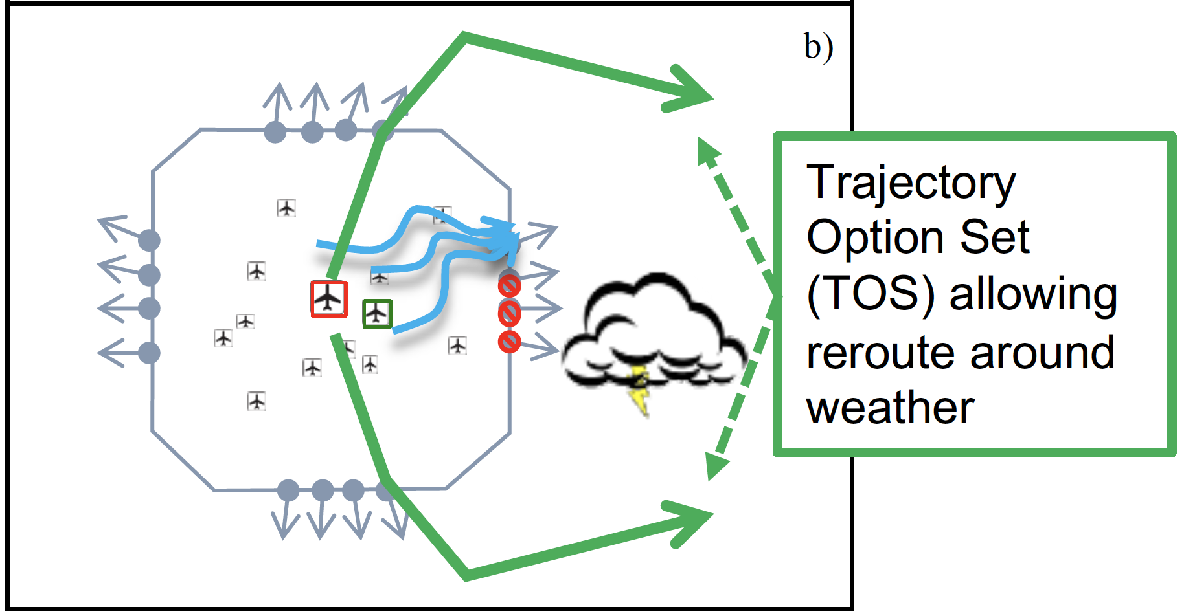
Collaborative Digital Departure Reroute (CDDR)
Problem
Solution
Dallas-Fort Worth TRACON (D10) map
TRACON: Terminal Radar Approach Control; TOS: Trajectory Option Set; ATC: Air Traffic Control; FO: Flight Operator
Notes:
Terminal Radar Approach Control
Problem: Some departure gates are not available during a weather event causing traffic congestion at other departure gates or departure fixes. Each aircraft represents an airport with the red and green boxes representing two major airports in this TRACON which are Dallas Fort Worth (DFW) and Dallas Love Field (DAL)
This surface congestion introduces surface delays which has a ripple effect on the entire system building up .
Solution: The pre-departure re-routing tool is a ML based model that continuously monitors the demand and capacity, incorporates TMIs and restrictions and suggests alternate routes to the decision maker to reduce surface delays.
Workflow: The tool identified the candidate flights that show significant surface delay savings if re-routes, presents the alternate routes to the FO dispatcher who then submits the request to the ATC. Once approved, the new aircraft takes the new route. Its most effective if the decision is made close to the lock-out period.

Slide 4
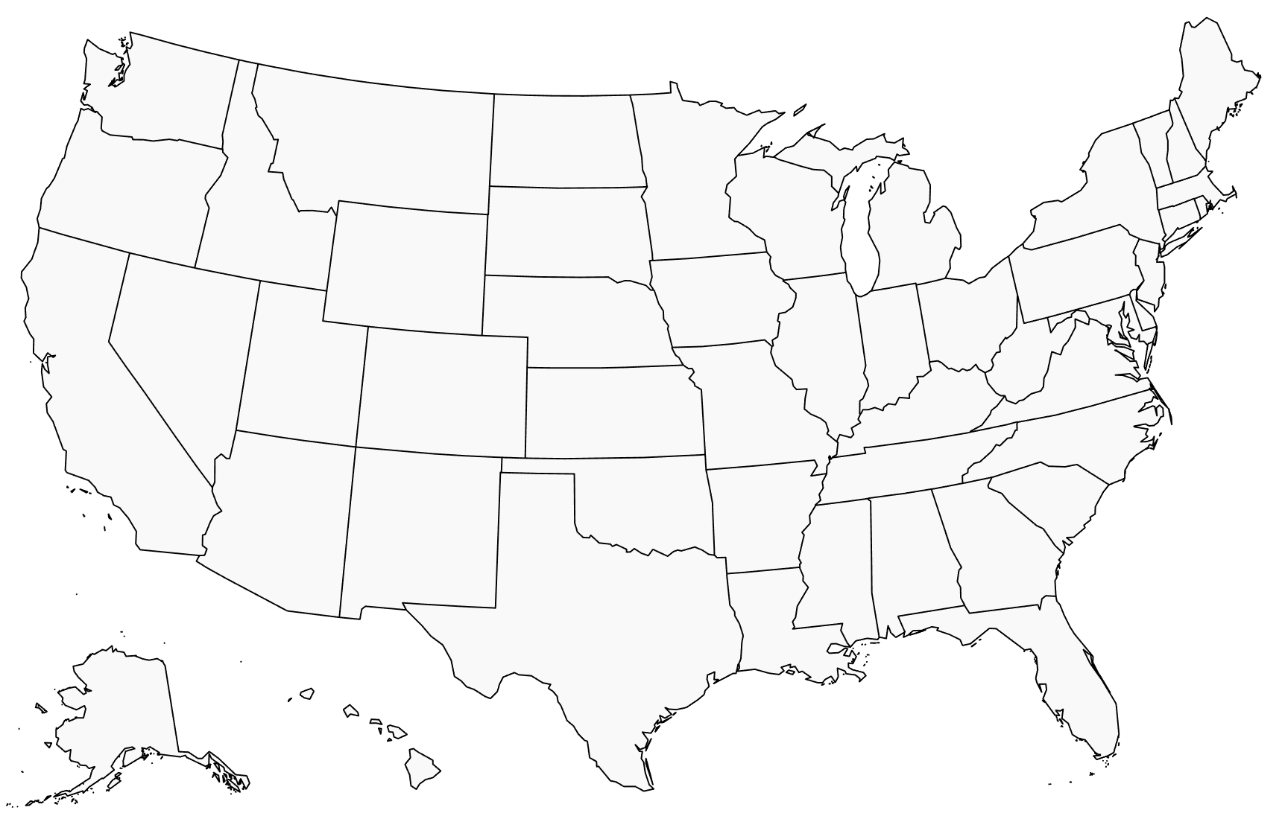
CDDR Field Implementation Benefits
Dallas Fort Worth (D10) Terminal Radar Approach Control (TRACON)
Live field data collected at D10 TRACON
D10
How will these benefits scale if CDDR is deployed and used nation wide?
Notes:
This chart shows the number of approved re-routes during the period of May 2022 to April 2023 in D10 TRACON in live operations. Now, these savings are local and if we want users to expand the use of this tool to other TRACONS, one obvious question is the estimation of benefits at those TRACONS or system wide benefits.
D10 TRACON:
68 reroutes
55k Ibs fuel
170k Ibs CO2
1260 urban trees

Slide 5
Goal - Extrapolate D10 Benefits Nation-wide
Top 10 US TRACONs with Coded Departure Routes (CDRs)
N90
C90
PCT
D01
CLT
SCT: Southern California
D01: Denver
I90: Houston
C90: Chicago
A80: Atlanta
MIA: Miami
CLT: Charlotte
PCT: Potomac
N90: New York
SCT
Live field data collected at D10 TRACON
A80
D10
Operations Network (OPSNET) TRACON Itinerant Air Carrier IFR Operations (May 2022 – April 2023)
I90
MIA
Notes:
Operations Network
This is the motivation behind this work.
Top 10 TRACONS are by no of operations.
In OPSNET, an "operation" is counted if the aircraft is under the TRACON's control jurisdiction and is either landing, taking off, or executing an unplanned missed approach.

Slide 6
Approach Overview
Predicted Number of Reroutes
Coded Departure Routes
TRACON Features
Prediction
Model
ASPM Weather Impacts
D10 CDDR Field Data
ASPM
Flight Level Data
Benefits per Reroute
Extrapolated Benefits
ASPM: Aviation Systems Performance Metrics
Notes:
Feature development process
Prediction Model
Predictions – extrapolated benefits

Slide 7
Approach Overview
Predicted Number of Reroutes
Coded Departure Routes
TRACON Features
Prediction
Model
ASPM Weather Impacts
D10 CDDR Field Data
ASPM
Flight Level Data
Benefits per Reroute
Extrapolated Benefits
ASPM: Aviation Systems Performance Metrics
Notes:
Feature development process
Prediction Model
Predictions – extrapolated benefits

Slide 8
TRACON Features
Data Sources
Feature Category
TRACON Feature Examples
Route Options
Number of flights grouped by their number of alternate route options
Average delays for each flight group
Number of flights exceeding a delay threshold
Number of flights exceeding a delay saved threshold
Number of flights grouped by weather impact type and severity
Number of flights within a given delay AND weather impact group
Coded Departure Routes
ASPM
Flight Level Data
Delays
ASPM Weather Impacts
Weather Impacts
ASPM: Aviation Systems Performance Metrics

Slide 9
Approach Overview
Predicted Number of Reroutes
Coded Departure Routes
TRACON Features
Prediction
Model
ASPM Weather Impacts
D10 CDDR Field Data
ASPM
Flight Level Data
Benefits per Reroute
Extrapolated Benefits
ASPM: Aviation Systems Performance Metrics
Notes:
Feature development process
Prediction Model
Predictions – extrapolated benefits

Slide 10
Prediction Model – Gradient Boost
TMI
favors weather impacts
TMI
Gradient Boost
10-fold cross validation
Most important features:
Enroute Thunderstorms
Nearby Thunderstorms
Off – Airborne Delay > 0min
Off Delay > 15 min
Alternate route options
Gate Out Delay
Taxi Out Delay
Number of TMI Candidates per week
D10 CDDR Field Data
63 D10 Features (normalized)
Both rely on route options and delay savings
non-TMI
Gradient Boost
10-fold cross validation
Most important features:
Off – Airborne Delay > 0min
Off Delay > 15 min
Alternate route options
EDCT Departure Delay
Gate Out Delay
Taxi Out Delay
Airborne Delay
Number of non-TMI Candidates per week
Non-TMI favors delay impacts
Sum TMI and non-TMI predictions to get total Candidate predictions
Notes:
TMI Model – to predict TMI candidates
Non-TMI model – to predict non-TMI candidates and then sum them up for total number of candidates
Top 10 features out of 63

Slide 11
Prediction Model - Linear Regression
Refine a single Alpha feature combining route options, delay savings, and weather impact correlating with daily total D10 Candidate counts
Select and combine highest D10 correlating feature from each category to create a single Alpha feature for linear regression
Alpha Feature
Weather Impact
Delay Saved
Route Options
Total Flights
AND
Each TRACON is characterized by the unique way in which each feature category filters its potential candidate flights
SCT has few route options
MIA has frequent weather impacts
N90, PCT, D01 often have surface delays exceeding rerouting expense
Notes:
Alpha feature identifies and counts flights meeting a combined set of Weather Impact, Delay Saved, and Route Options requirements. Requirements were manually selected an combined to maximize the correlation of daily D10 flight count with D10 field data candidate count.
The chart shows total numbers of Total Flights, set of flights meeting each individual requirement, and the Alpha set combining these requirements
TRACONS are arranged in order of most busy starting at bottom. Note how the Total Flights count generally follows the most busy order but when flights are filtered to meet the individual requirements, the count order fluctuates. For example: Interesting observations: SCT has lowest ratio of flights with route options, MIA has highest ratio of flights with weather impacts

Slide 12
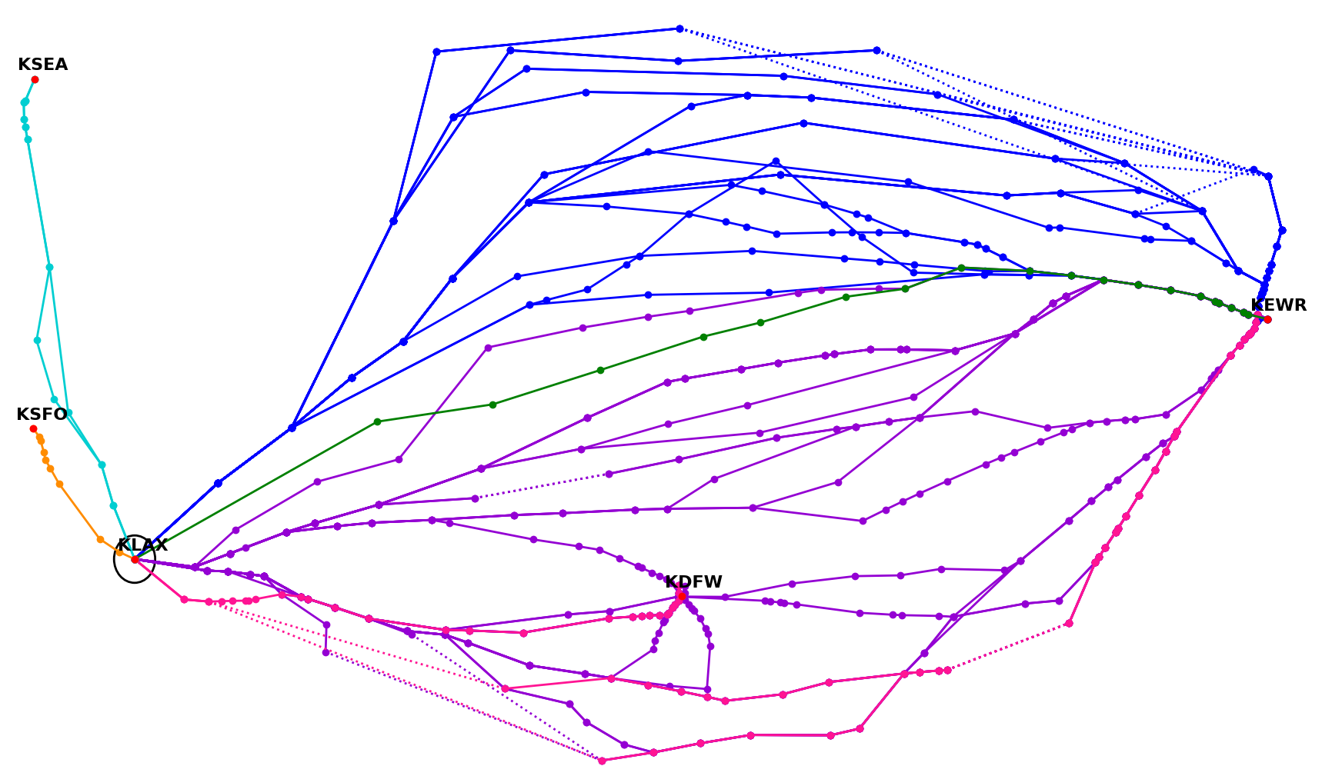
Why does SCT have so few Route Options?
In SCT, only destinations to the East have CDRs defined to use alternate Gate options
0 alt Gate options
KXYZ
1 alt Gate option
2+ alt Gate options
SCT
Notes:
Each color represents a different gate that is used.
If there is no CDR available for a particular airport pair, then it has 0 alternate gate options.
(for example number of flights with one alternate gate and so on) – this is a feature

Slide 13
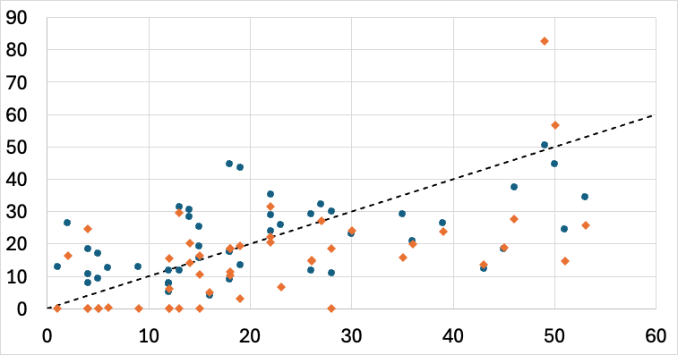
Prediction Model Performance
Model tested against D10 data
Gradient Boost (RSME = 12.97)
Linear Regression (RSME = 14.51)
Perfect Prediction
Predicted Candidates (weekly count)
Actual Candidates (weekly count)
Gradient Boost performs 11% better than Linear Regression
Notes:
Alpha Feature for comparing the performance of gradient boost and linear regression models. using the combined Alpha feature for linear regression.
Gradient Boost is the highest performing model for these predictions available
Linear Regression is simplest to implement, select combined features by hand and test against gradient boost
Root square mean error difference used to calculate the difference in two model performances

Slide 14
Approach Overview
Predicted Number of Reroutes
Coded Departure Routes
TRACON Features
Prediction
Model
ASPM Weather Impacts
D10 CDDR Field Data
ASPM
Flight Level Data
Benefits per Reroute
Extrapolated Benefits
ASPM: Aviation Systems Performance Metrics
Notes:
Feature development process
Prediction Model
Predictions – extrapolated benefits

Slide 15
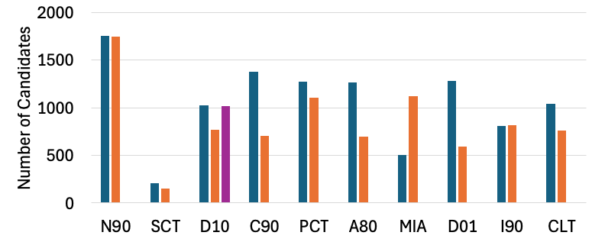
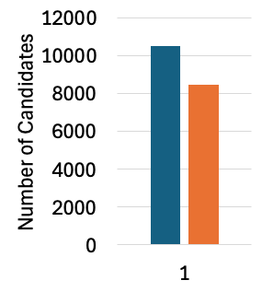
Predicted Reroutes
Gradient Boost Prediction
Linear Regression Prediction
Field Data Actual
Total
Submitted and accepted % from D10:
Model prediction agreement on most extreme cases N90 and SCT
Linear Regression more conservative except in the case of MIA
Submitted = 11.1% of Candidates
Accepted = 5.8% of Candidates
Notes:
Why are submitted and accepted percentages low

Slide 16
Approach Overview
Predicted Number of Reroutes
Coded Departure Routes
TRACON Features
Prediction
Model
ASPM Weather Impacts
D10 CDDR Field Data
ASPM
Flight Level Data
Benefits per Reroute
Extrapolated Benefits
ASPM: Aviation Systems Performance Metrics
Notes:
Feature development process
Prediction Model
Predictions – extrapolated benefits

Slide 17



Benefits Calculation
Net Delay Savings
= Taxi Out Delay Savings
– Airborne Delay Expense
System Delay Savings
Net Fuel Savings = (Taxi Out Delay Savings + System Delay Savings) x Surface Fuel Burn Rate
- (Airborne Delay Expense) x Airborne Fuel Burn Rate

Slide 18
Benefits Per Reroute
From ASPM Data for Alpha Flights
Taxi Out Delay Savings
Airborne Delay Expense
Net Delay Savings
10% Trimmed Mean Delay (min)
ASPM data used to set all benefits per reroute except System Delay Savings
D10 Field Submitted Flight System Delay Savings is used for all TRACONs
Notes:
Remove the D10 System Delay bar chart
Flights with Lowest and highest 5% delay savings taken out from the mean delay calculation.
Alpha Flights – any flight that ended up in the flight group with alpha feature

Slide 19
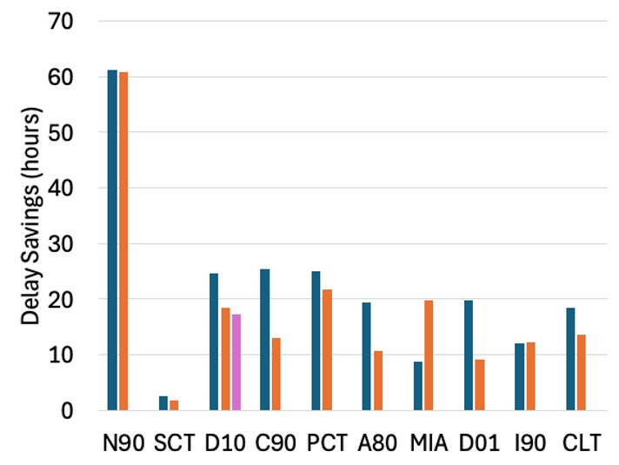
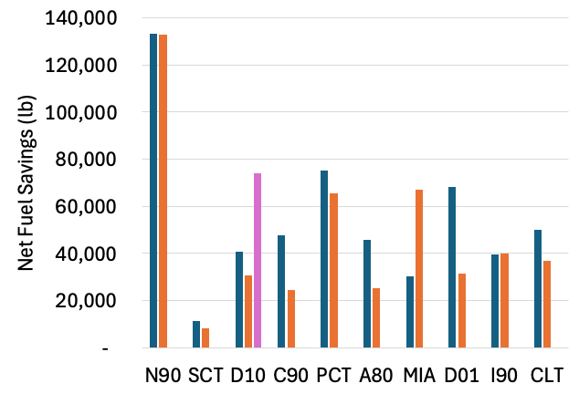
Extrapolated Benefits – Yearly per TRACON
Yearly Net Delay Savings for Submitted Flights
(May 2022 – April 2023)
Yearly Net Fuel Savings for Submitted Flights
Gradient Boost Prediction
Linear Regression Prediction
Field Data Actual
Delay Savings (hours)
Airborne Delay Expense is overestimated because it assumes original route is shortest. The effect is amplified in Net Fuel Savings due to higher airborne fuel burn rate.
Notes:
Comparison between performance of the two models
Update takeawy box

Slide 20
Summary
Designed TRACON features and developed Machine Learning models to predict CDDR Candidates at top 10 TRACONs
Estimate Delay/Fuel/Cost Savings per rerouted flight and extrapolate to yearly (May 2022 – April 2023) benefits per TRACON
Gradient Boost performs 11% better than Linear Regression
Results predict relatively high benefits at N90 and low benefits at SCT

Slide 21
Future Work Directions
Extend benefits prediction to more TRACONs
  Other TRACONS with CDRs
  Develop route options for TRACONS without CDRs
Use more recent field data to update projections
Incorporate field data from other TRACONs (e.g. I90)
Improve Airborne Delay Expense estimate – Use flight plan data to identify original route rather than assuming shortest route
Notes:
Assumptions, limitations
that would lead to the inaccuracies and error bar estimation
Bullet 1: Limitation: Route options are limited to CDRs. Using historic flight plans to identify popular routes that could be added to the TOS CDDR selects from, would expand the set of route options and enable extension to TRACONs without CDRs (note SFO and SEA as top 10 TRACONs without CDRs)
Bullet 2: Limitation: The CDDR algorithm has evolved as it's use become better understood and improvements made. The year of data studied may include periods of algorithm behavior change. If the algorithm has not been changed for a while, more recent data may provide more stable candidate selection behavior for training ML models.
Bullet 3: Limitation: The ML models are trained only on D10. Other TRACONs may routinely encounter operating conditions not encountered by D10. In addition to adding different operating conditions, adding another TRACON will help train the models to account for switching to a different TRACON, e.g. favor features that are more stable predictors of candidate counts when switching from one TRACON to another.
Bullet 4: Assumption: The filed flight plan is assumed to be the shortest CDR. Not always true as we have seen from D10 filed data. The filed route may even be a swap weather playbook route that is much longer and CDDR is suggesting a swap recovery reroute. Thus, airborne delay expenses are overestimated and resulting benefits per reroute are conservative (underestimated). Fllight plan data could be used to better estimate airborne delay expense for benefits per reroute calculations.

Slide 22
Backup

Slide 23
AIAA AVIATION, July 21 – 25, Las Vegas, NV
Title: Extrapolating the Sustainability Benefits of Collaborative Digital Departure Reroute
Authors: Shannon Zelinski , Heather Arneson , Swati Saxena, Dan Howell
Session: ATS-12: ML/AI in Air Transportation IV
Chair:
Date: Jul 24, 2025, Time: 2:20 pm – 2:40 pm, Location: Summit 226
Other Papers:
Thunderstorm Pattern Analysis Using Vision Transformers and Optimal Transport for Aviation Operations, The George Washington University,
Human-Centric Flight Planning Recommender System: A Chain-of-Thought Approach, The George Washington University
Aviation-Specific Large Language Model Fine-Tuning and LLM-as-a-Judge Evaluation, NASA Ames
Synthetic Data Generation for Computer Vision based Autonomous Landing for Small UAS Package Delivery, The George Washington University
Enhancing Clear-Air Turbulence Forecasts: A WTCNN-LSTM Framework Utilising Energy Dissipation Rate, The Hong Kong Polytechnic University, Hong Kong

Slide 24
Machine Learning Model Details (backup)
Gradient Boost
Target numbers of CDDR candidate flights per week May 2022 – April 2023
Train separate models targeting TMI and non-TMI candidates
63 normalized features
  divide flight count features by a total flight count
  divide average delay features by the appropriate average delay across all flights
Each fold of a ten-fold cross validation selected top 10 features
Hyperparameters tuned using D10 training set and top 10 features only
Average predictions from all 10 models from cross validation
Sum TMI and non-TMI candidate predictions to get total candidate prediction

Slide 25
Total Yearly Benefits for Top 10 TRACONs (backup)
 | Candidates |  | Submitted = 11.1% Cand |  | Approved = 5.8% Cand
Metric | Gradient Boost | Linear Regression | Gradient Boost | Linear Regression | Gradient Boost | Linear Regression
Flights | 10,526 | 8,458 | 1,169 | 939 | 610 | 491
Net Delay Savings (hours) | 1,956 | 1,632 | 217 | 181 | 113 | 95
Delay Cost Savings ($) | $17,709,322 | $14,772,942 | $1,965,735 | $1,639,797 | $1,027,141 | $856,831
Net Fuel Savings (lb) | 4,879,696 | 4,157,978 | 541,646 | 461,536 | 283,022 | 241,163
Fuel Cost Savings ($) | $1,707,894 | $1,455,292 | $189,576 | $161,537 | $99,058 | $84,407

