Slide 1


Silver Foam: A Novel Approach for Long-Term Passive Dosing of Biocide in Spacecraft Potable Water Systems – Update 2025
Tesia Irwin¹, Angie Diaz², Lucy Somervill², Mary Hummerick³, Wenyan Li¹, Nilab Azim⁴, and Michael Callahan⁵
1 Research Scientist, Astrion, Mail Code: LASSO-008, Kennedy Space Center, FL, 32899.
2 Research Scientist, Bennett, Mail Code: LASSO-008, Kennedy Space Center, FL, 32899.
3 Research Scientist, Noetic Strategies Inc., Mail Code: LASSO-008, Kennedy Space Center, FL, 32899.
4 NASA, Research Scientist, Exploration Systems and Development Office, Mail Code: UB-E, Kennedy Space Center, FL, 32899.
5 NASA, Water Technology Lead, Crew and Thermal Systems Division, 2101 NASA Parkway/EC3, Houston, Texas, 77058.
54th International Conference on Environmental Systems, 13-17 July 2025, Prague, Czech Republic ICES-2025-194

Slide 2
Acknowledgement
Funding: NASA MCO Life Support Systems​
Project Direction: Imelda Stambaugh and Paul Tatum ​
Technical Guidance: Michael Callahan and Jill Williamson

Slide 3

Agenda
01
Background
02
Technical Approach
03
Previous Work Summary
04
Recent Achievement
05
Path Forward

Slide 4

Agenda
01
Background
02
Technical Approach
03
Previous Work Summary
04
Recent Achievement
05
Path Forward

Slide 5
Introduction
Silver biocide is being investigated by NASA as the replacement for the current iodine water disinfectant used on ISS and for future mission architectures.
We propose a controlled-release material, namely AgFoam, as attractive option
  passive release (no power, dormancy compatible)
  low consumables
  microbial check valve (MCV) potential
Notes:
Silver ion is a broad spectrum biocide that shows potential for use in spacecraft water systems. Current active silver ion dosing technologies are based on the electrochemical production of silver ion from a silver electrode. To buy down risk, a passive controlled-release approach for dosing silver is an attractive option due to the low maintenance, low consumables, and potential for being used as a microbial check valve as well.

Slide 6
Key Performance Parameters
Requirements for in-line passive silver dosing and microbial check valve (MCV) technology:
Adding 200 to 400 ug/L of silver to the water at a flow rate of 0.1 to 0.15 L/min to maintain the microbial control.
Operating at ambient temperature, pH ranges 4.5 - 9.0, and system pressures up to 30 psig.
Preventing the passage and/or grow through of microbes across the device.
Microgravity compatible, minimal power and consumable mass requirements, small, robust, lightweight and easy to install and maintain.
No adverse effects on the potable water, safe for consumption.
Compatible with other ionic silver disinfection technologies
Providing continuous, stable and autonomous operation,
Fully functional following dormancy – up to 1 year

Slide 7
Agenda
01
Background
02
Technical Approach
03
Previous Work Summary
04
Recent Achievement
05
Path Forward

Slide 8
Technical Approach: Silver Foam Concept
Controlled-release materials are an attractive option
  comparable to current disinfection technology (minimum redesign)
  passive release (no power, dormancy compatible)
  low consumables
  microbial check valve (MCV) function
Matrix immobilizes the NPs
stable surface area
structural support
Driving force – dissolution
Polyurethane (PU) foam with embedded silver chloride (AgCl) nanoparticles (NPs)

Slide 9
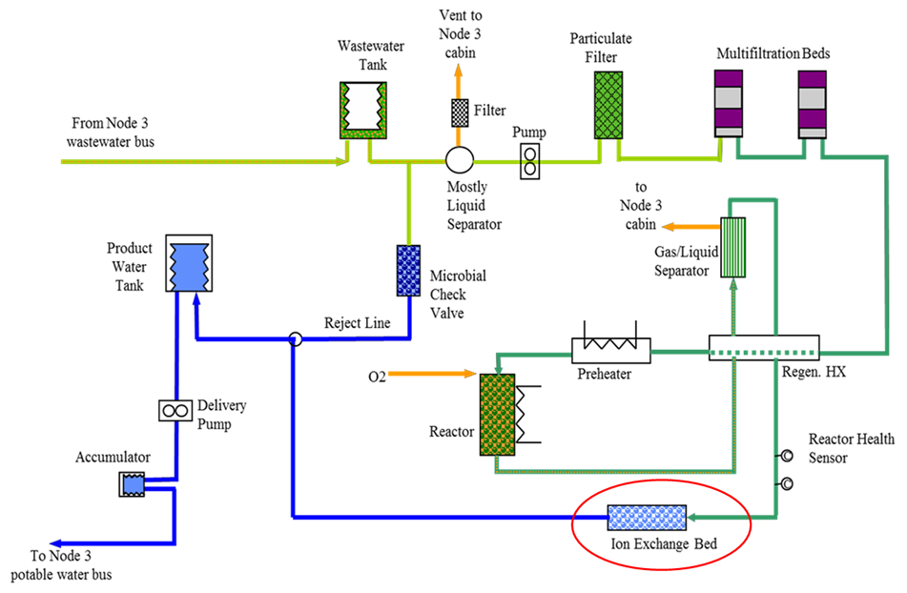
AgFoam Applications
Currently, the AgFoam is being tested for two separate uses:
Silver Doser (at Ion Exchange Bed location)
Microbial Check Valve (MCV)

Slide 10
Doser/MCV Schematic
AgFoam
Mesh
Mesh
Inlet
Outlet
Threaded Cap

Slide 11
Mass/Volume/Power Estimates
AgFoam Material:
  25-30 grams/foam
  290 mL/foam uncompressed
  4 crew, 3 year (3 AgFoam): 90 g and 870 mL
Cartridge (current design):
  196.5 grams
  550 mL
No power requirements

Slide 12
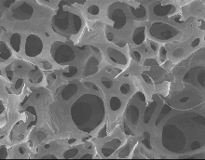
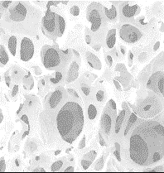



Physical/Math Model
A realistic math model was developed for the AgFoam flow-through cell.
This model predicts the silver ion concentration as a function of:
  flow rate (Q), and
  foam surface area: A = S_{A} × V
    foam S_{A} (surface area per unit volume),
    foam volume V
L
D
x
bulk flow:
dx
Q, $c_{x}$
Q, $c_{x+dx}$
diffusion:
$$c_{s}$$
$$J_{D}=D_{Ag}\frac{Cs−Cx}{δ}$$
$$c_{x}$$
$$δ$$

Slide 13
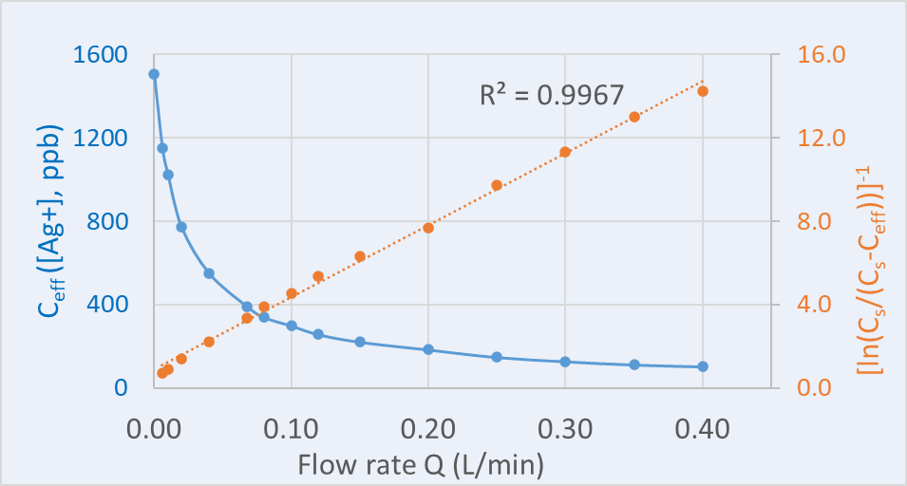


Physical/Math Model
  The solution of the math model:
$Ln\left(\frac{c_{s}−c_{eff}}{c_{s}}\right)=−\frac{D_{A_{g}}∙A}{Q∙δ}$
where
C_{s} = solubility limit,
C_{eff} = effluent concentration,
A= foam surface area,
D_{Ag} = the diffusion coefficient of silver ion in water,
δ = the diffusion boundary layer thickness.
Q = flow rate (volumetric)
Plot experimental data $1/{ln(\frac{c_{s}}{c_{s}−c_{eff}})}$ or C_{eff} vs Q

Slide 14
Agenda
01
Background
02
Technical Approach
03
Previous Work Summary
04
Recent Achievements
05
Path Forward

Slide 15
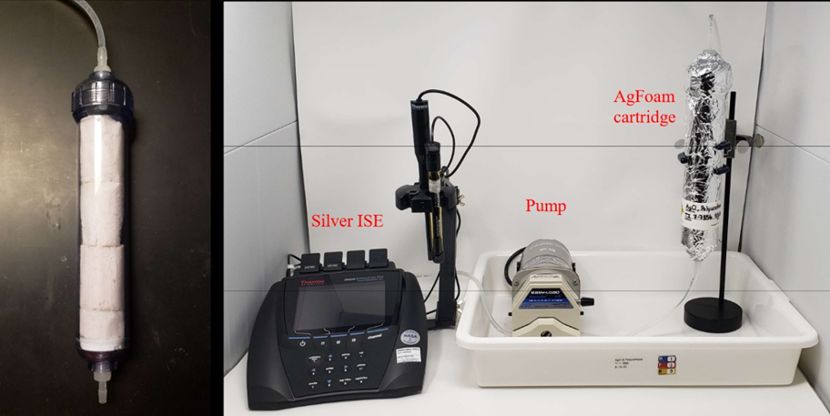
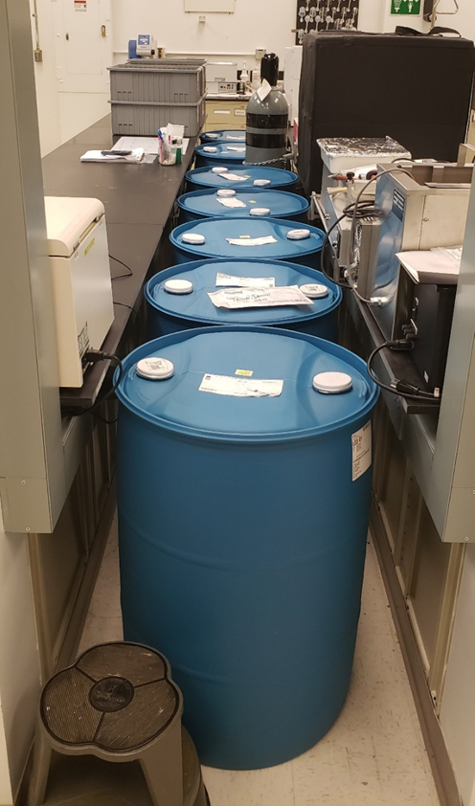
Doser Test: Expedited 1 Crew-Year Test
  AgFoam Sample (20% Ag Foam)
    Weight = 27.8 g, Volume = 290 mL
    Tested without washing (test began with dry foam)
  Test Conditions
    Flowrate = 0.1 L/min
    DI water
    Duration: 160 hr in 2 weeks, 16 hr/day
    The cartridge is fully wetted at all times.
    Cartridge kept in the dark

Slide 16
Doser Test: Expedited 1 Crew-Year Test
  First 4 hours:
    [Ag+] dropped ~100 ppb before leveling out.
    Potentially due to the dissolution of AgCl on the surface.
  After soaking over the weekend (t=170 hr):
    [Ag+] increased ~90 ppb over the next 16 hrs before leveling out.
    Foam became fully wetted (wetted surface area increased).
  Repeating the weekend soak test (t=340 hr):
    Only a small increase (~ 20 ppb) in [Ag+].

Slide 17
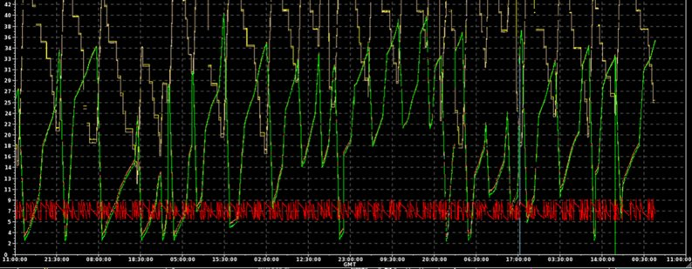
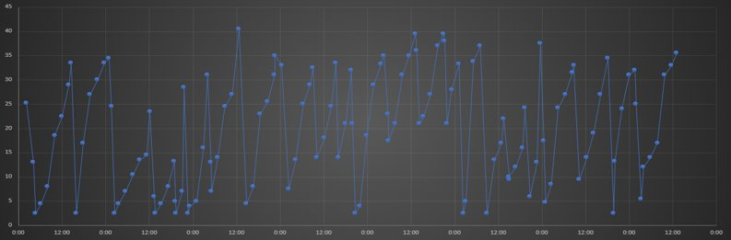
Doser Test: Realistic 4 Crew-Year Test
Test was scheduled based on ISS WPA tank flow pattern data (provided by AES water lead).

Slide 18
Realistic Long Term: 4 Crew-Year Test
Started 07/25/22, continued to stay in the targeted range (flow rate 0.1L/min) passed the scheduled finish date in July 2023.
When the accumulated silver average started to drop out of the target range (200 to 400 ppb at 0.1L/min):
    The test is at 118% completion (4290L of 3650L for 4 crew-year).
    Counting the accelerated 1 crew year test, this foam has dosed water for 5.7 crew-year.

Slide 19
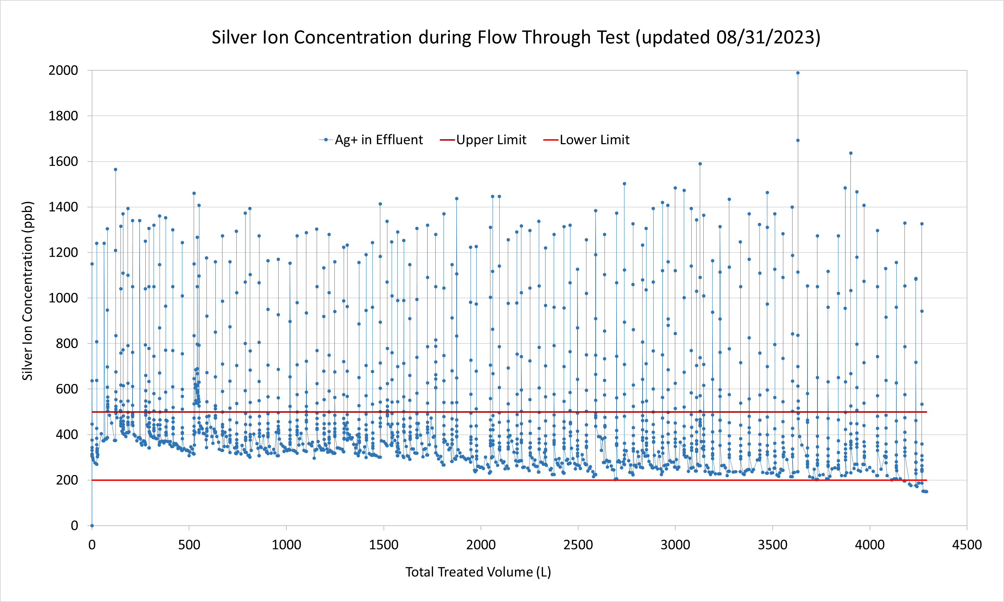
Realistic Long Term: 4 Crew-Year Test

Slide 20
Realistic Long Term: 4 Crew-Year Test

Slide 21
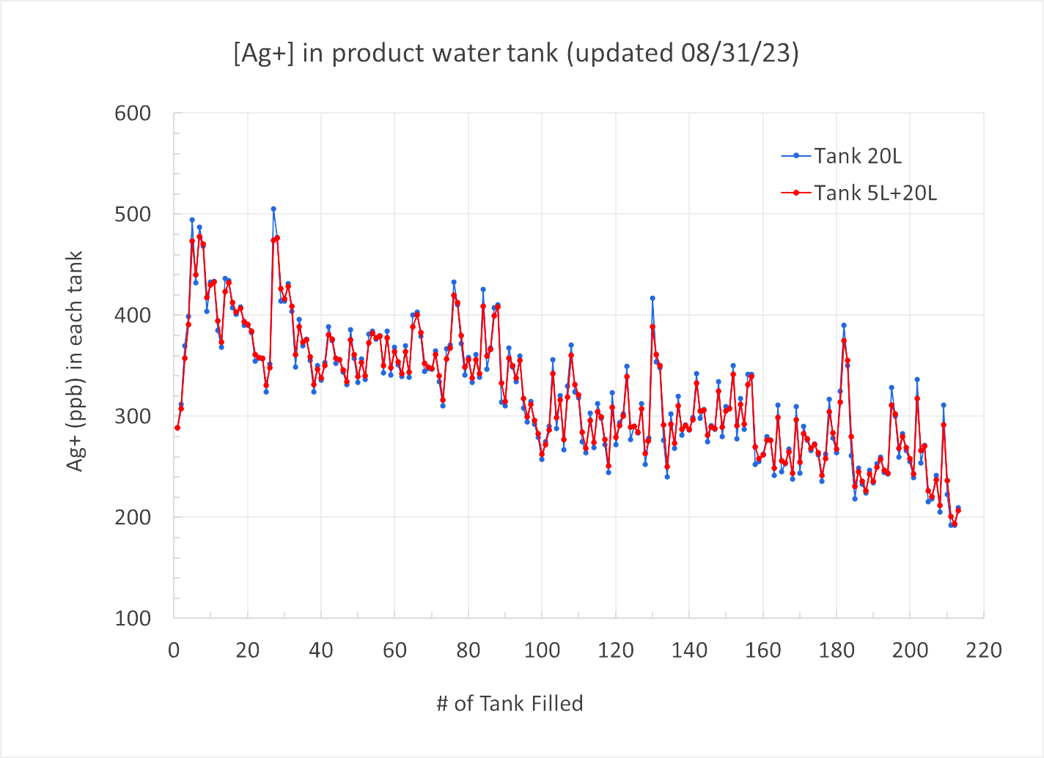
Realistic Long Term: 4-Crew Year Test

Slide 22
Agenda
01
Background
02
Technical Approach
03
Previous Work Summary
04
Recent Achievement
05
Path Forward

Slide 23
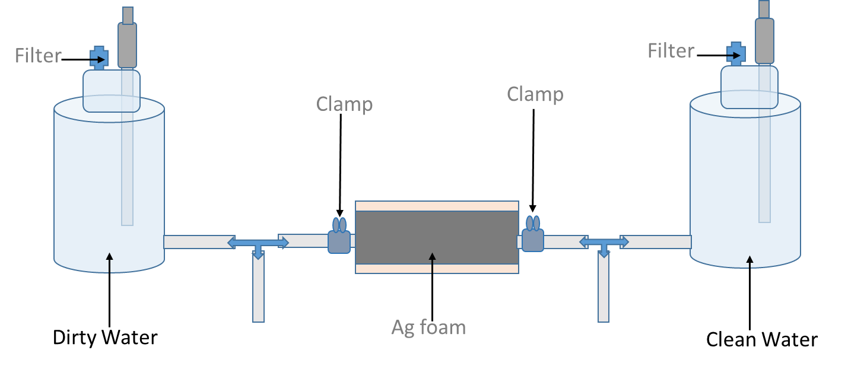
Recent Achievement: MCV Test
Media on both sides: simplified microbial ersatz (same nutrient level input as WPA Waste water tank)
Inoculation: 10⁶ CFU/mL Ralstonia insidiosa (ISS strain) on the left (dirty) side only.
The dirty and the clean side are connected during the test (clamps are used for sampling).
This was considered more challenging than the realistic one-way flow condition (clean to dirty):
  no mechanical check valve
  all connectors open
  Microbial Ersatz used for both sides

Slide 24
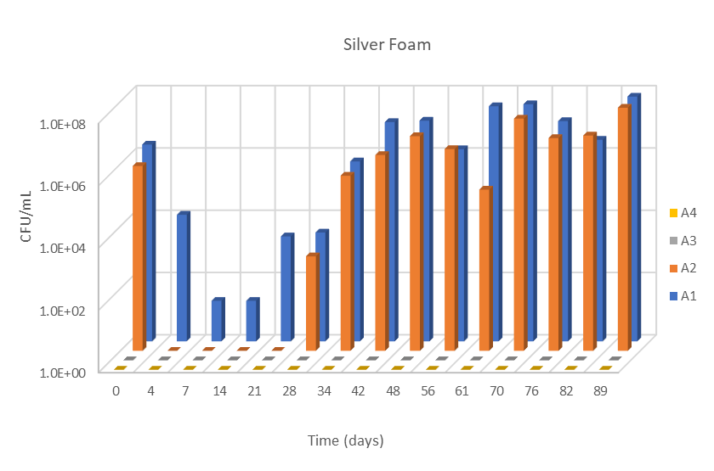
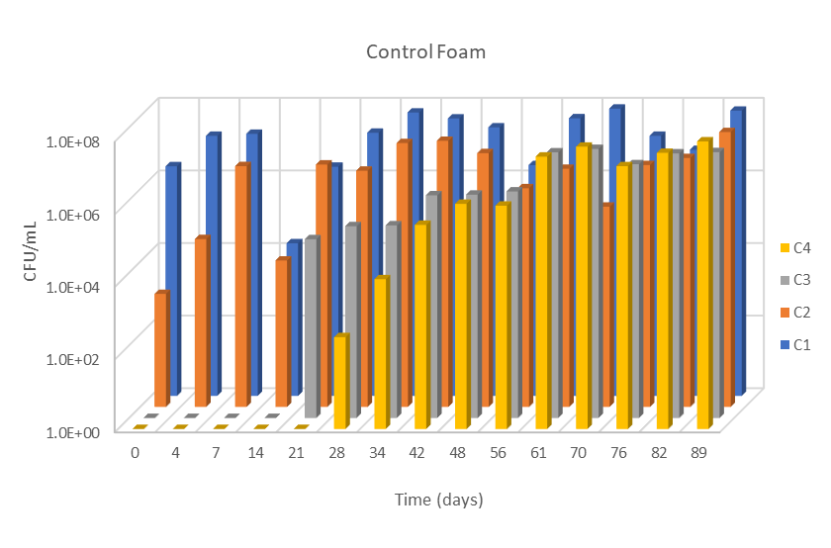
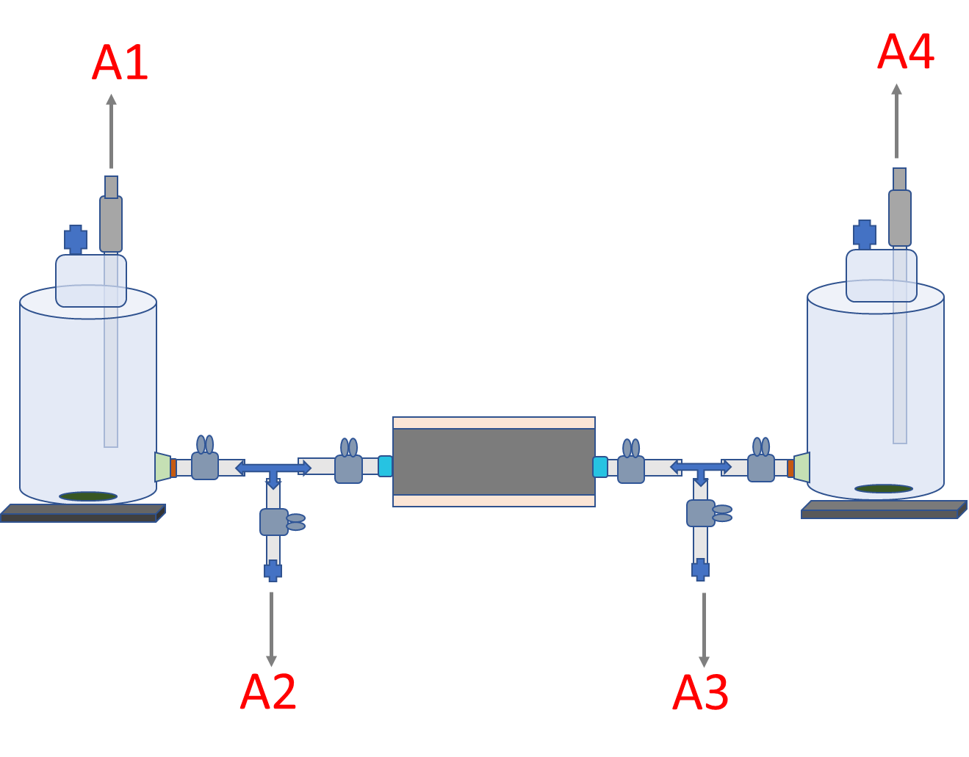
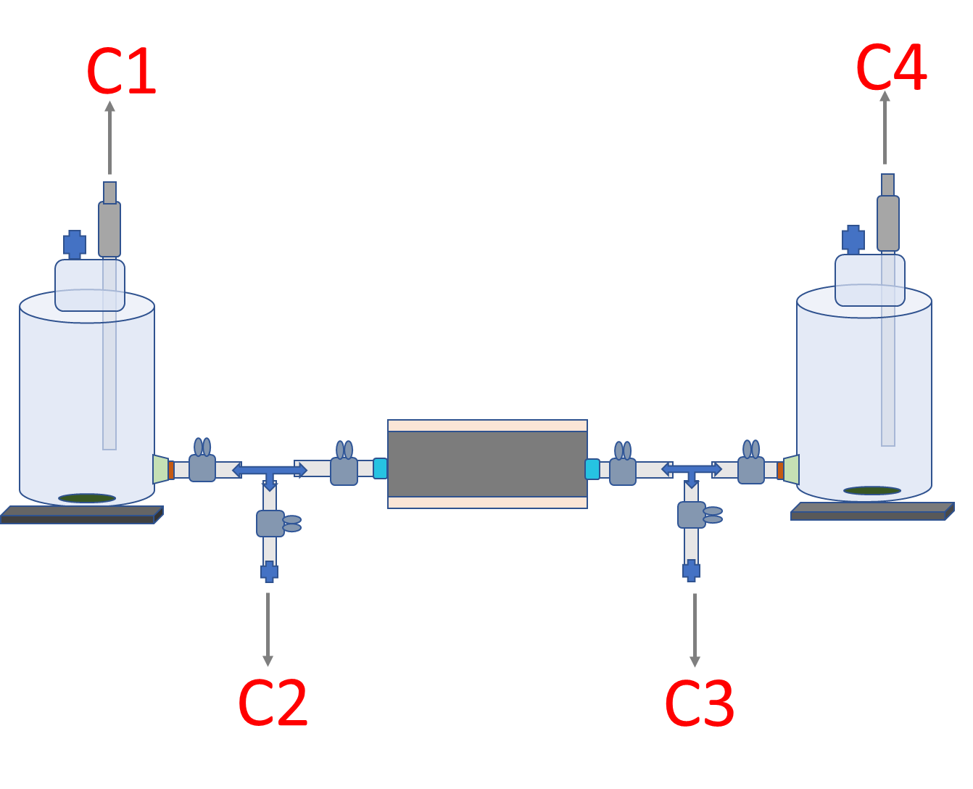
Recent Achievement: MCV Test Results
Three 3-month MCV test was successfully completed successfully.
AgFoam acted as MCV under test conditions to stop bacteria from crossing over.
R. insidiosa has crossed the control foam as expected.
Representative results are shown below.

Slide 25
Product Variability: AgCl Nanoparticles
Product variability is one of the identified risk for the AgFoam technology development.
AgCl nanoparticles are the key elements of the AgFoam, thus elimination of its product variability is important for the overall risk mitigation.
Up to 2024, AgFoam product variability has been a challenge due to lack of reliable supplier for AgCl nanoparticles.
Recently, a KSC in-house process was developed to produce AgCl nanoparticles with good silver ion dosing performance, with good yield and with relatively easy post treatment.
A commercial partner was able to scale this process successfully; now we have a good AgCl nanoparticle commercial product from a US company.

Slide 26
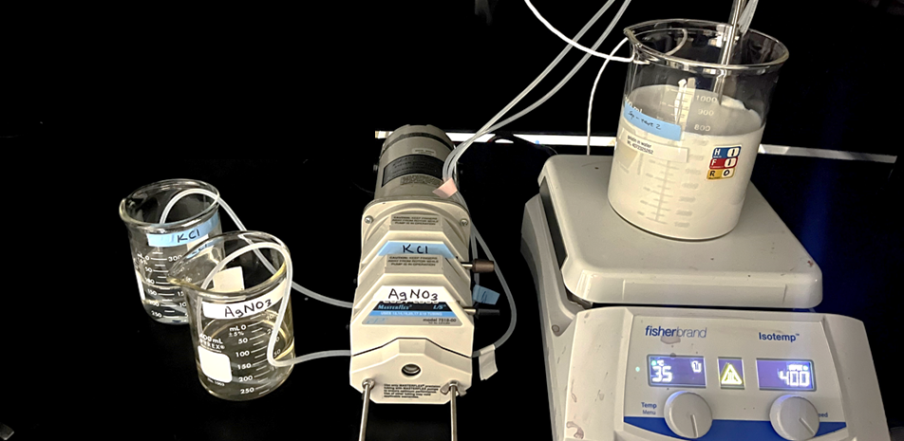
KSC In-House Process
After some initial trials, KSC developed a simple process to produce and clean AgCl nanoparticles that perform well for silver ion dosing.
The process: adding KCl (1M KCl with 2.5% gelatin, 300 mL) and AgNO3 (1M, 300 mL) to a gelatin solution (2.5%, 300 mL) at ~10 mL/min and 35 ºC.
A process was then developed to clean these particles with an enzyme solution to eliminate gelatin before drying.
Particle size and shape: ~100 nm, cubic (see next slides).

Slide 27
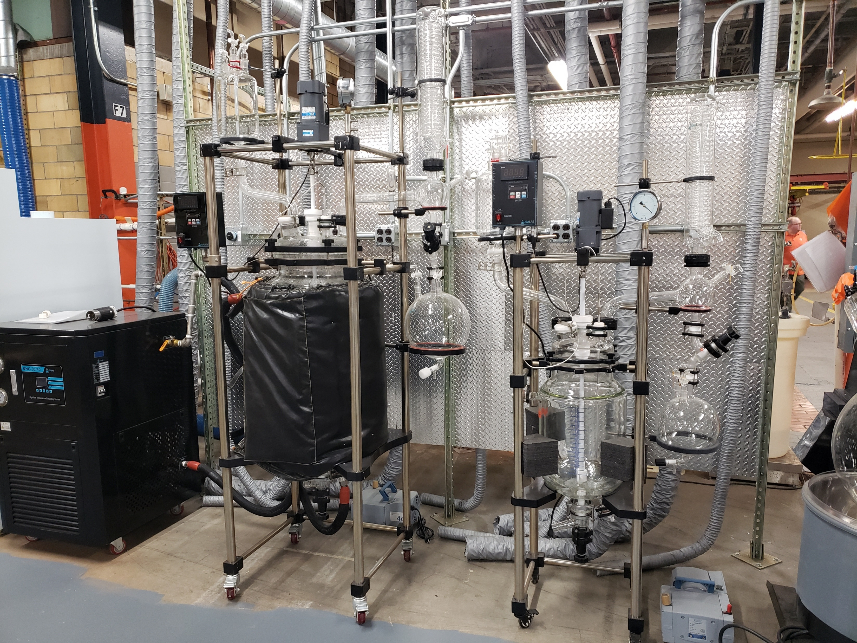
Cerion Scale Up Test
Our commercial Partner, Cerion, was able to scale up the process successfully.

Slide 28
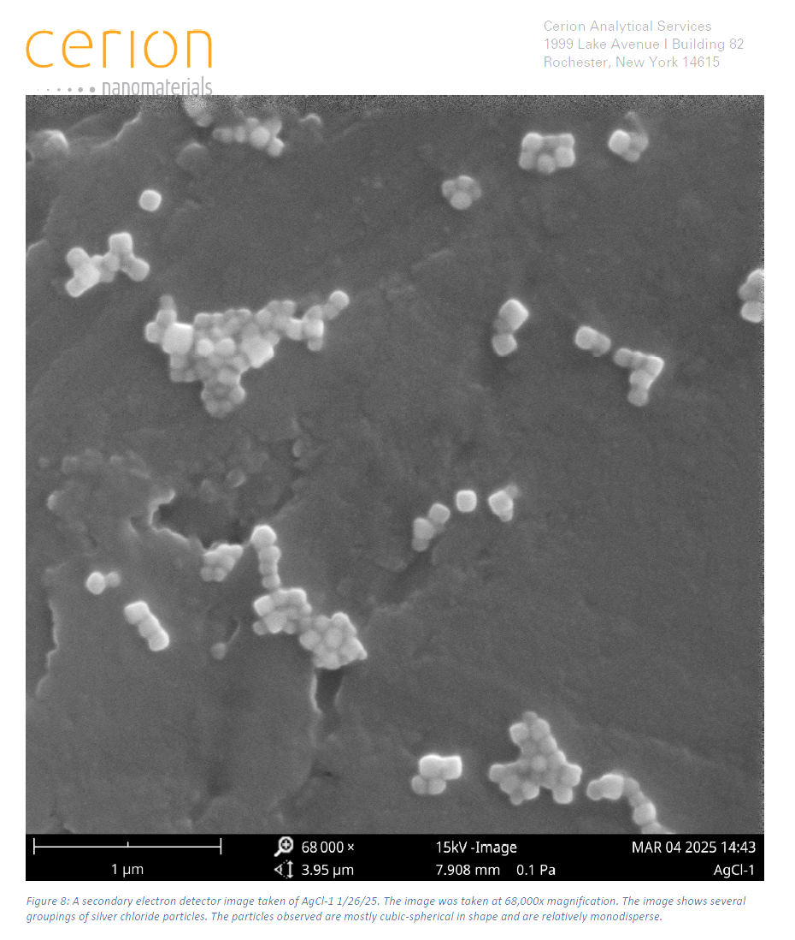
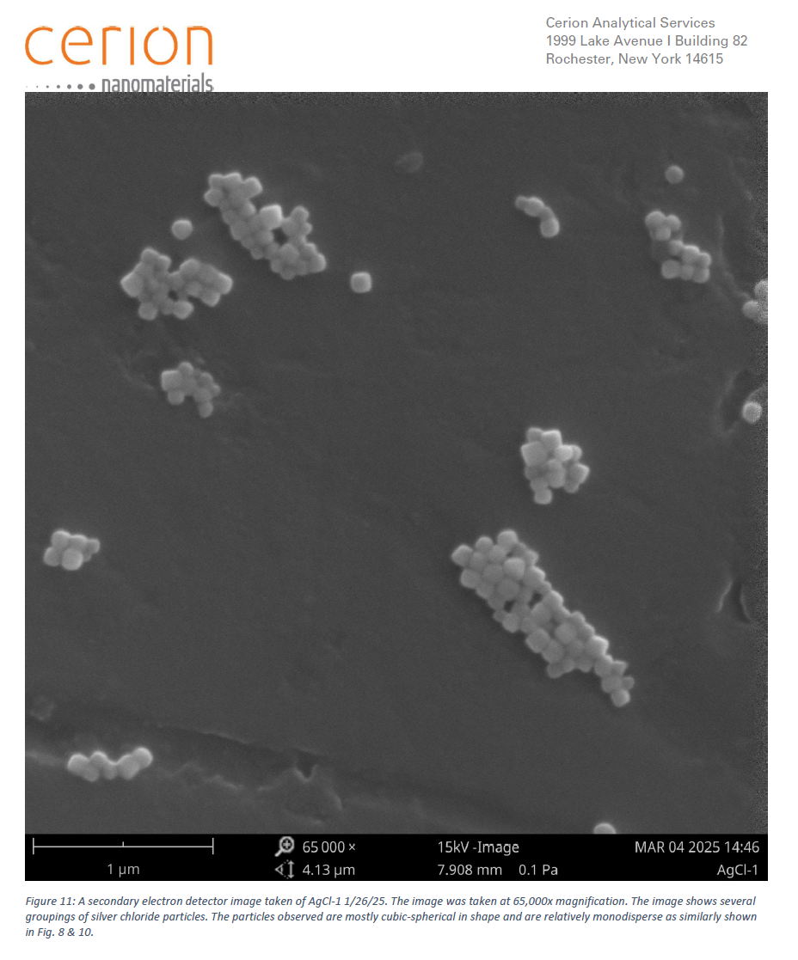
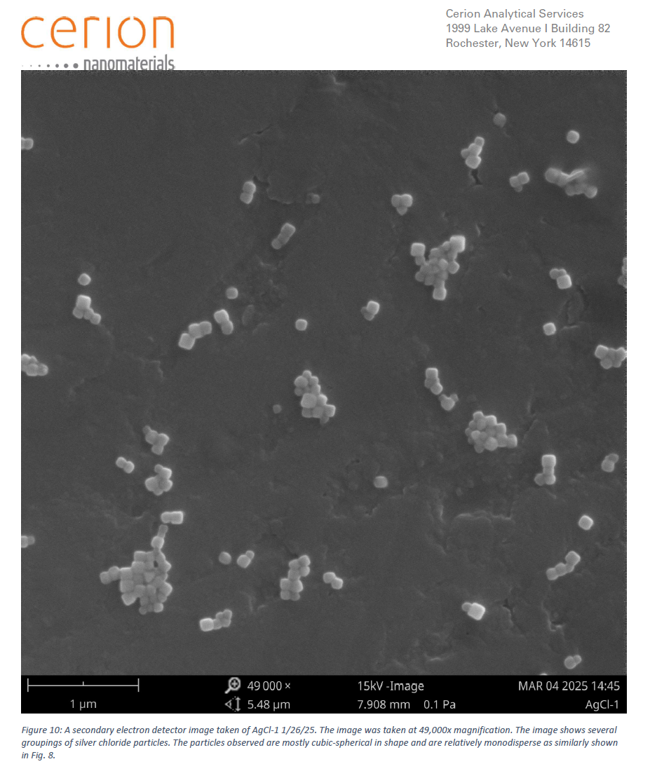
KSC In-House Process
AgCl nanoparticles synthesized by the KSC in-house process, characterized by Cerion.
Sample 1: (KSC Batch 16-18, enzyme cleaned, and freeze dried)

Slide 29
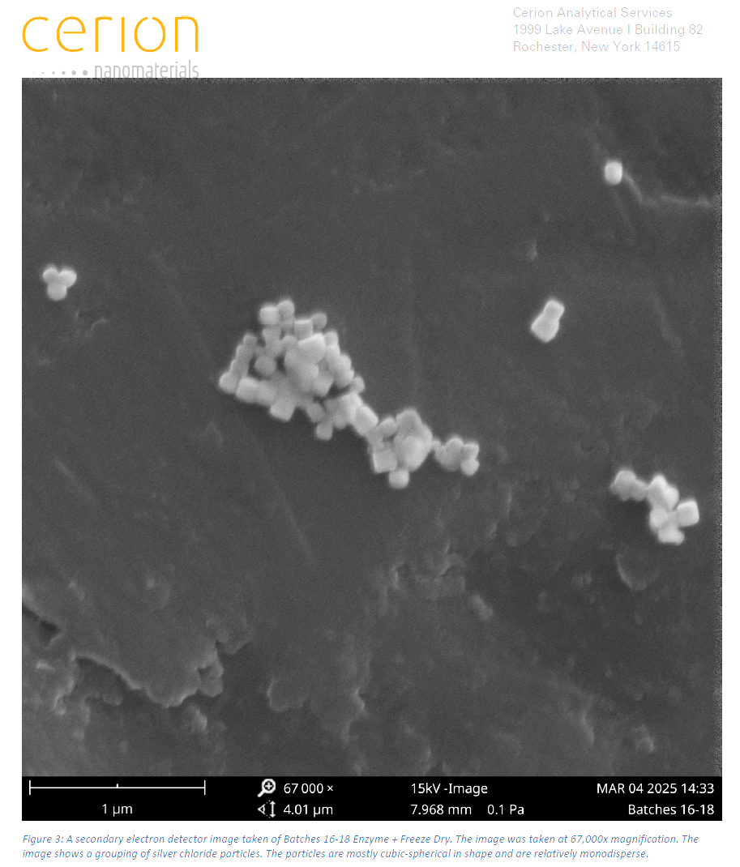
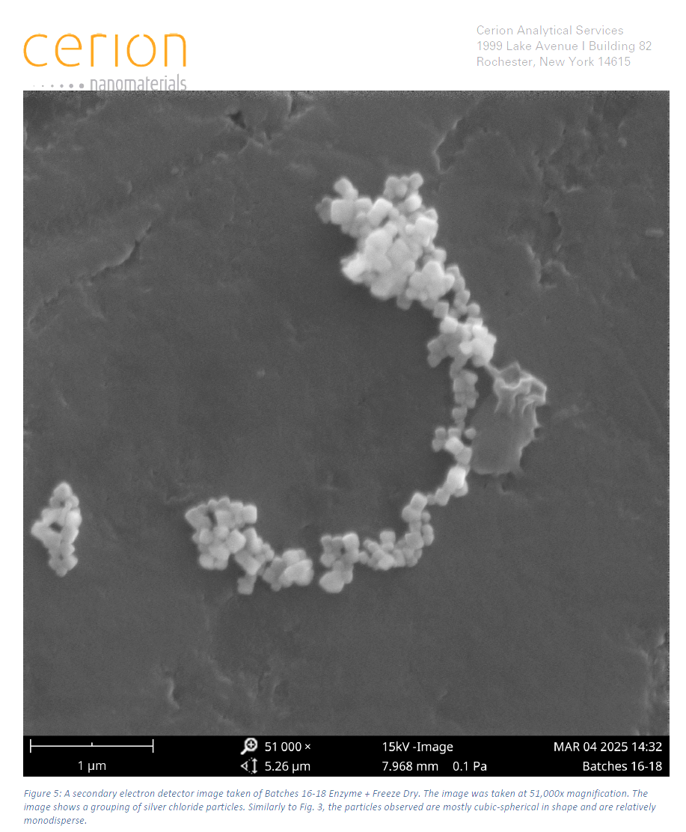
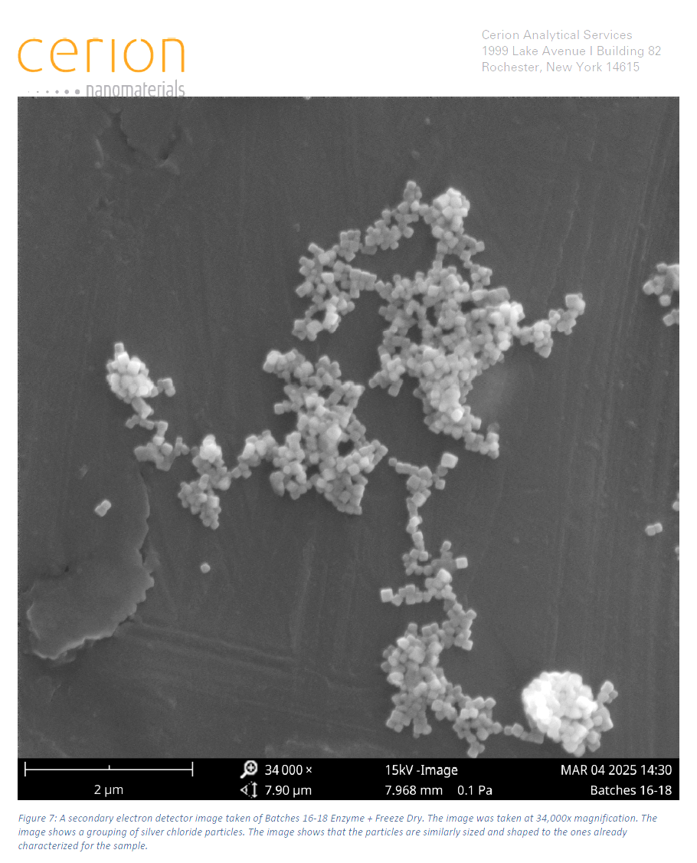
KSC In-House Process
Sample 2: (KSC sample 1/16/25, before drying)

Slide 30
AgCl Nanoparticles: Silver Ion Release Results
The Cerion commercial product (not shown) and earlier trials did not perform as well as the gold standard particles.
The KSC in-house particles performed better than the gold standard particles.
The Cerion scale-up particle performed the best ( likely due to better process control).

Slide 31
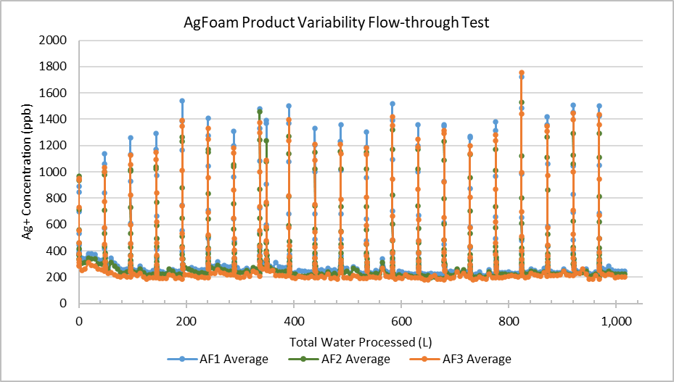
AgFoam: Flow Through Test
With freeze dried particles, some water is needed to mixed with the AgCl nanoparticles before they are incorporated into the polyol phase for AgFoam synthesis.
Some initial trials were done to determine the optimized water percentage used.
The new AgCl nanoparticle were used to prepare AgFoams which were test for silver ion dosing at 0.1L/min.
They were able to dose silver ion at the targeted dosing range.

Slide 32
Agenda
01
Background
02
Technical Approach
03
Previous Work Summary
04
Recent Achievement
05
Summary & Path Forward

Slide 33
Summary and Path Forward
Summary:
AgFoam was developed as a passive dosing technology for the silver biocide for water disinfection during future exploration missions.
Its doser function has been demonstrated by the 4 crew-year test.
Its MCV function is being evaluated. Three 3-months short test were successfully conducted. The long-term test has been planned.
Recent achievement includes risk mitigation in product variability.
  A KSC In-house process for AgCl nanoparticle synthesis was developed and scaled up by a commercial partner.
Path Forward:
The long-term MCV test
Environmental factor test (how T, P, pH of influent influence the AgFoam performance)
Flight-forward Cartridge Design and High-Fidelity Test

Slide 34
Questions ?

