Slide 1
An Introduction to Direct Simulation Monte Carlo (DSMC)
Thermal & Fluids Analysis Workshop (TFAWS)
Ames Research Center 2025

Slide 2
Introduction
Section 1

Slide 3

Computational Method/Flow Regimes
The Boltzmann Equation describes gas behavior from free molecular to continuum conditions.
Describes the evolution of the molecular velocity distribution function
In general, expensive and difficult to solve, so simplifications/assumptions are made
$$Kn= λ/L_{ref}$$

Slide 4
Computational Method/Flow Regimes
The continuum description leads to the Navier-Stokes equations of compressible gas dynamics
NS equations can be “derived” from the Boltzmann equation assuming “small” departures from thermodynamic equilibrium
The derivation results in expressions of the shear stress and heat flux that are functions of first derivatives of basic fluid properties such as density, temperature, and velocity
NS relations become inaccurate when the length scale of macroscopic gradients is on the order of the mean free path

Slide 5
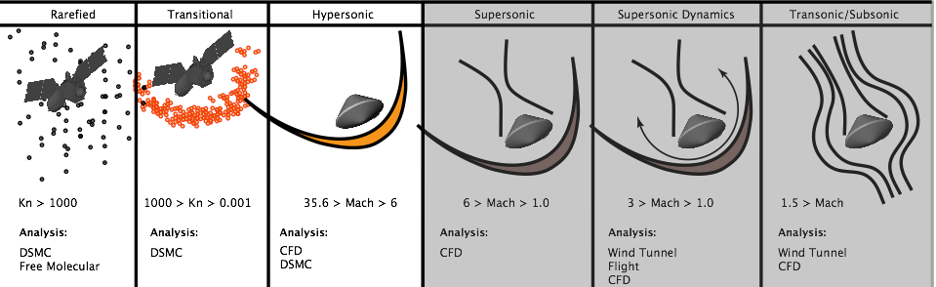
Computational Method/Flow Regimes
Rarefied gas dynamics (RGD) involves flow physics in regimes where traditional continuum CFD is not applicable – mean free path becomes significant fraction of characteristic dimension
The standard for simulating rarefied/transitional flows is the direct simulation Monte Carlo (DSMC) method

Slide 6
Significance to the NASA Mission
Rarefied gas dynamics using DSMC represents a critical core competency for the execution of broad NASA mission objectives (Human, Robotic, and Science)
Plume impingement during proximity operations with a space station or satellite
Spacecraft venting
Self impingement to critical spacecraft hardware
Attitude disturbances
Aerothermodynamic predictions for upper atmospheric vehicle analysis
Reentry, aerobraking, aerocapture, aerogravity assist missions
Control system interaction with the free stream – control surfaces, RCS, etc.

Slide 7
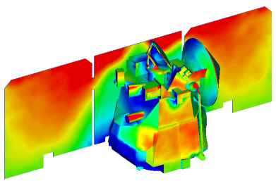
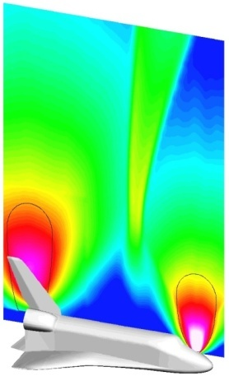
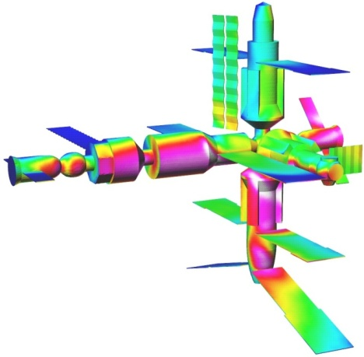
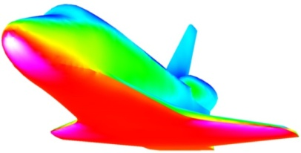
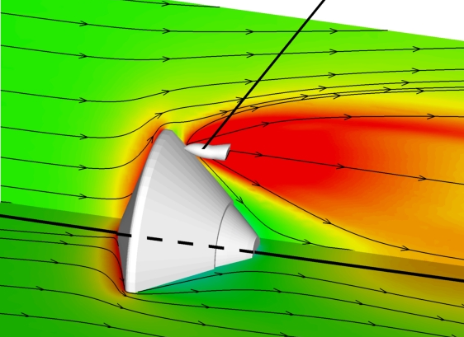
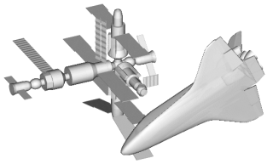
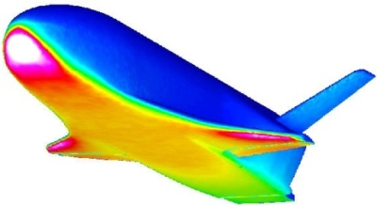
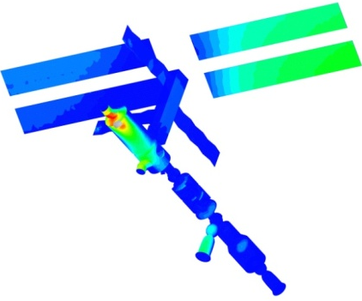
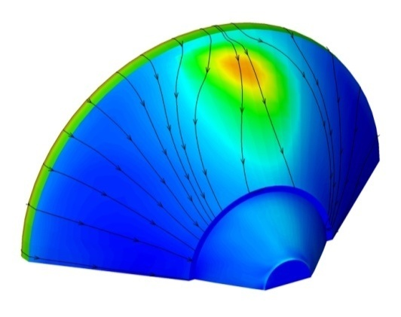
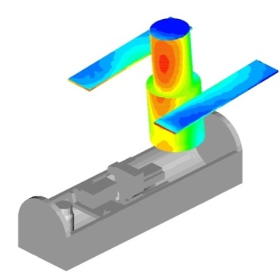
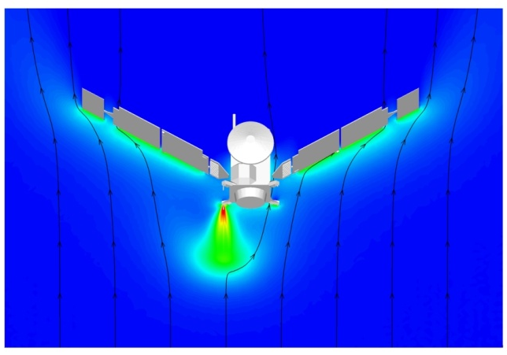
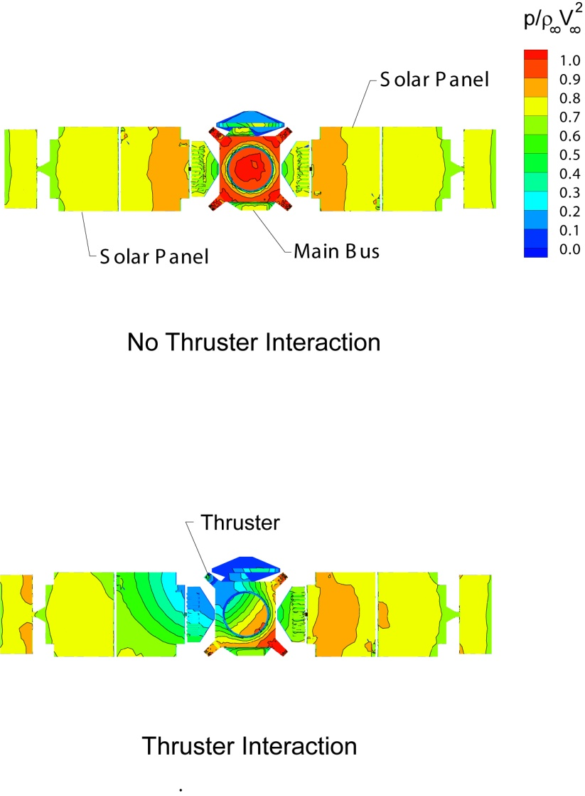
Previous NASA Applications Using DSMC
Space Shuttle
Shuttle / Mir
Plume Impingement
Mars Odyssey
X-37
Phoenix
Mars
Lander
Shuttle RCS Plumes
Mars Global Surveyor
Hubble
Servicing
Mission
Environments
ISS Venting
Self Impingement
7

Slide 8
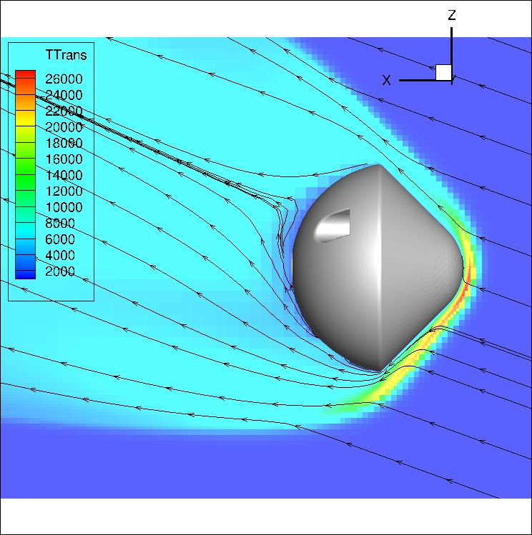
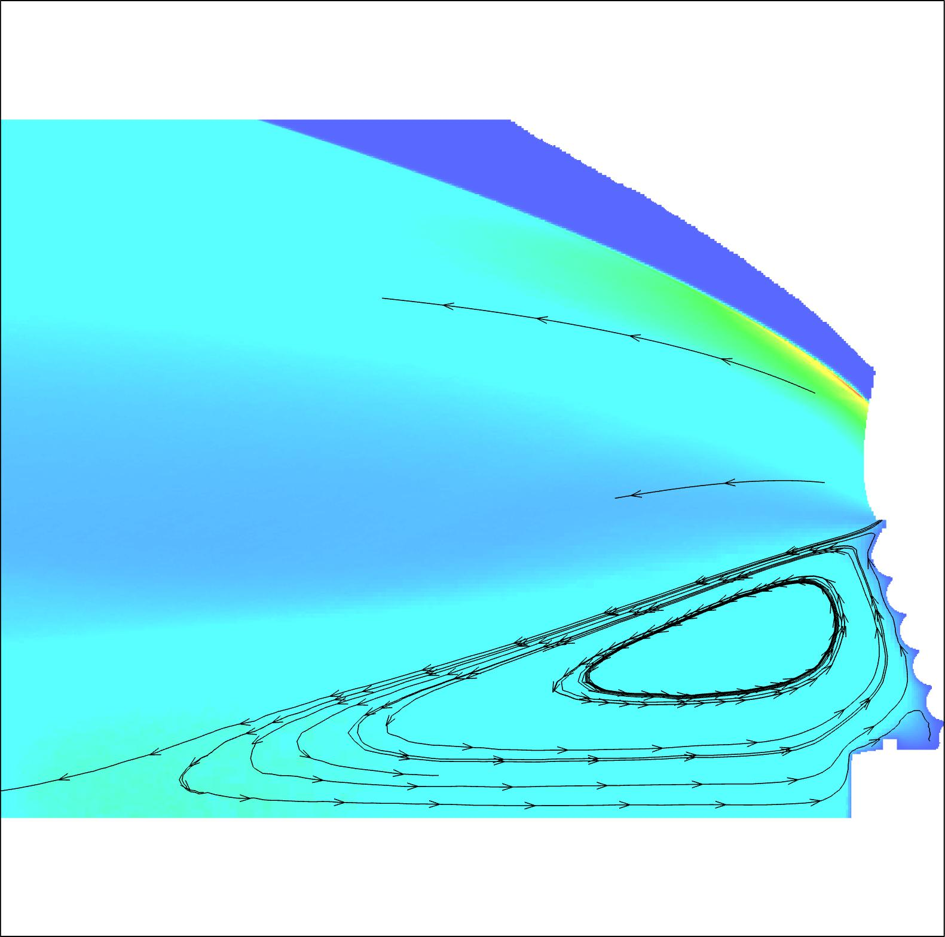
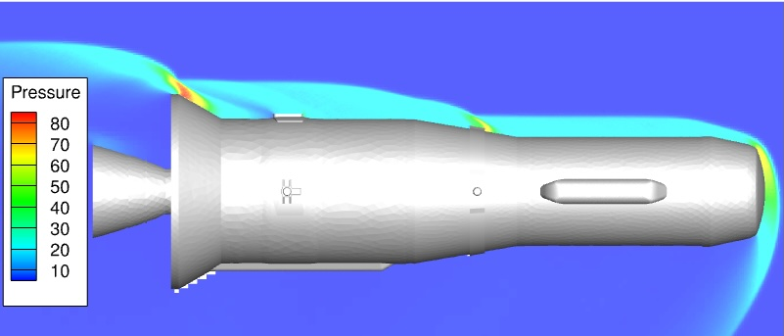
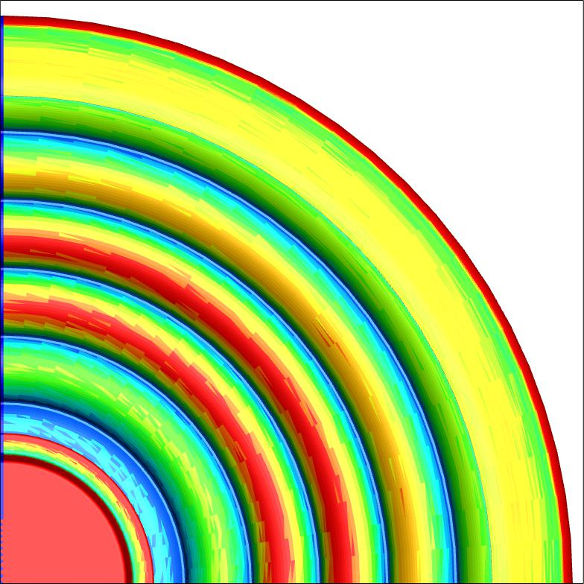
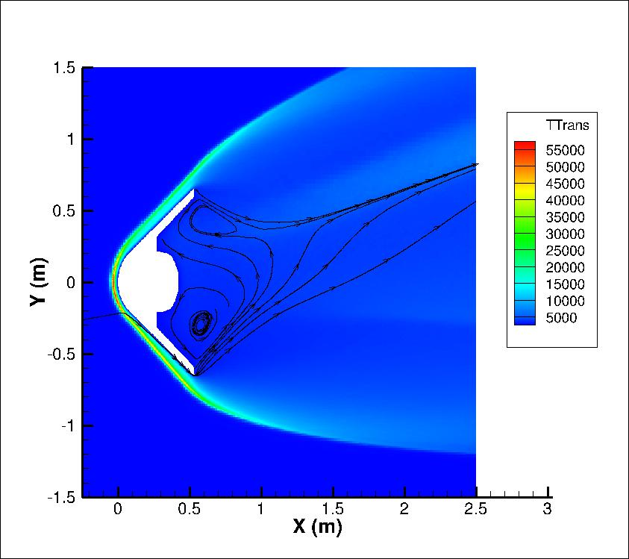
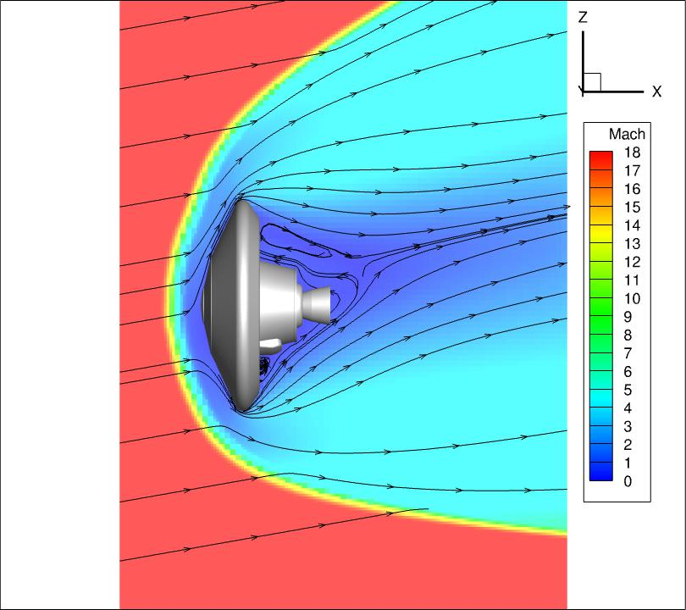
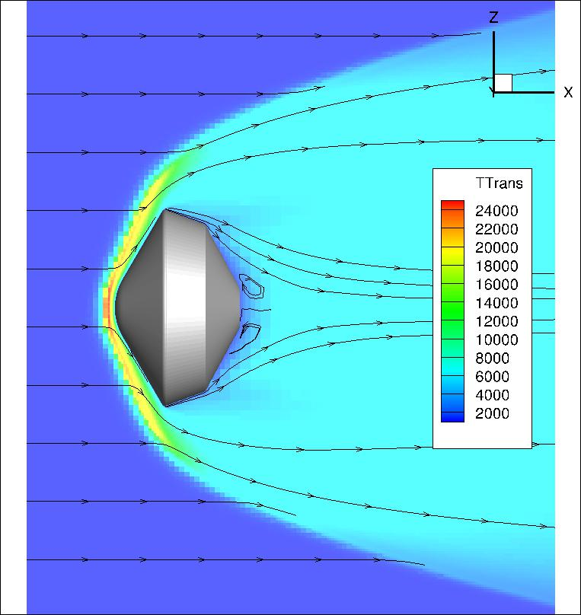
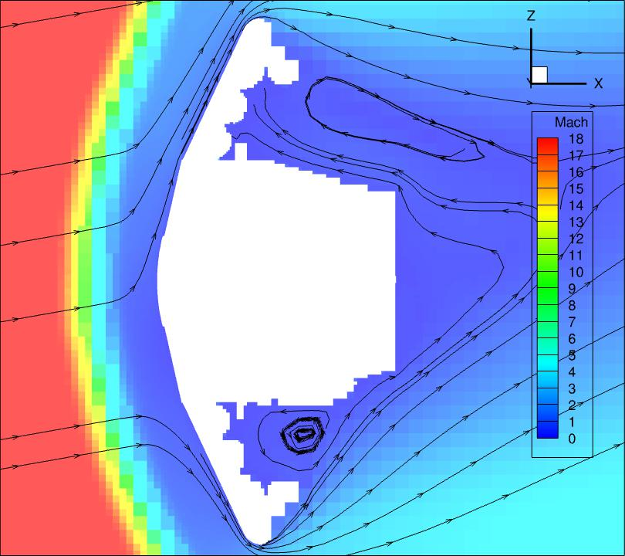
Recent LaRC Applications Using DSMC
HIADS
Varda
LOFTID
MSR
MAV
VERA
Dragonfly
EEV

Slide 9
Fundamental Aspects of DSMC
Section 2

Slide 10
The DSMC Method
Direct simulation Monte Carlo (DSMC) involves a physical, rather than mathematical (i.e. Boltzmann Equation), modeling of the gas at the microscopic level
Representative particles, each representing many real particles, are tracked in space and time
Motion is decoupled from collisions
Move
Collide

Slide 11
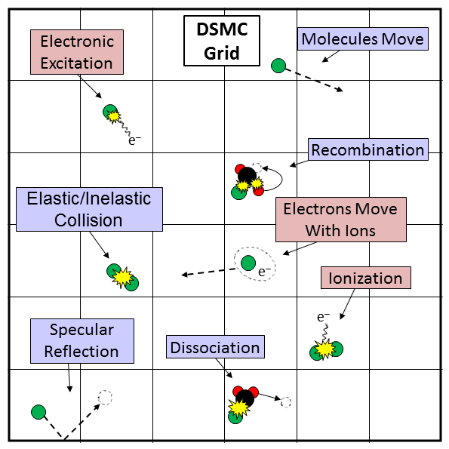
The DSMC Method
A network of cells is used to group neighboring particles into candidate collision pairs
Candidate pairs are selected to collide via a Monte Carlo technique that produces the correct collision rate as a function of relative velocity
Statistical sampling of particles provides macroscopic properties
Fundamental constraints must be satisfied for accurate simulation
First DSMC publication by Prof. Graeme Bird in 1963

Slide 12
The DSMC Method
Start
Read Input
The basics of DSMC are straightforward
A simple DSMC code can be as short as a few hundred lines of code
However, there are many subtleties
Care must be taken in how the steps are performed
DSMC does not have any stability criteria as is the case when solving NS equations
Poor choices on algorithms or simulation parameters do not lead to code “crashes” as often
Therefore, it is possible/easy to develop a DSMC code that can give poor results
Enter New
Particles
Move Particles
Index Particles
Collide
Sample
Update Restart
Stop

Slide 13
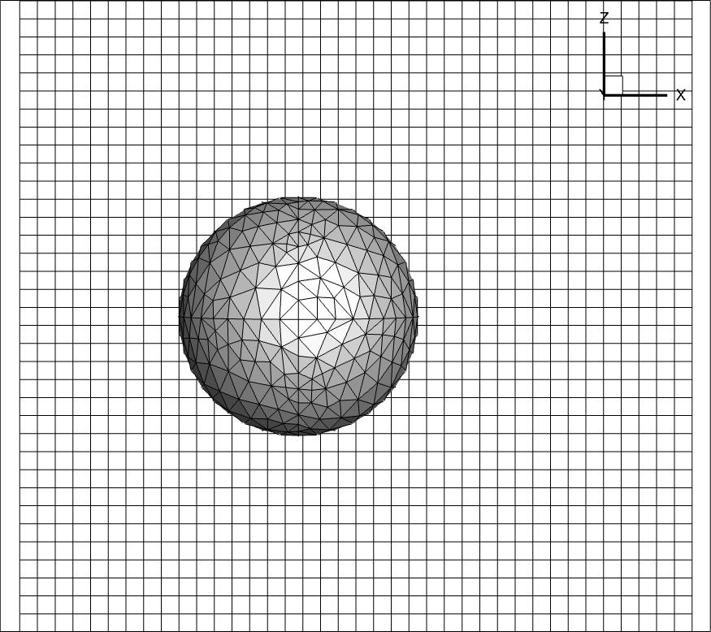
Particle Motion
Tracking the particles requires a general-purpose code that supports complex geometries and boundary conditions
In the mid-90’s, NASA, led by JSC, developed the DSMC Analysis Code (DAC) utilizing a hybrid grid system with a Cartesian-based 2-level flow field grid and a de-coupled unstructured surface grid.
Subsequent codes (MGDS, SUGAR, MAP, SPARTA, etc.) have leveraged off this design for more flexibility

Slide 14
Particle Motion
Introduction of particles at boundaries
At each time step, a number of particles are introduced at the boundaries to maintain the number flux of particles based on free stream or surface flux conditions
For each particle
Random location along cell face or surface
Velocity is sampled from the velocity distribution function
Internal energies are sampled from respective distribution functions
Particle time step is set to a random fraction of local simulation time step
Moving particles
Track motion through cells
Surface interactions
Specular, diffuse, other more complex interactions

Slide 15







Particle Collisions
$$i=0$$
Compute $N_{coll}$
$$i=i+1$$
No
$$i≤N_{coll}$$
Stop
Yes
Select Collision Pair
No Collision
No
$$P_{collision}>R_{1}$$
Yes
$$P_{reaction}>R_{2}$$
Yes
Select reaction
No
$$P_{internal}>R_{3}$$
Yes
Select post-reaction/
post-collision internal
states
No
Set post-collision
velocities

Slide 16
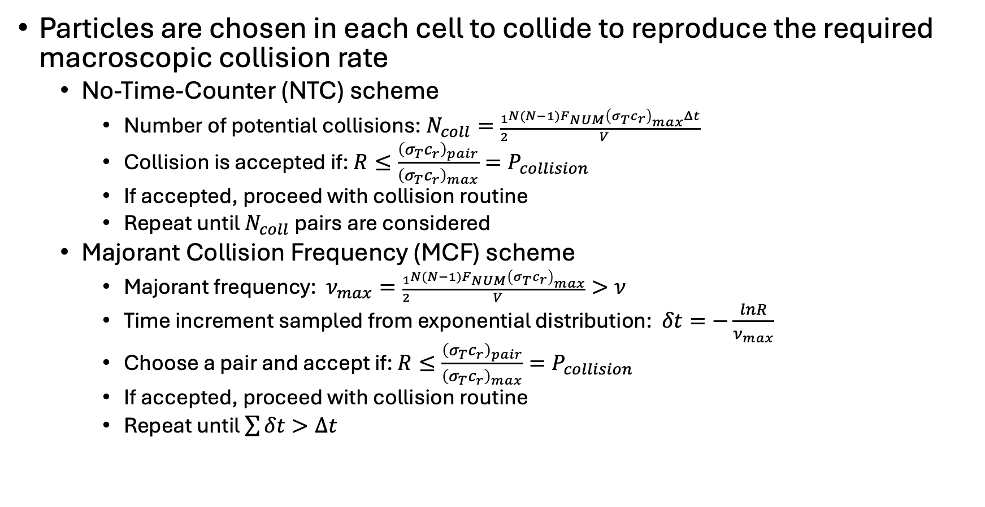
Particle Collisions
Particles are chosen in each cell to collide to reproduce the required macroscopic collision rate
No-Time-Counter (NTC) scheme
Number of potential collisions: $N_{coll}=\frac{1}{2}\frac{N(N−1)F_{NUM}{\left(σ_{T}c_{r}\right)}_{max}Δt}{V}$
Collision is accepted if: $R≤\frac{{\left(σ_{T}c_{r}\right)}_{pair}}{{\left(σ_{T}c_{r}\right)}_{max}}=P_{collision}$
If accepted, proceed with collision routine
Repeat until $N_{coll}$ pairs are considered
Majorant Collision Frequency (MCF) scheme
Majorant frequency: $ν_{max}=\frac{1}{2}\frac{N(N−1)F_{NUM}{\left(σ_{T}c_{r}\right)}_{max}}{V}>ν$
Time increment sampled from exponential distribution: $δt=−\frac{lnR}{ν_{max}}$
Choose a pair and accept if: $R≤\frac{{\left(σ_{T}c_{r}\right)}_{pair}}{{\left(σ_{T}c_{r}\right)}_{max}}=P_{collision}$
If accepted, proceed with collision routine
Repeat until $\sum{δt}>Δt$

Slide 17







Elastic Collision Models Physical Interaction Models
Given a spherically-symmetric interaction potential $φ=φ\left(r\right)$
Given initial conditions of kinetic energy $ε$ and impact parameter $b$, the elastic binary scattering is completely determined by
where $r_{0}$is determined from the implicit equation
$$χ=π−2b\int_{r_{0}}^{∞}{\frac{dr}{r^{2}{\left\{1−\frac{φ\left(r\right)}{ε}−\frac{b^{2}}{r^{2}}\right\}}^{1/2}}}$$
$$c_{r}=\sqrt{\frac{2ε}{m}}$$
$$c_{r}^{′}$$
$$χ$$
$$b$$
$$b^{2}=r_{0}^{2}\left(1−\frac{φ\left(r\right)}{ε}\right)$$

Slide 18
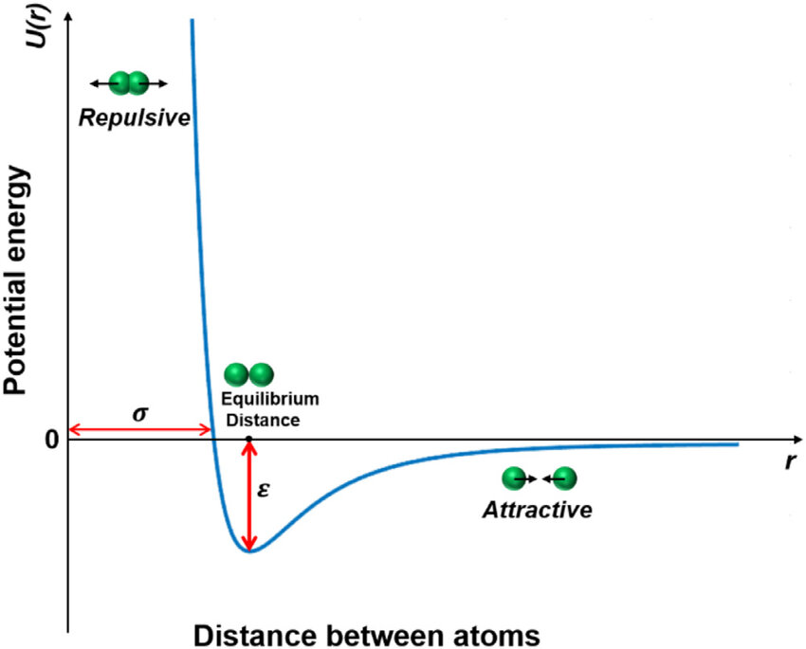
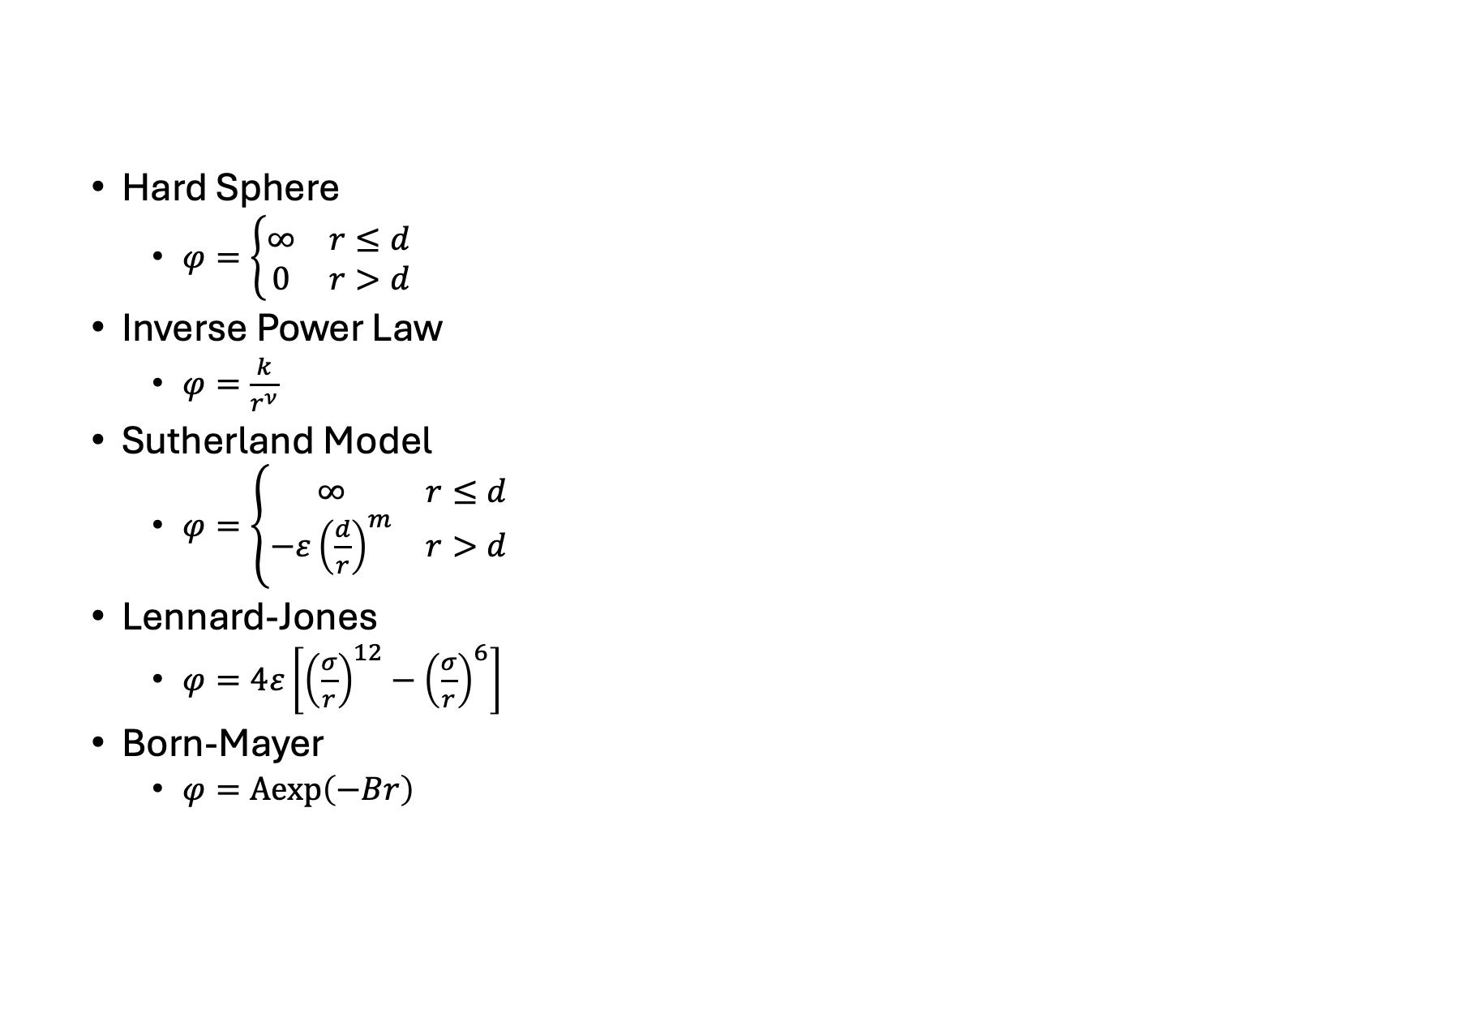
Elastic Collision Models Physical Interaction Models
Hard Sphere
$φ=\left\{\begin{matrix}∞ & r≤d \\ 0 & r>d\end{matrix}\right.$
Inverse Power Law
$φ=\frac{k}{r^{ν}}$
Sutherland Model
$φ=\left\{\begin{matrix}∞ & r≤d \\ −ε{\left(\frac{d}{r}\right)}^{m} & r>d\end{matrix}\right.$
Lennard-Jones
$φ=4ε\left[{\left(\frac{σ}{r}\right)}^{12}−{\left(\frac{σ}{r}\right)}^{6}\right]$
Born-Mayer
$φ=Aexp\left(−Br\right)$

Slide 19
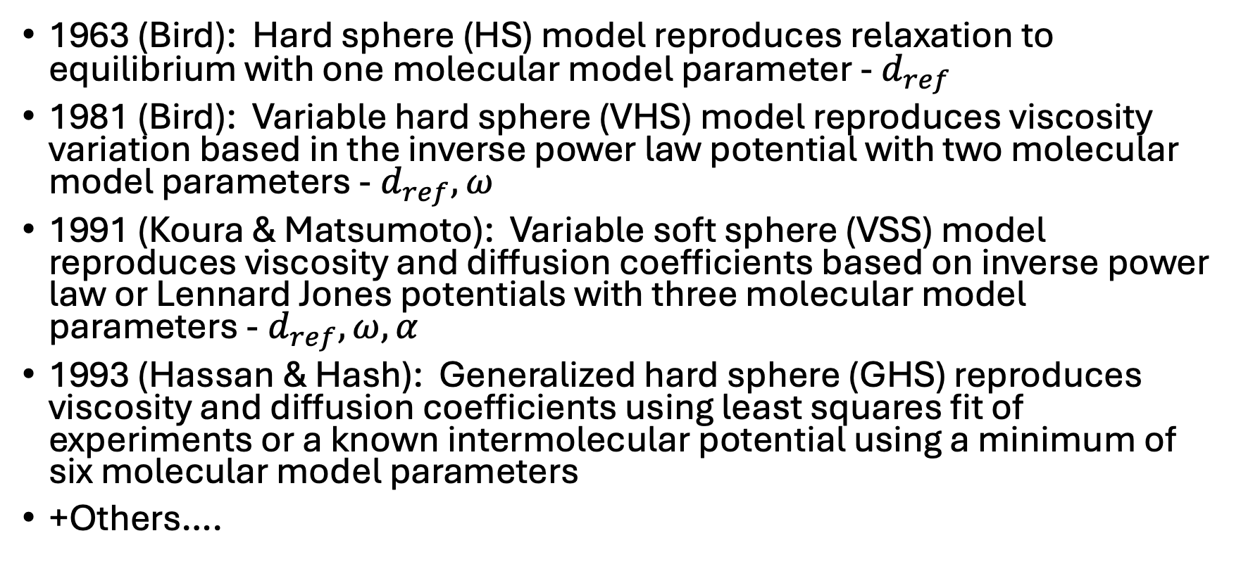
Elastic Collision Models DSMC Phenomenological Models
1963 (Bird): Hard sphere (HS) model reproduces relaxation to equilibrium with one molecular model parameter - $d_{ref}$
1981 (Bird): Variable hard sphere (VHS) model reproduces viscosity variation based in the inverse power law potential with two molecular model parameters -$d_{ref},ω$
1991 (Koura & Matsumoto): Variable soft sphere (VSS) model reproduces viscosity and diffusion coefficients based on inverse power law or Lennard Jones potentials with three molecular model parameters -$d_{ref},ω,α$
1993 (Hassan & Hash): Generalized hard sphere (GHS) reproduces viscosity and diffusion coefficients using least squares fit of experiments or a known intermolecular potential using a minimum of six molecular model parameters
+Others….

Slide 20

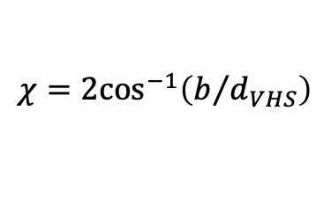

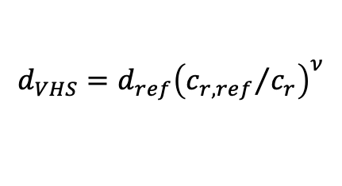

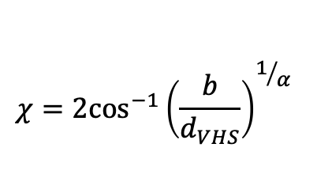
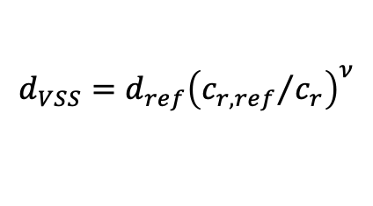
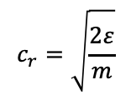
Elastic Collision Models DSMC Phenomenological Models
VHS model
Hard sphere scattering (isotropic) and power-law of viscosity
Simple closed form expression for scattering angle makes it the most widely used
VSS model
A modification introduced of VHS to have both viscosity and diffusion consistent with those of IPL or LJ potential
Only slightly more complex algorithm – should always be used if possible
$$d_{VHS}=d_{ref}{\left({c_{r,ref}}/{c_{r}}\right)}^{ν}$$
$$χ=2\cos^{−1}\left(b/{d_{VHS}}\right)$$
$$c_{r}=\sqrt{\frac{2ε}{m}}$$
$$c_{r}^{′}$$
$$χ$$
$$b$$
$$χ=2\cos^{−1}{{\left(\frac{b}{d_{VHS}}\right)}^{1/α}}$$
$$d_{VSS}=d_{ref}{\left({c_{r,ref}}/{c_{r}}\right)}^{ν}$$

Slide 21
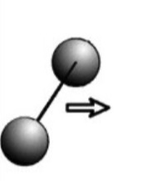
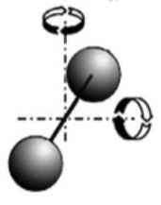
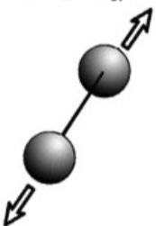
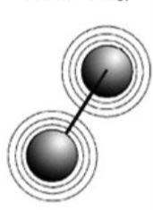
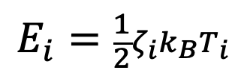

Internal Energy Modes
Atoms/molecules can store energy in internal modes
Different temperatures can be defined: $T_{tr}, T_{r}, T_{v}, T_{e}$
Under equilibrium, the total thermal energy is equipartitioned according to the number of degrees of freedom, $ζ_{i}$, and temperature associated to each mode
$$E_{i}=\frac{1}{2}ζ_{i}k_{B}T_{i}$$
Translation
Rotation
Vibration
Electronic

Slide 22
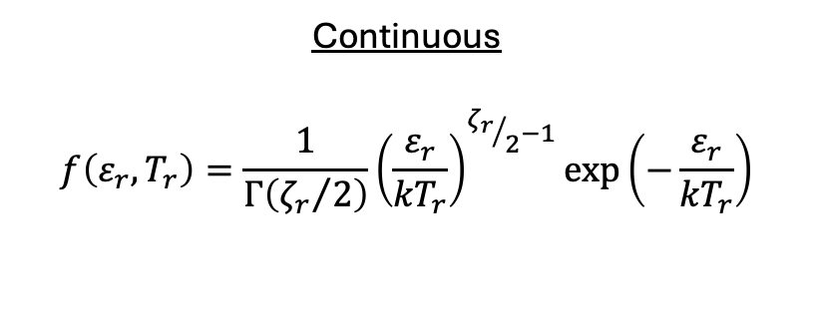
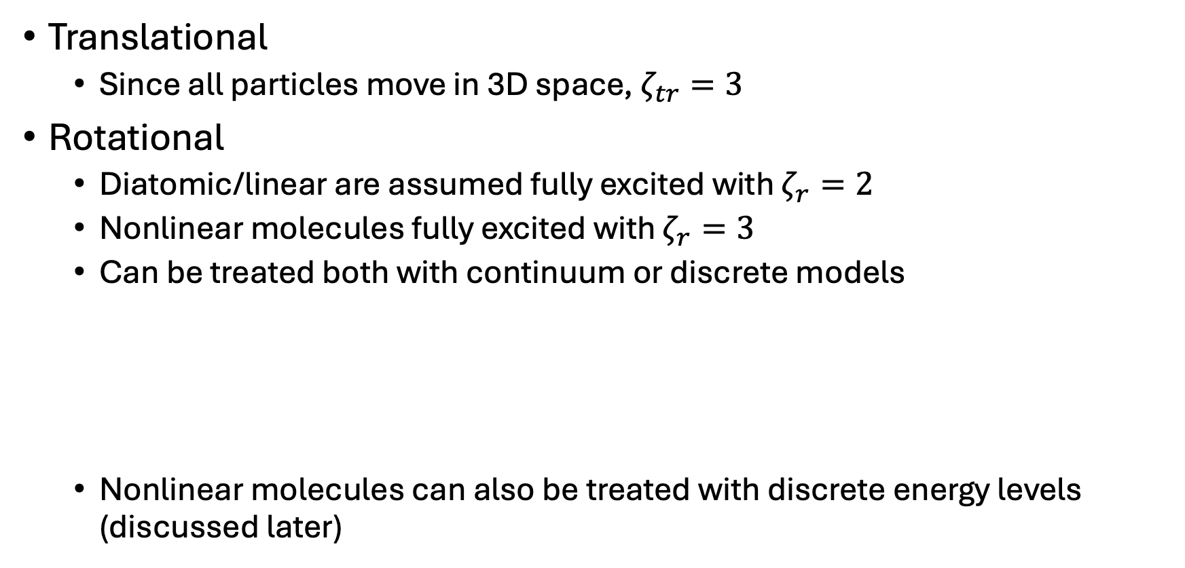

Internal Energy Modes
Translational
Since all particles move in 3D space, $ζ_{tr}=3$
Rotational
Diatomic/linear are assumed fully excited with $ζ_{r}=2$
Nonlinear molecules fully excited with $ζ_{r}=3$
Can be treated both with continuum or discrete models
Nonlinear molecules can also be treated with discrete energy levels (discussed later)
Continuous
$$f\left(ε_{r},T_{r}\right)=\frac{1}{Γ\left({ζ_{r}}/2\right)}{\left(\frac{ε_{r}}{{kT}_{r}}\right)}^{{ζ_{r}}/2−1}exp⁡\left(−\frac{ε_{r}}{{kT}_{r}}\right)$$
Discrete (Linear)
$$ε_{r}=kθ_{r}J\left(J+1\right)$$
$$f\left(ε_{r},T_{r}\right)=\left(2J+1\right)exp⁡\left(−\frac{ε_{r}}{{kT}_{r}}\right)$$

Slide 23
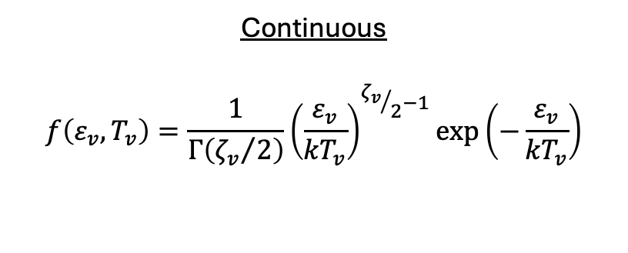
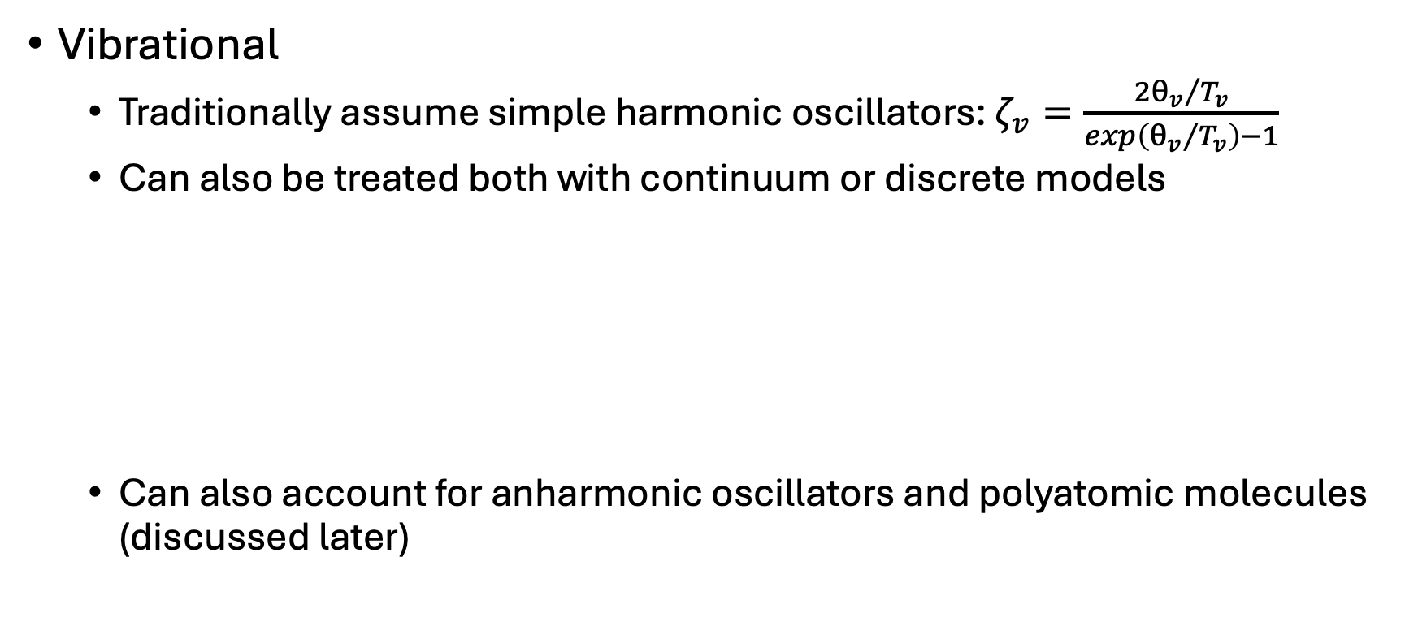

Internal Energy Modes
Vibrational
Traditionally assume simple harmonic oscillators: $ζ_{v}=\frac{2{θ_{v}}/{T_{v}}}{exp\left({θ_{v}}/{T_{v}}\right)−1}$
Can also be treated both with continuum or discrete models
Can also account for anharmonic oscillators and polyatomic molecules (discussed later)
Continuous
$$f\left(ε_{v},T_{v}\right)=\frac{1}{Γ\left({ζ_{v}}/2\right)}{\left(\frac{ε_{v}}{{kT}_{v}}\right)}^{{ζ_{v}}/2−1}exp⁡\left(−\frac{ε_{v}}{{kT}_{v}}\right)$$
Discrete (Diatomic)
$$ε_{v}=kθ_{v}v$$
$$f\left(ε_{v},T_{v}\right)=exp⁡\left(−\frac{ε_{v}}{{kT}_{r}}\right)$$

Slide 24
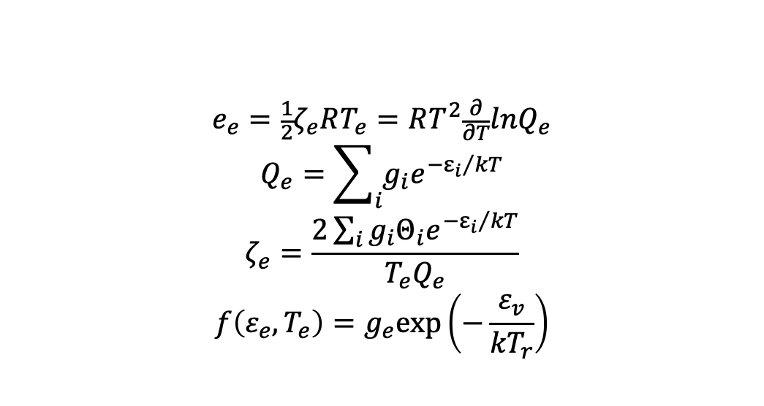
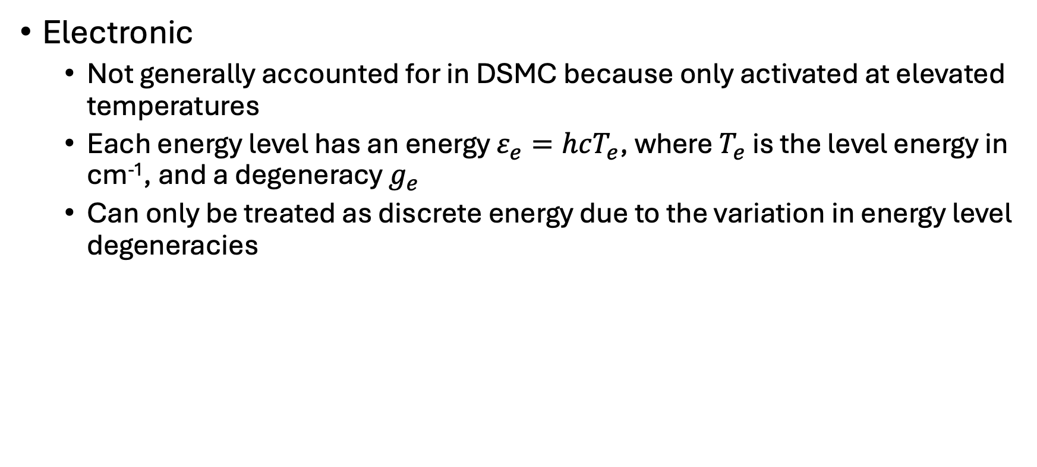
Internal Energy Modes
Electronic
Not generally accounted for in DSMC because only activated at elevated temperatures
Each energy level has an energy $ε_{e}=hcT_{e}$, where $T_{e}$ is the level energy in cm⁻¹, and a degeneracy $g_{e}$
Can only be treated as discrete energy due to the variation in energy level degeneracies
$$e_{e}=\frac{1}{2}ζ_{e}RT_{e}=RT^{2}\frac{∂}{∂T}lnQ_{e}$$
$$Q_{e}=\sum_{i}{g_{i}e^{{−ε_{i}}/{kT}}}$$
$$ζ_{e}=\frac{2\sum_{i}{g_{i}Θ_{i}e^{{−ε_{i}}/{kT}}}}{T_{e}Q_{e}}$$
$$f\left(ε_{e},T_{e}\right)=g_{e}exp⁡\left(−\frac{ε_{v}}{{kT}_{r}}\right)$$

Slide 25
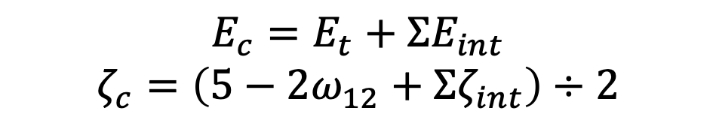


DSMC Inelastic Models
The Larsen-Borgnakke (LB) model has become the standard (phenomenological) approach to describe the energy exchange between translational and internal modes in DSMC.
Post-collision internal and translational energies are sampled from the collision equilibrium distribution.
Let $ζ_{a}$be one or more terms in $ζ_{c}$ and $ζ_{b}$ be the remaining terms. The ratio of energy redistributions can be written
$$E_{c}=E_{t}+ΣE_{int}$$
$$ζ_{c}=\left(5−2ω_{12}+Σζ_{int}\right)÷2$$
$$\frac{f}{f_{max}}={\left[\frac{ζ_{c}−2}{ζ_{a}−1}\left(\frac{E_{a}}{E_{c}}\right)\right]}^{ζ_{a}−1}{\left[\frac{ζ_{c}−2}{ζ_{b}−1}\left(1−\frac{E_{a}}{E_{c}}\right)\right]}^{ζ_{b}−1}⇒{\left(1−\frac{E_{a}}{E_{c}}\right)}^{ζ_{b}−1}$$

Slide 26


Internal Energy Relaxation Rates
If for some reason the gas system deviates from thermal equilibrium, collisions are the natural mechanism that attempts to restore energy equipartition.
In the simplest case, the relaxation of internal energy mode $i$ toward equilibrium can be described as
The definition of relaxation time is the time required for an exponentially decreasing variable to drop from an initial value to $1/e$ or 0.368 of that value
$$\frac{dE_{i}}{dt}=\frac{E_{i}^{eq}\left(t\right)−E_{i}\left(t\right)}{τ}⟹\frac{{\left(E_{i}^{eq}−E_{i}\right)}_{t}}{{\left(E_{i}^{eq}−E_{i}\right)}_{t=0}}∝exp\left(−\frac{t}{τ}\right)$$

Slide 27

Internal Energy Relaxation Rates
For vibrational energy, assuming, among other things, that $E_{v}$ follows a Boltzmann distribution under equilibrium conditions, the Jeans/Landau-Teller (JLT) equation can be derived: $\frac{dE_{v}}{dt}=\frac{E_{v}^{eq}−e_{v}}{τ_{v}}$
The vibrational relaxation time is given by: $τ_{v}=\frac{1}{k_{1→0}\left[1−exp\left({θ_{v}}/{T_{v}}\right)\right]}$
This can be related to the vibrational relaxation number: $Z_{v}^{C}≡\frac{τ_{v}}{τ_{c}}$
Similar analysis leads to the definition of the rotational relaxation number, $Z_{r}^{C}$

Slide 28






Internal Energy Relaxation
The probability of undergoing an energy exchange during a collision, $P_{int}$, to reproduce a relaxation rate $τ_{int}$ is based on the definition of relaxation numbers
Constant $C$ is found by linking the rate of energy exchange predicted by theory (macroscopic) to the collision-based DSMC-LB procedures (microscopic)
$$Z_{int}^{C}=\frac{τ_{int}}{τ_{c}}=$$
Average number of
collisions within $Δt=τ_{int}$
$$P_{int}=\frac{C}{Z_{int}^{C}}=\frac{1}{Z_{int}^{DSMC}}$$
$$Z_{r}^{DSMC}=Z_{r}^{C}\frac{ζ_{tr}}{ζ_{tr}+ζ_{r}}$$
$$Z_{V}^{DSMC}=Z_{V}^{C}\frac{ζ_{tr}}{ζ_{tr}+A\left(T_{tr}\right)}$$

Slide 29

Internal Energy Relaxation
Collision numbers are frequently set to constant values of $Z_{r}=5$ and $Z_{v}=50$
The most popular non-constant RT and VT relaxation rates used in DSMC are given by
Parker: $Z_{r}^{C}\left(T_{t}\right)=\frac{Z_{r}^{∞}}{1+\left({π^{3/2}}/2\right){\left({T^{∗}}/{T_{t}}\right)}^{1/2}+\left({π^{2}}/4+π\right)\left({T^{∗}}/{T_{t}}\right)}$
Millikan & White: $Z_{v}^{C}\left(T_{t}\right)=\frac{exp\left[A\left(T_{t}^{−1/3}−B\right)−18.42\right]}{p^{atm}τ_{c}}$
There are also formulations based on the collision energy, so a temperature doesn’t have to be defined

Slide 30




























Inelastic Collision Selection Methods
Particle Selection Permitting Multiple Relaxation
Particle Selection Prohibiting Multiple Relaxation
$$E_{t}+E_{r,1}$$
$$E_{t},E_{r,1},E_{r,2},E_{v,1},E_{v,2}$$
$$P_{internal}$$
$$E_{t}^{′}$$
$$E_{r,1}^{′}$$
$$R$$
Elastic
$$E_{t}^{′}+E_{r,2}$$
$$E_{t}^{′}$$
$$E_{r,2}^{′}$$
Case 1
Case 2
Case 3
Case 4
$$E_{t}^{′}+E_{v,1}$$
$$E_{t}^{′}$$
$$E_{r,1}^{′}$$
$$E_{r,2}^{′}$$
$$E_{v,1}^{′}$$
$$E_{v,2}^{′}$$
$$E_{t}^{′}$$
$$E_{t}^{′}$$
$$E_{t}^{′}$$
$$E_{t}^{′}$$
$$E_{v,1}^{′}$$
$$E_{t}^{′}+E_{v,2}$$
Case 1: $R<P_{1}$
$$P_{LB}$$
Case 2: $P_{1}<R<P_{2}$
$$E_{t}^{′}$$
$$E_{v,2}^{′}$$
Case 3: $P_{2}<R<P_{3}$
Case 2: $P_{3}<R<P_{4}$

Slide 31




Chemistry Modeling
In general, there are two main steps in the modeling of chemical reactions in DSMC
Specify the reaction probability $P_{R}$ of a colliding pair based on their kinetic parameters
Redistribute the post-reaction collision energy into the translational and internal modes of the product species
In DSMC, $P_{R}$ is usually a function of the translational and internal energies as well as the reaction activation energy
The total collision energy (TCE) model is the most widely used DSMC chemistry model. Its $P_{R}$ functional form assumes
$$P_{R}^{TCE}=\left\{\begin{aligned}0 \\ C_{1}\frac{{\left(E_{c}−E_{a}\right)}^{C_{2}^{}}}{E_{c}^{C_{3}}}\end{aligned}\right.$$
if $E_{c}≤E_{a}$
if $E_{c}>E_{a}$

Slide 32


Chemistry Modeling
The rate of change in the number density of species A due to the bimolecular reaction $A+B→C+D$ with reaction rate coefficient $k\left(T\right)$ can be expressed as
Note that the reaction probability can be written in terms of the reaction cross-section, $P_{R}={σ_{R}}/{σ_{T}}$
The RHS of the above can be approximated as $n_{A}n_{B}\overline{σ_{T}c_{r}P_{R}}≈N_{A,B}\overline{P_{R}}$ where $N_{A,B}$ is the bimolecular collision rate
Assuming $σ_{T}=σ_{VHS}$ and that $E_{c}$ and molecular velocities follow continuum Boltzmann distributions, the equations can be calculated analytically where the modified Arrhenius form $k\left(T\right)=ΛT^{η}exp\left(−{E_{a}}/{k_{B}T}\right)$ is used. Then…
$\frac{dn_{A}}{dt}=−n_{A}n_{B}k\left(T\right)=$ $−n_{A}n_{B}\overline{σ_{T}c_{r}P_{R}}$

Slide 33


Chemistry Modeling
By inspection we can obtain the constants to get
A slight modification is required for recombination reactions, and statistical mechanics can be used to formulate the reverse reaction rate from the forward rate
Possible issues in practical DSMC applications:
Accurate only near equilibrium
Probability may exceed unity under high temperature conditions
Limited range for $η$ due to singularities in equation
TCE rates deviate from exact rates when discrete ro-vibrational levels are used
This can be corrected with an empirical procedure
$$P_{R}^{TCE}=\left[\frac{\left(1+δ_{AB}\right)Λ\sqrt{π}T_{ref}^{η}}{2σ_{ref}{\left(k_{B}T_{ref}\right)}^{η−1+ω}}\frac{Γ\left(\overline{ζ}+5/2−ω\right)}{Γ\left(\overline{ζ}+3/2+η\right)}{\left(\frac{m_{r}}{2k_{B}T_{ref}}\right)}^{1/2}\right]\frac{{\left(E_{c}−E_{a}\right)}^{η+\overline{ζ}+0.5}}{E_{c}^{\overline{ζ}+1.5−ω}}$$

Slide 34

Chemistry Modeling
Other phenomenological models have been proposed to better reproduce available data on nonequilibrium reacting flows or to be alternatives to the TCE framework
Vibrationally Favored Dissociation (VFD) Model
Captures coupled vibration-dissociation behavior
Generalized Collision Energy (GCE) Model
Allows favoring of different energy modes
Maximum Entropy (ME) Chemical Reaction Model
Reaction probability linked to collision energy distribution
Extended Bias (EB) Dissociation Model
Quantum-Kinetic (QK) Model
Does not rely on previous $k\left(T\right)$ knowledge
Macroscopic Chemistry Method (MCM)
Instead of a per collision basis, #of reactions are based on the cell-wise macroscopic parameters

Slide 35
Model Consistency Between DSMC and CFD
Section 3

Slide 36
Transport Properties
Consistency between transport models used in important.
CFD: Transport properties are obtained from expressions involving collision integrals using either Chapman-Enskog formulation or mixing rules
DSMC: Transport properties are obtained as a result of transport of mass, momentum, and energy during collision processes, which are dictated by phenomenological collision cross section models
Can the express collision integrals in terms of DSMC collision model parameters from cross section models
Transport coefficients can then be computed in a similar manner for CFD and DSMC using the Chapman-Enskog theory

Slide 37


Collision Integrals
CFD¹
DSMC²
$$πΩ_{st}^{1}\left(1\right)=D_{1}T^{A_{1}{\left(lnT\right)}^{2}+B_{1}lnT+C_{1}}$$
$$πΩ_{st}^{2}\left(2\right)=D_{2}T^{A_{2}{\left(lnT\right)}^{2}+B_{2}lnT+C_{2}}$$
$B_{st}=D_{3}T^{A_{3}{\left(lnT\right)}^{2}+B_{3}lnT+C_{3}}$
${\left.Ω_{st}^{1}\left(1\right)\right|}_{VHS}=\frac{π}{2}d_{ref}^{2}{\left(\frac{k_{b}T}{2πm_{st}^{∗}}\right)}^{1/2}{\left(\frac{T_{ref}}{T}\right)}^{ω−1/2}\left[\frac{Γ\left(7/2−ω\right)}{Γ\left(5/2−ω\right)}\right]$
${\left.Ω_{st}^{2}\left(2\right)\right|}_{VHS}=\frac{π}{3}d_{ref}^{2}{\left(\frac{k_{b}T}{2πm_{st}^{∗}}\right)}^{1/2}{\left(\frac{T_{ref}}{T}\right)}^{ω−1/2}\left[\frac{Γ\left(9/2−ω\right)}{Γ\left(5/2−ω\right)}\right]$
${\left.{ B}_{st}\right|}_{VHS}=\frac{5Γ\left(9/2−ω\right)−Γ\left({11}/2−ω\right)}{5Γ\left(7/2−ω\right)}$
${\left.Ω_{st}^{1}\left(1\right)\right|}_{VSS}=\left(\frac{2}{α+1}\right){\left.Ω_{st}^{1}\left(1\right)\right|}_{VHS}$
${\left.Ω_{st}^{2}\left(2\right)\right|}_{VSS}=\left[\frac{6α}{\left(α+1\right)\left(α+2\right)}\right]{\left.Ω_{st}^{2}\left(2\right)\right|}_{VHS}$
¹A. Mazaheri, P.A. Gnoffo, C.O. Johnston, B. Kleb, NASA TM 2013-217800
²K. Swaminathan-Goplan, K.A. Stephani, Physics of Fluids, 28, 027101 (2016)

Slide 38


DSMC Model Parameters
Using the CFD collision integrals and the previous DSMC equations, a least-squared-fit can be performed for any species combination included in the CFD database.
Argon-Argon results using both LAURA and Mutation++ curve fits
Error is mostly $±6\%$

Slide 39


Internal Energy Diatomic Molecules
CFD relies on curve-fits for values of specific heat, entropy, and enthalpy, but these are based on molecular models.
Traditionally, DSMC has used rigid-rotor rotational and simple harmonic oscillator vibrational energy models and largely ignored electronic energy. This is reasonable for relatively low temperatures but inaccurately models the partition function at high temperatures
Partition Function: $Q^{int}=\sum_{n}^{∞}{g_{n}^{int}exp⁡\left(−\frac{ε_{n}^{int}}{kT}\right)}$
Specific Heat: $c_{p}^{int}=R\left[2T{\left(\frac{∂ln⁡Q^{int}}{∂T}\right)}_{V}+T^{2}{\left(\frac{∂^{2}ln⁡Q^{int}}{∂T^{2}}\right)}_{V}\right]$
Internal Mode | Energy | Degeneracy | Specific Heat
Rotation | $$\frac{ε_{J}^{rot}}{hc}=B_{e}J(J+1)$$ | $$g_{J}^{rot}=2J+1$$ | $$c_{p}^{rot}=R$$
Vibration | $$\frac{ε_{v}^{vib}}{hc}=ω_{e}\left(v+\frac{1}{2}\right)$$ | $$g^{vib}=1$$ | $$c_{p}^{vib}=R{\left[\frac{{Θ^{vib}}/{2T}}{\sinh\left({Θ^{vib}}/{2T}\right)}\right]}^{2}$$

Slide 40


Internal Energy Diatomic Molecules
With the addition of more advanced models, there are no closed form solutions, so summations must be performed to get the partition functions and associated thermodynamic properties
$Q^{int,full}=\frac{1}{σ}\sum_{n}{g_{n}^{ele}exp⁡\left[−\frac{ε_{n}^{ele}}{kT}\right]}\sum_{v}{exp⁡\left[−\frac{ε_{nv}^{vib}}{kT}\right]}\sum_{J}{g_{J}^{rot}exp⁡\left[−\frac{ε_{nvJ}^{rot}}{kT}\right]}$
$Q^{int,sep}=\left(\sum_{n}{g_{n}^{ele}exp⁡\left[−\frac{ε_{n}^{ele}}{kT}\right]}\right)\left(\sum_{v}{exp⁡\left[−\frac{ε_{v}^{vib}}{kT}\right]}\right)\left(\frac{1}{σ}\sum_{J}{g_{J}^{rot}exp⁡\left[−\frac{ε_{J}^{rot}}{kT}\right]}\right)$
Internal Mode | Energy | Degeneracy
Rotation | $$\frac{ε_{nvJ}^{rot}}{hc}=B_{nv}J\left(J+1\right)−D_{nv}J^{2}{\left(J+1\right)}^{2}$$ | $$g_{J}^{rot}=2J+1$$
Vibration | $$\frac{ε_{nv}^{vib}}{hc}=ω_{e,n}\left(v+\frac{1}{2}\right)−ω_{e}x_{e,n}{\left(v+\frac{1}{2}\right)}^{2}$$ | $$g^{vib}=1$$
Electronic | $$\frac{ε_{n}^{ele}}{hc}=T_{n}$$ | $g_{n}^{ele}$level dependent

Slide 41

Internal Energy Diatomic Molecules
Liechty [1], among others, have already begun implementing electronic energy in addition to the rigid rotor/harmonic oscillator models.
Civrais [2] recently introduced a method to include vibrational anharmonic effects in DSMC simulations and then extended this method [3] to include the coupling of the vibrational and electronic energy modes and demonstrated that coupling all three internal energies would reproduce the high-fidelity calculations.
Comparison of c_{v}/R for O₂ from [3]
[1] Liechty, D. et. al., Physics of Fluids, Vol. 26, 2014, Paper 027106
[2] Civrais, C. et. al., Journal of Thermophysics and Heat Transfer, Vol. 37, No. 3, July-Sept. 2023, pp 534-548
[3] Civrais, C. et. al., Physics of Fluids, Vol. 36, 2024, Paper 086112

Slide 42


Internal Energy Linear Polyatomic Molecules
The general procedure of considering electronic, vibrational, and rotational states is similar, but more complex.
There are two rotational axes for linear molecules and three for others (discussed later)
There are $n_{m}=3n_{a}−5$ vibrational modes for a molecule with $n_{a}$ atoms for linear molecules and $n_{m}=3n_{a}−6$ for non-linear molecules with $m$ independent modes each having a degeneracy of $d$. The vibrational angular momentum quantum number $l$ is also introduced for vibrational modes with $d>1$
Internal Mode | Energy | Degeneracy
Rotation | $$\frac{ε_{n[v]J}^{rot}}{hc}=B_{n[v]}J\left(J+1\right)−D_{n[v]}J^{2}{\left(J+1\right)}^{2}$$ | $$g_{J}^{rot}=2J+1$$
Vibration | $$\frac{ε_{n[v]}^{vib}}{hc}=\sum_{i}^{m}{ω_{e,i}\left(v_{i}+\frac{d_{i}}{2}\right)}+\sum_{i}^{m}{\sum_{j≥i}^{m}{x_{i,j}\left(v_{i}+\frac{d_{i}}{2}\right)\left(v_{j}+\frac{d_{j}}{2}\right)}}+\sum_{i}^{m}{\sum_{j≥i}^{m}{x_{l_{i},l_{j}}l_{i}l_{j}}}$$ | $$g_{[v]}^{vib}=\prod_{i}^{m}{\frac{\left(v_{i}+d_{i}−1\right)!}{v_{i}!\left(d_{i}−1\right)!}}$$
Electronic | $$\frac{ε_{n}^{ele}}{hc}=T_{n}$$ | $p_{n}^{ele}$level dependent

Slide 43

Internal Energy Linear Polyatomic Molecules
The partition functions are again similar but more complex
$Q^{int,full}=\frac{1}{σ}\sum_{n}{p_{n}^{ele}exp⁡\left[−\frac{ε_{n}^{ele}}{kT}\right]}\sum_{v_{1}}{\sum_{v_{2}}{…\sum_{v_{m}}{g_{[v]}^{vib}exp⁡\left[−\frac{ε_{n[v]}^{vib}}{kT}\right]}}}\sum_{J}{g_{J}^{rot}exp⁡\left[−\frac{ε_{n\left[v\right]J}^{rot}}{kT}\right]}$
$Q^{int,sep}=\left(\sum_{n}{p_{n}^{ele}exp⁡\left[−\frac{ε_{n}^{ele}}{kT}\right]}\right)\left(\sum_{v_{1}}{\sum_{v_{2}}{…\sum_{v_{m}}{g_{[v]}^{vib}exp⁡\left[−\frac{ε_{[v]}^{vib}}{kT}\right]}}}\right)\left(\frac{1}{σ}\sum_{J}{g_{J}^{rot}exp⁡\left[−\frac{ε_{J}^{rot}}{kT}\right]}\right)$
To calculate the thermodynamic properties, the derivatives of the partition function must be taken. We define $S_{p}=\sum_{n\left[v\right]J}{D_{n\left[v\right]J}{\left(\frac{ε_{n\left[v\right]J}^{int}}{k}\right)}^{p}}$ $exp⁡\left[−\frac{ε_{n\left[v\right]J}^{int}}{kT}\right]$ where $S_{0}$ is defined as the partition function (this can be done for any atom/molecule). Then we have:
$e^{int}=R\frac{S_{1}}{S_{0}}$
$c_{p}^{int}=R\frac{S_{0}S_{2}−S_{1}S_{1}}{{\left(S_{0}T\right)}^{2}}$
$s^{int}=R log\left(S_{0}\right)+{e^{int}}/T$

Slide 44

Internal Energy Linear Polyatomic Molecules
Carbon Dioxide
LAURA[1]
Direct Summation – Separate Energies
Rotation – rigid rotor w/ centrifugal distortion
Vibration – anharmonic oscillator
Electronic
Direct Summation – Coupled Vibration/Electronic
Assuming spectroscopic constants are the same across all electronic energy levels
Vibration/Electronic
Electronic
LAURA
Vibration
Rotation
[1] Gordon, S., NASA RP 1311, 1994

Slide 45







Internal Energy Nonlinear Polyatomic Molecules
Vibrational energy is the same as linear molecules
Rotational – 3 principal axes ($A,B,C$); 3 moments of inertia ($I_{A},I_{B},I_{C}$)
Molecules are classified in terms of the relative values of $I_{A}$, $I_{B}$, and $I_{C}$
Type | Linear | Symmetric: Oblate Top | Symmetric: Prolate Top | Spherical Top | Asymmetric
Relative Magnitudes of $A$, $B$, and $C$ | B$=C$; A$=0$ | $$A=B>C$$ | $$A>B=C$$ | $$A=B=C$$ | $$A≠B≠C$$
Examples | CO₂ | CH₃ | CH₃F | CH₄ | H₂O

Slide 46


Internal Energy Nonlinear Polyatomic Molecules
Different energy and degeneracy for each rotational type
Introduction of second rotational quantum number, $K$
Asymmetric is complex – assume nearly prolate ($B≈C$)
Internal Mode | Energy | Degeneracy
Linear | $$ε_{r}=hcBJ\left(J+1\right)$$ | $$g=2J+1$$
Oblate | $$ε_{r}=hc\left[BJ\left(J+1\right)+\left(C−B\right)K^{2}\right]$$ | $$g=\left\{\begin{aligned}2J+1;K=0 \\ 2\left(2J+1\right);K≠0\end{aligned}\right.$$
Prolate | $$ε_{r}=hc\left[BJ\left(J+1\right)+\left(A−B\right)K^{2}\right]$$ | $$g=\left\{\begin{aligned}2J+1;K=0 \\ 2\left(2J+1\right);K≠0\end{aligned}\right.$$
Spherical | $$ε_{r}=hcBJ\left(J+1\right)$$ | $$g={\left(2J+1\right)}^{2}$$
Asymmetric – Nearly Prolate | $$ε_{r}=hc\left[\frac{1}{2}\left(B+C\right)J\left(J+1\right)+\left(A−\frac{1}{2}\left(B+C\right)\right)K^{2}\right]$$ | $$g=\left\{\begin{aligned}2J+1;K=0 \\ 2\left(2J+1\right);K≠0\end{aligned}\right.$$

Slide 47










Internal Energy Nonlinear Polyatomic Molecules
CO₂ (Linear)
CH₄ (Spherical Top)
LAURA
LAURA
$c_{p}^{tr}+$ $c_{p}^{r}$
$${+c}_{p}^{v,harmonic}$$
$${+c}_{p}^{v,anharmonic}$$
$${+c}_{p}^{e}$$
CH₃ (Oblate Top)
H₂O (Asymmetric – Nearly Prolate)
$$+c_{p}^{ve}$$
$${+c}_{p}^{LAURA}$$
Anharmonic
LAURA/Harmonic
Anharmonic
Mutation++/Harmonic

Slide 48
Questions?

