Slide 1

STAMPS: Ad-Hoc Sensors for Dynamic Anomaly Response in Space
Jordan Kam^{1*}, George Gorospe², Christopher Teubert²
University of California, Berkeley¹, NASA Ames Research Center²
Point of Contact: jordan.k.kam@nasa.gov*
Student Innovations in SpaceTech Track, Paper Number: 144
1

Slide 2
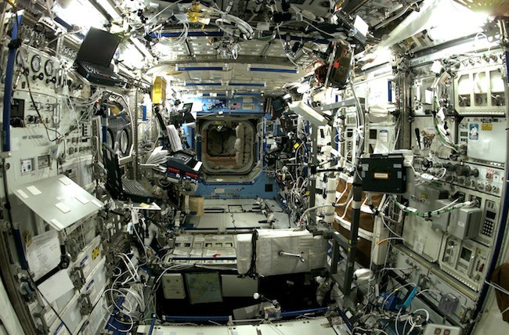








Anomaly Detection and Response in Space
On the International Space Station (ISS), anomaly response (AR) includes:
Ground-based mission support that monitors ISS 24/7 for anomalies.
Ground has extensive system/subsystem knowledge/expertise.
Crew is tasked with assigned AR procedures.
Unexpected anomalies and intermittent faults still occur on ISS [1,2].
Anomaly Occurs on Station
Mission Control
Crew Anomaly Response on Station
AR procedures
Ground instructs crew on AR for the fault
!
!
ISS Crewmember
Battery fault
!
!
!
Temperature Anomaly
Ground-support communication
!
[1] Lee et al. "Migrating fault trees to decision trees for real time fault detection on international space station." 2005 IEEE Aerospace Conference.
[2] Beil et al. International Space Station (ISS) Anomalies Trending Study. No. NASA/TM-2015-218991 Vol. 1. 2015.
2

Slide 3
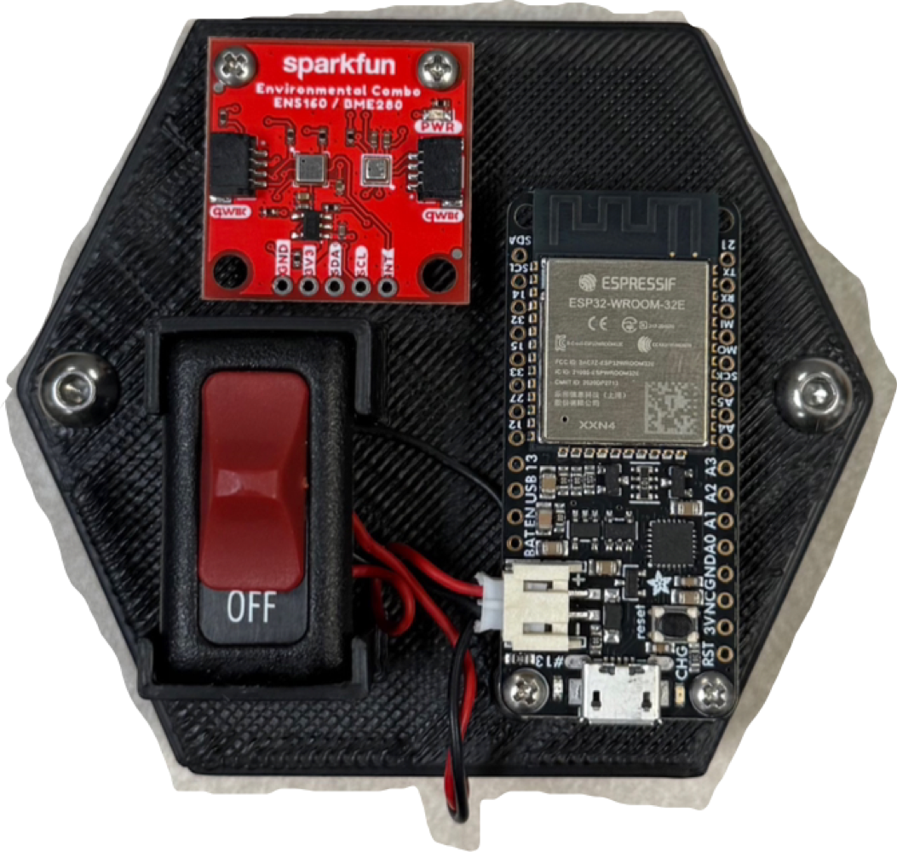




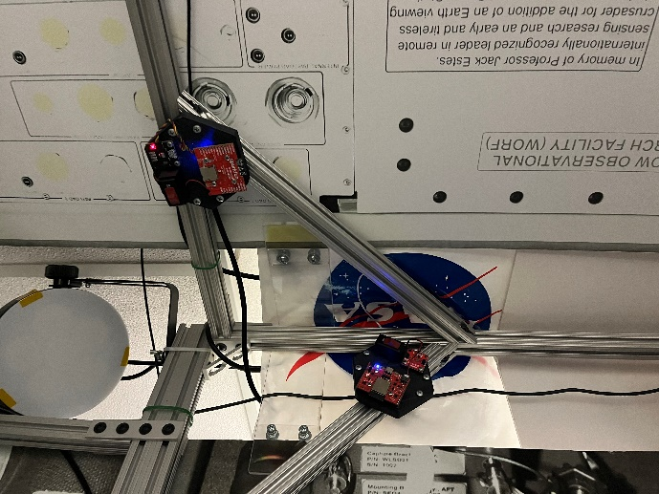

Dynamic and Distributed Anomaly Response
The Dynamic Anomaly Response and Integrated Analysis (DARIA) projects aims to develop a novel AR architecture around a distributed network of ad-hoc sensors.
DARIA AR Architecture
Leak Detection
Heavy Gas
Ad-hoc placement could give crew an increased state-awareness outside the purview of rigid integrated sensor networks.
Modular sensing capabilities could equip crew with tools to respond to unforeseen faults.
Data products could increase crew autonomy in AR decision making procedures for habitats that are operated independently from Earth [3,4].
DARIA’s AR Architecture could allow for increased state awareness, system health, and crew autonomy.
Integrated Analysis
= Pressure Data
= Temperature Data
Electronics
UI
crew
Radiation
= Telemetry Data
= Radiation Data
[3] Kam et al. "Dynamic Anomaly Response and Integrated Analysis (DARIA): A Fault Investigation Toolset Supporting EIO in Future Crewed Mars Missions." Northern California Aerospace Symposium (NCAS) 2025.
[4] Kam et. al, “Development of Wireless Sensing Prototype, “STAMPS” for Data Acquisition, Analysis, and Visualization” International Astronautical Congress (IAC) 2025
3

Slide 4
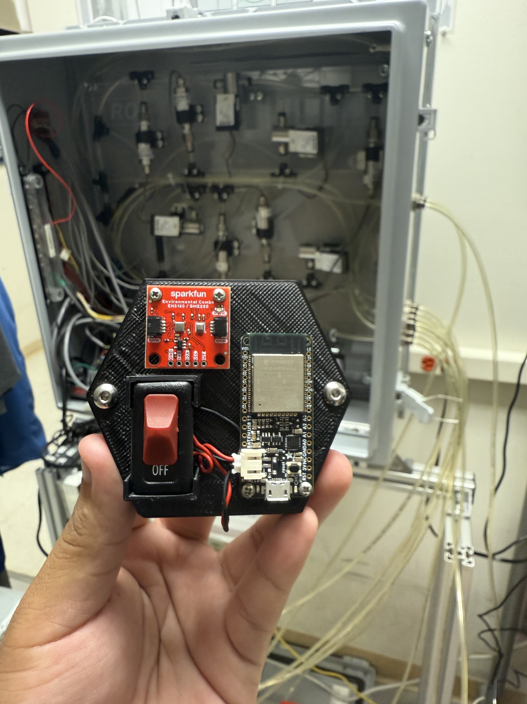
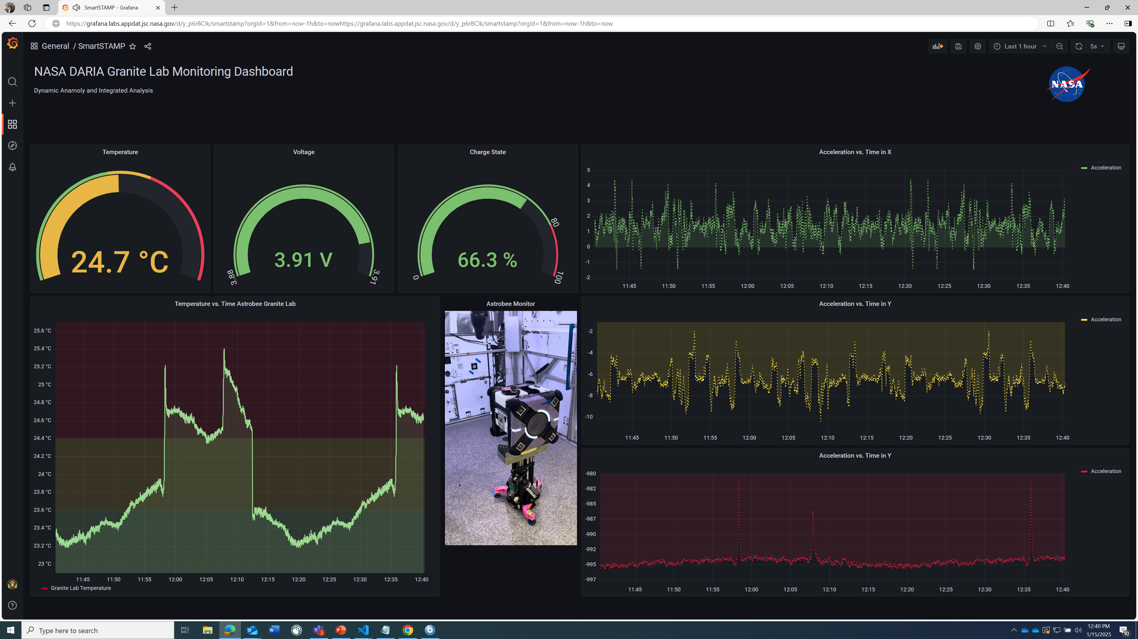
System of Telemetry Amalgamation of Multimodal PrognosticS (STAMPS) Prototypes
STAMPS Hardware Overview
STAMPS Software Overview
COTS environmental sensor(s)
2mm screws
Deployed STAMPS
Centralized STAMPS
LabVIEW UI
Automatically logging and sending time-series data
Receives bytes of data via ESP-NOW
Echoes data to LabVIEW via UART Echo
~3”
Uses ESP-NOW a wireless P2P communication protocol.
Free Real-time Operating System (FreeRTOS) for real-time data acquisition of deployed STAMPS.
Use Universal Asynchronous Receiver-Transmitter (UART) echo to transmit data between centralized STAMPS and LabVIEW.
Lab VIEW is used as the graphical user interface (GUI) to display time-series data (data product) in real-time.
switch
ESP-32 microcontroller
9V LiPo Battery Pack
4

Slide 5
Thank you! Questions?
Point of Contact: jordan.k.kam@nasa.gov
Student Innovations in SpaceTech Track, Paper Number: 144
5

