Slide 1
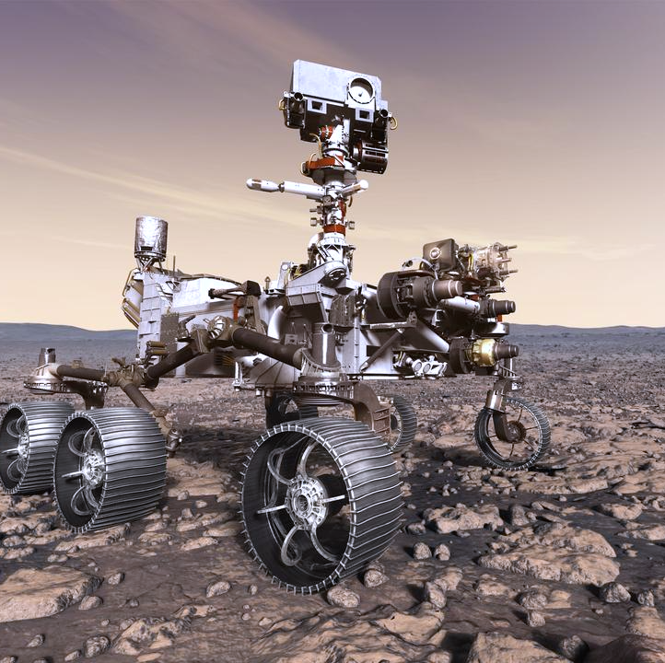
Robust Software Engineering at NASA Ames Research Center
Daniel Hulse (Ames Research Center)
Lukman Irshad (KBR)
Anastasia Mavridou (KBR)
Seydou Mbaye (Ames Research Center)
Irfan Sljivo (Wyle)
Hannah Walsh (Ames Research Center)
Notes:
https://images.nasa.gov/details/PIA22109

Slide 2
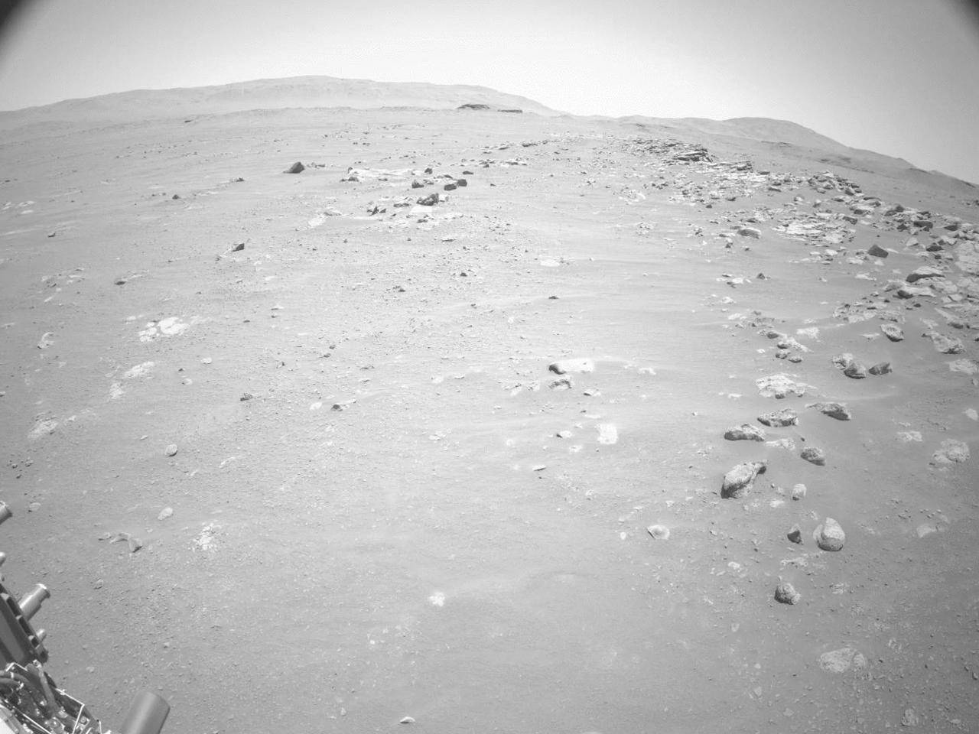
Presentation Outline
Part I: Robust Software Engineering
Robust Software Engineering
Part II: Introduction to Tools
AdvoCATE
HADES
FRET
Proposed Workflow with Tools
Part III: Troupe 2.0
Part IV: Application of Tools to Troupe 2.0
Representation and Analysis in AdvoCATE
Modeling and Analysis in HADES
Requirements Specification and Analysis in FRET
Further Reading
Notes:
https://images.nasa.gov/details/PIA24934

Slide 3
Part I: Robust Software Engineering
Motivation, Past Work, V&V Approach, and Objectives

Slide 4

RSE: Robust Software Engineering
The Robust Software Engineering team is part of the Intelligent Systems at NASA Ames.
We specialize in developing tools that catch problems early on in system design.
We develop tools that are designed to be intuitive and extensible

Slide 5
RSE: From Design to Operations
Many of our tools utilize formal methods to functionally decompose the system and prove its properties
These properties can be captured as requirements
We can generate simulations and test cases for these requirements and prove the properties of the system
Verification and Validation
Concept of Operations
Operations and Maintenance
Requirements and Architecture
Verification and Validation
Project Definition
Detailed
Design
Integration and test
Test and Integration
Implementation
Time

Slide 6
Part II: Introduction to Tools
AdvoCATE, HADES, FRET, and Proposed Workflow

Slide 7
AdvoCATE: Assurance Case Automation Toolset
Capabilities​
Hazard analysis and risk assessment
Safety and assurance requirements capture
Structured argument development
Safety architecture development
Traceability and consistency
Evidence management and analytics via dashboards

Slide 8
HADES: Hazard Analysis DESigner
Hazard Analysis Environment
Capabilities
Scenario-based hazard analysis that accounts for all system elements (human, hardware, and software)
Knowledge-assisted fault simulation capabilities with broad scenario coverage
Parameterizable simulation (to study emergent failures even when hazards are not present)
System-of-Systems simulations and fault combination evaluations
Resilience studies and metrics
Historic knowledge utilization for hazard identification and classification
Safety requirement generation and validation
Traceability with other system design artifacts
Maintain design assurance artifacts dynamically
Iterative testing, trade study setup, and mitigation validations
HADES is currently under development, but most of the listed capabilities are included in the existing toolkits fmdtools and MIKA.
Graph-based System Modeling
Historic Knowledge Extraction via MIKA
Scenario-based Resilience Simulation via fmdtools
Traceable Design Artefact Generation Environment
Hazard Tables
Safety Architectures
Safety Requirements
Safety Assurance Evidence

Slide 9
MIKA: Manager for Intelligent Knowledge Access Used in HADES
Capabilities
Searches through large number of historical documents and updated reports to generate knowledge
Captures high level themes in large sets of documents
Topic Modeling
Identifies documents relative to high level themes
Semantic Search

Slide 10

fmdtools: Fault Model Design Tools Used in HADES
Mental Model of System and Hazards
Capabilities
Modelling of system architecture and behavior in consistent, composable, and parameterizable modelling paradigm, including:
Functions, Components, and Human Actions
Systems and Systems-of-Systems Architectures
Simulation of system behavior over scenarios of interest, including:
Single and multiple-fault scenarios
Wide ranges/sets of scenarios and system parameters
Optimized cases, e.g., worst-case scenarios or most robust system parameters
Analysis of system resilience
Visualization of behaviors and properties over time
Scenario-based hazard/FMEA tables
Visualization of system structure and scenario propagation
Modelling
Modelling
Analyst
Analysis
Simulation
Results
(e.g., Risk/Resilience Measures)

Slide 11
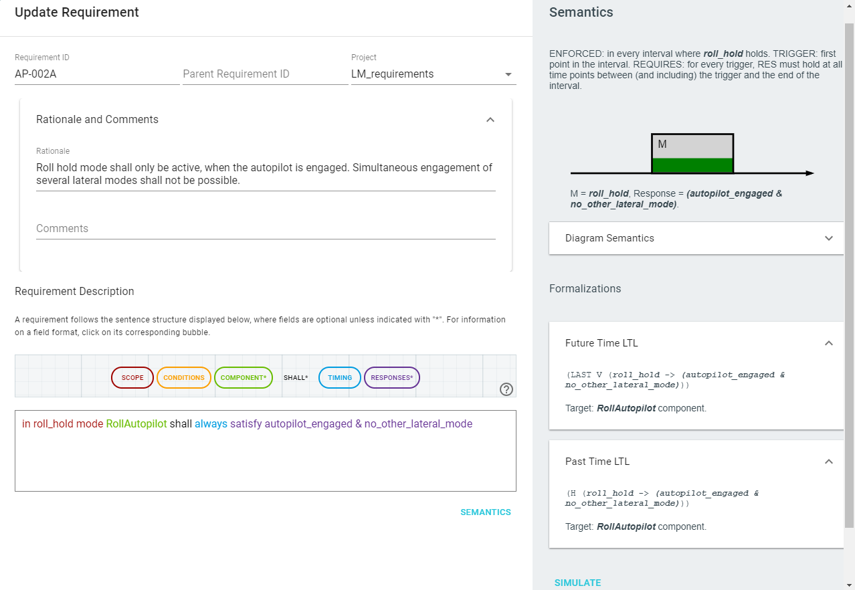
FRET: Formal Requirements Elicitation Tool
Capabilities​
Captures requirements in structured natural language with unambiguous semantics
Explains formal semantics in various forms
Formalizes requirements in a compositional (hence extensible) manner
Analyzes consistency of requirements and provides feedback
Generates test cases from requirements
Connects with analysis tools:
Model checkers
Realizability analysis tools
Runtime monitoring tools
​

Slide 12
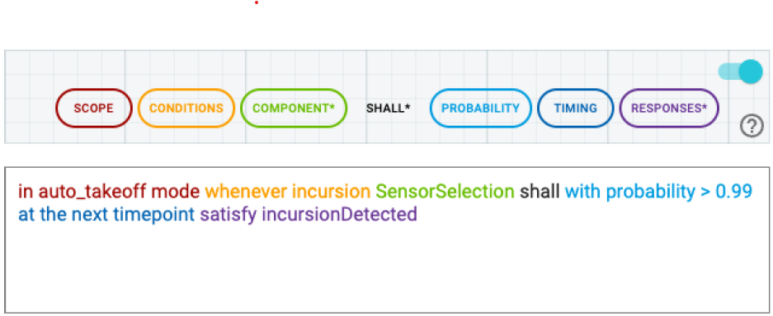
FRET: Formal Requirements Elicitation Tool
Autonomous systems bring new challenges: need to express uncertainty in requirements.
Automatic translation to PCTL* (uninterpretable to >99% of engineers according to RTX, US aviation industry)
Probabilistic FRET: capture behavior of learning-enabled components using probabilistic requirements in a structured nature language
P>=1[((G ((! (((! auto_takeoff_mode) & (X
auto_takeoff_mode)))) | (X ((auto_takeoff_mode
& (X (! auto_takeoff_mode))) R (q_k =>
(P>0.99[((auto_takeoff_mode & (X (!
auto_takeoff_mode))) | ((X incursionDetected)
& (! (auto_takeoff_mode & (X (!
auto_takeoff_mode))))))])))))) & (auto_takeoff_mode
=> ((auto_takeoff_mode & (X (! auto_takeoff_mode)))
| ((auto_takeoff_mode & (X (! auto_takeoff_mode)))
R (q_k => (P>0.99[((auto_takeoff_mode
& (X (! auto_takeoff_mode))) | ((X
incursionDetected) & (! (auto_takeoff_mode & (X
(! auto_takeoff_mode))))))]))))))]
Plain English requirement:
Often ambiguous, not amenable to analysis
(Assists with formalization and understanding of complex system requirements)

Slide 13
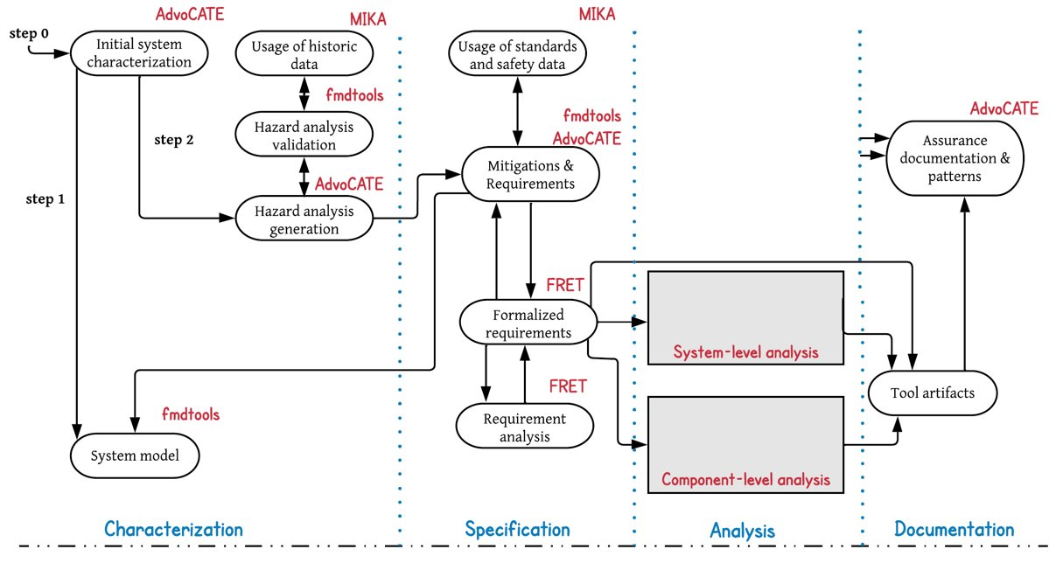
Proposed Workflow with Tools
HADES
HADES
HADES
HADES
HADES

Slide 14
Additional Tools: Testing and Runtime Verification
Inference Kernel for Open Static Analyzers (IKOS): Static analyzer for detecting runtime errors in C/C++.
AdaStress: Monte Carlo Simulations for optimized testing
CoPilot: Runtime monitors that validate the state of the system during execution

Slide 15
Part III: Troupe 2.0
Representation and Analysis in AdvoCATE, Modeling and Analysis in HADES, and Requirements Specification and Analysis in FRET

Slide 16
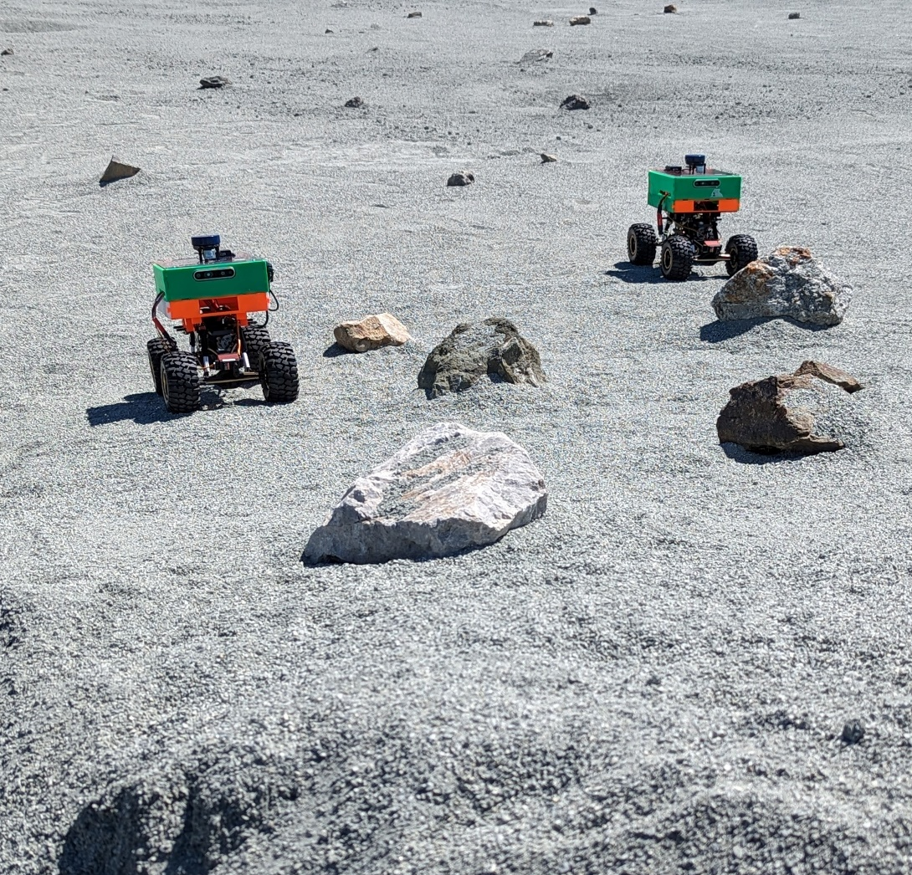
Troupe: Autonomous Micro Rover Swarm
Internal NASA Ames RSE project
Technology demonstrator and knowledge transfer
Aims at developing a fleet of rovers capable of autonomously mapping unknown terrain
Including no-GPS zones such as caves

Slide 17
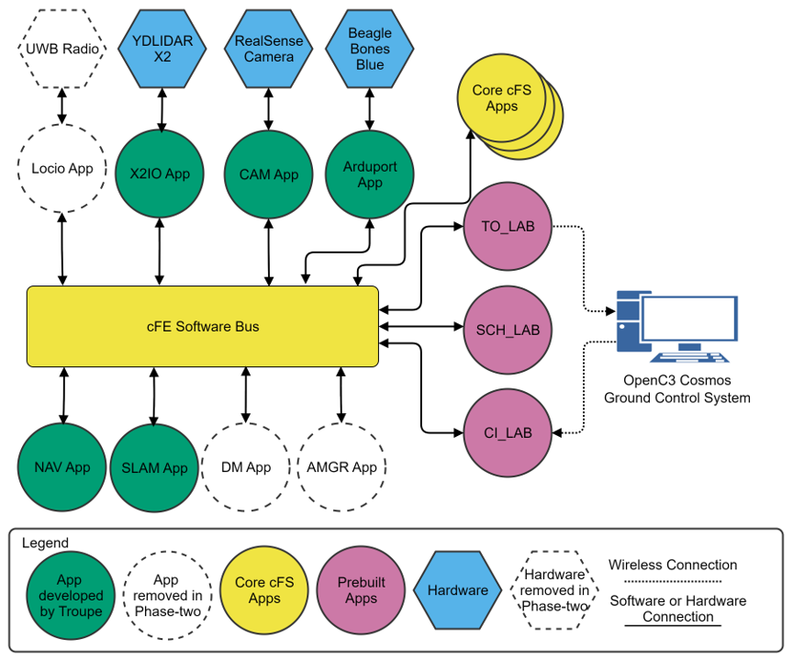
Troupe: System Overview
Each rover runs the same core Flight System (cFS) application
High-level cFS block diagram for a single Troupe rover
Publish/subscribe architecture
Messages are passed via shared memory on the core Flight Executive (cFE) software bus.
Some applications are manually-coded others are code-generated using MATLAB/Simulink and an external code interface (ECI).

Slide 18
Part IV: Application of Tools to Troupe 2.0
Representation and Analysis in AdvoCATE, Modeling and Analysis in HADES, and Requirements Specification and Analysis in FRET

Slide 19
Representation and Analysis in AdvoCATE

Slide 20
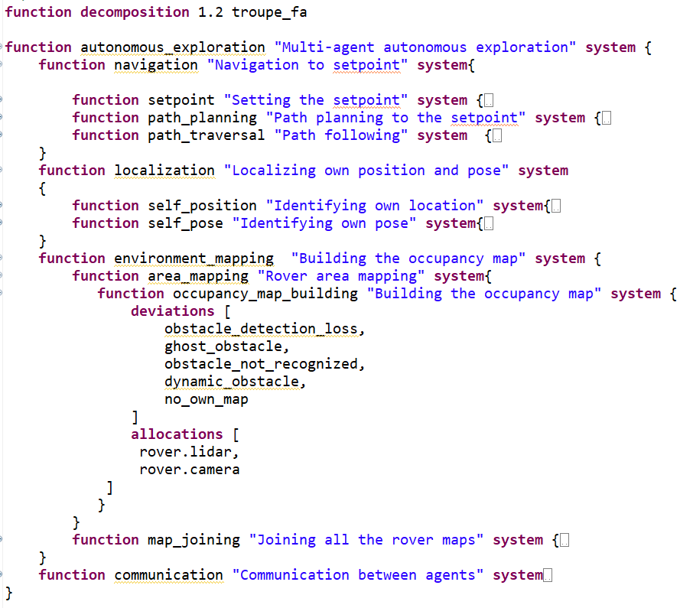
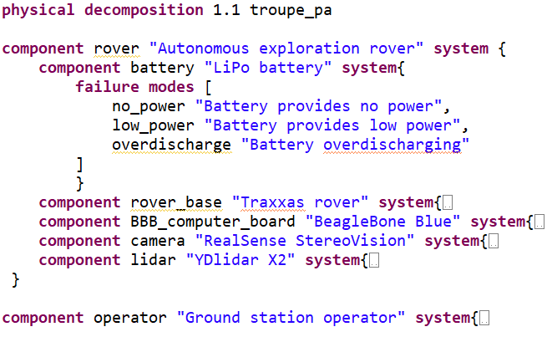
AdvoCATE: Physical and functional decomposition
Basis for hazard analysis
Includes failure mode and deviation specification

Slide 21
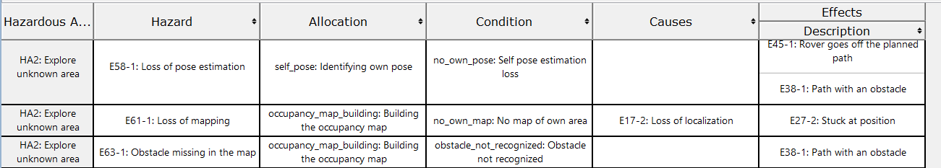
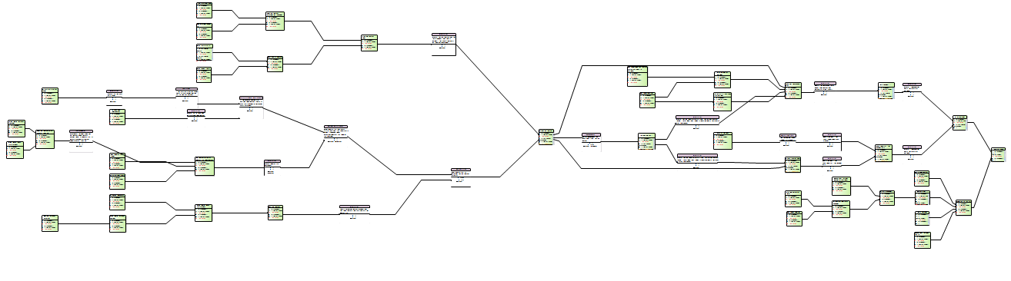
AdvoCATE: Hazard Analysis and Safety Architecture
Hazard analysis goes through all the functional/physical components and the related conditions (failure modes/deviations), and identifies their effects
A safety architecture is automatically generated from the hazard log
All the hazards/events (green boxes) connected with other events (causes/effects) and the applied mitigations (white/purple boxes)

Slide 22
Modeling and Analysis in HADES: Complementing AdvoCATE Analysis

Slide 23
System Modeling with HADES: Functional Model using Functional Reasoning Design Language (FRDL)
FRDL was developed to help specify hazard simulations in fmdtools
Something that can be used to inform analysis prior to computer-based modelling activities
Using FRDL means diagrams of system architectures will translate to fmdtools-based simulations
Replacement for Functional Decomposition/Function Block Diagrams typically used in FHA
Goal: Language to inform analysis of fault/failure propagation (as much as possible)
Key improvement: Better representation of causal propagation between functions, including shared variables (flows) and activations
Key improvement: Provides means of annotating diagrams to better specify structure and behavior of functions

Slide 24
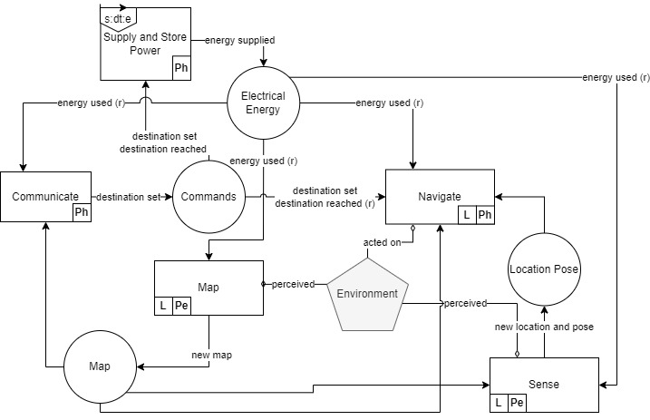
System Modeling with HADES: Functional Model using Functional Reasoning Design Language (FRDL)
Behavioral Elements
Function
Shared Variables (Flows)
Flow
MultiFlow
Connection Types
Propagation
Reverse Propagation (r)
Aggregation)

Slide 25
System Modeling with HADES: Functional Model using Functional Reasoning Design Language (FRDL)
6: Damage or Fuse Blown
Behavioral Elements
5: Adverse/Undesired
Current Draw (locked wheels)
7: No Power supply
Function
3: Incorrect Map
Communicated
8: No Power
Shared Variables (Flows)
4: Crashes into
Obstacle
10: No Power
Flow
MultiFlow
1: Loss of Obstacle
Detection
9: No Power
Connection Types
Propagation
Reverse Propagation (r)
Aggregation)
2: Incorrect Map
(None existent obstacle)

Slide 26
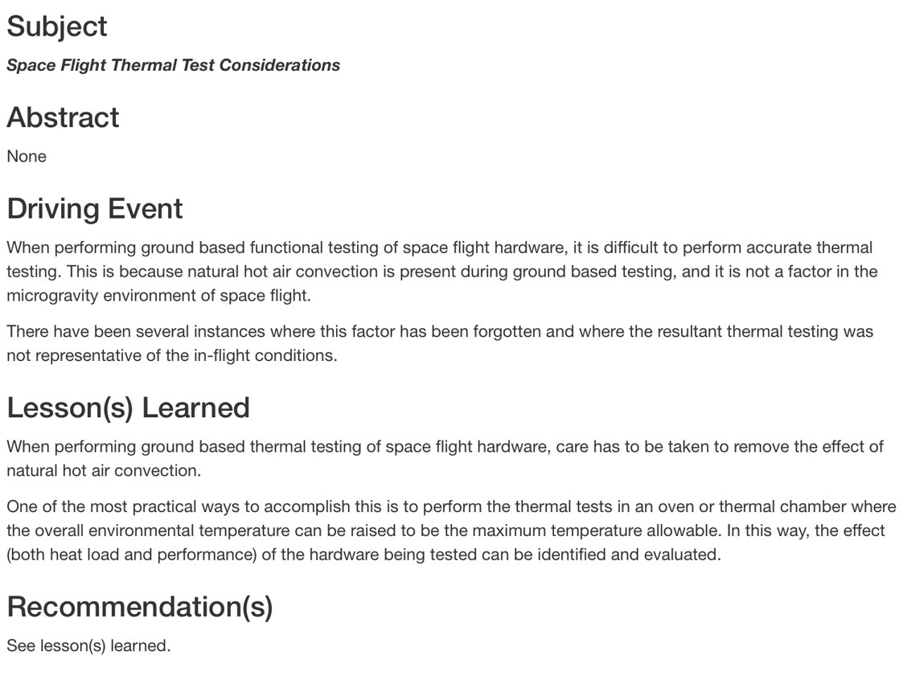
Dataset for Use with HADES Knowledge Retrieval Capability: NASA Lessons Learned Information System (LLIS)
https://llis.nasa.gov​
Publicly available database of lessons learned at NASA​
Over 2000 lessons
For internal users, the database can be downloaded as a spreadsheet​
At right: Lesson 630

Slide 27
Updating FHA with HADES Knowledge Retrieval Capability
NEW CAUSE from LLIS: anomaly with pose estimation - inaccurate relative pose
Hazardous Activity | Hazard | Allocation | Conditions | Causes | Effects
HA2: Explore unknown area | E58-1: Loss of pose estimation | self_pose: Identifying own pose | no_own_pose: Self pose estimation loss | Inaccurate relative pose | E45-1: Rover goes off the planned path
 |  |  |  |  | E38-1: Path with an obstacle
HA2: Explore unknown area | E61-1: Loss of self mapping history | occupancy_map_building: Building the occupancy map | no_own_map: No map of own area | Loss of map retention | Loss/incorrect localization
HA2: Explore unknown area | E63-1: Loss of obstacle detection | occupancy_map_building: Building the occupancy map | obstacle_not_recognized: Obstacle not recognized | Invalid/no inputs due to loss of sensors, poor physical/software connection to the feed, software unable to initialize obstacles Loss of/incorrect localization | Path plans with obstacles can result in collision with obstacles resulting in loss of rover, Incomplete mission due to not reaching destination
HA2: Explore unknown area | E64-1: Non-existant obstacle detection | occupancy_map_building: Building the occupancy map | ghost_obstacle: Obstacle recognized where not supposed to | Loss of/Incorrect locatlization Invalid inputs due to physical/software connection interference , software initializes obstacles incorrectly | Path plans that are suboptimal resulting in rover traversing unwanted areas delaying or possibly compromising the mission. The mission may be compromised due loss of power because of the additional distance rover travels.
 | loss of mapping function | occupancy_map_building: Building the occupancy map | complete loss of mapping function | no inputs due to loss of sensor, poor physical/software connection to the feed, software unable to initialize obstacles Loss of power | Rover will get stuck inside the already mapped area may result in adverse energy use. Unable to complete the mission due to being stuck inside the already mapped area. In a dynamic environment, rover may collide with new obstacles on the return path due to being unable to detect them potentially resulting in the loss of the rover.
 | Delay in mapping | occupancy_map_building: Building the occupancy map | Delay in mapping | low energy supply poor computational resource allocation computational resource limitation latency in the sensor feed Poor parameter tuning | Delayed mission due to rover waiting for new maps. Incomplete mission due to additional energy used waiting for updated maps. Potential collision with obstacles due to delayed localization due to delayed mapping.
NEW CAUSE from LLIS: anomaly with memory from flight computer - rover lost ability to execute tasks requiring memory
NEW HAZARD from LLIS: loss of ability to anticipate harsh terrain, effects include damage to rover

Slide 28
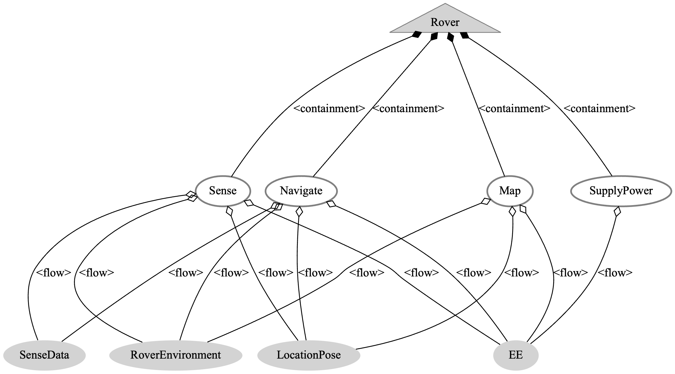
Simulation: Function-based System Representation and Behavior Simulation
FRDL system model further simplified to ensure computational efficiency
Communicate function which represents the communications with the ground control is represented as a parameter instead of the function, since it has no major behavioral effects on the rest of the system during a mission
Navigate includes path planning and drive capabilities

Slide 29
Simulation: Parameters
Parameters may be varied along with injected fault modes to create scenarios; they include
Environment-related
terrain size, resolution of the grid, max objects and object size
Objects are placed randomly on the terrain in varying sizes
Ground control-related
Destination, acceptable buffer area from the destination, max rover speed
Mission-related
Mean and standard deviation of location and pose estimation error in the navigate function, mean and standard deviation of location and pose error in the sense function when there is a malfunction in sensing, safety buffer between rover and obstacles, maximum sensing delay
Variations of the mission-related parameters can be analyzed to generate requirements

Slide 30
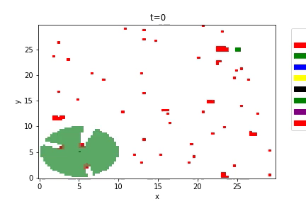
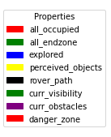
Simulation: Example execution with the fault “no obstacle detection” in the Map function at t = 50
Initially, the rover detects the objects creating blind spots in the visible area
After the fault is injected, some objects are detected while others are not. Undetected objects have no blind spots.
Finally, the rover crashes into an obstacle at t=240 due to not detecting it.

Slide 31
Simulation: Tracking the rover performance
We track the rovers’ safety and performance through a variety of metrics
Mission status
Number of explored obstacles
Numbers of perceived obstacles
Number of obstacles not detected
Number of ghost obstacles detected
Number of safety breaches

Slide 32
Analysis: Planned
Response of the rover for individual and joint failure modes. For example, what is the response of the rover when there is no obstacle detection and sensing malfunction.
Variation of mission parameters to generate requirements: e.g., what is an ideal safety buffer, what is an acceptable location and pose estimation error for the navigation function
Variations in environment to define the rover operational envelope: e.g., can the rover perform safely in terrain with a high obstacle density?

Slide 33
Requirements Specification and Analysis in FRET

Slide 34
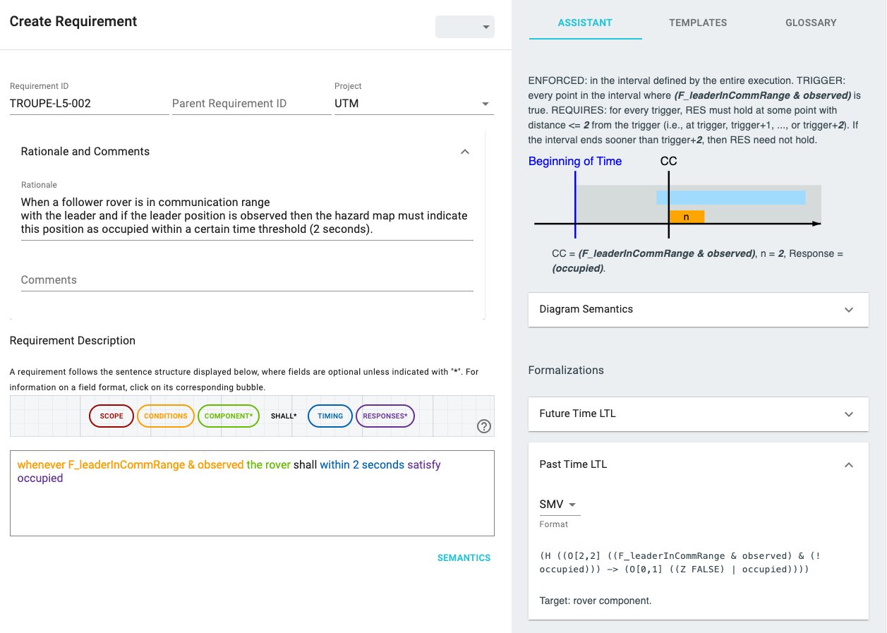
Specification, Understanding and Formalization: Requirements in FRETish
Understanding: Explanation of semantics in various formats. E.g.,
English description
Diagrammatic explanation
Example TROUPE requirement in FRET
FRET uses a structured natural language, namely FRETish, which is based on 6 fields. Asterisk indicates mandatory fields.
Formalization: Automatic translation to temporal logic formulas, which can be used for analysis.
Specification: FRETish text (structured natural language)

Slide 35
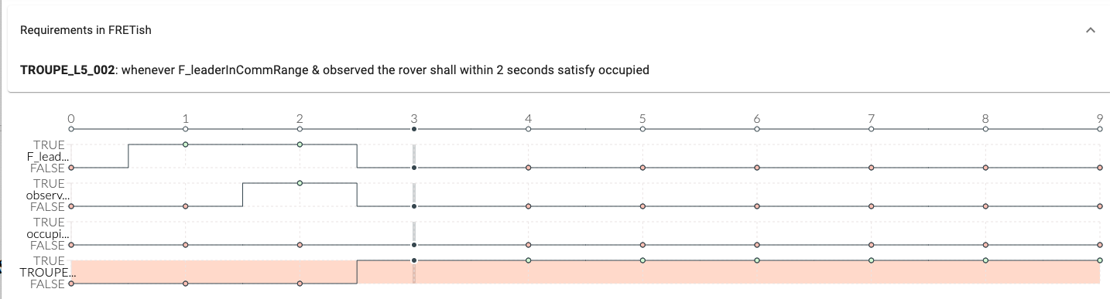
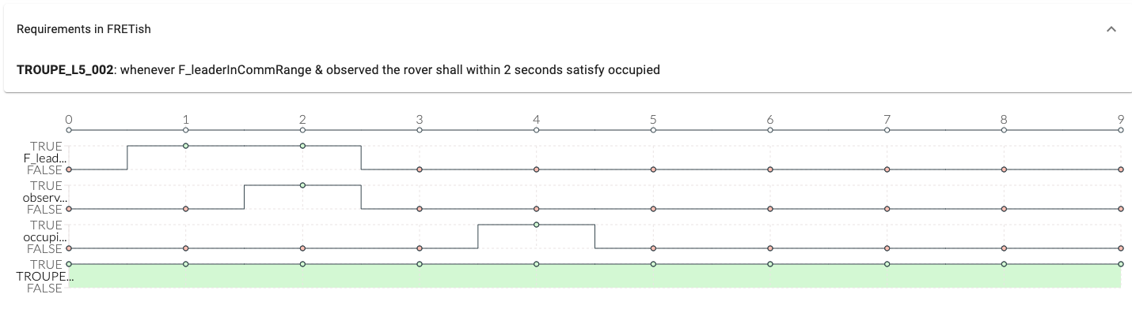
Simulation: Interactive visualization of requirement semantics
Variable valuation that violates the requirement. Occupied does not become true within 2 seconds of the condition (F_leaderInCommRange & observed) being met.
Variable valuation that satisfies the requirement.

Slide 36
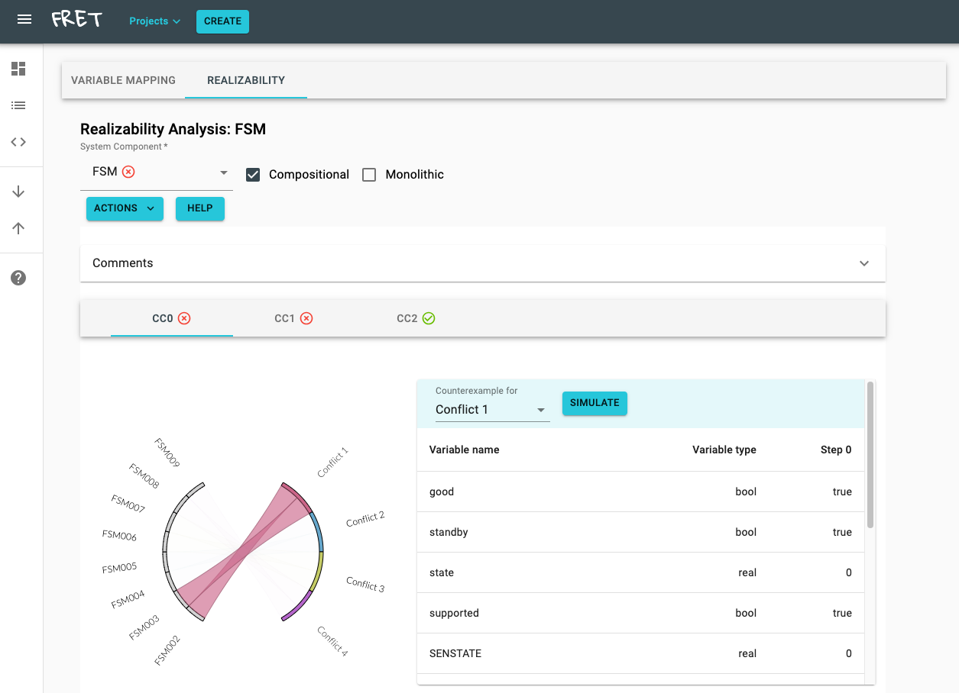
Analysis: Consistency/Realizability Checking of Requirements
Return counterexamples that help repair conflicting requirements
Identify conflicting requirements

Slide 37
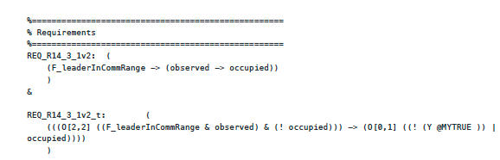
Runtime monitoring: Connection with tools
FRET connects with different runtime monitoring tools such as NASA's R2U2 and Copilot/Ogma tools.
Here is a simplified workflow diagram:
Natural language
requirement
Formalized
requirement
FRET
R2U2 or Copilot/Ogma
Monitor app
Example of R2U2 monitor that was created using the formalized requirement exported by FRET:

Slide 38
Further Reading
AdvoCATE
fmdtools
MIKA
FRET
https://ntrs.nasa.gov/api/citations/20220009664/downloads/AdvoCATE%20User%20Guide_1.4.pdf
https://github.com/nasa/fmdtools
https://github.com/nasa/mika
https://github.com/NASA-SW-VnV/fret

