Slide 1

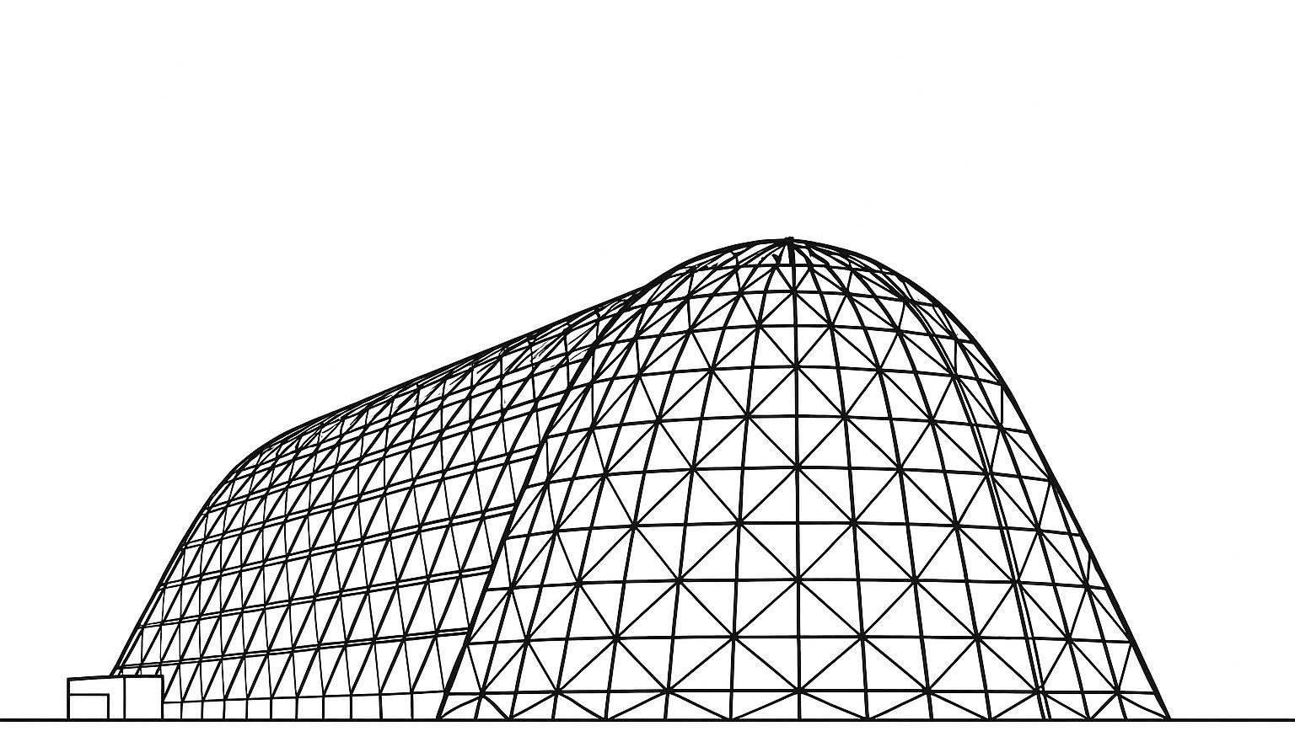


Volatiles Investigating Polar Exploration Rover (VIPER)
System Integrated Thermal Vacuum Test Planning and Preparation
TFAWS 2025 Passive Thermal Technical Session
Presented by: Jodi Turk¹
Thomas Slusser⁵
Geronimo Quintanilla⁵
Zane Mittag⁵
Juan Barragan⁵
Angel Alvarez-Hernandez⁵
Elijah Stewart¹
Tim Page²
Ezequiel Medici³
Jose Dobarco Otero⁴
1. NASA Marshall Space Flight Center, 2. Amentum Space Exploration Division Huntsville, AL, 3. S&K Global Solutions Houston, TX, 4. HX5 LLC Houston, TX, 5. NASA Johnson Space Center
Thermal & Fluids Analysis Workshop 2025
NASA Ames Research Center
San Jose, CA
August 4-7, 2025

Slide 2
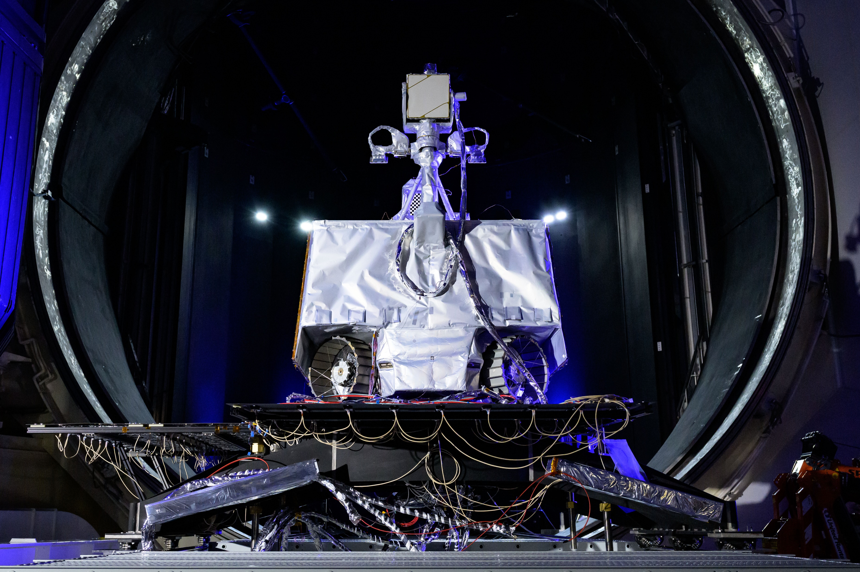
Introduction
VIPER is a rover designed to operate at the lunar south pole
Using the drill and science instruments on board VIPER will be looking for ice and other volatiles

Slide 3
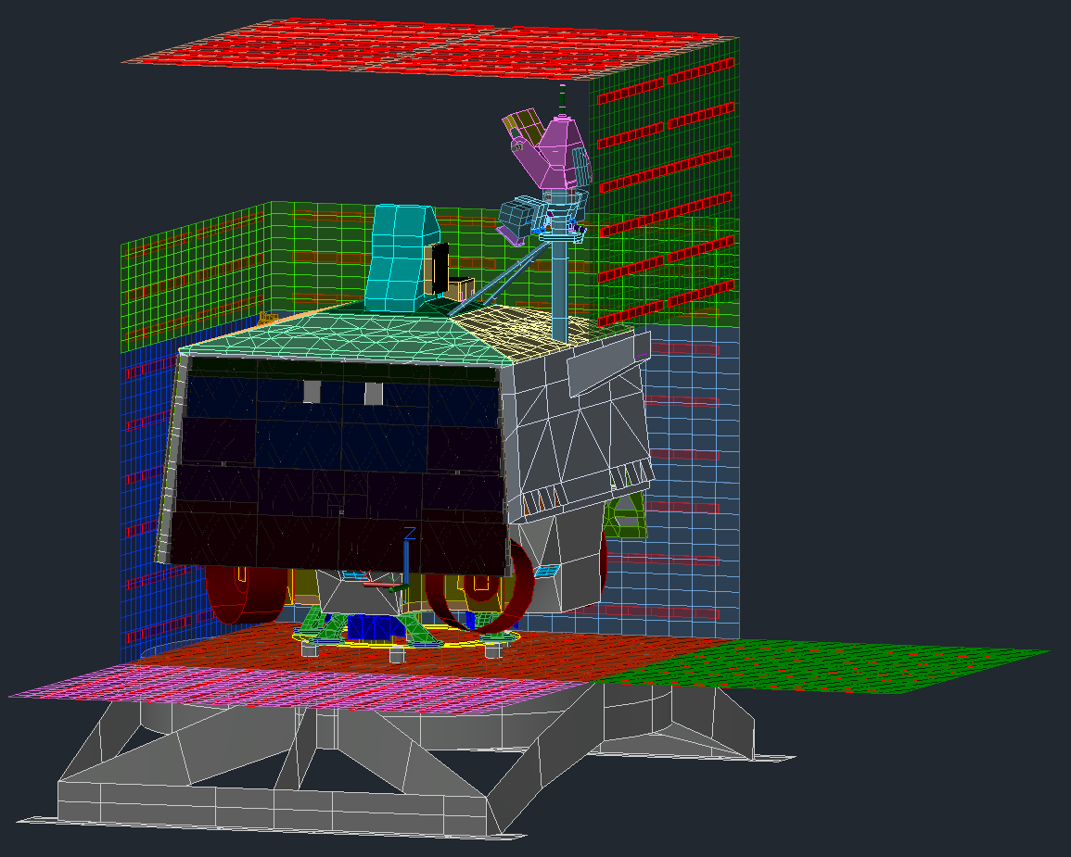
System TVAC
Test VIPER’s thermal management system in hot and cold environments
Follow specifications in
ARC-STD-8070
Collect data to correlate thermal model
Gain experience operating the rover
Understand how VIPER’s loop heat pipes (LHPs), heat pipes, and thermosiphons work together

Slide 4
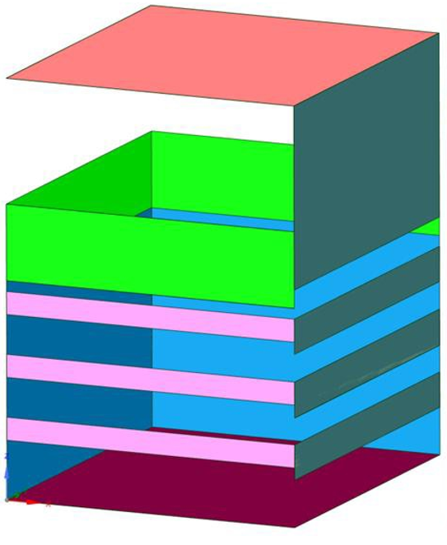
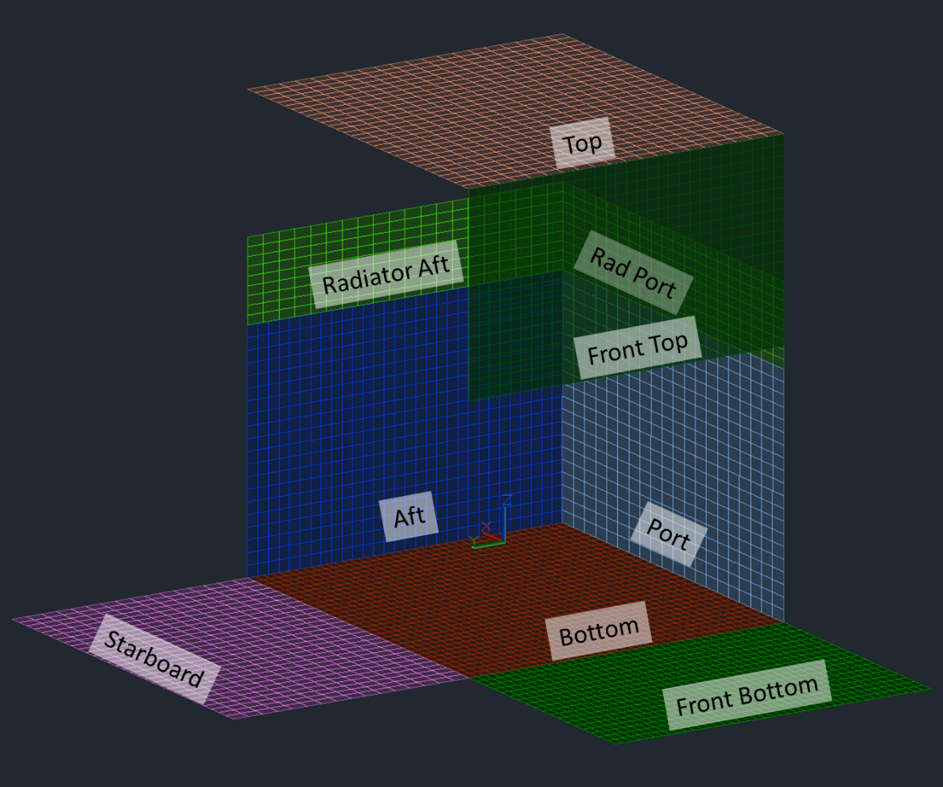
Thermal Radiant Heat Enclosure (TRHE)
The TRHE was designed to impose the hottest lunar surface environment on the rover while also remaining open to have a view to the chamber shroud for hibernation testing
The TRHE went through multiple design phases from slated panels to laying side panels flat to balance heating and cooling VIPER and reduce the construction complexity of the TRHE

Slide 5
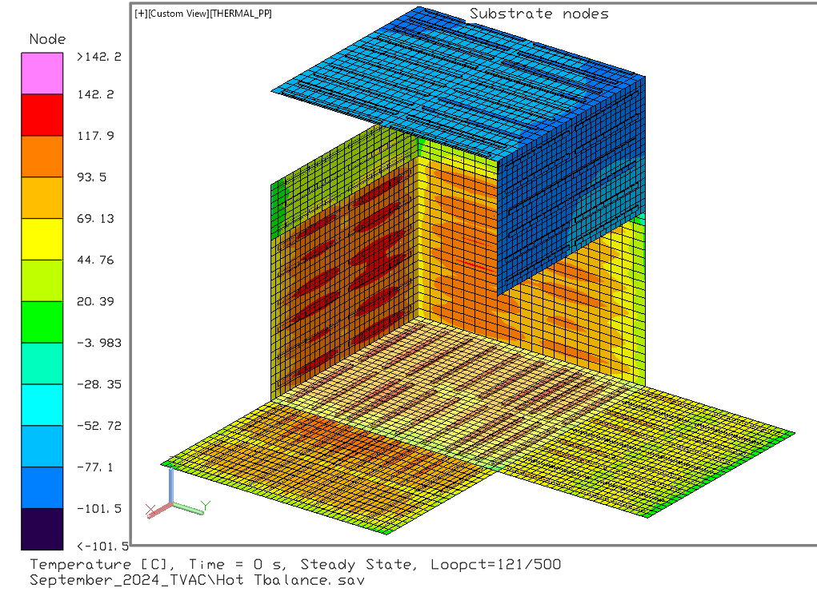
Thermal Desktop Modeling of the TRHE
Initially the panels were modeled without the heater bars and the panels were controlled by a heat load across the panel
The thermal model was updated to include the heater bars to account for the temperature gradients across the panels due to the localized heating

Slide 6
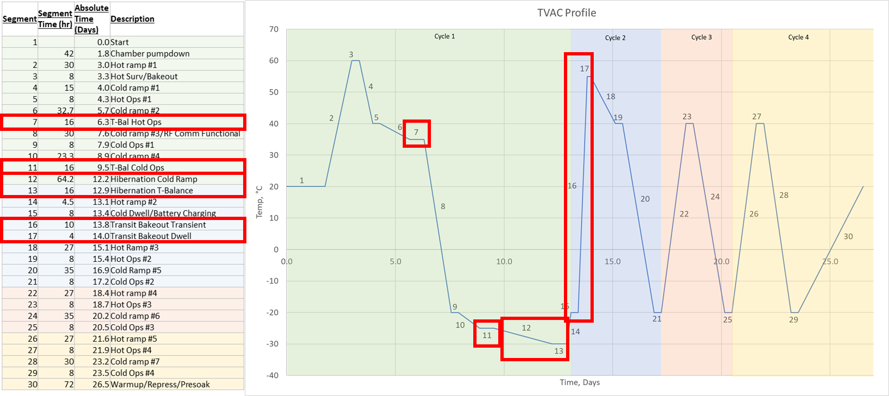
TVAC Test Profile

Slide 7
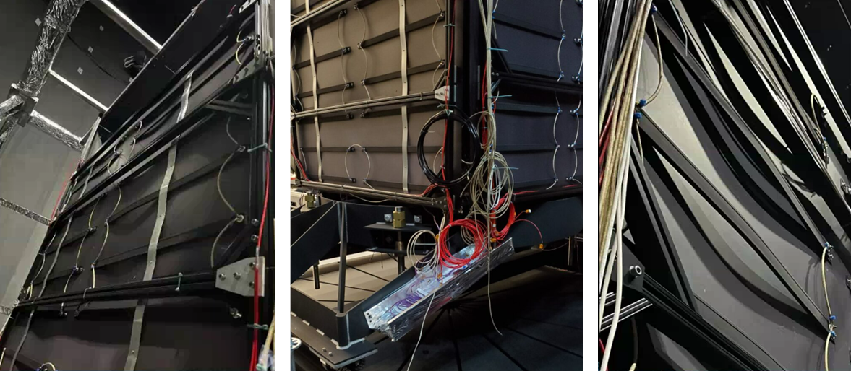
Chamber A TRHE Functional Check

Slide 8
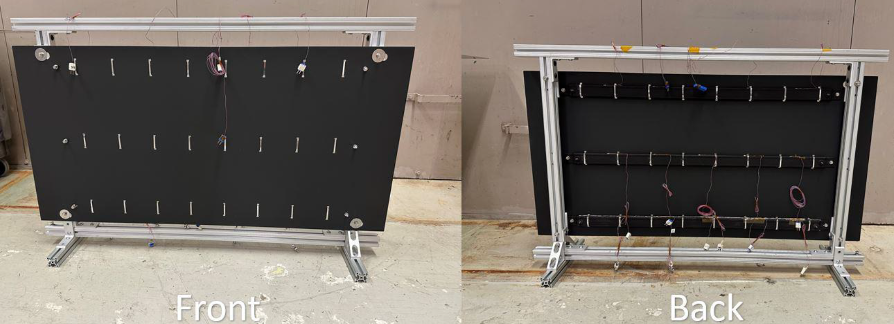
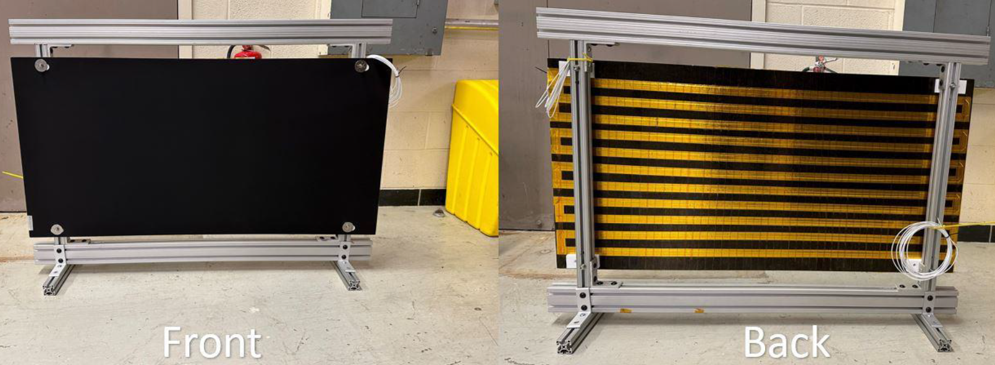
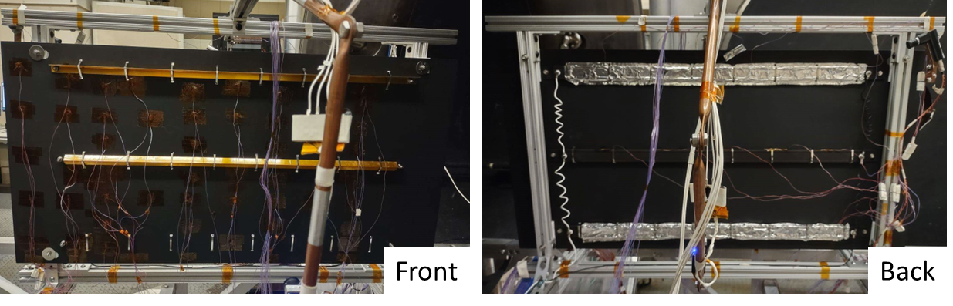
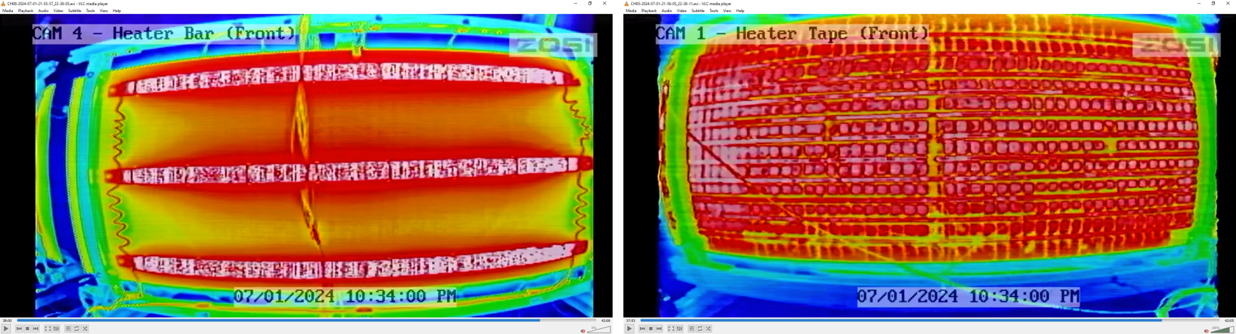
TRHE Design Assessments
Sample panels were created to compare Clayborn Heater Tape and heater bars
Multiple attachment methods were compared for the heater bar design
  Metal ties only
  Metal ties and thermal interface material (TIM)
  Metal ties with a stiffener and ultra high vacuum (UHV) foil
  Metal ties and UHV foil

Slide 9
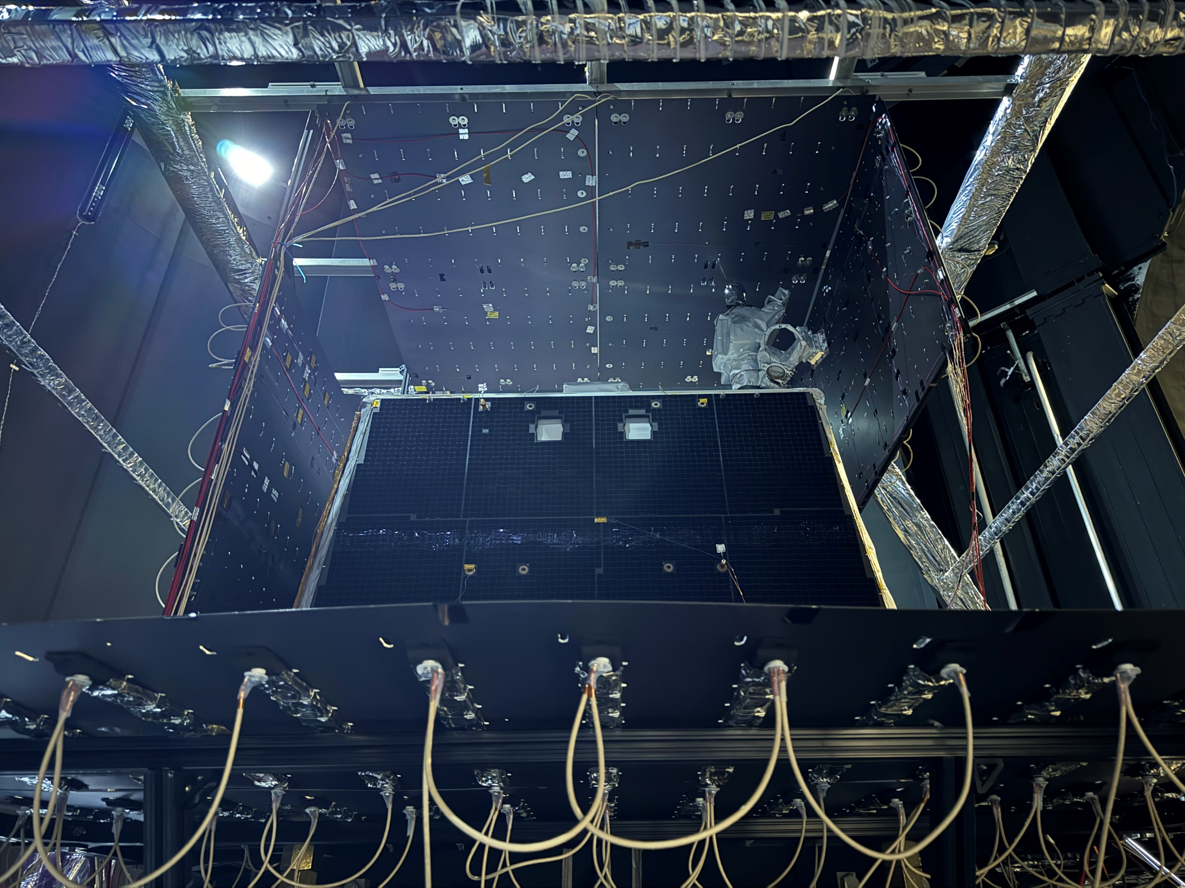
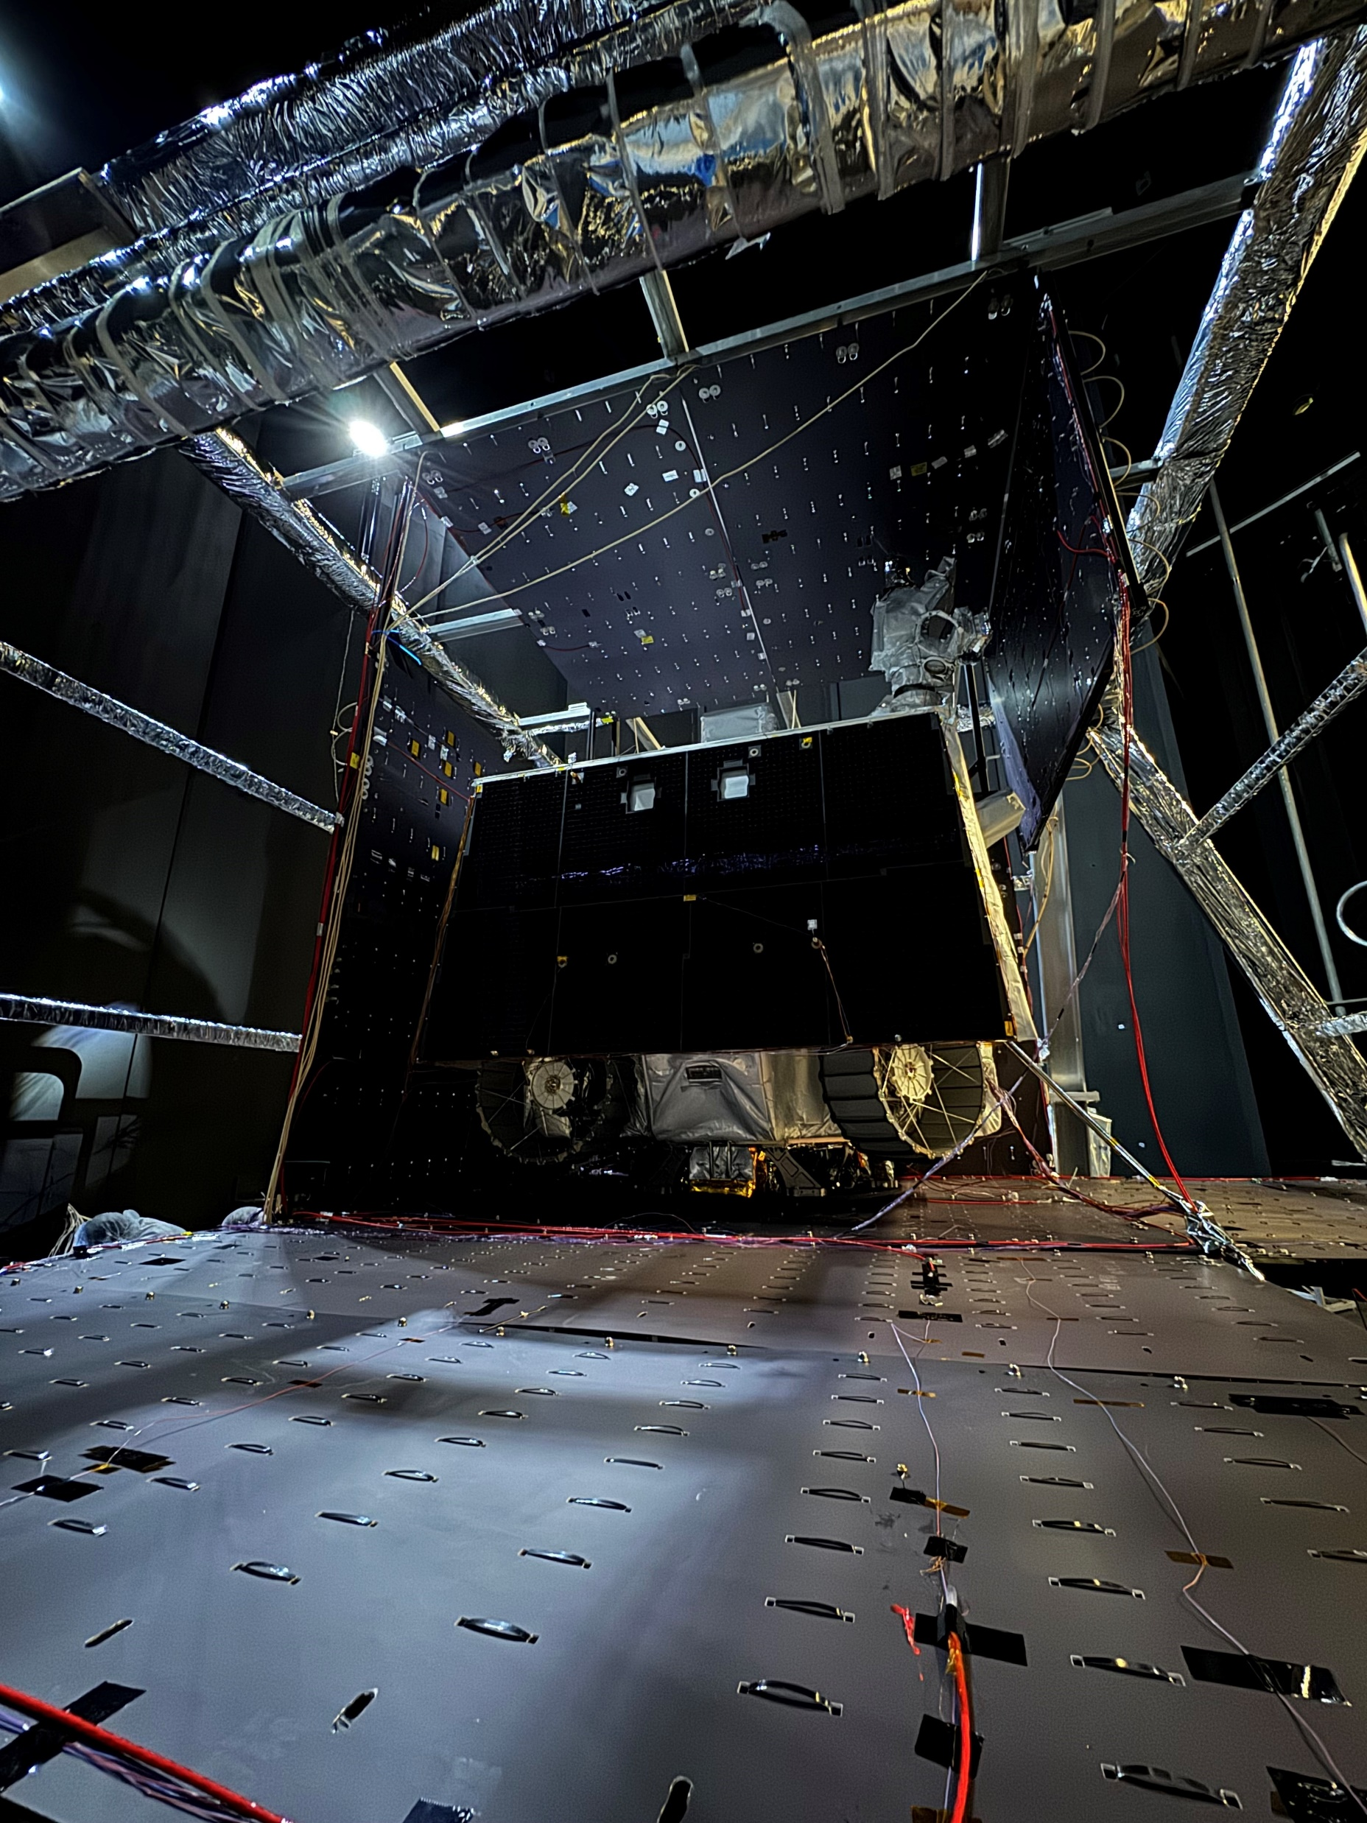
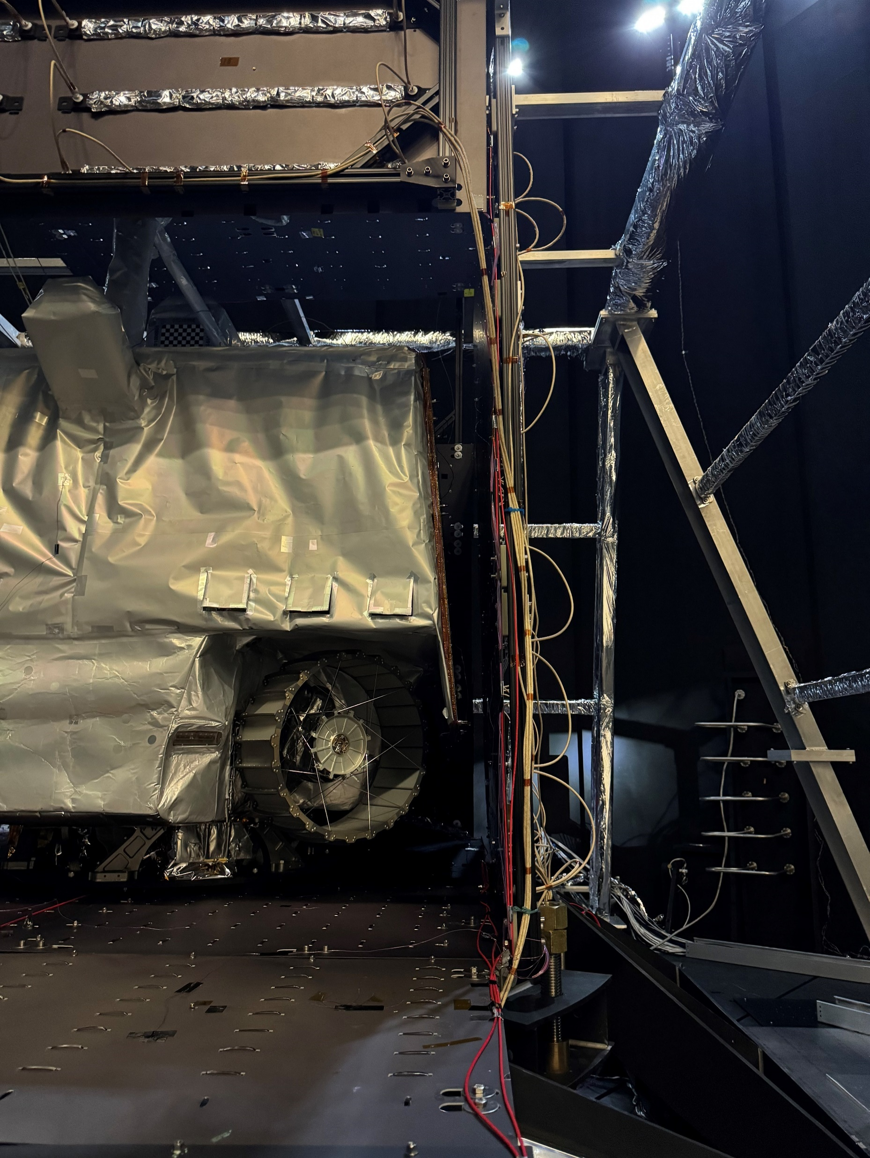
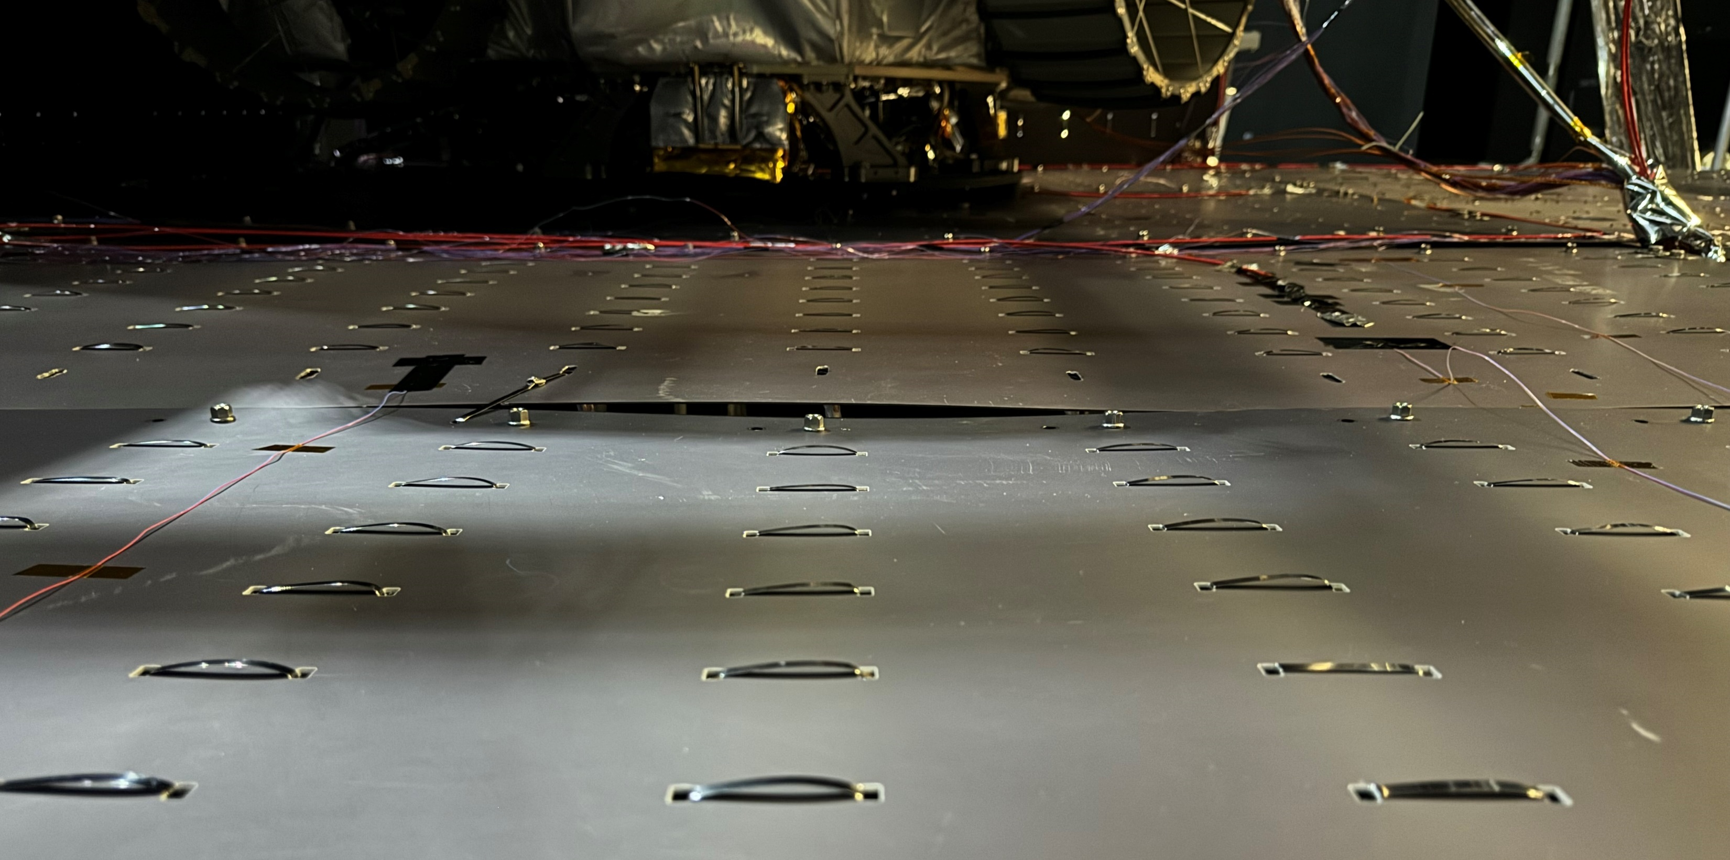
VIPER and THRE in Chamber A

Slide 10
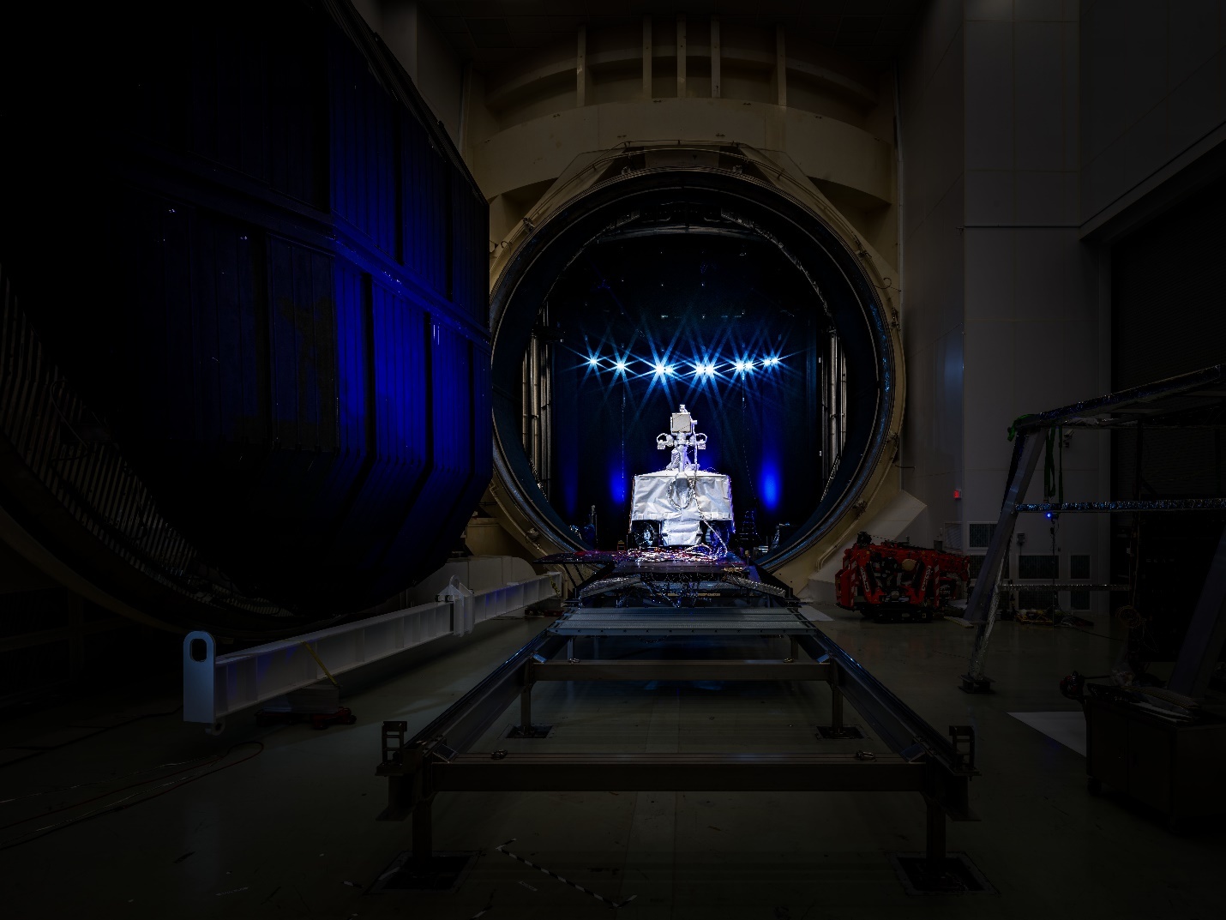
Questions
For more information on the LHP design check out “Thermal Vacuum Testing of VIPER Loop Heat Pipe” by Ezequiel Medici presented at TFAWS 2025
For more information on the model correlation check out “Speeding up Model correlation with BREAKOUT MODELS: The VIPER integrated Thermal model Correlation Story” by Lisa Erickson presented at TFAWS 2025
A future presentation and paper are planned to discuss the VIPER TVAC test
Thank you to the MSFC ET20 team for making the heater tape panel tested in Chamber E, the JSC Chamber A test team for their support in developing the TRHE and TVAC test plan, Miria Finckenor and Meghan Carrico of MSFC material group for traveling to JSC to measure the emissivity of the TRHE.

