Slide 1
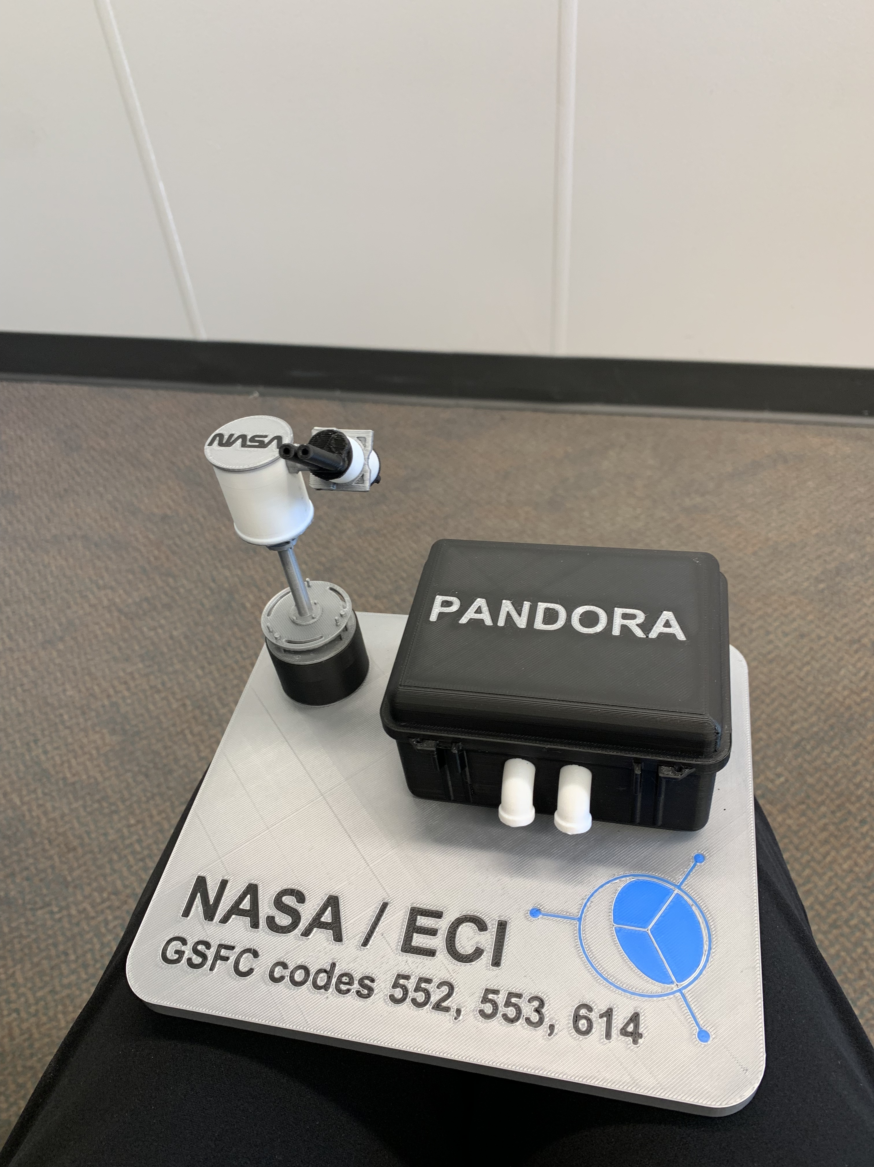
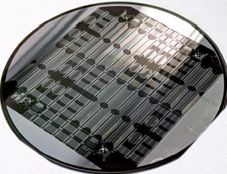
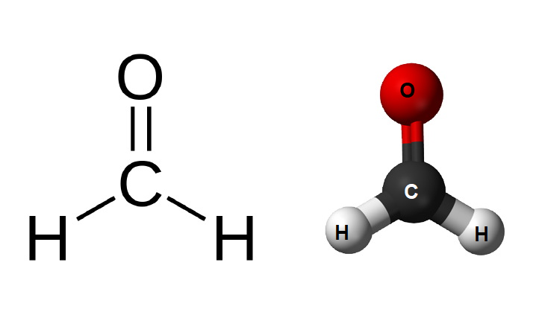
Production and Validation of novel SiC UV Instrumentation for Astronomy and Planetary applications
Dr. Chullhee (Chace) Cho
NASA Goddard Space Flight Center
SPIE Optics+Photonics 2025
UV, X-Ray, and Gamma-Ray Space Instrumentation for Astronomy XXIV
San Diego, CA

Slide 2
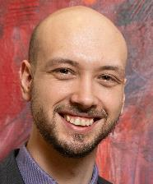

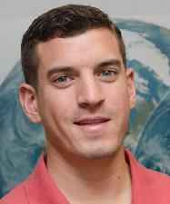
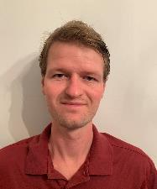

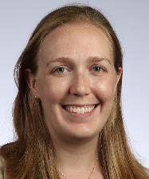

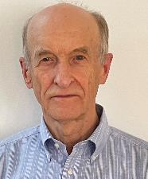


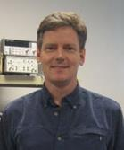

NASA GSFC – Detector Post-Processing, Readout Development, Integration, and Application Formation
Peter Snapp
PI: Engineering, EC
Chace Cho
PM: Engineering, EC
Ryan Stauffer
PM: Meteorology, EC
Bryan Place
Atmospheric Chem., EC
Prabal Saxena
Planetary Sci., EC
Allison Youngblood
Astrophysics, EC
Anh La
Instrumentation, Senior
Augustyn Waczynski Electronics, Senior
Carl Kotecki
Electronics, Senior
Tilak Hewagama
Engineering, Mentor
Thomas Hanisco
Atmospheric Chem., Mentor
Ish Aslam
Planetary Sci., Mentor

Slide 3

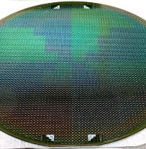
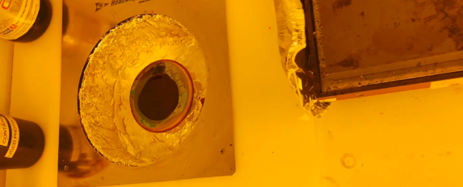

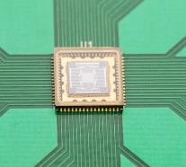

CoolCAD Electronics Inc.
SiC Photodetector Design and Fabrication
UV Linear photodiodes on 4” wafer
SiC Feature Patterning
Industry leader in SiC Device Production
Pre-existing relationship with GSFC for easy collaboration
Access to advanced fabrication facilities for device production
Zeynep Dilli
Director of Engineering
NASA PICASSO
Integrated UV Pixel Array

Slide 4

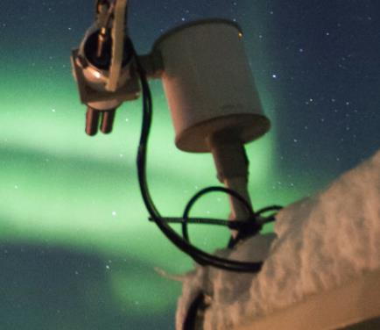
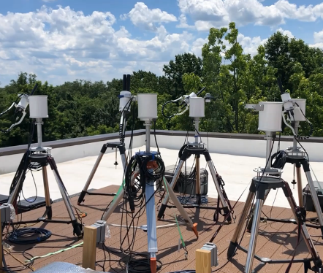
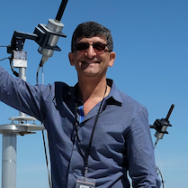
SciGlob Instrument and Services, LLC.
Pandora Integration/Software Development and Field Demonstration
Pandora Science Platform
Developed and maintains the Pandora Instrument platform
Focused on atmospheric remote sensing for air quality monitoring and satellite verification
Nader Abuhassan
Co-Founder

Slide 5
Driving Scientific Motivation: Better Formaldehyde Measurements
Easy to measure potent climate forcing gas
Extremely difficult
to measure
Unlocks chemical
relationship
CH₄ + OH → HCHO
(Methane plus OH yields HCHO)
Methane (CH₄) is an extremely potent climate forcing gas (80x more warming power than carbon dioxide), however, methane’s long lifetime (~9 years) and complex chemistry in the atmosphere make full understanding of its lifetime and mechanism controlling it concentration are elusive
Methane's lifetime in the troposphere is primarily influenced by global hydroxyl (OH) concentration, but hydroxyl’s extremely short lifetime (~1s) makes direct quantification extremely difficult
Formaldehyde (HCHO) is a direct product of methane oxidation via hydroxyl and has an intermediate lifetime (~2 hrs) allowing for constraint of hydroxyl concentrations and methane lifetime (Liao, Jin, et al. "Towards a satellite formaldehyde–in situ hybrid estimate for organic aerosol abundance." Atmospheric Chemistry and Physics 19.5 (2019): 2765-2785. https://doi.org/10.5194/acp-19-2765-2019)

Slide 6
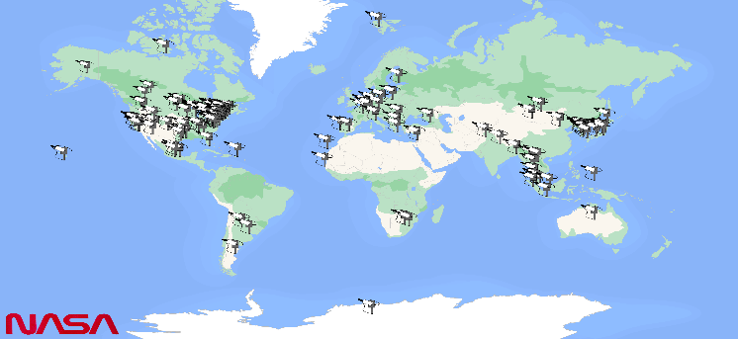
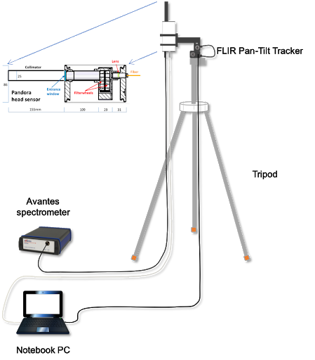
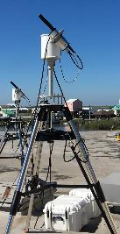
Platform for Measurement: Pandora Spectrometer System Forming the Pandonia Global Network
Sentinel-4
TEMPO
GEMS
Pandonia Global Network
Compact spectrometer coupled to tracking head with integrated optics for differential optical absorption spectroscopy (DOAS) measurement of columnar trace gases, developed and maintained by our partner, SciGlob Instruments and Services, LLC.
Networked across globe for long term observation of trace gases and validation of LEO geostationary orbit-based UV sensors
Currently uses cooled, back-thinned, silicon CCD as focal plane array for detection (https://pandora.gsfc.nasa.gov/)
Pandora Instrument

Slide 7
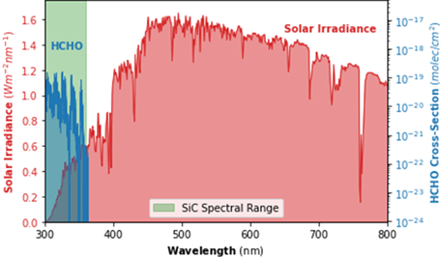
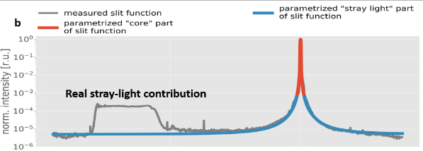
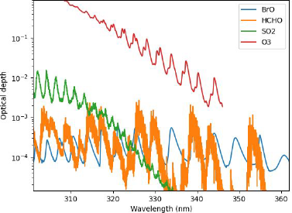
Technological Need: Low Noise Visible Blind UV Detectors
Declining Solar Irradiance
300
400
500
Scattered Visible Light
Interfering Gases
Solar irradiance (red) demonstrating drop-off at wavelengths less than 400 nm as and formaldehyde light absorption starts (blue) (HiTRAN Online Database, Rothman LS. History of the HITRAN database. Nat Rev Phys 2021;0123456789. https://doi.org/10.1038/s42254-021-00309-2)
High density of UV active gases in region of interest complicates capture of data for any specific species, especially formaldehyde which has a relatively low optical depth
Within instrument strong visible signals result in internally scattered light which can overwhelm UV signal at detector

Slide 8
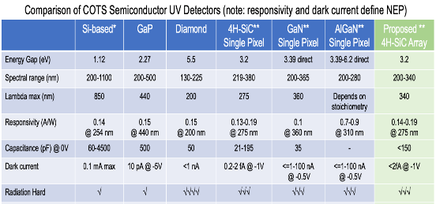
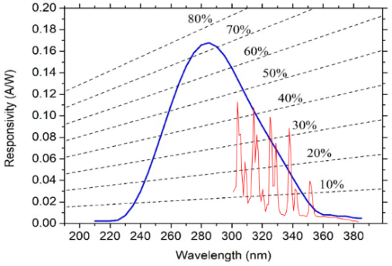
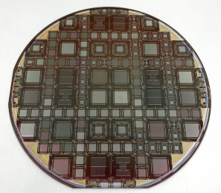
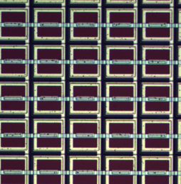
Produce Focal Plane Array from Low Noise, Visible Blind 4H-SIC
Synergistic Responsivity and Absorption
Silicon Carbide (SiC) is a wide bandgap semiconductor resulting in the following benefits
  Effective insensitivity to wavelength >380 nm
  fA level dark current
  Inherent radiation hardness and temperature stability
SiC possesses excellent material maturity (defect density 5-7 orders of magnitude better than GaN) and is being Co-Matured at NASA Through ROSES/PICASSO (Saxena/Hewagama: PReSSiC: Planetary Remote Sensing using SiC detectors) as well as Various SBIRs with our Partner, CoolCAD Electronics Inc. CADlectronics Inc.
Responsivity curve uniquely suited to detection of formaldehyde
4H-SiC Photodiode Arrays

Slide 9
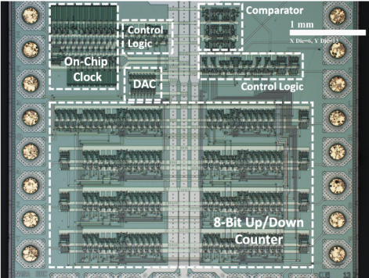
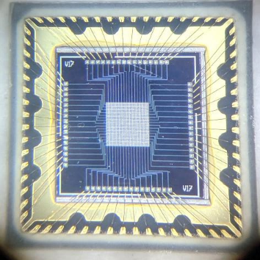
Enabling Elements to Encourage Adoption of SiC
Recent advances in SiC fabrication and integration processes motivate adoption of SiC technology
  Nasa General SiC development work: realization of high temperature (500 ºC) operable SiC JFETs at NASA Glenn [Neudeck, Philip G., et al. "Upscaling of 500° C Durable SiC JFET-R Integrated Circuits." Additional Papers and Presentations 2021.HiTEC (2021): 000064-000068. https://doi.org/10.4071/2380-4491.2021.HiTEC.000064]
  Specific work at NASA GSFC, co-initiated with our external partner CoolCAD, priming SiC for infusion into UV Photodetectors:
    SiC readout electronics and individual detector elements, optimized through a series of SBIRs
    SiC focal plane array demonstration through a peer reviewed ROSES/PICASSO (Hewagama et al: PReSSiC: Planetary Remote Sensing using SiC detectors).
SiC Based Analog to Digital Converter
SiC Pixel Array

Slide 10
Diode Structure Definition
Detector Cross Section
Pixel geometry developed by CoolCAD yields lower dark current
Including pixel-to-pixel isolation structures between neighboring active areas
Include backside metallization (Nickel with Gold Coating) to allow control of the N+ substrate bias
Pixel Isolation
P+ contact implant/diode p side
N+ contact implant/diode n side
P+ contact implant/diode p side
~5 um
P- epi
Backside metallization
~300 um
N+ substrate

Slide 11
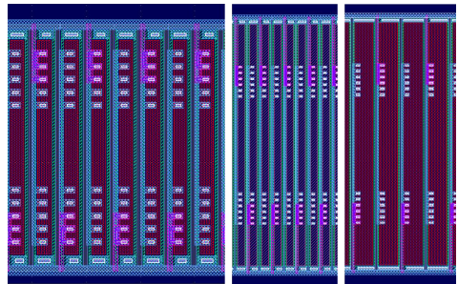
Individual Diode Designs Targeted
Across initial run targeted an expanded range of individual diode geometries to balance performance with ease of fabrication including
  Optimized 25 um x 500 um geometry
  Vertically constrained 25 um x 200 um (in case high aspect ratio presents issues)
  Horizontally expanded 50 um x 500 um geometry (in case small pitch presents issues)
Also included variation in implant type N- (wider depletion region and increased responsivity), N+ (reduced serial resistance)
Within process test diodes included variation in metallization pattern to balance active area and serial resistance
n+ implant
25 x 200 μm
n- implant
25 x 500 μm
n+ implant
50 x 500 μm

Slide 12
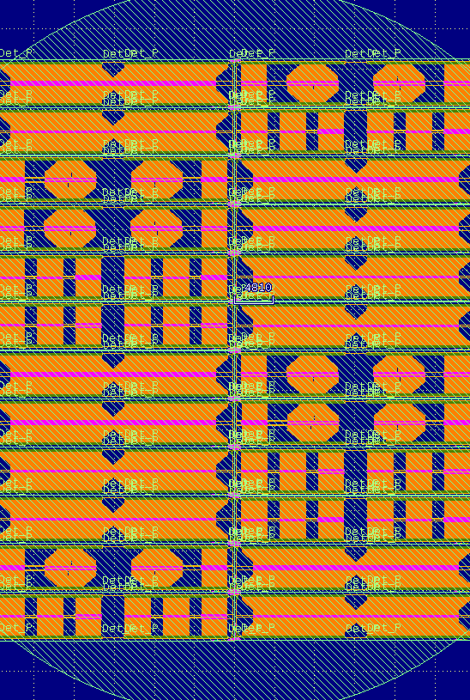




First Run Fabrication Wafer Layout
Integrated 1x128s
25x200 um, 1x1024
25x500 um & 50x500 um
25x500 um, 1x1024
Condensed designs from true 1x128 into continuous arrays to increase number of 1x128 arrays testable with a single integration
Included 50x500 um variants as an added insurance policy
Also included limited number of full 1x1024 arrays for structure validation and earlier field campaign kickoff
Same variations on width of isolation between pixels (2 um and 4 um) and Implant type (N+ or N-) are present on this wafer
1x1024 Array Wafer

Slide 13





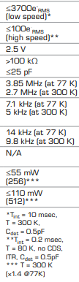
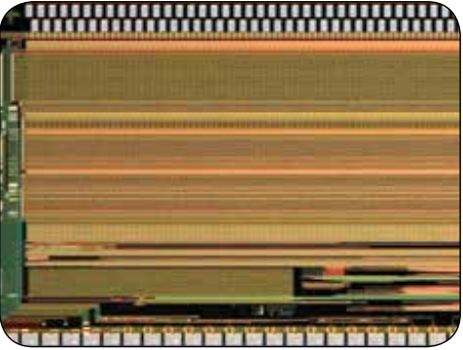


Identifying ROIC Suited for Reading Desired SiC Array
ISC9802 Wire-bondable ROIC
Targeted fabrication of 1D passive array with wire bondable interface
Identified FLIR ISC9802 as best option
ISC9802 Core Properties

Slide 14
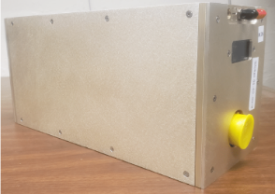
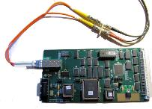
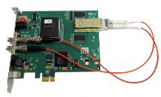
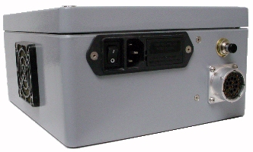
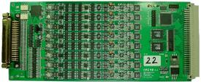
Selection of ROIC Operation Method
ISC9802 requires specific series of analog and logic supplies, bias adjusting voltages, clock inputs, and data outputs to function properly
Selected a Gen III Astronomical Research Cameras, Inc. imaging array controller, Controller with the following benefits:
  Fiber Optic Timing Board Coupled to PCIe interface board for low noise direct communication with a control computer
  8 Channel Video board (use 4) for supplying bias voltages to ROICS as ell as digitizing video outputs from our ROICs
  Dedicated and rugged power supply allowing for use in field demonstration
Imaging array controller
Timing + PCIe
Video Board
Power Supply

Slide 15
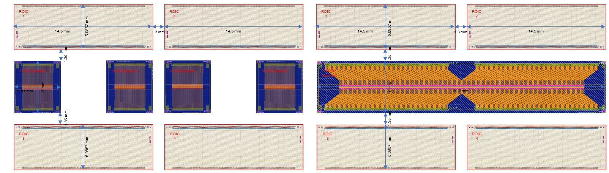
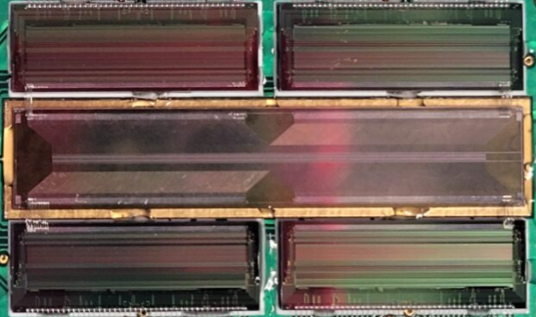
Detector and ROIC Integration Pan
Generalized interface between 256 element ROICs and 1x1024 SiC Detectors
Readout integration scheme illustrating a core 1 x 1024 SiC photodiodes array in the middle which fans out to wire bond pads matched to the input of wire bondable 4 x CTIA ROICs, each with 256 inputs.
Integration of 1 x 1024, 25 µm x 500 µm pixel size of n-/p SiC photodiodes array with 4 ISC9802 ROICs. The top and bottom rows of dies are 4 CTIA ROIC, and the middle die is 1 x 1024 SiC photodiodes array, subsets of connected diodes have been wirebonded for validation and are visible at the corners of the 4 detectors.

Slide 16
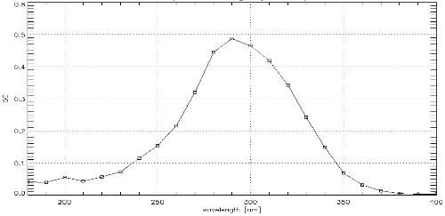
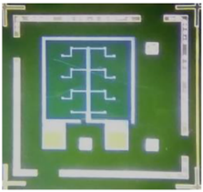
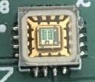
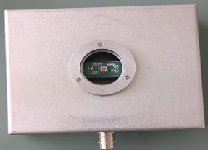
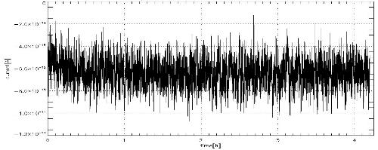
Direct QE and Dark Current Measurement
Diode
Diode Carrier
Diode Package
SiC Diode Quantum Efficiency
CoolCAD and GSFC Electronics teams coordinated to package an isolated P-on-N sSiC photodiode for preliminary characterization
Characterized to confirm confirmed proposed SiC detector structure achieves performance necessary for reconstruction:
  QE = ~0.4 (325 nm)
  Dark current < 10 fA
SiC Diode Dark Current

Slide 17
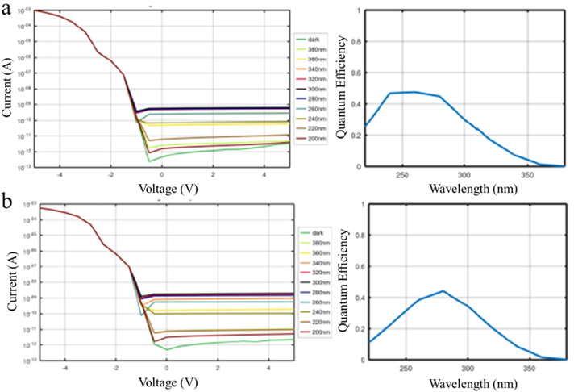
Direct QE and Dark Current Measurement (continued)
Dark and photocurrent measure of the fabricated standalone SiC photodiodes (left), and the analytically calculated quantum efficiency (right).
Top panels show the results from a 25 µm x 200 µm n-/p diode structure and bottom panels shows the results from a 25 µm x 500 µm n+/p diode structure.

Slide 18
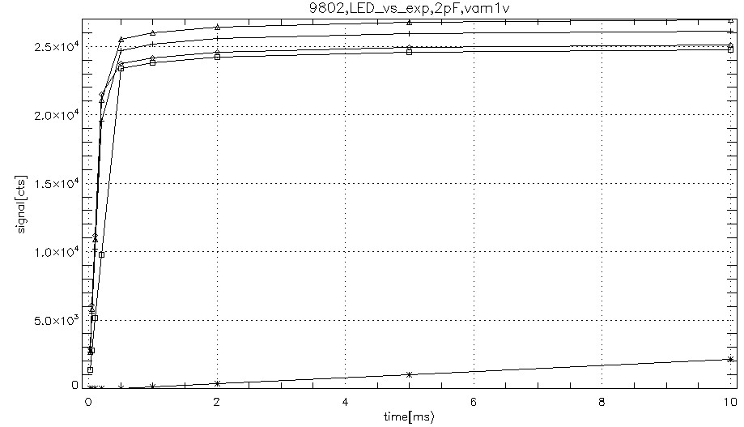
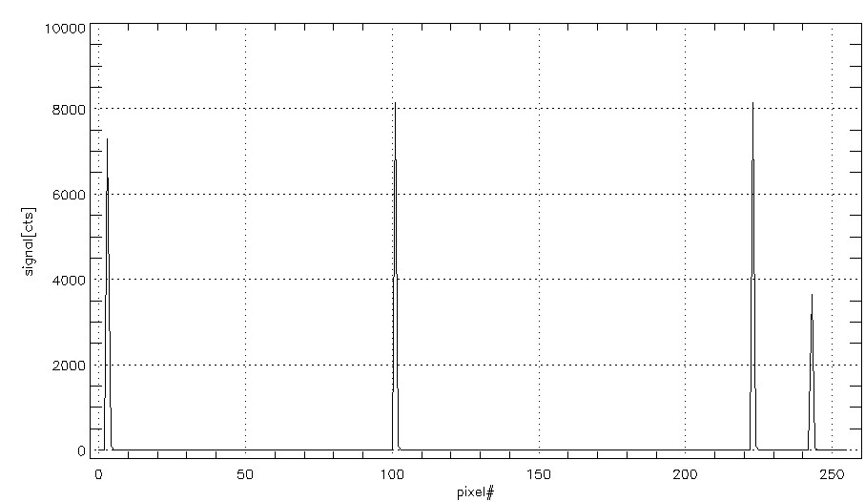
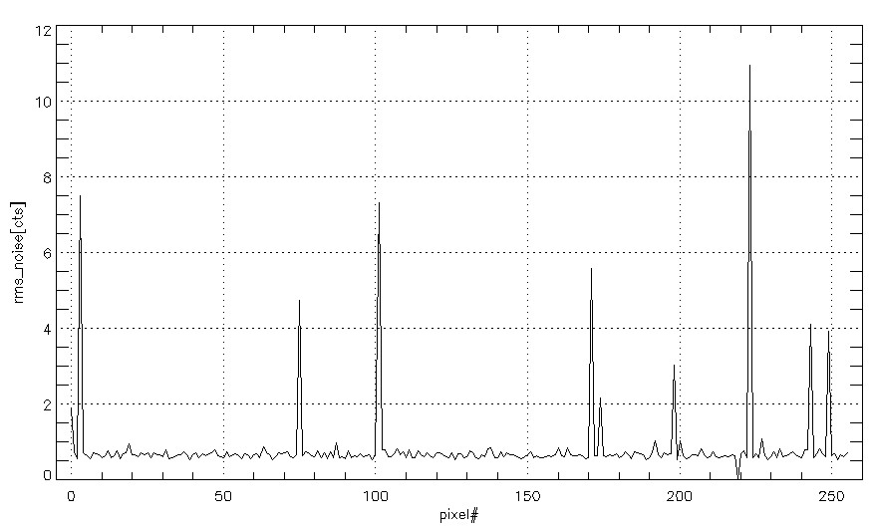
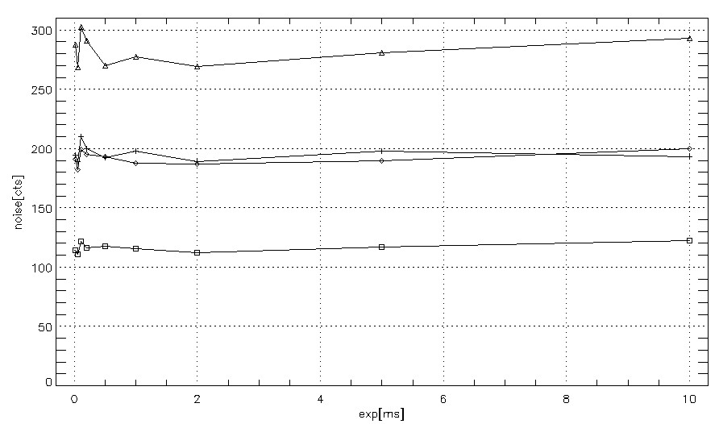
Readout noise Assessment of integrated SiC photodiodes
Response of 4 photodiodes to LED illumination at 293nm – top 4 traces, and control resistor integration of 50pA current versus exposure time. Test resistor used to verify setup gain.
Response of 4 photodiodes to low illumination from LED293
Noise of average of 500 samples of 10ms exposure (5s of acquisition).
Photodiode noise versus exposure times

Slide 19
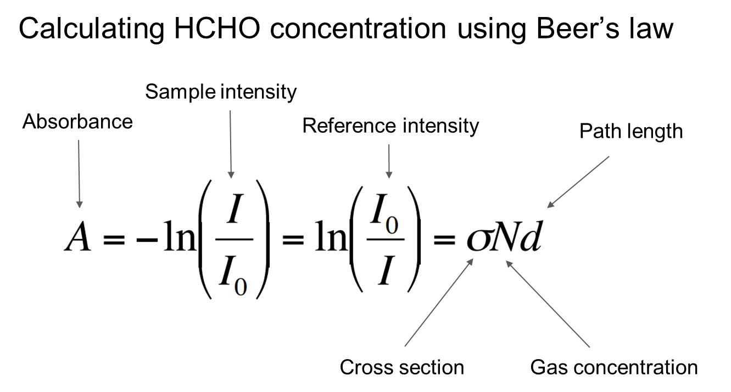
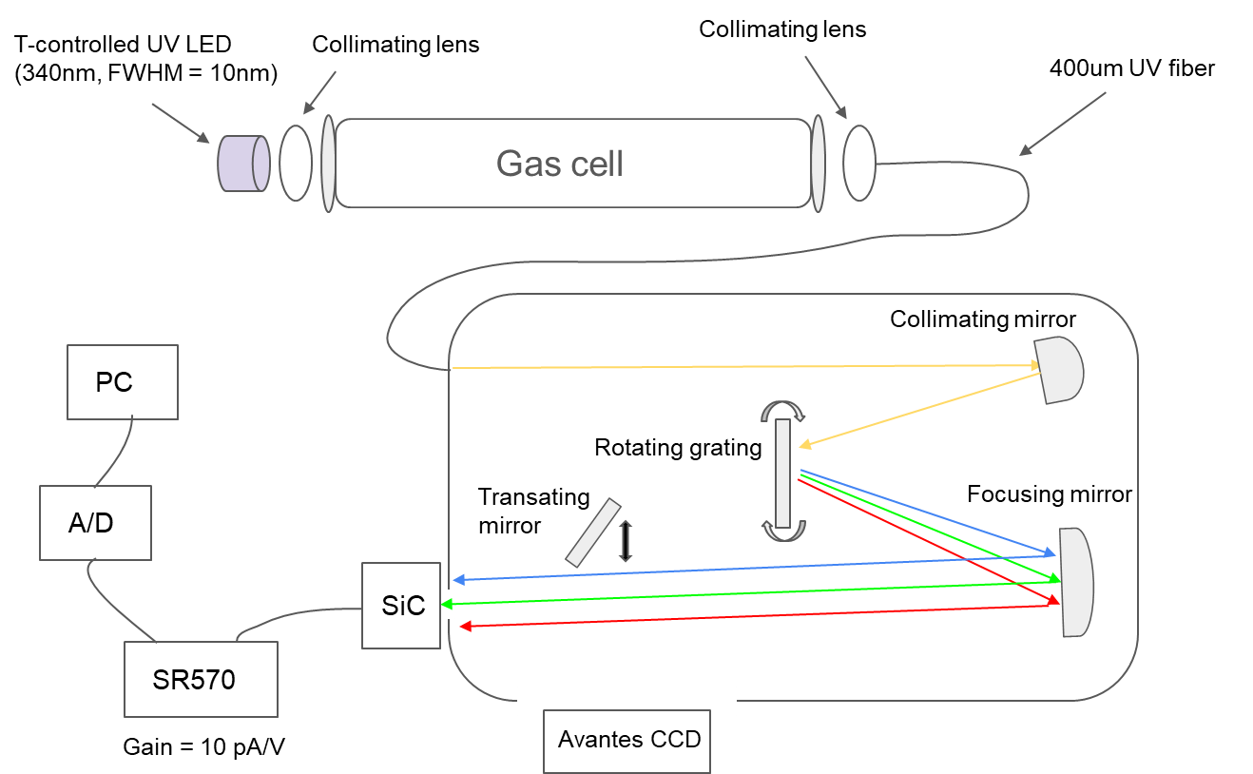

Validate Performance through Simulated Formaldehyde Retrievals
Experimental setup design for lab-level formaldehyde (HCHO) gas cell test
Experimental results of convoluted HCHO cross section (blue) vs absorbance peak (orange)

Slide 20





Atmospheric Monitoring Field Campaign Plan
Concept of Operation for simultaneous, Direct Sun, measurements with a Standard Pandora Spectrometer, operating with an Si based CCD detector, and a SiC Detector based spectrometer:
  Utilize a 2S Pandora head with 1 output running to the standard Pandora, Avantes spectrometer unit and a second output running to the SiC optical bench
  Sun tracking is fully accomplished using the Avantes channel, while SiC data will not be used for active sun tracking, SiC measurements will still be taken during the sun tracking operation so proper alignment to sun can be demonstrated post facto.
  For atmospheric measurements Avantes and SiC acquisitions will be linked

Slide 21


Upcoming Radiation hardness Testing Plan
Pre-radiation exposure defect analysis on SiC photodiodes. Top panels show spatial mapping of photoluminescence over anticipated carbon antisite-vacancy pair wavelength range. Bottom panels show corresponding Photoluminescence (PL) spectroscopy results without (left) and with (right) occasional capture of the carbon antisite vacancy defect as red-circled.
UC Davis Crocker Nuclear Laboratory for Space Radiation Testing schedule for later this year, will simulate the radiation environment of Low Earth Orbit (LEO) and the L2 Lagrange point, with total ionizing dose levels corresponding to 1-to-5-year mission durations through systematic gamma-ray and proton irradiation testing.

Slide 22





Outlook of SiC-based space instrument for UV observation
Hartley-Huggins ozone
absorption band (200-350 nm)
Moon
Europa
Enceladus

Slide 23
Summary
• Superior Performance Characteristics: SiC-based UV photodetectors demonstrate quantum efficiency exceeding 0.4 at 280nm, sub-pA dark currents, and dense linear arrays (25 µm pitch, 20:1 aspect ratio), significantly surpassing requirements for demanding space applications.
• Validated Detection Capabilities: Ground-based formaldehyde detection has been successfully validated with representative diodes, with full 1x1024 array testing in progress, establishing viability for atmospheric trace gas detection.
• Exoplanet Research Applications: These detectors enable sensitive detection of atmospheric biosignatures like ozone at concentrations below Earth levels, supporting habitability assessments through missions like the Habitable Worlds Observatory.
• Solar System Exploration Benefits: Technology applications span lunar volatile detection, icy world plume analysis, and UV exposure monitoring for human Mars and Moon exploration where radiation exceeds terrestrial levels by orders of magnitude.
• Future Space Observatory Integration: As radiation hardness testing and field instrument integration advance, SiC technology is positioned to become a cornerstone component for next-generation space observatories studying planetary atmospheres and cosmic habitability

