Slide 1
AIAA: ASCEND
ISMAC:
Marshall Space Flight Center’s In-Space Manufacturing Advancement Center
Presenting: Ben Rupp
NASA Marshall Space Flight Center
Materials Engineer, ISMAC Lead
AIAA ASCEND Las Vegas, NV July 21-24, 2025
Contributors: M. James, P. Shake, J. McElderry, W. Evans, A. O’Connor, S. Calhoun, I. Lu, R. Subedi, J. Ivester, B. Phillips, S. Burlingame, C. Protz - NASA MSFC
K. Bergeron, J. Lydon - ESSCA, MSFC
I. Prado - METTS III, MSFC

Slide 2
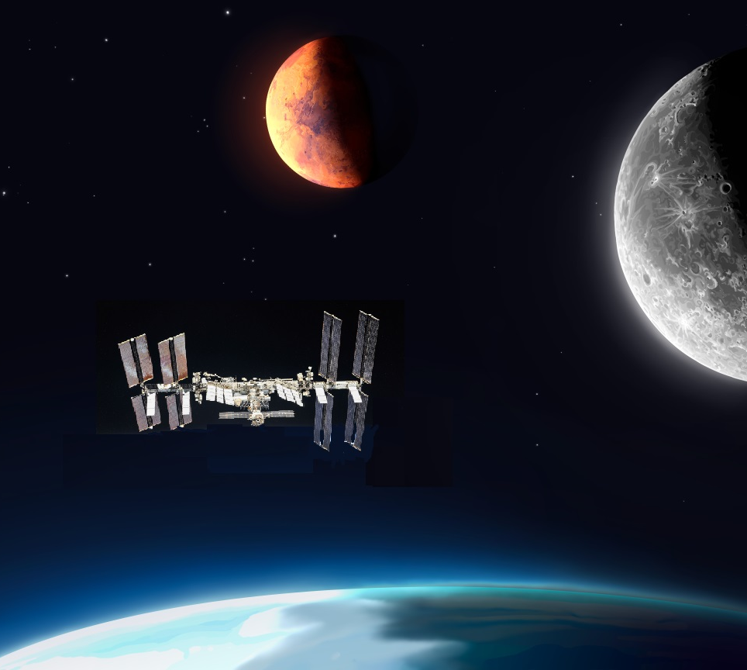

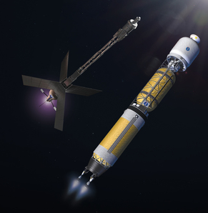
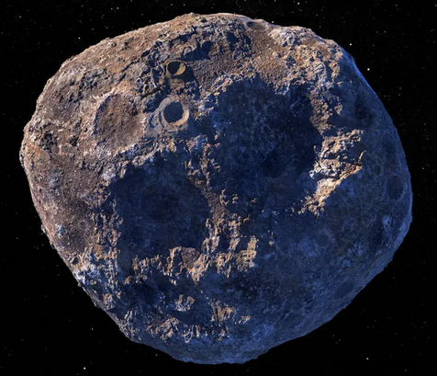
AIAA: ASCEND
Deep Space Missions/Transit
What is ISMAC?
Martian Operations
(surface & orbit)
The In-Space Manufacturing Advancement Center is the Materials and Processes Laboratory’s one-stop shop for tackling the difficulties of manufacturing in space.
ISMAC Mission:
  To facilitate In-Space Manufacturing development through shared resources, networking, and communication.
ISMAC Vision:
  To overcome all barriers to development of In-Space Manufacturing
What is “In-Space”? Anything above the Earth’s atmosphere.
  In the near term:
    LEO Mfg. for LEO Use
    LEO Mfg. for Earth Use
  Middle term:
    Lunar Mfg. for Lunar Use
    LEO Mfg. for Lunar Use
    Transit Mfg. for Transit Use
  Long term:
    Martian Mfg. for Martian Use
    Asteroid/Deep Space Resources for Lunar and LEO use
    Lunar Mfg. for Earth Use
    Martian Mfg. for Deep Space use
Other Resources
(L4 & L5, Asteroid Belt, etc.)
Lunar Operations
(surface & orbit)
Earth Orbit
Earth
In-Space Manufacturing in the Moon-to-Mars paradigm
nasa.gov

Slide 3
AIAA:ASCEND
Project Highlights To-Date
nasa.gov

Slide 4
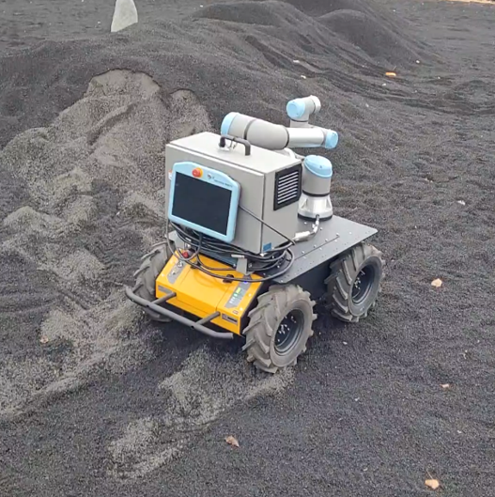
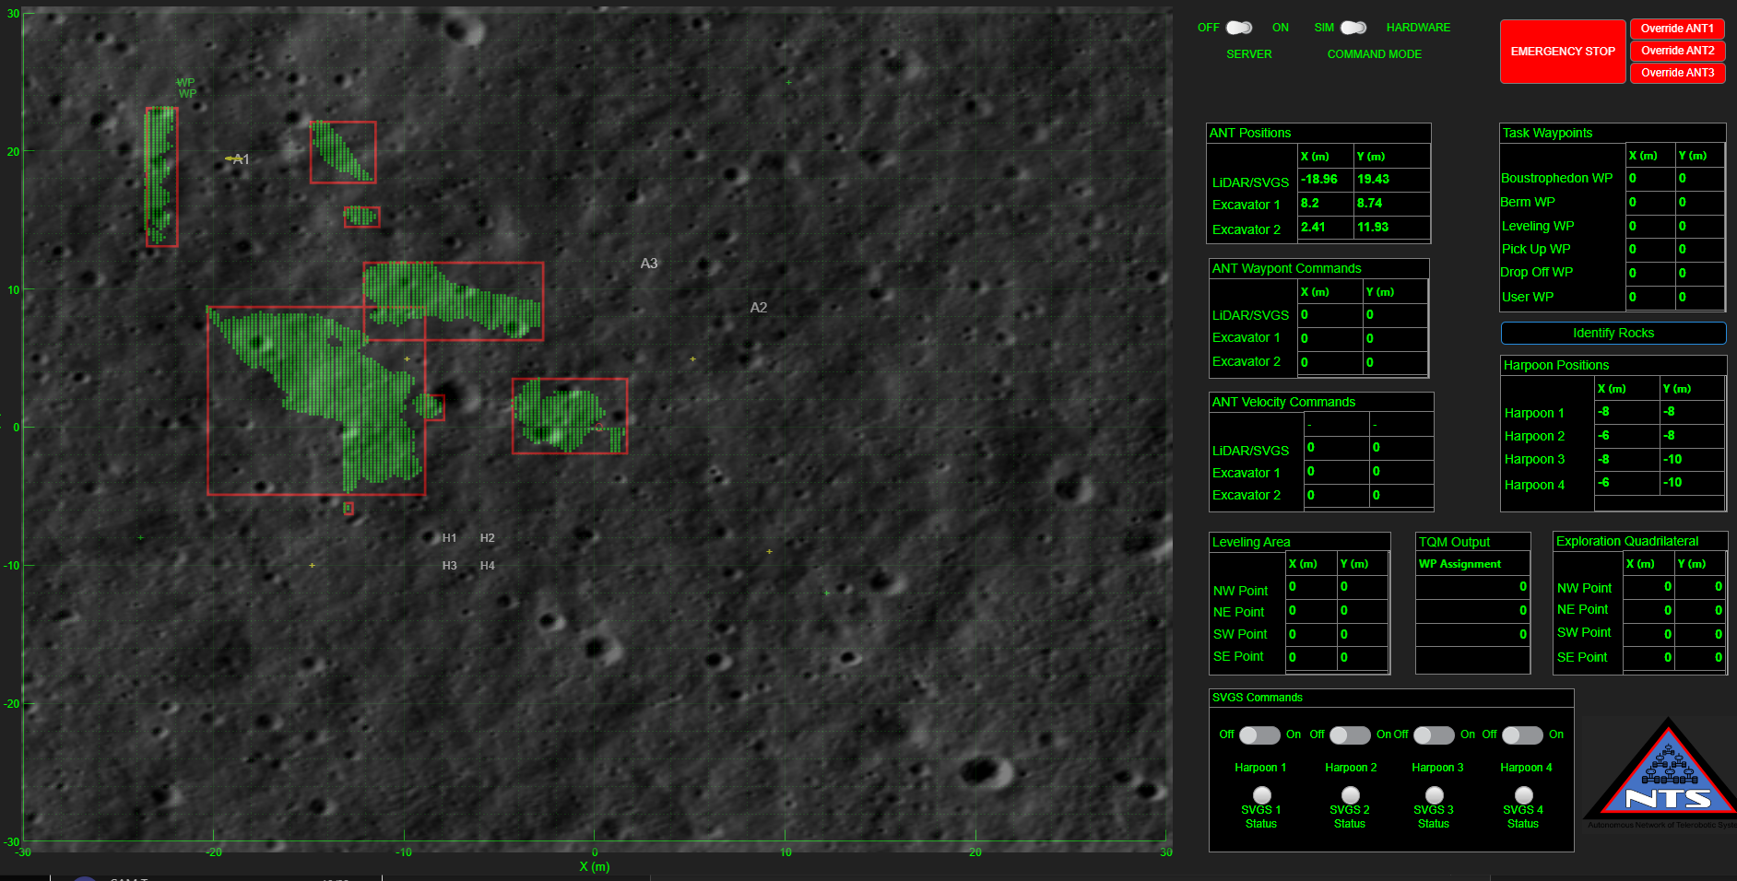
Robotic Test Beds
Purpose/Goal:
  Test quickly, learn, and iterate at low cost and without dedicated robotics expertise
  Allow an investigator to expose a nascent technology to the field faster via mobility and robotic manipulation for simulated surface operations
  Avoid long-lead, bespoke rover solutions in favor of modular test beds to decrease integration time
Hardware:
  Husky Rovers
  Universal Robotics UR5e and UR10e arms
  ROS-2 and LabVIEW programming
Current Applications/Investigations
  Capability testing in MSFC’s Lunar Regolith Test Bed (LRT) has been completed.
  Simulated detecting, collecting, beneficiation, and use of surface resources
  Access to existing MSFC architectures such as:
    Collaborative Autonomous Surface Mobility (CASM)
    Autonomous Network of Telerobotic Systems (ANTS)

Slide 5
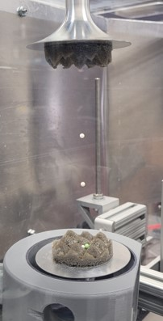
Acoustic Levitation
Purpose/Goal:
  Manipulate material and provide ground-based equivalents for materials processed in microgravity
Hardware:
  Pressure-wave driven, containerless processing
  Humidity- and temperature-controlled glovebox
  Various cameras, microscopes, lasers, sensors, etc. for interrogating samples in-situ
Current Applications/Investigations:
  Sorting of powders and particulate for pre-manufacturing beneficiation
    Regolith powders
    Recycled metals and polymers
    AM feedstocks
  Dust mitigation traps and cleaning methods for habitats and fabrication areas
  Control of crystallization rate for potential pharmaceutical and biological studies
  Material solidification and fluid diffusion experiments

Slide 6
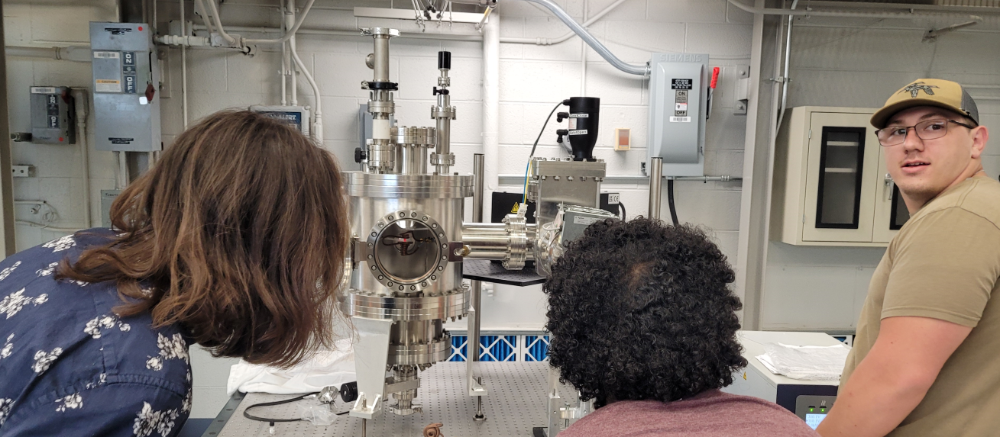
Electromagnetic Levitation
Purpose/Goal
  Manipulate material and provide ground-based equivalents for materials processed in microgravity
  Containerless thermal processing of regolith material, including regolith “slag” from oxygen and metals generation is required to characterize and understand their thermophysical properties for manufacturing utilization
Hardware
  Electromagnetic levitator/induction furnace
  Various cameras, microscopes, lasers, sensors, etc. for interrogating samples in-situ
Current Applications/Investigations
  Physical properties of regolith and related process products and biproducts
  Physical properties of conductive and semiconductive materials manufactured in space
  Informing Integrated, Computational Materials Engineering (ICME) models for process-structure-property relationships
  Ground-analog to ongoing experiments, e.g. DLR’s EML aboard the ISS, to better isolate effects of microgravity on materials processing.

Slide 7
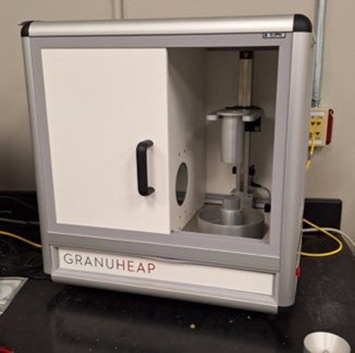
Powder Characterization
Purpose/Goal
  Powder characterization as a precursor to any powder-based manufacturing process (e.g. PBF, DED, etc.)
  Effectiveness of beneficiation of regolith prior to metals or oxygen extraction processes.
Hardware
  GranuHeap: Measures angle of repose​ and cohesive index​, providing quantitative measurement of flowability ​
  Spreadstation: Measures spreadability of powders by physically spreading layers and analyzing the layer properties​ for spreading speed, density, and other factors to quantify performance in processing.
Current Applications/Investigations
  Multiple metallic AM powders for DED and L-PBF have been quantified
  Quantifying as-received regolith simulants prior to study in application
  Spot-testing properties of fines and separation during processing

Slide 8
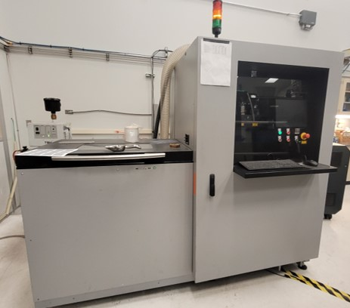
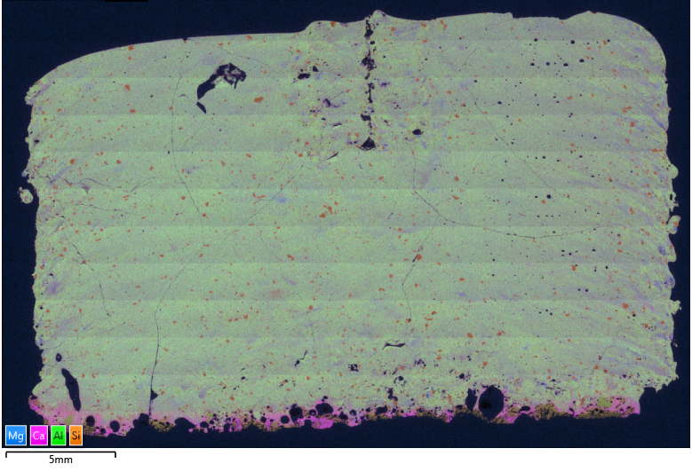
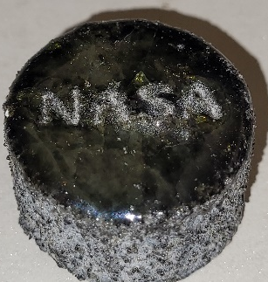
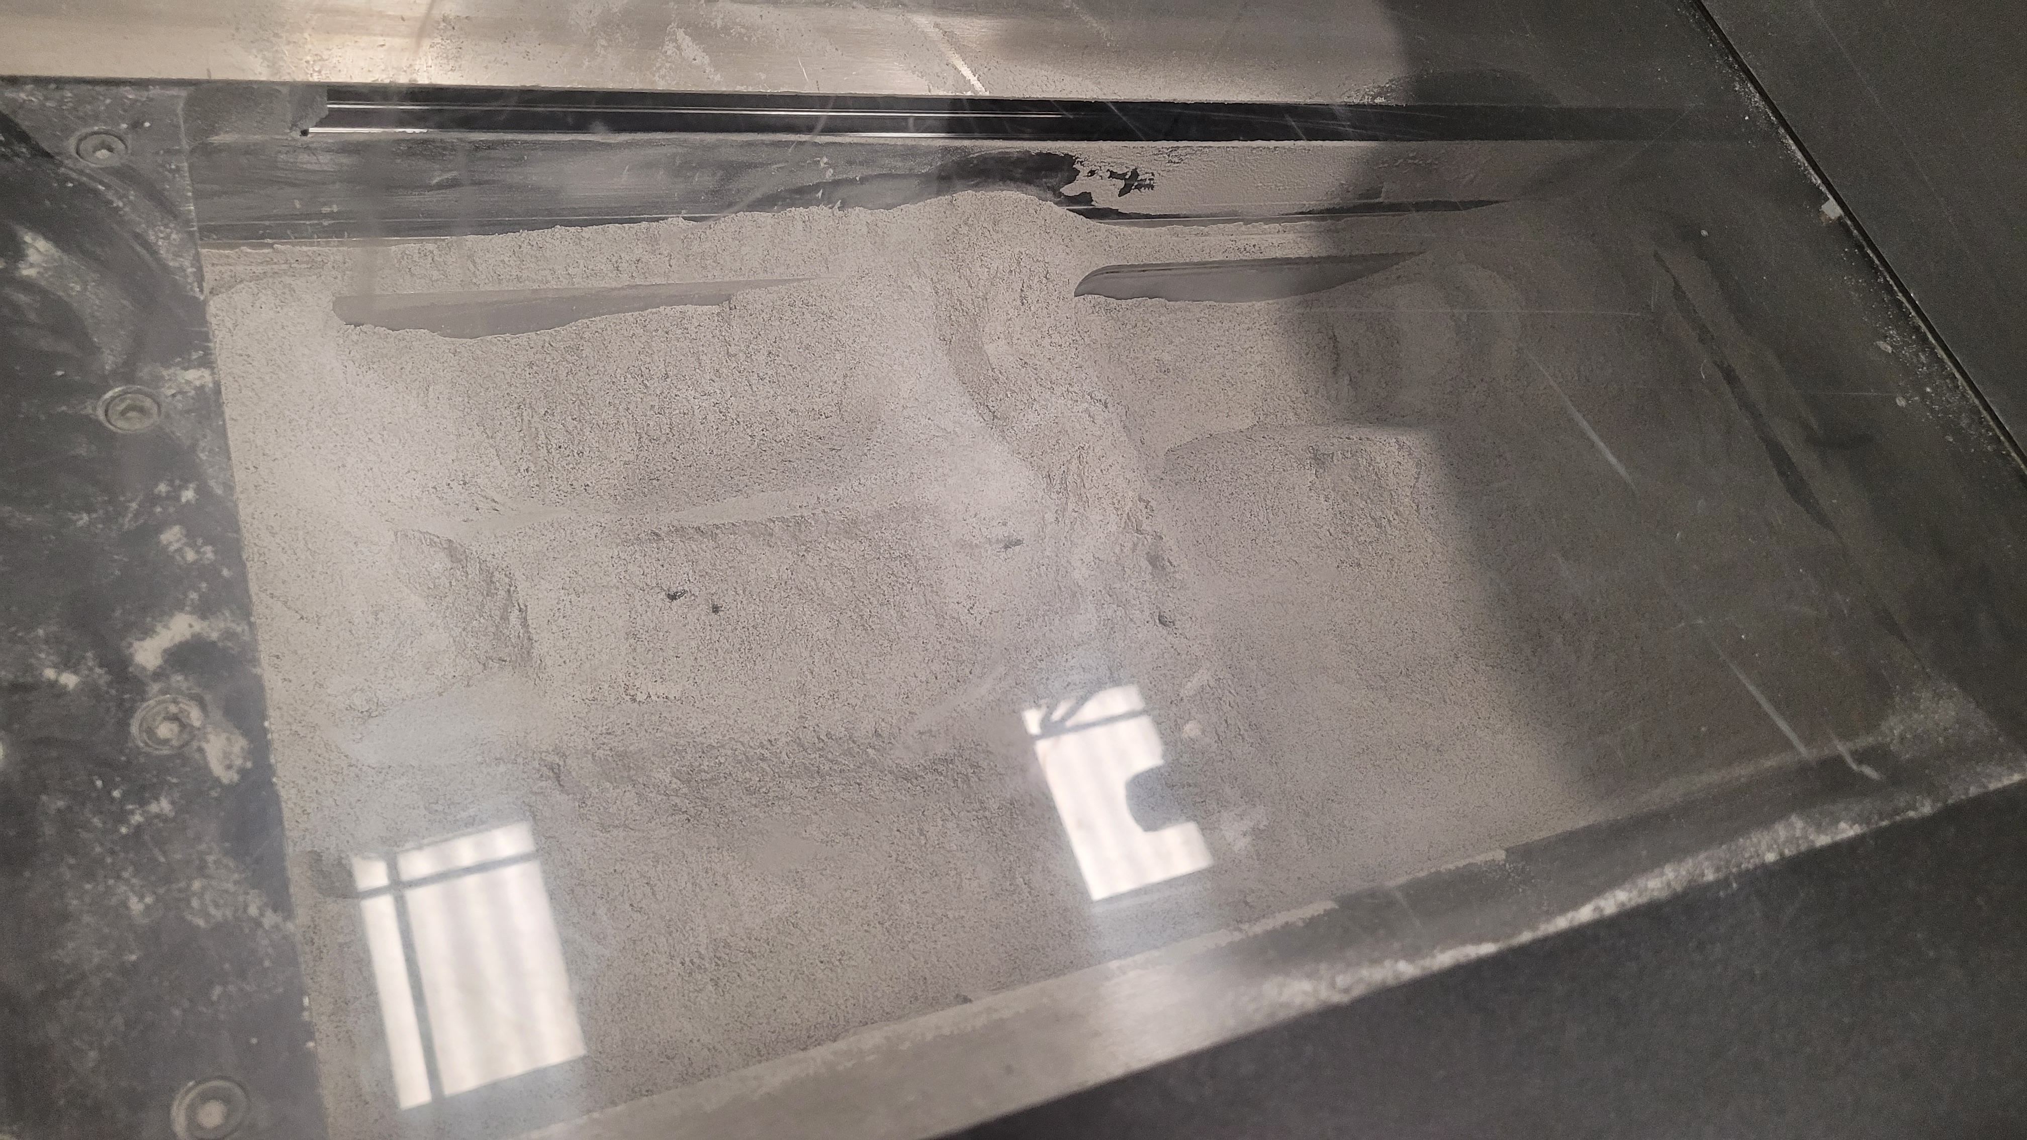
Regolith Laser Powder Bed Fusion
Purpose/Goal
  Direct printing of harvested regolith material
Hardware
  Modified early-generation laser powder bed fusion printer to include an upgraded laser and a complete “jailbreaking” of process parameters
  IR camera for in-situ monitoring and thermography
Current Applications/Investigations
  Check-out with a standard Inconel 718
  Lunar highland regolith simulant
  Increasingly complex, glassy structures
  Leveraged the materials diagnostic and mechanical test capabilities at MSFC for rapid process improvement
    SEM/EDS, hardness, fractography, tensile testing, bend testing, crush testing, etc.

Slide 9
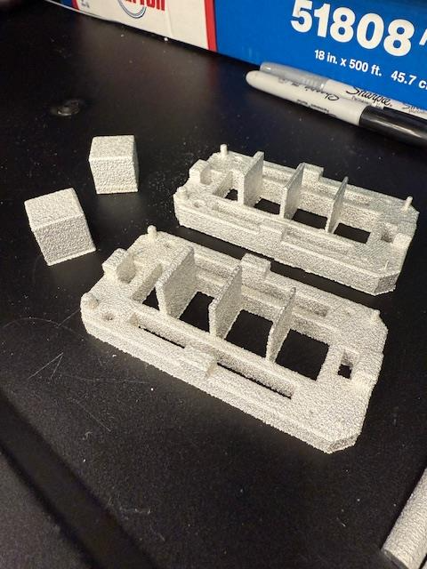
Liquid-Metal Printer
Purpose/Goal
  Explore alternatives to AM without reliance on powder handling
  Investigate possibilities of additional build space in microgravity conditions
Hardware
  ElemX 3D Printer: Aluminum liquid droplets formed from wire are used to build without the need for powder handling and spreading, while offering finer detail resolution than other wire deposition processes.
Current Applications/Investigations
  Baseline process with aluminum feedstocks via materials characterization
  Study of recycled aluminum feedstocks
  Investigate process modifications required for adaptation for potential use in microgravity

Slide 10
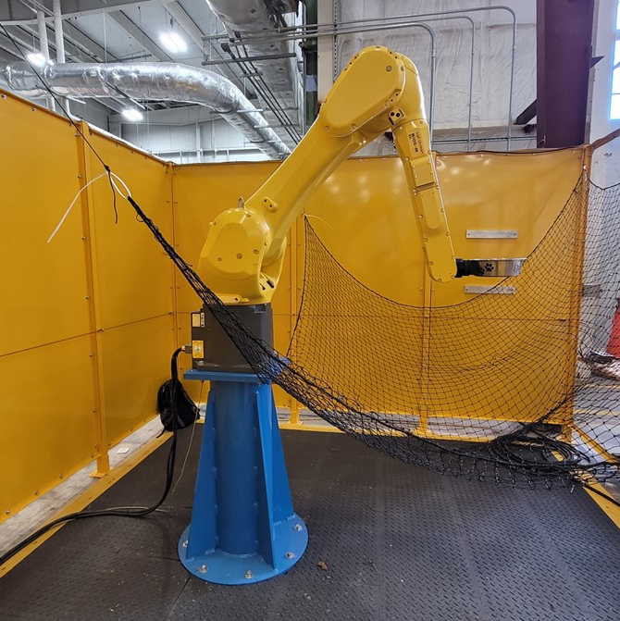
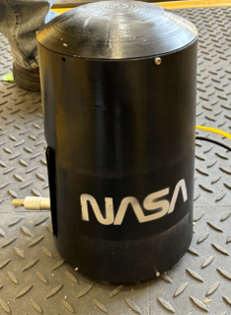
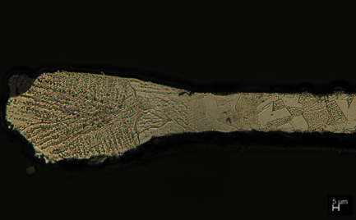
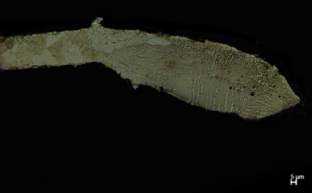
Microgravity Simulation
Purpose/Goal
  Develop an inexpensive, quick turnaround, short-duration microgravity simulator.
Hardware
  FANUC industrial robot arm
  Diode Laser Package
Current Applications/Investigations
  Initial development trials of Inconel 625 foil sample heated with a diode laser in a “single toss” run mode.
    Accelerometer measurements confirmed around 0.5 seconds of “microgravity” conditions.
    Dendritic spacing and branching angles appear to be consistent with that expected from previous microgravity experiments
  Developing “spot weld” of folded foil sheet and
  Cyclic testing mode by which multiple microgravity melting and solidification tests could be run in quick succession.
1-g solidification
Simulated µg

Slide 11
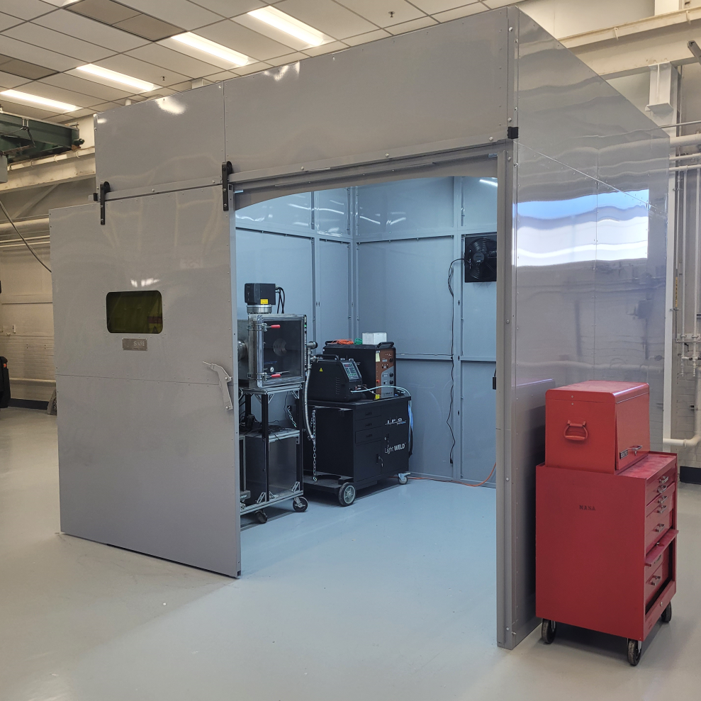
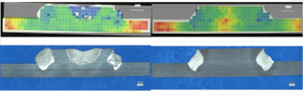
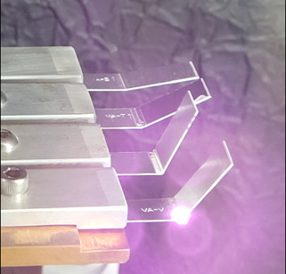
Laser Manufacturing
Purpose/Goal
  Develop robust, noncontact methods for manufacturing and joining in space.
  Develop methods of large-scale construction capability in space and on planetary bodies.
Hardware
  IPG “LightWELD” handheld laser welding unit
  1500 and 3000 W IPG fiber lasers
  4000 W LaserLine diode laser
  Keyence 50W scanning laser
  10’ x 10’x 10’ laser-safe work cell
Current Applications/Investigations
  “LASAR” Early Career Initiative (ECI) project for laser welding in TVAC
  DARPA NOM4D program, demonstrating laser forming of sheet metal
  “DISCMAN” a laser welding testbed for vacuum and microgravity conditions
  Various integration of laser welding, cutting, and forming heads onto cobot arms for process maturation

Slide 12
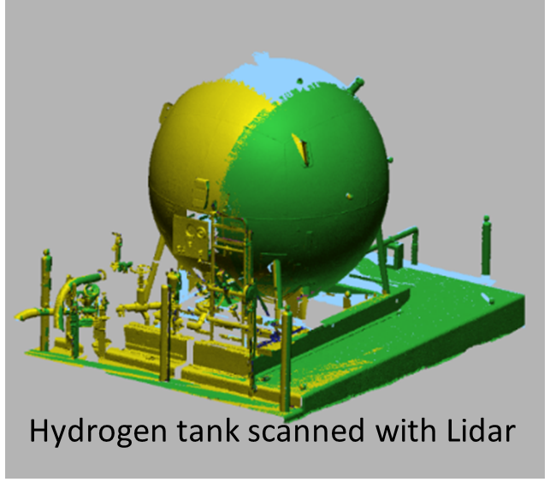
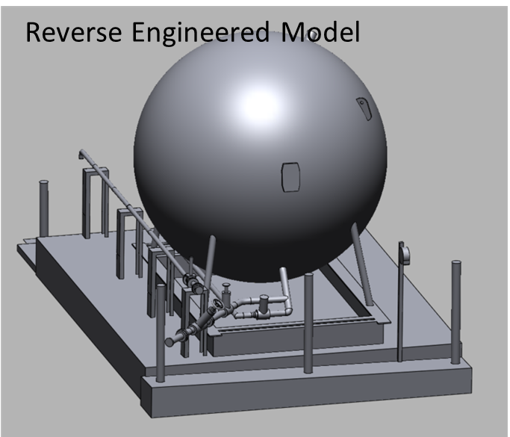
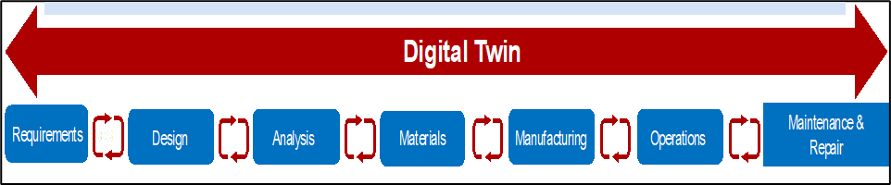
3D Scanning and Digital Twins
Purpose/Goal
  Precisely detect the “actual” status of as-built and existing structures for validation, verification, and certification for use.
  Information for generation and maintenance of Digital Twins
Hardware
  LiDAR units
  Structured light scanning capability
Current Applications/Investigations
  LiDAR of large-scale structures on the order of habitats, with details enhanced with structured light scanning
  Reverse-engineering of components, parts, structures, and assemblies, complete with detailed FEA meshes
  Digital twin creation to establish the “digital thread” connecting requirements and design through repair and end-of-life activities.
  Feedback into engineering systems for further autonomous development, NDE, and structural health monitoring after initial release for use

Slide 13
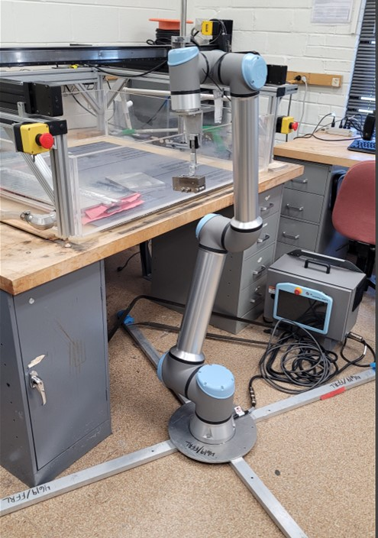
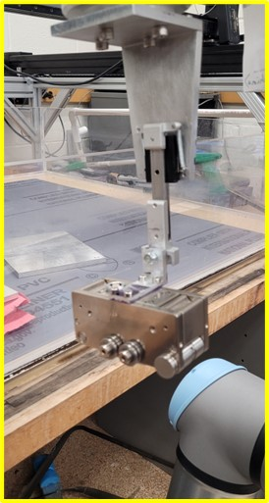
NDE Integration
Purpose/Goal
  Automatic and autonomous nondestructive evaluation (NDE) of as-built parts and structures
  NDE of manufactured products will be even more important in-space than it is on Earth due to the costs that destructive testing would carry.
Hardware
  Various NDE methods, including but not limited to Electromagnetic Acoustic Transducer (EMAT), thermography, vision systems, eddy current (EC), and hyperspectral imaging
  Robotic testbeds
Current Applications/Investigations
  Integration of EMAT head onto a UR10e arm for volumetric inspection of laser welds
  In-line EC investigation of recycled aluminum wire
  Verification, validation, and certification of manufactured parts, welded assemblies, and repair of structures without destructive test
  Structural Health Monitoring systems and closed-loop digital models for digital twin development.

Slide 14

AIAA: ASCEND
Call to Action:
Partner with the ISMAC team today!
Leverage ISMAC equipment and capabilities
Connect to the larger test capabilities of NASA MSFC for quicker iteration turnaround and shorter development times
Benefit from subject-matter expertise at NASA MSFC
Test new ideas for in-space manufacturing without exposure to infrastructure and facilities cost-exposure
Find points of mission infusion for your technologies
Feel free to reach out to the ISMAC Lead, Ben Rupp directly with any questions: benjamin.l.rupp@nasa.gov

Slide 15


