Slide 1
Chemical Equilibrium with Applications for MATLAB (CEAM)
NASA Software Catalog Webinar:
Chip Kopicz, ESSCA.
July 22, 2025

Slide 2
Obtaining CEAM
https://software.nasa.gov
Enter CEAM in search box.
  For civil servants it’s an instant download
  Non-civil servants are vetted by shared services center
CEAM was once restricted (EAR99) but is no longer restricted.

Slide 3
Obtaining CEA for Matlab
Provided on download:
    CEA for MATLAB file CEA.p
    CEA for MATLAB help file CEA.m
    CEA for MATLAB thermodynamic library thermo_lib.mat
    CEAM quick-start slide package.
    CEAMstandaloneApplication.zip contains an executable file. The executable is compiled per MatLab 2024a and needs a run-time version of MatLab to work.
    CEAPythonPackage.zip is compiled per MatLab 2024a to provide files to incorporate CEAM to python. Authors have not tried this.

Slide 4
CEA for MATLAB
Units include English, MKS, CGS, and default units for reactants and bulk properties
Can be called from script
Output
  Always written to a structured array; immediately available for calculations.
  Option to write to a text file or to the screen or to both

Slide 5
Input Deck Format
The CEAM input was designed to be as close to the legacy FORTRAN input as possible.
Example of a legacy FORTRAN input deck
problem hp
equilibrium
o/f=2.34
case=fastrak(O2/RP-1)
p(psi)=633.
reactants
fuel = RP-1(L) C=1. H=1.9423, wt% 100. h,cal/mol -5430. t(k) 300.0
oxid = O2(L) O=2., wt% 100. h,cal/mol -3032. t(k) 94.44
output calories transport
end
Step 1 in CEAM Conversion
  Add output assignment, and function call. The added text is in red to show contrast.
Output=CEA(problem hp
equilibrium
o/f=2.34
case=fastrak(O2/RP-1)
p(psi)=633.
reactants...

Slide 6
Input Deck Format
Step 2
  Add commas to separate variables and bring inputs to a line format from a paragraph format. Remove equal signs and replace with commas
Output=CEA(problem,hp,equilibrium,o/f,2.34,case,fastrak(O2/RP-1), p(psi),633.,reactants,fuel,RP-1(L),C,1.,H,1.9423,wt%,100., h,cal/mol,-5430.,t(k),300.0,oxid,O2(L),O,2,wt%,100., h,cal/mol,3032.,t(k),94.44, output,calories,transport,end
Step 3
  Encase words in single quotes
Output=CEA('problem','hp','equilibrium','o/f',2.34,'case','fastrak(O2/RP-1)', 'p(psi)',633.,'reactants','fuel','RP-1(L)','C',1.,'H',1.9423,'wt%',100., 'h,cal/mol',-5430.,'t(k)',300.0,'oxid','O2(L)','O',2,'wt%’,100., 'h,cal/mol',-3032.,'t(k)',94.44,'output','calories','transport','end'
Step 4
  Close the input with a closed parenthesis and a semicolon.
  Output=CEA('problem','hp','equilibrium','o/f',2.34,'case','fastrak(O2/RP1)', 'p(psi)',633.,'reactants','fuel','RP-1(L)','C',1.,'H',1.9423,'wt%',100., 'h,cal/mol',-5430.,'t(k)',300.0,'oxid','O2(L)','O',2,'wt%',100., 'h,cal/mol',-3032.,'t(k)',94.44,'output','calories','transport','end');
Step 5
  Execute the code

Slide 7
CEAM General Inputs
CEAM is called in MATLAB with the following syntax:
  Output_Variable=CEA(User_Defined_inputs);
    Where Output_Variable is the user defined variable that will store the structure that CEAM outputs
    “CEA” is case sensitive
    User_Defined_inputs is the compilation of all applicable datasets
    Mandatory
      Reactants
      Problem (optional Insert, Only, Omit, ions)
      End
    Optional
      Output (options trace, trace_limit, mass/mole fractions for products, units, short)
Datasets can be entered in any order except for “end” which must be the last dataset
Data entries are comma separated

Slide 8
Mandatory Datasets
Reactant
  The reactant dataset contains:
    Type of each reactant
    Name of each reactant
    Chemical formula of each reactant
    Type of amount of each reactant (mass or mole)
    Amount of each reactant with respect to type of reactant
    Specific information such as enthalpy, temperature, or density for each reactant (if applicable) for each reactant
  In the event of duplicate input between the problem dataset and the reactant dataset, the reactant dataset input will be used, and the problem dataset input will be dismissed.
Problem
  Problem contains the type of problem, and the bulk property inputs. The bulk property inputs vary on the type of problem and will be addressed on a later slide.
End
  End marks the end of an input

Slide 9
Units accepted as input
Temperature
    The keyword for temperature is 't’
Energy
    The keyword for enthalpy is 'h'
    The keyword for internal energy is ‘u’
    Units for both are energy/mass
    Enthalpy can also be entered 'h/r' , where r is the universal gas constant in metric units.
Temperature | Keyword
Rankine | R, r
Fahrenheit | F, f
Kelvin | K, k
Celsius | C, c
Energy | Keyword(s)
BTU | Btu
calorie | cal, c
kilocalorie | kc, kiloc
Joule | J
kilojoule | kj,kiloj
Mass | Keyword(s)
Gram | g
Kilogram | kilog, kg
Pound Mass | lbm
Mole | mol

Slide 10
Units accepted as input
Entropy
    The keyword for entropy is 's'
    Units for both are energy/mass-temperature
    Units on previous chart apply.
    Can also be entered as 's/r' where r is the universal gas constant in metric units.
Density
    The keyword for temperature is 'rho'
    Units are mass/volume
    Specific volume is the inverse of density: volume/mass
    Keyword is 'v'.
Pressure
    The keyword for pressure is 'p'.
Mass | Keyword(s)
Gram | g
Kilogram | kg
Pound Mass | lbm
Volume | Keyword(s)
Cubic centimeter | cc
Cubic meter | m^3
Cubic foot | ft^3
Pressure | Keyword
Bar | bar
Atmosphere | atm
Pounds per square inch absolute | psi
Millimeters of mercury | mmh

Slide 11
Units accepted as input
Rocket Problem Finite Area Chamber
    The keyword for the finite chamber option is 'fac' and is not case sensitive.
    Defining a finite chamber by mass flux
      The keyword for the contraction ratio option is exactly 'ma’
      Mass flux is a flow per unit area. The area is the throat of the chamber.
      All mass fluxes are mass per area-second.
      Definition example: 'fac','ma,lbm/ft^2-s',800
      Allowable input units for mass and area are shown below.
Mass | Keyword(s)
Gram | g
Kilogram | kilog, kg
Pound Mass | lbm
Area | Keyword
Square meter | m^2
Square millimeter | mm^2
Square inch | in^2
Square foot | ft^2
Shock Problem
    Defined by Mach number (dimensionless) or velocity.
    Acceptable units for velocity:
Length | Keyword
meter | m
centimeter | cm
feet | ft
Time | Keyword(s)
second | s

Slide 12
Output Units
Units systems
  These are the current options.
  The keywords are not case sensitive.
 | English | MKS | CGS | Default | Calories
keyword | eng | mks | cgs | N/A | cal
Pressure | psia | bar | mmh | Bar | Atm
Temperature | R | K | K | K | K
Density | lbm/ft^3 | kg/m^3 | g/cc | kg/m^3 | g/cc
Enthalpy | BTU/lbm | kJ/kg | J/g | kJ/kg | cal/g
Energy | BTU/lbm | kJ/kg | J/g | kJ/kg | cal/g
Gibbs | BTU/lbm | kJ/kg | J/g | kJ/kg | cal/g
Entropy | BTU/lbm-R | kJ/kg-K | J/g-K | kJ/kg-K | cal/g-K
Cp | BTU/lbm-R | kJ/kg-K | J/g-K | kJ/kg-K | cal/g-K
Velocity | ft/s | m/s | cm/s | m/s | m/s
Viscosity | lbm/ft-s | uPa-s | uPa-s | millipoise | millipoise
Thermal Conductivity | BTU/hr-ft-R | W/m-K | mW/m-K | mW/cm-K | mcal/cm-K-s

Slide 13
Problem Options
Problem Types
    The problem type identifies the state variables that will be used to solve the combustion problem
    State variable problem types are reversible. For example: 'HP', and 'PH' represent the same problem type
    The keywords for shock, detonation, and rocket are order sensitive. For example: 'DET' is recognized, but 'TED' is not recognized
    The problem type is not case sensitive
Assigned Variables | Keywords
Temperature and Pressure | TP, PT
Enthalpy and Pressure | HP, PH
Entropy and Pressure | SP, PS
Temperature and Volume(Density) | TV, VT
Energy and Volume(Density) | UV, VU
Entropy and Volume(Density) | SV, VS
Rocket | RKT, or RO
Shock | SH
Chapman-Jouget Detonation | DET
Note:
Shock problems
Based on shock tube calculations. Generally, Mach numbers less than 10 provide reasonable results.
Calculations begin to fail beyond Mach 10.
Detonation problems – Chapman-Jougeut calculations.

Slide 14
Using CEAM for Fluid Properties
Problem set up:
  Output=CEA('problem','tp','p,psi',100,'t,r',540,'o/f',0.0,'react','fuel','CH4','wt%',100,'t,r',540,'oxidizer','Air','wt%',100,'t,r',540,'output','short','end');
When attempting to use CEAM to calculate properties for a single fluid, define the fuel as your desired fluid, define the oxidizer as air, and set the O/F ratio to zero.
  The following message will appear, but can be ignored:
    “OXIDANT NOT PERMITTED WHEN SPECIFYING 100% FUEL(main)”
  This process was verified using results from CEARUN.
The user is cautioned to avoid conditions near melting and boiling points. The experience of programmers is heat of vaporization and heat of fusion are not a guaranteed part of the fluid curves.

Slide 15
Mixture Ratios
    Mixture ratio is required if the reactant amount defined in the reactant dataset are not in moles
    There are several keywords for the mixture ratio depending the definition of the mixture ratio. The mixture ratio types are as follows:
    Only one type of mixture ratio can be used for a single problem.
Mixture Ratio Type | Keyword
Percent fuel by mass | %f
Fuel-to-oxidant weight ratio | f/o, f/a
Oxidant-to-fuel weight ratio | o/f
Equivalence Ratio (Equation 9.19 in NASA 1311) | phi
Chemical equivalence ratio (Equation 9.18 in NASA 1311) | r

Slide 16
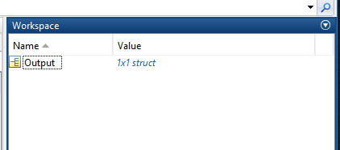
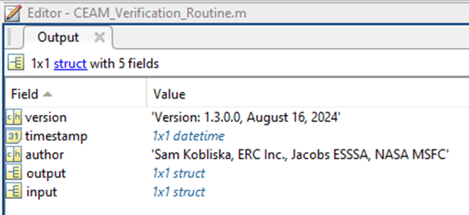
Accessing the Structure Outputs
Output is always written to structure array.
The structure can be opened either by typing the name into the command line, or by double clicking on it in the workspace
The fields of greatest interest will likely be “output”, and if applicable, “transport” and/or “rocket”
Double clicking on a field name will open the structure of that field

Slide 17
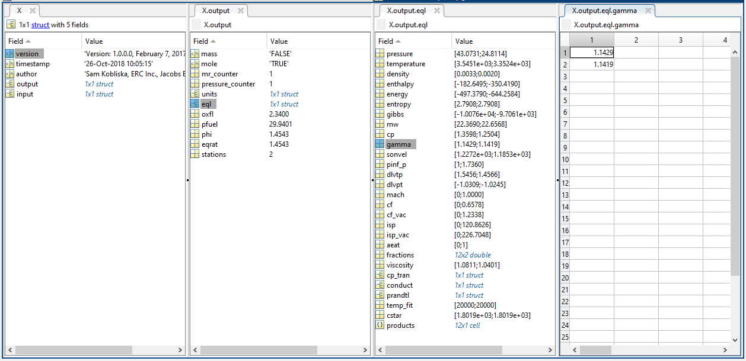
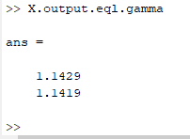
Accessing the Structure Outputs-Continued
The final array is #MRx#PCx#T array except for rocket which is a #MRx#PCx#Area Ratio array
Below is an example of gamma from a Rocket problem
Gamma can be found either by double clicking on the appropriate field or by entering “x.output.gamma” into the command line
Click
Command Line

Slide 18
CEAM Executable
The CEAM executable file can be found in the CEAMstandaloneApplication.zip folder. To run the executable from the command prompt:
Unzip the CEAMstandaloneApplication.zip folder
Open the command prompt
Change the directory to the location of CEAM.exe
  Use >cd <file location>
Call CEAM.exe with input parameters
  Use >CEAM <input parameters>
  Input parameters are the same for the executable version, but spaces should be used to separate input arguments instead of commas, and string arguments should not include quotes
Executable outputs a text file
CEA.m input example:
CEA('problem','hp','equilibrium','o/f',6.0338,'case','CEAM-HP1’,'p,psia',3126.24, 'reactants’, 'fuel','H2(L)','H',2,'wt%',100,'h,cal/mol',-2154,'t(k)',20.17, 'oxid','O2(L)','O',2,'wt%',100,'h,cal/mol',-3102,'t(k)',90.18,'output','transport','end','screen');
CEAM.exe input example:
CEAM problem hp equilibrium o/f 6.0338 case CEAM-HP1 p,psia 3126.24 reactants fuel H2(L) H 2 wt% 100 h,cal/mol -2154 t(k) 20.17 oxid O2(L) O 2 wt% 100 h,cal/mol -3102 t(k) 90.18 output transport end screen

Slide 19
CEAM for Python
CEAM has been compiled for use in Python. The authors have not tried implementation.

Slide 20
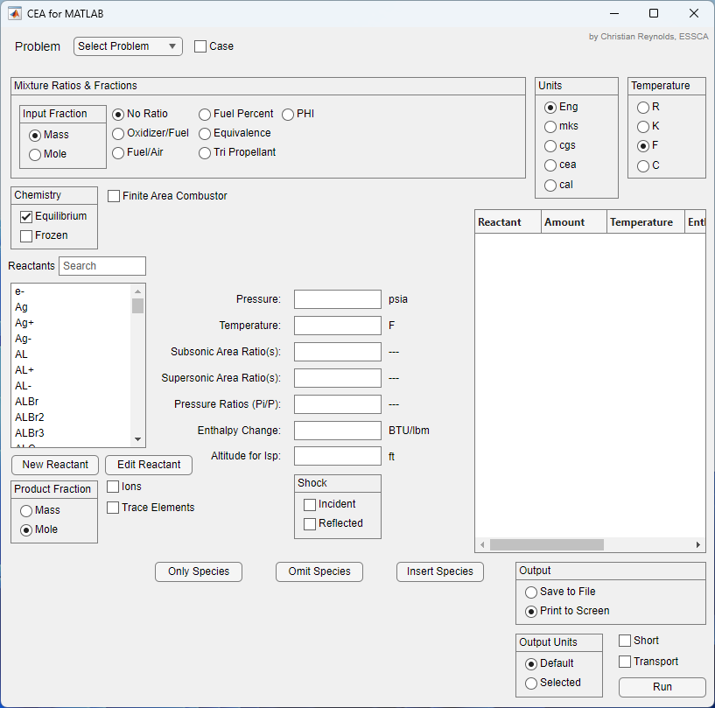
GUI
GUI is available as an App within MatLab and as a standalone program.

Slide 21
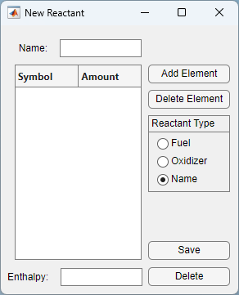
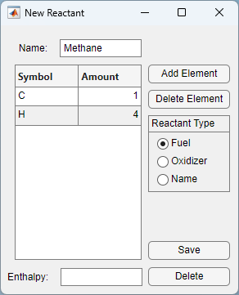

GUI (cont)
Reactant Editing
  Reactants can be created by clicking “New Reactant” or modified by clicking “Edit Reactant” with a reactant selected
  The formulas of reactants from the thermodynamic library cannot be edited
Reset Reactants
  The GUI comes with an option to reset all changes to match the thermodynamic library
  To call this function, input “obj = MLCEA_Main; obj.ResetReactants;” (without quotes) into MATLAB’s command window
  This will permanently delete all custom reactants and fuel/oxidizer selections!

Slide 22
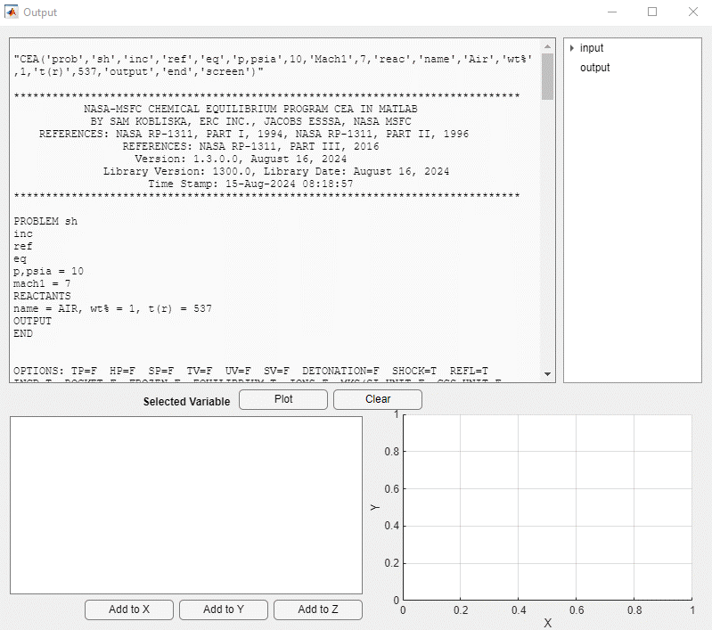
GUI (cont)
First line of Console output provides the CEA in MATLAB command that executed the problem.
Console output
Variable plot
Plots can be extracted to separate windows. These are not cleared when a new problem is run.
Note: Each time the GUI is run a new Output Window is generated.

Slide 23
Backup

Slide 24
Generic CEAM Command Lines
    Point Problems:
    [UserVariable]=CEA('problem','[point_problem_type]',['equilibrium','frozen'], 'o/f',2.34,'case','[problem_title]','[required identifiers and values]', 'reactants',[reactant_data],'ions','nfz',[nfz_condition],['insert','omit', 'only'],[reactant(s) to be inserted, omitted, or evaluated],'output', 'transport','trace',[trace_limit],'[unit_system]','short','end', [Destination:'screen','filename_with_path']);
    Rocket Problem:
    [UserVariable]=CEA('problem','rocket',['equilibrium','frozen'],['fac','acat', [contraction_ratio_value]],['pi/p','subsonic','supersonic'] 'o/f',2.34,'case','[problem_title]', 'p(psi)',[chamber_pressure(s)], 'reactants',[reactant_data],'ions','nfz',[nfz_condition],['insert','omit', 'only'],[reactant(s) to be inserted, omitted, or evaluated],'output', 'transport','trace',[trace_limit],'massf','[unit_system]','short','end', [Destination:'screen','filename_with_path']);
    Shock Problem:
    [UserVariable]=CEA('problem','shock','inc','refl','fr','eql', 'case','[problem_title]','reac',[reactant_data],['Mach',[Mach numbers] OR 'u1',[velocities]],'t',300.,'p,atm',1.0,'output','transport','massf','end',[Destination:'screen','filename_with_path']);
    Detonation Problem:
    [UserVariable]=CEA('reac',[reactant_data],'problem','det','case','[title]', 't([temperature units])',[temperature value(s)], 'p,[pressure_units]',[pressure values], 'r,e',1, 'output','trace',[trace_limit_value],[output_units],'transport','massf', 'end', [Destination:'screen','filename_with_path']);

