Slide 1
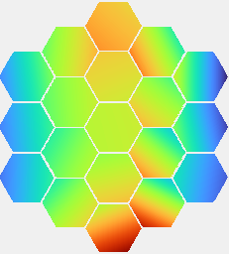

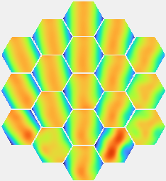
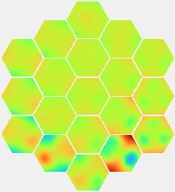
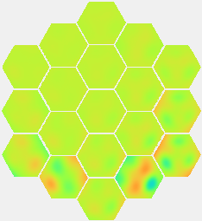

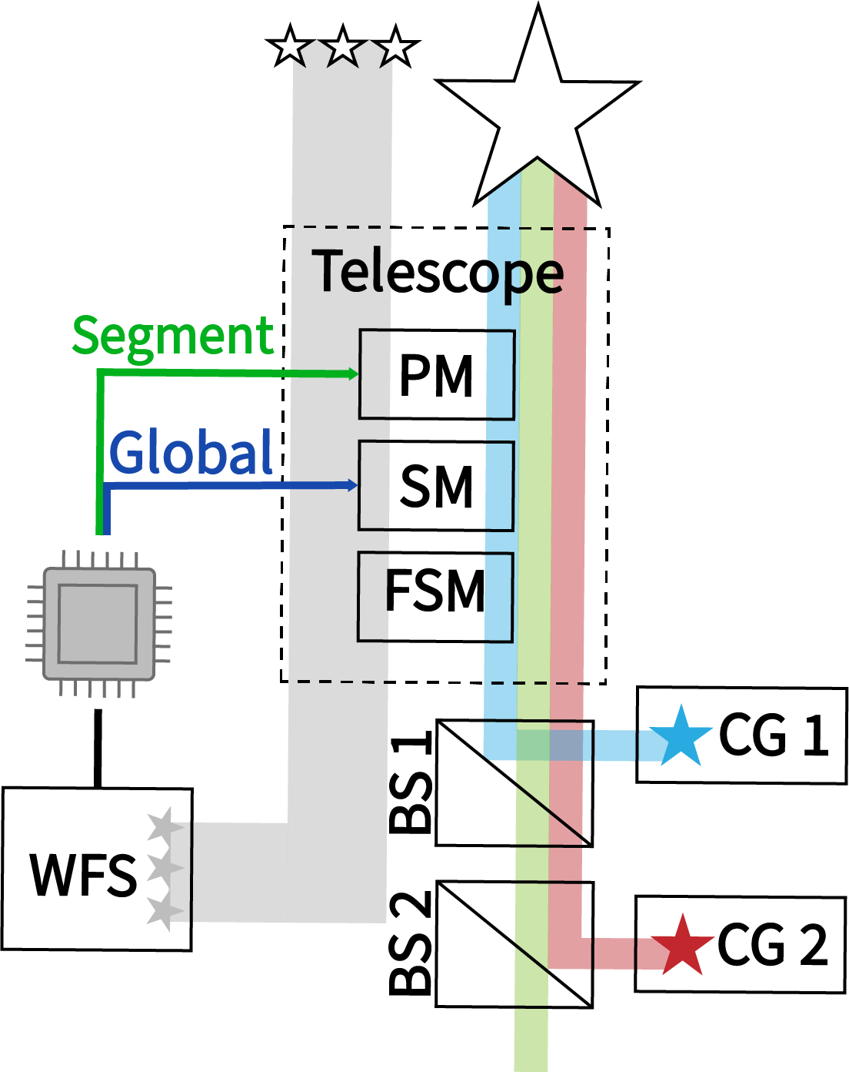
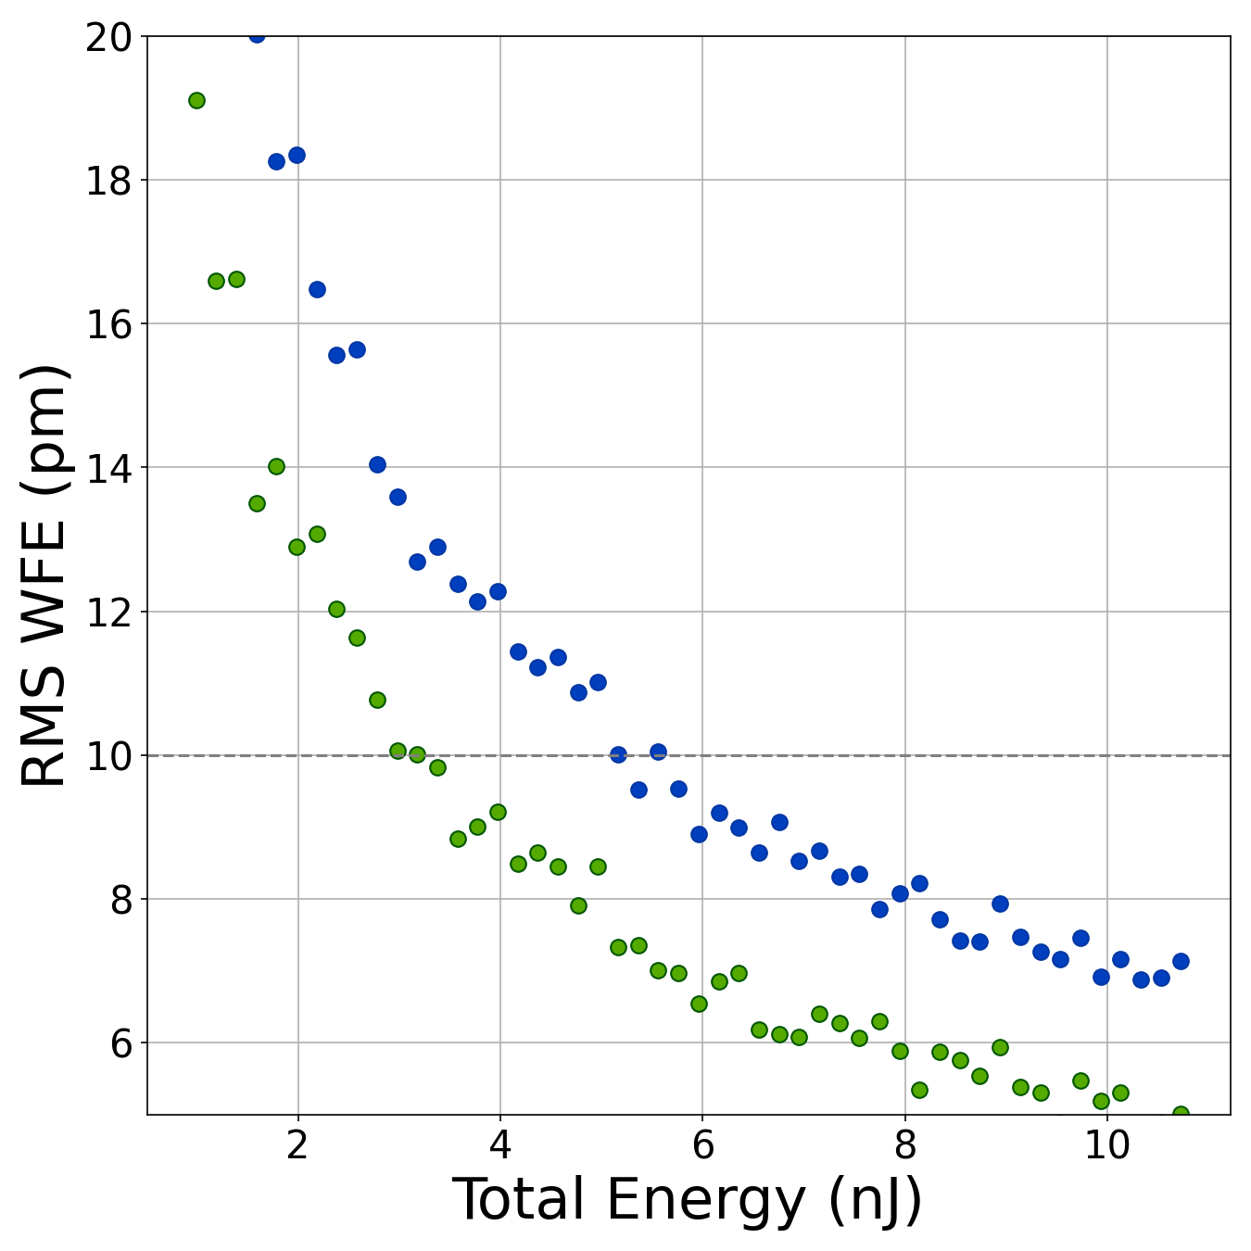

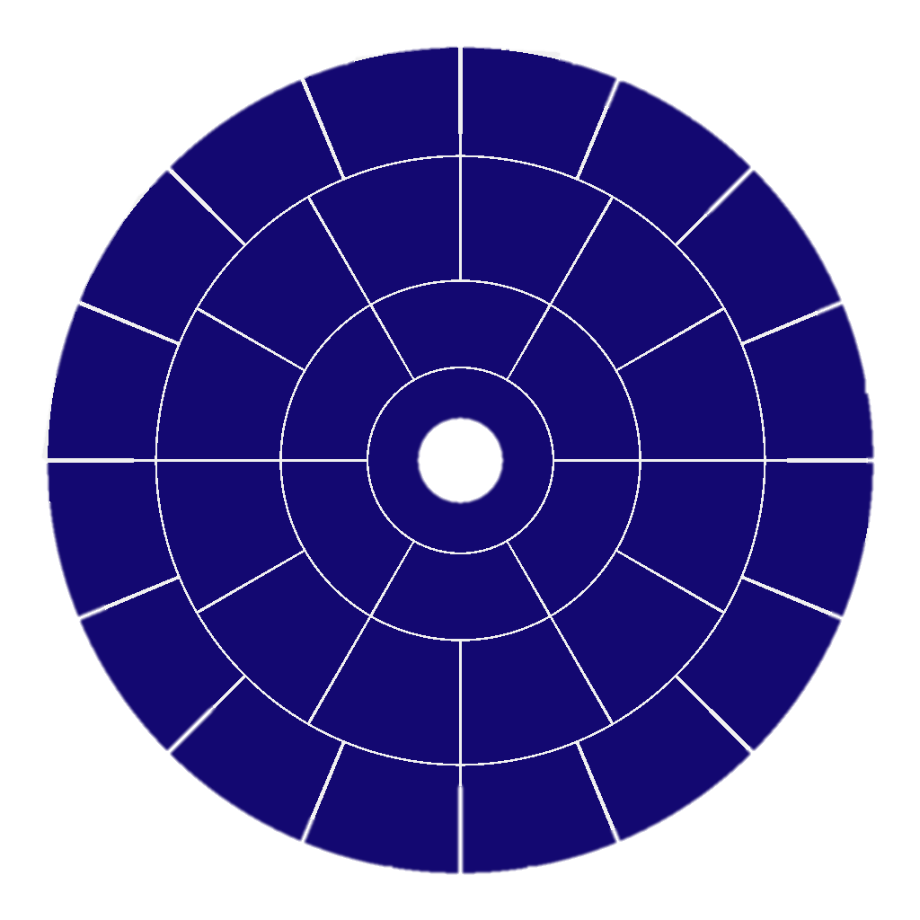
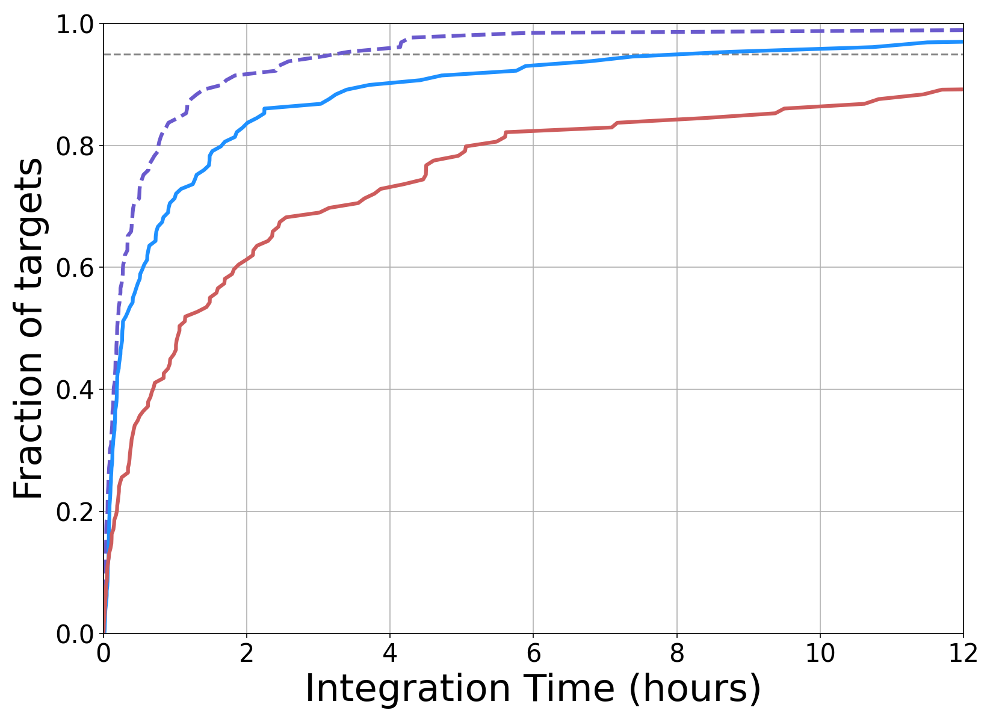
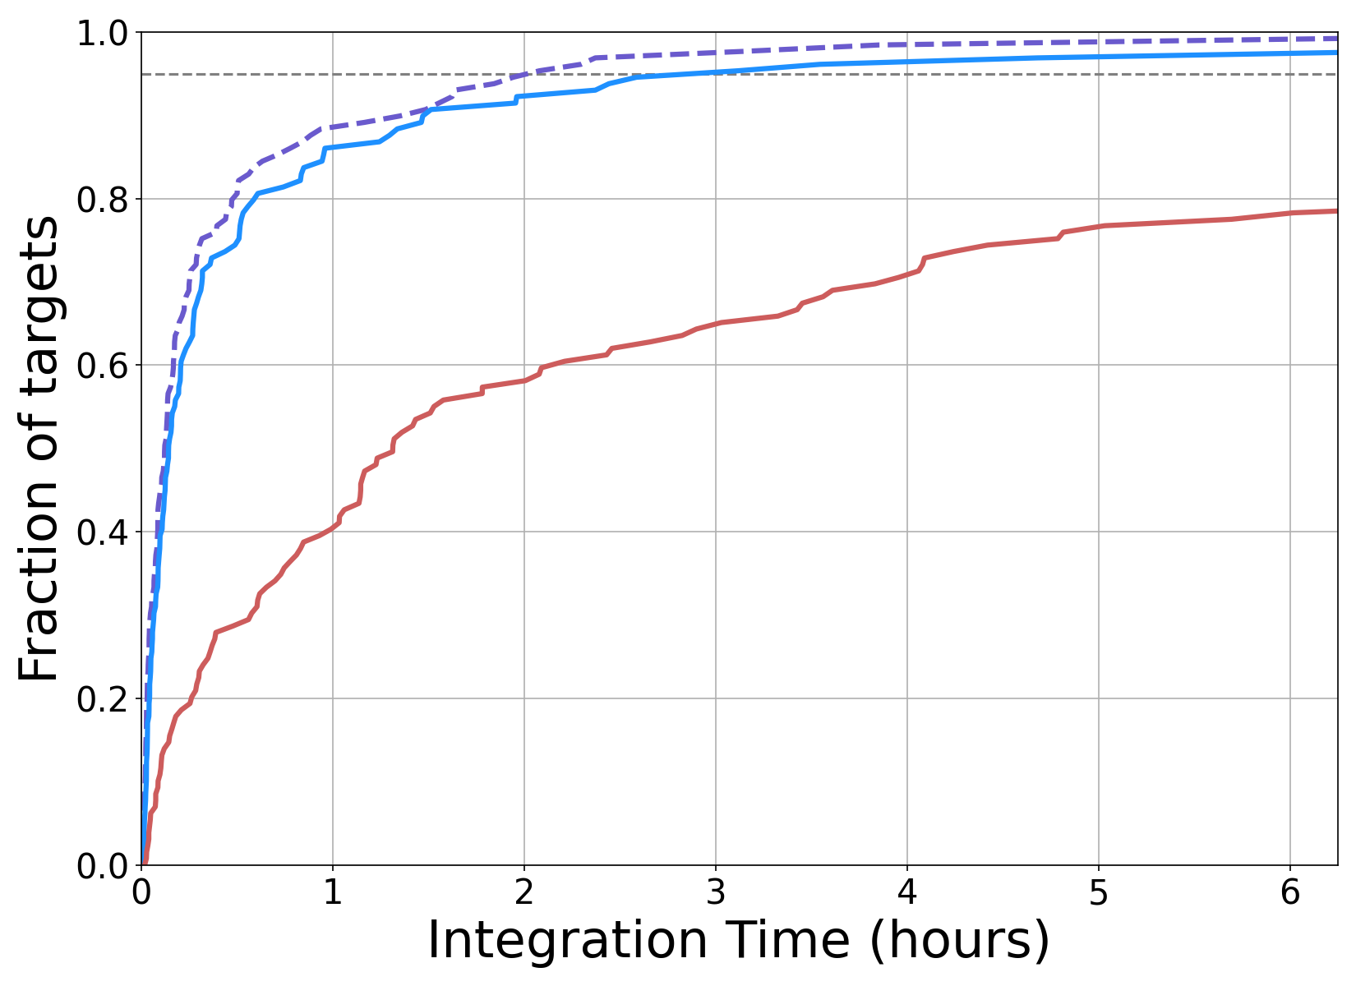

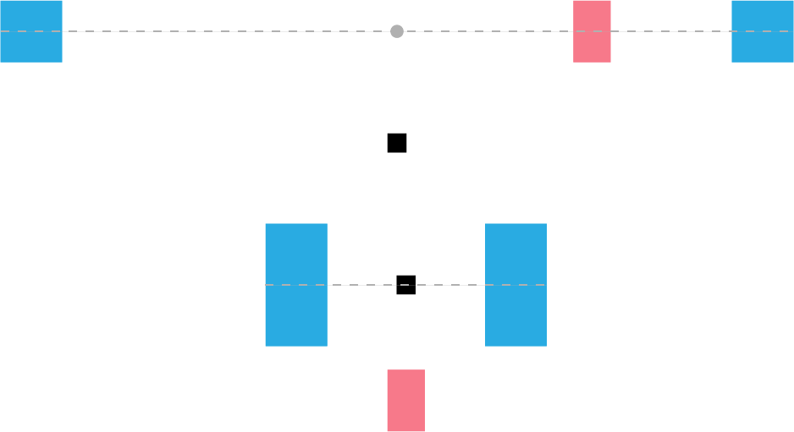
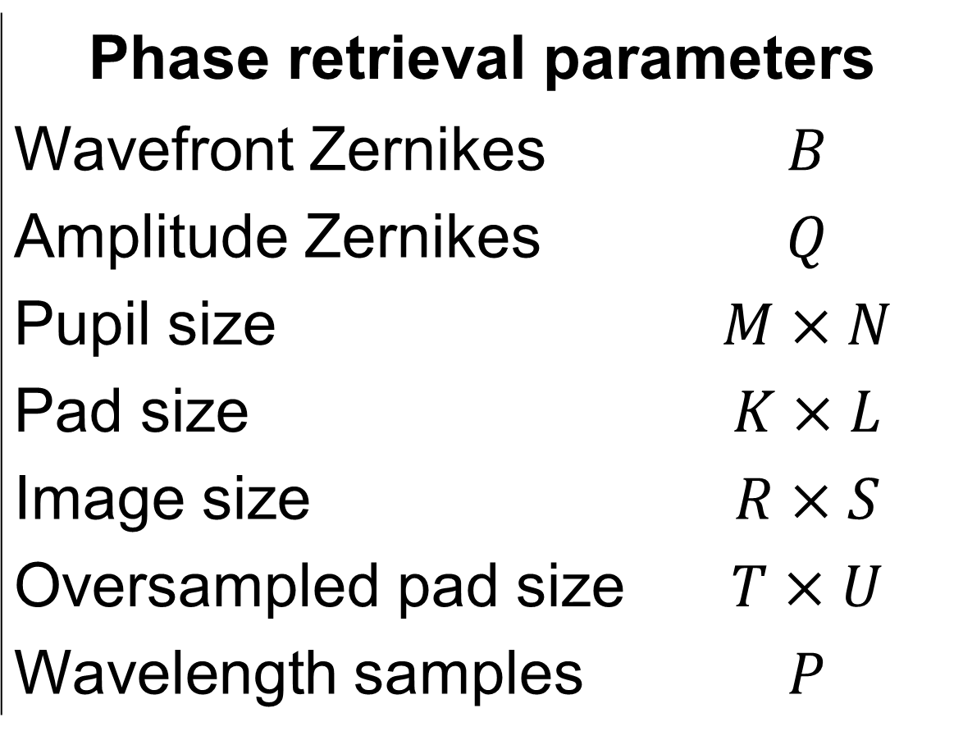


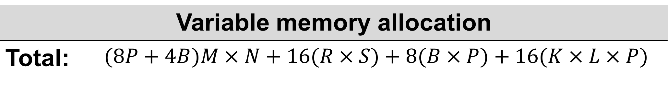
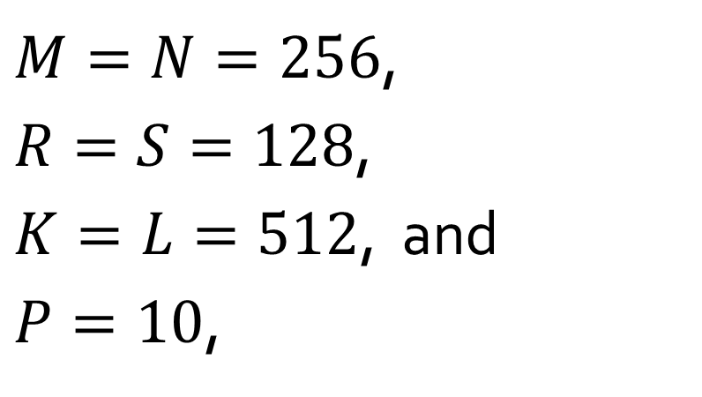
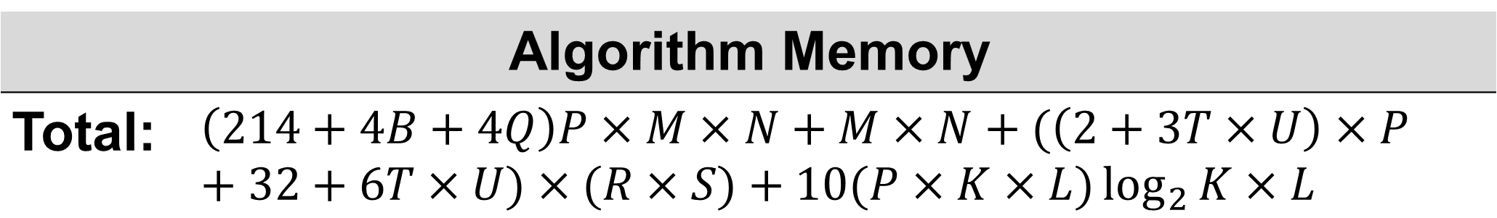
Onboard Phase Retrieval for Habitable Worlds Observatory
1: NASA GSFC
2: Genesis Engineering Solutions, Inc.
Alden Jurling^{*,1}, PhD. Kaitlyn Summey¹, Der-You Kao², PhD., and Thomas Zielinski¹, PhD. *: alden.s.jurling@nasa.gov
Project Overview:
Background:
We investigated “perfect” control over different degrees of freedom, and it shows that using a joint primary + secondary mirror control scheme gives promising performance.
PM 5 DOF
PM 3 DOF + SM 4 DOF
PM 5 DOF + SM 5 DOF
A key area of technology development for the Habitable Worlds Observatory (HWO) is telescope wavefront control capable of meeting the picometer-level telescope stability requirement.
We propose using phase retrieval in HWO imaging instruments and the light from out-of-field stars to measure the primary and secondary mirror alignment and enable closed-loop, onboard control or calibration of environmental disturbances. We have
Conducted parametric studies to determine the driving factors in phase retrieval performance
Established a flux budget and compared out-of-field instrument designs using realistic target stars and current Exploratory Design Concepts (EAC)
Developed a computing budget and proposed hardware for on-board computation
Compared parallel programming paradigms for phase retrieval
For our out-of-field wavefront sensor studies, we compared the performance of segment-level piston, tip, and tilt of the primary mirror (PM) and global secondary mirror (SM) control for two EACs. Previous parametric studies showed that phase retrieval accuracy is not heavily influenced by things like bandwidth, wavelength, or number of stars, but an out-of-field system will be dependent on the stars available in the sky area around the target star.
EAC Designs
 | HRI (NIR) |  | GI
 | EAC-1 | EAC-3 | EAC-1 | EAC-3
FOV | 3x2 |  | 3x3 | 3x6 | arcmin
Pixel size | 10 |  | 10 | 5 | um
Wavelength | 800-2500 |  | 400-1000 |  | nm
Focal length | 120 | 160 | 93.8 | 149.3 | m
f/# | 15.6 | 18.7 | 15.6 | 18.7
We looked at the hexagonal segmented EAC-1 and keystone segmented EAC-3 designs.
We took into consideration the instrument FOV size and layouts to conduct our sky dependent studies.
Flux budget:
Global, low order
We evaluated phase retrieval performance using simulated, noisy PSFs with a range of total energies to estimate a flux budget for our integration time comparisons. The flux budget is based on requirements for measuring segment level piston tip and tilt.
Segment tip/tilt
Integration Time Simulations:
HRI – High Resolution Instrument
GI – Guider Instrument
Integration Times (minutes)
Percentage of Targets | EAC-1 |  |  | EAC-3
 | HRI | GI | HRI+GI | HRI | GI | HRI+GI
25% | 14.2 | 9.1 | 4.2 | 21.1 | 3.1 | 2.3
50% | 63.6 | 16.1 | 11.5 | 78 | 8.6 | 7.4
75% | 268.8 | 77.7 | 33.1 | 282 | 30.3 | 18.9
95% |  | 487.4 | 195 |  | 172.6 | 121.2
Method:
Use LUVOIR target list
Query 2Mass and Gaia catalogs to find 50 brightest point sources inside detector field of view
Calculate total flux
Calculate integration time to get required number of photons for 10 pm accuracy
Avg. RMS WFE Monte Carlo Results
EAC-1
To meet our sensing requirements for segment-level control, we need approximately
over the instrument’s field of view.
EAC-3
Cumulative Sum of Integration Times for Segment PTT
*For 20% bandwidth
EAC-1 → $\sim 3$ nJ
In our parametric studies, we found that bandwidth was not a driving factor in phase retrieval accuracy.
If we increase the bandwidth and factor in the RMS relaxation for LO control, we get:
EAC-3 → $\sim 5.5$ nJ
EAC-3 Instrument FOV
EAC-1 Instrument FOV
CI
Integration Times (minutes)
Percentage of Targets | EAC-1 | EAC-3
 | HRI+GI w/ 40% BW
75% | 8.4 | 1.74
95% | 47.4 | 11.1
Computing Budget:
GI A
CI
HRI
GI B
GI A
GI B
We investigated the floating-point operations (FPOs) and memory required for onboard phase retrieval
HRI
Assuming LO wavefront control and
Phase retrieval parameters
Wavefront Zernikes | $$B$$
Amplitude Zernikes | $$Q$$
Pupil size | $$M×N$$
Pad size | $$K×L$$
Image size | $$R×S$$
Oversampled pad size | $$T×U$$
Wavelength samples | $$P$$
Real-Time Numerical Simulation Framework:
$M=N=256$,
$R=S=128$,
$K=L=512$, and
$P=10$,
Approx. Parallelized Basis Set Operations Times (ms) Simulated using M, N = 1024, 18 segments, and 36 segment and 20 global Zernikes
 |  | Setup | Fit | Project | Expand
CUDA SM60 | FP32 | 1510 | 3 | 3 | 1
 | FP64 | 1587 | 10 | 7 | 2
C++ OpenMP + Baselet | FP32 | 1333 | 7 | 5 | 4
 | FP64 | 1347 | 11 | 8 | 6
C++ OpenMP | FP32 | 351 | 33 | 27 | 37
 | FP64 | 381 | 30 | 35 | 57
Trades initial setup time for faster subsequent operations
~60x faster basis setup, ~200x faster fitting, ~300x faster projection, ~140x faster expansion operations than Phase Retrieval Metrology Software used during JWST Commissioning
Enables possibility of manipulating optical pupils at KHz rates (FP32) or hundreds of Hz (FP64)
We would need:
695 M FPOs/iteration
45 MiB memory
Algorithm Memory
Total: | $$\left(214+4B+4Q\right)P×M×N+M×N+(\left(2+3T×U\right)×P+32+6T×U)×(R×S)+10(P×K×L)\log_{2}{K×L}$$
CPU: Xeon E5-2696v4 22-core
GPU: GTX 1080
Conclusion:
Variable memory allocation
Total: | $$(8P+4B)M×N+16(R×S)+8(B×P)+16(K×L×P)$$
GI FOV largest impact on integration time for both EAC designs
A combined HRI + GI system is ideal
Stars in J-band tended to be brighter
NIR instrument performs better than VIS with equivalent FOV
Future Work:
Conduct trade studies for additional (and future) EAC designs
Integrate results from phase retrieval studies to simulate more realistic control outcomes
Developing RISC-V phase retrieval tools
Proposed Hardware:
Gaisler GR765 with NOEL-V
6.95 seconds to compute 10 iterations per star
45 MB memory needed per star
→Use RAM to overcome 4 MiB L2 cache limitation

