Slide 1

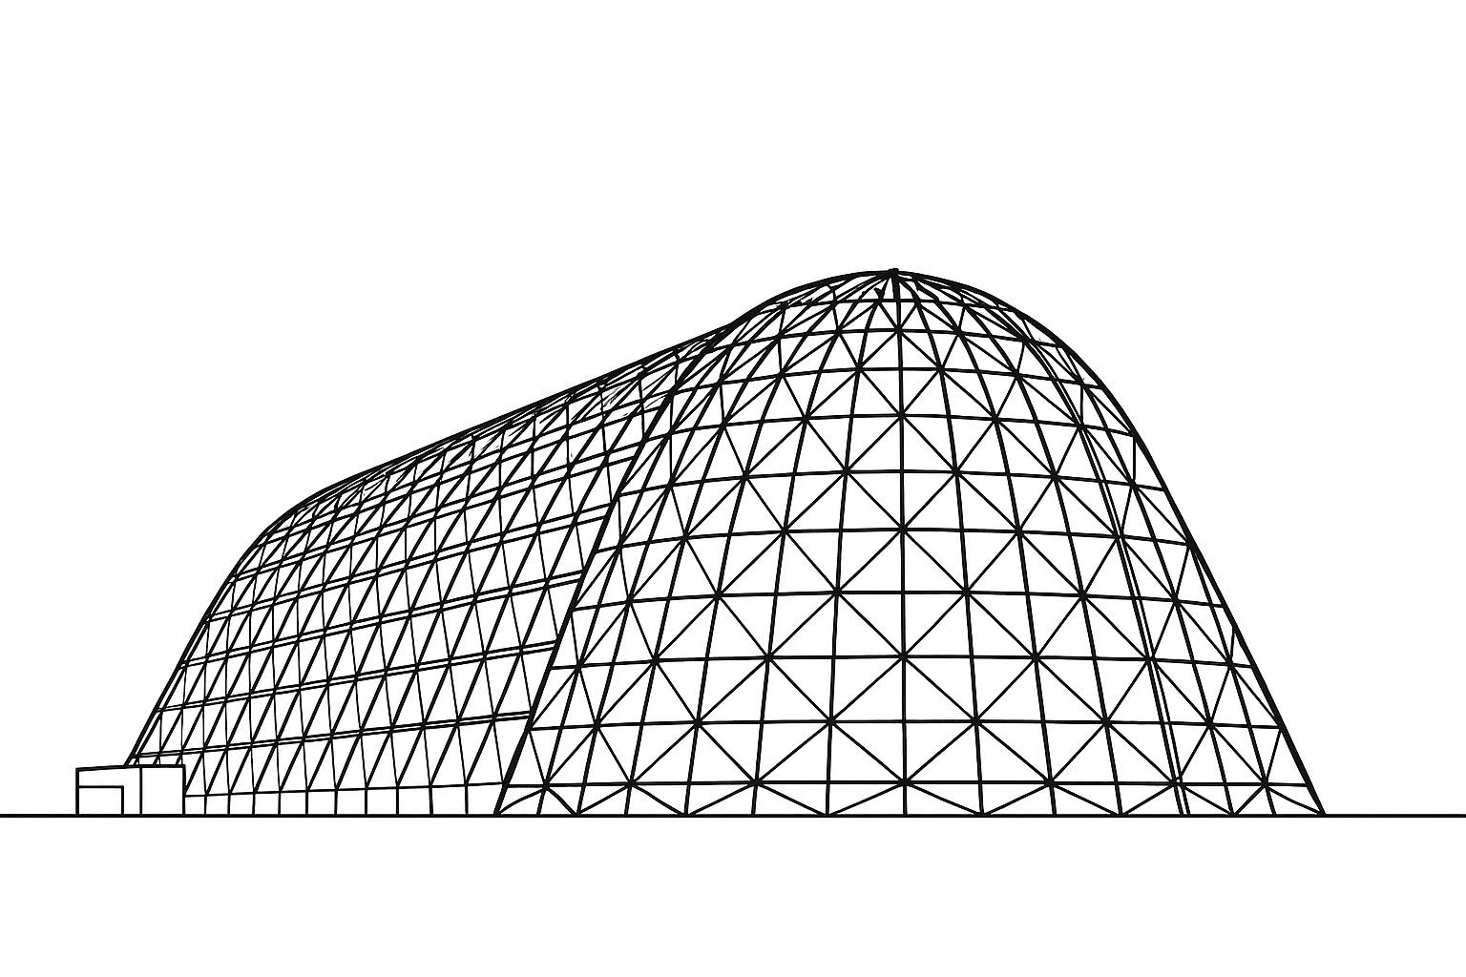

CLPS Electrodynamic Dust Shield Payload
Thermal Design and Analysis
TFAWS 2025 Passive Thermal Technical Session
Presented by: Melissa Young, NASA KSC
Thermal & Fluids Analysis Workshop 2025
NASA Ames Research Center
San Jose, CA
August 4-7, 2025

Slide 2

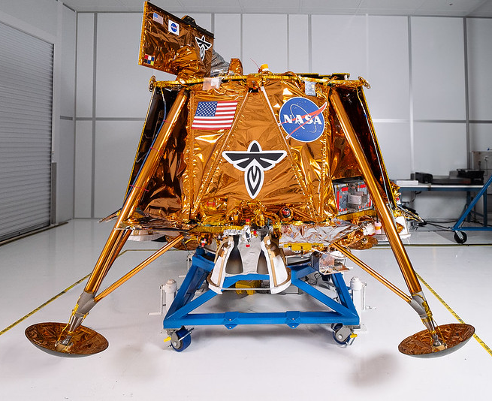
Background
CLPS Lander: Firefly Blue Ghost M1
  Carrying 10 science payloads
  Launched 1/15/25
  First successful CLPS landing on 3/2/25!
Electrodynamic Dust Shield (EDS) payload
  Demonstrator of dust mitigation strategy from KSC Electrostatics & Surface Physics Lab
    Utilizes principle of non-uniform traveling electric field to suspend and move insulating particles (regolith)
  EDS Payload was transported on a deployable 5th lander leg
  Lander approach and descent to landing site at beginning of lunar day
  EDS to perform nominal operations during lunar morning
Payload thermal risks identified
  Lander transit orientation with top deck facing sun, EDS payload below lander lower deck (~no solar exposure)
  EDS proximity to lander main engine for approach and descent
  Exposure to solar heat, regolith, and hot surface conditions during lunar day
EDS Payload
Images from Firefly Aerospace website
EDS Payload required to survive the harsh thermal environments of transit, descent, and surface operations

Slide 3
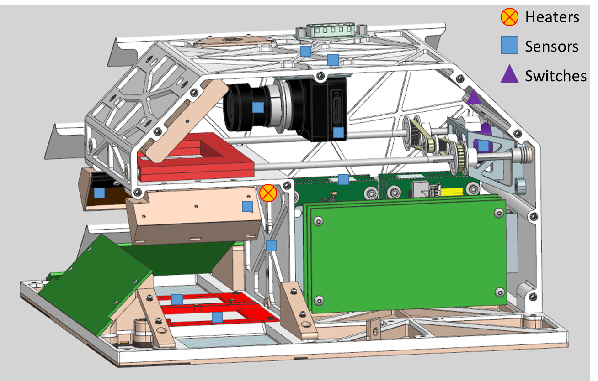
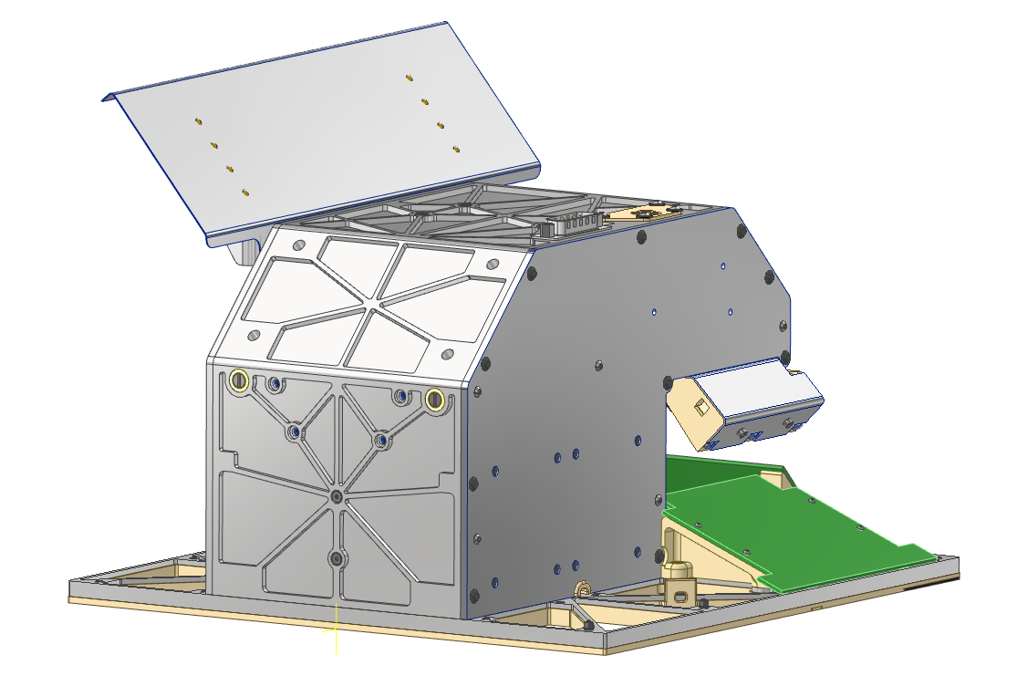
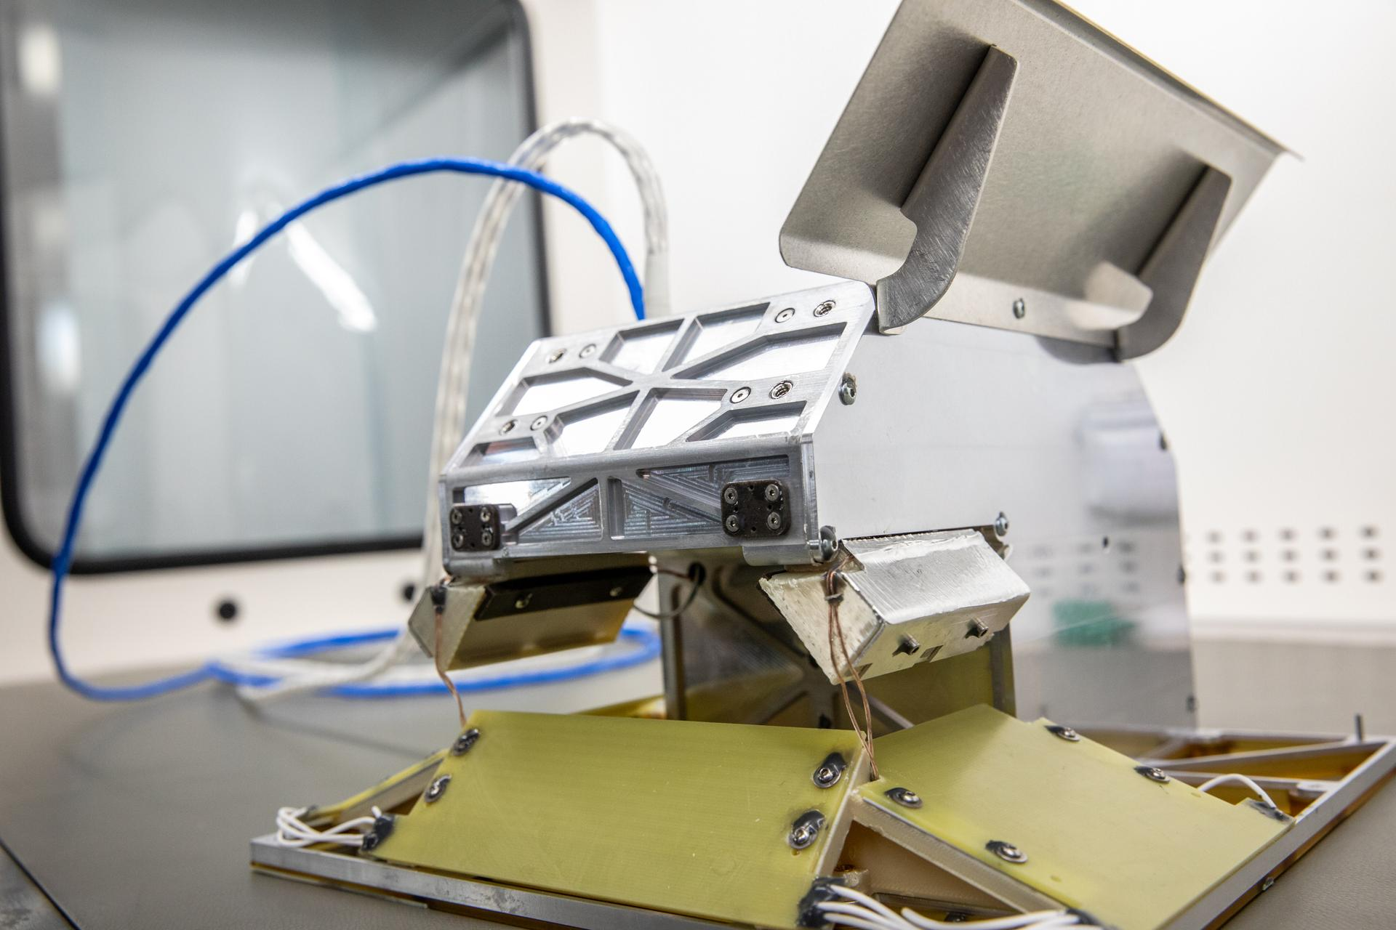
EDS Payload Thermal Design Overview
Transit & Descent
  Two Minco HK6903 Thermofoil_{TM} Heaters
    4” x 0.5”, 16W each, 10W/in² density
  Two Honeywell 700 series thermal switches to heaters
    Opted to wire heaters/switches in parallel in case one failed
  MLI
    Double aluminized Kapton on engine-facing side (low ε)
    StaMet Black Kapton MLI on rest of insulated surfaces
  Foil
    Baseplate ribs, reduster PCBs, engine-side LED enclosure, backside of added flat plate radiator
Hot Lunar Day Ops
  Passive flat plate radiators, AgFEP film
    Installed with Indium foil “gaskets” for improved contact area
Temperature Measurements
  Internal camera temperature sensor
  Up to 17 added temperature sensors (see top right image)
CDR Design Image
Final Design
AgFEP
MLI
Engine side MLI
MLI
AgFEP
MLI
From nasa.gov

Slide 4
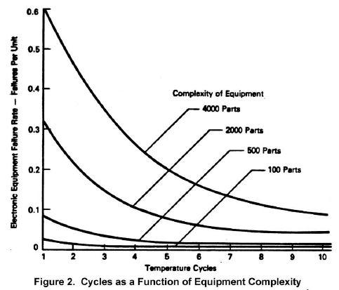
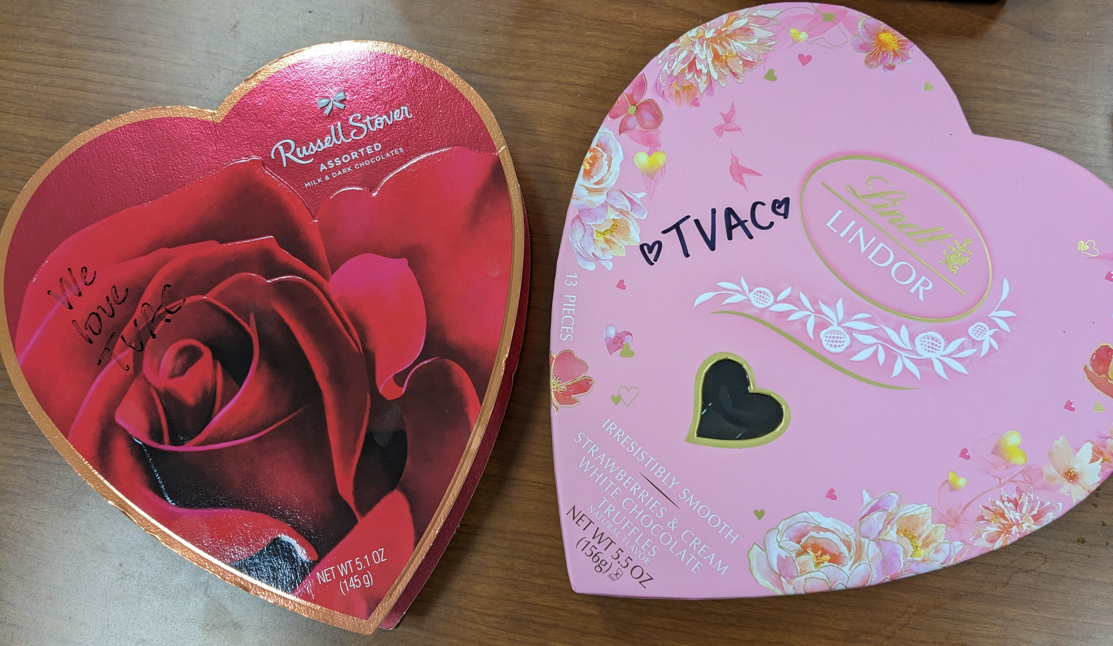
Protoflight Test Tailoring
Lander test approach followed NASA General Environmental Verification Standard (GEVS) GSFC-STD-7000, payloads expected to perform testing following GEVS approach
  GEVS: 8 cycles at component/unit level, 4 cycles at instrument level
EDS team received concurrence to tailor testing requirements to 4 payload-level cycles only
  Low complexity of payload electronic components; utilized guidance from NAVMAT P-9492, which surveyed aerospace manufacturers for failure rates of EEE parts/components (right)
  GEVS recommends 4 cycles minimum for radiator testing
EDS team qual’ed DSU (Data Storage Unit) on lander by similarity to SCALPSS DSU
From NAVMAT P-9492
EDS TVAC completed Feb 2023

Slide 5
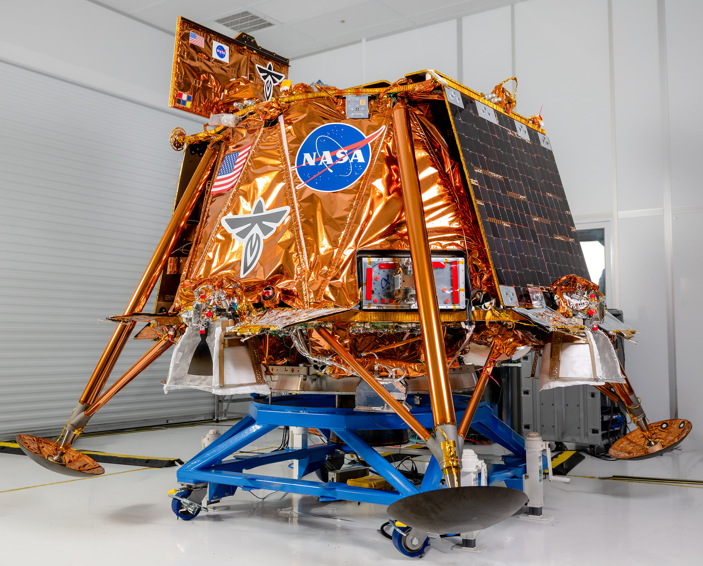
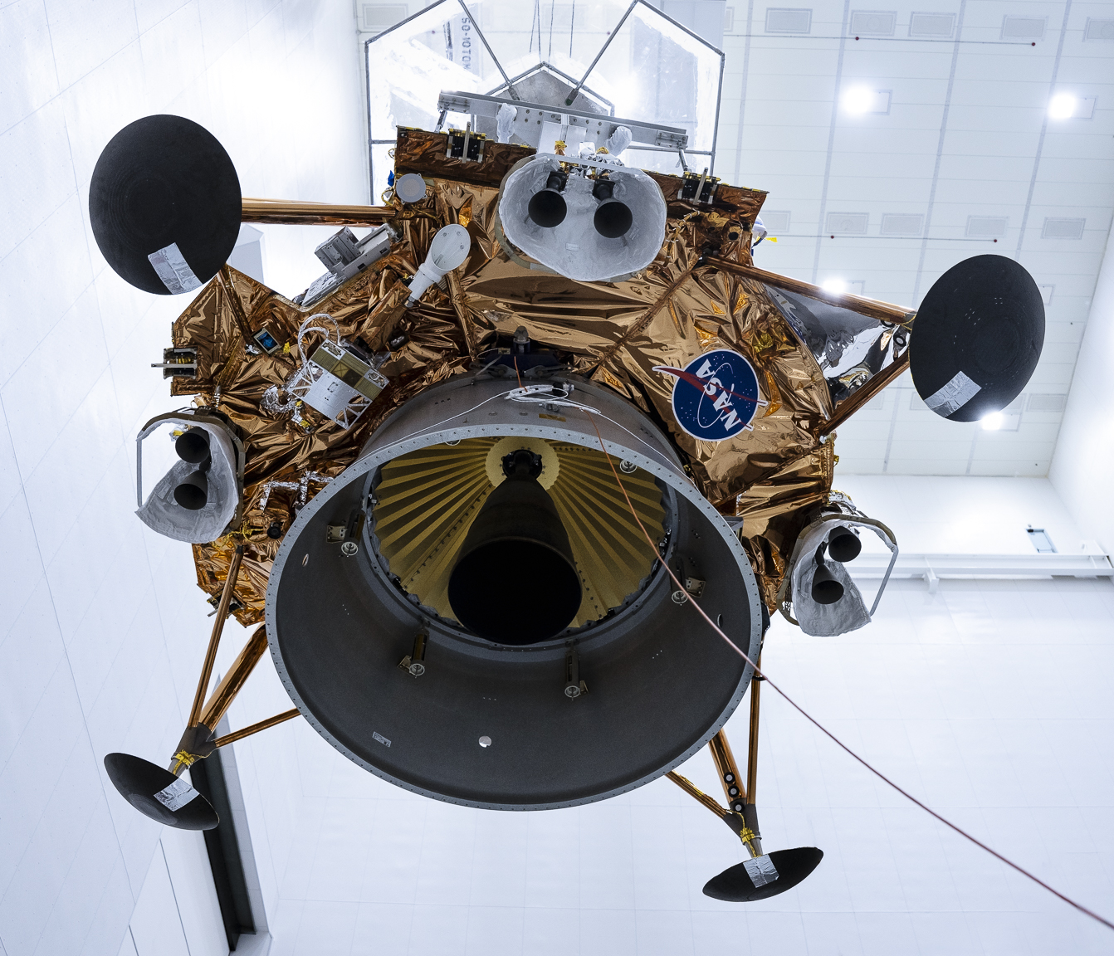
Blue Ghost Mission 1: Ghost Riders in the Sky
EDS Payload
EDS Payload
Pre-flight images at Firefly
Images from Firefly Aerospace website

Slide 6
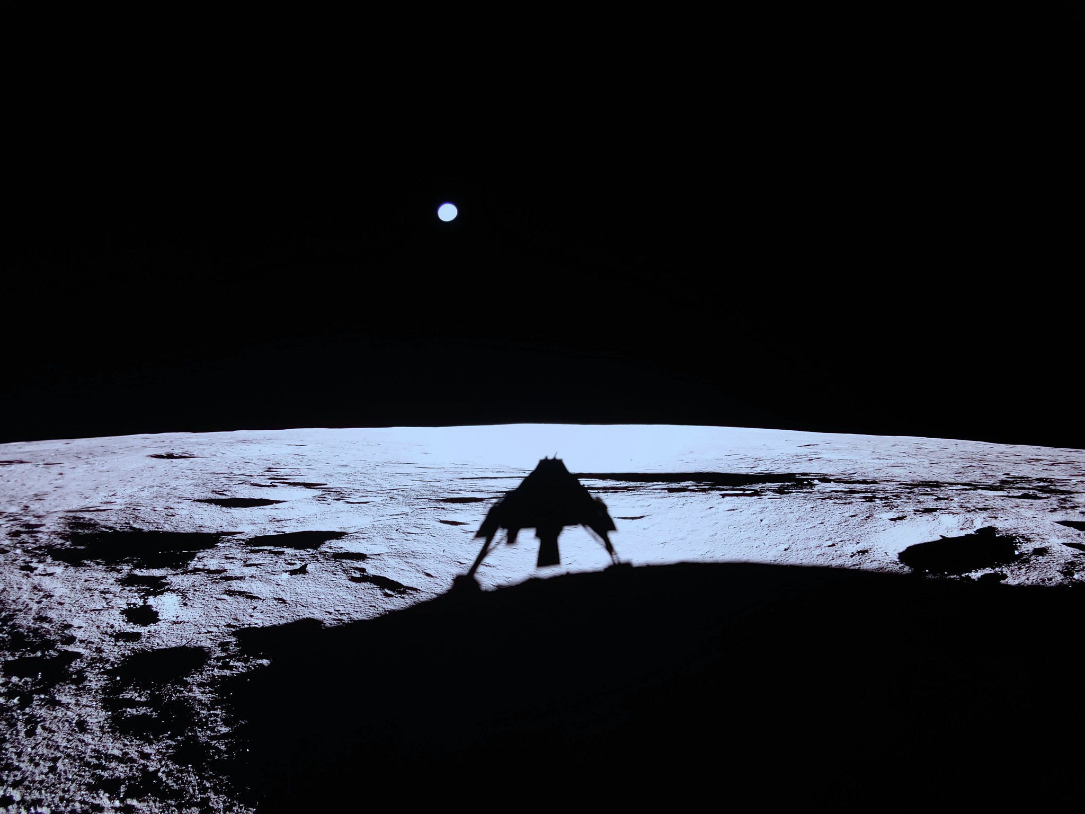
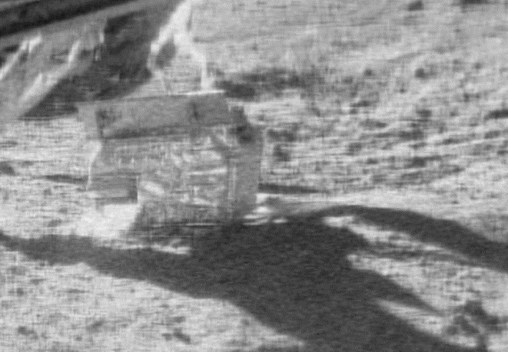
Blue Ghost Mission 1: Ghost Riders in the Sky
EDS Payload
Deployed
On the moon! 3/2/25 2:34CT
Image credit: SCALPSS (LaRC)
Image from Firefly Aerospace website

Slide 7
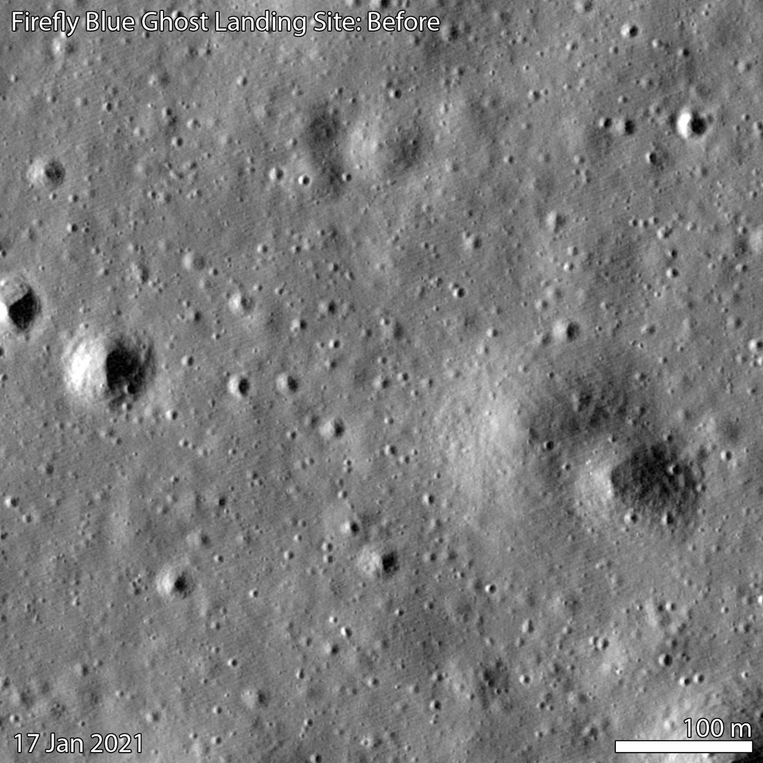
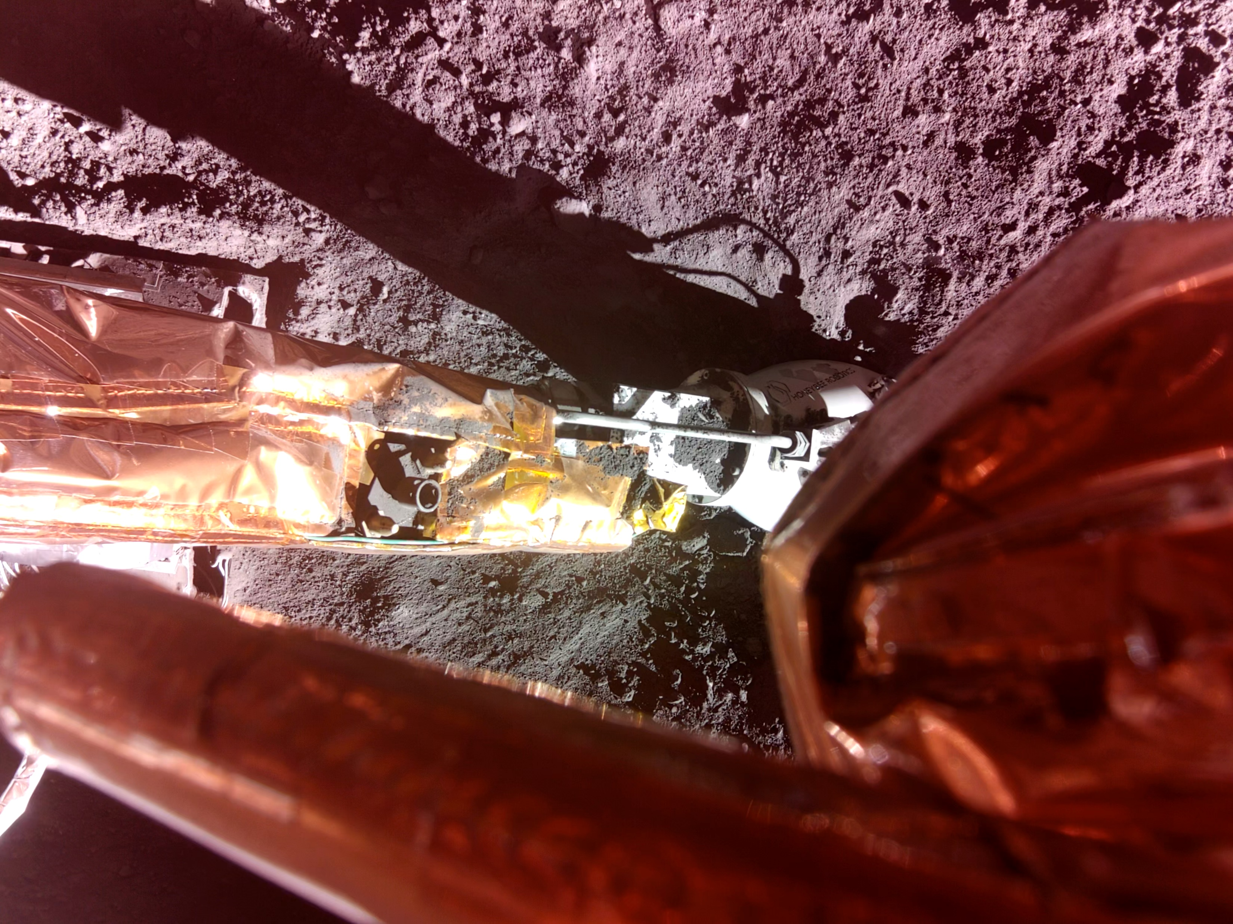
Blue Ghost Mission 1: Ghost Riders in the Sky
EDS Payload
Image from Firefly Aerospace website
GIF from Lunar Reconnaissance Orbiter Camera

Slide 8
Summary of Events
Launch: 1/15/2025
Transit
  For majority of transit, EDS remained within expected temperatures, heaters/switches worked well
    Mostly utilized one heater/switch channel, second one necessary after power anomalies
  Power anomalies occurred, resulting in EDS losing heater power for up to 90 minutes
Surface
  Landing: 3/2/2025 2:34am CT, near small crater; 18.56°N, 61.81°E
  Observed surface environments diverged from correlated TVAC model… [resulting in] “components running 10-18°C hotter than prediction”
    LSIC Spring Meeting 2025
  EDS operations performed 3/2/2025 12:34pm – 10:23pm CT (began 10 hours after landing)
    Did not have enough time to run planned mission operations
  Solar noon start 3/9/2025 5:33am CT

Slide 9
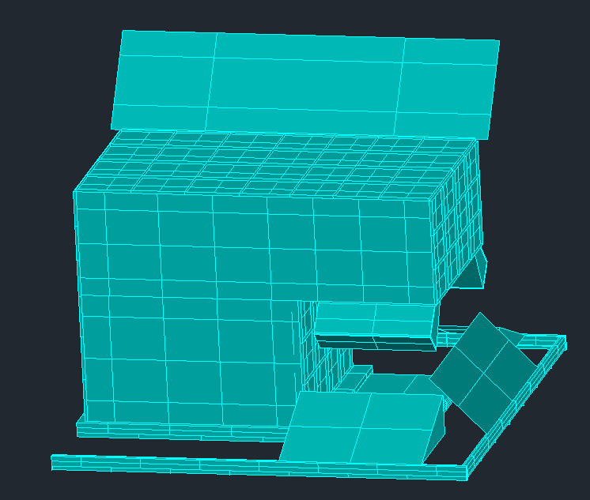
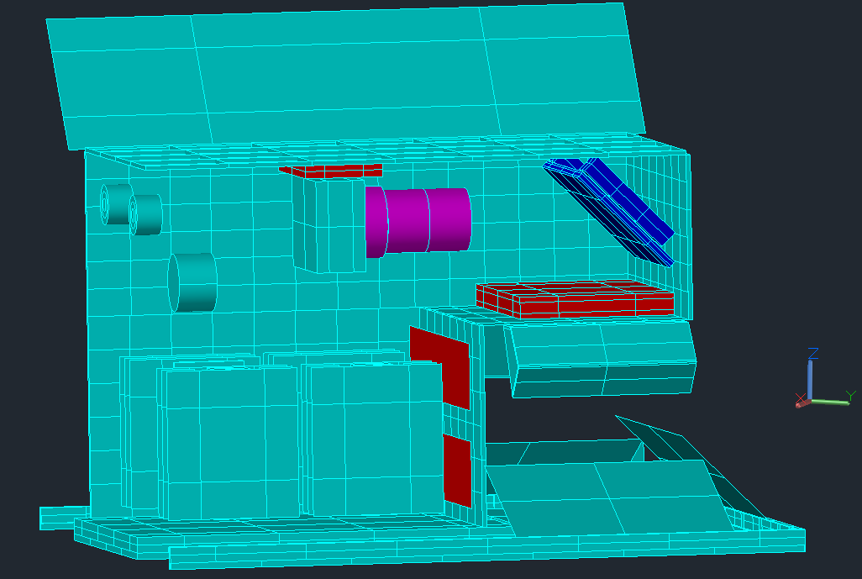
Thermal Model
Coating/Material | Purpose
Foil Tape (3M 425) | Engine heat mitigation
Double Aluminized Kapton MLI | High-temp capability MLI, for transit
StaMet Black Kapton MLI | Low-temp capability MLI, for transit
Silver Teflon (10 mil) | Radiators
Components Modeled:
Camera & lens, with mounting bracket
Thermal switches and heater strips
Camera EDS & motor
Circuit boards with HVPS’s
LEDs
Footpad & outer structure
Not pictured: EDS situated on lander leg during transit & landing, moves to lunar surface for ops

Slide 10
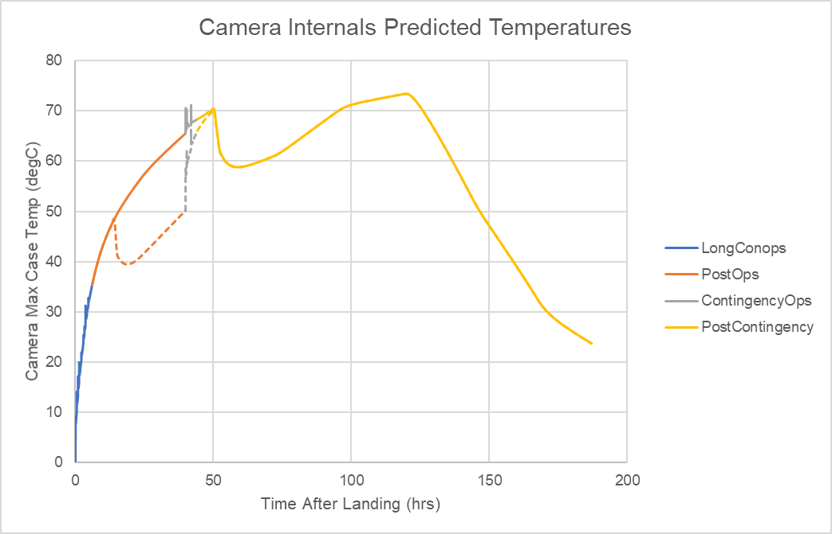
Pre-flight Predictions after TVAC Data-Match
Max TVAC measured
camera off
camera idle
camera off
Adding 11C degrees of uncertainty margin, camera internals predicted to reach 81C after downlinking contingency ops data (~50 hours after landing), peak camera temperatures may reach ~85C during lunar day

Slide 11
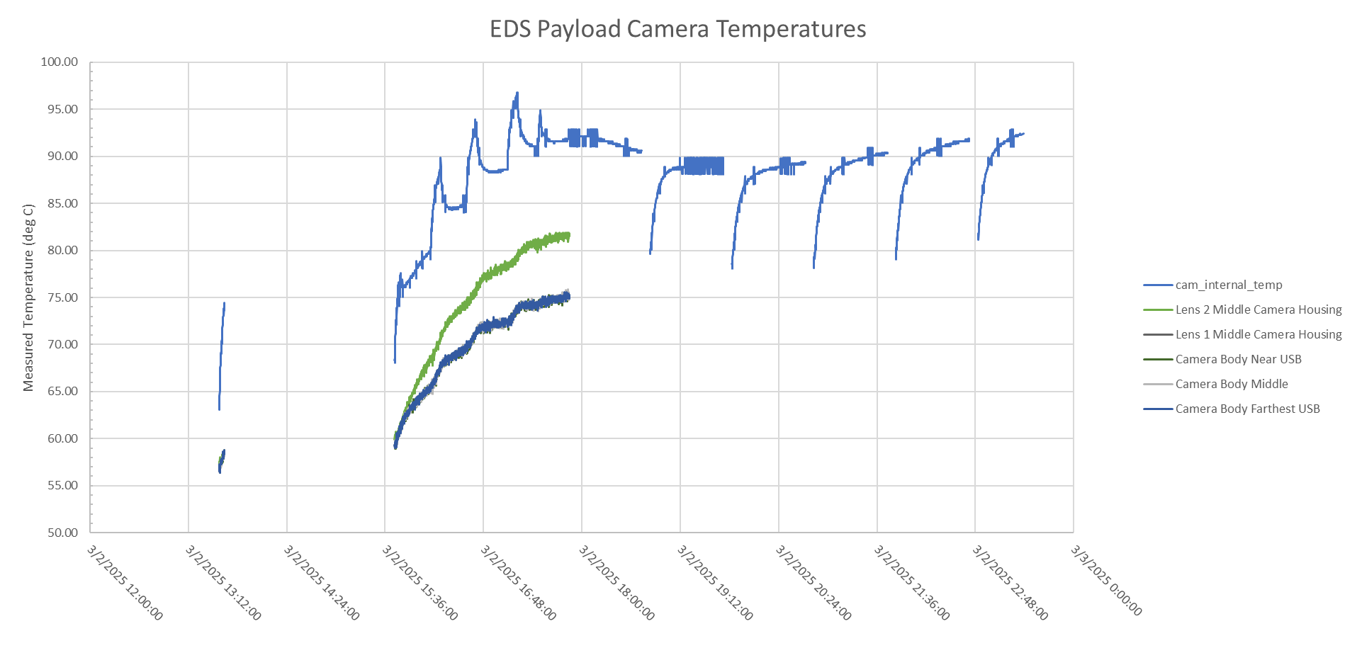
Flight Actuals On Surface
Auto-ops
Conops
Data Transfer
Peak measured internal camera temp during TVAC
Peak measured camera case temp during TVAC
15-18 deg warmer than predictions

Slide 12
Closing the Gap
Steps to matching model to flight actuals:
Adding in adjacent crater geometry
  Per Lunar Reconnaissance Orbiter Camera data, landed adjacent to a 12m-diameter crater
Updating lunar surface orbit to match landing date
  TERRESTRIAL Orbit
  Right Ascension Definitions: Use date 3/2/2025
Tilting the lander based on flight orientation images
  Lander leg opposite EDS sunk into crater, which lifted leg near EDS (unknown height, likely 6-12”)
  Lander tilt increased EDS payload’s view to sun
Optical property degradation due to dust coverage

Slide 13
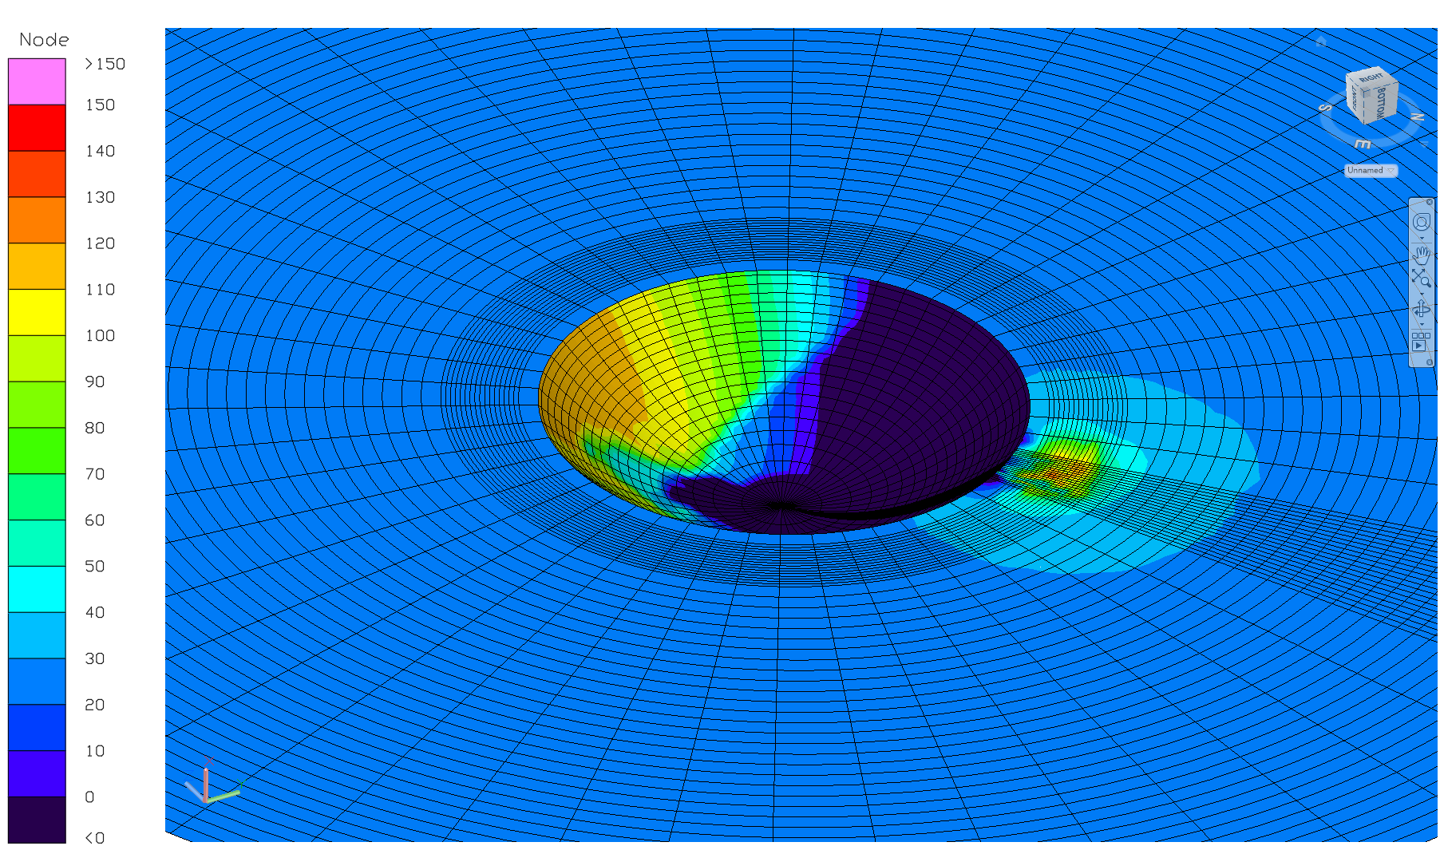
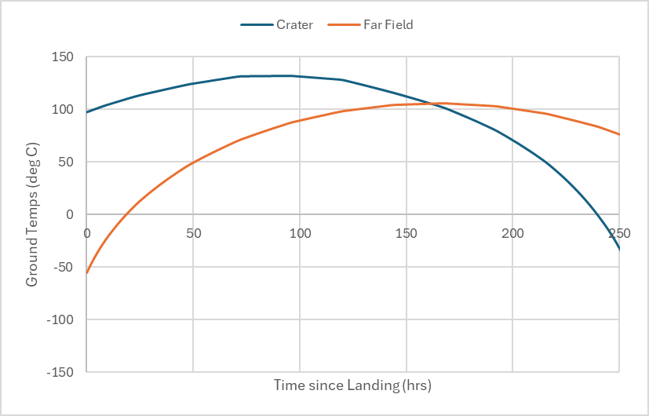
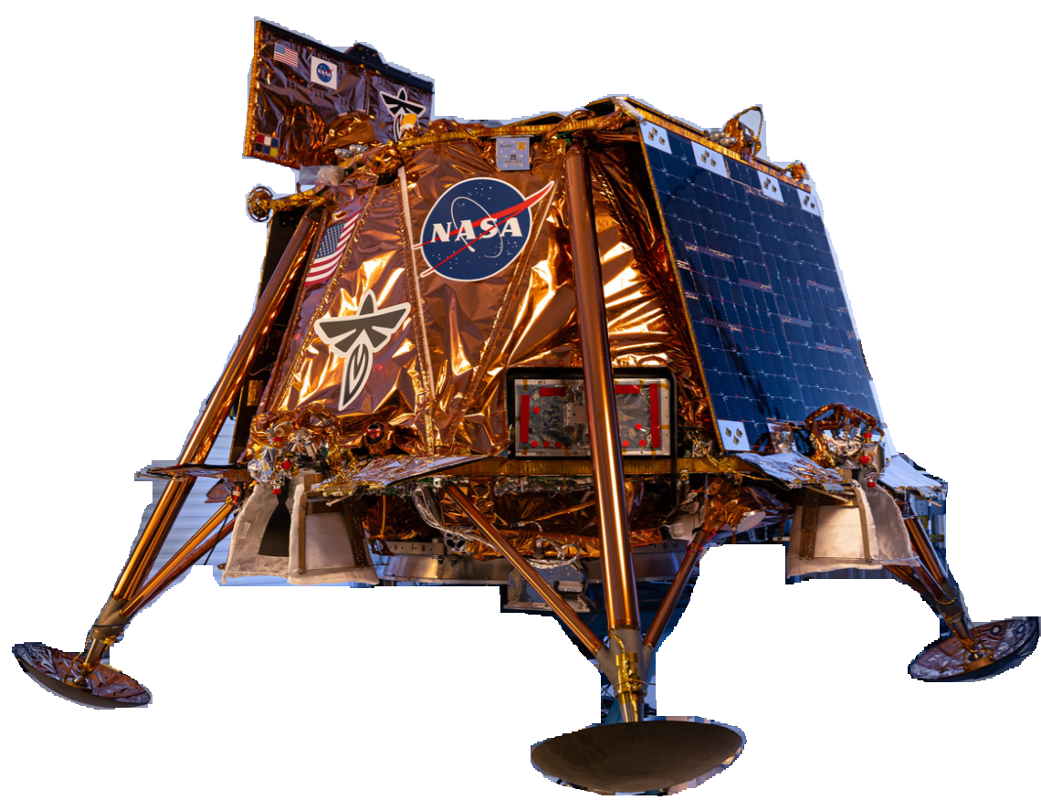
Adding Crater & Lander Tilt
Crater surface facing lander may have been ~150C warmer than rest of lunar surface at landing
1 lander leg sunk into side of crater, lifting lander leg closest to EDS
Estimated lander tilt from photos and tilted lander geometry to match

Slide 14
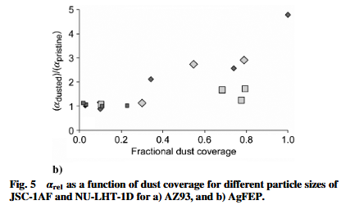
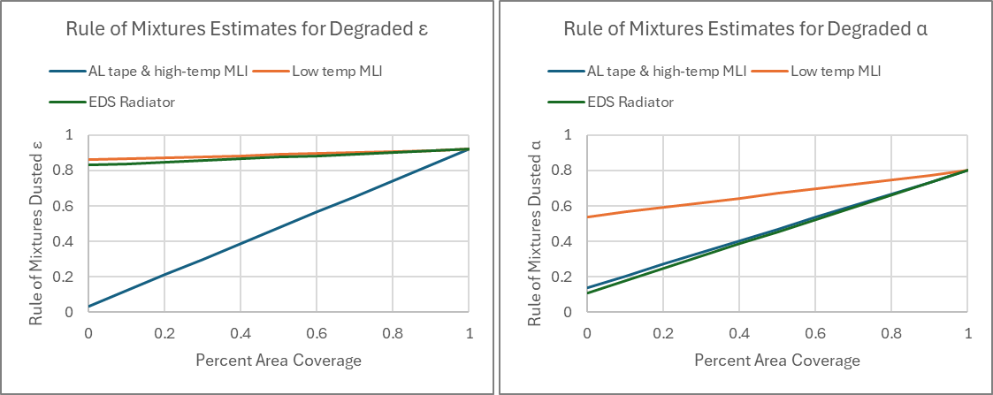

Optical Property Degradation
Unknown amount of dust on EDS hardware
Images show significant loading on ~horizontal surfaces, assuming a monolayer on other faces
Per Gaier et. al, the rule of mixtures for degradation of solar absorptivity overestimates the impacts, but estimates well for emissivity changes
  Data focuses on radiator materials, so utilized data trends from data below to estimate degradation in AgFEP
  Used rule of mixtures for degradation of MLI and foil tape
Rule of Mixtures
$$ε_{new}=PAC_{dust}ε_{dust}+\left(1−PAC_{dust}\right)ε_{pristine}$$
$$α_{new}=PAC_{dust}α_{dust}+\left(1−PAC_{dust}\right)α_{pristine}$$
Large: 25-50μm
Medium: 10-25μm
Small: <10μm
“Studies of Simulated Lunar Dust on the Properties of Thermal Control Surfaces”
James Gaier et al.

Slide 15
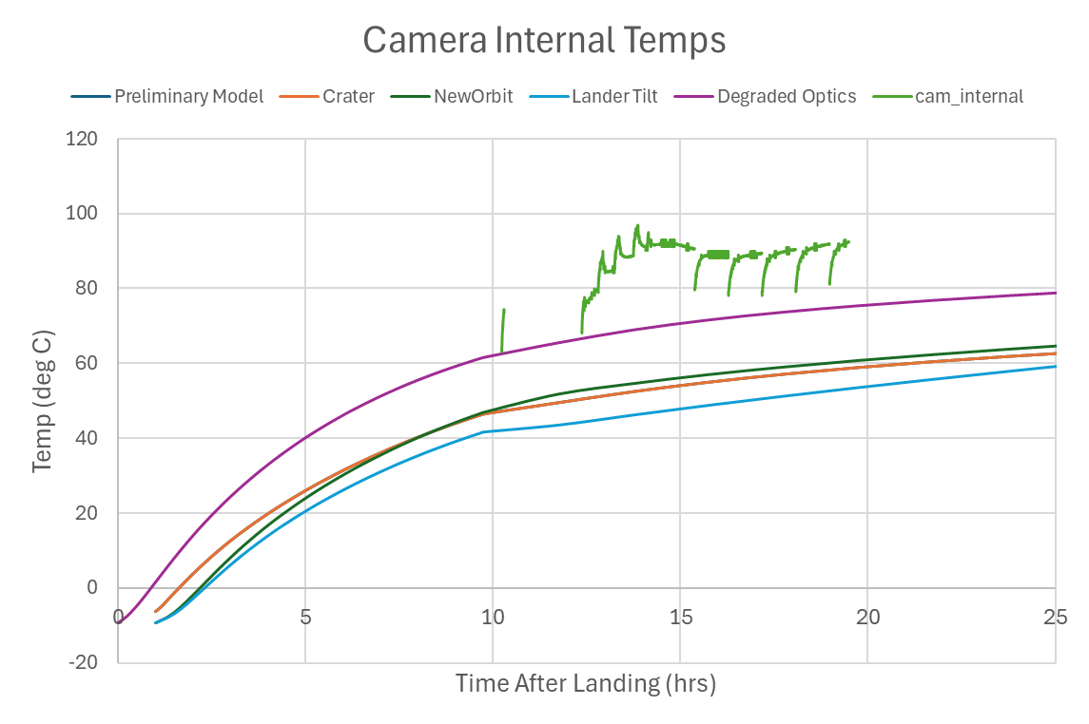
Data-Matched Lunar Surface Environment
Takeaways:
No noticeable impact of crater on EDS, likely due to EDS being on the ground
  May have impacted lander hardware
Lander tilt may have created extra shadowing of EDS from lander foot
Degraded optics played biggest role in temperatures
Degrading payload optics to an average percent area coverage of ~50% matched unpowered payload temperatures

Slide 16
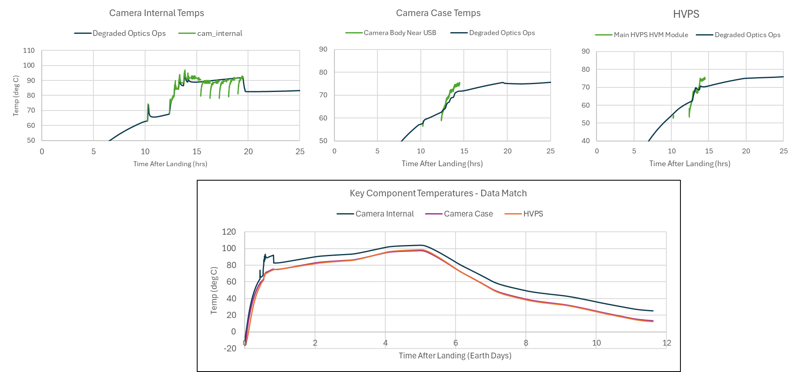
Data-Matched Lunar Surface Environment
~Lunar noon
Shadowing from lander

Slide 17
Lessons Learned
As a CLPS Payload
  Be prepared to react to lander design changes
    Blue Ghost main engine and thruster manufacturer changed post-CDR, lead to radiator redesign and change in high temperature-capability MLI
  Aim for open communication with lander team regarding payload conops
Testing & Hardware
  If possible, test key hardware beyond manufacturer’s limits to ensure robustness
    Some manufacturer’s limits may just have been set to their facilities’ limits and not necessarily to the point of failure. Recommend inquiring with manufacturers
    Should have tested camera to extreme hot temperatures to have confidence in hardware health during surface ops…had not expected such extreme hot temperatures during mission ops
  Perform MLI fit checks with all hardware that will be used for flight
Run those absolute worst-case scenarios, it could happen
  Be prepared for possible payload heater power outages in-flight
    Estimate beforehand how long hardware can survive without heater power
    Test sensitive hardware to extreme cold temperatures in lab was necessary to have confidence in hardware health during outages
  Build conservatism into a lunar surface thermal environment model
    There is some confidence that CLPS landers will land in their planned orientation (if equipped with sensors/star trackers/etc.), however…
    Do not assume hardware will land upright, assess tilting hardware or creating an incline that will negatively affect your hardware
    Do not assume the mission timeline will go as planned; assess alternative timelines
    Create artificial lunar surface geometry that could make a harsher lunar environment
    Assume dust loading will occur on all hardware (aim for conservative amount)
      Human Landing System Lunar Thermal Analysis Guidebook (HLS-UG-01) recommends 100% monolayer coverage, i.e. use regolith optical properties instead of degraded properties (unless a lesser percentage can be justified), and consider adding a regolith layer to hardware thermophysical properties if likelihood of significant dust coverage is high

Slide 18
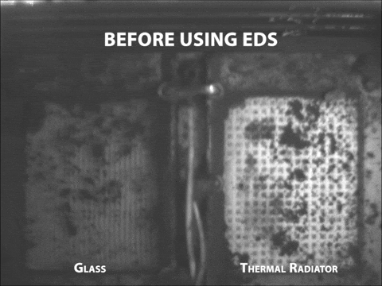
EDS Success!
97% clear on glass
82% clear on thermal radiator
Contact KSC Electrostatics and Surface Physics Lab if interested in using EDS technology on your project (Possible applications: thermal radiators, solar panels, camera lenses, spacesuits, seals and gaskets)
Dr. Charles Buhler, NASA KSC
Dr. Joseph Toth, NASA KSC
Dr. Krystal Acosta, NASA KSC
GIF from NASA Article Link
LSIC Spring Meeting 2025

Slide 19
BACKUP

Slide 20
Protoflight Test Profile
Limited Performance Test
Functional Health Check
Payload Heater On
Camera: Hot Non-Op
60°C ± 2°C
Camera: Hot Op
55°C ± 2°C
Ambient
5°C ≤ T ≤ 30°C
Camera: Cold Op
-10°C ± 2°C
Cold Non-Op
Thermal switch wall < -20°C
Originally planned to run cold non-op point after first hot op point
Struggled to reach cold non-op temps with chamber set up, proceeded with operational points
Had to shut down and install chamber’s liquid nitrogen chiller plate to achieve cold non-op and demonstrate heater system functionality

Slide 21
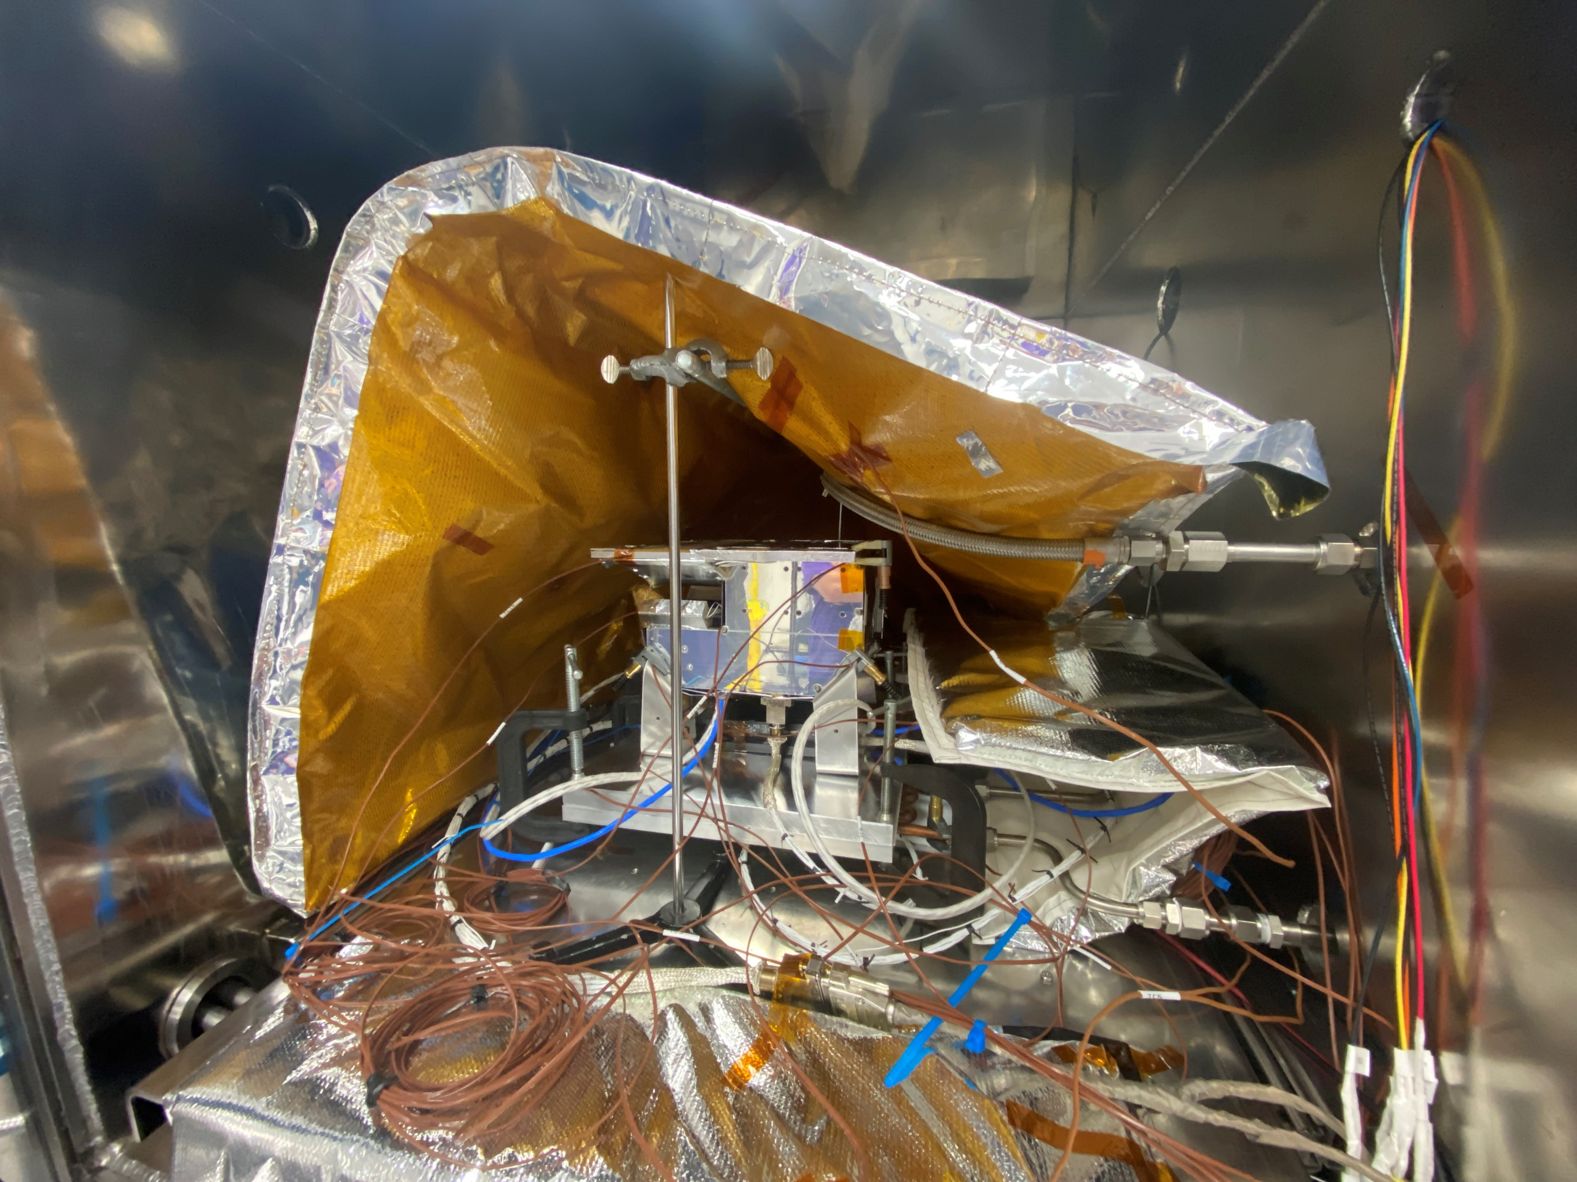
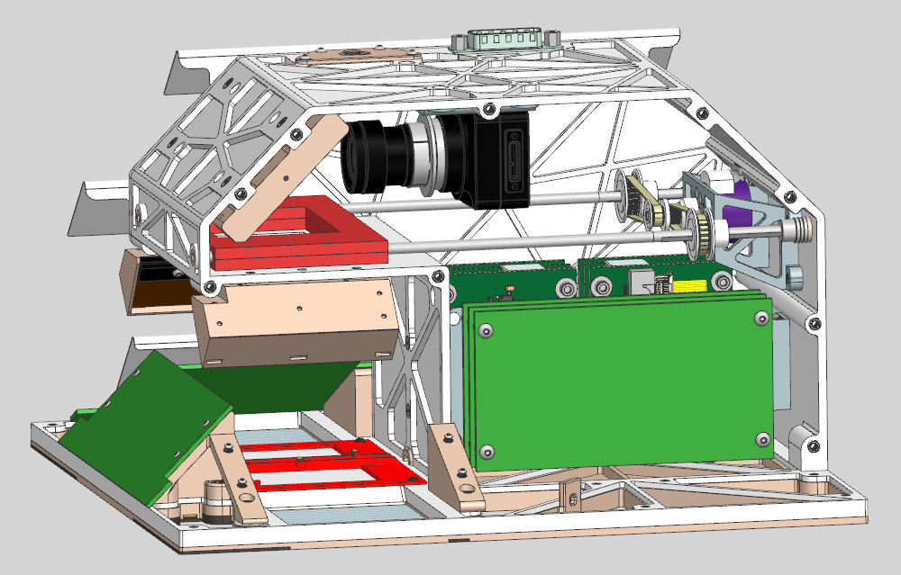
Protoflight Testing
Manufacturers’ Limits
Camera
Storage: -30 to 60C
Operating: -30 to 45C
Lens
-10 to 50C (TBD)
LEDs
-40 to 95C
HVPS
-40 to 70C
Performed TVAC tests on camera and lens below manufacturers’ limits to -40C
Payload installed in chamber upside down:
Baseplate made of insulating ULTEM, i.e. limited conduction through cold plate
Mounted via same fittings as lander mounting brackets

Slide 22
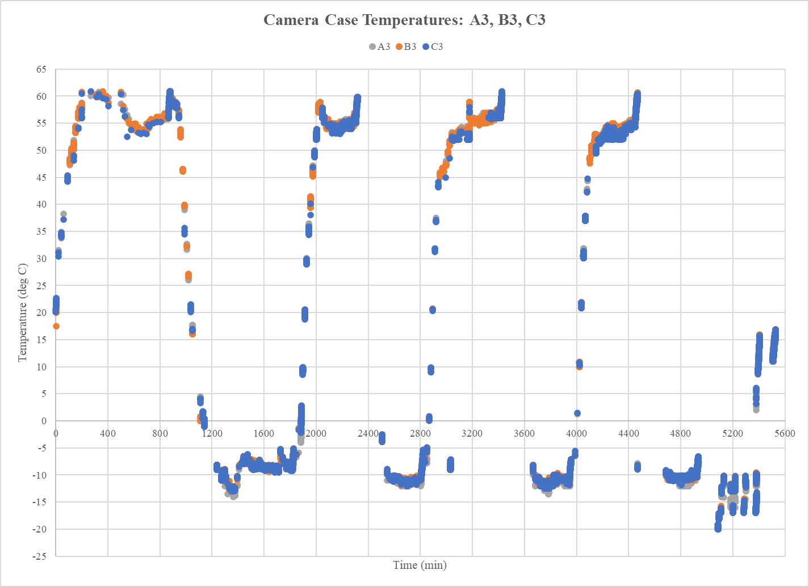
Protoflight Testing – Completed
EDS TVAC Feb 2023
Switches turned on/off at
~-17C and -10C
Originally planned to run cold non-op point after first hot op point
Struggled to reach cold non-op temps with chamber set up, proceeded with operational points
Had to shut down and install chamber’s liquid nitrogen chiller plate to achieve cold non-op and demonstrate heater system functionality

Slide 23
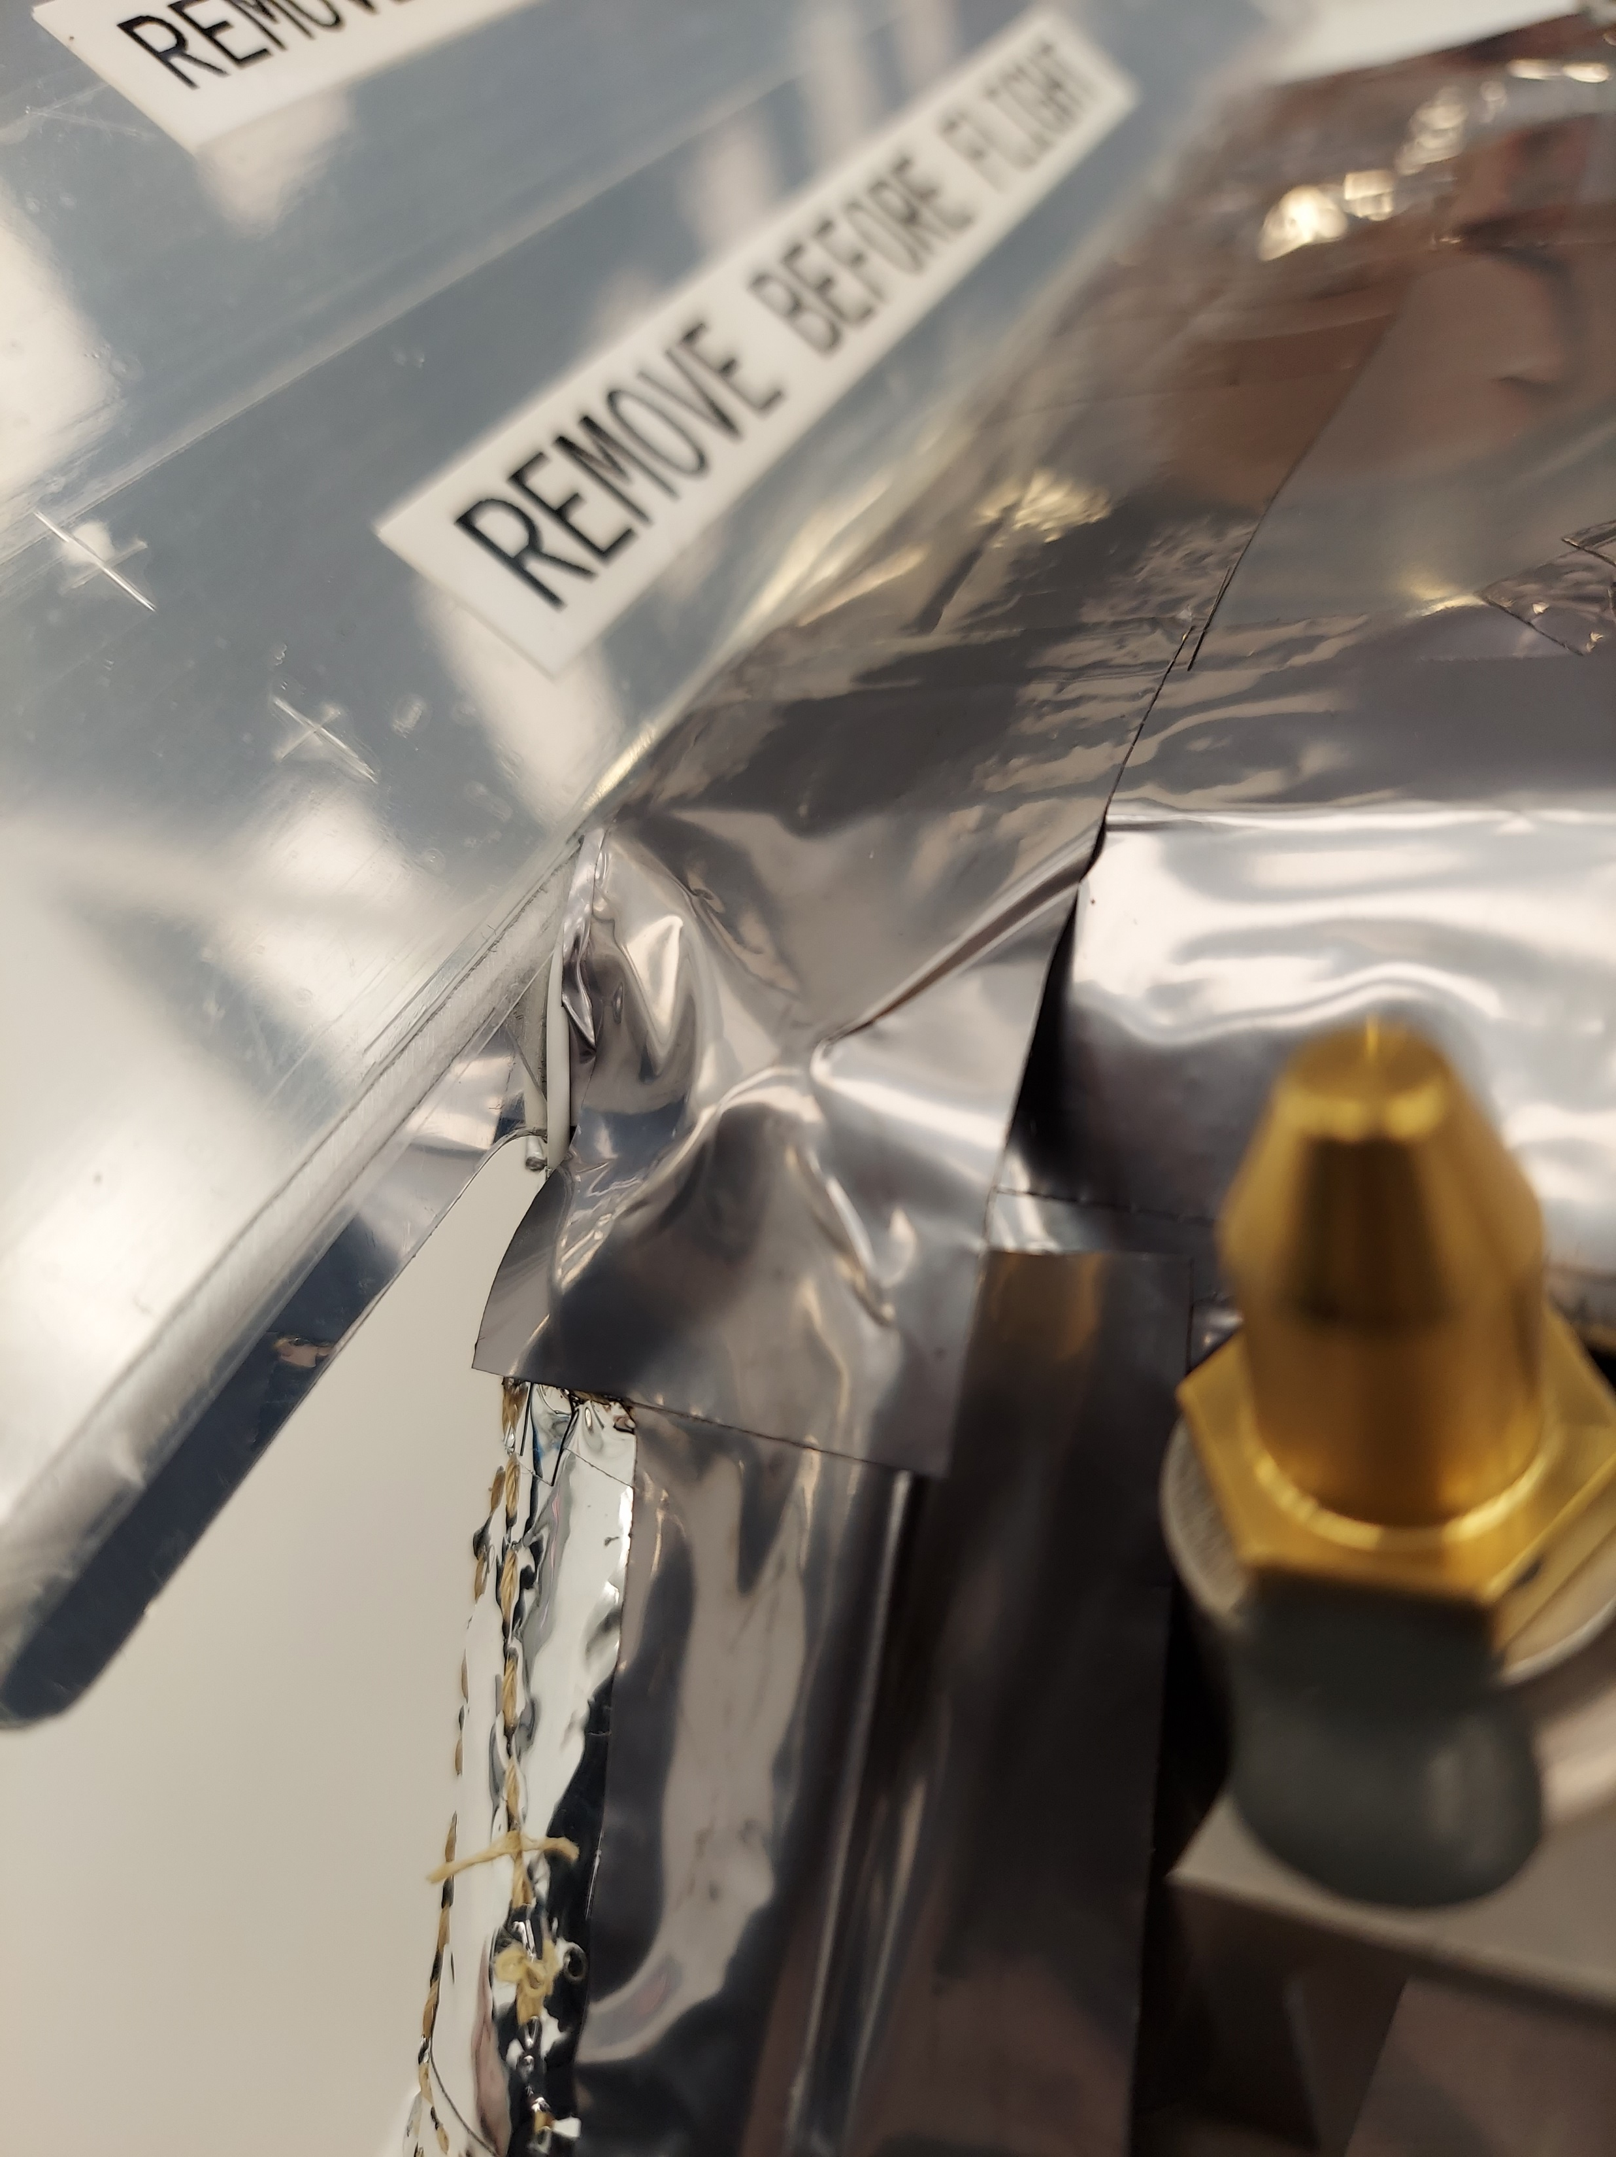
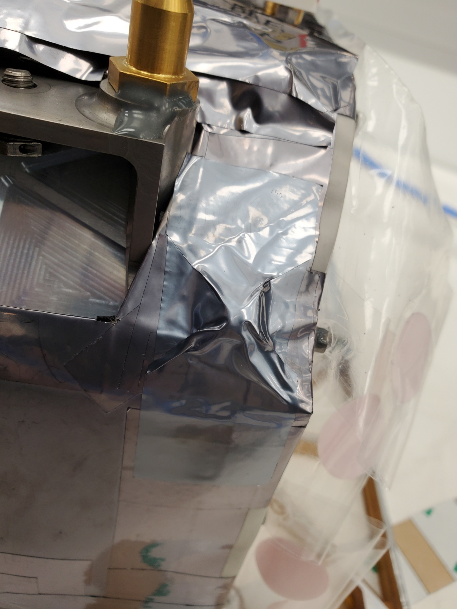
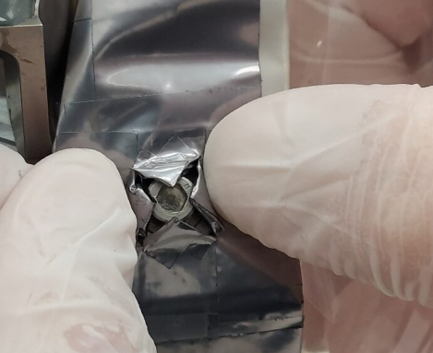
Flight MLI Installation – Lessons Learned
Ran into a few issues during flight MLI installation that required real-time problem solving and discussions with MLI manufacturer:
Missing holes for clearance of lander interface bracket bolts
Weak close-out tape adhesive
Lessons Learned
Be sure to check tape expiration date and make sure it aligns with install date
  Add “check expiration tape” to pre-check list
Have conversation with technical expert(s) on MLI installation to get tips before installation date
  I.e. increase communication with MLI supplier
Make sure to have the right flight hardware (including mounting bolts) during blanket fit check
Electrically conductive close-out tape might not have the best adhesion, may need a “striped” tape for combination of conductivity and adhesion
Do a dry run of the MLI installation procedure beforehand
Electrically conductive Stamet tape did not stay adhered to MLI
“Striped” adhesive worked much better
X-cuts made & closed out

Slide 24
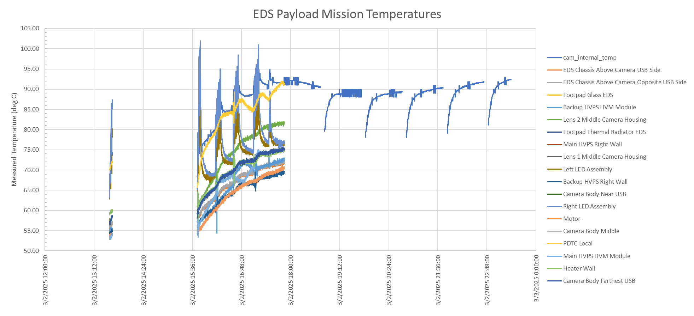
Flight Actuals
~18 deg warmer than predictions
Peak measured internal camera temp during TVAC

