Slide 1
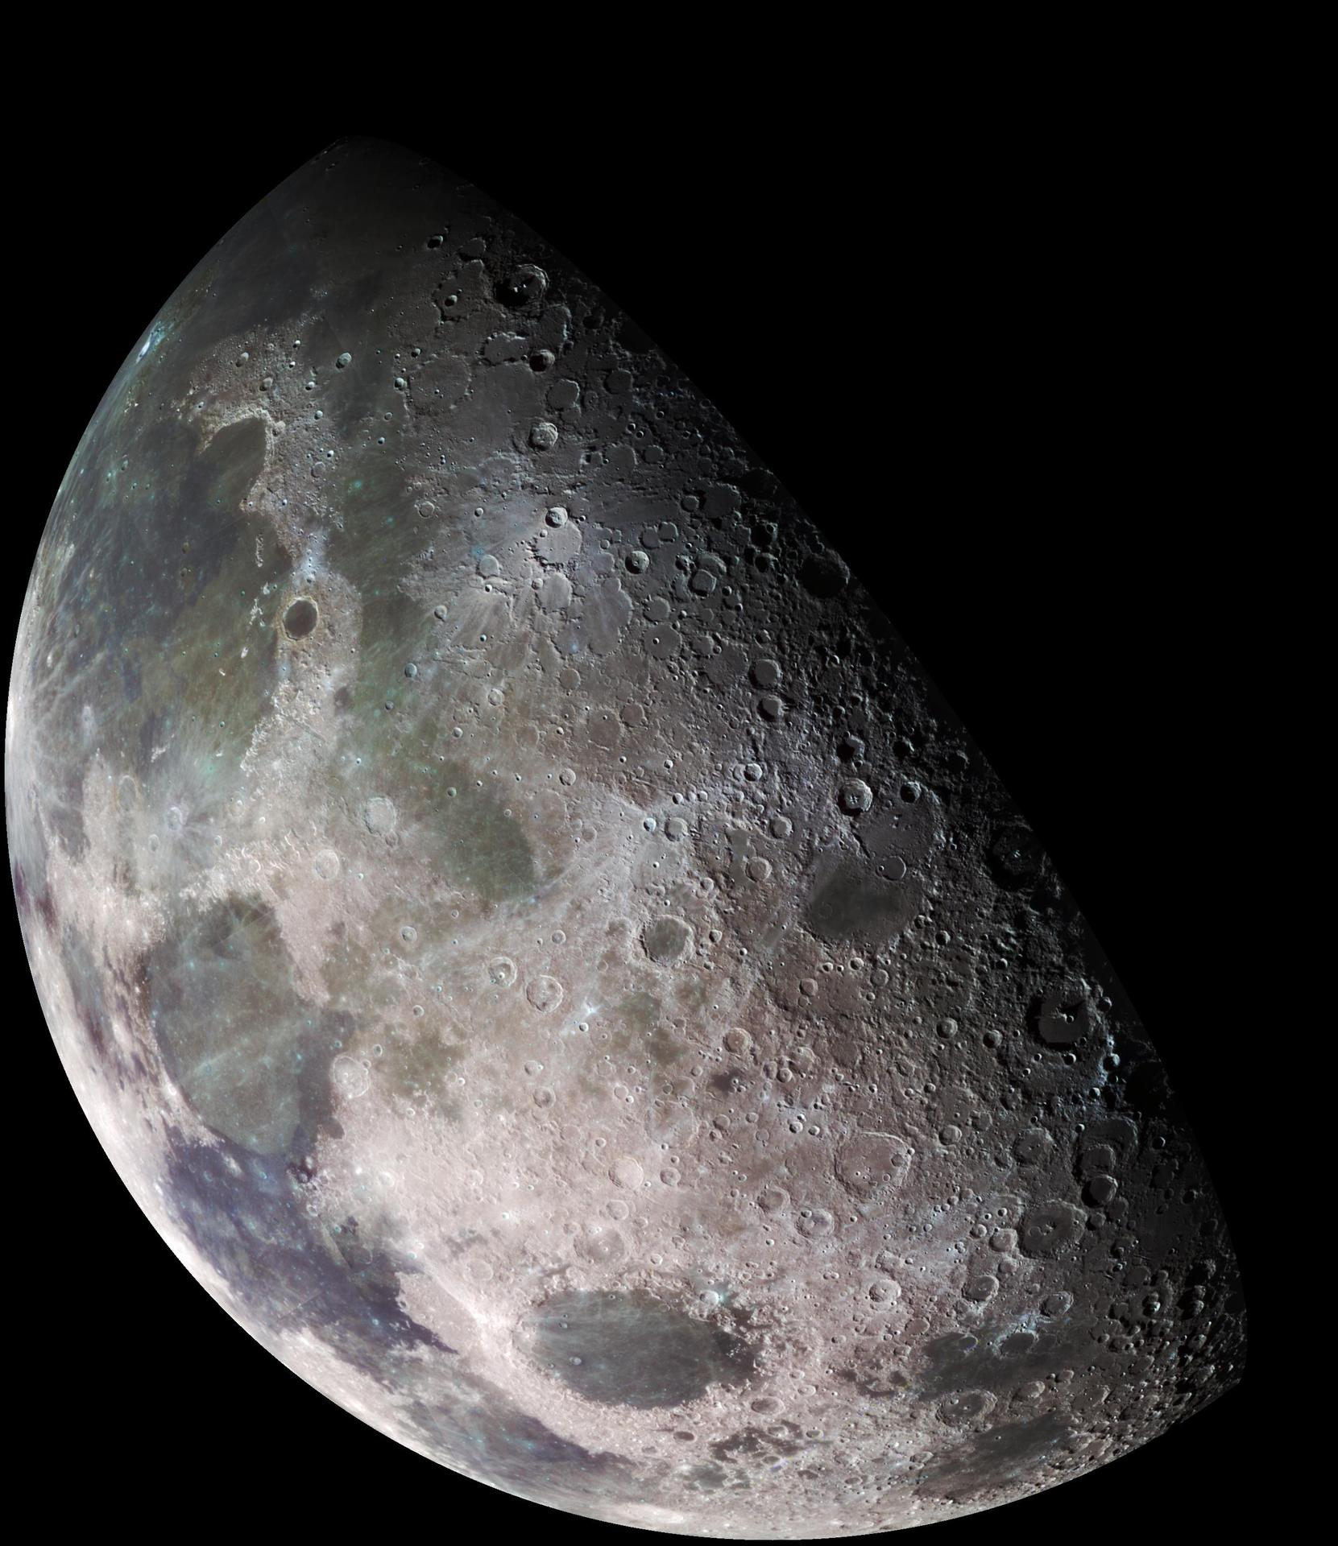
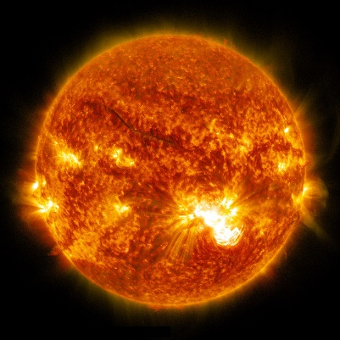
Thick Regolith Shielding
on the Lunar Surface
Tony C. Slaba¹
¹ NASA Langley Research Center, Hampton VA
Key Non-Polar Destinations Across the Moon to Address Decadal-level Science Objectives with Human Explorers: Panel on Applied Sciences - In-person/hybrid Meeting #2

Slide 2
Outline
Lunar Surface Radiation Environment
Shielding Analyses
Research Needed to Guide Thick Regolith Shielding
Summary

Slide 3
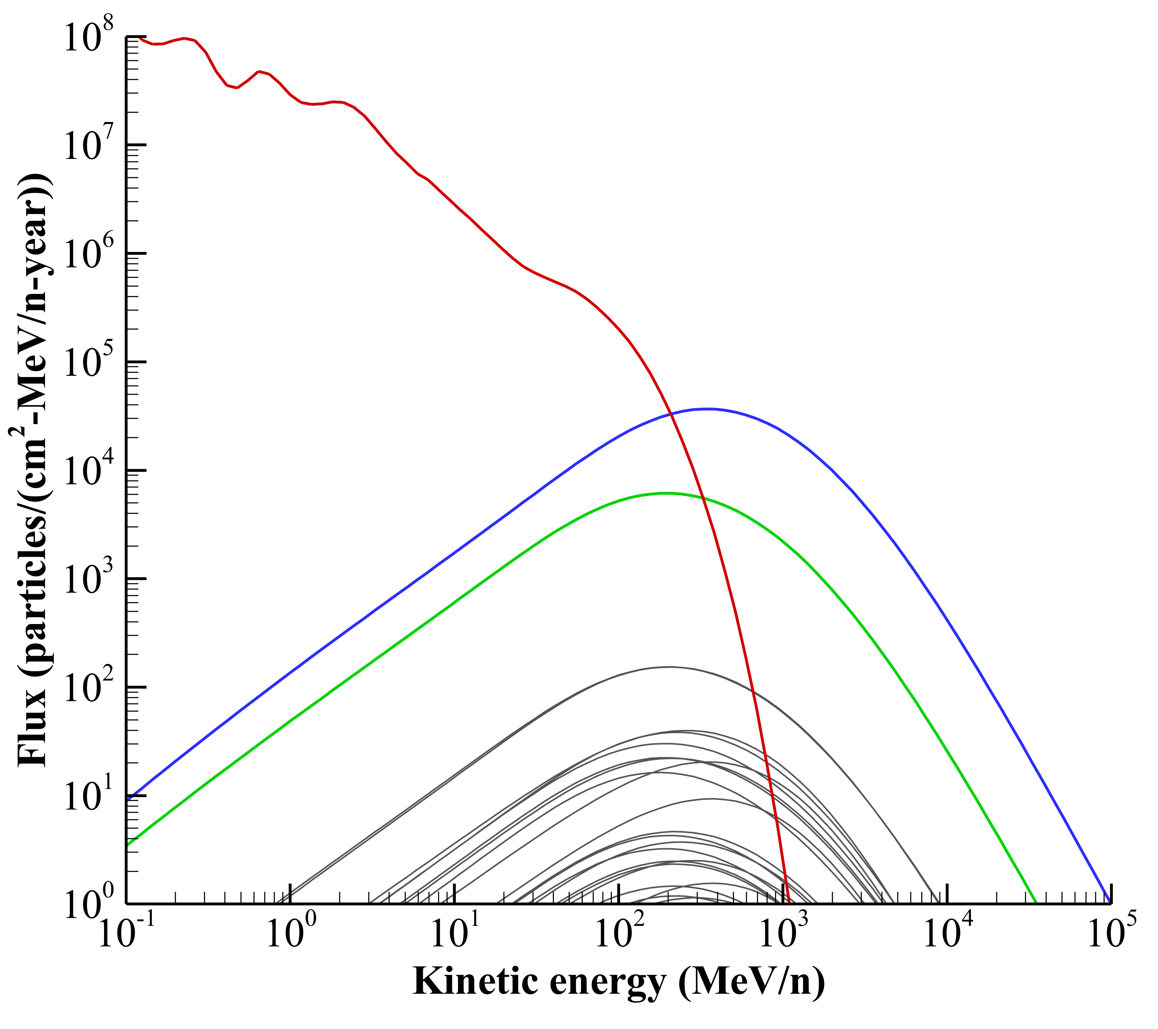
Lunar Surface Radiation Environment
Galactic Cosmic Radiation (GCR)
Continuous background of low dose radiation
~ 89% protons, ~10% alpha particles (He), and ~1% heavier nuclei
Broad energy spectrum from 10’s of MeV/n to >100 GeV/n
Highly penetrating and difficult to shield against
Nuclear fragmentation into lighter, penetrating species
Intensity varies with ~11 year cycle between solar min and solar max
Induced albedo environment (mainly neutrons)
Downward directed GCR interacts with lunar regolith
Albedo (backscattered) environment emanates from surface
Includes neutrons, gammas, and low energy charged particles
Gaps
High energy (>100 MeV) spaceflight neutron detection
Effective shielding
Accurate quantification of biological effects & health risks
Validated biomarkers and countermeasures
Accurate prediction of solar cycle duration
Solar min lunar radiation environment
Lunar albedo neutrons
(upward directed)
GCR protons
GCR helium
GCR heavy ions
(Z > 2)

Slide 4
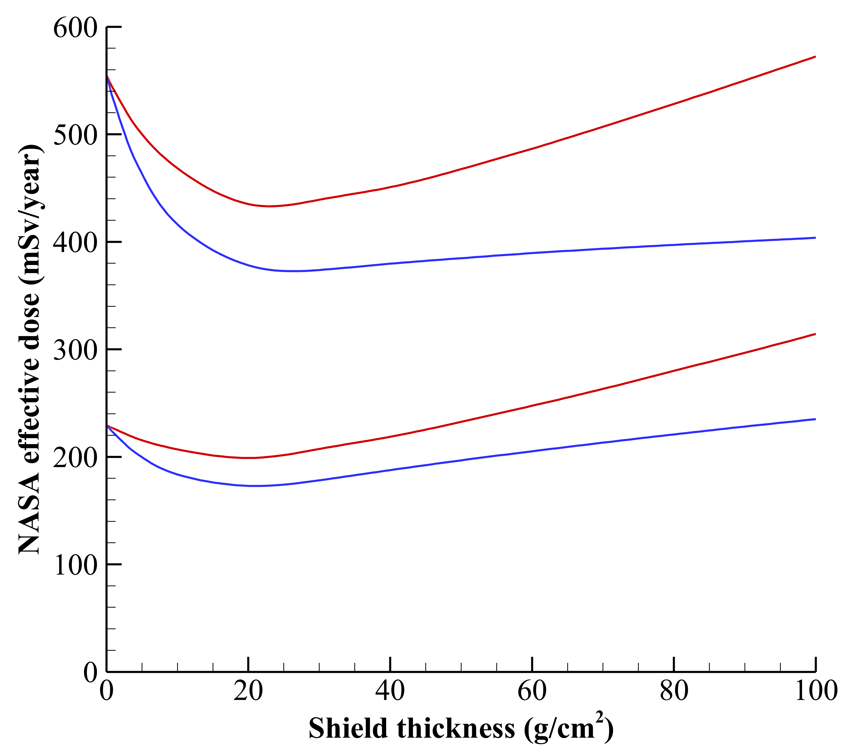
Vehicle Shielding in Free Space
Optimized vehicle shielding can reduce exposures by 10-15%
  10 – 30 g/cm² range
    Further optimization limited by physics/transport uncertainties and lack of spaceflight measurements
Radiation field behind thick shielding is dominated by secondary particles produced from nuclear collisions
  Heavier ions (e.g. heavier than ⁴He) suffer nuclear collisions and break-up into lighter particles and secondaries
  Secondary particles: gammas, electrons, positrons, muons, pions, neutrons and light ions
Measurements are needed to better understand the mixed radiation field behind thick shields
  Dose-depth for GCR beyond 100 g/cm²
  Neutron energy spectrum up to ~1 GeV
  Additional ground-based measurements
Free space
GCR effective dose vs depth
aluminum
15% reduction @ 20 g/cm²
Solar min
polyethylene
30% reduction @ 20 g/cm²
aluminum
Solar max
polyethylene
Also needed to support lunar regolith thick shielding concepts

Slide 5
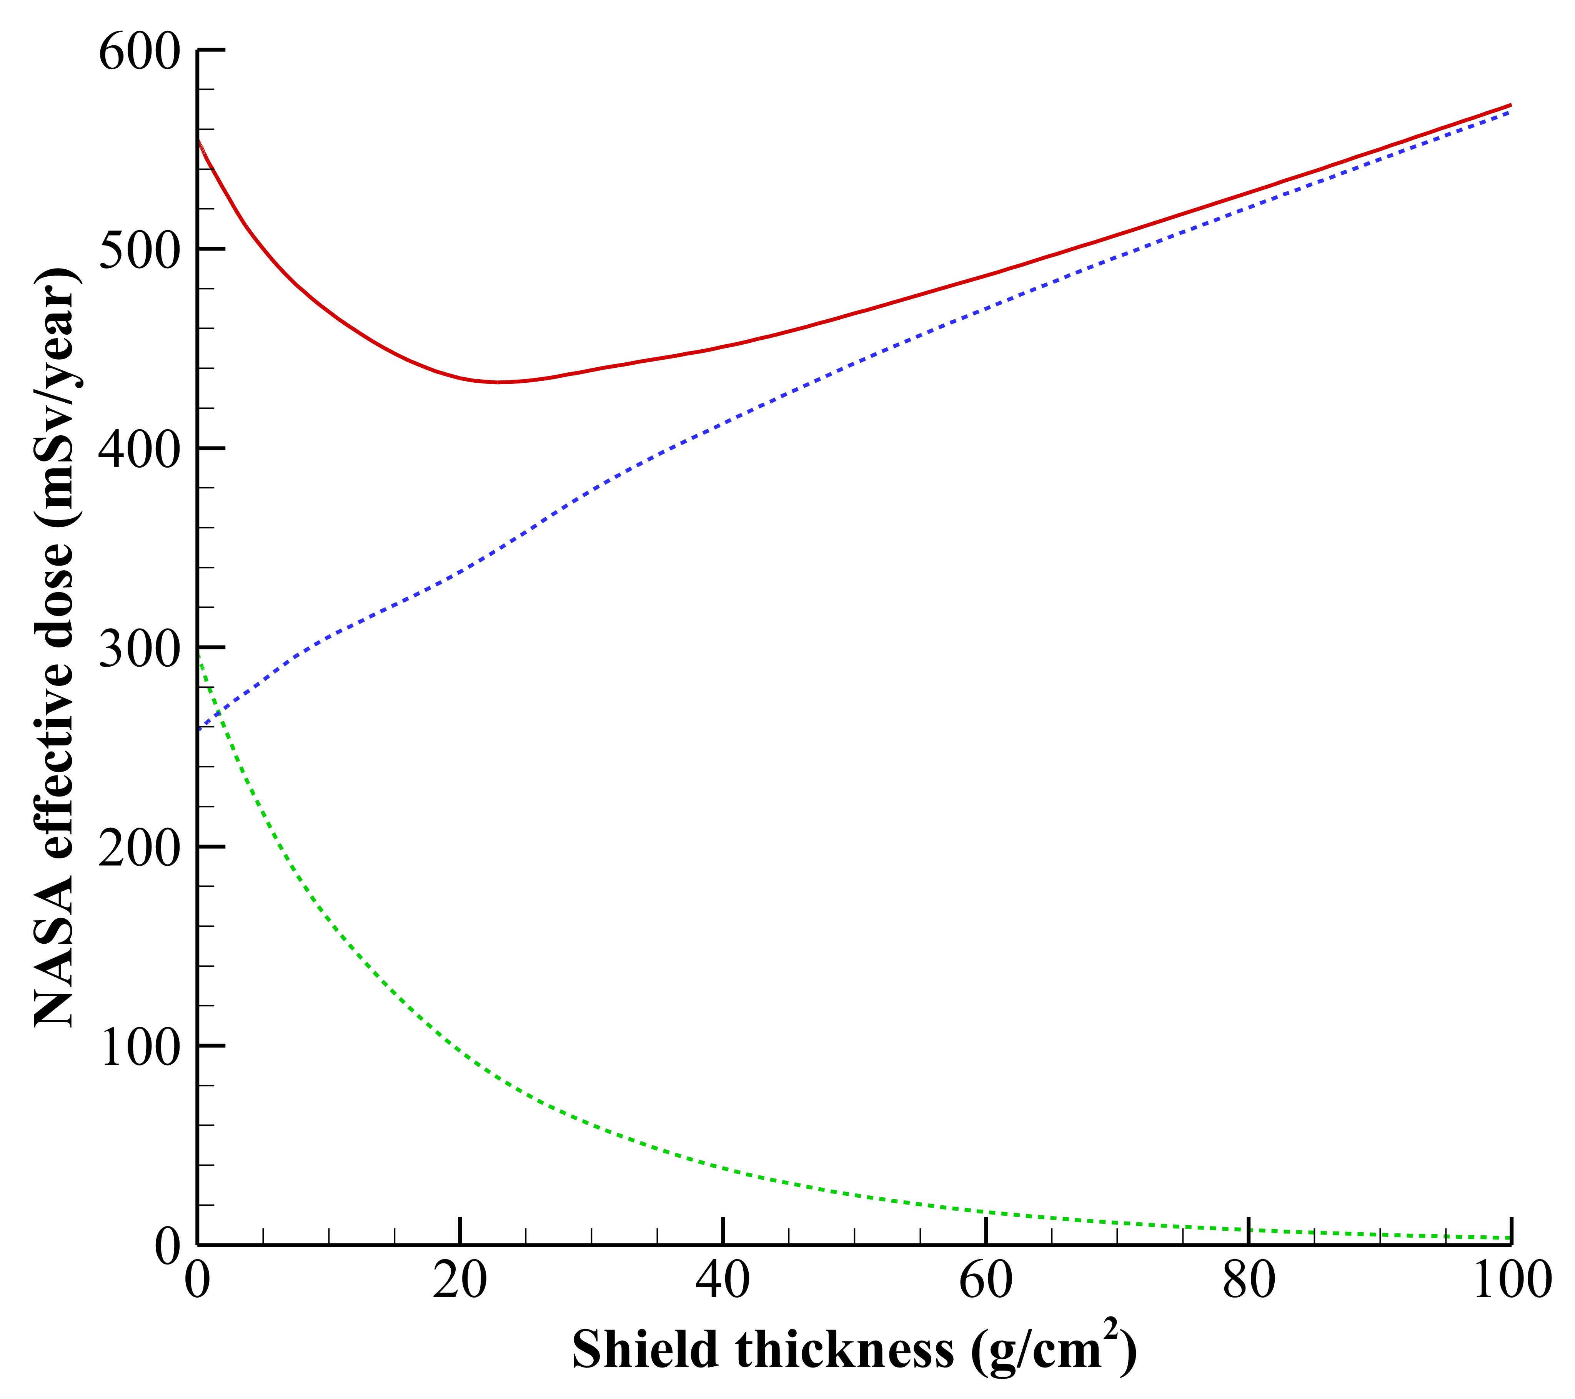
Vehicle Shielding in Free Space
Optimized vehicle shielding can reduce exposures by 10-15%
  10 – 30 g/cm² range
    Further optimization limited by physics/transport uncertainties and lack of spaceflight measurements
Radiation field behind thick shielding is dominated by secondary particles produced from nuclear collisions
  Heavier ions (e.g. heavier than ⁴He) suffer nuclear collisions and break-up into lighter particles and secondaries
  Secondary particles: gammas, electrons, positrons, muons, pions, neutrons and light ions
Measurements are needed to better understand the mixed radiation field behind thick shields
  Dose-depth for GCR beyond 100 g/cm²
  Neutron energy spectrum up to ~1 GeV
  Additional ground-based measurements
Free space
GCR effective dose vs depth
aluminum
Solar min
Light ion & secondary particle components
Secondaries: gammas, electrons, positrons,
muons, pions, neutrons, and light ions
Heavy ion components
Also needed to support lunar regolith thick shielding concepts

Slide 6
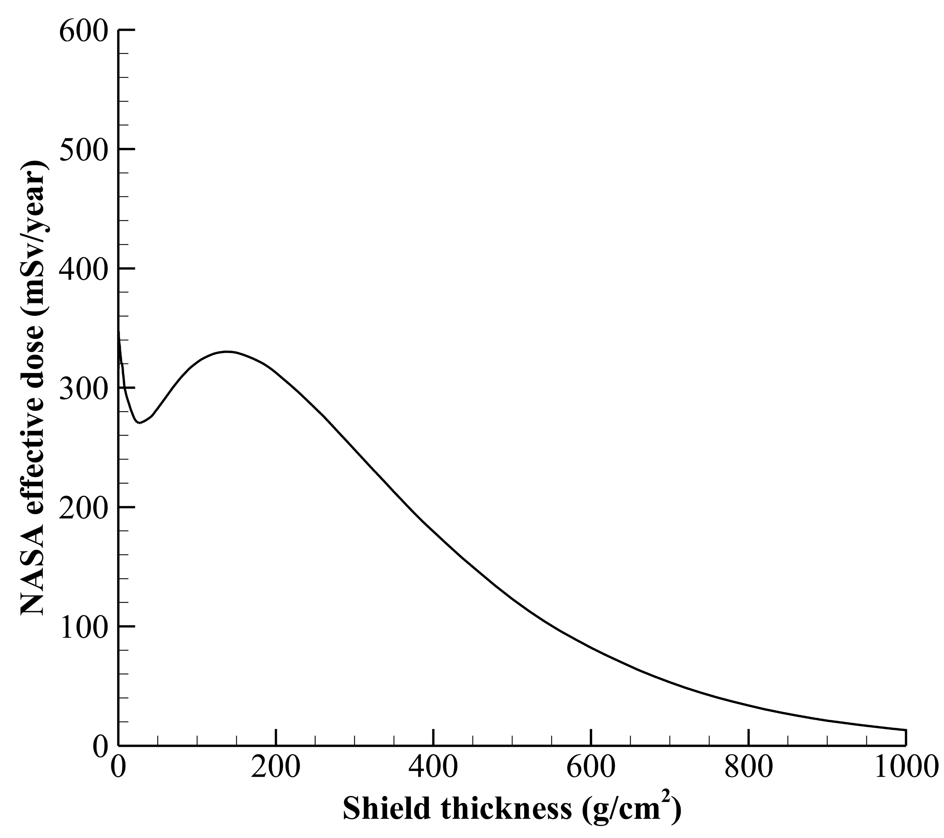
Thick Regolith Shielding on the Lunar Surface
Radiation exposure eventually decreases after 100 g/cm²
  Analog validation in the Earth’s atmosphere (~1000 g/cm2)
  Dose-rate measurements peak at ~60,000 ft (Pfotzer maximum)
Radiation physics and transport models have not been directly validated beyond 100 g/cm²
  Measurement campaign in 2016 focused on 20-60 g/cm² to validate local minimum for vehicle design space
  Measurements needed:
    In situ dose vs. depth (incremental from 20 g/cm² to >300 g/cm²)
    Neutron energy measurement
Current models suggest >300 g/cm² (~2 m) of regolith required to reach same shielding effectiveness as ~20 g/cm²
  Results not heavily dependent on regolith composition
  Local topology and geographic features may be utilized to achieve thick shielding levels
Lunar surface
GCR effective dose vs depth
No direct validation of physics models beyond 100 g/cm²
Rad. Worker limit on Earth (50 mSv/year)
Assumed homogeneous regolith composition and constant density of 1.6 g/cm³

Slide 7
Measurements Needed for Regolith Shielding
Radiation measurements behind thick shields exposed to GCR are needed to inform
  Sizing of thick shield concepts (>100 g/cm²) for vehicles/habitats in free space
  Regolith shielding concepts on the lunar surface
Ground-based experiments?
  Thick shield evaluations at ground-based facilities are challenging
  Need ultra-high energy beams (e.g. > 5 GeV) to recapitulate nuclear interactions as in space
  Need massive targets with large lateral dimensions (several meters) to reduce leakage effects as on the lunar surface
Measurements in lava tubes or drilled bore-holes?
  Lava tube/bore-hole radiation environments do not allow direct model validation
  Complex shielding distribution surrounding interior locations
  Uncertain shielding characteristics hinder model validation

Slide 8
Thick Shield Measurements
Humans and Robotics needed to conduct lunar shield experiment
  Dose measurement: Detector system positioned under increasingly thick hemispherical layers of regolith - measure radiation attenuation as a function of thickness
  Constructed shielding: Regolith excavation and in-situ manufacturing/construction used to achieve uniform hemispherical thicknesses between 20 g/cm² to >100 g/cm²
  Site Survey: Perform measurement far enough away from lander/habitat and large topographical features to avoid ambiguity in shielding and dose measurements
  Shielding: Measure regolith composition and density and confirm uniform thickness either visually or with technologies such as ground penetrating radar
  Concept of operations:
    Needed to optimize human robotic interactions, coordination with other surface ops
    Additional resources available such as power, data transmission, crew dosimetry systems, and ability to consider multiple measurements sites simultaneously
Incrementally stacked regolith layers
Detector suite

Slide 9
Summary
Radiation measurements behind thick shields exposed to GCR are needed to
  validate radiation physics and transport models
  enable sizing of thick shield concepts (>100 g/cm²) for vehicles/habitats in free space
  enable regolith shielding concept evaluation on the lunar surface
Current models suggest >300 g/cm² (~2 m) of regolith required to reach same shielding effectiveness as ~20 g/cm²
    Model predictions beyond 100 g/cm² have not been validated and are uncertain at this time
Measurements needed
    In situ dose-depth based on hemispherical regolith shielding concept
    Neutron energy spectrum

Slide 10
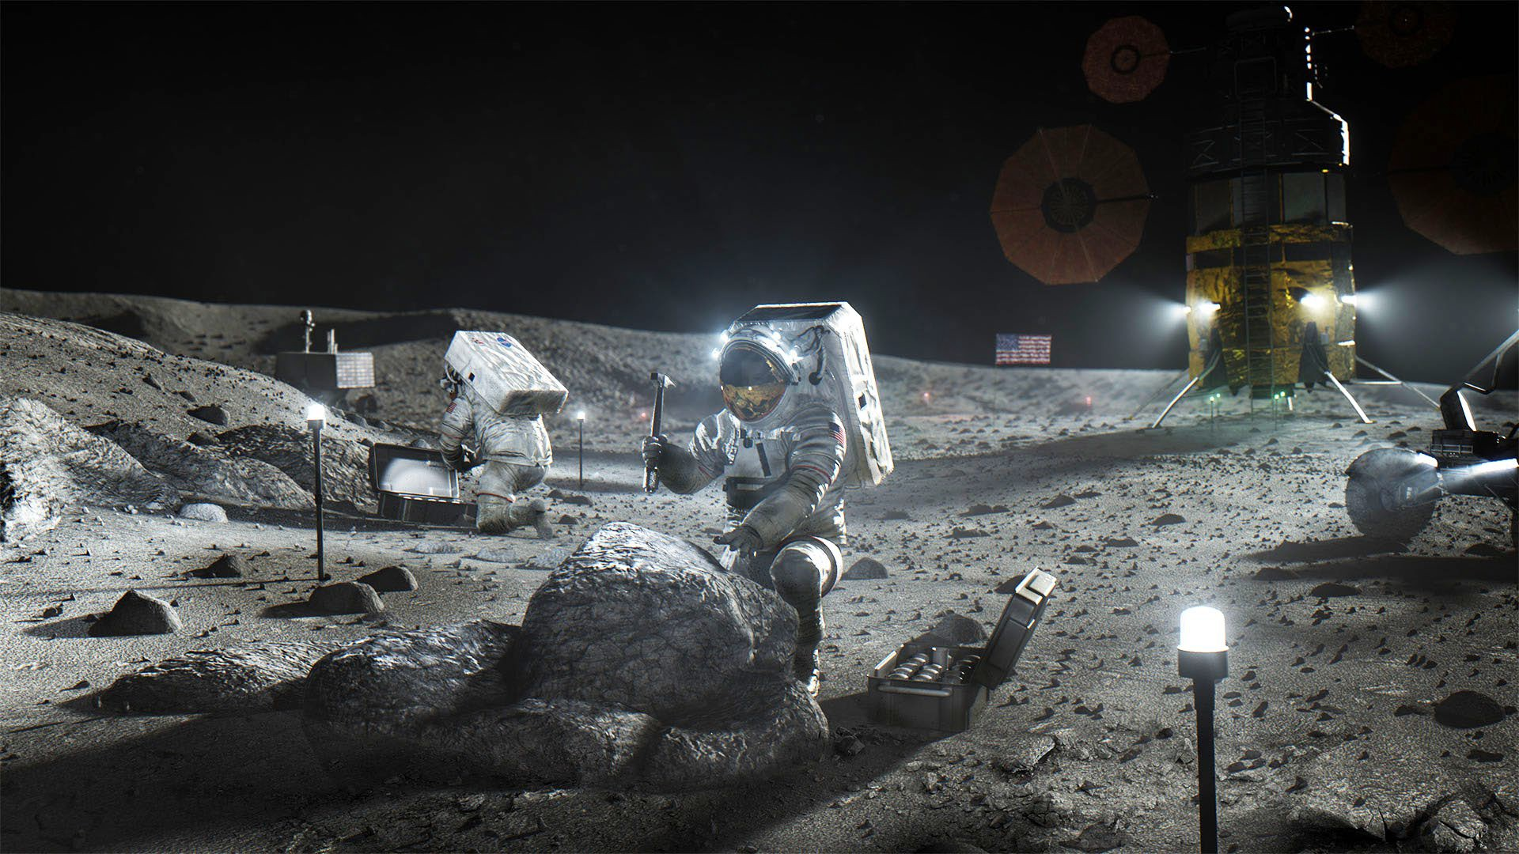
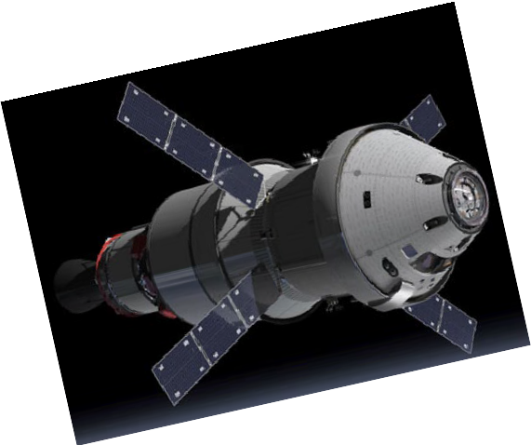
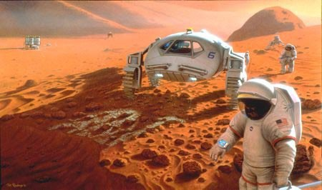
Questions?
Image Credit: NASA Artemis JM 058
Image Credit: NASA/Pat Rawlings, SAIC

