Slide 1


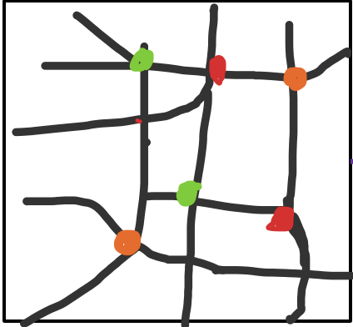







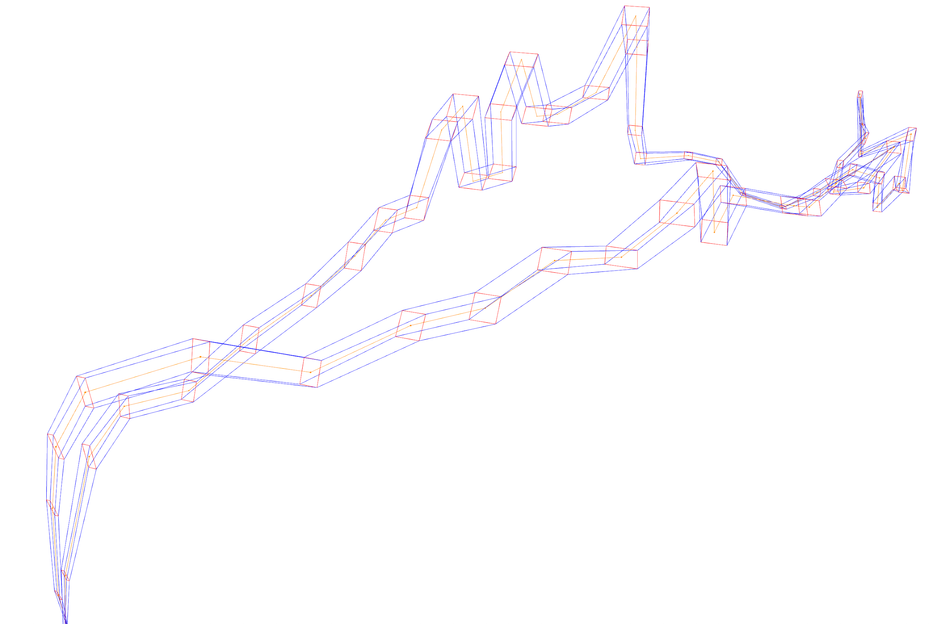
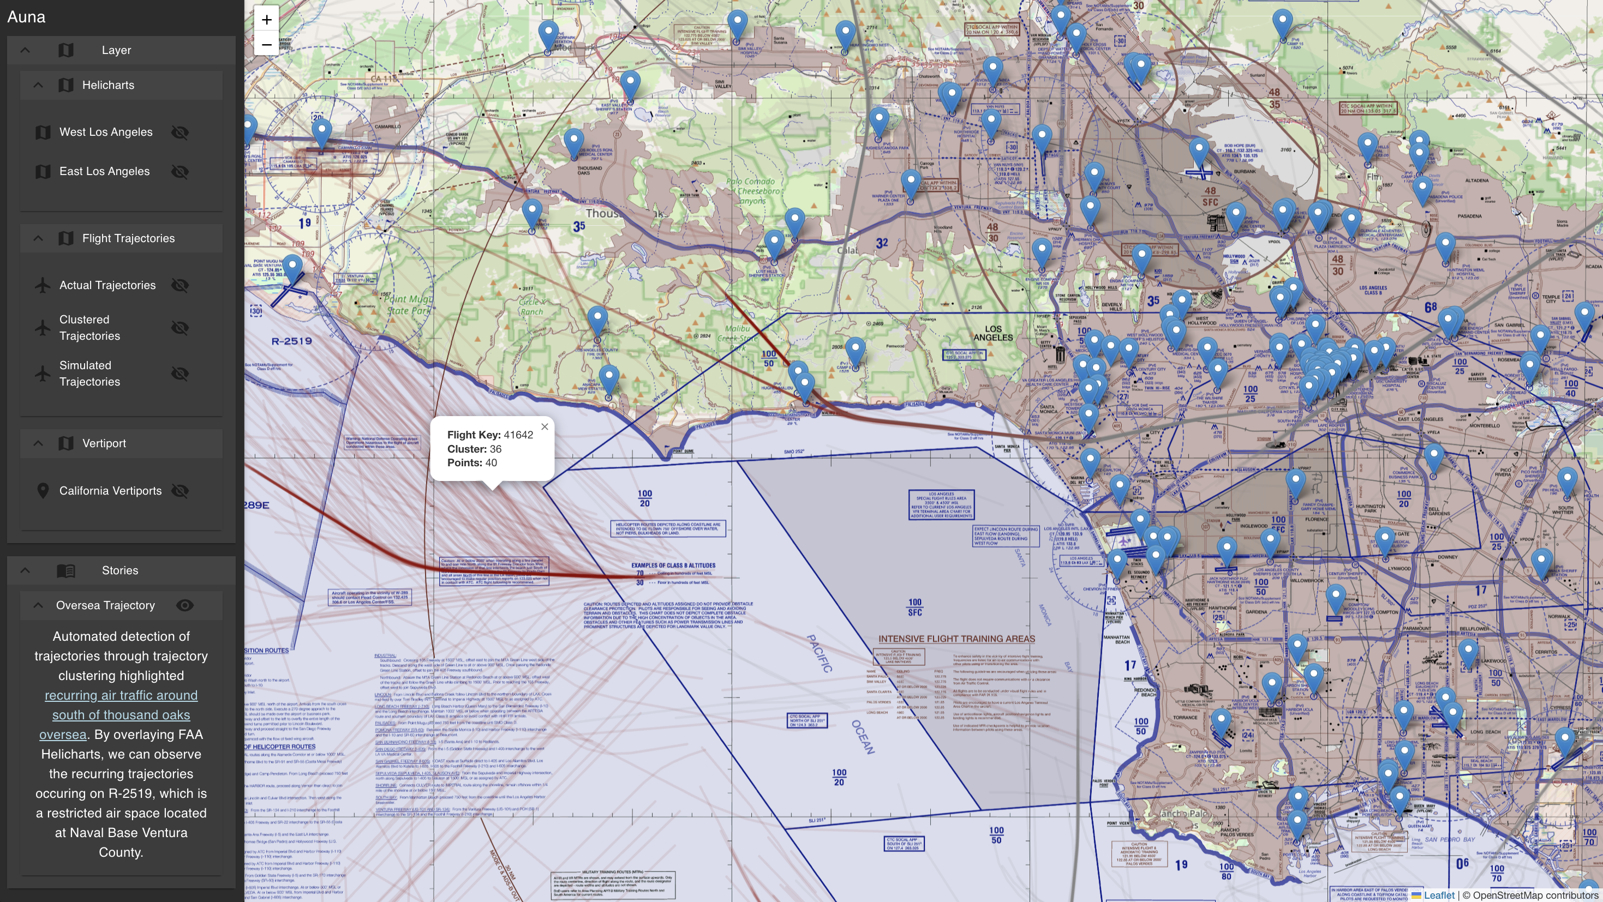



Modeling Existing Urban Air Mobility Operations for Transportation Network Congestion
Yair Guerrero
University of Illinois at Urbana-Champaign
Carlos Paradis
KBR @ NASA Ames Research Center
Misty Davies
NASA Ames Research Center
Synthetic Population
SYNTHETIC POPULATION
GROUND NETWORK
UAM NETWORK
UAM Network
A synthetic population is derived from census and travel survey data. The data is processed to represent an approximation of the real world in respect to where people live, the modes of transportation available for commute and the destination of the commute (e.g. home, work, school). This is represented as the agent plan.
OpenStreetMap
Sherlock
Database
The UAM network is derived from existing urban air mobility traffic (e.g. air taxis, tourism). Utilizing trajectory clustering methods to identify “highways in the sky”, we construct a network of recurring flight path links, and vertiport nodes. To supplement the location of existing vertiports, FAA vertiport metadata is used to add existing ground stations (serving similar purpose to bus stops for air taxi mobility).
Census Data
ftKey
lat
lon
American Census
Survey
California Household
Travel Survey
Public Transportation Schedule
1
timestamp
clusterID
FAA
Vertiport
1
2
3
Agents
Corridor Clustering
Gender
Age
Household
Gender
Age
…
nodes.csv
links.csv
Stations.csv
vehicles.csv
Visualization
Ground Network
Network.xml
Transit.xml
Auna Visualization contains a suite of tools to better understand the various parts of the simulation pipeline. The 3D Trajectory Geometry utilizes both actual and simulated air traffic to derive an interactive reconstruction of the UAM network corridors.
Auna’s layers and stories allow the overlay of additional metadata such as helicharts, which contain recommended helicopter air traffic route in congested areas, which can then be compared to chosen simulation trajectories.
The trajectory reconstruction can be used to inspect and replay a given agent’s chosen route in a specific iteration of the simulation.
The ground network is derived from maps (i.e. roads, buildings) and public transport schedules. This information is represented as a network of street intersection nodes, and street links, which the synthetic population can use to commute.
Agent_Plan.xml
MATSIM UAM
SIMULATION
UAM_Network.xml
MatSIM-UAM Simulation
Auna Visualization
By combining the synthetic population, ground network, and UAM network, in MatSIM-UAM in high-traffic urban areas, different scenarios of ground and urban air mobility modes of transportation can be simulated, where the population chooses personal best route on each iteration, facilitating traffic analysis.
Config.xml
3D Trajectory Geometry
References
…
metadata.json
{
"type": "Feature",
"id": 1,
"geometry": {
"type": "Polygon",
"coordinates": [
[
[-118.245...
[-118.234…
[-118.224…
Acknowledgement
1. Rothfeld, Raoul Leander. "Agent-based Modelling and Simulation of Urban Air Mobility Operation." PhD diss., Ph. D. thesis, Technische Universität München, 2021.
2. Balac, Milos, and Sebastian Hörl. "Synthetic population for the state of California based on open-data: examples of San Francisco Bay area and San Diego County." In 100th Annual Meeting of the Transportation Research Board (TRB). 2021.
3. Paradis, Carlos, and Misty D. Davies. "Visualizing Corridors in Terminal Airspace using Trajectory Clustering." In 2022 IEEE/AIAA 41st Digital Avionics Systems Conference (DASC), pp. 1-9. IEEE, 2022.
4. Identifying, Simulating and Visualizing Highways in the Sky: https://ntrs.nasa.gov/citations/20250005662
Iteration N
Iteration 1
Standardized Frontend GeoJSON
Format [.geojson]
Layers and Stories
t=1
t=2
Iter_1.experienced_plans.xml
Iter_N.experienced_plans.xml
t=3
t=4
Trajectory Reconstruction
Contact: carlos.v.paradis@nasa.gov

