Slide 1

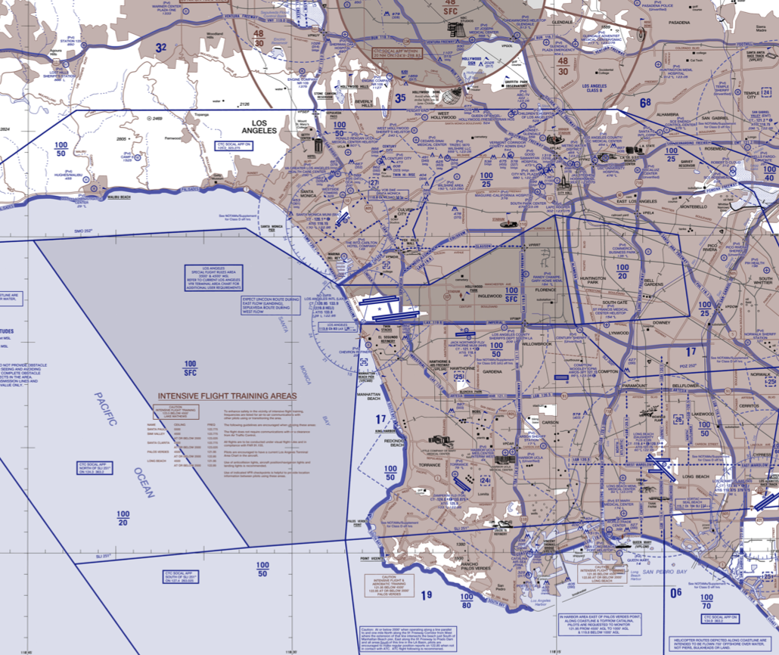
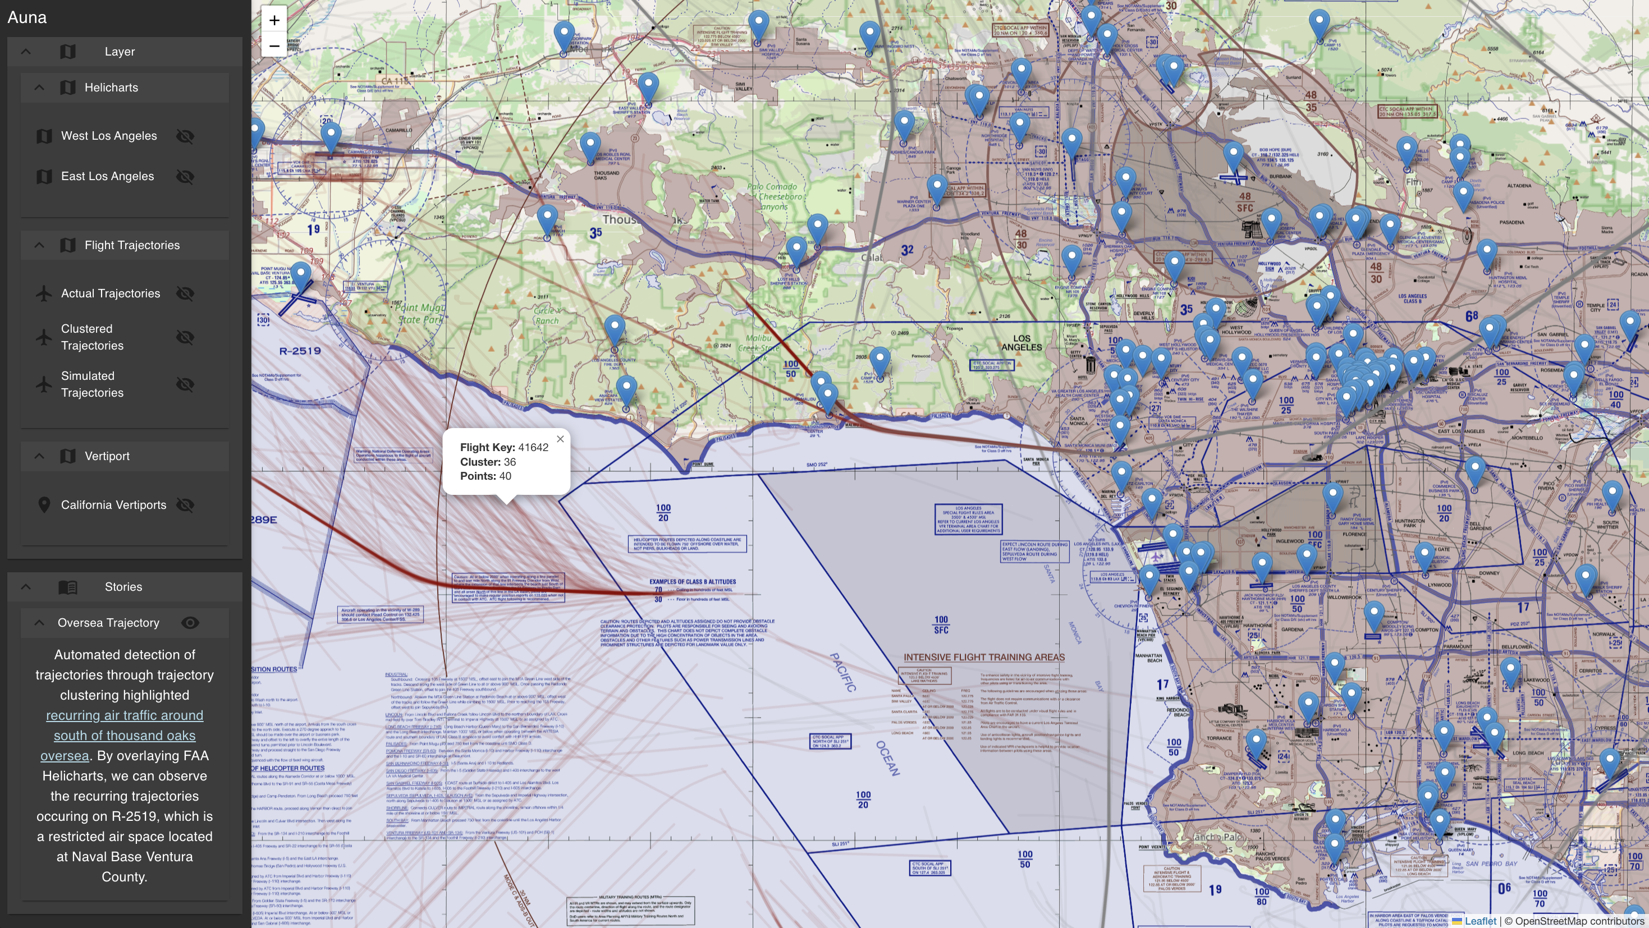






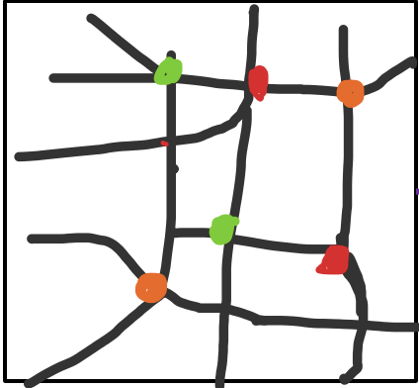







Auna: A Configuration Driven Geospatial System for Multimodal Mobility
Kiana Partovi
University of Nevada Reno
Vedant Malhotra
University of Nevada Reno
Carlos Paradis
KBR @ NASA Ames Research Center
Misty Davies
NASA Ames Research Center
Maps and Statistics
Config and Databases
Corridor Clustering
Auna integrates geospatial datasets from multiple sources. The maps & statistics pipeline processes maps, polygons (e.g. regional statistics), lines (e.g. air traffics), and points (e.g. vertiports) and displays them as layers.
Configuration files are used to customize database data as layers. Each data pipeline is documented as Python Notebooks and scripts. The data pipelines output a standardized data format for Auna frontend.
Auna can identify recurring flight paths over time (candidate corridors) using trajectory clustering. These clusters can then be display on Auna’s interface as layers for exploring or explaining as stories.
CONFIG
Auna
auna.yml
CORRIDOR CLUSTERING
Corridor Simulation
MAPS AND STATISTICS
asrs.yml
esea.yml
ftKey
lat
lon
timestamp
ftKey
CORRIDOR CLUSTERING
Auna is a configuration-driven interface where geospatial data sources are displayed as layers or stories. The configuration file defines the path to the required data sources, layers, and stories to be displayed on runtime. Together, Auna can be tailored to specific project needs.
1
1
lat1
lon1
lat2
lon2
…
latn
lonn
Once corridors are identified, Auna can export these corridors as an air traffic network graph for different scenario simulations. The air traffic network is then combined with ground traffic network and agent plans derived from census and other map data to generate realistic agent-based travel plans using UAM Simulation tools.
The simulation models agents navigating a hybrid network of air and ground traffic subject to the placement of vertiports. On each iteration, the agents (people) use different modes of transportation to find their optimal route. Each iteration can be displayed in Auna as a layer to visualize the optimal configuration for vertiports.
Python Notebook [.ipynb]
DATABASES
1
2
2
3
KMZ
CSV
GEOTIFF
3
KML
GEOJSON
Geo
Flight Track Points
4
Standardized GeoTIFF
Format [.tiff]
Standardized Frontend GeoJSON
Format [.geojson]
Data
Standardized Frontend GeoJSON
Format [.geojson]
Flight Trajectories
clustering
Layers
metadata.json
{
"type": "Feature",
"id": 1,
"geometry": {
"type": "Polygon",
"coordinates": [
[
[-118.245...
  [-118.234…
[-118.238…
[-118.224…
ASRS
ESEA
metadata.json
{
"type": "Feature",
"id": 1,
"geometry": {
"type": "Polygon",
"coordinates": [
[
[-118.245...
  [-118.234…
[-118.238…
[-118.224…
ftKey
lat
lon
timestamp
clusterID
1
Each geospatial dataset is represented as a “Standardized Frontend GeoJSON”. Layers can be toggled on and off for data exploration.
1
2
3
Stories
CORRIDOR SIMULATION
Stories are pre-defined sets of layers that can jointly be toggled on and off. They are accompanied by a text description and set of keywords that highlight a map region to explain patterns.
metadata.json
{
"type": "Feature",
"id": 1,
"geometry": {
"type": "Polygon",
"coordinates": [
[
[-118.245...
  [-118.234…
[-118.238…
[-118.224…
Air Traffic Network
Census Data
MatSIM UAM
Agent Plan.xml
California Household Travel Survey
Standardized Frontend GeoJSON
Format [.geojson]
Iter. 0
Iter. 3
Iter. 5
Iter. 1
Iter. 4
Ground Traffic Network
(OpenStreetMap)
American Census Survey (Work)
References
Acknowledgements
1. Rothfeld, Raoul Leander. "Agent-based Modelling and Simulation of Urban Air Mobility Operation." PhD diss., Ph. D. thesis, Technische Universität München, 2021.
2. Rothfeld, Raoul, Milos Balac, Kay O. Ploetner, and Constantinos Antoniou. "Agent-based simulation of urban air mobility." In 2018 Modeling and Simulation Technologies Conference, p. 3891. 2018.
3. Rothfeld, Raoul, Mengying Fu, Miloš Balać, and Constantinos Antoniou. "Potential urban air mobility travel time savings: An exploratory analysis of munich, paris, and san francisco." Sustainability 13, no. 4 (2021): 2217.
4. Balac, Milos, and Sebastian Hörl. "Synthetic population for the state of California based on open-data: examples of San Francisco Bay area and San Diego County." In 100th Annual Meeting of the Transportation Research Board (TRB). 2021.
5. C. Paradis and M. D. Davies, "Visualizing Corridors in Terminal Airspace using Trajectory Clustering," 2022 IEEE/AIAA 41st Digital Avionics Systems Conference (DASC), Portsmouth, VA, USA, 2022, pp. 1-9, doi: 10.1109/DASC55683.2022.9925823.
6. Identifying, Simulating and Visualizing Highways in the Sky: https://ntrs.nasa.gov/citations/20250005662
Contact: carlos.v.paradis@nasa.gov

