Slide 1

Segmented Replicated X-ray Optics (SRXO): A concept for future flagship X-ray telescope
Panini S. Singam¹, David D. Smith², Jessica A. Gaskin², Stephen D. Bongiorno², Danielle N. Gurgew¹, David A. Banks², Amy Meekham³, Julian Torstenson⁴ ,Nicholas E. Thomas²,Walter P. Maksym², Kirtan P. Dixit⁵, Brian D.Ramsey^{2.}
¹ Science and Technology Institute, Universities Space Research Association.
² NASA- Marshall Space Flight Center.
³Amentum- NASA Marshall
⁴ New Century Technology High School.
⁵ NASA postdoc program fellow- Oak Ridge Associated Universities.

Slide 2
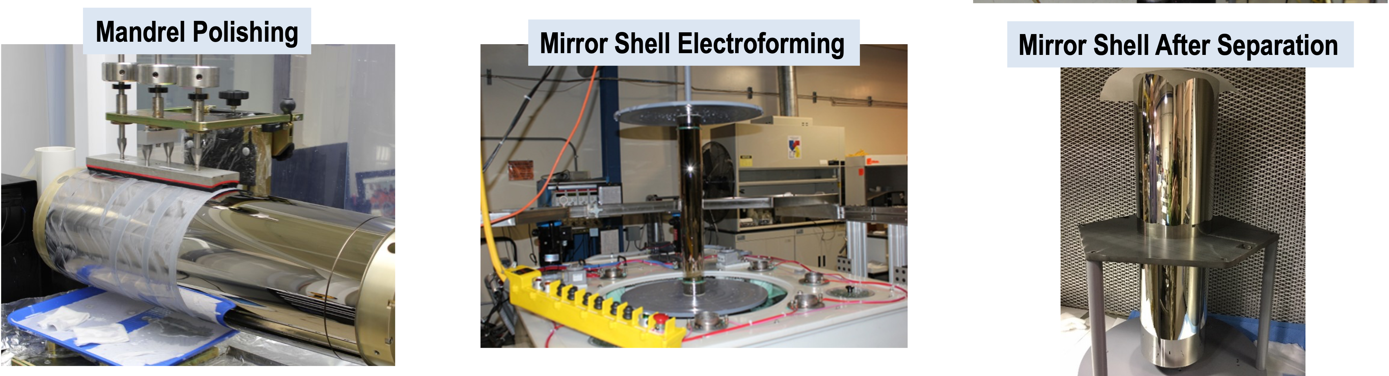
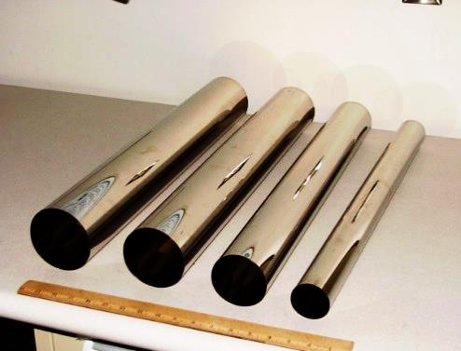
Replicated full shell X-ray optics at NASA-MSFC
Full shell geometry.
Structurally stable geometry.
Reduced alignment errors.
Good endurance with coating and deposition stresses.
High resolution mandrel polishing.
Excellent control on replication process.
Favors multiple module design to increase the effective area.
Over 3 decades of experience.
Flight experience.

Slide 3
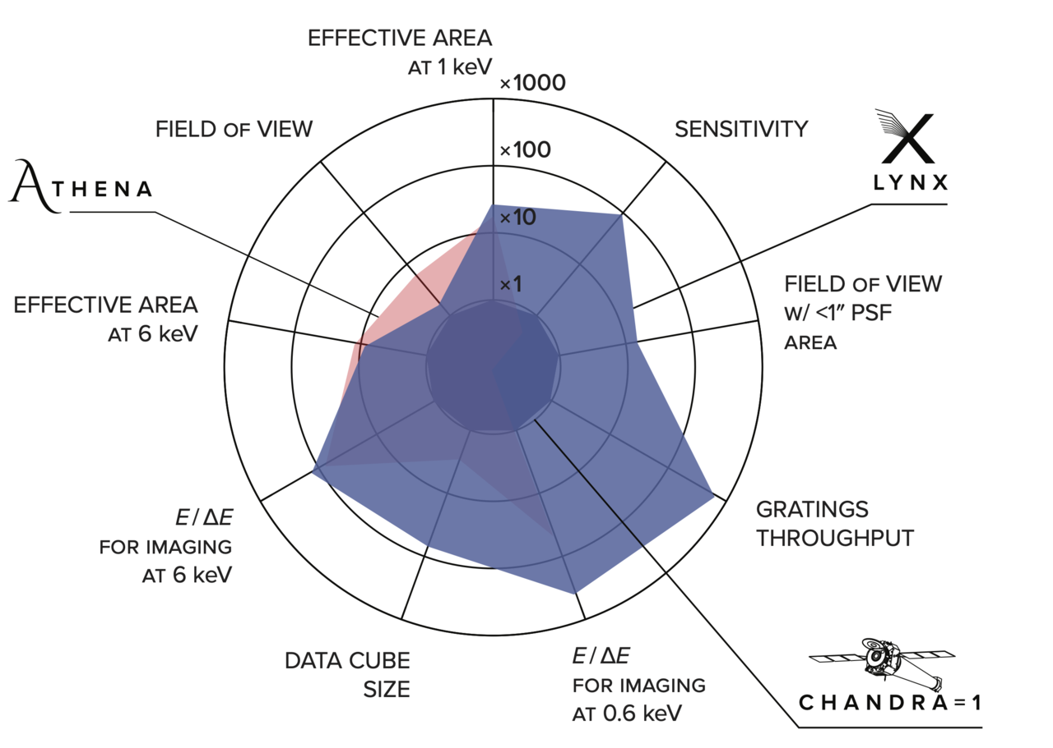
Future X-ray flagship requirement
Science Requirements
Large effective area: ~ 2 Sq.m @ 1keV.
High resolution: 0.5”
Flat FOV-HPD response: sub arcsec over 10’
High spectral resolution: ~300 at 0.6 keV.
Instrument Requirements
Large area X-ray optics: Large diameter mirrors.
High resolution optics: Tigh control over polishing and alignment errors.
Wolter Schwarzschild configuration.
Micro calorimeter: Single focal plane (Single mirror module).
Full shell X-ray optics provides high resolution imaging.
Achieves large effective area by building multiple modules.
Multiple modules down scales effective polishing per module.
High resolution large diameter shells (>1 m) are expensive and currently have low TRL.

Slide 4
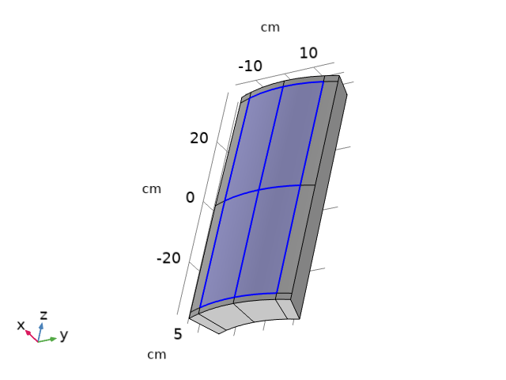
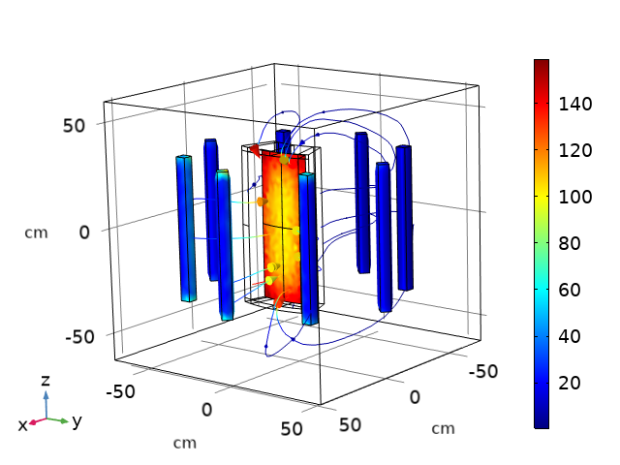
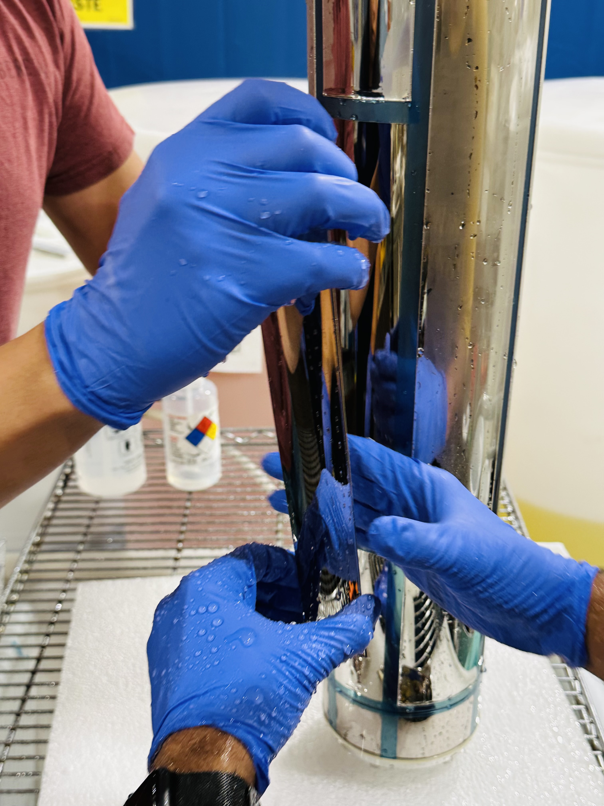
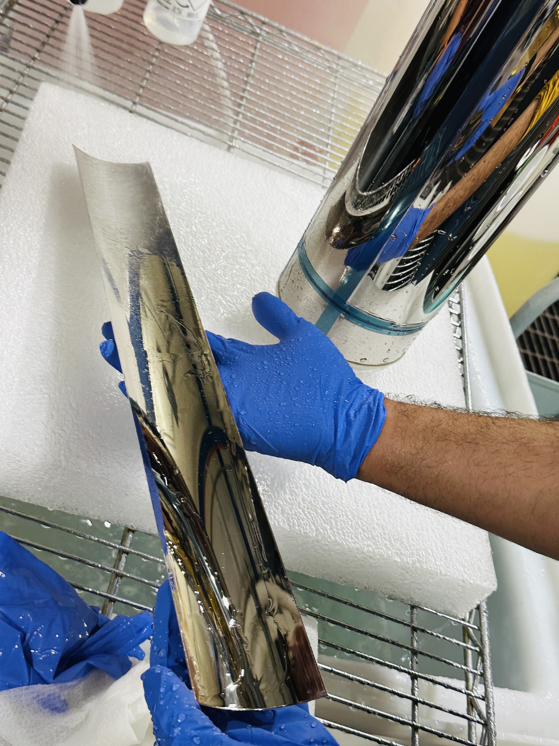
Concept of Replicated Segmented X-ray optics
1. Super polish a segmented mandrel
2. Electroforming NiCo on segmented mandrel
3. Segment separation
4. A segment with parabolic and hyperbolic portions.
Banking on in-house experience in high resolution mandrel polishing.
Deep understanding of electroforming process.
Reuse the segment mandrel to make multiple segments.

Slide 5
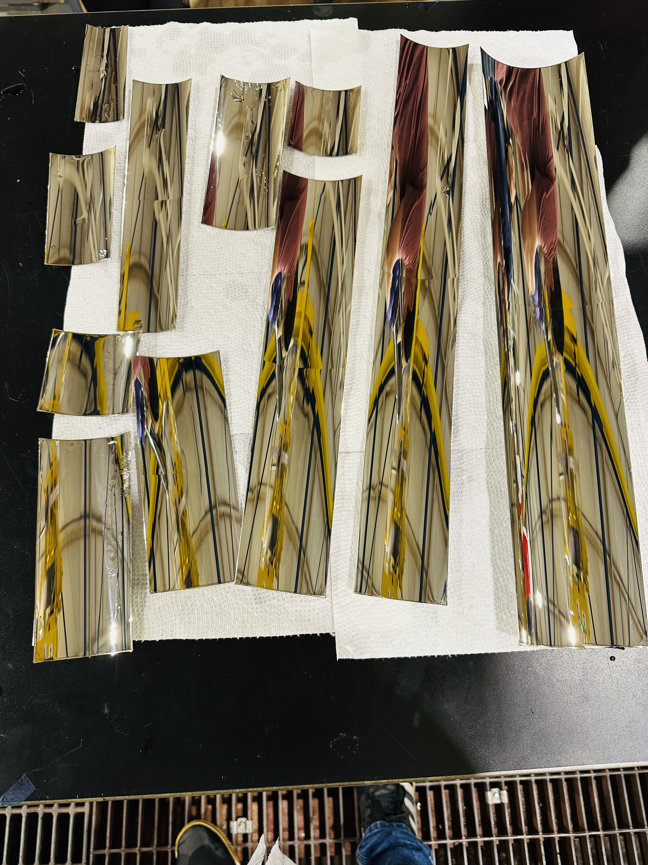
Key features of SRXO
Advantages
Challenges
Ability to handle large diameter optics.
Ability to direct polish segments.
Mandrel polishing efficiency.
Combined P and H segments.
Larger segment lengths. Improved high energy sensitivity.
Harder to align and mount the optics.
More sensitive to coating and electroforming stresses.
Low(er) TRL.
MSFC Heritage
Mandrel polishing experience.
Replication experience.
Alignment and mounting experience.
Delivering flight optics experience.
Replicated segments
Notes:
Challenges

Slide 6
Conceptual design comparison for Lynx
 | Si meta shells (from literature) | Full shell X-ray optics (concept) | SRXO (concept)
Number of shells | 611 mod. & 12 meta shells | 200 | 280
D_{min}-D_{max} | 24 cm-300 cm | 20 cm-281 | 20 cm- 252 cm
Thickness | 0.5 mm | 0.9 mm – 5.3 mm | 0.5 mm
Number of segments | 37,492 | 200 | ~6500
Total surface area | 374 sq. m | 201 sq. m | 260 sq .m
Total polishing surface area | 374 sq. m | 201 sq. m | 20 sq. m
Weight | 2,035 kg | 16,238.3 kg (1/3rd for Mount) | 4,624 kg (1/2 for Mount)
Max. graze angle | 2.13º | 2º | 1.8º
EA@ 1 keV | 21,000 cm² | 20,456 cm² @10% loss | 21,219 cm² @25% loss
EA @ 6 keV | 2,000 cm² | 2,660 cm² @10% loss | 3,316 cm² @25% loss
EA @ 10 keV | 600 cm² | 1,063 cm² @10% loss | 1,305 cm² @25% loss
The conceptual designs of Full shell and SRXO for Lynx are preliminary and are made for comparison.
SRXO uses Full shell concept uses mirrors with axial length of 30 cm which are not optimal for inner shells given the flat resolution requirements for large fields.
Notes:
The conceptual designs of Full shell and SRXO for Lynx are preliminary and are made for comparison.
SRXO uses Full shell concept uses mirrors with axial length of 30 cm which are not optimal for inner shells given the flat resolution requirements for large fields.

Slide 7
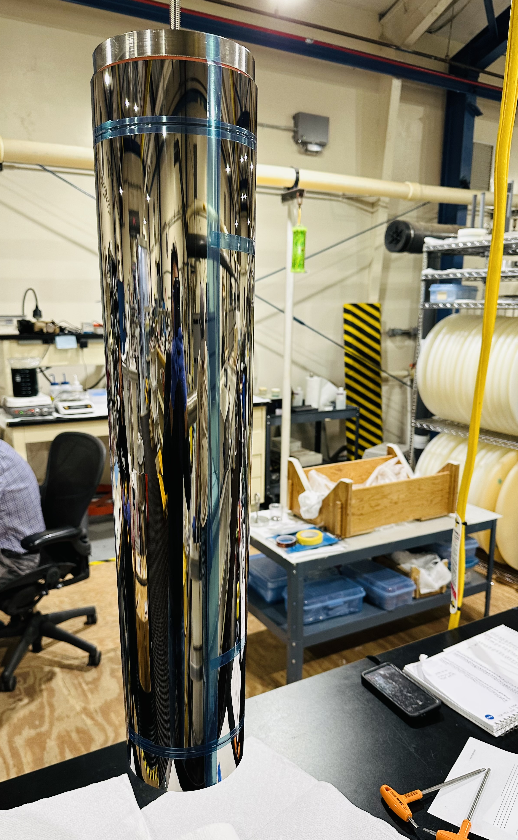
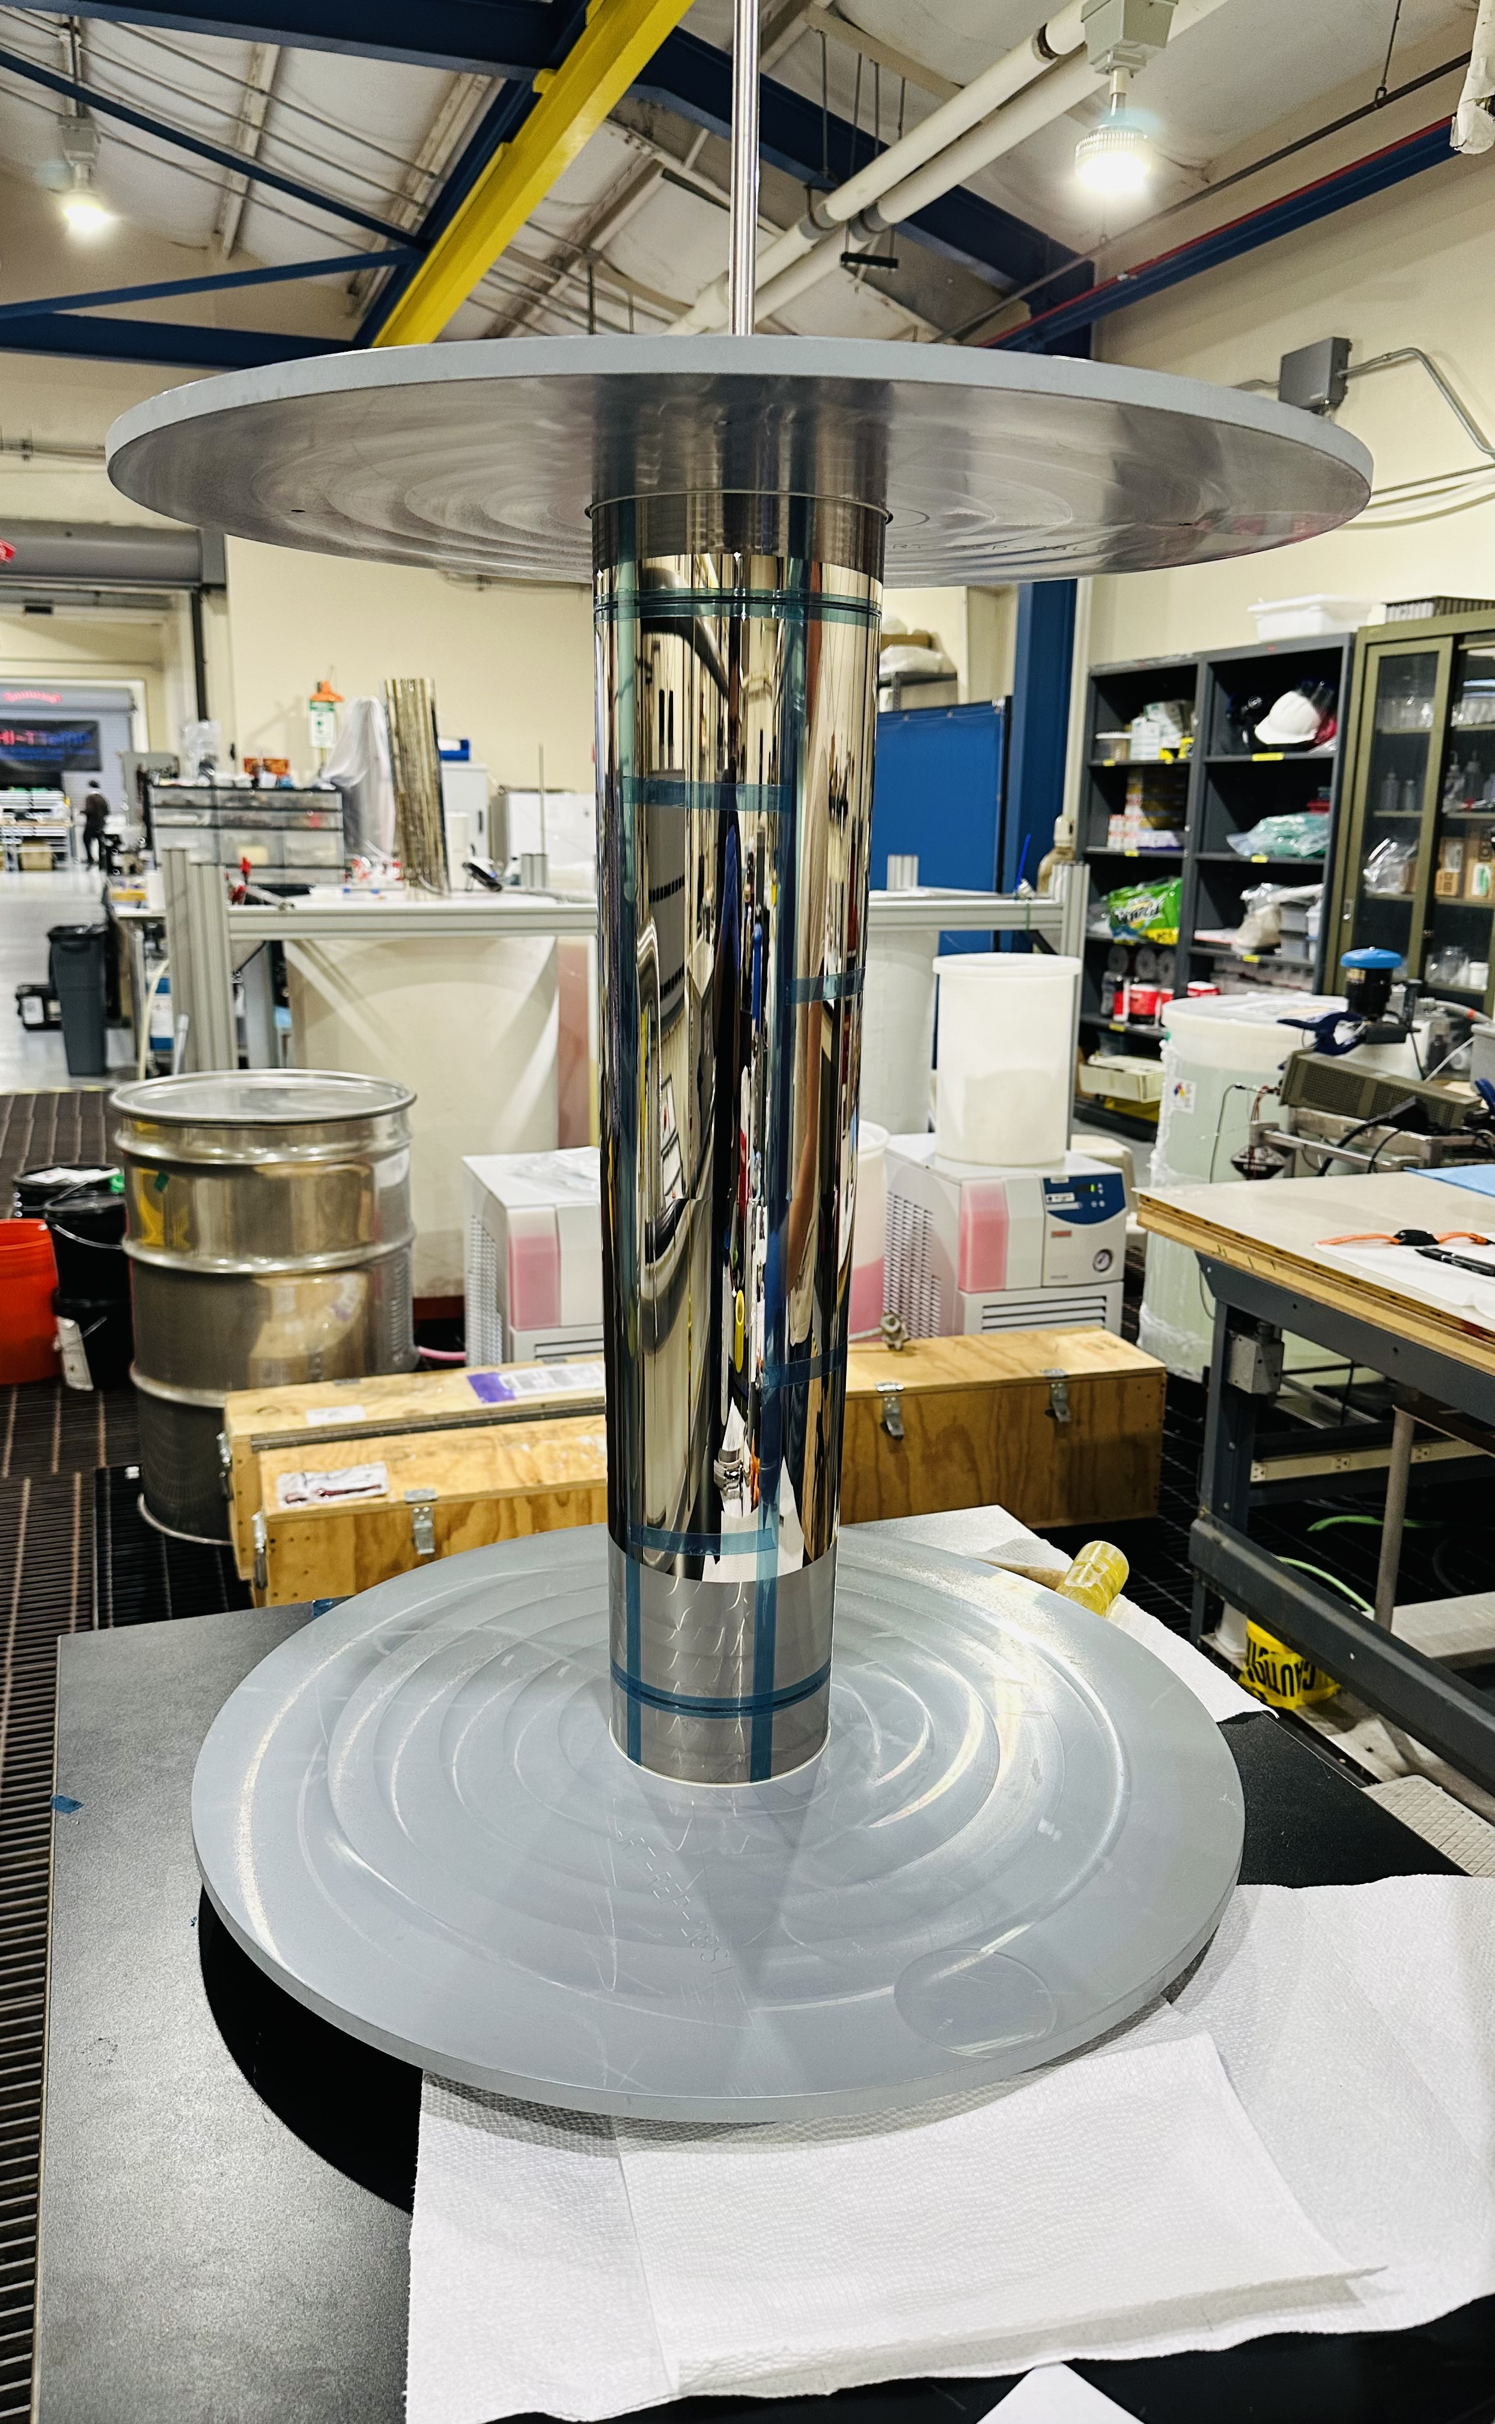
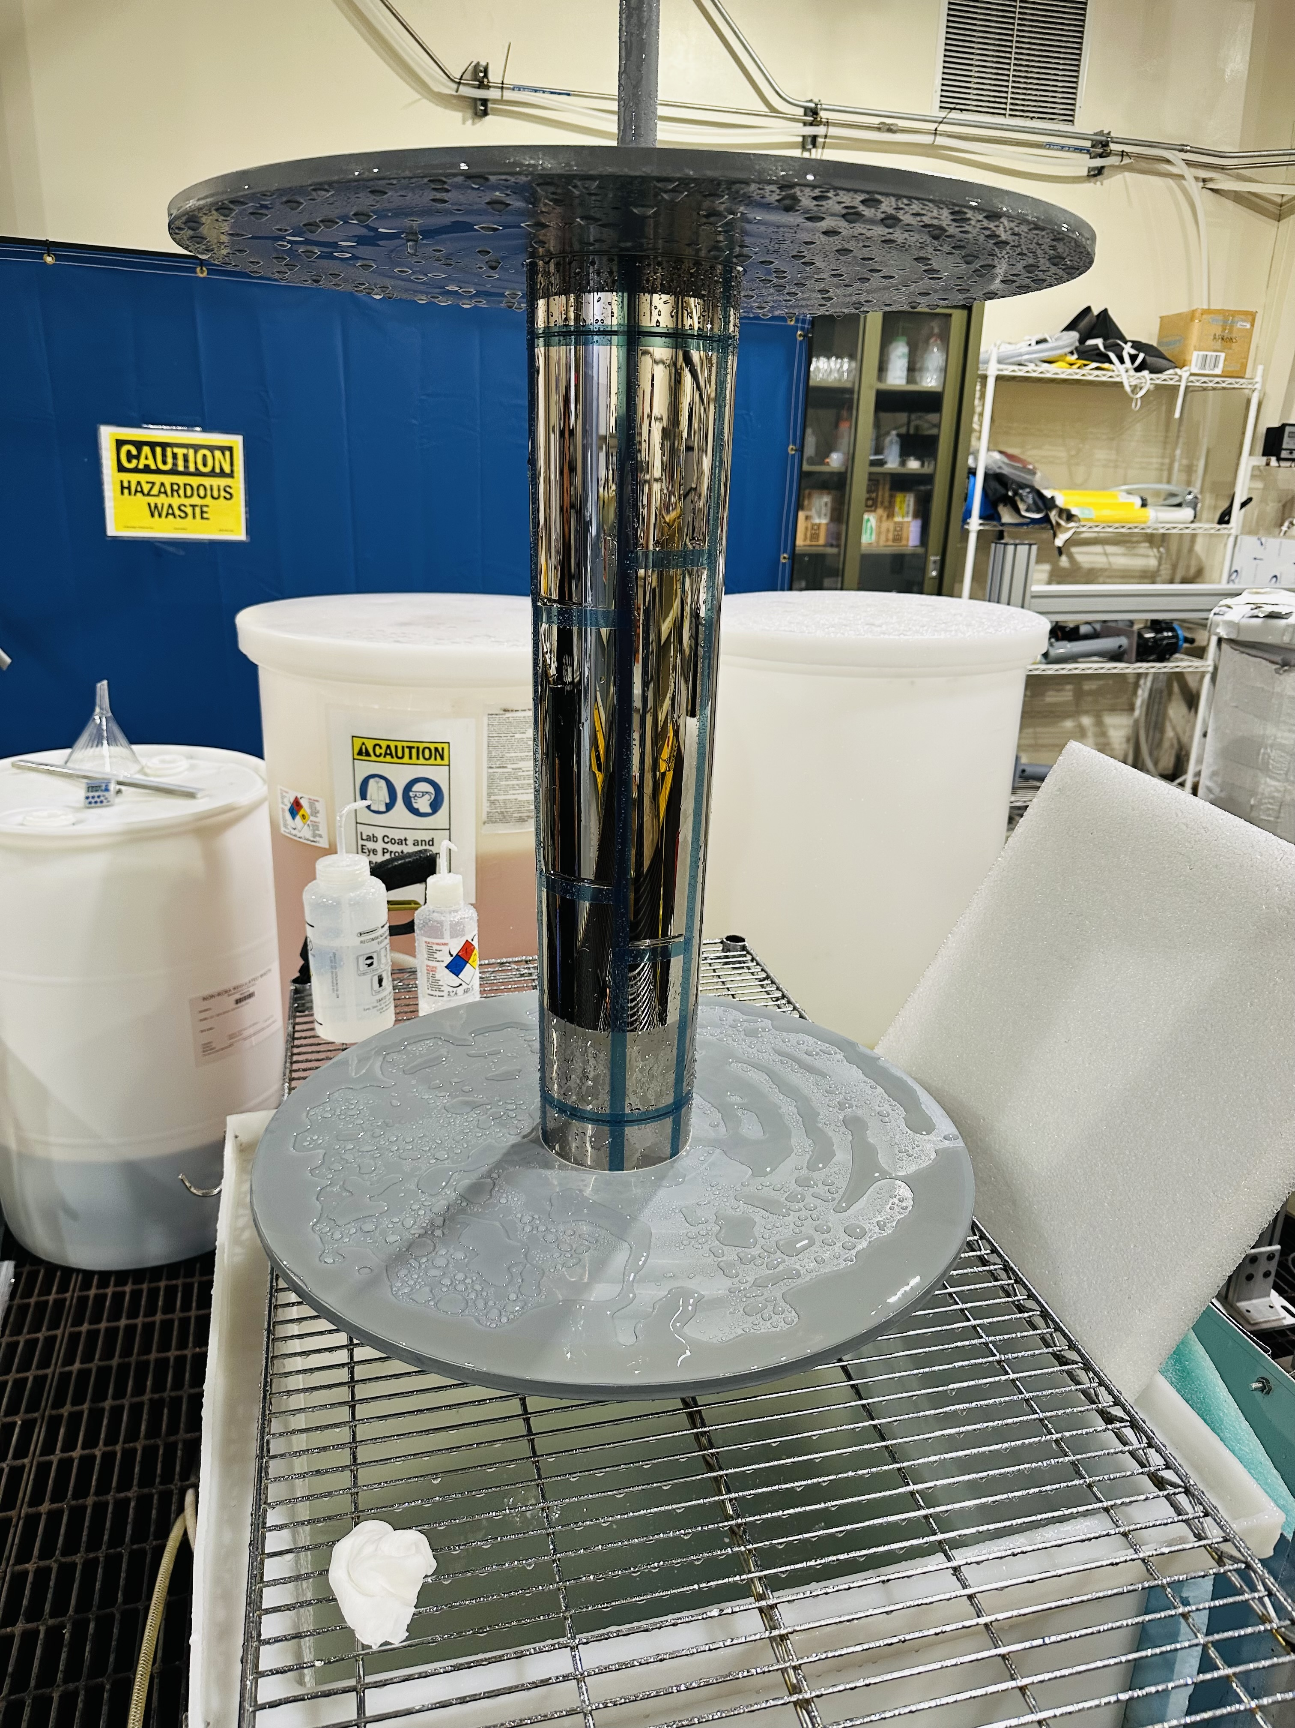
Fabrication of prototype segments
Used existing full shell mandrel to replicate segments.
a. Used insulating tape to define the segment boundaries
b. Install plating hardware and shields to control the e-field
c. Coat the potassium dichromate release layer.

Slide 8
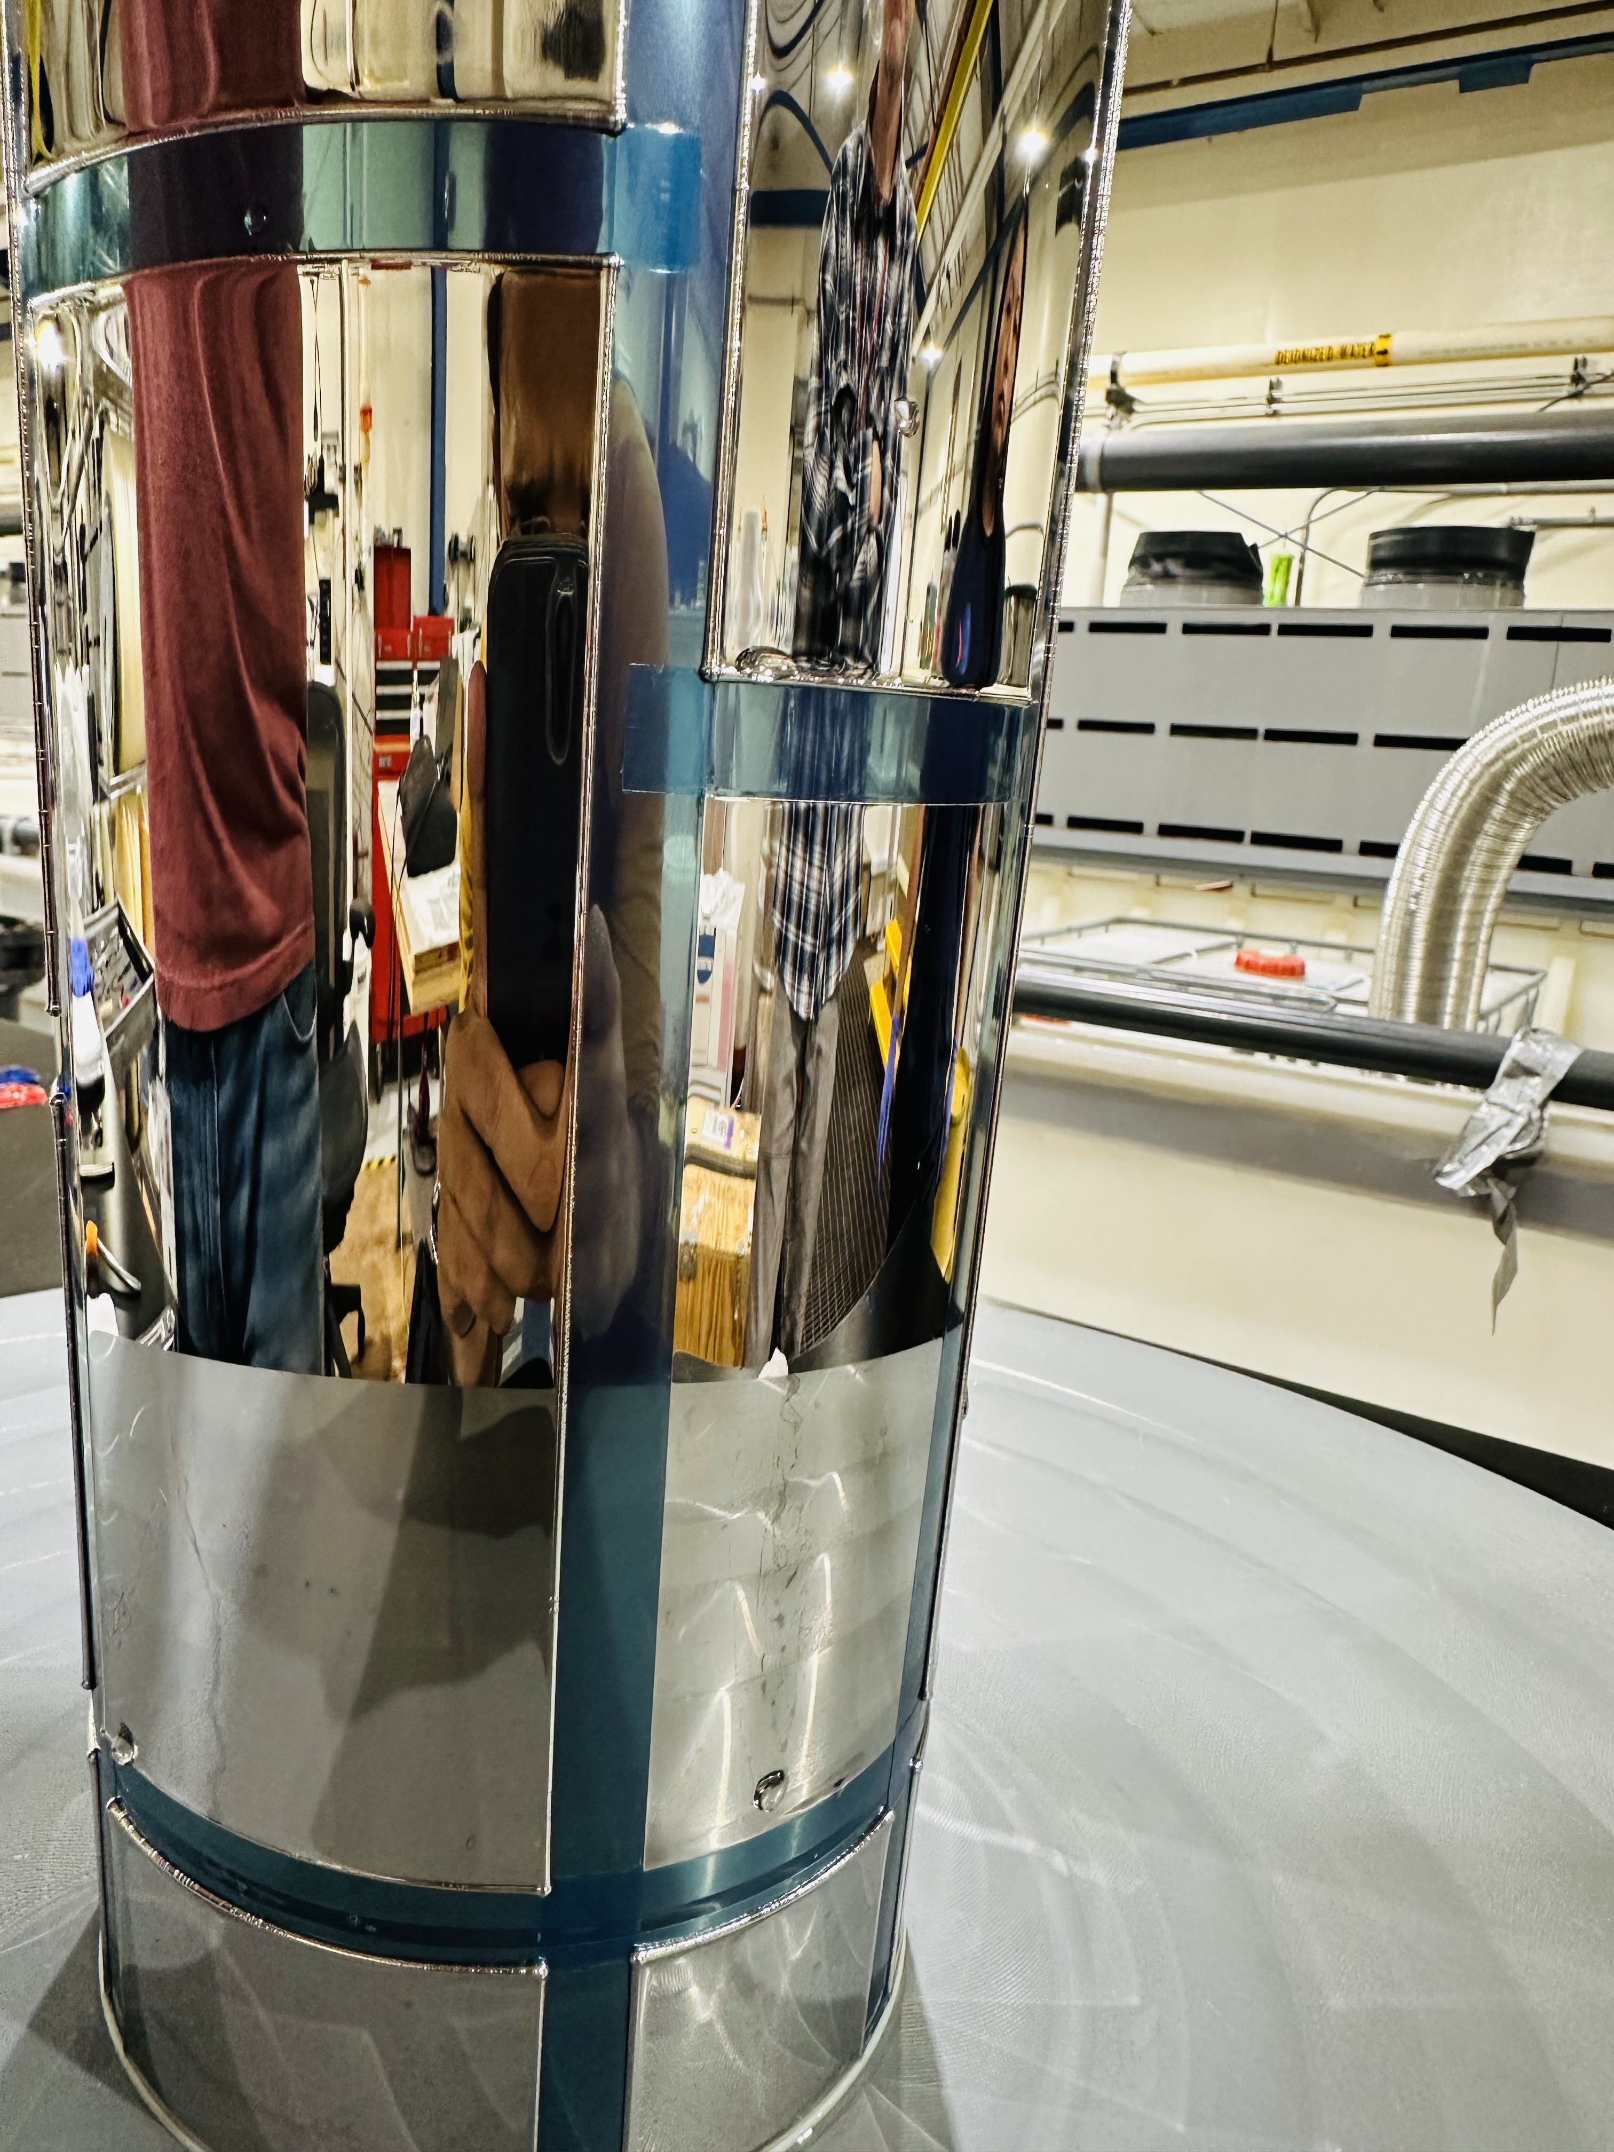
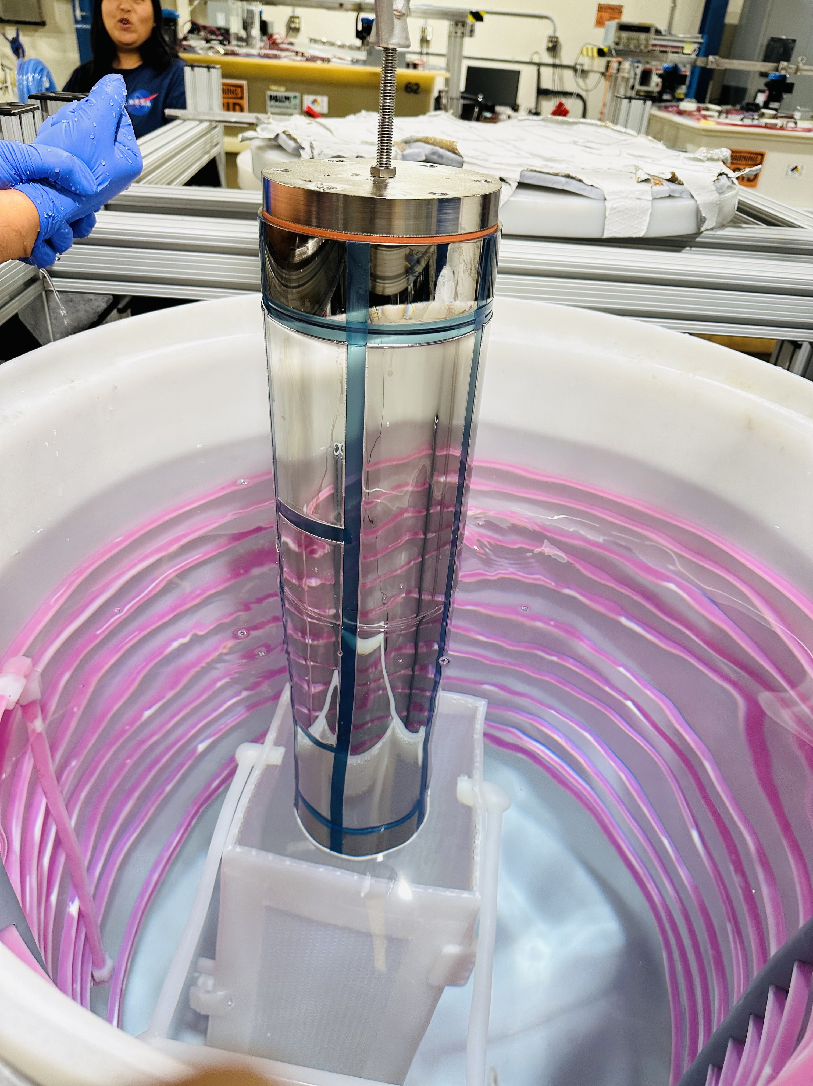
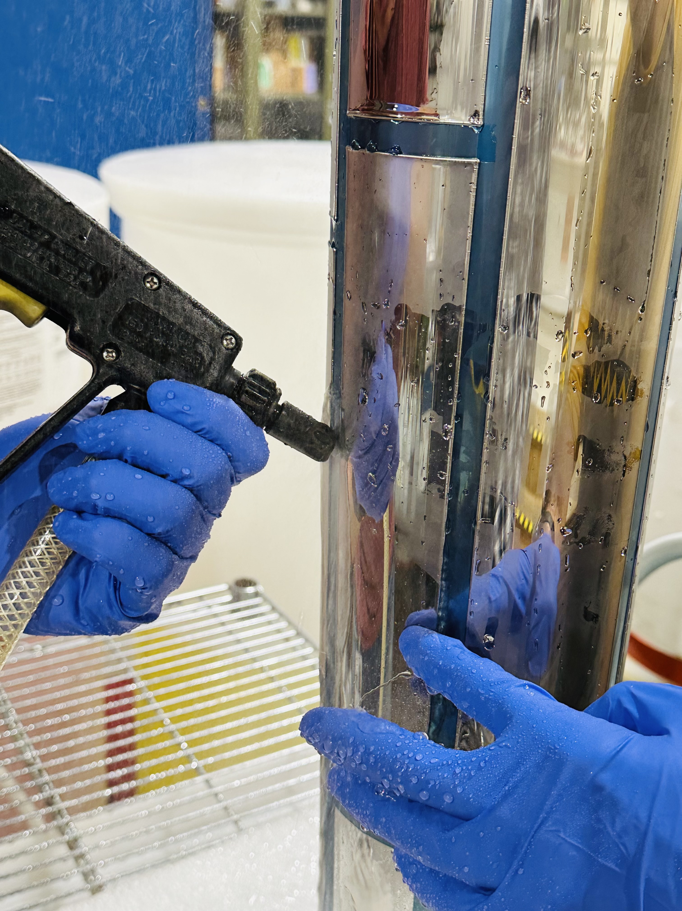
Fabrication of prototype segments
d. Plated ~350 microns of NiCo. Tape defines the boundaries of each shell.
e. Segment separation in cold water with CTE mismatch.
f. Water spray to separate the segments.

Slide 9
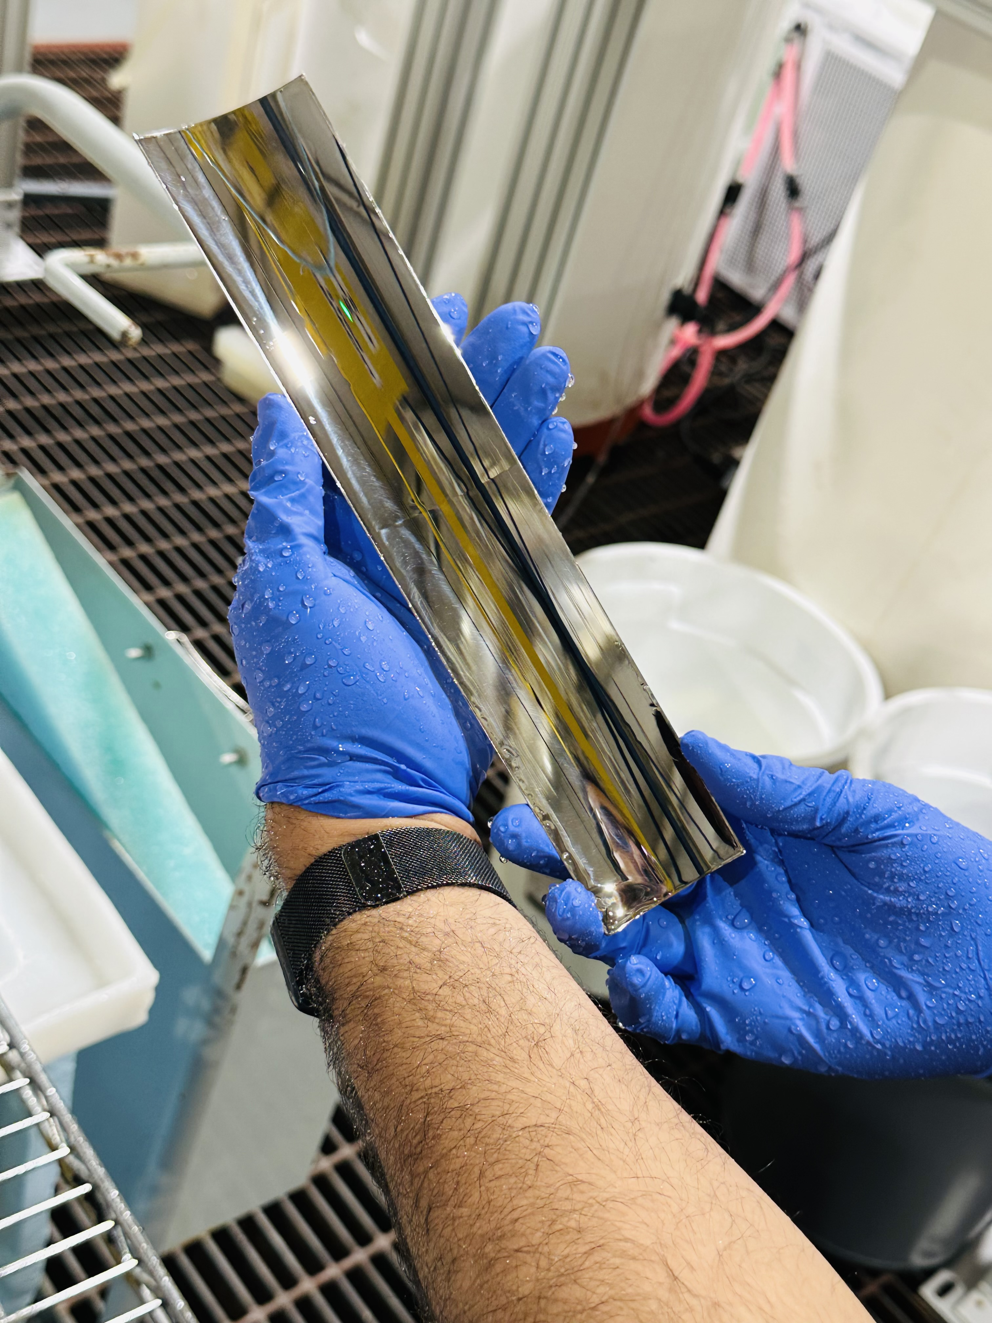
Fabrication of prototype segments
Separated segments!!!

Slide 10
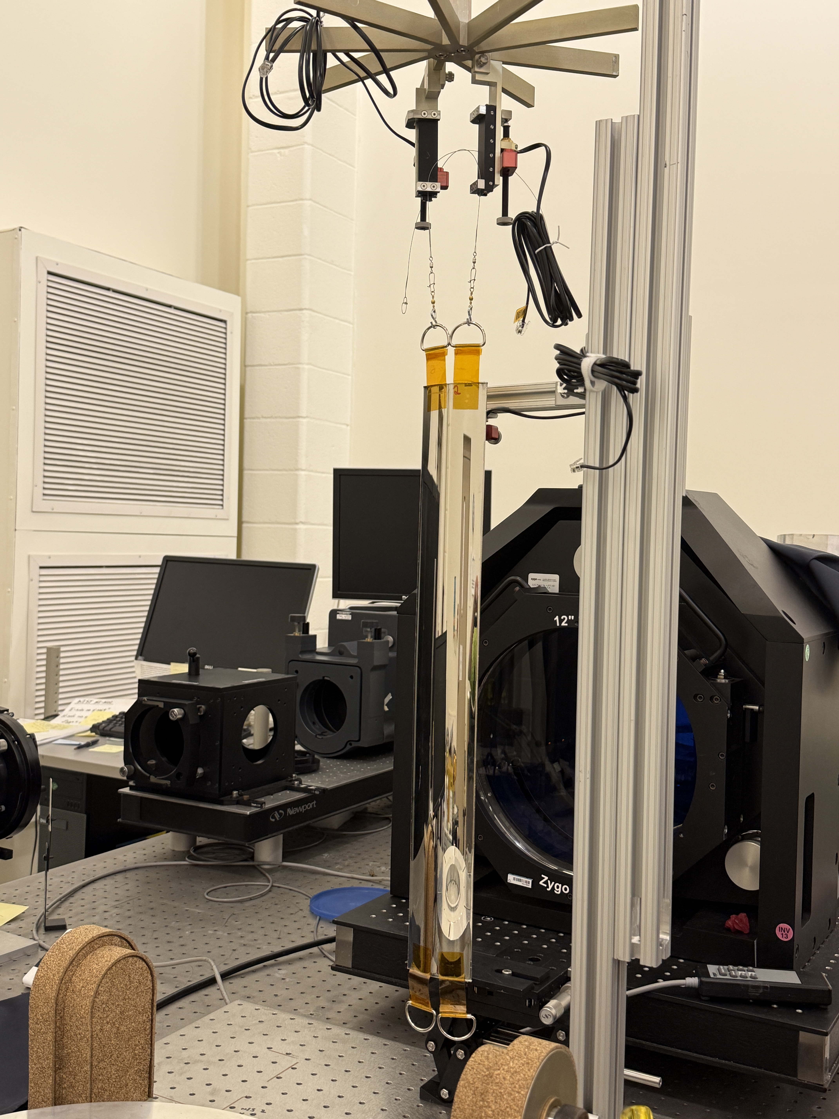
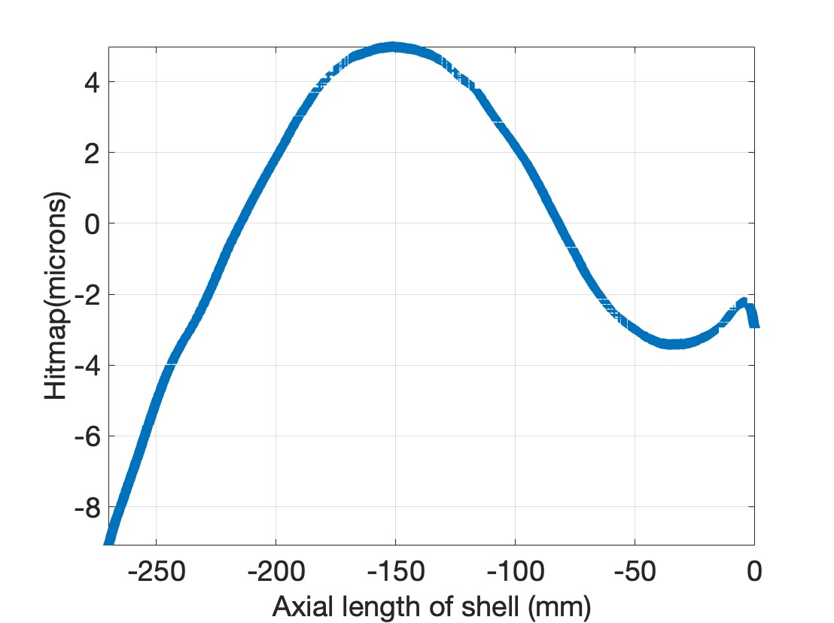
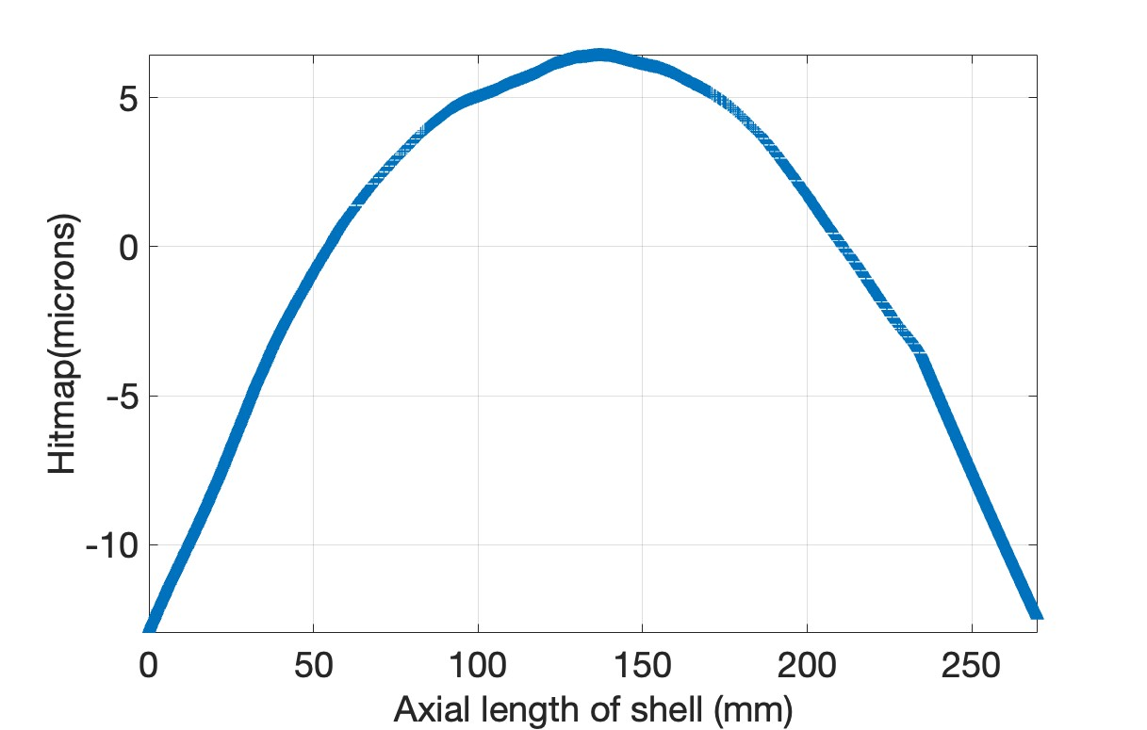
Axial profile measurement
Axial profile of the segments is measured by using Zygo interferometry.
Segments are suspended at two points and stabilized at three points.
Tilt is adjusted using Pico motors.
Measured profile indicates that the segments are highly curved!!!

Slide 11
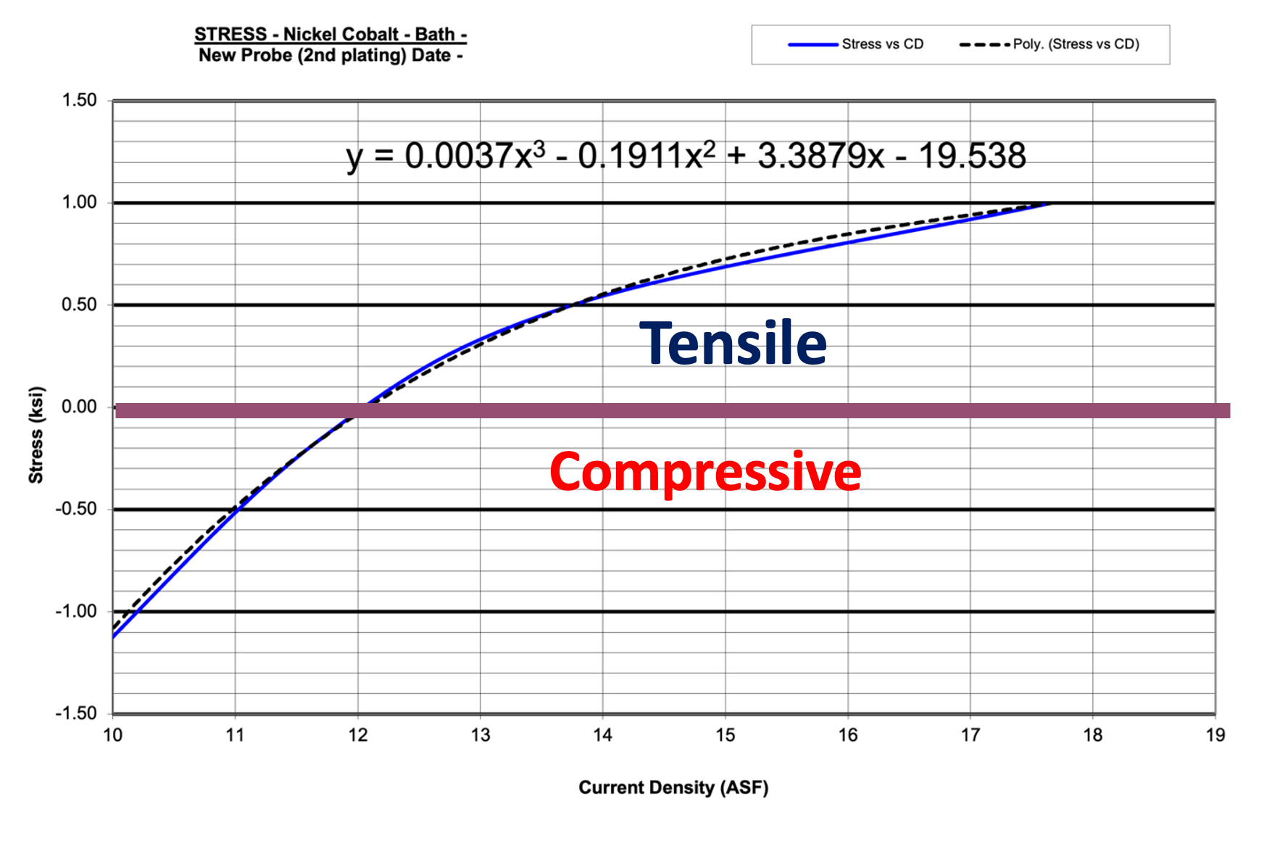
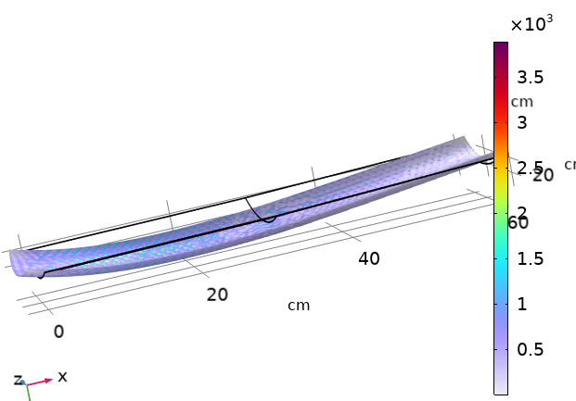
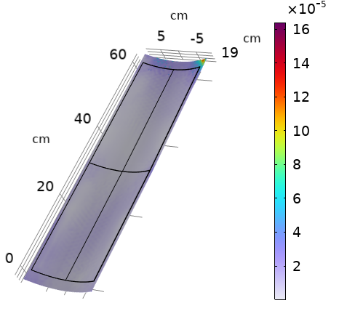
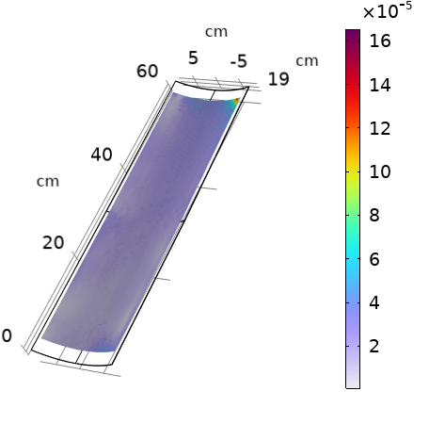
Electroforming stress in Segment replication
(a) Non uniform stress
Stress distribution is proportional to the surface current density.
With improper gasket configuration, the current density (and stress) varies a lot in both axial and azimuthal direction.
From FEM simulations, we understand that the non-uniform stress fields introduces the curvature in segmented optics.
By optimizing the plating conditions, one can increase the stress uniformity that’s can improve the surface profile.
Uninform stress fields does not result in curvature of the unconstrained.
(b) Compressive uniform stress
(c) Tensile uniform stress

Slide 12
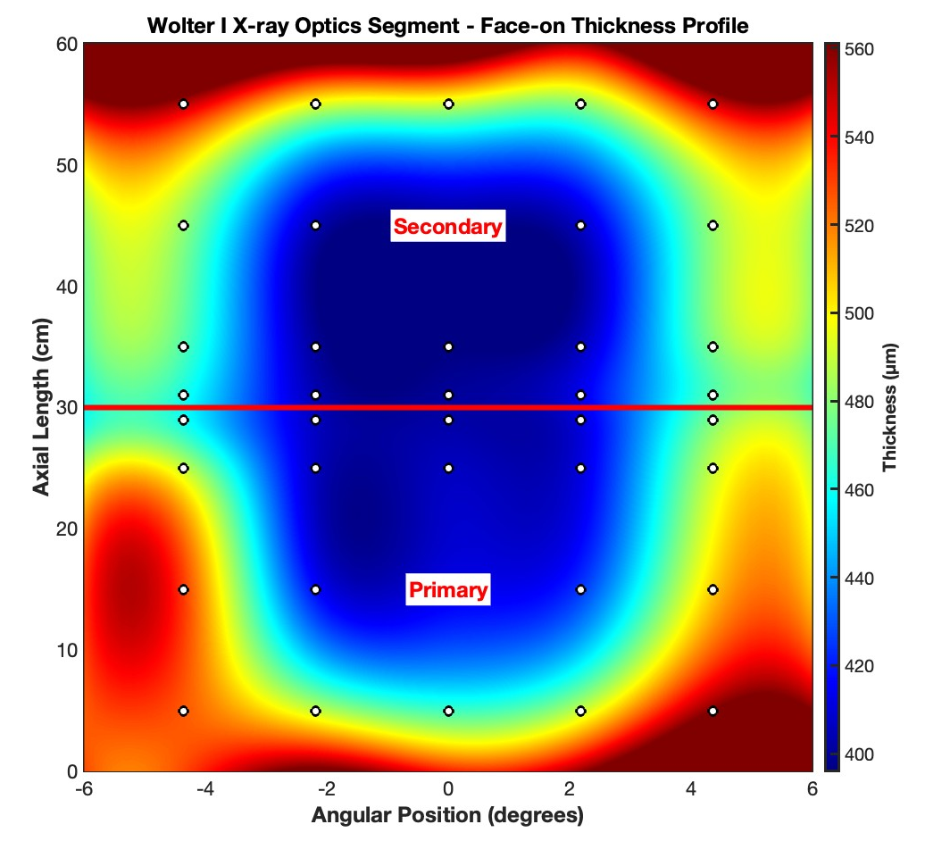
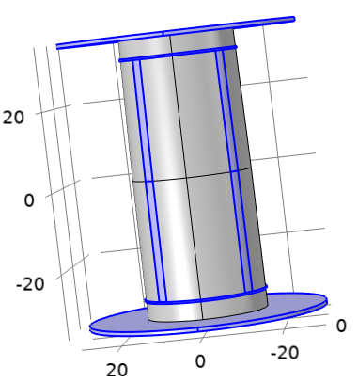
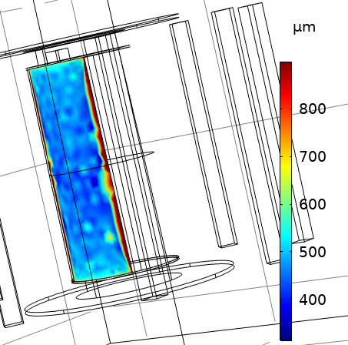
Thickness uniformity of segments
Thickness distribution of the segment is measured using ultra-sound sensor.
The measured thickness is very high at the edges compared to the center of the segment.
Similar trend for all the segments.
It is due to sharp discontinuity of cathode surface at the edge.
This is observed even in full shell X-ray optics but we have developed techniques to mitigate it.
Measured thickness variation
Excepted thickness variation from COMSOL modelling
Notes:
Excepted thickness variation from COMSOL modelling

Slide 13
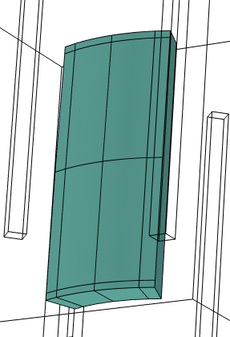
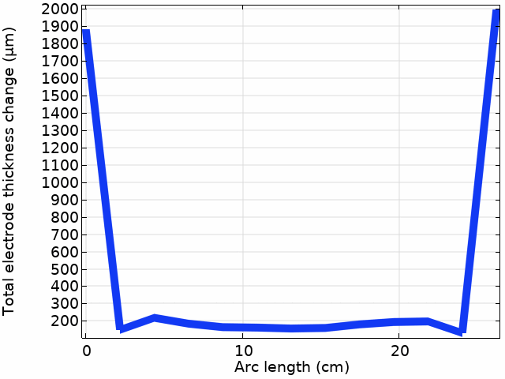
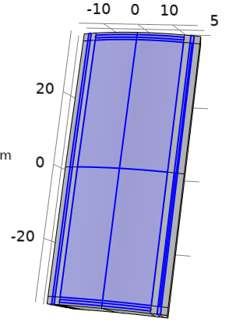
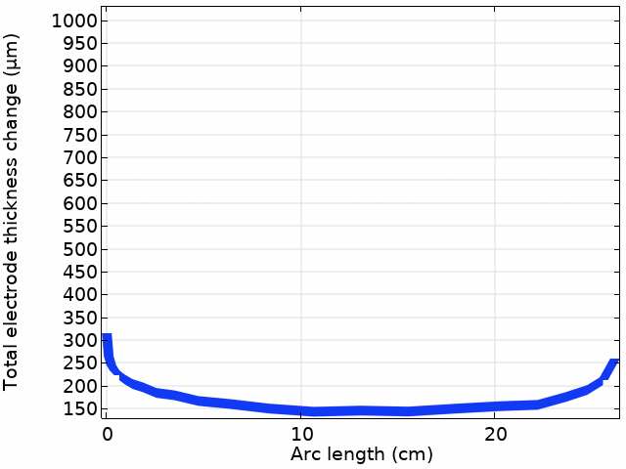
Optimizing the thickness variation in segmented mandrels
Segmented mandrel plating configuration
(a) Increase the Boundary height
(b) Cu tape anode
Segmented mandrel has more relatively larger edge area to the optics surface ratio.
Increasing the gasket height improves the thickness uniformity at the edges.
But such configuration may not be suitable as it disturbs the electrolyte flow.
Alternately, we use Cu strips on the tape as small anode regions which controls the excess e-fields at the edges.
Thickness of the Cu tape influences the thickness uniformity.
Notes:
Segmented mandrel plating configuration

Slide 14
Summary and future work
Summary:
Concept of segmented replicated X-ray optics is explored.
Prototype segments are fabricated.
Thickness and axial profiles are measured and compared them with the modelling results.
Future work:
Design and optimize plating geometry for uniform thickness.
Design segment mandrel for polishing.
Work on the electroforming flow geometry.
Understand the stress and its error contribution for segmented geometry.
Effects of excepted deformation and its error contribution.
Study the effect of coating stress.
Alignment and mounting protocol.

