Slide 1
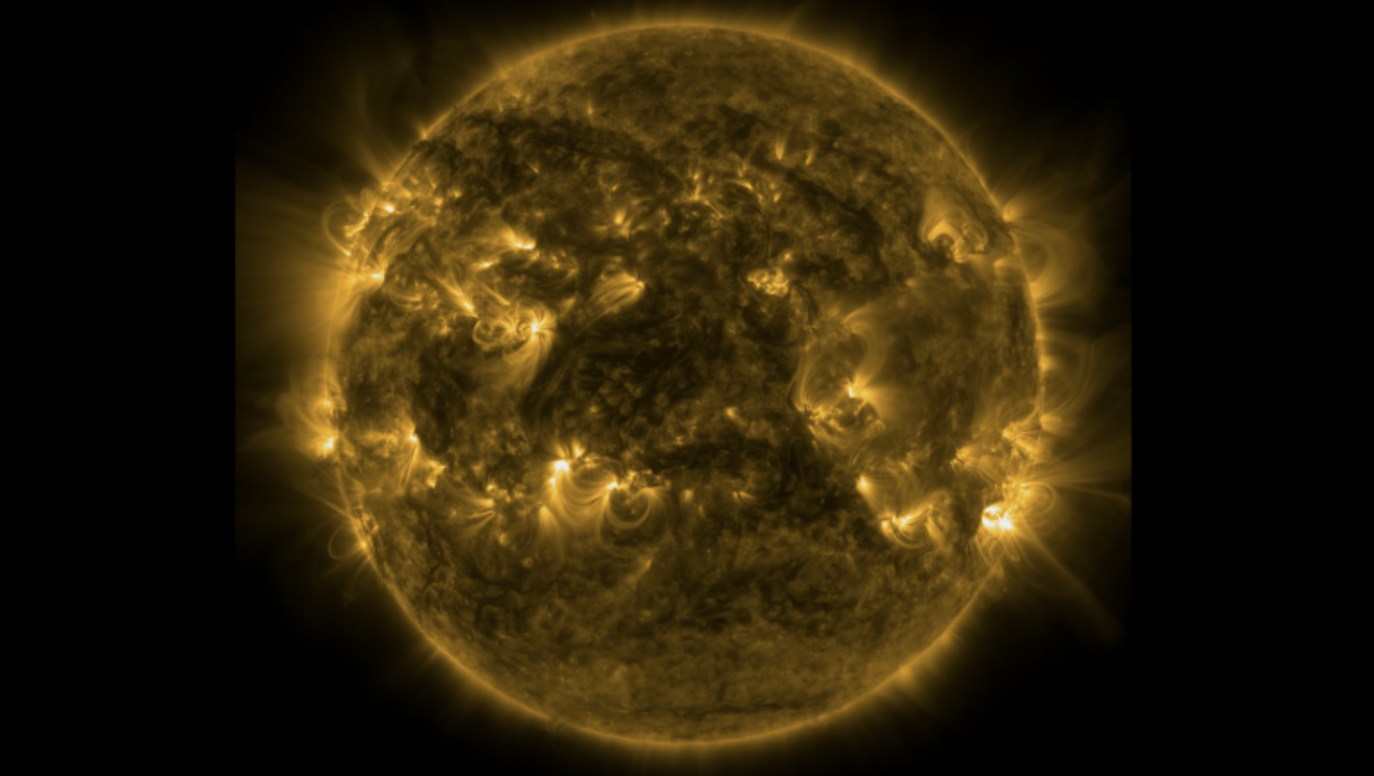

Nanoflare Heating: Field-Aligned Modeling and Observations of Coronal XBPs and ARs
Biswajit Mondal¹, Amy R. Winebarger²
¹NASA Postdoctoral Program (biswajit.mondal@nasa.gov)
²NASA Marshall Space Flight Center
Huntsville, Alabama, USA
ISWAT S2-06 team meeting
August-06-2025

Slide 2
Group and collaborators
MSFC heliophysics team:
Dr. Amy R. Winebarger,
Dr. P.S. Athiray,
Dr. Adam R. Kobelski
and MaGIXS team.
Collaborators:
Dr. J.A. Klimchuk (NASA GSFC)
Dr. Helen E. Mason (Univ. Cambridge)
Dr. Giulio Del Zanna (Univ. Cambridge)
Dr. Aveek Sarker (PRL)
Dr. Santosh Vadawale (PRL) and others!

Slide 3
Outline
Observable Properties of nanoflare heating in non-flaring coronal structure
Observations
Implementation of Parker nanoflare model using field-aligned hydro simulations.
Compare model with observational properties.
Results and discussion.

Slide 4
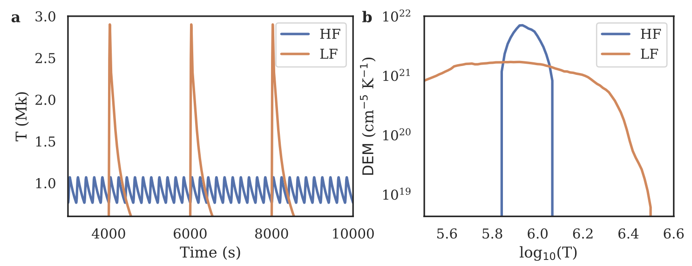
Observable properties
Direct detection of individual nanoflares are difficult.
Used indirect methods, e.g., Differential Emission Measure (DEM) or existence of hot plasma etc.
See Klimchuk et al 2006, 2015 for more details.

Slide 5
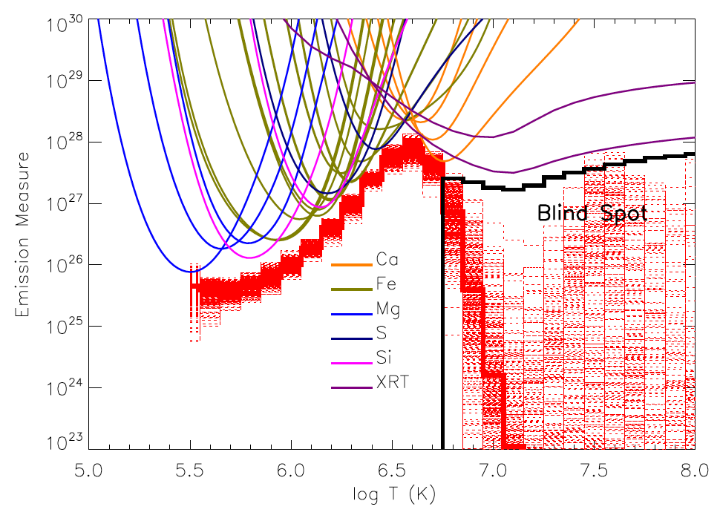
Challenges in determining DEM!
EIS + XRT
Winebarger et al. (ApJL 746:L17, 2012)

Slide 6
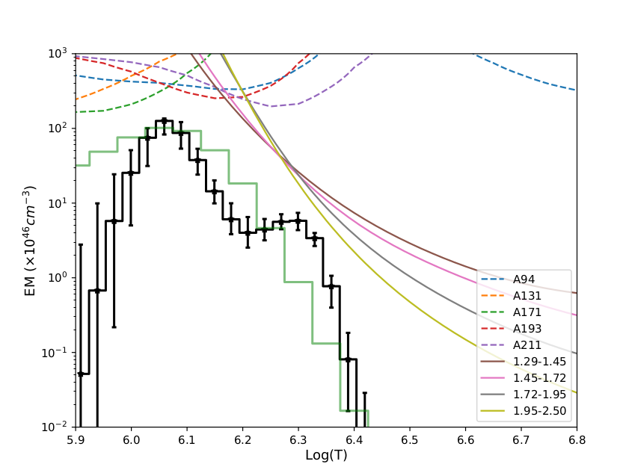
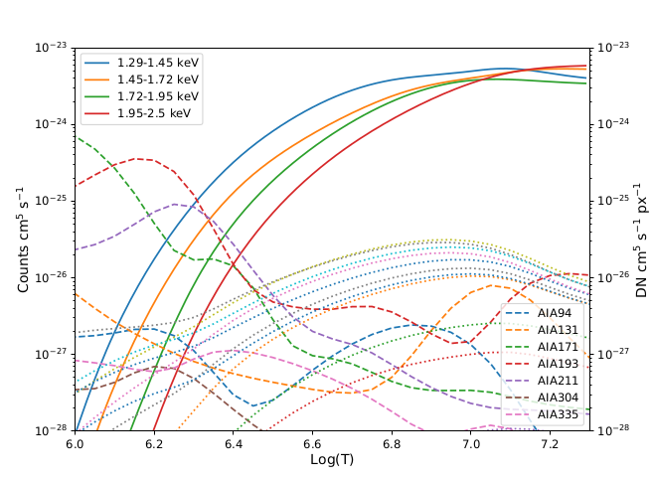
Better constraint of DEM
AIA
XSM
XSM
XSM
AIA
XRT
AIA / XRT

Slide 7
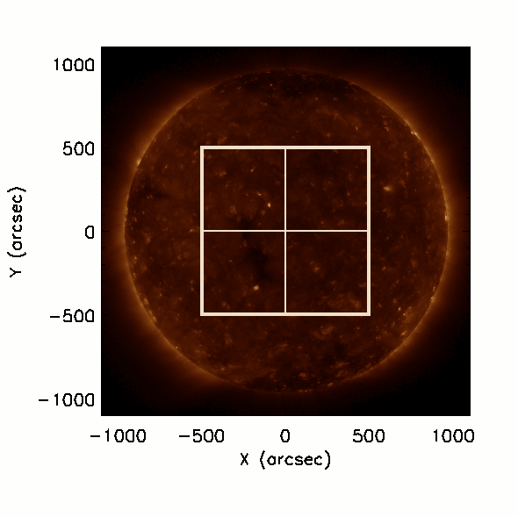
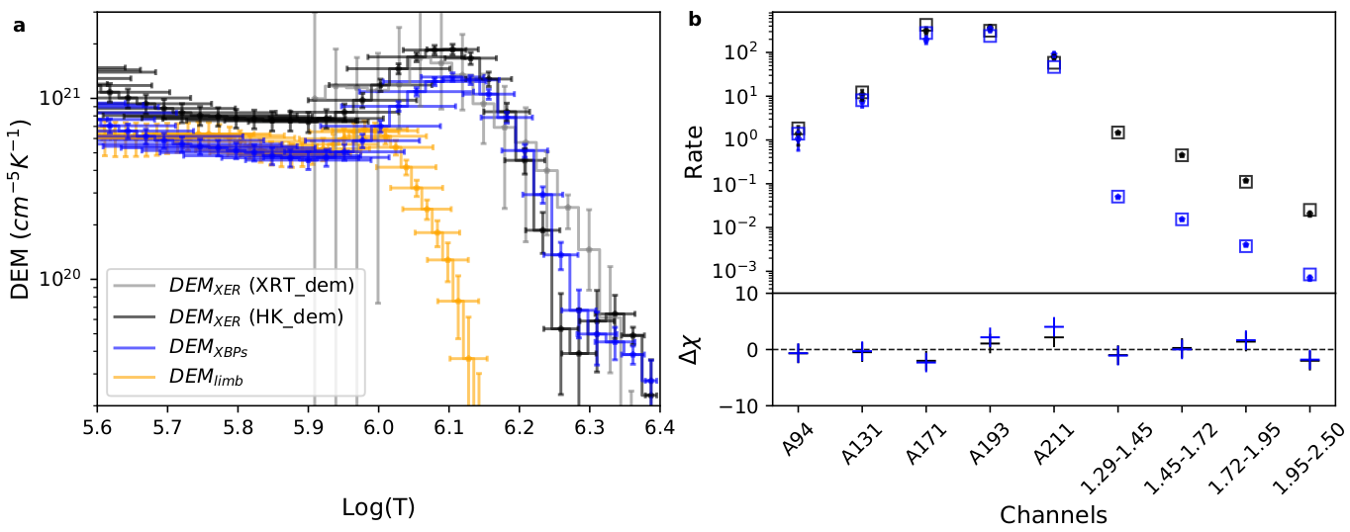
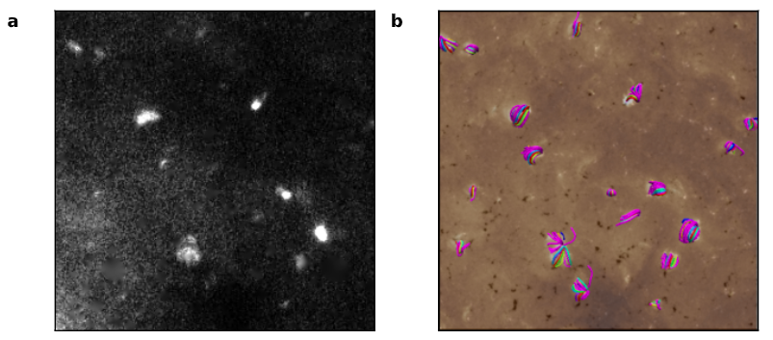
different QS components
XER
XBP
Limb
FOV-2
FOV-3
FOV-1
FOV-4

Slide 8
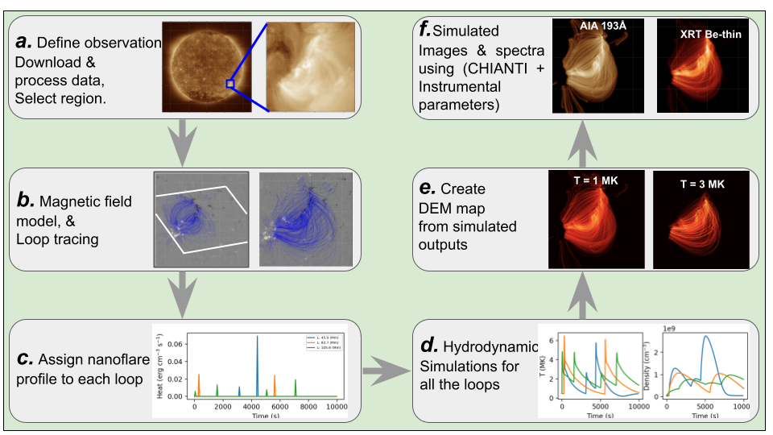
Combined observations with model
https://github.com/biswajitmb/SunX.git

Slide 9
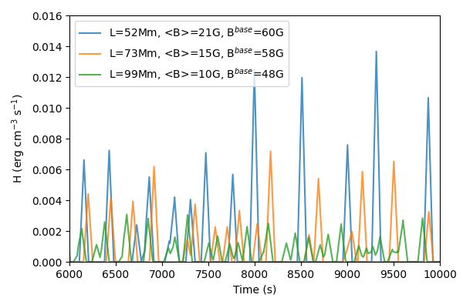
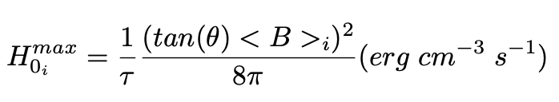
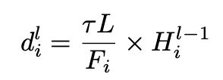
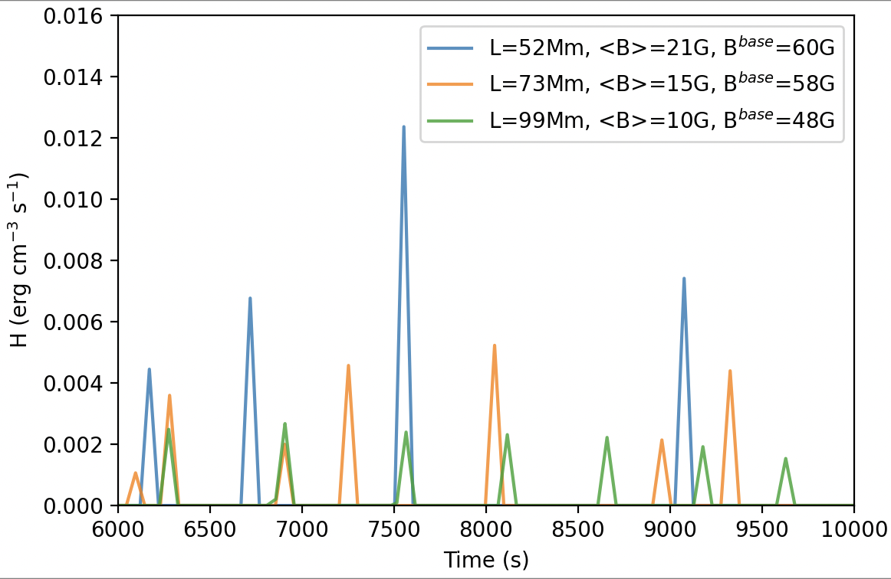
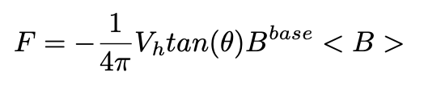
Create nanoflare profile
Consider triangular heating profiles having a duration, 𝜏 = 100 s.
The peak heating rate during an event is randomly chosen between minimum (H₀^{min} ) and maximum (H₀^{max}) values that are loop dependent
tan(θ) = 0.2
V_{h} = 1.5 km/s
tan(θ)= 0.2
V_{h} = 0.5 km/s

Slide 10
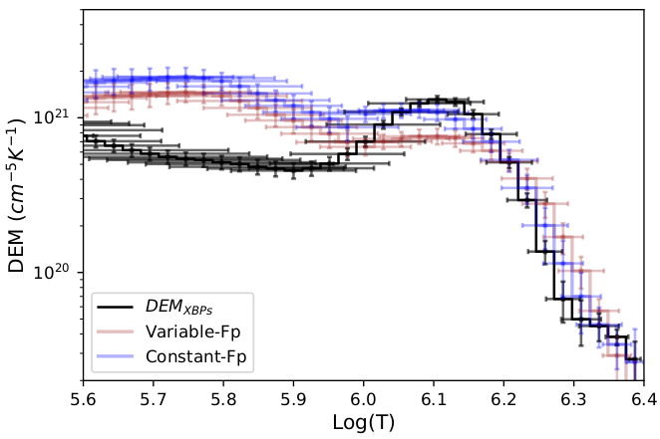
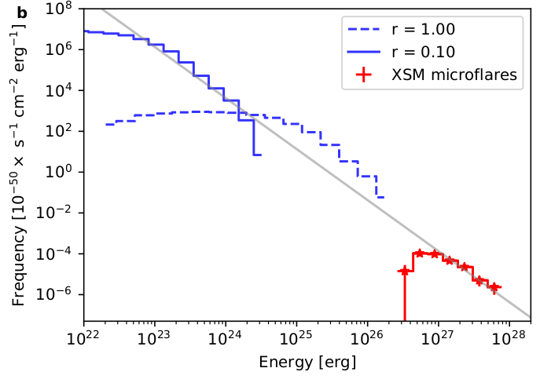
Nanoflare heating of quiet-sun XBPs
Simulated DEMs
∝ E ^{-𝛼}
Observed DEM
Mondal et al, (ApJ, 945:37, 2023)

Slide 11
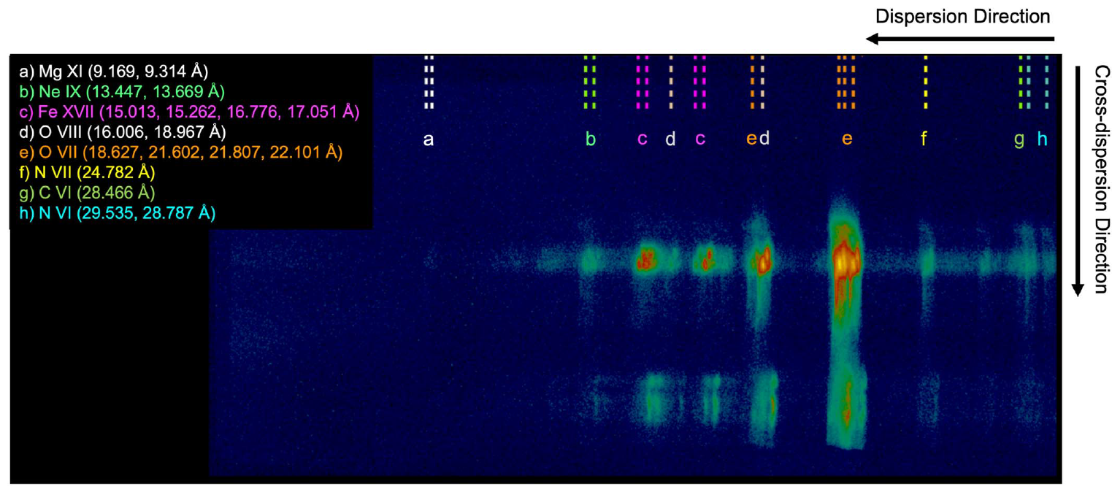
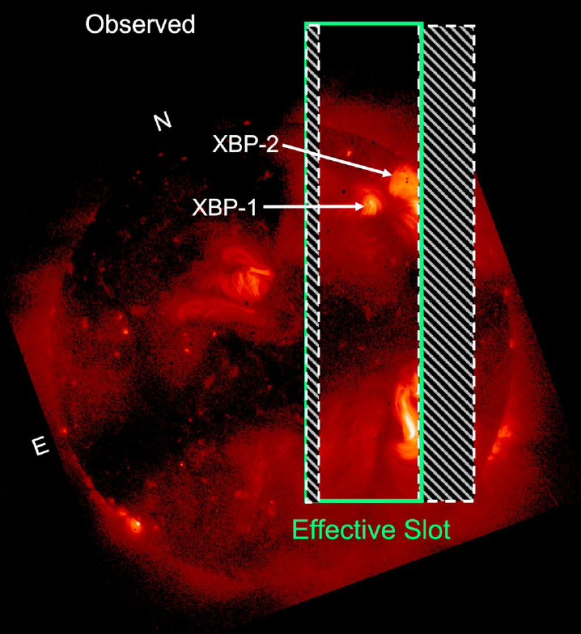
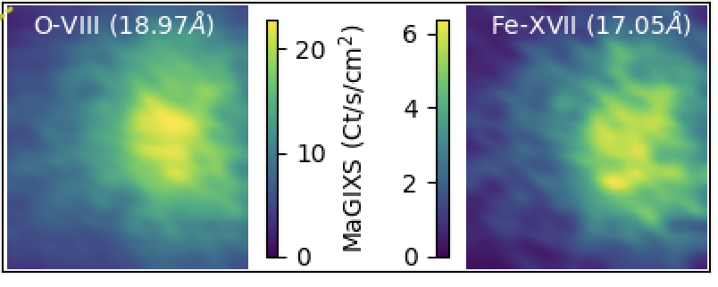
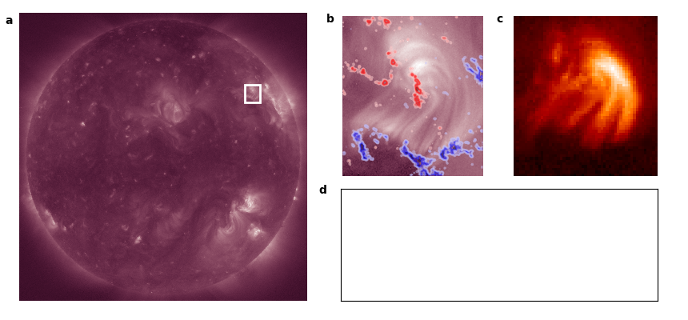
Overlapping spectral images observed by MaGIXS-I
AIA 193 + HMI
XRT
XBP-1
XBP-1
Savage et al (ApJ 945:105, 2023)

Slide 12
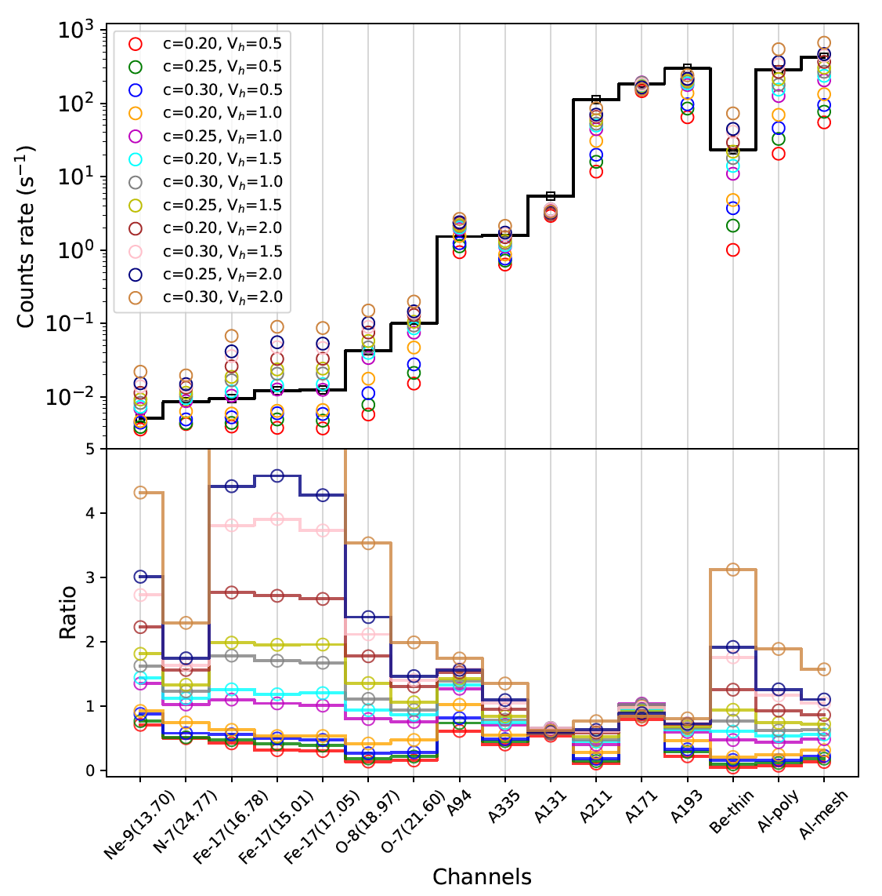
Comparison between simulations and observations
AIA
XRT
MaGIXS

Slide 13
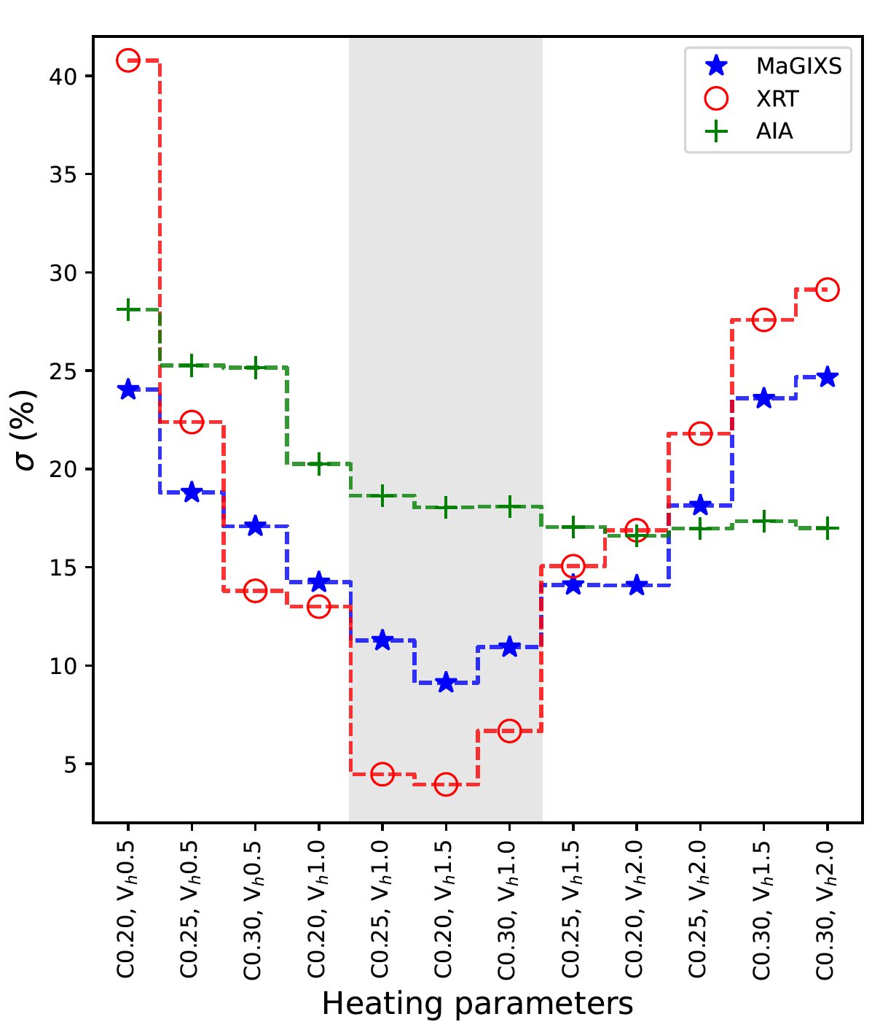
Determine best heating parameters
Avg. delay = 1500-3000 s.
Avg. flux ~ 3 ✕ 10⁵ erg cm⁻² s⁻¹.

Slide 14
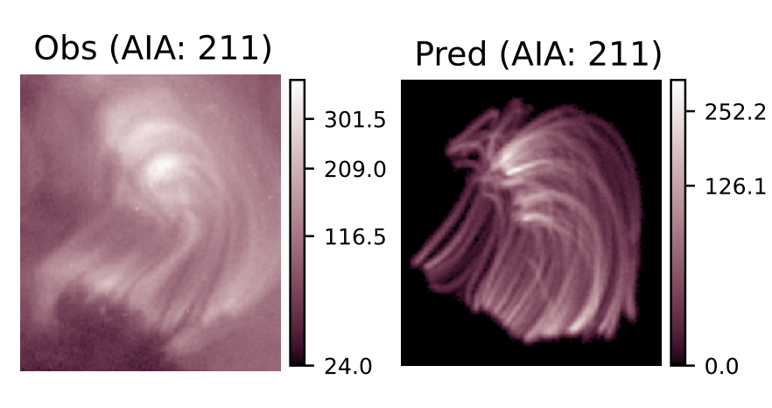
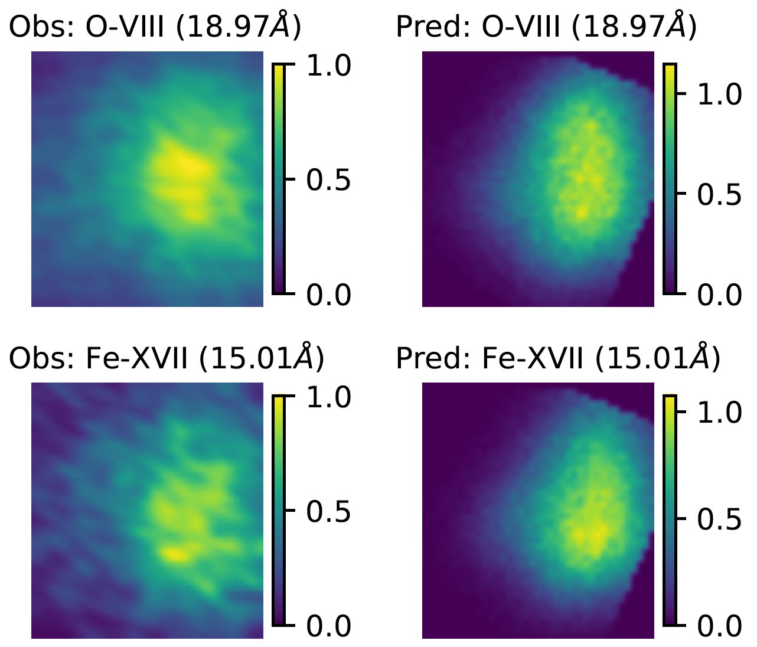
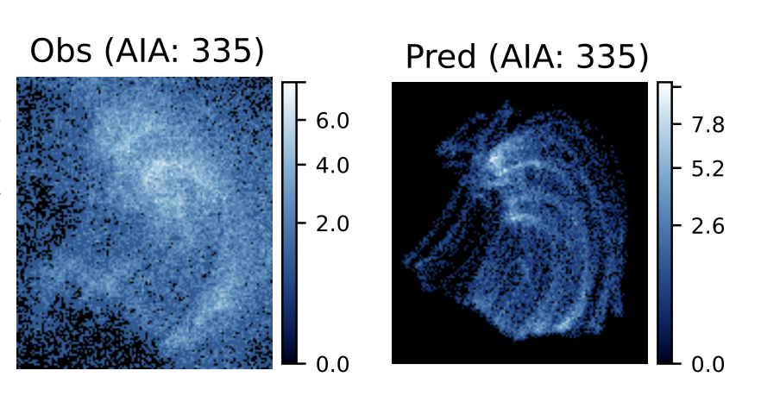
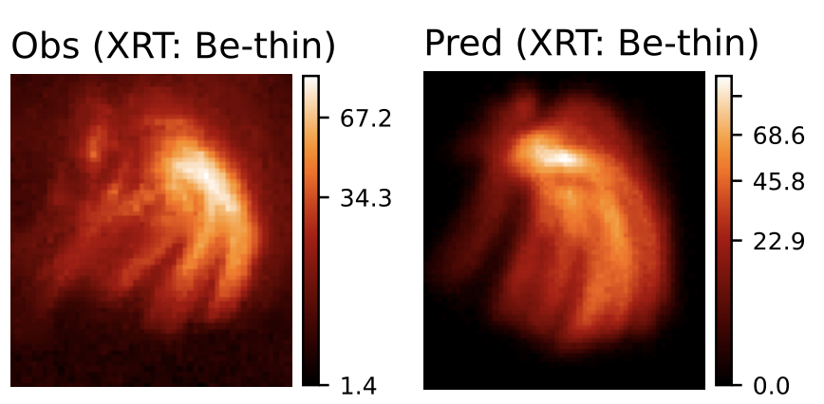
Observed and Predicted images of XBP-1
DN/s
DN/s
Derived from MaGIXS
Simulated
Observed by AIA & XRT
Simulated
Mondal et al, (ApJ 967, 23, 2024)
HF nanoflare -> average delay = 1500 - 3000 s -> smaller than the cooling time.
Average Poynting flux = ~3e5 erg/cm2/s
MaGIXS and XRT are more sensitive.

Slide 15
Can we use a similar approach to understand the heating and predict X-ray irradiance during the evolution of an ARs?

Slide 16
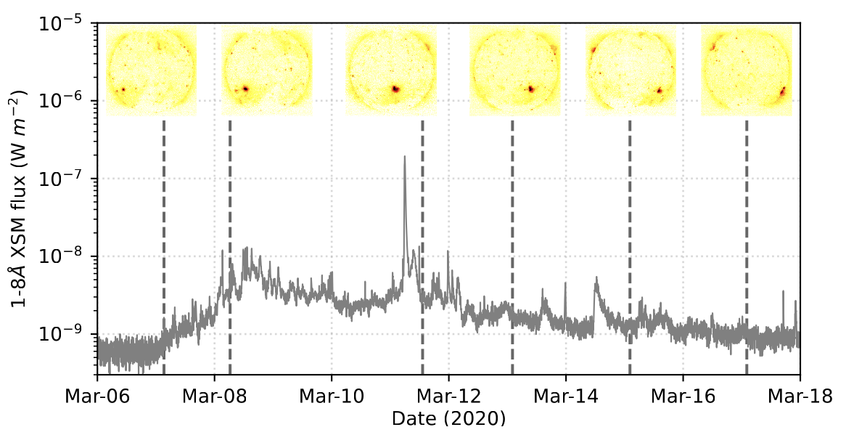
AR 12758

Slide 17
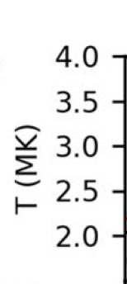
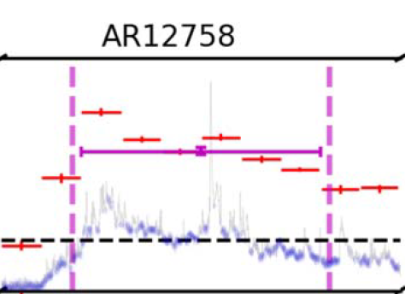

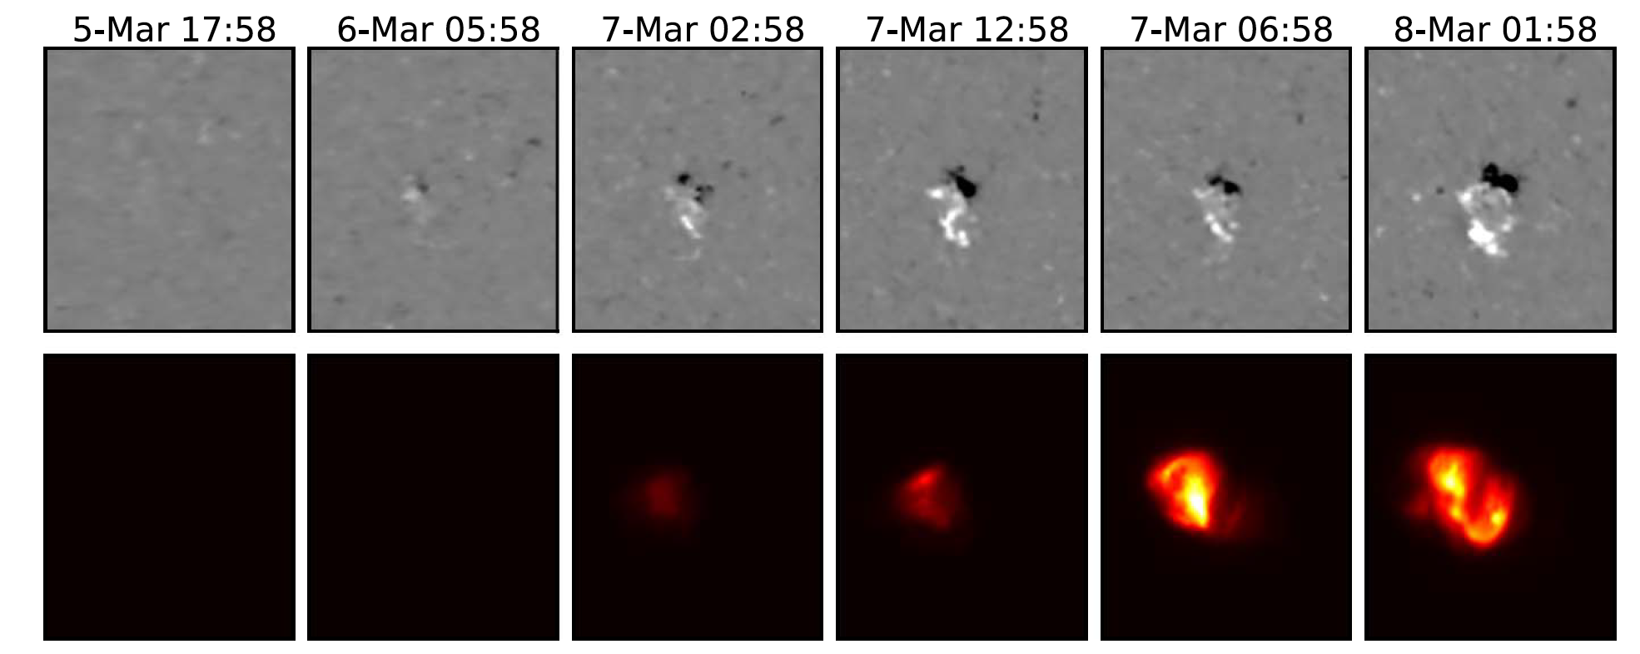
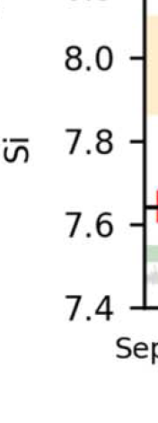
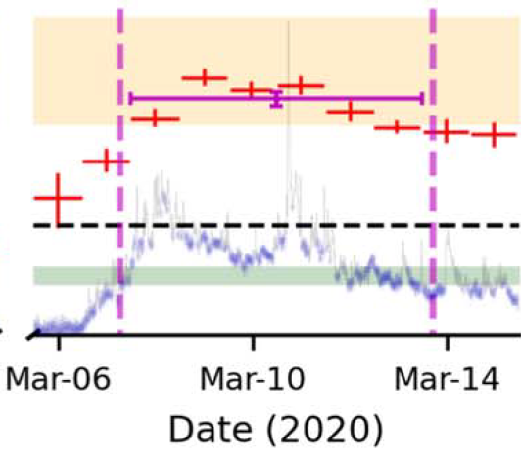

Formation of AR12758
Evolution of plasma parameters!
FIP bias
Evolution of this AR was studied from soft X-ray disk-integrated spectroscopy by Chandrayaan-2/XSM.
Step-1: Simulate the evolution of this AR and compared with disk-integrated quantities.
Mondal et al (ApJ 955:146, 2023b)

Slide 18
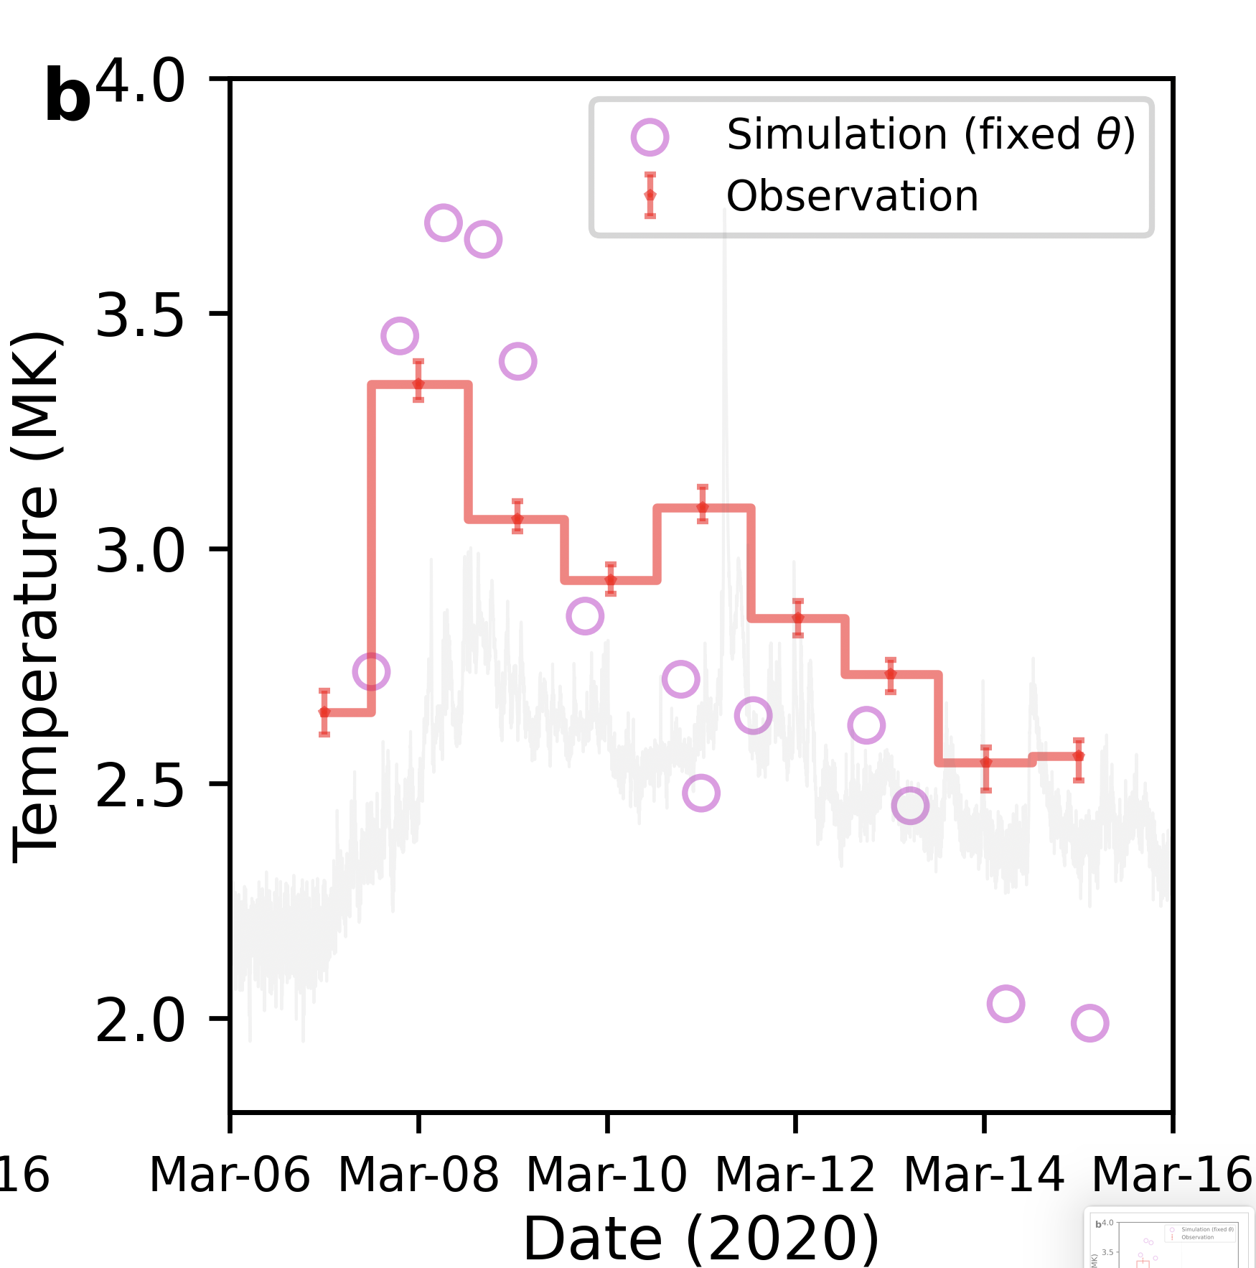
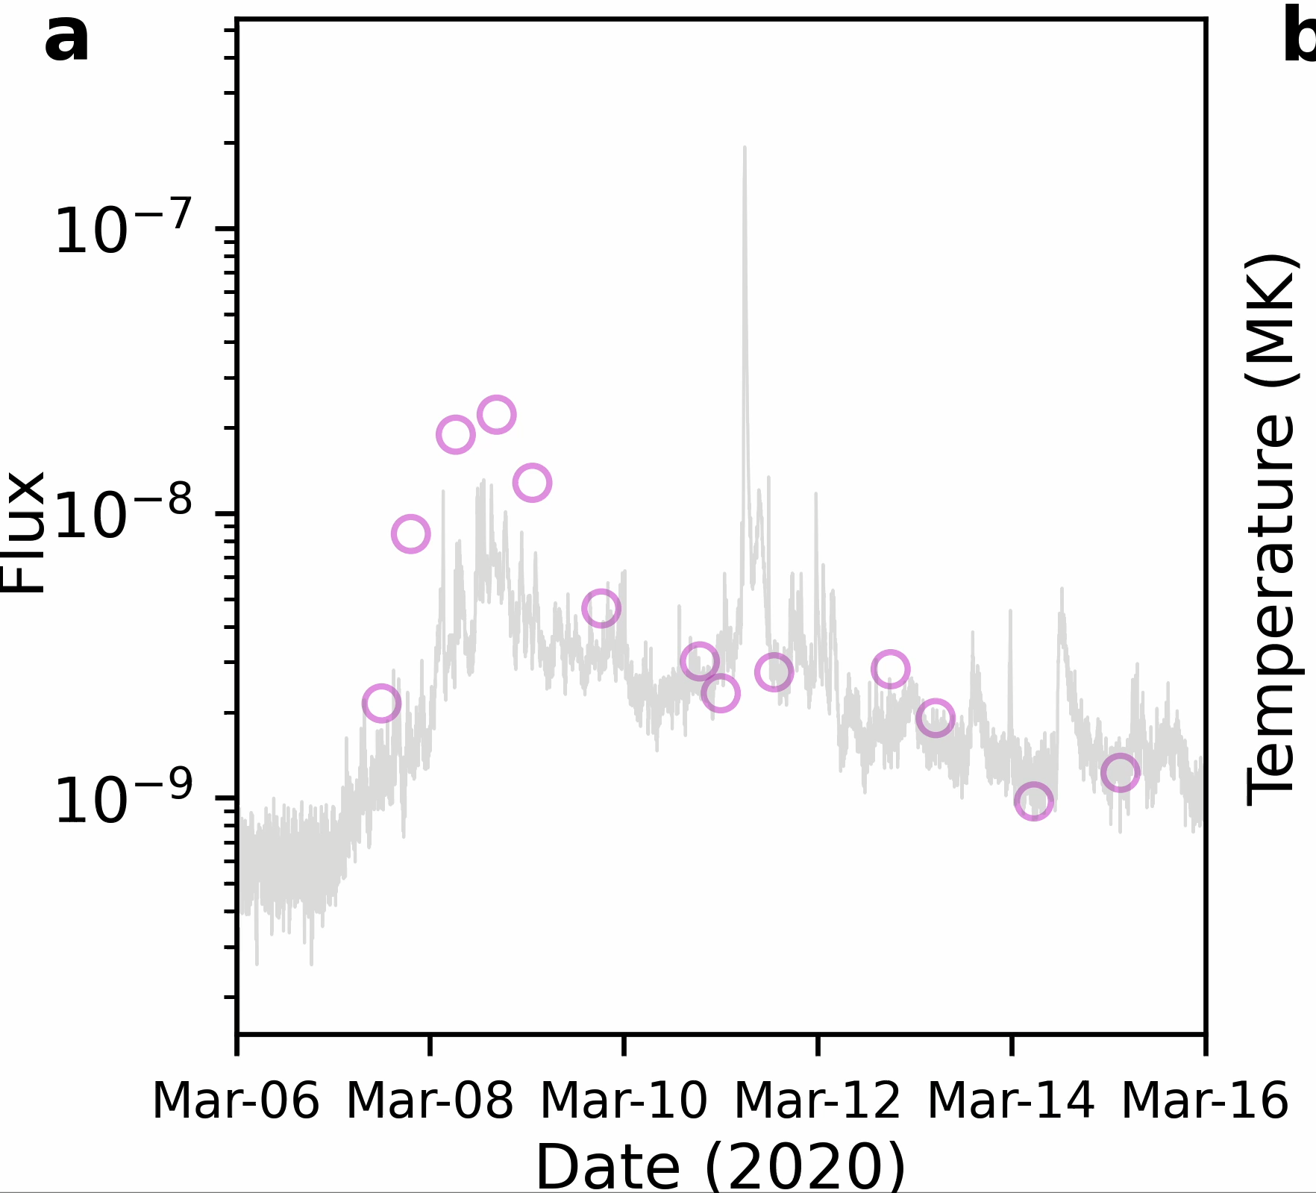
Observed and predicted X-ray flux and temperature

Slide 19
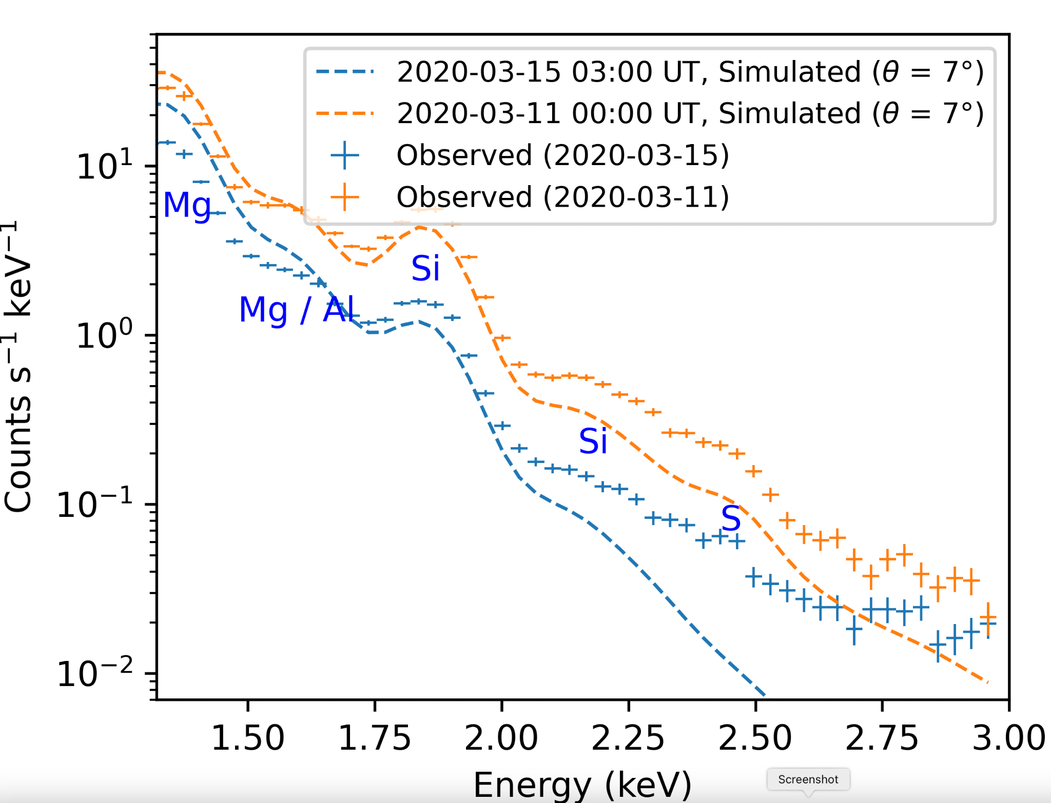
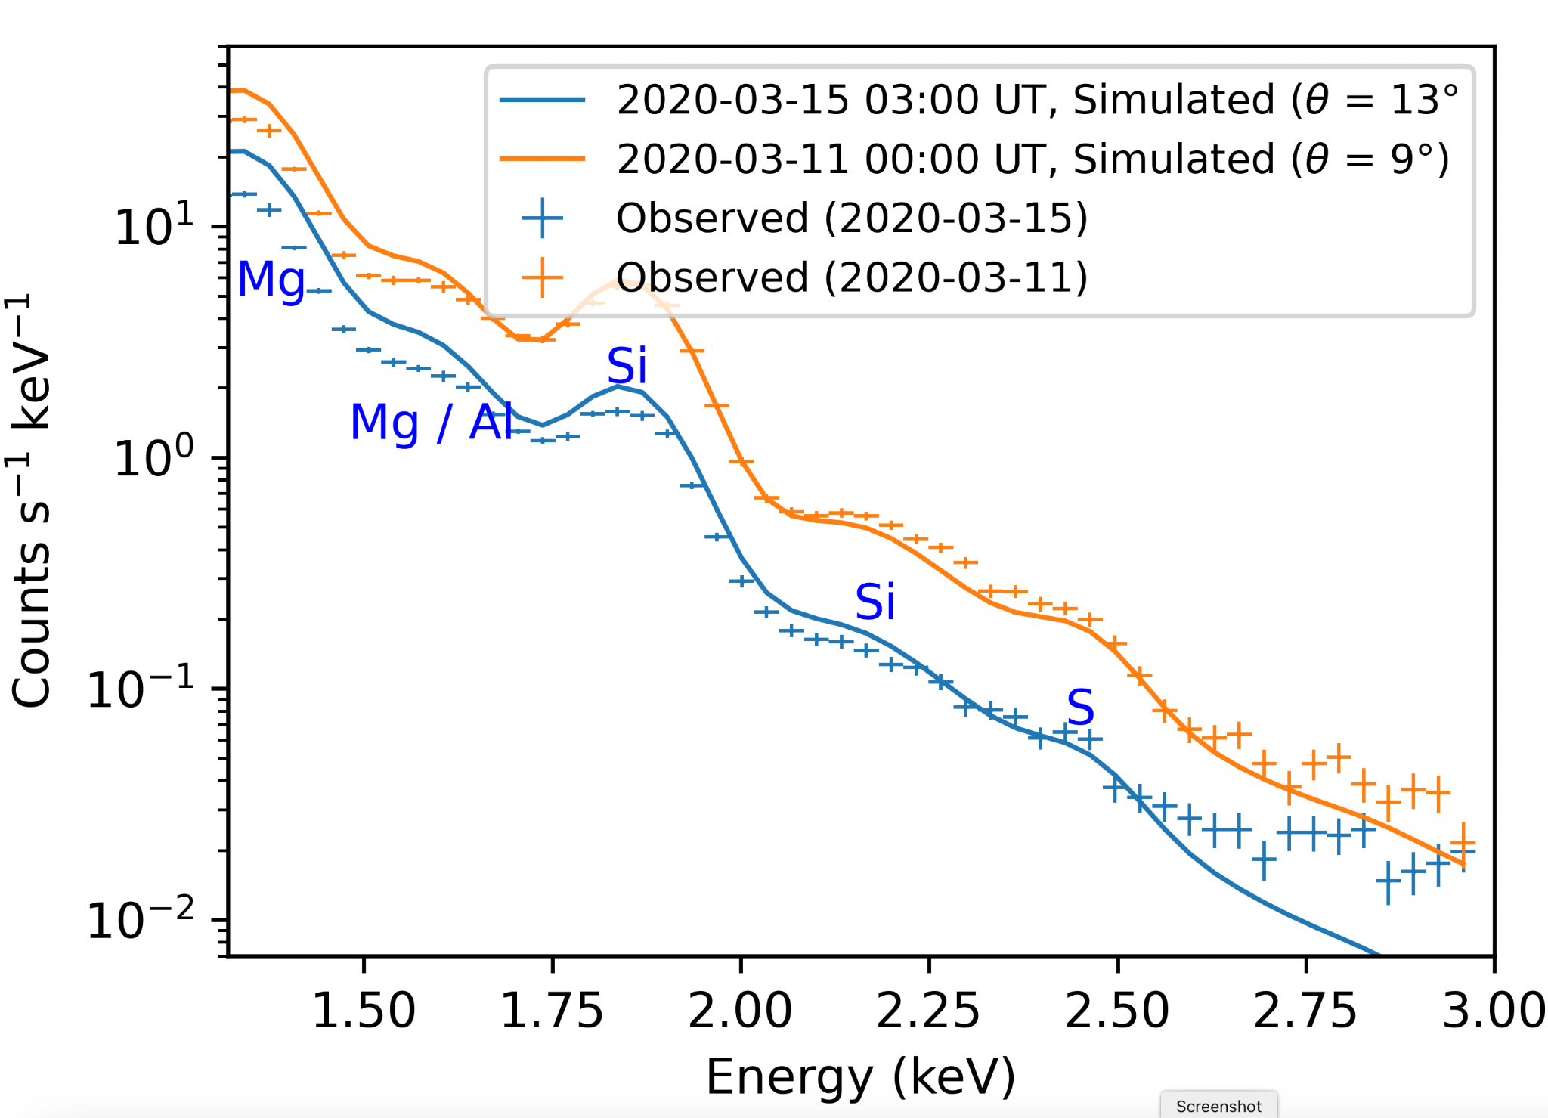
Observed and predicted X-ray spectra

Slide 20
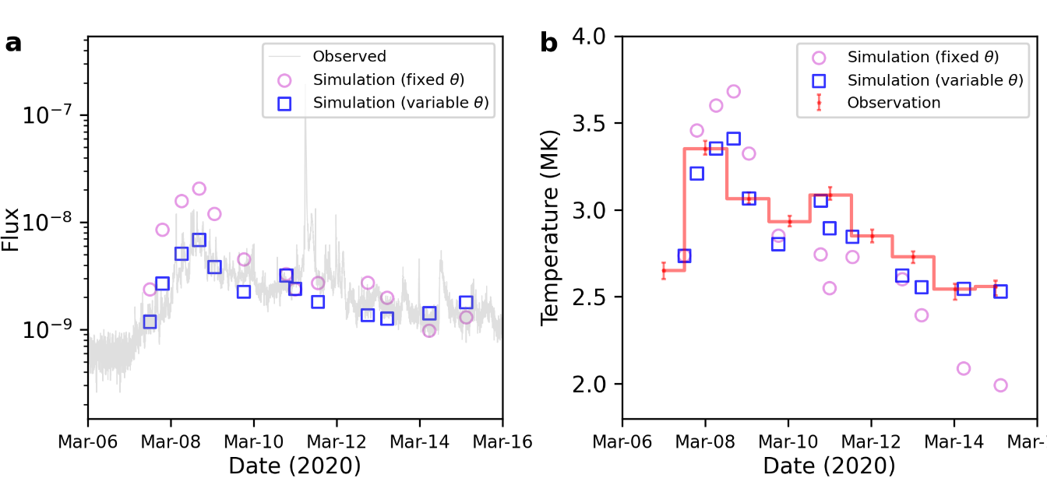
Observed and predicted X-ray flux and temperature

Slide 21
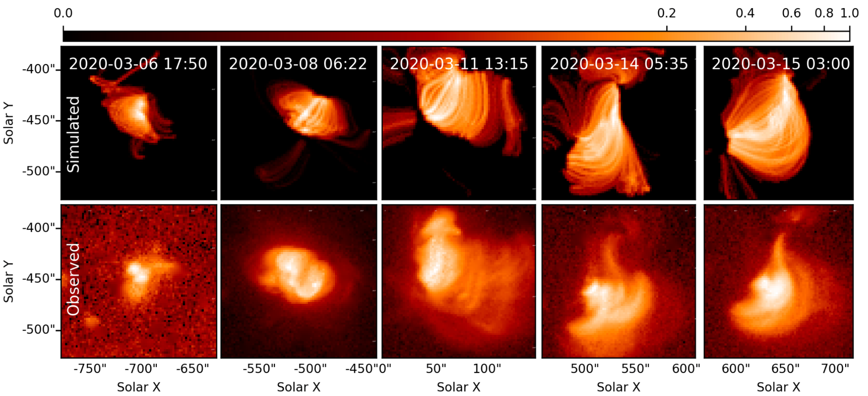
Spatial variation of X-ray emissions

Slide 22
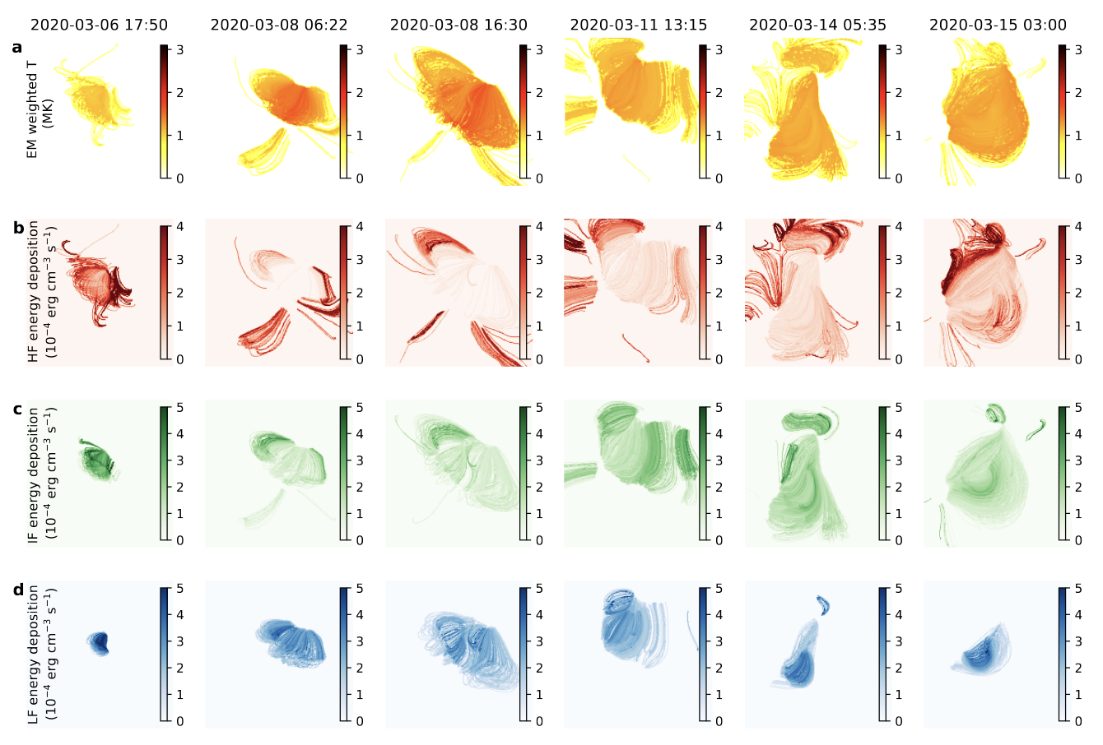
Spatial variation of temperatures
EM weighted T varies (1 to 3 MK) with spatial location of the AR.
Indicating different heating frequency.

Slide 23
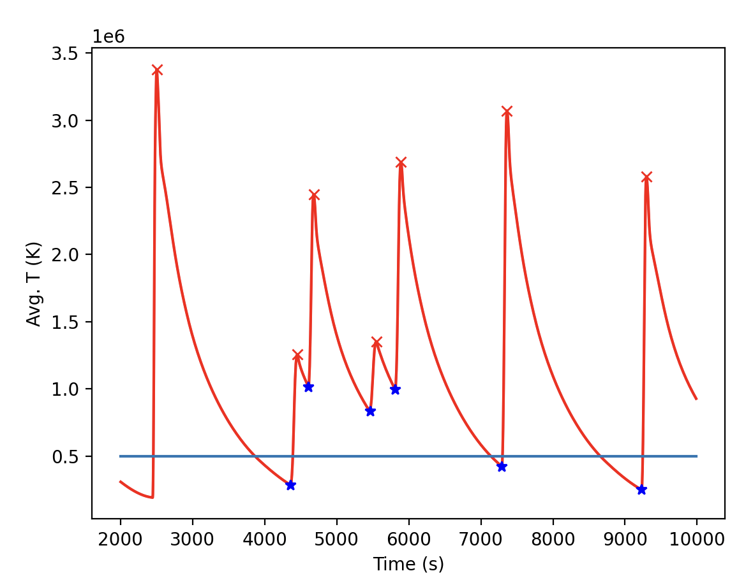
Classify different heating frequency
𝛕_{repeat}
𝛕_{cool}
HF: 𝛕_{repeat}> 0.5* 𝛕_{cool}
IF: 0.5* 𝛕_{cool}> 𝛕_{repeat}> 2* 𝛕_{cool}
LF: 𝛕_{repeat}> 2* 𝛕_{cool}
HF
IF

Slide 24
Contributions of different heating events
Mondal et al, 2025 (ApJ 980:75)

Slide 25
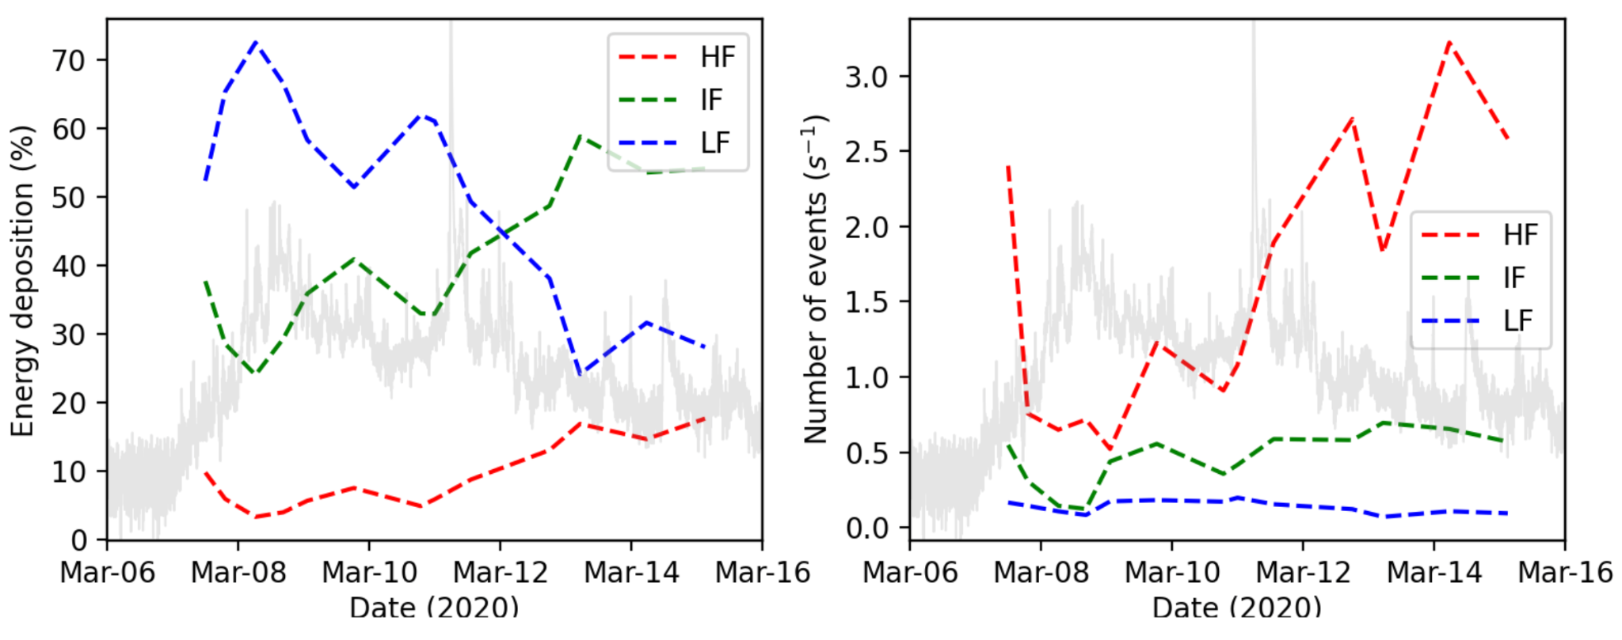
Evolution of heating frequency and their contributions
Mondal et al, 2025 (ApJ 980:75)

Slide 26
Summary
Investigated the nanoflare heating of QS XBP observed by XSM, MaGIXS, AIA and XRT
Nanoflare heating can reproduce the observed intensity of the XBP with an average nanoflare delay time in the order of 1500-3000 s, which is likely to be high-frequency.
The average Poynting flux is found to be in the range of ~3 ✕ 10⁵ erg cm⁻² s⁻¹.
X-ray observations, (e.g., MaGIXS and XRT) are more sensitive to diagnose the heating model
Emerging phase shows more LF energy depositions, while in the decay phase, energy depositions by IF nanoflares are dominating.
This model can predict the X-ray irradiance throughout the evolution of an AR.

Slide 27
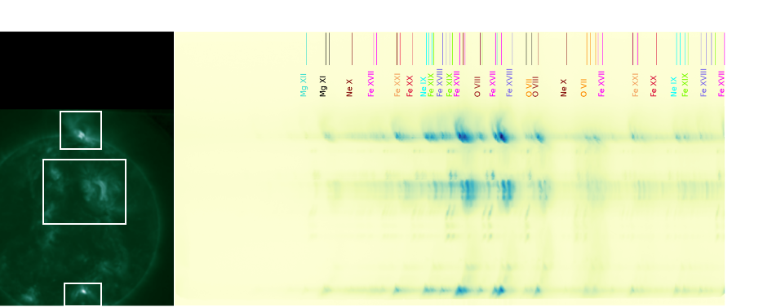
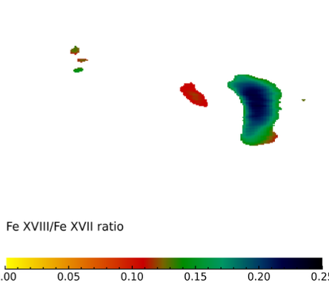

Highlights from recent second flight of MaGIXS
Credit: Amy
Thank You for your attention!

