Slide 1
Impingement Analysis
Unreal Engine Implementation
Elijah Crouch (Amentum)
encrouch@ndc.nasa.gov
8/8/2025

Slide 2
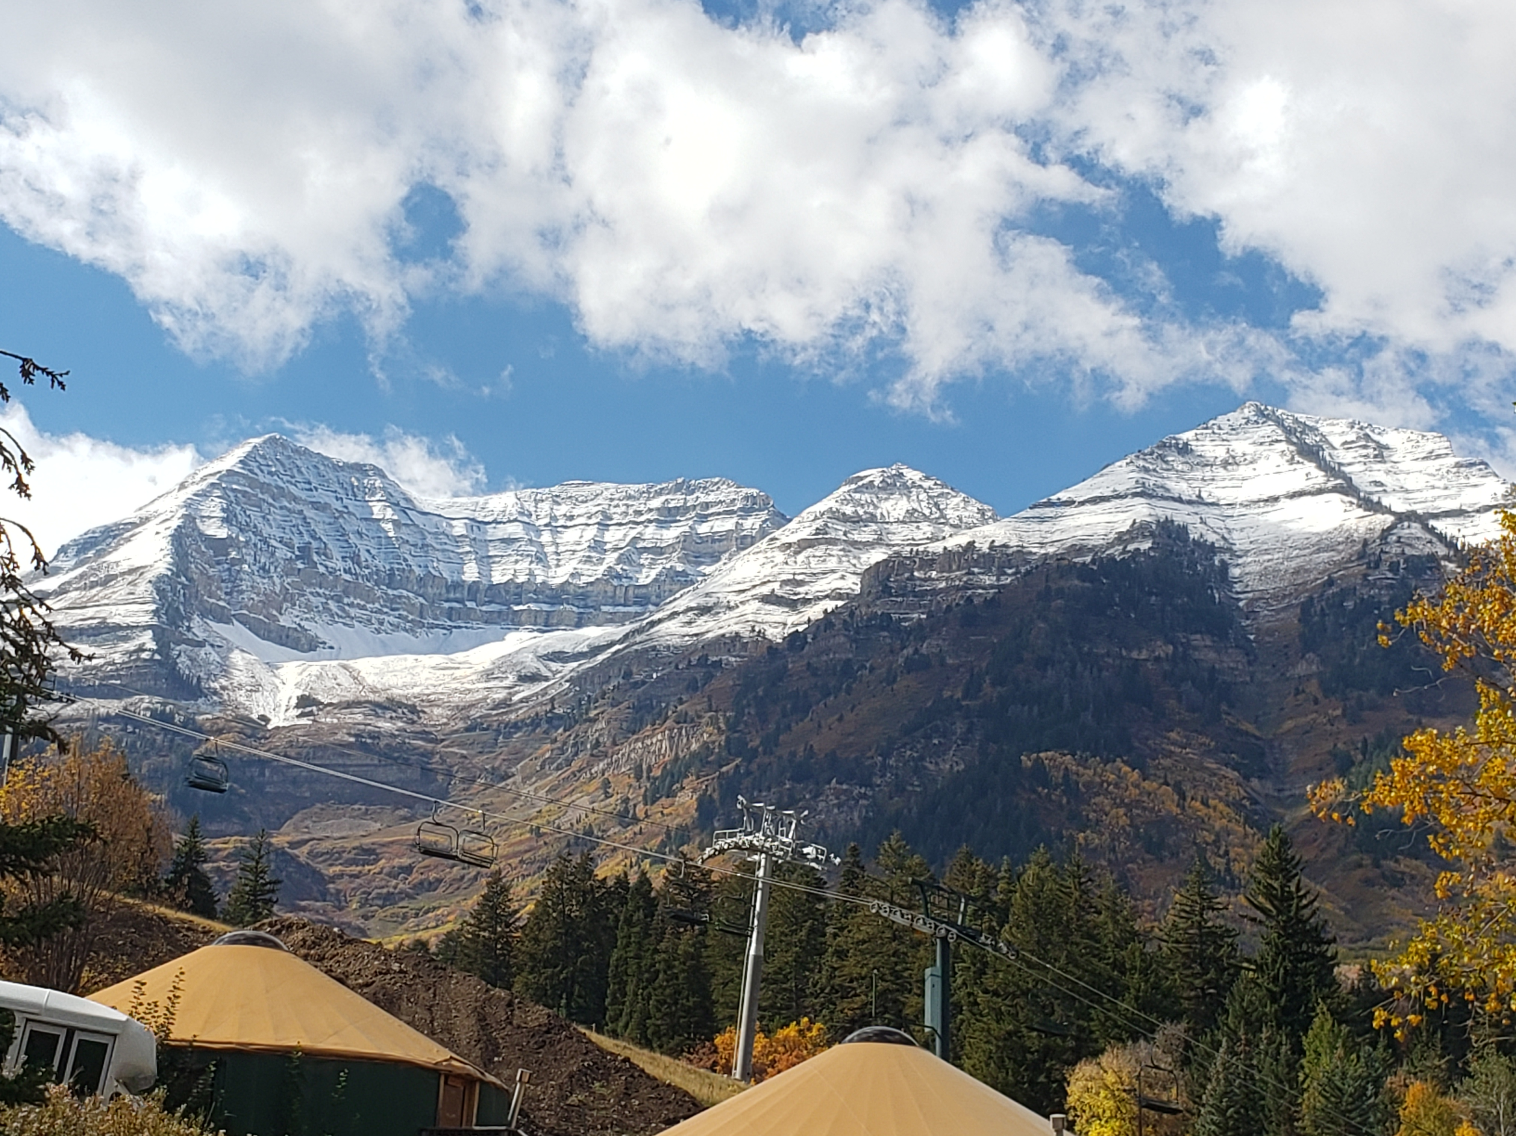
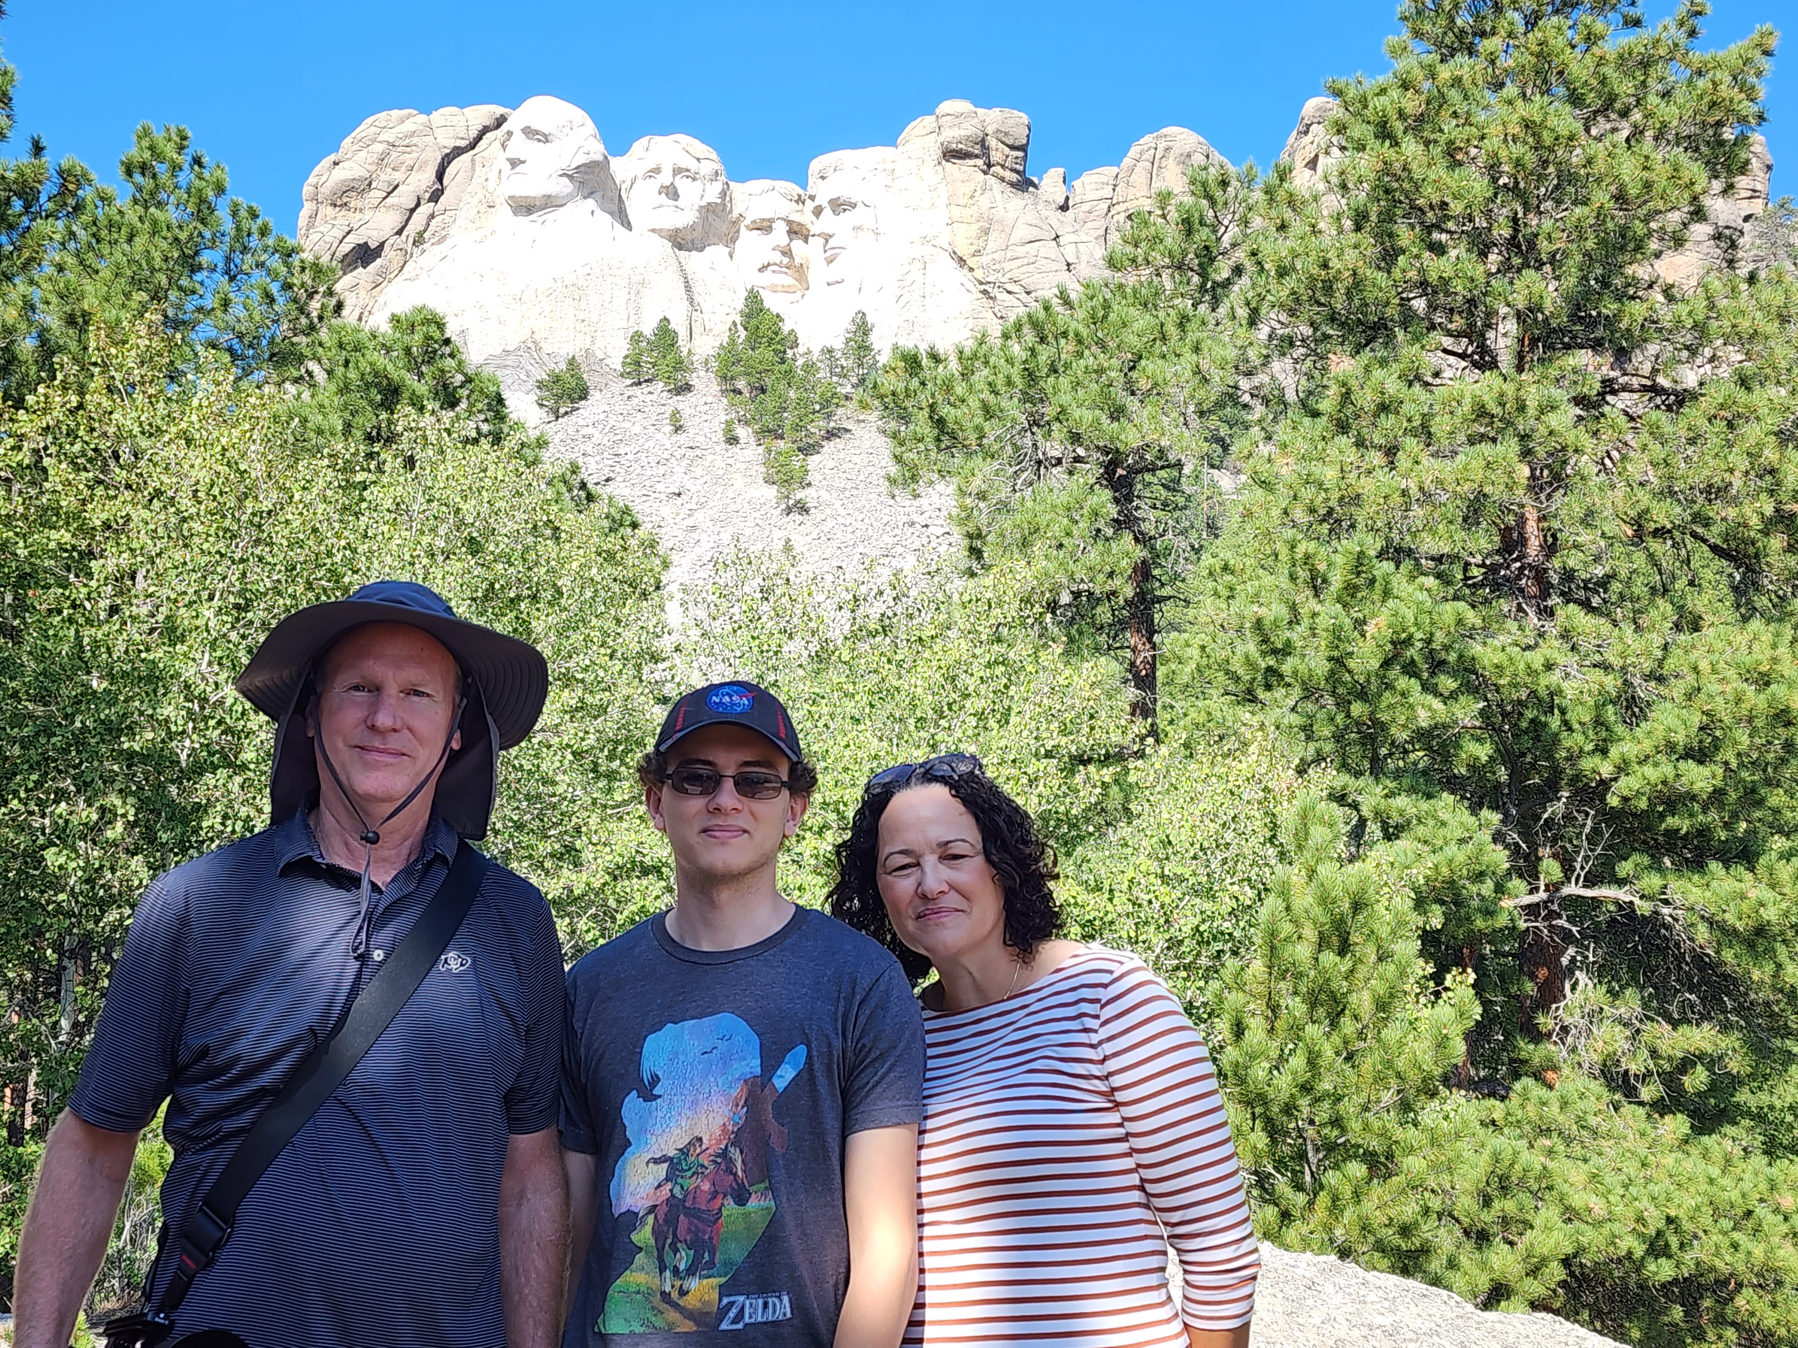
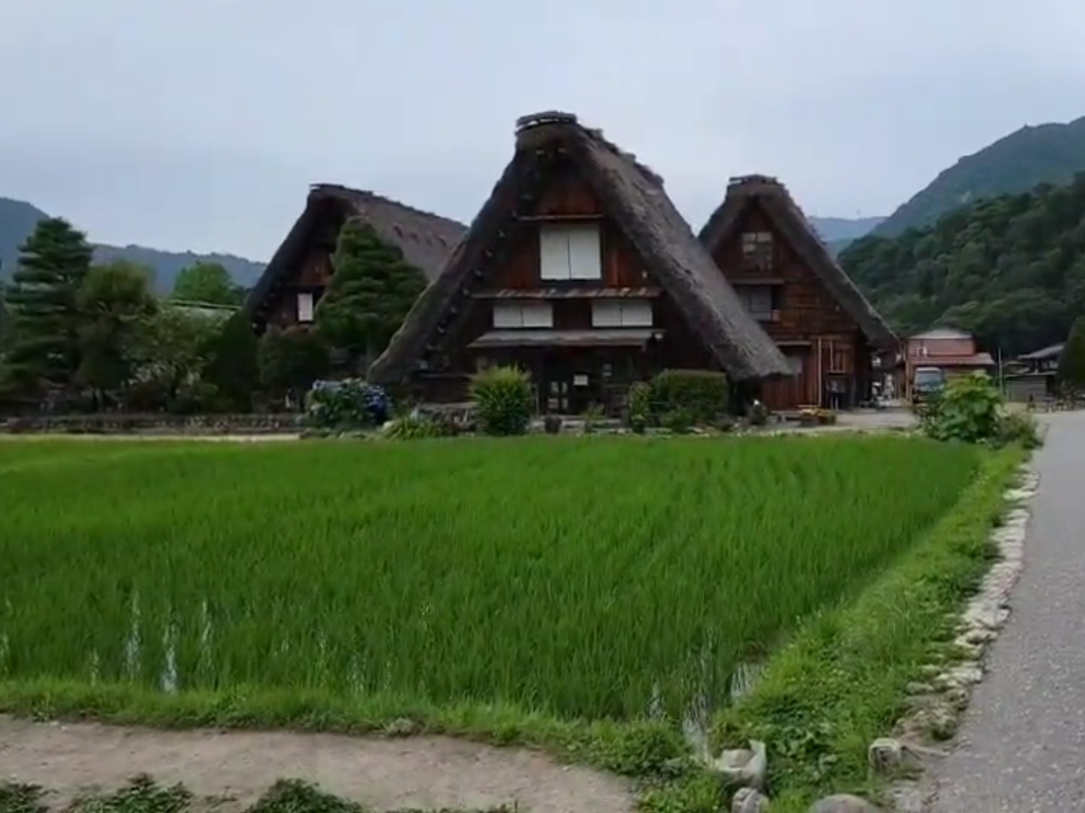
About Me
Background
Brigham Young University
Mechanical Engineering – Aerospace Emphasis
Graduating April 2027
Hobbies
Playing Instruments
Playing/Making games
Tennis
Traveling

Slide 3
Impingement Visualization Development
Primary Objectives
1. Represent plume impingement on booster during separation
  Performant and Highly customizable decals
  Plume cutoff on collision
2. Surface Deformation to represent Plume Surface Interaction
  Both playback and real-time (Simulink co-simulation capability)
  Customizable shapes for more in-depth analysis
3. Elevation and slope shaders for hazard analysis

Slide 4
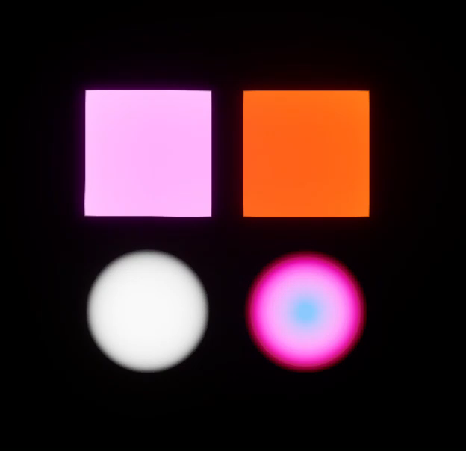
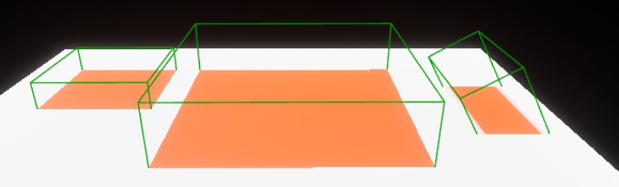
Decals and Materials
Materials
Rendering process that sends data to the graphics card to change the look of pixels.
Dynamics parameters such as color, emission, roughness, transparency, etc.
Decals
Projects a material onto bodies within a localized area
Dynamic rotation, position, and size parameters

Slide 5
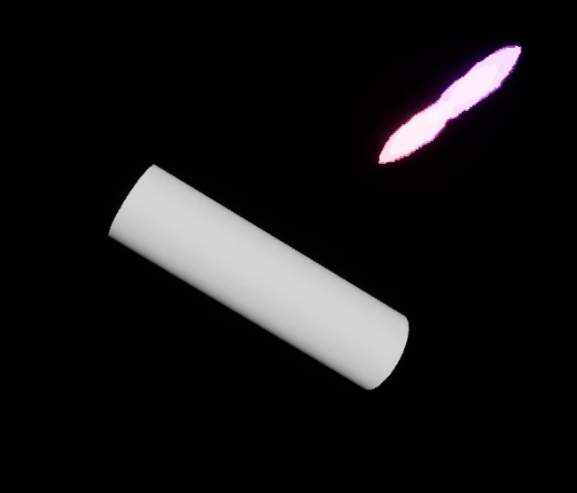
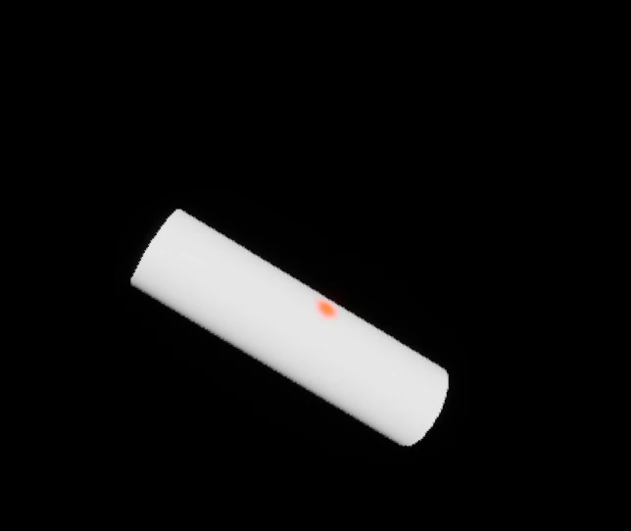
Separation Impingement – Collision Detection and Application
Trace a vector matching the position and rotation of each engine on the tanker as separation begins
Send the collision location to plume visuals to remove plumes past the collision
Place a decal on the hit location with the z axis and face normal aligned
Without Collision Detection
With Collision Detection

Slide 6
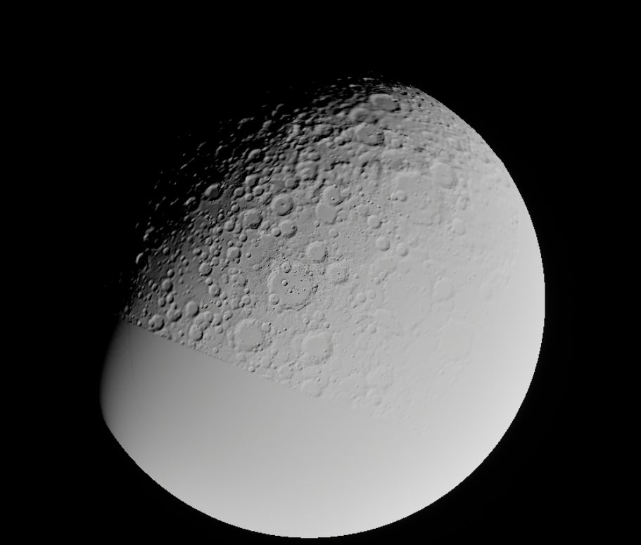
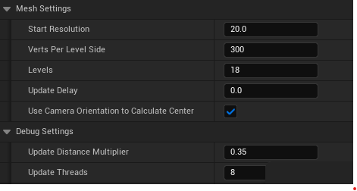
Modeling the Moon
The moon is rendered using a tool called Clip Map Unreal Terrain developed by JSC.
Converts DEMs to vertex height coordinates.
Applied to a lunar mean radius sphere mesh.
Uses clip mapping to render vertices in subsections called levels.
Subsequent levels have reduced vertex resolution.
Saves on VRAM and RAM.
Resolution is highest within center of camera view.
Updates with camera motion.
Multi-threaded to increase speed.

Slide 7
Modeling Craters
Playback
Real-Time
CSV
Simulink
Input Source
Unreal Engine Data Table
MathWorks Interface
API
Crater Shaping Plugin
Processing
Rendering
Visualization

Slide 8
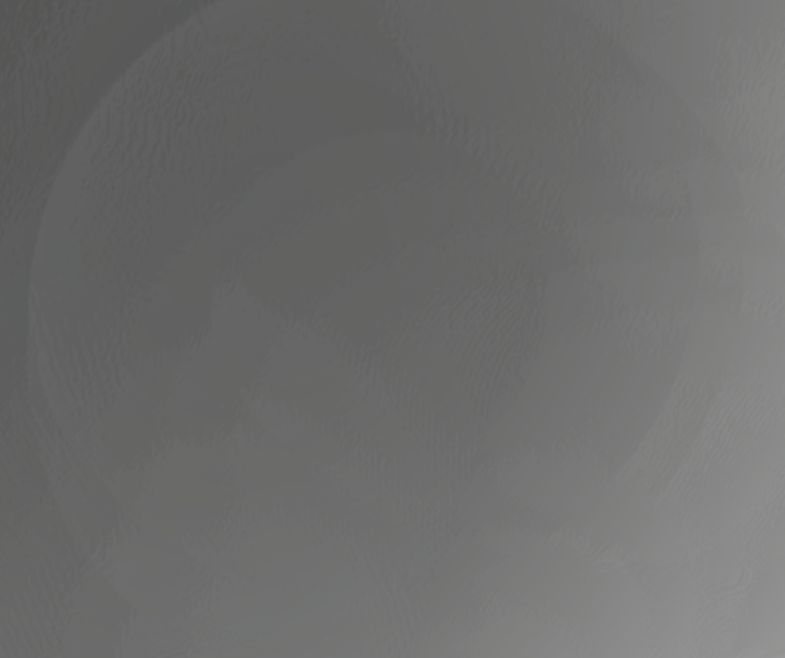
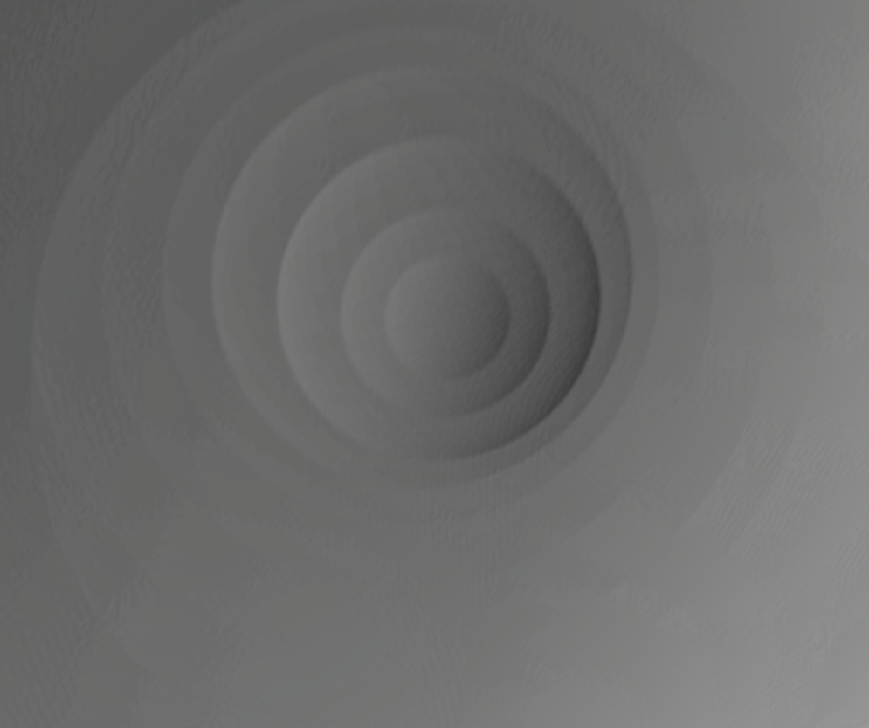

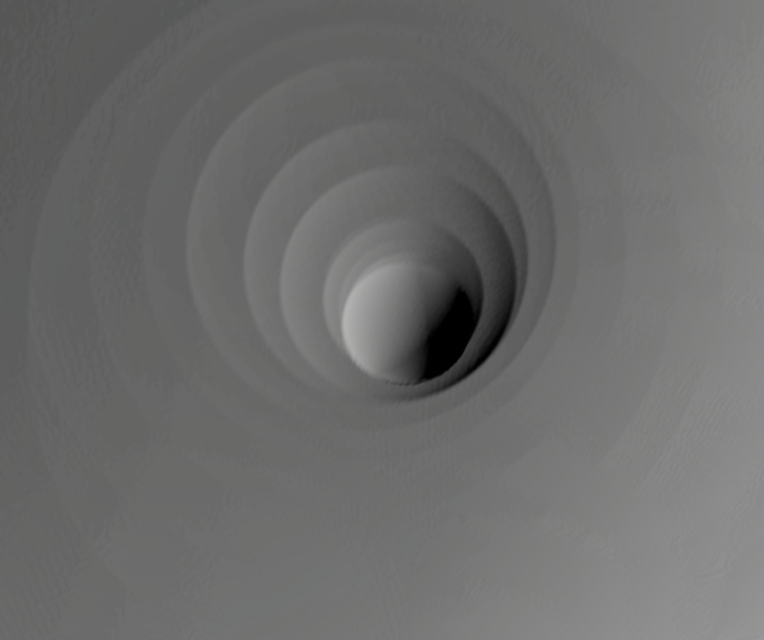
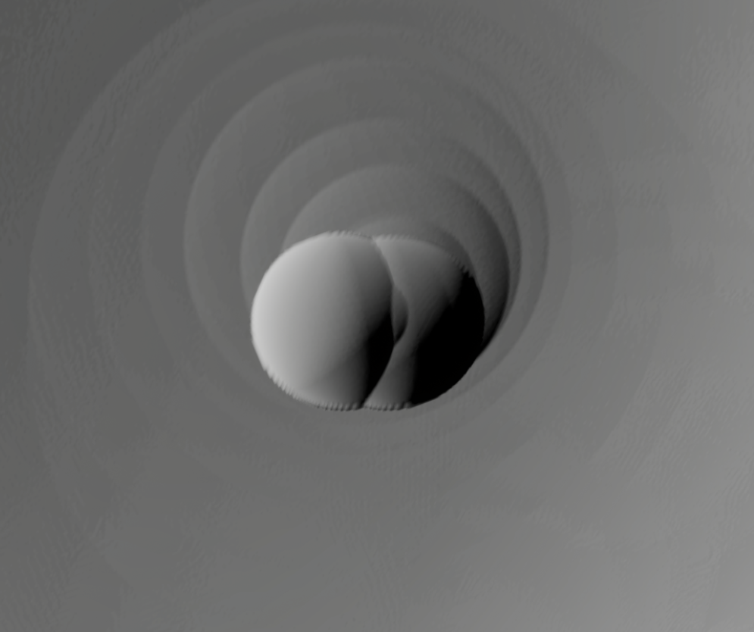
Playback vs Real-time
Playback
Complete data available
Specified time can be selected for viewing
Unreal Engine sequencer compatible
Requires CSV data
Real-time
Speed of formation is visible
Simulink compatible
Active during simulation

Slide 9
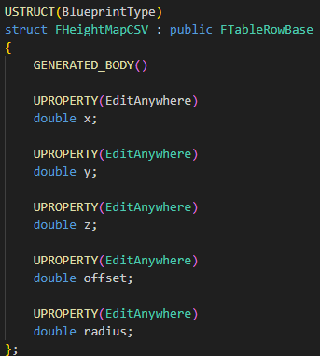
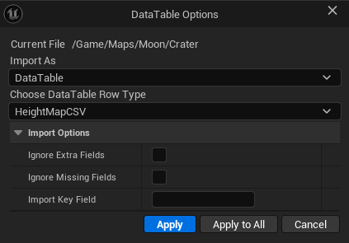
Playback Data Handling
Format and Importing Notes
Data Tables must have unique entries in the first column.
The first column in a data table will not have a name. Every column after must have a name.
Edits to the data format must be reflected in the custom struct.
Csv files are not natively supported.
Csv data must be converted to a data table which is an array of structs. Each struct contains one row of column data.

Slide 10
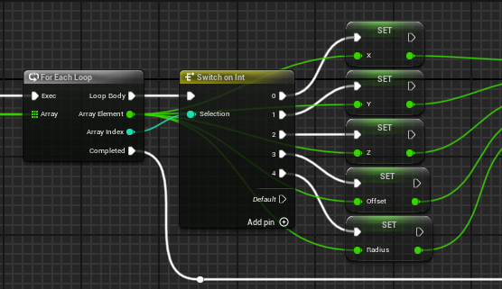
Real-Time Simulink interface
Simulink
As of MATLAB 2025a, a plugin is available that connects Unreal Engine and Simulink called MathWorks Interface.
Data sent as an array
Sent every time step
Same format as csv data
Mux
Write Message Block
Data
Array
Shared C++ memory space
Height Map Modifier
Sim3dGetFloat
Array
Unreal Engine

Slide 11
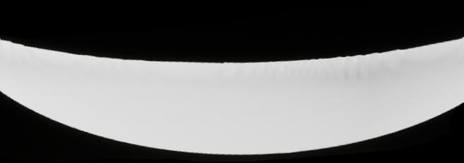
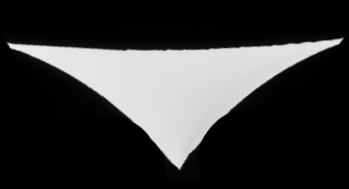

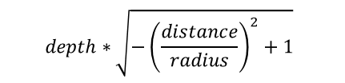
Crater Shaping
Crater Shape side views
Equation Editing
Defaults to circular equation on the left
Blueprint or C++ editable
  Blueprint equation performs slower than C++ equation
  C++ is more robust
$$depth∗\sqrt{−{\left(\frac{distance}{radius}\right)}^{2}+1}$$
Calculation
Crater depth scales the equation
Blueprint available variables
  Vertex distance from center of crater
  Radius of crater
$$depth∗e^{−distance}$$

Slide 12
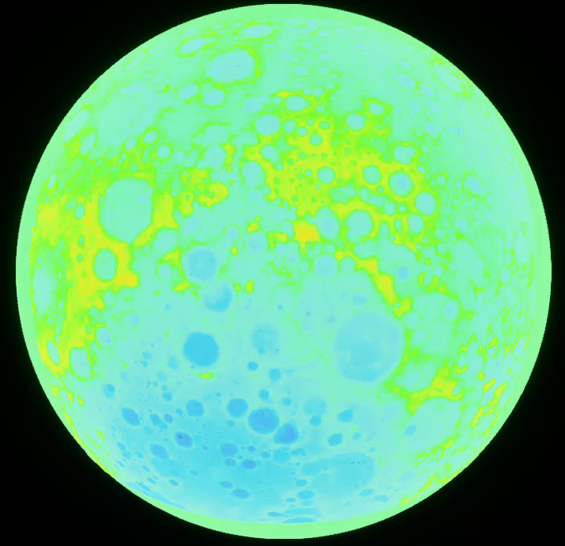
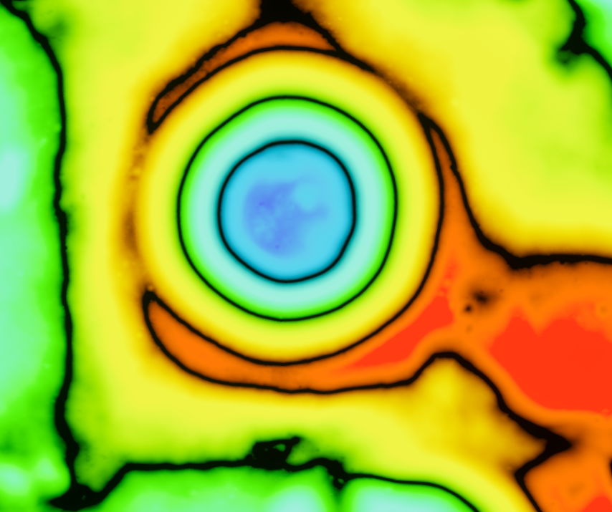
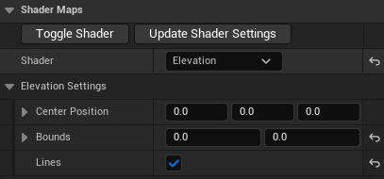
Elevation Map

Slide 13
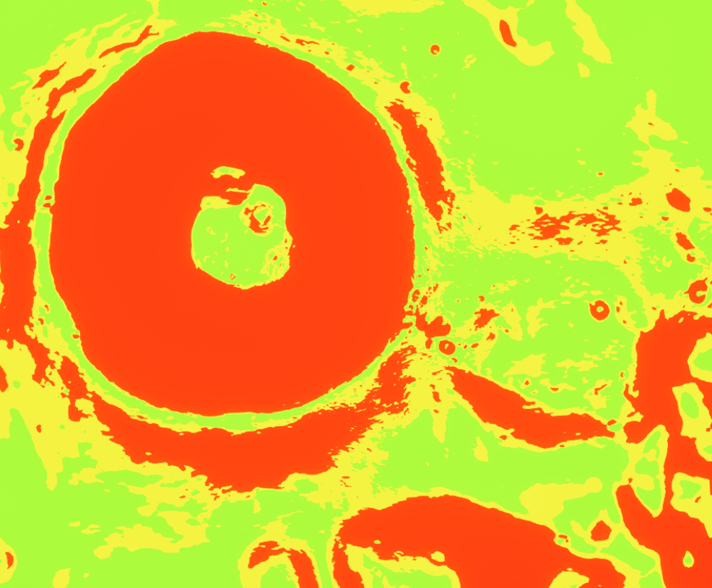
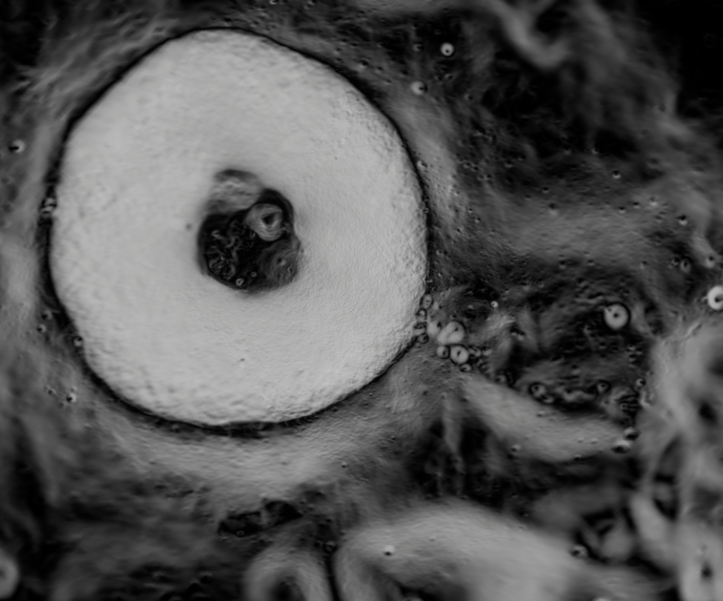
Slope Map
Green < 10° < Yellow < 15° < Red
Black = 0° White = 90°

Slide 14
Questions?
Special thanks to Patrick Serafin (ESSCA), Peter McDonough (ESSCA), EV42, and the Amentum Intern team

