Slide 1
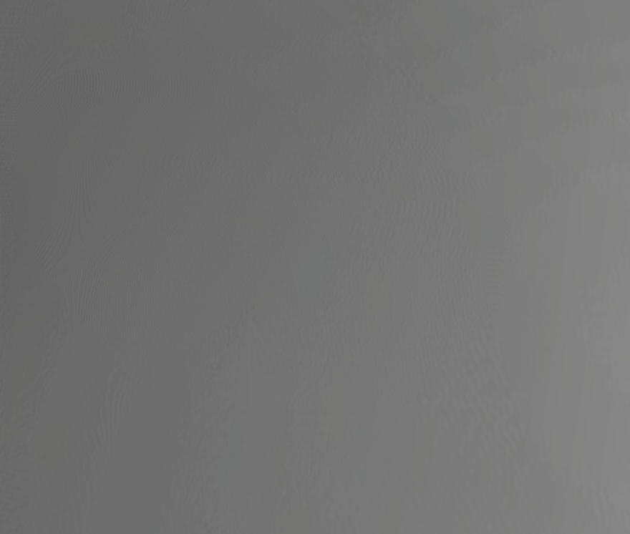
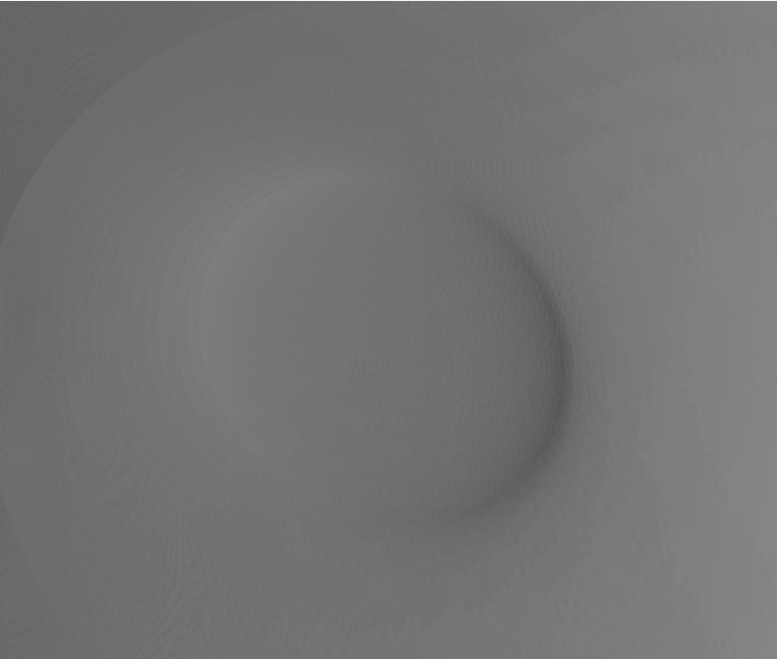
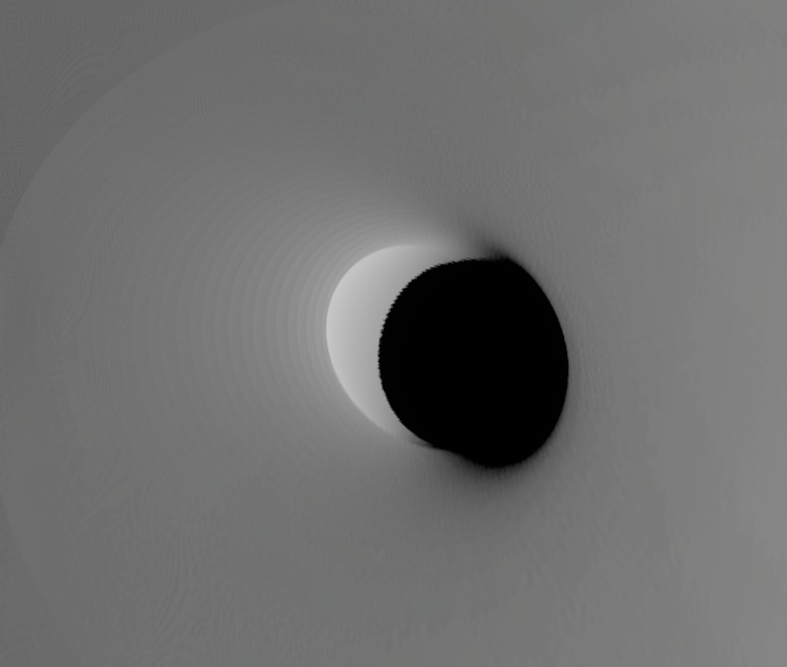
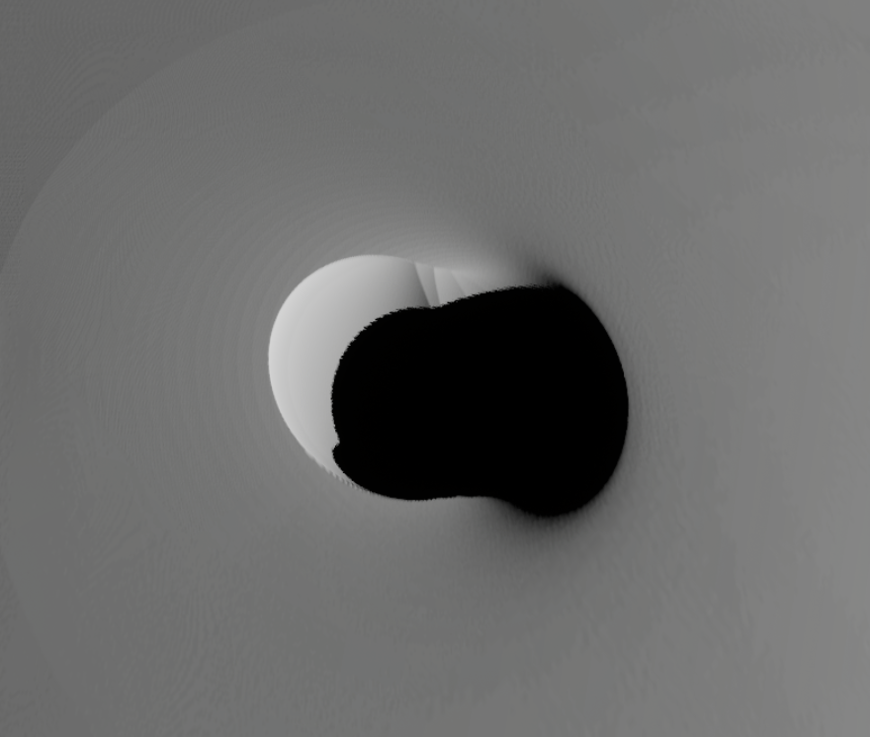
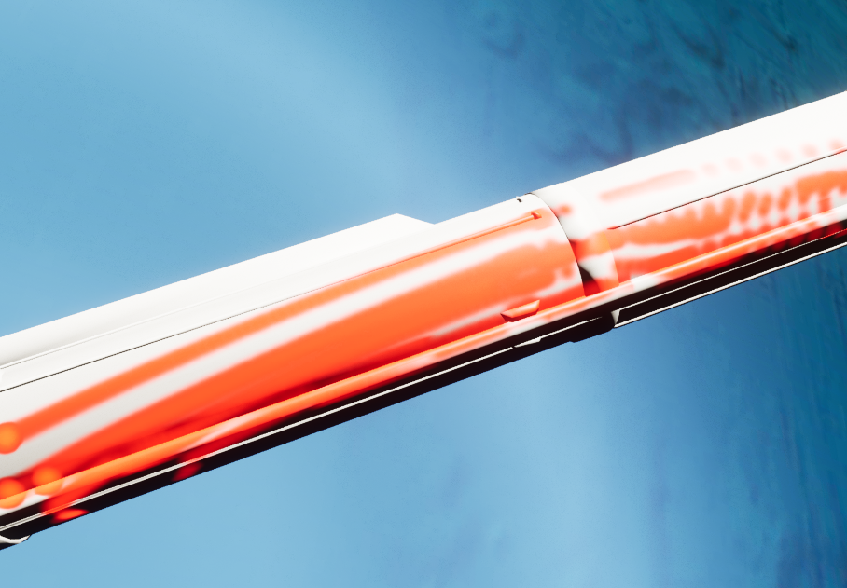
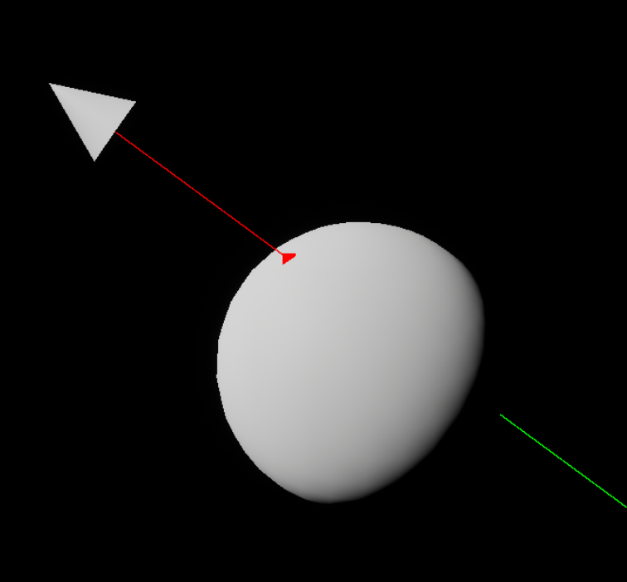
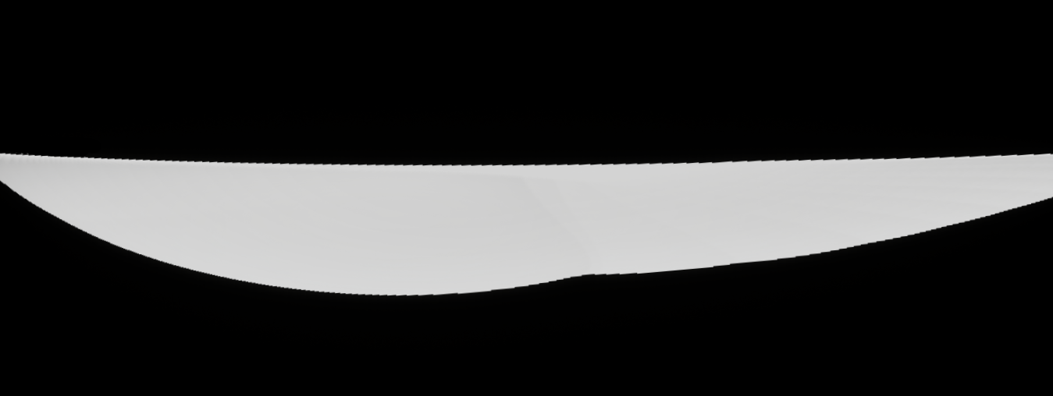
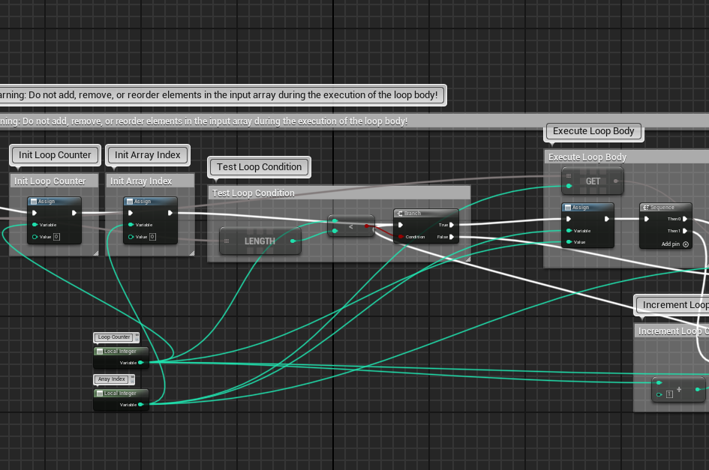
Impingement analysis
Unreal Engine Implementation
Elijah Crouch (ESSCA)
Mentors: Patrick Serafin (EV42 ESSCA), Dr. Peter McDonough (EV42 ESSCA)
Overview
Plume Cratering
Separation
The Artemis Program is a NASA initiative to bring humans back to the moon. The HLS is the vehicle chosen to do so. For the HLS to arrive safely, all aspects of the booster separation and landing sequences need to be understood.
Separation dynamics can be very complex and take a lot of time to model, especially for impingements between bodies. Using the ray tracing methods, we can quickly visualize these impingements. The new material added at the collision location can also be changed to represent various values.
The easiest way to understand these events is through visualization. We have used Unreal Engine to show the locations of plume impingement during separation and the result of plume surface interactions on the lunar surface.
The visualized collisions are discontinuous as a new ray trace must be evaluated at each time step making the system discrete. Datasets with higher fidelity result in less discontinuities.
Why Unreal Engine?
Unreal Engine is a real-time 3D creation tool with features created by leading experts in visual simulation. These features allow us to quickly iterate upon and improve our visualizations.
Methodology
There are two main approaches used for visualizing and/or detecting impingements.
The first method is to create a line tangent to an emitter (motors, radars, sensors, etc..) and trace along the line until a point of collision with an object of interest is found. This is called ray tracing. We can then take the collision point found and apply a new material to make the collision visible. This is the method used for the separation impingements as shown in the figure 3.
Figure 2a: Progression of crater formation during landing
Above are pictures visualizing an example of crater formation due to the pressure of lunar lander engines displacing lunar regolith.
To create a static visual, data is taken from a specially formatted csv containing the position of the crater at a point in time, the depth of the crater, and the radius. This data is then stored in internal variables for the duration of the visualization.
Figure 3: Example impingements of plumes on
booster during separation
The crater is formed in code by taking a lunar mesh (3D representation) and altering the height of the vertices. This is done in a custom plugin written in C++. The position of each vertex relative to the positions in the csv data are used to calculate the proper height depending on the desired shape. The above images use a simple circle equation to create a bowl shape. The deepest height value is then taken for each vertex to handle any overlap.
Future Work
The described tools are specific to Unreal Engine. Engineers unfamiliar with Unreal Engine can face difficulties in using these tools. Further simplification of usage can be made to make the capabilities more accessible. Expanding these capabilities requires experience with Unreal Engine blueprint visual scripting and the C++ coding language.
Figure 1: Example ray trace.
Red square shows collision.
Currently, these tools can perform slowly on lower end computers. Optimization improvements can be made to enhance performance.
The second method is to have a dynamic math model find locations of impingement and return values that may be statistically important for the visualization such as crater depth. These data points are then read into Unreal Engine and used to modify the visual models appropriately. This method was used to create the plume cratering visualization.
Value to NASA
Figure 2b: Side view of fully formed crater
When using csv data to create a non-static deformation, there is a time component available for use. The time variable determines how much of the loaded csv data is used during calculations. This time variable can then be controlled through a sequencer to create an animation of the crater forming.
The development of visualization technology allows NASA engineers to rapidly deepen understanding of their models by:
Quickly discovering mathematic modeling errors
Closely analyzing data points of interest
Replaying real events at various speeds.
Quickly comparing the sizes of different bodies and terrain features.
Discovering unaccounted for parameters
For fully real-time capabilities, the plugin is compatible with Simulink. Data is sent dynamically from Simulink into Unreal Engine. The plugin then adds the data into stored variables for calculation. This allows the crater to form in real-time during a simulation.
Figure 4: Unreal Engine Blueprint Workspace
Separation impingement visualization can help engineers determine if motors are causing problems during separation and where these problems might occur.
Safety Engagement
Acknowledgements
Amentum informed me about an interesting hazard when working on Marshall Space Flight Center. During a safety meeting presentation, the topic of natural resource management was shared. This included endangered and hazardous animals living on Redstone Arsenal. Many of these animals can come onto the base or into the roads and become injured posing a threat to us and themselves. Make sure to stay aware during commutes to prevent such a situation.
Thank you to Patrick Serafin for the technical support and guidance during this project.
Thank you to Dr. Peter McDonough and Amentum for the opportunity to support the HLS mission.
Thank you to the EV42 branch for having me a part of their team.
Thank you to the Amentum intern team for coordinating this program and creating a fun summer.
Cratering visualization can show the size of a hole dug from a lander’s engine relative to the size of the lander itself. This allows NASA to know how big of a threat the plume surface interactions pose to the ship during the landing sequence. Visualizing the size also allows NASA to know if the crater poses a risk to astronauts exiting the ship as well.

