Slide 1
NASA Conjunction Assessment Risk Analysis (CARA) Compendium for Artificial Intelligence and Machine Learning for Satellite Collision Avoidance
AMOS Conference 2025
Conjunction/RPO Session
September 17, 2025
Authored by Dr. Alinda K. Mashiku
NASA CARA Manager
NASA Goddard Space Flight Center
Presented by Dr. Dolan E. Highsmith
NASA CARA Chief Engineer
The Aerospace Corporation

Slide 2
Agenda
Motivation & Background
AI and ML for Risk Assessment
AI and ML for Decision Support
Findings & Challenges
2

Slide 3
Motivation
Investigate and construct an architecture with physics-based statistical parameters using AI/ML for:
  Use statistical representation of the random vector (state) and the uncertainties (covariance) to construct the parameters
  CA (collision avoidance) decision making involves mostly Pc, however in operations additional constructs are considered ex. miss-distance, OD quality etc.
  Sensor tasking is also a key component/contributor to the CA decision support. How can we incorporate this qualitatively and quantitatively?
Intelligent and augmented risk assessment
Reliable and rapid/early decision-support
2 MAIN QUESTIONS
Can we perform risk assessment with increased certainty using available conjunction data?
Can we perform rapid/early decision support for collision avoidance using available conjunction data?

Slide 4
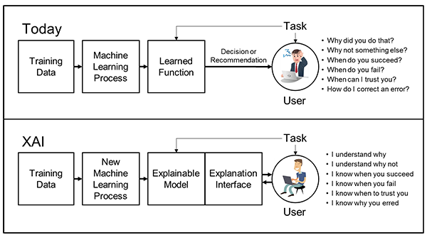
Key Points to Consider
Explainable AI (XAI) Concept
In Machine Learning, quality data is imperative.
  Must have a clear goal for the outcome.
  Can we explain the outcome?
    Explainable AI
Training AI/ML to do CARA requires access to “truth” data
  Need both hits and misses, but very few actual collisions
  Viable alternative: historical database of high-risk conjunctions
  Can also use realistic simulated data
Existing conjunction data poses analysis challenges
  Multiple non-deterministic factors involved
  Each conjunction is unique
Ref: https://www.darpa.mil/program/explainable-artificial-intelligence
Comprehensive historical and simulated data sets, but with lots of variability

Slide 5





Conjunction Data for AI/ML Data Curation
Day 3
Day 4
Day 2
Day 5
TCA
Day 6
Day 1
Day 7
Sat A
Maneuver
Sat B
Sensor Tracking
Sat C
Sensor Tracking
Solar Activity
Varying quantities of CDMs per event (ranging from 1 to 21)
Varying prediction durations to TCA; impacting accuracies
Space weather atmospheric perturbations
Varied observation solutions; depend on geometry and state accuracy
Complex and Nuanced Data Archive!
Can’t predict future maneuvers from CDM data

Slide 6
AI and ML for Risk Assessment

Slide 7
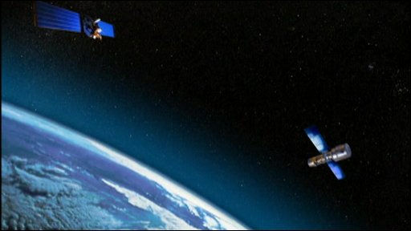
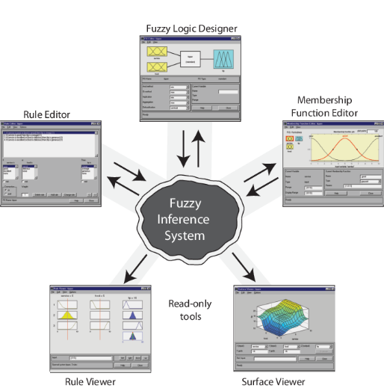
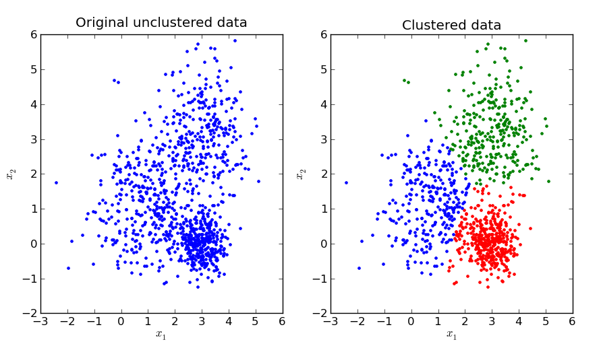
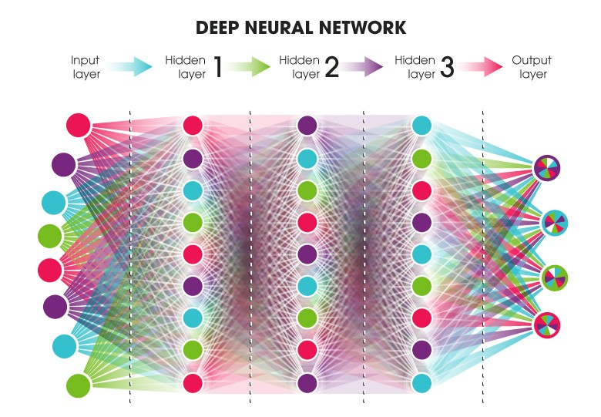
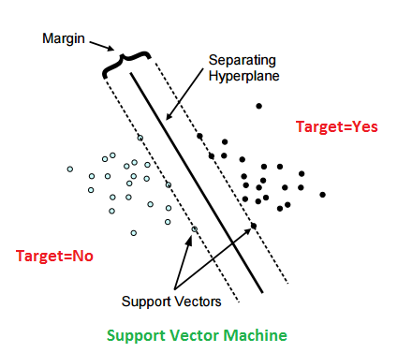
Approach
(1) Obtain Data
(2) Data Wrangling
(3)Train Model
Fuzzy Inference System (FIS)
Unsupervised Machine Learning Methods: Clustering and Classification
K-means
Two spacecraft at Time of close approach (TCA)
Partition N observations into K clusters.
Statistical Parameters
Probability of Collision
Miss Distance
Mahalanobis Distance
Bhattacharyya Distance
Kullback-Leibler Distance etc.
SVM-Support Vector Machines
Separation into K groups with the widest gap possible
Deep Neural Network (DNN)
Notes:
GOAL: Classification of information parameters (substitute and/or supplement Pc)
GOAL: Provide a binary decision output based on
aggregated weighted parameters
GOAL: Training a Deep
Neural Network model for
decision making based on
known inputs and known
outputs.
10 hidden layers
Scaled conjugate gradient training algorithm
Training 70
Testing 15
Validation 15

Slide 8
Parameter Set Considerations
Investigate statistical parameters using the available information that could provide augmented insight into conjunction events.
Developed a set of “statistical information parameters” (and their variations) derived from some of the same information used to compute Pc.
    Probability of Collision (Pc)
    Mahalanobis Distance (MHD)
    Miss Distance (MD)
    Bhattacharyya Distance (BD)
    Angle between two orbit planes(OA)
    Kullback-Leibler Distance (KLD)
    Other?
(Both Primary and Secondary)
-Position and Velocity
-Covariance matrix
-Other?

Slide 9
Data Wrangling: Unsupervised Machine Learning
Unsupervised learning methods classify data into groups based on features within the dataset that may not be immediately obvious to a human operator.
Two clusters/classifications were defined:
  “safe” or “not safe”
The performance metric was compared to a
Monte Carlo computation for the ground truth
based on Pc
  1 – ensemble’s correct assignment
  0 – ensemble’s incorrect assignment
Clustering Performance Methods for K-means and SVM using the Performance Metric
Parameter | K-means | SVM
Probability of Collision (Pc) | 0.7742 | 0.9995
Miss Distance (MD) | 0.6389 | 0.8314
Mahalanobis Distance (MHD) | 0.6983 | 0.8810
Bhattacharyya Distance (BD) | 0.7611 | 0.8864
Kullback-Leibler Distance (KLD) | 0.7736 | 0.8459
Orbit Angle (OA) | 0.5387 | 0.8711
These performance values were used as input weights for the risk assessment tools
Notes:
The data fed into unsupervised learning algorithms are not initially labeled with their classifications, but rather, the algorithms infers its own functionality onto the data to generate those classifications.
The intention of this initial approach of using unsupervised machine learning on the information parameter set, was to explore the data and determine if an internal representation existed that would cluster the parameter sets into two categories: safe or close-encounter (not safe).

Slide 10
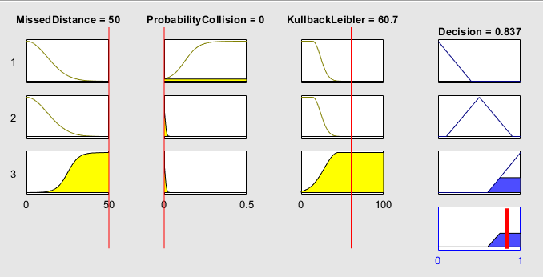
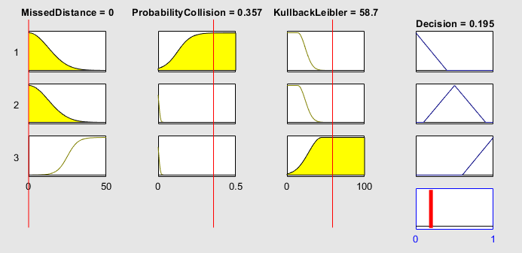
Fuzzy Inference Systems
Fuzzy Inference Systems (FIS) map input to output using fuzzy logic, which is able to express partial membership of variables or parameters to certain sets using Fuzzy Membership functions (FMF).
Using the Mamdani FIS, we investigated the decision-making tool’s output using three informational parameters: Miss-Distance, Probability of Collision and the Kullback-Leiebler Divergence
High – MD Low – Pc Mid – KLD
Output : 0.837 {Safe}
Low – MD High – Pc Mid – KLD
Output : 0.195 {Unsafe}
Notes:
FIS’s are used mostly in decision making problems, where there is not a concise certainty on whether an input belongs to a discretized set.
The information parameters are modeled to produce an output ranging from 0 1o 1, based on the continuous distribution of the Fuzzy Membership Function. The resulting Decision plot output CHANGES as the parameter values change (i.e. Miss distance from 0 to 50, Pc from 0 to 0.5, KLD from 0 to 100.
A high MD, Low Pc and average KLD – results into a “Safe” conjunction decision ….1 is SAFE
A low MD, High Pc and average KLD – results into an ”Unsafe” conjunction decision…0 is UNSAFE

Slide 11
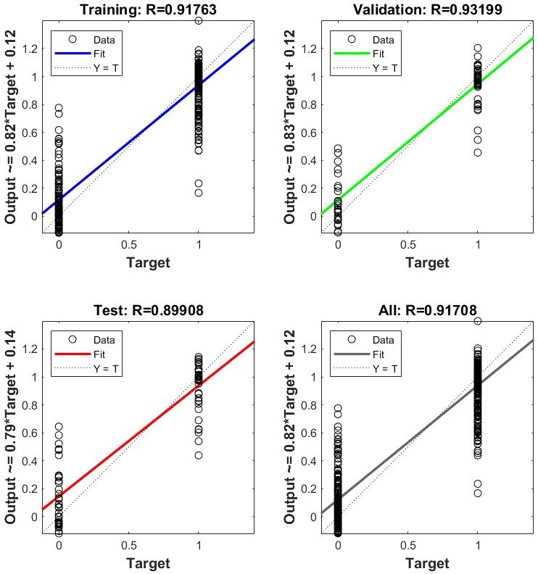
Machine Learning for Space Situational Awareness
Using Deep Neural Networks
A Deep Neural Network has nodes and weights operated by nonlinear functions
500 simulated cases
10 hidden layers
Scaled conjugate gradient training algorithm
  Training 70
  Testing 15
  Validation 15
Target and Output
  0 – Safe
  1 – Close approach (unsafe)
Preliminary overall performance was ~92% accurate
Notes:
10 hidden layers
Scaled conjugate gradient training algorithm
Training 70
Testing 15
Validation 15
The simulated cases included cases that simulated “collisions” at TCA and then were back propagated several days back. The cases included random orbits that were extrapolated from the 12 cases generated by Alfano’s 2009 paper. The variability of these conjunctions were used to train 70% of the data sets. The performance of the Testing and validation is not very surprising however, a 92% overall performance is not necessary a performance of a model that can be used for any future conjunction but perhaps ONLY the conjunctions for specific cases that the model has been trained on.

Slide 12
AI and ML for Decision Support

Slide 13
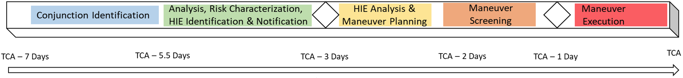
Background on AI/ML for Decision Support
Continual exponential growth in launched spacecraft and tracked debris.
Risk Assessment is necessary to prevent collisions in a timely manner.
KEY QUESTIONS:
When we have a list of high interest events, how do we prioritize the risks for mitigation?
What parameters are associated with higher Pc events OR high-risk events?
How many observations leading to TCA are needed before a collision avoidance decision can be implemented?
Can we move the Decision Points Earlier?
Decision Point: Begin Maneuver Planning
Decision Point: Maneuver Go / No-Go
13

Slide 14
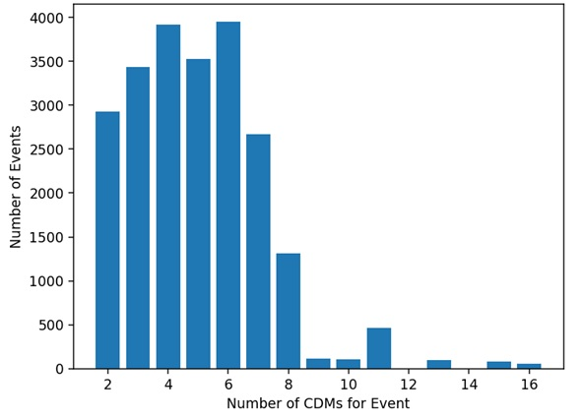
Approach
Spacecraft data from 2015-2018 from 365,000+ Conjunction Data Messages (CDMs)
Supervised Learning (SL)
Binary Classification
Using those trends to try to predict miss distance with uncertainty
Long-Short Term Memory (LSTM) Neural Networks
  Type of Recurrent Neural Network that retains information from each input
  Mean squared log error loss function with an 80/20 data split with min-length of two CDMs
14
Notes:
The CDMs have a plethora of conjunction parameters that help inform the level of conjunction risk in addition to space weather parameters that were included at the time the CDMs were generated.
For a typical conjunction event, one can expect anywhere btn 1 to 21 CDMs, however, the distribution of the number of CDMs for a conjunction event are shown in the histogram plot.
When training the LSTM neural networks, using the time-series of the CDMs, any gaps in the duration of the conjunction assessment are accounted for in the LSTM neural network to ensure a uniformity of the time series of CDMs considered.

Slide 15
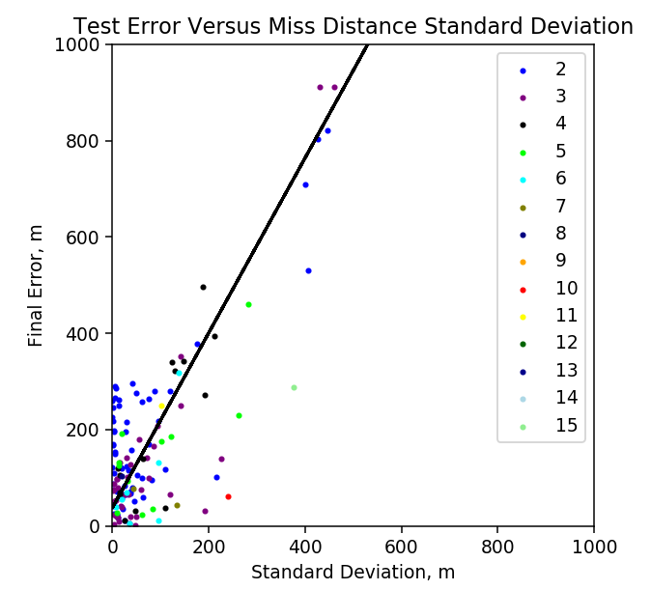
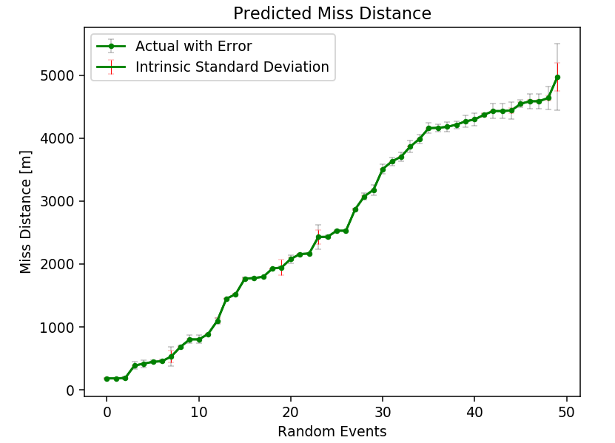
SL: LSTM (Long Short-Term Memory) Model Results
Chose an LSTM model because of its potential to predict values using data in a time-series approach
Most events contain < 4 CDMs
Large Stand. Dev. yields large error
Average prediction at one day until TCA
Larger error as miss distance increases
Predicts miss distance with an average error of < 0.2 km, but affected by intrinsic error in prediction
Increased decision uncertainty with increased miss-distance.
15

Slide 16
Findings and Challenges

Slide 17
Comparison of AI/ML Approaches
Unsupervised learning (hierarchical clustering and competitive networks):
  Valuable for parameter relationship discovery, e.g., miss distance to Pc
  Inadequate for operational risk classification, e.g., correlations to actionable risk assessments
Supervised learning:
  Demonstrated stark differences between shallow and deep neural network architectures
  Shallow binary classification networks:
    Marginal improvements in risk classification when incorporating multiple parameters beyond Pc
    Questionable practical value due to increased computational complexity of incorporating many parameters
  Deep neural networks:
    Theoretically offered most promising approach for handling evolving nature of conjunctions
    Suffered from insufficient “ground truth” for training and poor generalization to diverse conjunction scenarios

Slide 18
Fundamental Challenges & Bottlenecks
Stochastic and nonlinear nature of conjunction evolution creates inconsistent parameter behavior patterns
  Difficult for ML models to capture reliably
  Exacerbated by rarity of actual collisions in training data
Lack of explainability
  “Black box” nature of neural networks provides little insight for predictions
  Difficult to make operational decisions without clear understanding of basis for risk assessment
Significant advances required for operational use of ML techniques in conjunction assessment:
  Covariance realism
  Model interpretability / explainable AI
  Validation methodologies
Near-term way forward: Hybrid approach using physics-based methods with targeted ML components

Slide 19


Slide 20
ACRONYMS REFERENCE
ASAT | Anti-Satellite Test | NOAA | National Oceanic and Atmospheric Administration
CA | Conjunction Assessment | NPR | NASA Procedural Requirements
CAOIA | Conjunction Assessment Operations Interface Agreement | NSDC | National Space Defense Center
CAPO | Conjunction Assessment Program Office | OADR | Open Architecture Data Repository
CARA | Conjunction Assessment Risk Analysis | OCAP | Orbital Collision Avoidance Plan
CCSDS | Consultative Committee for Space Data Systems | OD | Orbit Determination
CIC | Commercial I Cell | OEM | Orbit Ephemeris Message
COSA | CARA Orbital Safety Analysts | O/O | Owner/Operator
COSMOS | Kosmos (Russian satellites operated by the former Soviet Union and subsequently Russia) | OSA | Orbital Safety Analysts
DOC | Department of Commerce | PC | Probability of Collision
DOD | Department of Defense | PPBE | Planning, Programming, Budgeting, and Execution
EGA | Earth Gravity Assist | SAA | Space Act Agreement
ESMO | Earth Science Missions Office | SAC-T | Sprint Advanced Concept Training
FAA | Federal Aviation Authority | SC | Spacecraft
FCC | Federal Communications Commission | SDS | Space Defense Squadron
HBR | Hard Body Radius | SMD | Science Mission Directorate
HIE | High Interest Event | SME | Subject Matter Expert
HSF | Human Space Flight | SSA | Space Situational Awareness
MADCAP | Multimission Automated Deepspace Conjunction Assessment Process | SSN | Space Surveillance Network
MRPP EMI | Mission Resilience and Protection Program Electro Magnetic Interference | SW | Software
MSA | Maneuver Screening Analysis | TCA | Time of Closest Approach
NID | NASA Interim Directive

Slide 21
Acknowledgements
This work was performed over several years with various funding sources and multiple collaborators:
  Dr. Carolin Frueh; Purdue University, Aeronautical and Astronautical Engineering, 2018
  Dr. Nargess Memarsadeghi, NASA Goddard Space Flight Center, Software Division, 2018,
  Dr. Evana Gizzi, NASA Goddard Space Flight Center, Software Division, 2019
  Mitch Zielinski, Purdue University, Graduate Student, 2019
  Briana Robertson, Louisiana State University, Undergraduate Student, 2020
Reference Papers: https://www.nasa.gov/cara/cara-publications/#pub-i
  Predicting Satellite Close Approaches Using Statistical Parameters in the Context of Artificial Intelligence – Mashiku et al (2019)
  Early Information Parameter-Set Analysis for Satellite Close Approaches using Machine Learning – Robertson and Mashiku (2021)
21

Slide 22
Deep Neural Networks
For comparison we designed and implemented a Deep Neural Network (DNN) model for decision making augmentation with Pc.
In this context of using DNN for decision making, we considered a few informational parameters: Pc, KLD, MHD, BD, MD and the OA. We grouped the informational parameter into arbitrary assignments of 4 groups:
-Group 1 = {KLD, MD, BD, Pc, MHD}
-Group 2 = {KL, MD, MHD, Pc}
-Group 3 = {Pc, MHD, OA}
-Group 4 = {Pc}
DNN model design considerations:
  Three sets of numbers for hidden layers: {10, 20 and 40}
  Backpropagation training functions: Scaled-conjugate gradient (SCG) and Levenberg-Marquardt (LM)
  Training, Validation and Testing ratios: 0.7, 0.15 and 0.15 respectively
Used a sample data set of 1000 samples of simulated data containing both safe and unsafe encounter classifications.
Group 3 and Group 4 will be presented.
(Note the binary outputs assignments for the DNN are not the same assignments as for the FIS, but bear similar theoretical meaning and representation).
Notes:
In our application, we chose the scaled conjugate gradient algorithm due to its enhanced performance compared to other gradient derivatives methods²⁴. During training, several stopping conditions need to be pre-defined such as the number of epochs (iterations), maximum duration, performance goal, minimum performance gradient and a validation performance²⁵.
In our application, we chose the LM backpropagation training function because of its promising performance and speed and it has an efficient implementation in MATLAB. The LM algorithm was designed to reach second-order training speed without having the need to compute the Hessian, which is a second order derivative matrix or the derivative of the Jacobian²¹.

Slide 23
Deep Neural Networks: Group 3
This was the best performing Group of all 4 considered here.
The best performing DNN model used the LM algorithm with 10 hidden layers
Performance Metrics for Group 3.
DNN Performance analysis after training and testing.
Error histograms for SCG (top) and LM (below). The vertical red line is the zero error mark.
Notes:
The performance will be measured using the regression R value which is an indication of the relationship between the outputs and the targets.
If Regression is equal to 1, then this indicates that there is an exact linear relationship between the outputs and targets, and if Regression is equal to 0, then there is no linear relationship between outputs and targets.
This is what we will be using for this preliminary exploration, however there are other non-linear Regression constructs²⁶, that could be explored and may perhaps provide an improved result when the results are not constrained to a binary output {0,1} = {unsafe, safe}

Slide 24
Deep Neural Networks: Group 4
This was the least performing Group of all 4 considered here.
The best performing DNN model used the LM algorithm with 10 hidden layers
Performance Metrics for Group 4.
Training state output and function fit (target vs output) with an error subplot
Error histograms for SCG (top) and LM (below). The vertical red line is the zero error mark.
Notes:
The performance will be measured using the regression R value which is an indication of the relationship between the outputs and the targets.
If Regression is equal to 1, then this indicates that there is an exact linear relationship between the outputs and targets, and if Regression is equal to 0, then there is no linear relationship between outputs and targets.
This is what we will be using for this preliminary exploration, however there are other non-linear Regression constructs²⁶, that could be explored and may perhaps provide an improved result when the results are not constrained to a binary output {0,1} = {unsafe, safe}

Slide 25
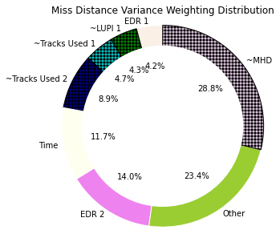
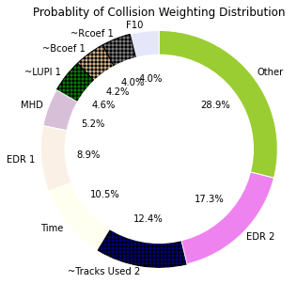
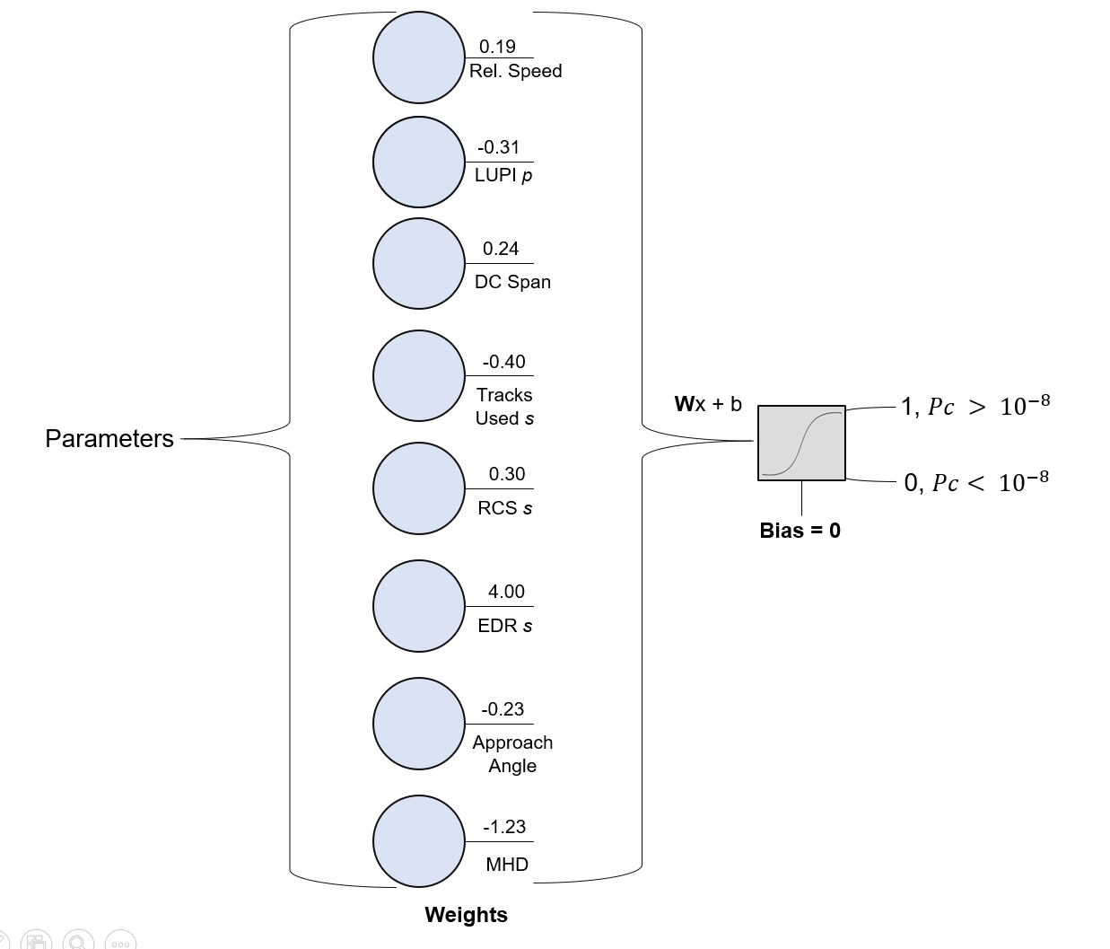
Binary Classification Results
High EDR and low Tracks Used correlate to larger PC Values
82% accuracy for high Pc
92% accuracy for low Pc
25
Notes:
These parameters are highlighted as having the most relationship to high 0.2 importance
Input is standardized event parameters across a sequence

Slide 26
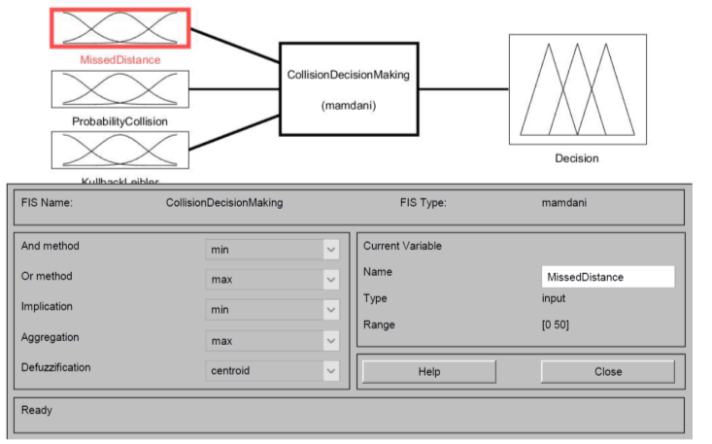
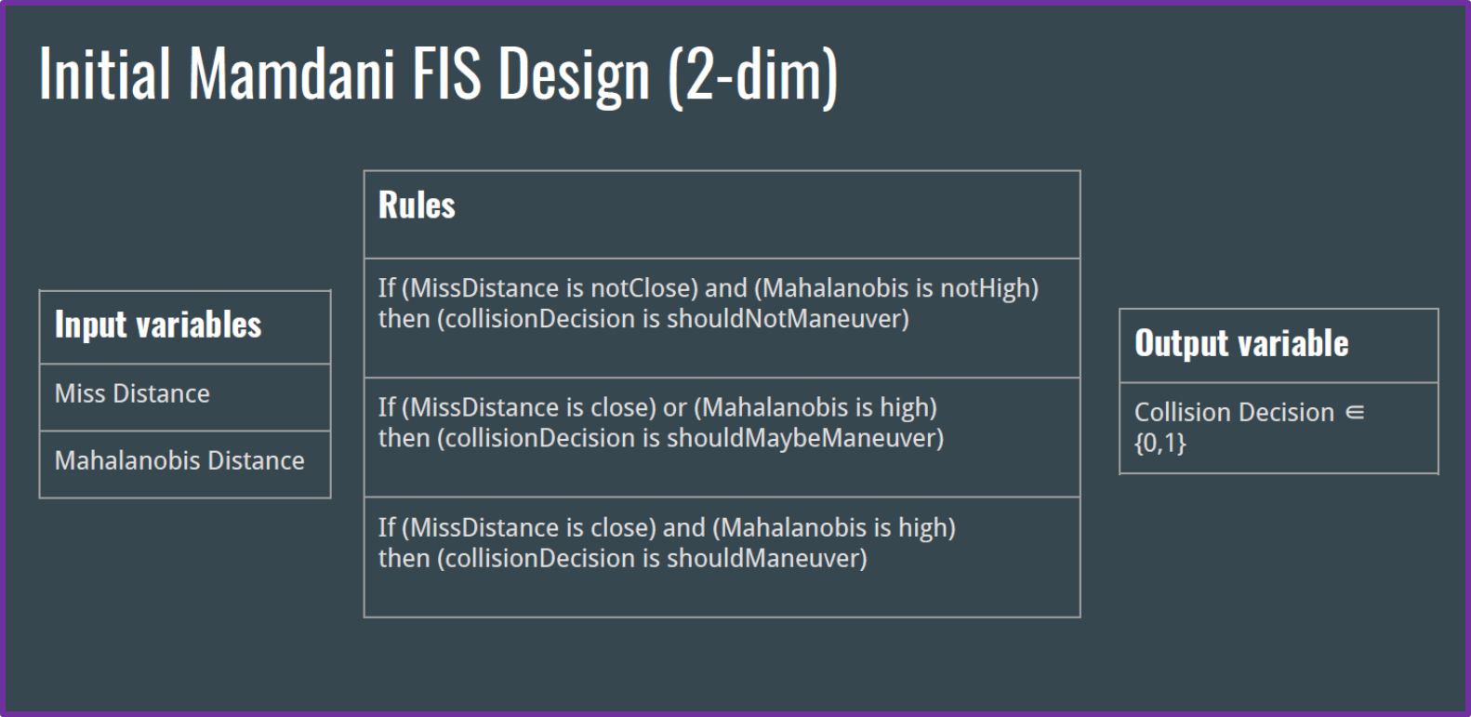
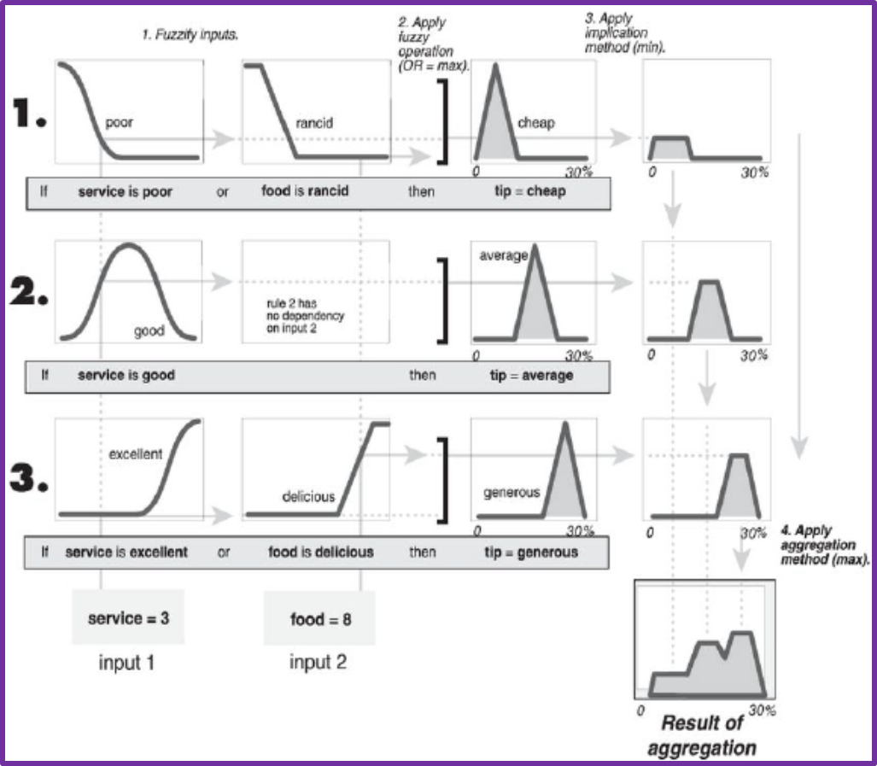
Machine Learning for Space Situational Awareness
Using Fuzzy Inference System (FIS)
FIS
Evaluation
Fuzzy-Inference System (FIS) Logic Design
Two spacecraft at Time of close approach (TCA)
(500 simulated cases)
K-means
FIS Input-Output Determination
Partition N observations into K clusters.
Statistical Parameters
Probability of Collision
Miss Distance
Mahalanobis Distance
Bhattacharyya Distance
Kullback-Leibler Distance etc.
SVM-Support Vector Machines
Separation into K groups with the widest gap possible
Summer Internship work (Partial) by
Evana Gizzi (Tufts University)
Mitch Zielinski (Purdue University)
Non-definitive output
Notes:
10 hidden layers
Scaled conjugate gradient training algorithm
Training 70
Testing 15
Validation 15

Slide 27
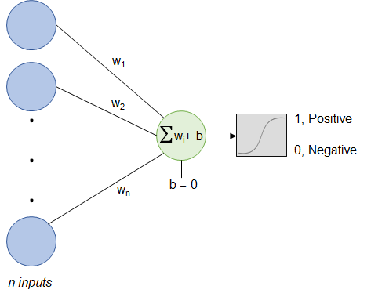
USL: Shallow Binary Classifier
Weights analysis for clustered parameter-set importance
Standardized parameters to have a zero mean with standard deviation of 1
Full events are combined into a single event to monitor deviations across the set
27

Slide 28
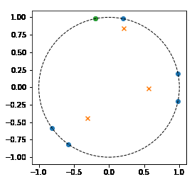
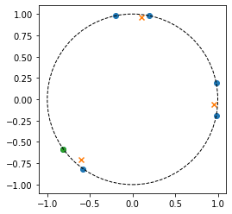
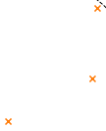
USL: Competitive Networks for Binary Classification
Learns the feature space through migrating weights towards clustered regions
Identifies regions where similar inputs exists
Standardized inputs to have same range of activation space
Time-varying convergence to a solution (clustered region); with some uncertainty.
28

Slide 29
Summary of Results
Risk Assessment: Fuzzy Inference Systems
  Generated a decision space that may not be able to successfully capture the bi-modal classifications made by unsupervised or supervised techniques for this application.
  It provided an aggregated output based on the weights of the Fuzzy-membership functions.
Risk Assessment: Deep Neural Networks
  Presented more promising results compared to the Fuzzy Inference System for a collision avoidance decision-making tool.
  An augmented or exclusive satellite collision avoidance decision-making construct suggests a favorable architecture with modeled binary or tertiary decisional outputs.
Decision Support: Shallow Binary Classifier
  Parameters, such as EDR, RCS, Rcoef, and MHD are consistently grouped together with Pc and Miss Distance.
  Time-varying convergence to a solution (clustered region); with some uncertainty.
Decision Support: Long- Short Term Models (LSTM)
  LSTM Models can predict miss distance with an average error of < 0.2 km but affected by intrinsic error in prediction. Is this good enough for operational decision making?
NOW WHAT?
29
Notes:
Parameters, such as EDR, RCS, Rcoef, and MHD are consistently grouped together with Pc and Miss Distance
Higher than average EDR yield higher Pc values
LSTM Models can predict miss distance with an average error of < 0.2 km, but dependent on intrinsic error in prediction
Future research includes:
LSTM uncertainty model
Introducing weighted loss functions

