Slide 1
Advancements in Satellite-based Hyperspectral Microwave Sounding at NASA GSFC
Antonia Gambacorta¹, Fabrizio Gambini^{1,2}, Matt Fritts¹, Berhanu Bulcha¹, Alexander Kotsakis^{1,3}, Narges Shahroudi^{1,3}, Stephen Nicholls^{1,4}, Patrick Stegmann^{1,3}, Jordan Caraballo-Vega¹,Victor Torres¹, Priscilla Mohammed^{1.6}, Jared Lucey¹, Mark Stephen¹
Eumetsat Meeting, Lyon, France, September 19th, 2025
1. NASA Goddard Space Flight Center;
1.2 NASA Goddard Space Flight Center, University of Maryland Baltimore County, CRESST II
1.3 NASA Goddard Space Flight Center, University of Maryland College Park, ESSIC
1.4 NASA Goddard Space Flight Center, SSAI, Inc.
1.5 NASA Goddard Space Flight Center, SAIC, Inc.
1.6 NASA Goddard Space Flight Center, ASRC Federal System Solutions

Slide 2

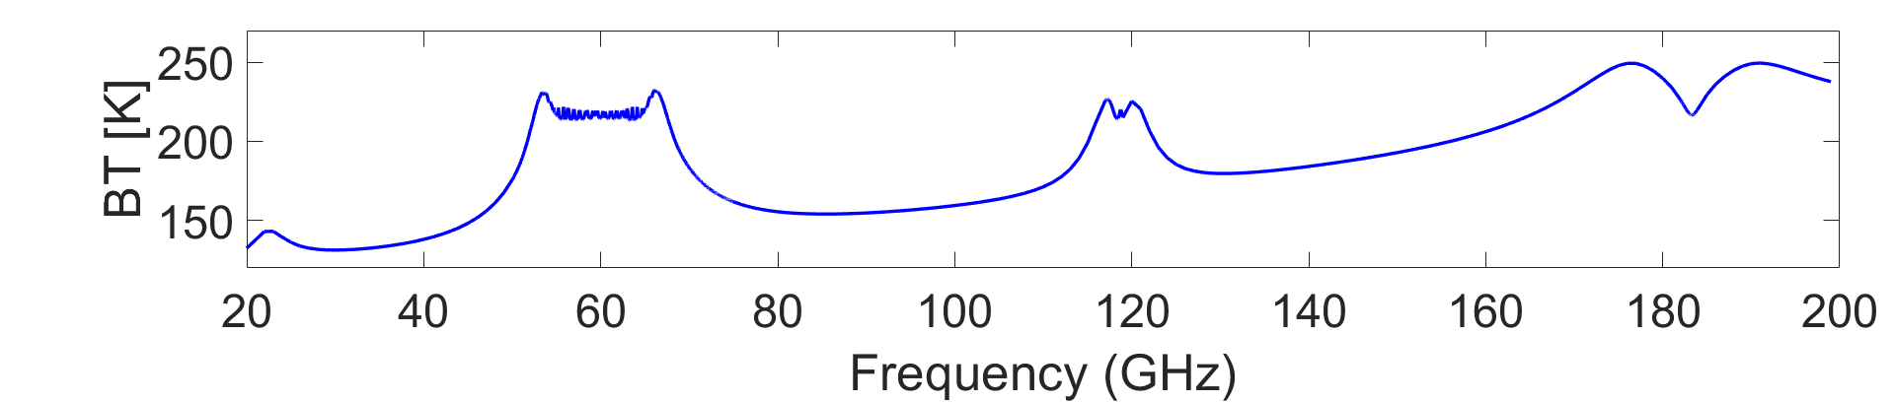
Harnessing Improved Atmospheric Content in Hyperspectral Microwave Measurements
Total Precipitable Water
Total Cloud Liquid Water
Light Precipitation
Surface Temperature
Surface Emissivity
Surface Wind Vector
Sea Ice Concentration
Snow Depth
Snow Water Equivalent
Bare Surface Soil Moisture
Temperature
Surface Temperature
Precipitation
Temperature
PBL Water Vapor
Surf. Emissivity
Hydrometeors
Water Vapor
Hydrometeors
Advanced Ultra-High Resolution Optical RAdiofrequency (AURORA) Pathfinder

Slide 3
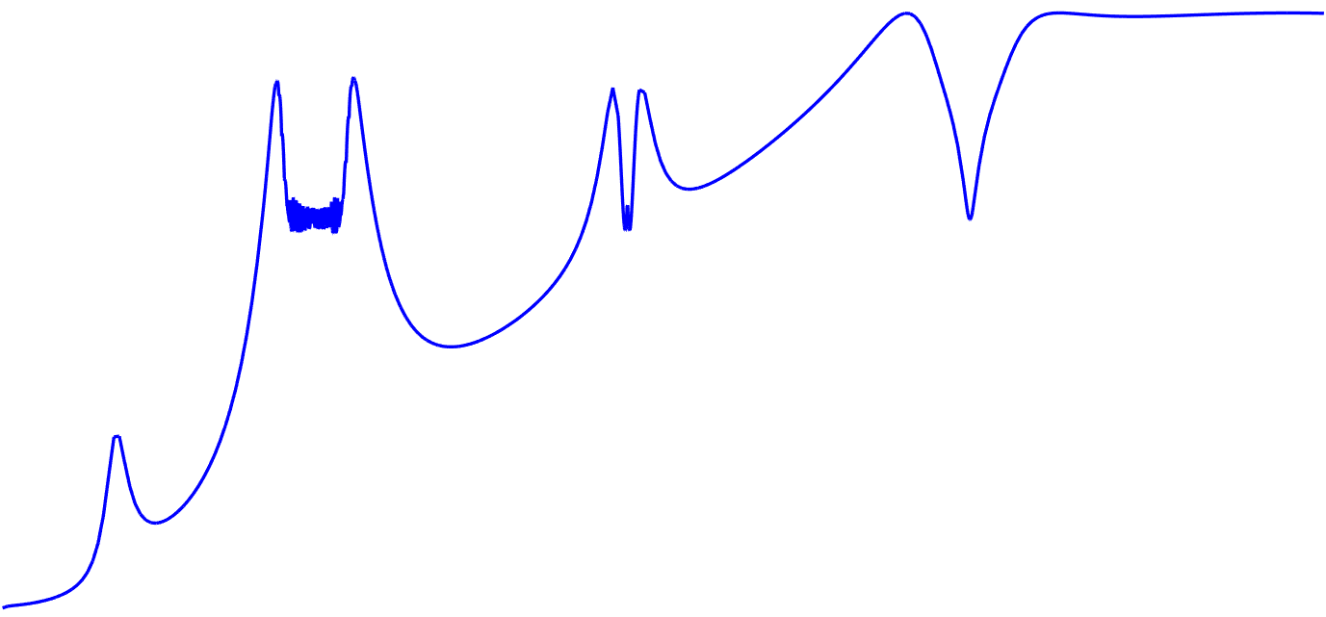

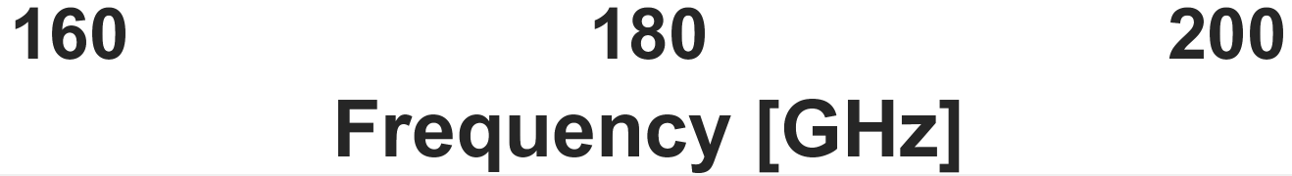
MW Photonics Design
Antenna
Captures MW spectrum.
RF domain
HyMPI is a modular design, with simultaneous 40 GHz coverage
Can be applied to multiple parts of the spectrum to obtain full, contiguous coverage of the MW thermal domain
Paired with ASICs - “PICASIC” - it enables full, contiguous, hyperspectral resolution coverage in entire Earth’s MW thermal domain
G-Band Rx
Amplifies spectra.
RF domain
EOM
Converts microwave
spectrum to optical domain.
Optical
domain
Separates spectrum into
10 x 4 GHz sub-bands.
Optical
domain
SAWG
4 GHz
BPR
Sub-bands with structure
are mixed with a new
optical tone and digitized
(Hi-Res Channels).
Baseband domain
(0 – 4 GHz)
ASIC
Lo-Res Channel
Lo-Res Channel
Sub-bands with minimal
structure are measured directly (Lo-Res Channel).
Hi-Res Channel
PD
US Patent 11852864
Title: “Serial Arrayed Waveguide Grating”​
Gambini et al., 2024, https://ieeexplore.ieee.org/stamp/stamp.jsp?arnumber=10380670

Slide 4

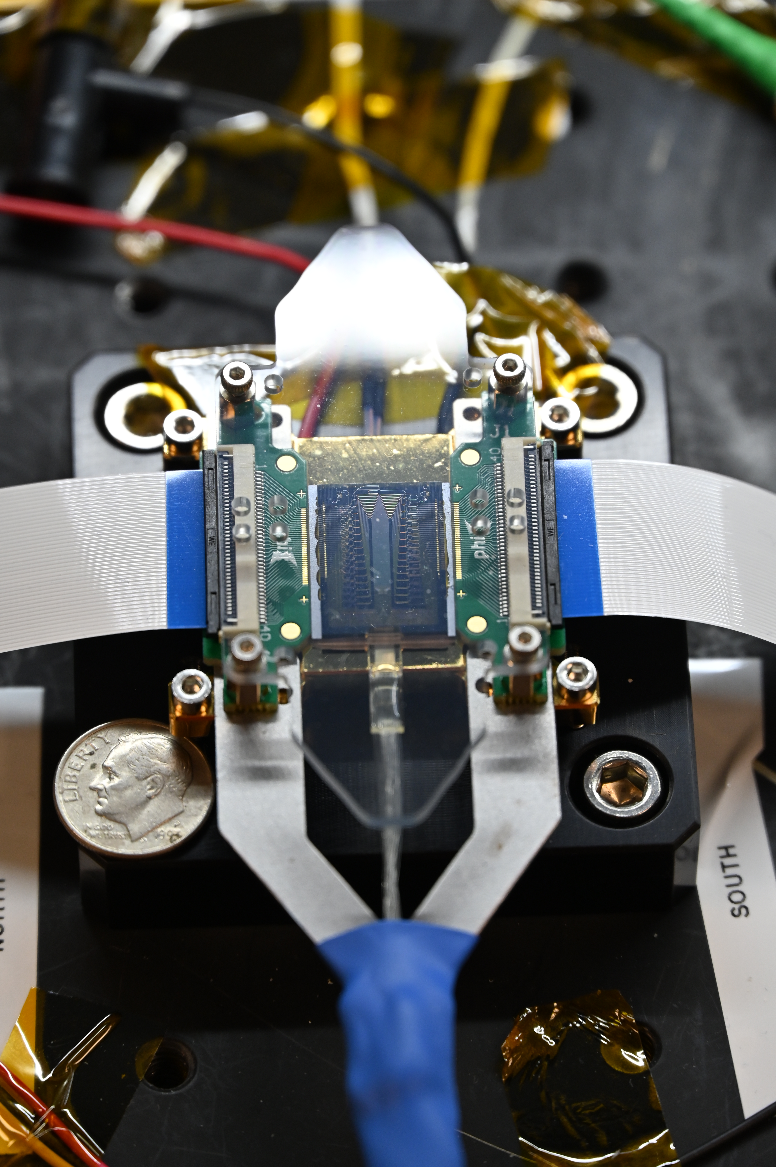
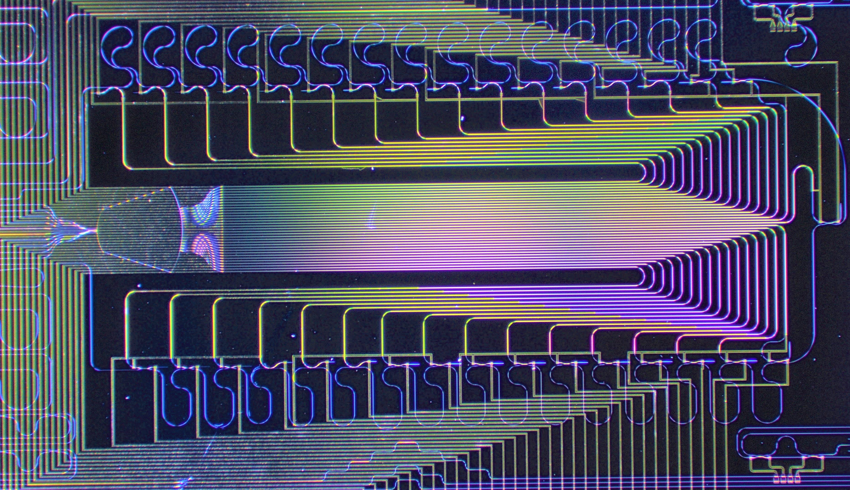
Serial Arrayed Waveguide Grating - SAWG
PIC microscope image
20 mm (0.8’’)
12.5 mm (0.5’’)
US Patent 11852864 – M. Stephen, “Serial Arrayed Waveguide Grating”
Gambini et al., 2024, An Ultra-Compact, Narrow-Bandwidth, and High-Density Channel Photonic Integrated Channelizer Based on Serial Arrayed Waveguide Grating Architecture, J. Lightwave Technol. 42, 2908-2916 (2024)

Slide 5
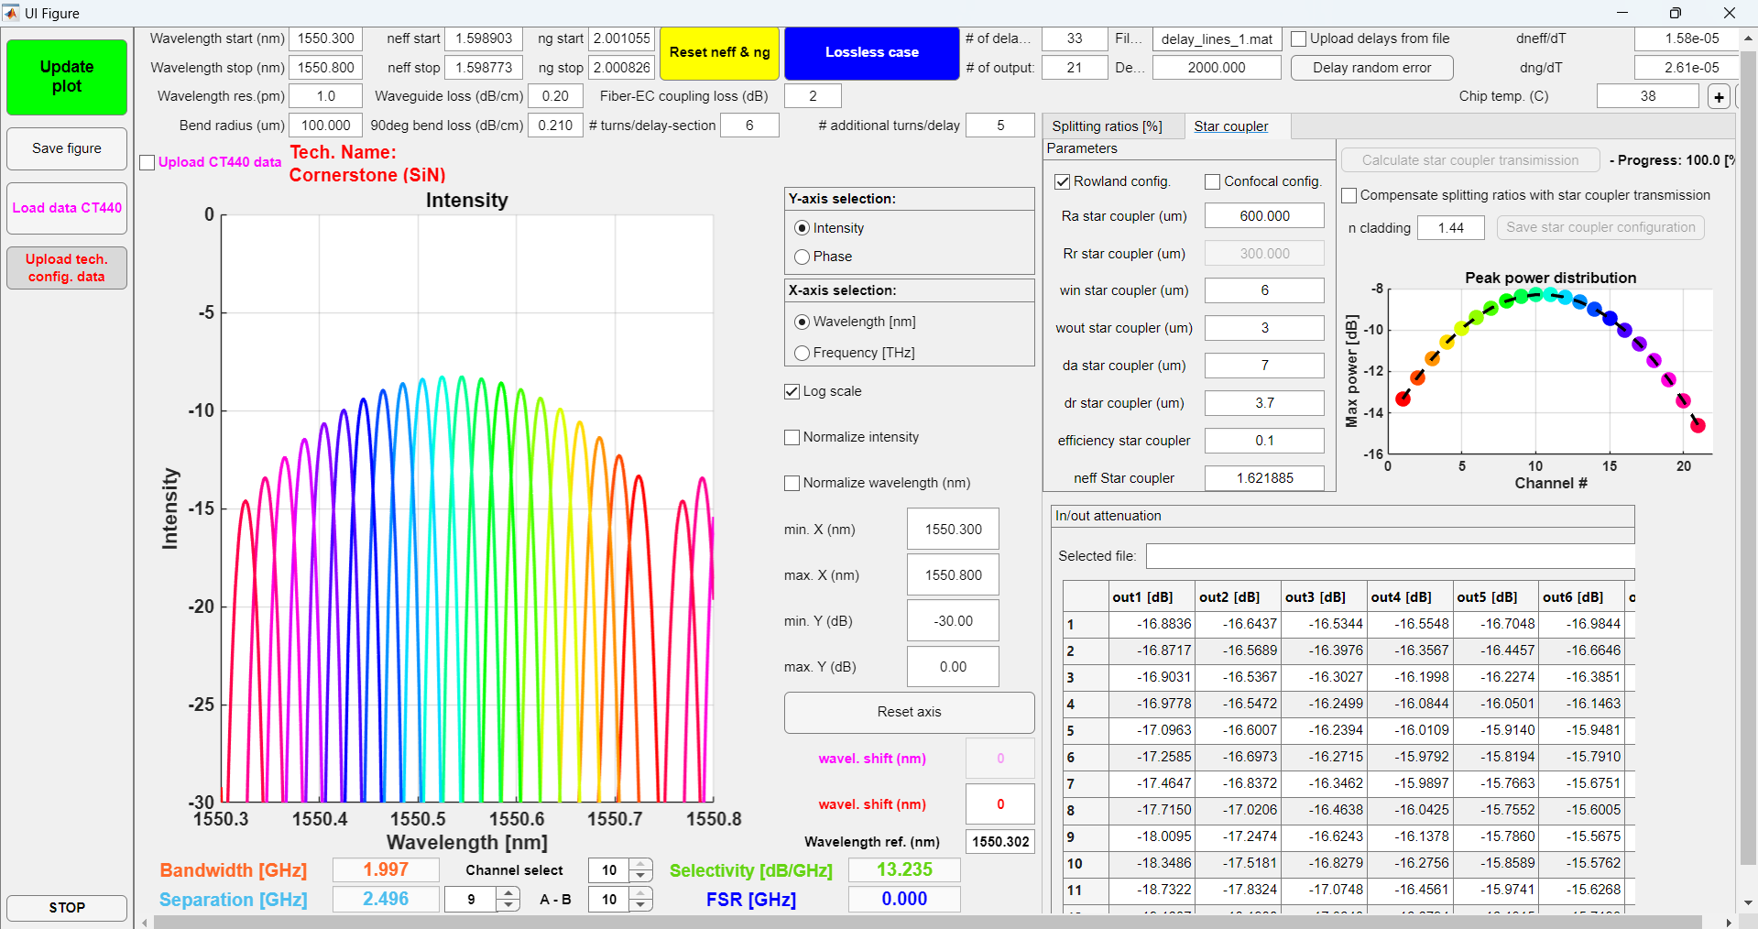
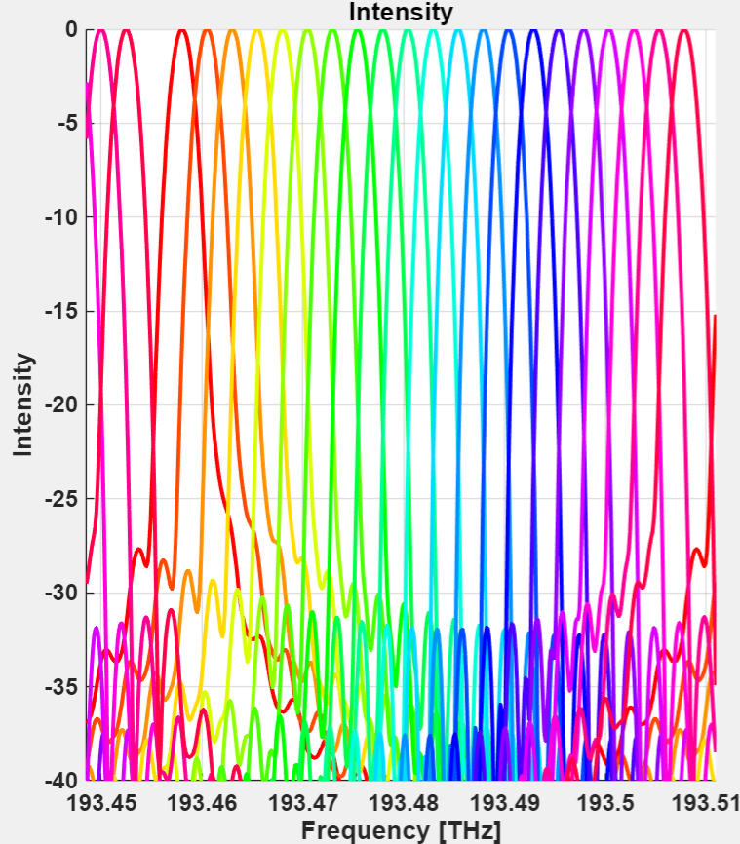
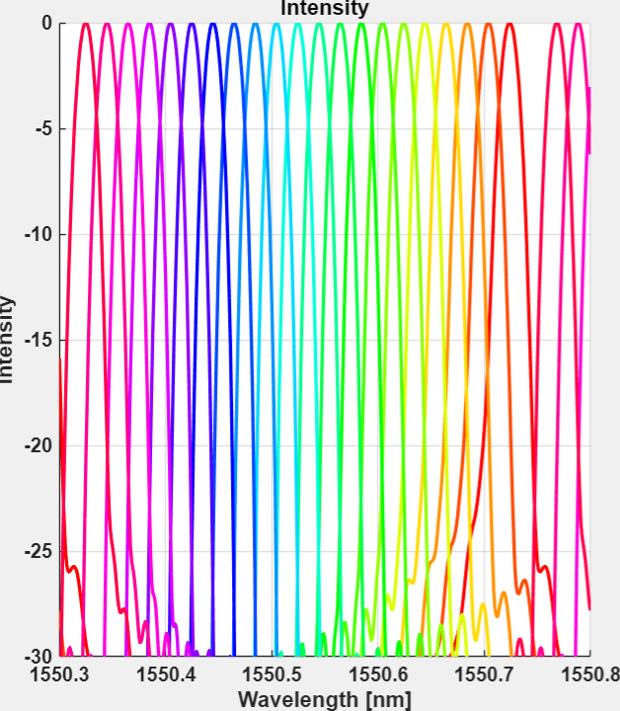
SAWG system model
Optical and geometrical parameters
define the frequency response
of the filter:
  33 delay lines
  21 output channels
  2.5 GHz channel separation
  2.0 GHz channel 3dB bandwidth
  30 dB side-lobe suppression
[dB]
Normalized intensity[dB]
Example of SAWG Matlab model result

Slide 6
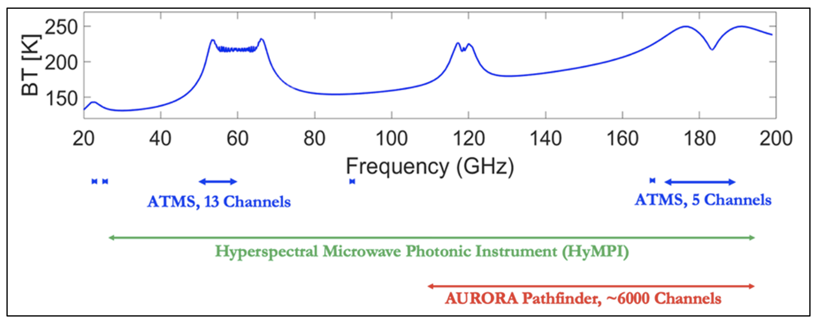
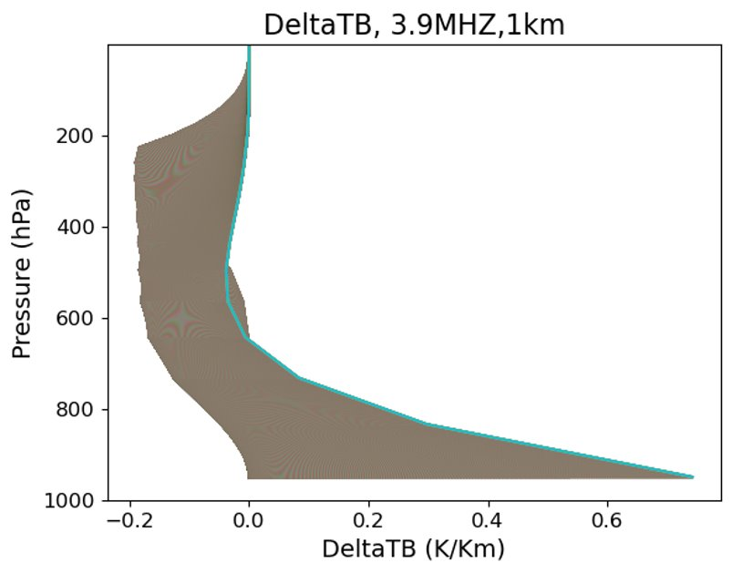
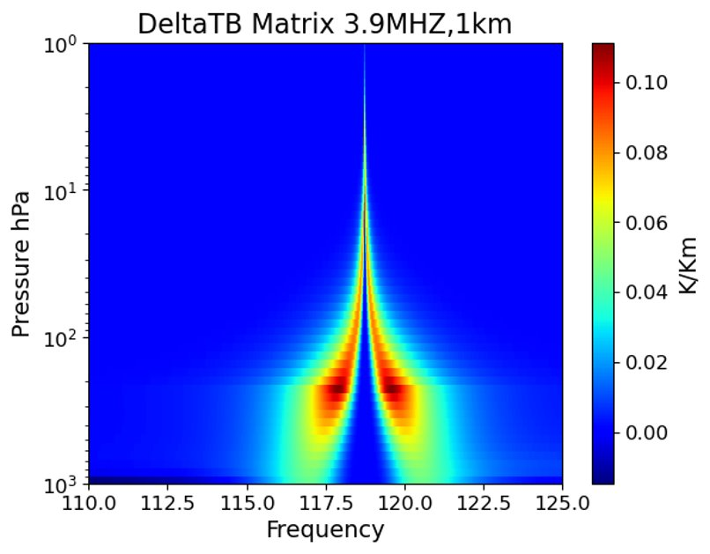
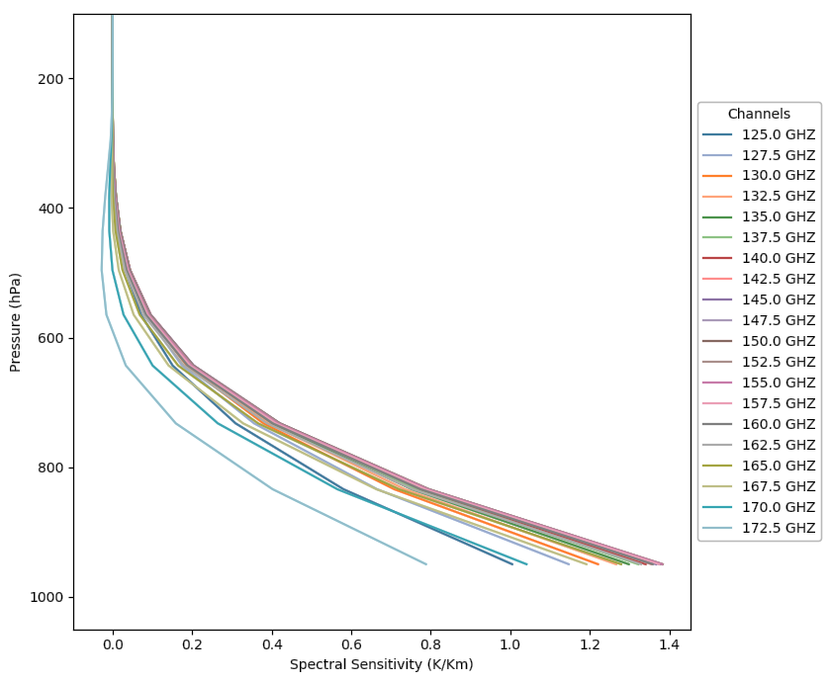
The Advanced Ultra-high Resolution Optical and RAdiofrequency (AURORA) Pathfinder
~PBLH

Slide 7
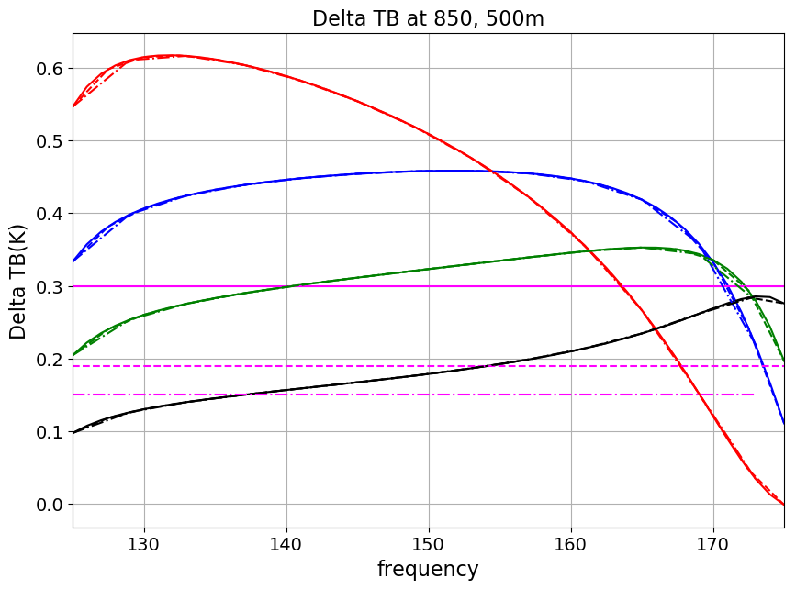
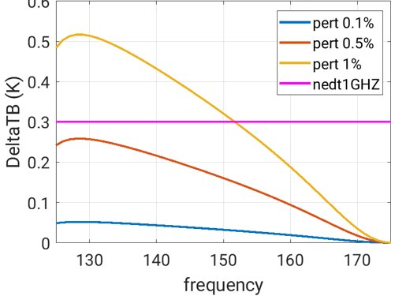
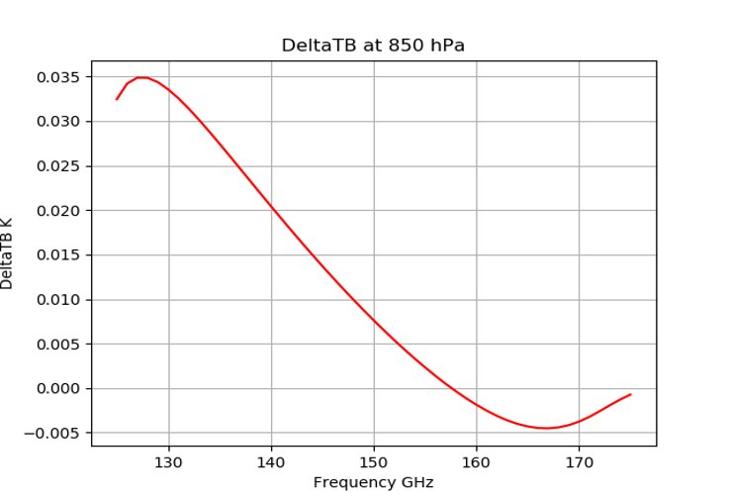
AURORA Pathfinder: harnessing PBL, Surface, Cloud information content in unexplored MW spectral domain
10% Delta Water Vapor @ 850hPA
Midlat Sum: Surf. Emissivity Perturbation
Midlat Sum: CLW 10% Perturbation
Midlat Summer
US Standard
Midlat Winter
NEdT @ 1 GHz
Delta BT(K)
Arctic Winter
NEdT @ 2.5 GHz
NEdT @ 4 GHz
Frequency (GHz)
Frequency (GHz)
Frequency (GHz)
Aurora Pathfinder = Sounder + Imager

Slide 8
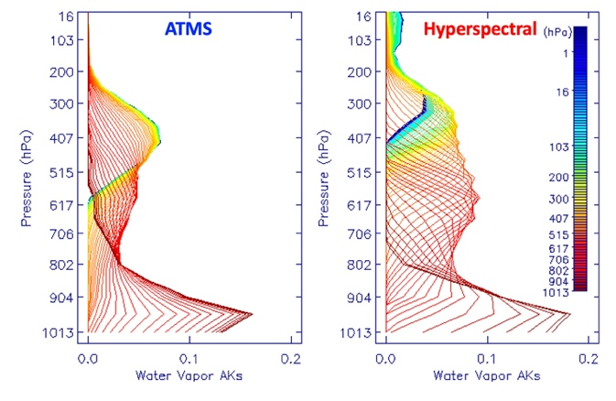
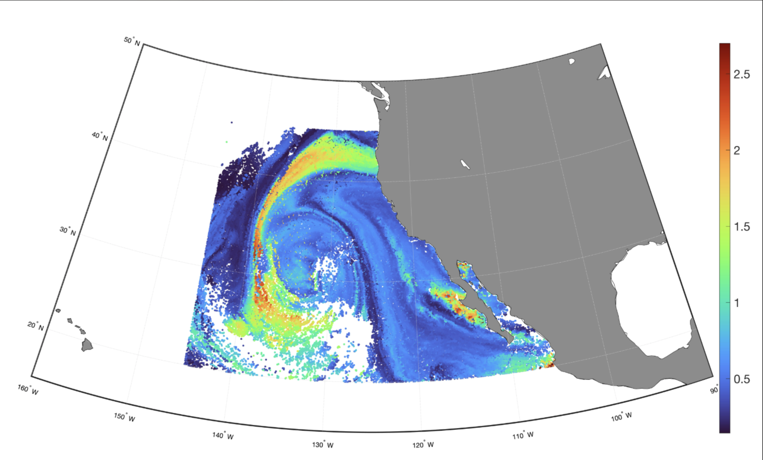
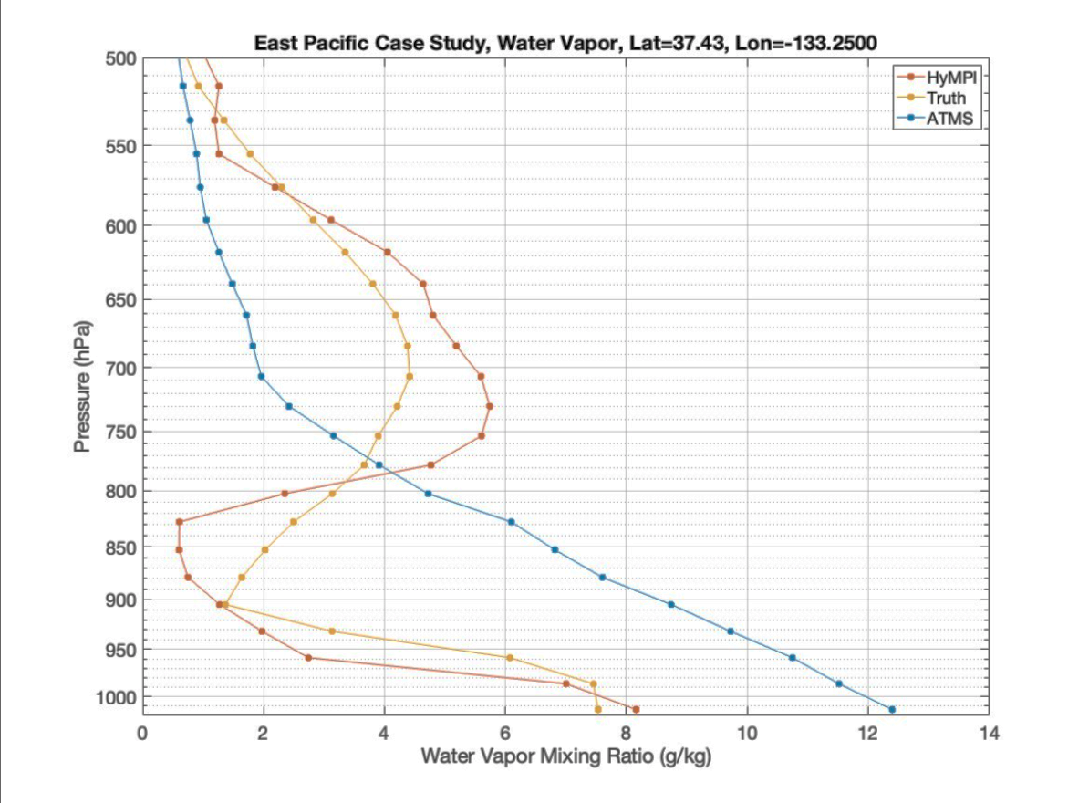
Applications: AURORA Pathfinder Will Enable Improved Sounding under Extreme Weather Measurements
Truth
ATMS
AURORA

Slide 9
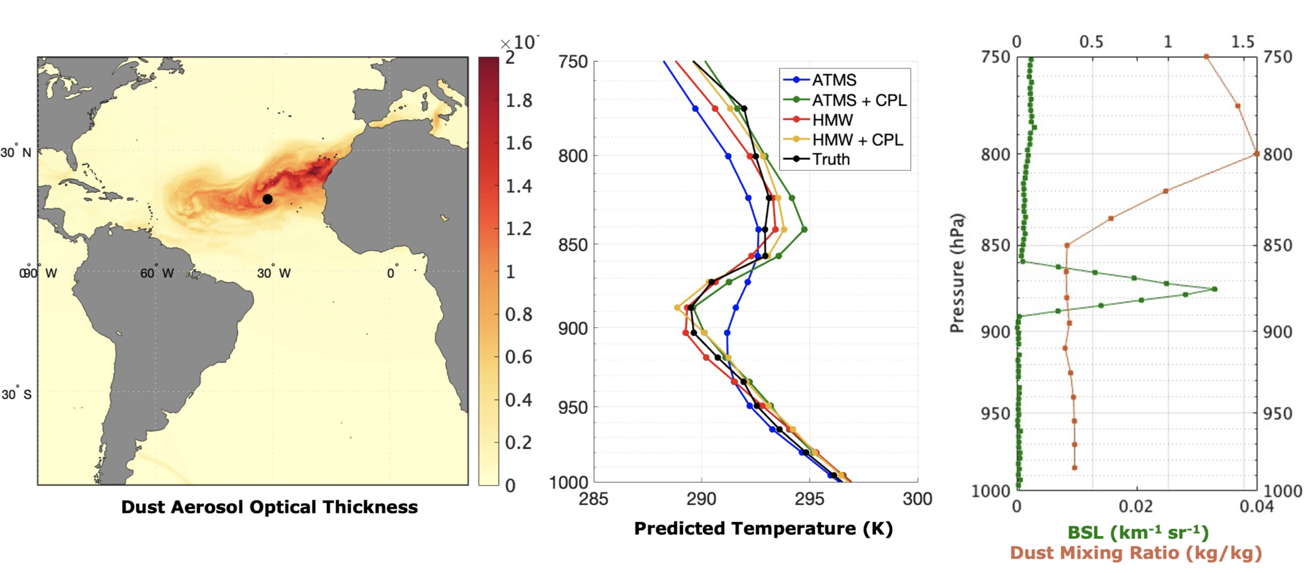
Applications: AURORA Pathfinder Will Enable New Discoveries in Temperature, Water vapor, Aerosol and Cloud Feedbacks
ATMS
AURORA v1
AURORA v2
AURORA v3
Gambacorta et al., IEEE TGRS, 2025 - In publication

Slide 10
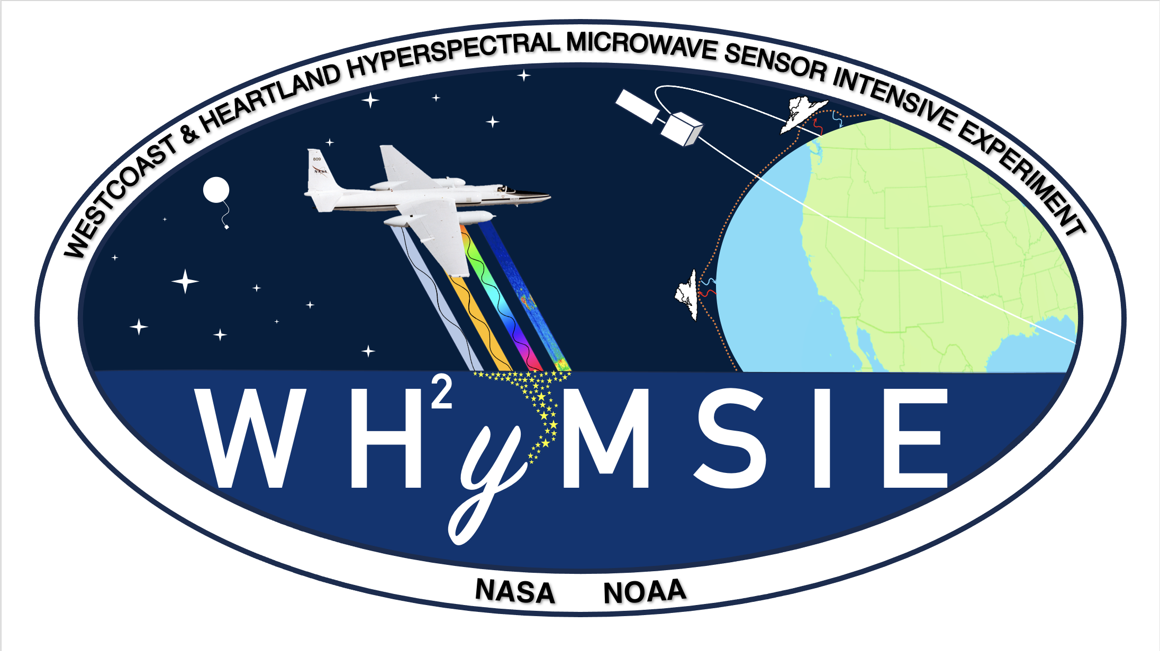
https://earth.gsfc.nasa.gov/climate/campaigns/WHyMSIE

Slide 11
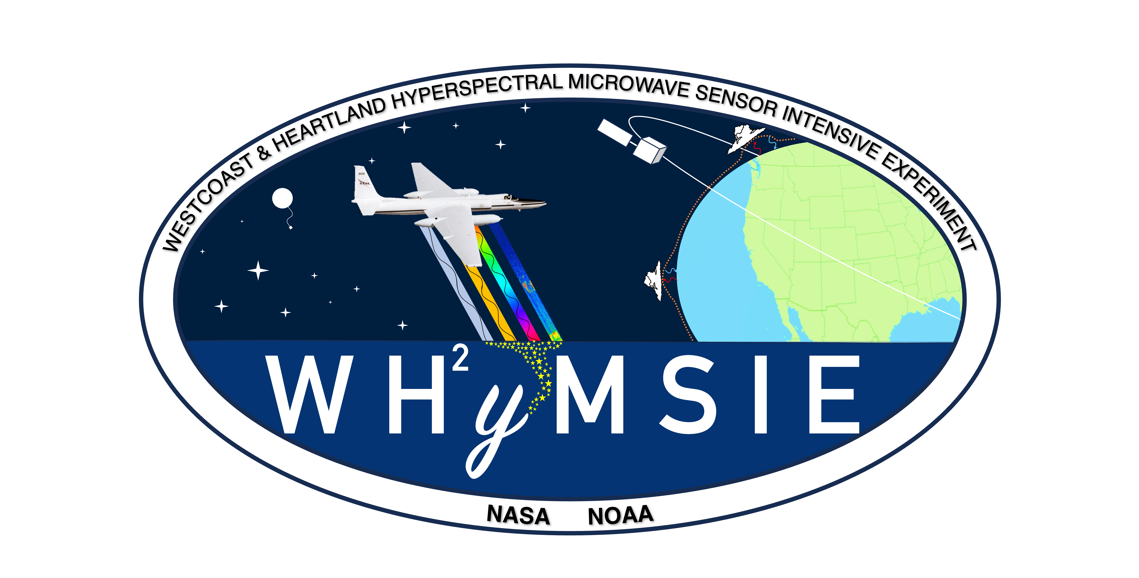
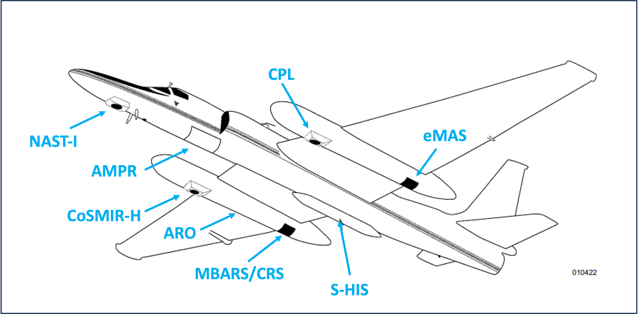
West-coast & Heartland Hyperspectral Microwave Sensor Intensive Experiment - WH²yMSIE
Objectives
Demonstrate the capabilities of CoSMIR-H
Maximize sampling of ocean clear sky environments and under fly various POR satellites equipped with microwave instruments (ATMS, AMSU/MHS)
Capture a wide variety of atmospheric states that contribute to variability in PBL and surface emissivity over land (e.g. convective/non-convective)
Maximize validation opportunities and overflights of ground based PBL-focused networks (e.g. SGP, NCAR Boulder, G-III dropsondes)
Challenge the capability of the combined remote sensing payloads (ER-2 + G-III) by sampling baroclinic zones (T/q gradients) and cloudy environments (e.g. marine stratocumulus)
ER-2
Instrument | Measurement Type | Spatial Scale
Conical Scanning Millimeter-wave Imaging Radiometer - Hyperspectral (CoSMIR-H) | Hyperspectral Microwave | 1 km
Microwave Barometric Radar and Sounder (MBARS) | Doppler Radar | 1-4 km
Cloud Radar System (CRS) | Doppler Radar | 300 m
Cloud Physics Lidar (CPL) | Backscatter Lidar | 125 m
Scanning High-resolution Interferometer Sounder (S-HIS) | Infrared | 2 km
National Airborne Sounder Testbed – Interferometer (NAST-I) | Infrared | 2.5 km
Advanced Microwave Precipitation Radiometer (AMPR) | Microwave | 0.64 – 2.78 km
MODIS/ASTER Airborne Simulator (MASTER) | Visible-Infrared | 50 m
Airborne Radio Occultation (ARO) | GPS Radio Occultation | ~125 km
G-III
High Altitude Lidar Observatory (HALO) | Differential Absorption Lidar | 6-12 km x 315 m
Aerosol Doppler Wind Lidar (AWP) | Doppler Lidar | ~ 2 km
Dropsondes | In Situ | ~ 20 km

Slide 12


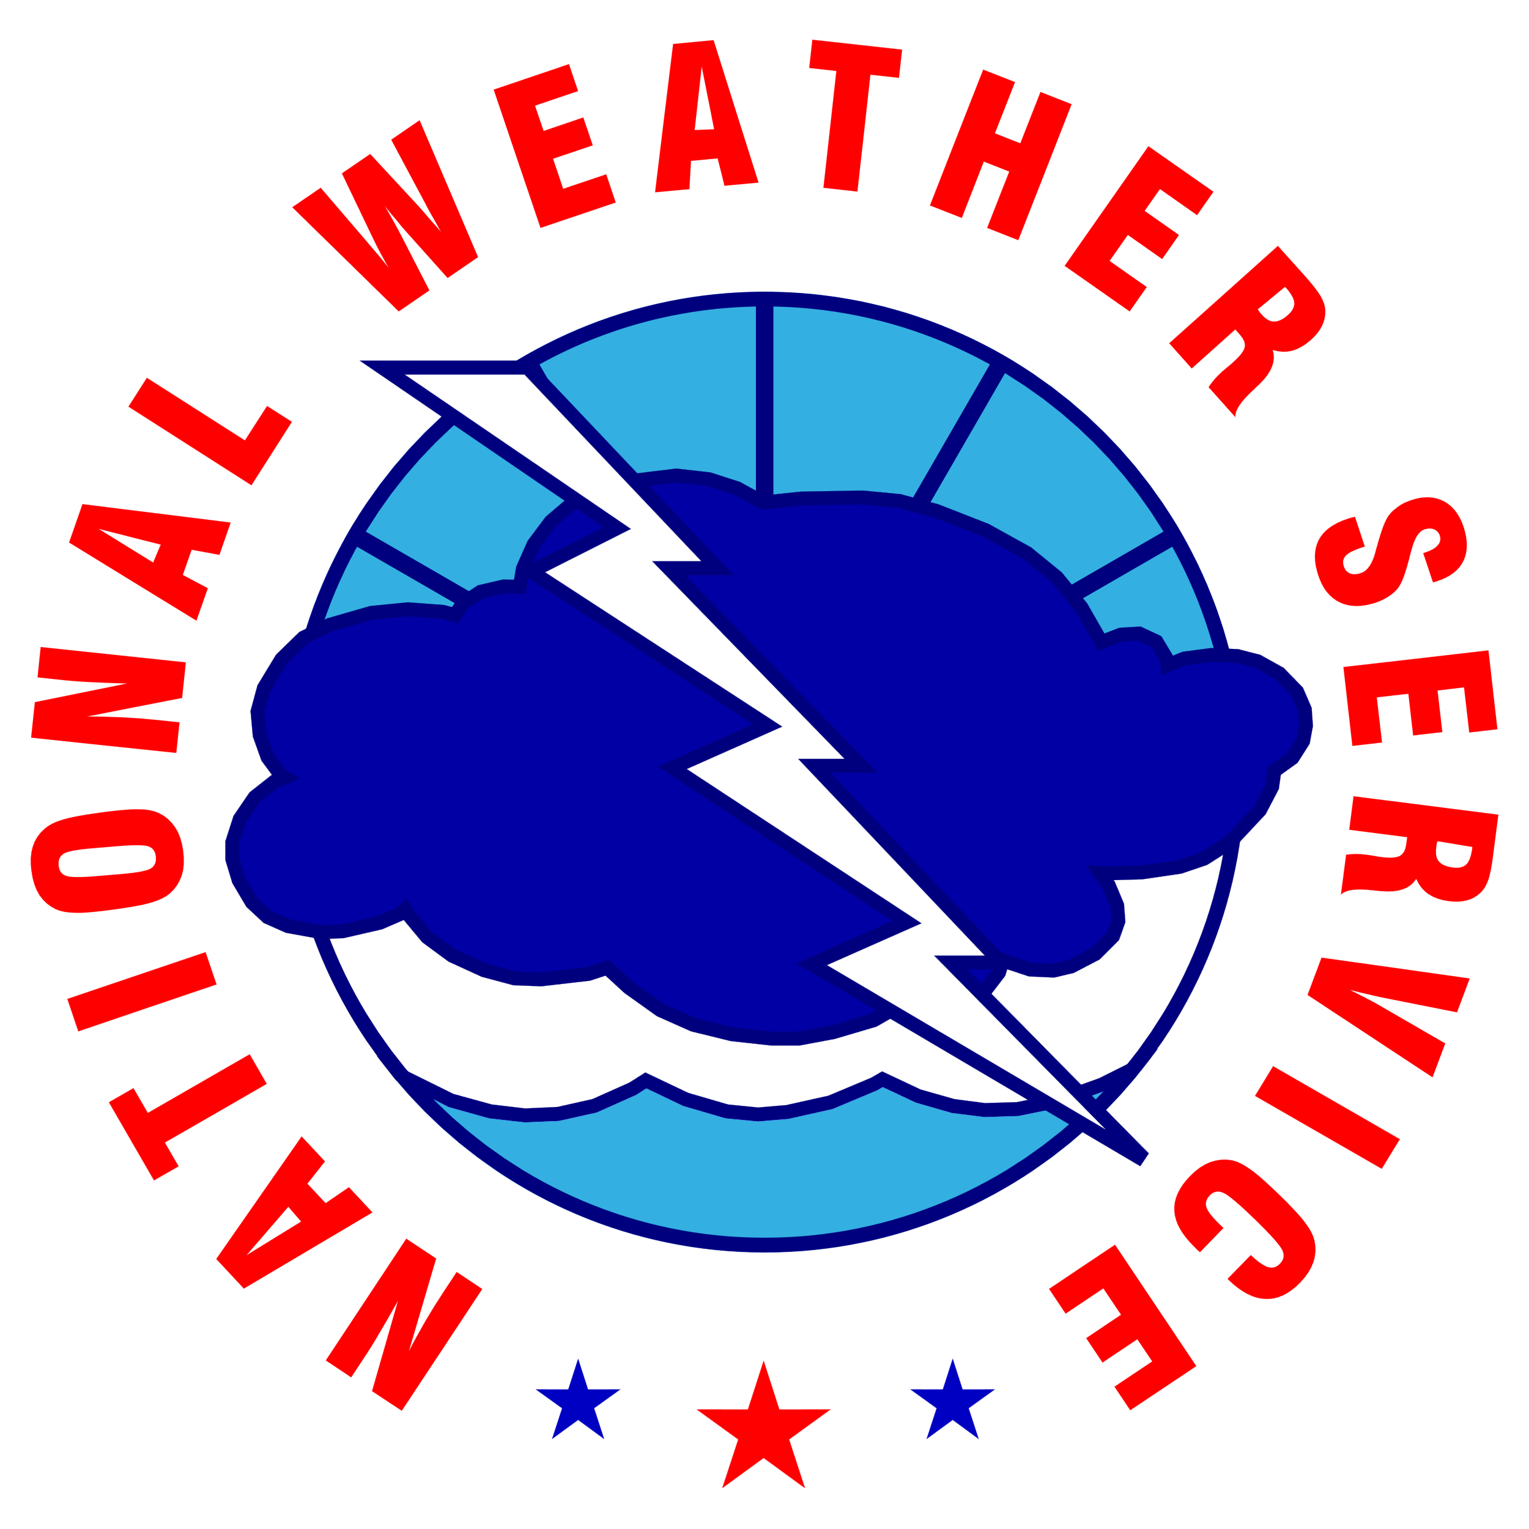
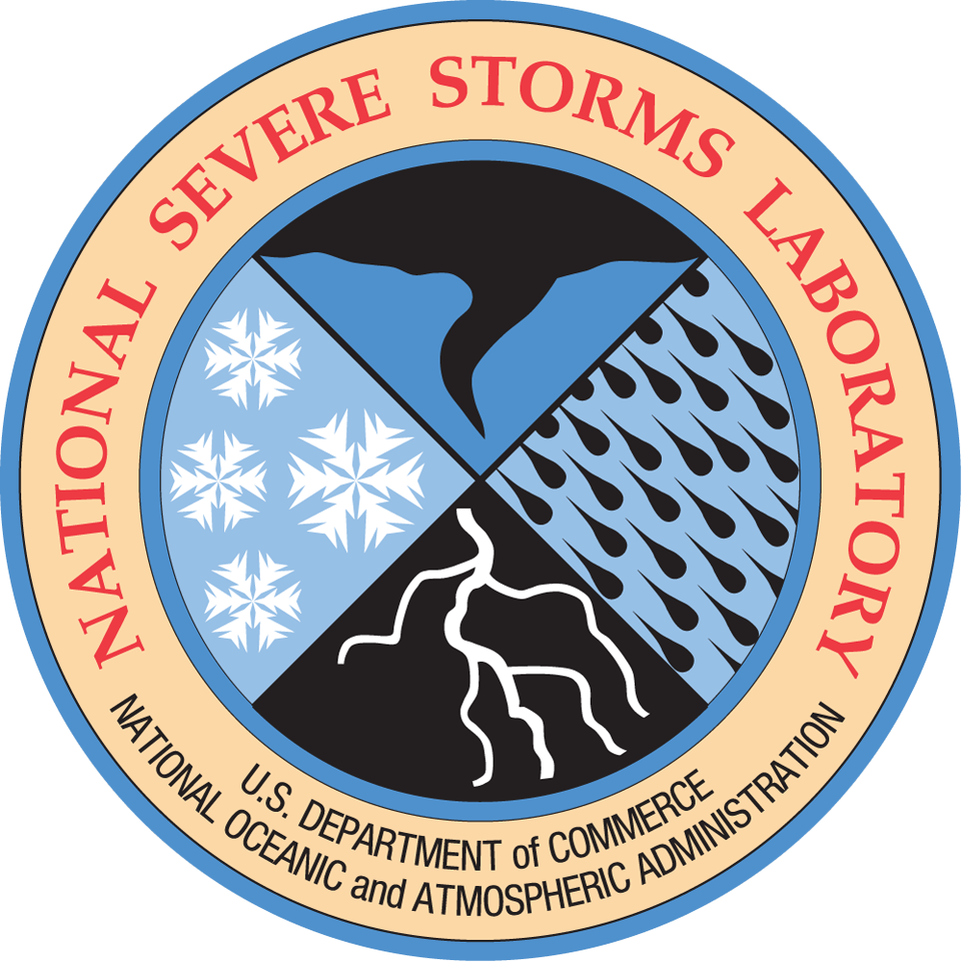

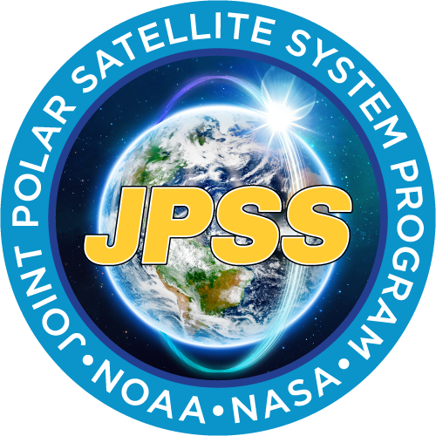














WH²yMSIE Over Land Objectives and Ground-Based Support
Capture wide range a surface types to develop improved surface emissivity models critical for future PBL-relevant microwave retrievals of temperature and water vapor
Observe PBL dynamics over different surface types (dessert, grasslands, etc.) at different times of day to capture diurnal variability
Land Flight Overview
4 science flights
27 radiosondes
Clear sky
NOAA-21, EarthCare
WH²yMSIE Over Water Objectives and In Situ Validation Support
Maximize clear sky data points and under fly POR satellite instruments for future MW and IR cal/val comparisons
Observe a variety of marine PBL environments in clear and cloudy conditions
Ocean Flight Overview
6 science flights
40 dropsondes
Mix of clear and cloudy scenes
NOAA-21, Arctic Weather Satellite (AWS), EarthCare
WH²yMSIE Data Archive is located at https://www-air.larc.nasa.gov/

