Slide 1

Landing Loads Analysis
Author : Jeff Peck - MSFC/EV31
Alternate POCs : Kelsey Buckles- MSFC/EV31
NASA Landing Loads Methodology - Beam Reduction LS-Dyna
DISCLAIMER: The information contained in this data deliver is for PUBLIC distribution and is not under restriction. No ITAR, CUI, or ownership rights exist on this specific item, as it was designed and developed by NASA.
This information does not express, imply, or in any way make any statement as to the item(s) described pertaining to their use, ability or other performance determining information. Any use of this information is purely the responsibility of the receiver.

Slide 2
Analysis Approach for Landing Loads Insight
Start with reduced model (Hurty-Craig-Bampton)
Recover loads through OTMs
Remove substructures
Run 7 cases
(Optional, run monte carlo using LS-Opt
Export HCB model to LS-Dyna binary format for use with *ELEMENT_DIRECT_MATRIX_INPUT
Attach landing leg model and solar array point masses in LS-Dyna

Slide 3
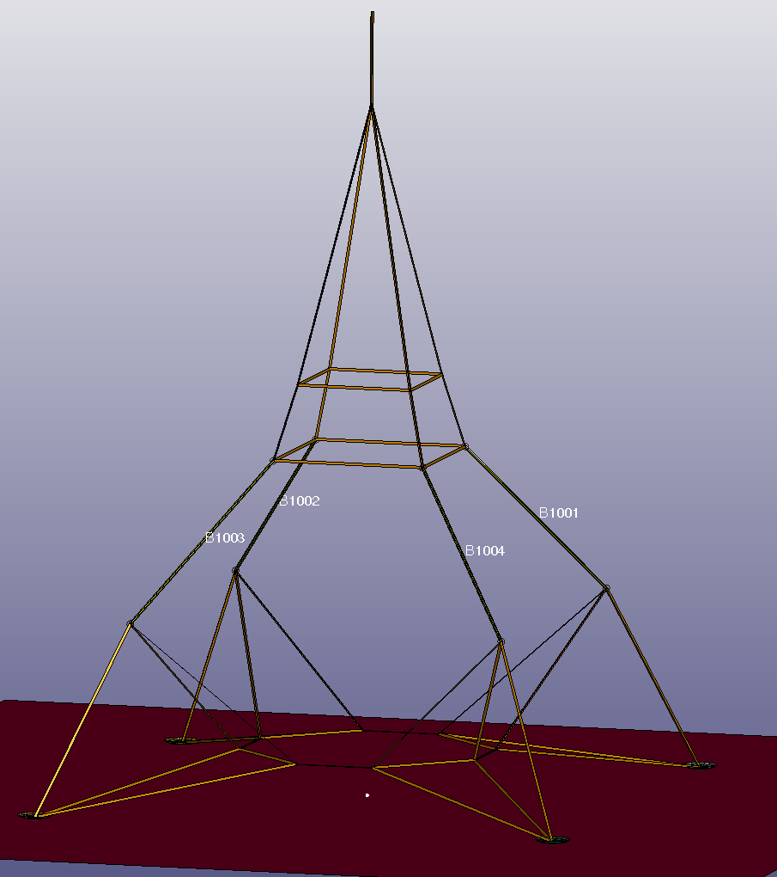
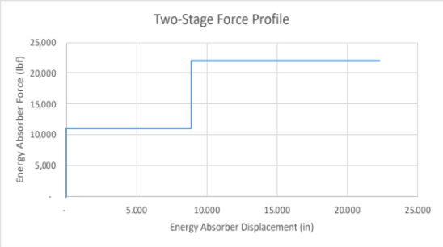
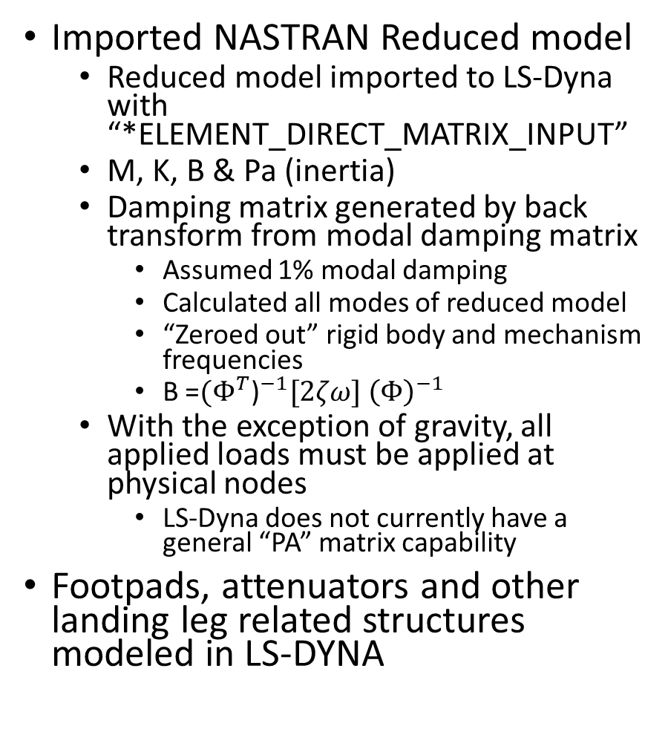
LS-DYNA Model
All display elements are “plotels” except for attenuators, foot pads, and rigid lunar surface
Generic Lander Representation
Imported NASTRAN Reduced model
  Reduced model imported to LS-Dyna with “*ELEMENT_DIRECT_MATRIX_INPUT”
  M, K, B & Pa (inertia)
  Damping matrix generated by back transform from modal damping matrix
    Assumed 1% modal damping
    Calculated all modes of reduced model
    “Zeroed out” rigid body and mechanism frequencies
    B =${{(Φ}^{T}\text{)}}^{−1}[2ζω] {\left(Φ\right)}^{−1}$
  With the exception of gravity, all applied loads must be applied at physical nodes
    LS-Dyna does not currently have a general “PA” matrix capability
Footpads, attenuators and other landing leg related structures modeled in LS-DYNA
Force-Deflection curve modeled in MAT_29 for Attenuators
Attenuator beams, B1001, B1002, B1003, B1004
Rigid lunar surface used for contact algorithm

Slide 4


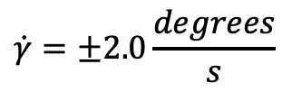

Generic Landing Cases
Past analyses have used a set of seven landing cases to bound landing loads
  These cases are duplicated from a presentation by Adam Slagle titled “HLS Landing Gear Landing Cases Analysis Slagle 4-16-20”
$$V_{s}=±78.74\frac{in}{s}$$
$$pitch={±6}^{∘}$$
Cases 2, 4, 5, 6 & 7 use lateral restraints on selected foot pads.
Surface depressions are 12” deep
Surface ”slopes” are 6 degrees from initial contact to farthest foot pad.
$$V_{f}=−39.37\frac{in}{s}$$
$$\dot{γ}=±2.0\frac{degrees}{s}$$

Slide 5
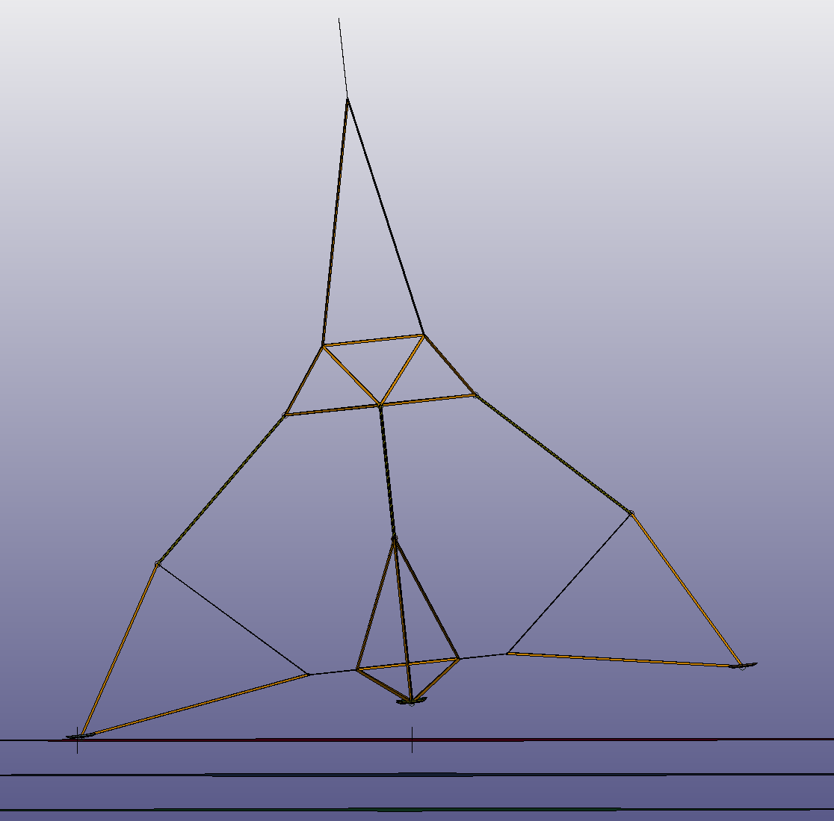
Analysis Configuration
Each foot pad has a separate (vertical) contact surface
  Lunar surface angle and local elevation variations are simulated by modifying the X position of these surfaces.
  Position variations are limited to restrict undeformed resting angle to less that 6 degrees
Lateral restraints are achieved by positioning a lateral contact surface for each case, and activating a contact definition with the proper slave grids for that case
  Coincident grids with stiff springs are used to extract restraint forces
Lateral Contact Surface
(shown in position for Case 2)
Pad A Surface
6 deg.
Pad B & D Surface
Pad C Surface

