Slide 1
Validation of Non-condensable Pressurant Gas Requirement During Liquid Propellant Expulsion
H. Q. Yang – CFD Research/Amentum Space Exploration Division
Jacob M. Brodnick – NASA, Fluid Dynamics Branch (MSFC-ER42)
Presented at APS Division of Fluid Dynamics Annual Meeting 2025
Houston Convention Center, Houston, TX
November 23-25, 2025

Slide 2
Background
  The Fluid Dynamics Branch within the Propulsion Systems Department at the Marshall Space Flight Center is currently supporting multiple programs in need of in-space cryogenic fluid management (CFM) analysis
    Space Launch System (SLS) upper stages
    Commercial Lunar Payload Services (CLPS)
    Human Landing System (HLS)
    Nuclear Thermal Propulsion (NTP) systems
  Understanding of thermodynamics and pressurant gas requirement during liquid propellant expulsion is important
    Propellant is typically expelled from the tank bottom, while high-temperature helium gas or gaseous propellant is injected into the ullage to maintain tank pressure and prevent cavitation at the pump inlet.
    This process involves complex thermodynamic phenomena, including interfacial heat and mass transfer, ullage–liquid–wall thermal interactions, vapor–liquid mass exchange, and multi-species transport in the ullage gas.
  Validation of computational tools has been undertaken leveraging available ground test data
  Predictions were made using computational fluid dynamics (CFD) and a standard Volume of Fluid (VoF) method
    The Loci-STREAM-VOF multiphase computational fluid dynamics (CFD) code developed at the NASA Marshall Space Flight Center (MSFC) is employed to predict non-condensable pressurant gas requirements during the ramping, holding, and draining phases of tank operation with liquid methane.
    Experimental data from NASA’s K-site facility are used for validation, in which both helium and hydrogen were used as non-condensable pressurants.

Slide 3
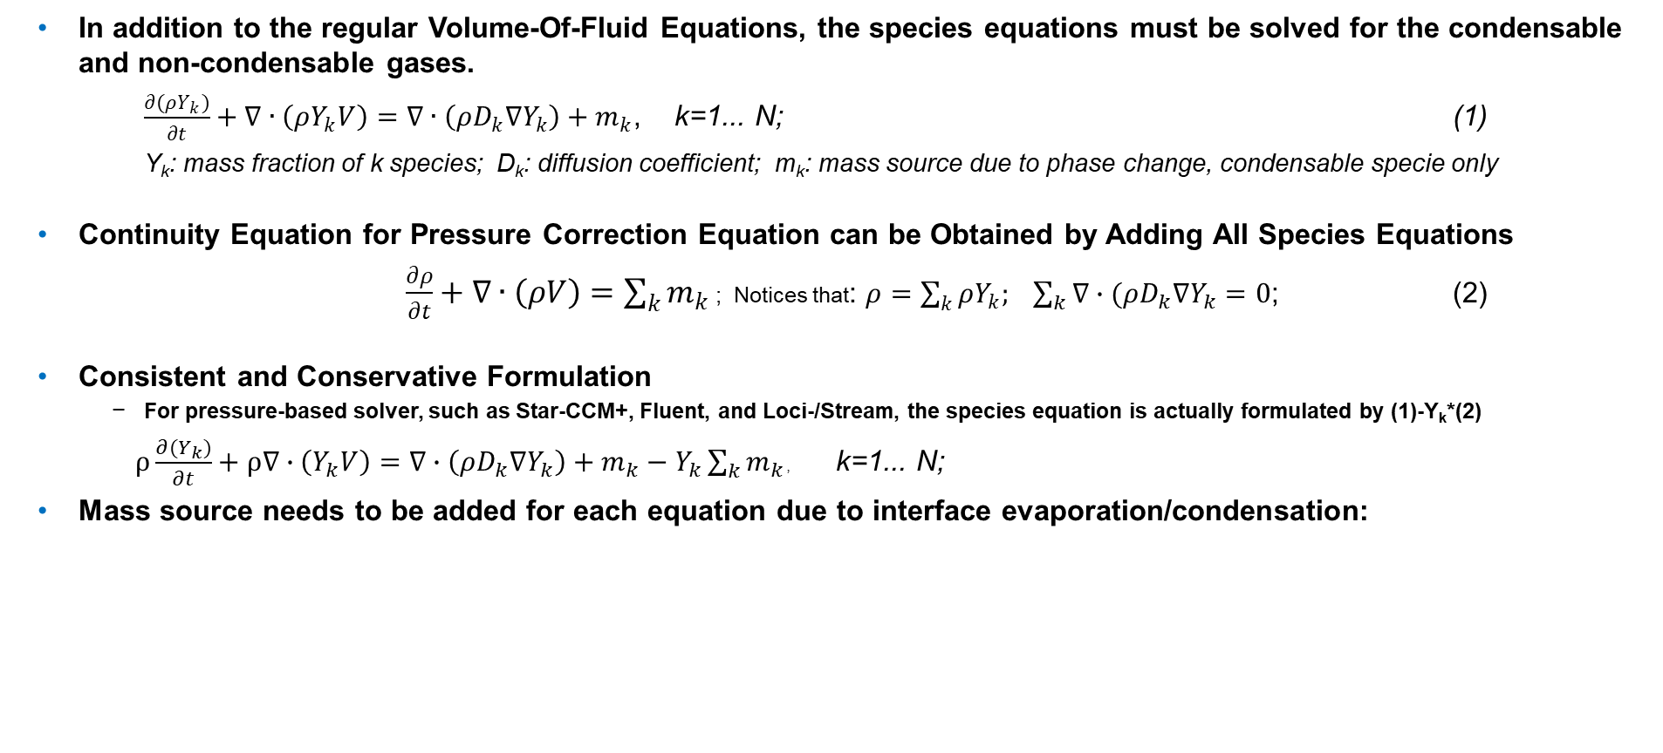
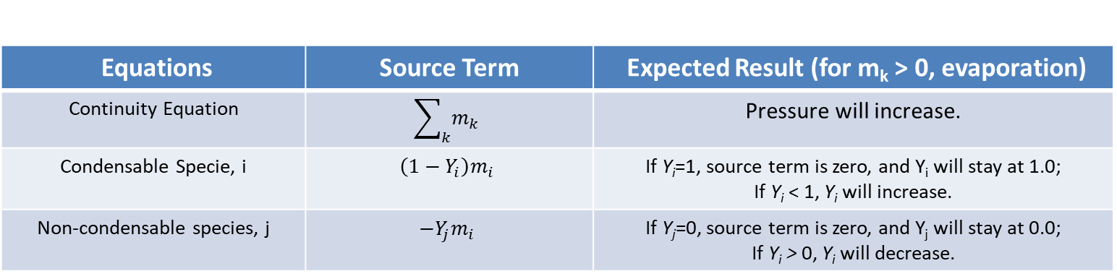
Fundamental Governing Equation for Non-condensable Gas
  In addition to the regular Volume-Of-Fluid Equations, the species equations must be solved for the condensable and non-condensable gases.
  $\frac{∂(ρY_{k})}{∂t}+∇∙\left(ρY_{k}V\right)=∇∙\left(ρD_{k}∇Y_{k}\right)+m_{k}$, k=1... N; (1)
  Y_{k}: mass fraction of k species; D_{k}: diffusion coefficient; m_{k}: mass source due to phase change, condensable specie only
  Continuity Equation for Pressure Correction Equation can be Obtained by Adding All Species Equations
    $\frac{∂ρ}{∂t}+∇∙\left(ρV\right)=\sum_{k}{m_{k}}$ ; Notices that: $ρ=\sum_{k}{ρY_{k}; \sum_{k}{∇∙(ρD_{k}∇Y_{k}=0}}$; (2)
  Consistent and Conservative Formulation
    For pressure-based solver, such as Star-CCM+, Fluent, and Loci-/Stream, the species equation is actually formulated by (1)-Y_{k}*(2)
  $ρ\frac{∂(Y_{k})}{∂t}+ρ∇∙\left(Y_{k}V\right)=∇∙\left(ρD_{k}∇Y_{k}\right)+m_{k}−Y_{k}\sum_{k}{m_{k}}$, k=1... N;
  Mass source needs to be added for each equation due to interface evaporation/condensation:
Equations | Source Term | Expected Result (for m_{k} > 0, evaporation)
Continuity Equation | $$\sum_{k}{m_{k}}$$ | Pressure will increase.
Condensable Specie, i | $$\left(1−Y_{i}\right)m_{i}$$ | If Y_{i}=1, source term is zero, and Y_{i} will stay at 1.0; If Y_{i} < 1, Y_{i} will increase.
Non-condensable species, j | $$−Y_{j}m_{i}$$ | If Y_{j}=0, source term is zero, and Y_{j} will stay at 0.0; If Y_{i} > 0, Y_{i} will decrease.

Slide 4
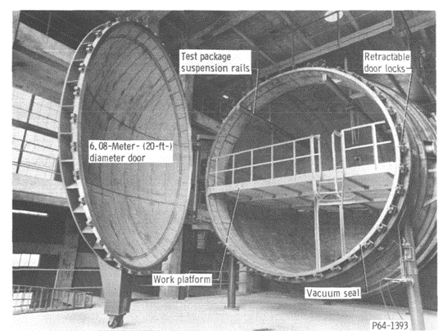
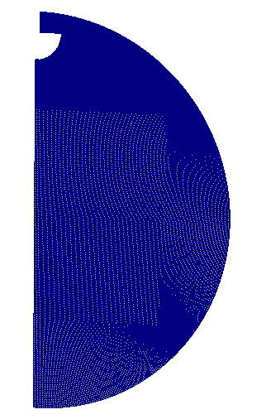
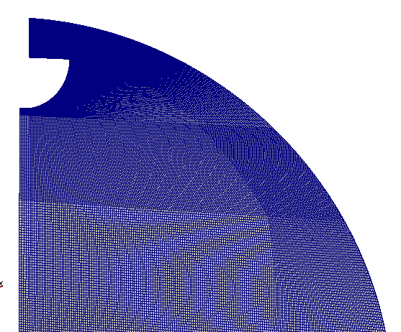
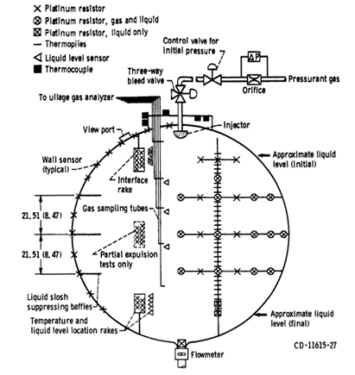
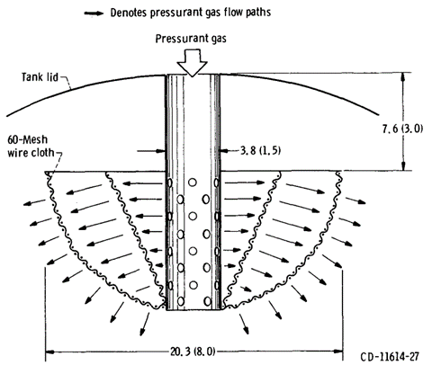
Experimental Setup: Pressurant Requirements for Discharge of Liquid Methane Under Both Static and Slosh Conditions ¹
Tank and Fluid
Spherical Tank, D=1.52m;
Propellant: methane, hydrogen and nitrogen. This study: LCH4.
Initial 95% fill, Pressure at 1.0365x10⁵Pa; Pressurized to 3.45x10⁵ Pa, hold, and then drain.
During drain, with slosh and without slosh.
Different inlet pressurant temperatures; different expulsion times.
CFD Model:
3D, 1 degree pi-sector.
Coarse Mesh: 18k cells, 5.0mm near wall. y+ ~5
Medium Mesh: 46k cells, 2.5mm near wall; y+ ~3
Fines Mesh; 56k cells, 1.0mm near wall; y+ ~2
DeWitt, R.L. and McIntire, T.O. "Pressurant Requirements for Discharge of Liquid Methane from a 1.52-meter- (5-ft-) Diameter Spherical Tank Under Both Static and Slosh Conditions" NASA-TN-D-7638. 1974.

Slide 5
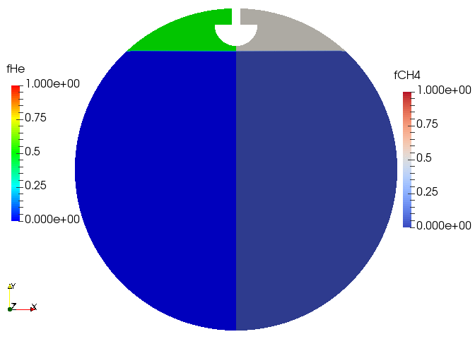
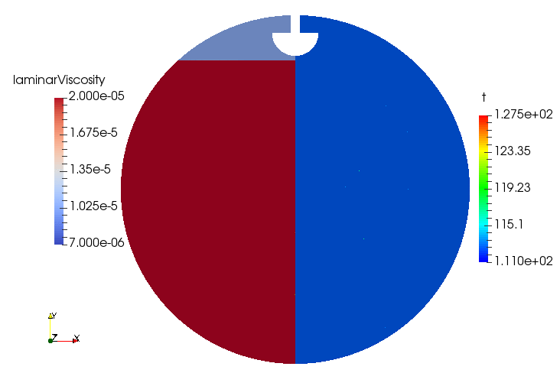
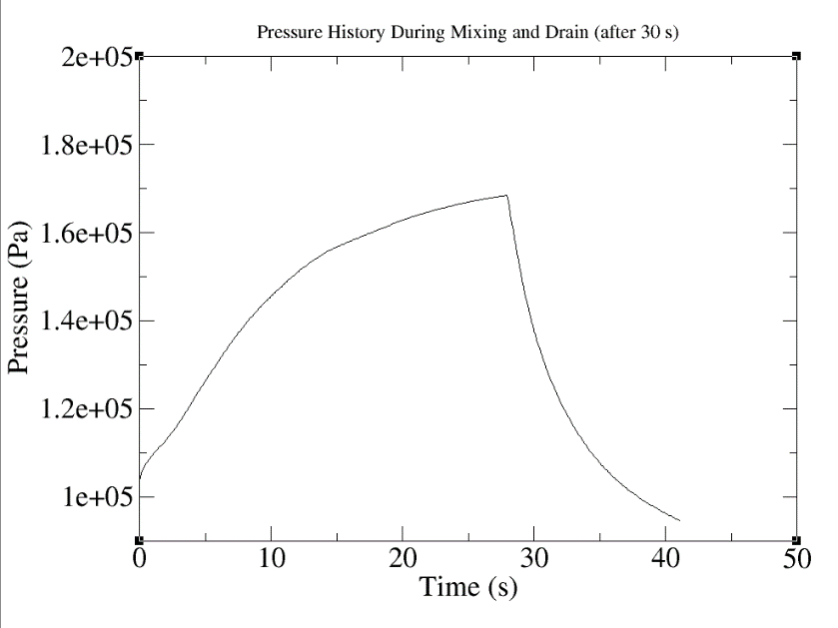
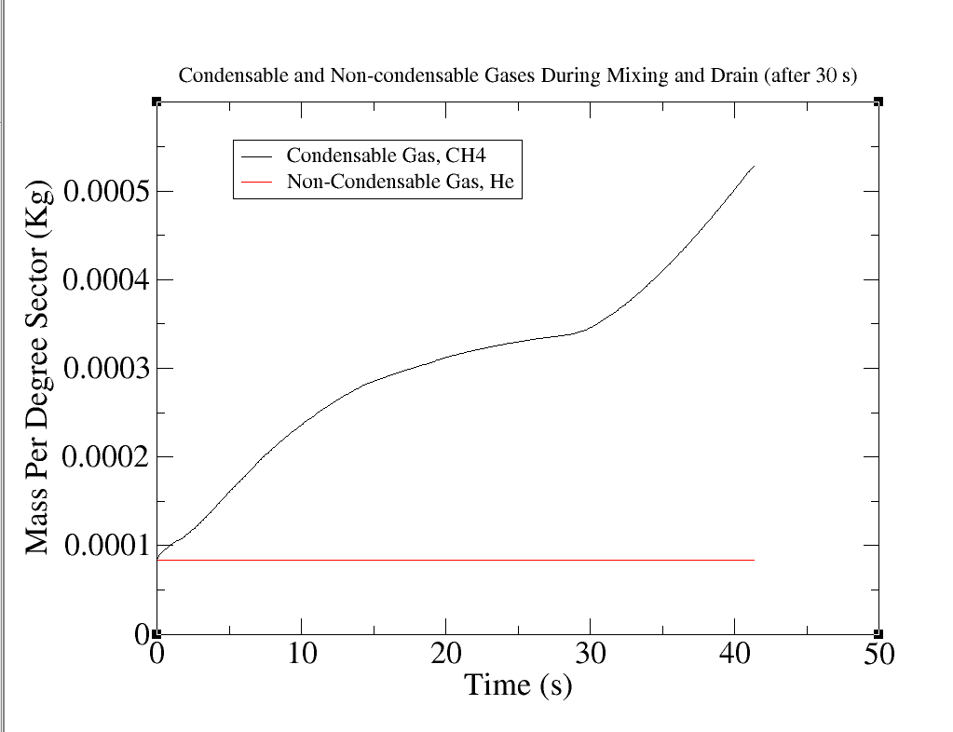
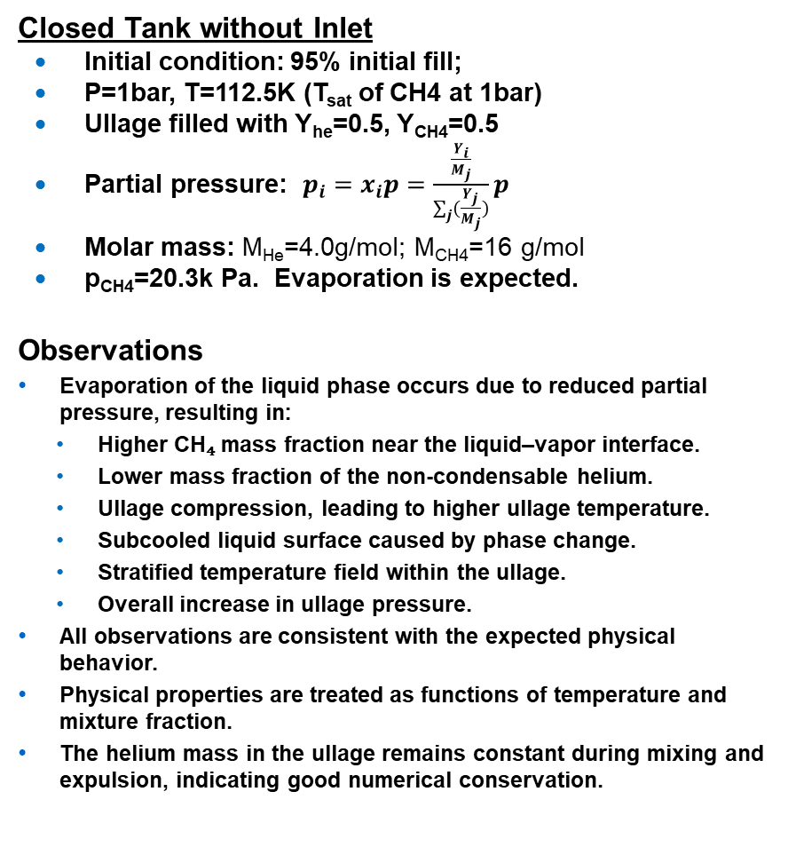
Conservation and Consistency Check
Closed Tank without Inlet
  Initial condition: 95% initial fill;
  P=1bar, T=112.5K (T_{sat} of CH4 at 1bar)
  Ullage filled with Y_{he}=0.5, Y_{CH4}=0.5
  Partial pressure: $p_{i}=x_{i}p=\frac{\frac{Y_{i}}{M_{j}}}{\sum_{j}{(\frac{Y_{j}}{M_{j}})}}p$
  Molar mass: M_{He}=4.0g/mol; M_{CH4}=16 g/mol
  p_{CH4}=20.3k Pa. Evaporation is expected.
Observations
Evaporation of the liquid phase occurs due to reduced partial pressure, resulting in:
  Higher CH₄ mass fraction near the liquid–vapor interface.
  Lower mass fraction of the non-condensable helium.
  Ullage compression, leading to higher ullage temperature.
  Subcooled liquid surface caused by phase change.
  Stratified temperature field within the ullage.
  Overall increase in ullage pressure.
All observations are consistent with the expected physical behavior.
Physical properties are treated as functions of temperature and mixture fraction.
The helium mass in the ullage remains constant during mixing and expulsion, indicating good numerical conservation.
Helium
Mass fraction
CH4
Mass fraction
Laminar
Viscosity
Temperature
Mixing
Expulsion
Expulsion

Slide 6
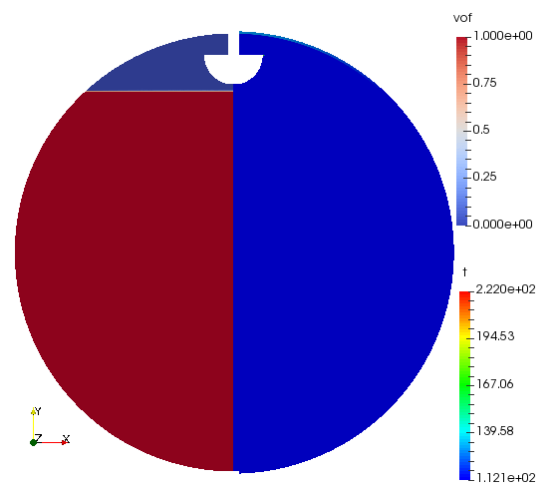

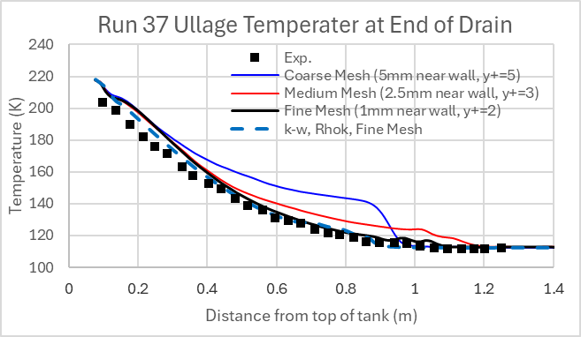
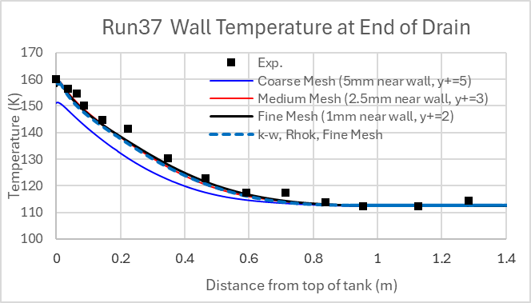
K-site Pressurized Expulsion of LCH4 Using Helium
Ramp-Hold-Drain of Run 37
Experimental Conditions:
  Initial condition: 95% initial fill; pressure 1bar at 112.5K.
  Ramp: 34s; from 1bar to 3.41 bar; Helium as pressurant at 229K
  Hold: 24s at 3.41 bar.
  Expulsion: 223.4 second; from 95% to 5% at 3.41bar; no slosh
CFD Model
  Laminar and turbulence k-ω model with ρk formulation.
  Conjugate heat transfer
  Temperature and species dependent properties
  Mass transfer coefficient: C=1.0e-3.
VOF
Temperature
VOF
He mass fraction
 | Mass of Added Pressurant During Expulsion (kg)
Mesh | Coarse Mesh (Y+=5) | Medium Mesh (Y+ =3) | Fine Mesh (Y+=2) | Fine Mesh (Y+=2)
Model | Laminar |  |  | Turbulence Rhok
Exp. | 1.871 | 1.871 | 1.871 | 1.871
CFD | 1.743 | 1.892 | 1.930 | 1.849
Error | -6.84% | 1.12% | 3.15% | -1.13%

Slide 7
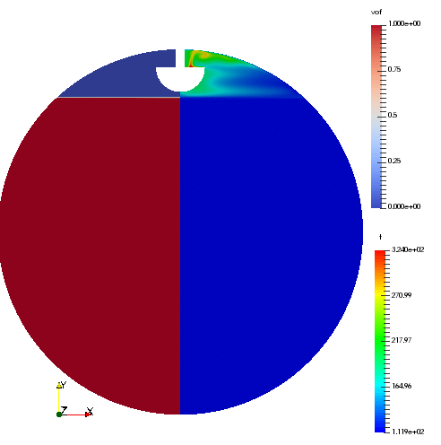
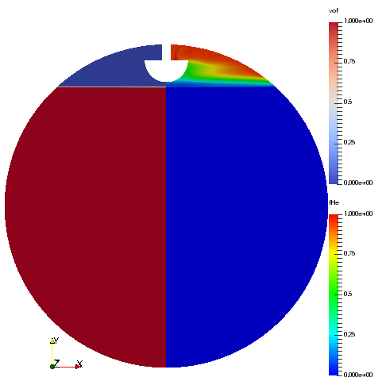
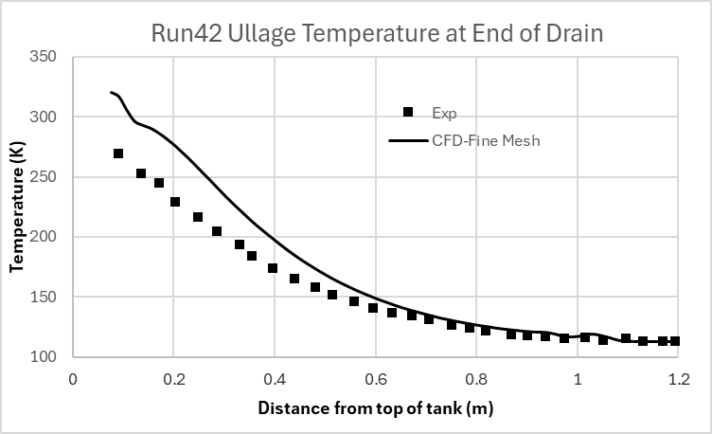
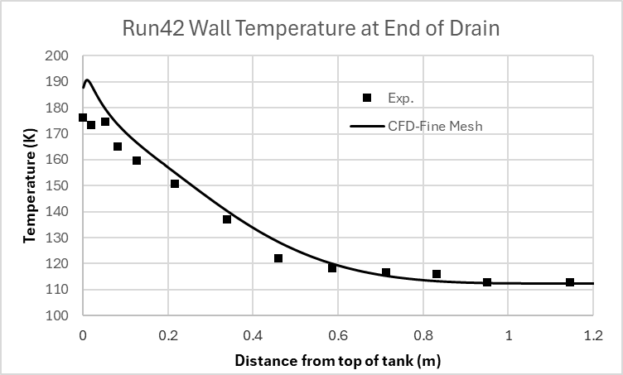
K-site Pressurized Expulsion of LCH4 Using Helium
Ramp-Hold-Drain of Run 42
Experimental Conditions:
  Initial condition: 95% initial fill; pressure 1bar at 112.5K.
  Ramp: 34s; from 1bar to 3.41 bar; Helium as pressurant at 324K
  Hold: 24s at 3.41 bar.
  Expulsion: 223.4 second; from 95% to 5% at 3.41bar; no slosh
CFD Model
  Laminar and turbulence k-ω model with ρk formulation.
  Conjugate heat transfer
  Temperature and species dependent properties
  Mass transfer coefficient: C=1.0e-3.
VOF
Temperature
VOF
He mass fraction
 | Mass of Added Pressurant During Expulsion (kg)
 | Exp. | CFD | Error
Comparison | 1.770 | 1.778 | 0.45%

Slide 8
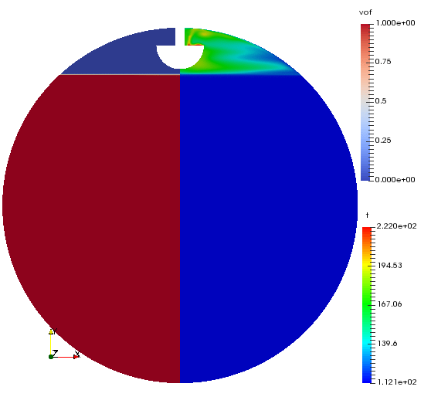
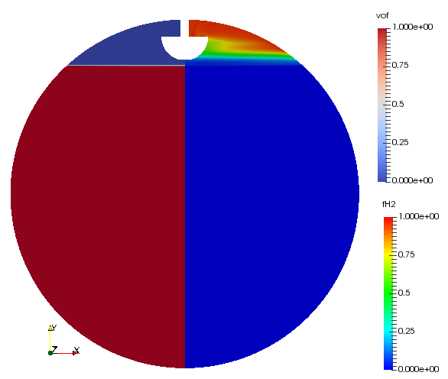
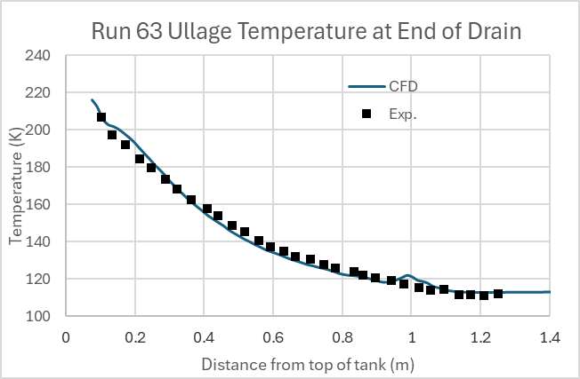
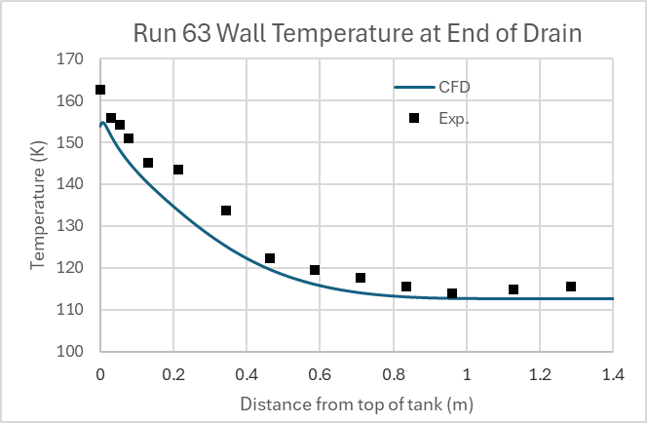
K-site Pressurized Expulsion of LCH4 Using Hydrogen
Ramp-Hold-Drain of Run 63
Experimental Conditions:
  Initial condition: 95% initial fill; pressure 1bar at 112.5K.
  Ramp: 34s; from 1bar to 3.41 bar; Hydrogen as pressurant at 223K
  Hold: 24s at 3.41 bar.
  Expulsion: 223.4 second; from 95% to 5% at 3.41bar; no slosh
CFD Model
  Laminar and turbulence k-ω model with ρk formulation.
  Conjugate heat transfer
  Temperature and species dependent properties
  Mass transfer coefficient: C=1.0e-3.
VOF
Temperature
VOF
H2 mass fraction
 | Mass of Added Pressurant During Expulsion (kg)
 | Exp. | CFD | Error
Comparison | 0.978 | 0.953 | 2.56%

Slide 9
Conclusion
Conclusion
  A model verification and validation study has been performed for predicting pressurant requirements under static expulsion conditions using the Loci/STREAM-VOF code.
  A consistent and conservative approach for solving the species transport equations has been developed.
  The implementation ensures mass conservation for both stationary and moving interfaces. Consistency among multiple gas-phase species and conservation with the VOF multiphase formulation have been demonstrated.
  Validation of propellant expulsion with helium pressurization has been conducted, showing mesh convergence and good agreement with experimental data.
  A newly developed turbulence model based on the density weighted kinetic energy (ρk) formulation exhibited improved predictive performance.
  Validation studies showed excellent agreement with experiments across a range of inlet temperatures and with different non-condensable gases, including hydrogen.

