Slide 1
Accelerated Knowledge Discovery: A Vision for NASA Science
Rahul Ramachandran¹, Kaylin Bugbee¹, Juan Bernabe-Moreno²
¹NASA Marshall Space Flight Center, ²IBM Research Europe

Slide 2
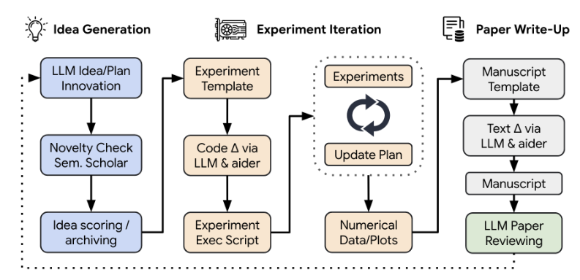
AI Integration into Scientific Processes
Use of Large Language Models (LLMs) in transforming scientific steps
LLM-powered scientific agents streamline labor-intensive processes such as literature review, hypothesis generation, and information synthesis.
Designed to augment—not replace—human researchers, enhancing productivity while maintaining rigor and accountability (e.g., AI Scientist-v2, AI Cosmologist).
AI Scientist: http://arxiv.org/abs/2408.06292

Slide 3
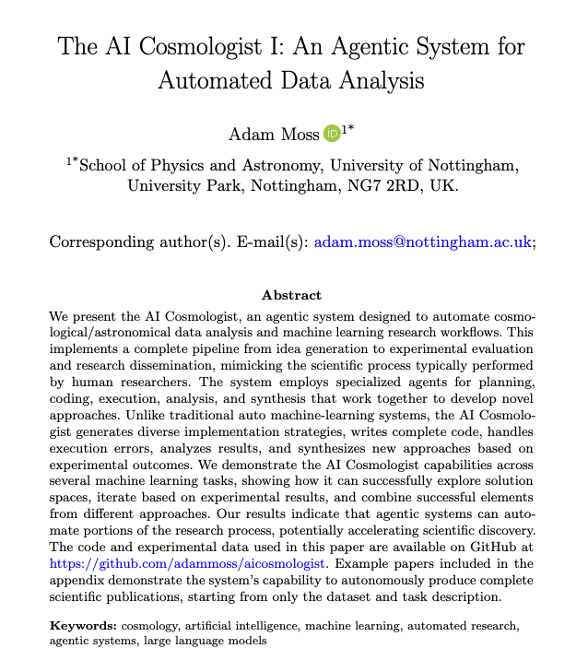
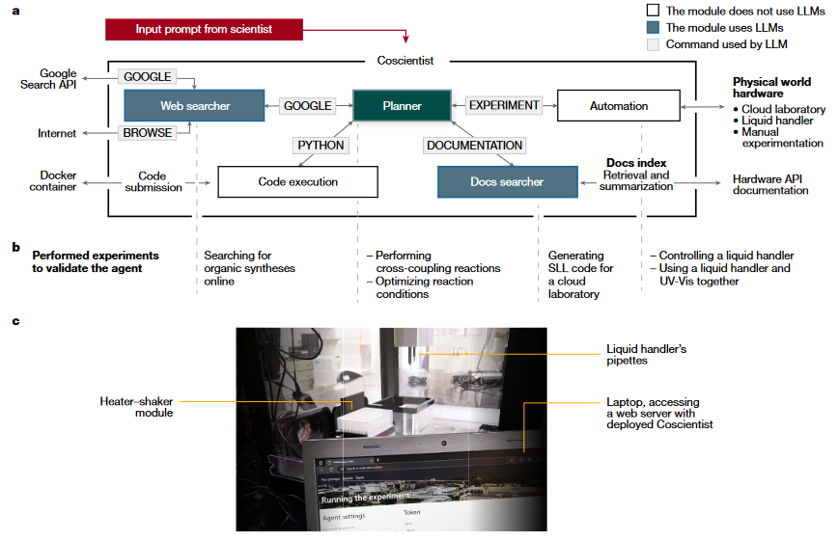
AI Integration into Scientific Processes
CoScientist: https://www.nature.com/articles/s41586-023-06792-0

Slide 4

The Sixth Paradigm:
Accelerated Knowledge Discovery Concept
AKD is the sixth scientific paradigm, integrating all previous modes of inquiry (empirical observation, theoretical modeling, computational simulation, data-intensive discovery, and AI/ML-driven inference).
It converges advanced AI models, autonomous agentic systems, and human-AI collaboration.
AKD is a shift where AI is used as a cognitive tool to augment human thinking, with agents executing workflows across the entire scientific lifecycle.
Human researchers guide the scope and constraints, while AI agents contribute speed, scalability, and reasoning support.
Scientific Paradigms
Empirical
Theoretical
Computational
Data Intensive
AI/ML
Accelerated Knowledge Discovery

Slide 5
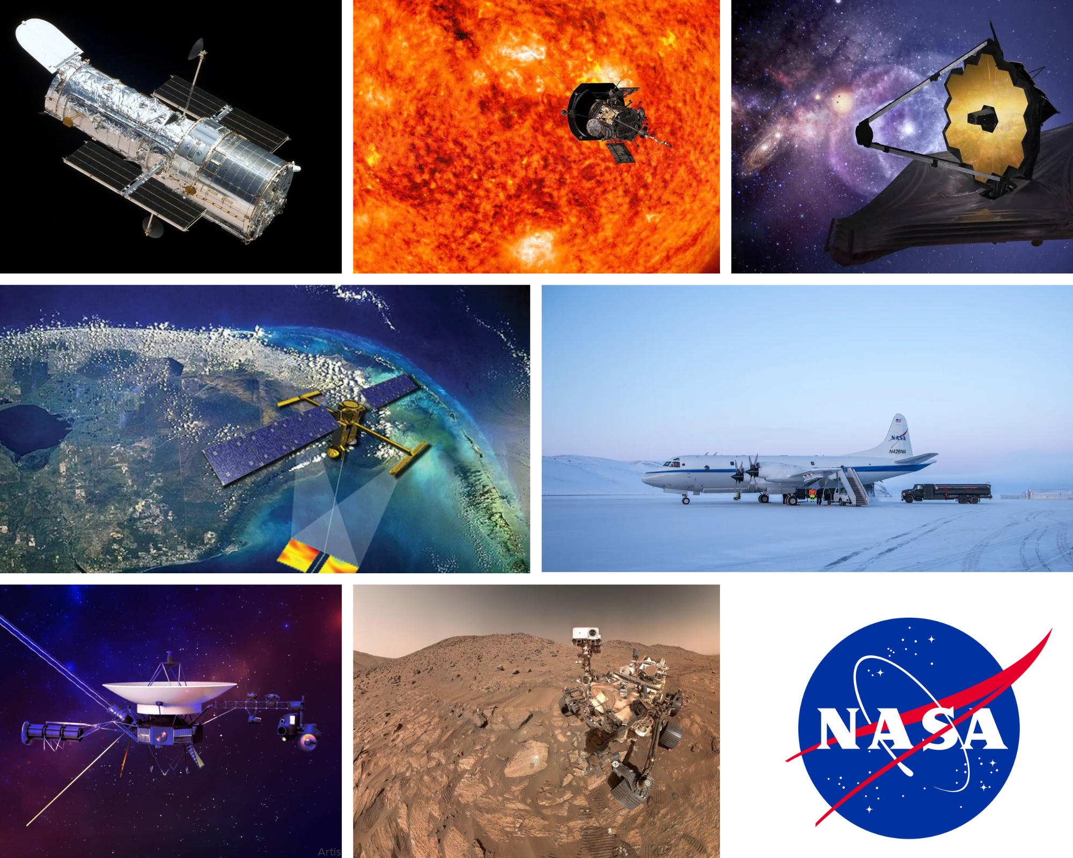
Science at NASA
NASA's science enterprise is vast and interdisciplinary, aiming to generate actionable knowledge across five divisions: Astrophysics, Biological and Physical Science, Earth Science, Heliophysics, and Planetary Science.
NASA generates an immense and perpetually increasing volume of data (petabytes), requiring robust end-to-end data stewardship.
The scale, heterogeneity, and disciplinary fragmentation of NASA’s data ecosystem create a pressing need for agentic AI systems like AKD to orchestrate complex scientific workflows.

Slide 6
5 Key AKD Technologies
Generative AI & LLMs
Agentic AI Frameworks
Explicit Knowledge Representation
(Knowledge Graphs)
Act as the cognitive engine for interpretation and synthesis
Autonomously plan, execute, and manage scientific workflows
Provide contextual grounding and guide coherent AI reasoning
Domain-Specific Foundation Models
Robust Computational Infrastructure (HPC & Cloud)
AKD reflects the convergence of generative AI/LLMs, modern data infrastructures, and evolving scientific workflows.
Provide specialized models for prediction and anomaly detection
Ensures scalability, responsiveness, and real-time capabilities

Slide 7
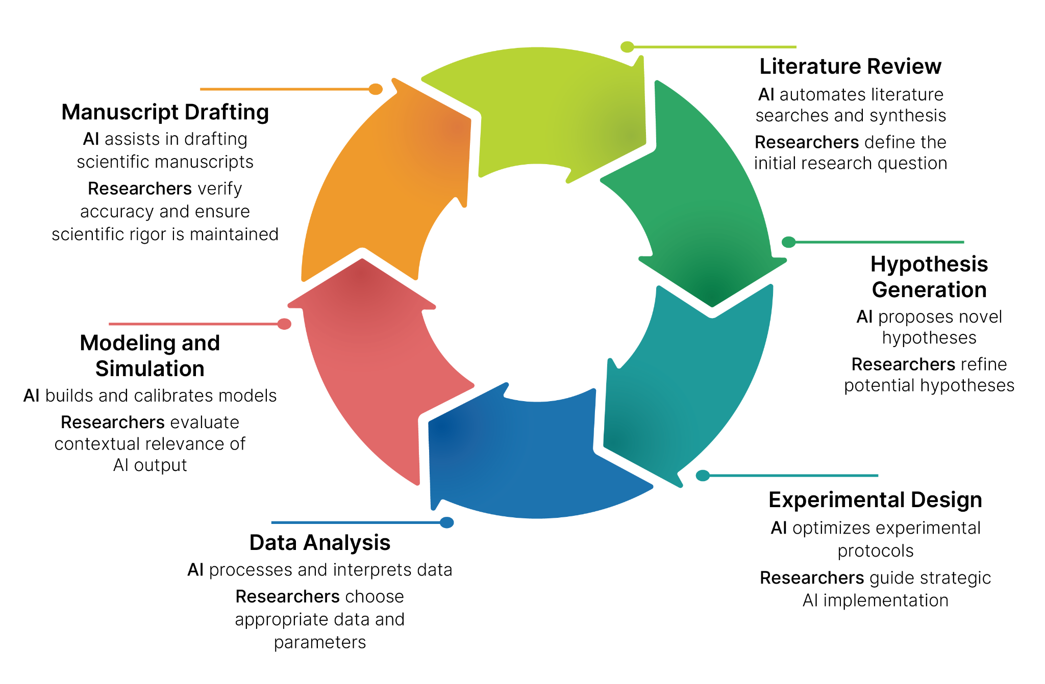
Reimagining Scientific Workflows with AKD
Human-in-the-Loop (HITL) oversight is a foundational principle.
AI agents augment human intellect across the entire scientific lifecycle.
These capabilities lead to Closed-Loop Scientific Workflows (CLSWs), which are self-updating, iterative research cycles that safely and cost-effectively manage routine, data-heavy tasks.

Slide 8




Building Trust and Mitigating Risks in AKD
Agentic AI introduces risks like irreproducible results, automation bias, and a loss of scientific accountability.
Trustworthiness must be a grounded in principles: explainability, reproducibility, robustness, adaptability, and transparency.
Alignment with Open Science Principles to support open data, open code, open results, and reasoning transparency.
Human oversight and scientific accountability necessitates intervention points at every critical decision, transparent system design, and the ultimate responsibility for scientific integrity resting with human researchers.
Reproducibility and provenance are supported by automated logging of all research artifacts (datasets, models, environments, hyperparameters) and tracking the decision-making logic of agentic processes.

Slide 9
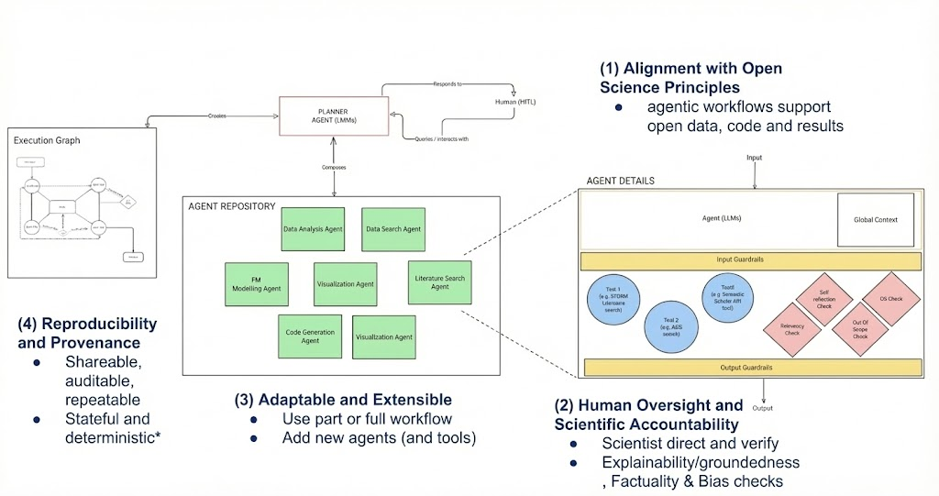
AKD as an Agent Development Kit For Science
Trust is Foundational

Slide 10
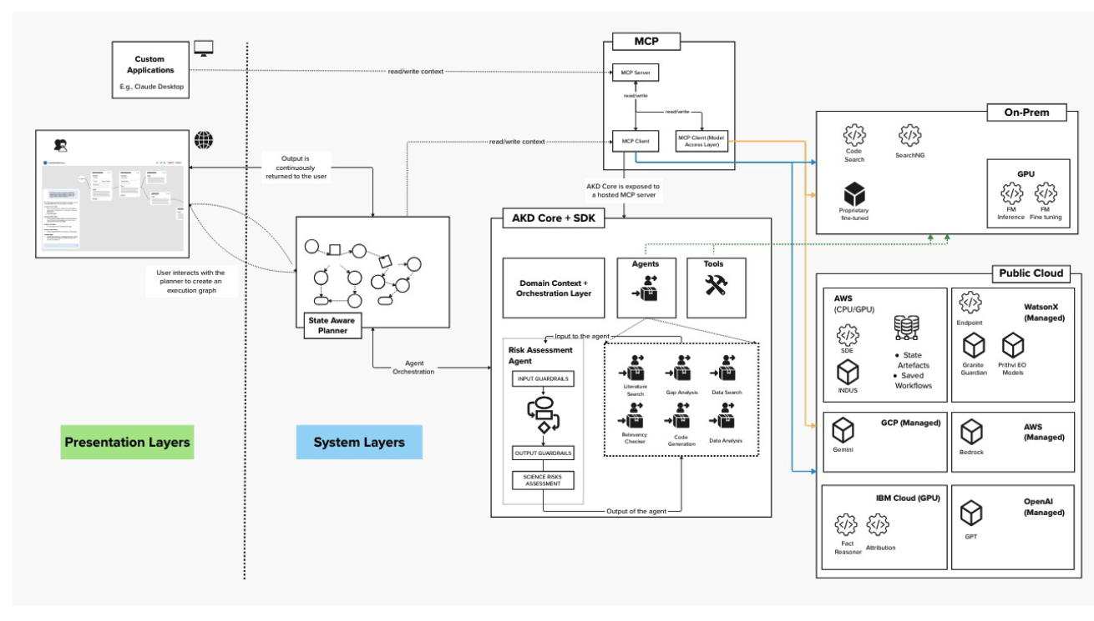
Deployment and Use of AKD at Enterprise Level
Mix use of on-prem and cloud infrastructure
Some models will be on prem gpu (Large FMs)
AKD Toolkit customized by different project
Uniform level of Guardrails across NASA SMD enterprise
Existing tools exposed via MCP (Model Context Protocol) at an enterprise level
With security
Adapted to augment existing application or build new applications
WorldView
Full agentic workflows available for selected science projects
Includes CLSW

Slide 11
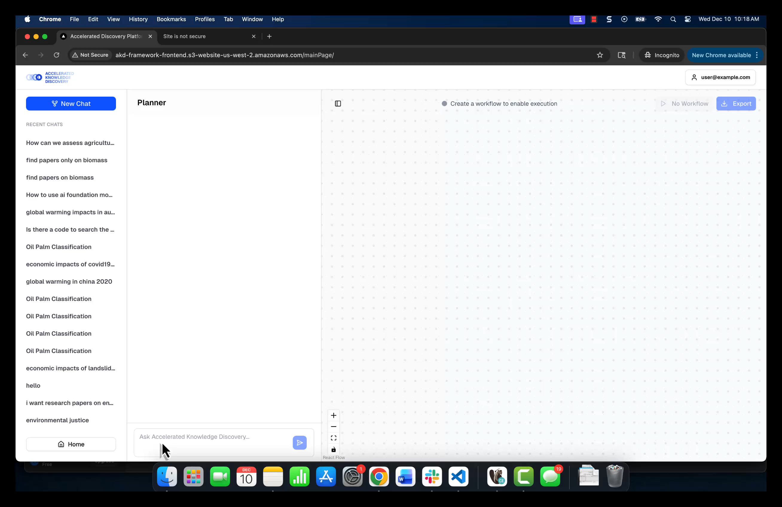
AKD Framework Prototype

Slide 12
Scientific Objectivity in the Age of Agentic AI
The Dual Framework of Objectivity
Scientific Objectivity
systematic minimization of personal bias, opinion, and error in the creation and representation of knowledge
Objectivity of Knowledge
ensuring scientific claims align with empirical facts and truth, distinguishing accurate representations of the world from subjective beliefs
Objectivity of Process
implementing unbiased, rigorous methodologies in observation, experimentation, and analysis

Slide 13
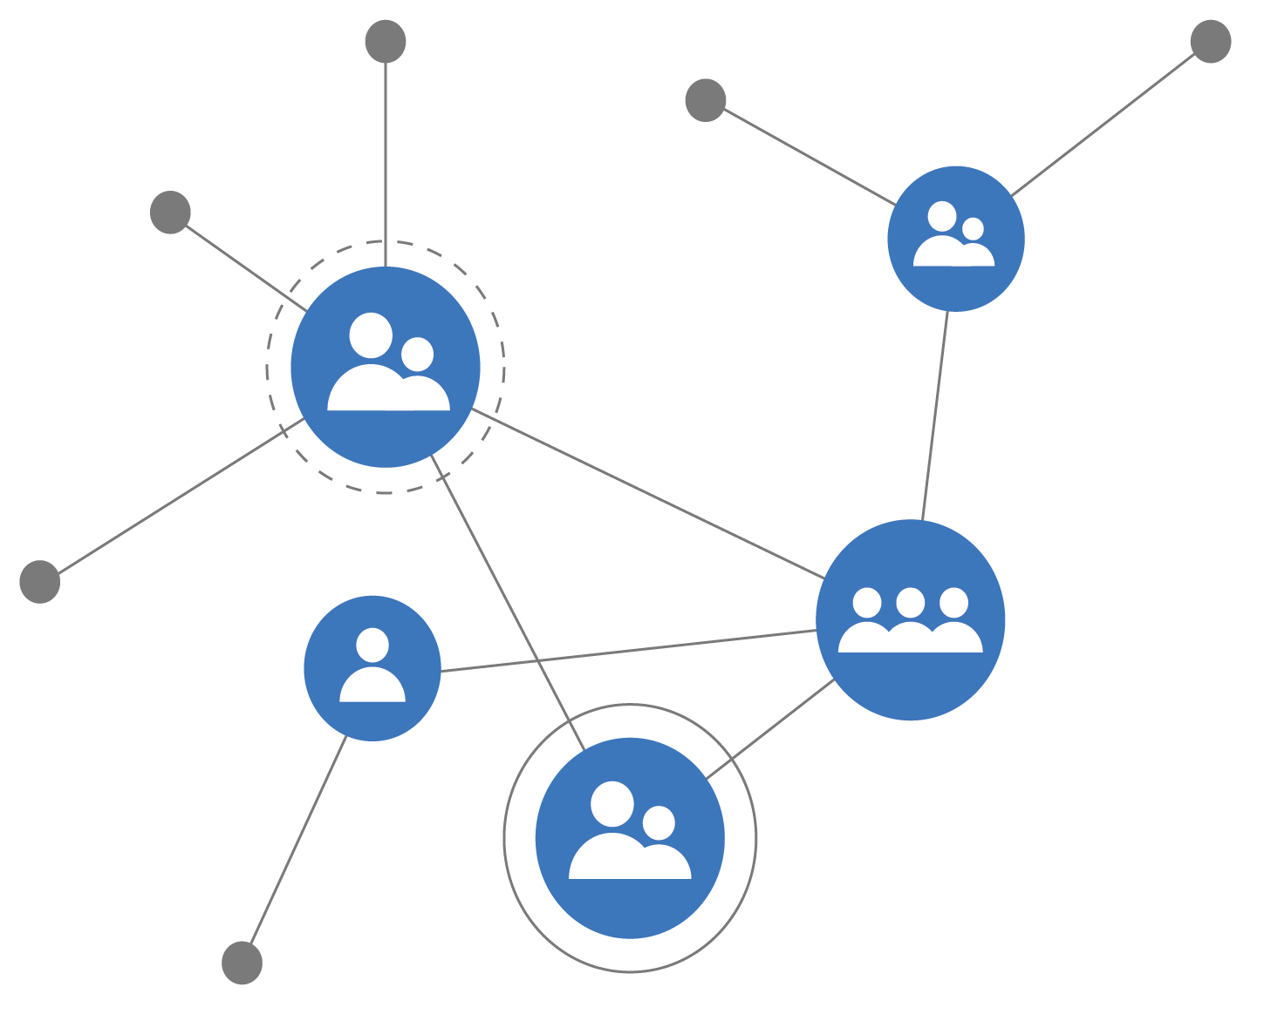
Scientific Objectivity in the Age of Agentic AI
Objectivity as a Collective Endeavor
Individual scientists remain susceptible to bias, but community consensus mitigates these errors through replication and peer review.
Organizations like AGU are critical for maintaining standards as AI changes the landscape.

Slide 14
Cultivating “Scientific Skepticism” in the Age of AI
Scientific skepticism is valuable not only for scientists but for everyone, especially in the age of AI.
  Encourages people to question responsibly:
    How are claims made?
    What evidence supports them?
    Can evidence be independently verified?
For AI-generated outputs, scientific skepticism treats these outputs as starting points for inquiry, not final truths.
  Encourages people to ask:
    Where did the data come from?
    What assumptions shape the model?
Cultivating scientific skepticism fosters informed trust, confidence grounded in understanding how science and technology will correct themselves over time.

Slide 15
Thank you

