Slide 1
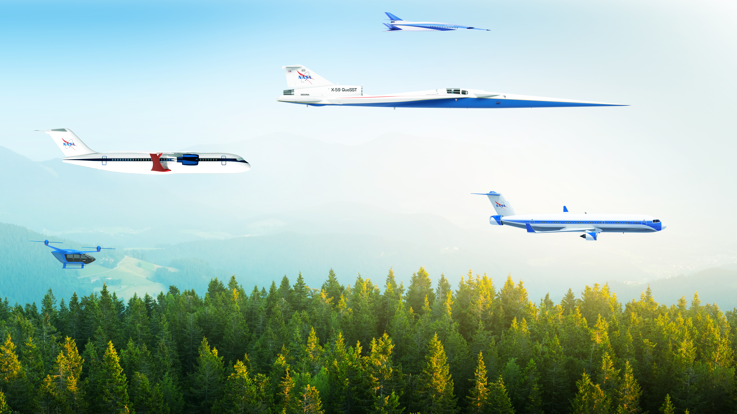

National Aeronautics and Space Administration
Model-Based Systems Analysis & Engineering for the Sustainable Flight National Partnership
Irian Ordaz
NASA Langley Research Center
January 14, 2026
www.nasa.gov

Slide 2
Topics
Overview
Digital integration
Demonstrations
NASA Research Announcement (NRA)

Slide 3


Sustainable Flight National Partnership
Next-Generation Capability on the Path to Net-Zero Greenhouse Gas Emissions by 2050
Advance engine efficiency and emission reduction
Advance airframe efficiency and
manufacturing rate
Enable integrated trajectory optimization
Enable use of 100% sustainable aviation fuels
Accelerate toward net-zero greenhouse by 2050 through up to 30% energy efficiency improvement
in next-generation transports, 100% sustainable aviation fuel, and optimal trajectories.
Source: AAVP, NASA ARMD
Notes:
Source: Jim Heidmann, LaRC Townhall, AAVP, 2/2023

Slide 4
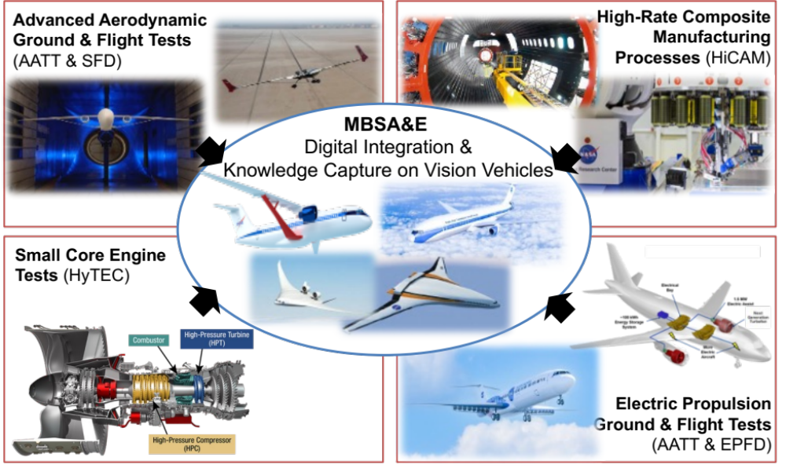
MBSA&E Vision for the Sustainable Flight National Partnership
A systems-level, digital integration across Sustainable Flight National Partnership (SFNP) projects which will support the assessment, advancement, and adoption of sustainable technologies for 2030s entry into service subsonic transport aircraft concepts
Notes:
Objectives:
Develop an open, cross-project, cross-program, external-capable MBSA&E framework building off ARMD investments and capabilities across AAVP/IASP/TACP in support of the SFNP
Conduct coordinated, integrated systems analysis studies in support of SFNP
Common, open, reference and vision vehicle models
Technology benefit assessments and sensitivity studies informed by the SFNP demos

Slide 5
Digital Integration

Slide 6
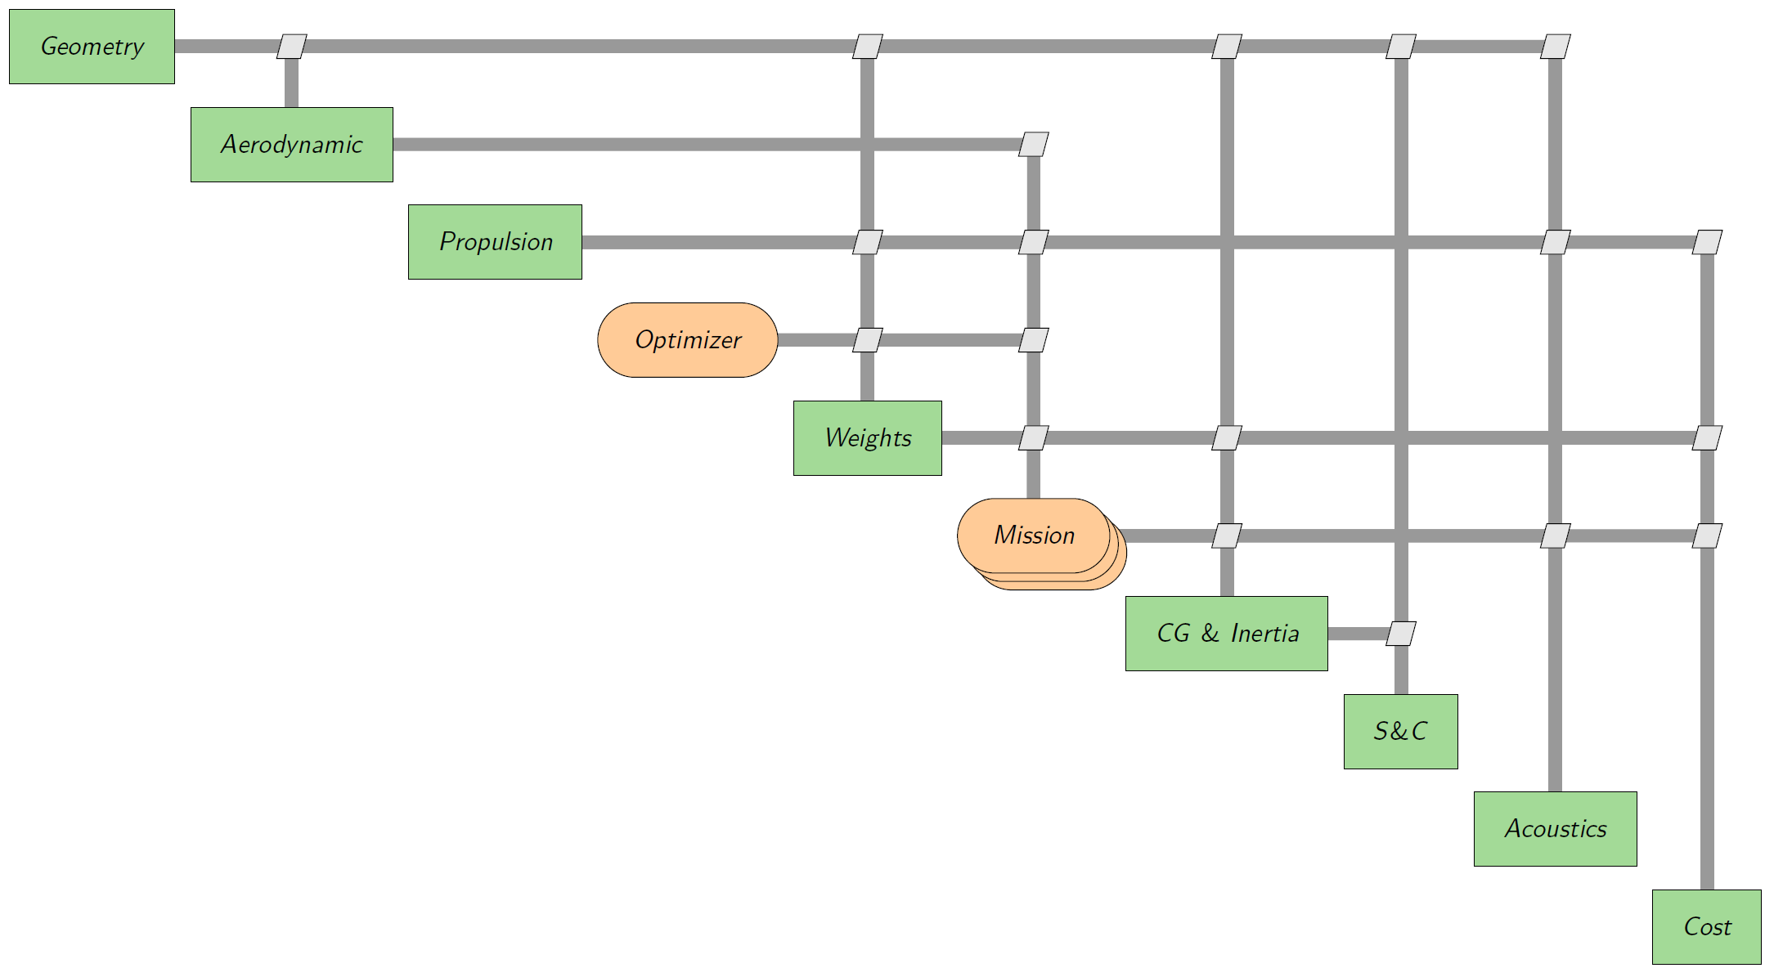

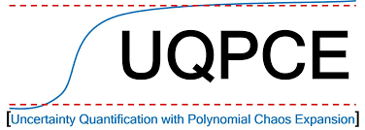
Cross-Domain Architecture
MBSE System Model
MBSA&E
MagicDraw
MBSA Disciplinary Models
Structural decomposition
Requirements verification simulation
System validation
MBSE
MBSE Driver
Translates MBSA-MBSE parameters
Evaluates mission scenarios and vehicle designs
Executes UQPCE analysis
UQ Analysis Model
Non-intrusive polynomial chaos expansion
Efficiently estimates uncertainties
MBSA
UQ

Slide 7
System Modeling Capability in MBSE
Developed an MBSE system model of a TTBW aircraft concept and identified data interfaces required to couple MBSE and MBSA/MDAO models into an integrated modeling environment (IME)
Approach and Implementation
Developed an architectural framework using SE principles and MBSE tools to generate a system model, and applied it in an integrated design environment for analysis of a concept aircraft
Architecture, Tools and Methods
Used industry and NASA’s SE processes, requirements, standards and best practices to develop the system model, interactions and instantiation in a cross-domain architecture
Knowledge Sharing
Applied models and methods from NASA’s MBSE community of practice, and informed through cross-agency technical interchanges
MBSE and MBSA coupling enables the integration of research results from all projects to ensure system level aircraft design and mission requirements are satisfied

Slide 8





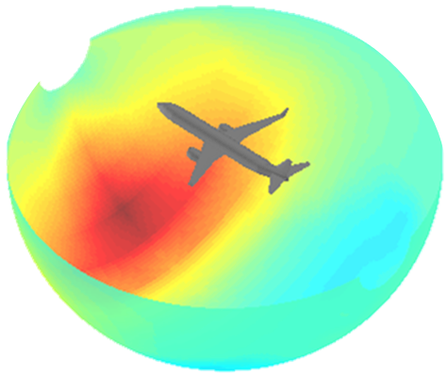

Multi-Fidelity Analysis Capability
Geometry
Aerodynamics
Aviary external subsystem API used to integrate disciplinary components and extend analysis capability for non-conventional concepts for which historical empirical data is not available
Common variable hierarchy and metadata organized using physical decomposition is accessible by all disciplinary components to avoid variable duplication and ensures consistency across disciplines
AIMEE - AIrcraft Modeling and dEscriptive Environment, an abstraction layer that allows automated construction and execution of a framework, provides a common, unified, and descriptive input file, and decouples the problem definition from the architecture/assembly development
Cart3D
OpenVSP
OpenAeroStruct
Propulsion
Cost
NPSS
Aviary
& ADH
Increasing Complexity/Fidelity
STATIC
STABILITY
TAIL/CS SIZING
FLYING QUALITIES
&
OpenAeroStruct
Mission
S&C
SUITCASE
Mphys
TACS
NASTRAN
Noise
Sizing/Structures

Slide 9
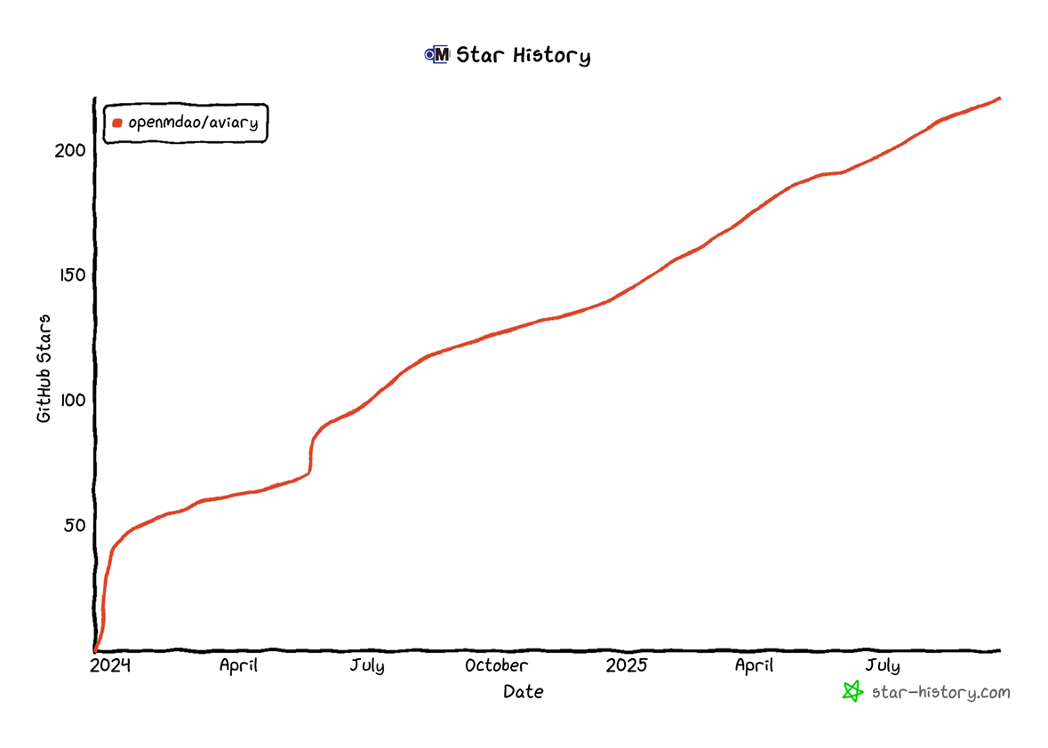

What is Aviary?
Aviary is NASA’s next-gen conceptual aircraft design tool
Developed as a partnership between AATT, TTT, and EPFD
Legacy Tool Capabilities
External Tool Integration through API
Open-Source Release
State-of-the-Art Optimization (OpenMDAO)
“Stars” on Aviary GitHub Repository
Featured article on nasa.gov
GitHub Stars
Public release of Aviary
Date

Slide 10
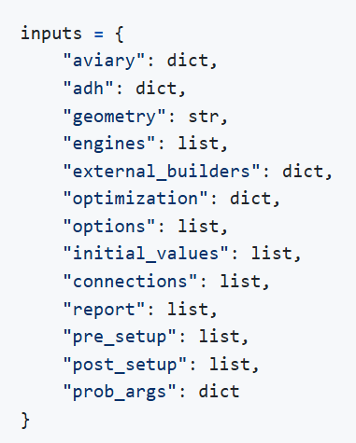
AIMEE - AIrcraft Modeling and dEscriptive Environment
A builder and abstraction layer that allows the automated construction and execution of aeronautics framework problems based on Aviary level 2 user interface and external physics-based analysis tools.
Concepts Library
Repository for aircraft-specific input files
Unified Input File
AIMEE
External Subsystems
Aero: OAS, VSPAero
CG & Inertia
S&C: Statics, CS Sizing, HQ
Cost:
PTIRS
Noise: ANOPP
          Aviary
Propulsion: Deck, NPSS, PyCycle
Geom: OpenVSP
Structures: Suitcase, OAS, TACS
Notes:
Simplify the construction and execution of Aviary problems
Decouple the problem definition from the architecture/assembly development
Reduce the development workload and setup time to allow the user to focus on problem definition
Reduce the maintenance associated with upstream development that impacts framework assembly
Provide a unified input file

Slide 11
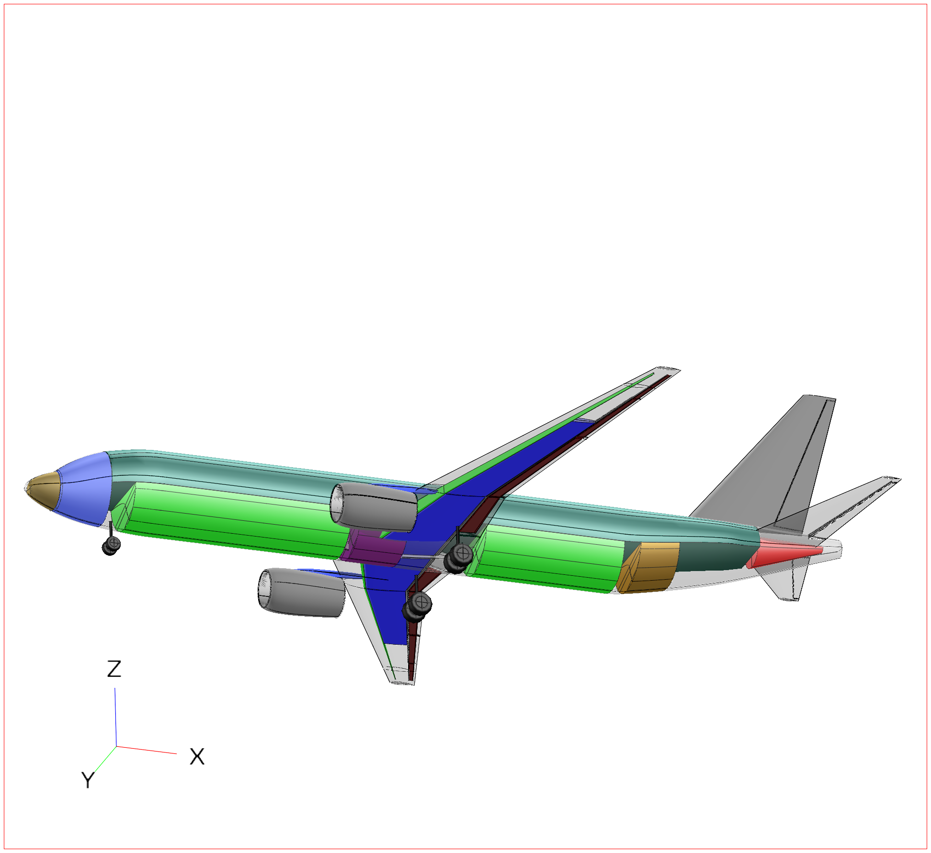
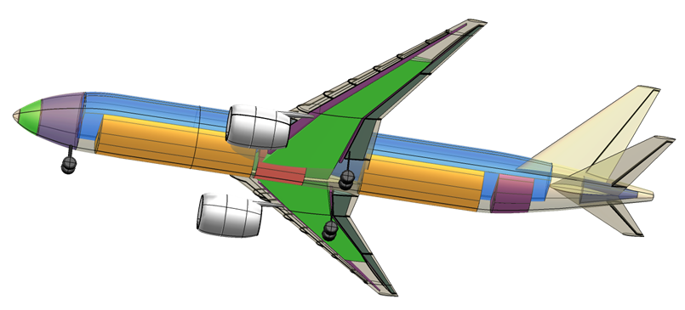
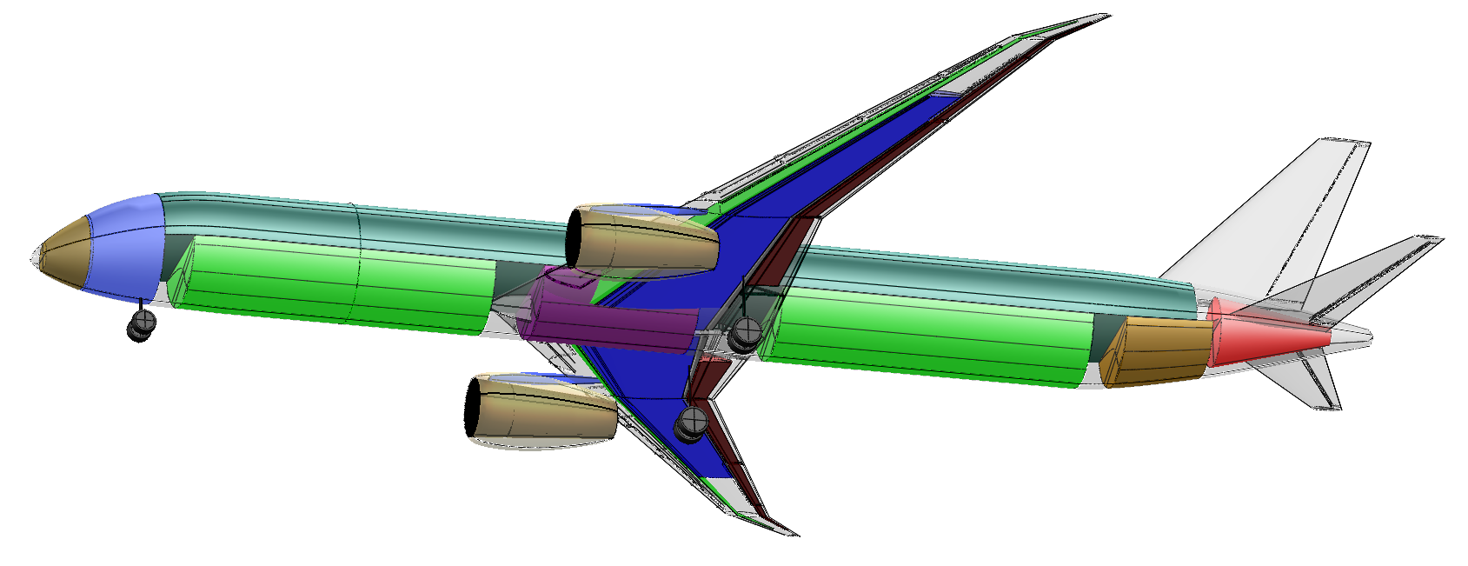
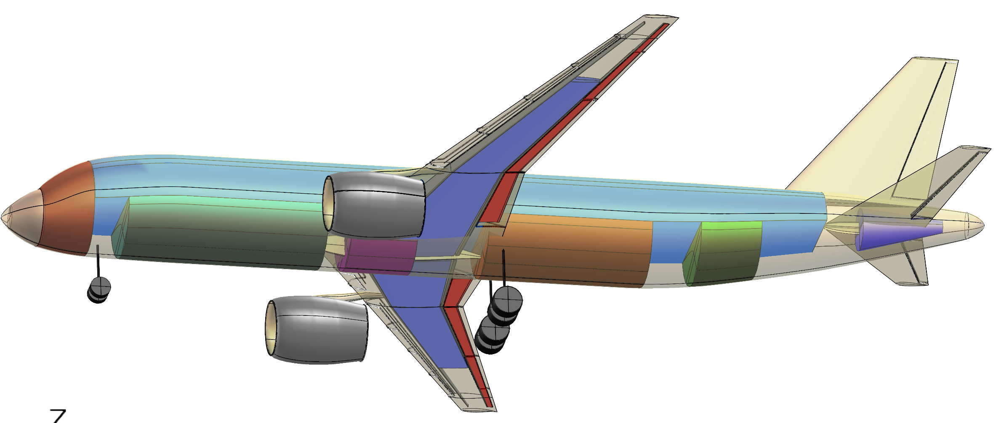
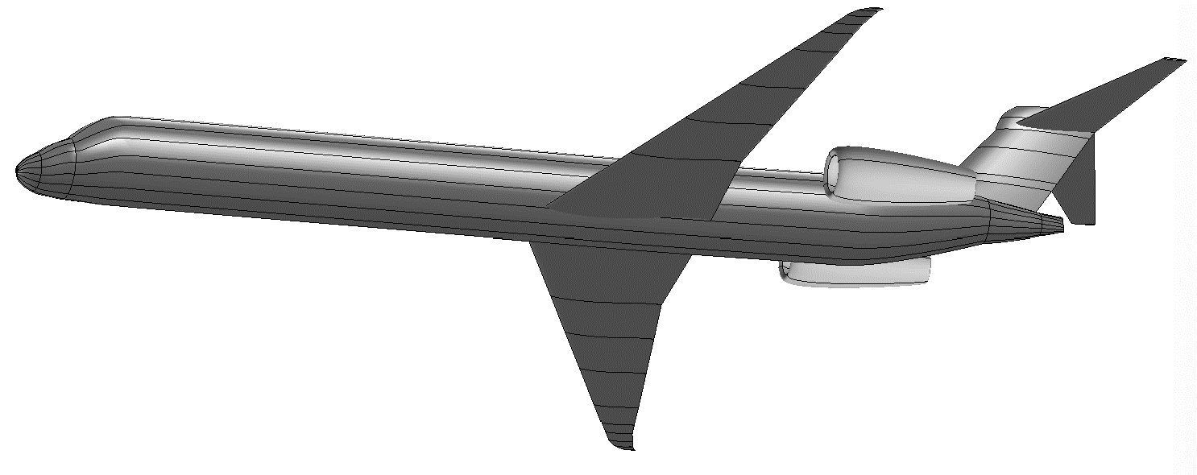
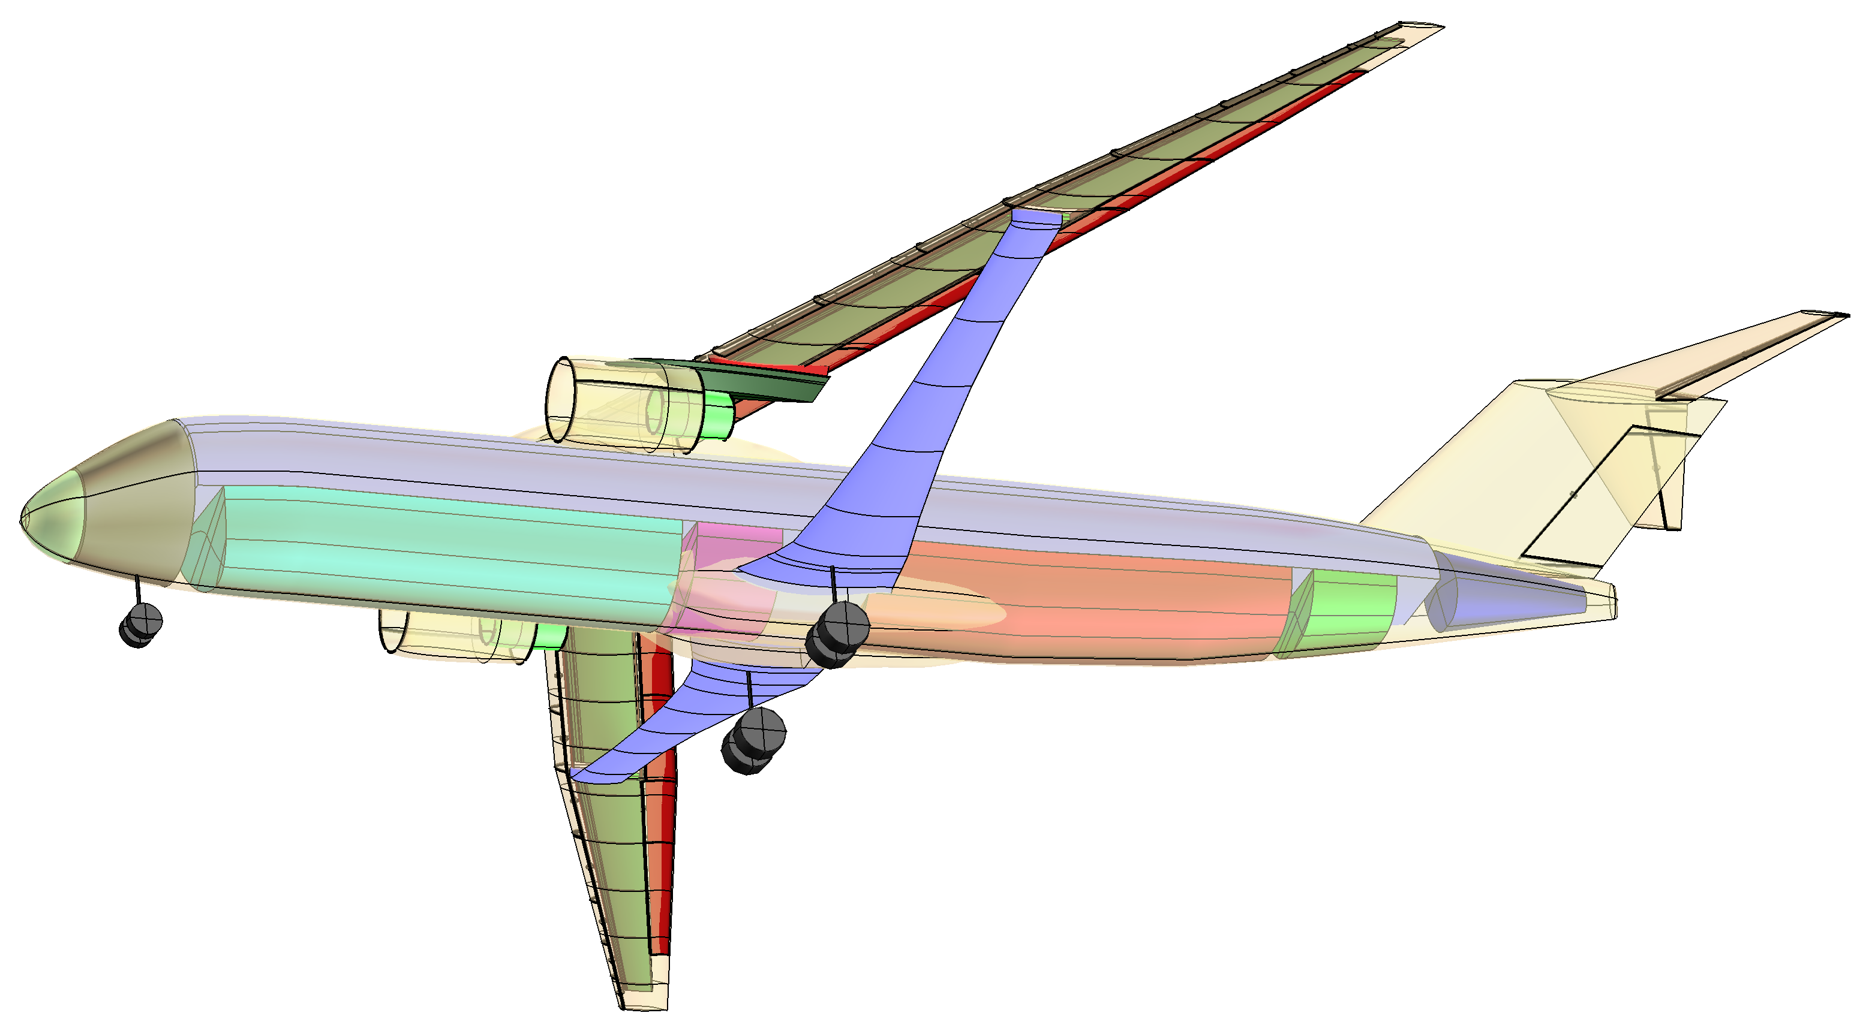
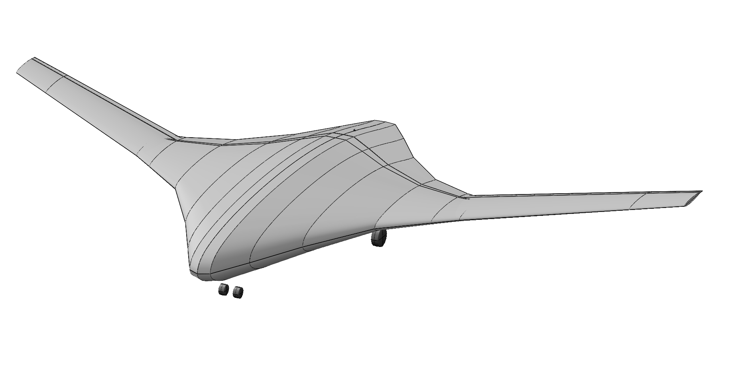
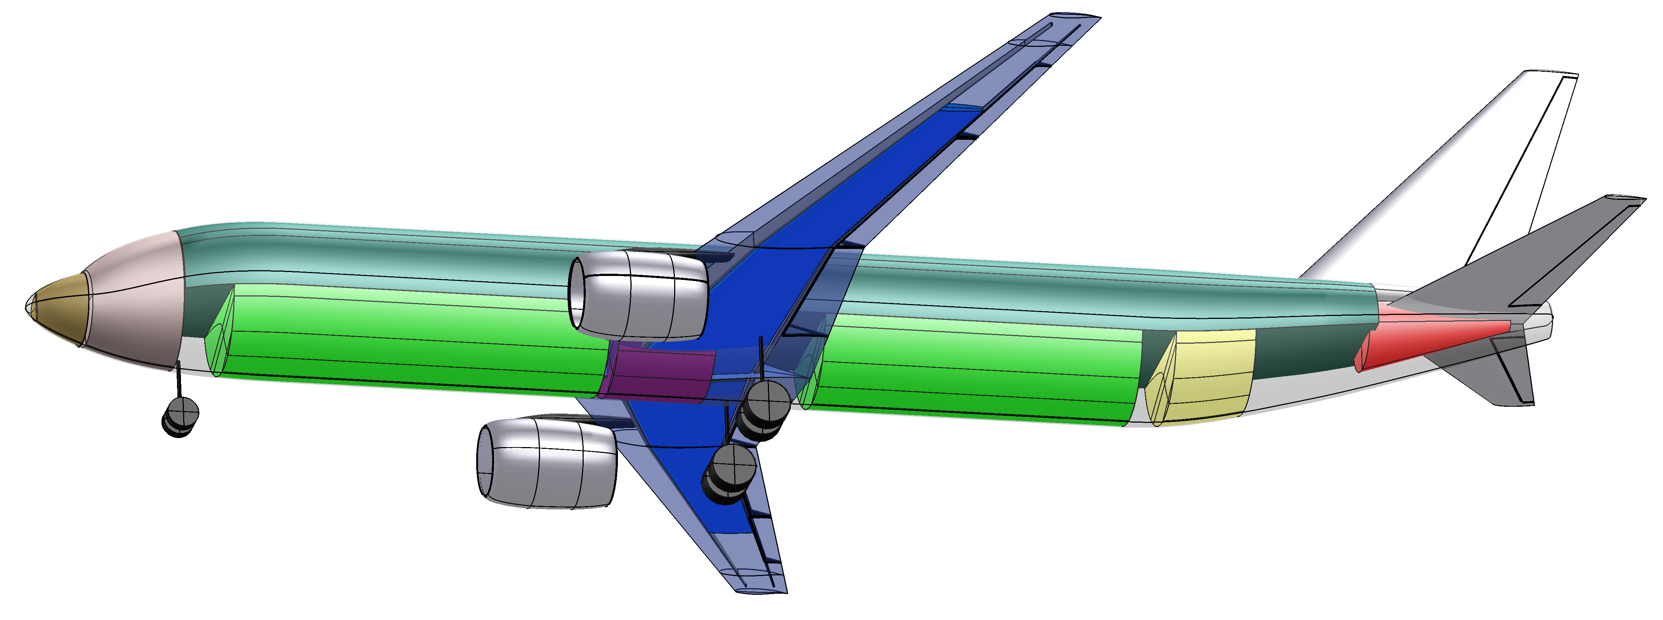
Aircraft Models
Present Day Technology
BOEING 777-200ER “LIKE”
GE90 ENGINE
BOEING 787-10 “LIKE”
GenX/RR Trent 100 ENGINE
BOEING 737 MAX 8 “LIKE”
LEAP 1B ENGINE
AIRBUS A320 Neo “LIKE”
PW1100 GTF / LEAP-1A ENGINE
MD 90-30 “LIKE”
IAE V2500 ENGINE
2035 Entry-into-Service
Future Technology
N3CC CONCEPT
gFAN+ ENGINE
TTBW “LIKE” CONCEPT
gFAN+ / N+3 ENGINE
ADVANCED CONCEPTS

Slide 12
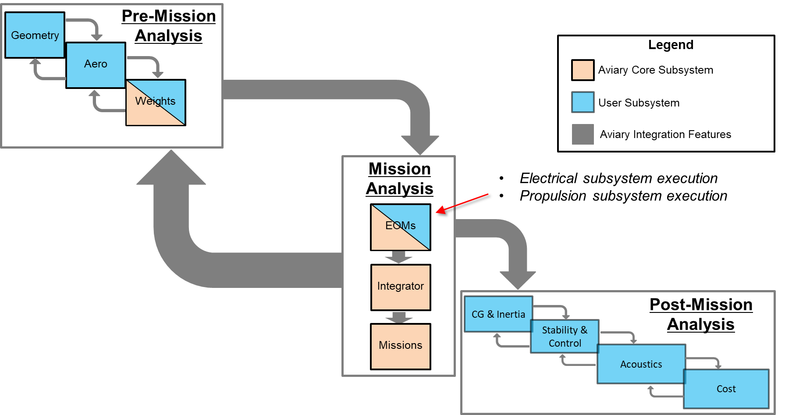
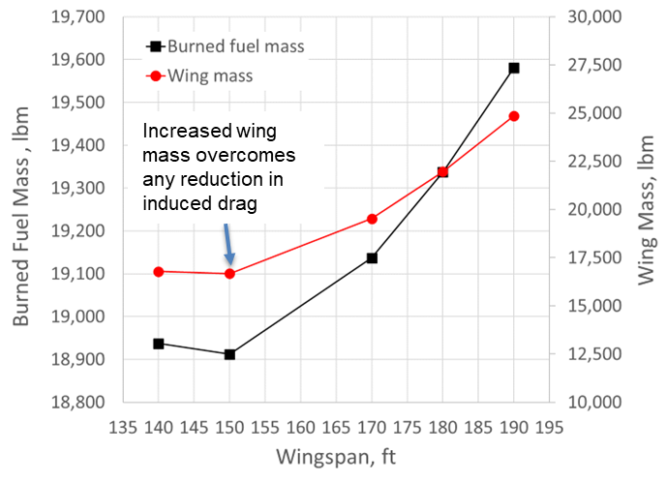
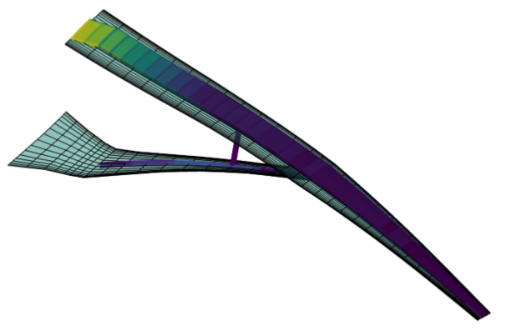
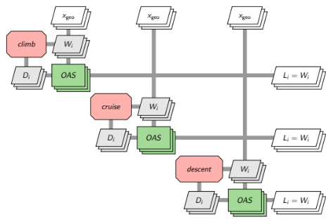
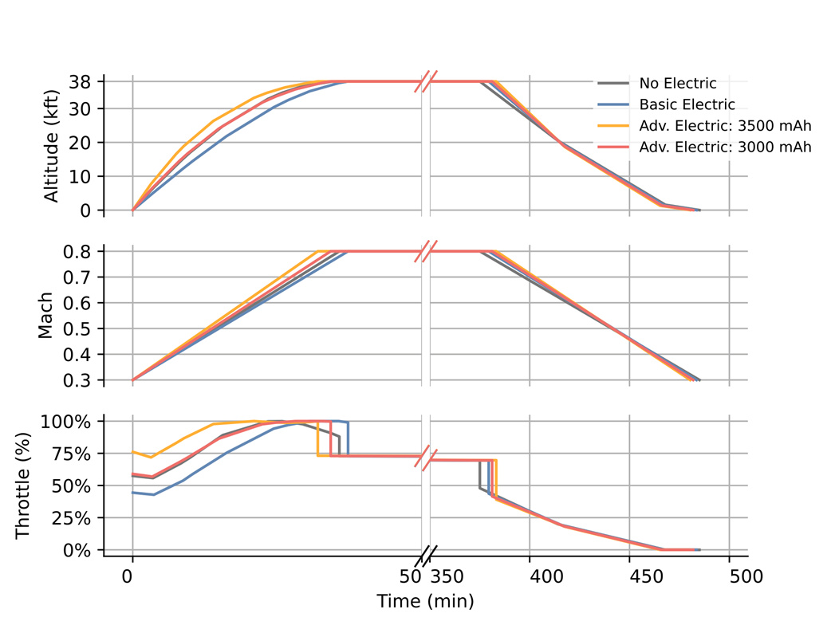
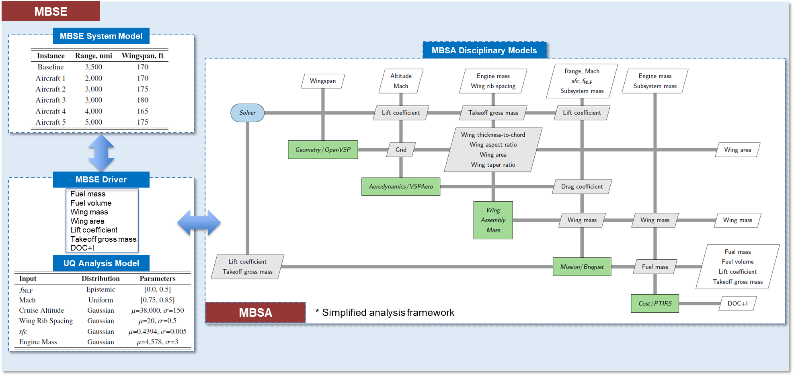
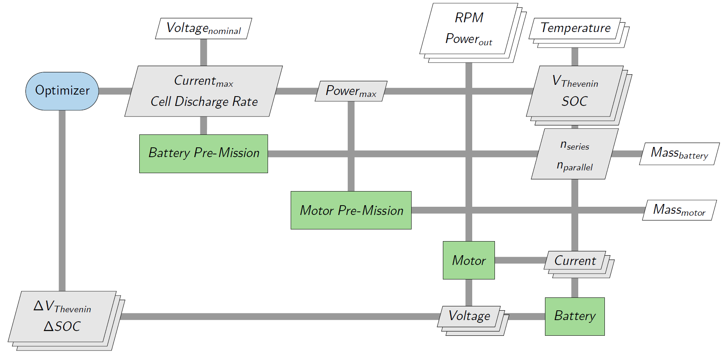
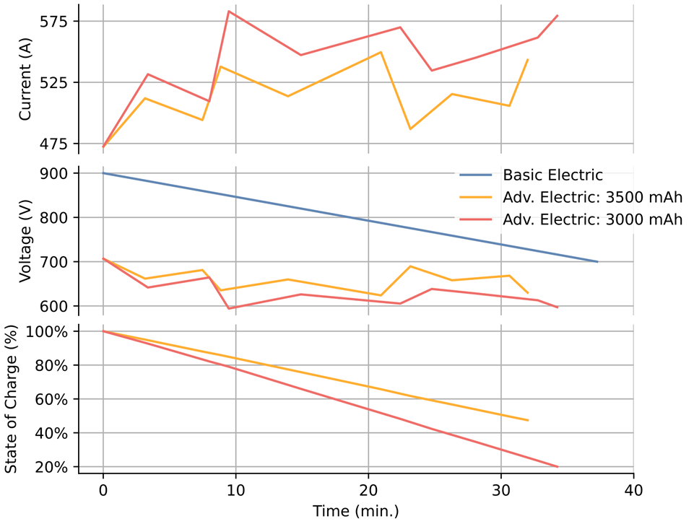
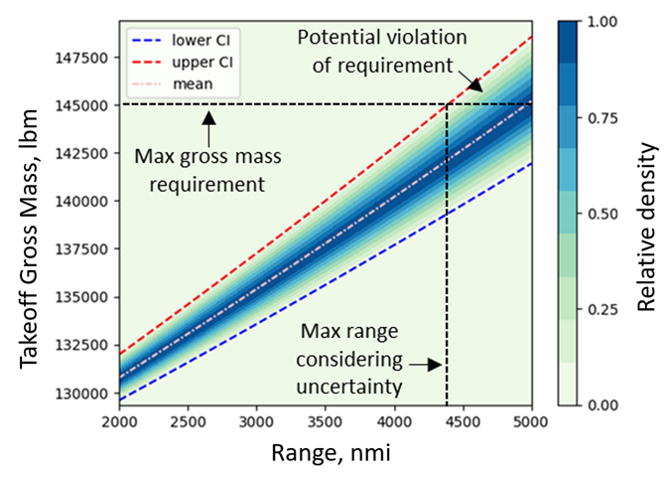
Demonstrations
System Level Optimization of Hybrid Electric Aircraft Concept
Minimize fuel burn
Design variables include gross mass, engine mass flow, battery current and capacity, electrical motor max power, and trajectory
Constraints placed on mass residual, state of charge, and trajectory
Aerostructural Optimization (AIAA Aviation 2025)
Minimize fuel burn
Design variables include wing twist, span, gross mass, structural sizing, and trajectory
Constraints placed on mass residual, structural strength, lift, pitching moment trim, and trajectory
Hybrid-Electric Propulsion System Development (AIAA Aviation 2024)
Minimize fuel burn
Design variables include gross mass, trajectory, engine mass flow, max power and current, battery cell discharge rate and total energy capacity
Constraints placed on mass residual, trajectory, throttle, Thevenin voltage, min state of charge, and max power and current
MBSA&E and UQ Integration (AIAA Aviation 2024)
Enables engineers to assess and mitigate uncertainties associated with a system model, design parameters, and constraint inputs, leading to more complete design studies and better-informed decision-making processes
*Simplified MBSA model
Notes:
PyCycle, hybridized two-spool turbofan engine by injecting power on the low-pressure shaft by an electric motor/battery system in climb
The motor efficiency is based on a 2D efficiency map using RPM and torque as inputs
Determines current draw demanded from the battery
Battery system computes voltage output to motor system which feeds back required current
Battery voltage decreases linearly with state-of-charge (SOC)
Motor power is integrated over time resulting in total energy used; battery pack is sized to support total energy used with 20% SOC remaining at the end of the mission
Specific battery energy for the baseline is 0.2 kW-hr/kg

Slide 13
NRA Overview

Slide 14
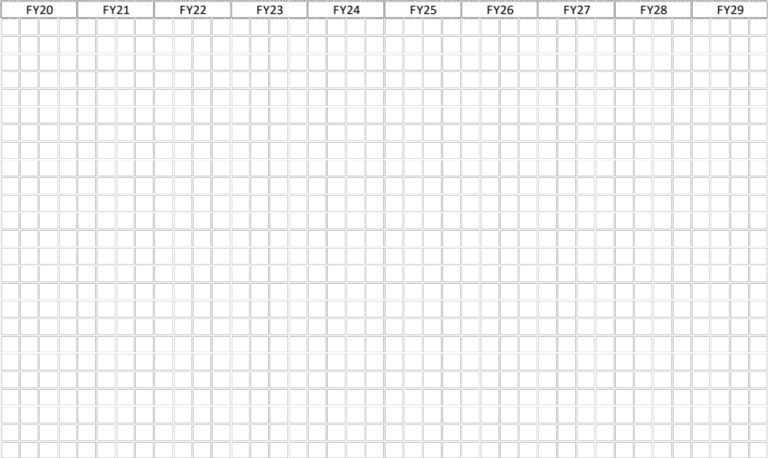
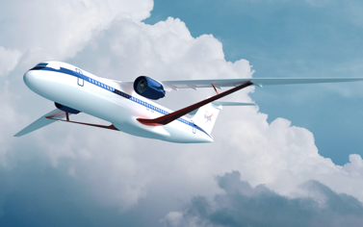
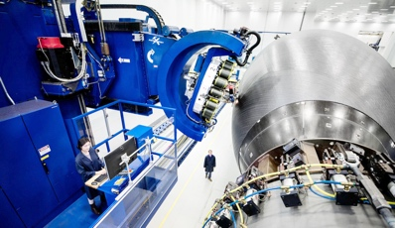
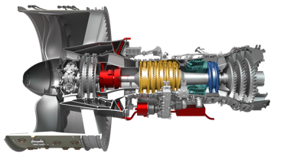
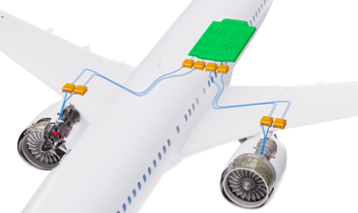
NRA Objectives
NRA PoP
Model Based Systems Analysis & Engineering
“Digital Flight Test”
Framework milestone
A key element of the SFNP was the development of an MBSA&E framework to facilitate technology integration and assessment at the system level and enable collaboration through data exchange and model integration between numerous NASA Aeronautics projects and industry partners.
Industry partnership in the development of the MBSA&E framework was needed to:
Develop and incorporate consistent, state-of-the-art methods for systems analysis and systems engineering across all SFNP partners
Establish best practices within the MBSA&E framework for data exchange and model sharing between industry and government
Develop system-level models of SFNP technologies which will be incorporated into the MBSA&E framework for technology evaluation

Slide 15
NRA Topics
Aircraft Data Hierarchy/Definition
Standard Interface Definition Between Disciplinary Models/Tools
Systems Analysis and Systems Engineering Integration
Comprehensive Model Sharing and Collaboration Approaches
Narrow Model Sharing and Collaboration Approaches
Aircraft and Component/Subsystem Models
Disciplinary Analysis Tool Integration with OpenMDAO
Disciplinary Analysis Tool Development with OpenMDAO
Boeing
Boeing
Boeing
Boeing
Boeing
Boeing, Northrop Grumman
M4 Engineering
Georgia Tech

Slide 16


Questions?
Publications and Reports

