Slide 1
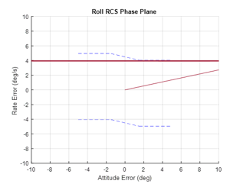
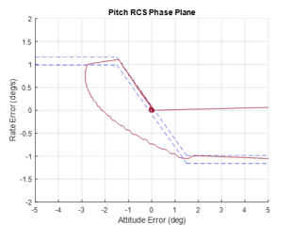
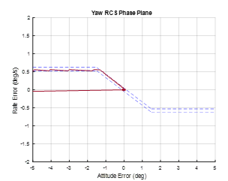
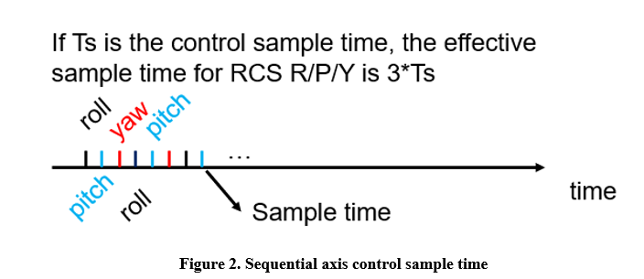
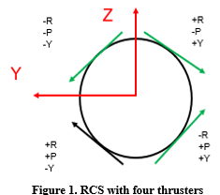
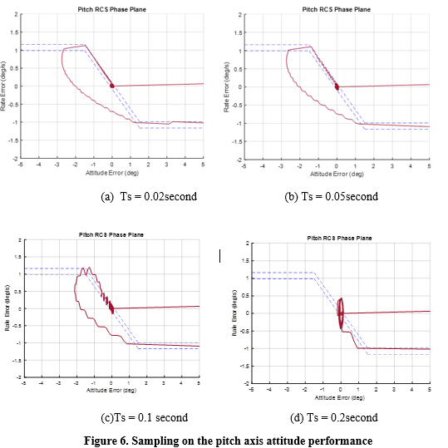
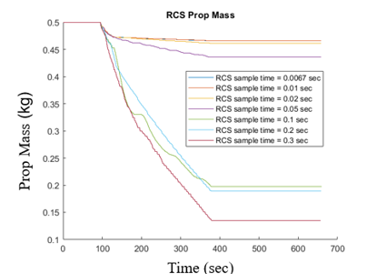

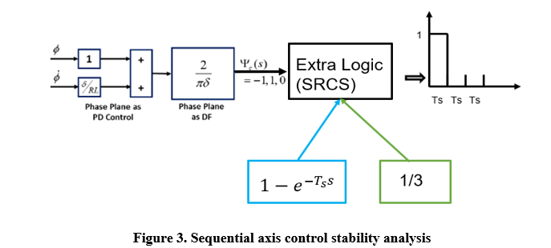
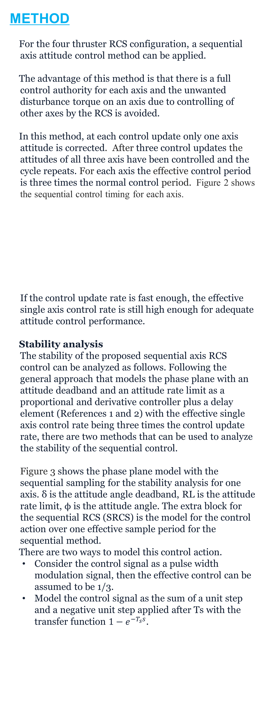
An Axial Sequential RCS Design For Spacecraft And Launch Vehicle Control
Wei Wu, Ph.D., Associate GNC Technical Fellow; wei.wu@nasa.gov
Amentum Space Exploration Division
INTRODUCTION
Reaction control systems (RCS) are commonly used for spacecraft and upper stage attitude control. Normally attitude angles of all three axes are corrected by the RCS controller at each control loop update assuming that the commanded torque for each axis is provided by the thruster. This usually requires 6 or 8 thrusters for independent axis control capacity.
Consider a four-thruster RCS configuration due to a strict mass constraint. For each axis, the RCS controller issues a positive/1, a negative/-1, or a zero/0 torque command. There are, for three axes, a total of 27 torque command combinations. With only four canted thrusters, see Figure 1, 12 of the 27 combinations are undesired: for a multi-axis maneuver requiring a positive or negative torque, only a half of the torque is realized; and a thruster disturbance torque is introduced in other axes.
For an example, the combination of a negative roll torque, a negative pitch torque, and a zero yaw torque command ([-1 -1 0]) is not achievable, because when thrusters generating the desired negative roll and pitch torques are fired, the resultant torques are half of the negative design roll torque, half of the negative design pitch torque, and half of the positive design yaw torque, thrusters firing shown in green in Figure 1. Thus, the roll and pitch axis only have a half of the commanded control torques and the yaw axis has an unwanted disturbance torque.
Although this RCS system may be unfeasible for simultaneous three axis attitude control, it can still be used for successful attitude control if the axes are controlled sequentially one axis at a time. There is enough control authority for each single axis. If the RCS control system updates at a fast rate, it is demonstrated in a simulation that the full three axes attitude control can be achieved even under the thruster hardware limits such as the minimum off time and the minimum on time.
METHOD
For the four thruster RCS configuration, a sequential axis attitude control method can be applied.
The advantage of this method is that there is a full control authority for each axis and the unwanted disturbance torque on an axis due to controlling of other axes by the RCS is avoided.
In this method, at each control update only one axis attitude is corrected. After three control updates the attitudes of all three axis have been controlled and the cycle repeats. For each axis the effective control period is three times the normal control period. Figure 2 shows the sequential control timing for each axis.
If the control update rate is fast enough, the effective single axis control rate is still high enough for adequate attitude control performance.
Stability analysis
The stability of the proposed sequential axis RCS control can be analyzed as follows. Following the general approach that models the phase plane with an attitude deadband and an attitude rate limit as a proportional and derivative controller plus a delay element (References 1 and 2) with the effective single axis control rate being three times the control update rate, there are two methods that can be used to analyze the stability of the sequential control.
Figure 3 shows the phase plane model with the sequential sampling for the stability analysis for one axis. δ is the attitude angle deadband, RL is the attitude rate limit, ϕ is the attitude angle. The extra block for the sequential RCS (SRCS) is the model for the control action over one effective sample period for the sequential method.
There are two ways to model this control action.
Consider the control signal as a pulse width modulation signal, then the effective control can be assumed to be 1/3.
Model the control signal as the sum of a unit step and a negative unit step applied after Ts with the transfer function $1−e^{−T_{s}s}$.
SIMULATIONS
Consider a small launch vehicle with thruster hardware constraints such as the minimum off time and the minimum on time.
The performance for the axis sequential attitude control for 50Hz sampling rate is shown below.
The sampling rate effects on the attitude control performance are shown below. Under normal RCS control update rate, the axis sequence RCS method is capable of satisfactory attitude control. With decreasing loop update rates, the control performance degrades due to the increasing time delay introduced by the discrete control.
Finally, the RCS fuel consumption of this method, under varying control update rates, are shown in Figure 7. For very low update rates, an excessive amount of fuel is burn for correcting the attitude errors due to the sequential nature which leaves two axes uncontrolled at each control update cycle. However, under normal RCS control update rates, i.e., 50Hz, the fuel usage is very reasonable and is considered acceptable for real flight applications.
CONCLUSIONS
When a mass constraint dominates a vehicle design, a four thruster RCS system may be used. However, some commanded simultaneous attitude torques cannot be realized and some unwanted torque disturbances can be introduced.
To overcome these drawbacks, instead of controlling three axis all at the same time at each control cycle, an axis sequential attitude control has been proposed.
The concept guarantees the full control authority for every single axis with an effective control interval being three times the actual control sample period. The stability analysis approaches for this method are described. A launch vehicle simulation demonstrated the control performance and the fuel usages under various sampling rates for this new method.
Results show that this method is feasible with a good control performance and an acceptable fuel usage using a normal control sampling rate is used, i.e. 50Hz.
Thus, a practical, new, RCS attitude control method has been proposed for the case of lean RCS configuration with a smaller number of thrusters.
This method can be also applied to RCS system with more thrusters
REFERENCES
¹ Hall, R.A., et. al., “Design and Stability of an On-Orbit Attitude Control System Using Reaction Control Thrusters,” GN&C Conference, AIAA SciTech 2016, San Diego, CA, January 2016.
² Jang, J., Plummer, M., Bedrossian, N., Hall, C., Jackson, M., Spanos, P., “Absolute Stability Analysis of a Phase Plane Controller Spacecraft”, 20th AAS/AIAS Space Flight Mechanics Meeting, San Diego, California, February 2010, AAS-10-112.
ACKNOWLEDGEMENTS
Funded by NASA ESSCA contract 80MSFC18C0011
Notes:
Poster template modified from - https://publicaffairs.illinois.edu/resources/research-poster-template/

