Slide 1
Lensless Particle Image Velocimetry
Dr. Jenna Eppink and Dr. Chung-Sheng Yao*
Flow Physics and Control Branch, NASA Langley Research Center
*Emeritus Langley Associate
Dr. Nicholas Antipa
Department of Electrical and Computer Engineering, UC San Diego
Hogan Choi
Khoury College of Computer Sciences, Northeastern University

Slide 2
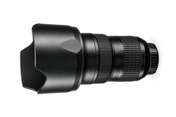
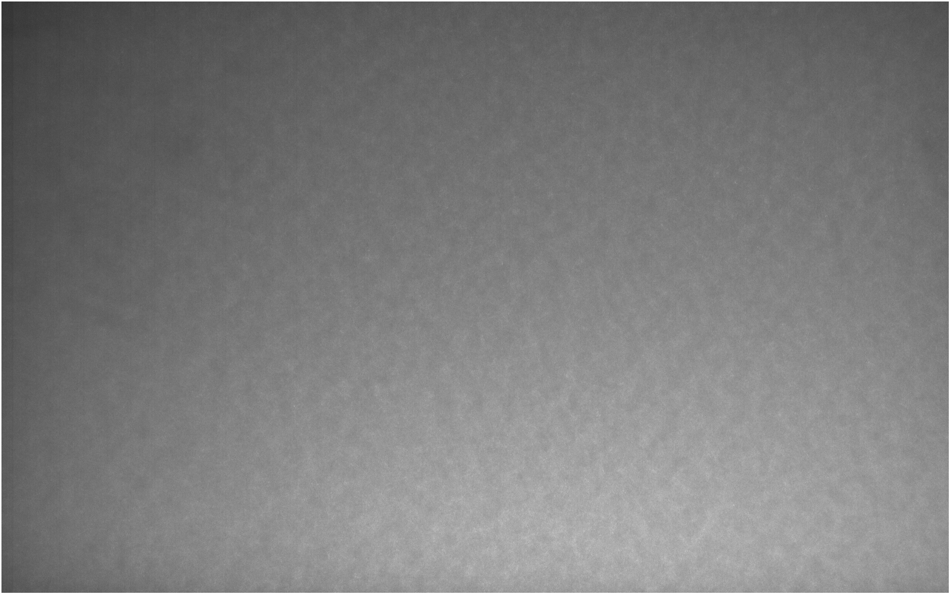
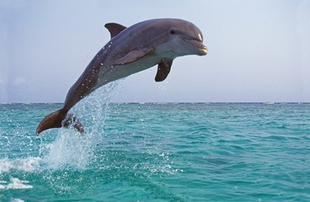
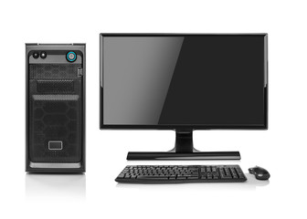

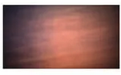
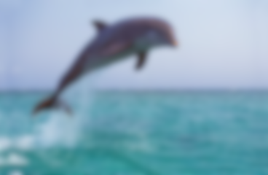
Lensless Imaging
Instead of a lens, some type of optical modulator (coded amplitude mask, diffuser) is placed in between the scene and the sensor, usually very close to the sensor.
Current applications: microscopy, wearables, implantables, photography, and in vivo imaging
Lens
Sensor
Image
Conventional
*
Lensless
Mask
Sensor
Raw Image
Computer Algorithm
Reconstruction
*Credit: Adobe Stock

Slide 3
Motivation and Background
Lensless PIV is not meant to replace standard PIV setups for larger working distances.
Motivation/Advantages of Lensless PIV
  Compact Size:
    Potential to embed sensors in models to perform near-wall flow-field measurements.
    Applications: Complex flow geometries, internal flows, limited/no optical access
  Versatility:
    3D measurement capabilities from a single sensor.
    Once the sensor/mask setup is calibrated, the laser plane location is not critical.
    Field of view is not tied to the magnification/working distance.
    Masks can be low cost and versatile.
Existing Lensless/Single-sensor 3D PIV Concepts
  Astigmatism PIV¹ – a controlled astigmatism is introduced into the optical system to deform the particle image based on its depth position.
  Structured/colored light PTV – Uses structured or colored light to distinguish particle depth²⁻³.
  Holographic PIV⁴ – records 3D information of tracer particles in fluid volume by capturing phase information of light waves scattered off the particles.
¹Cierpka, C., and Christian J. Kähler. "Particle imaging techniques for volumetric three-component (3D3C) velocity measurements in microfluidics." Journal of visualization 15 (2012): 1-31.
²Aguirre-Pablo, et al. "Single-camera 3D PTV using particle intensities and structured light." Experiments in Fluids 60 (2019): 1-13.
³Xiong, Jinhui, et al. "Rainbow particle imaging velocimetry for dense 3D fluid velocity imaging." ACM Transactions on Graphics (TOG) 36, no. 4 (2017): 1-14.
⁴Hinsch, Klaus D. "Holographic particle image velocimetry." Measurement Science and Technology 13, no. 7 (2002): R61.

Slide 4
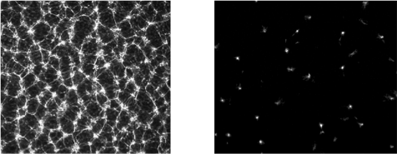
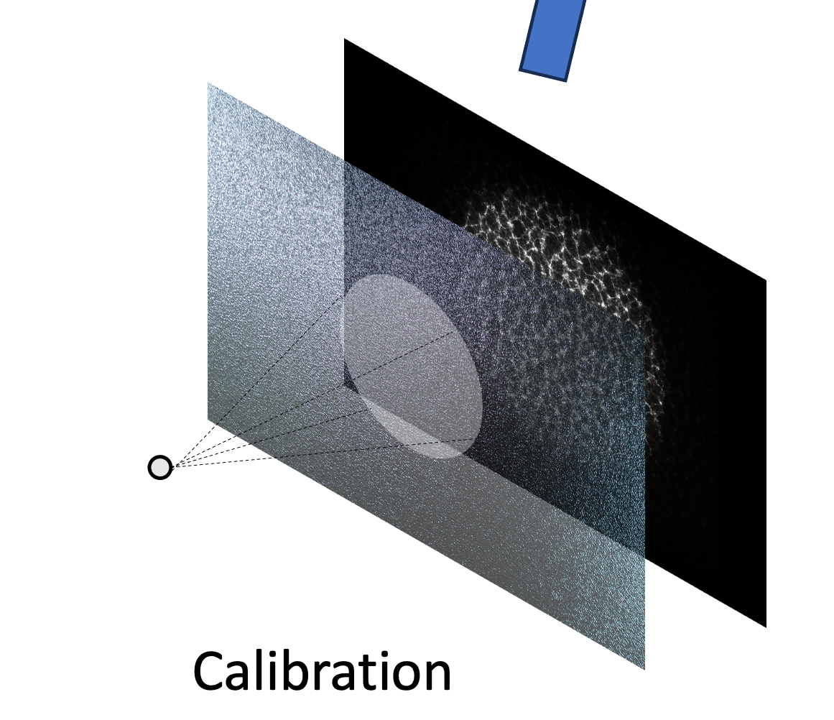
Point Spread Function Examples
The point spread function (PSF) is measured using a simulated point source: an LED light source shining through a 15 µm pin hole.
Original Mask PSF
New Mask PSF

Slide 5
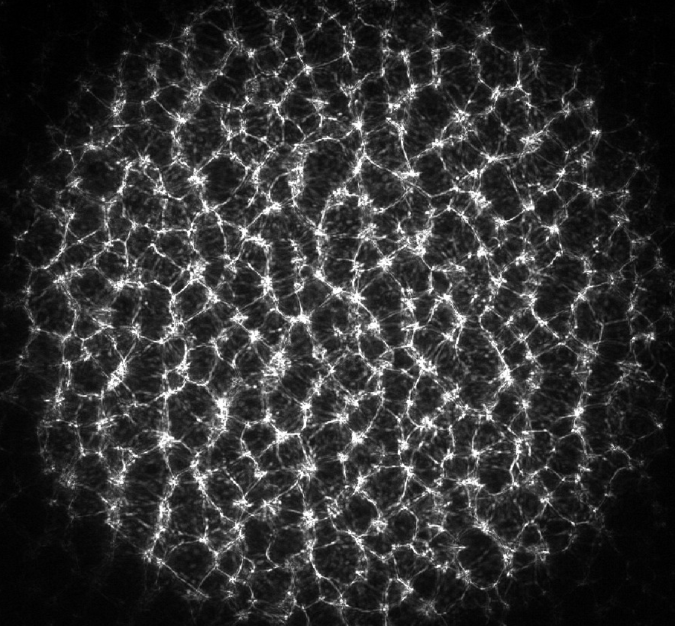
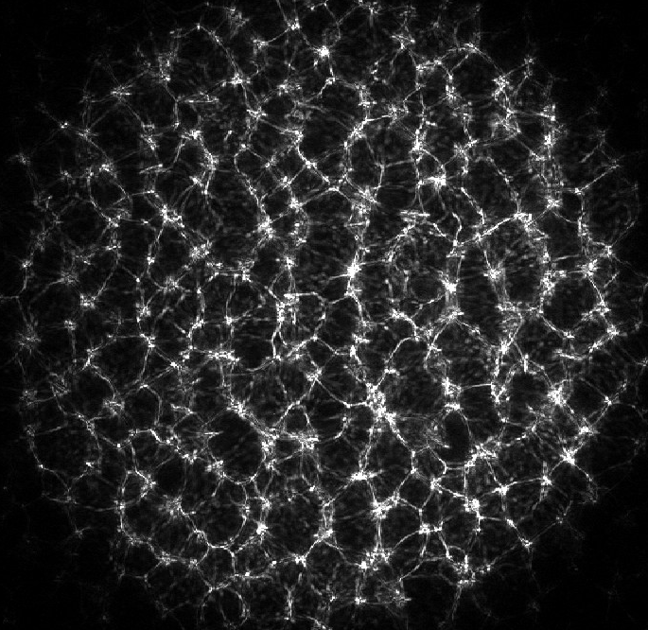
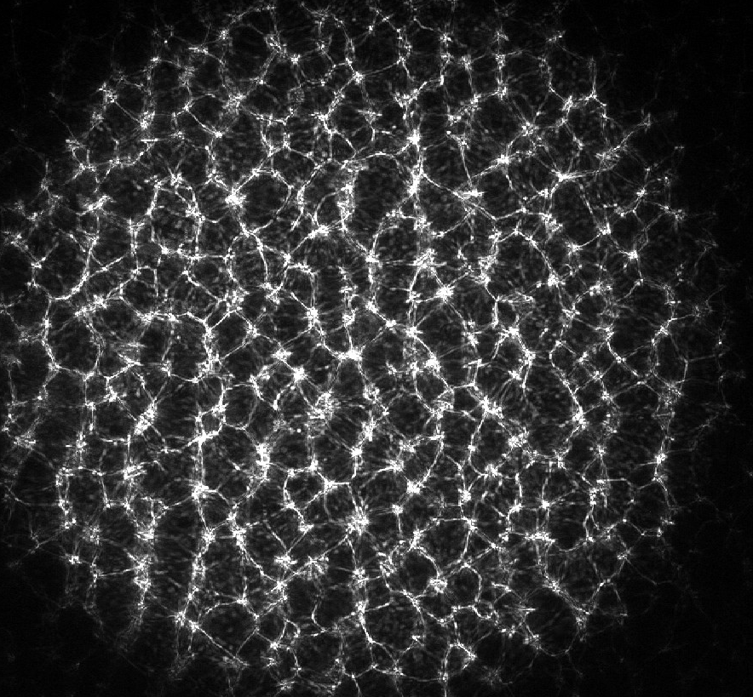
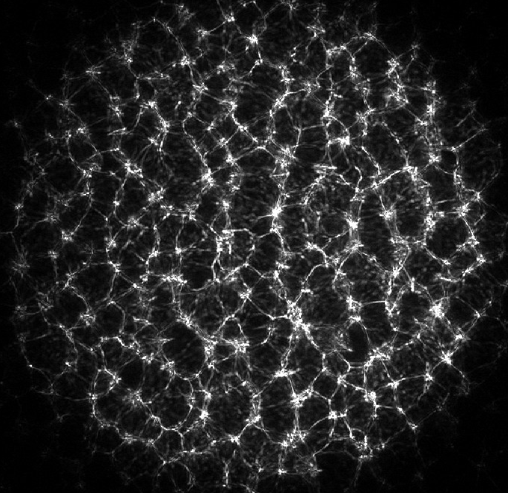
Point Spread Function Examples
Sensor
Sensor
In-plane Movement
Out-of-plane Movement

Slide 6
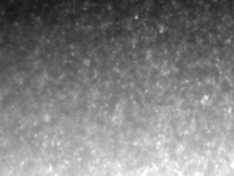
Image Reconstruction
The lensless images need to be decoded using the PSF(s) to recover the scene information.
  Some cases can be modeled as shift-invariant (only one PSF is required)
  Our setup is shift-variant, so multiple PSFs were acquired over the field of view and at different depths.
The simplest image reconstruction is a deconvolution of the scene with the PSF (shift-invariant system).
  Our previous reconstruction approach used a sliding-window Lucy-Richardson deconvolution to account for the shift-variance.
Other methods include: ADMM (Alternating Direction Method of Multipliers) and Deep-Learning Algorithms
We have been exploring using shift-variant deep-learning algorithms due to the enhanced speed of the reconstruction (~2000 times improvement).
Example lensless image

Slide 7
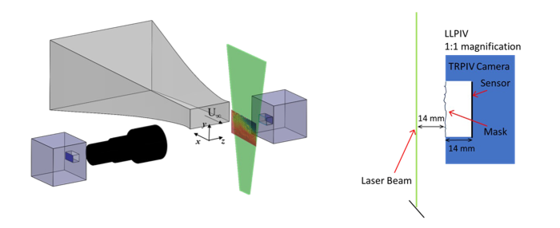
Benchtop Setup
Lensless PIV and Traditional PIV Experimental Setup
Sketch of Lensless PIV Camera Setup
TRPIV Camera
Sensor
14 mm
Mask

Slide 8
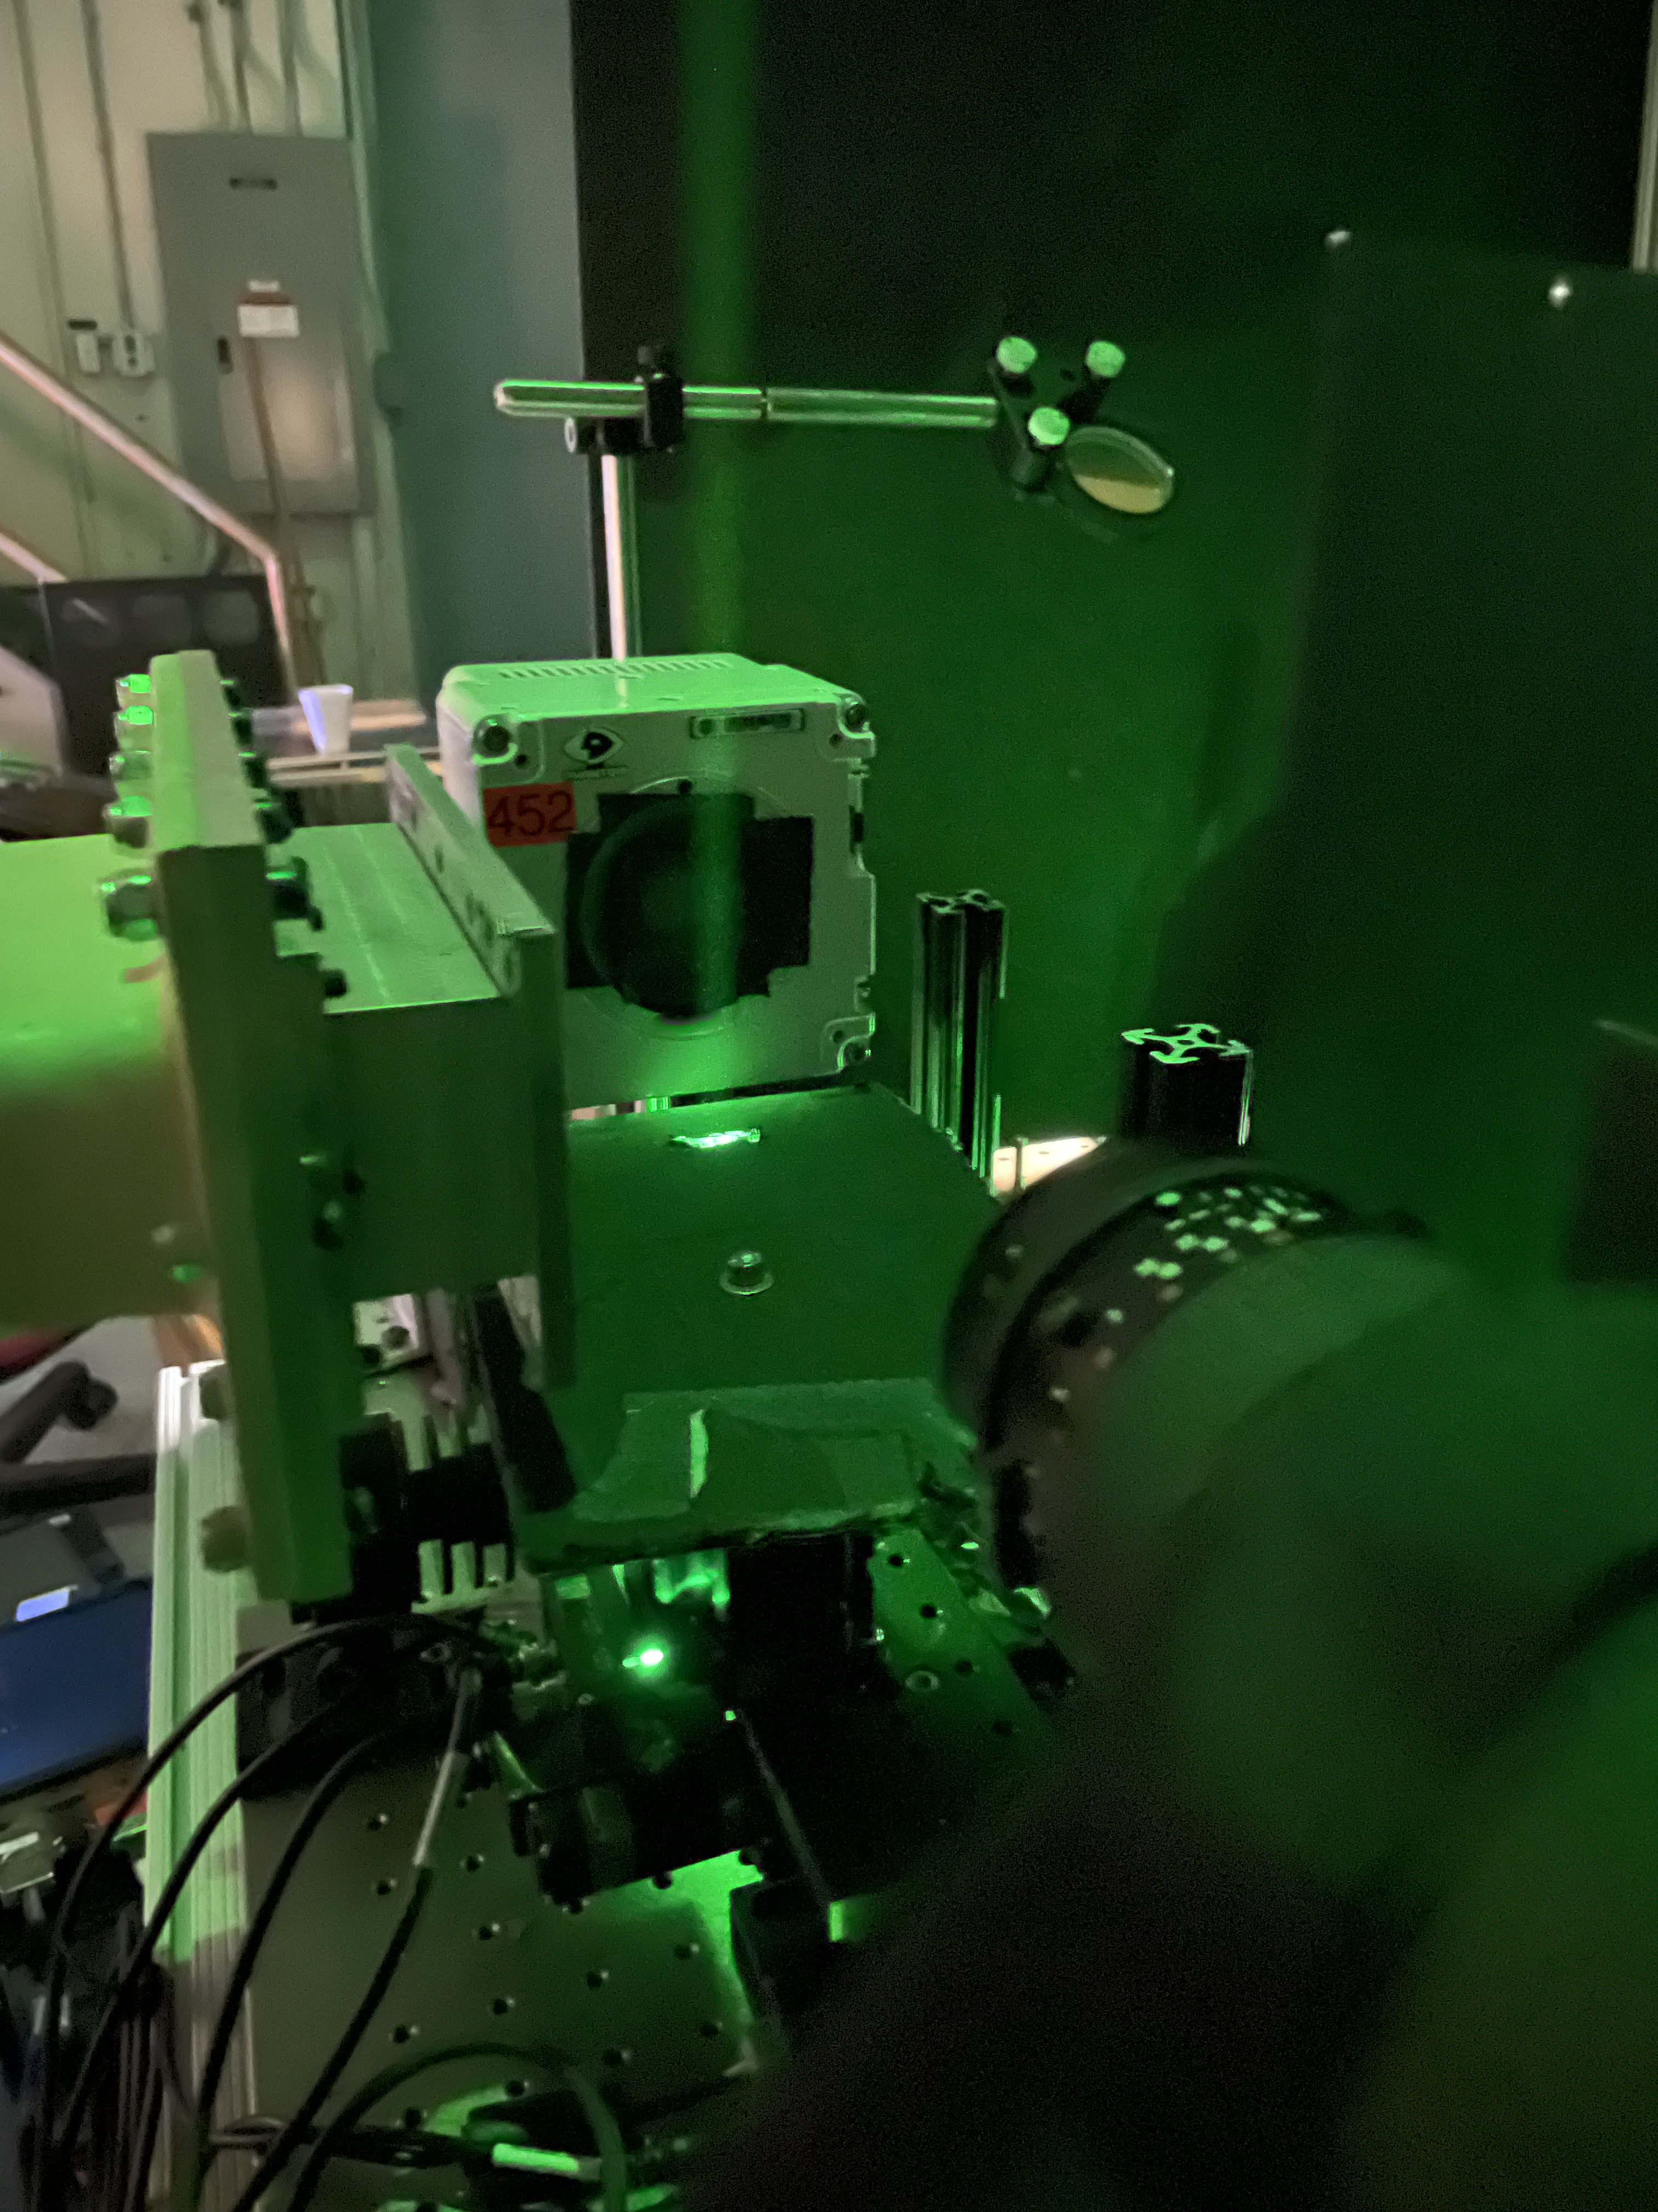
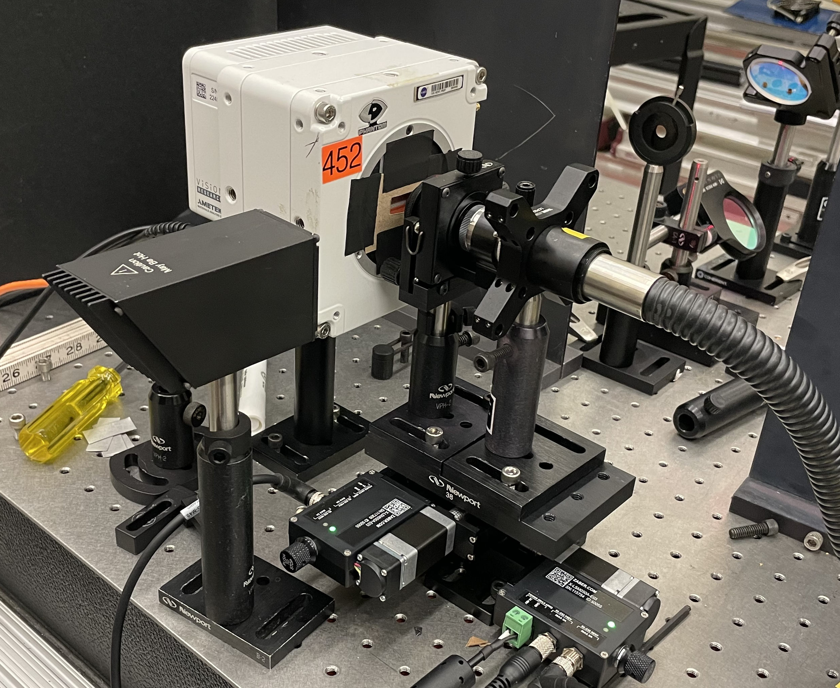
Lensless PIV Setup
Particle Imaging Setup
PSF Calibration Setup
PIV camera
15 μm pinhole
PIV camera
Mask
Light source
Wind tunnel
Laser sheet
Flow
Direction
Lens
Source: NASA
Source: NASA

Slide 9
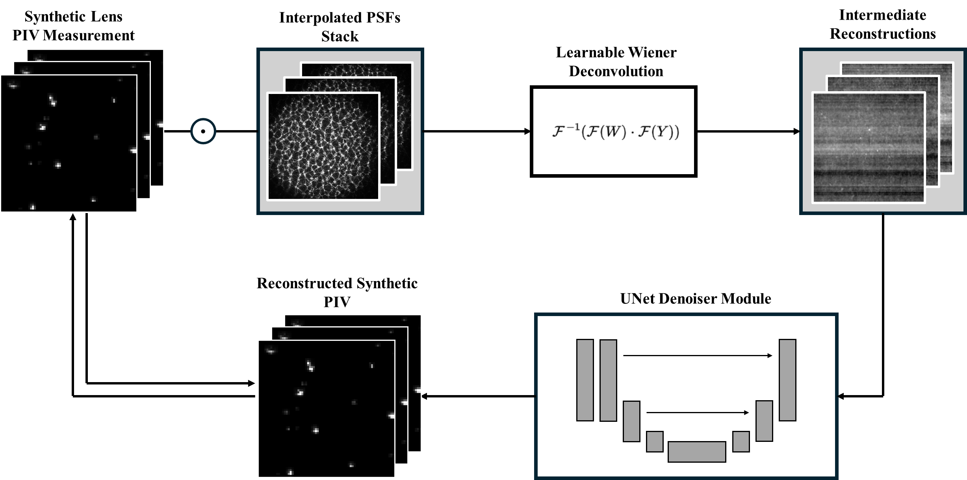
Deep Learning Reconstruction Model: Synthetic Data
Based on method of:
Kyrollos Yanny, Kristina Monakhova, Richard W. Shuai, and Laura Waller, "Deep learning for fast spatially varying deconvolution," Optica 9, 96-99 (2022)

Slide 10
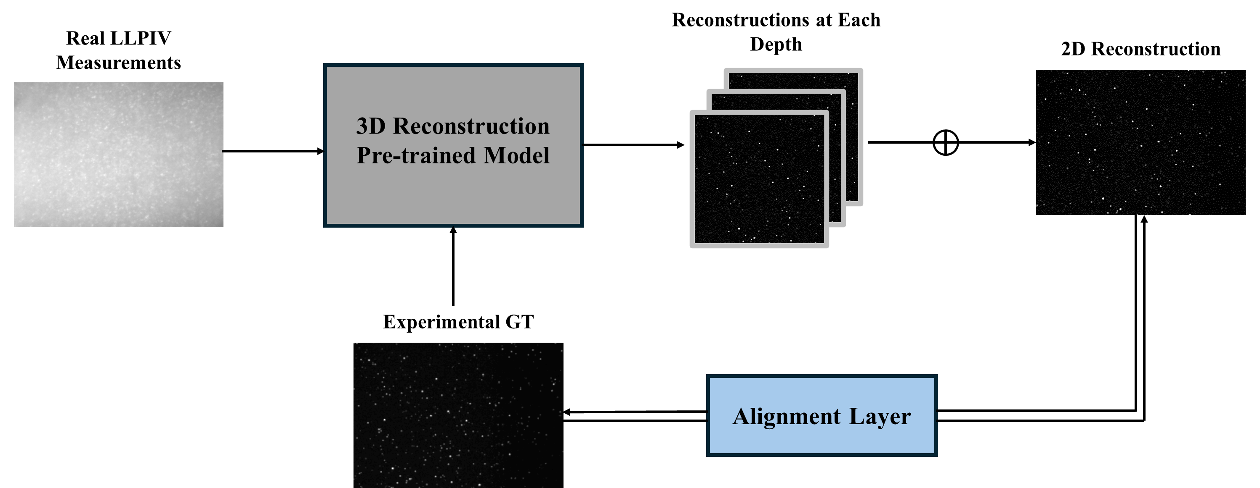
Finetuning with Experimental Data

Slide 11
Model Reconstruction Performance
Three different types of background noise were added to the synthetic images:
Model A: Empirical background noise (lensless images with no particles present)
Model B: Gaussian and Poisson noise
Model C: Gaussian noise with intensity gradient
Models |  | Recall | Precision
Original | Model A | 15.1 ± 10.8 % | 52.8 ± 21.7 %
 | Model B | 7.5 ± 5.1 % | 74.2 ± 21.8 %
 | Model C | 17.9 ± 5.8 % | 49.4 ± 19.1 %
Finetuned | Model A’ | 16.1 ± 4.0 % | 91.1 ± 5.3 %
 | Model B’ | 16.2 ± 4.0 % | 95.2 ± 3.8 %
 | Model C’ | 16.6 ± 4.0 % | 91.8 ± 5.1 %
Recall: Percentage of ground-truth particles that were accurately reconstructed
Precision: Percentage of reconstructed particles that corresponded to ground-truth particles
Notes:
Percentages, combine t0 and t1, define recall and precision on the chart

Slide 12
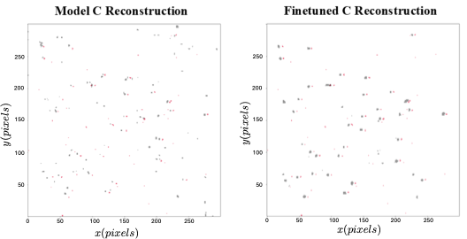
Particle Image Reconstructions
Red: Ground Truth (Lensed Image) Particles
Black: Reconstructed (Lensless Image) Particles
*Ground truth and reconstructed particles are shifted slightly in x for clarity of presentation
Notes:
Inset blowup, particles shifted

Slide 13
Lensless PIV Results
PIV vectors computed with a 256x256 window size and 75% overlap
  This window size was required to get about 10 particles per window for the reconstructed lensless images.
Averages and statistics computed from 1100 image pairs
  All statistics were computed on the U and V velocity components and normalized by the time-averaged velocity magnitude.
Two flow fields were investigated:
  The steady, uniform flow was acquired near the center of the wind tunnel exit.
  The unsteady flow was generated by partially blocking the wind tunnel exit with a plate.
 | Time-Averaged Statistics |  | Instantaneous Statistics
Flow field | Mean | Standard Dev. | Mean Error | RMS Error
Steady Flow | 3.0 % | 2.9 % | 6.0 % | 7.5 %
Unsteady Flow | 9.3 % | 10.4 % | 29.0 % | 38.0 %
Notes:
percentages

Slide 14
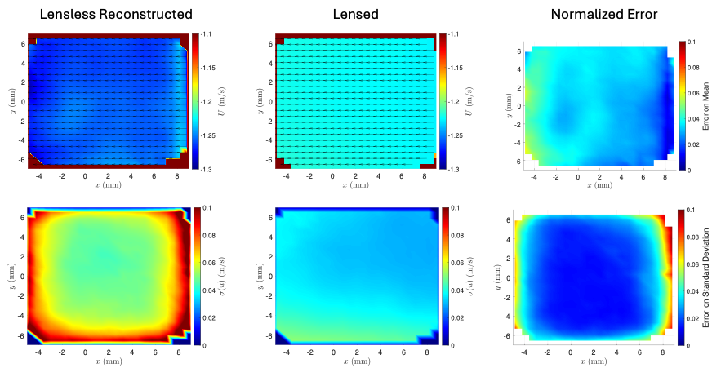
PIV Results – Time-Averaged Flow Statistics: Uniform Flow
Mean
Standard Deviation
Notes:
Systematic error

Slide 15
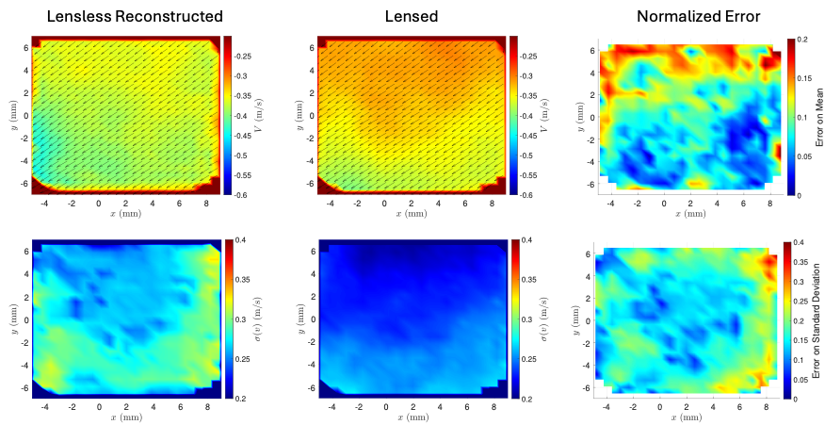
PIV Results – Time-Averaged Flow Statistics: Unsteady Flow
Mean
Standard Deviation

Slide 16
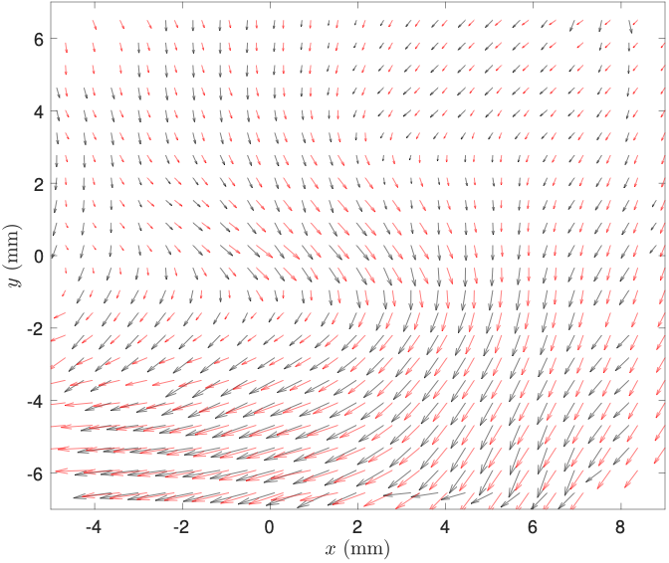
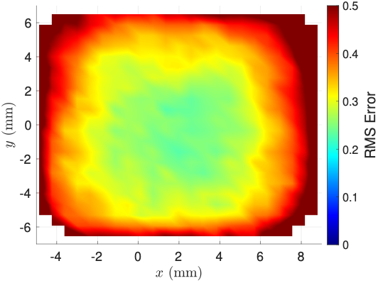
PIV Results – Instantaneous Flow Statistics: Unsteady Flow
Instantaneous Flow Vector Comparison
Root Mean Square Error
Red: Ground Truth (Lensed Image)
Black: Reconstructed (Lensless Image)
*Ground truth and reconstructed vectors are shifted slightly in x

Slide 17
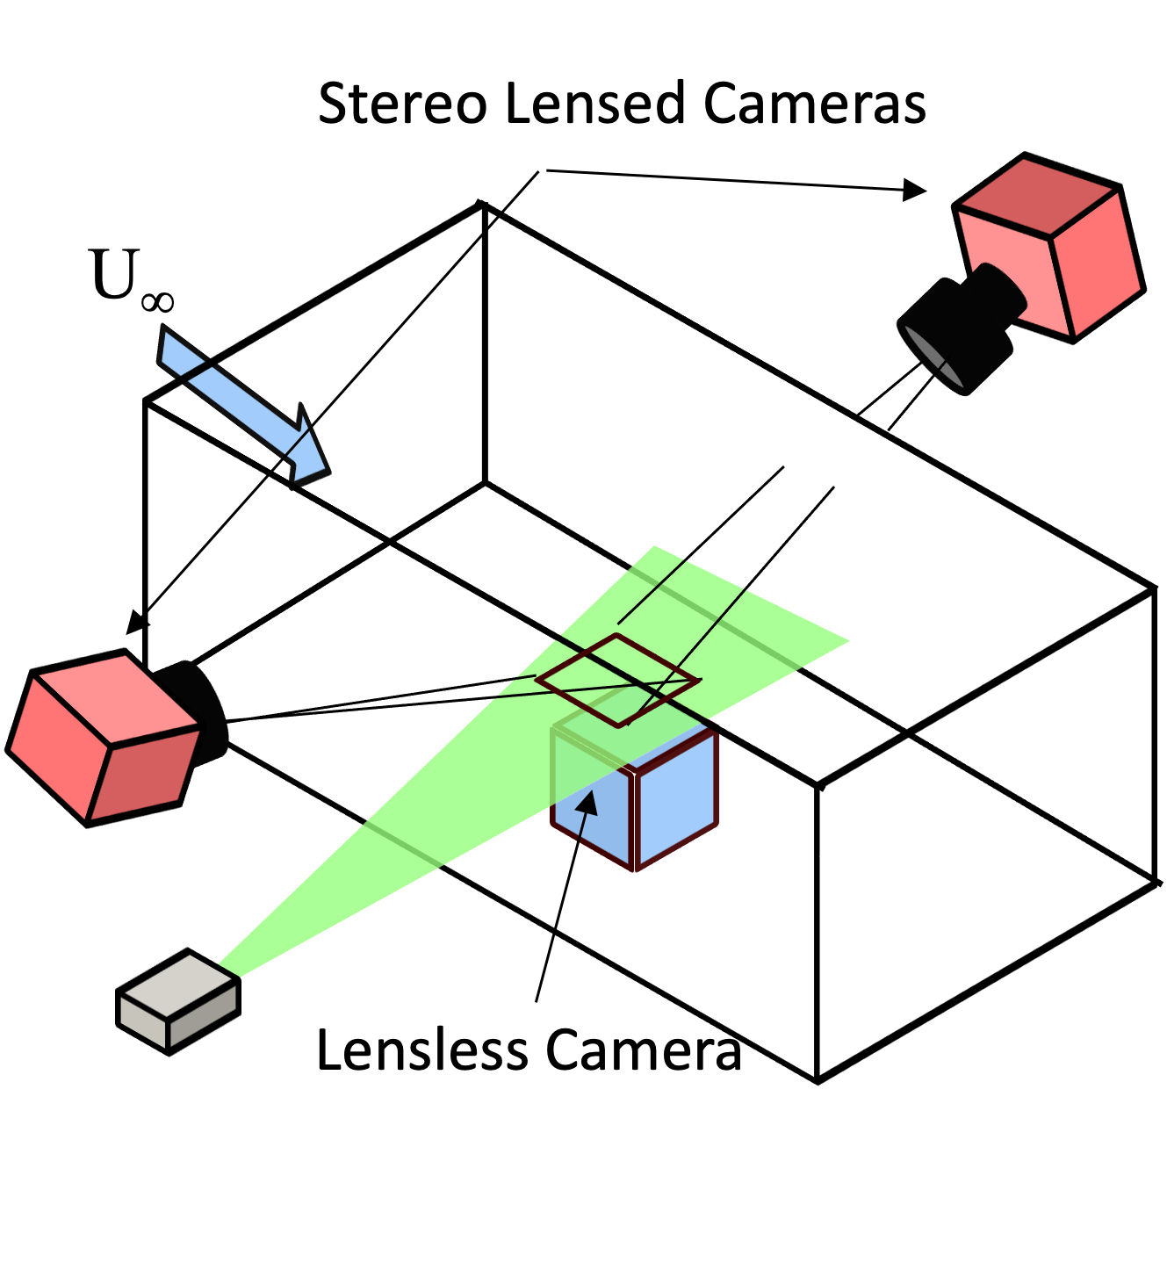
Summary and Future Outlook
Lensless PIV successfully demonstrates proof-of-concept capability for measuring general flow structures and patterns.
Future development aims to achieve quantitative measurement accuracy suitable for practical applications, including:
  Near-surface measurements in constrained environments.
  Embedded sensors for wind tunnel/flight testing.
Main areas for improvement include particle reconstruction rates and velocity field accuracy.
Planned areas of focus include:
  Algorithms:
    Adjust deep-learning training using different deconvolution algorithms, loss functions, and denser training images.
    Implement 3D algorithms with stereo validation data.
    Develop algorithms to directly compute velocity, bypassing the particle image reconstruction step.
  Hardware:
    Better mask design/fabrication
    Development of thin embeddable sensor
Sketch of Stereo PIV Wind Tunnel Setup

