Slide 1
BSCW Computations Using KESTREL and AEROM
Walt Silva
Emeritus Langley Associate (ELA)
SciTech 2026, Orlando, FL
January 14, 2026

Slide 2
Outline
Benchmark SuperCritical Wing (BSCW), Aeroelastic Prediction Workshop (AePW)
Background
AEROM
Results
  Alpha=0, 1, 3, and 5 degs (skip alpha=1 deg; similar to alpha=0 deg)
  Amplitudes = 0.04, 0.01, 0.08, and 0.001 (modal)
  Comparison of full solution GAFs vs ROM GAFs (error quantification)
  Root locus
  Comparison of full solution transients vs ROM transients (at a specified Q)

Slide 3
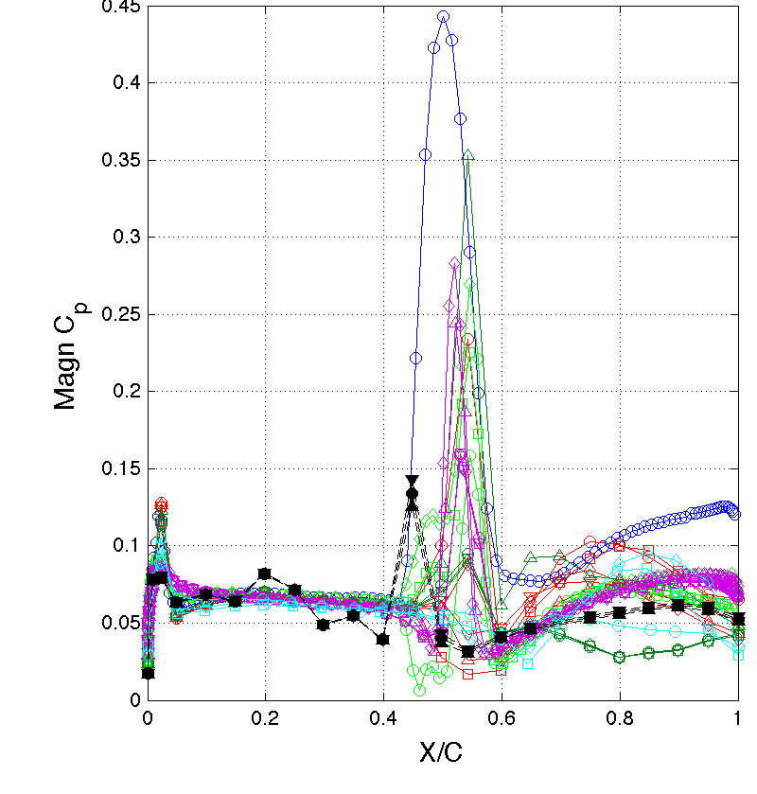
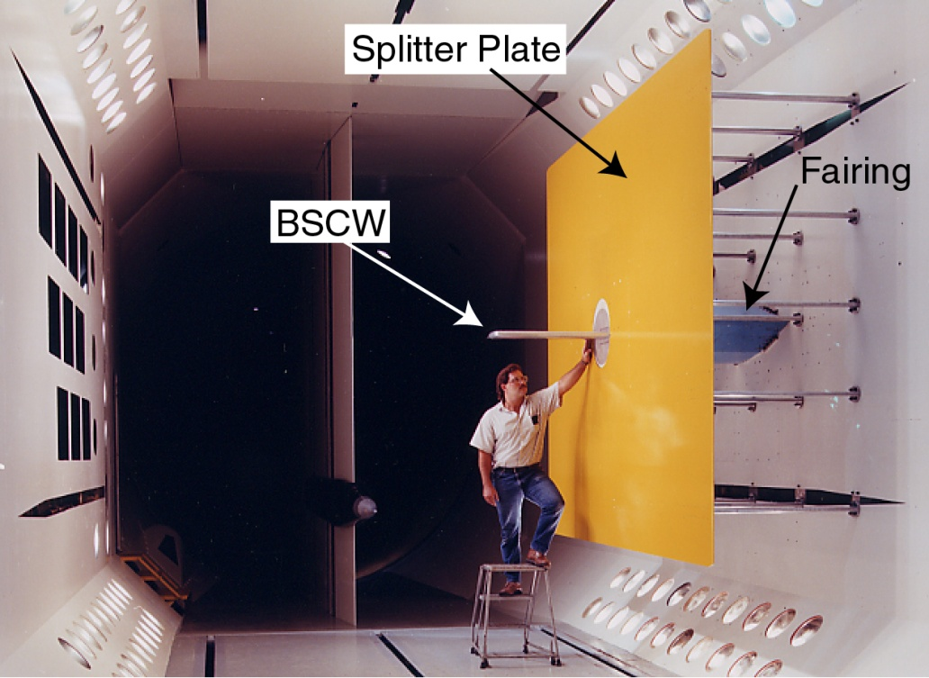
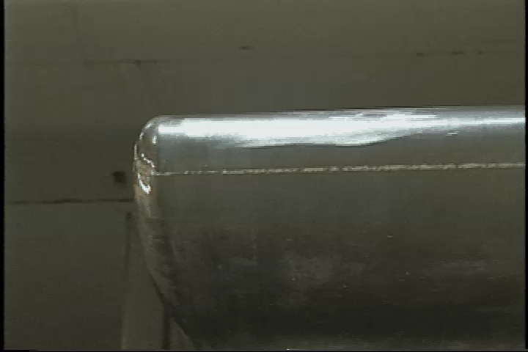
Benchmark Supercritical Wing (BSCW)
Credit:NASA
Chosen as a challenging test case, flow-wise, but simple geometry
  Strong shock with suspected shock-induced separated flow
Some preliminary assessments from AePW
  Computational methods had difficulty producing converged solutions due to flow field complexity
  Complex flow field also observed in experimental data; Largest magnitude of dynamic behavior appears to represent shock oscillations
  CFD solutions vary widely, even for static solution;
M=0.85, Re_{c}=4.49 million, test medium: R-134a, α = 5°, θ = 1°, freq 1 & 10 Hz
Likely plan of action:
Form technical working group of BSCW analysts
Extensive study of available experimental data; characterize different flow phenomena
Benchmark against more benign cases- lower Mach number, lower angle of attack
Analyze the static (unforced) problem using time-accurate evaluation methods
Study of time convergence criteria
Credit:NASA
From AePW-1 Debrief

Slide 4
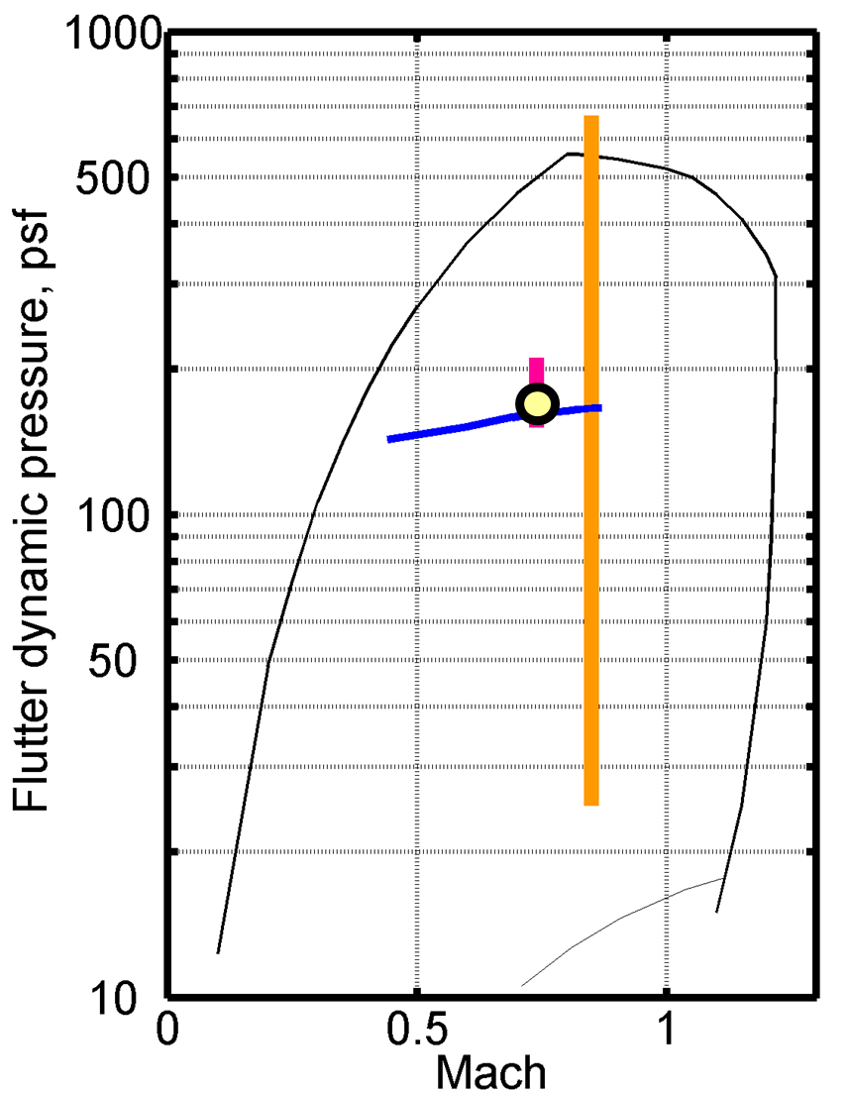
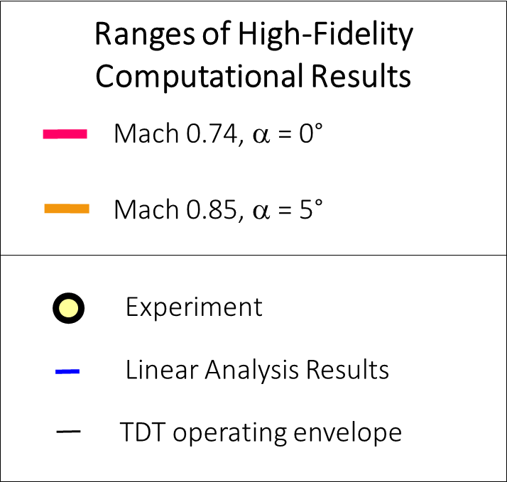
AePW-2 Summary of Results
At Mach 0.74, a = 0°
  Small variation in computational results
  Match the experimental results well
  Match the linear results well
At Mach 0.85, a = 5°
  Significant variation in predictions
  No experimental data for comparison

Slide 5
Background
Application of KESTREL and KESTREL/AEROM to BSCW wing
At M=0.74, alpha=0 deg, KESTREL, KESTREL/AEROM, FUN3D, and FUN3D/AEROM all compare nearly exactly with data
At M=0.85, alpha=5 deg, large flow separation/unsteadiness; very challenging problem
Large variance from one code to another at this condition; differences between KESTREL and FUN3D
Goal of this analysis: evaluate application of AEROM using KESTREL at M=0.80 and alpha=0, 1, 3, and 5 deg (similar unsteadiness to M=0.85) using multiple amplitude excitations (Walsh functions)
Follow-up with investigation of code-to-code comparisons
”Characterizing Aerodynamic Damping of a Supersonic Missile with CFD”, Shelton (AF), Martin (AF), Silva (NASA), SciTech 2018

Slide 6
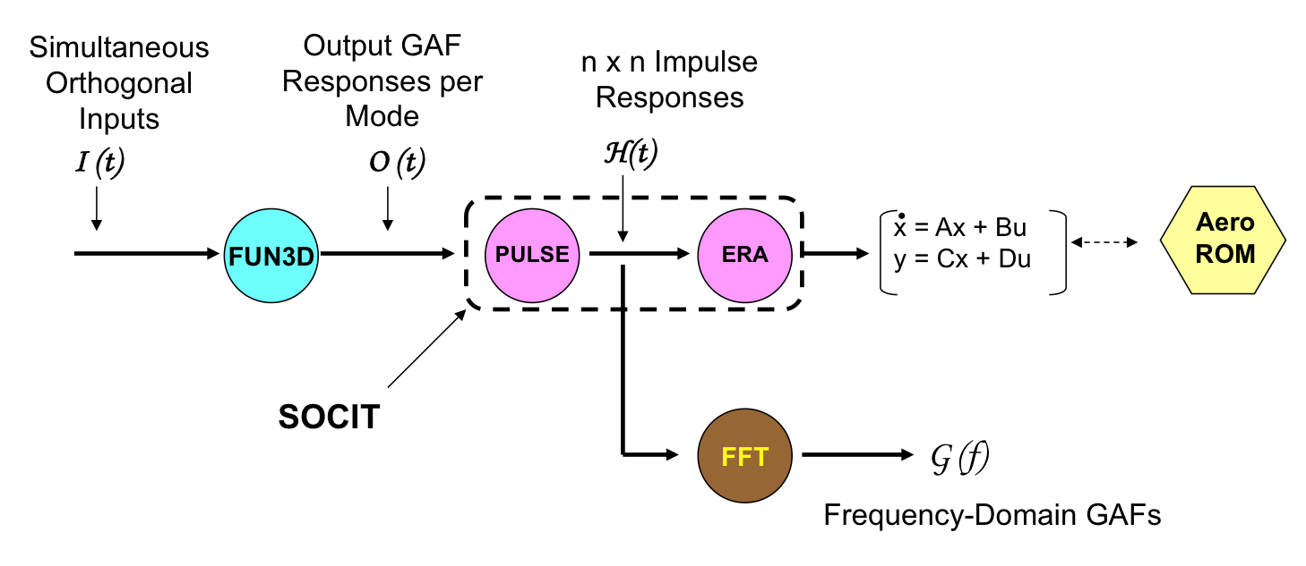
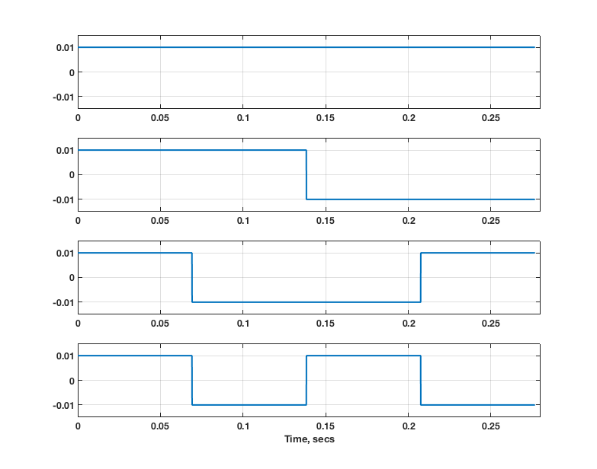
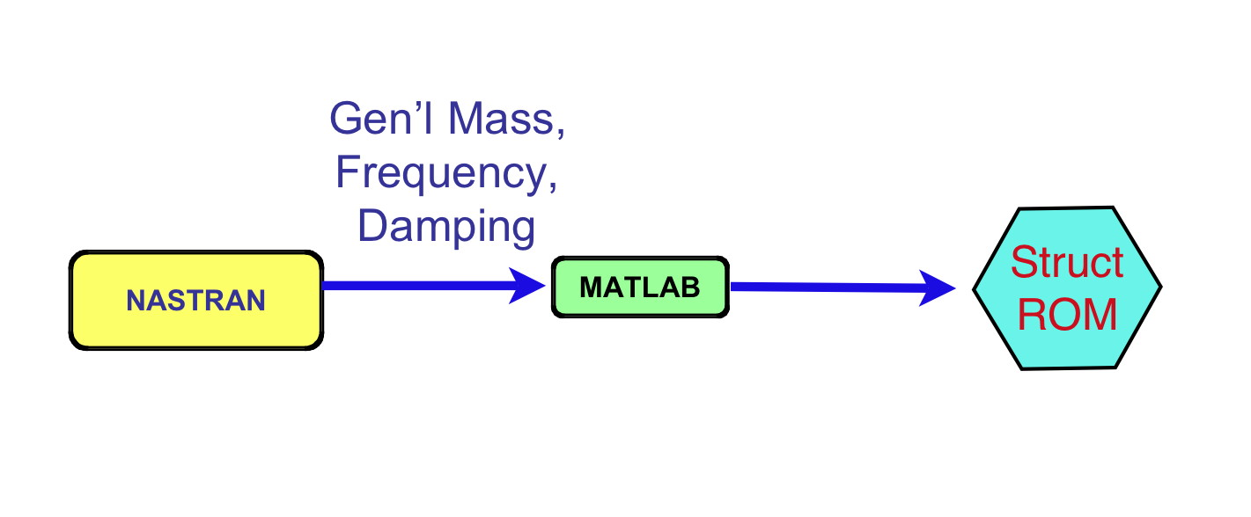
AEROM: ROM Development Process
Unsteady Aerodynamic State-Space ROM
Walsh Functions
(modal)
KESTREL
1
2
3
4
Structural state-space ROM

Slide 7
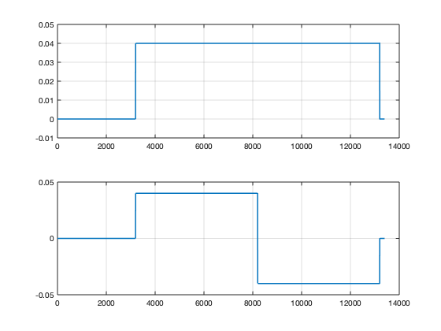
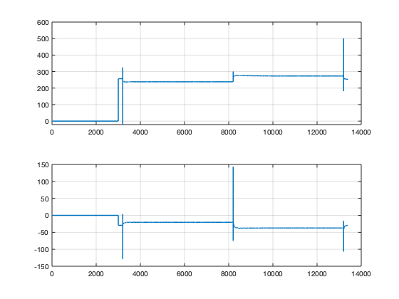
BSCW Application (KESTREL), Two Modes
*.fmh file
*.modes file
KESTREL
BSCW
Two Walsh input functions
Two GAFs output functions

Slide 8
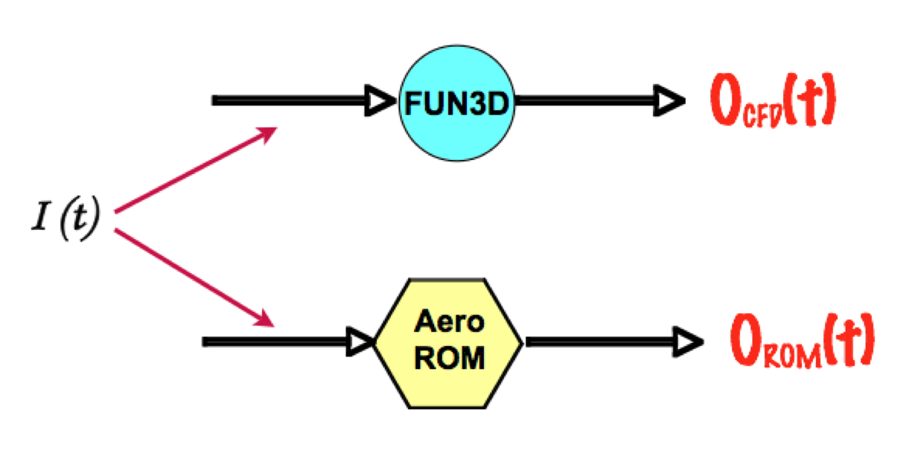
AEROM: ROM Development Process
Error Minimization (Unsteady Aerodynamics)
Low
Error
?
Yes
Continue
No
ERA
PULSE

Slide 9
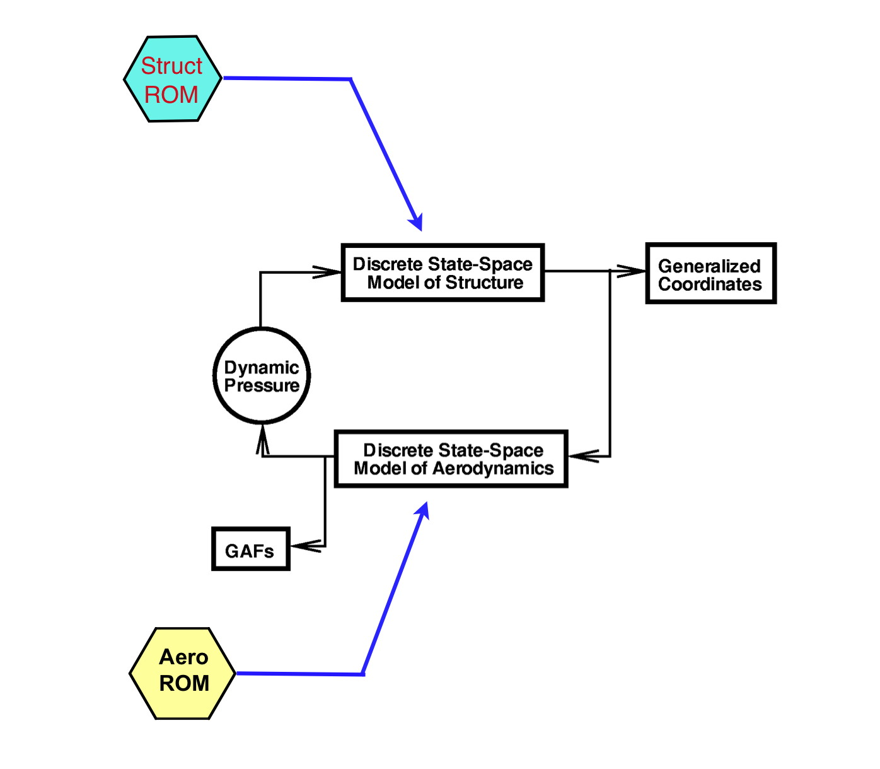
AEROM: ROM Development Process
Aeroelastic Simulation ROM (Simulink)
Simulink model that includes
Unsteady Aero ROM and
Structural Dynamic ROM used
to compare ROM responses at any
Dynamic pressure with full KESTREL
Solutions.

Slide 10
AEROM: ROM Development Process
Aeroelastic Root Locus Plot Using Aeroelastic Simulation ROM
Modeled as a closed-loop
system with gain (dynamic
pressure) in MATLAB
Eigenvalues
Z-Plane
Root Locus
Frequency vs
Damping Ratio
Root Locus
S-Plane
Root Locus

Slide 11
Walsh Function Amplitudes and Alphas
Modal Amp/Alpha (deg) | 0 (K) | 1 | 3 (K) | 5 (K)
0.04 | M8A0a | M8A1a | M8A3a | M8A5a
0.01 | M8A0b | M8A1b | M8A3b | M8A5b
0.08 | M8A0c | M8A1c | M8A3c | M8A5c
0.001 | M8A0d | M8A1d | M8A3d | M8A5d
K = comparison with full KESTREL solution available or underway; using ‘Venkat’ limiter
KESTREL Solutions: Alpha = 0 deg, Q = 100 psf, Initial Modal Velocity = 5
Alpha = 3 deg, Q = 100 psf, Initial Modal Velocity = 5
Alpha = 5 deg, Q = 50 psf, 130 psf, Initial Modal Velocity = 5
CPU Cost (NAS)
ROM solution: 10K steps, 240 cores, 9hrs 45min (set up for high alpha case; shorter duration for benign cases)
Full Solution per Q: 15K steps, 240 cores, 53 hrs 04min (~5.5 cycles)

Slide 12
Alpha = 0 deg

Slide 13
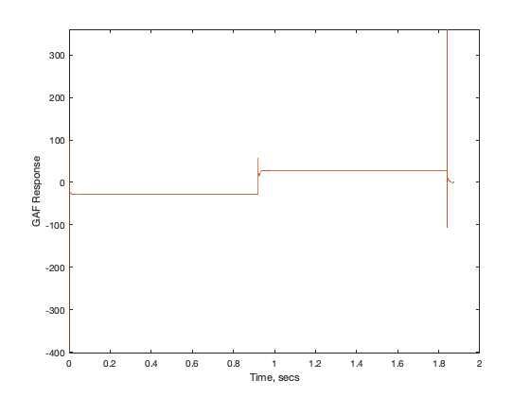
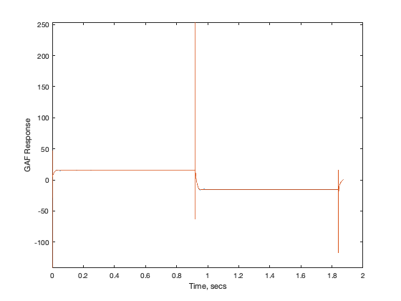
M8A0a – ROM/KESTREL GAFs
M=0.8, Alpha=0 deg, Amplitude ‘a’
a | .04
b | .01
c | .08
d | .001
KESTREL
KESTREL
AEROM
AEROM

Slide 14
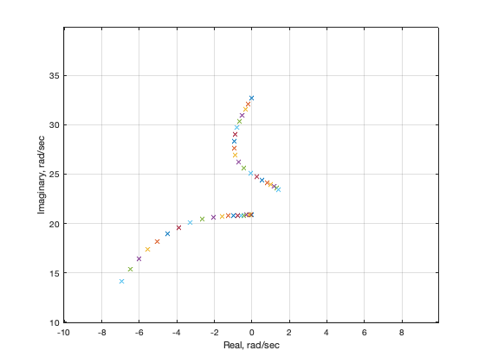
M8A0a – AEROM Root Locus

Slide 15
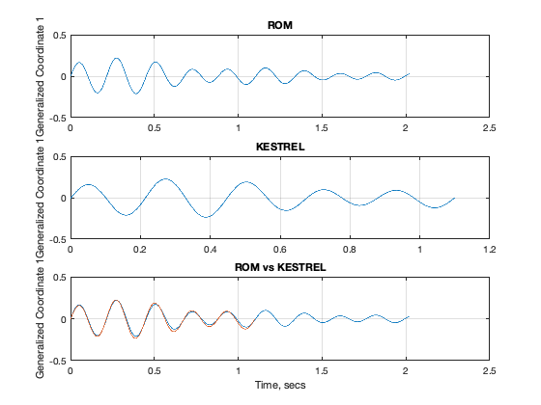
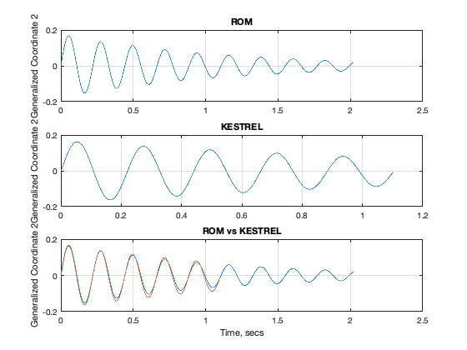
M8A0a – ROM/KESTREL Responses, Q=100 psf
Mode 1
Mode 2

Slide 16
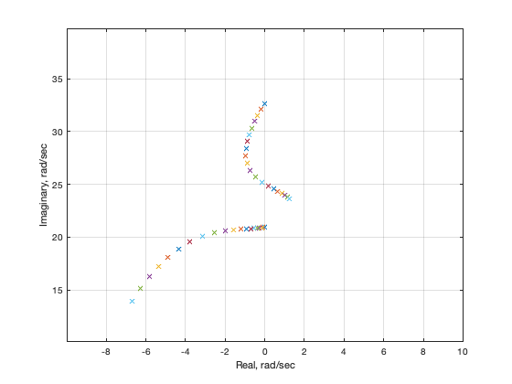
M8A0b – AEROM Root Locus

Slide 17
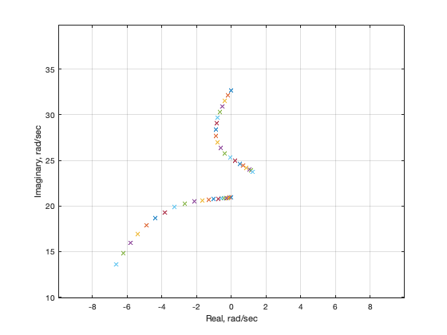
M8A0c – AEROM Root Locus

Slide 18
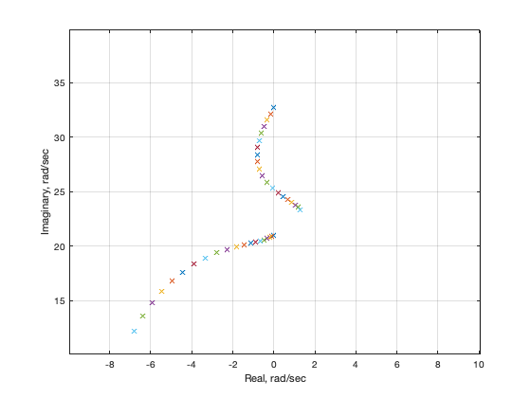
M8A0d – AEROM Root Locus

Slide 19
Alpha = 5 deg

Slide 20
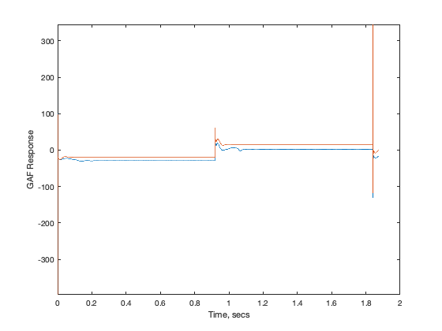
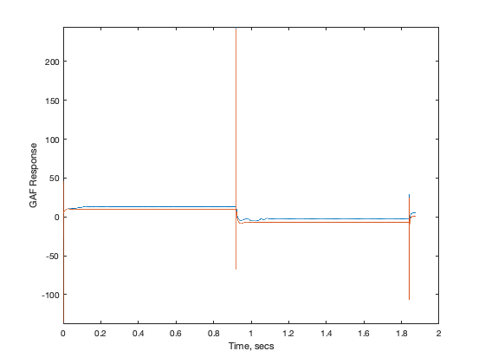
M8A5a – ROM/KESTREL GAFs
KESTREL
AEROM
AEROM
KESTREL

Slide 21
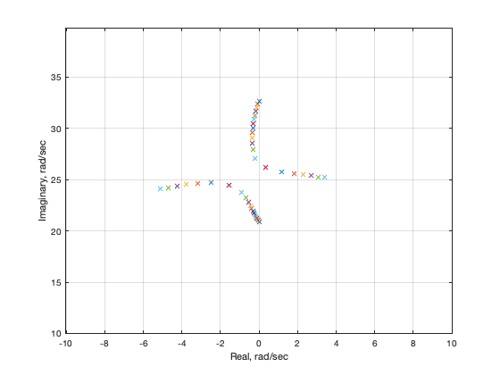
M8A5a – ROM/KESTREL Root Locus

Slide 22
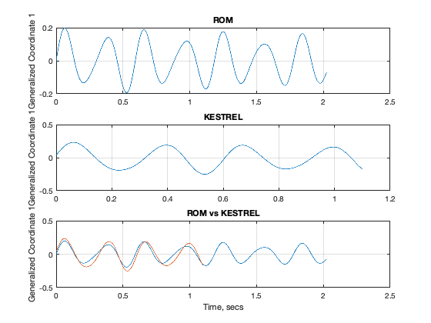
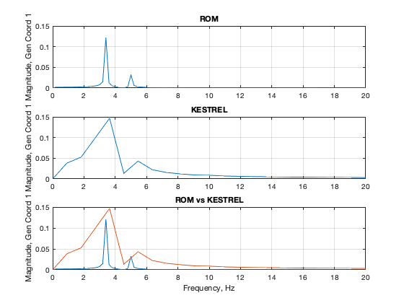
M8A5a – ROM and KESTREL Responses
Q = 50 psf, Mode 1
Time
Frequency

Slide 23
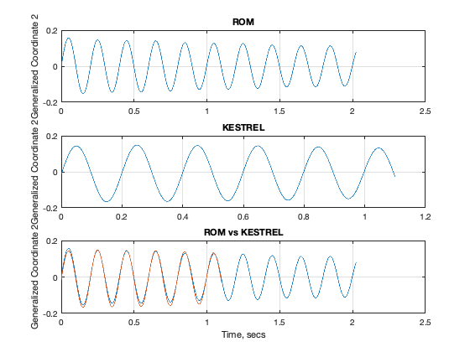
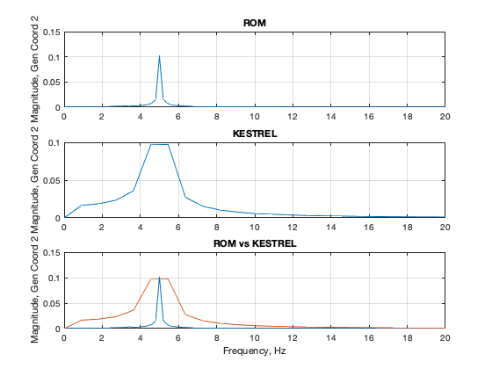
M8A5a – ROM and KESTREL Responses
Q = 50 psf, Mode 2
Time
Frequency

Slide 24
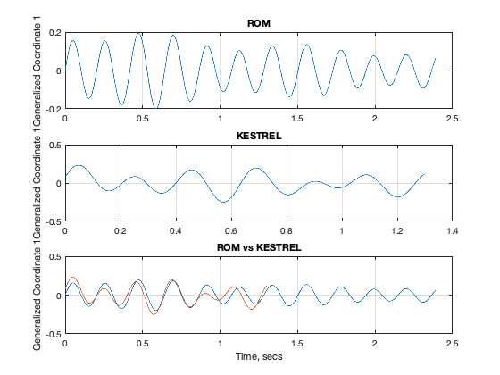
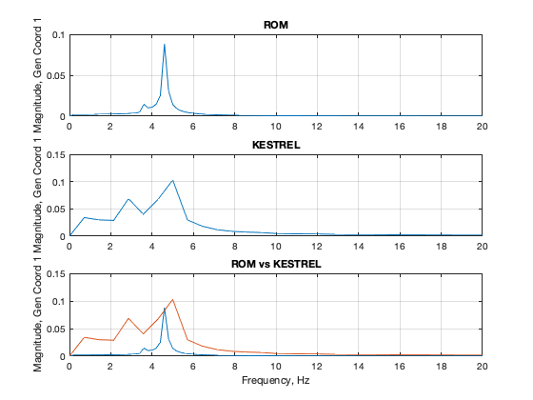
M8A5a – ROM and KESTREL Responses
Q = 130 psf, Mode 1
Time
Frequency

Slide 25
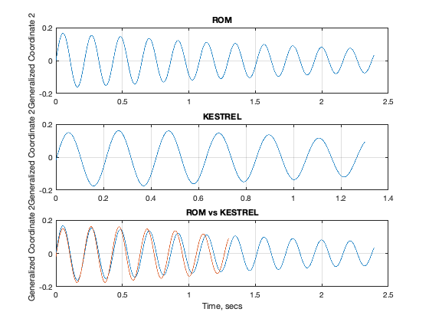
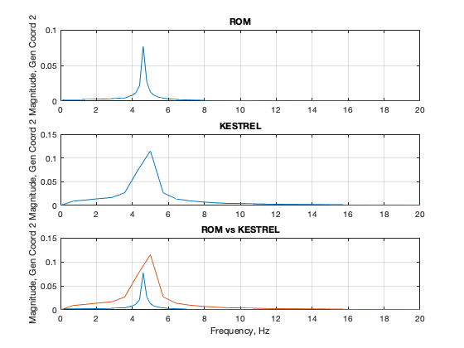
M8A5a – ROM and KESTREL Responses
Q = 130 psf, Mode 2
Time
Frequency

Slide 26
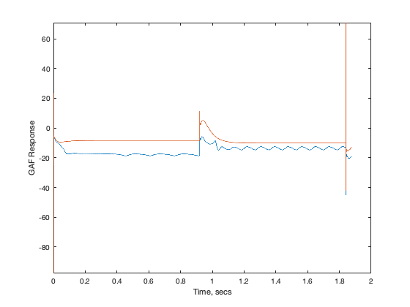
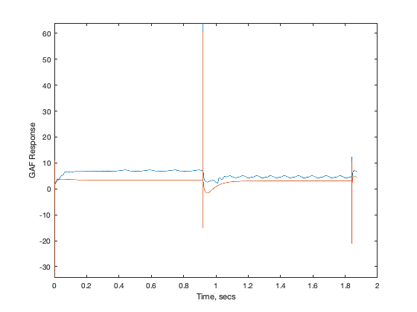
M8A5b – ROM/KESTREL GAFs
KESTREL
AEROM
AEROM
KESTREL

Slide 27
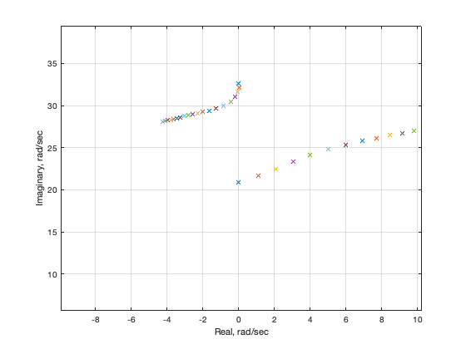
M8A5b – ROM/KESTREL Root Locus

Slide 28
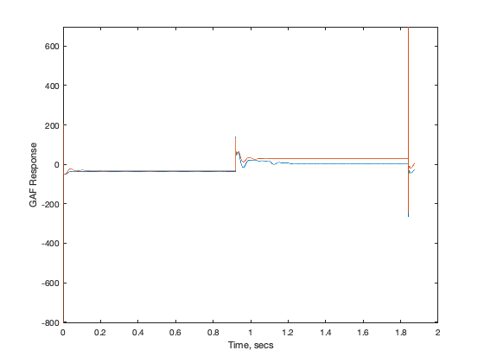
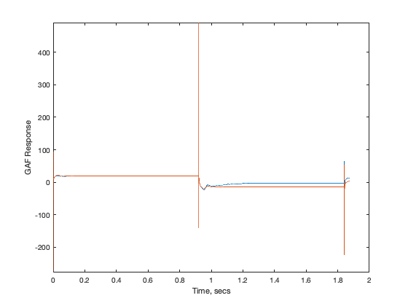
M8A5c – ROM/KESTREL GAFs
KESTREL
KESTREL
AEROM
AEROM

Slide 29
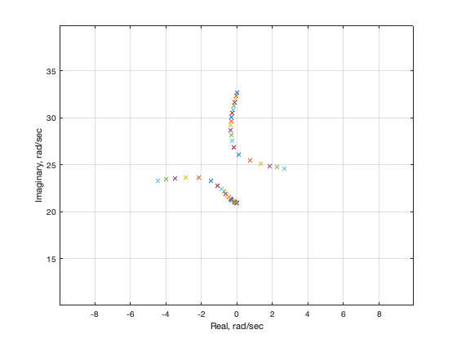
M8A5c – ROM/KESTREL Root Locus

Slide 30
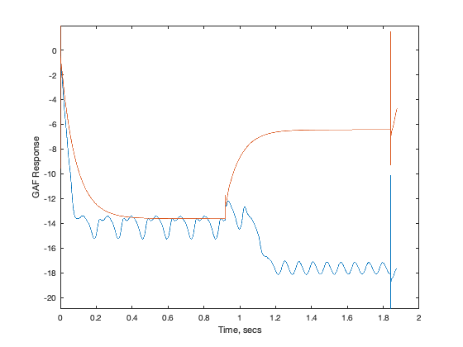
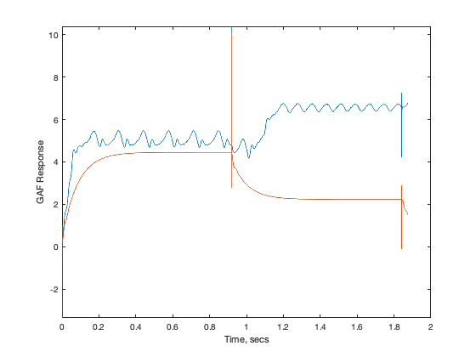
M8A5d – ROM/KESTREL GAFs
KESTREL
AEROM
AEROM
KESTREL

Slide 31
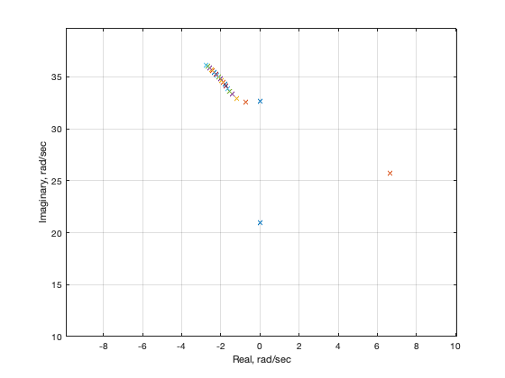
M8A5d – ROM/KESTREL Root Locus

Slide 32
Alpha=0 deg Alpha=5 deg

Slide 33
Concluding Remarks
At benign conditions (alpha=0 deg), all ROMs provide same result; gratifying, as it indicates linearized flow dynamics
As alpha is increased, variations between the different ROMs (amplitudes) start to become obvious
At alpha=5 deg, there are noticeable differences between the ROMs, indicating that the higher-amplitude ROMs do a better job (at this condition) of predicting the aeroelastic responses at multiple dynamic pressures
So far, ROM Flutter Q=179 psf; KESTREL Flutter Q=168 psf (~6.5%)
Will start analyses at M=0.85, similar alpha ranges.

