Slide 1

Shortcomings of Li-Ion Cell Visual Screening Methods
By: Ruth Young CACI International (United States),
Eric Darcy Johnson Space Center,
Aidan Byrne Amentum
Trade names and trademarks are used in this report for identification only. Their usage does not constitute an official endorsement, either expressed or implied, by the National Aeronautics and Space Administration

Slide 2
Acknowledgements
Eric Darcy (JSC)
Thank you for the mentorship and technical guidance
Frank Samonski (JSC)
JSC Materials Analysis Lab for the support
Symmetry Resources Inc
For continued cell testing support
Ovidio Oliveras (JSC) & Aidan Byrne (JSC)
Thank you for providing the CT scan support and expertise

Slide 3
Outline
JSC Cell Strategic Reserve (CSR)
  Models in the Reserve
  Screening Process
  Lifecycle Quality
Shortcomings of Visual Screening Methods
  Example: Leaking Electrolyte on Passing Visual Inspection Cell
Capacity vs Voltage Balance in Cell Screening
Forward Work

Slide 4
NASA’s Cell Strategic Reserve
What is it?
  A reserve of Li-Ion cells screened via NASA standards
  Several cell designs are kept in stock with various key performance advantages (ex: High Energy vs High Power)
    Molicel M35A
    Molicel P28B
    Samsung 30Q
    LG M36

Slide 5
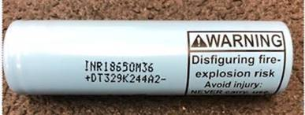
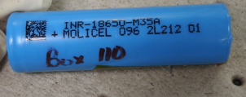
High Energy Cell Designs
LG INR18650 M36
Previous heritage
Superior resistance to side wall rupture
At C/10 and room temperature
  270 Wh/kg, 710 Wh/L
  ACR is 23.9 mohms
  DCR is 29.8 mohms
70k lot (Nov 2020) delivered in Apr to JSC
Molicel INR18650-M35A
Little previous heritage
Same manufacturer of ICR18650J, primary power for > 25 EVAs
Superior extreme cold performance
  214 Wh/kg at C/20 and -20ºC
At C/10 and room temperature
  277 Wh/kg, 725 Wh/L
  ACR is 24.4 mohms
  DCR is 32.5 mohms
120k lot (Feb 2021) delivered in Apr to JSC

Slide 6
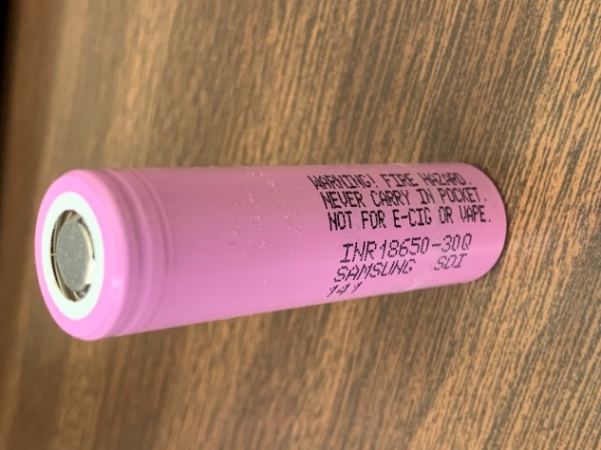
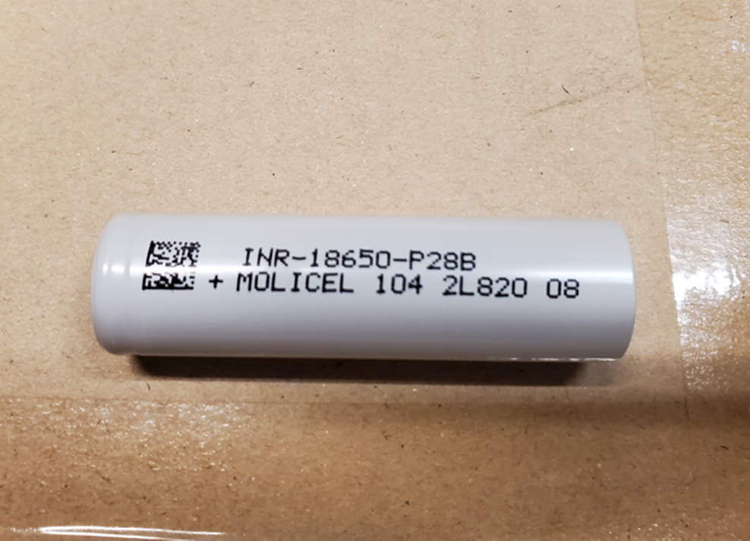
High Power Cell Designs
Samsung INR18650-30Q
Previous heritage
  X-57 Electric Airplane
  Safe high power battery demo
At 3C and room temperature
  2483 W/kg, 206.9 Wh/kg
  6340 W/L, 528.1 Wh/L
  12.4 mohm ACR
  26.2 mohm DCR
60k lot (Mar 2021) delivered in June to JSC
Molicel INR18650-P28B
No previous heritage
Not mass produced due to 2nd cathode tab
At 3C and room temperature
  2528 W/kg, 202.3 Wh/kg
  6376 W/L, 510.3 Wh/L
  9.2 mohm ACR
  22.3 mohm DCR
  5.5% waste heat – Smallest of the 4 cell types
60k lot (Aug 2021) delivered in Oct to JSC

Slide 7
The Importance of Cell Screening
Manufacturer Cell Acceptance Standards
vs
NASA Flight Battery Cell Acceptance Standards
  Human Rated Missions
  JSC20793

Slide 8
Cell Process Flow Chart
Cell Design Surveillance
~10 cell designs/yr
Basic performance verification
Deeper Dive into best 5 designs
Longer cycling & special performance,
TR calorimetry, ISC trigger cells,
Audit production line
Buy large cell lot
w/ traceability to manufacturer
Receiving Inspection, EP-WI-035
Inventory Cell Lot
Initial Lot Assessment
EP-WI-036B, N₂
270 unscreened cells for SWR
Fail
Pass
Cell Screening for EDU
EP-WI-037A
Cell Screening (Mission)
EP-WI-037A
SDR test or OCV (>1yr after BOD)
Pass
Lot Acceptance
EP-WI-033A
N₂ - 5 cells
Pass
Fail
Pass
Pass
Reject Lot or Cells
EDU Batteries
Fail
Qualification & Mission Batteries
Reject Lot or Cells

Slide 9
Initial Lot Assessment (ILA)
EP-WI-036 Specification for Initial Lot Assessment of Commercial Lithium-ion Cells Lots
Determine if cell lot (N₁ lot size) is worthy before proceeding with an expensive
lot acceptance testing - Quick & less expensive (8 weeks, ~$150k)
  Expected performance in accordance with cell surveillance results
  Acceptable lot uniformity of performance, particularly charge retention
  Acceptable quality of manufacture
  Propensity to sidewall rupture during TR (90% confidence level, 5% MOE)
Verify cell design has not changed
n ≥ 5
n ≥ 3
Computed Tomography (CT) on 5 cells
Capacity Cycling, C/20 Rate with dQ/dV, 3 cells
Assess manufacture performance and quality
Sample size N₂ at 90% confidence level with a 5% margin of error (MOE) (for N₁ = 70k cells, N₂ = 270 cells) or one cell from each box, whichever is greater
Destructive Physical Analysis (DPA) on 5 cells
Electrochemical Impedance Spectroscopy (EIS) 3 cells
AC Impedance
Visual Inspection
Report Results, Data and Statistics
Report Results, Data and Statistics
Identification
Mass
Pull another N₂ cells from Inventory
Open-Circuit Voltage (OCV)
Dimensional
Side Wall Rupture (SWR) Characterization
N₂- 8 cells for
Lot Acceptance
testing
Self-Discharge Rate (SDR)
Capacity Cycling, C-Rate with DC Resistance
Closed Circuit Voltage (CCV)
Report Data and Statistics. May reject, but not accept!
Report Results & Data
May reject, but not accept

Slide 10
Lot Acceptance Testing
Design, Performance, Quality, and Safety Testing
N ≥ 173 cells
14.0 Archive (spare cells) n ≥ 12
n ≥ 12
n ≥ 36
11.0 Electrical Abuse n ≥ 36
11.1 Overcharge
n ≥ 12
11.2 External Short Circuit n ≥ 24
n ≥ 30
n ≥ 42
4.0 Capacity Performance n ≥ 30
n ≥ 53
n ≥ 23
4.1 Charge, 27 cells
3 temperatures, 3 rates
13.0 Life Tests (53 cells)
n ≥ 6
10.0 Performance Calorimetry
n ≥ 3
13.1 Cycle Life
n ≥ 8
(n also depends on battery configuration)
13.2 Calendar Life n ≥ 45
n ≥ 13
4.2 Discharge, 27 cells
3 temperatures, 3 rates
7.0 Cell Seal Integrity
n ≥ 13 (3 control)
4.3 OCV vs. SoC, 3 cells
C/20 rate at ambient T&P
12.0 TR Calorimetry
n ≥ 20
N ≥ 3
N ≥ 6
N ≥ 3
5.0 Environmental Tests n ≥ 30
15 cells 100% SoC, 15 cells 0% SoC at each Environment
9.0 Cell Enclosure Vent/Burst Pressure n ≥ 12, or n ≥ 18 for bottom vent
6.0 Post Environment Capacity Performance
n ≥ 30 Repeat 4.0
8.0 CT/DPA
n ≥ 9
N ≥ 3
9.1 Vent Pressure n ≥ 6
Fully discharged C/10
5.1 Thermal Cycling
5.2 Pressure Cycling
9.1 Vent Pressure n ≥ 6
Bottom vent, Fully discharged
5.3 Random Vibe.
9.2 Burst Pressure n ≥ 6
Fully discharged C/10
Notes:
11.2 elinimatred. 36 for 11.1 and 11.3

Slide 11
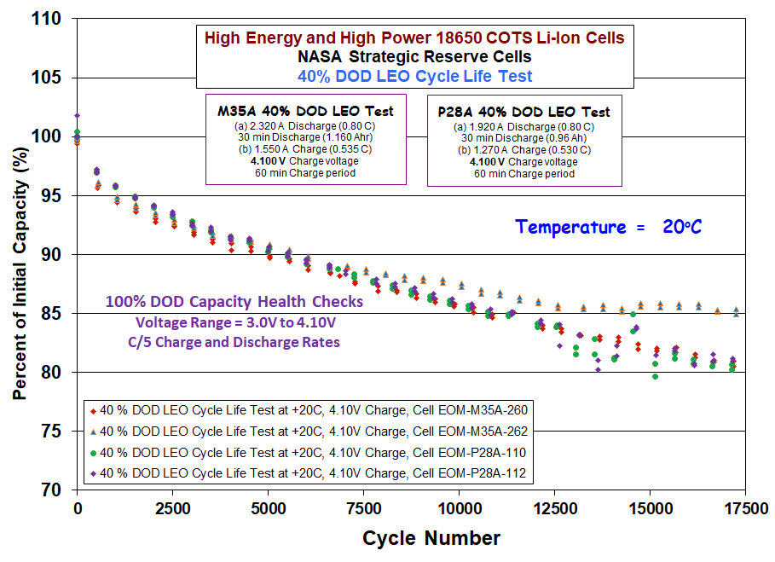
Lifecycle Quality of Cells
Source: “JPL Testing of COTS Li-ion Cells - NASA Strategic Reserve (10-06-2025) Rev. B”
Notes:
1 year is 6000 cycles approx. (16 cycles a day, 90 min orbit around earth), station wanted 10 year cycle life (60,000 cycles)
Lithium plating in LEO cycles bc you are always charging or discharging – no chance for lithium to dissolve back into solution – leads to build up of dendrites
***add in some sort of take home 1 liner – what is capacity degradation over 17500 cycles

Slide 12
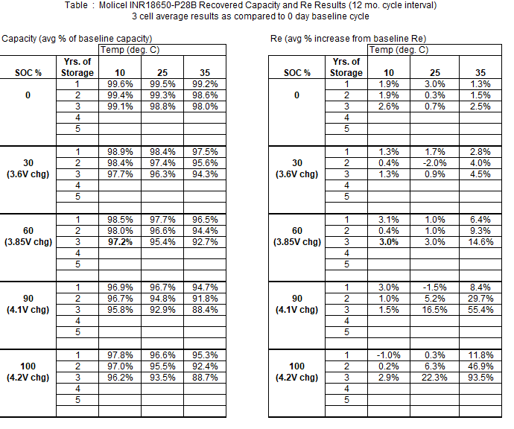
Calendar Life Testing

Slide 13
Overall Stats on 68,000 Screened 18650 Cells
Visual Inspection (8.17%)
  Scratches
  Corrosion
  Dents
  Cuts
  Discoloration on weld surfaces
Electrical (3.61%)
  Majority due to outlying OCV
Dimensional/Mass (0.24%)

Slide 14
Defects

Slide 15
Current Shortcomings of Visual Screening
Throughput capacity for high volume
Subjectivity of analysis

Slide 16
Example – Leaking P28B

Slide 17
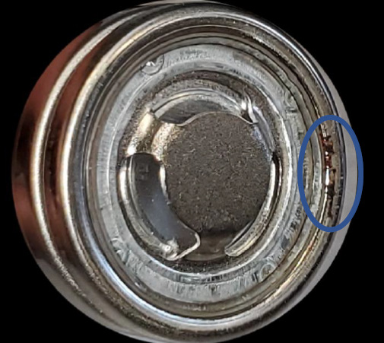
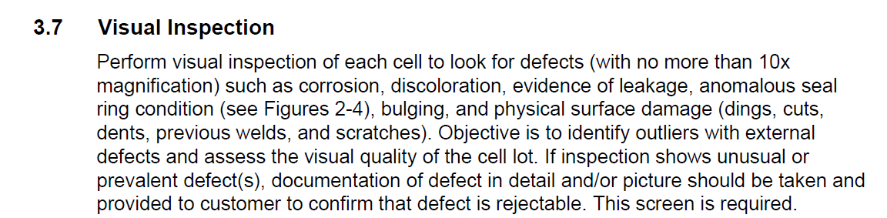
Screening for Leaks
EP-WI-037B

Slide 18
Screening for Leaks
EP-WI-037B

Slide 19
Leaking P28B Cell
Calendar life Testing year 3
  Lost 15% capacity
  DCR changed +178%
  Lost 1.2g electrolyte
Tried various optical methods to find a hole -> unsuccessful
  Profilometer
  Stereomicroscopy
  CT scan
  Dye penetrant analysis

Slide 20
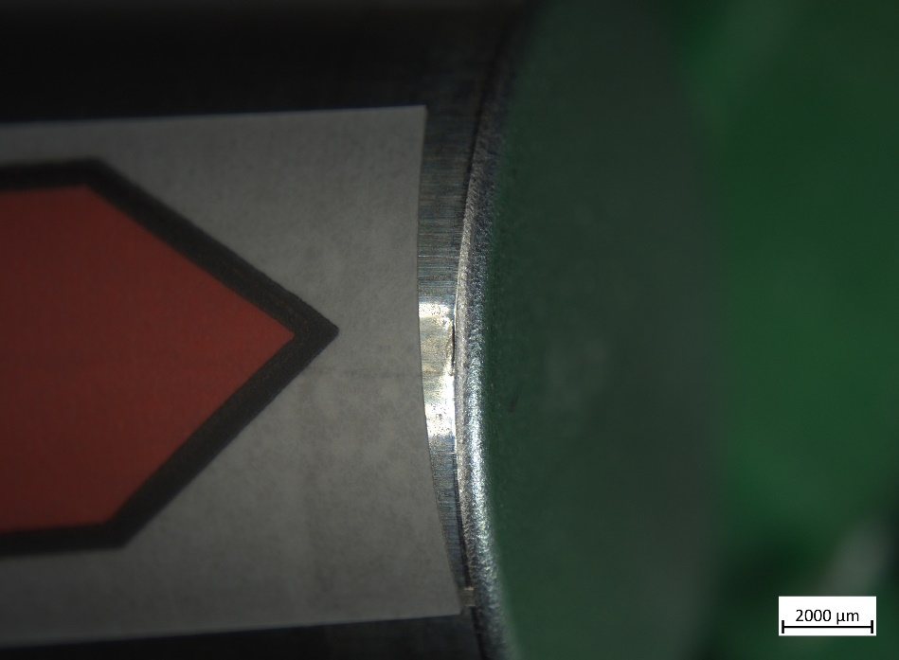
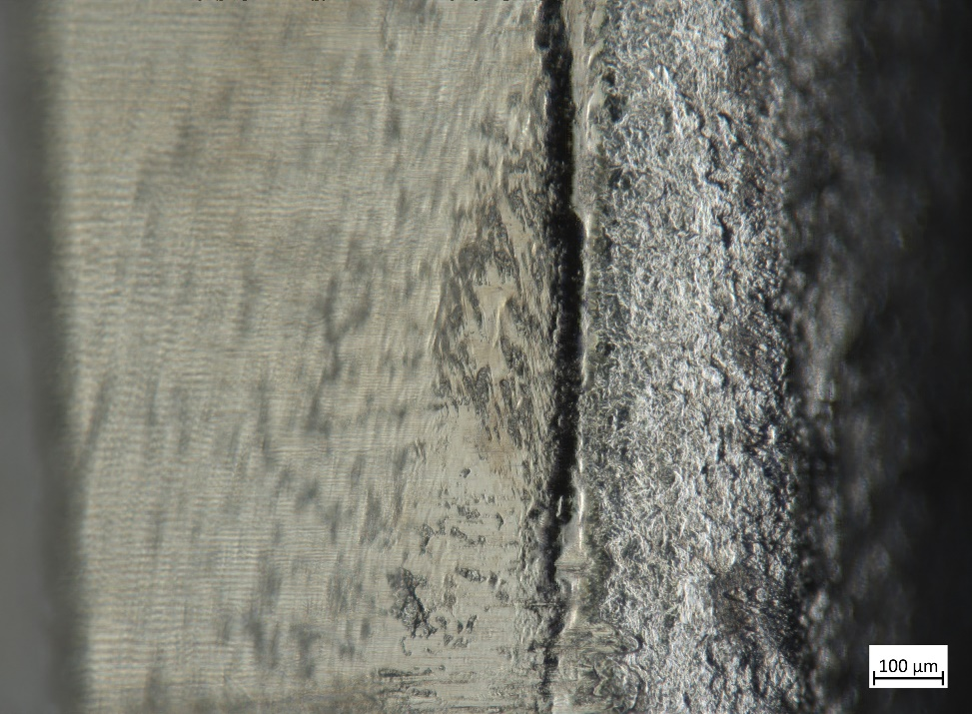
Stereomicroscope Examination
Inclined
Inclined
7x
100x

Slide 21
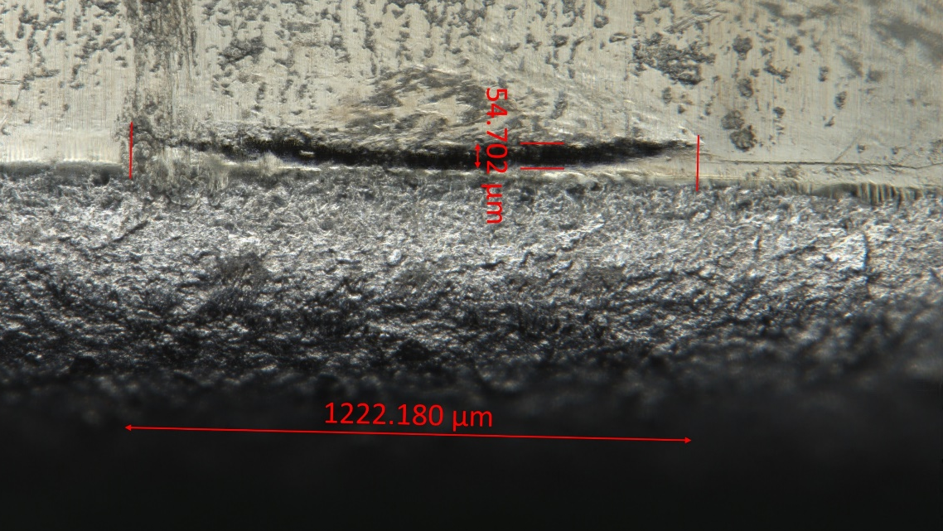
Screening for Leaks
EP-WI-037B
Electrolyte salts leaves colorful residue
Crack may have grown in 3rd year upon capacity cycling
  54µm crack width at 0% SoC
  Measured the same at 100% SoC

Slide 22

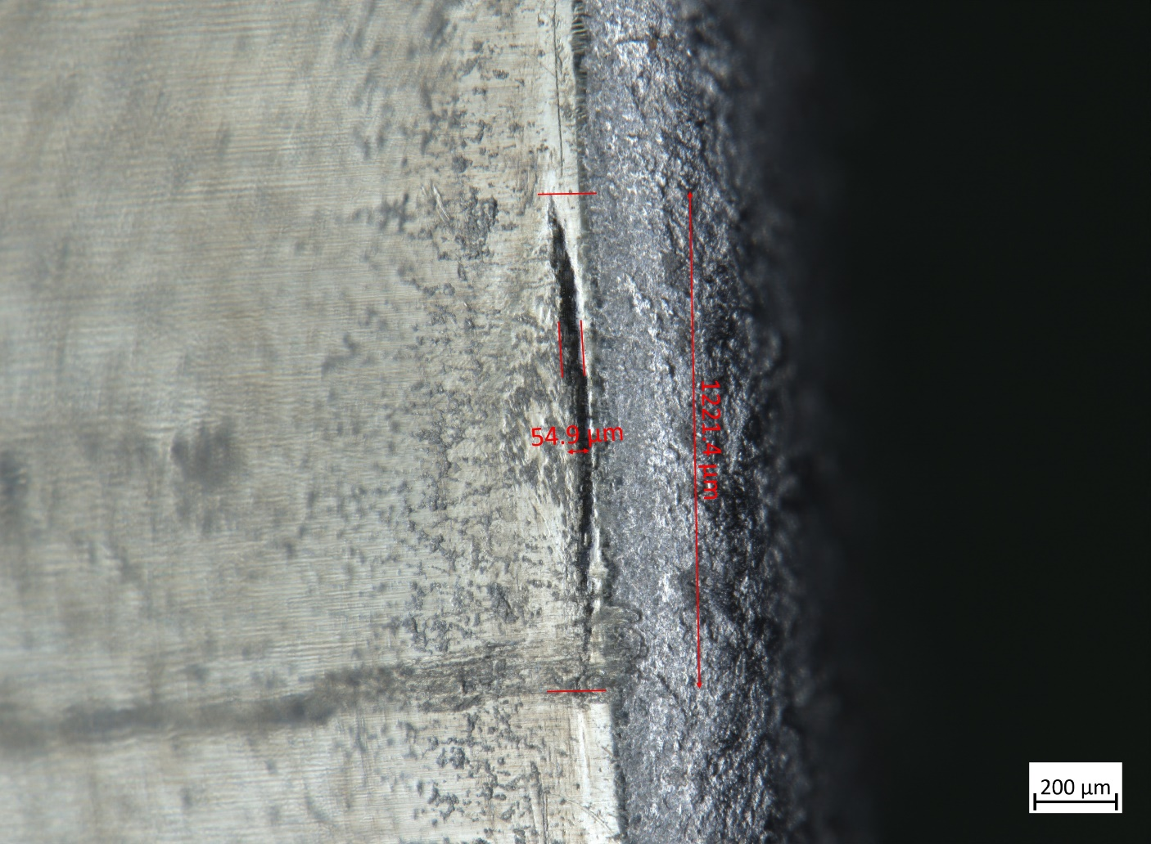
SOC Impact
OCV = 3.101V
OCV = 4.109V
At 4.11V during 300mA charging, rise of ΔT = 9°C terminating charge. No odor, no discoloration

Slide 23
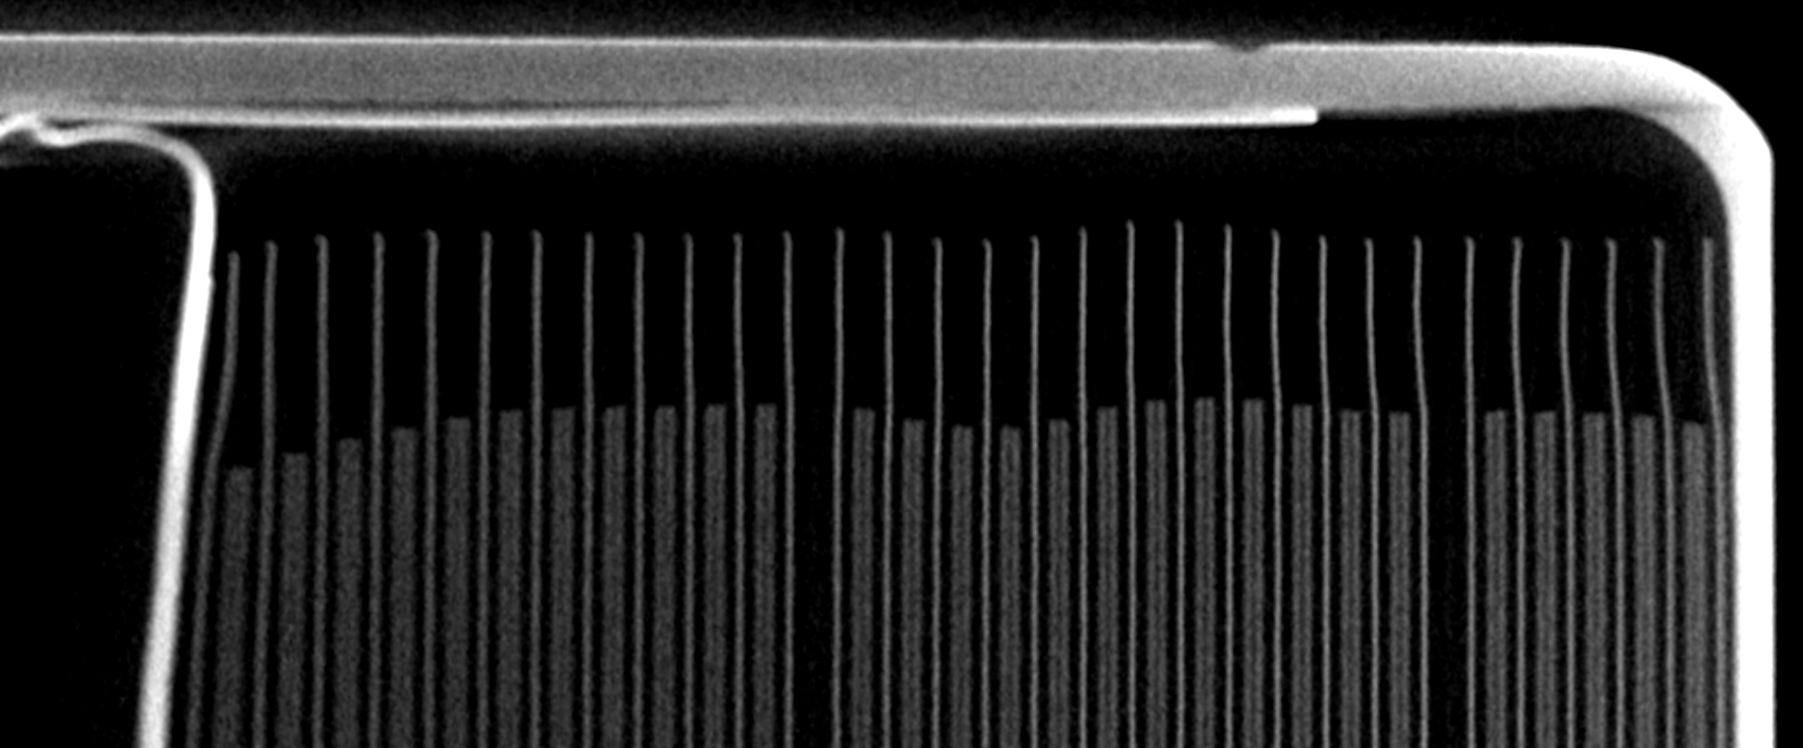
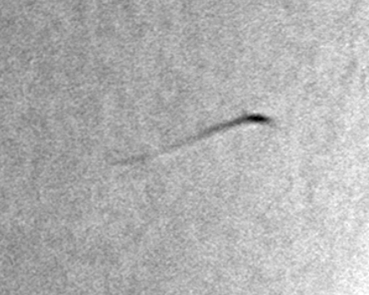
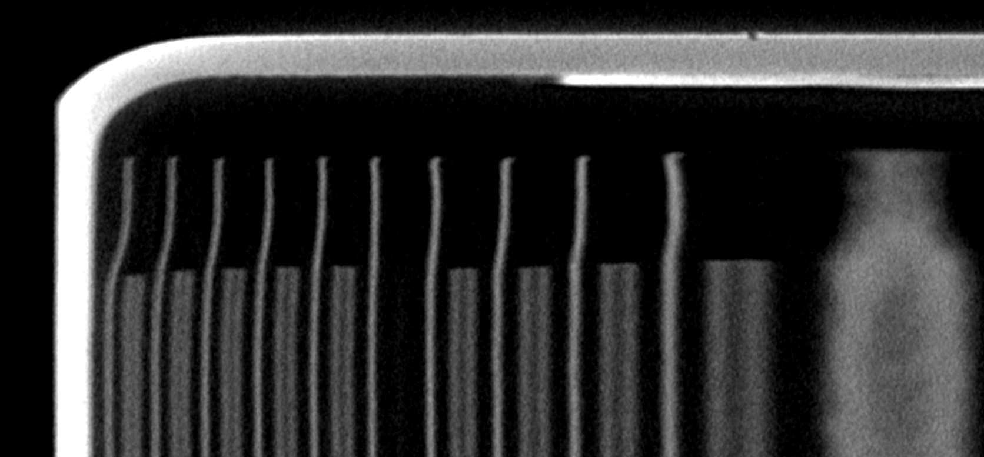
CT Scanning/Profilometer

Slide 24
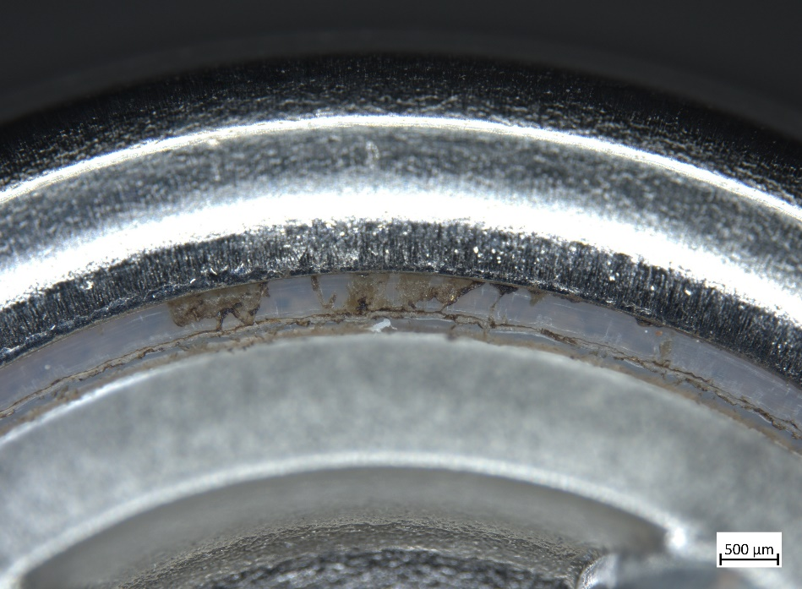
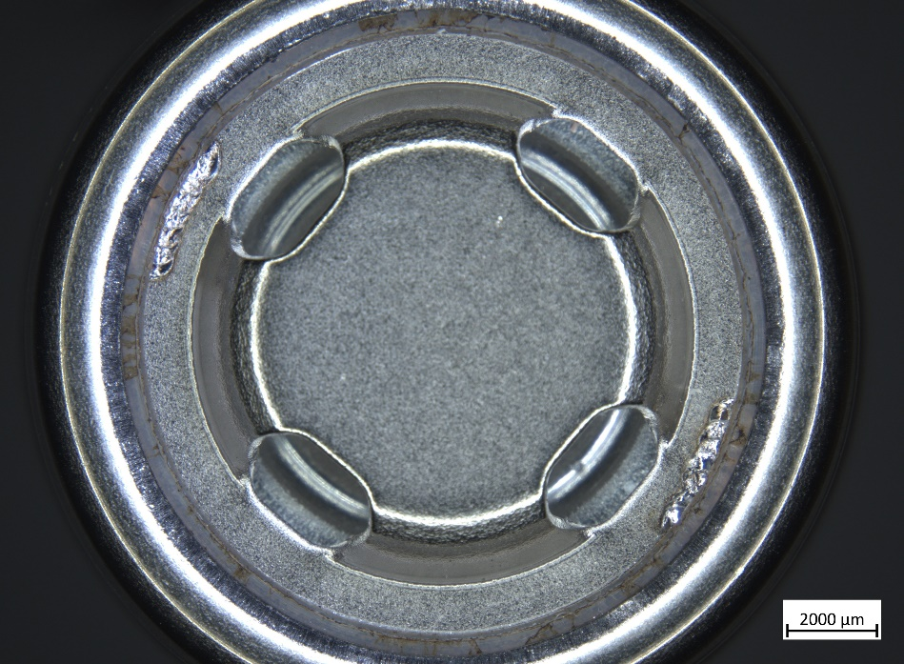
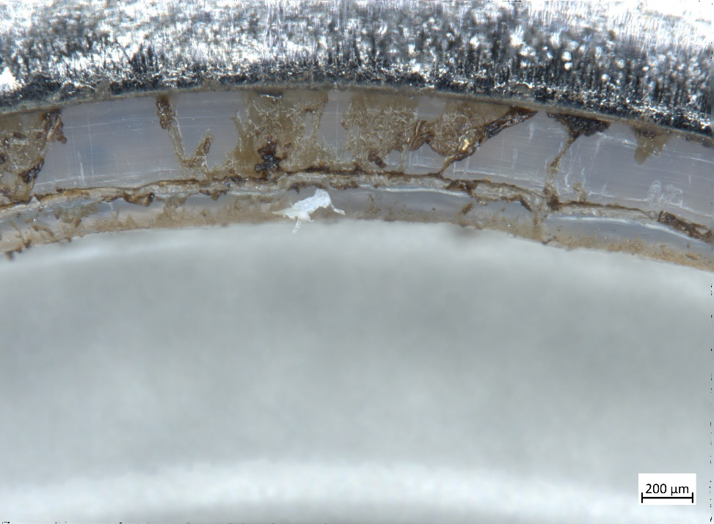
Examination of Header

Slide 25
Leaking P28B Cell
Leak detector
  Inficon’s ELT3000 Plus
    Instrument has a leak threshold of 1.8x10⁻⁶ mbar*L/s for DMC (Dimethyl Carbonate)
  Measured Leakage Rates:
    7.3x10⁻⁵ mbar*L/s
    1.8x10⁻⁴ mbar*L/s
  Capped bottom and top of cell in various configurations, isolated leak to top of cell

Slide 26
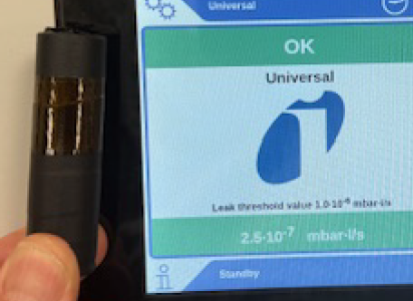
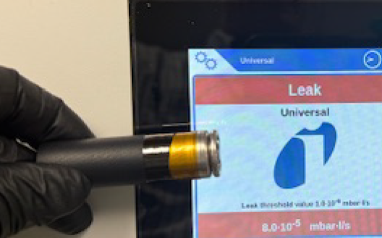
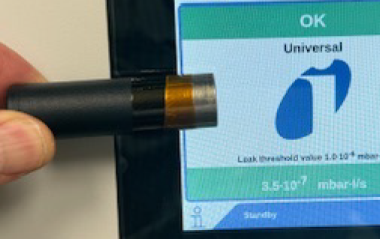
Leaking P28B Cell

Slide 27
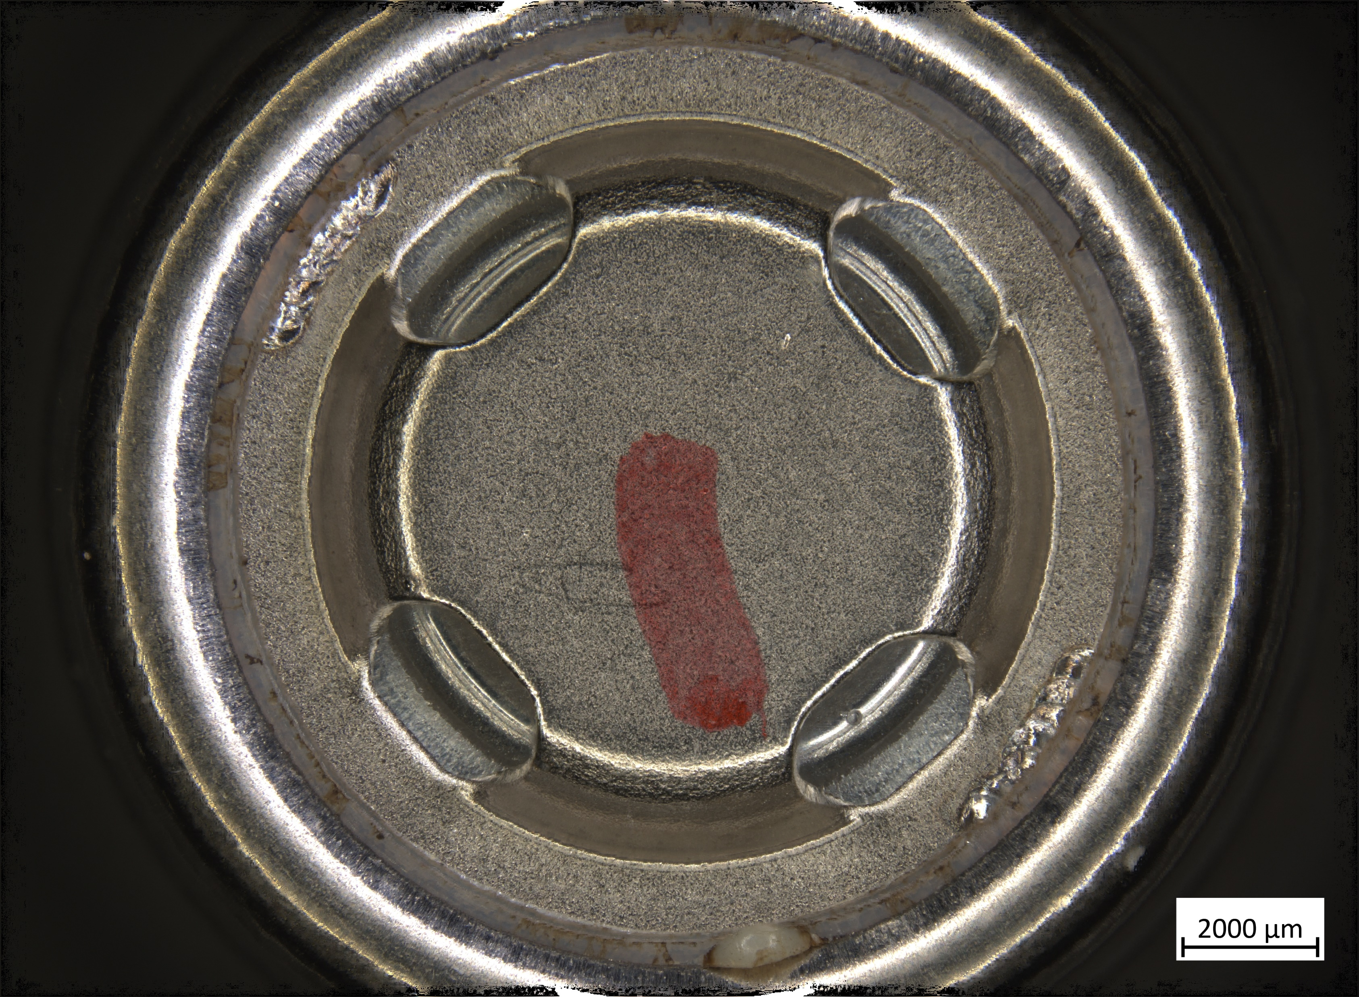

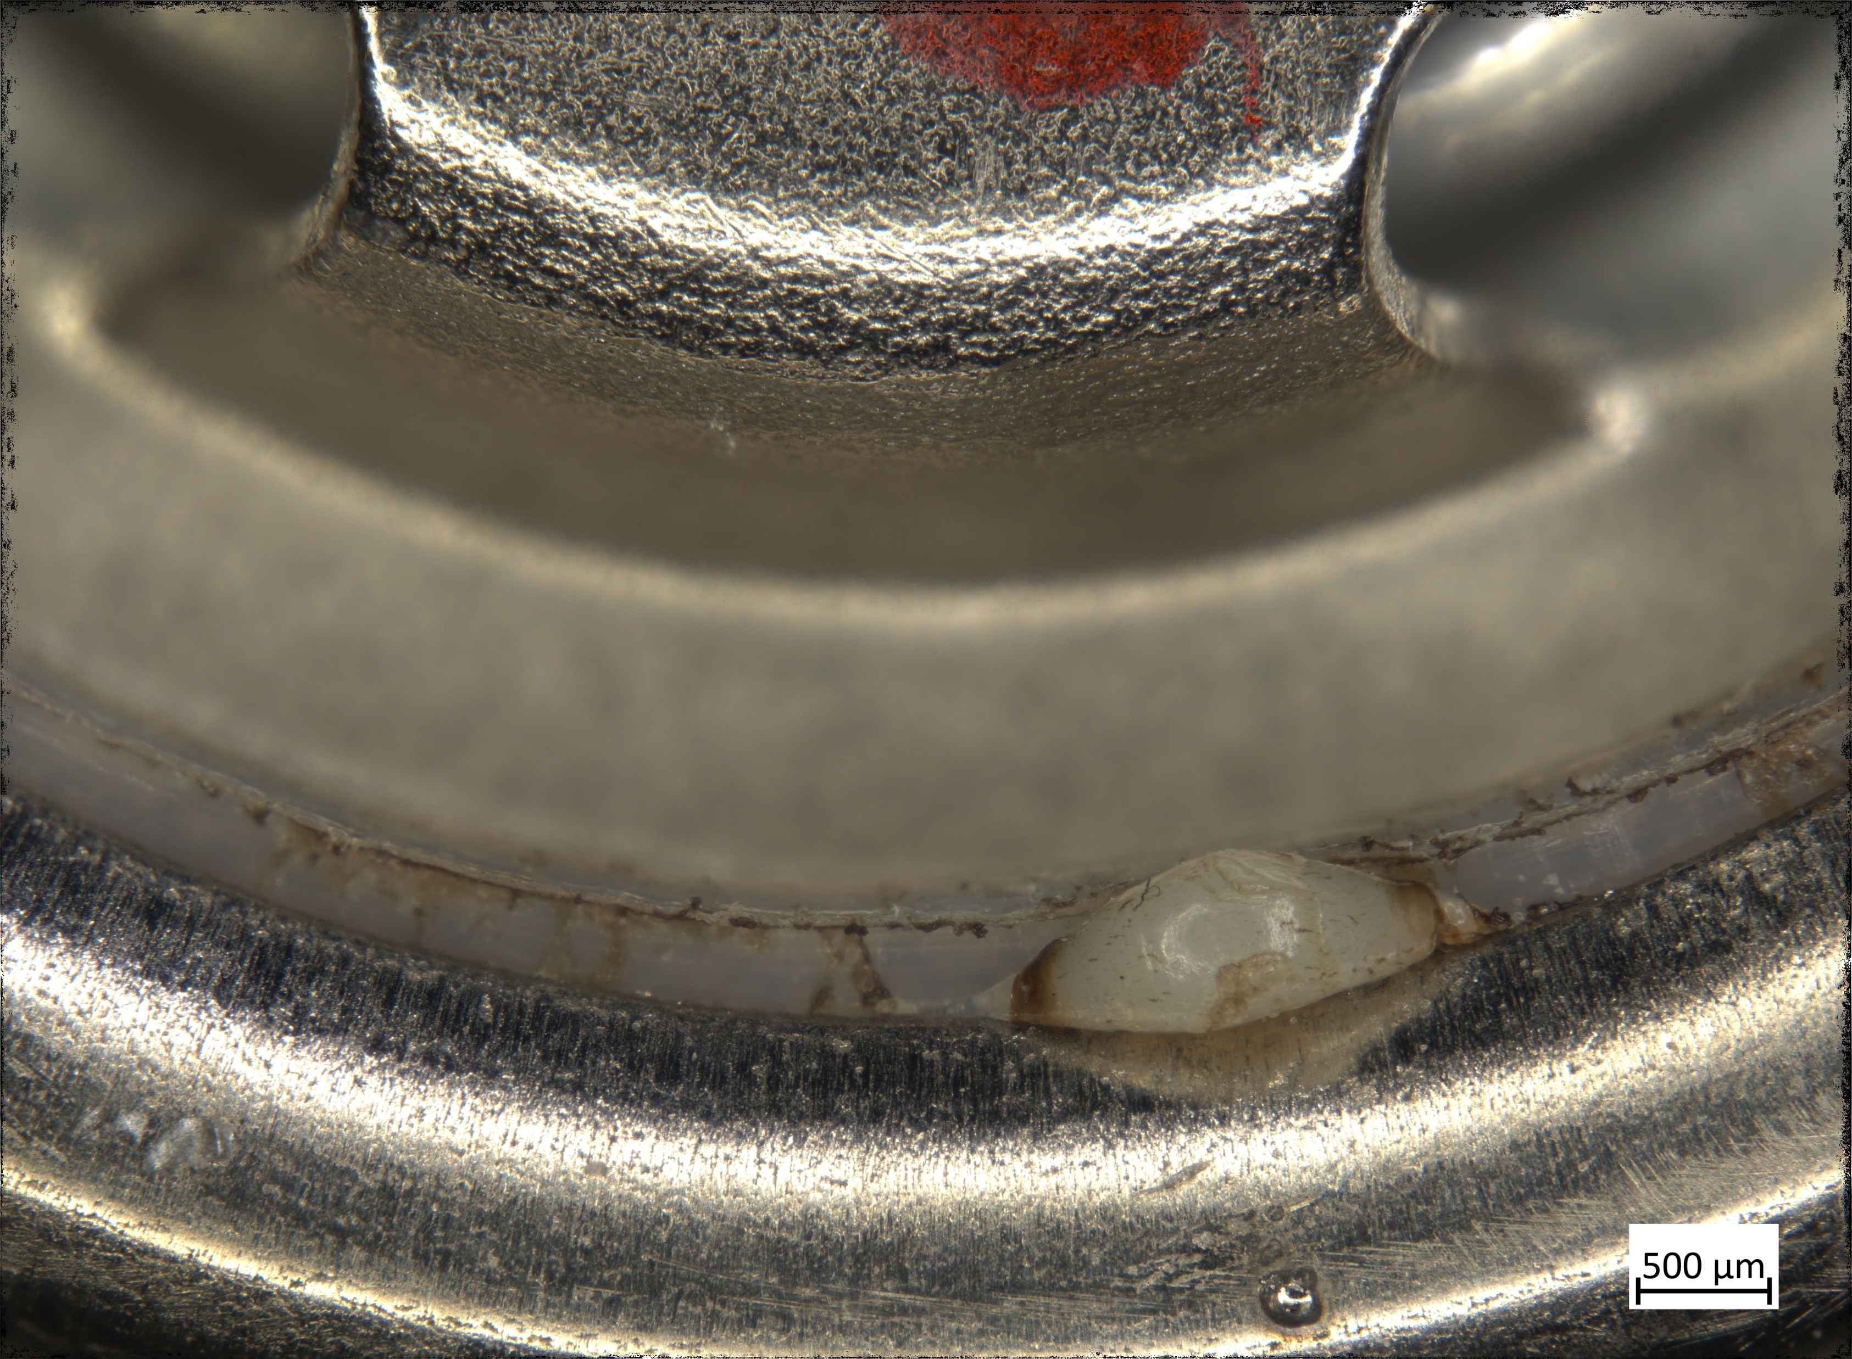
Post Inficon Scans

Slide 28
Post Inficon Scans

Slide 29
Capacity vs Voltage Balance

Slide 30
Cell Screening -> Pack Preparation
1. Determine cell capacity and DCR uniformity
  Reject ± 3σ outlying cells
  Reject lot with insufficient uniformity
    > 5% for 6σ/μ for capacity
    > 15% for 6σ/μ for DCR
2. Prepare cells for battery assembly with highest OCV balance at the top of charge
3. Verification of cell balance
  Assemble screened (passing) cells into 8S battery strings
  Charge each string fully without any cell balancing
  Measure OCV balance at 100% SoC

Slide 31
Voltage Balance Determination
CC/CV charge to 4.2V and C/50 taper current
Discharge fully to minimum voltage
  With DCR pulse at 50% SoC
  Screen for cell capacity and DCR from this discharge
  This leaves the cells in voltage balance but not in capacity balance
Partial recharge with 10% capacity input (~10% SoC)
  Constant current input with Ah termination

Slide 32
Capacity Balance Determination
Discharge to minimum voltage
Full CC/CV charge to 4.2V and C/50 taper current
  With DCR pulse at 50% SoC
  Screen for cell capacity from the charge cycle
  Cells balanced at the TOP of cell CAPACITY
Discharge to 10% SoC based on capacity output
  Remove the same Ah from each cell

Slide 33
Voltage vs Capacity Balance Impact on 8S Battery String at Top of Charge

Slide 34
Voltage vs Capacity Balance Impact on 8S Battery String at Top of Charge
Capacity balancing the SOC of cells during cell screening improves OCV uniformity from 30 to 3 mV in an 8S string.

Slide 35
Conclusions & Forward Work
Measured Leak Rate of Cell
  7.3x10⁻⁵ mbar*L/s
  1.8x10⁻⁴ mbar*L/s
Forward work to analyze protruding material
How do we improve on screening of cells to account for shortcomings of visual screening methods?
  Why did it only impact year 3 of the calendar life test?
    Screen LAT/ILA cells using leak rate instrument
    Crack doesn’t grow with SOC
    No visual confirmation of deformity until several cycles under vacuum with leak detector
  Industry standards for leak detection are under development
    Inficon’s leak rate instrument using quadropole mass spectroscopy tuned for DMC solvent in Li-ion electrolyte is a leading method
  Economic trade – Cost of screening every cell going into a battery using leak detector
Notes:
People that do nothing besides remove shrink wrap vs residual gas analysis of every single cell (we used to do the latter, got no failures, and it was expensive)

Slide 36
End

Slide 37
Overall Cell Screen Stats

Slide 38
High Energy Cell Designs
Molicel INR18650-M35A
Little previous heritage
  Same manufacturer of ICR18650J, primary power for > 25 EVAs
  Superior extreme cold performance
    214 Wh/kg at C/20 and -20ºC
  Multiple batches of ISCD trigger cells delivered to JSC
At C/10 and room temperature
  277 Wh/kg, 725 Wh/L
  ACR is 24.4 mohms
  DCR is 32.5 mohms
120k lot (Feb 2021) delivered in Apr to JSC
LG INR18650 M36
Previous heritage
  250 µm can wall
  Safety fully characterized by JSC
  Multiple variations beam tested in FTRC
  3 batches of ISCD trigger cells delivered to JSC
At C/10 and room temperature
  270 Wh/kg, 710 Wh/L
  ACR is 23.9 mohms
  DCR is 29.8 mohms
70k lot (Nov 2020) delivered in Apr to JSC

Slide 39
Our High Power Cell Designs
Samsung INR18650-30Q
Previous heritage
  X-57 Electric Airplane
  Safe high power battery demo
At 3C and room temperature
  2483 W/kg, 206.9 Wh/kg
  6340 W/L, 528.1 Wh/L
  12.4 mohm ACR
  26.2 mohm DCR
  8.3% average waste heat
60k lot (Mar 2021) delivered in June to JSC
Molicel INR18650-P28B
No previous heritage
Not mass produced due to 2nd cathode tab
At 3C and room temperature
  2528 W/kg, 202.3 Wh/kg
  6376 W/L, 510.3 Wh/L
  9.2 mohm ACR
  22.3 mohm DCR
  5.5% waste heat
60k lot (Aug 2021) delivered in Oct to JSC

Slide 40
LG M36
Electrical (2.90%)
  Majority due to outlying OCV, CAMX CST, or ACZ
Dimensional/Mass (0.23%)
Visual Inspection (5.85%)
  Corrosion
  Scratches
  Pitting
  Dents

Slide 41
Molicel M35A
Electrical (8.80%)
  Majority due to outlying OCV or CAMX CST
Dimensional/Mass (0.37%)
Visual Inspection (8.44%)
  Dents
  Scratches
  Corrosion
  Discoloration on weld surfaces

Slide 42
Molicel P28B
Electrical (1.68%)
  Majority due to outlying DC
Dimensional/Mass (0.21%)
Visual Inspection (21.61%)
  Scratches
  Corrosion
  Dents
  Discoloration

Slide 43
Samsung 30Q
Electrical (3.02%)
  Majority due to outlying CCV
Dimensional/Mass (0.16%)
Visual Inspection (9.11%)
  Dents
  Corrosion
  Scratches
  Cuts

Slide 44
Backup Slides

Slide 45
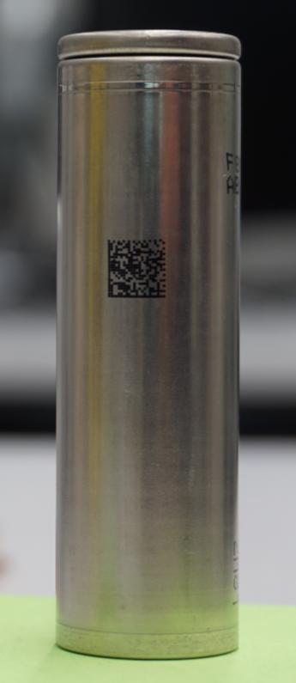
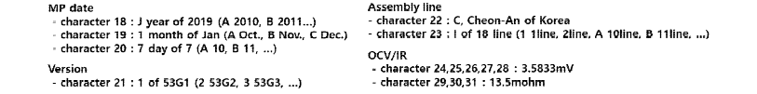
Samsung 53G1 Cell
Samsung makes OCV data out to 4 decimal places available via QR code on each cell can

Slide 46
P28B dOCV Screen Data

Slide 47
Example - dOCV Cell Screening

Slide 48
P28B Pre-Screen OCV Check
OCV measurement 1 yr after fabrication
  Want 10-12 mV range for +/-3 sigma, NOT 40 mV
Trimodal distribution seen, decided a dOCV measurement was needed to pass or fail cells on OCV

Slide 49
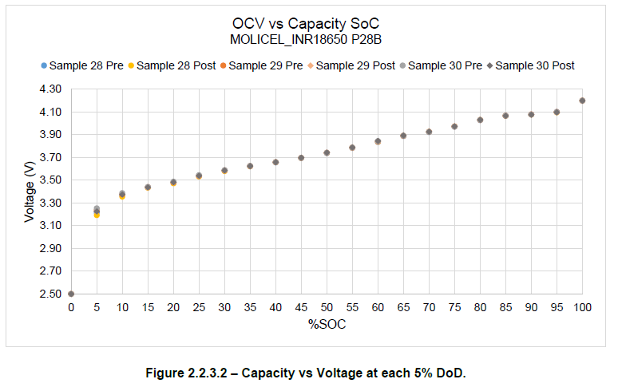
Motivation for dOCV Screen
Going from 95% to 65% SOC is ~200mV delta
  Some NASA programs will condemn battery at a 50 mV un-balance (~7% SOC drop)
  Spacesuit battery is NO GO for EVA if there is >20 mV difference
Want to screen out potential latent internal cell shorts
  Some latent defects could be showing very subtle OCV decays
Chart from “Capacity Performance, Environmental Test, and Post Environment Capacity Performance for Lot Assessment Test Report” done by PCTest for JSC CSR P28B Cell Lot

Slide 50
dOCV Process
Measured to 4 dec places, 18-bit (or better) resolution meter
Pre-OCV Check at JSC
9 mo. Gap where cells are shipped back to CSR
Manufacturer (Manf. SN)
OCV check #1 (Manf. SN)
OCV check #2 (Manf. SN)
Rest of screening (Manf. SN -> Screen SN)
Screened Data Used to determine passing dOCV for a given lot
Passing Cells reserved for upgrade for use on flight
CT image sample of passing/failing cells
Notes:
Question: Is there a correlation between dOCV failure and a bridging defect between anode and cathode visible by CT?
Hypothesis: Presence of high density (metallic) “bright spots” in JR could bridge anode to cathode causing internal shorts and leading to dOCV failures

Slide 51
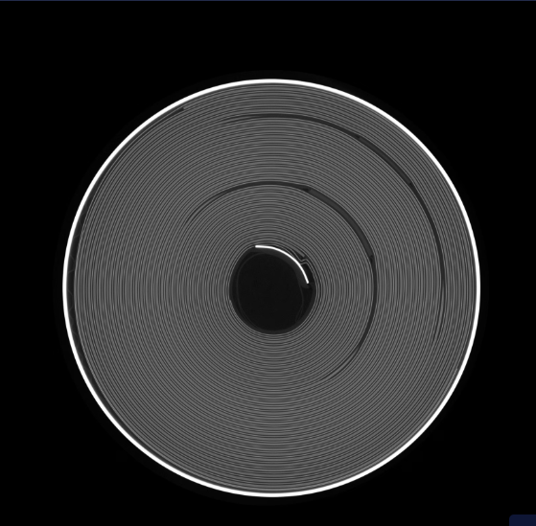
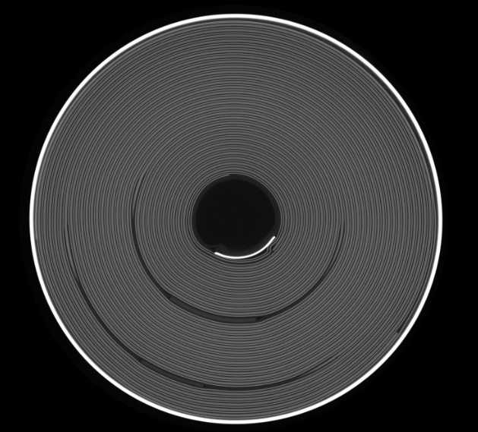

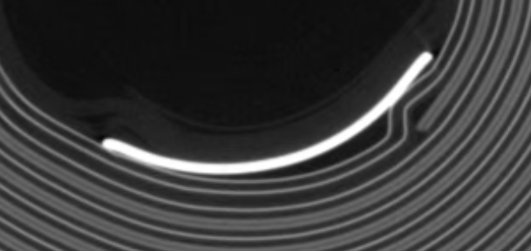
Key Cell Finding #1 – Anode Buckling
FAILING Cell
Passing Cell
Overlap of inner wind anode tab with start of cathode layer leading to severe buckling angle of anode
  Buckling appears in both PASS and FAIL dOCV cells

Slide 52
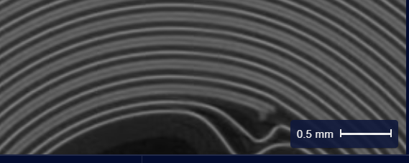
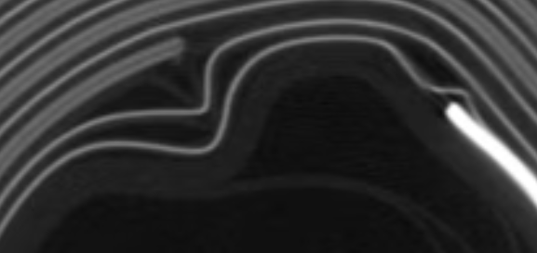
Key Cell Finding #2 – Delamination/Cathode Damage
FAILING Cells
Severe buckling on failing cells showed a trend of delaminating graphite from anode
Severe dOCV fails tend to have delamination at start of cathode at the inner wind

Slide 53
Follow- Up Work
Follow up dOCV measurements taken 10 weeks later
  Failing cells:
    Monthly voltage decrease: 2.4 mV/mo
    Avg dOCV: 5.8 mV
  Passing cells:
    Monthly voltage decrease: 1.1 mV/mo
    Avg dOCV: 2.7 mV
Clear difference in passing vs failing cells
  DPA not performed due to CT defects occurring in center of JR
Notes:
Pull in darcy slides, add in slide with CT scan of leaking cell
With cell at 60 SOC and 10 deg C there should be very little degradation
Key messages,
There is a cell reserve you can tak advantage of
Cells are ~5 years old but there is cal life testing / cycle life testing that shows that cells are good (can pull from the JPL presentation for this one)
Add in this years cal life testing
Grab the ILA/LAT flow plots from dec 24 reserve presentation so that you can put it in the appendix
Slides 191-196 from cell review chart deck for showing how many cells get rejected
Store cells in freezer under 30 SOC for best longevity
Stopping at capacity determination vs stopping at a voltage determination
Voltage determination is worse, when you go put cells in series you charge to same # of Ah and then they are not as balanced
Capacity determination, balance all cells at the top of the charge cycle (balance at same voltage for 100 SOC)
30 -> 0 -> 100 -> 90 to compare charge capacity
1 year is 6000 cycles approx. (16 cycles a day, 90 min orbit around earth), station wanted 10 year cycle life (60,000 cycles)
Lithium plating in LEO cycles bc you are always charging or discharging – no chance for lithium to dissolve back into solution – leads to build up of dendrites

Slide 54
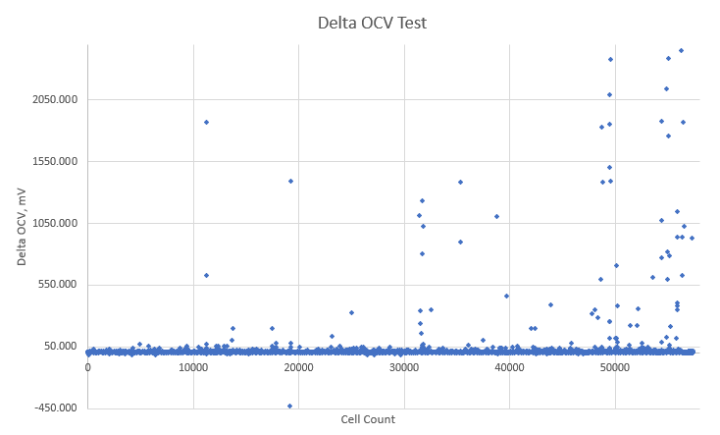
Pre-dOCV Screen Data
Arrow denotes failing Cell Selection for CT scans

Slide 55
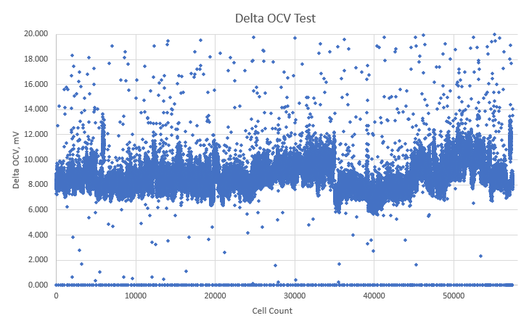
Pre-dOCV Screen Data
Failing Cell Selection for CT scans
 | # | % Entire Lot (56,552)
Total Rejects | 679 | 1.2%
Low Rejects | 27 | 0.0477%
High Rejects | 447 | 0.79%
No Data Rejects | 205 | 0.362%
Passing Cell Selection for CT scan
Note 2 cells from failing negative range were picked, range not shown on graph
Ignored low rejects that were not negative

Slide 56
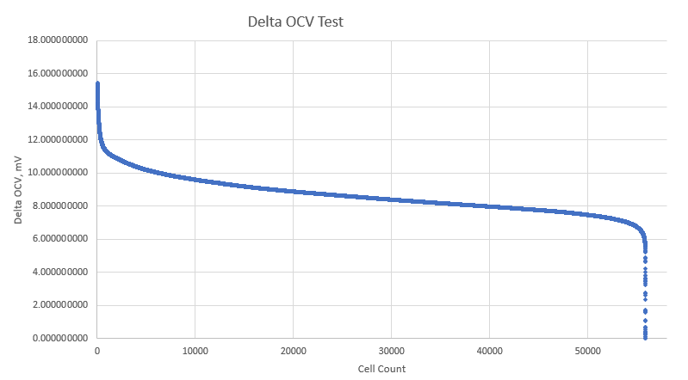
Passing Cell dOCV Data
Removal of 3σ outliers until 3σ range is stable and 6σ% approaches 0
  -/+3σ = 5.34 / 11.96 mV
  6σ% = 0.765%
*Ignored low rejects that were not negative

Slide 57
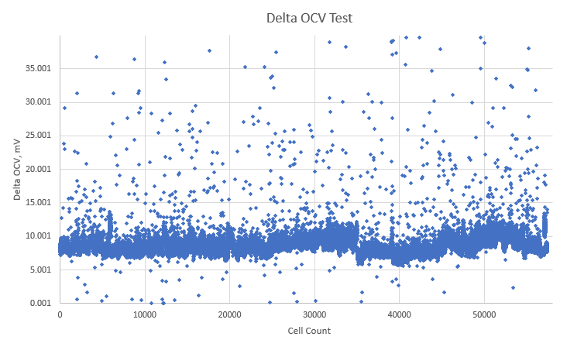
Raw Data*
*Graph does not show extreme outliers as it causes the rest of the graph to be unreadable

Slide 58
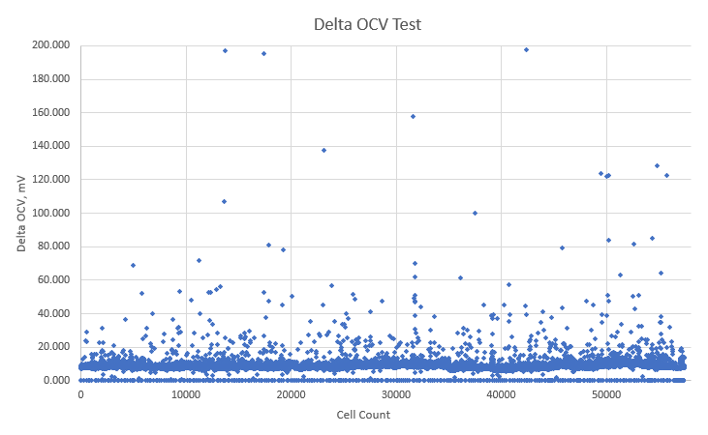
Raw Data*
*Graph does not show extreme outliers as it causes the rest of the graph to be unreadable

Slide 59
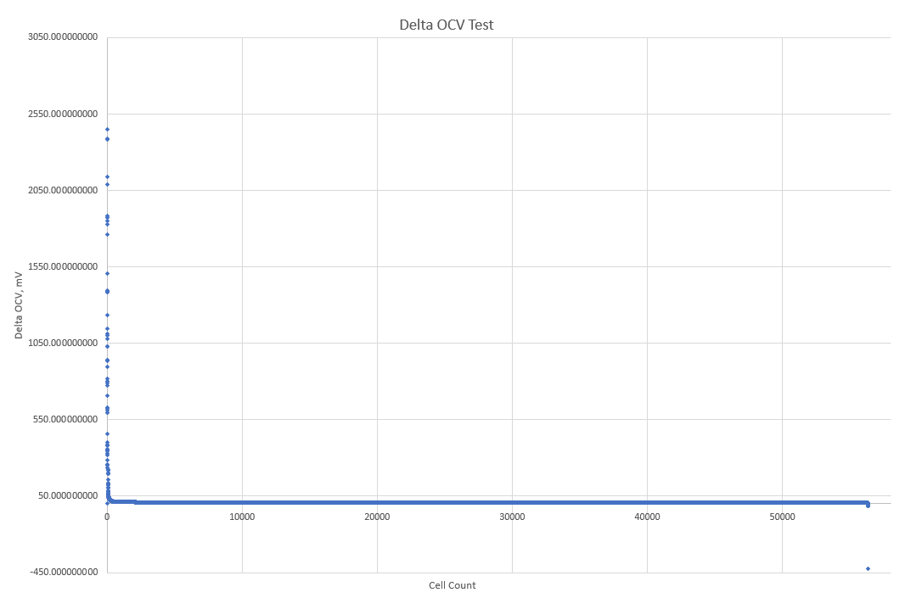
Raw Data ALL - Sorted

