Slide 1

Development of Value-Added Products in Support of the North American Land Data Assimilation System – Phase 3
Jonathan L. Case*¹, Kim A. Locke², Ryan A. Wade¹, Robert A. Junod¹, Vikalp Mishra¹, Andrew T. White¹, Siddharth Chaudhary¹, Mitchell T. Dodson¹,
Fadji Zaouna Maina³, Kristen M. Whitney⁴,
David M. Mocko², Augusto Getirana²,
Shahryar K. Ahmad², Christopher R. Hain**⁵,
Sujay V. Kumar**⁶, and Timothy M. Lahmers⁶
**Project institutional PIs
¹University of Alabama – Huntsville
²Science Applications International Corp.
³University of Maryland – Baltimore County
⁴University of Maryland – College Park
⁵NASA Marshall Space Flight Center
⁶NASA Goddard Space Flight Center
Talk 8B.5; 27 Jan 2026; 40th Conf. Hydrology; 106th AMS Annual Meeting, Houston, TX

Slide 2
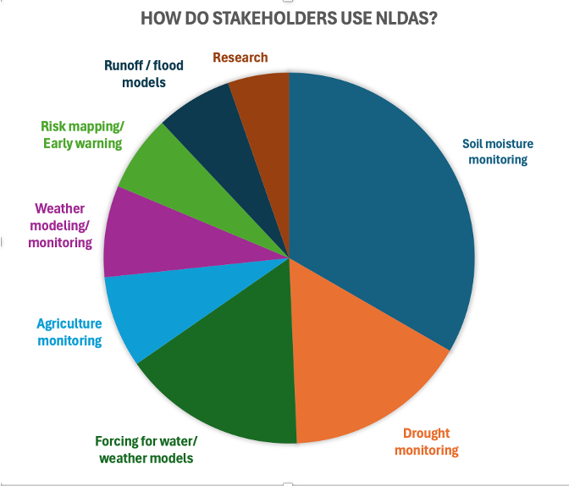
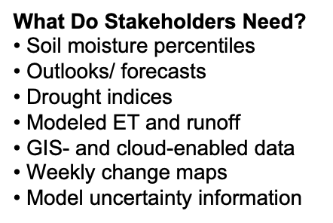
What is NLDAS Version 3?
NLDAS-3: Land & hydrologic modeling system
Gets you closer to the ground-level impacts
Used by:
  U.S. Drought Monitor/drought.gov
  State-level climate offices
  NOAA NIDIS, NWS, CPC, PSL
  OpenET, EDDI, QuickDRI, etc.
  SPoRT-LIS
NLDAS-3 details: https://ldas.gsfc.nasa.gov/nldas/v3

Slide 3
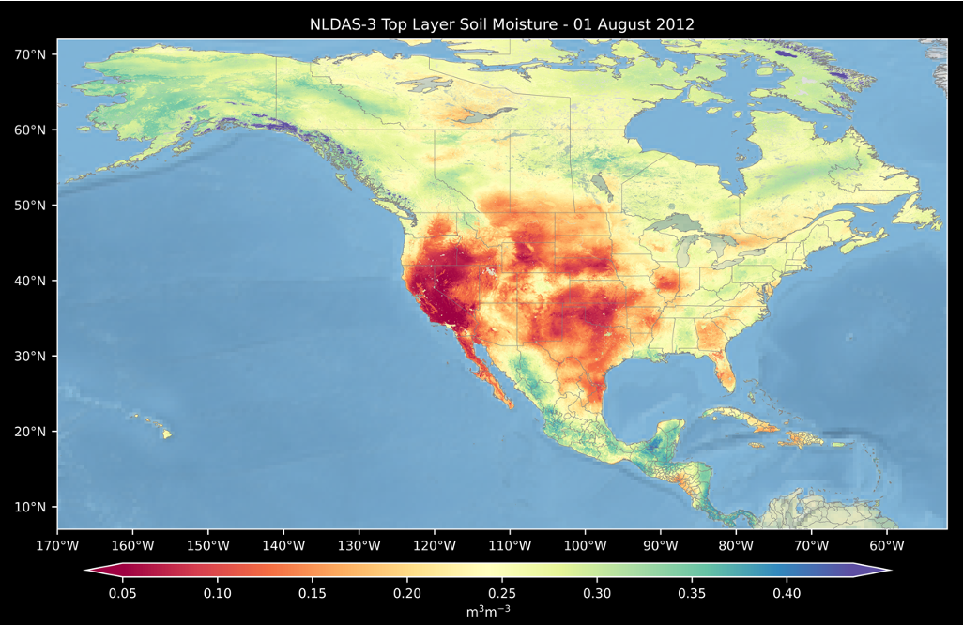
NLDAS-3 Upgrades at a Glance: Soil Moisture at 1 km over N. America
Larger domain: North America, Central America, & Caribbean
Higher-resolution:
1 km for the entire domain
Land & water variables in
near real-time
Improved satellite data assimilation for better estimates of soil moisture, snow, water storage, ET, runoff, etc.
NLDAS-2
& SPoRT-LIS extent
Notes:
Land points: 76,088 vs. 27,245,580 for NLDAS-3

Slide 4
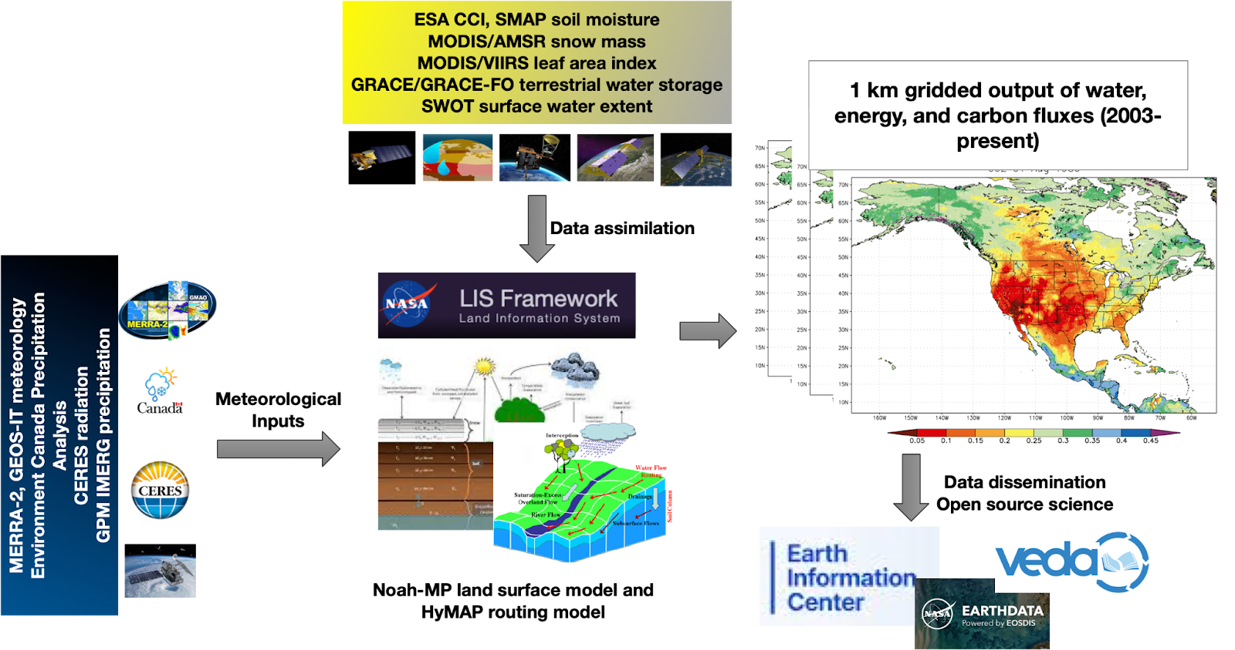
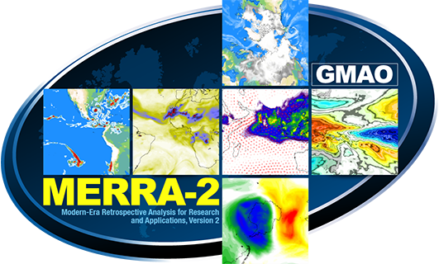

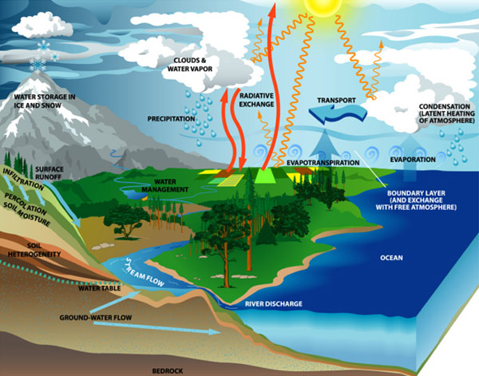

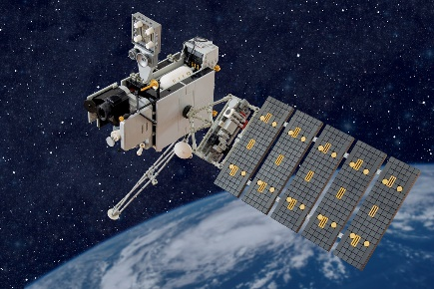


NLDAS-3 System Setup and Improvements
Improvements in red
High resolution outputs
(water, energy, carbon fluxes)
over a larger domain
Satellite Data Assimilation (soil moisture, snow, terrestrial water, vegetation)
Land Information System
Running Noah-MP model
Blended meteorological inputs
Providing real-time cloud-based outputs (with more variables) & analysis platforms
Notes:
Basic depiction of the general framework improvements shown in red; more details on Land Information System in slide below.

Slide 5
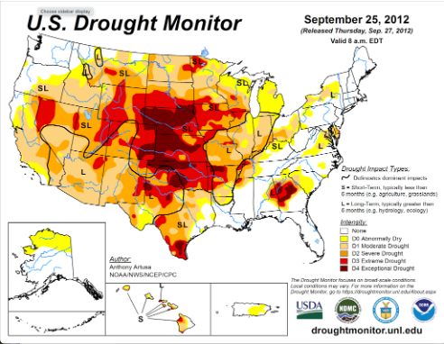
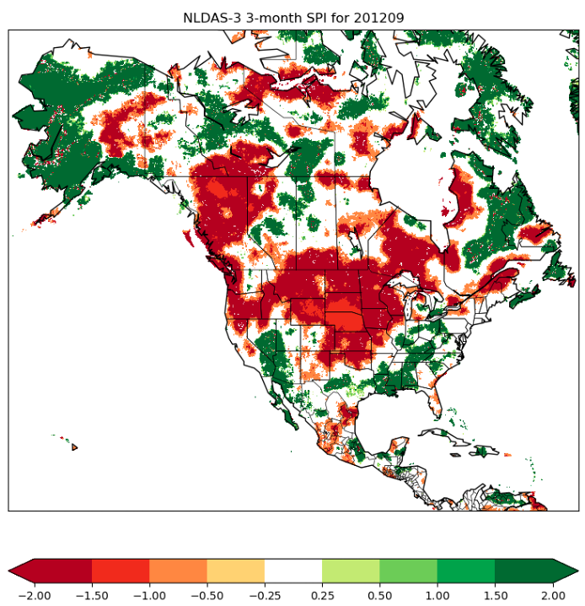
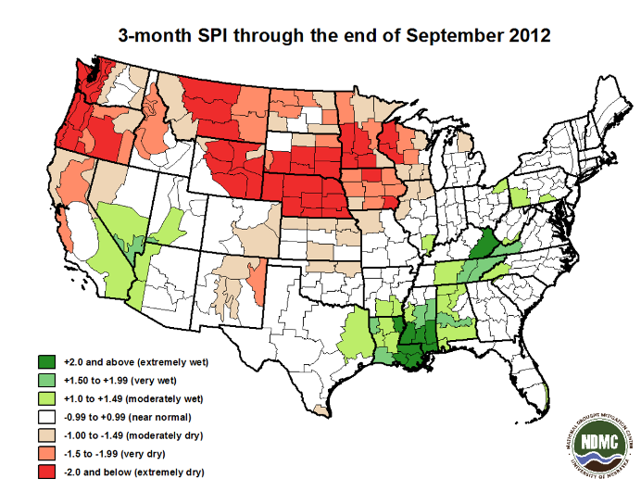
NLDAS-3 Standardized Precipitation Index Example:
2012 Midwest Drought
Known denning elevations

Slide 6
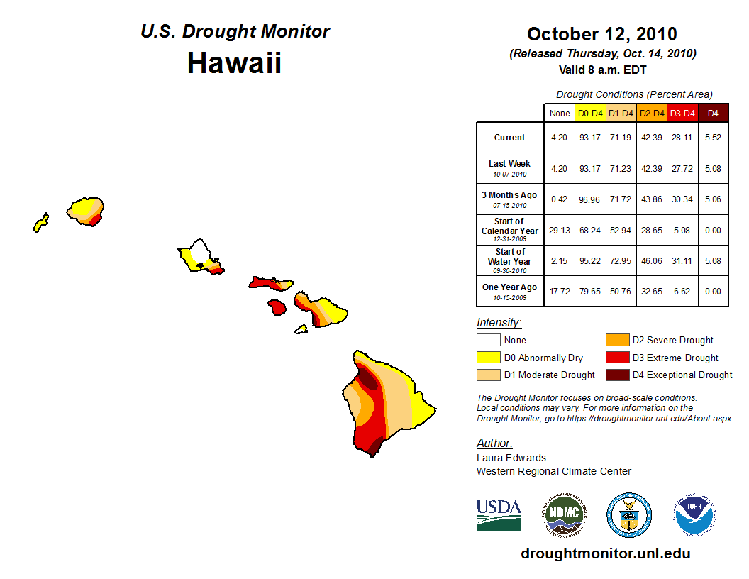
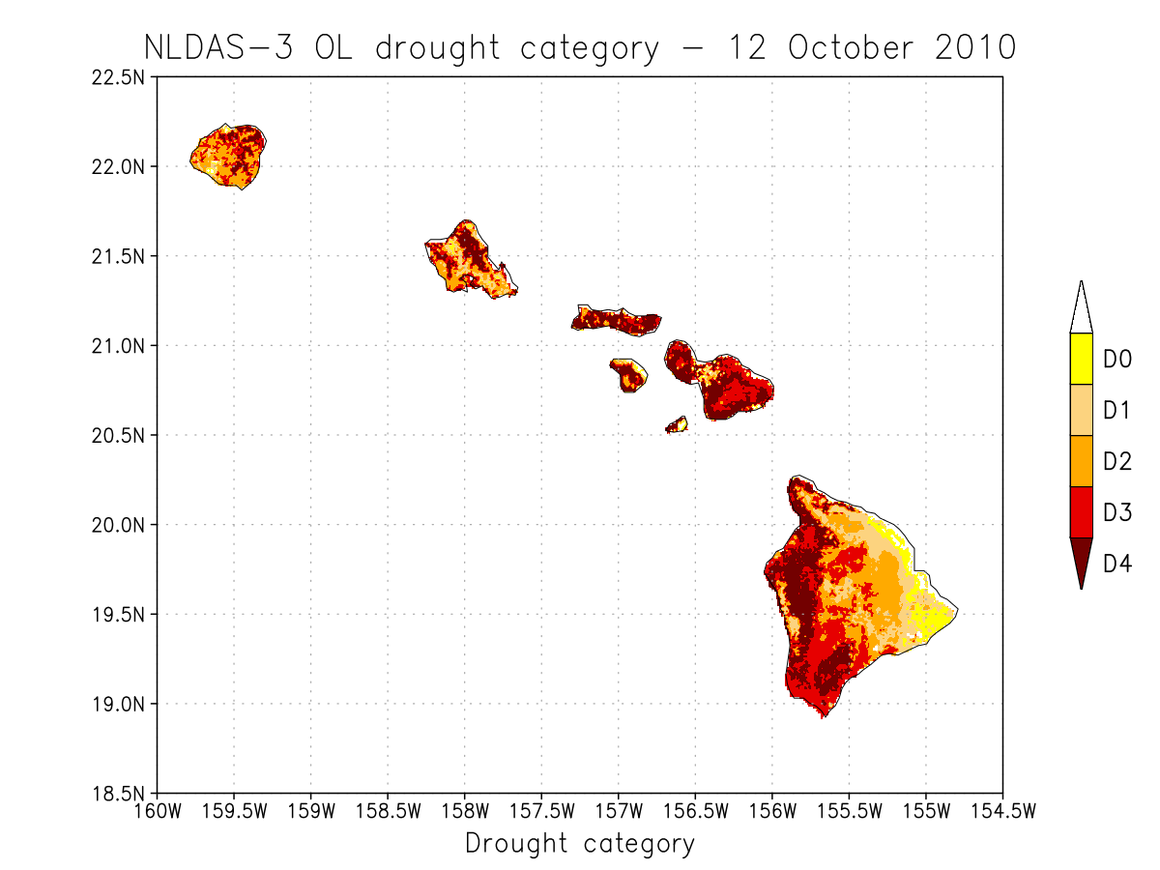
Example Soil Moisture Percentiles (retrospective)
vs. 2010 Drought Monitor Conditions Maps
Known denning elevations
Notes:
From Open Loop

Slide 7
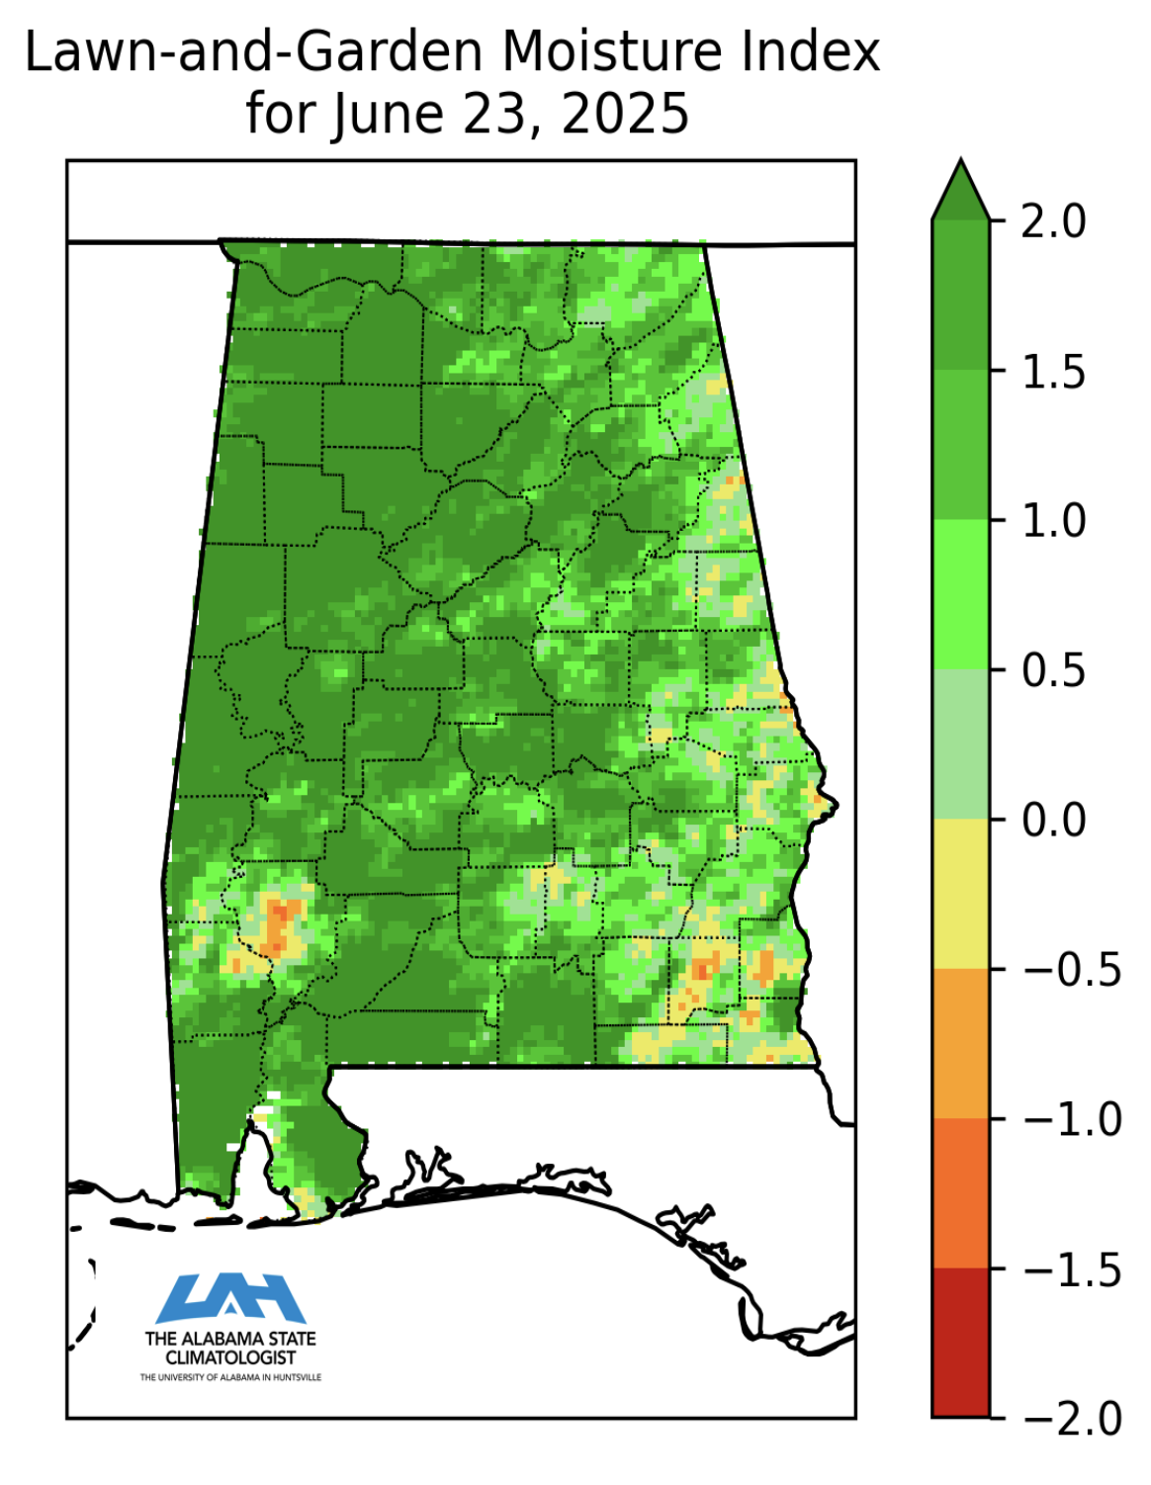
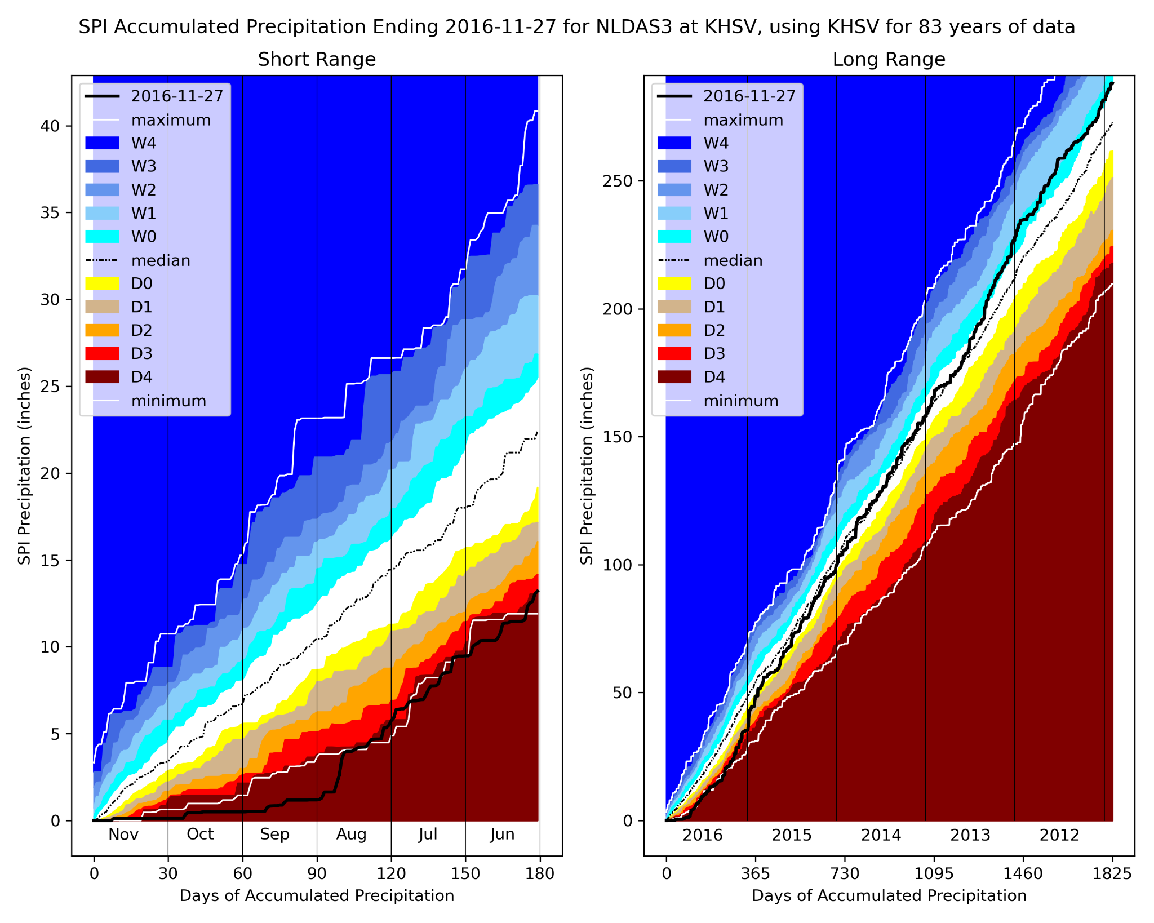
Other Derived Products Co-Development Examples
Lawn-and-Garden Moisture Index:
Capacity of soil moisture to sustain healthy lawns and gardens (NASA + AL State Climate Office)
Drought Fingerprint Plot: Short- (6mo) and long-term (5yr) SPI of antecedent cumulative precip; adapting to NLDAS-3 forcing (NASA + TX State Climate Office)
Notes:
Move to research-based ones

Slide 8
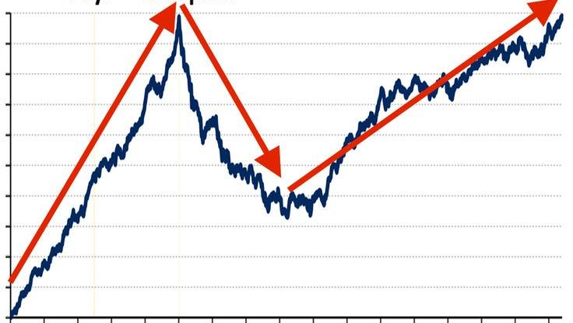
Soil Moisture Volatility Index (SMVI)
From Osman et al. (2021; Hydrol. Earth Syst. Sci.) publication
  Motivated by stock market trend analysis, SMVI examines
  soil moisture trends for rapid and significant changes
  Designed to capture fast soil moisture declines as one indicator
  contributing to flash drought onset
Testing with current SPoRT-LIS
soil moisture model
To be implemented into NLDAS-3
Trend Analysis

Slide 9
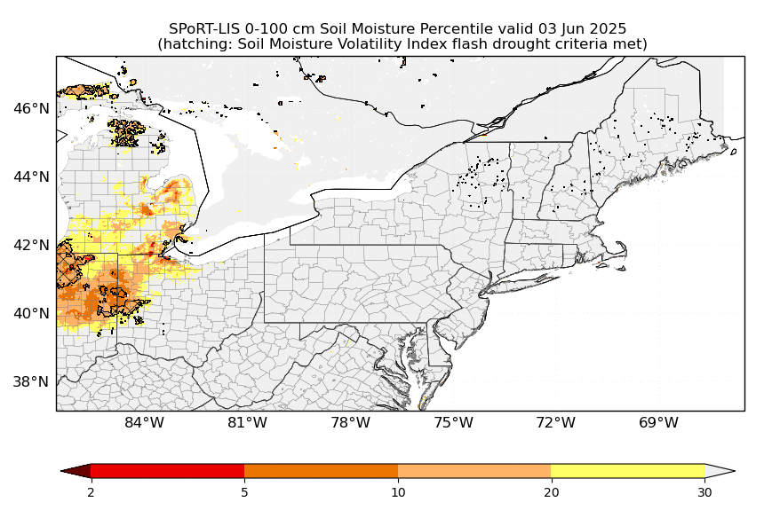
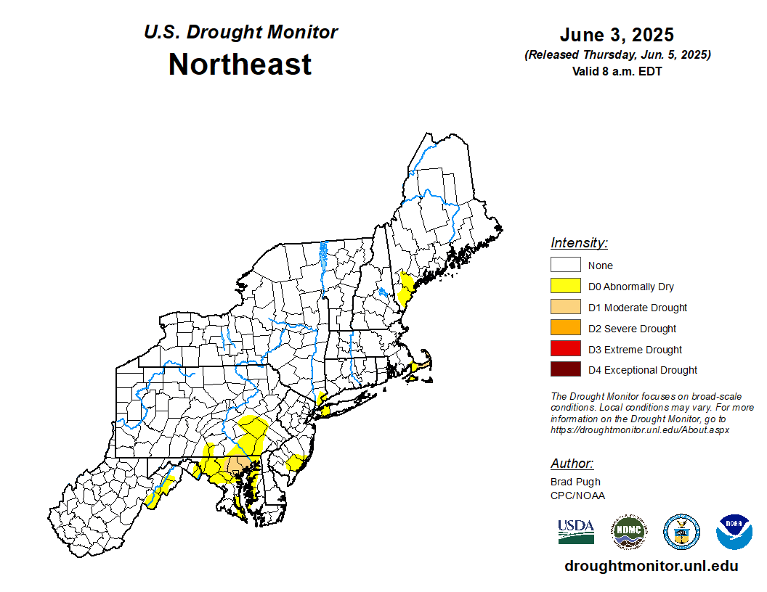
Example Flash Drought Data Product:
Summer 2025 Rapid Onset Drought over New England
D4 D3 D2 D1 D0
Weekly soil moisture percentiles with hatching showing where flash drought criteria are met (using NASA SPoRT-LIS as proxy).
U.S. Drought Monitor for the same time period.
Notes:
Soil Moisture Percentiles relative to 1981 to 2013 historical normals. Example of soil moisture volatility index (SMVI)

Slide 10
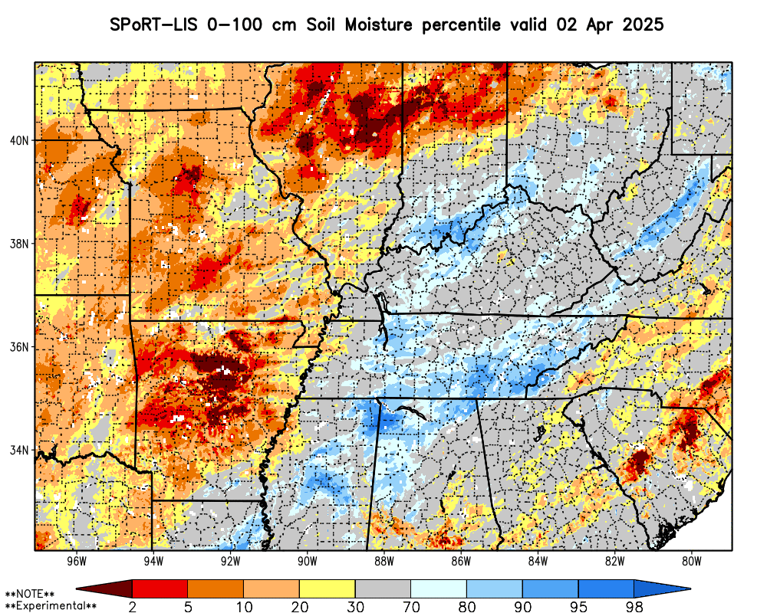
NLDAS-3 Forecast Soil Moisture Percentiles (SPoRT-LIS as proxy)
NASA SPoRT-LIS generates 14-day forecast soil moisture percentiles
For NLDAS-3 forecasts:
  14-30 day forecasts, bridging gap from short-term forecasting to S2S
  Deterministic and ensemble outputs
Forecast ensemble ideas:
  Variability of forecast soil moisture
  Probabilities of soil moisture or other variables falling below or exceeding threshold percentiles
  Soil Moisture Volatility Index for
  flash drought prediction
https://weather.ndc.nasa.gov/sport/viewer/?dataset=lis_conus&product=rsoim0-100

Slide 11
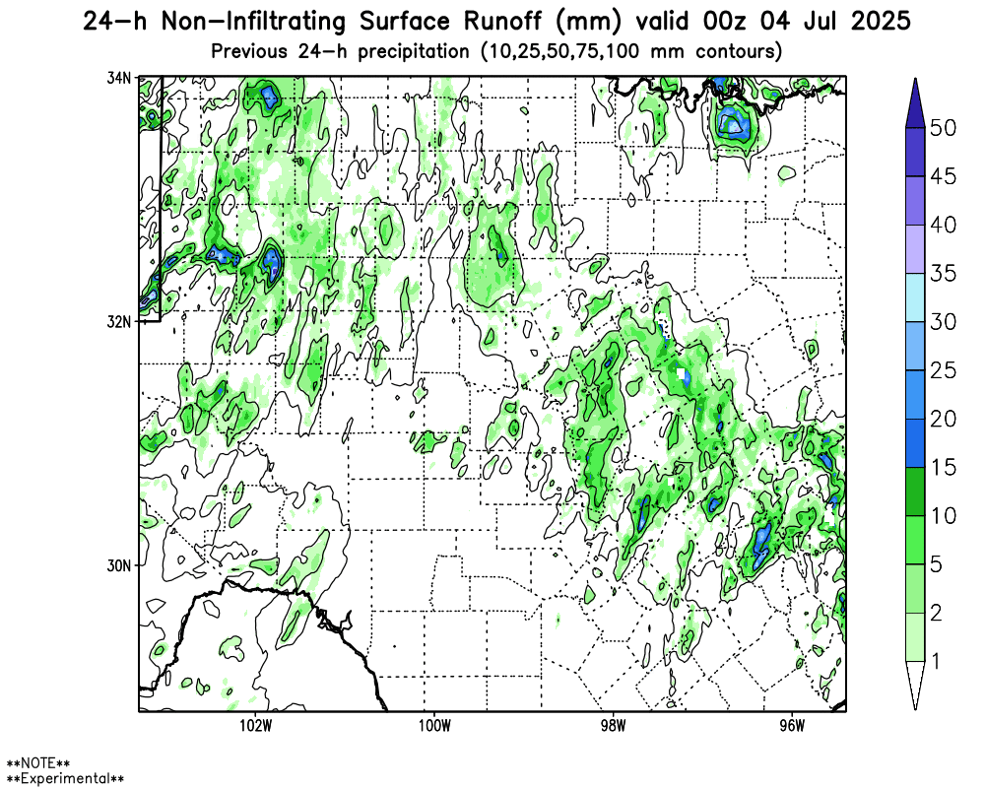
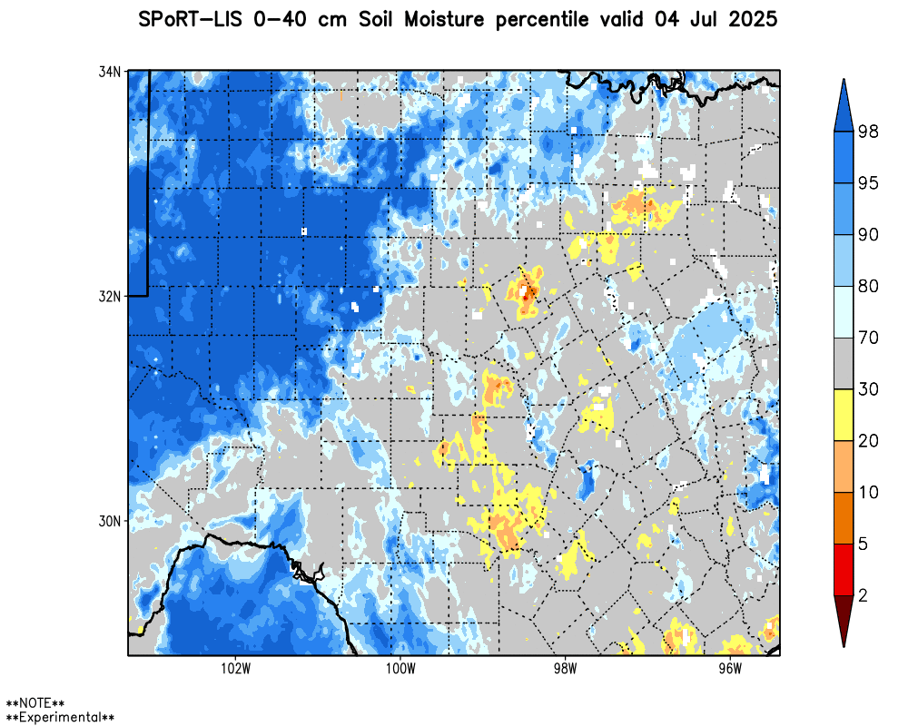
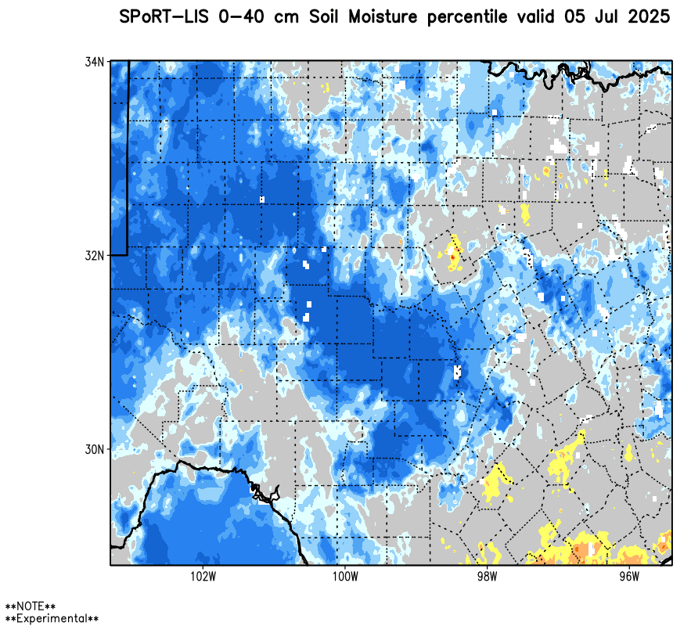
Soil Moisture Runoff and Flooding
Soil conditions important to flooding threat
“Whiplash” effect: drought flips to excessive wetness (and vice versa)
NLDAS-3 will help quantify such behavior with precision and accuracy
Before
After
(Above) Hourly animation of accumulated
rainfall runoff (mm) for the central Texas
flooding event of 4 July 2025

Slide 12
NLDAS-3 Development Timeline
Product | Variables | Production Estimate
NLDAS-3 surface meteorology (hourly; Jan 2001 to Dec 2023) 2024 to near real-time in development | Precipitation, SW / LW down at the surface, 2-m T / q, 10-m winds | Beta version available now (daily / monthly-averages also available)
NLDAS-3 Open Loop (no data assimilation) | Soil moisture/temps, snow, surface fluxes, groundwater, LAI, streamflow | Completed Nov 2025
NLDAS-3 Full DA (multivariate data assimilation) | Same as Open Loop | Spring 2026
NLDAS-3 Forecasting | Soil moisture, hydrometeorology | 2026

Slide 13

THANK YOU !!!
NLDAS-3 project page
QR Code

Slide 14
Hydrology Copilot Demonstration
(time permitting)

