Slide 1
Apollo 11 Lunar Module Touchdown Dynamics Reconstruction V&V for Human Landing Systems
Rekesh Ali (NASA/MSFC/EV42/ESSCA/Mclaurin Aerospace)
48th Rocky Mountain AAS GN&C Conference
February 4th, 2026
Co-Authors:
Adam Slagle, NASA LaRC
Alessandro Mordasiewicz, Amentum
Juan Orphee, NASA MSFC
Peter McDonough, Amentum

Slide 2
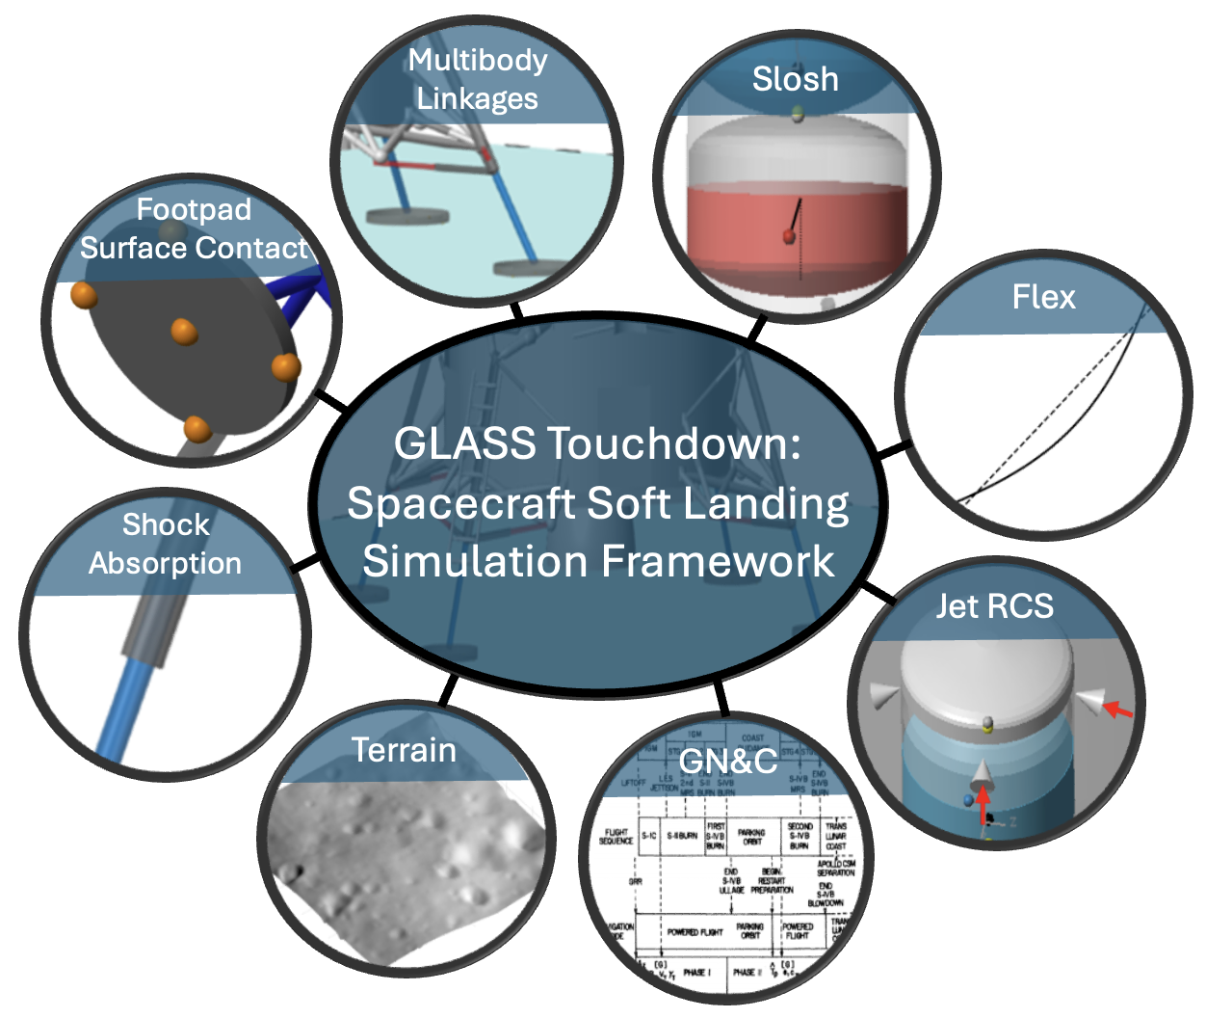
GLASS Touchdown Simulation
The GeneraLized Aerospace Simulation in Simulink® (GLASS) is NASA MSFC’s high-fidelity 6-DOF analysis framework for insight support on NASA’s Human Landing Systems (HLS) commercial partner program¹
GLASS Touchdown is an extension that allows for the simulation of soft landing
This addition enables full end-end analysis capability of deorbit, descent, landing, and ascent mission phases
The present work is dedicated to the V&V of models related to the landing gear (highlighted in orange)
¹J. Orphee, N. Olson, K. Clements, M. Hawkins, A. Summers, W. Wu, M. Fritzinger, and K. Miller, "Evaluation of
Precision Landing Performance Using a Generalized Aerospace Simulation in Simulink Framework." 45th Annual AAS
Guidance, Navigation and Control (GN&C) Conference, Breckenridge, CO, 2023. NASA Technical Reports Server,
Doc. ID 20230000011

Slide 3
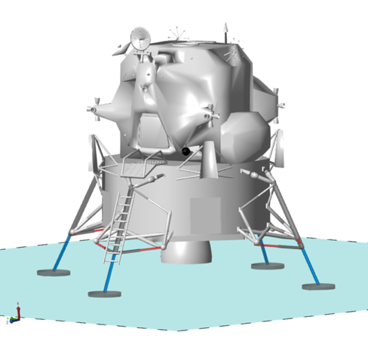
Touchdown Simulation Verification and Validation
GLASS Apollo LM Reconstruction
Verification Data
Validation Data
Integrated comparisons against Apollo 11 reconstructions
Rogers (1972)¹
Zupp (2010)²
MSC Adams (2022)³
Component-wise unit tests of individual models
Apollo 11 historical flight data¹
Attitude and rate telemetry
Strut stroke and surface penetration estimates from photographic analysis
¹W. F. Rogers, Apollo Experience Report – Lunar Module Landing Gear Subsystem, NASA Technical Note, Rept. NASA TN D-6850 (also MSC S-316), Manned Spacecraft Center, Houston, TX, June 1972.
²G. A. Zupp, An Analysis and a Historical Review of the Apollo Program Lunar Module Touchdown Dynamics, NASA Johnson Space Center (ret.), 2010
³A. Slagle, Reconstructing the Apollo 11 Lunar Landing in ADAMS, NASA Langley Research Center, 2022, unpublished

Slide 4
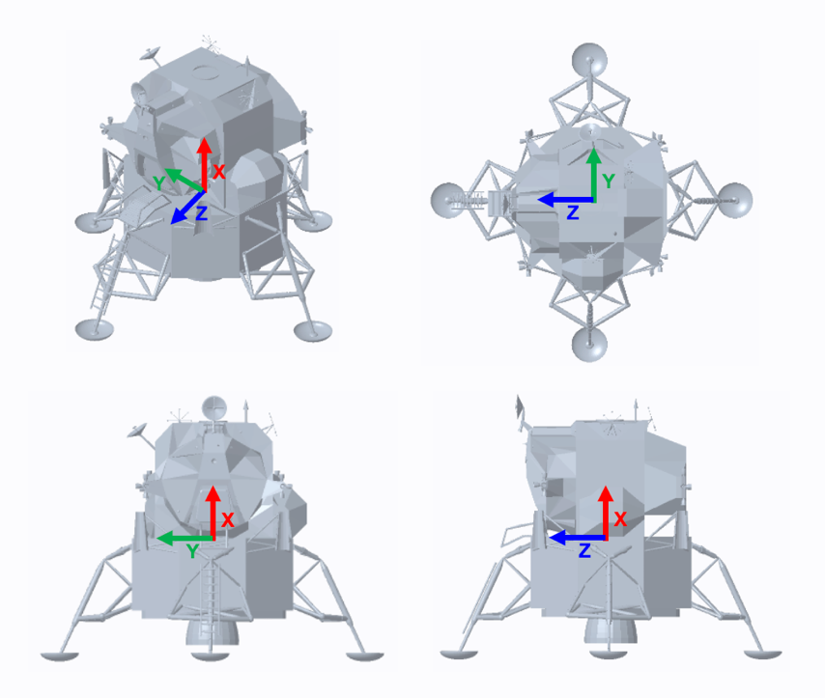
Apollo Lunar Module
3D Model: NASA, "Apollo Lunar Module,” https://science.nasa.gov/3d-resources/apollo-lunar-module/
Euler angle conventions: +Z Roll, +Y Pitch, +X Yaw
Reconstruction is conducted with two sets of mass properties one for nominal fuel at landing the other for depleted (Apollo 11)
The nominal parameters are for the Zupp comparison
Depleted parameters for the Adams comparison
Parameter | Nominal | Depleted | Unit
Total Vehicle Mass | 7,063.5 | 4,932 | kg
Primary Strut Mass | 43.1 | 43.1 | kg
Primary Inner Piston Mass | 13.6 | 13.6 | kg
Secondary Strut Mass | 5.12 | 5.12 | kg
Footpad Mass | 11 | 11 | kg
CG Height Above Footpad Bottom (+X) | 3.62 | 3.62 | m
Roll Moment of Inertia at CG (XX) | 16,492 | 7,953 | kg/m²
Pitch Moment of Inertia at CG (YY) | 17,409 | 6,332 | kg/m²
Yaw Moment of Inertia at CG (ZZ) | 20,800 | 5,879 | kg/m²

Slide 5
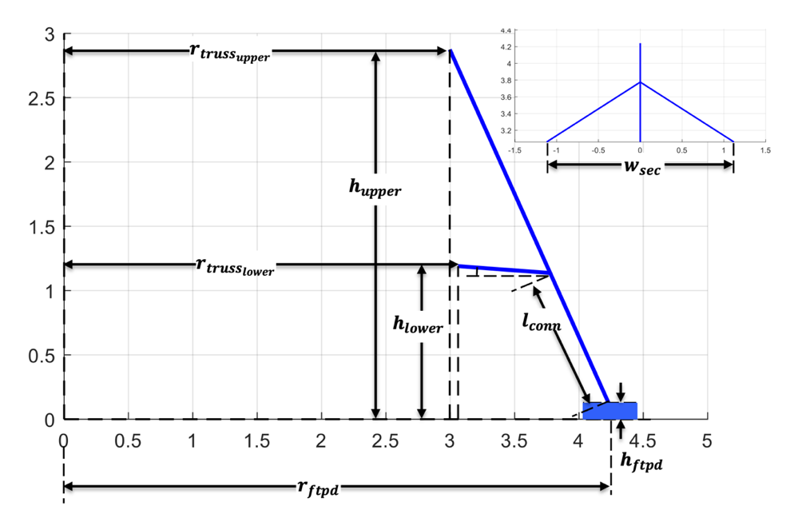
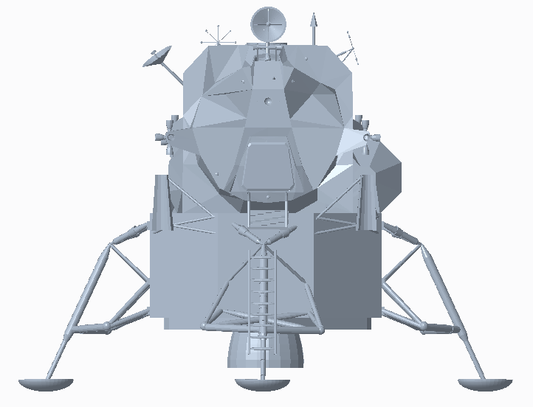
Landing Gear Geometry
Apollo LM CAD Model (static)
Orthogonal Projections of Geometry
Parameter Table
Parameter | Description | Value | Unit
r_{ftpd} | Footprint radius | 4.242 | m
r_{truss_upper} | Truss radius upper | 3.061 | m
r_{truss_lower} | Truss radius lower | 2.996 | m
h_{upper} | Upper truss height | 2.874 | m
h_{lower} | Lower truss height | 1.19 | m
h_{ftpd} | Footpad height (base to ball joint) | 0.10 | m
w_{sec} | Secondary truss width | 2.239 | m
l_{conn} | Prim-sec connection length | 1.157 | m

Slide 6
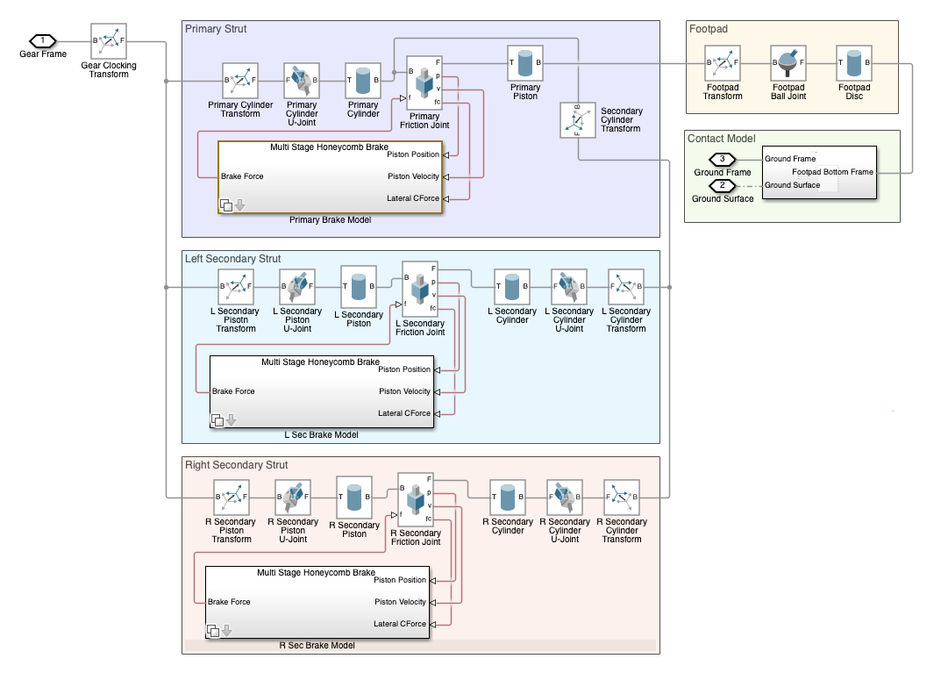
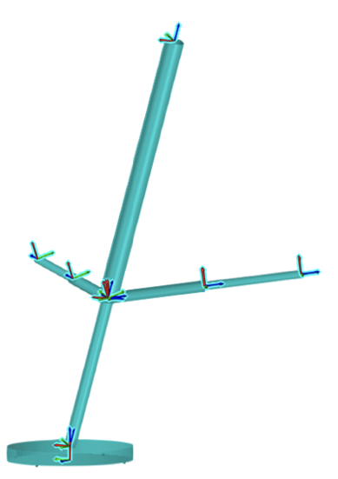
Landing Gear Diagram
Simscape™ Multibody™ block diagram of single cantilevered landing gear
Polymorphic geometry consists of basic cylinders connected by universal (2-axis rotation) and prismatic (1-axis sliding) joints for the struts; ball joint at the footpad
Custom force blocks provide forces from honeycomb attenuators and contact interaction

Slide 7
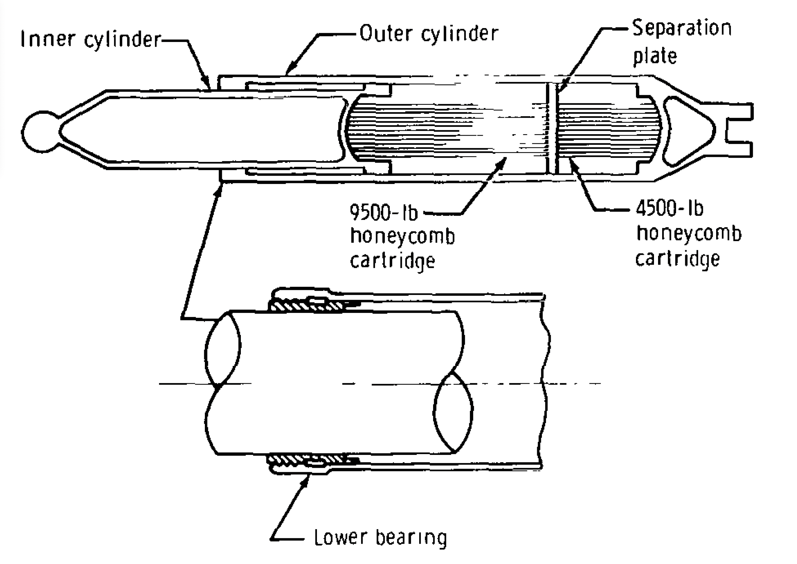
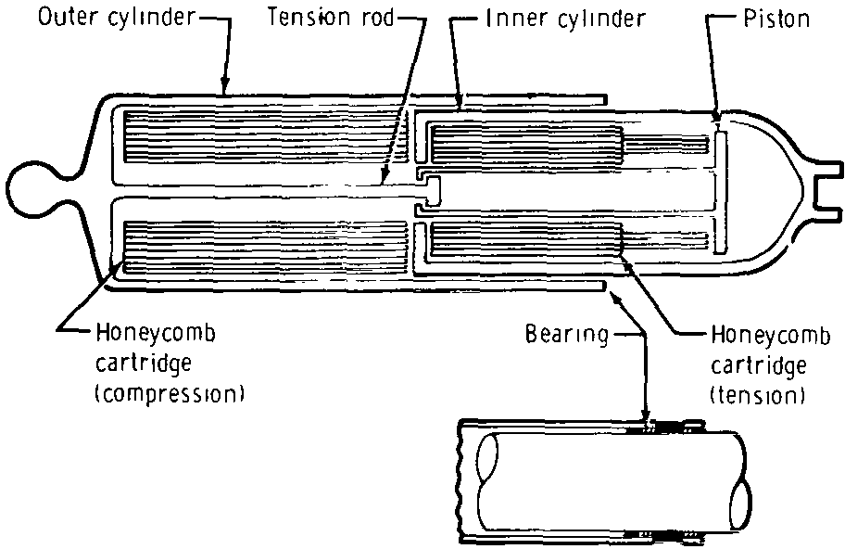
Crush Core Attenuators
Honeycomb “crush-cores” within the landing gear struts provide load mitigation upon impact
Expendable aluminum cores are machined to provide a predictable and constant (zero-order) load response under plastic deformation
The transmitted loads are limited to the deformation strength of the honeycomb
Parameter | Value | Unit
Primary Compression Stroke Limit | 0.812 | m
Primary Compression Stroke Length (Stage 1) | 0.254 | m
Primary Compression Stroke Length (Stage 2) | 0.558 | m
Primary Compression Deformation Load (Stage 1) | 20,017 | N
Primary Compression Deformation Load (Stage 2) | 42,358 | N
Secondary Compression Stroke Limit | 0.305 | m
Secondary Compression Deformation Load | 20,017 | N
Secondary Tension Stroke Limit | 0.407 | m
Secondary Tension Stroke Length (Stage 1) | 0.102 | m
Secondary Tension Stroke Length (Stage 2) | 0.305 | m
Secondary Tension Deformation Load (Stage 1) | 2,224 | N
Secondary Tension Deformation Load (Stage 2) | 22,241 | N
Contact Bearing Coefficient of Friction | 0.23
Primary Strut
Strokes in compression only
Multiple load stages
Secondary Strut
Strokes in compression and tension
Multiple load stages in tension

Slide 8
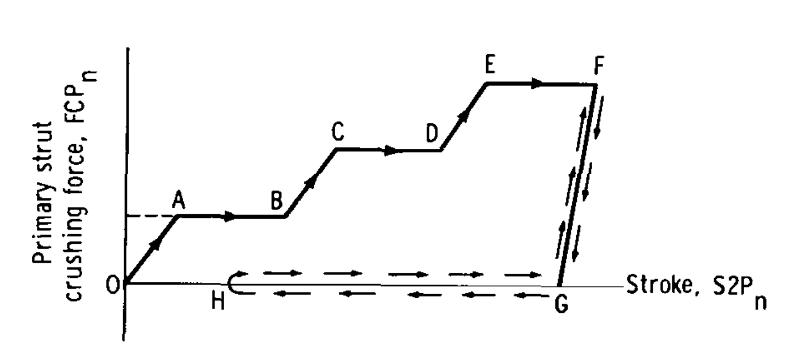
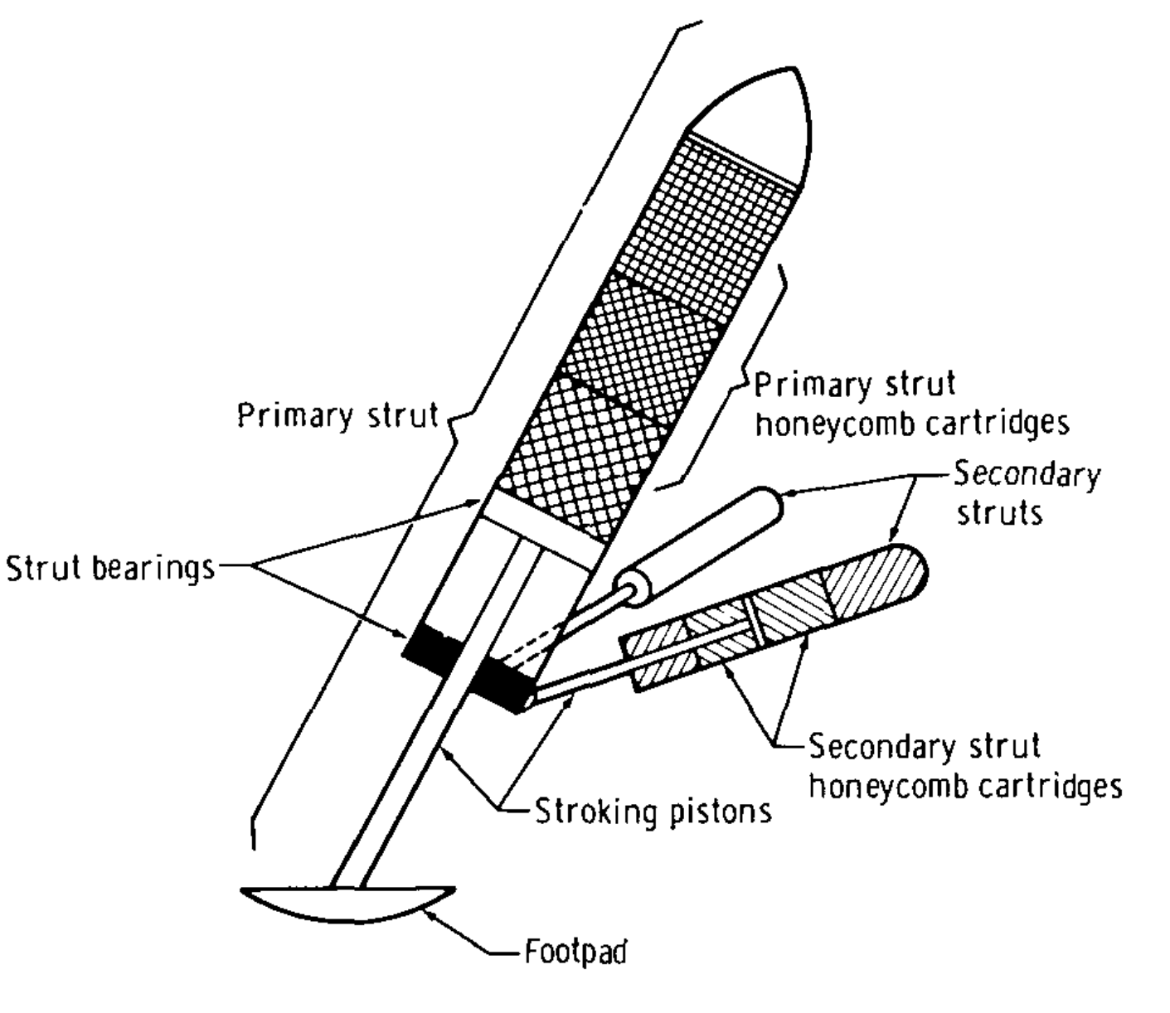





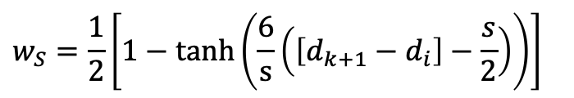







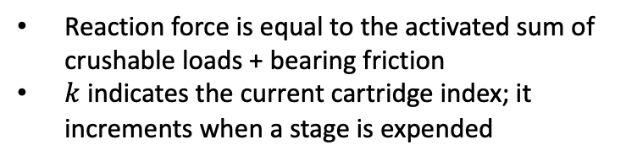




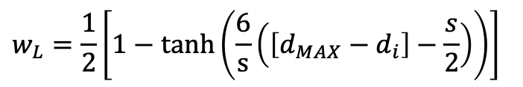



Load-Stroke Model
$$F_{k=3}$$
$$F_{k=3}$$
$$F_{k=2}$$
$$F_{k=2}$$
$$F$$
$$F_{k=1}$$
$$d_{k=3}$$
$$F_{k=1}$$
$$d_{k=3}$$
F
$$d_{k=2}$$
$$d_{k=1}$$
$$d_{k=2}$$
$$d_{i}$$
$$s$$
$$d_{MAX}$$
$$d_{k=1}$$
$$s$$
F_{c}
This load-stroke diagram illustrates the linear ramp as force ramps up to the crush load and similarly for stage transition, 0->A, B->C, etc.
The unloading segment from F->G demonstrates a similar linear ramp
Hyperbolic tangents are used for activation functions because they are numerically smooth and approximately linear over the activation distance
$$F=w_{L}\left[F_{k}+w_{S}\left(F_{k+1}−F_{k}\right)\right]+{μ_{B}F}_{c}$$
$$w_{S}=\frac{1}{2}\left[1−\tanh\left(\frac{6}{s}\left(\left[d_{k+1}−d_{i}\right]−\frac{s}{2}\right)\right)\right]$$
Stage Transition:
Reaction force is equal to the activated sum of crushable loads + bearing friction
$k$ indicates the current cartridge index; it increments when a stage is expended
$$w_{L}=\frac{1}{2}\left[1−\tanh\left(\frac{6}{s}\left(\left[d_{MAX}−d_{i}\right]−\frac{s}{2}\right)\right)\right]$$
Load/Unload:
Zupp, Jr., G.A. and Doiron, H.H., “A Mathematical Procedure for Predicting the Touchdown Dynamics of a Soft-Landing Vehicle,” NASA TN D-7045, 1971.

Slide 9
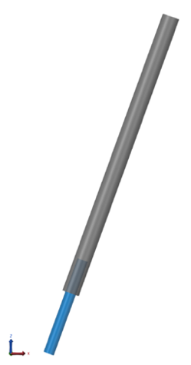
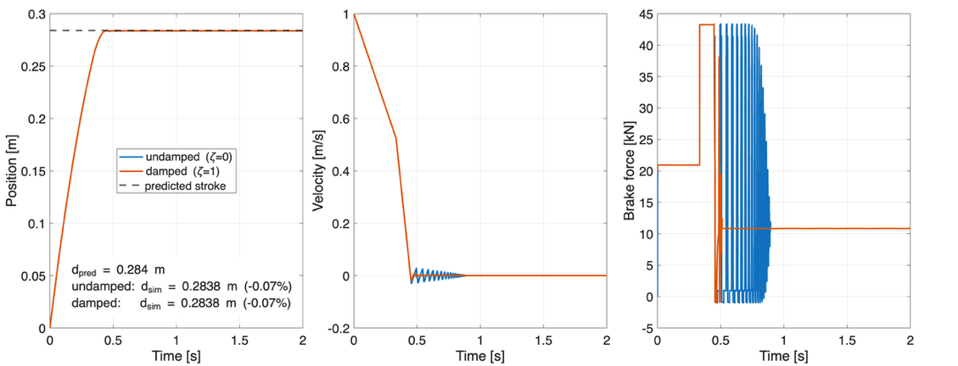
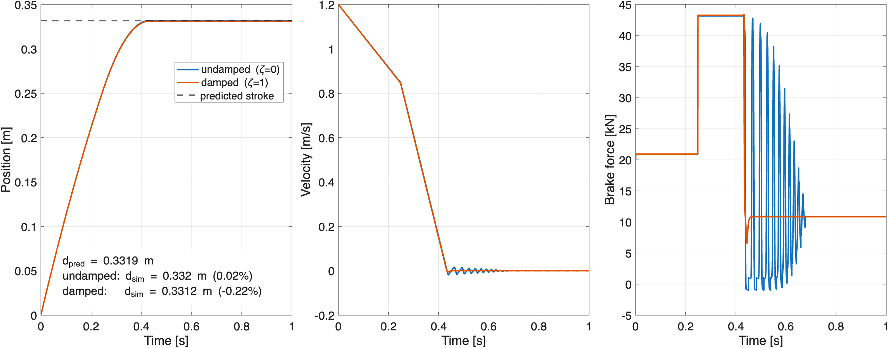
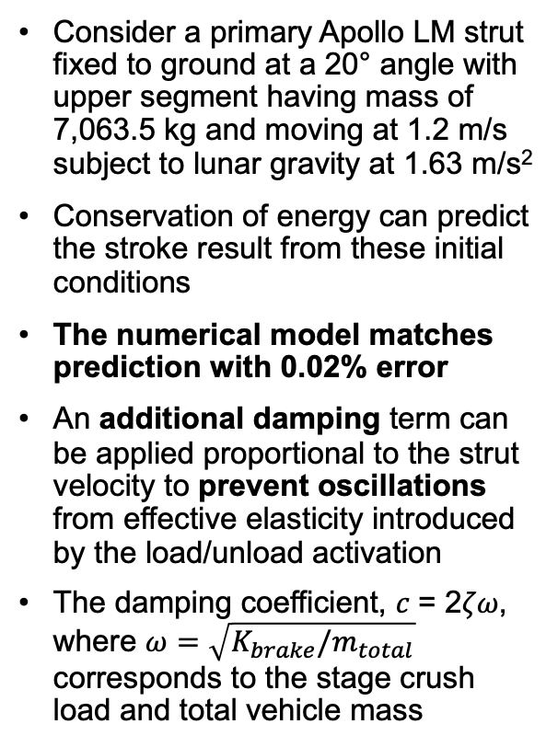
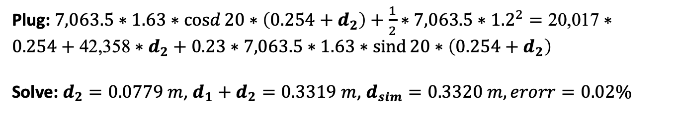
Crush Core Model Verification
Consider a primary Apollo LM strut fixed to ground at a 20° angle with upper segment having mass of 7,063.5 kg and moving at 1.2 m/s subject to lunar gravity at 1.63 m/s²
Conservation of energy can predict the stroke result from these initial conditions
The numerical model matches prediction with 0.02% error
An additional damping term can be applied proportional to the strut velocity to prevent oscillations from effective elasticity introduced by the load/unload activation
The damping coefficient, 𝑐 = 2𝜁𝜔, where $ω=\sqrt{K_{brake}/m_{total}}$ corresponds to the stage crush load and total vehicle mass
COE: $mg\cos{θ}\left(d_{1}+d_{2}\right)+\frac{1}{2}mv^{2}=F_{1}d_{1}+F_{2}d_{2}+μ_{B}mg\sin{θ}\left(d_{1}+d_{2}\right)$
Plug: $7,063.5∗1.63∗\operatorname{cosd}{20}∗\left(0.254+d_{2}\right)+\frac{1}{2}∗7,063.5∗{1.2}^{2}=\text{20}\text{,}\text{017}∗0.254+\text{42,358}∗d_{2}+0.23∗7,063.5∗1.63∗\operatorname{sind}{20}∗\left(0.254+d_{2}\right)$
Solve: $d_{2}=0.0779 m$, $d_{1}+d_{2}=0.3319 m$, $d_{sim}=0.3320 m, erorr=0.02\%$

Slide 10
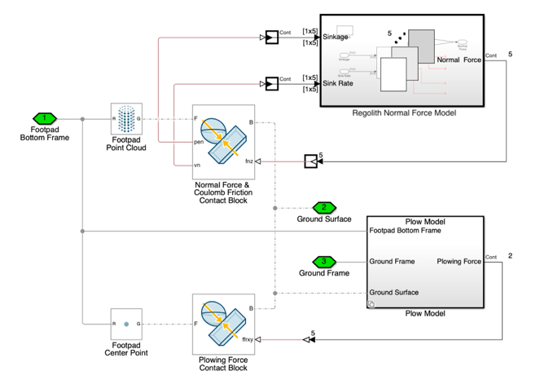
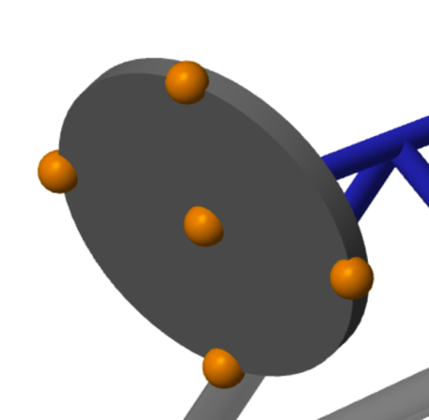
Footpad Contact Diagram
Simscape™ Multibody™ block diagram of point cloud footpad contact model
Point cloud allows for attaching linear mechanical elements to footpad
Contact blocks provide state tracking information such as penetration level and rate
Custom force blocks provide reactions to the footpad

Slide 11
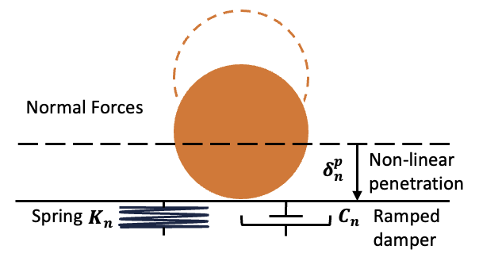
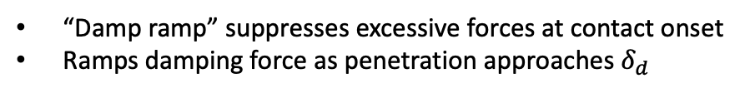
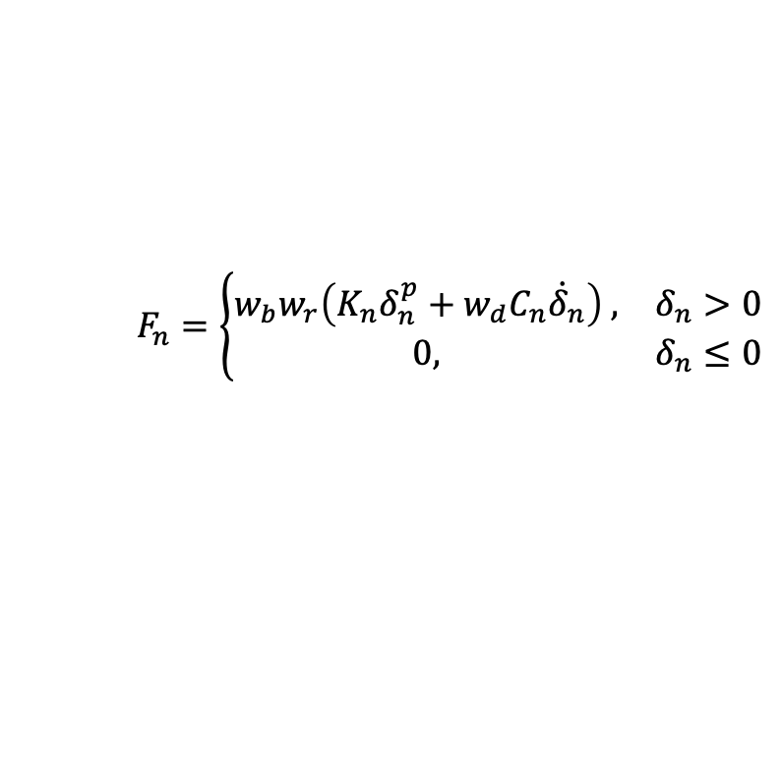
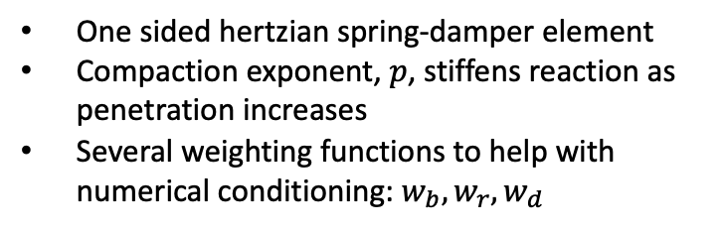
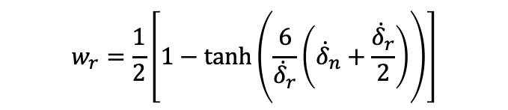

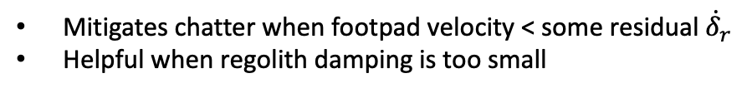
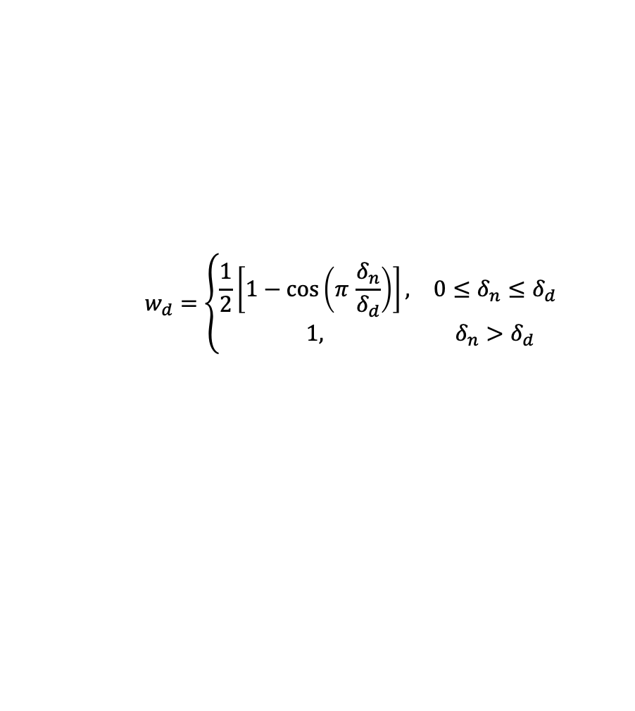
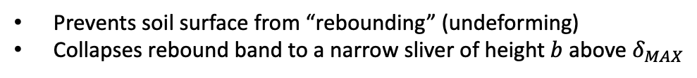
Regolith Contact Model – Normal Component
Damping Activation
$$w_{d}=\left\{\begin{matrix}\frac{1}{2}\left[1−\cos\left(π \frac{δ_{n}}{δ_{d}}\right)\right], & 0≤δ_{n}≤δ_{d} \\ 1, & δ_{n}>δ_{d}\end{matrix}\right.$$
“Damp ramp” suppresses excessive forces at contact onset
Ramps damping force as penetration approaches $δ_{d}$
Rebound Band
$$w_{b}=\frac{1}{2}\left[1−\tanh\left(\frac{6}{b}\left(\left[δ_{n}−δ_{MAX}\right]−\frac{b}{2}\right)\right)\right]$$
Normal Force Law
Prevents soil surface from “rebounding” (undeforming)
Collapses rebound band to a narrow sliver of height $b$ above $δ_{MAX}$
$$F_{n}=\left\{\begin{matrix}w_{b}w_{r}\left(K_{n}δ_{n}^{p}+w_{d}C_{n}{\dot{δ}}_{n}\right) , & δ_{n}>0 \\ 0, & δ_{n}≤0\end{matrix}\right.$$
Sinkrate Residual
$$w_{r}=\frac{1}{2}\left[1−\tanh\left(\frac{6}{{\dot{δ}}_{r}}\left({\dot{δ}}_{n}+\frac{{\dot{δ}}_{r}}{2}\right)\right)\right]$$
One sided hertzian spring-damper element
Compaction exponent, $p$, stiffens reaction as penetration increases
Several weighting functions to help with numerical conditioning: $w_{b}, w_{r}, w_{d}$
Mitigates chatter when footpad velocity < some residual ${\dot{δ}}_{r}$
Helpful when regolith damping is too small

Slide 12
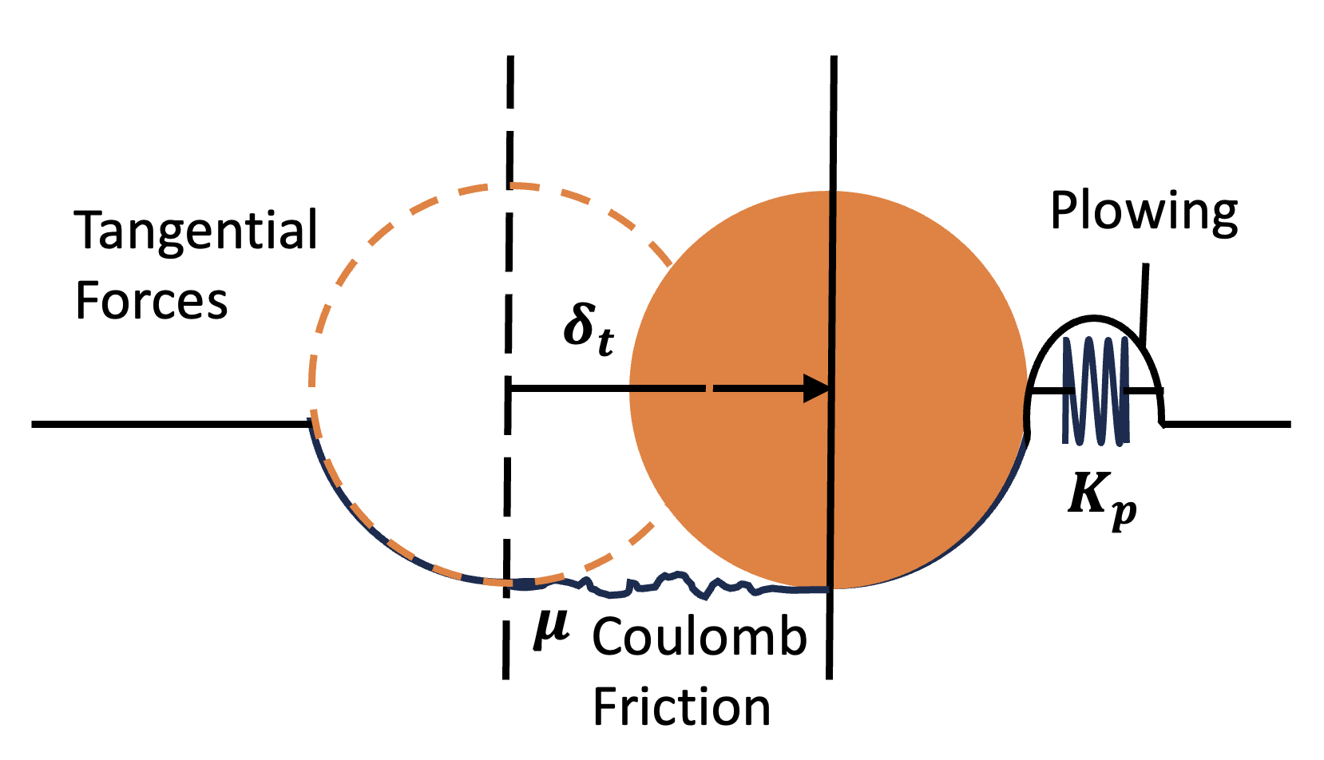

Regolith Contact Model – Tangential Component
Tangential Force Law
$$F_{t}=μF_{n}+K_{p}δ_{t}$$
Comprises friction and plowing
Friction is standard and proportional to the regolith normal force
Plowing resistance occurs as material is built up in front of footpad leading edge due to lateral “skid” motion

Slide 13
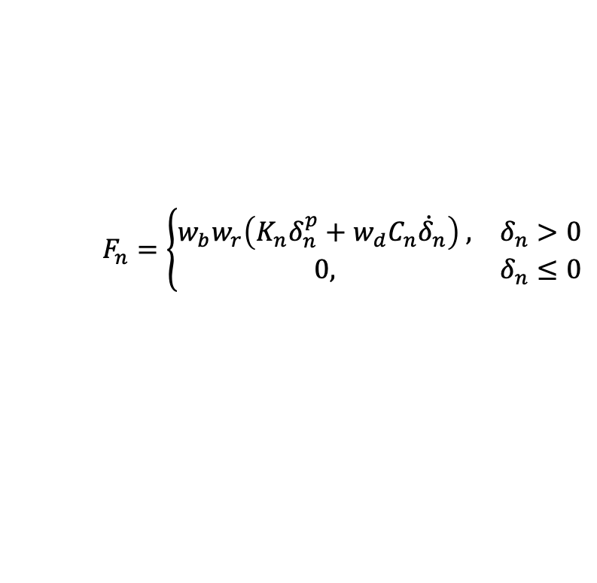
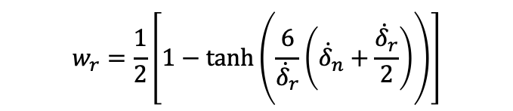
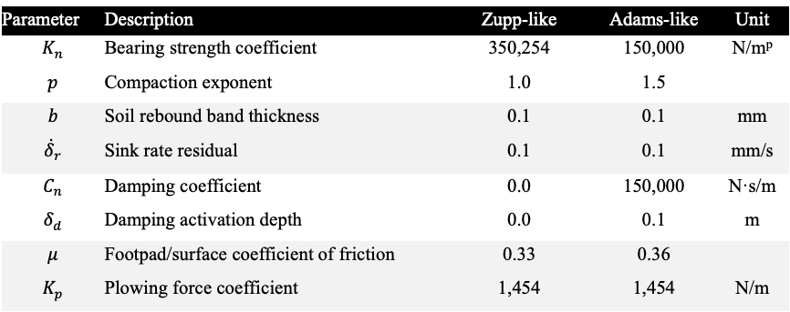

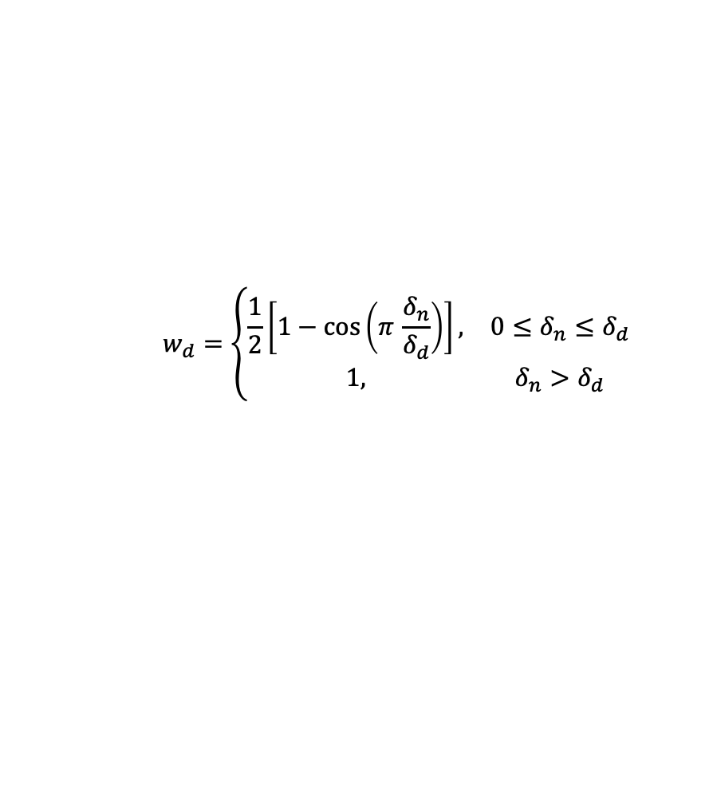

Contact Model Parameters
There are two sets of contact model parameters for reconstruction comparisons against both Zupp and Adams simulations
The Zupp simulation uses a linear spring (no compaction exponent) and no damping whereas the Adams simulation supports both
The rebound band thickness and sink rate residuals are the same for both sets
Both sets of parameters were tuned iteratively by sweeping across a range and selecting the set that produced results which best matched Apollo 11 touchdown telemetry
Parameter | Description | Zupp-like | Adams-like | Unit
$$K_{n}$$ | Bearing strength coefficient | 350,254 | 150,000 | N/m^{p}
$$p$$ | Compaction exponent | 1.0 | 1.5
$$b$$ | Soil rebound band thickness | 0.1 | 0.1 | mm
$${\dot{δ}}_{r}$$ | Sink rate residual | 0.1 | 0.1 | mm/s
$$C_{n}$$ | Damping coefficient | 0.0 | 150,000 | N·s/m
$$δ_{d}$$ | Damping activation depth | 0.0 | 0.1 | m
$$μ$$ | Footpad/surface coefficient of friction | 0.33 | 0.36
$$K_{p}$$ | Plowing force coefficient | 1,454 | 1,454 | N/m
Normal Force Law
Damping Activation
Sinkrate Residual
$$w_{d}=\left\{\begin{matrix}\frac{1}{2}\left[1−\cos\left(π \frac{δ_{n}}{δ_{d}}\right)\right], & 0≤δ_{n}≤δ_{d} \\ 1, & δ_{n}>δ_{d}\end{matrix}\right.$$
$$w_{r}=\frac{1}{2}\left[1−\tanh\left(\frac{6}{{\dot{δ}}_{r}}\left({\dot{δ}}_{n}+\frac{{\dot{δ}}_{r}}{2}\right)\right)\right]$$
$$F_{n}=\left\{\begin{matrix}w_{b}w_{r}\left(K_{n}δ_{n}^{p}+w_{d}C_{n}{\dot{δ}}_{n}\right) , & δ_{n}>0 \\ 0, & δ_{n}≤0\end{matrix}\right.$$
Rebound Band
Tangential Force Law
$$w_{b}=\frac{1}{2}\left[1−\tanh\left(\frac{6}{b}\left(\left[δ_{n}−δ_{MAX}\right]−\frac{b}{2}\right)\right)\right]$$
$$F_{t}=μF_{n}+K_{p}δ_{t}$$

Slide 14
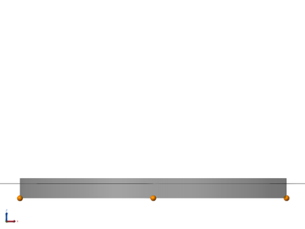
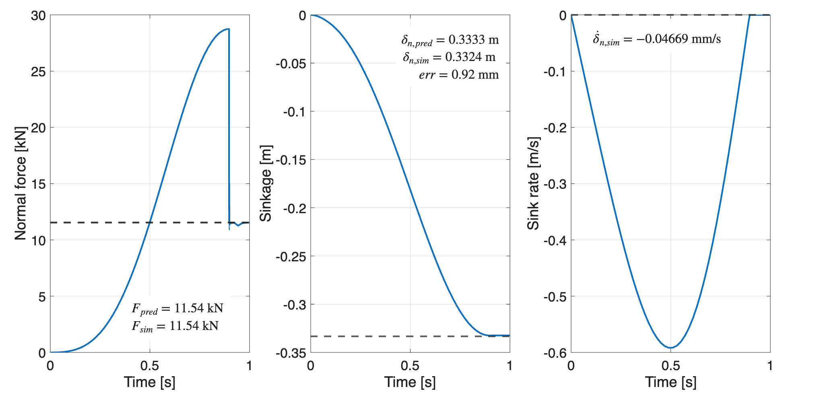
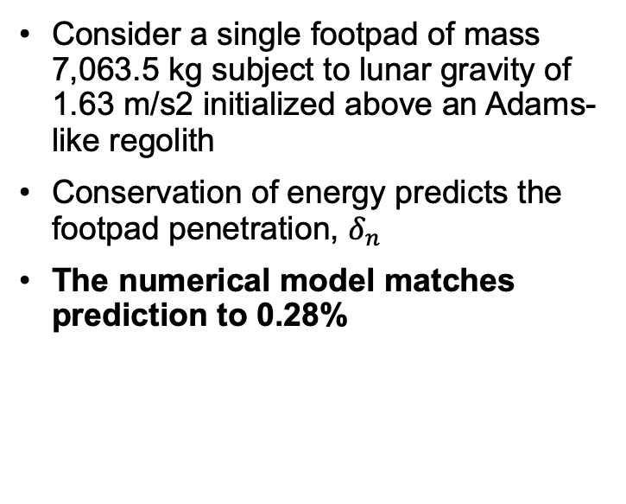

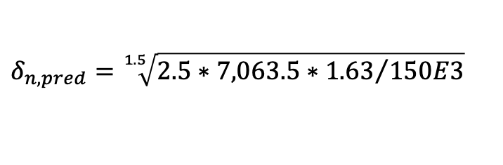
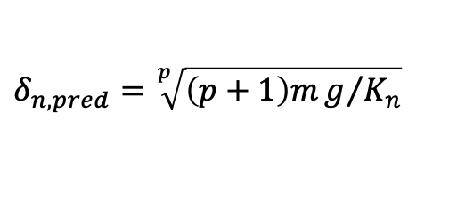
Contact Model Verification
Consider a single footpad of mass 7,063.5 kg subject to lunar gravity of 1.63 m/s2 initialized above an Adams-like regolith
Conservation of energy predicts the footpad penetration, $δ_{n }$
The numerical model matches prediction to 0.28%
Footpad Disc Visualization
Regolith Surface
Footpad Point Cloud
$$δ_{n,pred}=\sqrt[p]{\left(p+1\right)mg/{K_{n}}}$$
$$δ_{n,pred}=\sqrt[1.5]{2.5∗{7,063.5∗1.63}/{150E3}}$$
$δ_{n,pred}=0.3333 m$, $δ_{n,sim}=0.3324 m$

Slide 15
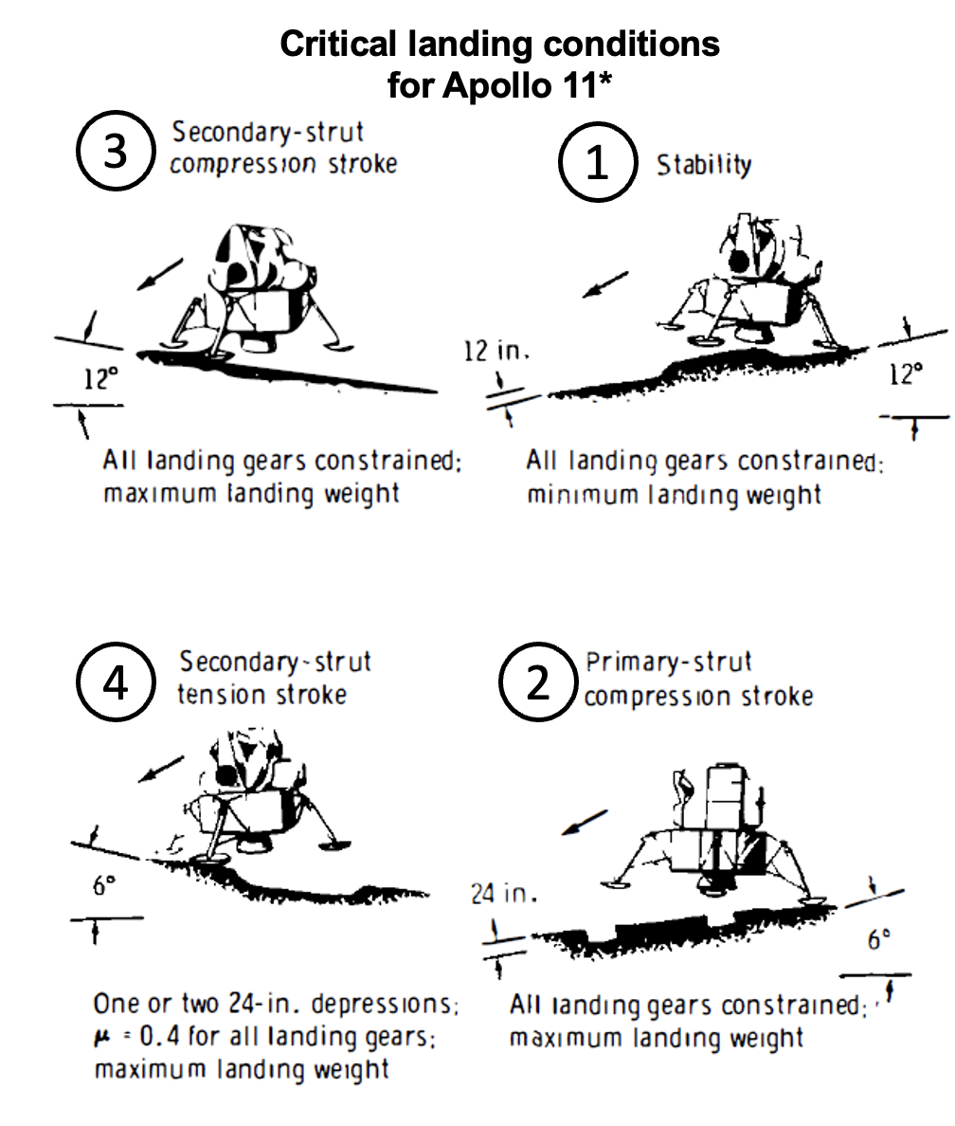
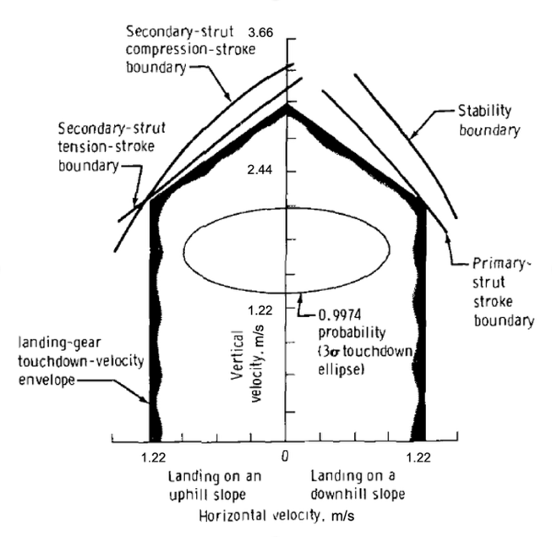
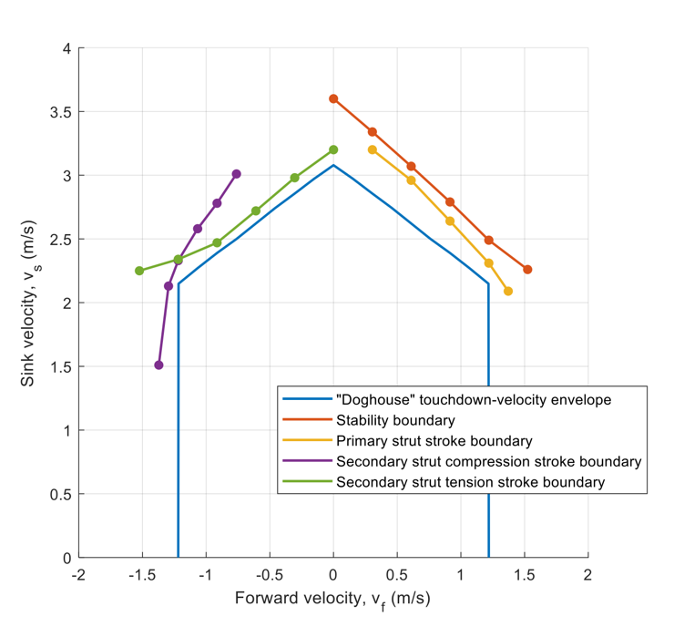
Performance Bounds “Doghouse”
Historical Doghouse
Adams Reconstruction

Slide 16
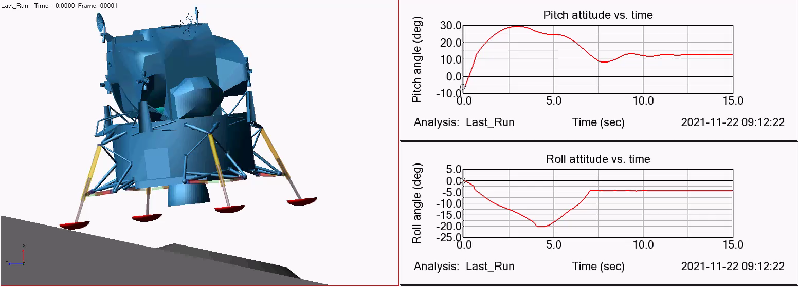
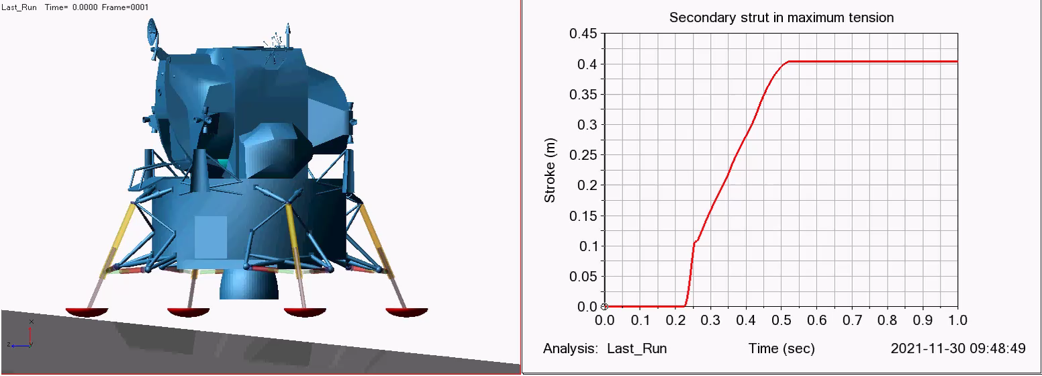
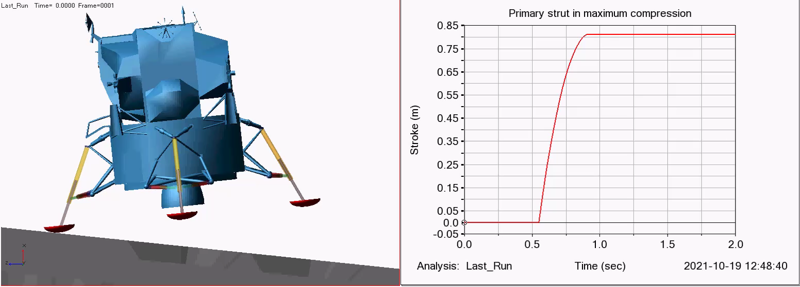
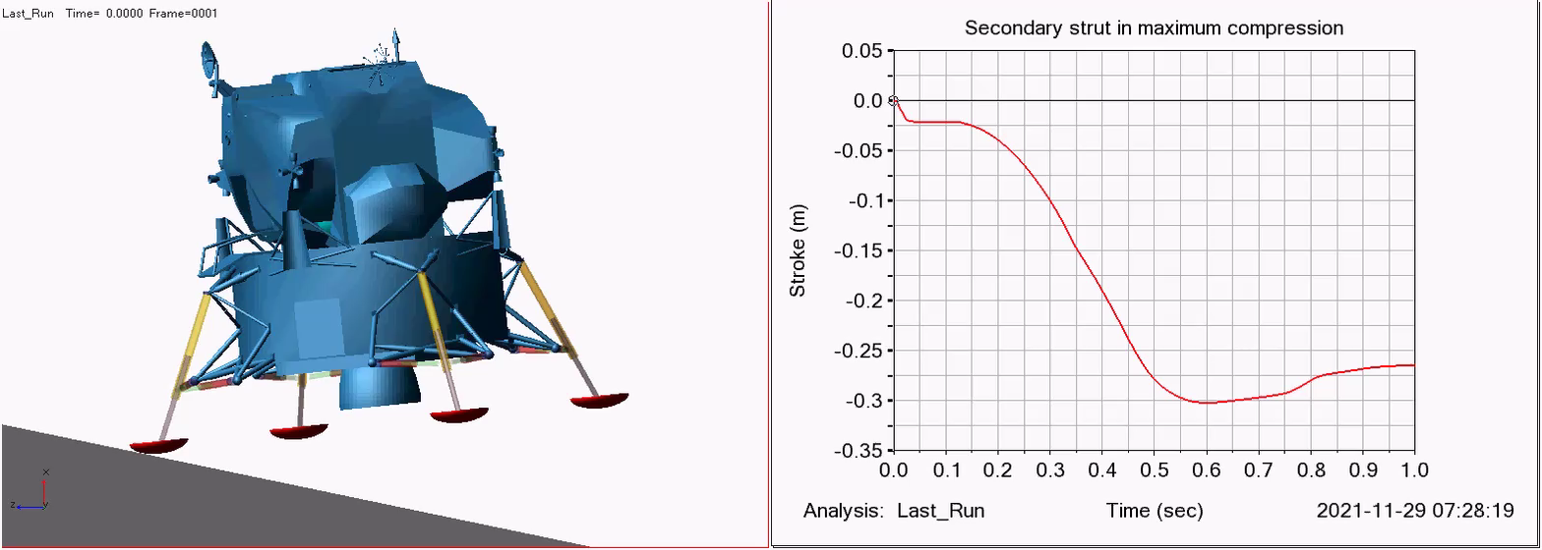
MSC Adams Bounding Performance Videos
Stability Boundary
Secondary Strut Tension Boundary
Primary Strut Compression Boundary
Secondary Strut Compression Boundary

Slide 17
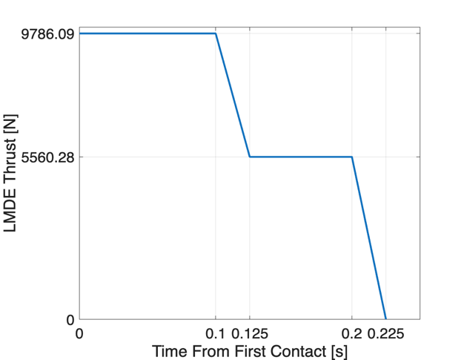
Apollo 11 Tail Off Thrust
The vehicle is outfitted with the LM Descent Engine (LMDE)
The Apollo 11 LM made contact with the surface before the LMDE had fully shut down
Due to the limited gimbaling range, it is assumed that this thrust acts through the body +X axis at the center of mass¹
¹R. F. Stengel, "Manual Attitude Control of the Lunar Module," AIAA Guidance, Control, and Flight Mechanics Conference, Princeton, NJ, Aug. 18–20, 1969, AIAA Paper 69-892.

Slide 18
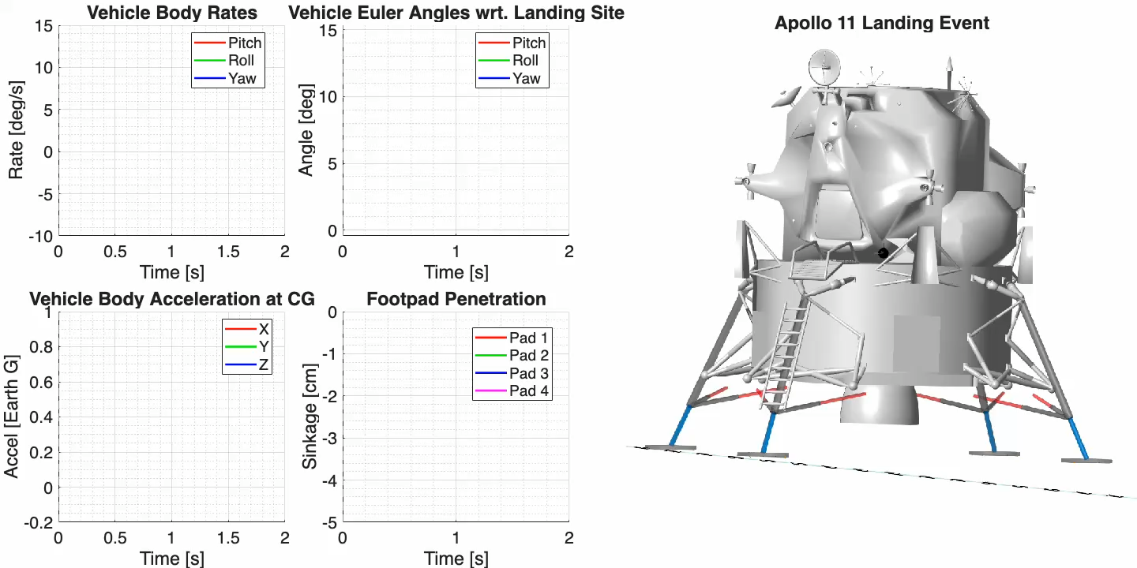
Zupp Landing Event

Slide 19
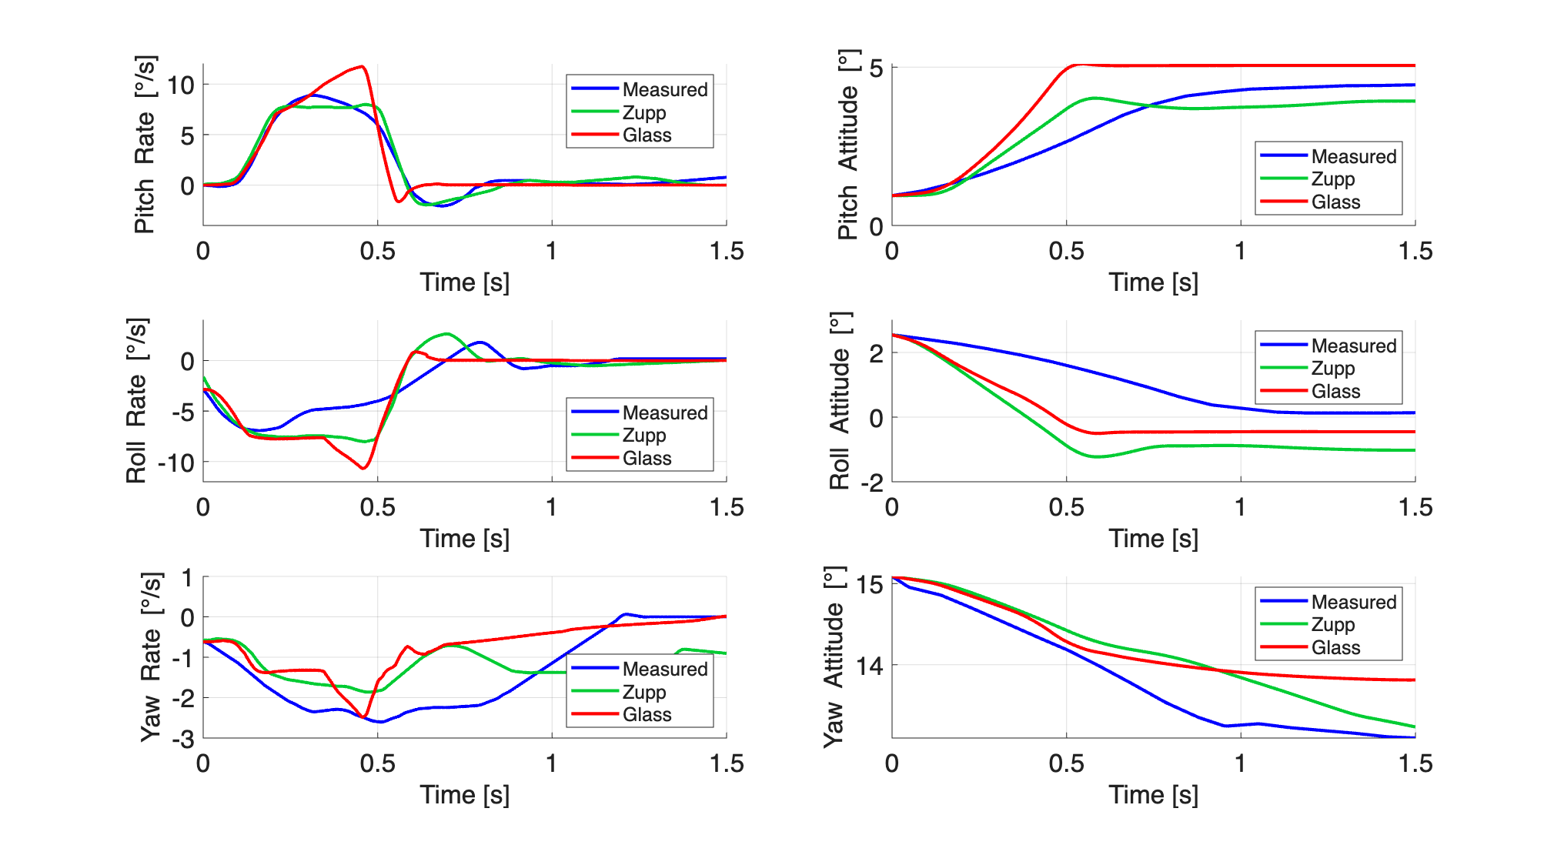
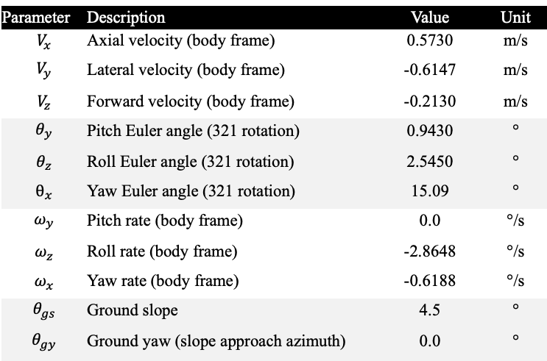
Zupp Comparison
As in Zupp, the +Y and +Z footpads hit nearly together, which kicks off the roll-left / pitch-up response
The rate histories evolve in-family and settle to similar final attitudes, with the best agreement in pitch and roll where the motion is largest
Yaw is the main disagreement, but GLASS is closer to the measured peak yaw rate and time-to-rest than Zupp
Zupp’s curves are missing the transient peaks seen in GLASS, which points to differences in contact rebound treatment or high-frequency sensitivity (Zupp integrator details aren’t available)
Penetration and skid are consistent with flight observations: photos suggest ~2–7.62 cm penetration; GLASS predicts 1.93–6.68 cm and a max skid of ~7.01 cm (flight up to ~7.62 cm)
Parameter | Description | Value | Unit
$$V_{x}$$ | Axial velocity (body frame) | 0.5730 | m/s
$$V_{y}$$ | Lateral velocity (body frame) | -0.6147 | m/s
$$V_{z}$$ | Forward velocity (body frame) | -0.2130 | m/s
$$θ_{y}$$ | Pitch Euler angle (321 rotation) | 0.9430 | °
$$θ_{z}$$ | Roll Euler angle (321 rotation) | 2.5450 | °
$$θ_{x}$$ | Yaw Euler angle (321 rotation) | 15.09 | °
$$ω_{y}$$ | Pitch rate (body frame) | 0.0 | °/s
$$ω_{z}$$ | Roll rate (body frame) | -2.8648 | °/s
$$ω_{x}$$ | Yaw rate (body frame) | -0.6188 | °/s
$$θ_{gs}$$ | Ground slope | 4.5 | °
$$θ_{gy}$$ | Ground yaw (slope approach azimuth) | 0.0 | °

Slide 20
Adams Landing Event

Slide 21


Adams Comparison
Contact sequence and resulting motion line up with the Apollo 11 measurements
GLASS and Adams are basically on top of each other in pitch/roll attitude, which are the dominant channels
The pitch-rate ramp is the vehicle pivoting on two planted footpads under near-constant acceleration; the sharp arrest is when the opposite pads come in
The measured rates are smoother and slightly time-lagged, consistent with low-pass telemetry filtering
Penetration stays in the flight-observed regime (4.14–6.32 cm). Skid tops out at 4.17 cm, which is expected with the higher assumed footpad friction in the Adams-like case
Parameter | Description | Value | Unit
$$V_{x}$$ | Axial velocity (body frame) | 0.5740 | m/s
$$V_{y}$$ | Lateral velocity (body frame) | -0.6481 | m/s
$$V_{z}$$ | Forward velocity (body frame) | -0.0447 | m/s
$$θ_{y}$$ | Pitch Euler angle (321 rotation) | 1.4827 | °
$$θ_{z}$$ | Roll Euler angle (321 rotation) | 2.2937 | °
$$θ_{x}$$ | Yaw Euler angle (321 rotation) | 0.0 | °
$$ω_{y}$$ | Pitch rate (body frame) | 0.0 | °/s
$$ω_{z}$$ | Roll rate (body frame) | -2.8648 | °/s
$$ω_{x}$$ | Yaw rate (body frame) | -0.6188 | °/s
$$θ_{gs}$$ | Ground slope | 4.2 | °
$$θ_{gy}$$ | Ground yaw (slope approach azimuth) | -12.0 | °

Slide 22

Strut Stroke Comparisons
Apollo 11 strut strokes were estimated with photographic analysis
Agreement rankings: Rogers, Adams, Zupp, GLASS
GLASS is the outlier in load: it predicts some primary stroke, which helps explain smaller secondary strokes
GLASS footpad shape and point cloud approach conflicting
Biggest measured conflict: −Z left secondary shows large stroke in photos, but all sims predict ~0
Landing Gear strut | Photo average | Rogers sim |  | Zupp sim | GLASS sim (Zupp-like) |  |  | Adams sim | GLASS sim (Adams-like)
Plus-Z, primary | 0.00 | 0.00 |  | 0.00 | 0.00 |  |  | 0.00 | 0.00
Plus-Z, right | -- | 0.51 |  | 0.00 | 0.00 |  |  | 0.00 | 0.00
Plus-Z, left | 10.16 | 9.14 |  | 4.57 | 2.85 |  |  | 6.10 | 2.24
Minus-Z, primary | 0.00 | 0.00 |  | 0.00 | 2.21 |  |  | 0.00 | 0.00
Minus-Z, right | 6.35 | 8.13 |  | 3.81 | 4.50 |  |  | 9.40 | 2.53
Minus-Z, left | 11.43 | 0.51 |  | 0.00 | 0.25 |  |  | 0.00 | 0.00
Plus-Y, primary | 0.00 | 0.00 |  | 0.00 | 0.00 |  |  | 0.00 | 0.00
Plus-Y, right | 7.11 | 8.64 |  | 4.57 | 3.43 |  |  | 9.14 | 2.17
Plus-Y, left | 1.27 | 2.54 |  | 1.78 | 1.21 |  |  | 2.29 | 0.84
Minus-Y, primary | 0.00 | 0.00 |  | 0.00 | 5.22 |  |  | 0.00 | 0.99
Minus-Y, right | 8.13 | 3.56 |  | 2.54 | 1.62 |  |  | 2.29 | 0.37
Minus-Y, left | 0.00 | 3.56 |  | 3.05 | 1.45 |  |  | 0.25 | 0.55
NASA photograph AS11-40-5915

Slide 23

Thank You!

