Slide 1
Implementation of Data-Driven Fault Recovery Actions for Gateway Vehicle Systems Manager
Nicholas Ohi¹, Gordon Aaseng², Javier Guzman Andara³, Michael Gasper⁴, Jacob Cira², Laura Barron², Jeremy Frank⁵
March 23, 2026
¹NASA Johnson Space Center/CACI
²NASA Johnson Space Center
³NASA Johnson Space Center/Amentum
⁴NASA Glenn Research Center
⁵NASA Ames Research Center
This document has been reviewed for Proprietary, CUI, and Export Control (ITAR/EAR) and has been determined to be non-sensitive.
It has been approved for public release via the NASA Scientific and Technical Information (STI) Process DAA <fill in the number, or modify this statement to identify the process the document was released under>.

Slide 2
Overview
Executive Summary: This presentation describes a data-driven approach taken to implement complex fault response behaviors for the Lunar Gateway Vehicle Systems Manager (VSM). The particular example highlighted is the unexpected loss of communication with Earth fault response. The approach uses the VSM autonomous Planning capability to create more complex behaviors from the building blocks of simpler behaviors. The key lesson learned is that data driven approaches can be used to implement complex autonomous behaviors, when the ability to update flight software is limited by schedule constraints.
Topics:
  Introduction: Gateway and VSM
  Problem Description
  Methodology
  VSM Planner and Task Constraint Design
  Conclusions, Lessons Learned, and Forward Work

Slide 3
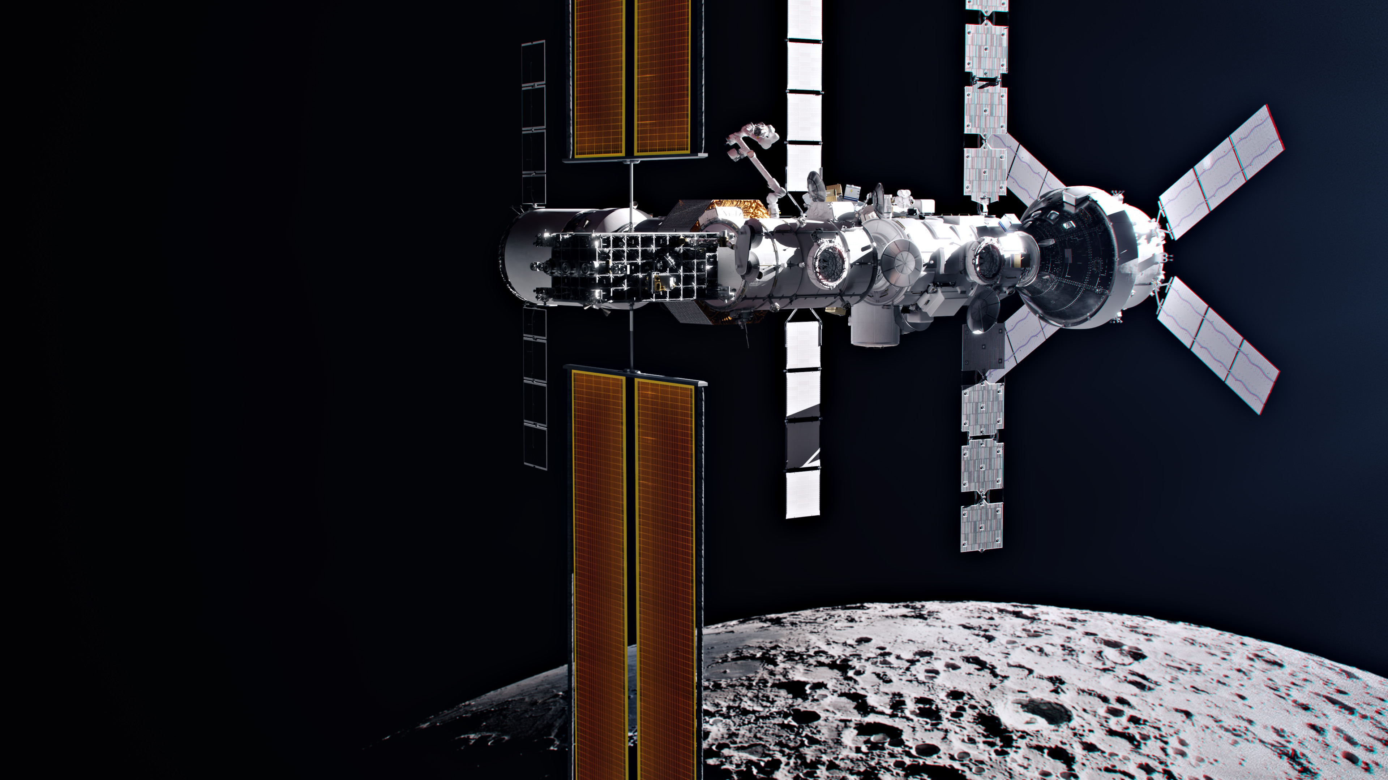

We’re building humanity’s first space station around the Moon
Gateway is central to the NASA-led Artemis missions to return to the Moon for scientific discovery and chart a path for the first human missions to Mars. The small space station will be a multi-purpose outpost supporting lunar surface missions, science in lunar orbit, and human exploration further into the cosmos. NASA is working with commercial and international partners to build humanity’s lunar Gateway.
nasa.gov/gateway

Slide 4
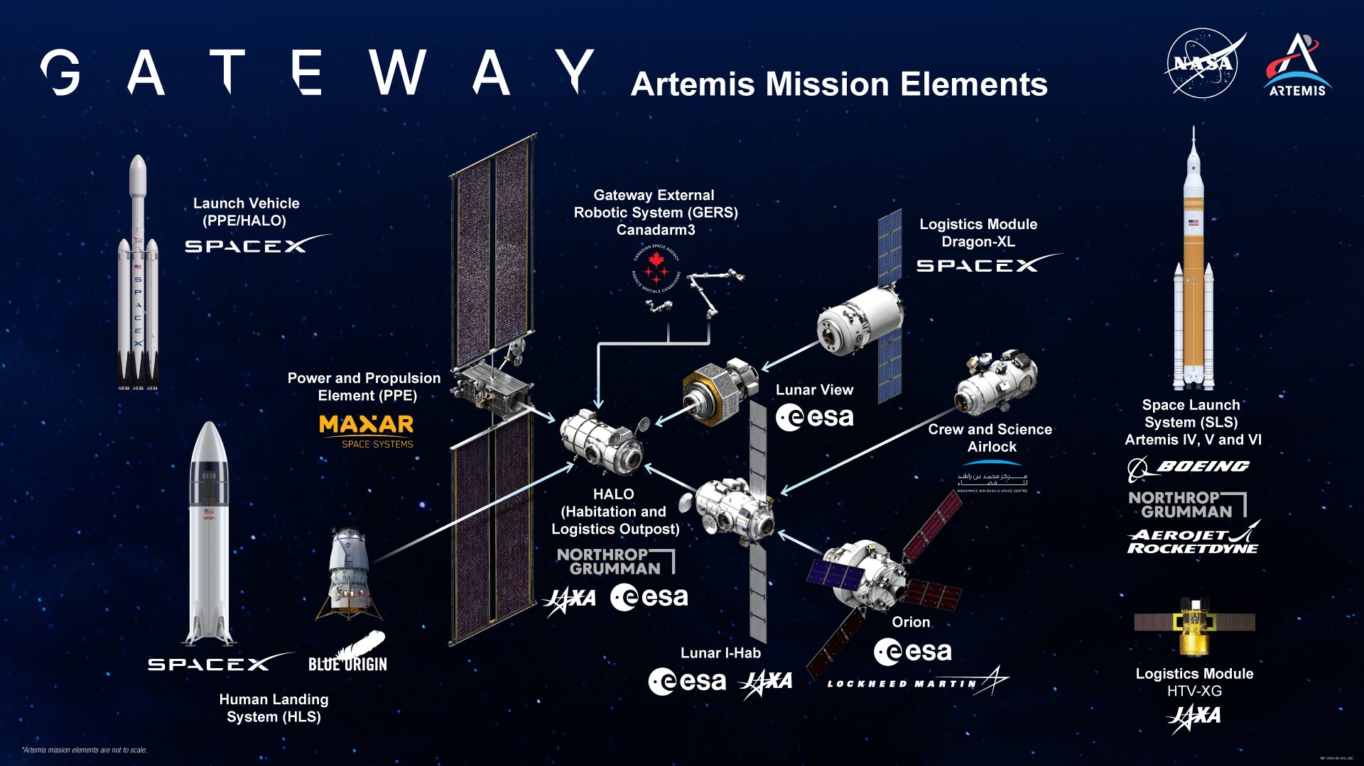

Slide 5
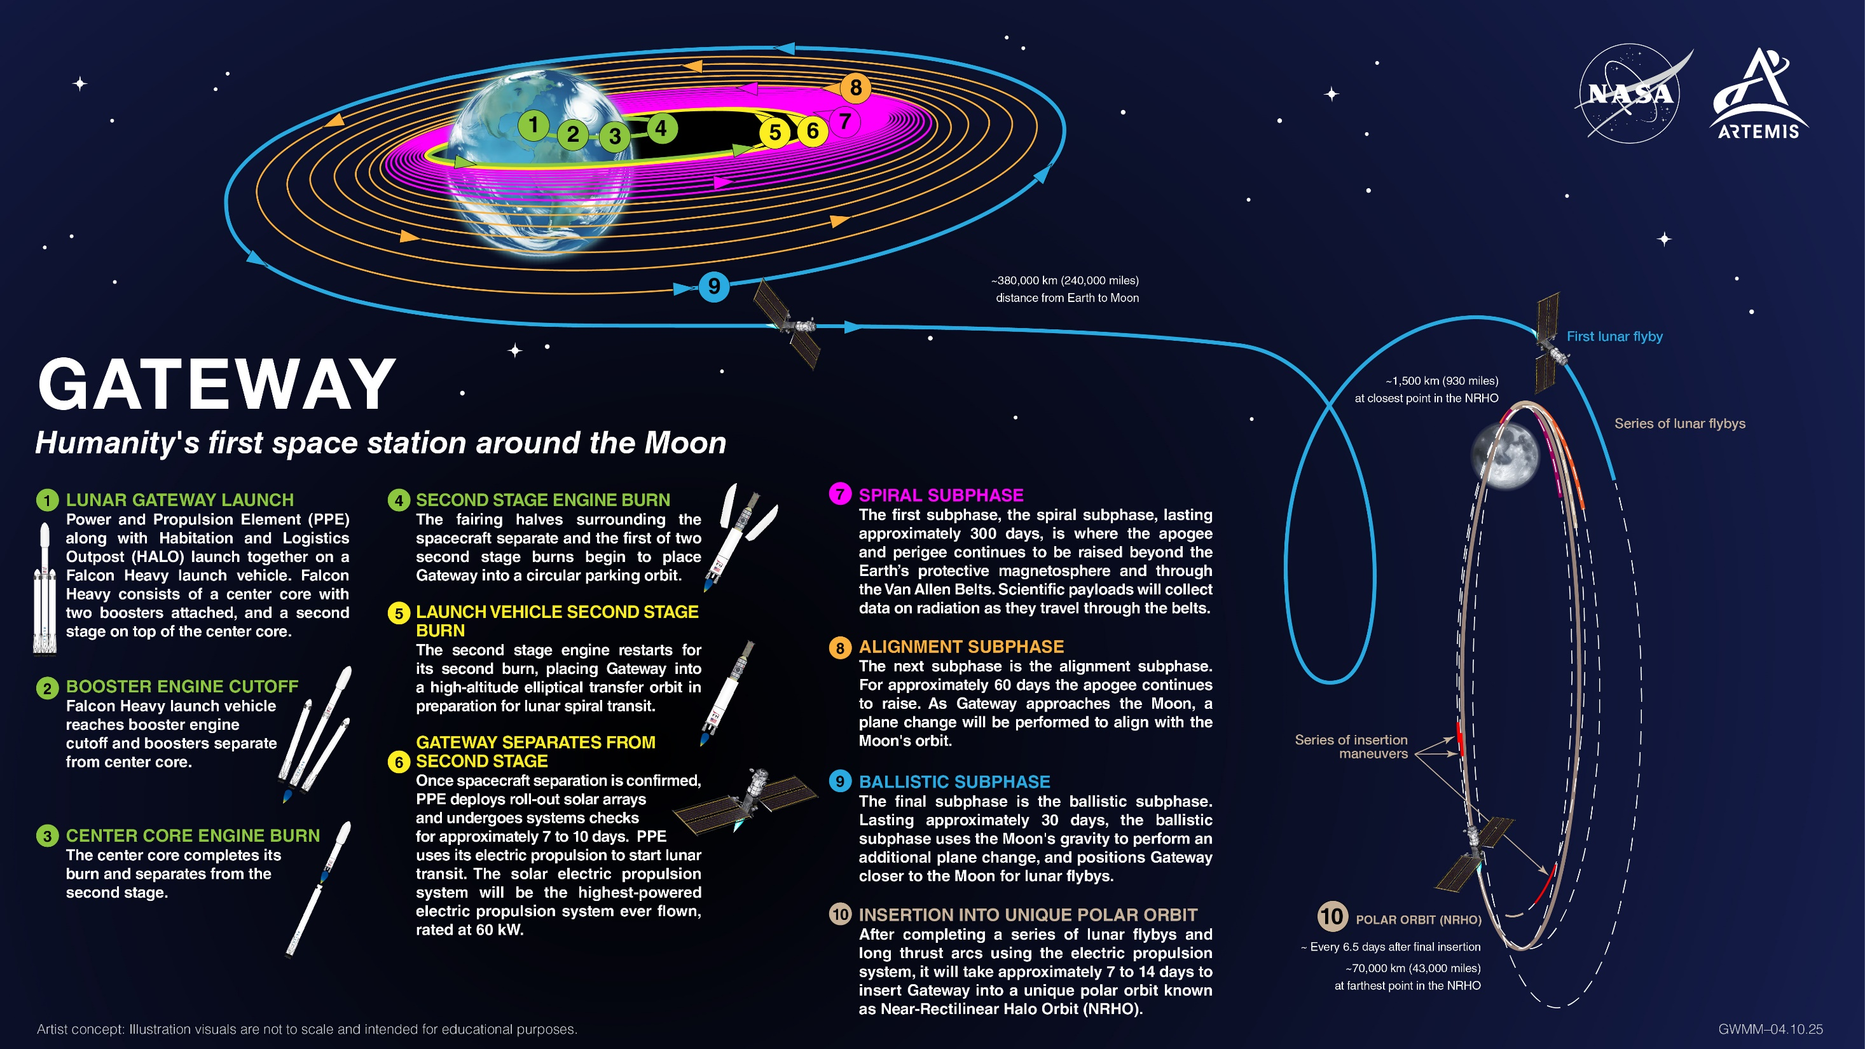
Notes:
The Lunar Gateway Launch, mapped. Gateway's first elements, the Power and Propulsion Element and HALO (Habitation and Logistics Outpost), will launch together to lunar orbit, where they’ll set the stage for Artemis IV: the first Gateway assembly mission. During this milestone mission, the Artemis IV crew will deliver the European Space Agency's Lunar I-Hab, dock it to HALO, and enter the space station for the very first time.
NASA is currently targeting a 2027 launch for HALO and the Power and Propulsion Element. This timeline allows for the roughly year-long journey to lunar orbit and ensures everything is in place ahead of Artemis IV.

Slide 6
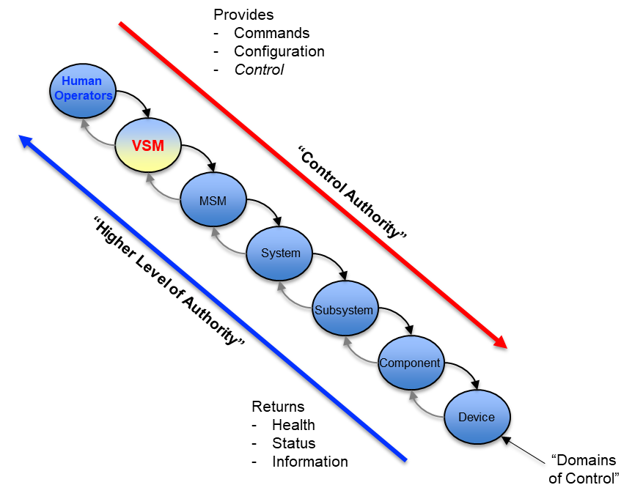
Vehicle Systems Manager (VSM)
VSM is the top-level Autonomous System Manager software system in the Lunar Gateway
  5 main functions: Mission Management and Timeline Execution,
  Resource Management, Fault Management, Vehicle Control
  and Operation (VCO), Human Interactions
  Interactions
    Modules
      Sends commands, accepts data. Coordinates across module
      boundaries.
    Humans
      Accepts commands, sends data. Allows direct control through
      various means
    Visiting Vehicles
      Gateway interaction point

Slide 7
Vehicle Systems Manager (VSM), cont.
Composition
  Component-based with assume-guarantee contracts
  Data-driven
  Implemented in core Flight Software (cFS)
Models & Abstraction
  Static data (data stores) and computable data (runtime models) will be needed for VSM to perform its functions
  Data and commands will have various abstraction levels to ensure that proper data and computation management occurs
Runtime Models | Data Stores
Fault trees/fault propagation Prognosis Spatial (distance calculations) Redundancy (for complex cases) Condition comparisons (e.g., linear regressions) Resource (e.g., future propagation) | Configurations & Modes Flight rules & constraints (typically) Inventory Network tables Tasks

Slide 8
Problem Description
Loss of Earth Communication Fault Response Behavior
  Desired behavior is to try each piece of comm hardware to find something that works to reestablish comm with ground operators on Earth
  Can be modeled as a Finite State Machine
  Loss of comm is detected by the sustained loss of cyclic Internet Control Message Protocol (ICMP) ping packets, transmitted by Gateway, to ground, and returned by ground to Gateway
Redundant RF hardware available?
Ping restored?
Lose ping
Turn off high-rate data
N
Swap to alternate antenna A
Y
Exit
Y
N
N
Ping restored?
Ping restored?
Swap to redundant RF hardware
Swap to alternate antenna B
Y
Exit
And more…

Slide 9
Problem Description, cont.
VSM Software and Data Product Development Schedule
  VSM flight software (FSW) is already in the late stages of development and nearing formal Verification and Validation (V&V)
  Do not have existing FSW capability to implement fault response behavior as Finite State Machine
  Any new FSW functions that require significant development at this stage creates schedule risk for the Gateway program
  Data products (e.g., Tasks, Goals, Constraints) have less restrictive schedule constraints at this stage of the program
  Use data-driven approach to implement the desired fault response behavior, rather than new FSW code

Slide 10
Methodology
Data driven approach, using existing VSM FSW capabilities
  Use the VSM Fault Model to trigger specific “Faults” associated with each step in the fault response
  Each fault sends a specific set of “Goals” to the VSM Planner algorithm
  Each Goal has an associated “priority value” associated with the order of actions in the fault response behavior
  The Tasks that will be considered by the Planner to satisfy these Goals have “Precondition Constraints” that ensure only one of the Goals can be achieved at a time
Goal 1
☑ Achievable
Set of Goals (Fault A)
Task α
Task β
Fault Model
Planner
Goal 2
☒ Conflicting outcome, lower priority
Set of Tasks
Scheduler
Task γ
Goal 3
☒ Conflicting outcome, lower priority
VSM Timeline

Slide 11
Methodology
Data driven approach, using existing VSM FSW capabilities
  Use the VSM Fault Model to trigger specific “Faults” associated with each step in the fault response
  Each fault sends a specific set of “Goals” to the VSM Planner algorithm
  Each Goal has an associated “priority value” associated with the order of actions in the fault response behavior
  The Tasks that will be considered by the Planner to satisfy these Goals have “Precondition Constraints” that ensure only one of the Goals can be achieved at a time
Goal 1
☒ Not Achievable
Set of Goals (Fault B)
Task δ
Task ε
Fault Model
Planner
Goal 2
☑ Achievable
Set of Tasks
Scheduler
Goal 3
☒ Conflicting outcome, lower priority
VSM Timeline

Slide 12
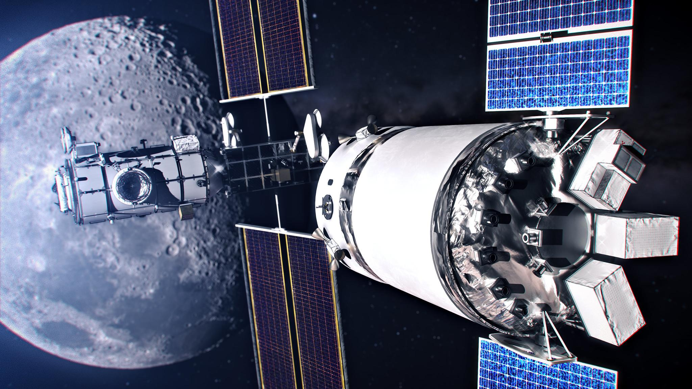
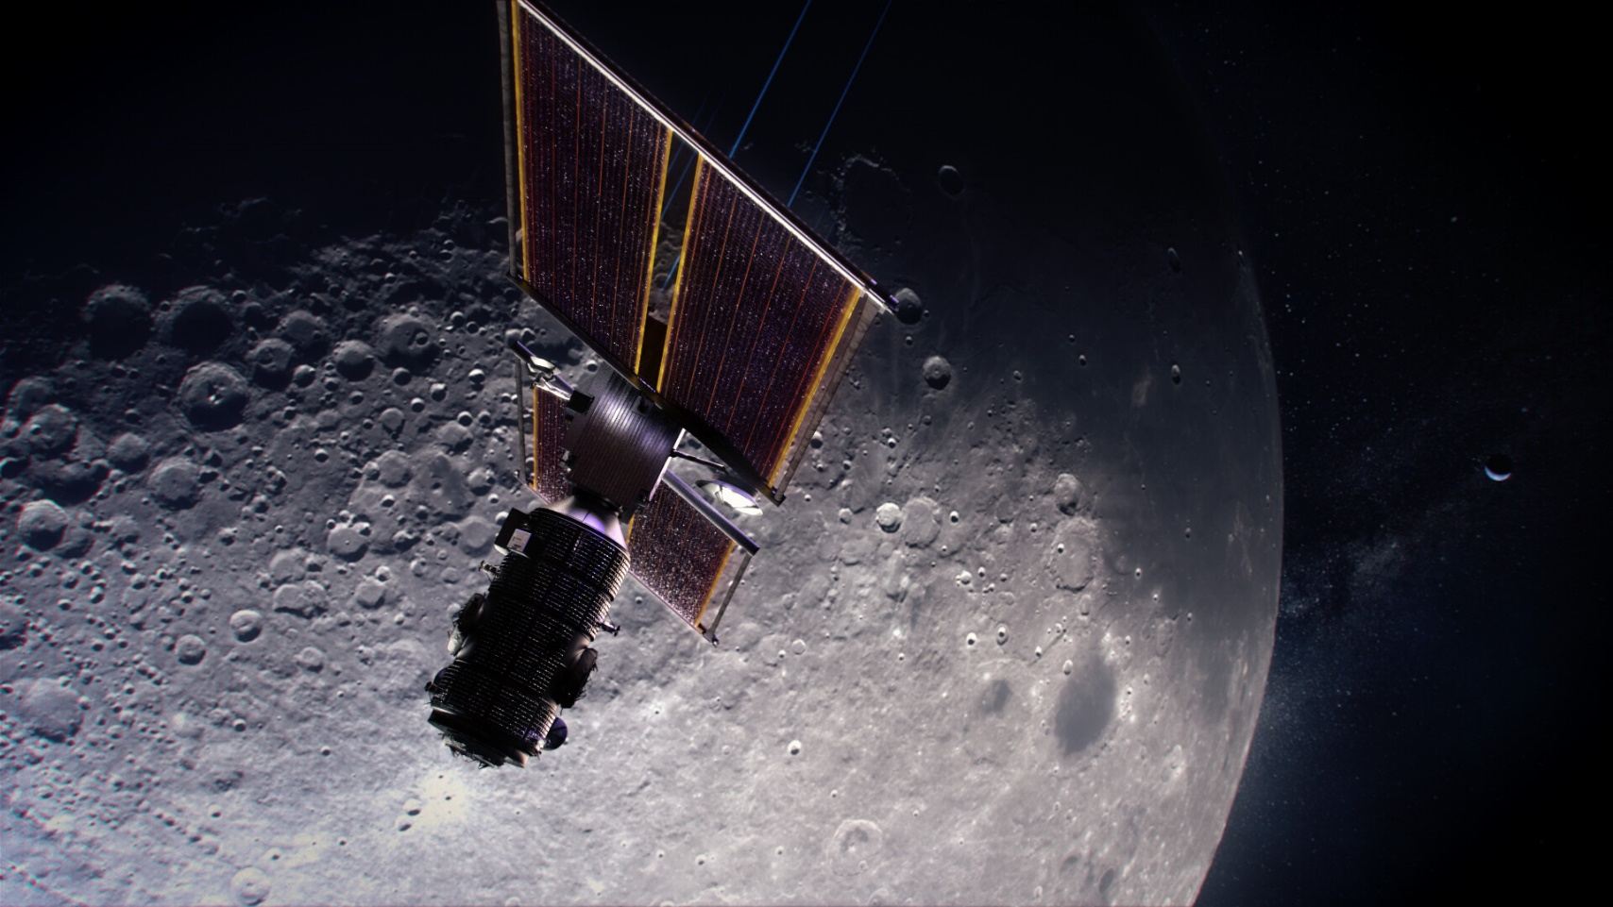
VSM Planner Concept of Operations
The VSM Planner creates timelines based on mission needs and objectives
Overview of Planner Functionality:
  Goals specify planning objectives
  Tasks carry out actions
  Planner finds tasks that achieve goals and establishes ordering to obey all constraints

Slide 13
Task Constraints
State Variables
  Properties of Gateway.
  Used in constraints and effects in task descriptions.
The Task.
  Has a fixed duration.
Preconditions, Invariant Constraints
  Conditions that must hold to insert task
Consequences / Postconditions
  Effects of task on state variables
Initial State
  Pre-determined values of state variables
Task
State_Var
Precondition
Invariant
Consequence
Mnemonic: Stoplight changes from red (constraints) to green (desired effect achieved)
Initial is light green because it satisfies constraints.
State_Var
Initial

Slide 14
Results
Task and Goal model has been developed and testing on Task and Goal model being performed
  As of Feb 2026, testing is still underway
  Preliminary Planner testing finding small bugs
  Integrated software testing with full VSM FSW planned for Q2 2026

Slide 15
Conclusions, Lessons Learned, and Forward Work
Conclusions
  Using a data-driven approach, utilizing the VSM Planner capabilities, avoided the need to write special-purpose FSW to implement this behavior and avoided causing a schedule impact to the Gateway program
  The data-driven approach is also easier to modify with less rigorous testing and verification needed if the desired behavior changes over the lifetime of Gateway
Lessons Learned
  This approach of using the VSM Planner capabilities to select from a set of prioritized goals that cannot all be achieved provides flexibility in defining other such complex behaviors in the future for Gateway or on other missions to which VSM and its derivatives may be applied
Forward Work
  Testing of the Task and Goal model in the VSM Planner to see if it provides the desired timelines is actively underway
  Broader integrated testing of the Fault Model, Task and Goal Mode and Planner with simulated comm systems and ground stations returning or not returning pings is planned to be tested in the coming months

Slide 16
Backup

