Slide 1
Jhonathan Rosales Ph.D – NASA Marshall Space Flight Center
Seminar Series – March 2nd 2026
Boise State University
(U,Zr)C
Nuclear Thermal Propulsion: Hydrogen Compatibility of Refractory Carbide Fuel (U,Zr)C

Slide 2
Agenda
Background on Space Nuclear Propulsion
Nuclear Fuel Fabrication
Nuclear Fuel Testing
Refractory Carbide Fuel Concept – (U,Zr)C
A Case Study: Hot Hydrogen Testing of (U,Zr)C Nuclear Fuel - The Effects of Composition and Density
Conclusions

Slide 3
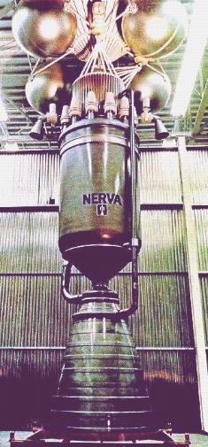
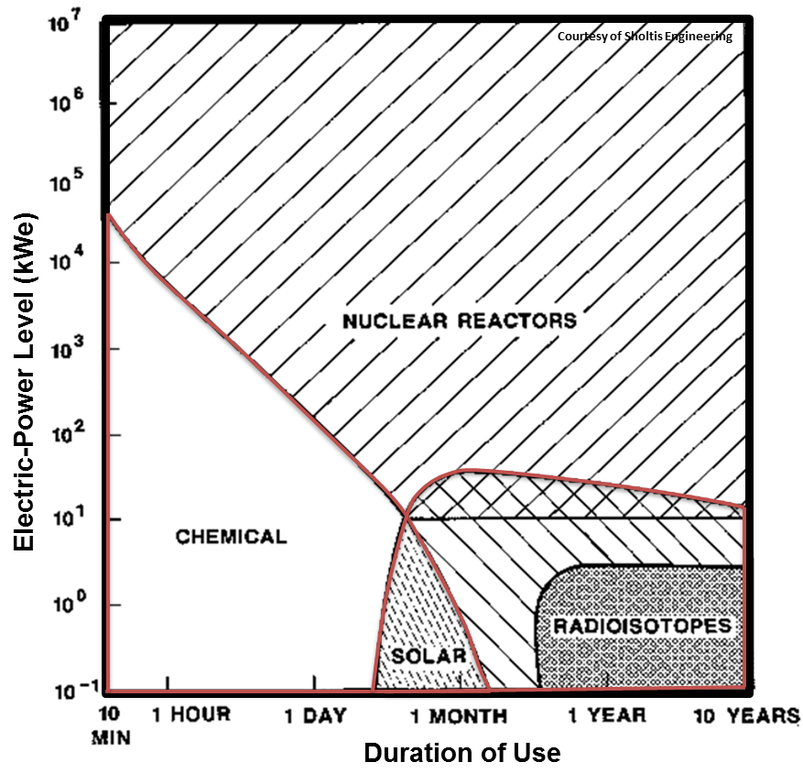
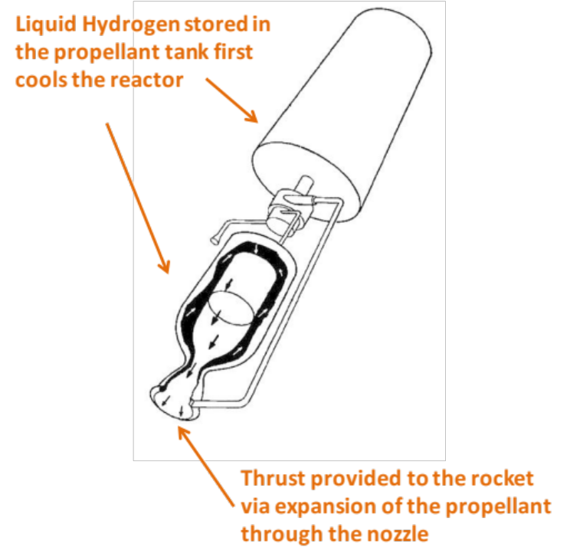
Background
Koenig, D. LA-10062-H (1986).
Nuclear reactor core. Houses nuclear fuel
Koenig, D. LA-10062-H (1986).
NERVA Nuclear Thermal Rocket Prototype
Development of nuclear technologies can allow a safer, more efficient, and effective space exploration

Slide 4

Background
D. Koenig LA-10062-H 1986
Specific Impulse (I_{sp})
$$Isp=\frac{FT}{ṁ}$$
2x
Ratio of thrust (F_{t} ) and mass flow rate (ṁ) during ejection. Measures the overall performance of the rocket engine. Unit (s).
Advantages of Nuclear Thermal Propulsion
Shorter transit times
Broader launch window timeframe
Increased payload mass
Mitigate cosmic radiation and microgravity exposure to crew

Slide 5
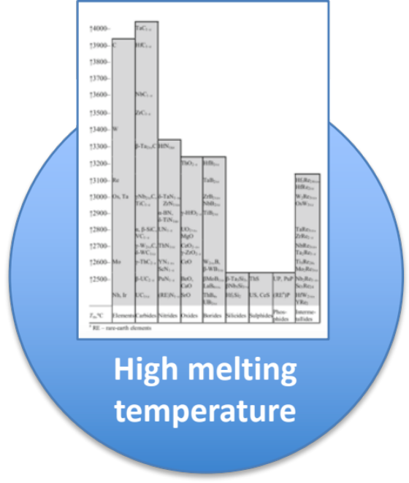
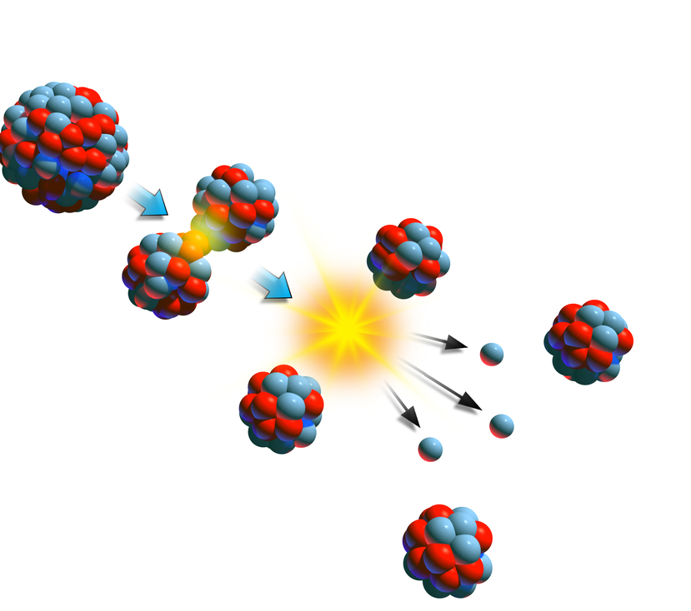
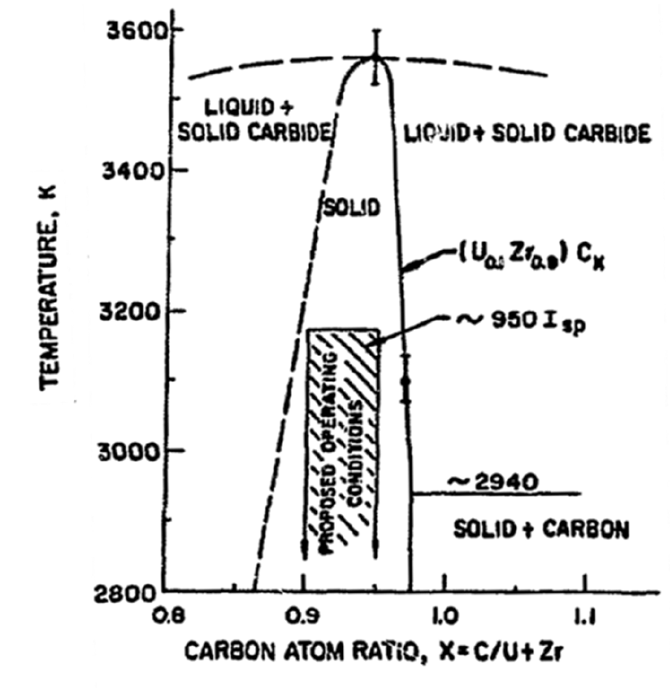
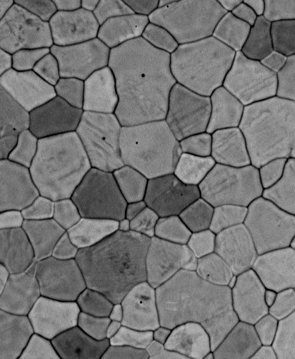

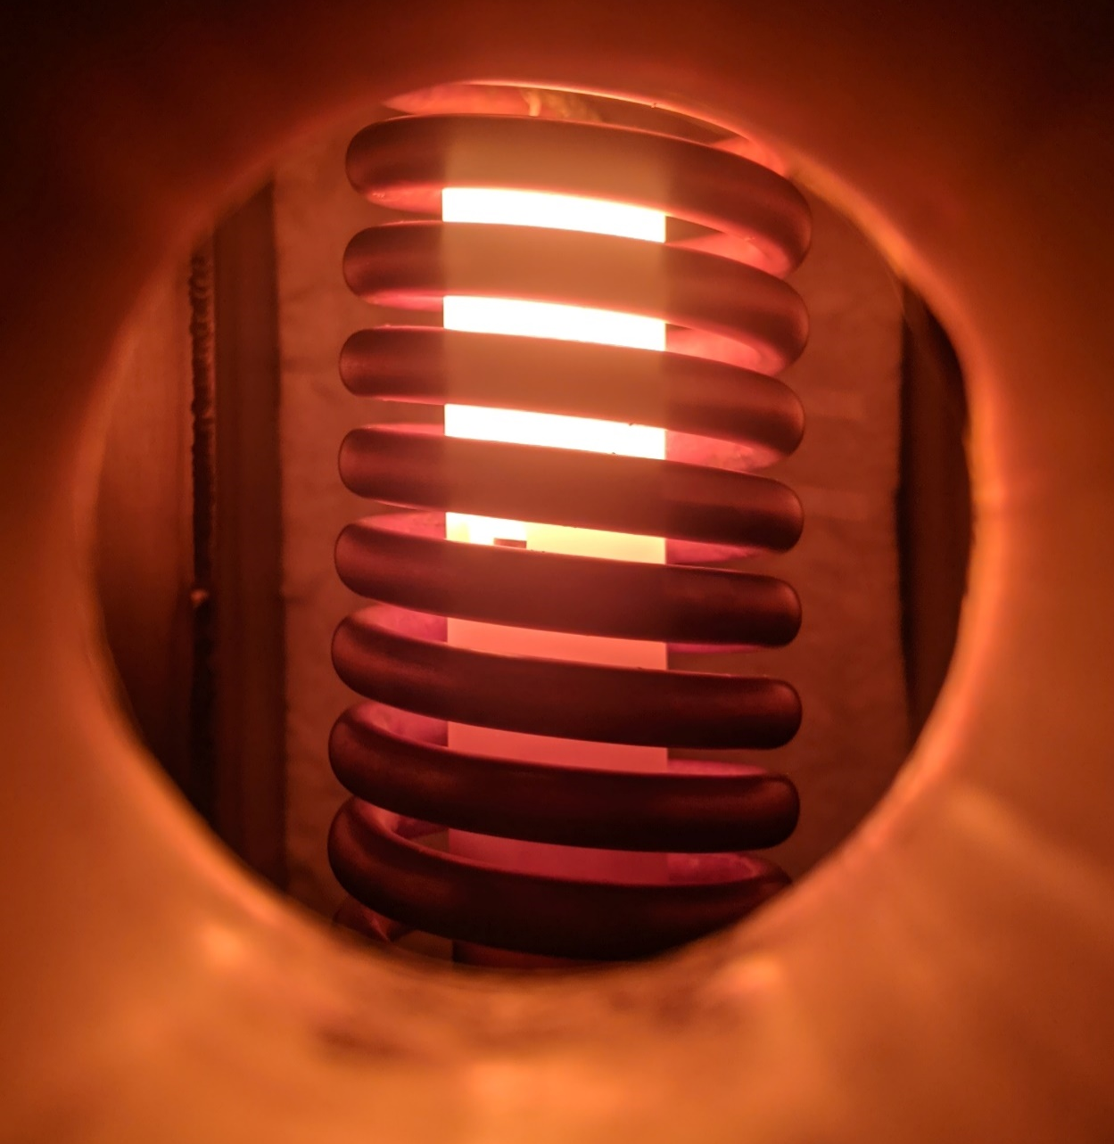
Limited material systems exist with the attributes desired for space nuclear propulsion applications
Background
Low neutron absorption
Hydrogen corrosion
Hydrogen Compatibility
Thermodynamic
Stability

Slide 6
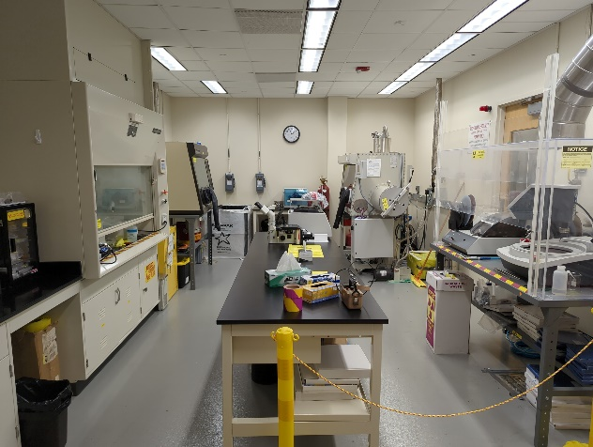
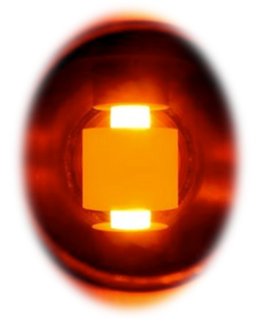
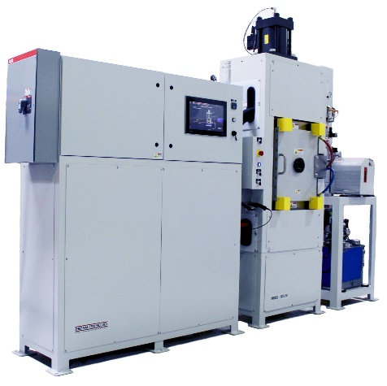
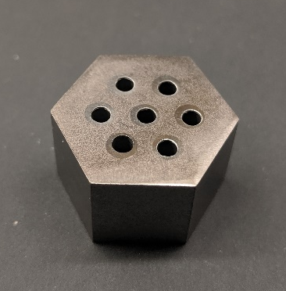

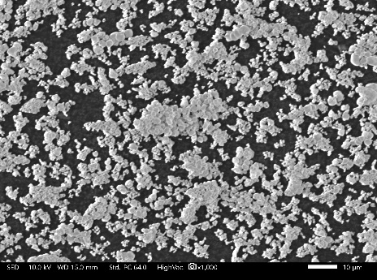
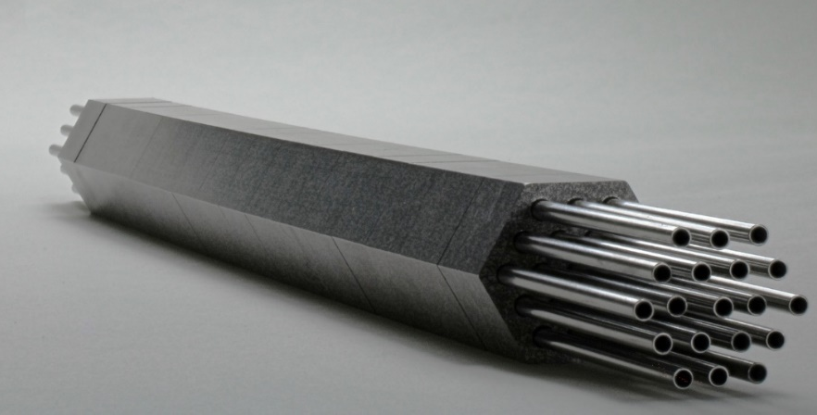
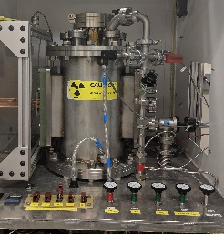
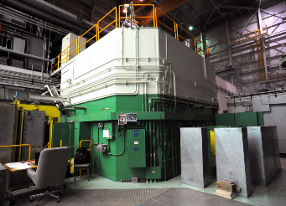
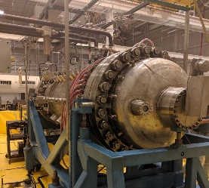
Nuclear Fuel Fabrication
Nuclear fuel wafer fabrication
Nuclear fuel powder feedstock preparation in radiological laboratory
Consolidation via Spark Plasma Sintering (SPS)
Nuclear Fuel Testing
TREAT Reactor (INL)
CFEET (NASA MSFC)
Nuclear fuel article assembly with multiple wafers
NTREES ( NASA MSFC)

Slide 7
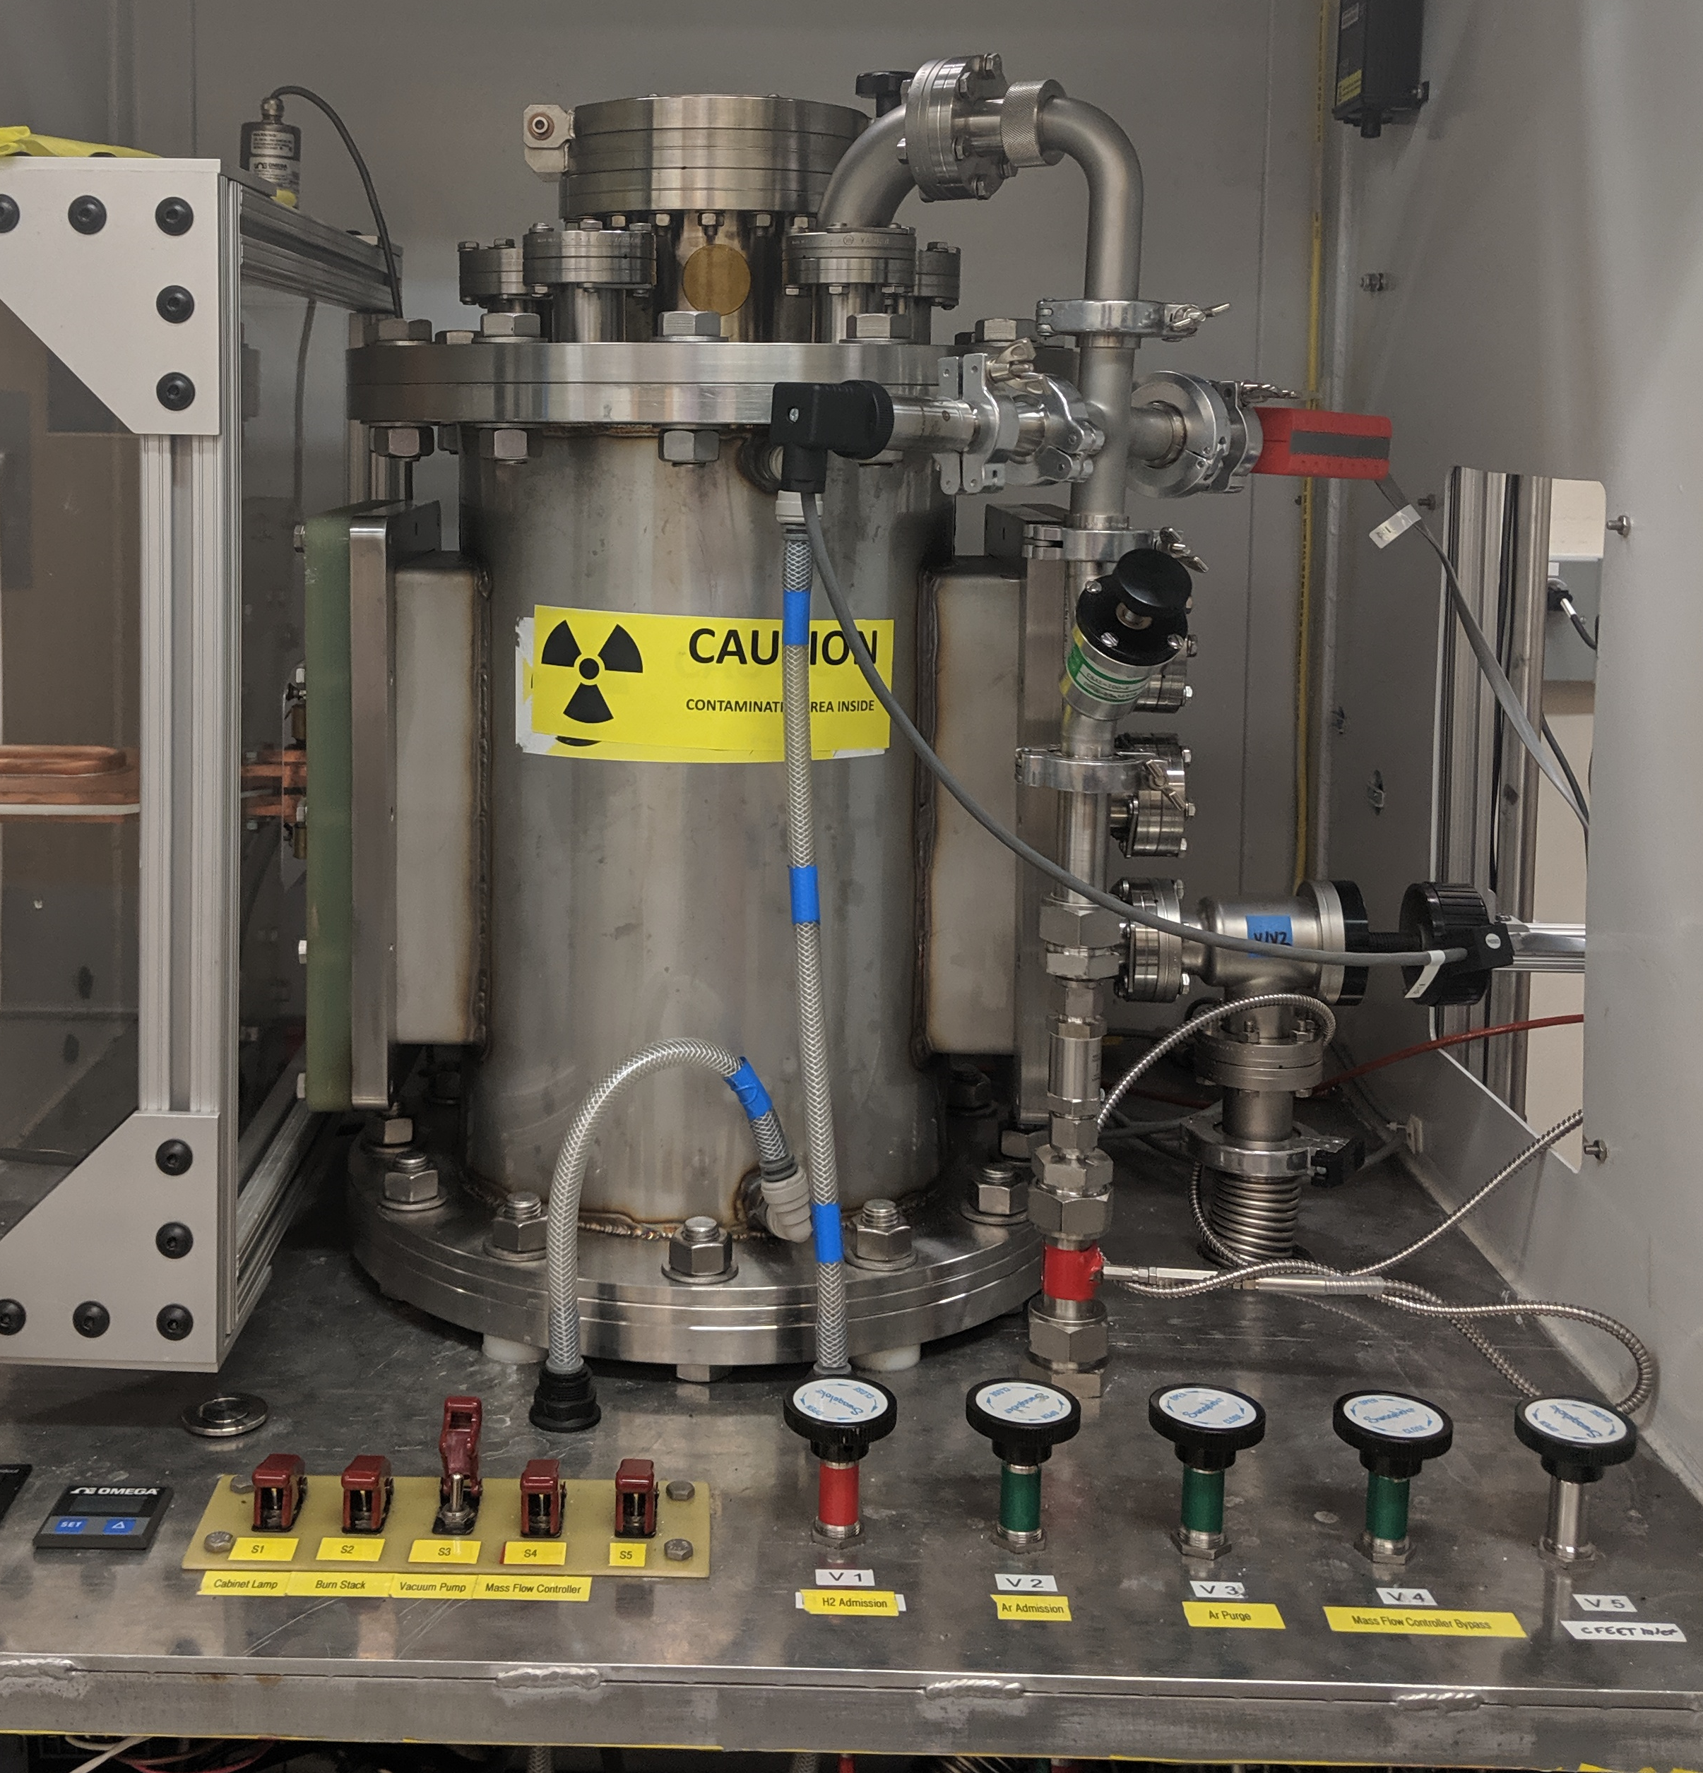

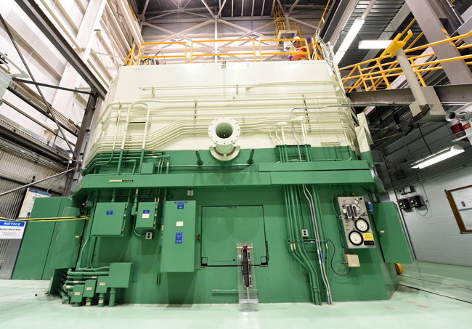
Nuclear Fuel Testing
CFEET – Compact Fuel Element Environmental Test (MSFC)
  Nuclear reactor temperatures, hydrogen rich environment
  Specimen size ~ 0.5-6 cm in length
NTREES – Nuclear Thermal Reactor Element Environmental Simulator (MSFC)
  Nuclear reactor temperatures and pressures, hydrogen environment
  Specimen size +4 m in length
TREAT – Transient Test Reactor Facility at Idaho National Laboratory
  Nuclear Reactor temperatures and pressures
  Test nuclear fuel under severe reactor accident conditions
CFEET
NTREES
Transient Test Reactor Facility (TREAT)
Notes:
TREAT tests nuclear reactor fuels and materials under extreme conditions. It produces sudden bursts of energy that bring fuels to failure on a small scale in a very controlled way. This allows researchers to examine fuel performance under simulated accident conditions.

Slide 8
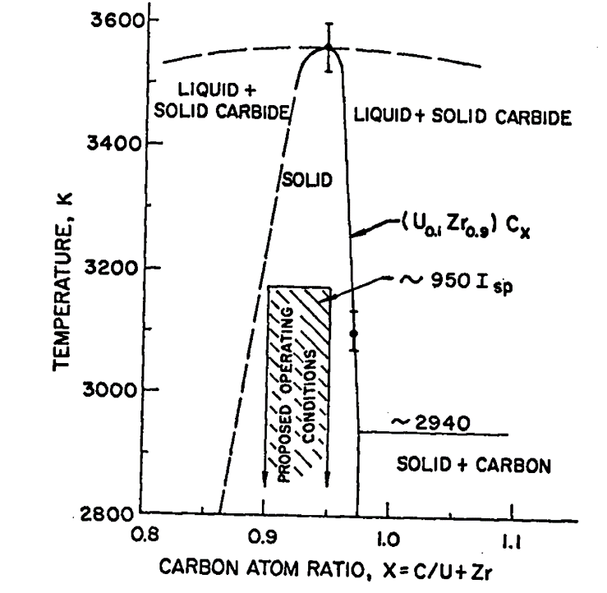
Refractory Carbide Fuel Concept - (U,Zr)C
Solid solution carbide fuel, (U,Zr)C, is an attractive fuel candidate material for space nuclear propulsion applications given its high temperature stability, high melting point, and hot hydrogen compatibility
Solid solution carbide fuels involving UC and refractory carbides TaC, ZrC, NbC were investigated in the 1960’s under the NERVA program
Studies suggest that a low UC content is crucial for enhancing operating temperatures along with hypo-stoichiometric carbon content [1]
Pseudo binary phase diagram for (U_{0.1}Zr_{0.9})C_{x} [1]
[1] Lyon, Luther L. Performance of (U, Zr) C-Graphite (Composite) and of (U, Zr) C (Carbide) Fuel Elements in the Nuclear Furnace 1 Test Reactor. No. LA-5398-MS. Los Alamos Scientific Lab., N. Mex.(USA), 1973.

Slide 9
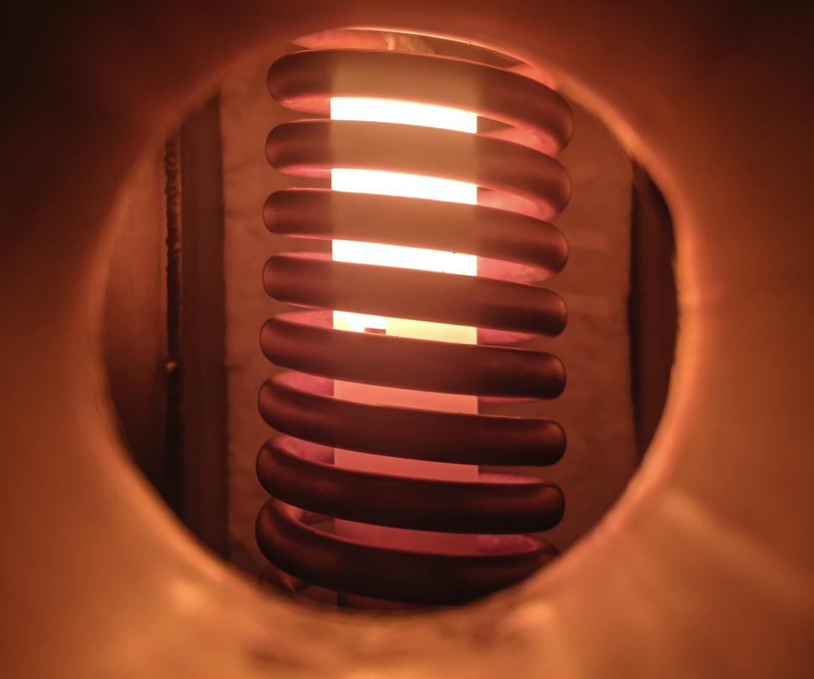
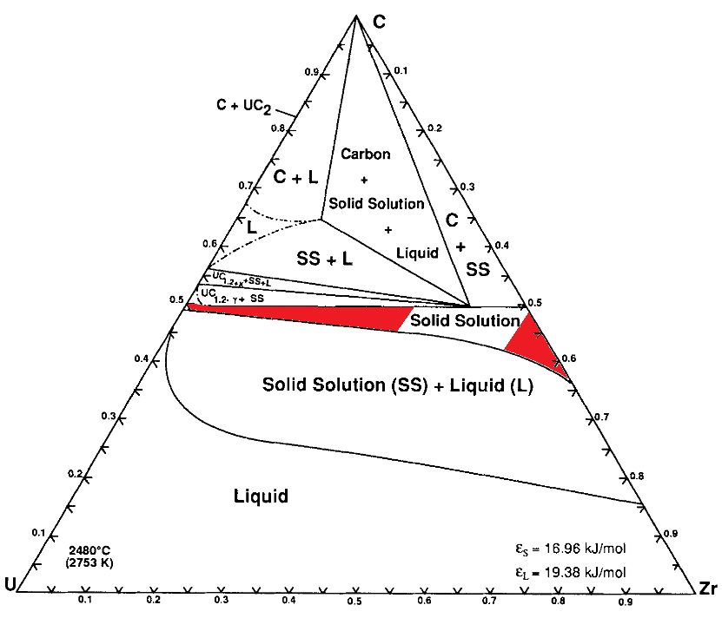
A Case Study: Hot Hydrogen Testing of (U,Zr)C Nuclear Fuel - The Effects of Composition and Density
Based on thermodynamic analyses [1] the following UC contents were down selected in (U,Zr)C:
  (U_{0.05}Zr_{0.95})C
  (U_{0.1}Zr_{0.9})C
  U_{0.2}Zr_{0.8})C
  (U_{0.3}Zr_{0.7})C
Hot hydrogen testing simulates the elevated temperature and H₂ environment inside a nuclear thermal rocket
Hot hydrogen testing was performed on distinct UC compositions in (U,Zr)C at 2600 K for a cumulative time of 300 minutes
The tested samples were characterized by scanning electron microscopy (SEM), energy dispersive spectroscopy (EDS), X-ray diffraction (XRD), mass loss, and density after selected intervals
Side port view during hot hydrogen testing in CFEET furnace at NASA MSFC.
Ternary phase diagram for the system U-Zr-C at 2753 K
[1]D. Butt and T. Wallace, The U─Zr─C Ternary Phase Diagram above 2473 K. J. Am. Ceram. Soc. 76 (1993) 1409-1419
Notes:
The temperature range 2473 to 3123K the solid solution phase region in the U-Zr-C ternary phase diagram is broad enough to provide operational margin for a reactor system

Slide 10
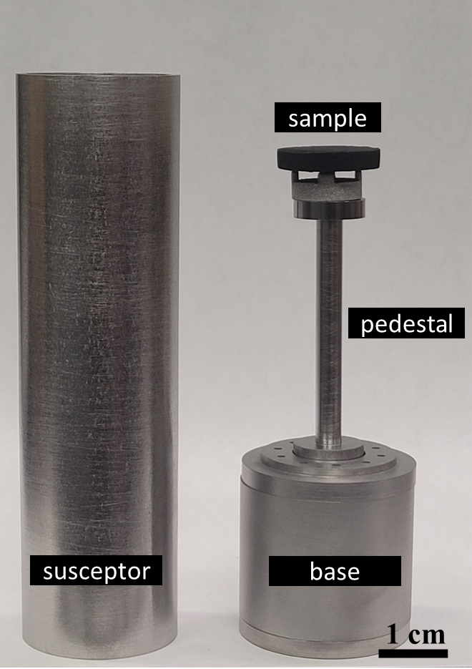
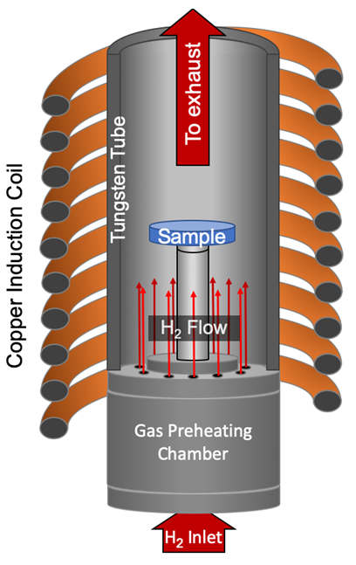
Experimental
Powder synthesis of (U,Zr)C was completed through a carbothermic reduction process with UO₂, ZrO_{2,} and carbon black as starting materials [1]
XRD confirmed the formation of a solid solution for all (U,Zr)C compositions with varying UC ratios
Consolidation was performed via Spark Plasma Sintering (SPS)
Process parameter development in SPS allowed consolidation of high-density samples
All fabricated samples were tested in hot H₂ for 300 minutes at 2600K
Testing intervals consisted of 30 min to perform mass loss assessment and characterization
Tungsten parts set up for testing samples in CFEET [2] furnace
CFEET furnace schematic
[1]Kardoulaki, E et al. "Synthesis, thermal conductivity, and hydrogen compatibility of a high melt point solid solution uranium carbide,(U0. 2Zr0. 8)C." Nuclear Materials and Energy 33 (2022): 101290.
[2] Cureton, W. et al. “Micro-structural evolution of Mo-UO₂ cermets under high temperature hydrogen environments,” J. Nucl. Mat., 538, 152297 (2020)

Slide 11
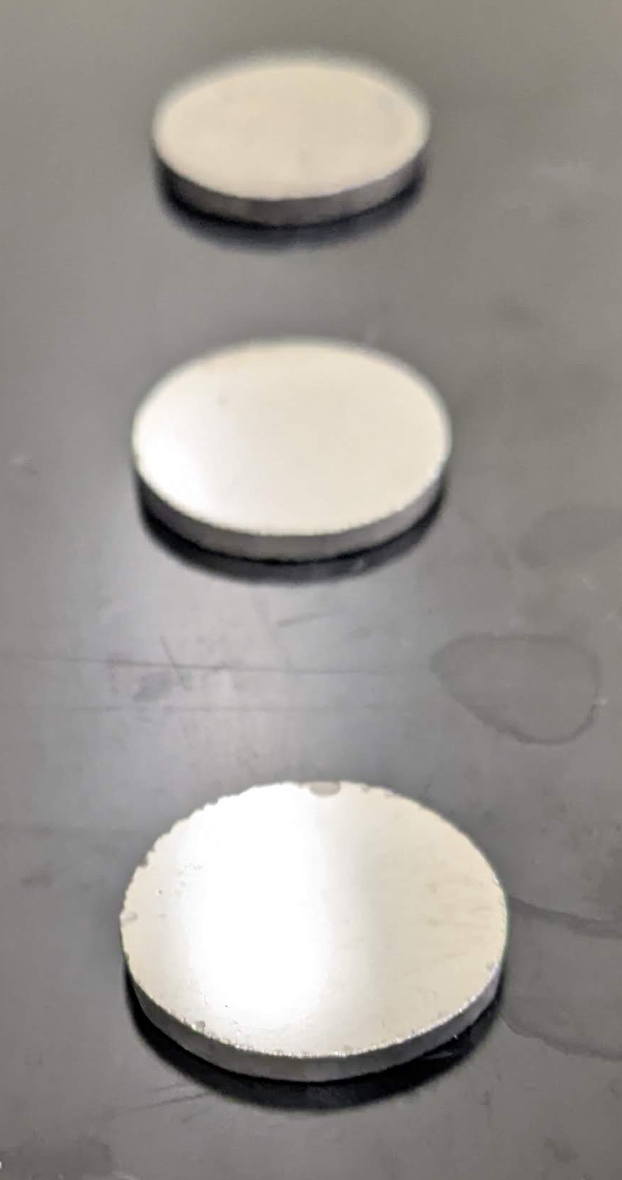
Results
High-density samples with average density of ~96 %TD were produced with optimized consolidation parameters via SPS. Reported densities consistent with previous studies [1-3].
Exposing the samples to H₂ for 300 minutes resulted in an average density of ~95% TD. The samples exhibited minimum changes in density during the total exposure time
The mass loss rate includes: the mass, surface area, and exposure time to adequately quantify material losses during the test
Comparison of mass loss rates of high-density (U,Zr)C samples with distinct UC loadings was conducted
Composition | Initial Density [% TD] | Density After H₂ Exposure [% TD]
U_{0.05}Zr_{0.95}C_{0.99} | 97.3 | 97.6
U_{0.1}Zr_{0.9}C_{0.98} | 91.5 | 91.4
U_{0.2}Zr_{0.8}C_{0.98} | 97.5 | 96.9
U_{0.3}Zr_{0.7}C_{1.17} | 95.1 | 93.5*
U_{0.3}Zr_{0.7}C_{0.96} | 95 | 92.1**
ZrC | 98.1 | 97.9
Fabricated (U,Zr)C samples after consolidation via SPS.
* Density recorded after fracturing at 240 min
** Density recorded after fracturing at 60 min
[1]E. Kardoulaki, M. Kosmidou, J. Rizk, D. Byler, N. Li, A. Croell, J.K.P. Williams. J. Rosales, K.J. McClellan, S.C. Vogel, Assessment of the Hydrogen Resistance of (U0.2Zr0.8)C Following Exposure up to 2327°C. Ceram. Int. (2025)
[2] J. Rosales, A. Croell, J.K.P. Williams, B. Taylor, The Effects of Hot Hydrogen Exposure on (U,Zr)C Fuel for Nuclear Thermal Propulsion. NETS Conf. Proc. (2024) 546–50 .
[3] A. Croell, J.K.P Williams, J. Rosales, J. Reynolds, M. Volz, Hot Hydrogen Exposure of U_{x}Zr_{1-x}C_{y} Nuclear Fuel : The Influence of Additional Carbon. J. Nucl. Mat.(2025) 156374

Slide 12
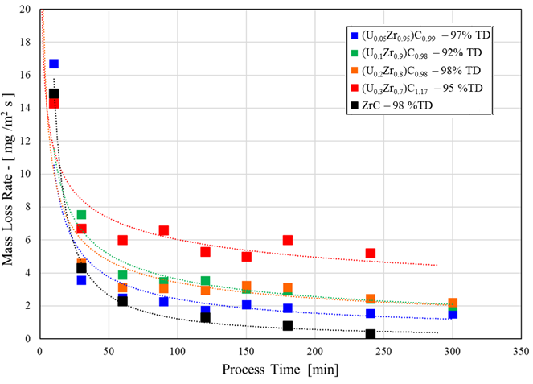
Results – Mass Loss Rates
  (U_{0.05}Zr_{0.95})C_{0.99} – 97% TD
  (U_{0.1}Zr_{0.9})C_{0.98} – 92% TD
  (U_{0.2}Zr_{0.8})C_{0.98} – 98% TD
  (U_{0.3}Zr_{0.7})C_{1.17} – 95 %TD
  ZrC – 98 %TD
Highest mass loss rates were observed during the initial cycle and subsequently plateau along the remaining cycles
The mass loss rate in (U,Zr)C is attributed to the rapid loss of carbon, along with preferential loss of uranium (higher vapor pressure than Zr)
All compositions displayed a similar trend, highest loses at beginning of cycle and subsequently plateau in decrements in remaining cycles
Highest mass loss was in the highest uranium concentration [1]
Highest mass loss rates
30% UC
Mass loss rate for different U_{x}Zr_{1-x}C_{y} compositions during each test interval of hot hydrogen exposure
[1]Rosales, J. et al. “Hot Hydrogen Exposure of UxZr1-xCy Nuclear Fuel: The effect of Density and Composition." J. Nucl. Mat. (2026) Submitted.

Slide 13
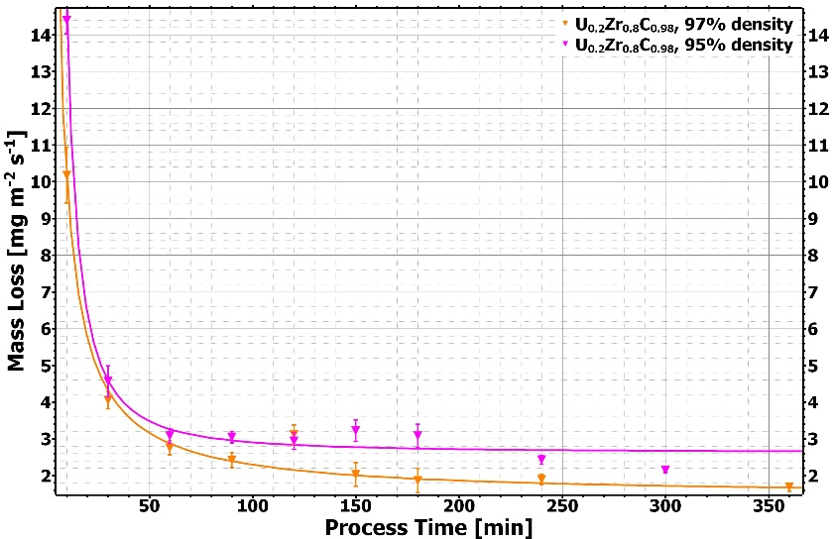
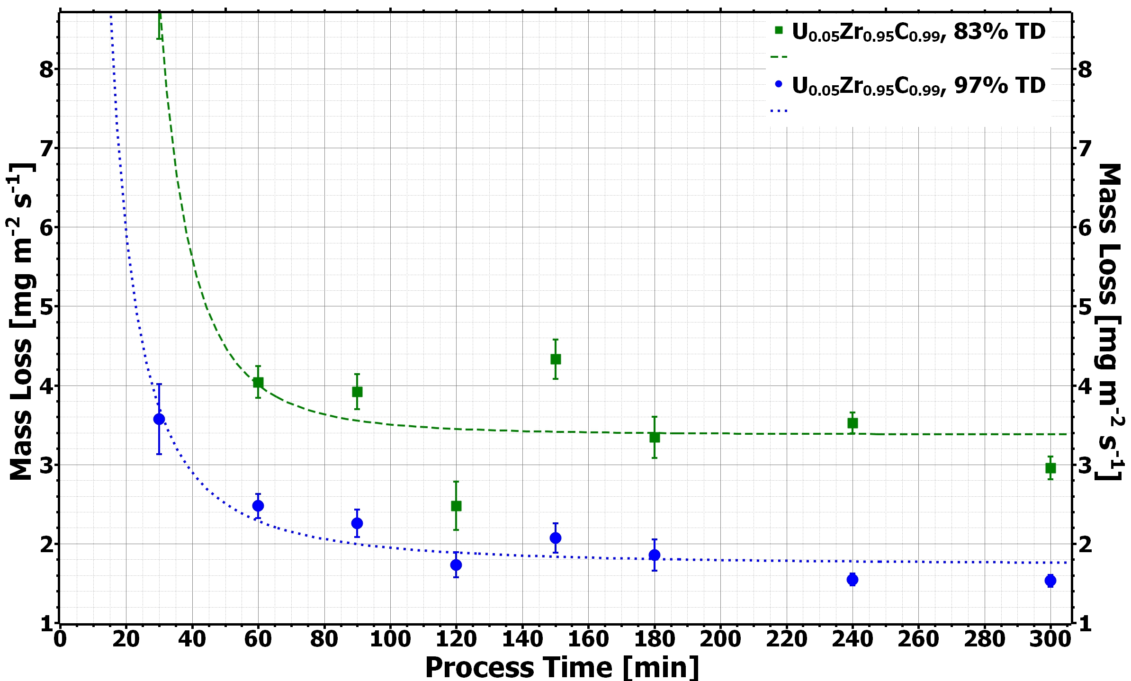
Mass Loss Rate – The Effects of Density
(U_{0.2}Zr_{0.8})C_{0.98}
(U_{0.05}Zr_{0.95})C_{0.99}
~90% increase
~55% increase
Minor Density Variation U_{0.2}Zr_{0.8}C_{0.98} - An increase in density from 95 to 97%TD resulted in approximately a 55% reduction in the mass loss rate
Major Density Variation U_{0.05}Zr_{0.95}C_{0.99} - A comparison between samples with densities of 83 and 97%TD showed that the lower density sample exhibited a mass loss rate approximately 90% higher than that of the higher density sample [1]
[1]Rosales, J. et al. “Hot Hydrogen Exposure of U_{x}Zr_{1-x}Cy Nuclear Fuel: The effect of Density and Composition." J. Nucl. Mat. (2026) Submitted.

Slide 14
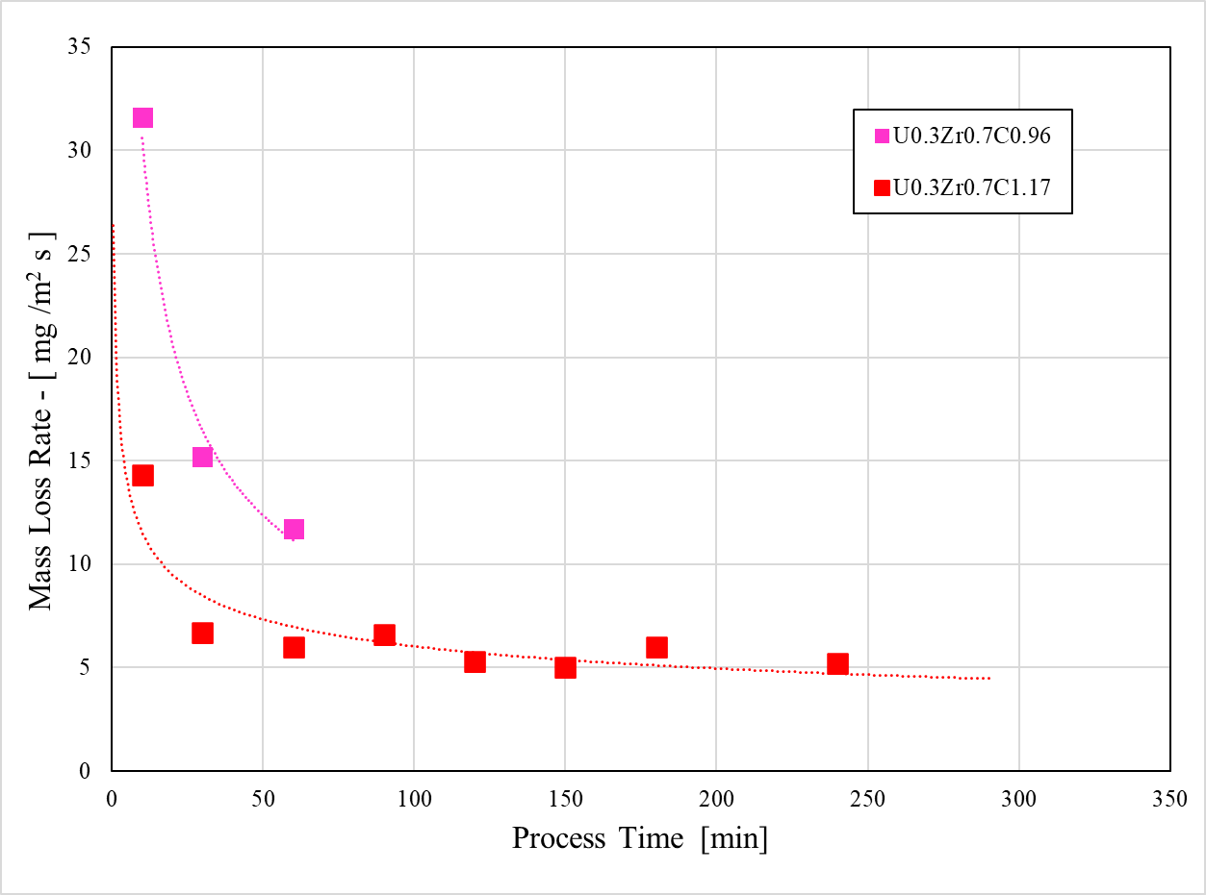


Mass Loss Rate
The highest mass loss rate was observed in composition U_{0.3}Zr_{0.7}C_{0.96} with slightly hypo-stoichiometric carbon content
The ZrC lattice can accommodate carbon losses up to ZrC_{0.7}[1], this is not possible for UC, thus resulting in the formation of metallic uranium even at small carbon losses [2]. Therefore, a pronounced mass loss is expected from surfaces with higher uranium content
The sample with composition U_{0.3}Zr_{0.7}C_{0.96} crumbled during the 90th minute and mass losses at this stage were inconclusive
The sample with composition U_{0.3}Zr_{0.7}C_{1.17} crumbled during the 90th minute and mass losses at this stage were inconclusive
UH₃ formation was identified as cause of crumbling: Confirmed by subsequent XRD analysis
  (U_{0.3}Zr_{0.7})C_{1.17} – 95 %TD
  (U_{0.3}Zr_{0.7})C_{0.96} – 95 %TD
Sample Crumbled
Sample Crumbled
[1] D.B.K. Rana, E. Zapatas Solvas, W.E. Lee, I. Farnan, An investigation of the Long Range and Local Structure of Substoichiometric Zirconium Carbide Sintered at Different Temperatures. Sci. Rep. 10 (2020) 3096.
[2] G. Vasudevamurthy and A.T. Nelson, Uranium Carbide Properties for Advanced Fuel Modeling –A Review. J. Nucl. Mat. 558 (2022) 153145

Slide 15
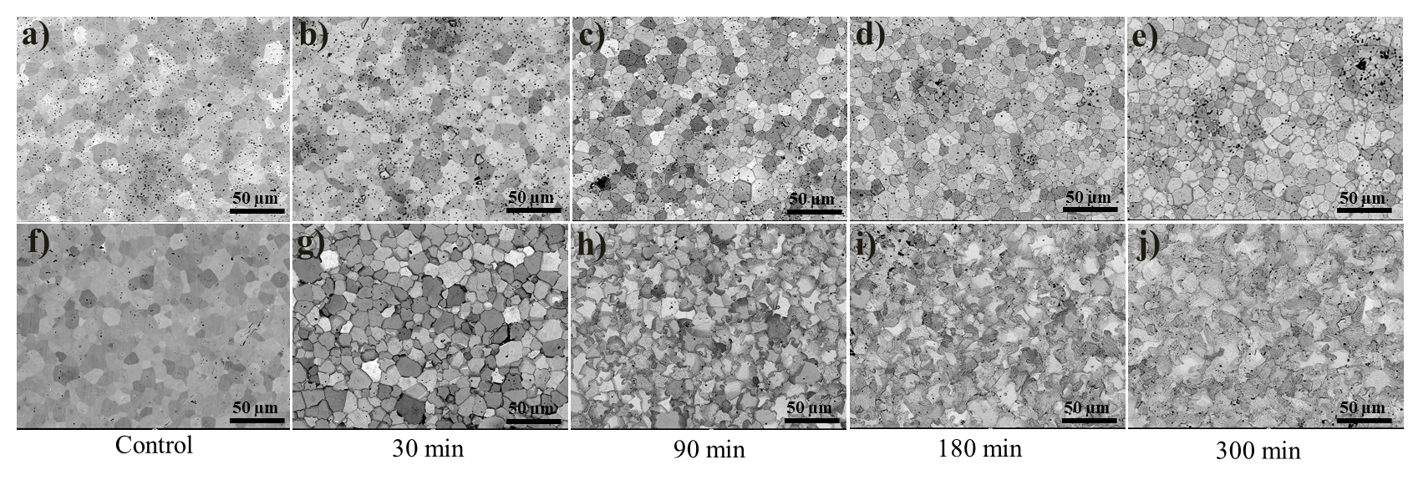
Results – Microscopy
97%TD
(U_{0.05}Zr_{0.95})C_{0.99}
97%TD
(U_{0.2}Zr_{0.8})C_{0.98}
5%UC : Displayed etched microstructure and increased porosity
20%UC: After 90 min developed interlocking grain boundaries and fine porosity. Attributed to C and U depletion and hydrogen transport along grain boundaries. This led to void formation and boundary grooving

Slide 16
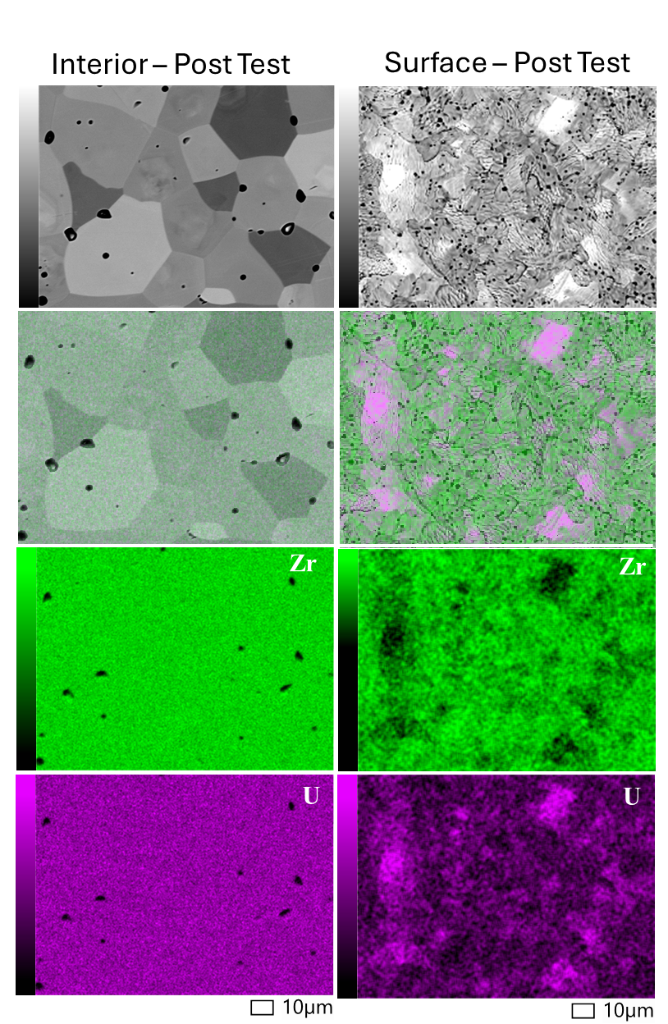
Results – Microscopy
Interior Post Test
Surface - Post Test
Uranium losses were identified at the surface of sample, while interior of sample preserved a uniform distribution of uranium
SEM imaging at the surface revealed that grain boundaries are no longer defined, in addition to surface deformation, increased porosity, and coalescence of grains
SEM/EDS after 300 min of H₂ exposure for interior of U_{0.2}Zr_{0.8}C sample (left) and surface of U_{0.2}Zr_{0.8}C sample (right). Uranium element mapping of surface displays a significantly lower uranium content

Slide 17
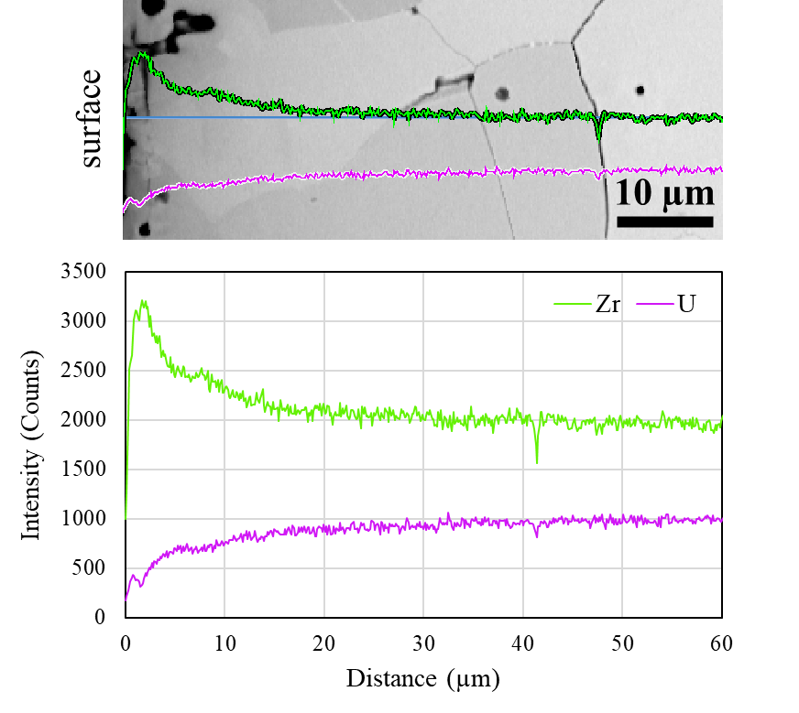
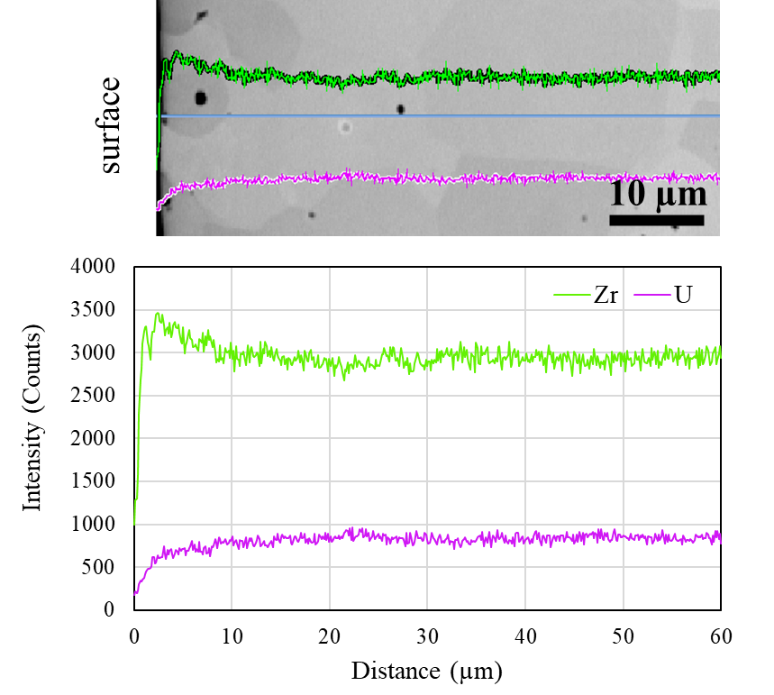
Results – Microscopy
EDS line scans displaying uranium losses at the surface after 300 min of hydrogen exposure
Uranium losses are more pronounced at the surface (<10 µm)
U_{0.3}Zr_{0.7}C_{1.17}
U_{0.2}Zr_{0.8}C_{0.98}

Slide 18
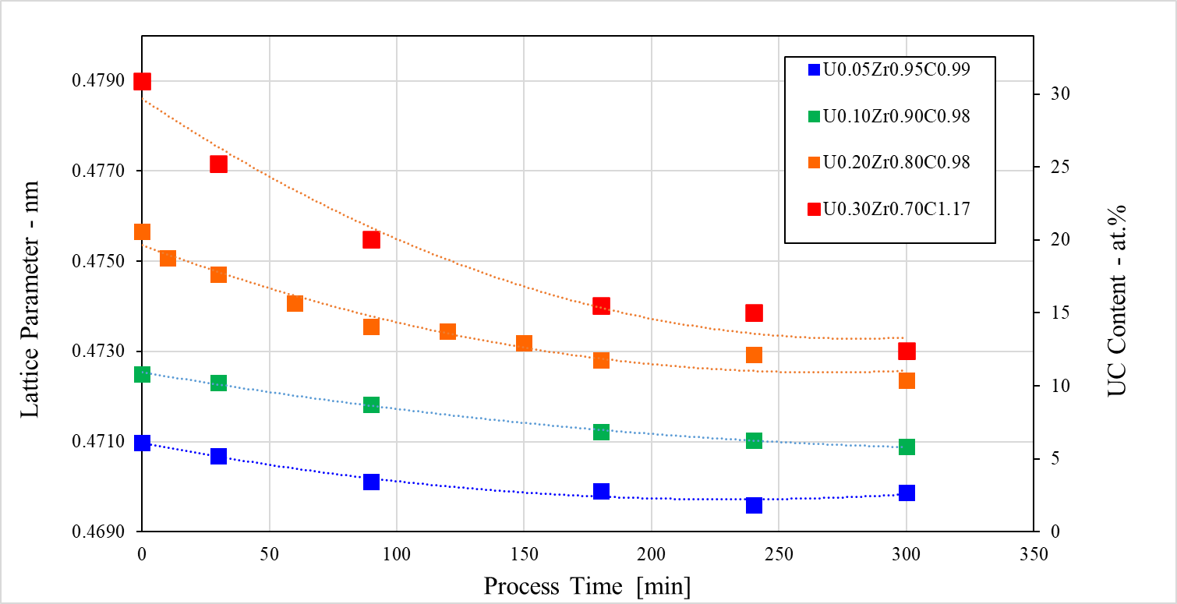
Results - X-ray Diffraction
XRD results confirmed that solid solution was preserved in all compositions throughout the hot hydrogen exposure
From the lattice constant, the UC content was determined using literature data on UC (0-30 at.%) and Vegard’s law
30 at.% UC exhibited the largest reduction in UC content, losing over 50% of the initial UC concentration
The preferential uranium losses are attributed to its high vapor pressure [1,2,3]
  (U_{0.05}Zr_{0.95})C – 97% TD
  (U_{0.1}Zr_{0.9})C – 92% TD
  (U_{0.2}Zr_{0.8})C – 98% TD
  (U_{0.3}Zr_{0.7})C – 95 %TD
Over 50% initial UC lost in 30%UC composition
Over 50% initial UC lost in 30%UC composition
30% UC
[1] Butt, D., and T. Wallace Sr. "The U─ Zr─ C ternary phase diagram above 2473 K." Journal of the American Ceramic Society 76, no. 6 (1993): 1409-1419. [6]
[2] MacMillan, Donald P. "Mass loss rates of uranium‐zirconium carbide in flowing hydrogen and hydrogen‐hydrocarbon mixtures." In AIP Conference Proceedings, vol. 217, no. 3, pp. 1037-1044. 1991.
[3] Storms, E. "The behavior of ZrC(1-x) and U(y)Zr(1-y)C(1-x) in Flowing Hydrogen at Very High Temperatures." LA-12043MS, Los Alamos National Laboratory, Los Alamos, NM (1992).

Slide 19
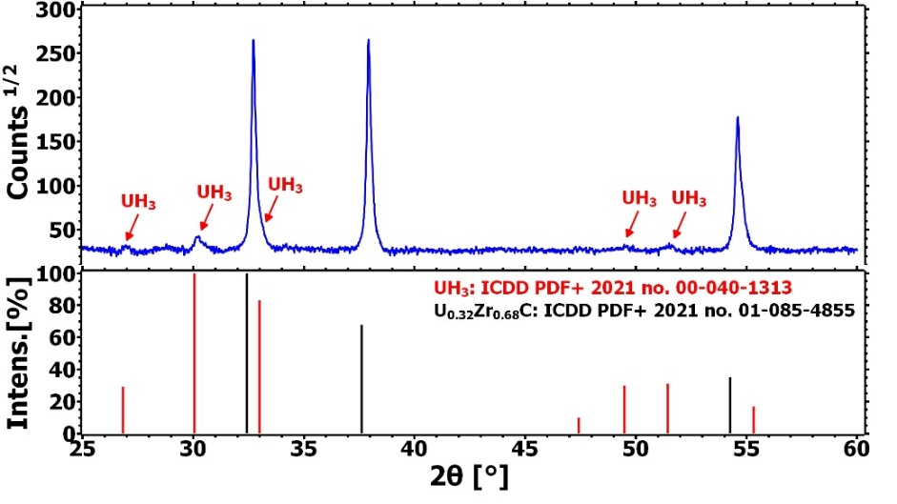
Results - X-ray Diffraction
UH₃ was revealed by XRD analyses in composition U_{0.3}Zr_{0.7}C_{0.96} after sample fragmentation at 90 min of testing
UH₃ was confirmed in the XRD spectrum collected on powder from the inside of the sample after fragmentation (no UH₃ was found on the outside)
UH₃ forms from metallic uranium between 473 – 573 K in the presence of H₂ – indicating its formation must have occurred during the cool down stage
The presence of UH₃ on the inside proves that hydrogen had diffused well into the interior of the sample
UH₃ has a much larger volume than metallic uranium [1,2], causing the fragmentation during cool down
[1] F. D. Manchester and A. San-Martin, The H-U (Hydrogen-Uranium) System. J. Phase Equilib. 16 (1995) 263-275 2.
[2] J. Harp, P. A. Lessing, and R. E. Hoggan, Uranium Silicide Pellet Fabrication by Powder Metallurgy for Accident Tolerant Fuel Evaluation and Irradiation. J. Nucl. Mater. 466 (2015) 728-738
Notes:
Burke [48] confirmed that UH₃ forms from metallic uranium between 473.15 and 573.15 K in the presence of H₂. Those conditions existed during the cool down stage and remain in agreement with work performed by Manchester et. al [49]. Any metallic uranium on the sample surface would have evaporated before those temperatures were reached, therefore no UH₃ was found at the surfaces.

Slide 20
Conclusions
High-density samples (up to 97% TD) significantly reduce mass loss by minimizing porous sites, reducing the available surface area for direct contact with hydrogen gas
The current results indicate that even small variations in sample density can induce drastic changes in mass loss rates, up to 90%
(U,Zr)C compositions with ≤ 20 at.% UC demonstrated high-temperature stability, whereas higher uranium content (e.g. (U_{0.3}Zr_{0.7})C ) proved to be unstable
The asymptotic decrease in the lattice parameter suggests progressive uranium losses from the material surface, resulting in the depletion of UC over the course of hydrogen exposure
Presence of UH₃ in (U_{0.3}Zr_{0.7})C suggests that metallic uranium formed inside the sample as a product of carbon losses. This induced sample fragmentation through changes in the lattice parameter on the transition from U to UH₃, generating stresses leading to sample fracture
Future work is being emphasized in evaluating the performance of different compositions with varying carbon stoichiometry in (U,Zr)C fuel

Slide 21



Questions?

